Slide 1

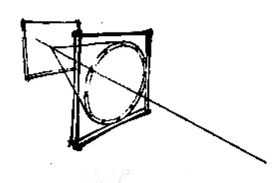
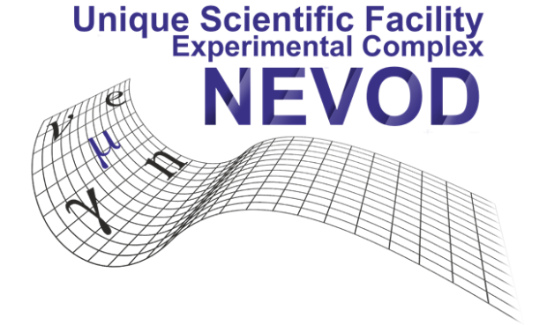
Ring Imaging Cherenkov Detectors (RICH 2018)
Cherenkov water detector NEVOD
and its further development
Anatoly Petrukhin
National Research Nuclear University MEPhI
(Moscow Engineering Physics Institute)
30 August 2018

Slide 2
Introduction
Cherenkov Water Detectors (CWD) are widely used for various investigations in which large volume or mass of detectors are required.
The basic characteristics of water – large angle of Cherenkov light emission and good transparency for its propagation make it possible to construct installations of very large dimensions with a relatively small number of Cherenkov radiation detectors (photomultipliers).
At that a problem of dependence of response PMT on Cherenkov light direction exists.

Slide 3
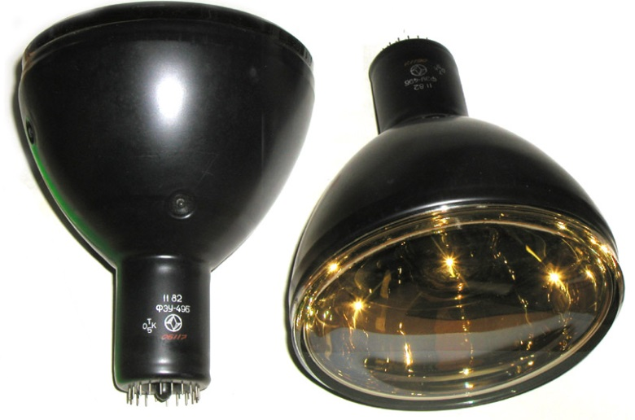
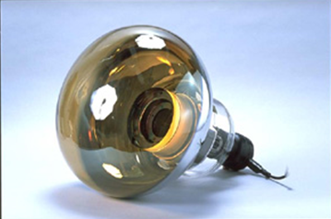
PMTs with flat and hemispherical photocathodes
PMT with flat photocathode
PMT with hemispherical photocathode
Response of PMT with flat photocathode depends on the angle of incidence of Cherenkov light, but response of some configurations of such PMTs does not depend on Cherenkov light direction.
Such combinations are named quasispherical modules (QSMs).

Slide 4
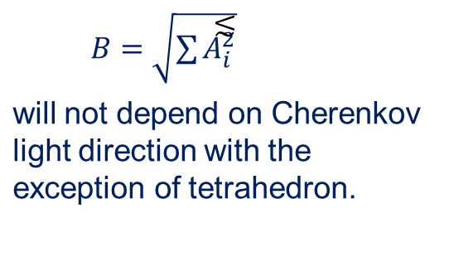
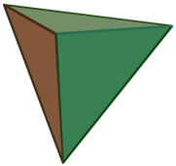
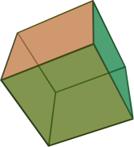
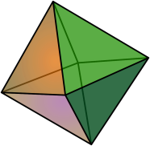
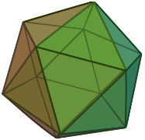
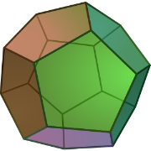
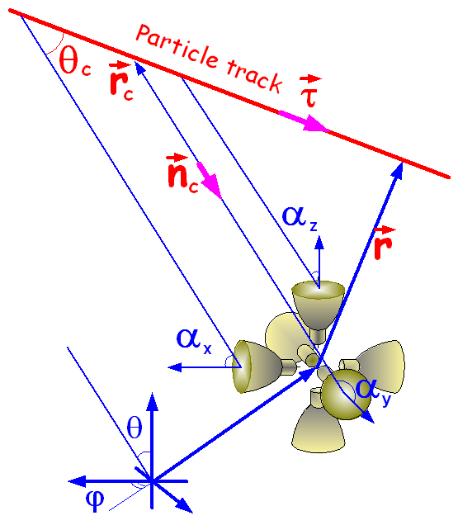
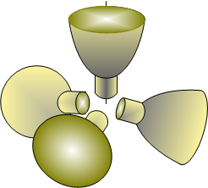
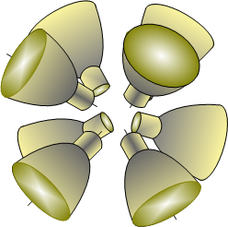
Quasispherical modules
If to place PMTs with flat photocathodes at the faces (or edges, or vertices) of regular polyhedron, the summarized response of all PMTs
Tetra | Hexa (cube) | Octa | Icosa | Dode
Notes:
Tetrahedron, Octahedron, Hexahedron, Icosahedron, Dodecahedron

Slide 5
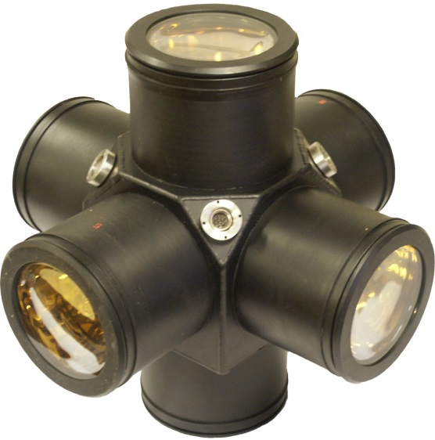
QSM with 6 PMTs
Idea of construction of quasispherical modules from PMTs with flat photocathodes was presented at Cosmic Ray Conference in Kyoto in 1979
(Borog V.V. et al., Proc. 16th ICRC, 1979 10, 380)
Module with six PMTs oriented along the axes of orthogonal coordinate system is the simplest configuration of photomultipliers with flat photocathodes, the response of which does not depend on Cherenkov light direction.
Besides independence of response of QSMs on Cherenkov light direction quasispherical modules allow to determine this direction using the amplitudes of signals from each PMT.
For more detailed information, see Poster, Board 23

Slide 6
Cherenkov Water Detector NEVOD-91 (1994)
Sizes 9 x 9 x 26 = 2100 m³
Spatial lattice from 91 QGM with steps 2 × 2 × 2.5 m³.
Russian PMTs – FEU-49, FEU-125 (now, FEU-200)
Placement of CWD NEVOD on the ground level allows investigate all components of cosmic rays reaching the Earth’s surface, including neutrinos from the bottom hemisphere.
Registering System allows measure signals in the dynamic range from 1 to 10⁵ ph.e. for each photomultiplier.
Trggering System allows separate events produced by particles coming from the top, the bottom, and any side.

Slide 7
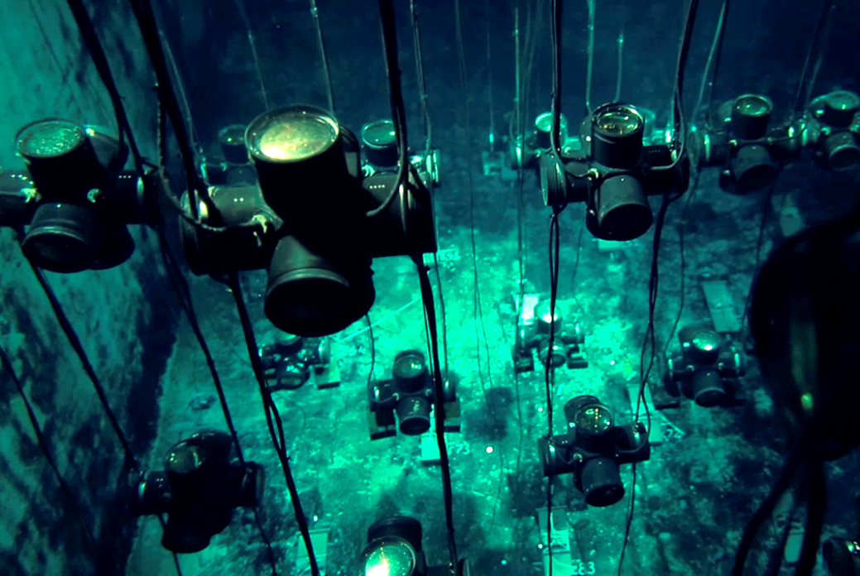
Cherenkov Water Detector NEVOD-91 (1994)

Slide 8
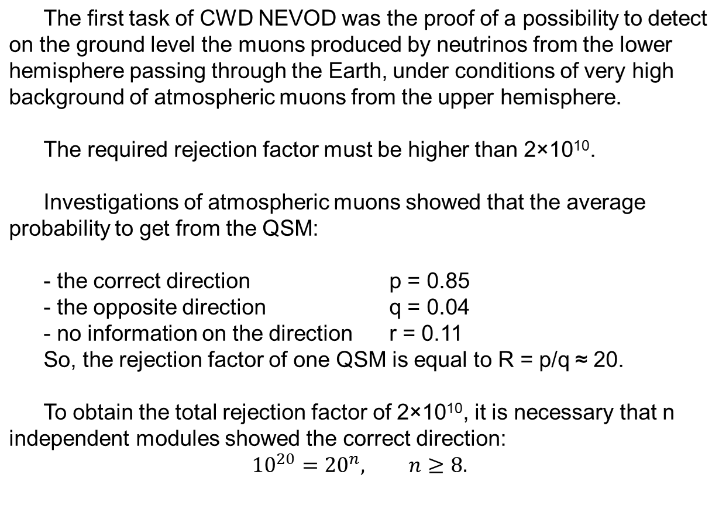
Cosmic ray neutrino detection on the Earth’s surface

Slide 9
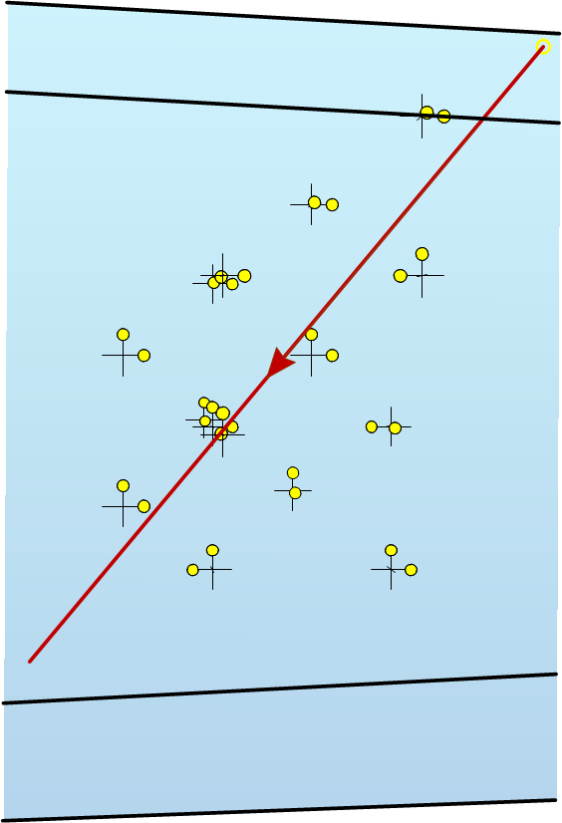
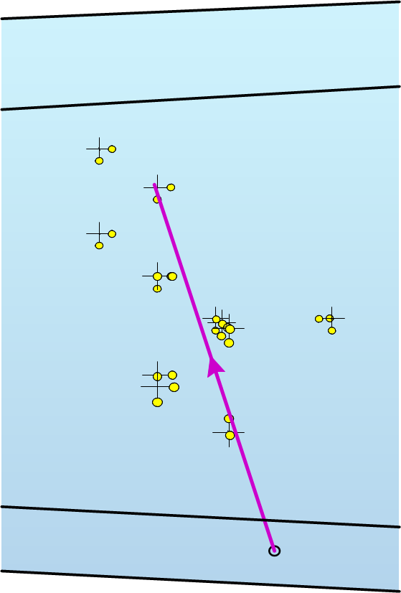
Examples of events with n ≥ 8
Downgoing muon
Upgoing muon

Slide 10
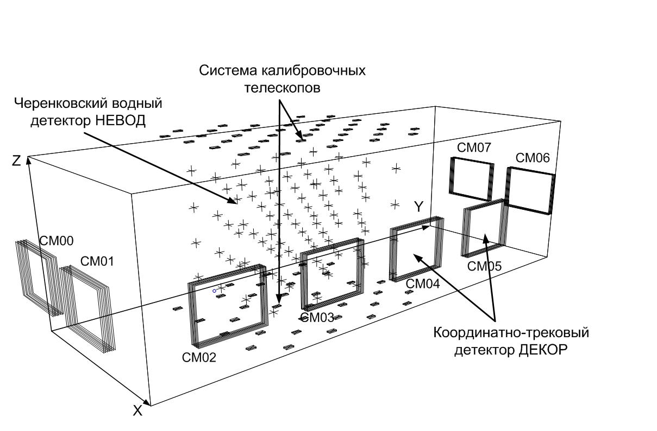
General scheme of NEVOD complex
System of
calibration telescopes (SCT)
Cherenkov water detector NEVOD
SM07
SM06
SM00
SM01
SM05
SM04
SM03
Coordinate detector DECOR
SM02
Water tank sizes 9 × 9 × 26 m³
Size of each supermodule 8.4 m²
Scintillation counters 20 x 40 x 2 cm³

Slide 11
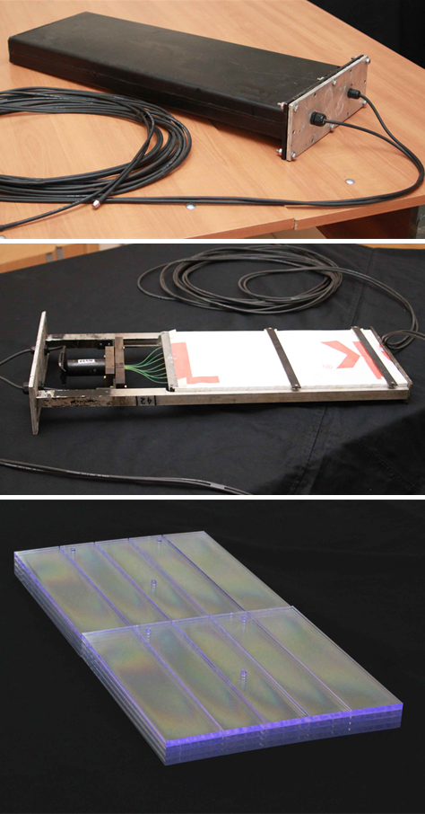
Calibration telescope system (CTS)
  To calibrate QSM in the flux of muons with known trajectories, a specialized calibration system was developed.
  Scintillation counters with sizes 20 x 40 x 2 cm³ were placed on the top and the bottom of the water reservoir in staggered order, in total 2 x 40.
  Each pair of counters (one on the top and one on the bottom) form a telescope, which gives position and direction of muon with a good accuracy.
  In total, there are 1600 telescopes which allow to calibrate QSMs by Cherenkov light from muons passing at different distances and angles.
  Additionally, CTS can be used as EAS detector:
  Top layer – for electromagnetic component;
  Bottom layer – for muon component.

Slide 12
Coordinate-Tracking Detector (DECOR)
  To improve angular accuracy of investigations of cosmic rays, the coordinate-tracking detector (DECOR) consisting of streamer tubes was constructed around CWD NEVOD. It has a modular structure and includes 8 supermodules (SMs).
  Each SM is independent and consists of 8 planes of streamer tubes 1 cm² combined in chambers with 16 tubes each.
  The modules are placed vertically and have the maximal efficiency for the detection of near-horizontal cosmic rays.

Slide 13
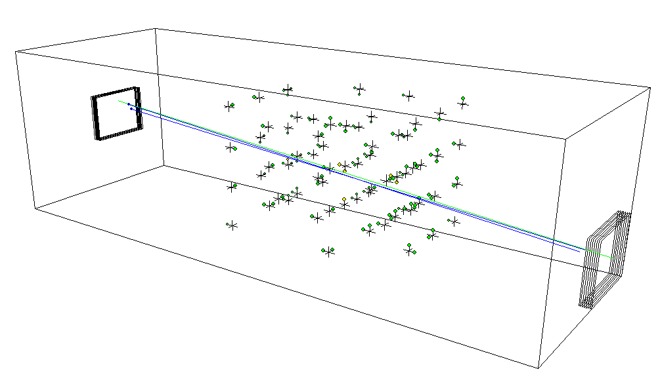
Response of CWD NEVOD on single muons
Response of QSM photomultipliers on single muons is the calibration point for measurements of cascade showers and energy deposit of muon bundles.
Example of CWD response on single muon.
61 QSM and 107 PMTs were triggered,
Σ_{amp} = 233 ph.e.
Red line – all events triggered by DECOR SMs in short galleries (without track reconstruction).
Black line – single horizontal muons reconstructed by means of DECOR data.
Notes:
…

Slide 14
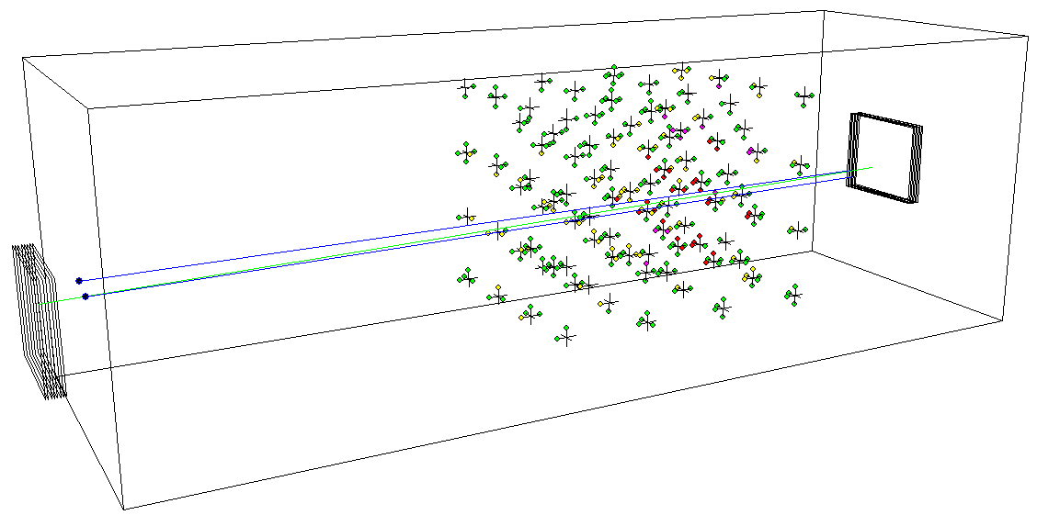
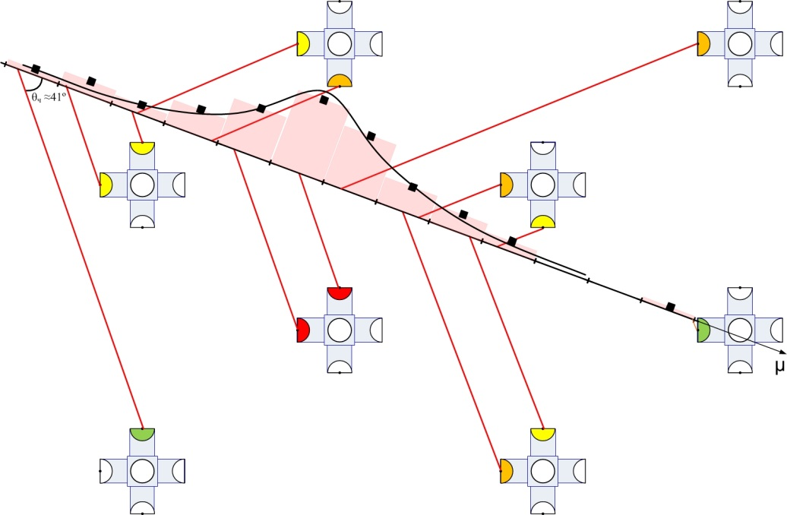
Investigation of cascade showers
The cascades produced by nearly horizontal muons were investigated.
Transition from responses of PMTs to the number of particles radiating Cherenkov light at the axes of showers was performed in the bins with the size of one radiation length each.
.
.
For more details, see Poster, Board 2

Slide 15
Detection of muon bundles in inclined EAS
D = m/S – local muon density,
m – multiplicity of muons in bundles,
S – effective area
Event # 271/4414 with muon bundle in coordinate-tracking detector DECOR.
Left projection gives azimuth angle, right projection – zenith angle.
Cherenkov water detector allows measure total energy deposit of muon bundles
Σ N (ph.e.) / D – normalized energy deposit calculated per muon density.

Slide 16
Low angles: around the “knee”
θ = 50º : 10¹⁵ – 10¹⁷ eV
θ = 65º : 10¹⁶ – 10¹⁸ eV
Large angles: around 10¹⁸ eV

Slide 17
Dependence of the average specific energy deposit on zenith angle and muon density in the bundles
Dependence on zenith angle
Dependence on muon density
Excess of muon bundles and high energy muons has got name “muon puzzle”
For more details, see Poster, Board 4

Slide 18
NEVOD Complex and “Muon puzzle”
Presented results show that NEVOD complex can solve “muon puzzle” since there are possibilities of separate measurements of muon number by means of coordinate-tracking detector DECOR and their energy deposit by means of CWD NEVOD.
But existing detectors have some drawbacks:
DECOR consists of separate supermodules between which there
are relatively big empty spaces, its spatial resolution is 1 cm, which allows separate two particles at distances not less than 3 cm only.
In CWD NEVOD, at present, only 40% of the total volume of the water reservoir is filled with quasispherical modules (QSM-6) and the response to particles passing through water tank in various places is substantially different.

Slide 19
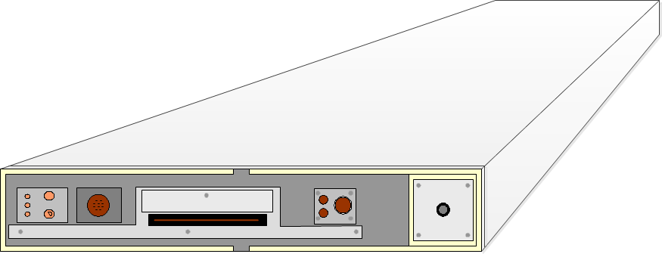
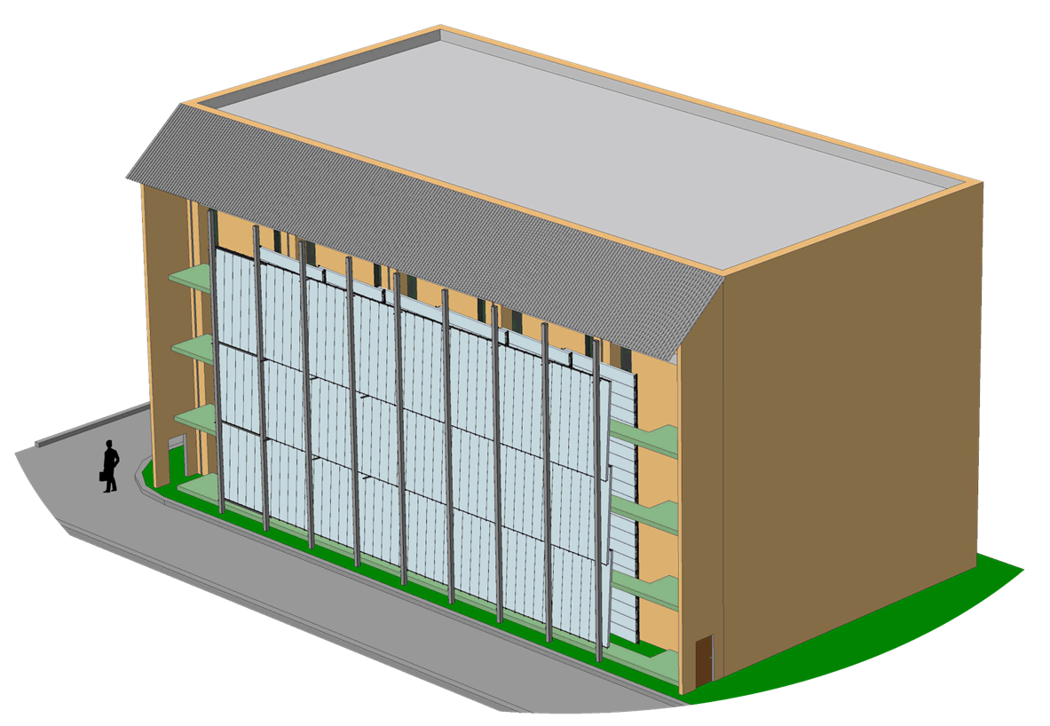
The new coordinate-tracking detector TREK
In order to essentially increase the sizes of coordinate-tracking detector, to eliminate empty spaces and to improve the accuracy of the number of particle measurements, the new coordinate-tracking detector TREK consisting of multiwire drift chambers of large volume (400 x 50 x 12) cm³ will be constructed.
Its total area will be 250 m², spatial resolution 1 mm, which allows separate two particle tracks at the distance of 3 mm, ten times better than in the existing detector DECOR.

Slide 20
Perspectives of CWD NEVOD development
It is supposed to reform the existing spatial lattice of QSM-6 by increasing the distances between them and to add additional new quasispherical modules (QSM-14), which will be developed.
It is supposed also to place new modules of the largest neutrino telescopes in the water reservoir: IceCube, KM3NeT and Baikal - several samples of each module.
The purpose of this experiment:
- to carry out mutual calibration of all modules at detection of:
single muons, muon bundles, cascade showers;
- to study characteristics of the modules and their temporal stability over a long period of time.

Slide 21
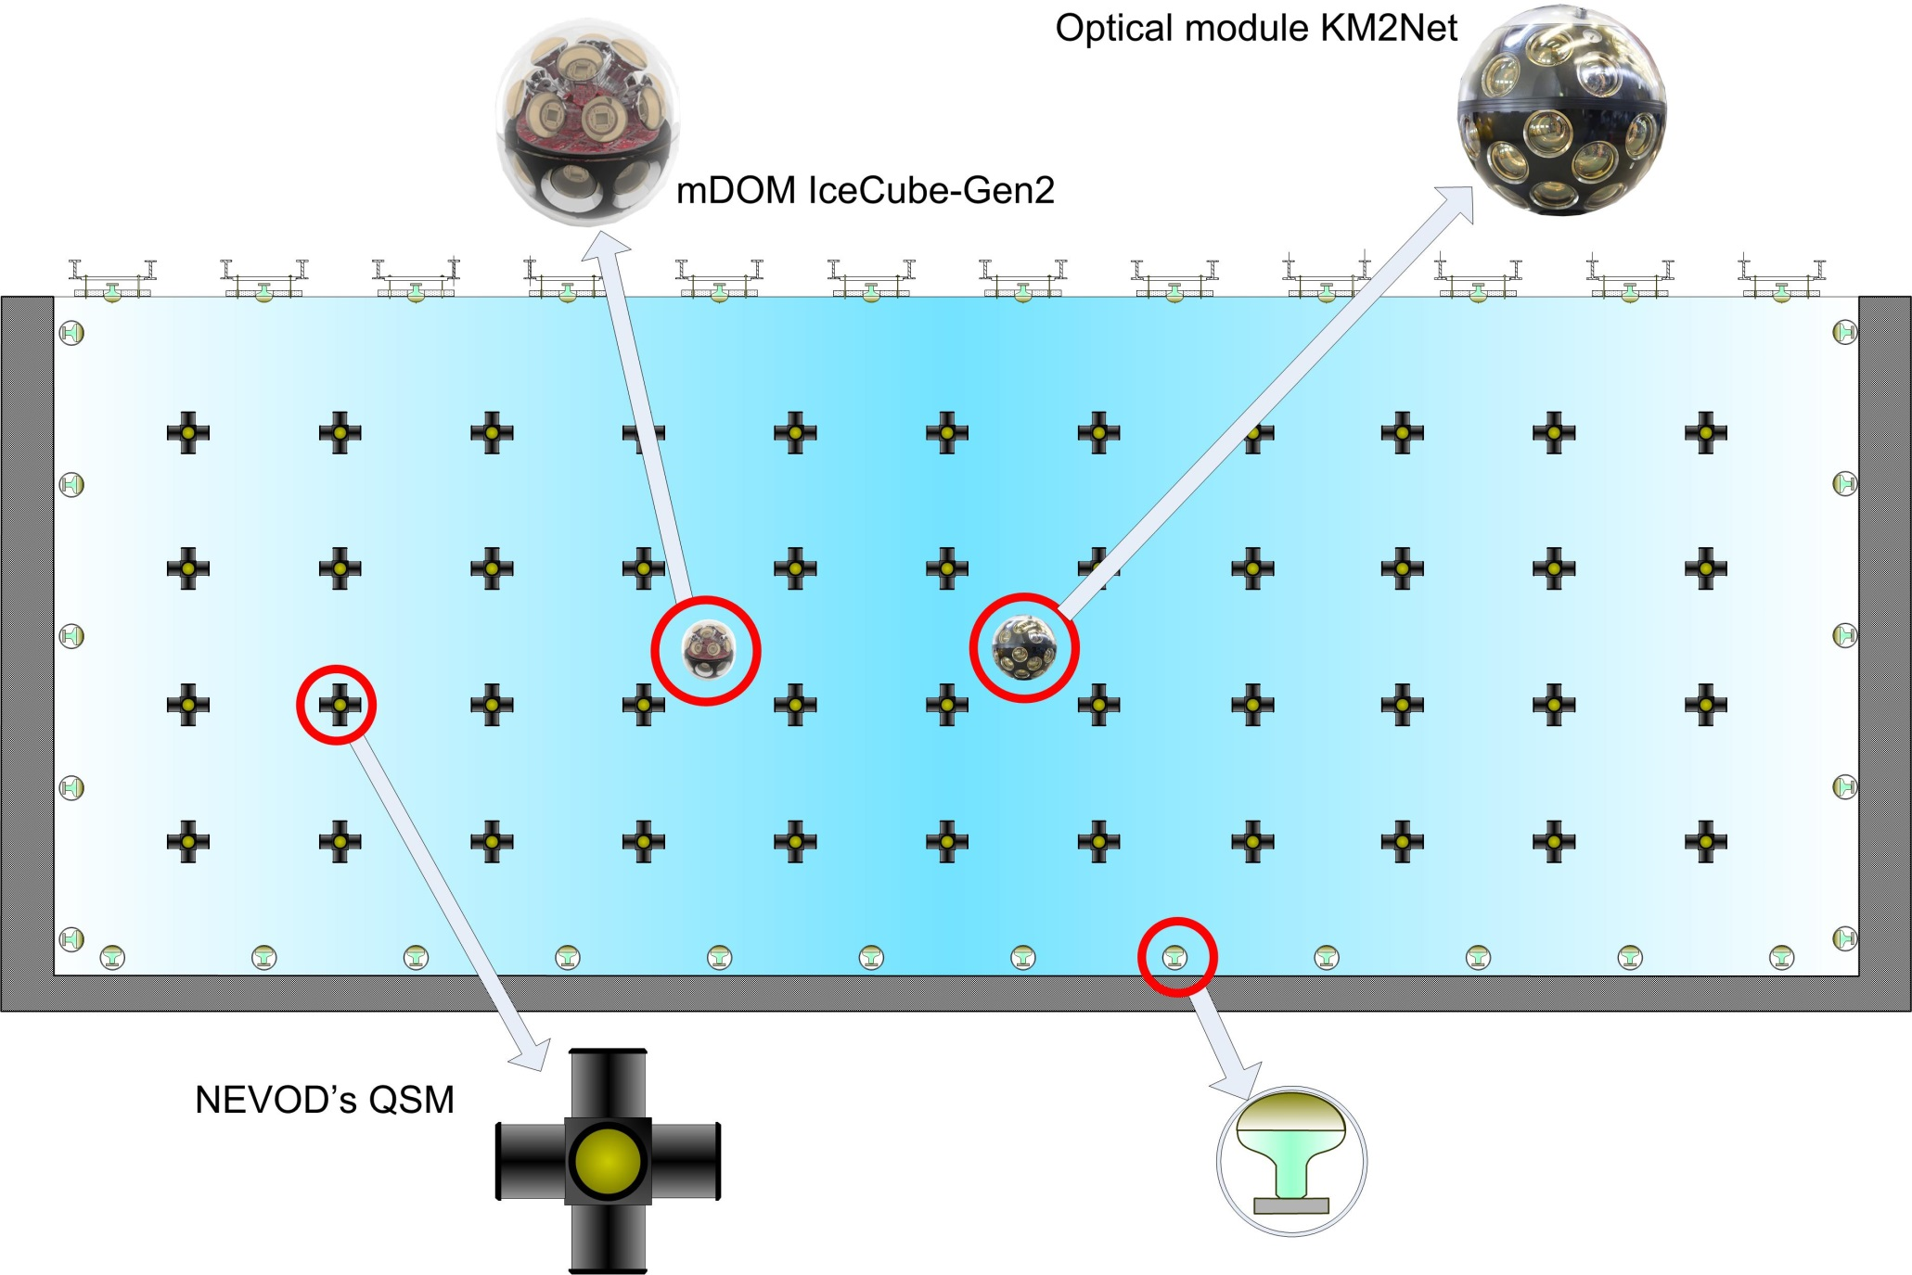
A scheme of new generation of CWD NEVOD
Optical module KM3NeT

Slide 22

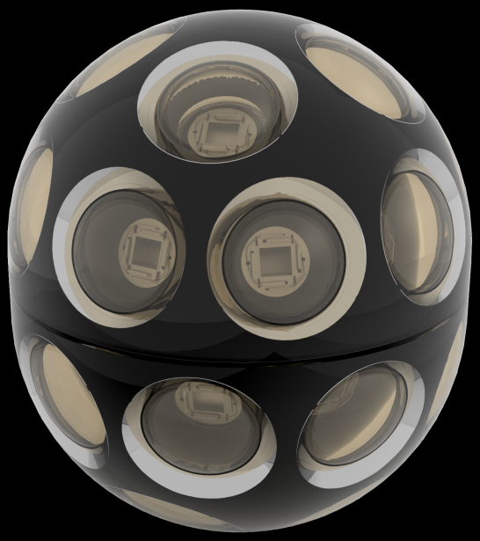
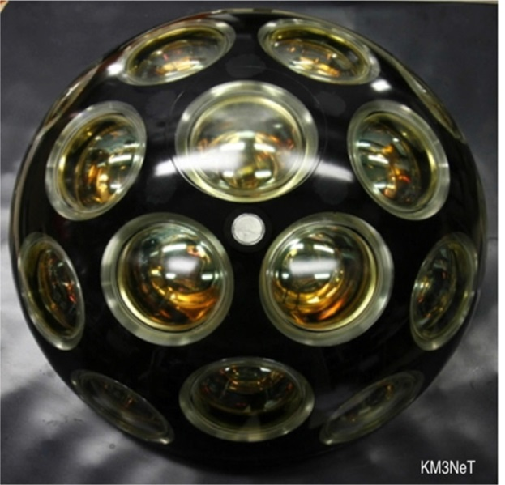
Tendency of CWD measuring module development
IceCube (1)
Baikal (2)
ANTARES (3)
NEVOD (6,14)
IceCube-Gen2 (24)
KM3NeT (31)

Slide 23
Conclusion
NEVOD is the first and up to present the only in the
world multi-purpose Cherenkov water detector on the Earth’s surface.
Its further development is connected with solution of “muon puzzle” and creation of universal test facility for investigations of characteristics and mutual calibration of measuring modules of any kind Cherenkov water detectors.

Slide 24
Thank you for your attention!

