Slide 1
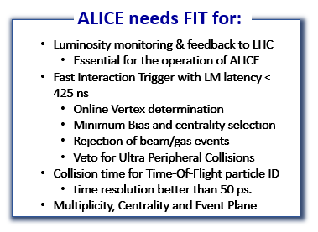
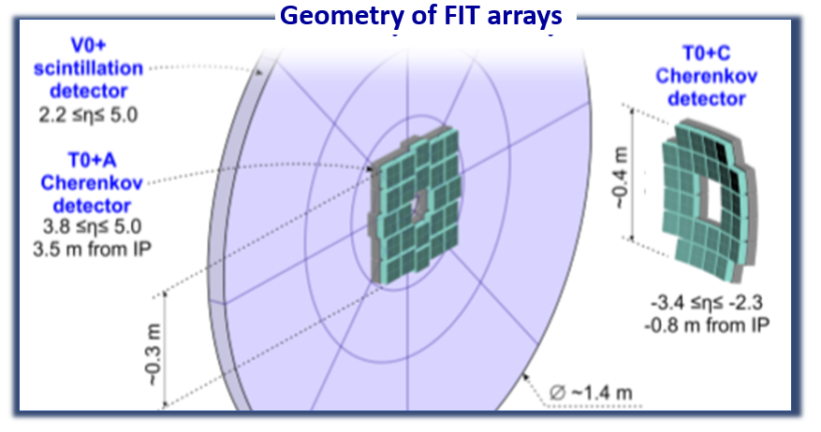
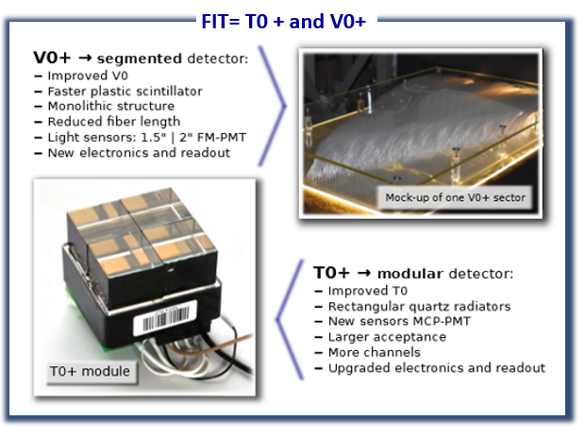
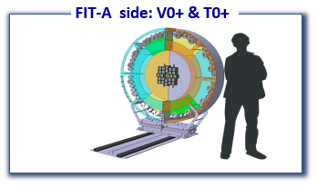
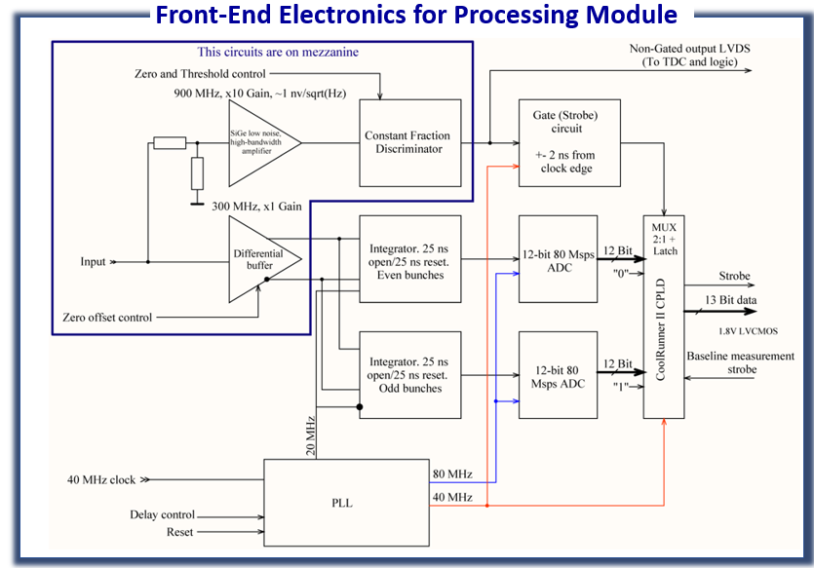
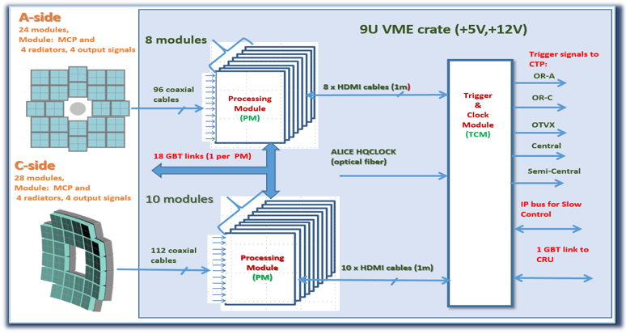
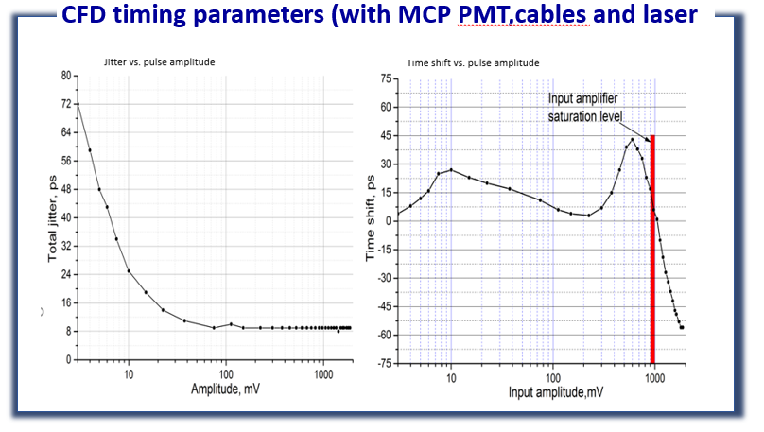
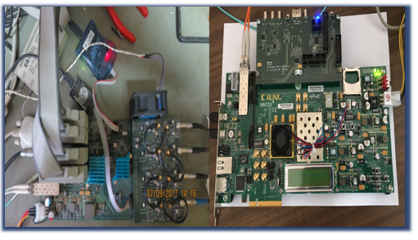
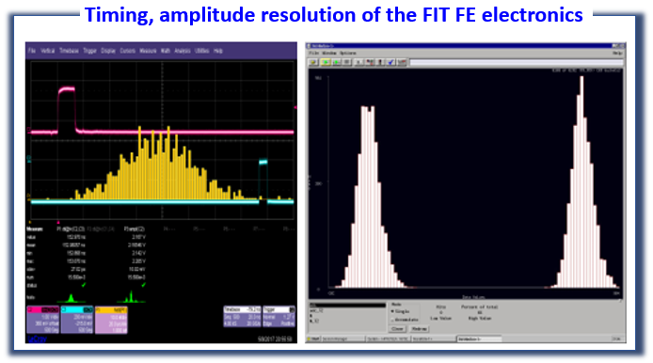
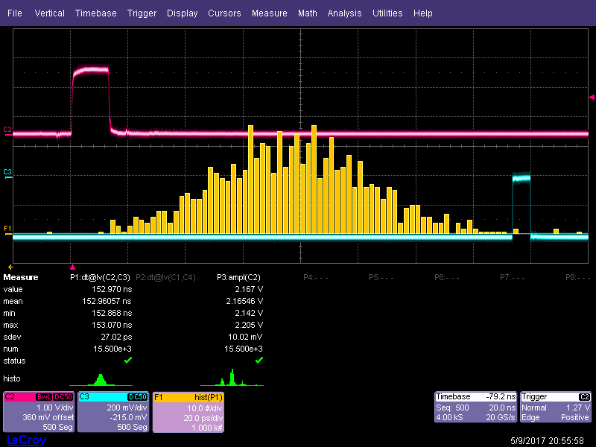
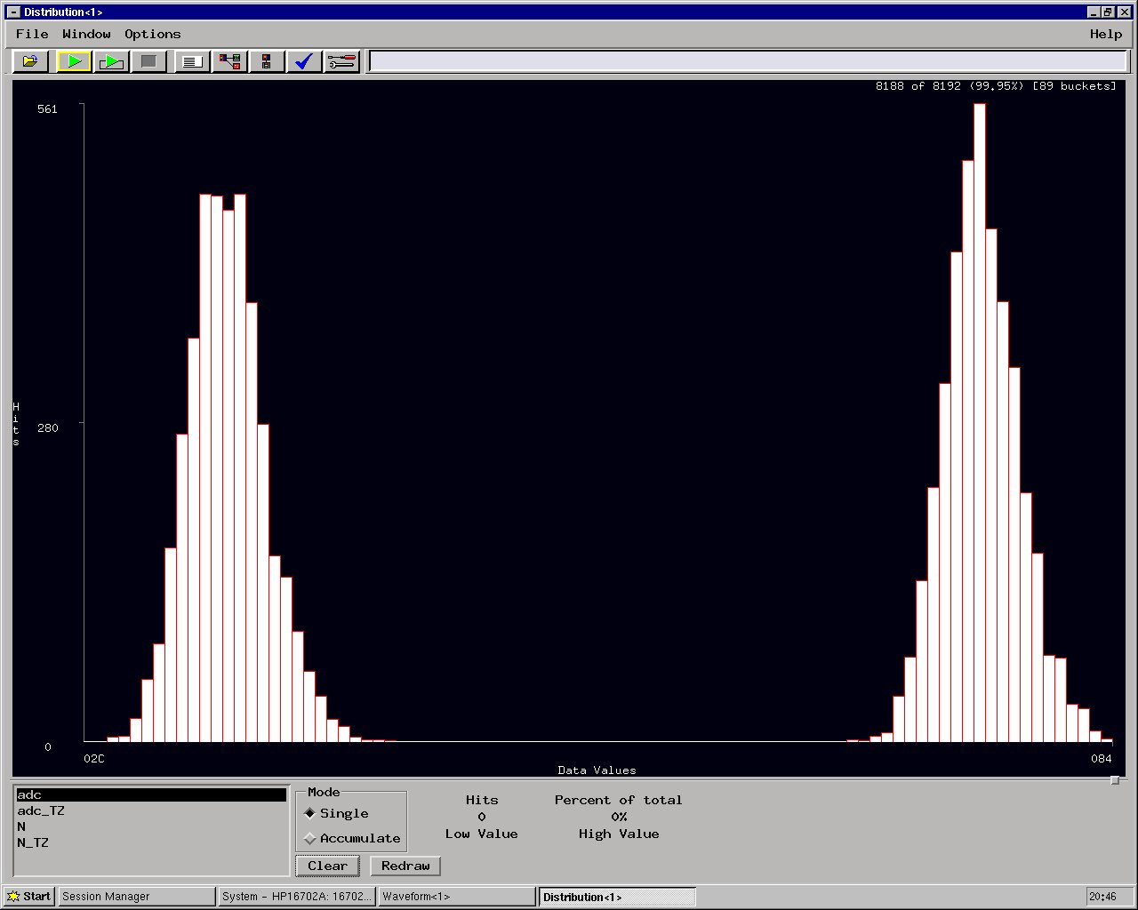
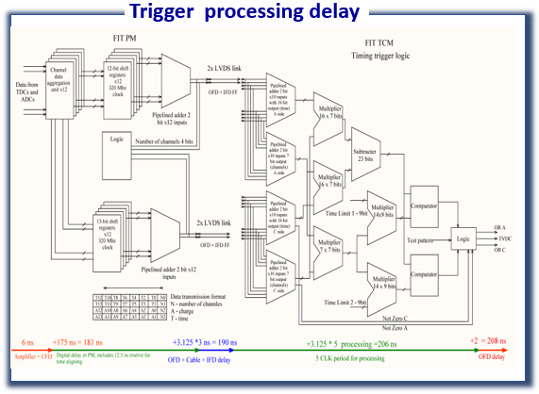
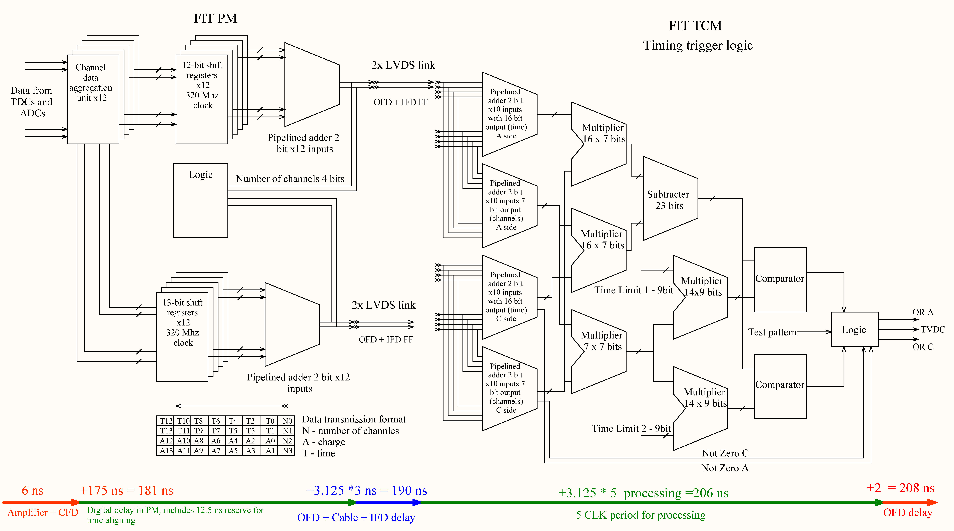
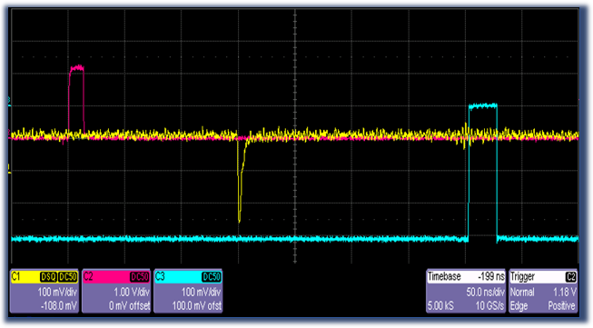
Fully integrated digital readout for the new Fast Interaction Trigger
for the ALICE upgrade
Dmitry Finogeev on behalf of the ALICE collaboration,
Institute for Nuclear Research of the Russian Academy of Sciences, Moscow, Russia.
Rich-2018
Fully integrated digital readout, pulse analysis, extraction of time and charge, signal alignment, multiplicity analysis and trigger generation electronics have been developed for the new Cherenkov-based Fast Interaction Trigger (FIT) for the upgrade of the ALICE detector at LHC,CERN. The main sensor will be Planacon XP85012/FIT-Q – a modified MCP-PMT with a pore size 25 um. Among the many challenges of this project are a high dynamic range (1:250), requirement to operate with the sustained bunch crossing of 25 ns, provide time resolution below 50 ps, complete the entire signal processing and trigger generation within 205 ns, etc. To ensure proper operation over the required running time, a very low output amplitude of 10 mV/MIP at the detector output will be used, requiring special cabling and low-noise fast electronics. Event time will be evaluated by a CFD and then digitized with an accuracy better than 50 ps over the entire dynamic range. The input charge will be integrated and measured by an ADC. The digitized event data will be sent to the Common Readout Unit (CRU) by 4.8 Gbps optical links. Trigger data processing will be done in the two-level FPGA processor, based on the Kintex-7 Xilinx FPGAs with a 320 MHz main processing clock and a 600 MHz timing input clock. In total, FIT electronics will be processing 256 independent channels in parallel. The project has already completed and passed the Engineering Design Review. The prototype testing has been completed and the 205 ns total processing time was confirmed. The first prototype of the sensor and the front-end electronics have been installed inside of the ALICE magnet and were used to collect data from LHC collisions since 2016.
ALICE needs FIT for:
V0+ A
scintillation detector
2.2 ≤ ɳ ≤ 5.0
Geometry of FIT arrays
T0+ C
Cherenkov detector
FIT = T0 + and V0+
Luminosity monitoring & feedback to LHC
Essential for the operation of ALICE
Fast Interaction Trigger with LM latency < 425 ns
Online Vertex determination
Minimum Bias and centrality selection
Rejection of beam/gas events
Veto for Ultra Peripheral Collisions
Collision time for Time-Of-Flight particle ID
time resolution better than 50 ps.
Multiplicity, Centrality and Event Plane
V0+ segmented detector:
Improved V0
Faster plastic scintillator
Monolithic structure
Reduced fiber length
Light sensors: 1.5” | 2” FM-PMT
New electronics and readout
T0+ A
Cherenkov detector
3.8 ≤ ɳ ≤ 5.0
3.5 m from IP
-3.4 ≤ ɳ ≤ -2.3
-0.8 m from IP
Requirements for RUN3
FIT-A side: V0+ & T0+
T0+ modular detector:
Improved T0
Rectangular quartz radiators
New sensors MCP-PMT
Larger acceptance
More channels
Upgraded electronics and readout
Interaction Rates: 50 kHz for Pb-Pb, and up to 200 kHz for p-p (max 1-2 MHz)
2 modes of running for detectors: triggered and continuous
The main “interaction” trigger via the “FIT” detector
LM trigger input latency <= 425 ns
Analog signals from the detector comes to the Processing Modules (PM), where arrival time and charge value of the pulse is evaluated and digitized by the Time to Digital converters and ADCs. Each processor module has 12 analog inputs (One PM per 3 Cherenkov module.) Processing module sends digitized data to the next processing level (O²) by the 4.8 Gbps optical link with CERN proprietary protocol GBT. This protocol includes Reed-Solomon error correction mechanism and has well-defined data latency, the later allows transferring of the trigger information to the detector in the downlink. Also, the PM module will provide first level of data processing for triggers. It packs the data from the inputs to the 32-bit data, which transmits every 25 ns to the Trigger and Control Module (TCM) through 4 differential links.
Trigger & readout concept
PM analog input parameters:
Tested noise count threshold limit from the FIT prototype in ALICE – 3 mV.
CFD linear range – 1 mV (Thermal noise limit) – 300 mV (CFD amplifier output saturation). To keep maximum possible input range for CFD, it is connected to input through 1/3 resistive divider, this gives linear input range for CFD 3 – 900 mV.
Charge integrator input range is 0 – 2 V to 0 – 5 V (defined by resistors). ADC resolution is 12 bit.
For FIT T0+ part input range is 0 – 2 V, thus gives 0.5 mV for ADC LSB.
1 mip = 7.5 mV = 15 LSB. MCP pulse dispersion at 1 mip at 50% level is ~3 LSB, this gives clear 1 mip peaks resolution.
Front-End Electronics for Processing Module
Fully integrated system based on an amplifier , a CFD, on-board TDC/ADCs and FPGA
processors which allow digital trigger processing and GBT based read-out.
Trigger decision based on digitized data (after TDCs & ADCs)
4-channel prototype of the Processing Module with Frontend Electronics mezzanine board (Amplifer &CFD).
TCM prototype based on Kintex 705 Evaluation board
CFD timing parameters (with MCP-PMT, cables and laser)
7.5 mV – 1 mip, 1 V – CFD input amplifier saturation point, 1.9 V (250 mip)– end of dynamic range. For low pulse amplitudes jitter is defined by the thermal noise of the input amplifier.
Timing, amplitude resolution of the FIT FE electronics
Trigger and Controller module receives the “pre-trigger” data from all PM modules in the system (up to 20) and forms the trigger signals, most important of them are ORs (at least one channel on the side has signal, arrived in the correct time), TVX (Both side has events from interaction and the time difference between them indicates that interaction occurs in the predefined area) and multiplicity triggers, which indicates that total charge in the detector exceeds the predefined thresholds. TCM module receives commands and configuration through the 1 Gb Ethernet optical link and transmit important parameters, such as event counters to the Detector Control System. TCM also provides synchronous high-quality clock for all PMs.
Trigger circuits in the FPGAs in the PM and TVX and OR A/C in TCM. Summing times from all channels, calculating average time per side and comparing them with thresholds).
Trigger processing delay
Timing resolution with MCP PMT for average pulse amplitude 3 mV
Charge measurement for 1 mip signal, two ADCs (baseline not subtracted).
Timing resolution with MCP PMT for average pulse amplitude 3 mV – 56 ps.
Timing resolution for 1 MIP pulse (7.5 mV average amplitude) is 27 ps.
MCP PMT pulse dispersion for 1 mip is about 6% (0.9 LSB).
One sigma for this plot is ~ 3 LSB. This is the noise level of the charge measurement channel, as MCP PMT contribution to the noise is negligible.
The signal/noise ratio for 1 mip is 5. (1 mip = 15 LSB)
Purple – laser pulse, Yellow – Analog input, Blue – trigger
output delay is 203.5 ns.

