Slide 1
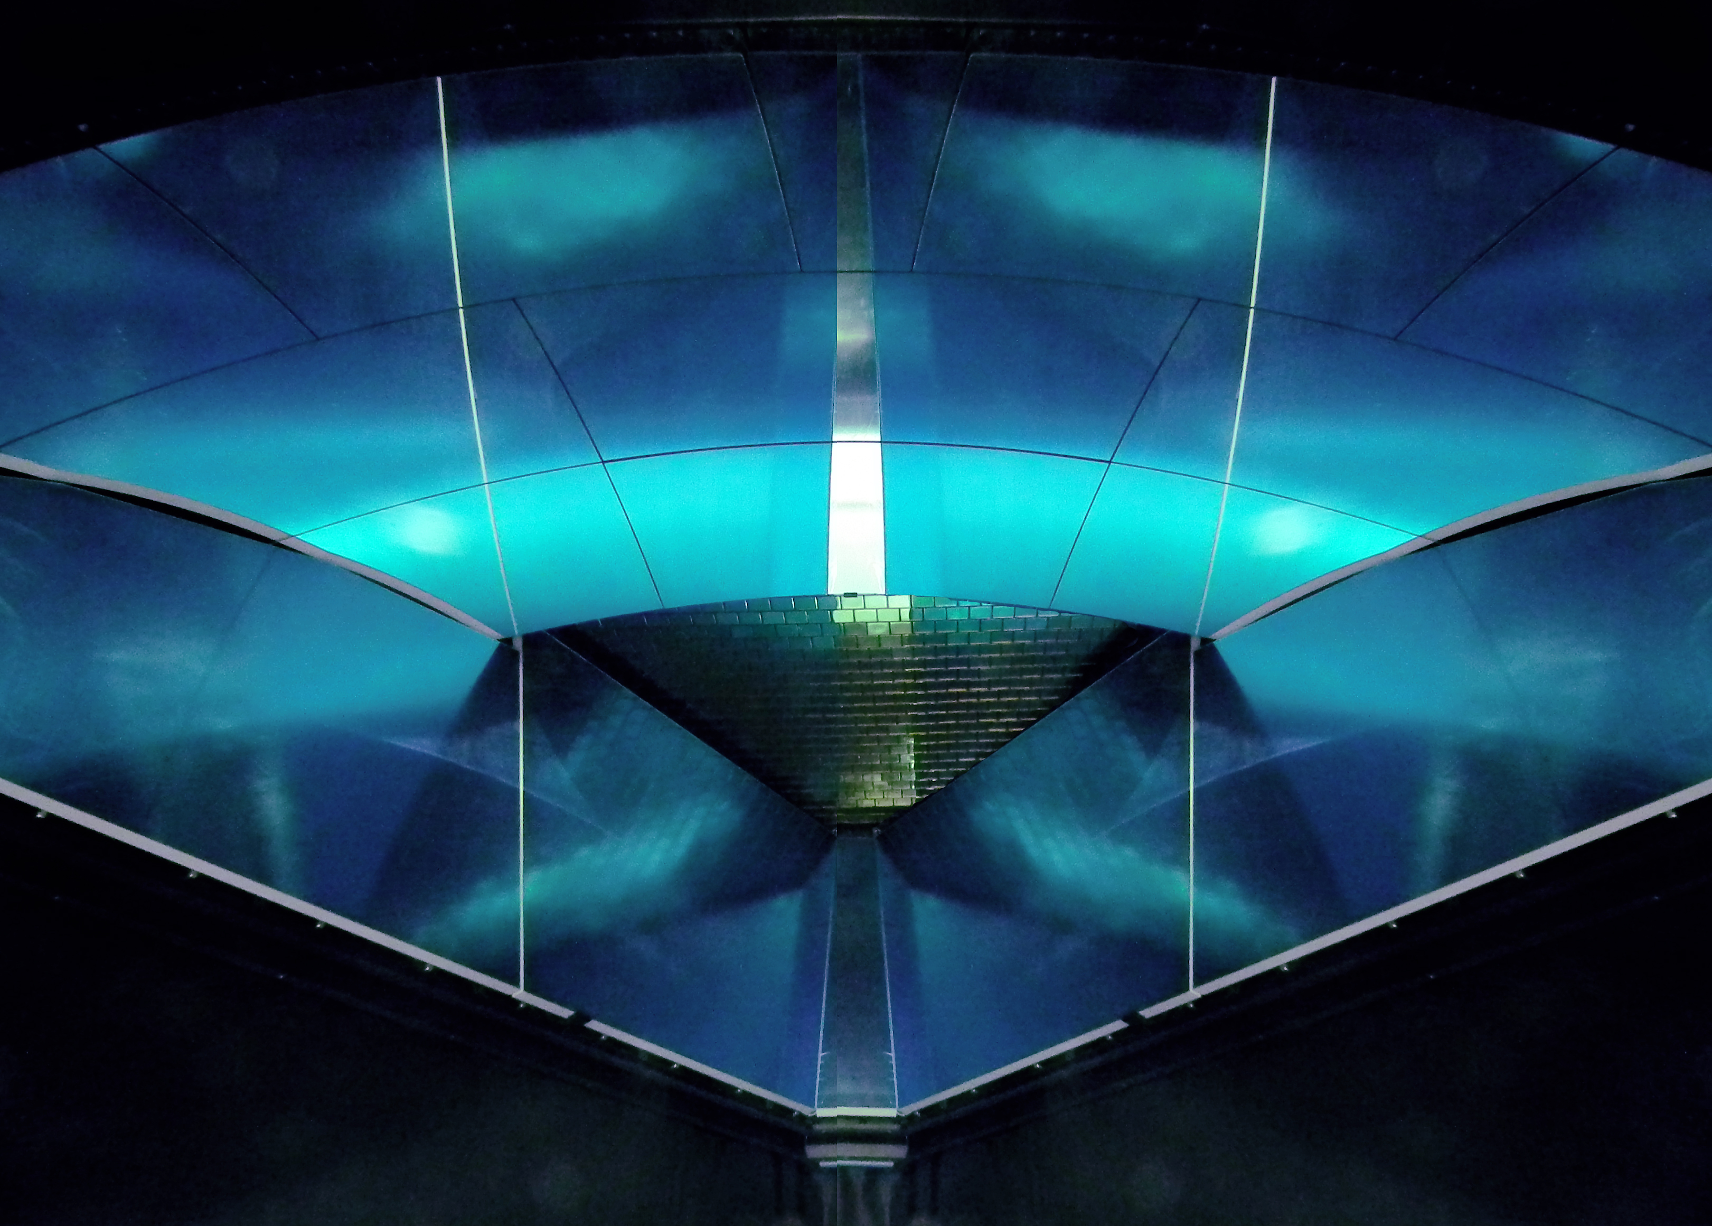
Single Photon Detection with the Multi-anode CLAS12 RICH Detector
M. Contalbrigo – INFN Ferrara – on behalf of the CLAS12 RICH group
10th International Workshop on
Ring Imaging Cherenkov Detectors
31st July 2018,
Russian Academy of Science - Moscow
Notes:
Vanno messi studi innovativi e pubblicazioni

Slide 2
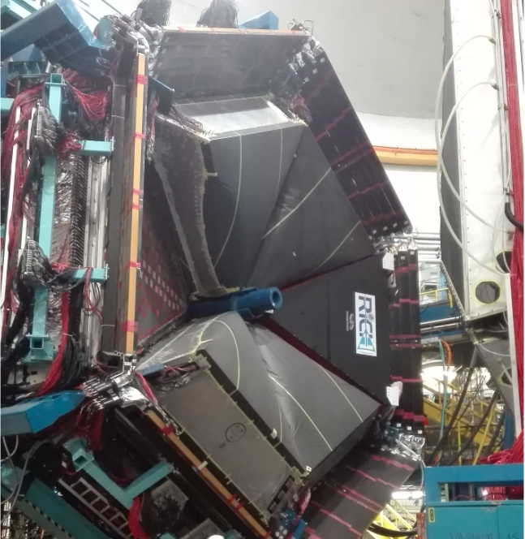
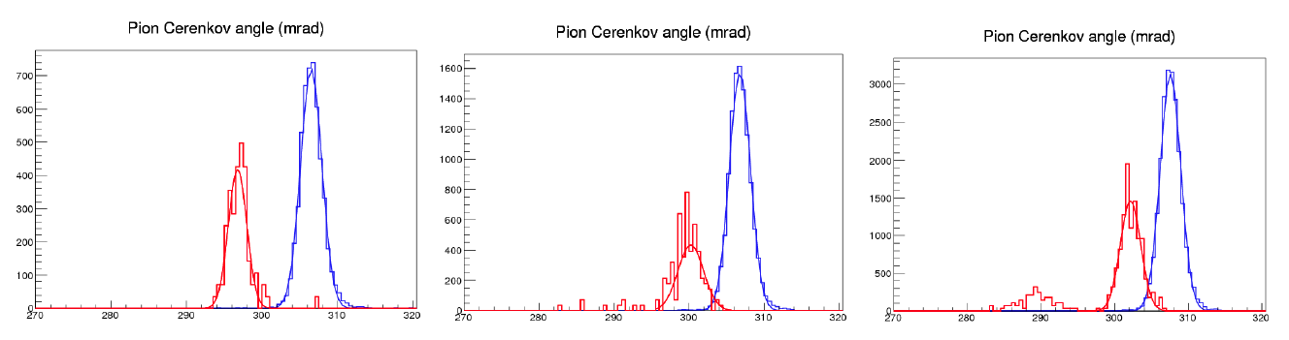
CLAS12 RICH
INSTITUTIONS
INFN (Italy) Bari, Ferrara, Genova, L.Frascati, Roma/ISS
Jefferson Lab (Newport News, USA)
Argonne National Lab (Argonne, USA)
Duquesne University (Pittsburgh, USA)
George Washington University (USA)
Glasgow University (Glasgow, UK)
Kyungpook National University, (Daegu, Korea)
University of Connecticut (Storrs, USA)
UTFSM (Valparaiso, Chile)
Goal kaon-pion separation up to 8 GeV/c (prototype results):
6 Gev/c
π
7 Gev/c
8 Gev/c
k
p
Cherenkov angle (mrad)
Contalbrigo M.
10th RICH Workshop, 31st July 2018, RAS - Moscow
2
Notes:
Vanno messi studi innovativi e pubblicazioni

Slide 3
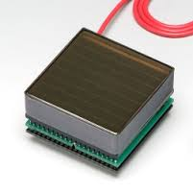
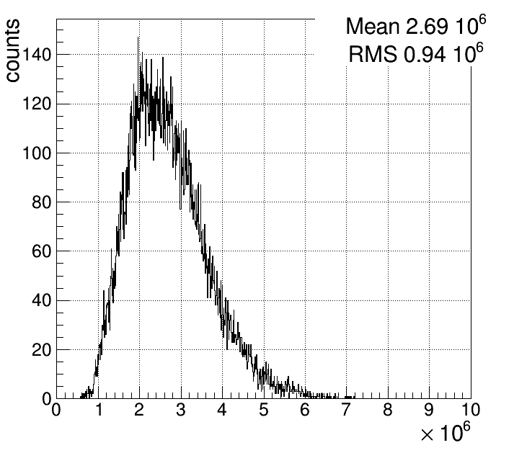
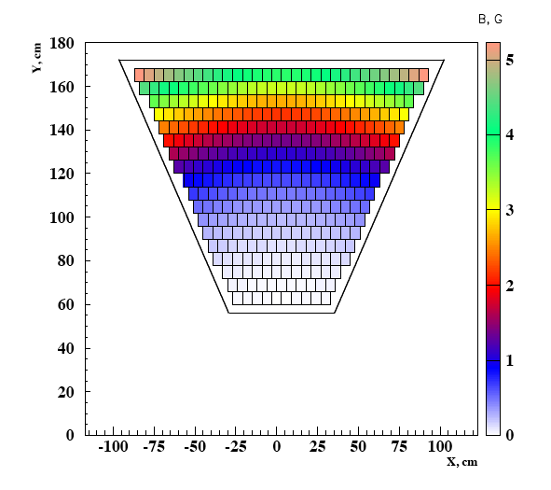
Photon Sensor: MA-PMT
MA-PMT
< 1 cm spatial resolution
< 1 ns time resolution
Compatible with the low torus fringe field
Average MA-PMT gain ~ 2.7 10⁶
Corresponds to SPE ~ 400 fC
✓ 64 6x6 mm² pixels cost effective device
✓ High sensitivity on VIS towards UV light
✓ Mature and reliable technology
✓ Large Area (5x5 cm²)
✓ High packing density (89 %)
✓ Fast response
✓ Expensive technology
~ 1 m² active surface
10th RICH Workshop, 31st July 2018, RAS - Moscow
3
Notes:
Dire meglio chi fa cosa.

Slide 4
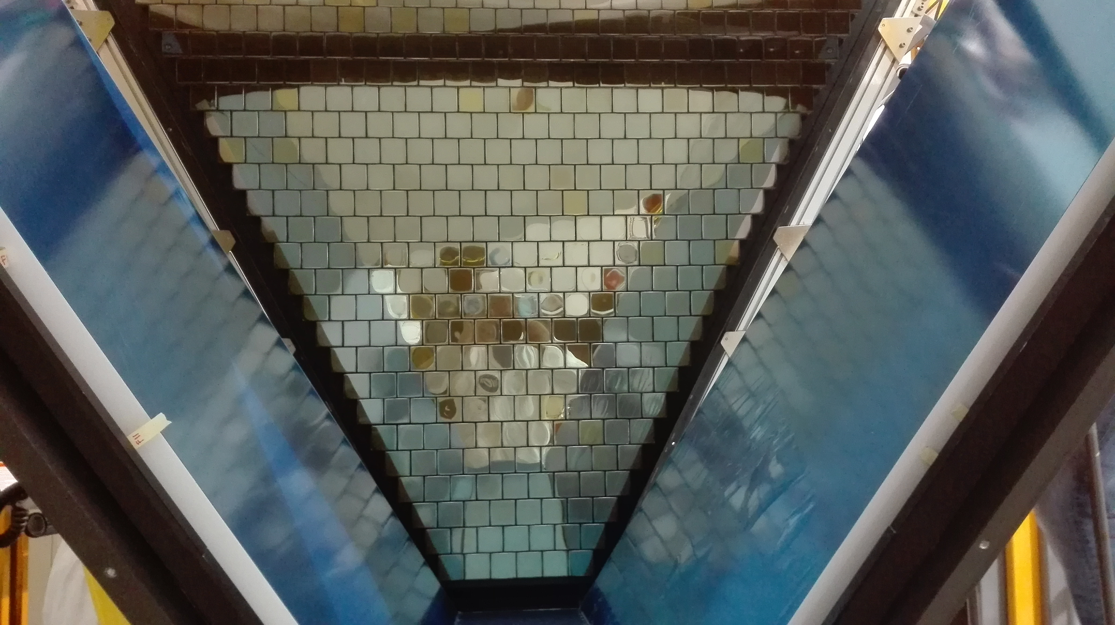
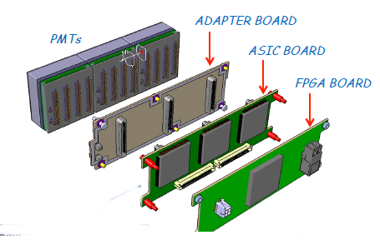
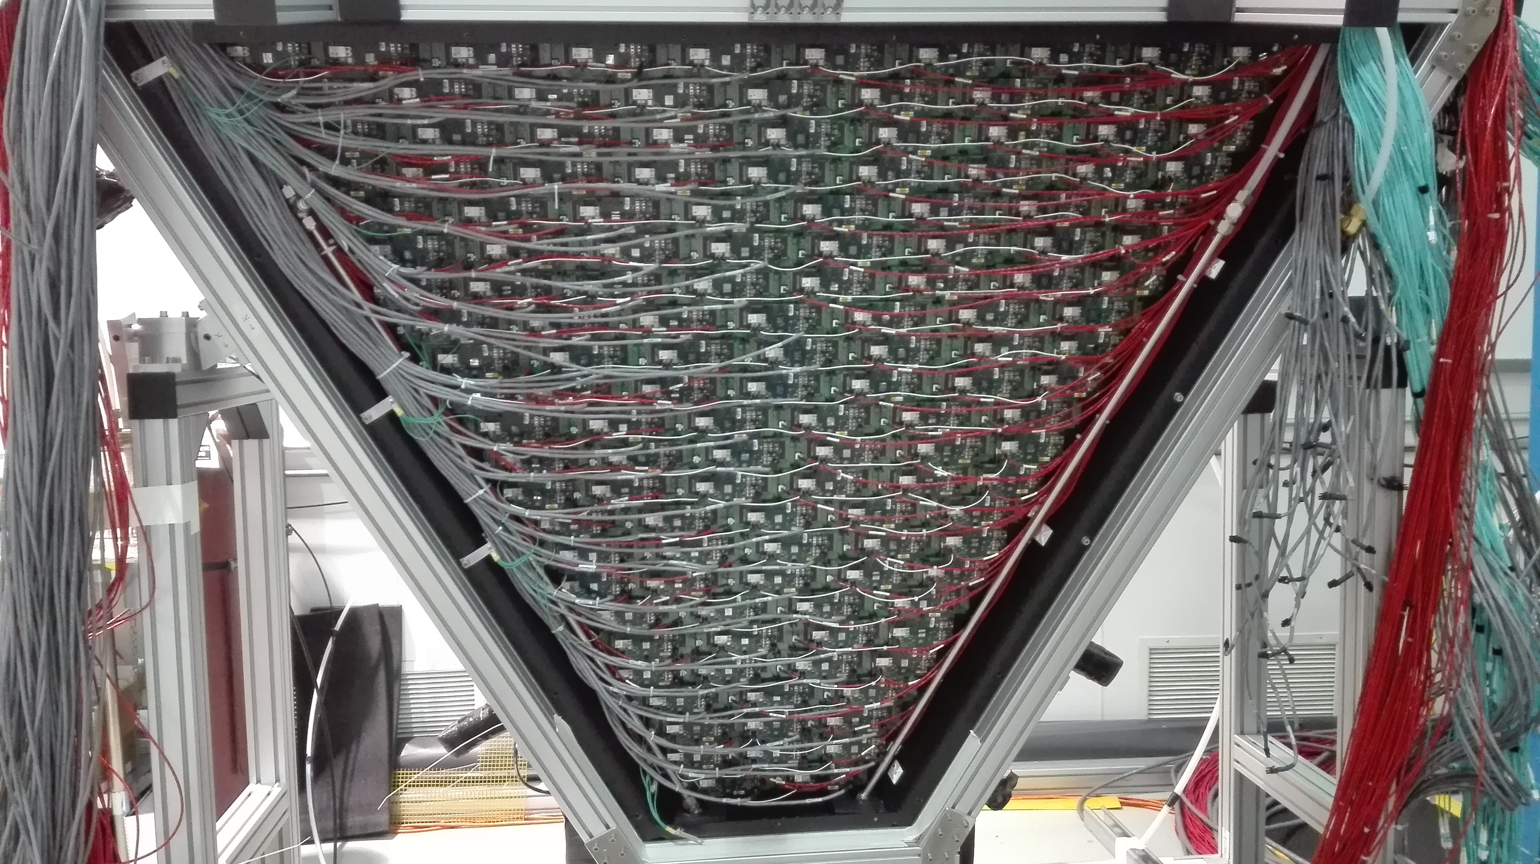
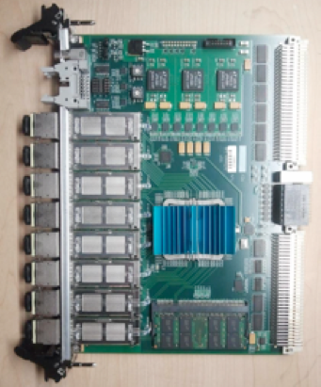
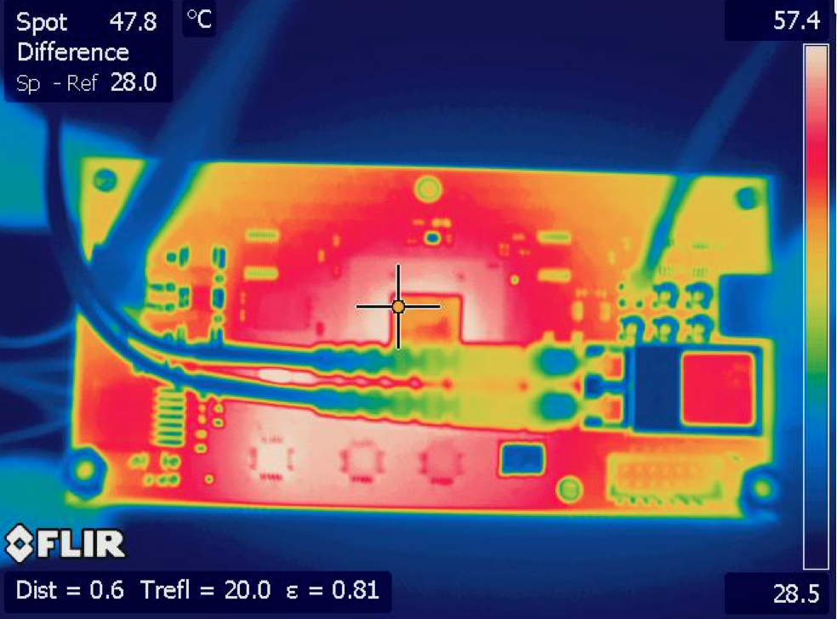
RICH Readout Electronics
Readout Electronics
Compact (matches sensor area)
Modular Front-End (Mechanical adapter, ASIC, FPGA)
Scalable fiber optic DAQ (TCP/IP or SSP)
Tessellated (common HV, LV and optical fiber)
Optical
Fiber
HV
LV
SSP Fiber-Optic DAQ
Tile power dissipation ~ 3.5 W
Contalbrigo M.
10th RICH Workshop, 31st July 2018, RAS - Moscow
4
Notes:
Immagine electronic panel e scheda ottica

Slide 5
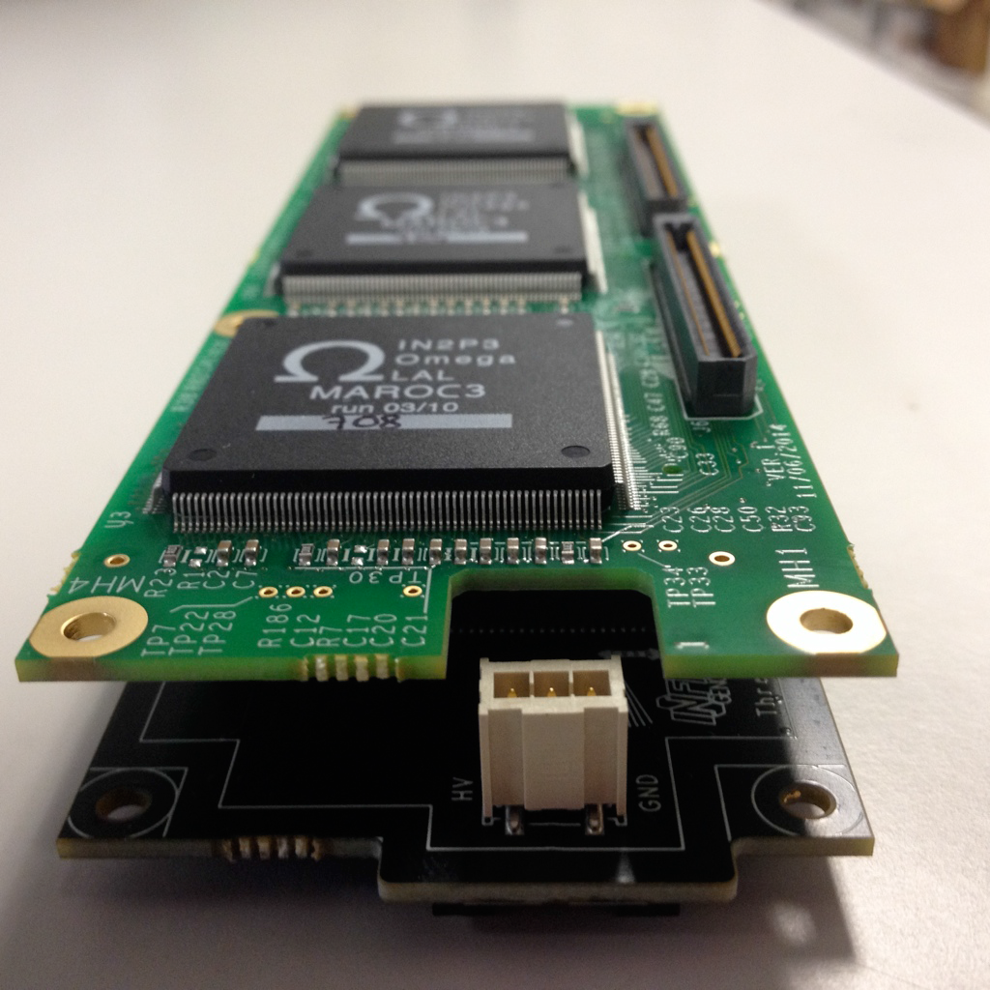
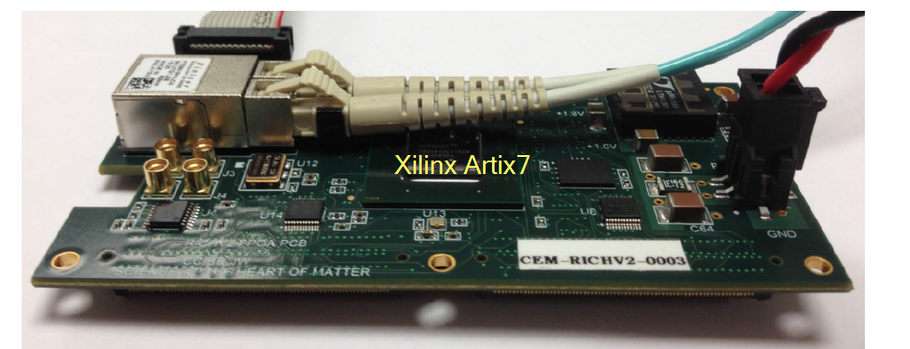
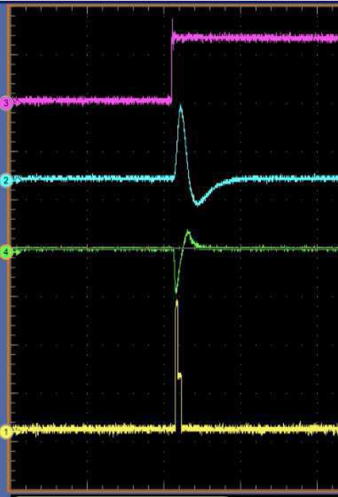
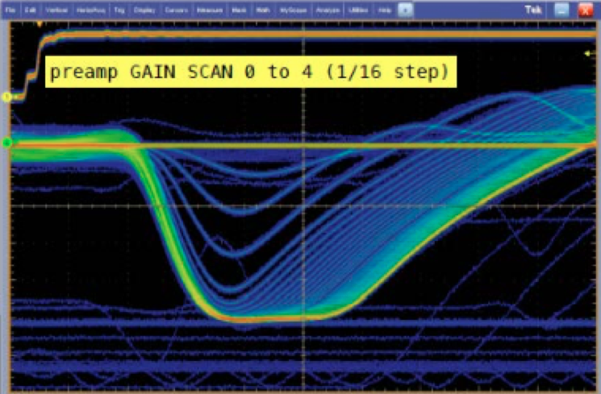

RICH Front-End Electronics
Test pulse
Charge
Analog: Charge (1 fC)
Digital: Time (1 ns)
Trigger latency (8 μs)
Optical ethernet (2.5 Gbps)
Trigger: external
internal
self
On-board pulser
Test
Slow shaper
Slow shaper
Linear response
Multiplexed readout
Limited holding time delays
Used for calibrations
Digital pulse
Contalbrigo M.
10th RICH Workshop, 31st July 2018, RAS - Moscow
Contalbrigo M.
5
Notes:
Aggiungere range di validita’ per fattorizzazione GPDs

Slide 6
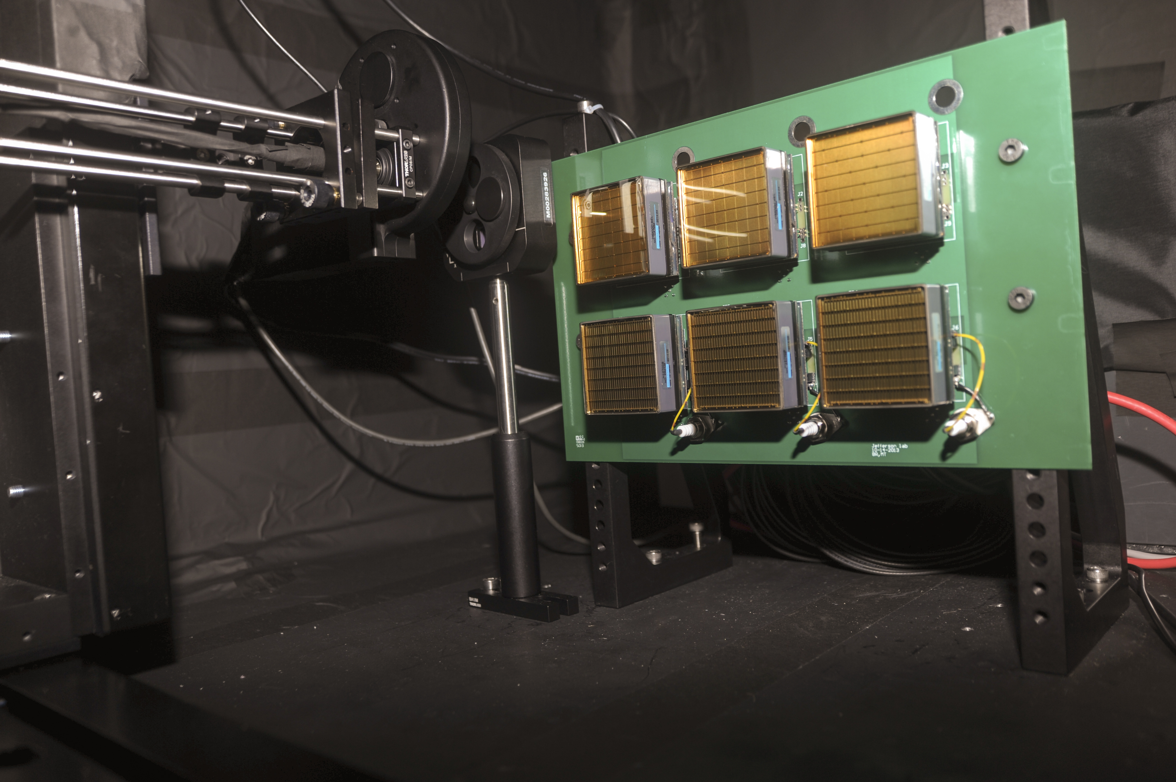
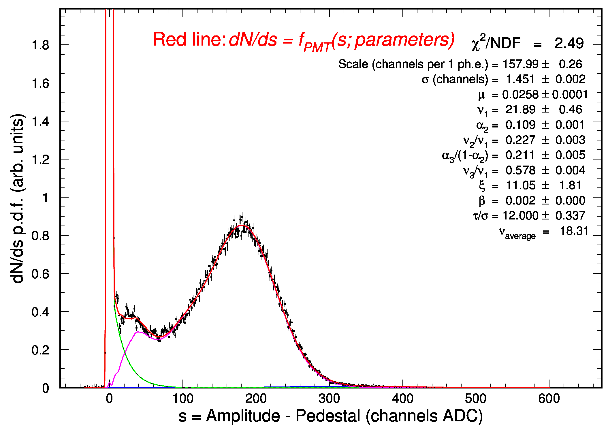
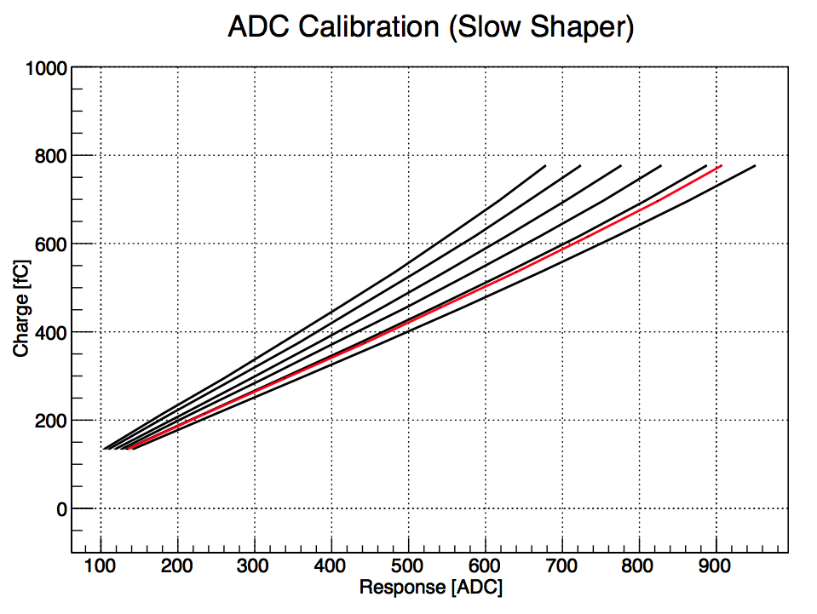
ADC Charge Measurement
Multiplexed readout up to 50 kHz
High resolution SPE spectrum
Viable for efficiency and gain monitors
In conjunction with timing, allows the
study of PMT discharge and cross-talk
Gain
Contalbrigo M.
10th RICH Workshop, 31st July 2018, RAS - Moscow
6
Notes:
Dire meglio chi fa cosa.

Slide 7
RICH Front-End Electronics
Digital response
Working in saturated regime
64 parallel channel readout
8 μs FIFO and delays
1 ns time resolution
Test pulse
Analog: Charge (1 fC)
Digital: Time (1 ns)
Trigger latency (8 μs)
Optical ethernet (2.5 Gbps)
Trigger: external
internal
self
On-board pulser
Test
Slow shaper
Slow shaper
Digital pulse
Start time
Stop time
Contalbrigo M.
10th RICH Workshop, 31st July 2018, RAS - Moscow
Contalbrigo M.
7
Notes:
Aggiungere range di validita’ per fattorizzazione GPDs

Slide 8
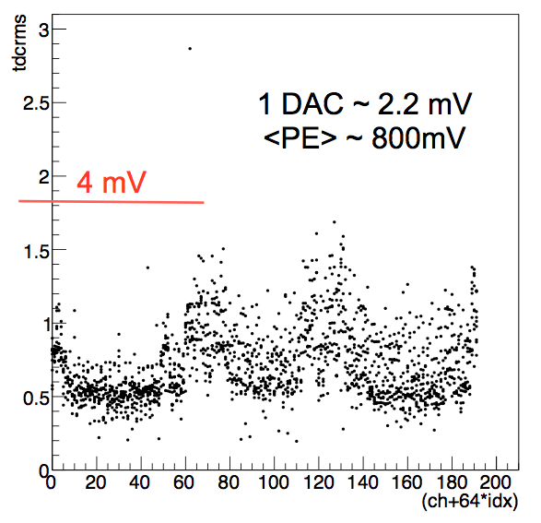
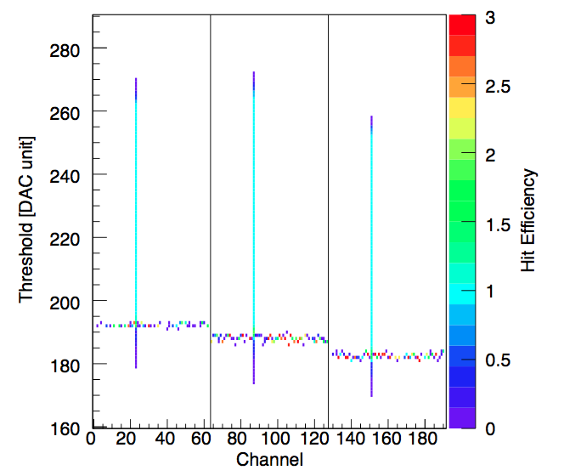
TDC Digital Readout
During Acceptance tests
During Internal Pulser Calibration
Pedestal rms as seen by a test-point
As seen by RICH readout
Discrimination down to 20 fC, i.e. few % of SPE, allows sensor characterization
Contalbrigo M.
10th RICH Workshop, 31st July 2018, RAS - Moscow
8
Notes:
Vedere presentazione Matteo

Slide 9
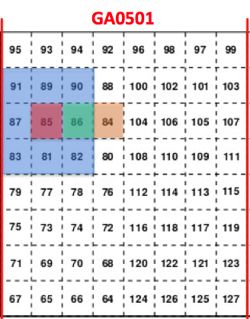
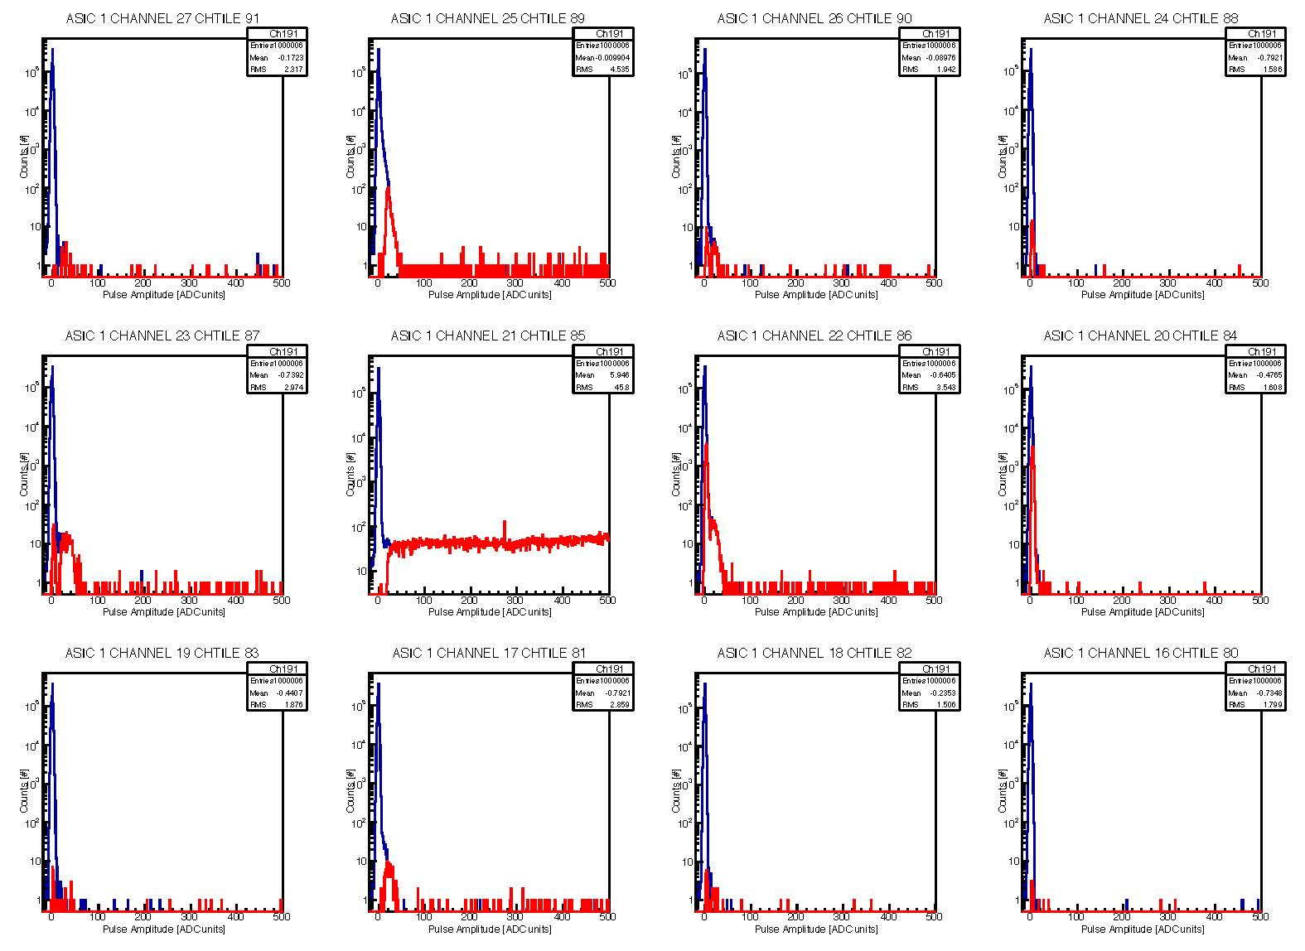
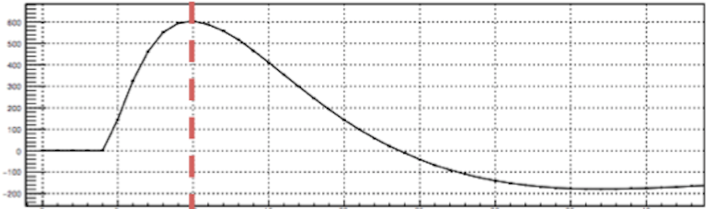
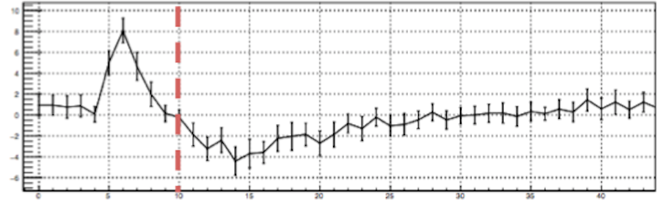
Optical and Electronic Cross-talk
Sensor
Gain x 4
THR ~ 1/80 SPE
Electronic
Signal
Cross-talk
Sampling time
10th RICH Workshop, 31st July 2018, RAS - Moscow
9
Notes:
Dire meglio chi fa cosa.

Slide 10
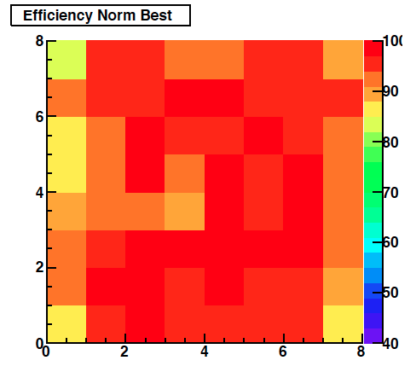
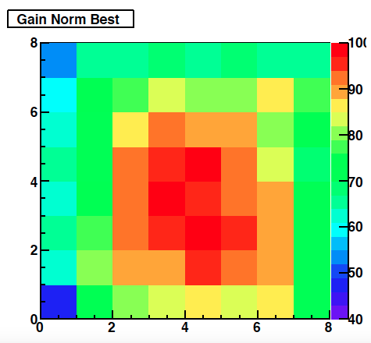
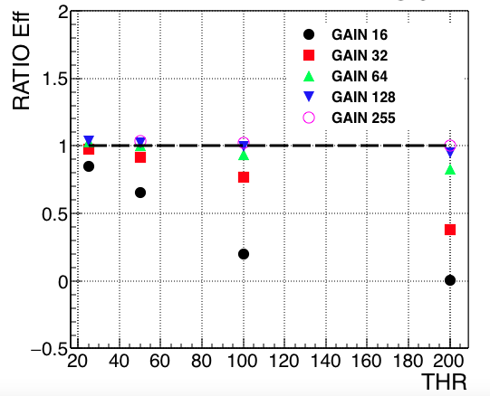
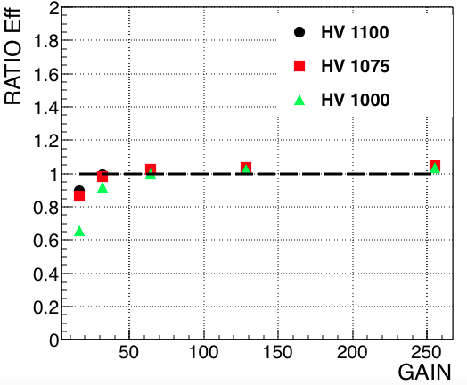
Single-photon Discrimination
Relative efficiency map
Relative gain map
x ¼
x ½ MAROC
x 1 GAIN
x 2
x 4
Eff. ratio
Eff. ratio
Maroc
Gain
Threshold
0 0.5 1 2 4
Contalbrigo M.
10th RICH Workshop, 31st July 2018, RAS - Moscow
10
Notes:
Mettere relazione con blue luminosity ?

Slide 11
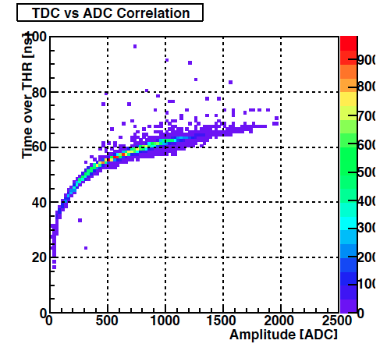
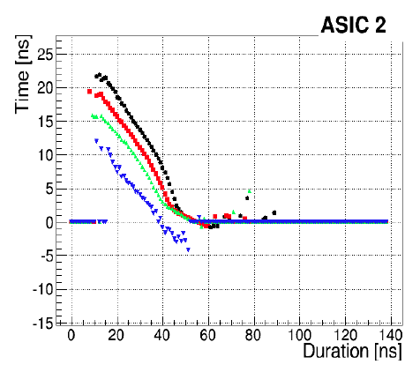
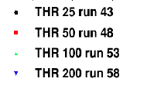
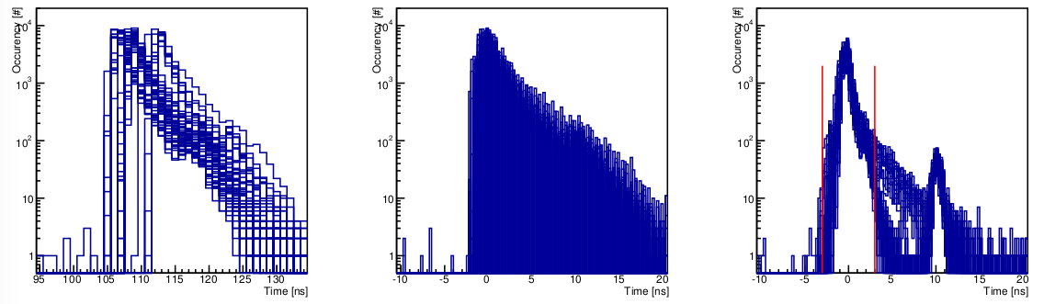
Single Photon Electron Timing
Time over threshold relates to charge
Typical time-walk with charge
1
Tme [ns]
Time over THR [ns]
ADC amplitude [DAC]
Duration [ns]
Cherenkov
angle
Channel by channel time calibration: no offsets no walk
± 3ns
Occupancy (#)
PMT
Laser
Time (ns)
Contalbrigo M.
10th RICH Workshop, 31st July 2018, RAS - Moscow
11
Notes:
Fare una immagine del PMT sulla risoluzione

Slide 12
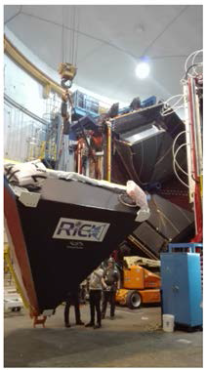
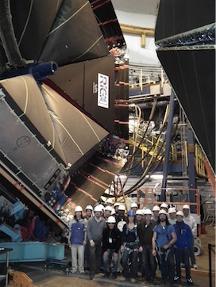
RICH Installation
Contalbrigo M.
10th RICH Workshop, 31st July 2018, RAS - Moscow
12
Notes:
Fare una immagine del PMT sulla risoluzione

Slide 13
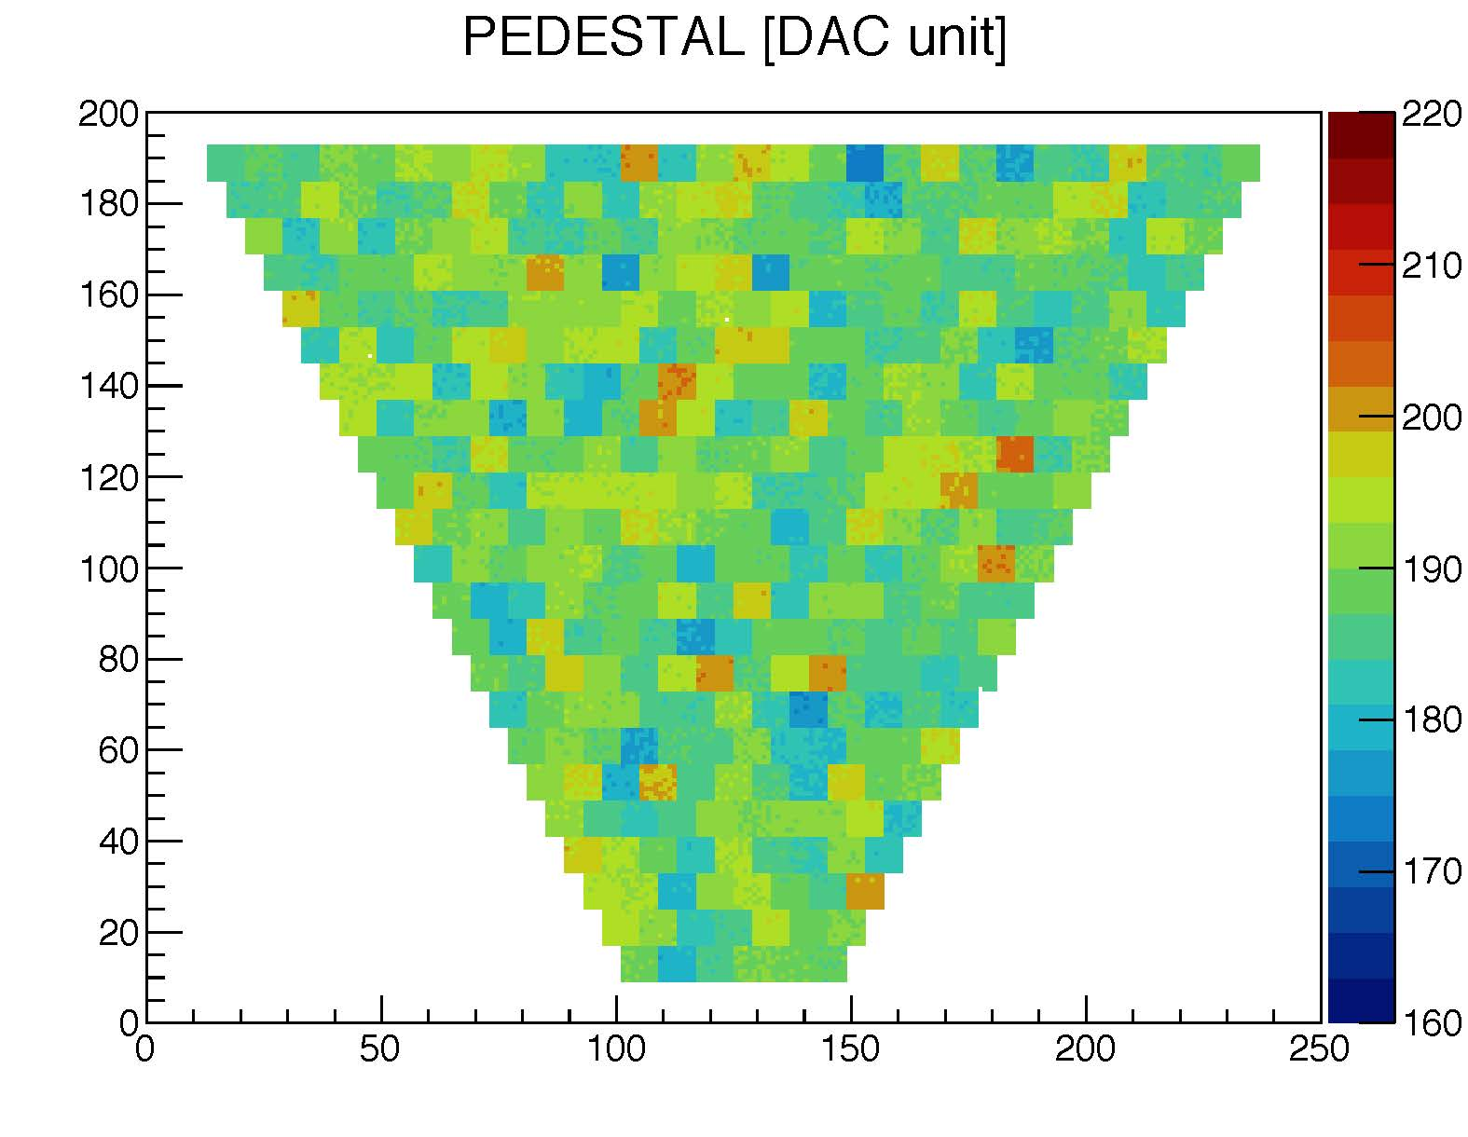
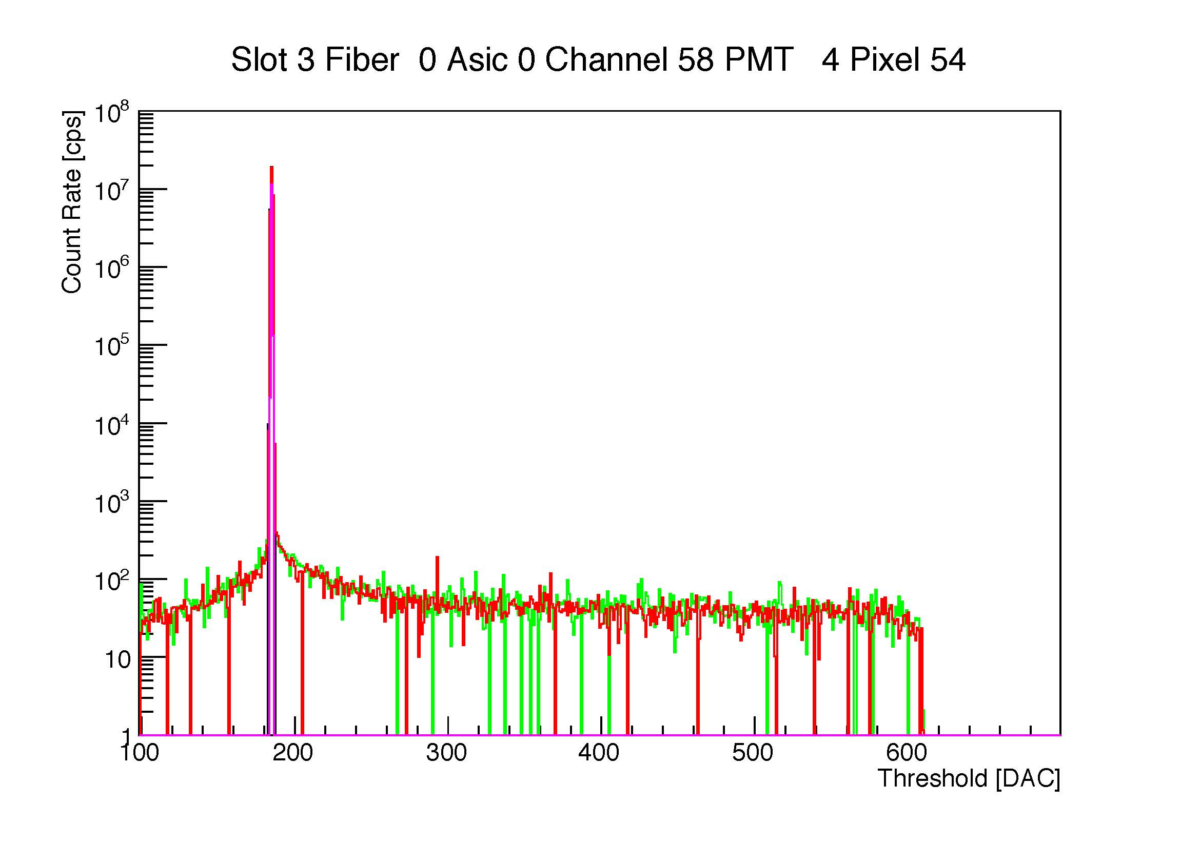
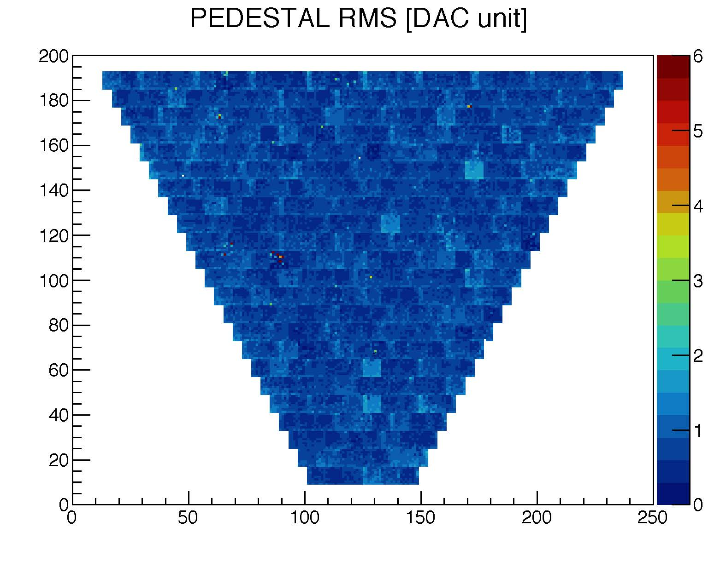
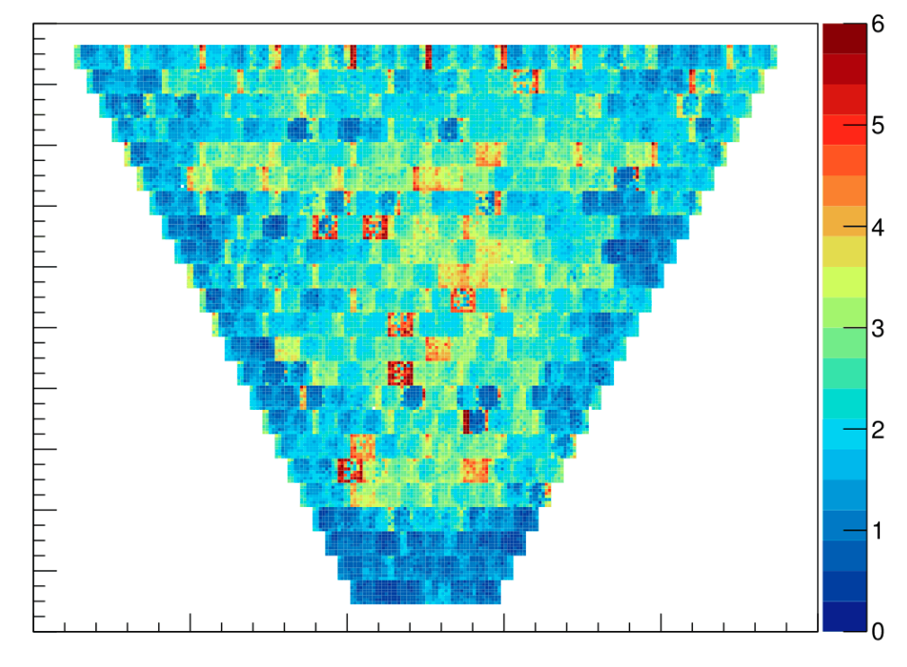
Electronic Pedestals
Pixel
Mar 18
-- off
-- 1000 V
Jan 18
-- off
-- 1000 V
Pixel #
Pedestal rms [DAC unit]: without and with grounding grid
Pixel
Pixel
Pixel #
Pixel #
Contalbrigo M.
10th RICH Workshop, 31st July 2018, RAS - Moscow
13
Notes:
Fare una immagine del PMT sulla risoluzione

Slide 14
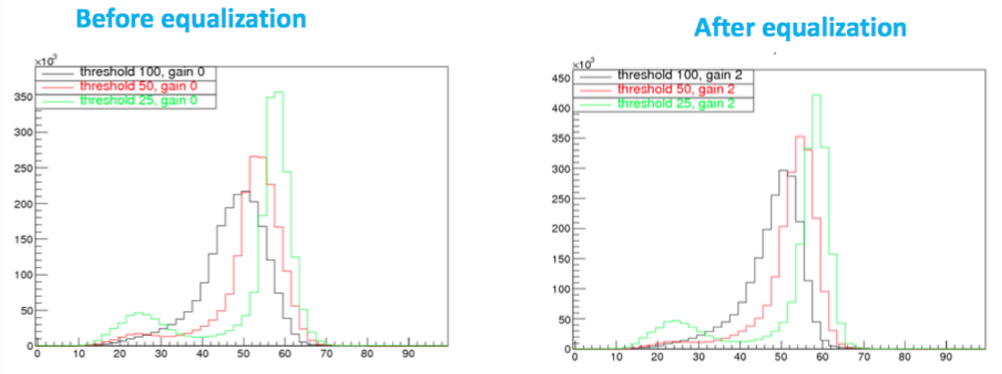
Online Equalization
After equalization: distributions narrower and less sensitive to the common threshold
saturate signals and cross-talk well separate
Contalbrigo M.
10th RICH Workshop, 31st July 2018, RAS - Moscow
14
Notes:
Fare una immagine del PMT sulla risoluzione

Slide 15
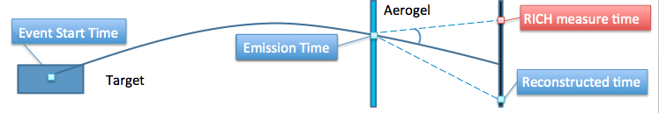
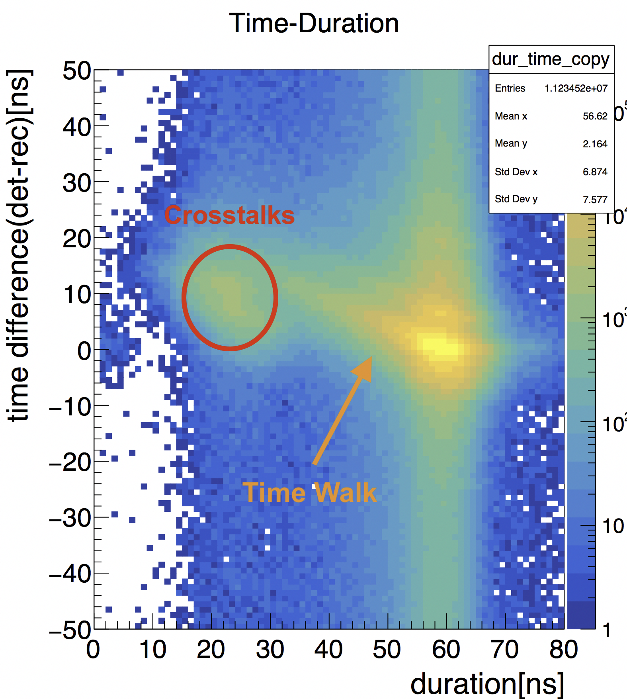
Single Photon Time Analysis
CLAS12 Reconstructed Time and Position:
Photons are traced using information
from other CLAS12 detectors
RICH Measured Time and Position:
Defined by the RICH DAQ
Other bunch
Good photons should match
in time and space
Time analysis allows to
separate spurious signals
Dark counts
Contalbrigo M.
10th RICH Workshop, 31st July 2018, RAS - Moscow
15
Notes:
Fare una immagine del PMT sulla risoluzione

Slide 16
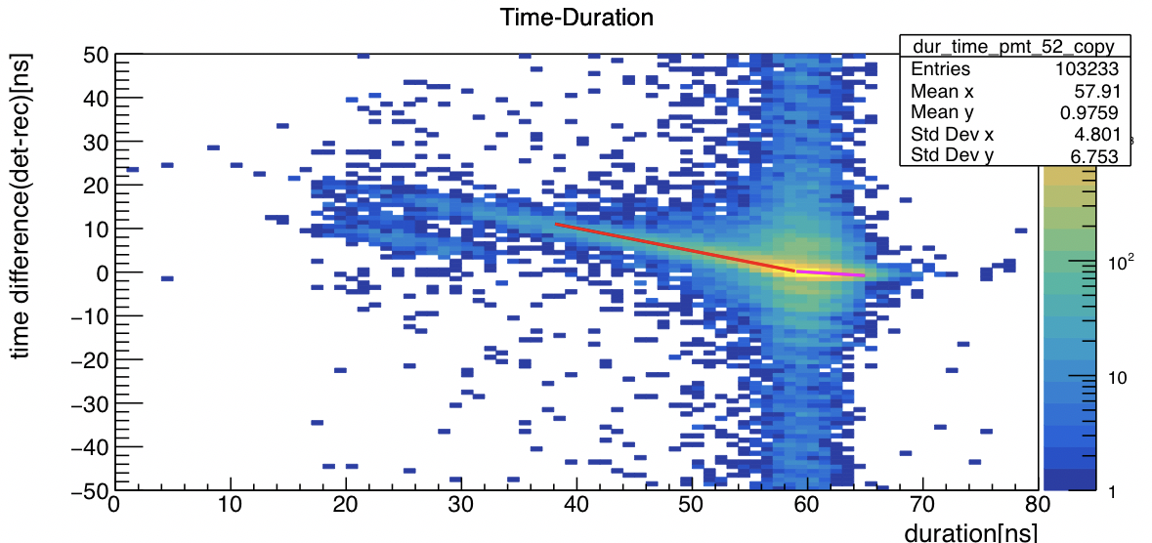
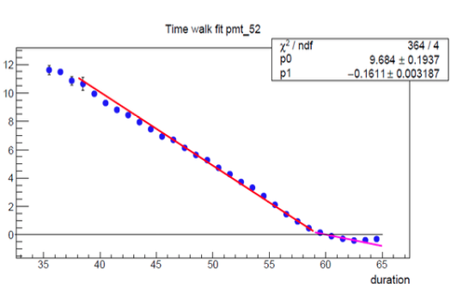
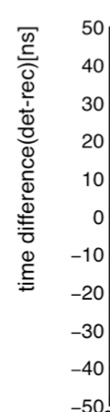
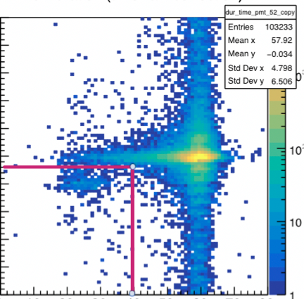
Time Calibration
Time vs Duration
after offset correction
Time vs Duration
after walk correction
Cross-talk
Contalbrigo M.
10th RICH Workshop, 31st July 2018, RAS - Moscow
16
Notes:
Fare una immagine del PMT sulla risoluzione

Slide 17
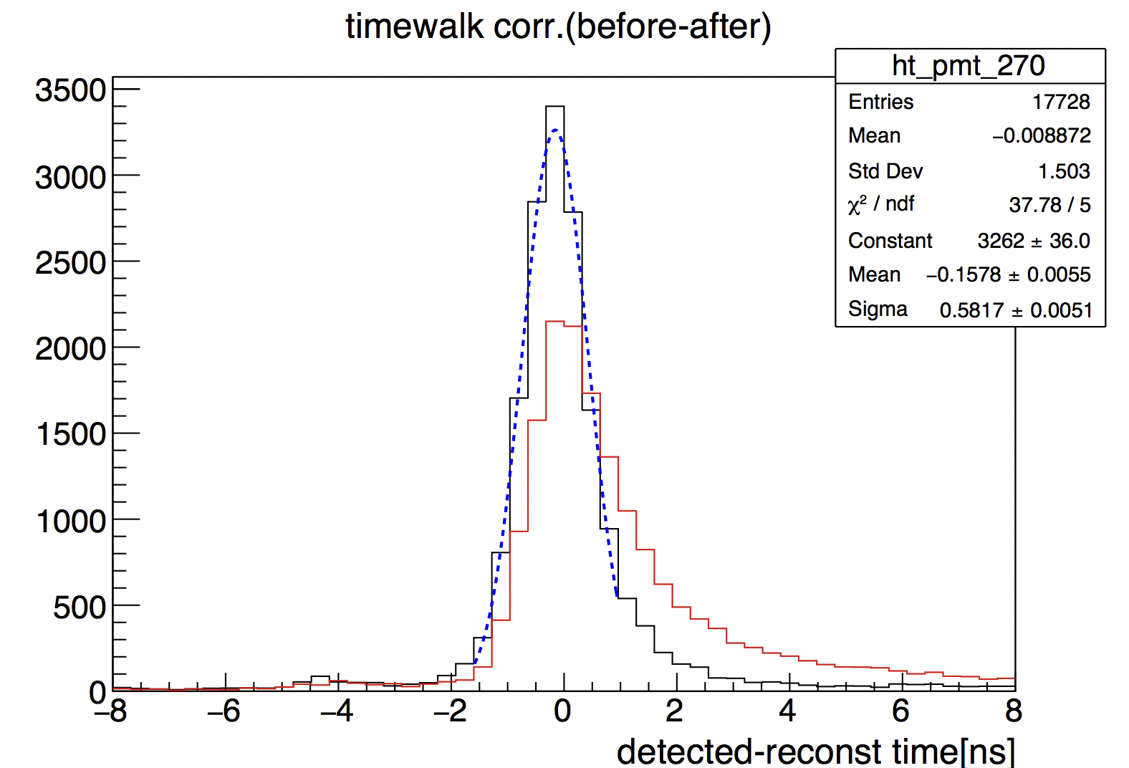
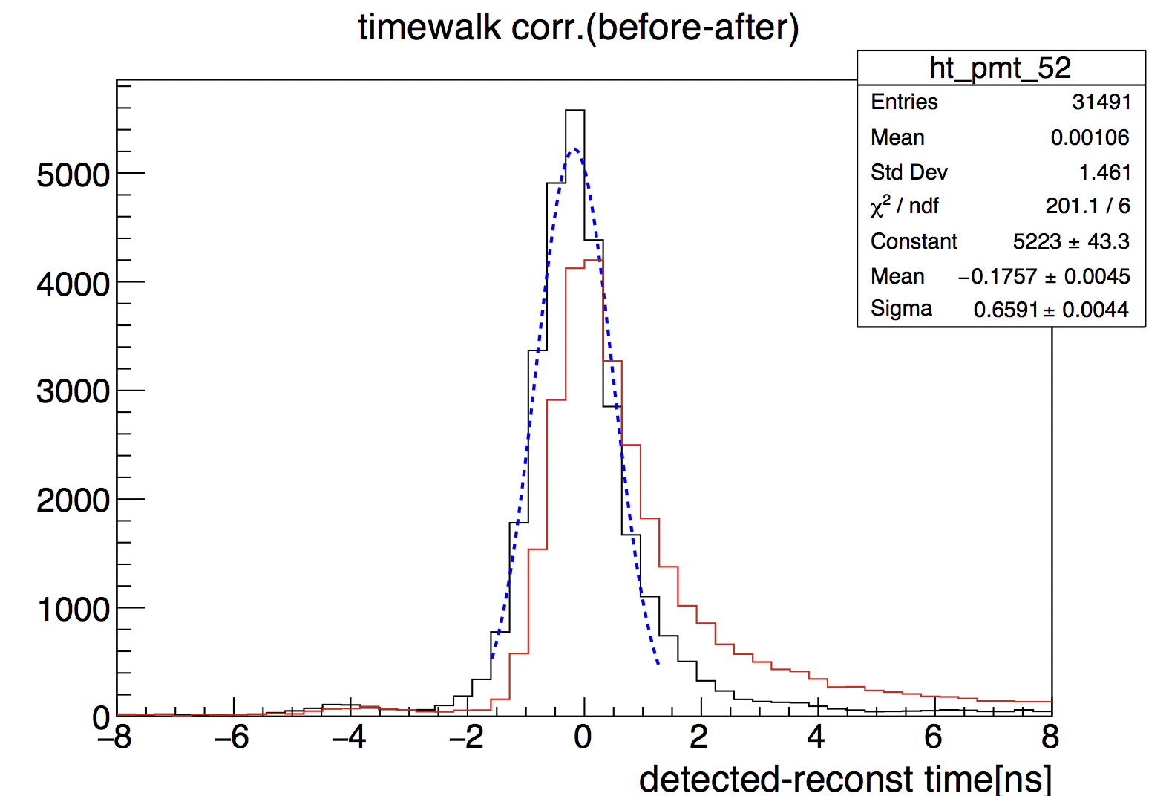
Single-photon Time Resolution
Single-photon time resolution better than the 1 ns specification
PMT 270
σ = 0.58 ns
PMT 52
σ = 0.66 ns
before time-walk correction
after time-walk correction
Contalbrigo M.
10th RICH Workshop, 31st July 2018, RAS - Moscow
17
Notes:
Fare una immagine del PMT sulla risoluzione

Slide 18
Cherenkov Photon Reconstruction
Example of signal hits identified by time consistent with CLAS12 reconstruction
Direct ring
Next
Page
Half recflected ring
Contalbrigo M.
10th RICH Workshop, 31st July 2018, RAS - Moscow
18
Notes:
Fare una immagine del PMT sulla risoluzione

Slide 19
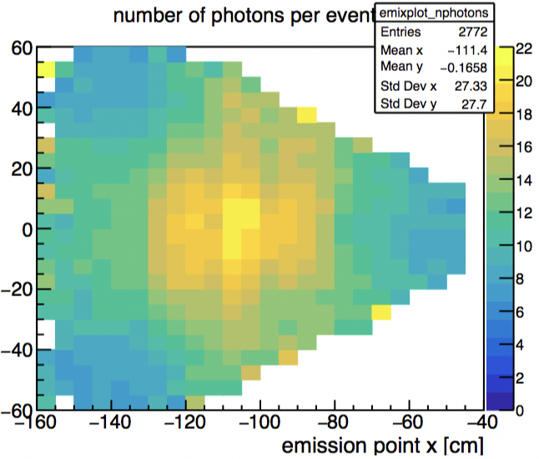
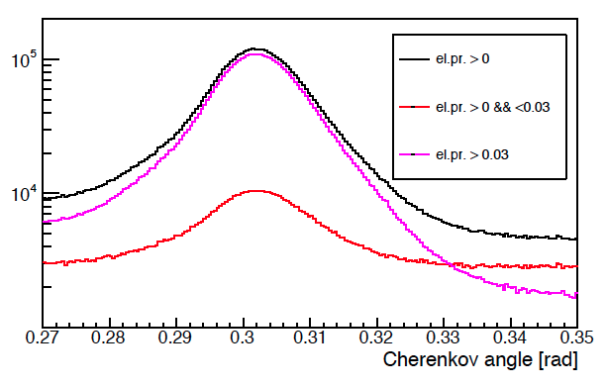
Direct Cherenkov Photons
About 18 photons for a center
ring (no reflection accounted for)
Consistent with the TDR projection
Preliminary single photon Cherenkov
angle resolution = 6 mrad
Close to the 4.5 mrad goal despite
No alignment
Nominal (no real) optical property
σ = 8 mrad
σ = 6 mrad
In principle enough for a Cherenkov resolution at track level of σ = σ₁/√N ~ 1.5 mrad
Contalbrigo M.
10th RICH Workshop, 31st July 2018, RAS - Moscow
19
Notes:
Fare una immagine del PMT sulla risoluzione

Slide 20
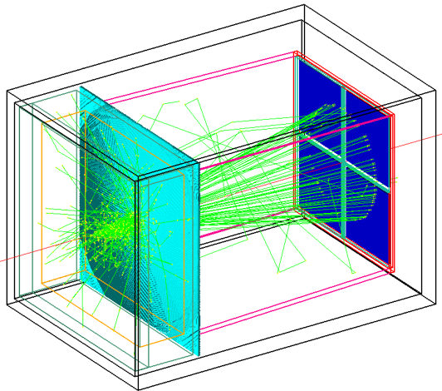



Application: Modular RICH @EIC
Compact and modular RICH indipendent elements
Fresnel lens
Aerogel
Sensor plane
See Xiaochun He talk
H13700 to reach the 3 mm spatial resolution
Contalbrigo M.
10th RICH Workshop, 31st July 2018, RAS - Moscow
20
Notes:
Fare una immagine del PMT sulla risoluzione

Slide 21



Application: SiPM Arrays
Pixel #
Pixel #
Peltier cell cooling
Down to -30º in N₂
Contalbrigo M.
10th RICH Workshop, 31st July 2018, RAS - Moscow
21
Notes:
Fare una immagine del PMT sulla risoluzione

Slide 22




Application: DIRC @ GlueX
Hadron discrimination up to 4 GeV/c
H12700 +
CLAS12
readout
Contalbrigo M.
10th RICH Workshop, 31st July 2018, RAS - Moscow
22
Notes:
Dire meglio chi fa cosa.

Slide 23
Conclusions
CLAS12 RICH designed to provide hadron identification in the 3 to 8 GeV/c momentum range
A hybrid-optic design has been adopted to minimize the instrumented area to about 1 m²
Flat-panel multi-anode PMTs are being used for the first module
SiPMs are being investigated for the second module
The readout electronics is designed to offer
Discrimination down to few % of SPE
Time resolution of 1 ns
Negligible dead time at 30 KHz
Trigger latency up to 8 μs
Featuring:
Compatibility with various sensors and applications
Modular Front-End (Mechanical adapter, ASIC, FPGA)
Scalable fiber optic DAQ (TCP/IP or SSP)
Compact and tessellated geometry (common HV, LV and optical fiber)
Flexible trigger logic (external, auto, self)
Charge measurement (multiplexed ADC or time-over-threshold)
Multi purpose electronics: in use also for GlueX DIRC and EIC R&D
Contalbrigo M.
10th RICH Workshop, 31st July 2018, RAS - Moscow
23
Notes:
Dire meglio chi fa cosa.

