Slide 1
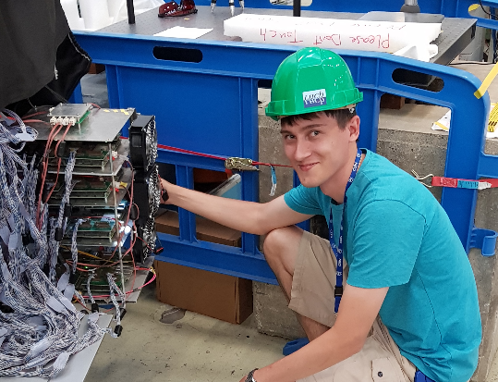
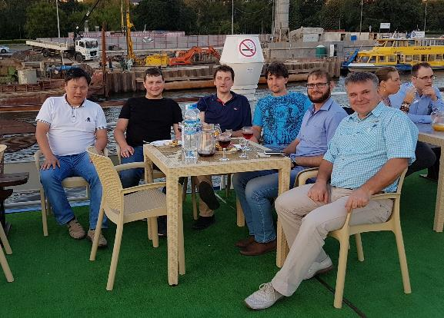
Development of the PANDA Forward RICH with an aerogel radiator
Sergey Kononov^{ab} on behalf of the PANDA Forward RICH group
ª Budker Institute of Nuclear Physics, Novosibirsk, Russia
^{b} Novosibirsk State University, Novosibirsk, Russia
10th International Workshop on Ring Imaging Cherenkov Detectors (RICH2018)
03.August.2018

Slide 2
Outline
Introduction
PANDA Forward RICH design
Simulation
Mirror samples measurements
Preliminary beam test results
Conclusion

Slide 3
Quartz vs Aerogel radiators
Difference in Cherenkov angle θ_{c} for π and K
Bands – chromatic dispersion in the wavelength range 350-700 nm
n=1.05

Slide 4
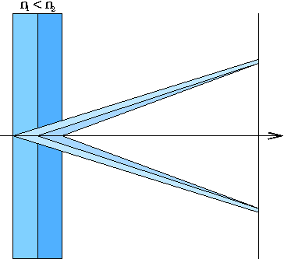
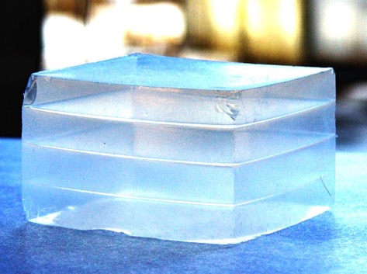
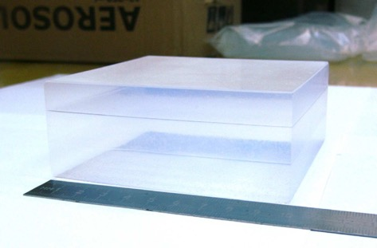
Focusing Aerogel RICH (FARICH)
First sample of 4-layer aerogel
Photon detector
Aerogel
Cherenkov light
Particle
n=1.030 6.0mm
n=1.027 6.3mm
n=1.024 6.7mm
n=1.022 7.0mm
T.Iijima et al., NIM A548 (2005) 383 A.Yu.Barnyakov et al., NIM A553 (2005) 70
3-layer aerogel 115x115x41 mm³
Focusing aerogel improves proximity focusing design by reducing the contribution of radiator thickness into the Cherenkov angle resolution
Multi-layer monolithic aerogels have been being produced by the Boreskov Institute of Catalysis in cooperation with the Budker INP since 2004.
Notes:
Идея ФАРИЧ появилась в 2004 г.
Точность измерения черенковского угла связана с точностью измерения скорости, а значит с качеством разделения частиц.

Slide 5
PANDA detector
Barrel DIRC
Endcap Disc DIRC
Forward RICH
$$\overline{p}$$
Antiprotons P=1.5 – 15 GeV/c with $σ_{p}/p={10}^{−5}…{10}^{−4}$
Luminosity up to 2∙10³² cm⁻² s⁻¹
$\overline{p}p$Interaction rate up to 2∙10⁷ s⁻¹
For details of the PANDA experiment see the talk on the PANDA DIRC detectors by J. Schwiening in the Saturday morning session

Slide 6
Requirements for the PANDA Forward RICH
Charged PID in the Forward Spectrometer
|θx| < 10°, |θy| < 5°
Approximately 3 x 1 m² transverse active size, ~0.8 m space occupied along the beam
Working momentum range for 3σ separation
π /K: 2÷10 GeV/c
μ/π: 0.5÷2 GeV/c possible may complement the muon system
Physics cases: processes with high charged hadrons multiplicity in the final states for high beam momenta

Slide 7
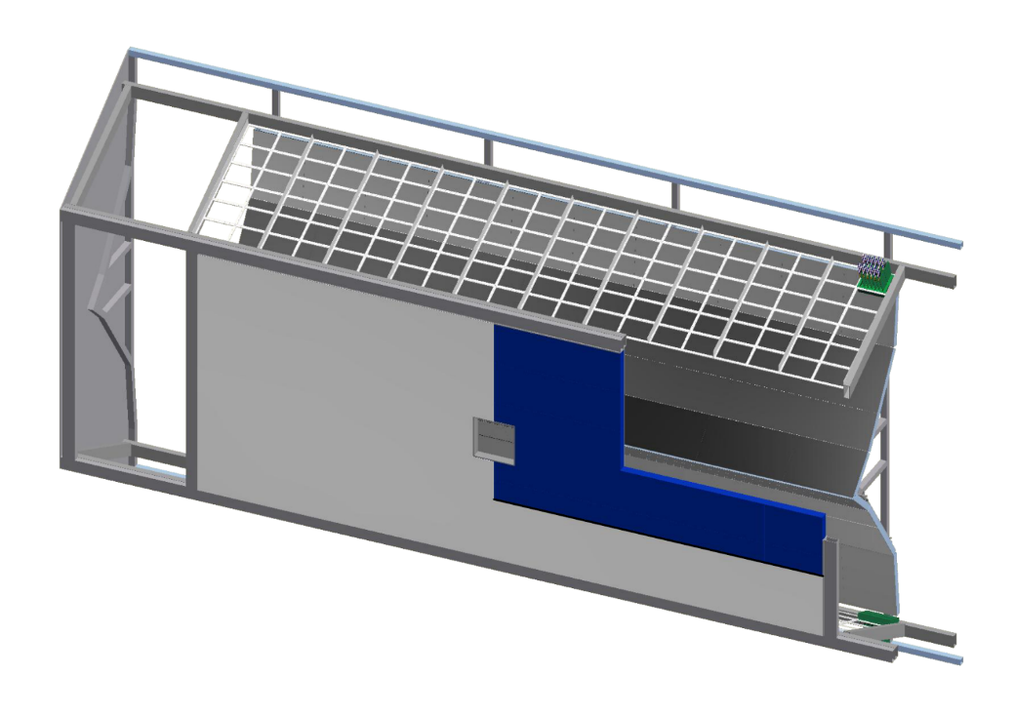
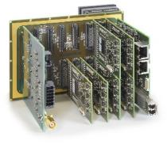
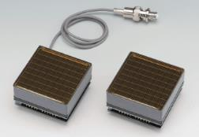
PANDA FRICH baseline design
DiRICH FEE (GSI)
Designed for H12700 readout
12x32ch preamp+disc+TDC
2 Gbps output link
Mirrors
2 mm float glass
Al+SiO₂ coating
Aerogel radiator
Focusing 2- or 3-layer aerogel
n≈1.05
Total thickness – 40 mm
Photon Detector
H12700 MaPMTs (Hamamatsu)
flat panel
8x8 anode pixels of 6mm size

Slide 8
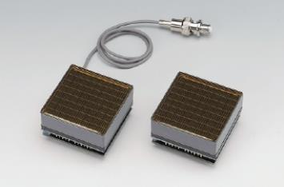
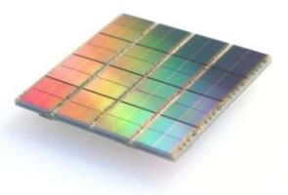
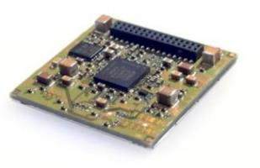
Readout candidates for PANDA FRICH
MaPMT Hamamatsu H12700B with DiRICH (GSI) FEE
a)
Cherenkov spectrum
H12700 QE
DPC3200-22 PDE
Digital Photon Counter
Digital silicon photomultiplier
TDC on-chip
b)

Slide 9
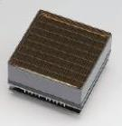
Comparison of photon detector options
MaPMT H12700
(Hamamatsu, Japan)
High active/total area ratio 87%
Robust
Long lifetime
High single photon efficiency
The MaPMT option was chosen for PANDA Forward RICH
Digital Photon Counter
(Philips Digital Photon Counting, Aachen, Germany)
Interesting readout solution – SiPM integrated with ASIC: TDC with 20 ps LSB, able to inhibit individual cells
Immune to magnetic field (not an issue for the PANDA FRICH)
High dark count rate, long dead-time (720 ns) – needs to be cooled for single photon detection
Low measured N_{pe} and PDE – about 2 times lower than expected from the producer’s data
Radiation hardness issues (DPC lifetime would be less than 1 year in the PANDA HL mode)

Slide 10
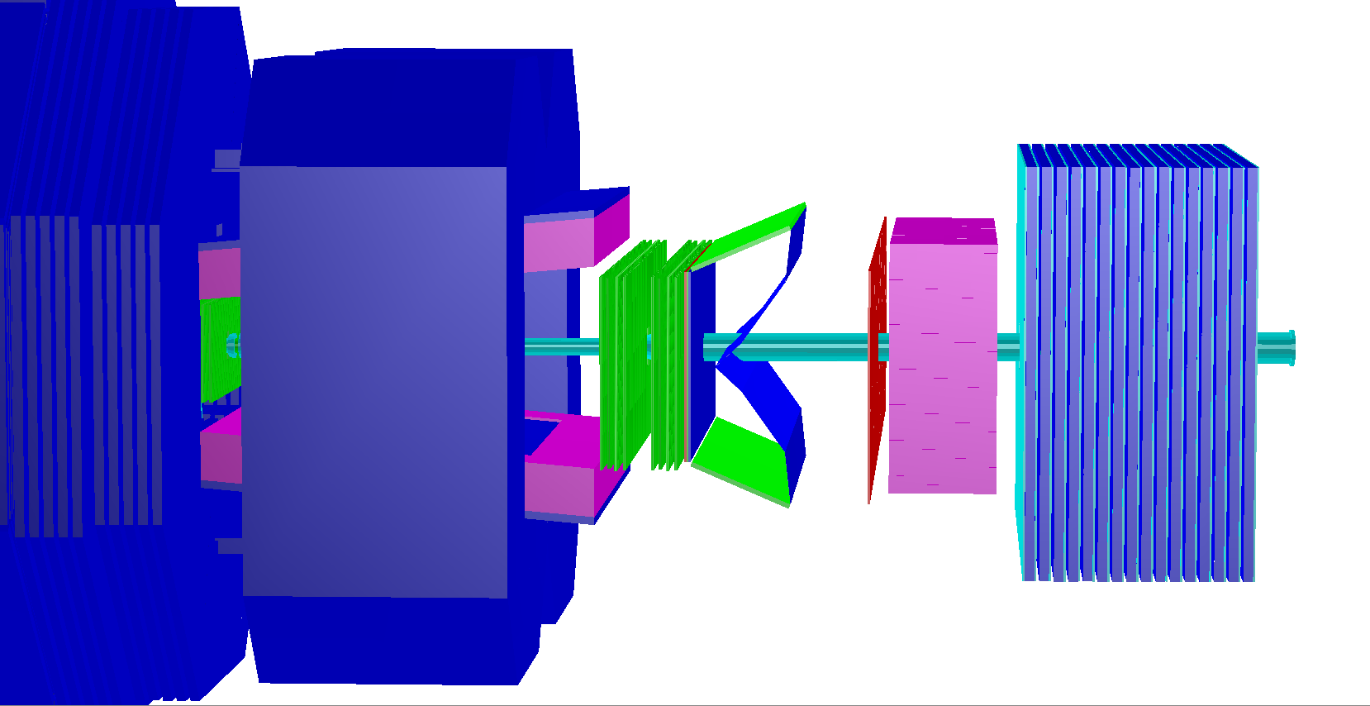
MC simulation of the PANDA Forward RICH
PANDA Forward Spectrometer geometry in PandaRoot
FRICH

Slide 11
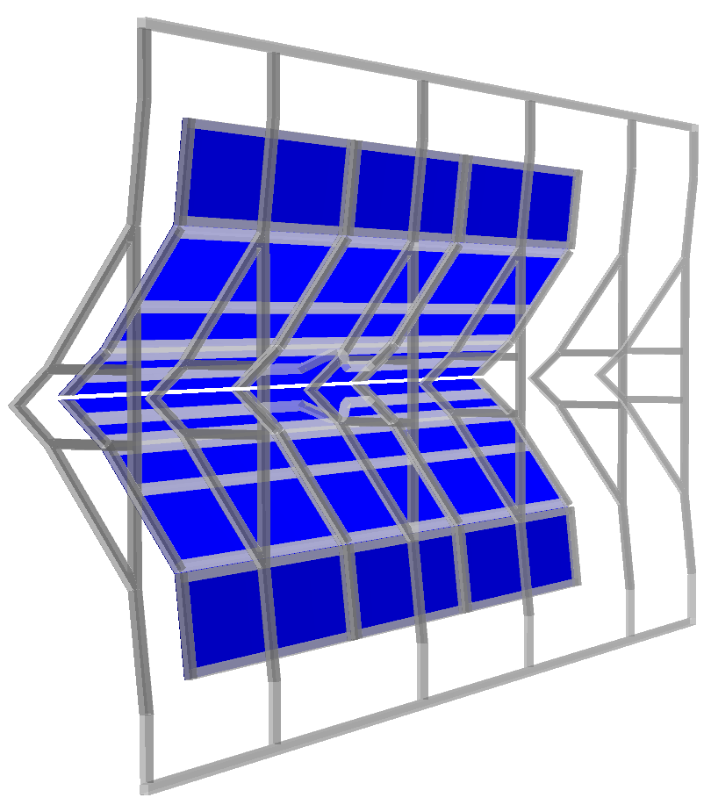
Description of inactive material in PandaRoot
Current version
only main elements
Full version
in progress
Elements to be described
Aerogel+Frame
Mirror+Frame
Photodetector+Frame
Envelope

Slide 12
Simulation code variants
Processes described in two simulation variants
FULL | FAST
Passage of particles through matter
Optical processes | -
Digitization | -
Tracking
Full event reconstruction | Calibration based event reconstruction
PID

Slide 13
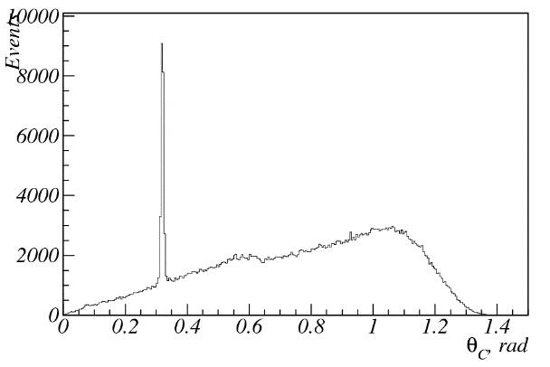
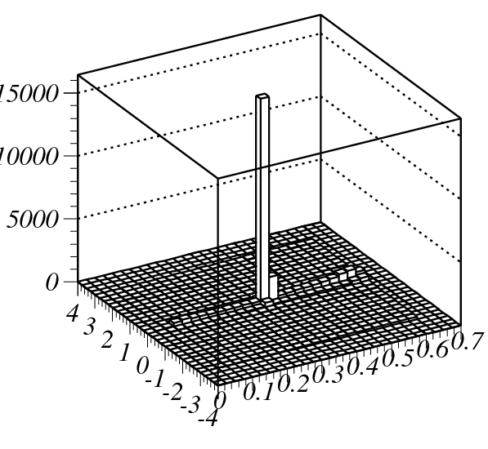
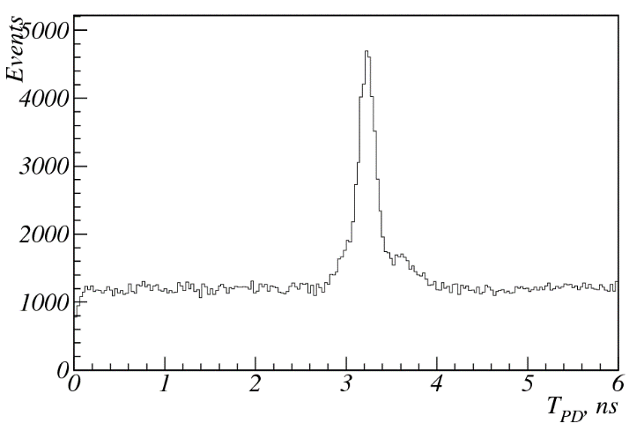
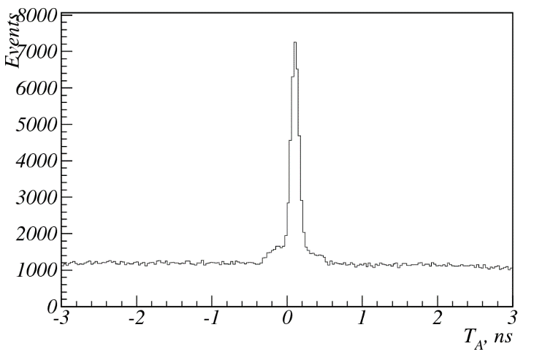
Hit pre-selection
1000 events
T_{A}, ns
θ_{C}, rad
hit time
time in aerogel
Hits around peak in θ_{с}-T_{A} are selected for fitting

Slide 14
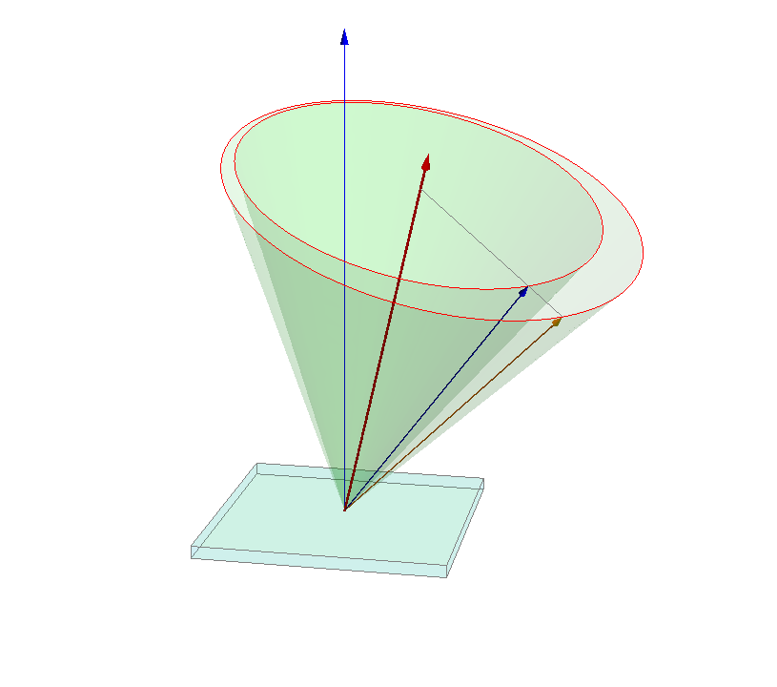
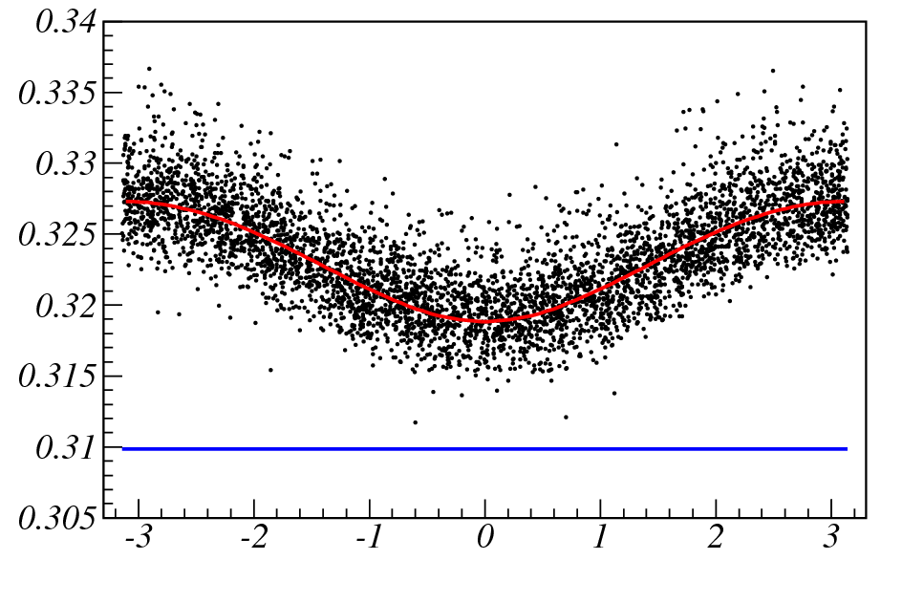
Ring fitting
Muons
p = 10 GeV/c
β = 0.99994θθ
β_{FIT} = 0.99912
θ_{c} , mrad
φ_{c} , mrad
Fit $θ_{c}\left(φ_{c}\right)$ dependence by an analytical formulae for each event and obtain particle’s velocity $β$ as a result

Slide 15
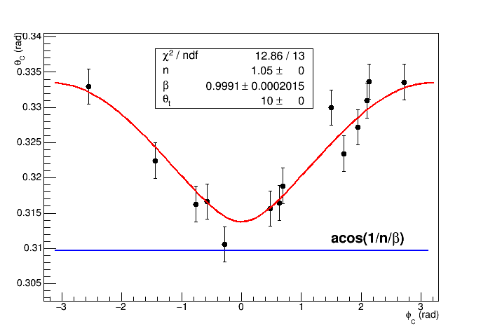
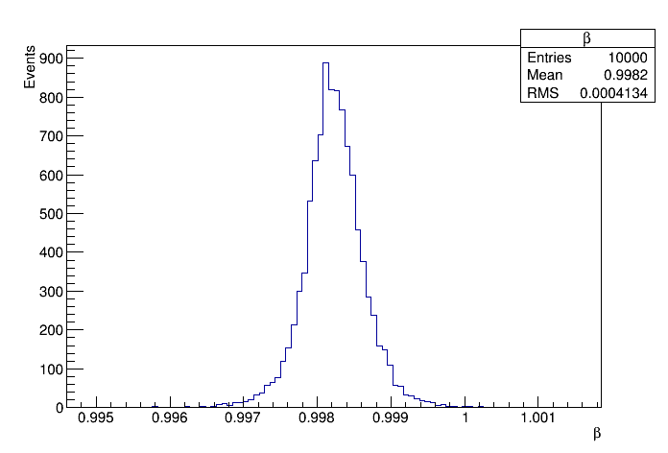
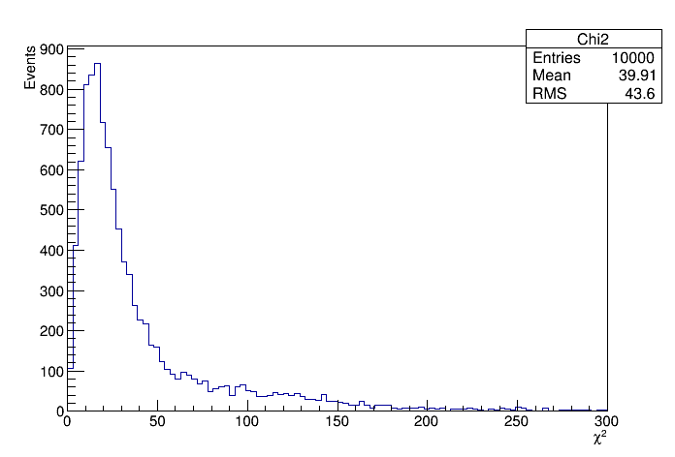
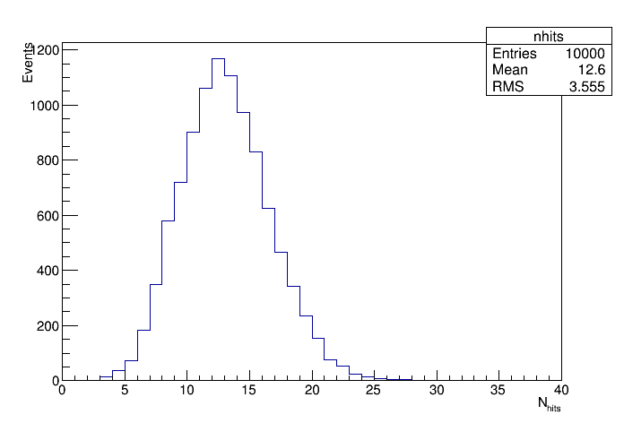
Event reconstruction in simulation DPC photon detector
$θ_{c}\left(φ_{c}\right)$event fit
β distribution
$χ^{2}$ distribution
number of hits

Slide 16
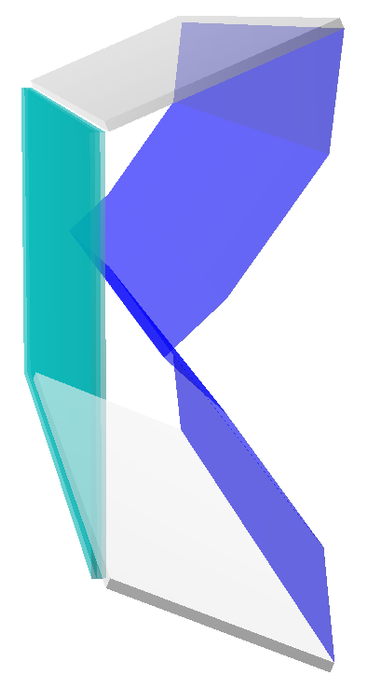
Focusing aerogel optimization (1)
Two layers
Three layers
1.05 − δn
1.05 − δn
1.05 + δn
1.05
1.05 + δn
Optimize Cherenkov angle resolution by varying $δn$

Slide 17
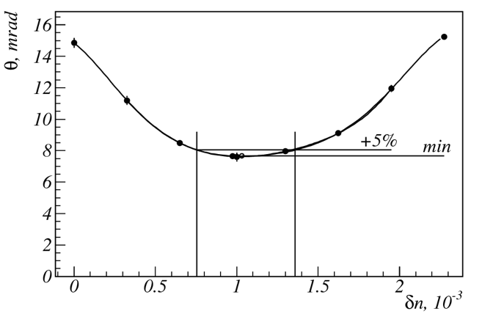
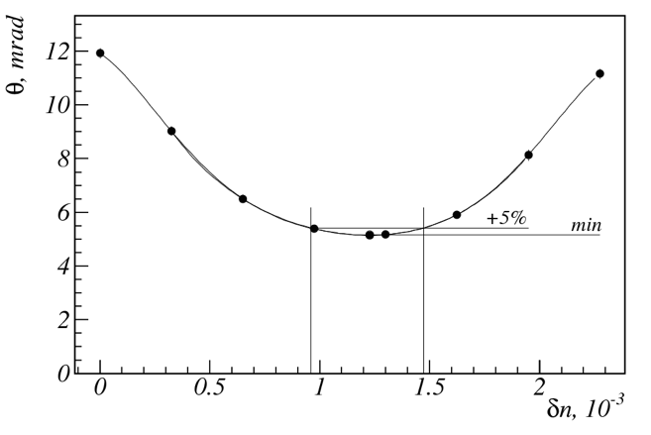
Focusing aerogel optimization (2) DPC photon detector
Two layers
Three layers
Optimal values:
$$δn={1.03}_{−0.27}^{+0.33}∙{10}^{−3}$$
$σ_{θ}=7.7$ mrad
$$\text{Optimal} \text{values}\text{:}$$
$$δn ={1.23}_{−0.27}^{+0.24}∙{10}^{−3}$$
$σ_{θ}=5.2$ mrad
3-layer aerogel was chosen for the following simulation

Slide 18
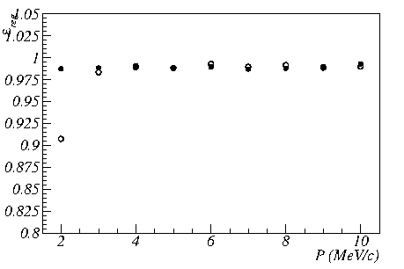
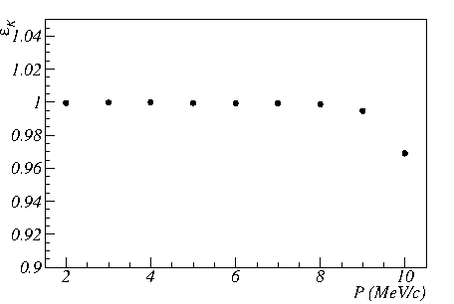
MC FRICH PID vs momentum H12700 photon detector
Reconstruction efficiency
(reconstructed β is within ±3σ of expected)
K identification efficiency at 1% π misidentification
ε_{reg}
ε_{reg}
ε_{reg}
ε_{K}
● π
○ K
● π
○ K
● π
○ K
P, GeV/c
P, GeV/c
P, GeV/c
P, GeV/c

Slide 19
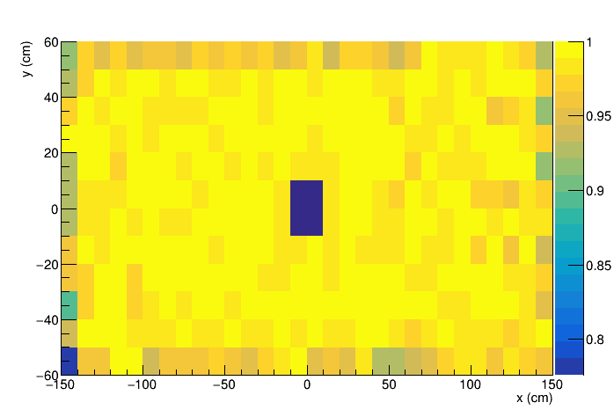
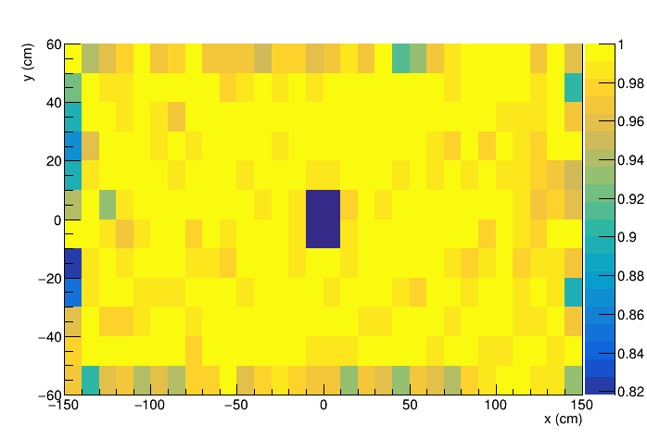
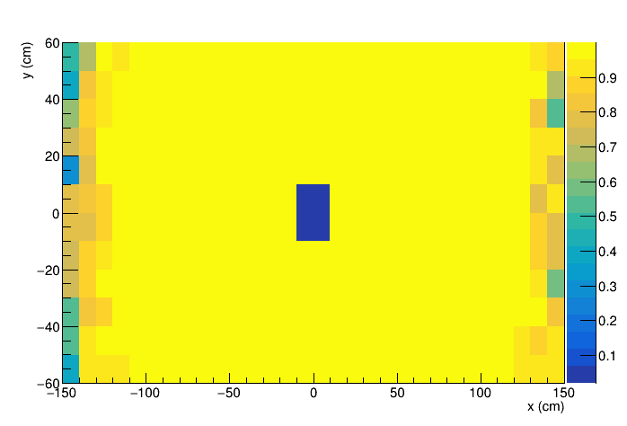
MC FRICH PID uniformity H12700 PD, p⁻ beam@ 10 GeV/c
π reco efficiency
K reco efficiency
Y (cm)
Y (cm)
Y (cm)
Y (cm)
X (cm)
X (cm)
X (cm)
X (cm)
Y (cm)
K identification efficiency at 2% π misidentification
X (cm)

Slide 20
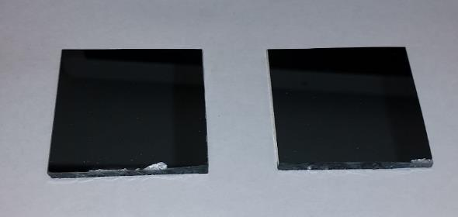
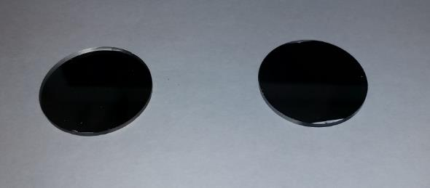
Mirrors for Forward RICH
Float glass + Al + SiO₂
Requirements on flatness for float glass (few μm) are met.
Mirror samples from two producers were obtained and compared by reflectivity.
Samples from the Tomsk Institute of High-Current Electronics: Float glass(4mm)+Al+SiO₂
Samples from BINP: Glass(2mm)+Al+MgF₂

Slide 21
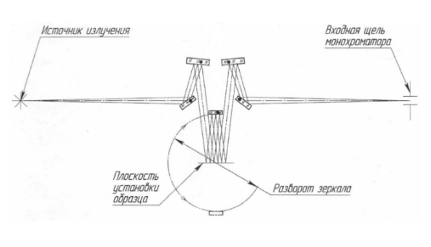
Mirror reflectance measurements
V-W scheme for reflectance measurement
130-1 with monochromator
with laser
Light source
Monochromator slit
W
Rotated aux. mirror
Sample position
V
260-3 with monochromator
$$R=\sqrt{\frac{I_{W}}{I_{V}}}$$
with laser

Slide 22
Reflectance vs angle of incidence
A
collimator
mirror
AoI
photodiode
B
collimator
photodiode
$$R=\frac{I_{A}}{I_{B}}$$

Slide 23
Test beam of F(A)RICH prototype at BINP VEPP-4 (2018)
Electron beam parameters in 2018
Energy range | 3 GeV
Averaged intensity | up to 100 e⁻ / s
Energy spread | 2.6%
Purpose of beam tests for PANDA FRICH:
Test H12700 MaPMTs and PADIWA&TRB3 readout
Obtain single photon resolution for several aerogel configurations and compare with expected ones

Slide 25
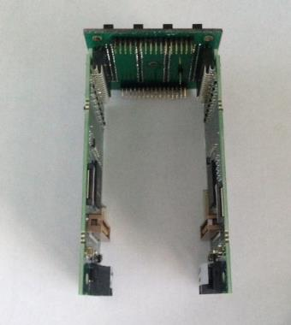
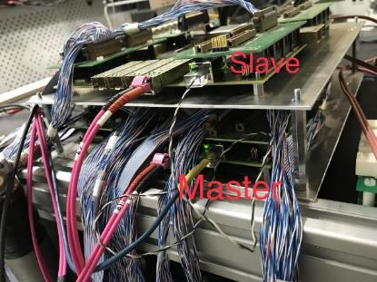
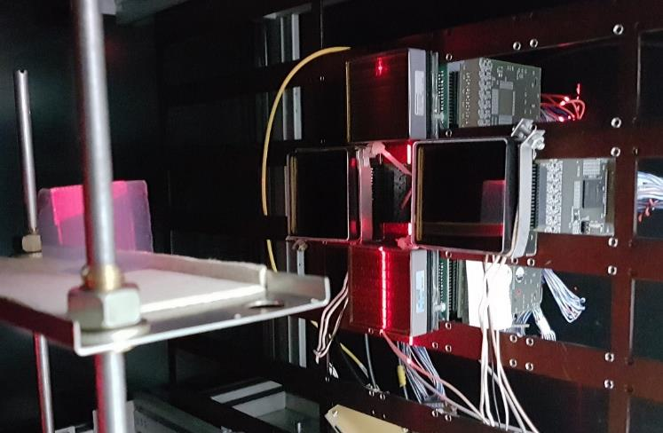
F(A)RICH prototype readout
Custom adapter
Custom adapter board to couple 4 PADIWAs to a H12700 MaPMT (PADIWA couple with Planacon MCP PMT without adapter)
2 TRB3 boards and 14 PADIWA3 boards – 224 channels (three and a half MaPMTs)
Each TRB board transmits data via Gbit-ethernet switch to a PC
GSI DABC software used for DAQ from TRB
Triggered by coincidence of signals from the sc. counter before F(A)RICH and the NaI calorimeter
Trigger signal is blocked by PC for readout period. Sync between subsystems is assured by the same event number observed
TRB3 boards
PADIWA
Planacon MCP PMT
H12700

Slide 26
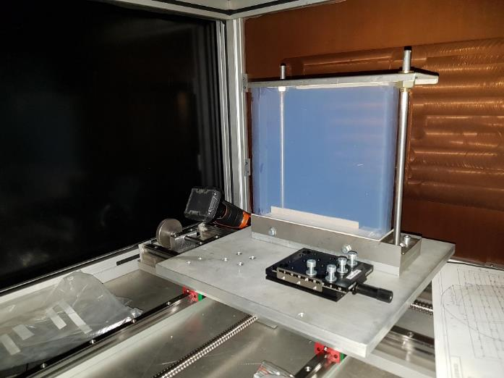
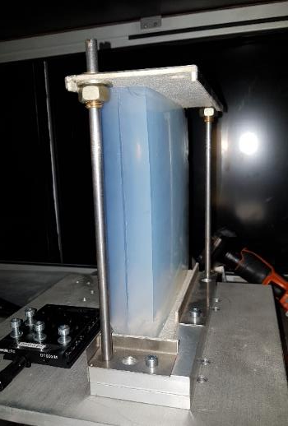
Tested aerogel radiator samples (test beam run on 3-4 June 2018)
1
2
Configuration 1 n₁ = 1.0514, t₁ = 2 cm
n₂ = 1.0503, t₂ = 2 cm
Configuration 2 n₁ = 1.0514, t₁ = 2 cm
n₂ = 1.0514, t₂ = 2 cm
Monolithic aerogels: 3 three-layer samples of 30-40 mm thickness
About 300k event per setup configuration were collected

Slide 27
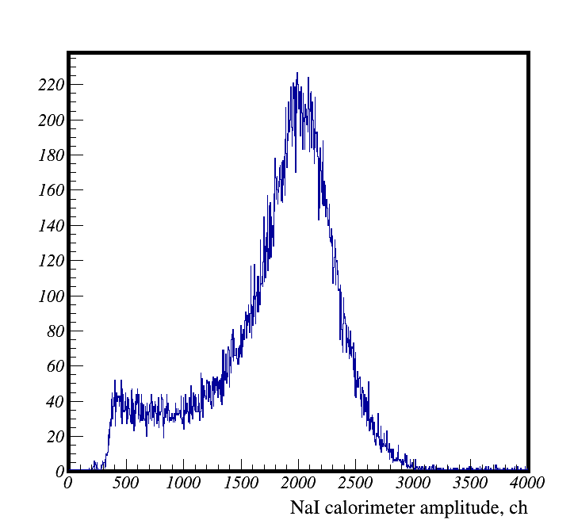
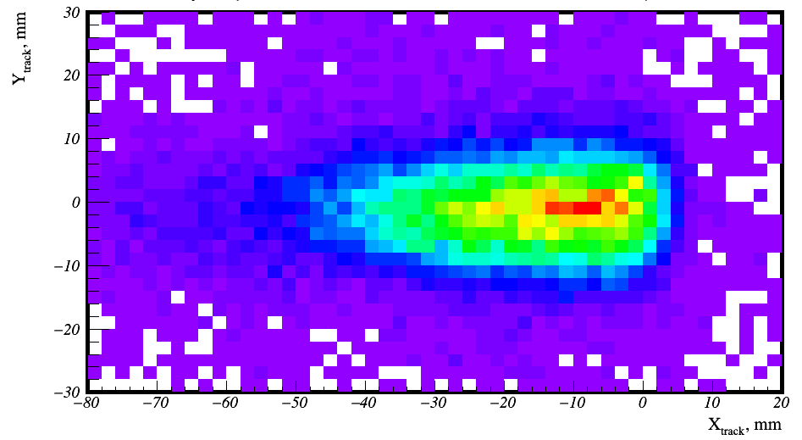
Event selection
NaI calorimeter amplitude distribution
and selected interval
Reconstructed track position XY-map at PMT
and selected region

Slide 28
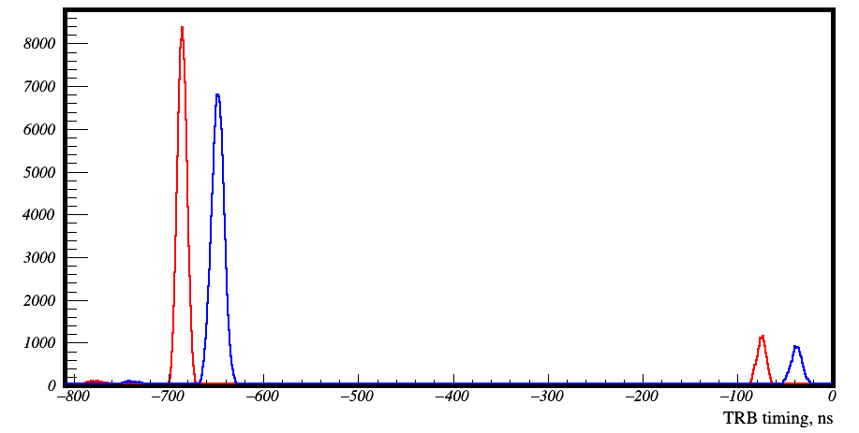
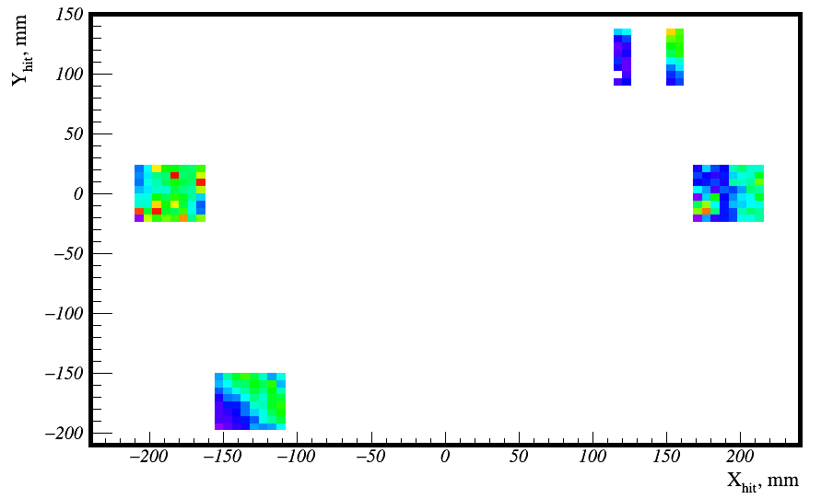
Hit plots
Leading edge
Hit timing distribution
VEPP-4M bunch structure can be seen with 600 ns separation.
Timing resolution here is determined by the rough measurement of reference timing in TRB3
Hits are selected by leading edge timing in 30ns interval
Trailing edge
Coincident bunch
Next bunch
Hit XY map
Ring is not seen here because the e⁻ beam is wide

Slide 29
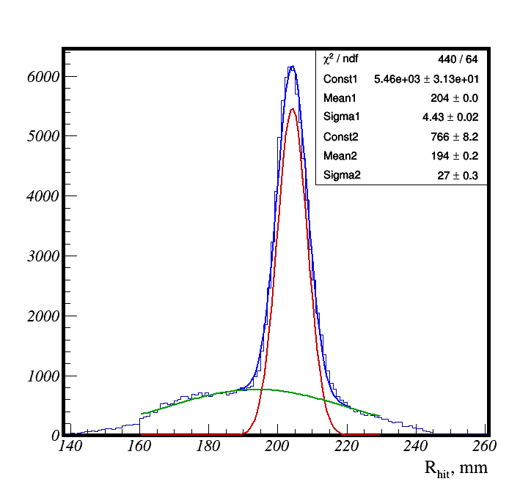
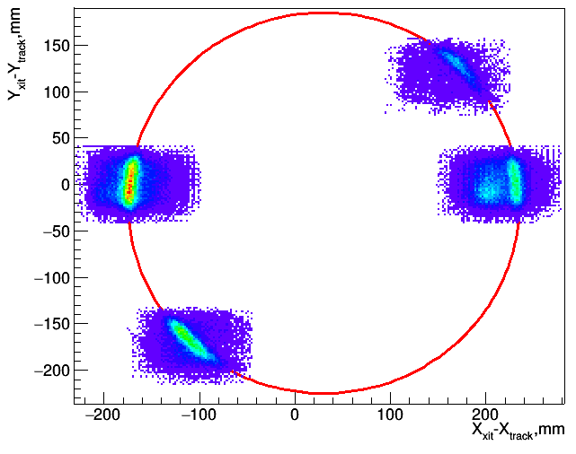
Track adjusted hit position
Configuration 1
Aerogel-PMT distance: 600 mm
Aerogel
PMTs
Preliminary
Preliminary
Background hits are to be understood
Preliminary results:
R = 204 mm
σ_{R1} = 4.4 mm (6.6 mrad)

Slide 30
Conclusion and outlook
Forward RICH PandaRoot simulation is almost ready.
Mechanical design draft is almost ready.
MaPMTs and FEE tests are in progress. DiRICH electronics is to be tested.
Mirror samples for FRICH were produced. Absolute reflectance measured is close to 85% — satisfactory.
FRICH prototype based on H12700 MaPMTs and PADIWA3+TRB3 with beams was tested in 2018. Data analysis is in progress.
TDR to be ready in 2019

