Slide 1
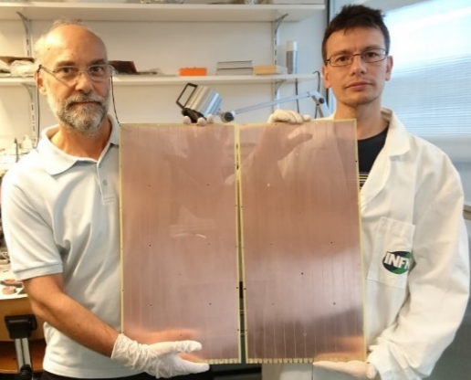
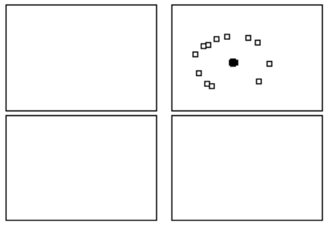
The Hybrid MPGD-based photon detectors of COMPASS RICH-1
Fulvio Tessarotto ( I.N.F.N. – Trieste )
on behalf of the COMPASS RICH Group
The COMPASS RICH-1 upgrade
The hybrid PD construction and installation
HV control, spark rates, noise level
Gain uniformity and stability
Hybrid PD preliminary characterization
Perspectives and Conclusions

Slide 2
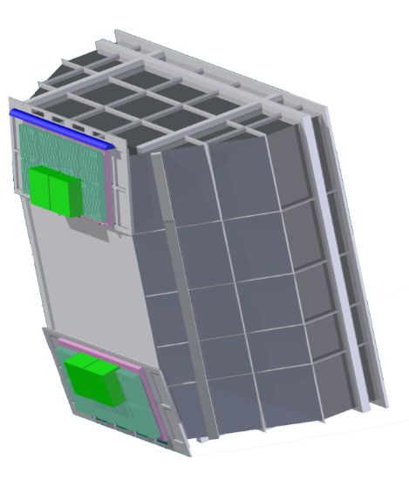
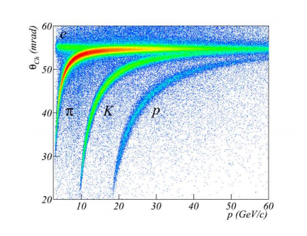
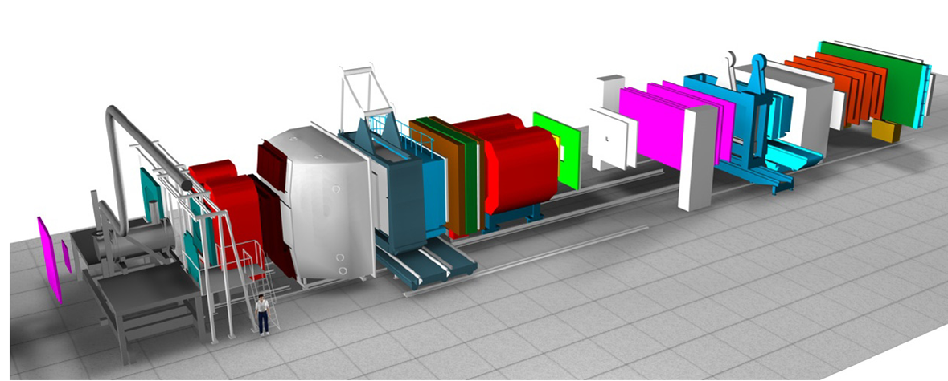
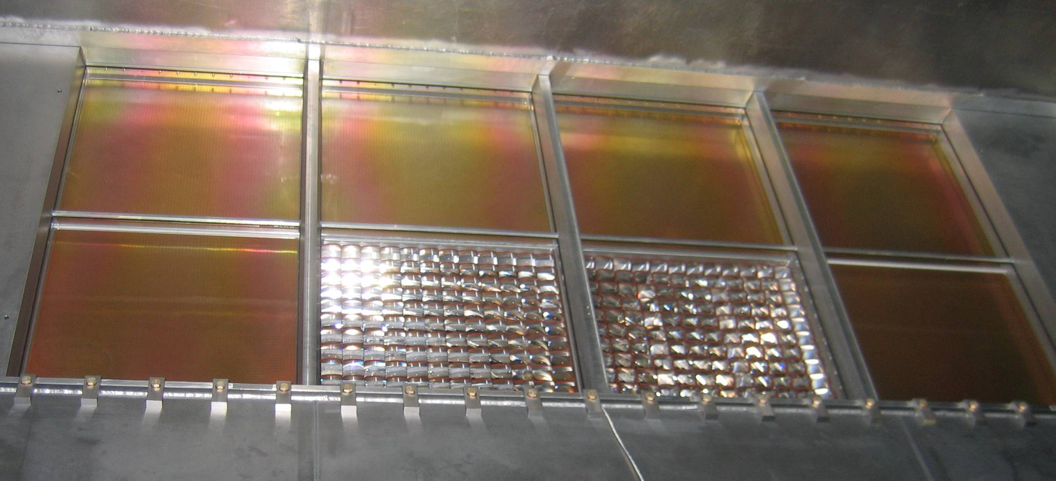
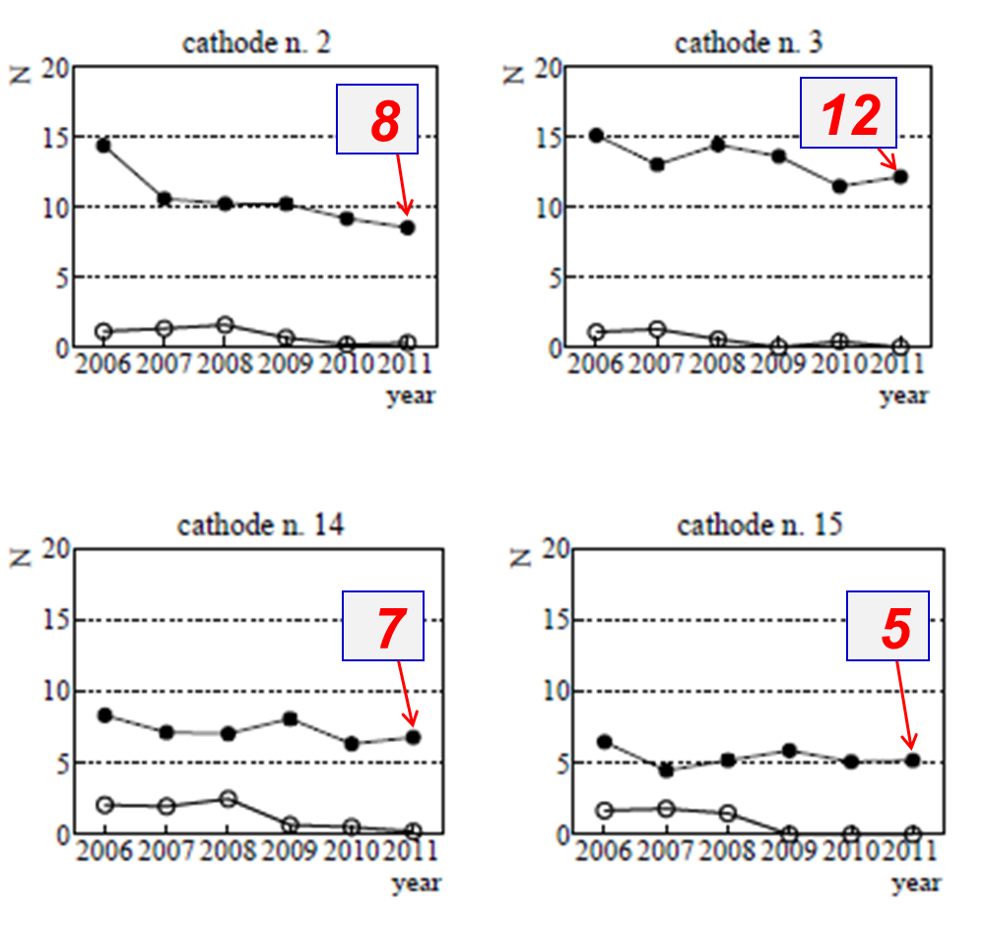
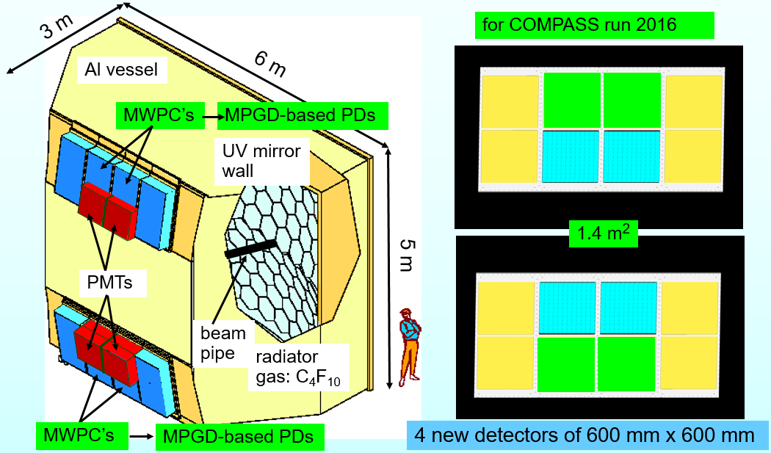
COMPASS RICH-1 upgrade
COMPASS Spectrometer
P. Abbon et al., NIM A 577 (2007) 455
P. Abbon et al., NIM A 779 (2015) 69
F. Tessarotto et al., JINST 9 (2014) C09011
hadron PID from 3 to 60 GeV/c; acceptance: H: 500 mrad V: 400 mrad;
trigger rates: up to ~100 KHz beam rates up to ~10⁸ Hz; material: 2.4% Xo (beam region), 22% Xo (acceptance)
80 m³ C₄F₁₀, 21 m² UV mirrors, 1.4 m² MAPMTs, 4 m² gaseous PDs
MWPCs+CsI: successful but with important performance limitations, in particular in the case of the 4 central chambers

Slide 3
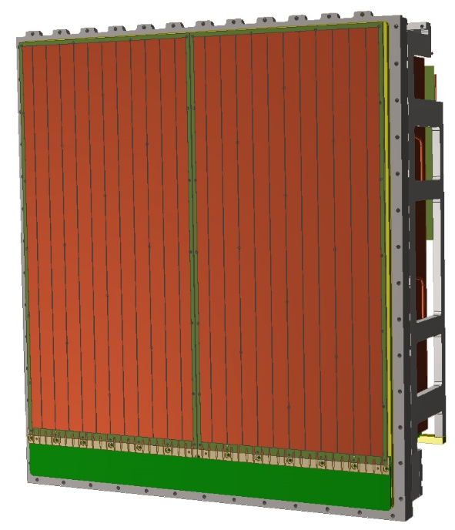
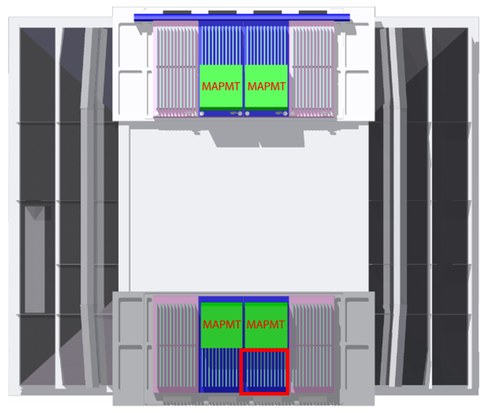
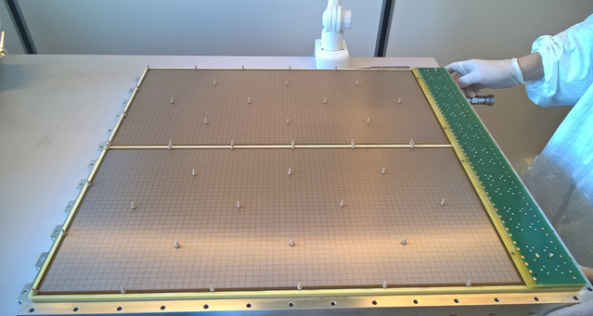
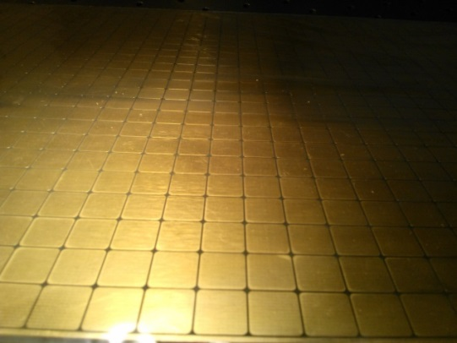
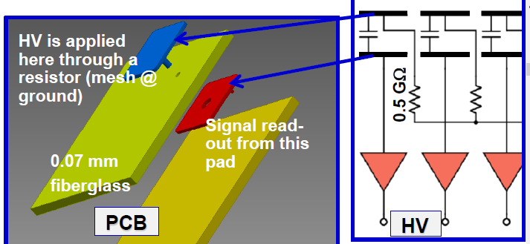
The hybrid THGEM+Micromegas PDs
Hybrid PD scheme
modular structure: one module = 600x300 mm²
quartz
CsI
Drift
TH1
TH2
MM
Standard Bulk Micromegas produced at CERN
good Micromegas gain uniformity
8mm X 8mm pads
at positive HV
Capacitive coupling → APV25

Slide 4
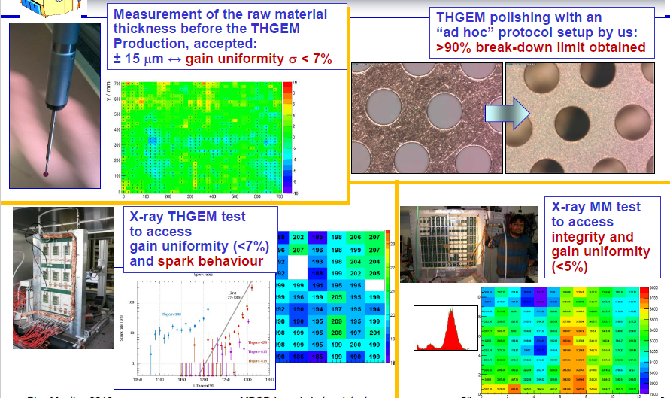
construction and quality control

Slide 5
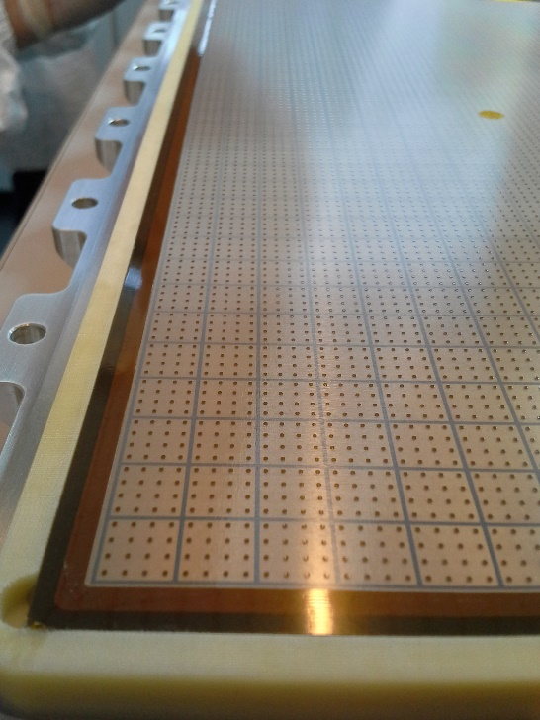
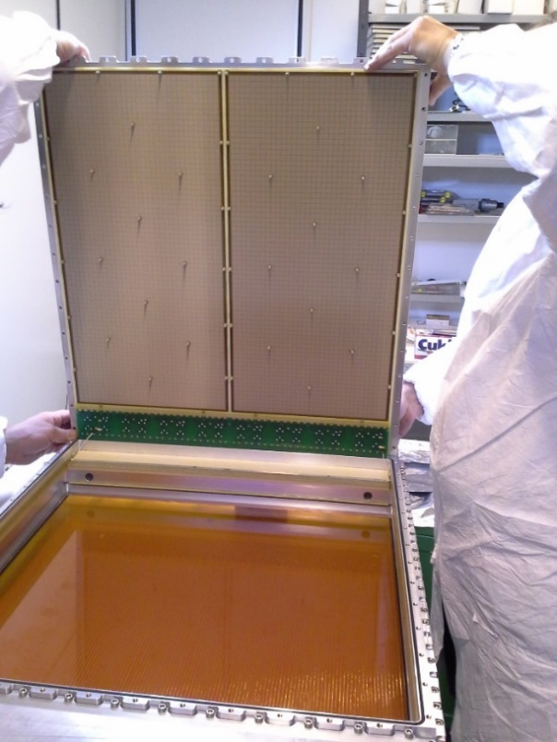
assembling

Slide 6
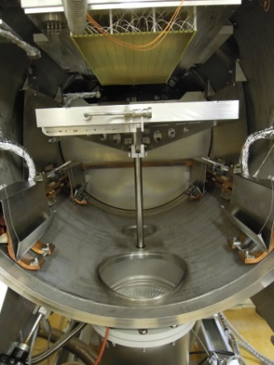
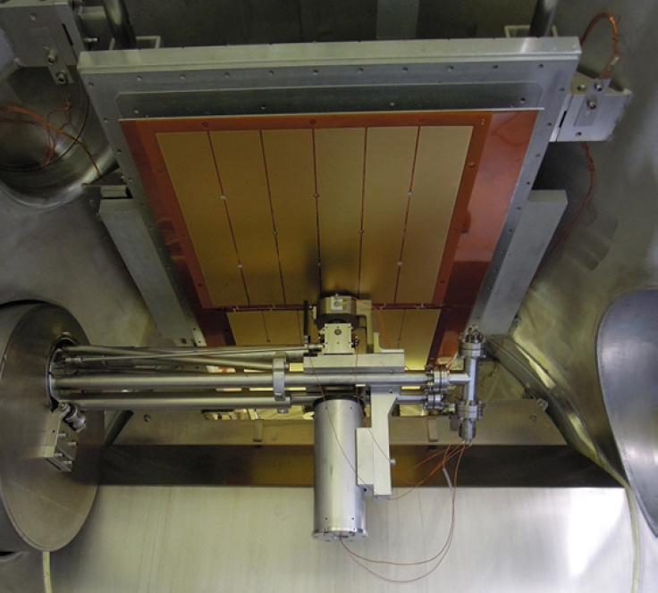
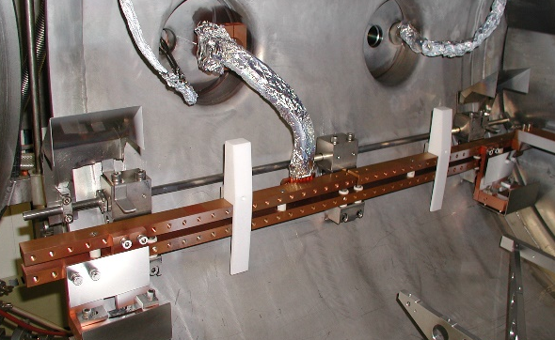
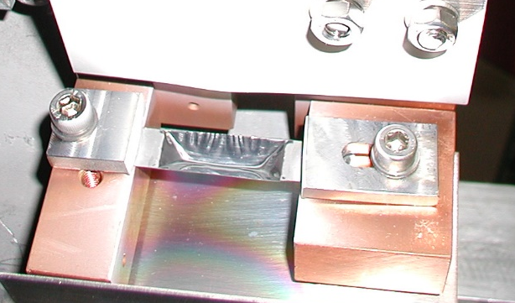
CsI coating of THGEMs
THGEM
THGEM box
piston
QE measurement
4 evaporators
Turbopump
evaporators

Slide 7

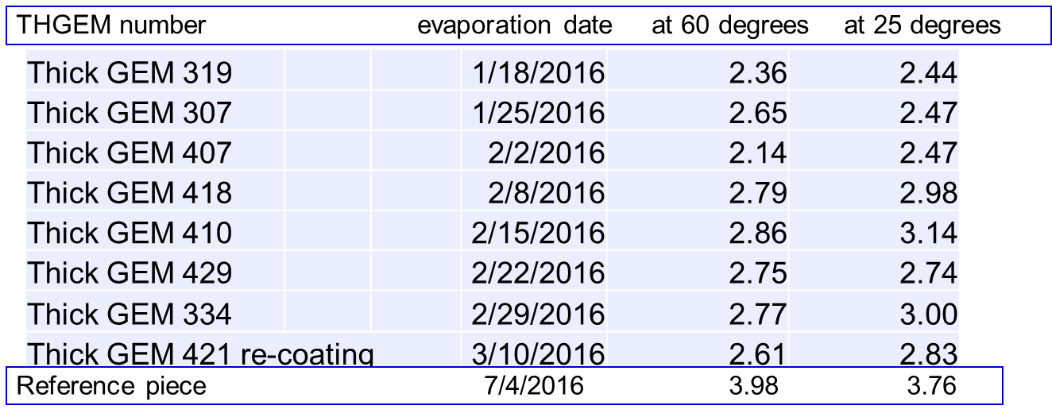
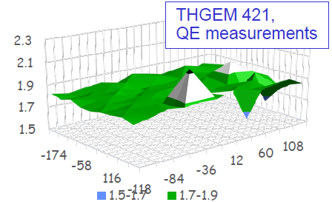
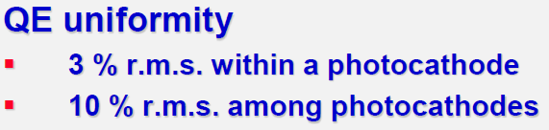
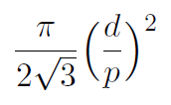
CsI QE measurement
19 CsI evaporations performed at CERN in 2015 - 2016
on 15 pieces: 13 THGEMs, 1 dummy THGEM,
and 1 reference piece (best from previous coatings)
11 coated THGEMs available, 8 used + 3 spares
  etching
coated by T. Schnider and M. Van Stenis
mean THGEM QE:
~ 93% of reference
Optical transparency: ~ 0.23

Slide 8
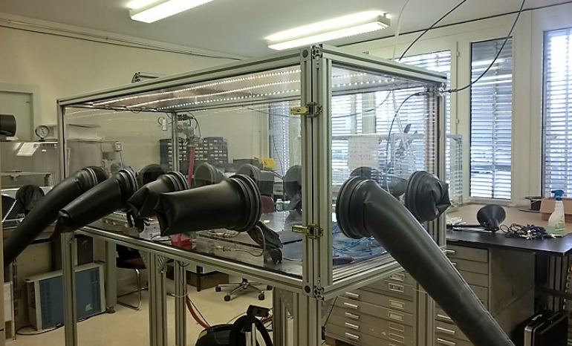
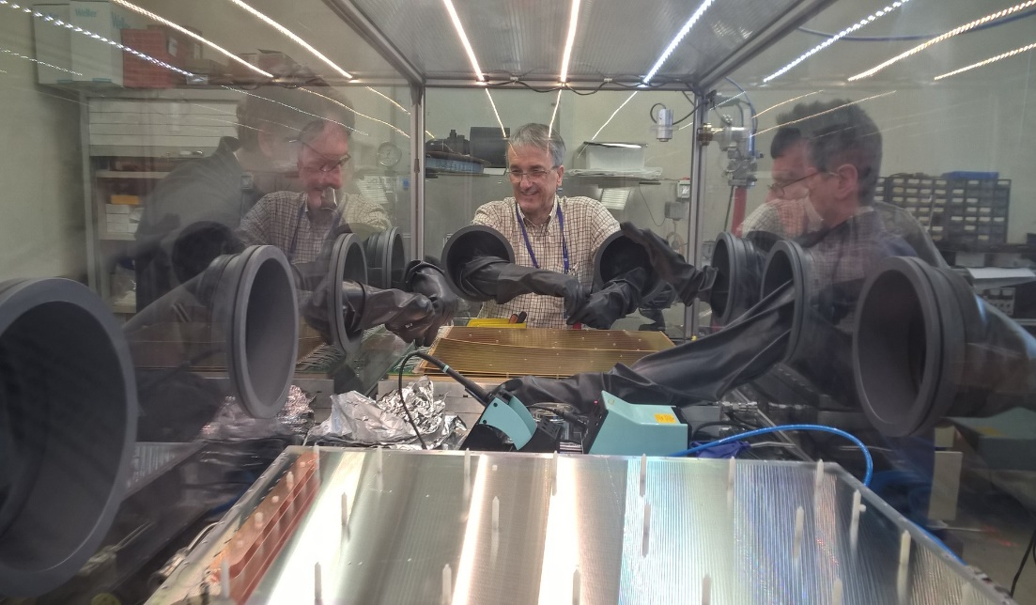
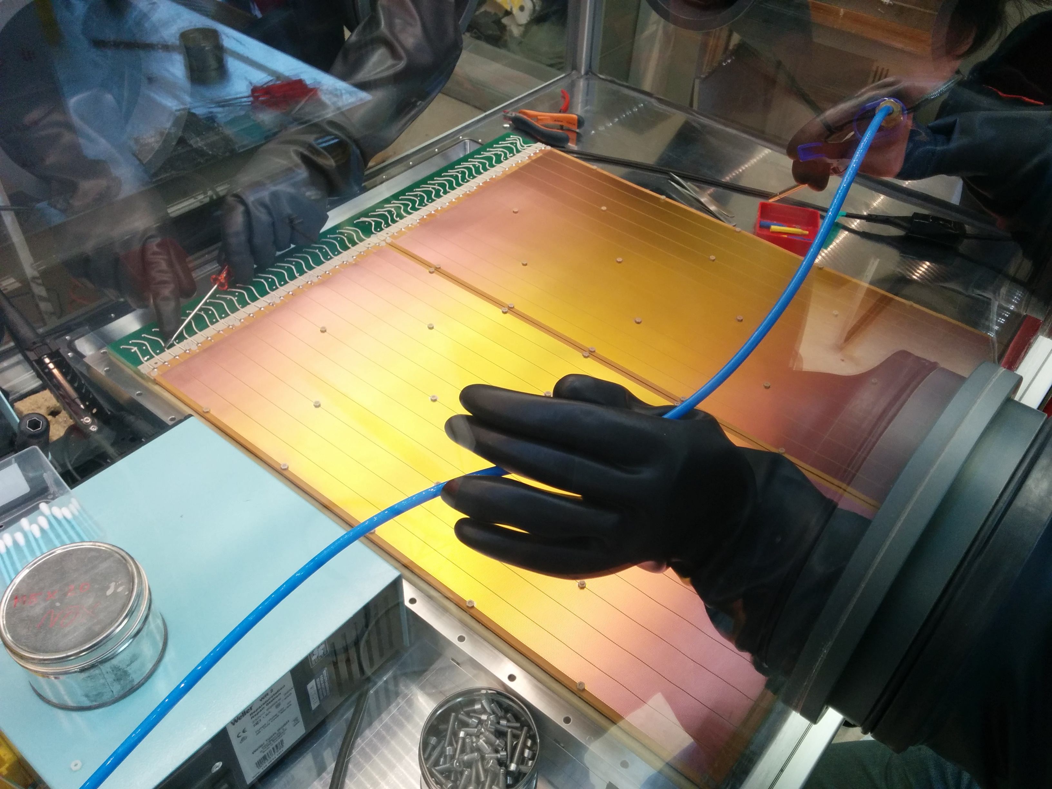
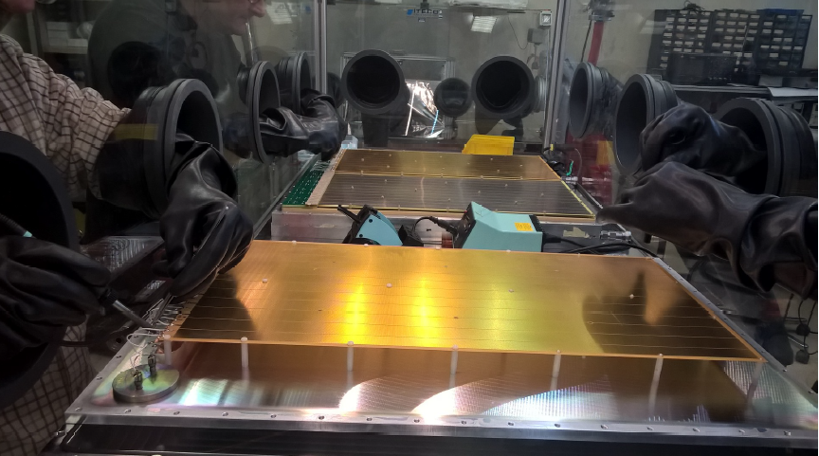
CsI THGEM mounting

Slide 9
The new COMPASS PDs

Slide 10
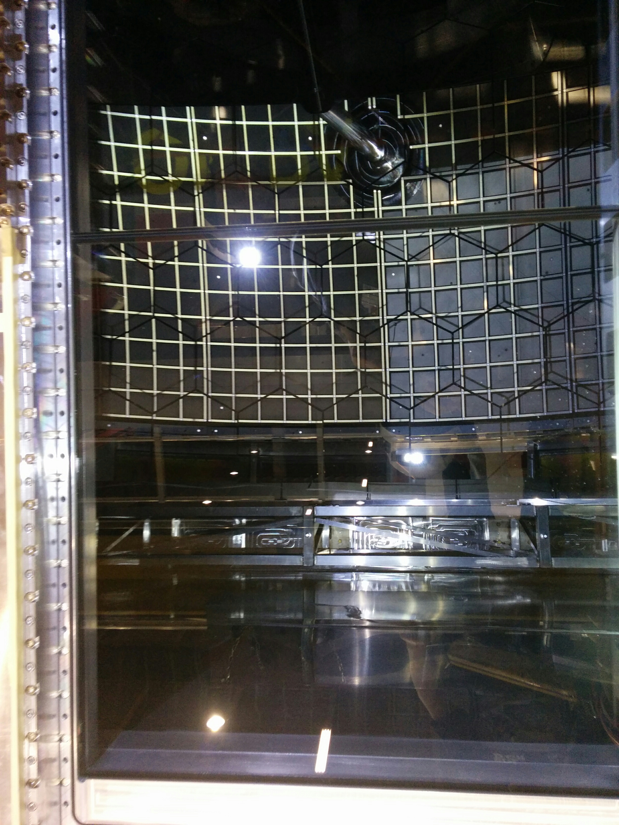
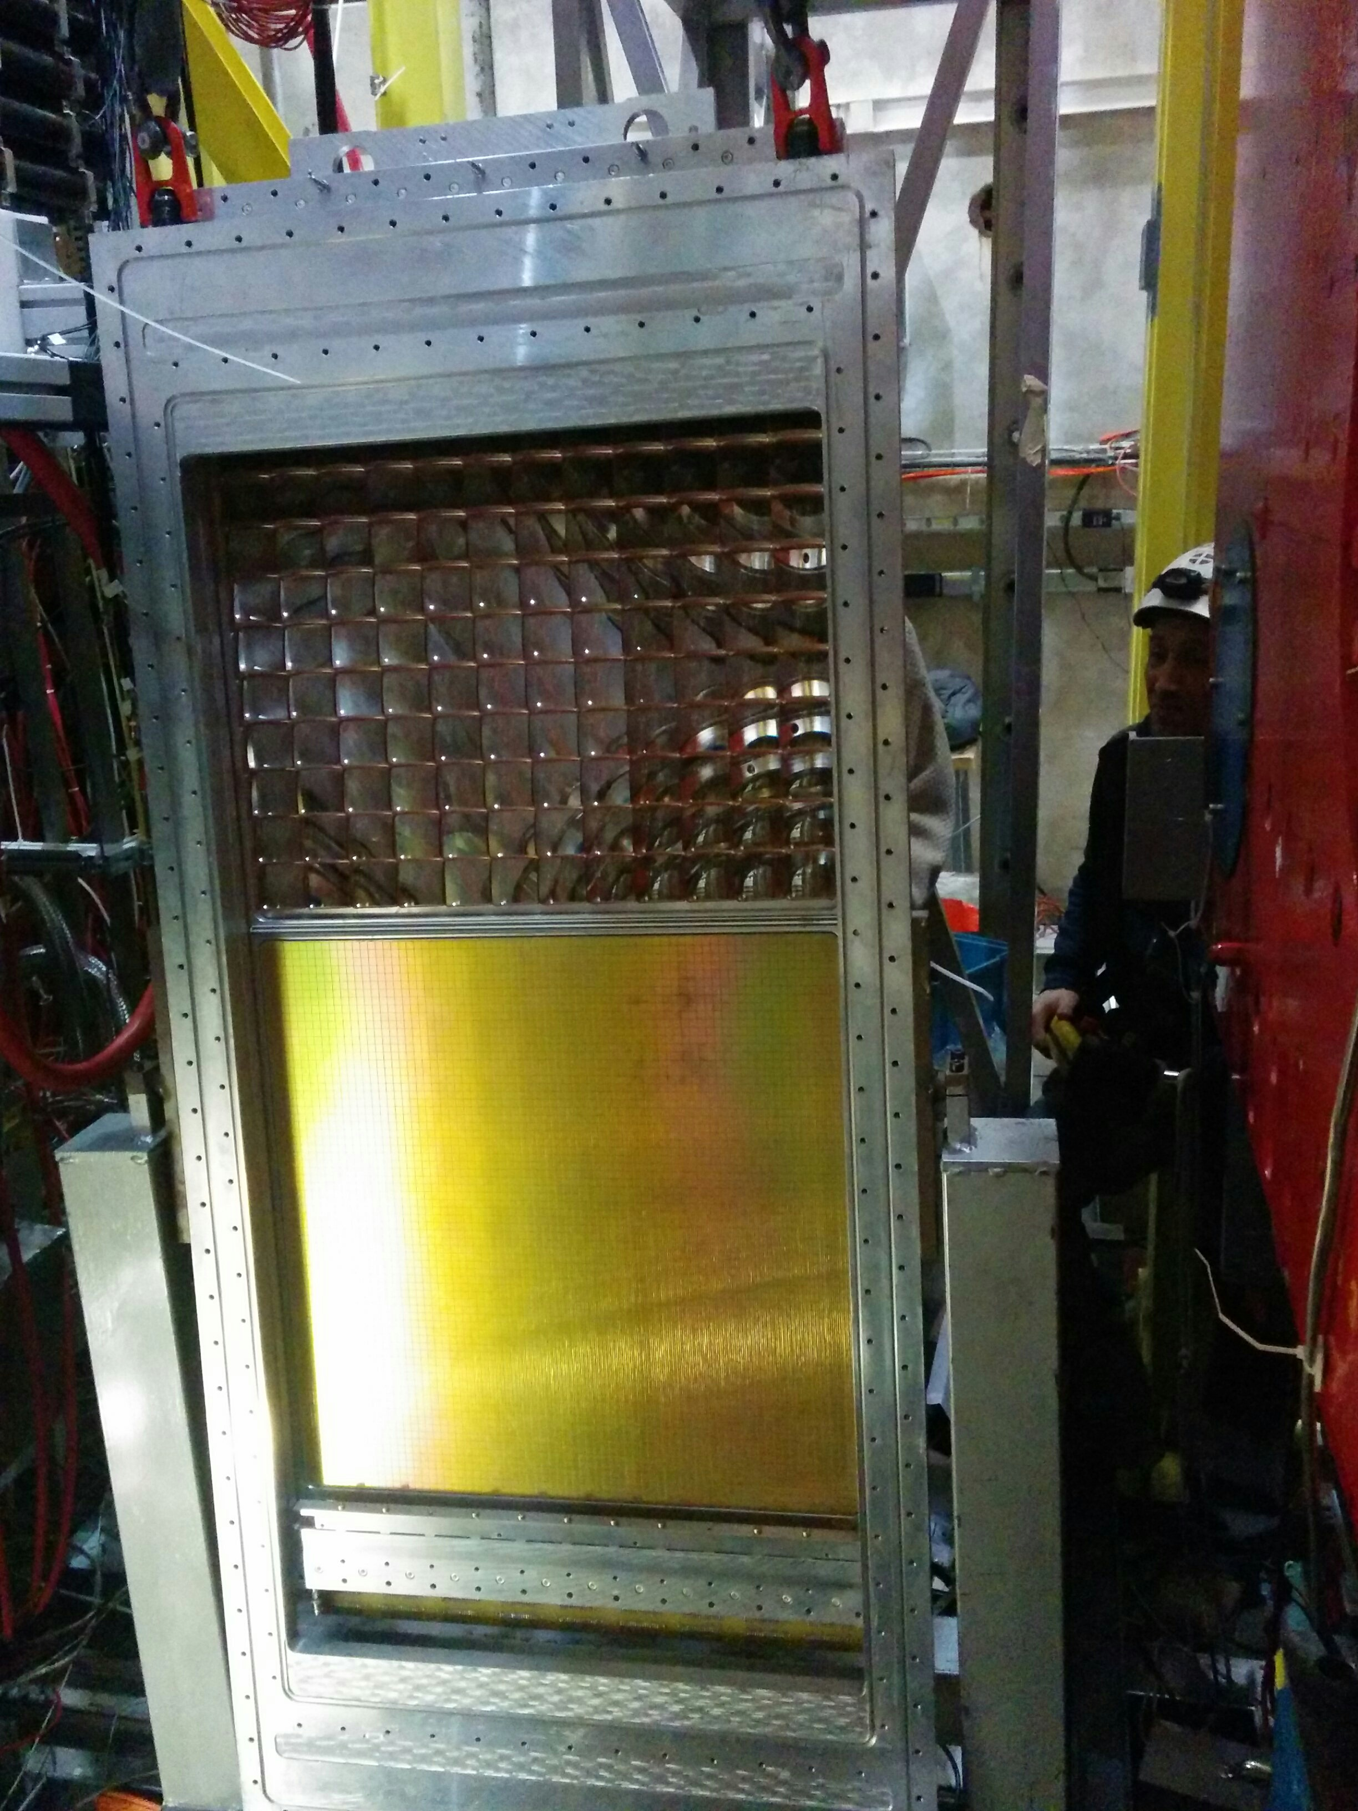
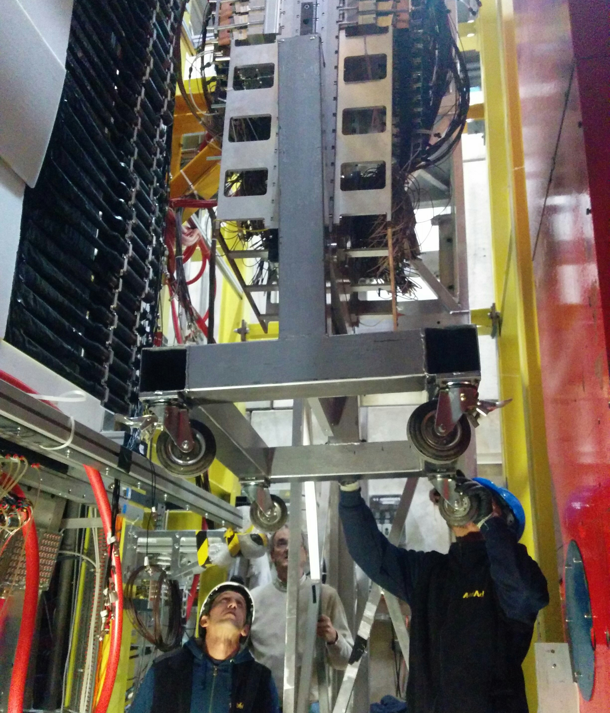
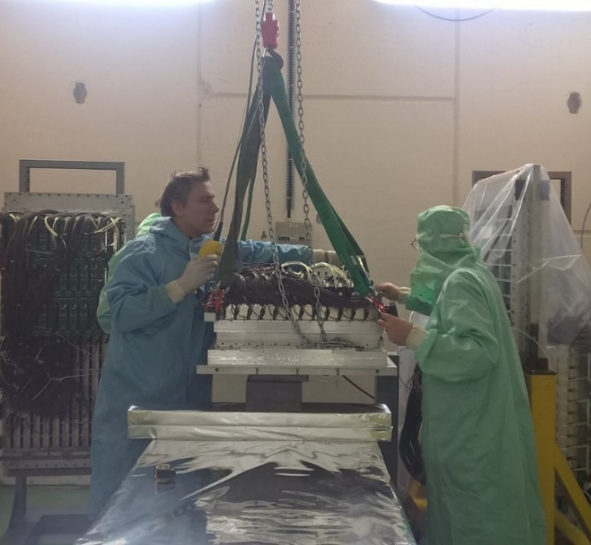
Installation of hybrids on RICH_1

Slide 11
Equipping the hybrids on RICH_1

Slide 12
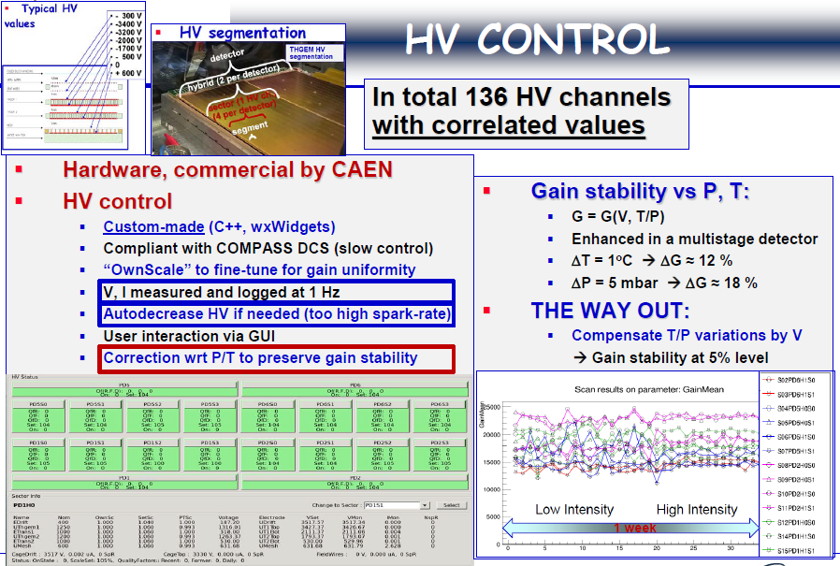
HV CONTROL

Slide 13
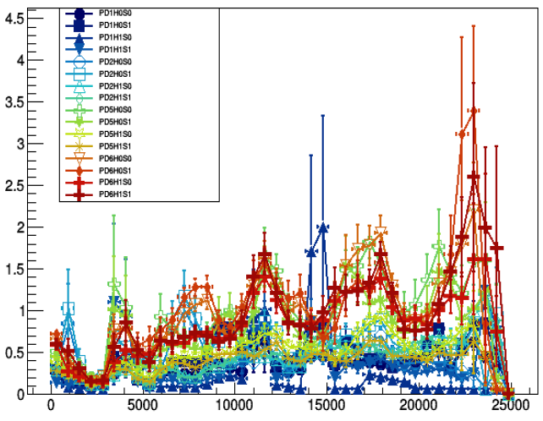
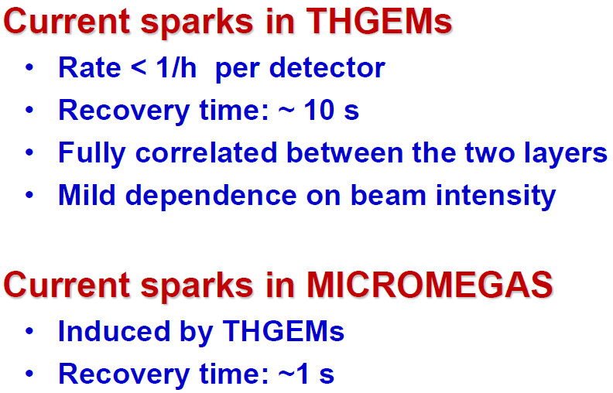
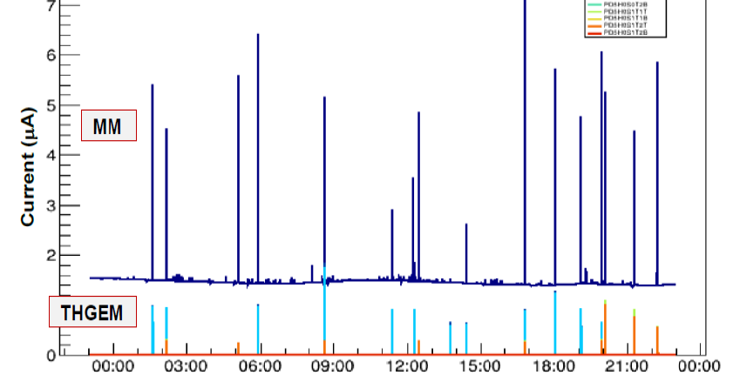
sparks
during 2017 COMPASS run
Spark: event with I > 23 nA
beam intensity ppp on T6 (10¹³ per h)
spark rate well under control
time

Slide 14
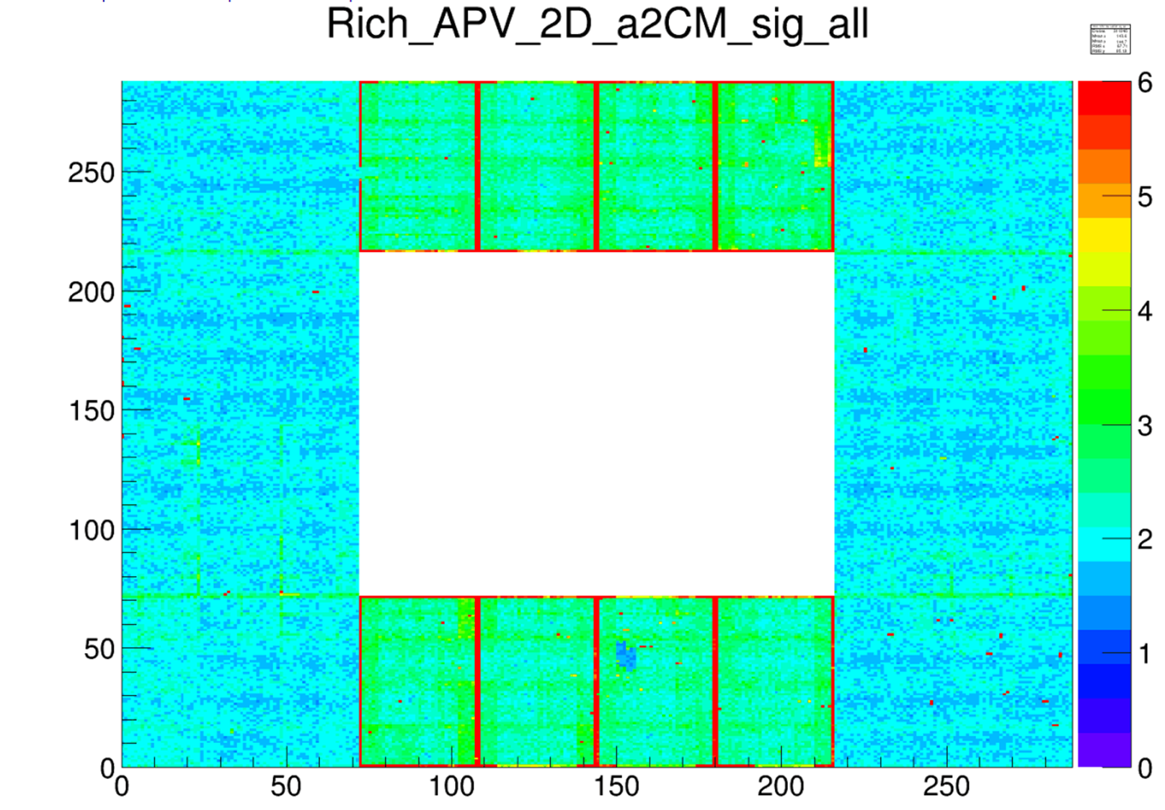
Noise figure for the 62208 ch.
MWPCs
Hybrids
MWPCs

Slide 15
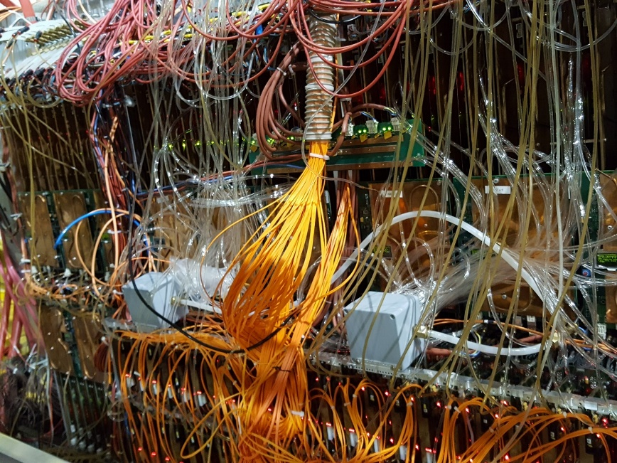
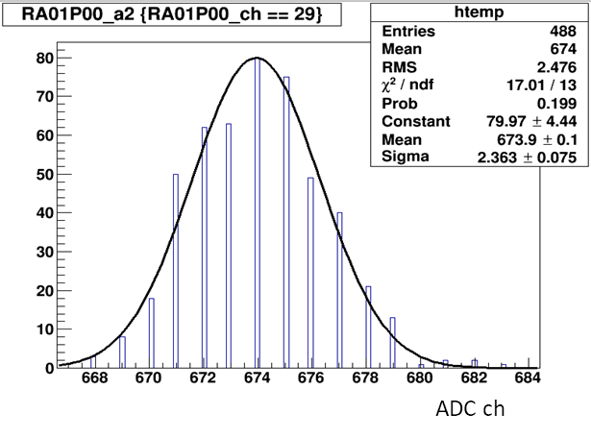
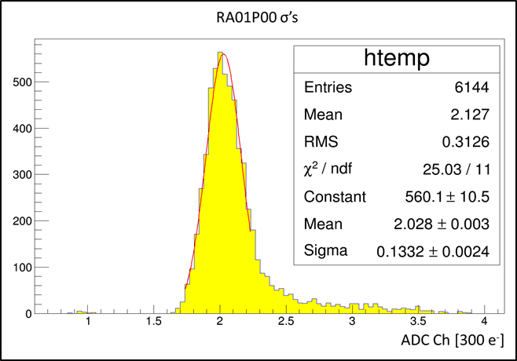
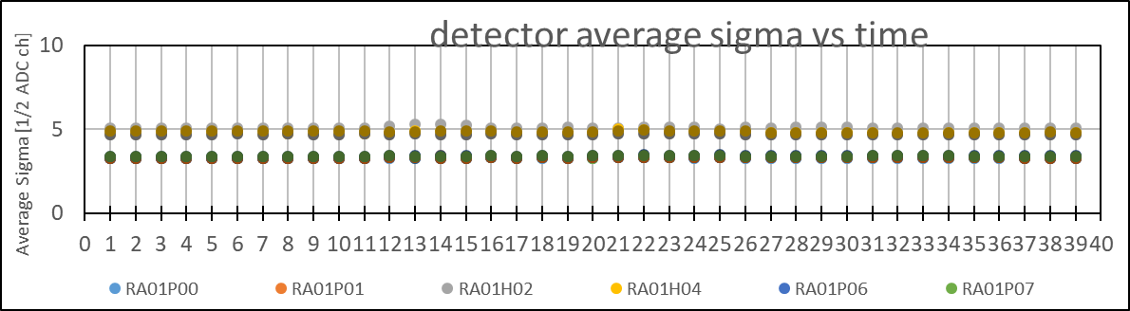
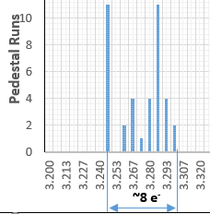
Noise level and pedestal stability
12 Detectors, 6144 Ch each.
6144 σ
values
single channel
39 APV Pedestal Runs during COMPASS 2017 run.
The APV-based F/E is the same for MWPCs +CsI and Hybrid PD’s
The niose levels are:
MWPC: ~ 600 e⁻
Hybrid: ~ 800 e⁻
The noise levels are very stable in time

Slide 16
gain shearing among the layers and IBF
Effective gain*transfer of THGEM1 in Ar/CH4, with THGEM2 and MM at nominal voltages
Effective gain of Mcromegas in Ar/CH4, with THGEM1 and THGEM2 at nominal voltages
nominal eff. gain: ~17000 with:
THGEM1 gain*transfer1: ~ 13
THGEM2 gain*transfer2: ~ 10
Micromegas gain: ~130
The Ion Back Flow
has been
measured to be ~ 3%
(dedicated exercise)

Slide 17
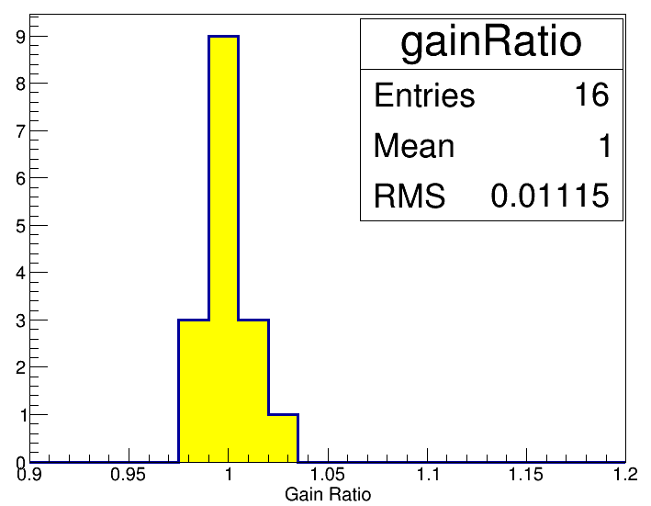
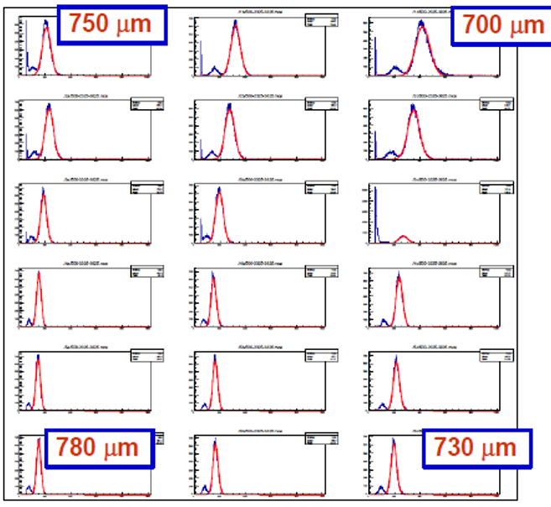
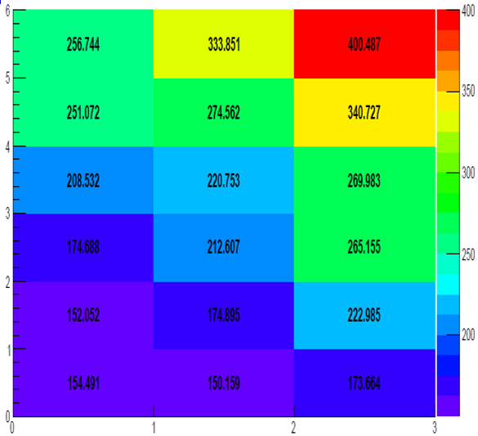
good gain uniformity
A specific gain equalization procedure has been developed and used
A specificgain equalization procedure has been developed and used
Sector | PD6S3 | PD6S2 | PD6S1 | PD6S0 | PD5S3 | PD5S2 | PD5S1 | PD5S0
Eff. Gain | 14322 | 14207 | 14346 | 14464 | 14675 | 14366 | 14349 | 14192
Ratio | 1.0020 | 0.9936 | 1.0037 | 1.0119 | 1.0266 | 1.0051 | 1.0039 | 0.9929
Eff. Gain | 14322 | 14024 | 14255 | 14073 | 14470 | 14291 | 14213 | 14099
Ratio | 1.0042 | 0.9811 | 0.9973 | 0.9845 | 1.0123 | 0.9998 | 0.9944 | 0.9863
Sector | PD2S3 | PD2S2 | PD2S1 | PD2S0 | PD1S3 | PD1S2 | PD1S1 | PD1S0
Average Eff. Gain |  | 14294 |  | σ | 159.40 | σ/Avg (%) | 1.1
uniform at ~ 1%
Q.E. uniformity
1.09 | 1.14 | 1.03 | 0.99
0.90 | 0.88 | 0.90 | 1.08
σ = 9.3%
old data
… compared to ~ 30% of old single “raw” PCB THGEMs
and ~9 % of CsI Q.E. variations

Slide 18
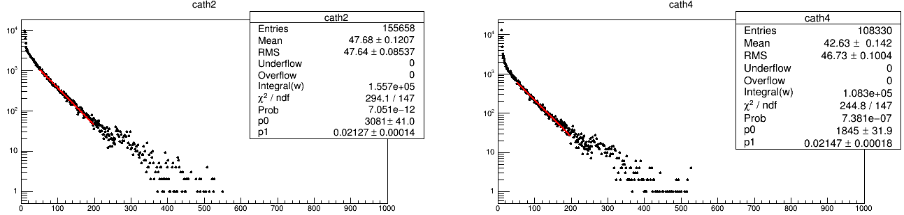
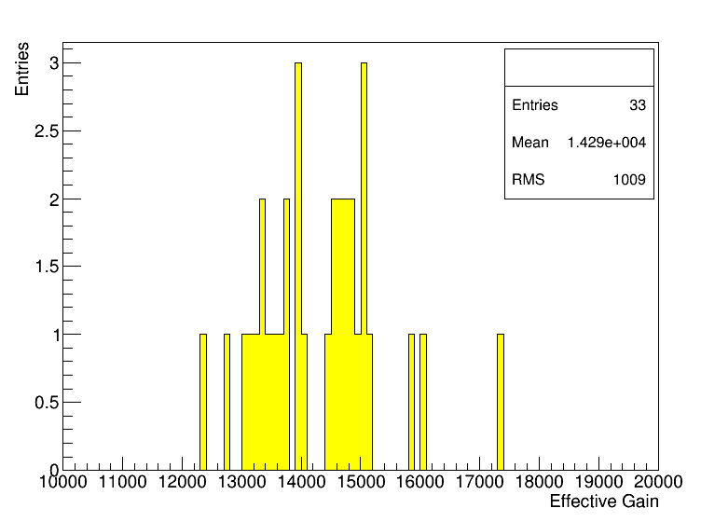
Gain stability in time
14104.8 +- 91.7
13976.1 +- 117.1
gain stabilization using global p, T
global corrections: σ/mean ~ 7%
individual chamber gain stabilization
individual corrections: σ/mean ~ 4%

Slide 19
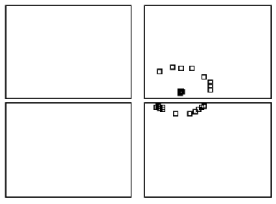
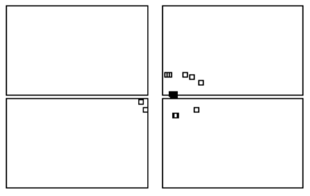

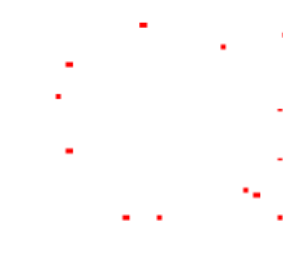

NICE RINGS
(in the 2017 run the Hybrid PDs were receiving Cherenkov photons from low p particles only)
6.36 GeV pion
6.76 GeV pion
6.4 GeV pion
ring center (calculated)
Hybrid PD
Hybrid PD
MAPMTs
MAPMTs

Slide 20







Single photon angular resolution
Hybrid PD’s
1.85 mrad
MWPC
2.0 mrad
MAPMT:
2.4 mrad
in terms of angular resolution the response of the new Hybrid detectors
is similar but slightly superior to the MWPC one. MAPMT’s have larger pads

Slide 21



Number of detected photoelectrons per ring
Critical chambers, have been changed from MWPC to Hybrid THGEM + Micromegas
MWPC
Hybrid PD
cathode n. 2
10.3
extrap. to 55.2 mrad, n. of det. ph.e.= 12.9
first part of the function = 10.3 +/- 0.4
second part of the function= 2.6 +/- 0.3
the n. of det. ph.e. (55.2 mrad)
in cathode n.2 was ~8 → 10.3
The number of detected photons per ring is in line with that of the good MWPC
cathode n. 8
MWPC: 8.5
cathode n. 1
MWPC: 10.3

Slide 22


Perspectives
The characterization of the Hybrid PD performance in terms of PID is ongoing
The remaining MWPCs of COMPASS RICH-1 are likely to be replaced for 2021
Development of an optimized detector for high space resolution based on the hybrid THGEM + MM and “mini-pads”
Study the compatibility of these hybrid PDs with CF₄ for a windowless RICH for
the Electron Ion Collider
Exploring the possibility to use a more robust photocathode in the far UV:
hydrogenated nano-diamond crystals
Talk by Shuddha Shankar Dasgupta
Poster by Chandradoy Chtterjee

Slide 23
CONCLUSIONS
COMPASS RICH-1 has been upgraded with 1.4 m² of MPGD-based PDs.
The Hybrid PD: 2 THGEMs (1 with CsI) + Micromegas are nicely operating.
They present good gain uniformity and stability, low IBF and clean rings.
1.85 mrad single photon angular resolution, 10 detected photons per ring.
A full characterization of the PID performance is ongoing.
More Hybrid PD’s will probably be mounted on RICH-1.
R&D for future RICH projects are considering the use of this technology.

Slide 24








THGEM + CsI: 8 years of dedicated R&D
Effective gain = 0.91 · 10⁶
Ar/CH₄: 50/50
PARAMETERS:
Diam. = 0.4 mm
Pitch = 0.8 mm
Thickn. = 0.4 mm
Rim = 10 μm
Photon yield & Charged Particles vs Drift Field
a. u.

Slide 25



The hybrid THGEM+Micromegas PDs
Hybrid PD scheme
modular structure: one module = 600x300 mm²
quartz
CsI
Drift
TH1
TH2
MM
Standard Bulk Micromegas produced at CERN
good Micromegas gain uniformity
$$δ_{G}=\frac{G_{max}−G_{min}}{G_{min}}<5 \%$$

Slide 26








THGEM quality assessment
current monitor recording,
discharge counting
rejected
rejected piece
ΔV(V)
accepted
first 4 pieces: 1 rejected. Possibly recovered by repeating the cleaning treatment
Gain uniformity measurement
AMPTEK Mini-X Au used at 15 kV, 200µA + Cu foil provides 8 keV X-rays uniform illumination at a rate > 5 kHz cm⁻² (for 1 cm Ar/CO₂ 70/30)

Slide 27





The anodic PCB
Signal read out via capacitive coupling pad readout and APV25 F/E boards
8mm X 8mm pads
at positive HV
anodic pad PCB produced by TVR
Strong technological effort from TVR Company for the PCB (multilayer 3.2 mm thick) to comply with specific requirements of planarity, surface quality, layer thickness uniformity, surface irregularities (E field).
Tests on 2500 pads:
electrical continuity
and capacity meas.
→ 38-42 pF/pad
470 MΩ resistor for each anodic pad
“Z drilling controlled
via” → planarity issue
“surface anode” pad
“buried pad”

Slide 28





The COMPASS THGEM design
Thickness: 0.4 mm, hole diameter: 0.4 mm, pitch: 0.8 mm
12 sectors on both top and bottom, 0.7 mm separation
24 fixation points to guarantee THGEMs flatness
border holes diam.: 0.5 mm
pillars in PEEK

Slide 29









THGEM raw material selection
Our thickness uniformity requirements are stricter than those offered by producers → material selection
50 foils of 1245 mm x 1092 mm → cut out borders → 800 mm x 800 mm → thickness measurement
Mitutoyo EURO CA776
coordinate measuring machine with ruby touch probe,
hosted in a thermalized room
  underpressure induced flatness
for each foil 36 x 36 points in square pattern are measured
2 measurements (direct and reversed) to allow consistency checks.

Slide 30







THGEM raw material selection
$$δ_{thickness}\sim 2.6\%$$
  typical result for a good piece.
  all foils have been labelled and measured → database of local thickness of all THGEMS
  δ for the 100 raw THGEM pcb (%)
THGEM 313
  from each foil twoTHGEMS can be produced:
  50 foils → 100 raw THGEM pcb
  THGEM pcb size = 620 mm x 320 mm,
  active area = 581 mm x 287 mm
THGEM 413
  60 THGEMs have been produced by ELTOS
49 p.cs
2%<δ<3%

Slide 31









Production of the THGEMs at ELTOS
  image transfer
  development
  etching
  stripping dry-film
  multi-spindle drilling
  mounting
In Trieste a specific cleaning procedure is applied : polish with fine grain pumice powder, pressure water cleaning, ultrasonic Bath with Sonica PCB solution (PH11), distilled water rinsing and oven @ 160 ºC

Slide 32





mechanical frames and wires
drift and field wires: Cu-Be, Au coated
4 mm pitch, 100 µm diam.
manual soldering
tension meter

Slide 33






field shaping electrodes
THGEM border study
large field values at the chamber edges and on the guard wires
Field shaping electrodes in the isolating material protections of the chamber frames
isolating material (Tufnol 6F/45) protection

