Slide 1
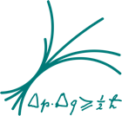

Extending the Observation Limits of Imaging Air Cherenkov Telescopes Toward Horizon
Razmik Mirzoyan,
I. Vovk, M. Peresano, P. Temnikov, D. Zaric, N. Godinovic, J. van Scherpenberg, J. Besenrieder for the MAGIC Very Large Zenith Angle Observation Working Group
Max-Planck-Institute for Physics, Munich, Germany

Slide 2
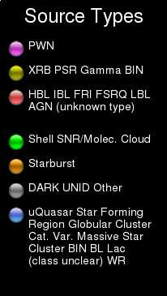
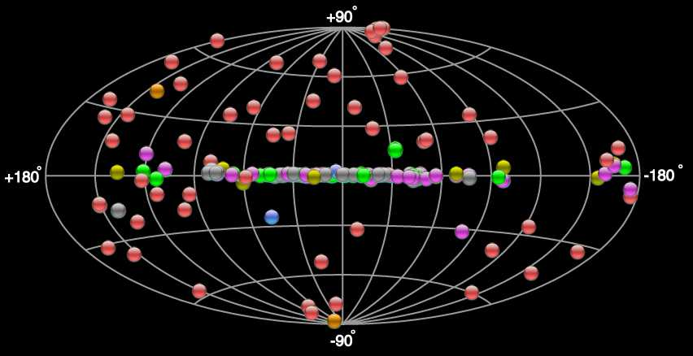
Today‘s VHE γ−ray Sources in the Sky
http://tevcat.uchicago.edu/
Almost ~200 Established Sources

Slide 3

Cherenkov light: the beginnings
Pavel Cherenkov: born July 28th 1904 in a poor peasant family in village Novaya Chigla, Voronezh province.
1924-1928 studying in Voronezh sate university.
1930: postgraduate student of Sergej Vavilov at the Institute of Physics of Soviet Academy of Sciences in Sankt-Petersburg (later on FIAN).
Had to find the fluorescence nature of solvents of uranium salts, emitting bluish light
Big was his surprise that also pure solvents and even water were emitting the annoying background light

Slide 4
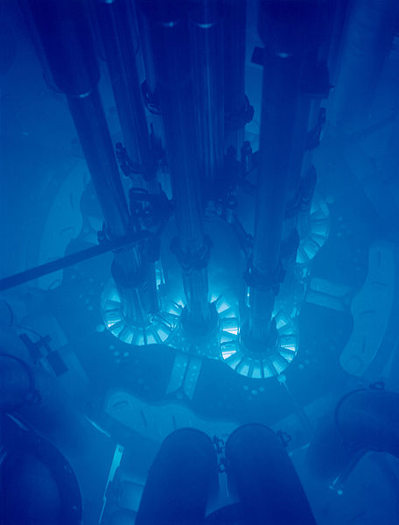
Initially complaning about his boss: he had to spend >1-1,5 hours in a dark, cold cellar, for accomodating his eyes
He noticed that the emission is not chaotic, but is related to the track of moving particle.
1934-1938 conducting a series of brilliant expeirments.
Obtained doctorate in 1940
Nobel Prize in 1958, with Tamm and Frank

Slide 5
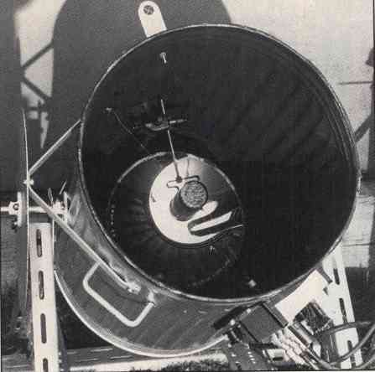
The Experimental Beginning of Studying Cosmic and Gamma-Rays
1953
By using a garbage can,
a 60 cm diameter mirror
in it and a PMT in its focus Galbraith and Jelly had discovered the
Cherenkov light pulses
from the extensive air
showers.

Slide 6
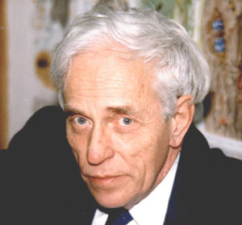
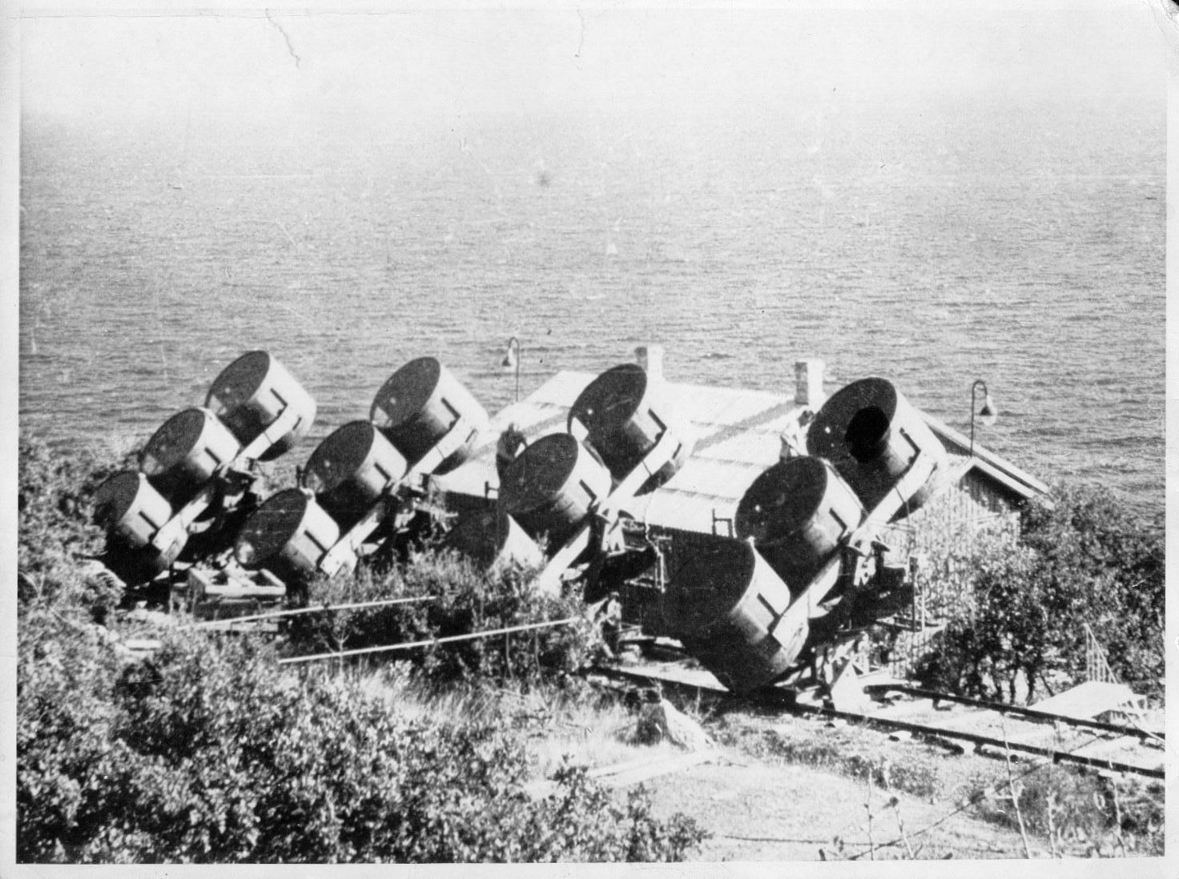
Alexander Chudakov and the Cherenkov Technique for
Gamma Ray Astronomy
1921-2001
Crimea Experiment 1959-1965, Chudakov, et al., (SNR, radio galaxies)

Slide 7
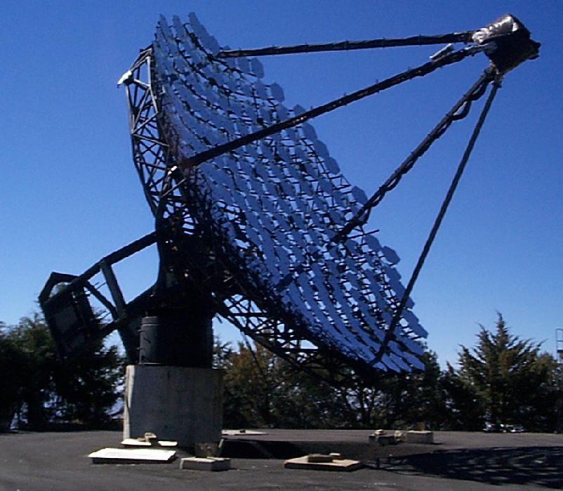
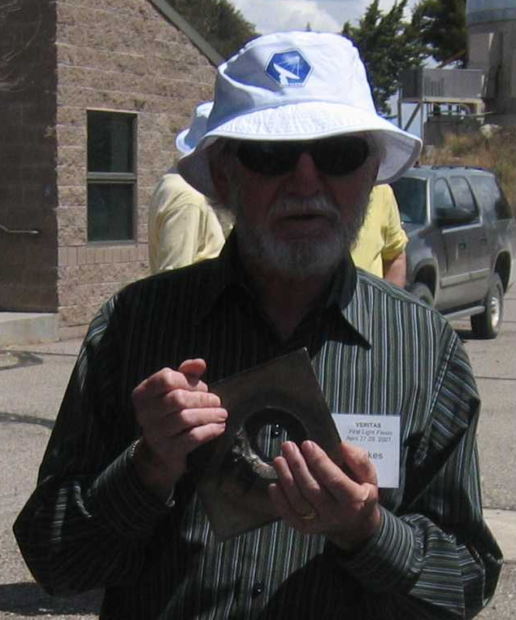
The Pioneer Trevor Weekes with his 10m Ø Whipple telescope gave birth to γ-ray astrophysics: 9σ from Crab Nebula in 1988 !
„This telescope can within
a few sec. drill (evaporate) a hole
in a solid piece of steel. Also, it
can measure gamma rays“ ;-)

Slide 8
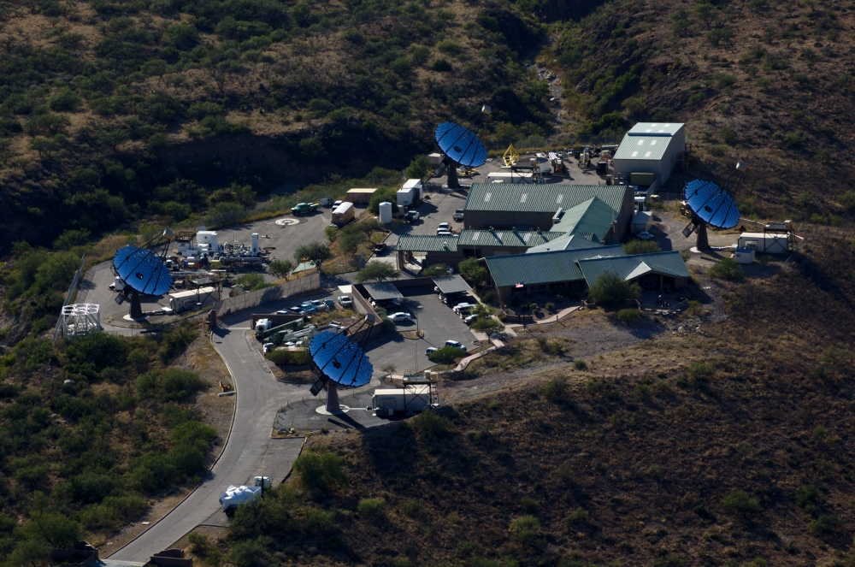
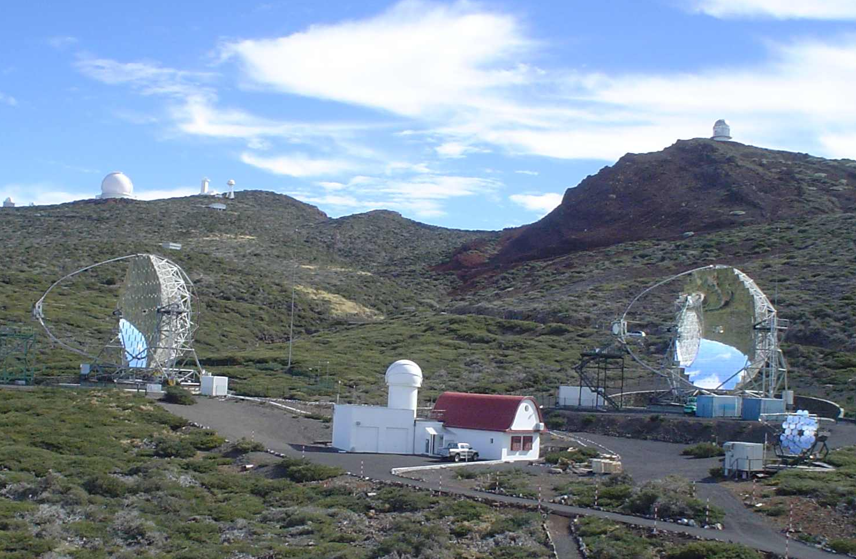
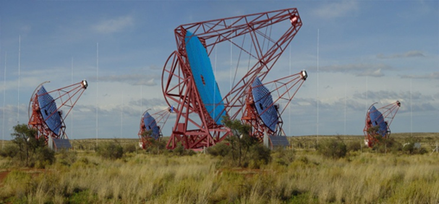
VERITAS, H.E.S.S. & MAGIC: the triumphal procession of VHE γ-astro-physics is continuing
and today…

Slide 9
The novel Sum-Trigger-II revived MAGIC operation down to a few tens of GeV
- Sum of analog signals
of a patch of PMTs
comparable in size to the
expected size of the low
energy images
- Use low photon signals
below the single channel
threshold
- Integration over larger area
- Increases S/N at low E

Slide 10
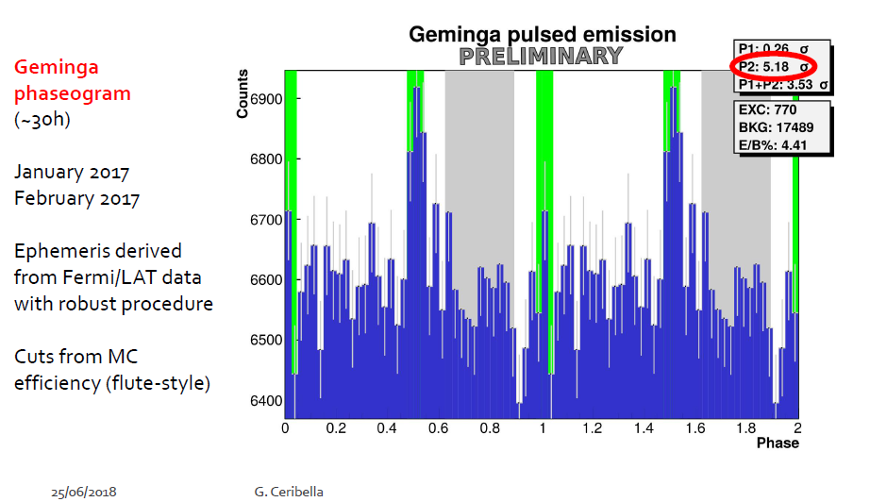
Discovery of the Geminga pulsar above ~ 30 GeV by MAGIC by using Sum-Trigger-II
Unlike Crab pulsar, it is radio-quiet
~ 340 kyr old
(Crab pulsar is 1 kyr old)
Nearby 150 pc
(Crab is at ~ 2000 pc)
Ė ~ 3.10³⁴ erg /s
(for Crab pulsar
Ė ~ 5.10³⁸ erg/s)
Fermi LAT saw pulsations ≥ 10 GeV
Fermi spectrum seems to deviate
from exponential cut-off
~30h observations

Slide 11
Extending the Observation Limits of
IACTs Toward Horizon
As a rule the IACT measurements are performed in the range of zenith angles, limited to ≤ 60 °
There exist few occasional measurements extended till the zenith angle range 65° and very few up to 70°
In the following we will discuss extending the observation limits at first to 75 - 80° and much beyond, practically down to the horizon
Increase of observation zenith angle provides a huge increase in the collection area of air showers, up to several km²
Such big collection area is mandatory when aiming to study the spectrum of gamma ray sources at the highest energies,
i.e. the galactic PeVatrons

Slide 12
PeVatrons are believed to be the sources of galactic cosmic rays
(Berezhko & Völk, 2007)
Very likely the cosmic ray “knee” is due to the chemical composition of accelerated cosmic rays
In general one expects
E_{max} ~ Z of the particle
(Peters, 1961)
Until few years ago one believed E_{max}~ 10¹⁴ eV for protons
Since the mechanism of the magnetic field amplification has been put forward (Bell, 2004) , one believes that E_{max} ~ 3x10¹⁵ eV for protons

Slide 13
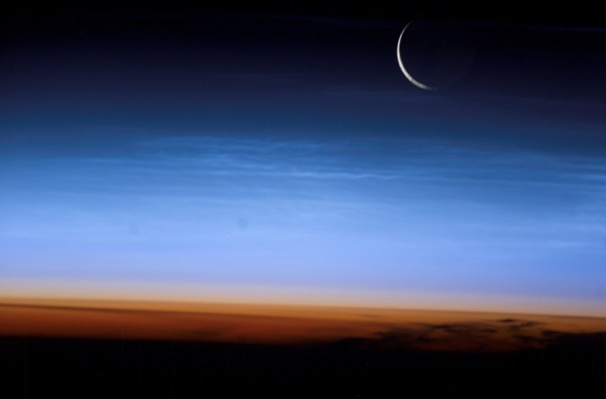
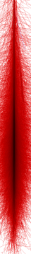


Cartoon on longer path length in atmosphere for an EAS @ large zenith angle observations
small zenith angle
Large zenith angle

Slide 14
Main Facts When Observing at
Very Large Zenith Angle Range
The shower development and its maximum move to larger distances from the telescope and its visible size shrinks
Because of much further distance but essentially the same angular range of emitted Cherenkov light, the light “pool” size on the observation level can increase by orders of magnitude, i.e. providing much larger collection area
Because of the same reason the produced Cherenkov photons distribute on a much larger area, thus resulting in much less photon density, i.e. the observation energy threshold will strongly increase
If the primary goal is to provide very large collection area at the very high energies, this can be a promising scenario to follow

Slide 15
Observations at Very High Zenith
Angle Range are Do Possible
One should take into account the large absorption and scattering of Cherenkov light from air showers due to passage through significantly “thicker” atmosphere
This demands good calibration method of light transmission
Below we will show two calibration methods
The 1st method, currently in use, is based on using the Lambert-Beer’s-law
The 2nd method, now under implementation, is based on measuring the spectrum of a selected star in a close proximity of the selected gamma-ray source

Slide 16
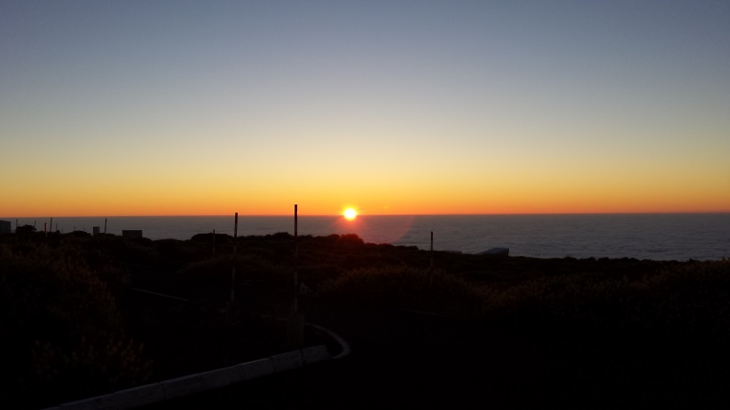
MAGIC Getting a Second Wind at ≥ 100 TeV With Very Large Zenith Angle (VLZA) Observations
Sunset @ ORM
2200 m a.s.l.
La Palma
Now we are working with a novel for IACTs calibration method of the
transmission of atmosphere as well developing a precise, advanced
calibration, based on a small optical telescope with a spectrograph

Slide 17
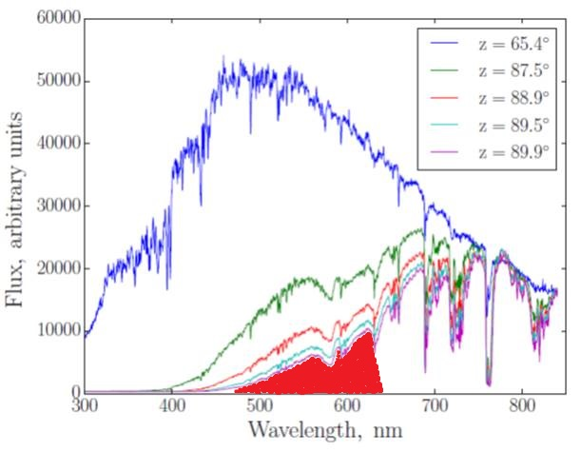
MAGIC Getting a Second Wind at ≥ 100 TeV With Very Large Zenith Angle (VLZA) Observations
Sunset @ ORM
2200 m a.s.l.
La Palma
Now we are working with a novel for IACTs calibration method of the
transmission of atmosphere as well developing a precise, advanced
calibration, based on a small optical telescope with a spectrograph

Slide 18
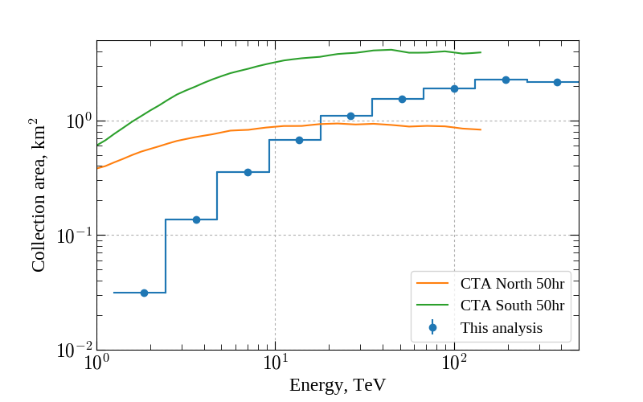
VLZA MAGIC collection area @100 TeV is comparable to CTA predictions (at 20° zenith)
Relative air-mass vs. zenith angle
Collection area for z.a. range 70°-80°
http://www.cta-observatory.org/science/cta-performance/ (version prod3b-v1)

Slide 19
CCD camera from SBIG used for calibrating the atmosphere (and mirror abs. reflectivity)
A rotating filter wheel
coupled to the CCD
can be set remotely

Slide 20
Observation of a selected star in close proximity of a target gamma-ray source with MAGIC
A bright star is chosen in the
proximity of the target source
SBIG camera integrates
starlight allowing for a given
zenith angle (air mass)
to find the number of stars
above a threshold magnitude
(Starlight is focused onto a
remotely controlled pop-up
target made of Spectralon
(diffuse refl. ≥ 99 %))
(The ratio of direct and reflected starlight allows one to measure the absolute reflectivity)

Slide 21
Atmospheric transmittance vs. zenith angle
The extinction of star-light passing the atmosphere can be described by the Lambert-Beer’s-law
I = I₀ e^{−K・X}
where I is the measured intensity, I₀ is its brightness out of the atmosphere, K is the extinction coefficient per air-mass and X is the relative air-mass
By taking logarithm one obtains the following equation
ln(I) = ln(I₀) − K · X
By measuring the brightness of a star at ≥ 2 different zenith angles (air-masses) one can determine its brightness out of the atmosphere I₀ and the extinction coefficient K
Once I₀ of a star is known one can determine the actual total transmittance of the atmosphere as I / I₀

Slide 22
Calibrating the total transmission of atmosphere with a selected star
A linear dependence between the airmass (zenith angle) and the
number of stars above a certain brightness magnitude manifests
a good measurement

Slide 23
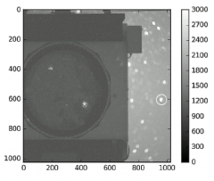
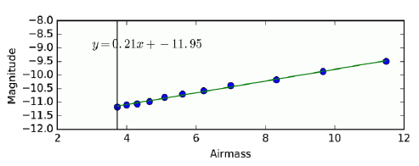
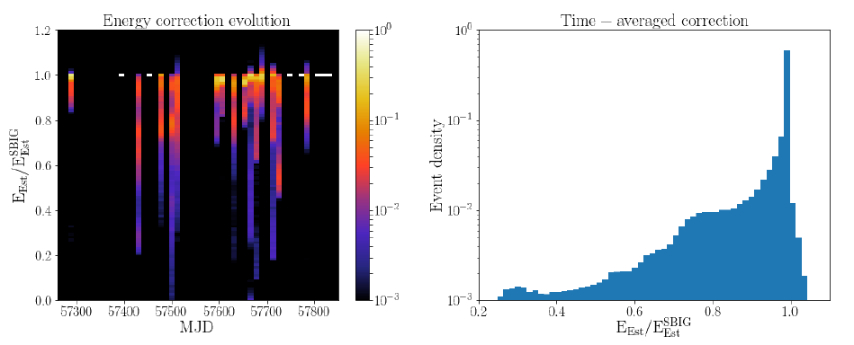
Implementation of Measured Atmospheric Transmission

Slide 24
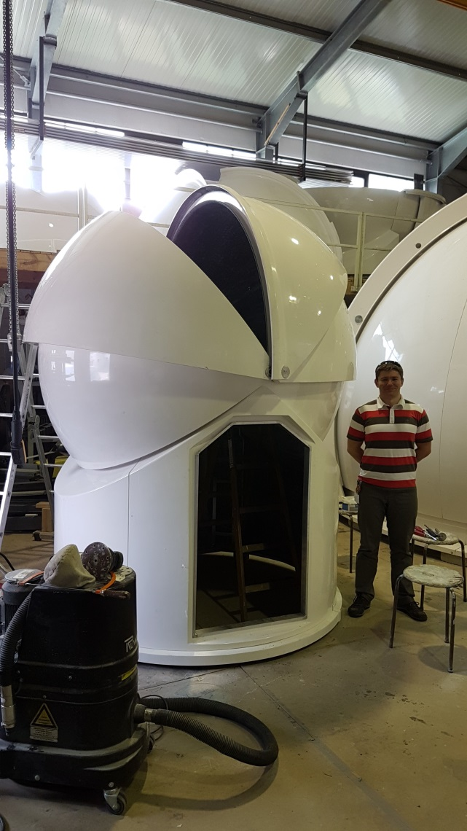
2.5m dome (left) for the 11 inch optical telescope with spectrograph (right)

Slide 25
The 11 inch optical telescope with spectrograph for calibrating transparency of atmosphere
With the optical telescope we plan tracking a star in the proximity of the observed gamma source
The spectrograph will provide the momentary spectrum
Knowing the spectrum of the star at any given moment we can precisely determine which part of the Cherenkov light spectrum from showers reaches the telescope
The maximum of an air shower, energy dependent, is typically reached after passing few hundred g/cm² of air
At ~80° zenith the atmosphere is ~5 air masses (~5200 g/cm²)
The integral measurement of the atmospheric transmission can be applied allowing for a small error
Currently installing the dome and the telescope in La Palma

Slide 26
VLZA γ event measured from a PeVatron candidate source at E ≥ 100 TeV
E = 141.8 TeV

Slide 27
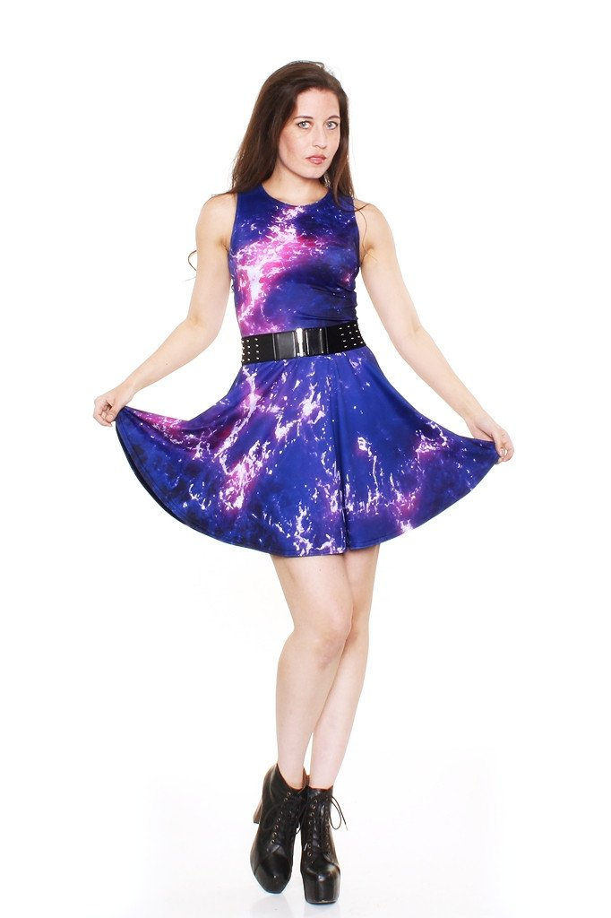
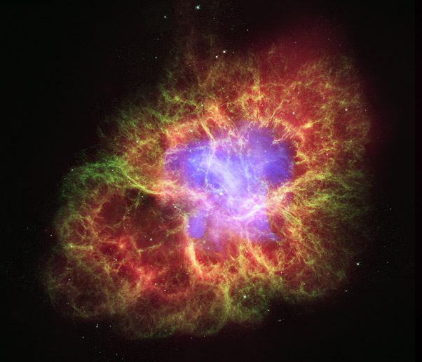
Crab Nebula
Results on Crab Nebula make astrophysics more
popular and fashionable in our society, the best proof
is shown below
Crab A-line dress
only $79.00

Slide 28
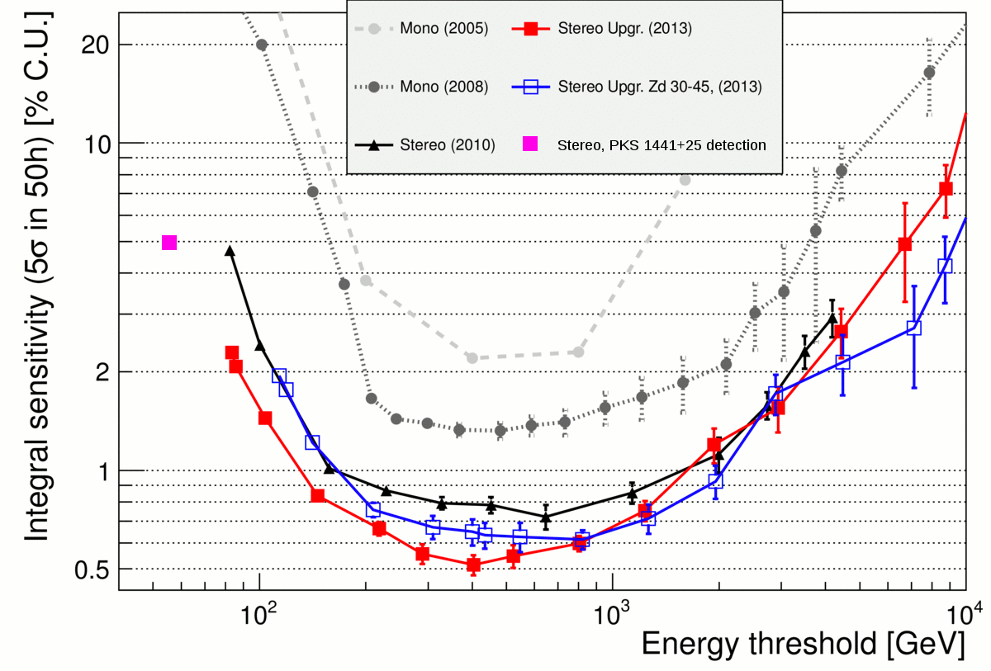
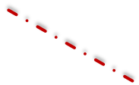
Significant Improvements of Sensitivity of MAGIC at Lowest and Highest Energies Due to Novel Sum-Trigger-II & VLZA Observations

Slide 29
Studying the Chemical Composition of Cosmic Rays at PeV Energies; Measuring Cherenkov Light Almost From Horizon
In the following we will show a couple of slides about an
experimental possibility to study the chemical composition of
cosmic rays at PeV energies
The suggested method is based on IACT observations of
Cherenkov light of the so-called µ-tail from air showers at the
presence of electromagnetic part of an air shower
Although a single µ from a very large impact parameter
cannot produce a measurable signal in a telescope, overlay of ~10⁵
or more µ’s can do produce a characteristic picture
The described before calibration methods can be successfully
applied also in this type of measurements

Slide 30
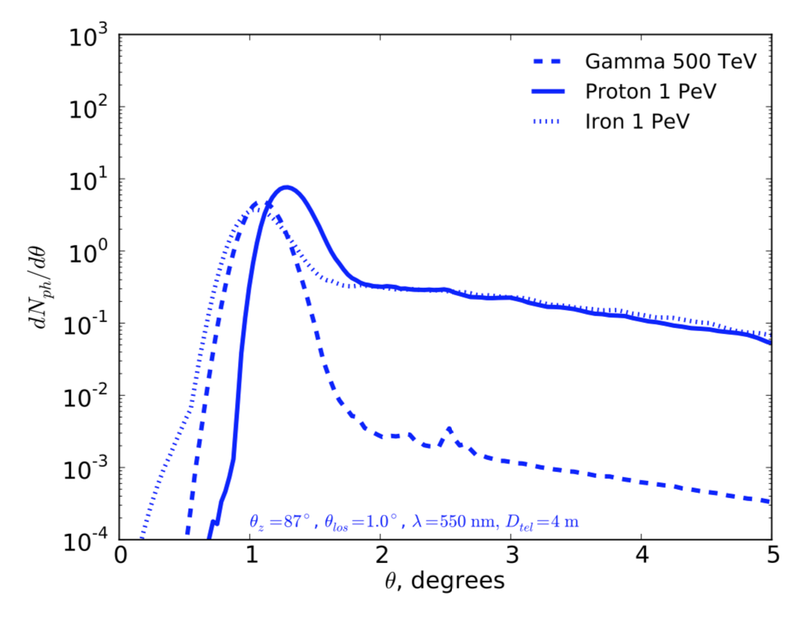
Primary particle ID with IACT
PeV proton-induced shower incident at 87º zenith angle
Neronov et al. ‘16
Muon component is largely sub-dominant in the shower maximum region.
It starts to dominate at large depth in the atmosphere.
μ
e

Slide 31
Primary particle ID with IACT
3 km impact 6 km
Neronov et al. ‘16
gamma
µ component is largely sub-dominant in the shower maximum region.
It starts to dominate at large depth in the atmosphere.
proton
µ “tail” or “halo” has different appearance in strongly inclined EAS initiated by different particles
iron

Slide 32
MAGIC Observations During the Next Years
MAGIC is in its best ever historical sensitivity and in a best
shape, also due to two recent novelties, just commissioned and
included into MAGIC operation
The project got a “second wind”, by significantly increasing its
sensitivity and the dynamic range at the lowest energies, down to
~30 GeV (and even below) (SUM-Trigger-II) and at the highest
energies ≥ 100 TeV (VLZA observations)
We have set up a VLZA observational program for a number of
selected candidate PeVatron sources; first results will follow soon
One can observe at VLZA the relatively nearby AGNs for assessing
the highest energies emitted by them – these can provide an
important input about sources and about EBL
Test observations are underway for studying the potential of near
horizon observations of air showers for chemical composition

Slide 33
Back-up slides

Slide 34
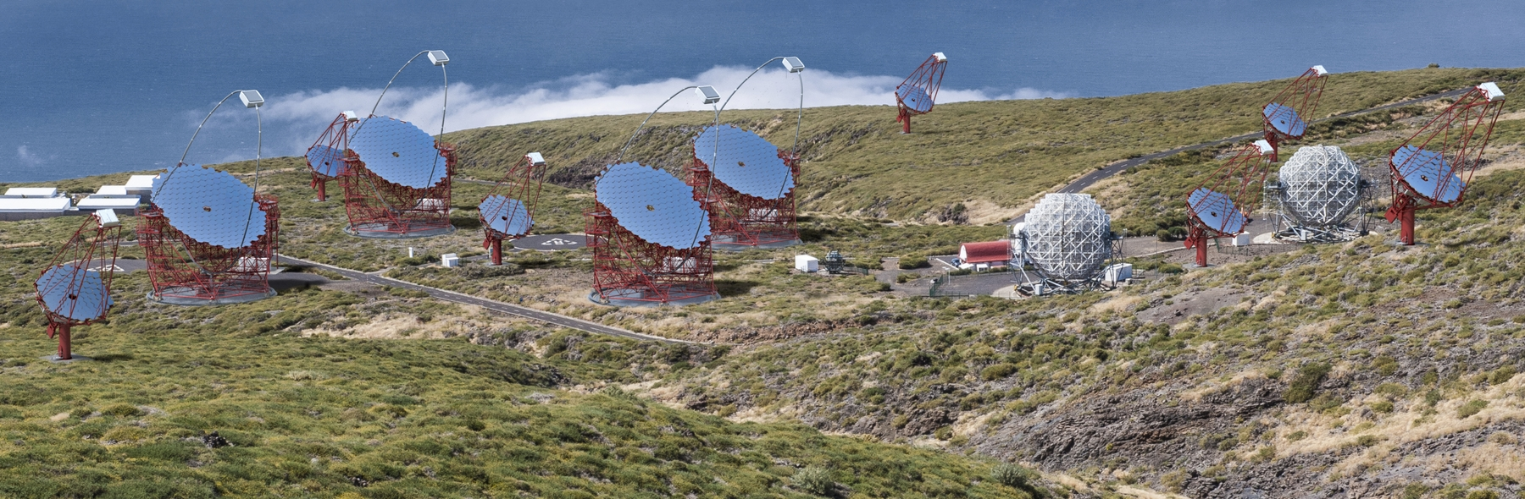
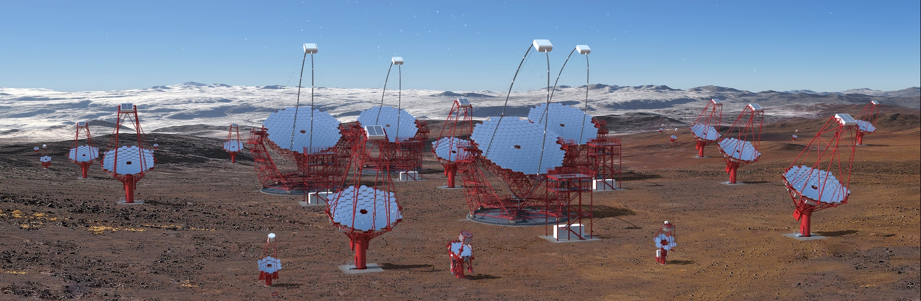
CTA North (top) and South (bottom) Observatories

