Slide 1
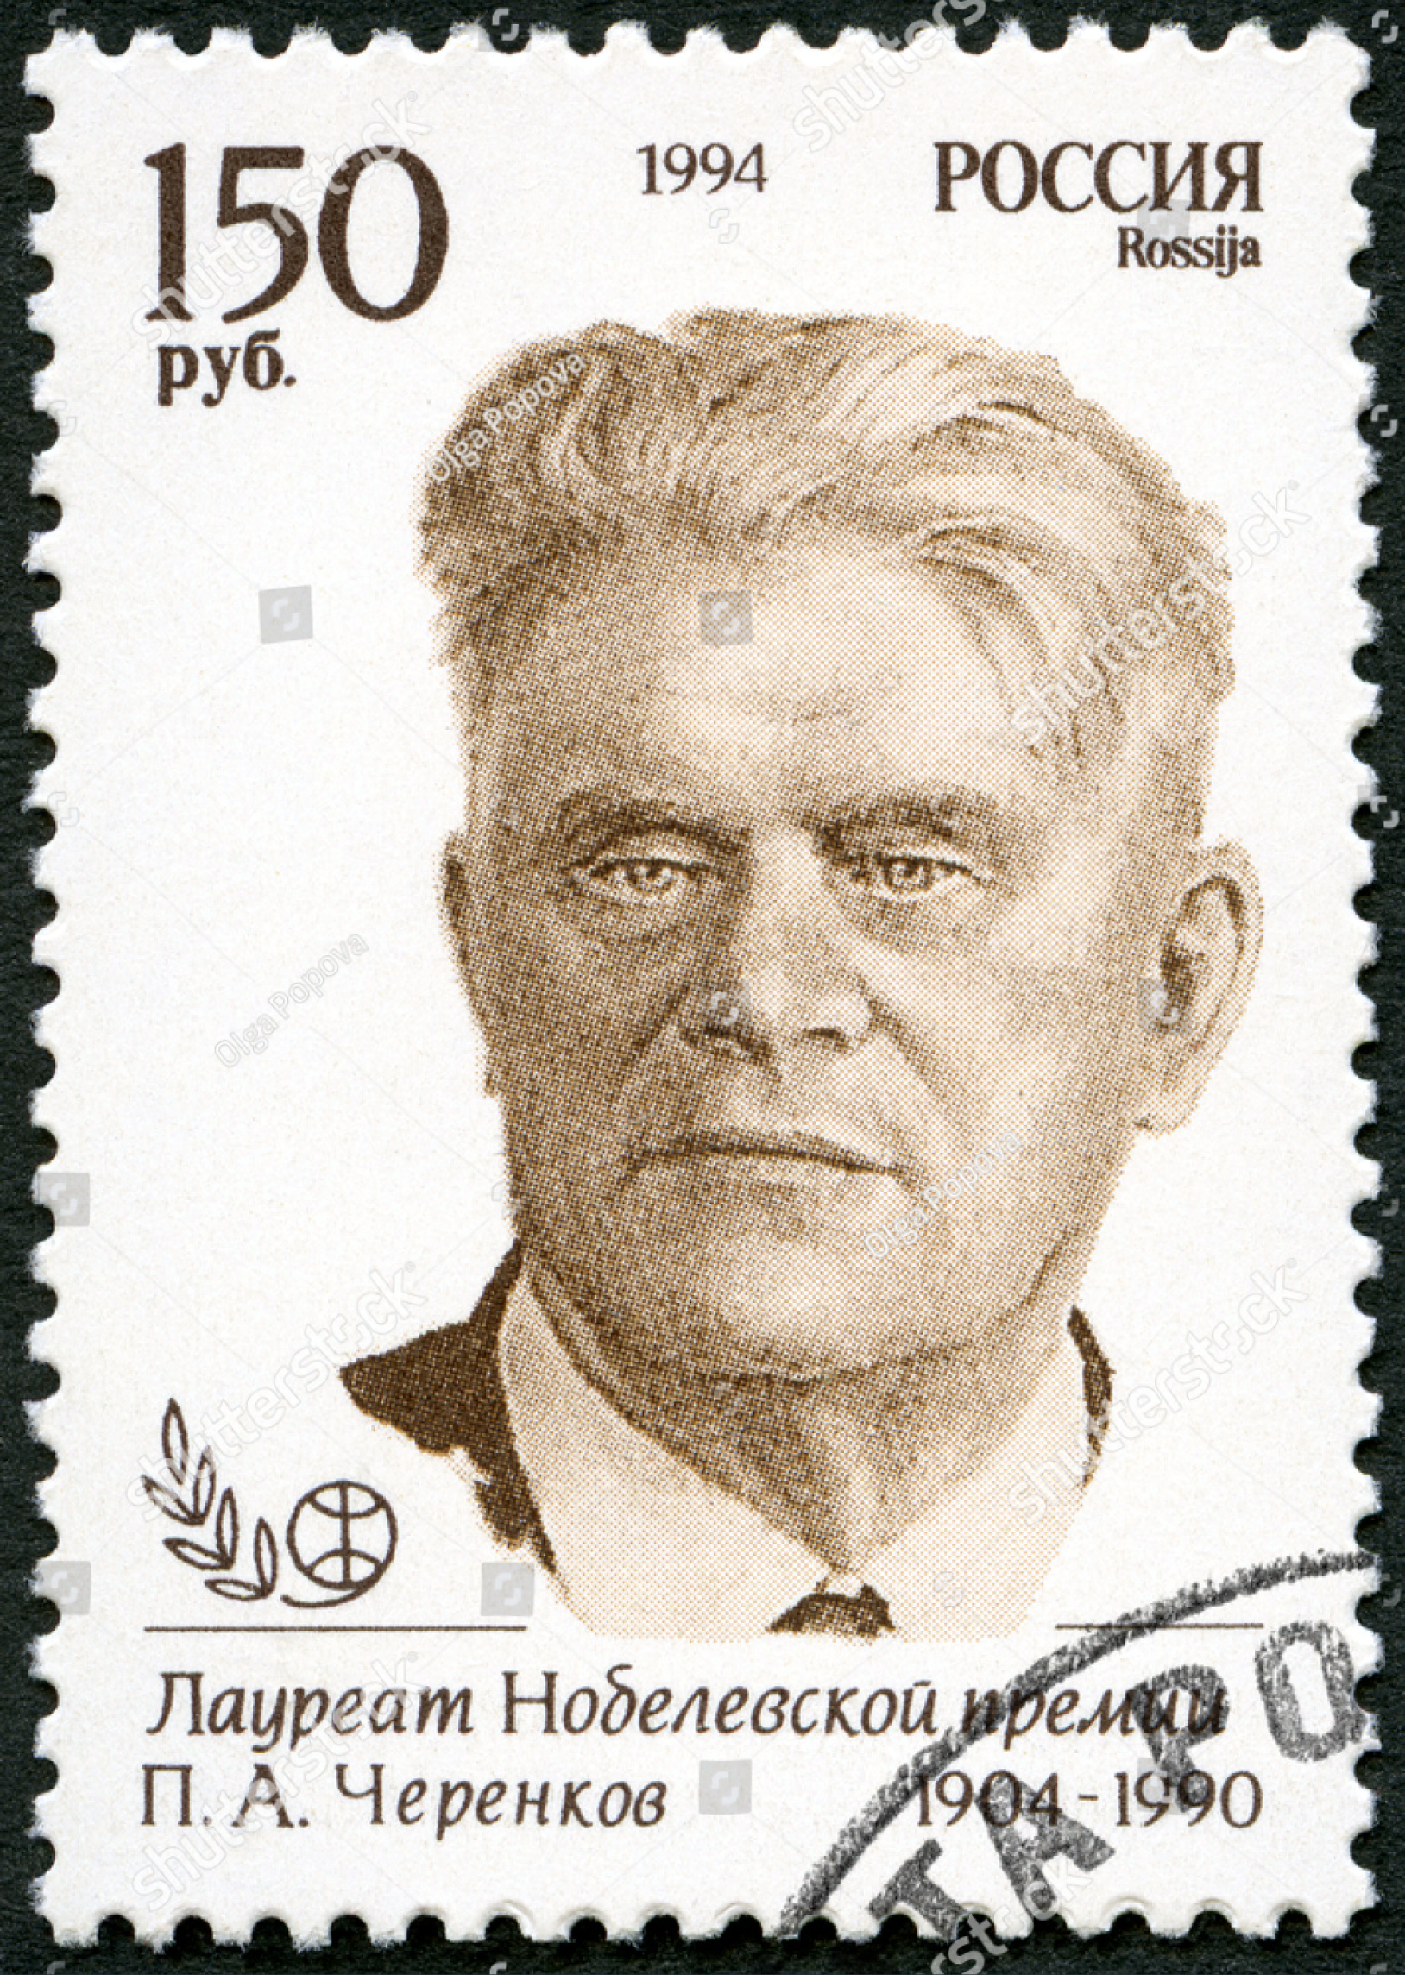
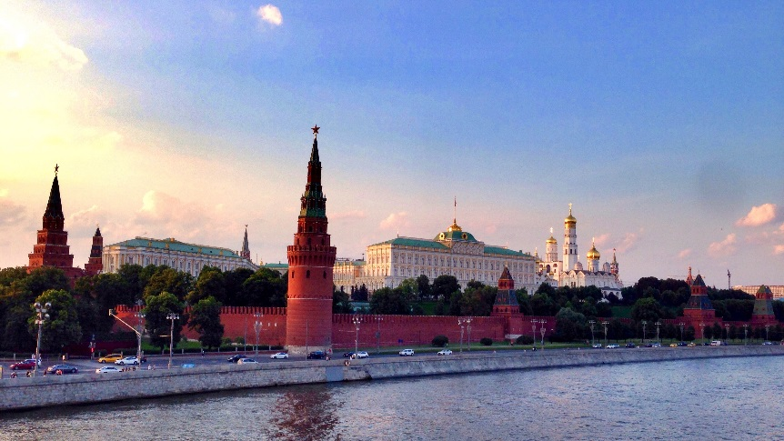

Photonic crystals as novel radiators
RICH 2018 conference
Moscow, Russia
On behalf of: S.Easo, X.Lin, I.Kaminer, M.Blago et.al.
Sajan Easo
04-08-2018

Slide 2
Outline
Limitations of conventional radiators
Photon production and propagation from photonic crystals
Example configurations for particle identification
Issues for design and optimization
Testing with prototypes

Slide 3
Some limitations of conventional radiators
For identification of particles with momenta in GeV/c range:
Dearth of materials to cover the full momentum range 1-10 GeV/c
Above 10 GeV/c, long gas radiators are used (n ~ 1.0013 or lower); thin radiators are desirable
Electron-pion discrimination difficult for momenta above a few GeV/c
limited set includes Quartz (n~1.47) , aerogel (n~1.03)
Dielectric materials with n > ~ 1.8 not suitable:
Saturated Cherenkov angles for most of the momentum range
Photon trapped inside due to total internal reflection at the boundary with ambient air/gas
Exception: DIRC like configuration for limited momentum region

Slide 4
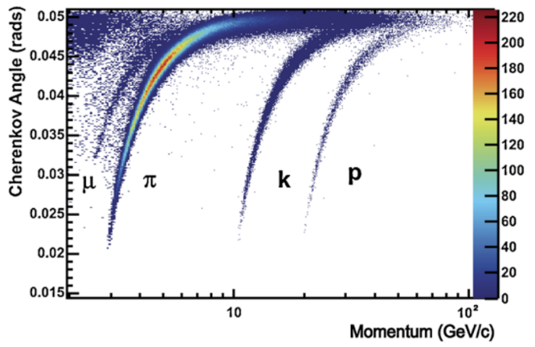
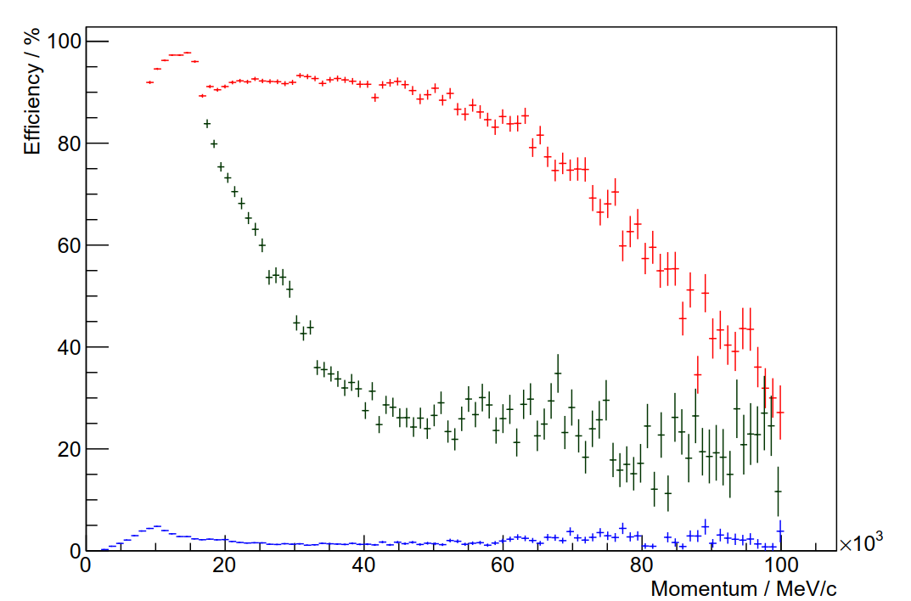
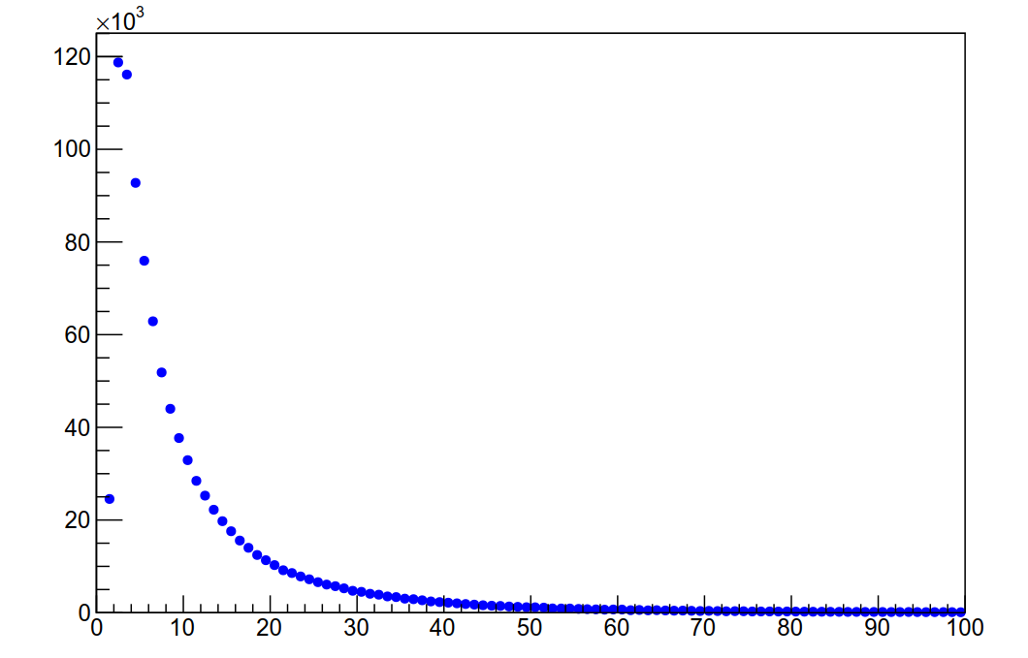
Radiator limitation in LHCb
Real data
C₄F₁₀
Large number of particles in low momentum range
Example of PID performance
Particle momentum
Red: Kaon efficiency
Blue: Pion misID
Dark Green: Proton misID
GeV/c
For now, using ‘veto mode’ for PID in low momentum
Aerogel was used in RUN1 , but was removed in 2015
Illustration using LHCb upgrade configuration
Thresholds in C₄F₁₀
Kaon : 9.3 GeV/c Proton : 17.8 GeV/c

Slide 5
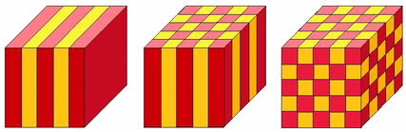
Radiator R&D
One approach:
Assemble materials to produce the desired ‘effective refractive index’
Requires designing photonic crystals from transparent dielectrics
Photonic Crystals :
1d 2d 3d
Typically made from two materials with different refractive indices, in alternating layers.
The magnitude of layer thickness is similar to that of the photon wavelengths.
Production of layers as thin as optical wavelengths, feasible in recent years.
This creates the current interest in using the crystals, as radiators
This presentation:
Concept and prospects for this approach

Slide 6
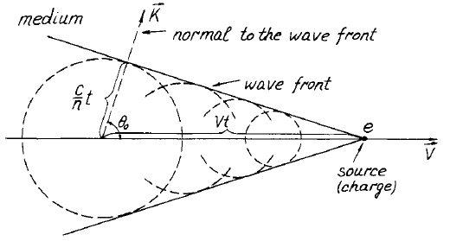
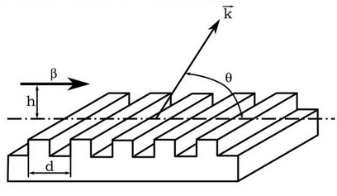
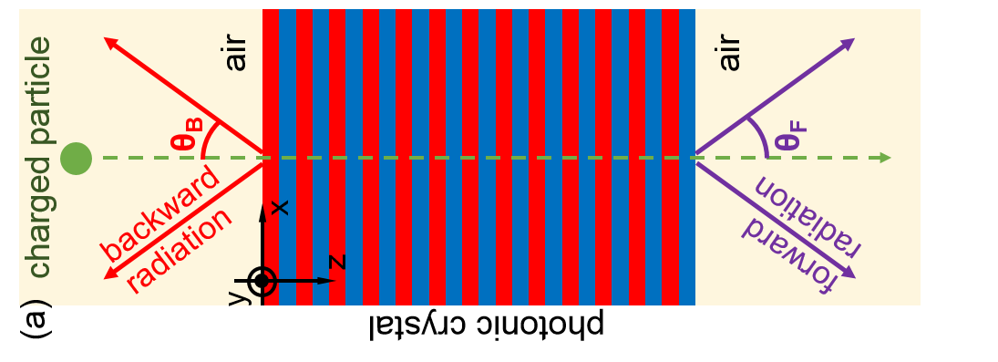
Photon Production
Conventional Cherenkov Radiation:
Smith-Purcell Radiation :
Frank and Tamm theory
Particle travels near a diffraction grating
Resonance Transition Radiation :
Has the features of conventional Cherenkov radiation
forward
radiation
1d photonic crystal

Slide 7

Photon production from photonic crystal
Photon production and propagation in a periodic structure can be determined from solving Maxwell’s equations.
This extends the Ginzburg and Frank theory on transition radiation.
This results in a linear equation:
To be solved using boundary conditions.
Solution: Particle generates Bloch modes of the crystal which have the form:
For a particle traversing a 1d photonic crystal along z :
Periodicity leads to coherent interference of electromagnetic waves in the air, from the various interfaces
Constructive interference : Resonance Transition Radiation
Components of the wave vector for the modes
which transmit into air : ,
Here θ = effective Cherenkov angle at exit from crystal into air
forward
radiation
1d photonic crystal

Slide 8
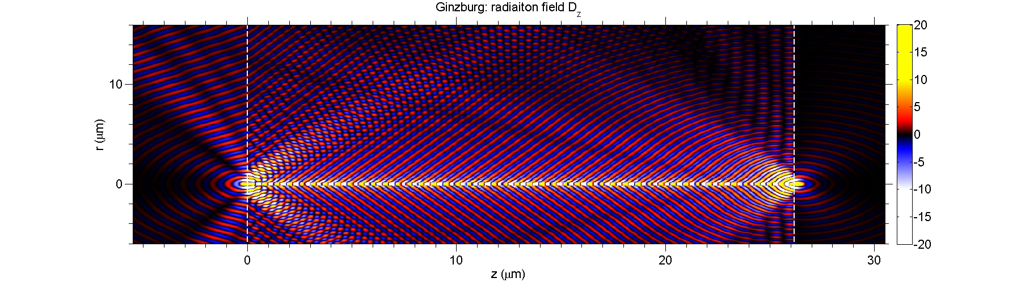
Resonance Transition Radiation
From the solution, the energy radiated into air can be determined
Involves integrating over angular spectral energy density,
which is the distribution of radiation as a function of (ω, θ).
In this context, Poynting vector:
air
0
Typically use ε_{r1}, ε_{r2} >>1. Hence conventional Cherenkov radiation
gets trapped inside due to total internal reflection :
$$\overline{S}$$
10
photonic crystal
$${\overline{v}}_{p}$$
Solutions for the 1d system are described in a recent paper:
z (μm)
“Controlling Cherenkov angles with resonance transition radiation”,
X.Lin, S.Easo, Y.Shen, H.Chen, B.Zhang,J.D.Joannopoulos,M.Soljacic,I.Kaminer ,
Nature Physics 14, 816-821 (2018)
also https://doi.org/10.1038/S41567-018-0138-4
20
Example of radiation field from
Resonance transition radiation
air
Some inferences from this paper, in the following pages
30
β=0.5
0
x (μm)
10

Slide 9
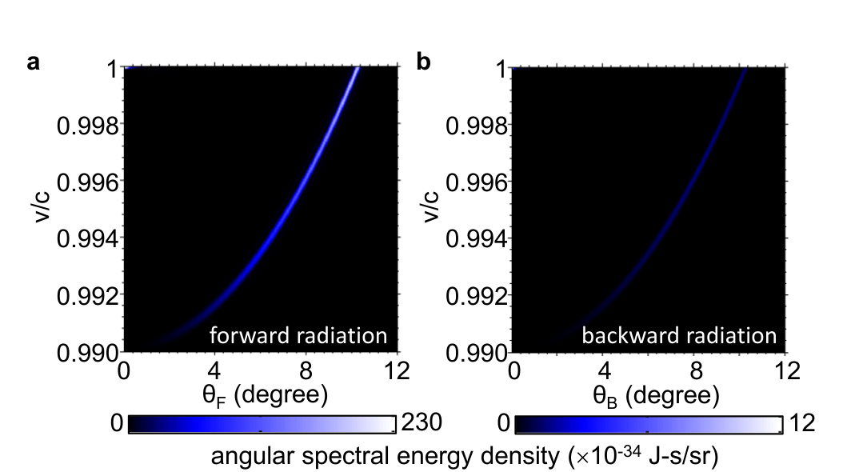
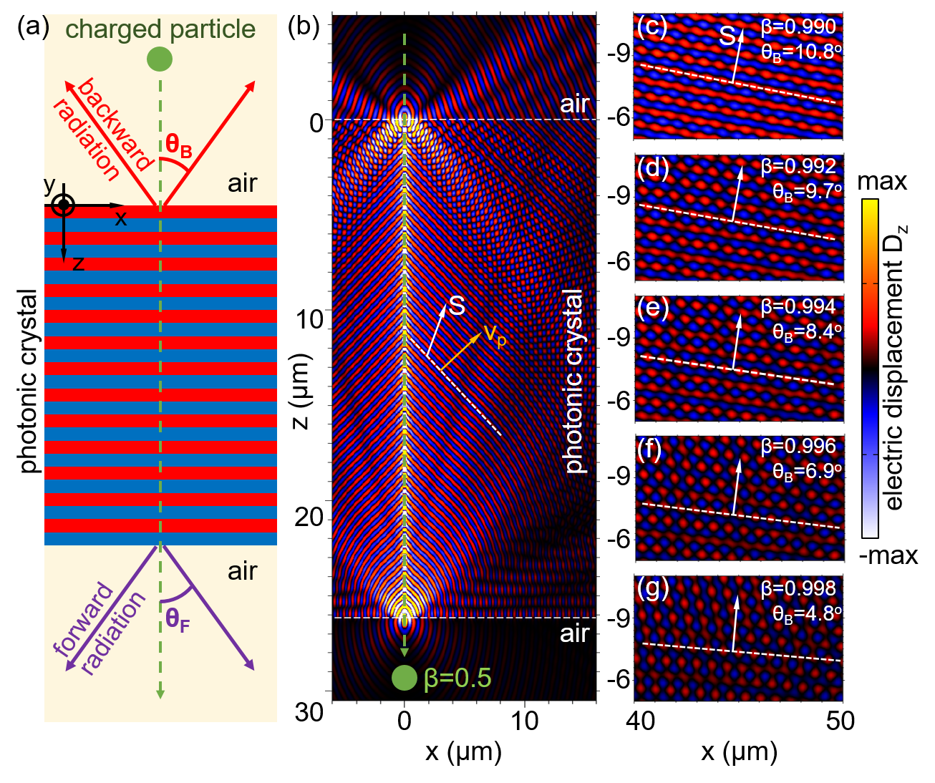
Forward configuration : example
β=
β=
Constructive interference in the forward radiation: strong signal
Destructive interference in the backward radiation: weak signal
Forward:
Example configuration 1:
Overall thickness = 2 mm, ε₁ = 10.6 (GaP), ε₂=2.1 (SiO2)
Forward setup: 2800 periods with (214.3 nm+ 500nm)

Slide 10
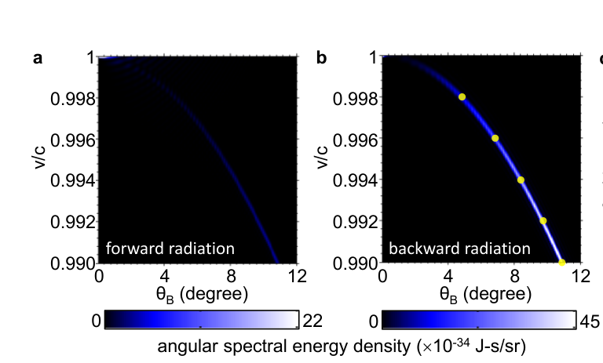
Backward configuration: example
β=
β=
Destructive interference in the forward radiation: weak signal
Constructive interference in the backward radiation: strong signal
Backward:
Example configuration 2:
Overall thickness = 2 mm, ε₁ = 10.6 (GaP), ε₂=2.1 (SiO2)
Backward setup: 10200 periods with (117.3 nm+ 78.1nm)

Slide 11
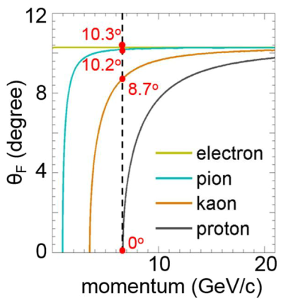
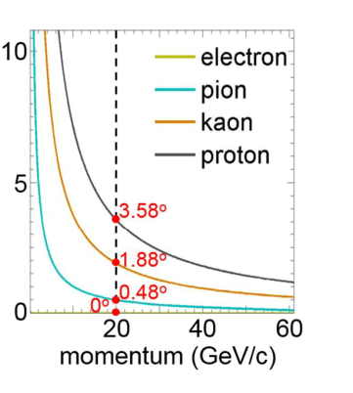
Results from different particle types
Forward configuration example
Backward configuration example
θ_{B} (degree)
The features are similar to those of conventional Cherenkov radiation
Can be configured for different momentum ranges

Slide 12
Another option
Existence of negative index of refraction, first proposed by Victor Veselago in 1968.
Meta materials:
Proposal to use meta materials as radiators for Cherenkov detectors :
“Controlling Cherenkov radiation with transformation-optical metamaterials”
Ginis V. , Danckaet J, Veretennicoff I., Tassin P. Phys. Rev. Lett. 113, 167402 (2014).
The meta materials suggested for this are made from highly anisotropic materials.
Effective refractive index near 1.0 along one axis and large values along other axes.
This leads to “photon loss” at optical frequencies and thus the Cherenkov signal is significantly reduced.
Hence, for now, the option to use meta materials is not pursued.
On the other hand, photonic crystals are made from ‘almost’ transparent dielectric materials and
hence the photon loss is minimal. So this option is pursued.
Experimentally verified in 1999-2000, and gave rise to the creation of meta materials
Layer thickness smaller than the wavelengths considered
Particles ‘see’ an ‘effective medium’ instead of the atoms
Normally made from resonant structure of metallic wires or nanomaterials
They can also have positive refractive index.
more info :
Backup pages,
paper listed on page 8

Slide 13
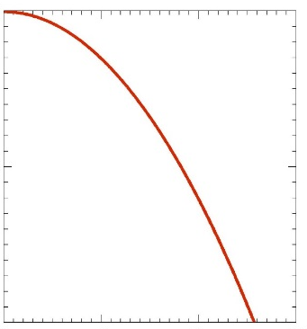
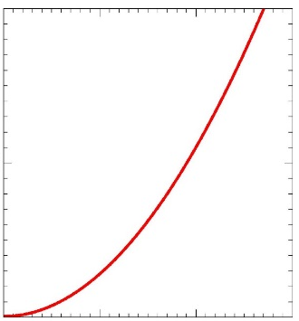


Designing photonic crystals
Normally a crystal may be designed for a specific momentum range of particles
It is envisaged to be used in forward or backward configuration, in a given momentum range
In principle, a crystal can even be designed for forward/backward in different momentum ranges
Forward configuration
Backward configuration
1.01
1.01
1.005
k_{z}/(ω/c) = c/v
k_{z}/(ω/c) = c/v
1.005
1
1
0
4
8
12
0
4
8
12
arcsin(k_{ρ}/(ω/c)) (degree)
arcsin(k_{ρ}/(ω/c)) (degree)
For any design:
Find materials with the appropriate refractive indices
Optimize the layer thickness, number of layers etc.
Optimize for optical/near-UV frequencies where the photon detectors are sensitive
In general, numerical solutions needed using software frameworks:
FDTD (Finite Difference Time Domain)
COMSOL
Proprietary software:
Analytical solution for 1d system
Allows simulation and design of 1d photonic crystals

Slide 14
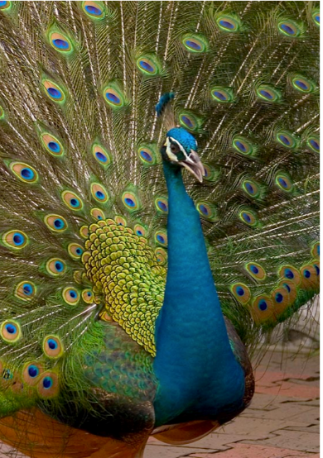

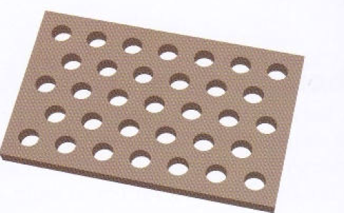
Theory to Practice
Production:
1d crystals:
2d crystals:
Crystals need to be designed and produced
This requires R&D
Can be produced in large scales
Use techniques like optical lithography, 3d printing
Some of these can attain
single nanometer precision in layer thickness
Using some type of polymers, also seems to be an option for large areas
Only produced in small scales so far.
Typically a periodic array of holes. They can be made thinner than 1d crystals
Phys. Rev. E 72, 010902(2005)
Examples of natural photonic crystals
Zhurin et.al., J.Vac. Sci.Tech. A 18 , 37-41 (2000)
Ponting. M. et.al., Macromol. Symp. 294-I , 19-32(2010)

Slide 15
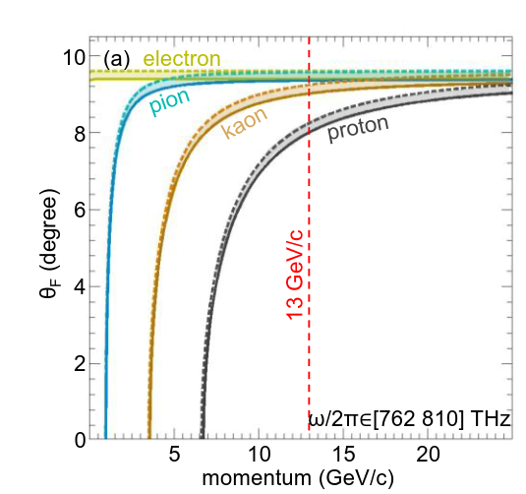
Theory to Practice
Issues in optimizing a design:
Ensure radiation hardness:
Periodicity can cause chromatic error, depending on the configuration
Many options to mitigate this effect.
Improving photon yield:
Use materials with anisotropy, which can directly compensate
for the achromaticity from periodicity
Use filters to use only a small wavelength range
Increase the number of layers
Upper limit from limitations of manufacturing and material budget
Use gain materials, which can increase the yield in a small wavelength range
There are many low Z materials to create the crystals from. (SiC, SiO₂ etc.)
They would need to be tested for radiation hardness
Example of optimization

Slide 16
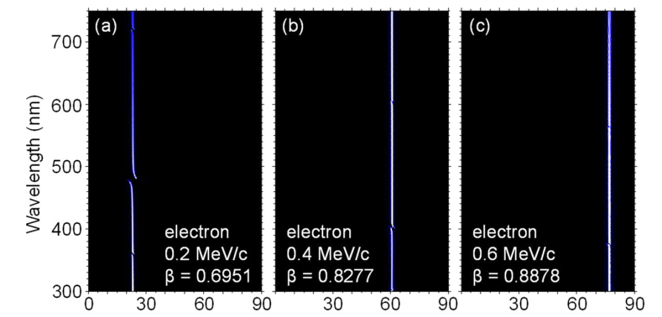
Testing Prototypes
Prediction from simulations
Goal: To verify the predictions from simulations
R&D work in early stages
Few 1d samples obtained from industry
Example used here:
Photon energy density
PVDF (n1=1.414) + PET (n2=1.567)
1024 layers, each with 250 nm thickness
This sample has negligible chromatic error
Sensitive to low momentum particles
from a radio active source
Wavelength vs forward Cherenkov angle

Slide 17
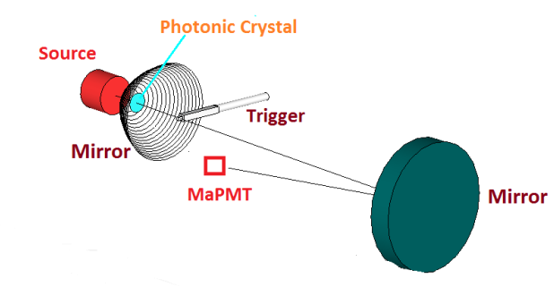
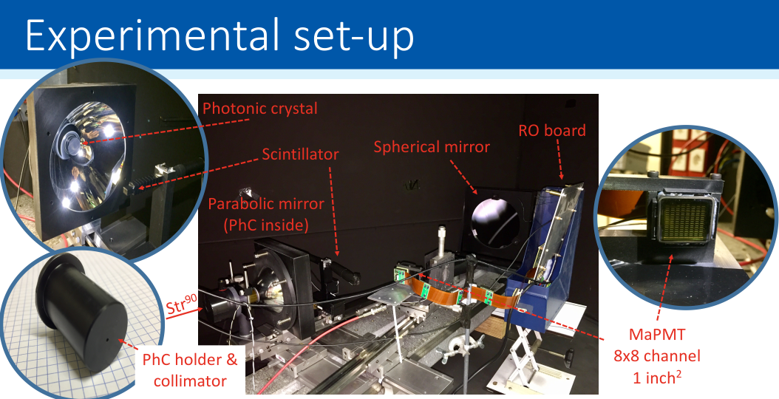
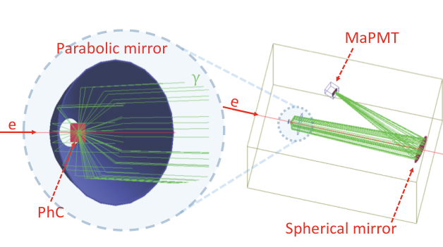
Testing Prototypes
With support from D.Piedigrossi, S.Jakobsen , F.Cindolo et.al.
Using Sr-90 source to produce electrons
DAQ : MaPMT with MAROC2+FPGA

Slide 18
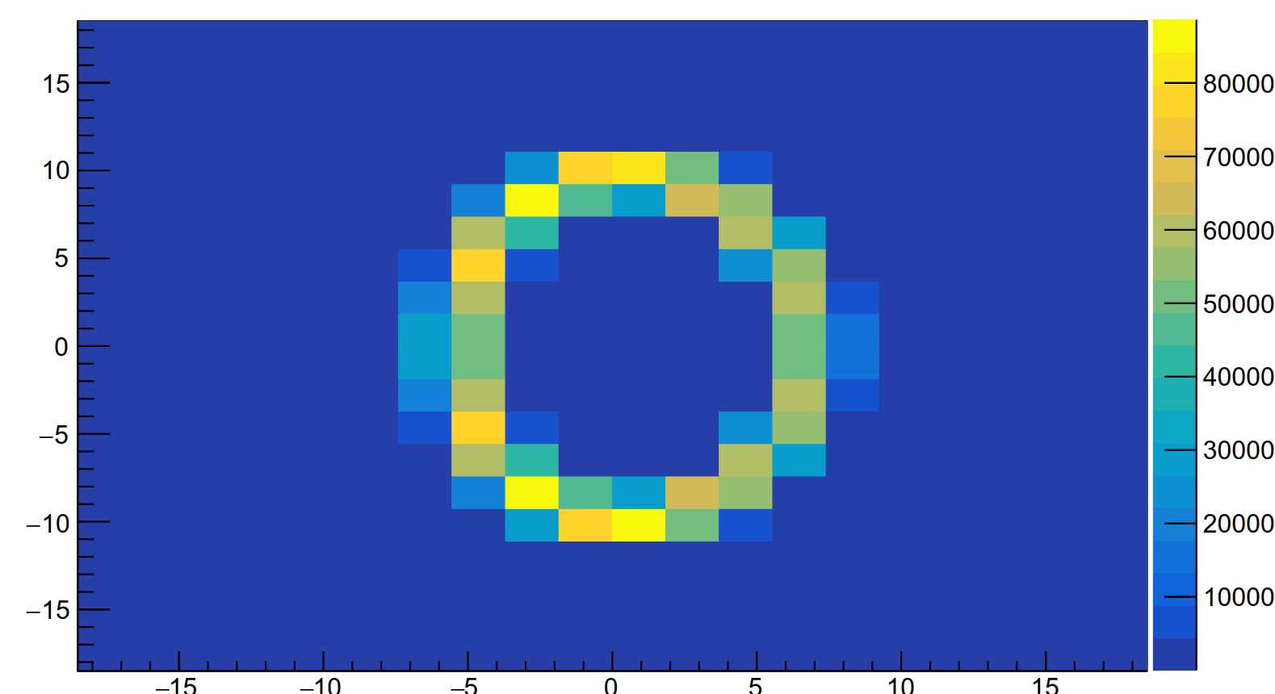
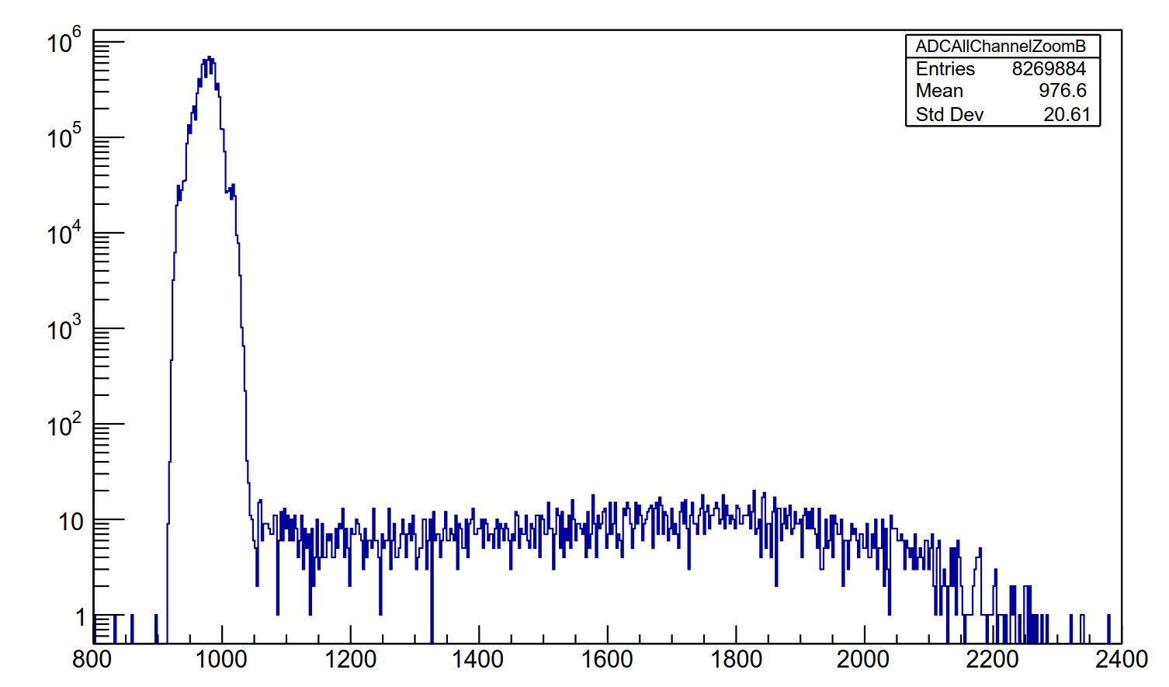
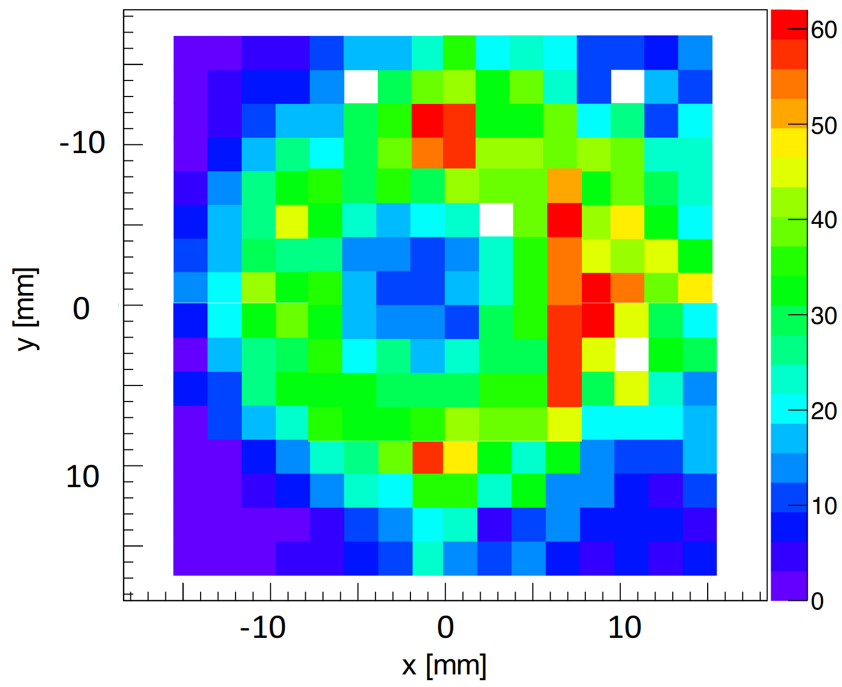
Testing Prototypes
Simulation: Hits on detector plane
Real data
ADC distribution
Optics simulation:
0.5 MeV/c electron
pedestal
signal
Preliminary
Threshold
Real data
Hits on MaPMT
Electron momenta
0.2 – 0.7 MeV/c
creating a thick ring
Further R&D in progress to improve this
Plan to test more prototypes

Slide 19
Summary
It would be desirable to develop radiators which can overcome the limitations of
conventional radiators
Using photonic crystals made from transparent materials is a potential option for this
The concept for usage of such crystals for particle identification is described
Issues related to optimizing a design, are being considered
Tests with prototypes have started

Slide 20
Backup slides

Slide 21
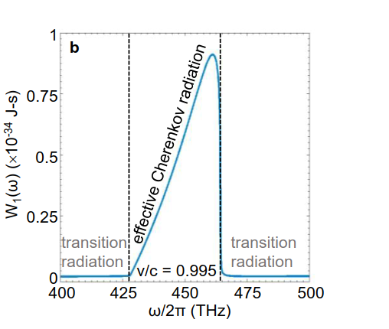
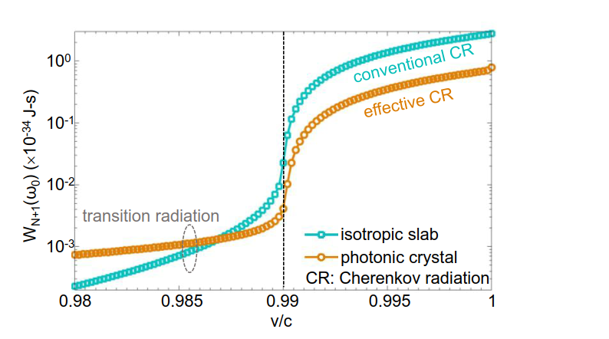
Comparison between different radiations
From a photonic crystal:
Constructive interference:
Destructive interference:
Resonance transition radiation occurs
“Effective Cherenkov radiation” since it has
the features of conventional Cherenkov radiation
Has a threshold for particle velocity
Conventional transition-like radiation occurs
Has no threshold for particle velocity
Example of radiation
spectrum
from a photonic crystal.
Example of radiation spectra
from a photonic crystal
and isotropic slab
Isotropic medium:
Conventional Cherenkov and transition
radiation occurs

Slide 22
Meta materials: Particle Identification
PRL 113, 167402 (2014)
LHCb RICH1 EDR: LHCb-2004-121
Sensitivity= θ _{eletron} – θ _{proton}
Transformation optics:
Longitudinal stretching=F=1.005 : Shift curves to right
Transverse stretching = G=10 : Increase θ

