Slide 1
P.A. Cherenkov in the mirror of world science
Yu.A. Bashmakov
P.N.Lebedev Physical Institute, Russian Academy of
Sciences
National Research Nuclear University ‘MEPhI’
Moscow 2018

Slide 2
Chronology
Basic stages of scientific activity
The entire scientific career of P.A.Cherenkov was held in FIAN (LPI).
1930 - admission to preparatory courses for graduate school of FIAN (LPI)
- Leningrad.
1932 - admission to graduate school of FIAN to SI Vavilov.
1934 - the first observation of the effect by the eye.
1937 - the opening of a sharp radiation direction - photo.
1940 - doctoral dissertation defense.

Slide 3
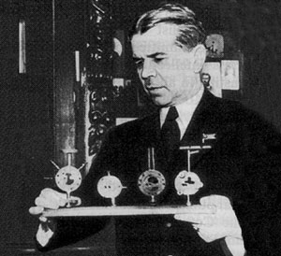
In 1932 P A Cherenkov became a postgraduate research student under the guidance of S I Vavilov at the Steklov Institute of Physics and Mathematics. At the time the institute was located in Leningrad.
S.I. Vavilov with optical instruments used by
P.N. Lebedev (photo: CERN Courier, Vol.44, No. 9, P.39, 2004)

Slide 4
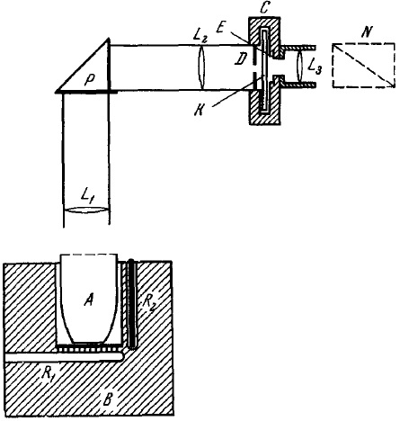
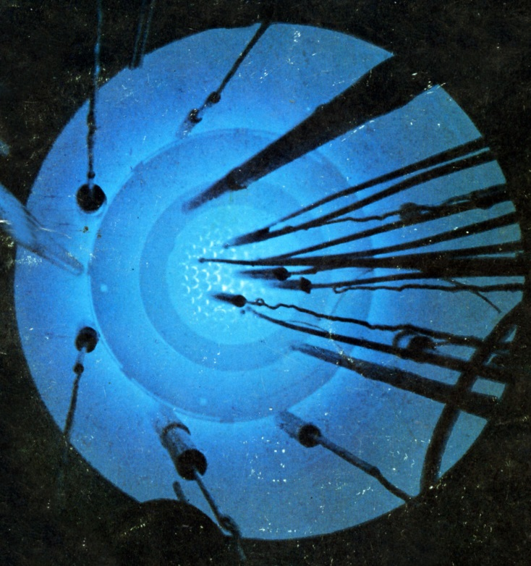
THE DISCOVERY of THE EFFECT
PA Cherenkov Visible emission of clean liquids by action of γ - radiation
- Doklady Akademii Nauk SSSR, 1934 Т. 2. - №. 8. - P. 451
Для всех чистых жидкостей свечение сосредоточено в сине-фиолетовой части спектра
Свечение оказалось частично поляризованным, причём преимущественная плоскость электрического вектора параллельна направлению γ лучей
Glow of water in the research reactor TRIGA.
Physics and Mathematics Institute of the Academy of Sciences. V.A. Steklov, Leningrad

Slide 5
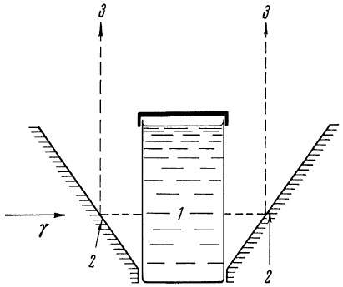
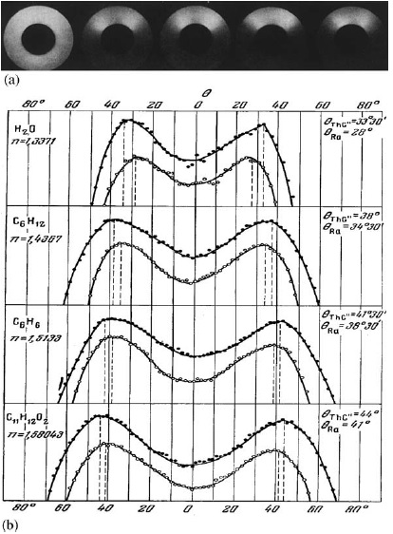
INVESTIGATION OF the RADIATION DIRECTIVITY
P.A. Cherenkov
Visible Radiation Produced by Electrons Moving in a Medium with Velocities Exceeding that of Light
Phys. Rev. 52 (1937) 378.

Slide 6
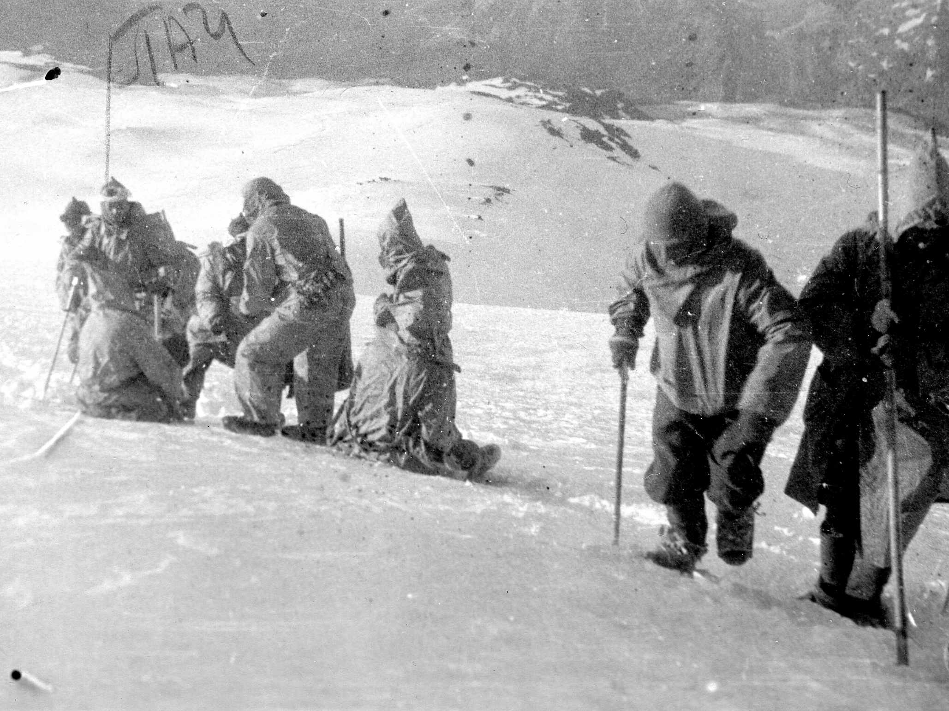
Beginning of high-energy physics in cosmic rays
Difficult way to the top

Slide 7
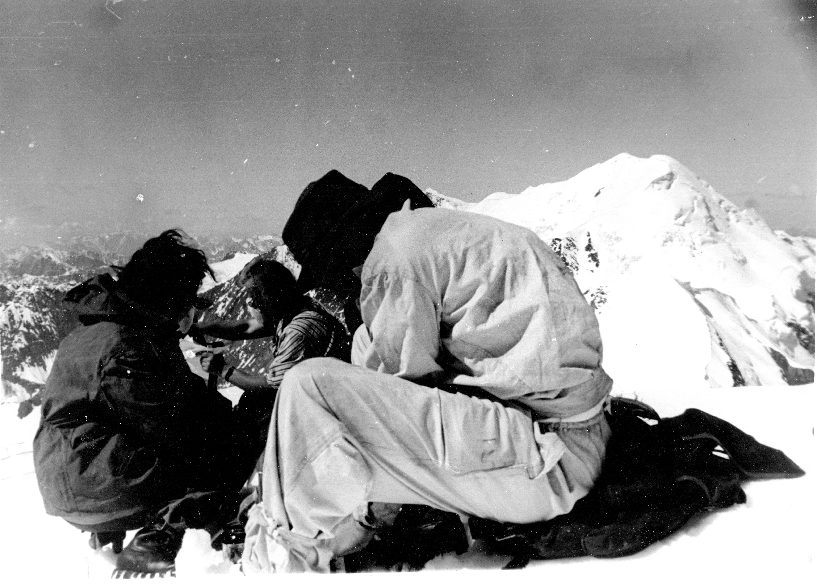
Trudy Elbrusskoi Ekspeditsii AN SSSR and VIEM (1934 and 1935) Sciences Publishers :
(
Trudy Elbrusskoi Ekspeditsii AN SSSR and VIEM (1934 and 1935)
NA Dobrotin, IM Frank, PA Cherenkov - 1936 - Acad. of Sciences Publishers :

Slide 8
A new era: the development, construction and operation of high-energy electron accelerators
1947 and later on development of the first electron synchrotrons in conjunction with VI Veksler and others.
1947 and later on professor MEPHI, participation in the VAK.
1956 - observation, investigation of synchrotron radiation on the synchrotron on 280 MeV with Yu.M. Ado.
1958 - awarding the Nobel Prize in Physics with IE Tamm and
I.M.Frank.

Slide 9
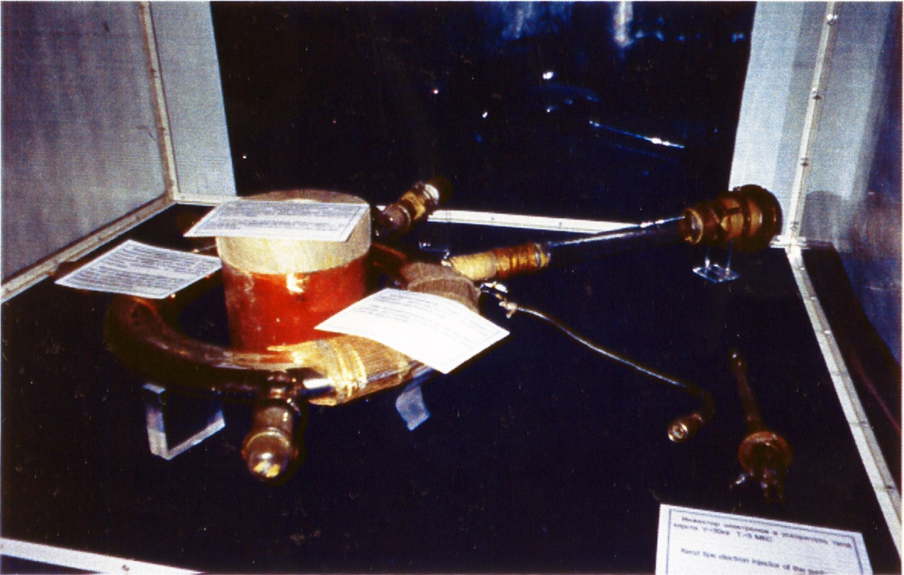
The discovery by V.Veksler in 1944 of the principle of phase stability and
construction of the first domestic synchrotrons.
Elements of the design of the synchrotron for 30 MeV <Pitomnik>

Slide 10
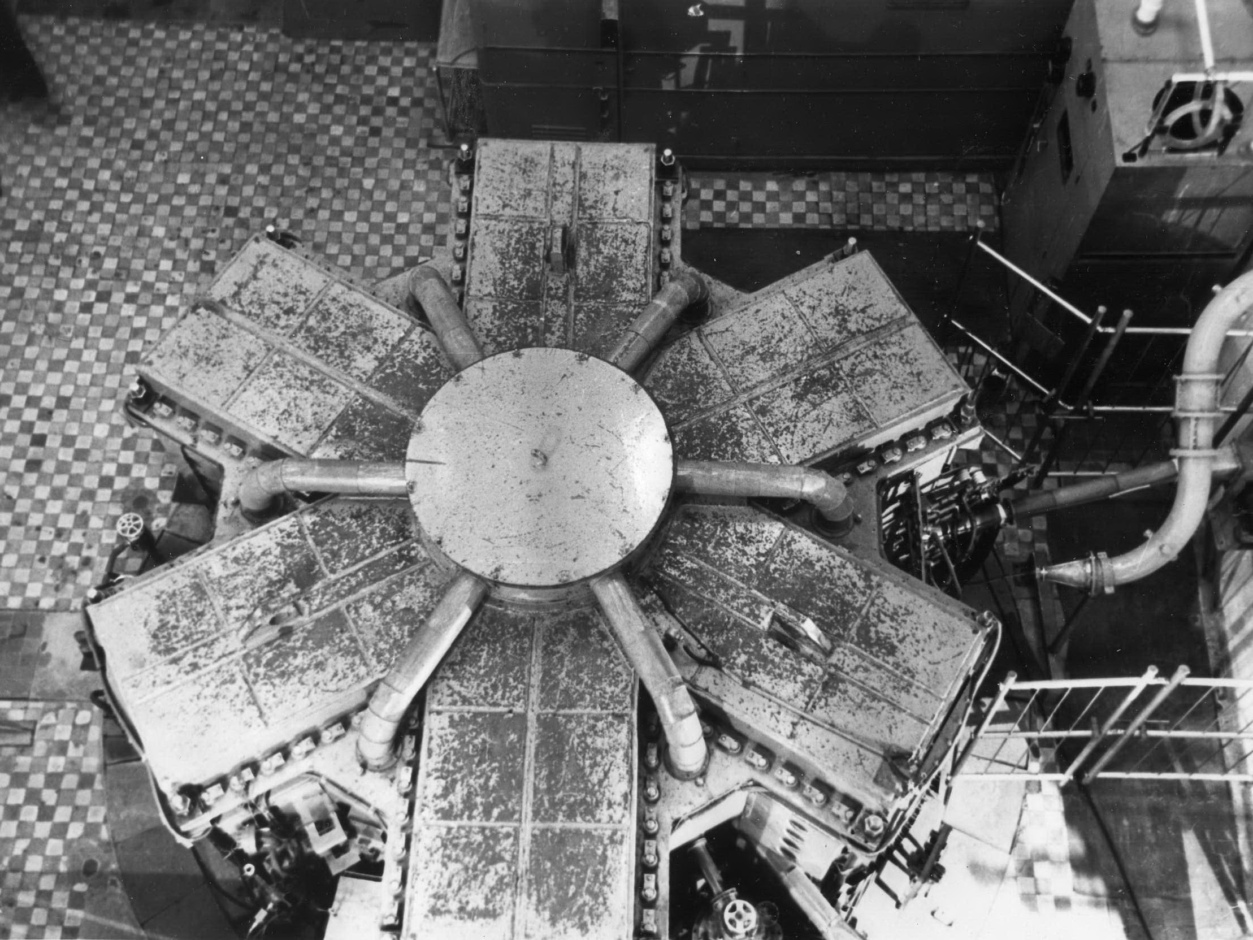
Electron synchrotron of FIAN on energy 280 MeV
The magnetic structure of the synchrotron, over view.

Slide 11
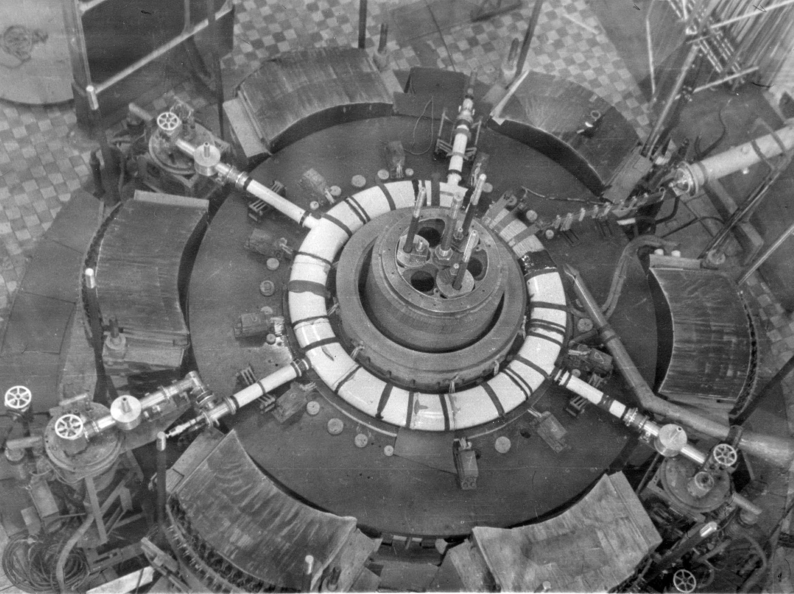
Electron synchrotron of FIAN on energy 280 MeV
Synchrotron weakly focusing, with axially symmetric magnetic field.
The radius of the circular orbit is about 1 m. Clearly visible is a porcelain vacuum chamber with suction pipes.

Slide 12
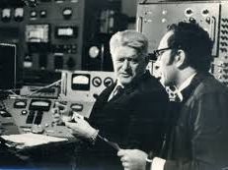
Electron synchrotron of FIAN on energy 280 MeV
For the first time, the external injection of electrons from the microtron was used.
Control room

Slide 13
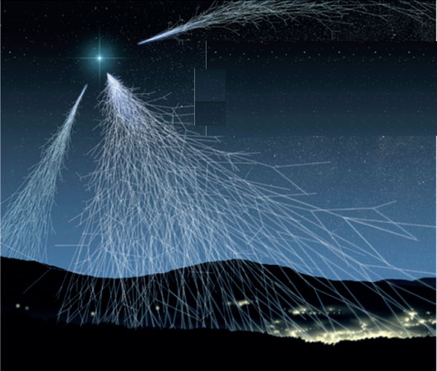
Recognition of merit
Observation of Cherenkov radiation from cosmic rays passing through
atmosphere (1952)

Slide 14
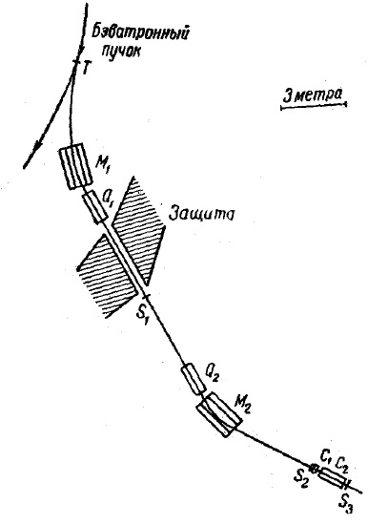
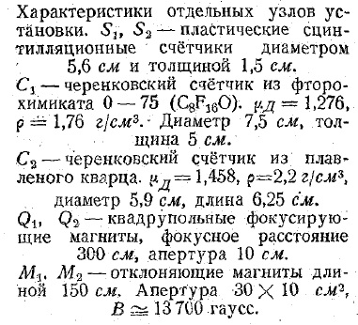
Discovery of the antiproton (Bevatron, 1955). The experimental scheme.
Observation of Anti-protons
O. Chamberlain, E. Segre, C. Wiegand, T. Ypsilantis (UC, Berkeley & LBL, Berkeley). Nov 1955. 4 pp.
Published in Phys.Rev. 100 (1955) 947-950

Slide 15
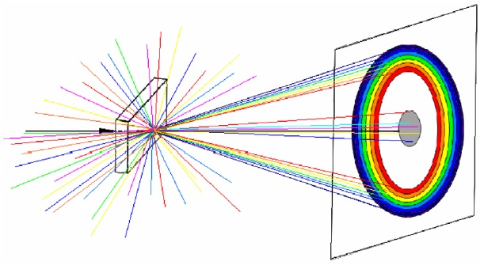
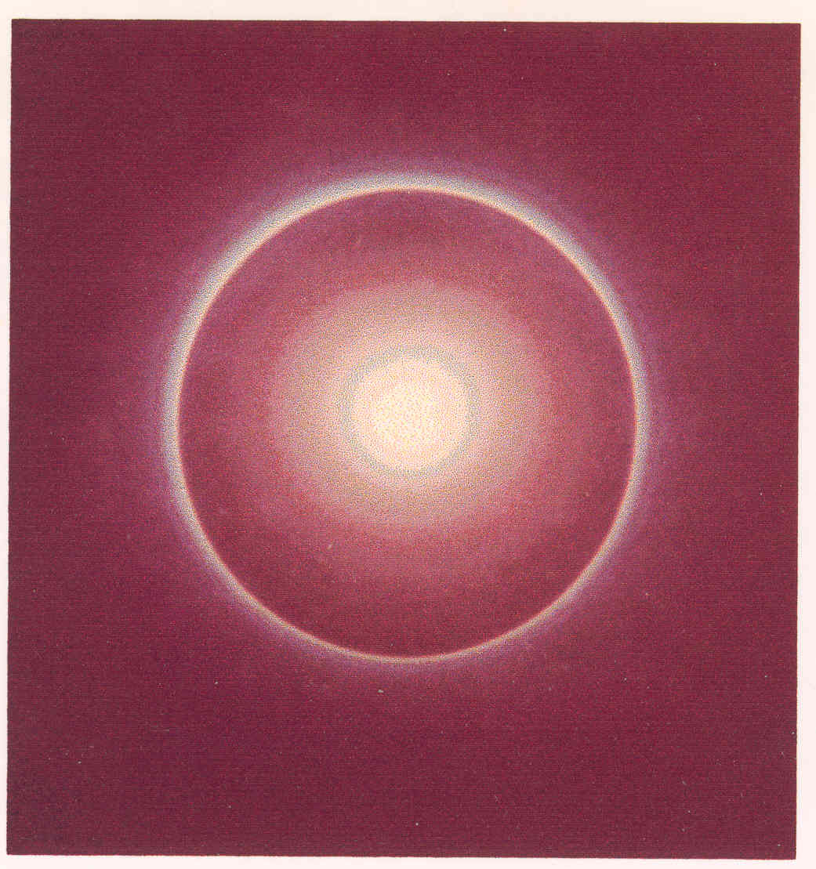
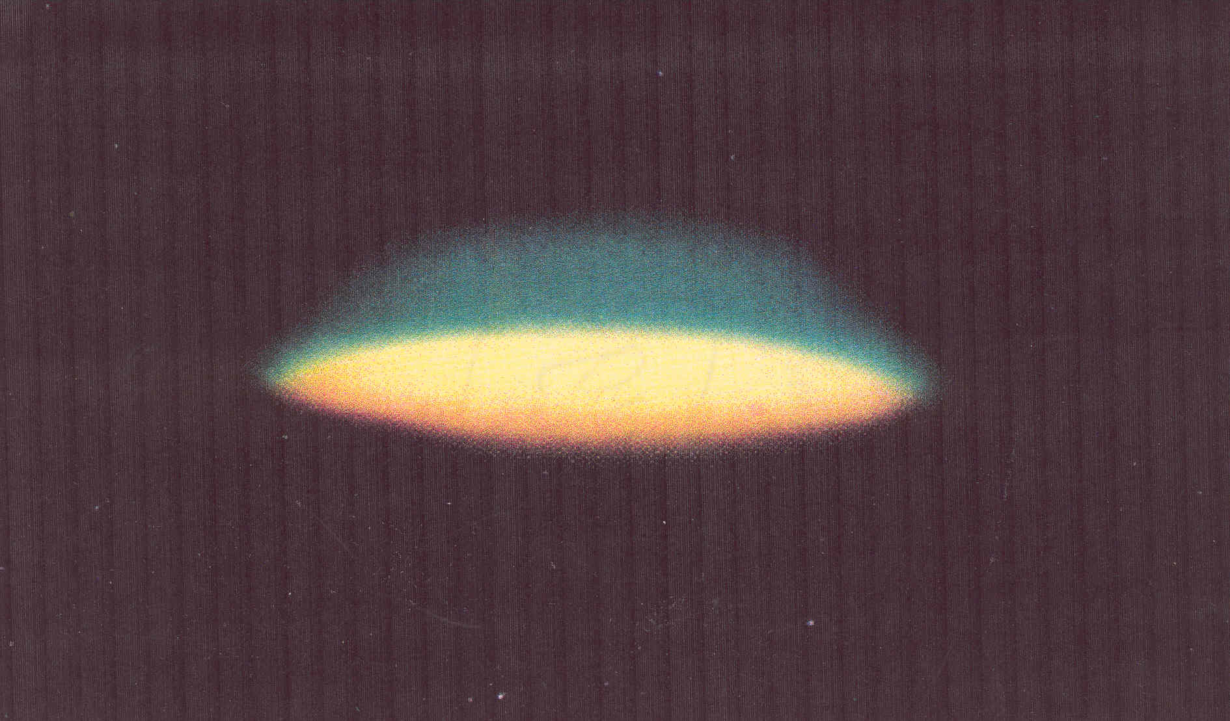

Slide 16
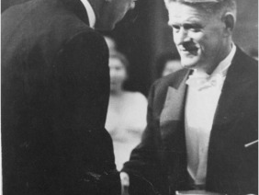
Presentation of the Nobel Prize.
Stockholm, December 1958

Slide 17
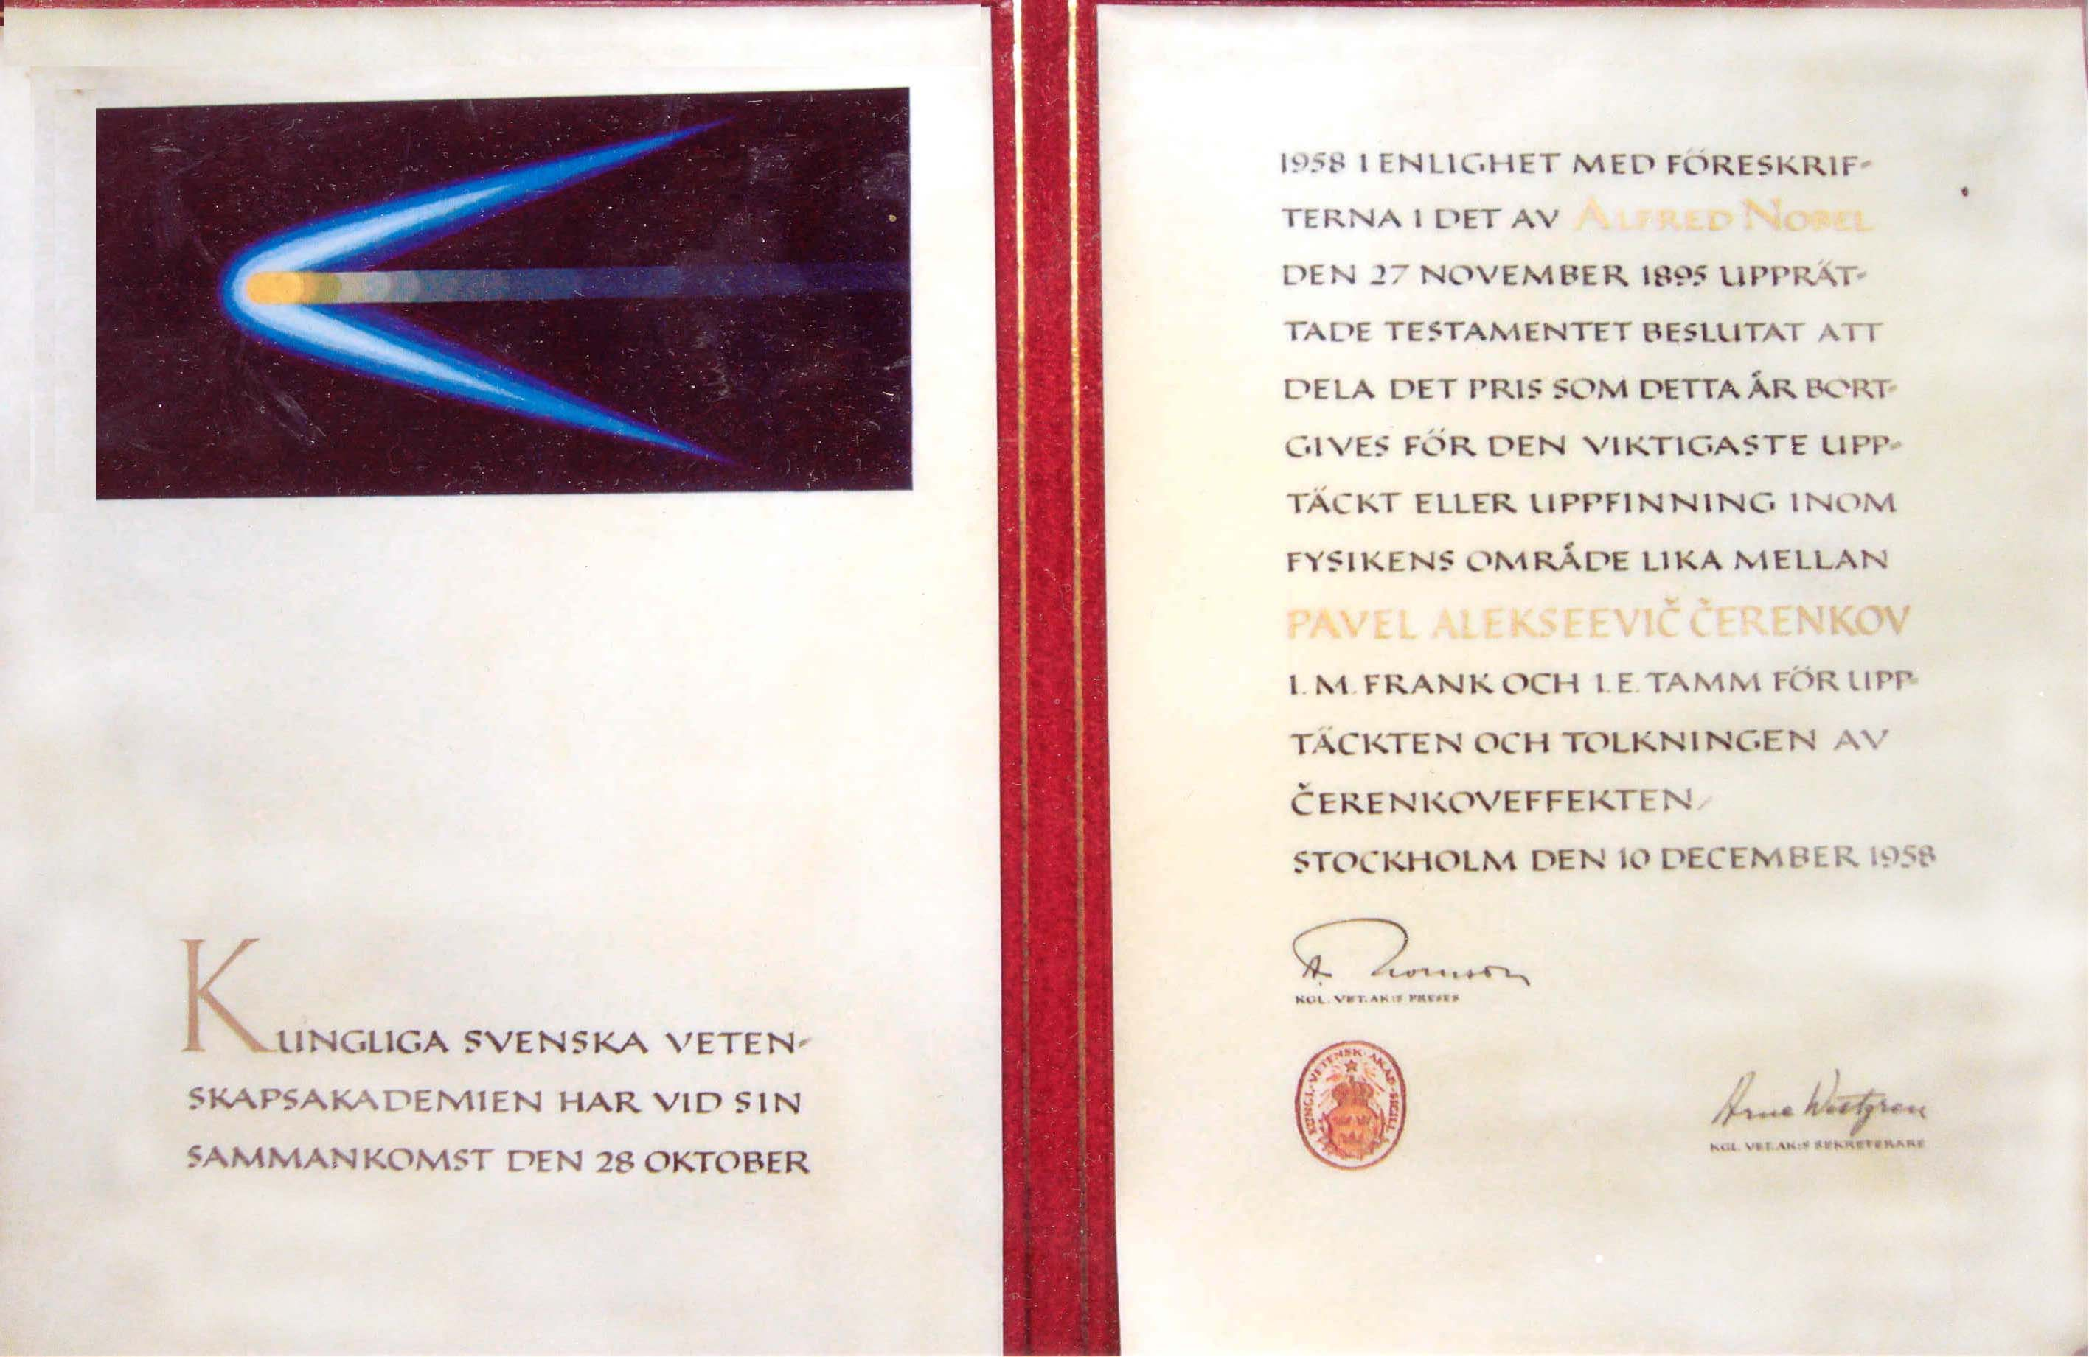
Nobel Prize in 1958. Diploma, medal

Slide 18
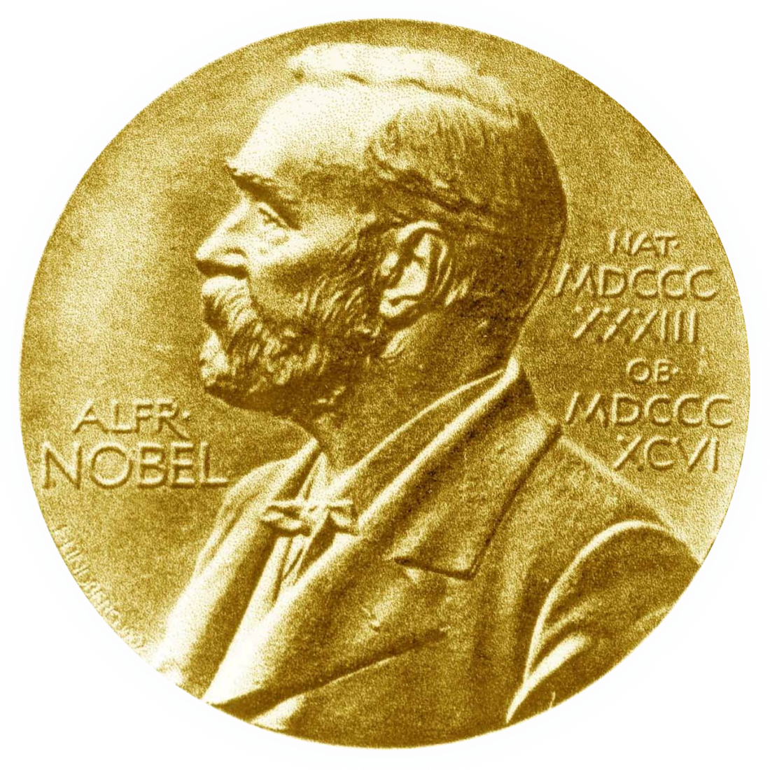
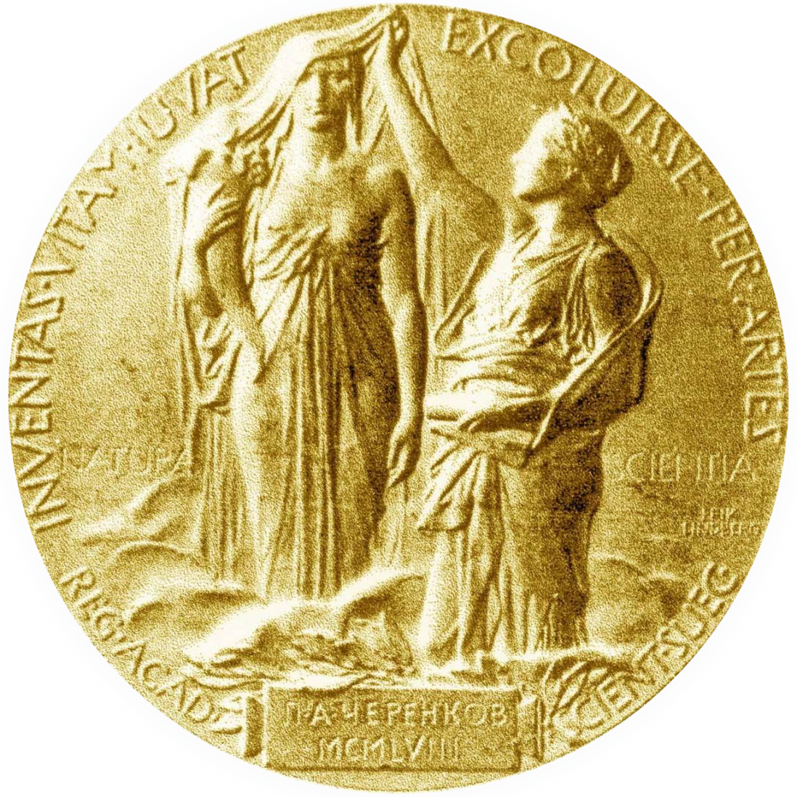

Slide 19
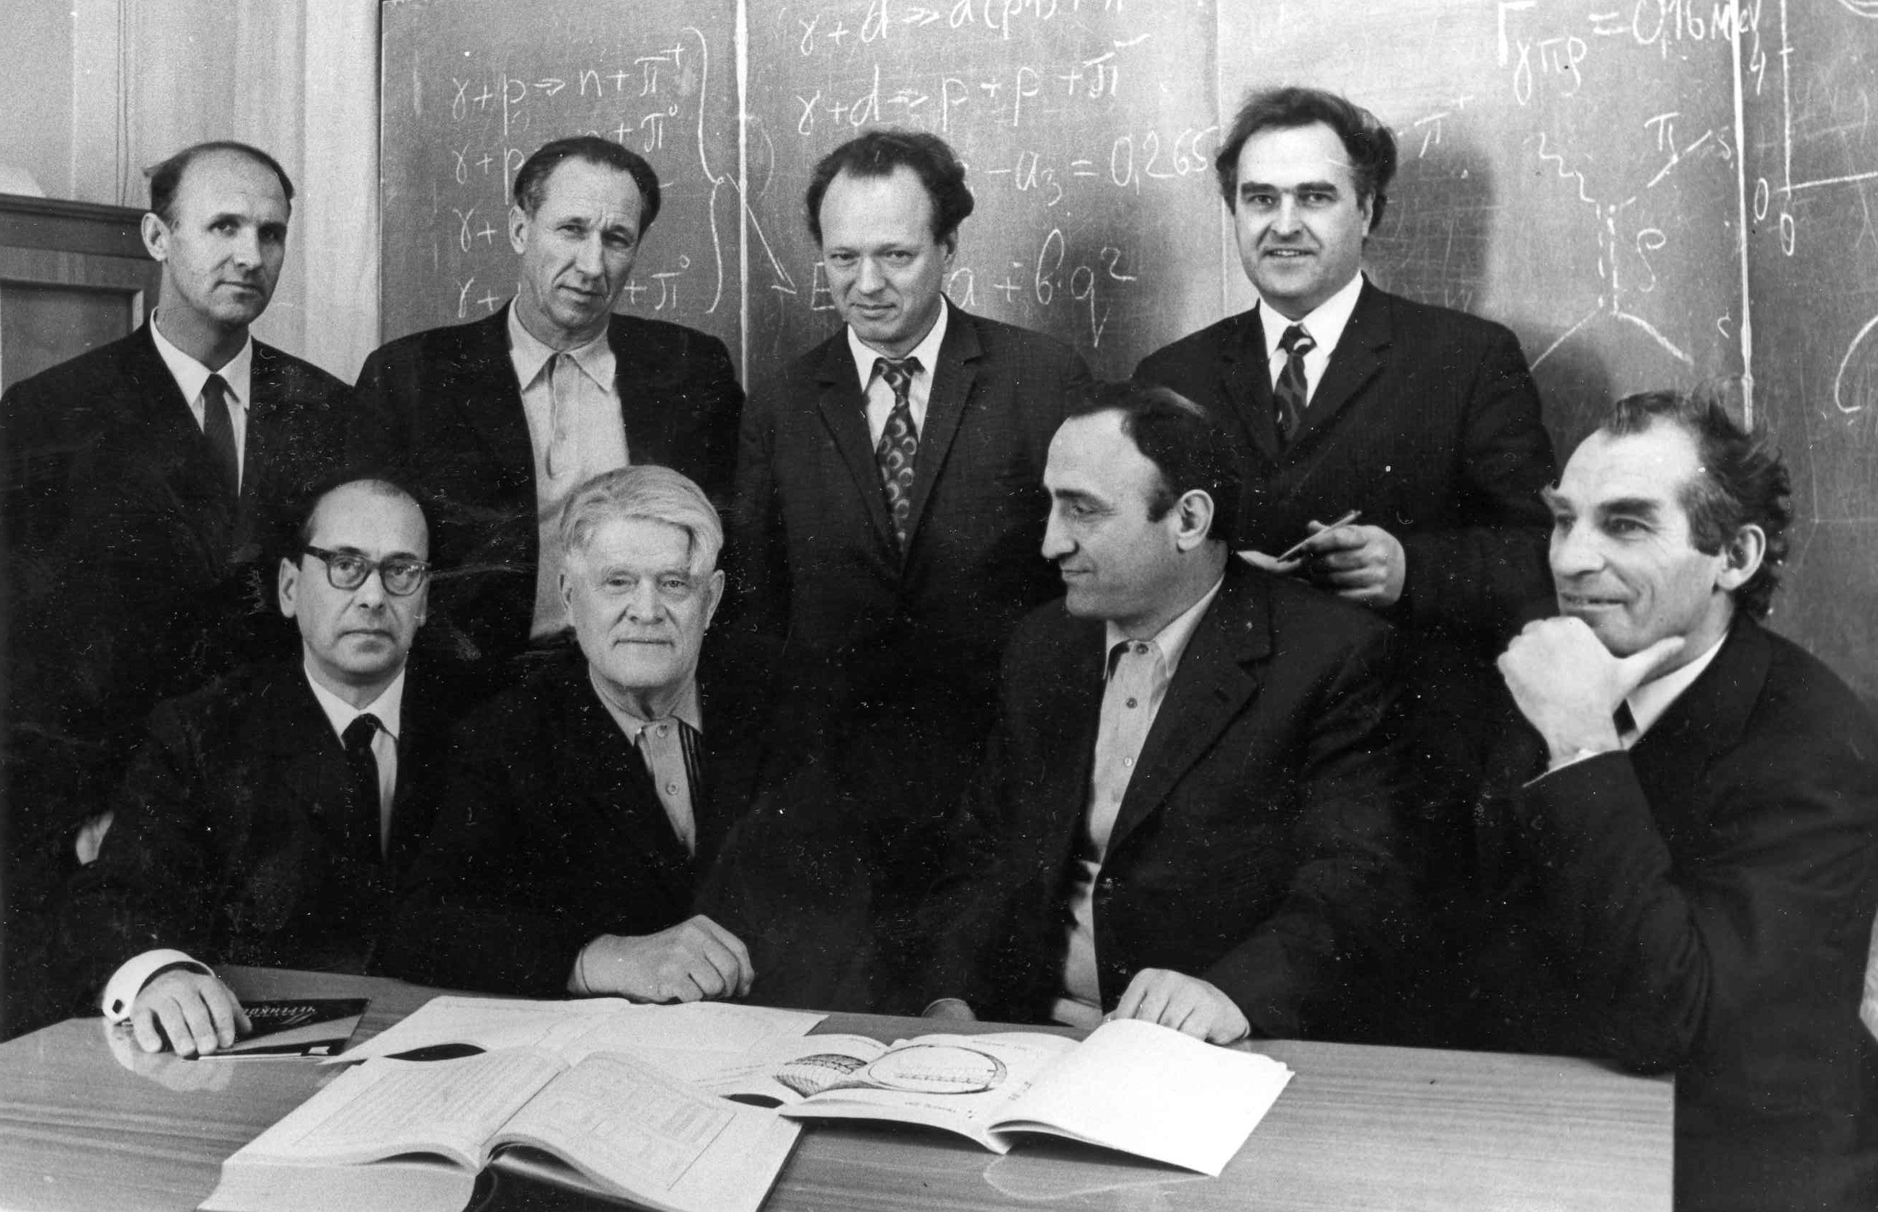
Employees and students. State Prize of the USSR in 1974

Slide 20
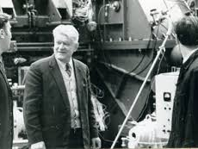
Electron synchrotron "Pakhra".
In the accelerator hall. Standing in front of the accelerating cavity

Slide 21
1959 - creation of the Laboratory of photomeon processes FIAN - head.
1963 - work on the use of a microtron as an electron injector
into the synchrotron on 280 MeV with KA Belovintsev and others.
1964 - election of the Corresponding Member of the USSR Academy of Sciences.
1964 - 1967 work on the storage of electron and positron beams in
in the synchrotron on 280 MeV with Yu.M. Ado, EG Bessonov and others.
1967 and later on management of works on the construction in Troitsk of the electroni synchrotron "Pakhra" for the energy of 1.3 GeV in conjunction with EI Tamm.
1967 and later on the call of numerous MEPhI students to work on
synchrotron "Pakhra".

Slide 22
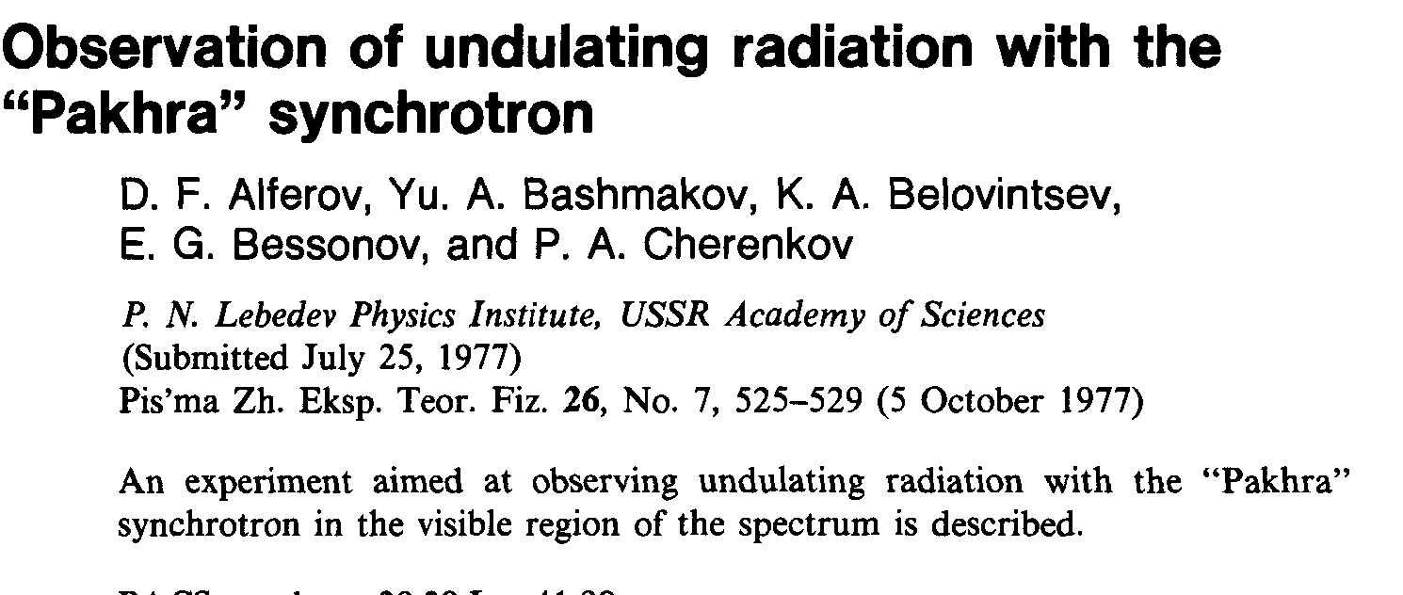
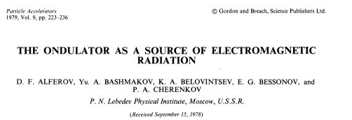

Slide 23
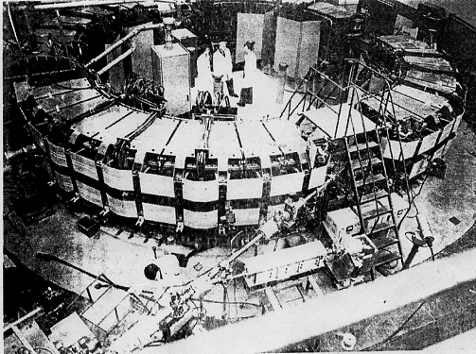
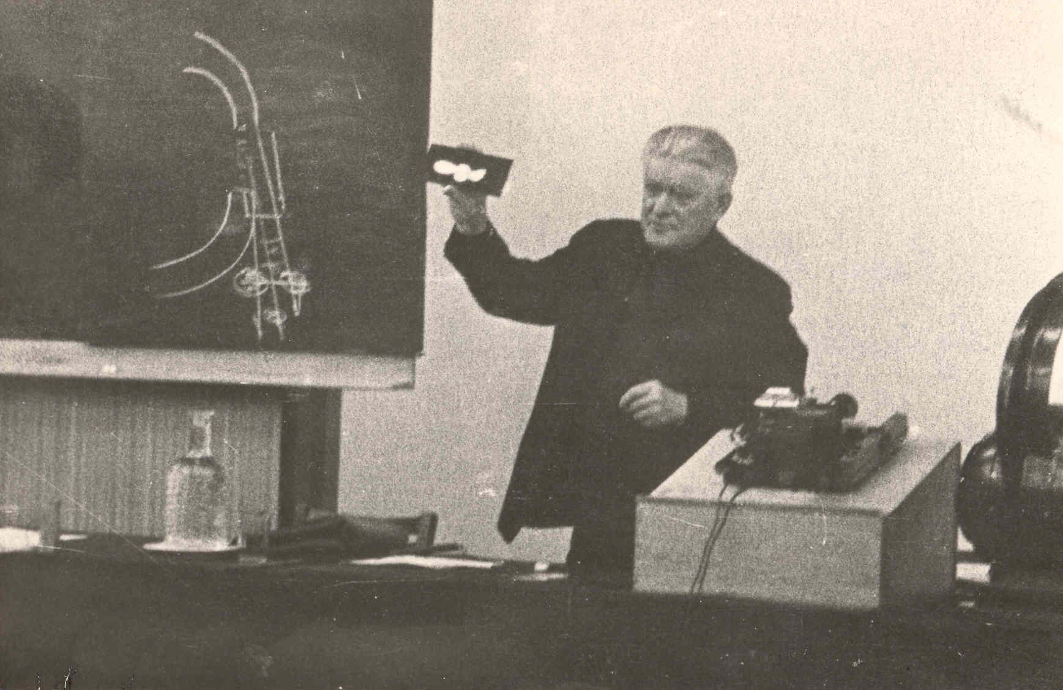
Alferov D F, Bashmakov Yu A, Cherenkov P A "Radiation from relativistic electrons in a magnetic undulator"
Sov. Phys. Usp. 32 200-227 (1989)

Slide 24
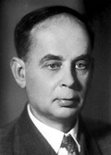
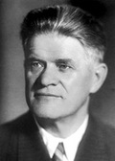
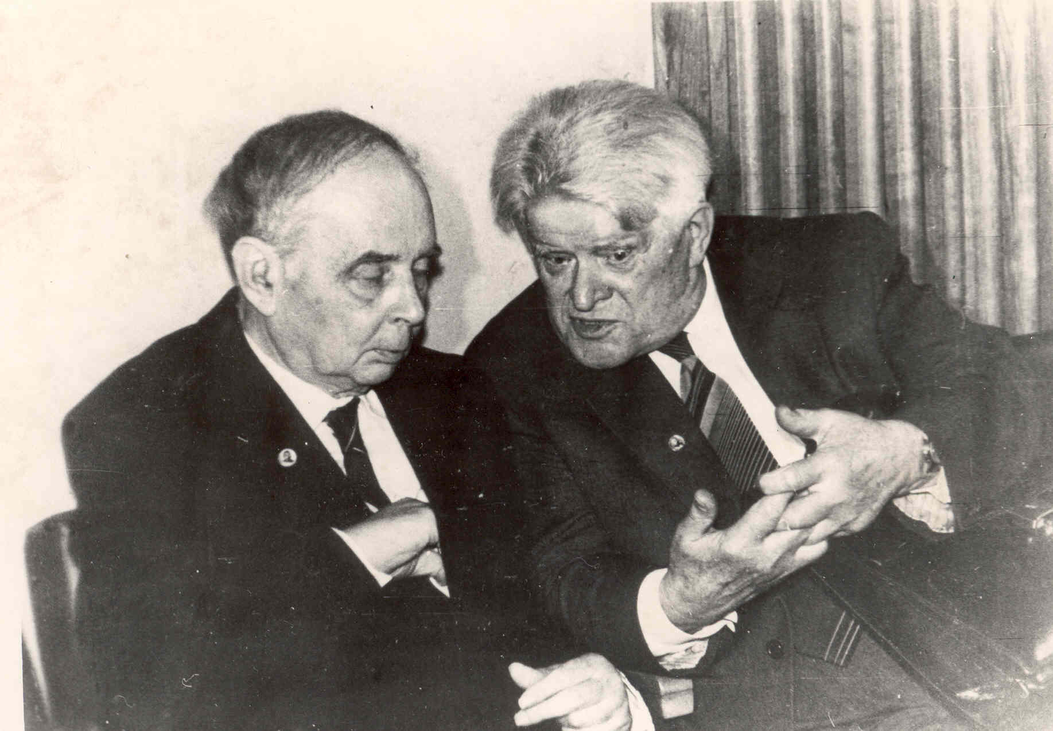
With Academician I.M. Frank

Slide 25
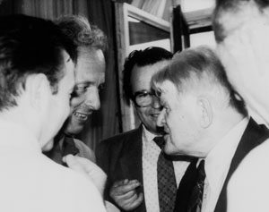
RICH - modern physics
Cherenkov's ideology in accelerators. HERA H1 - actively promoted.
Meeting of T. Ypsilantis and P.A. Cherenkov
at the Moscow conference in 1984.

Slide 26
1970 - election as a full member of the USSR Academy of Sciences.
1972 - the launch of the electronic synchrotron "Pakhra" in Troitsk together with EI Tamm, KA Belovintsev.
1972 and further guidance and participation in the work of collaborations at major proton synchrotrons in the USSR, USA, CERN. AS Belousov, BB Govorkov, MI Adamovich and others.
1975 - completion of the construction of a complex of buildings of OFVE in Troitsk.
1976 and further experimental investigation of undulator radiation on
Synchrotron "Pakhra" together with DF Alferov and others.
1984 - jubilee conference 50th anniversary of the opening and 80th anniversary.
1984 - FEI FEI entry into the H1 collaboration at the HERA Collider in DESY
Hamburg. Later on, the leaders: AS Belousov, PS Baranov, AI Lebedev,
EI Malinovsky, SVRusakov.

Slide 27
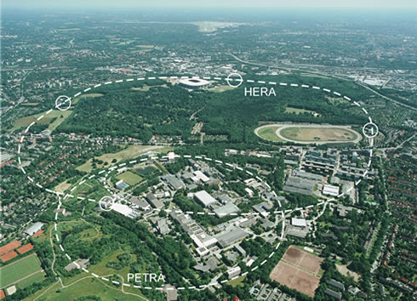
DESY, Hamburg
General view

Slide 28
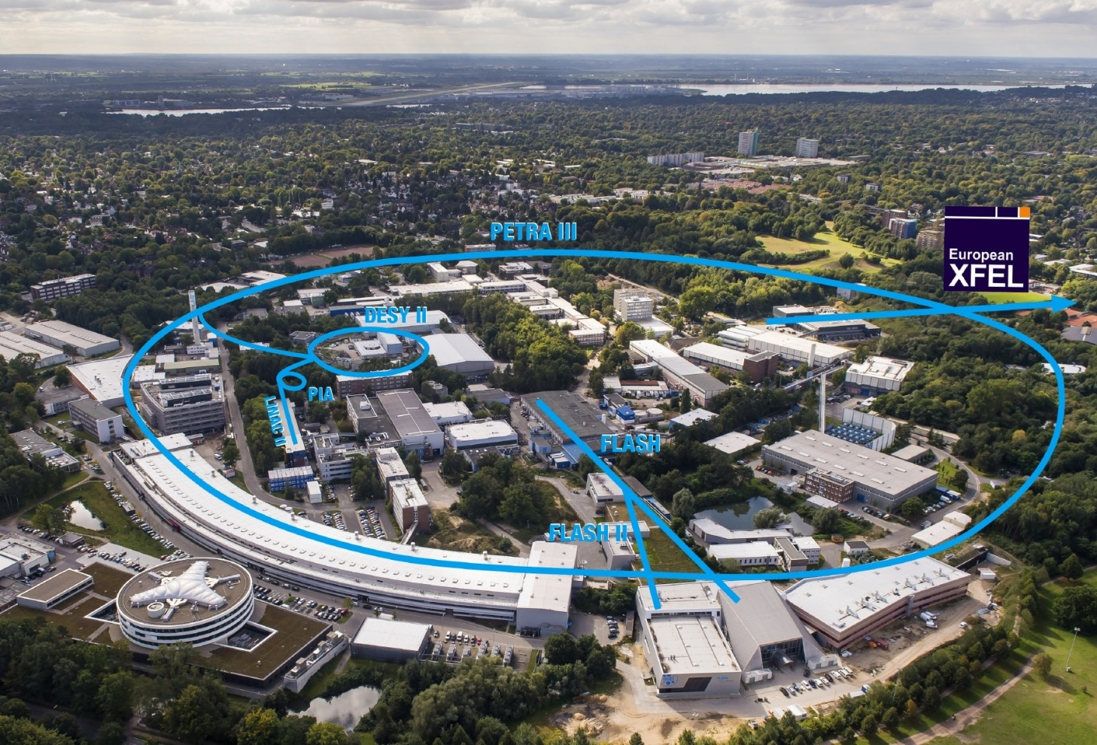
PETRA III
specialized source of synchrotron radiation

Slide 29
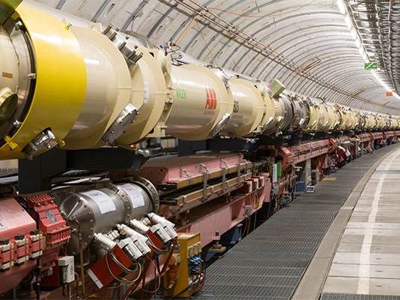
HERA Tunnel
e-p collider

Slide 30
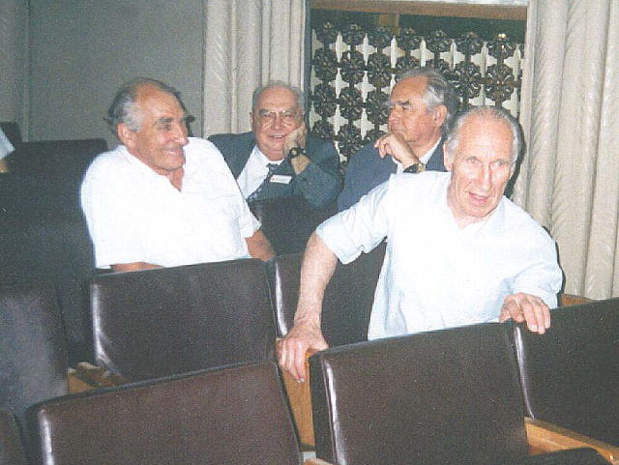
The closest colleagues, who began their scientific work under P.A.Cherenkov.
They themselves became famous scientists. Already in the old age they remember
their scientific youth.
B.B.Govorkov -- LPI (left to right), A.M.Baldin -- Dubna, Yu.M.Ado -- Protvino, E.I.Tamm -- LPI

Slide 31
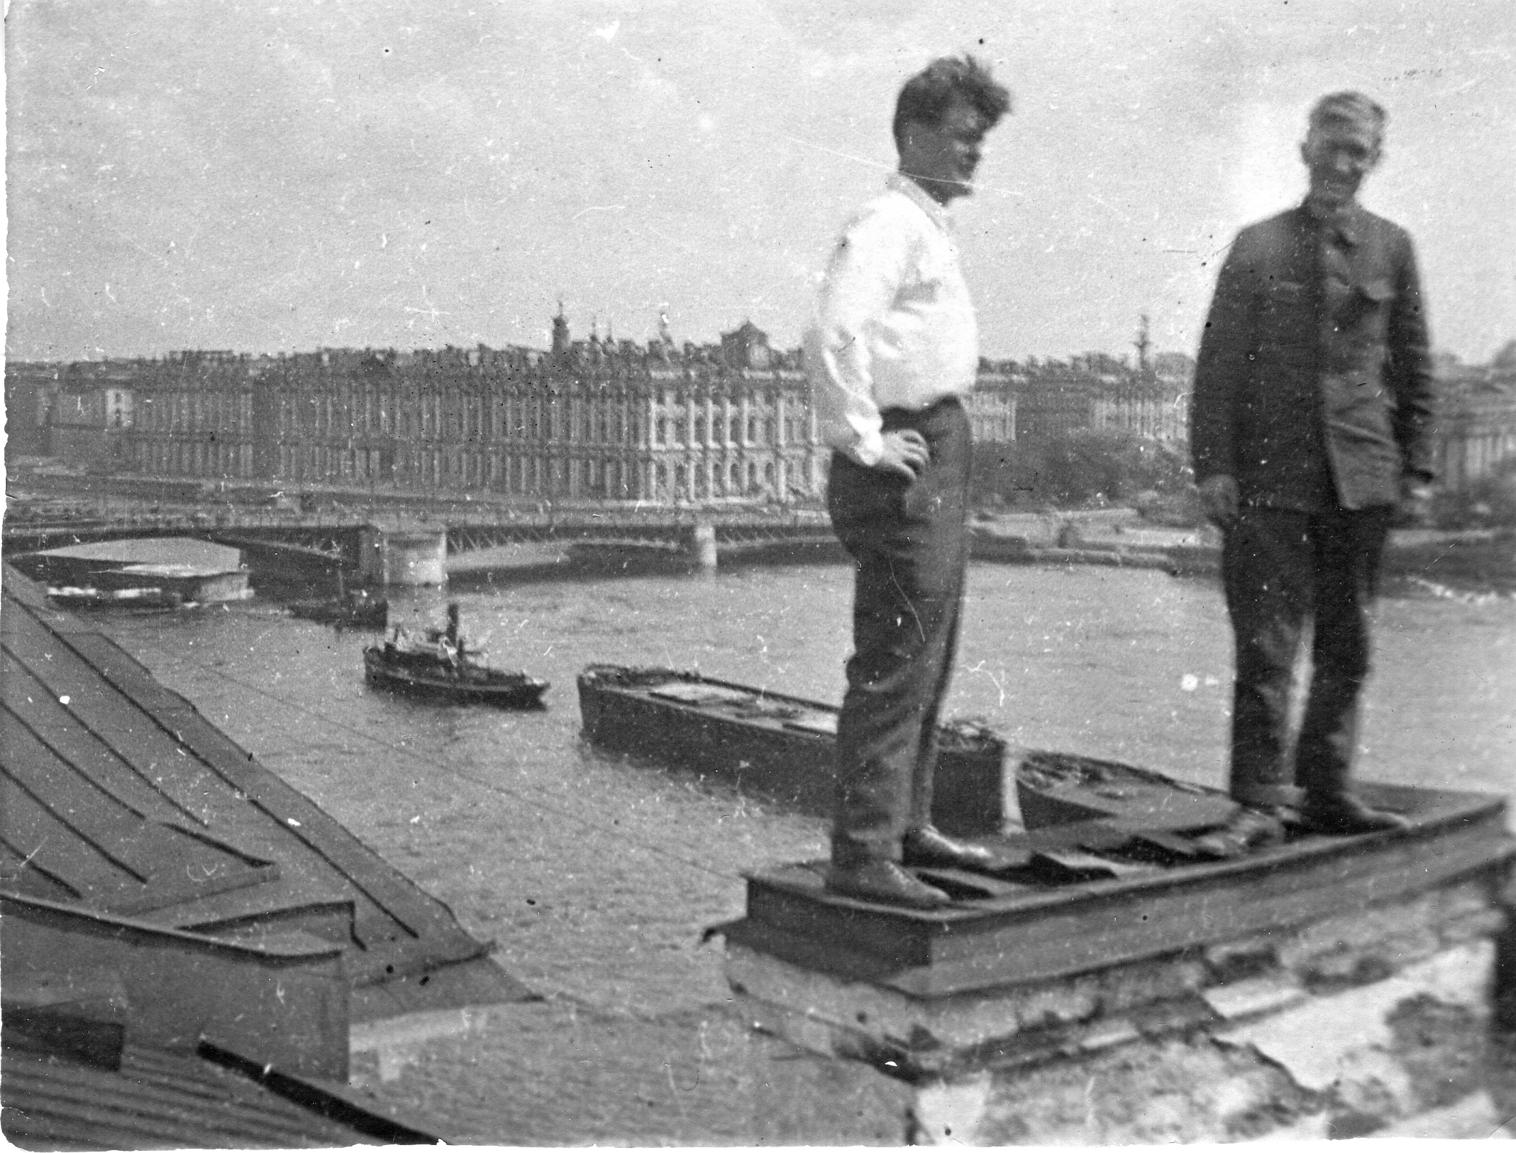
Whole life ahead! Ups and downs. Star hours and worldwide recognition.
PA Cherenkov (left) on the roof of the Kunstkamera. Neva. Winter Palace.
Life is like a river. Leningrad. 1933

Slide 32
