Slide 1
PID methods other than RICH
Antonello Di Mauro
(CERN)
RICH2018 Workshop, Moscow – 01/08/2018

Slide 2
The ALICE example

Slide 3
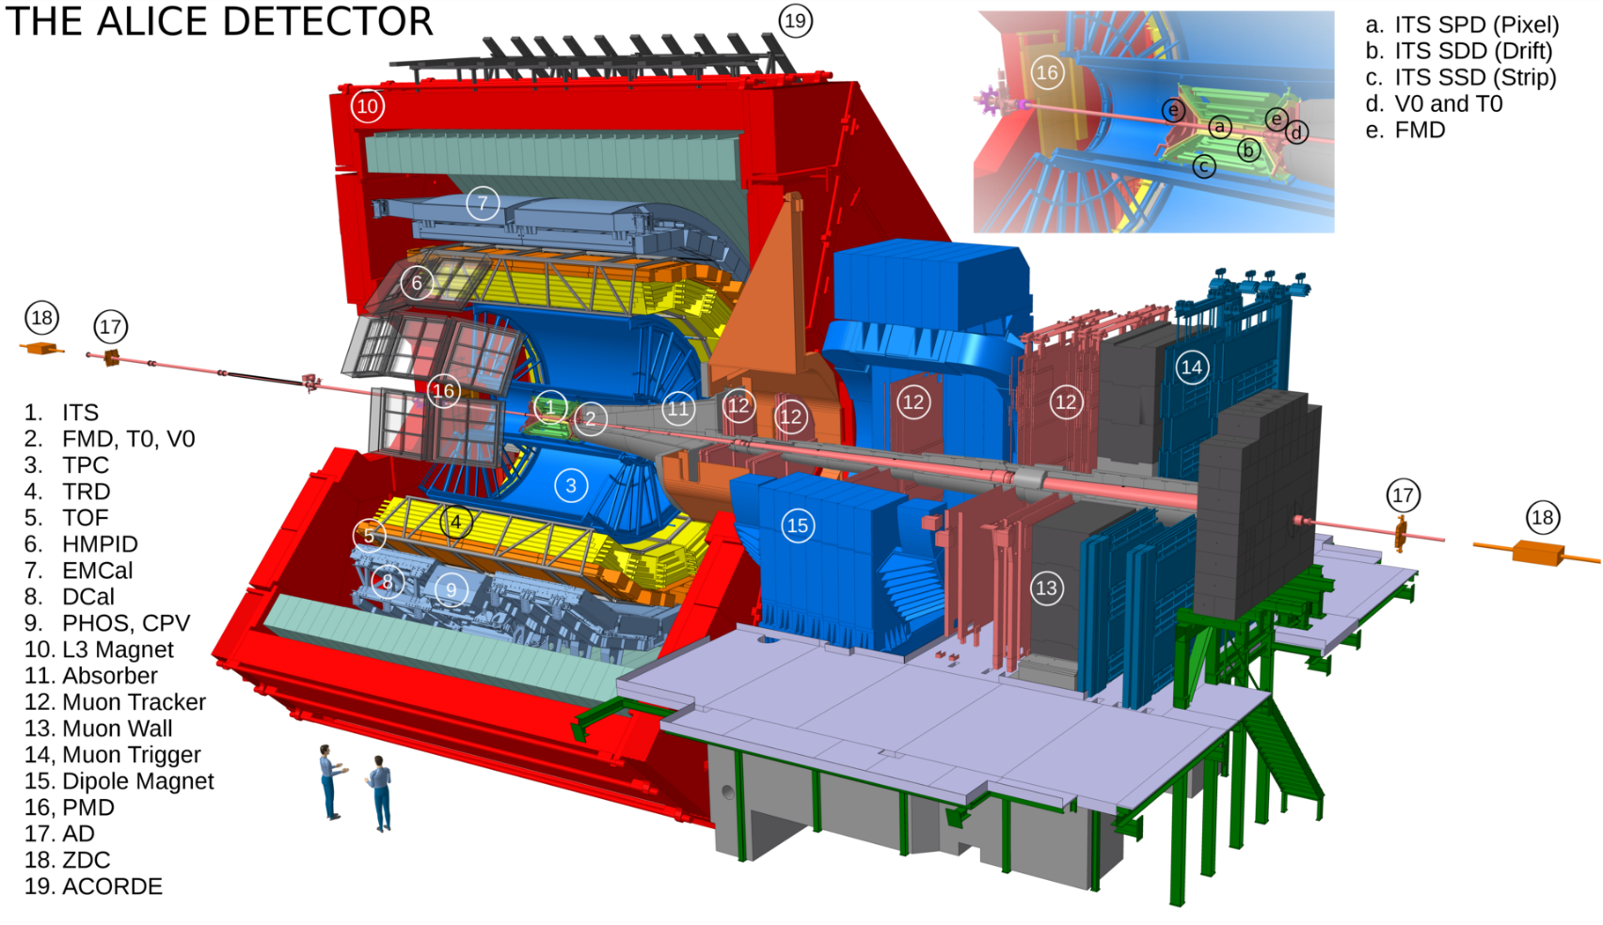
The ALICE detector
ALICE is the LHC experiment devoted to the study of QGP in Pb-Pb collisions →
PID essential for a comprehensive investigation
B=0.5 T

Slide 4
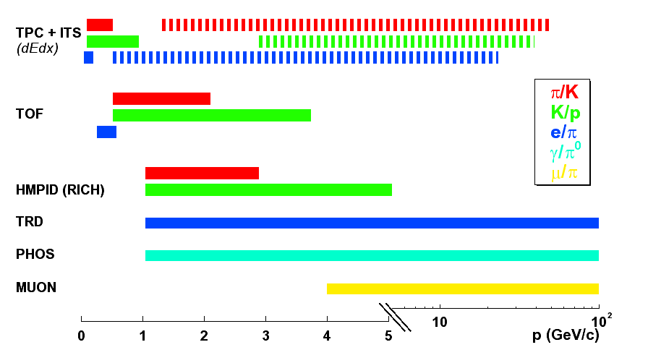
PID techniques in ALICE
Barrel detectors
Specific ionization energy loss | ITS (SSD, SDD), TPC
Transition radiation | TRD
Time of flight | TOF (T0)
Single arm
Calorimetry | PHOS, EMCAL, DCAL
RICH | HMPID
Muon spectrometry | Muon arm
Pre-shower | PMD

Slide 5
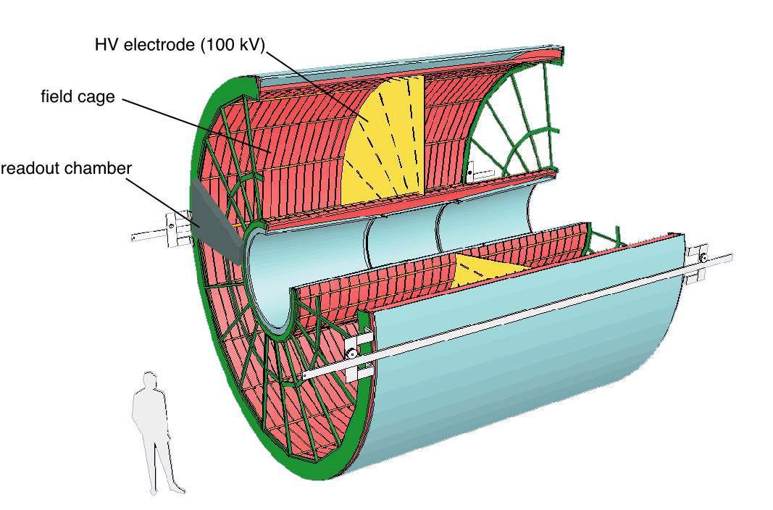
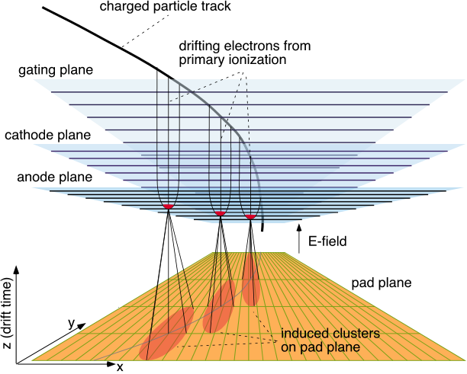
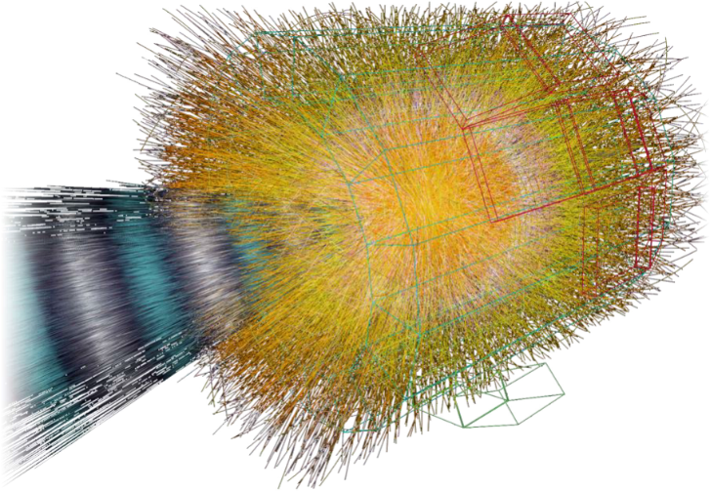
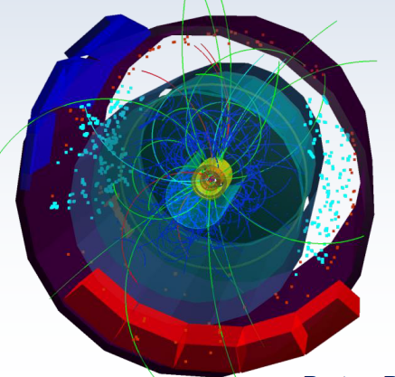
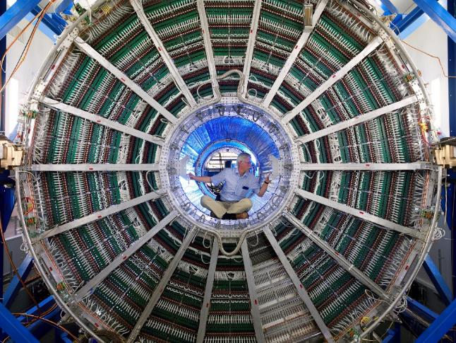
The ALICE Time Projection Chamber
High Voltage electrode
(100 kV)
845 < r < 2466 mm
90 m³ drift gas volume
Ne/CO₂ (90/10) in RUN1
Ar/CO₂ (90/10) in RUN2
e⁻ drift time ~ 100 μs
MWPC R/O with IBF gating grid (10⁻⁵)
R/O rate ~ 1 kHz in pp and 200 Hz in Pb-Pb
~560000 R/O pads of 4x7.5, 10,15 mm²
gas filtering and purity monitoring
gain equalization by ⁸³Kr gas runs
laser system for drift velocity calibration and distortion corrections
field cage
E
E
400 V / cm
beam
readout chambers
92us
500 cm
pp
Pb-Pb

Slide 6
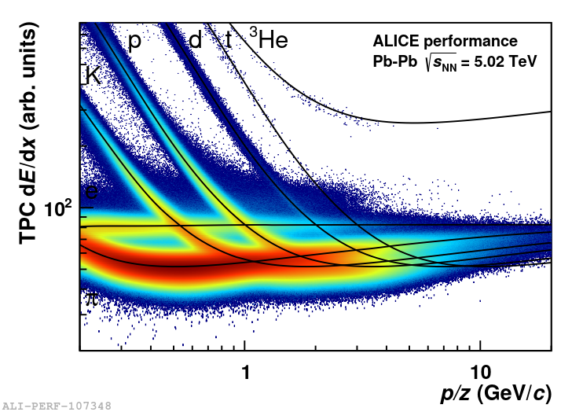
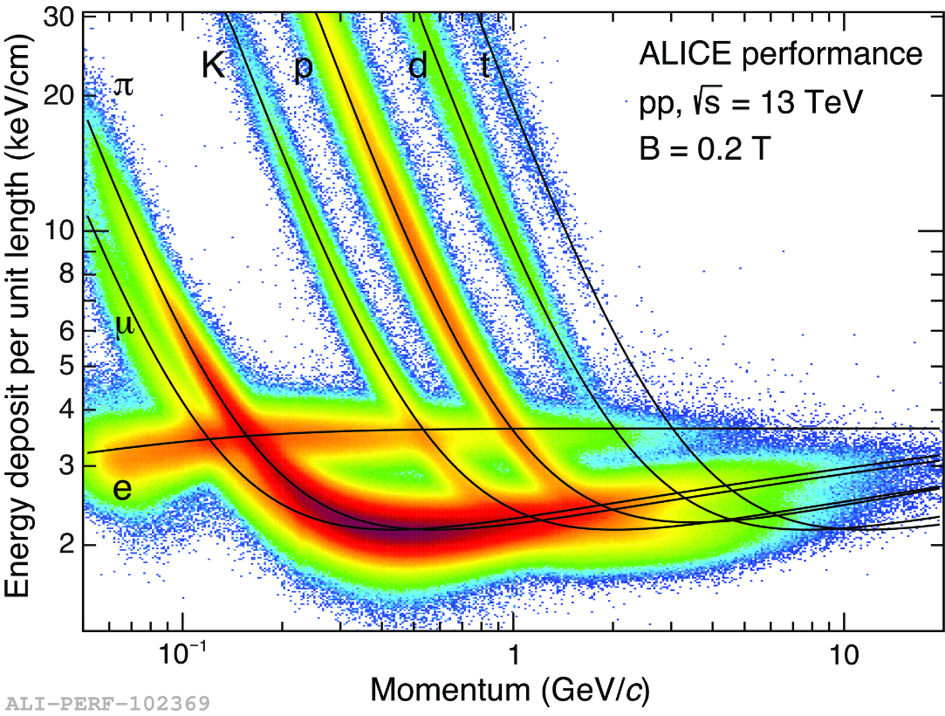
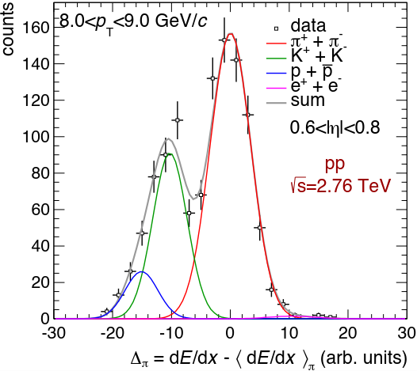
The ALICE TPC performance
Excellent tracking and PID in high multiplicity environment
Space point resolution σ_{x} ≈ 0.3 mm, σ_{y} ≈ 0.4 mm
Truncated mean algorithm 60% (max 159 clusters/track)
σ_{dE/dx} ≈ 5.2 % in pp
σ_{dE/dx} ≈ 6.5 % in central Pb-Pb
Track-by-track PID @ p <1 GeV/c
Statistical unfolding techniques @ p > 1GeV/c

Slide 7
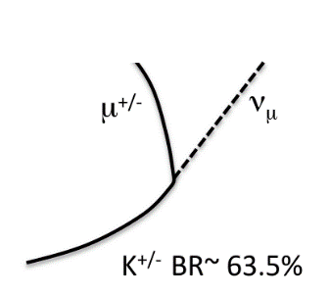
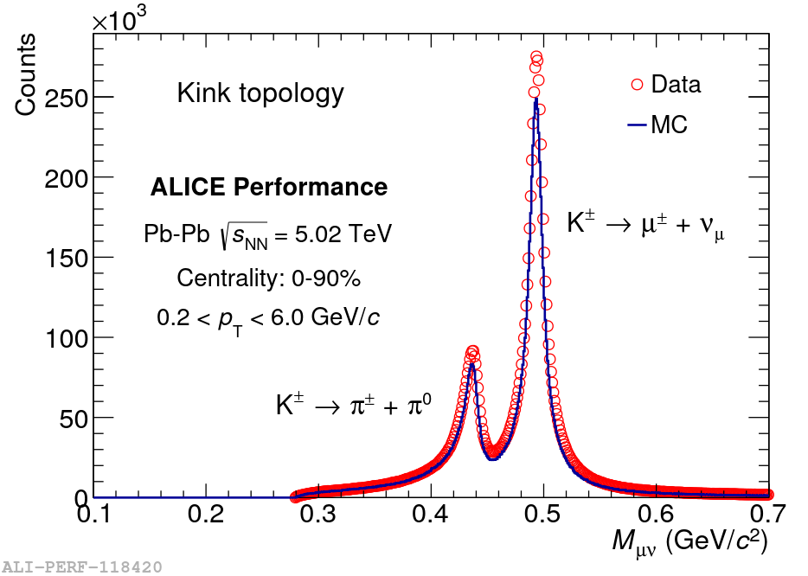
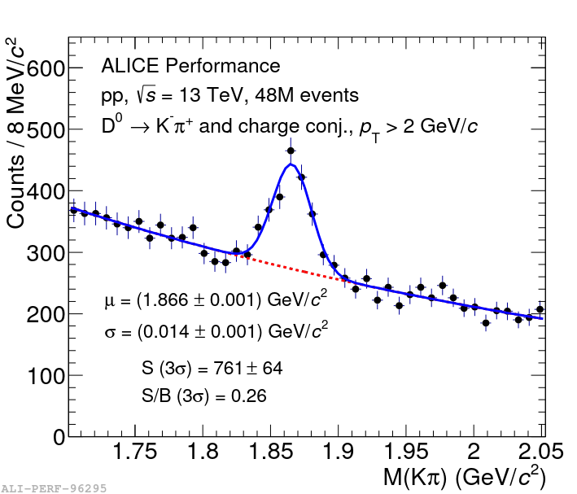
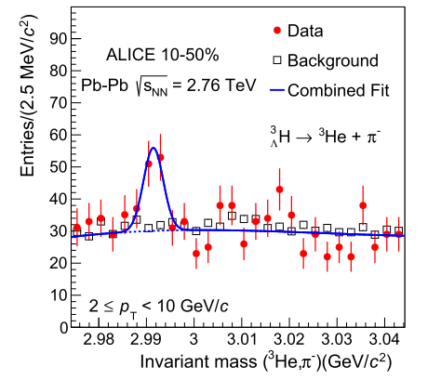
PID by decay topology
arXiv:1709.00288v1 [nucl-ex] 1 Sep 2017
Phys. Lett. B 754 (2016) 360
kink: secondary vertex in TPC
Hypernuclei ID
Vertex: ITS and TPC tracking, cτ ~ 8 cm
³He and π⁻ ID by dE/dx in TPC
D⁰ ID
Vertex: ITS and TPC tracking, cτ ~ 123 μm
K⁻ ⁽⁺⁾ and π⁺ ⁽⁻⁾ ID by dE/dx in TPC

Slide 8
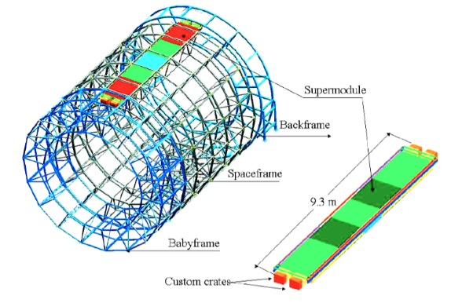
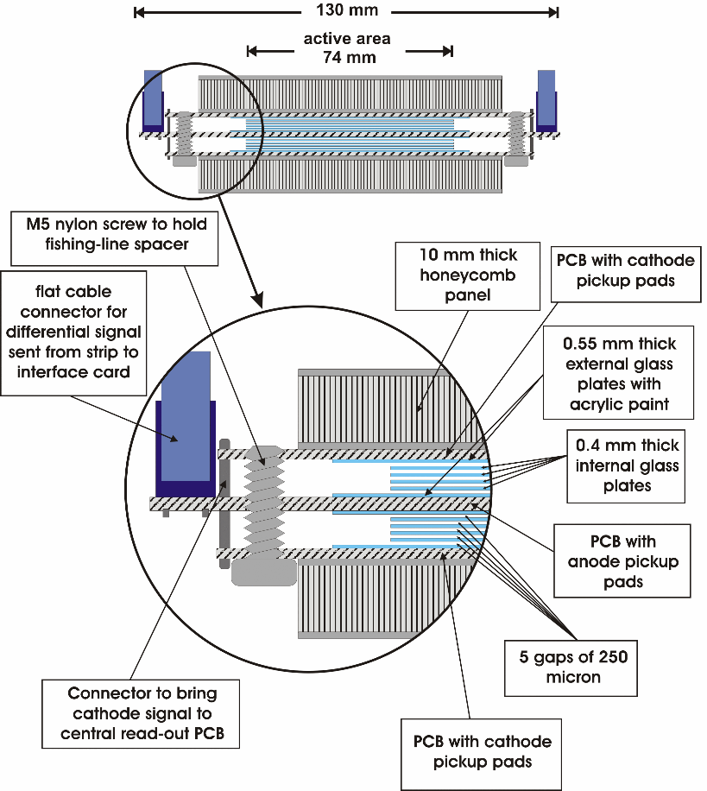
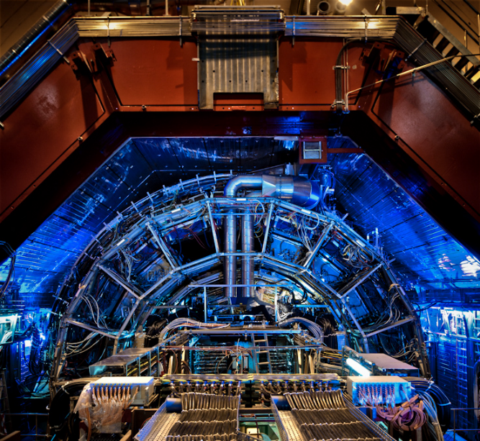
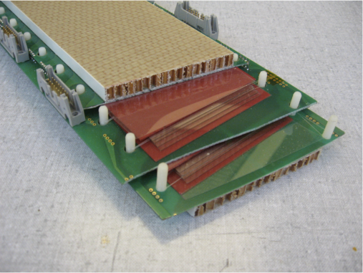
The ALICE TOF detector
|η| < 0.9, full 𝜑 —> 18 SuperModules(SM)
5 Modules each SM, 15-19 MRPCs (120x7.4 cm²) per module, 2.5x3.5 cm² R/O pads
total of 141 m², 152928 R/O channels
93% C2H2F2 + 7% SF6
3.7 - 4.0 m

Slide 9
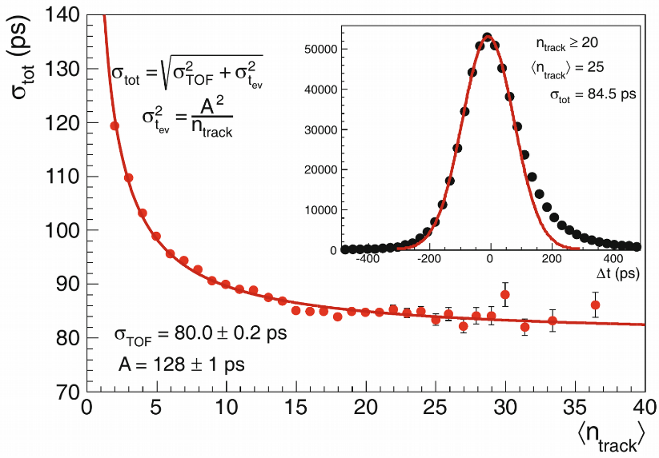
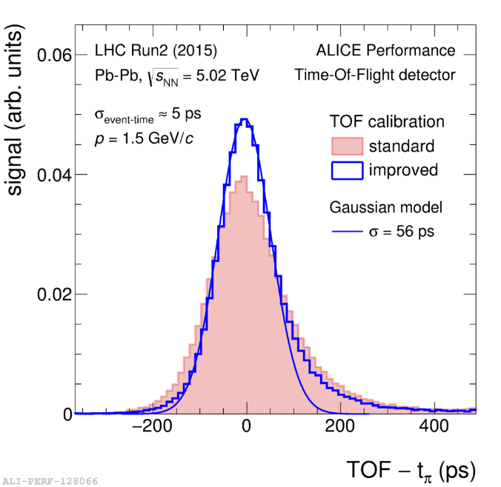
The ALICE TOF performance
Eur. Phys. J. Plus (2013) 128
New calibration procedure to correct time slewing at single channel level (see R. Preghenella’s talk)
56 ps
constant terms
σ²_{TOF}= σ²_{MRPC} + σ²_{TDC} + σ²_{FEE} + σ²_{Cal}

Slide 10
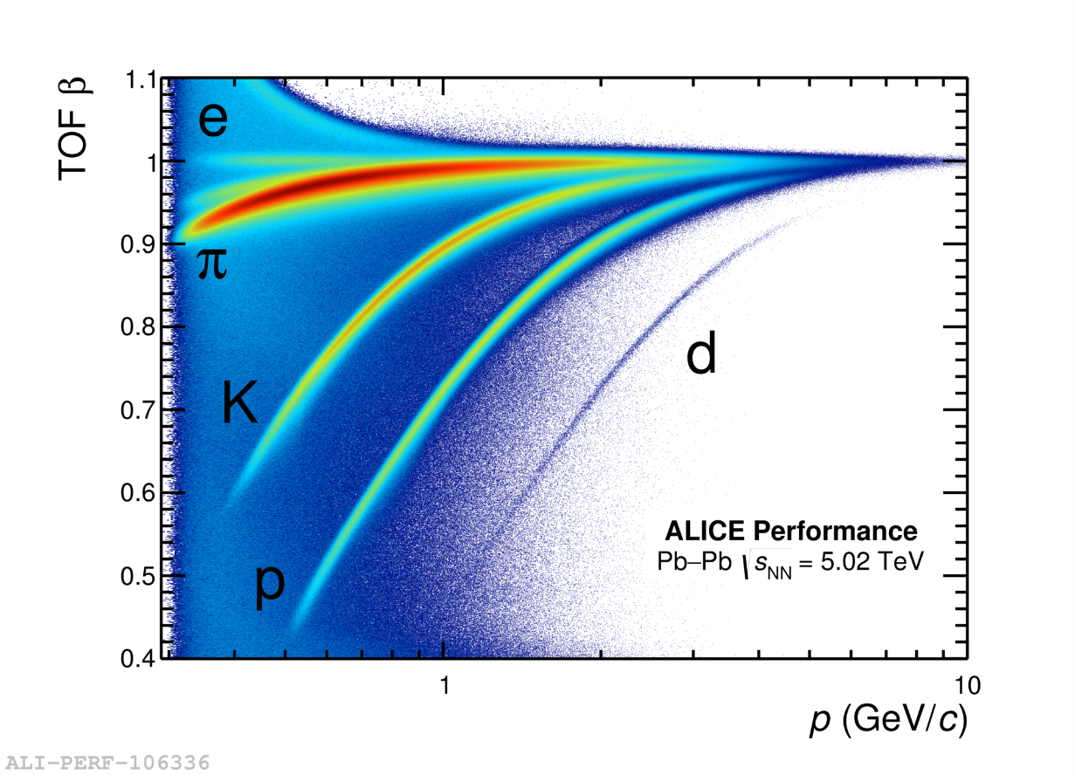
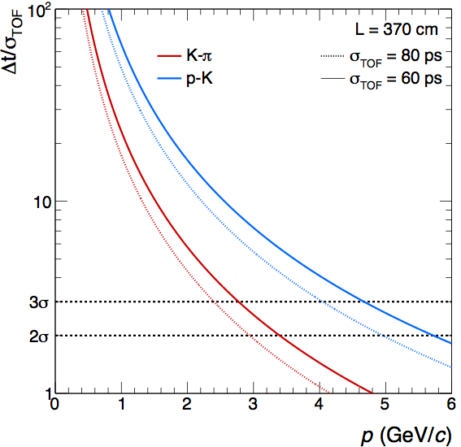
The ALICE TOF performance

Slide 11
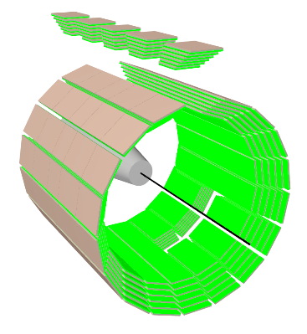
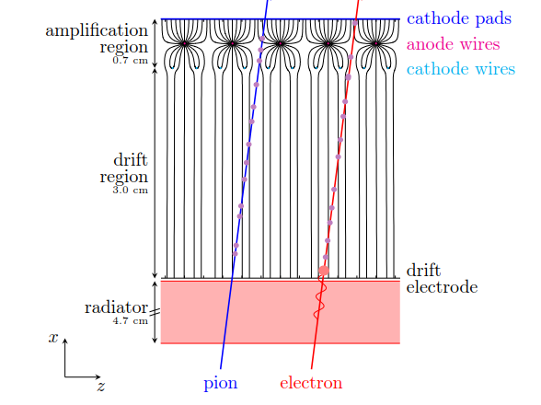
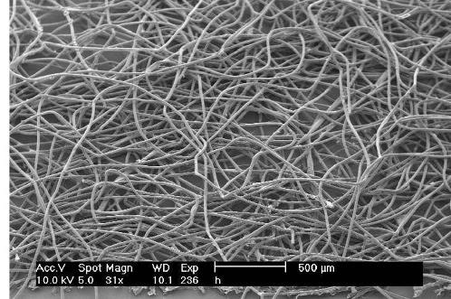
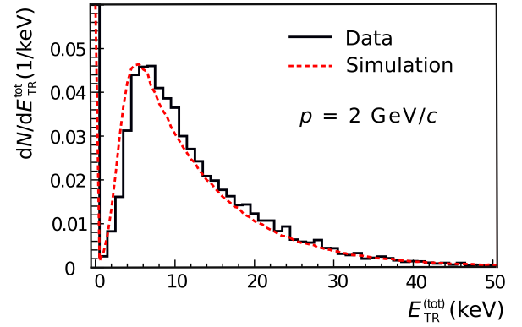
The ALICE TRD detector
Nucl. Inst. and Meth. A 881 (2018) 88–127
|η| < 0.84, 2π in azimuth → 18 SuperModules
5 stacks in beam direction, 6 layers in radial direction, 522 chambers (18 missing in front of PHOS)
Each chamber consists of a radiator sandwich (RohacellHF71 and polypropylene fibre mats) and a MWPC filled with Xe/CO₂ (85:15)
Total active area: ~673 m²
Gas volume: ~27 m³
1.15 million R/O channels
2.9 – 3.7 m
17 μm fibres

Slide 12
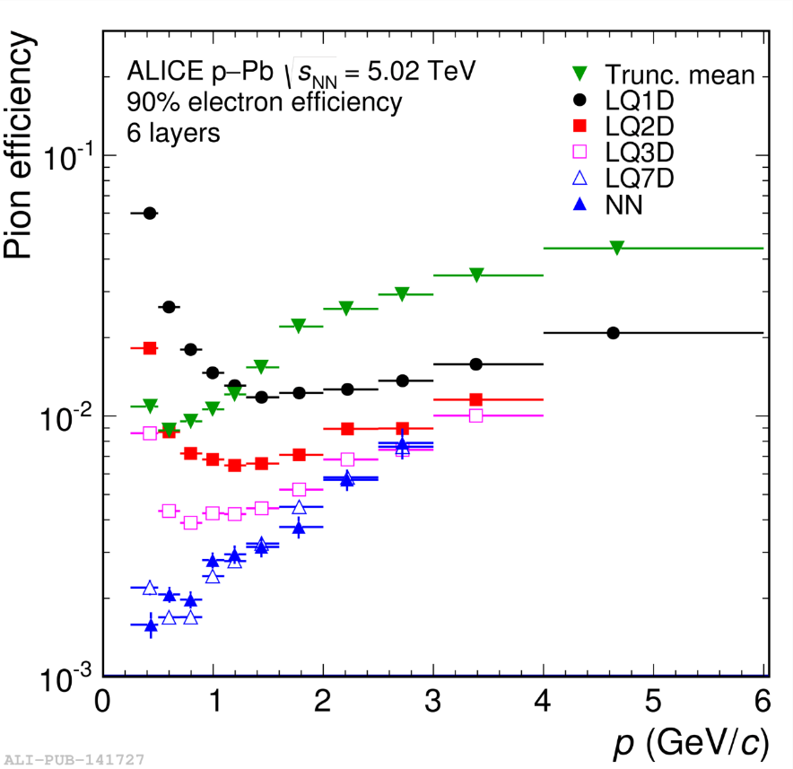
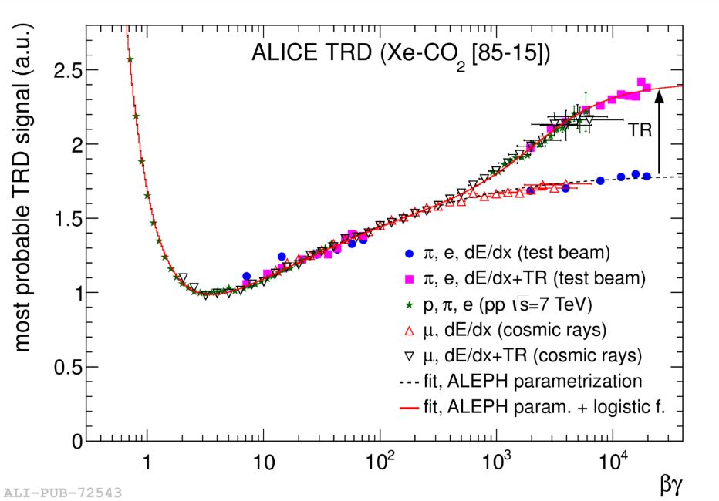
The ALICE TRD detector performance
Excellent agreement with parametrization of dE/dx and TR from various particles and sources (cosmics, testbeam, pp @ $\sqrt{s}=$7 TeV), TR onset @ βγ > 800
Nucl. Inst. and Meth. A 881 (2018) 88–127
π rejection ~ 410
Different analysis methods:
Truncated mean
Single or multidimensional likelihood (based on signal t evolution)
Neural network

Slide 13
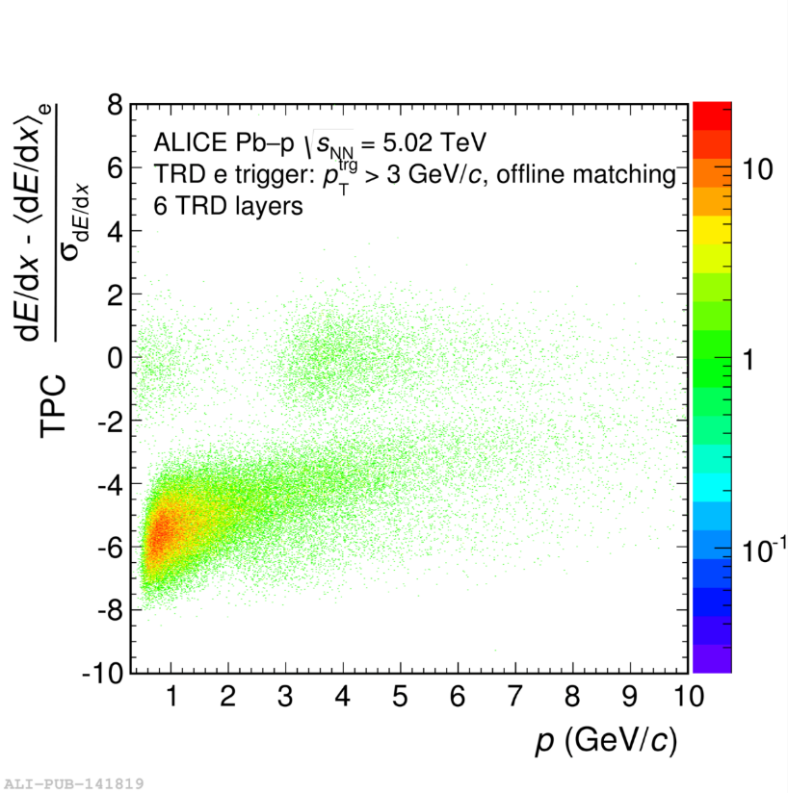
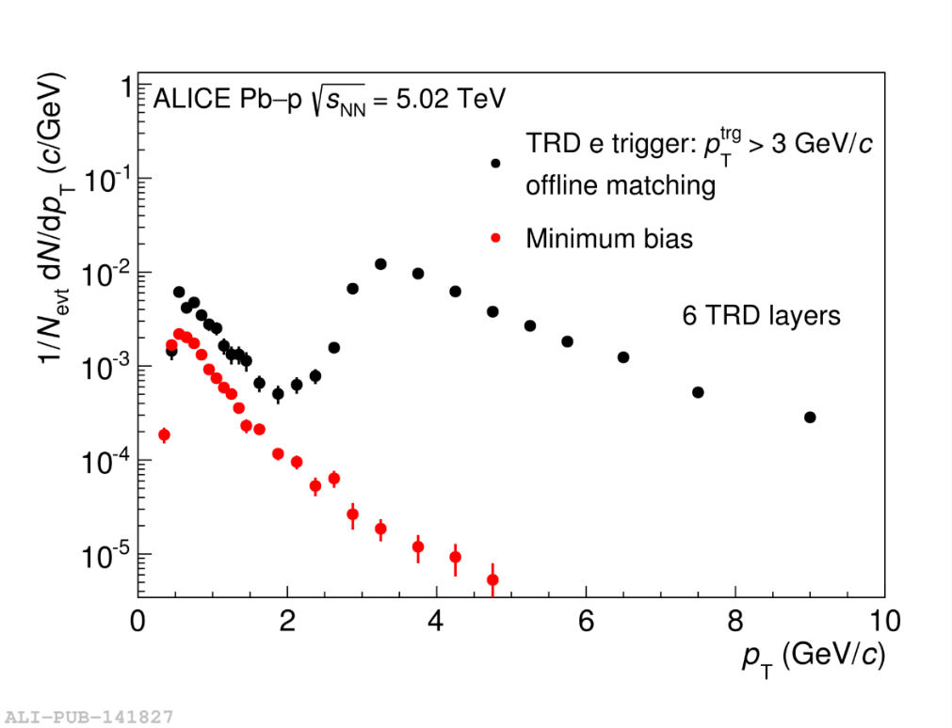
The ALICE TRD e-trigger performance
Enhancement of 700 wrt minimum bias (TPC+ TOF only)

Slide 14
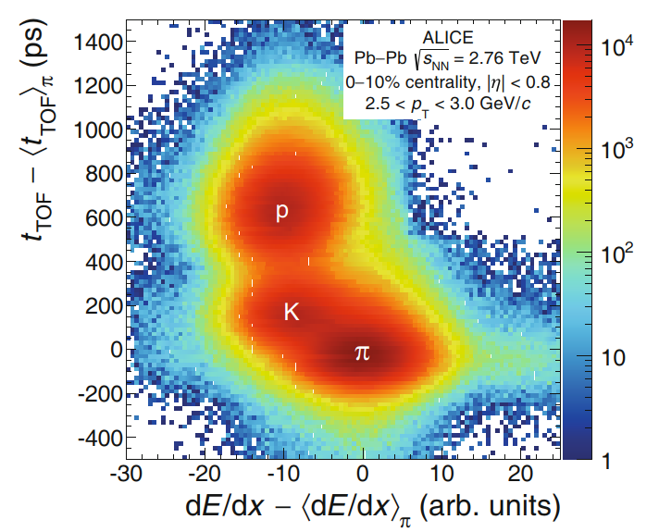
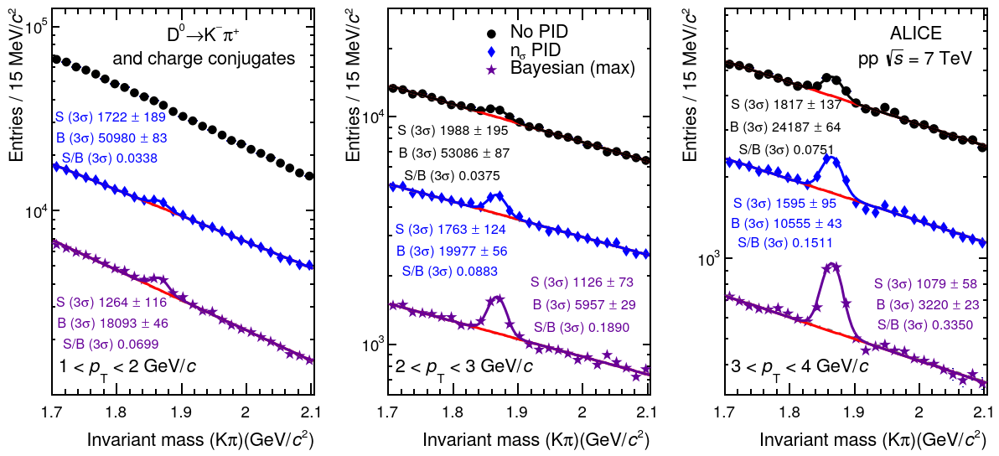
Combined PID in ALICE: Bayesian approach
Eur. Phys. J. Plus (2016) 131: 168
Using accurate detector response parametrization → for each particle species (π, K, p, …) conditional probability corresponding to measured detectors signals
Comparison with Monte Carlo and verification by benchmark analysis of known decay channels (V⁰)
PID from threshold or max probability

Slide 15
The ALICE Upgrade in LS2 (2019-2020)
High precision measurements to explore new frontiers in QGP properties
Probe rare physics channels
Heavy flavour down to very low p_{T}
Charmonium states
Low mass di-leptons
Light (anti-)nuclei and hyper-nuclei
LoI, March 2013
RUN3+RUN4: 10¹¹ events ~ 13 nb⁻¹ in Pb-Pb ( 100x RUN2 statistics)
Main requirements
Untriggered data sample
→ fully exploit the 50 kHz Pb-Pb interaction rate delivered by LHC
Improved tracking performance down to very low p_{T}
The strategy
New ultra-light silicon trackers based on MAPS: ITS (mid-rapidity), MFT (forward rapidity)
New TPC read-out chambers (GEMs) and electronics
New Fast Interaction Trigger (FIT)
New R/O of other detectors (TOF, TRD, PHOS, Muon arm, ZDC, …)
New merged Online and Offline systems (O² project)

Slide 16
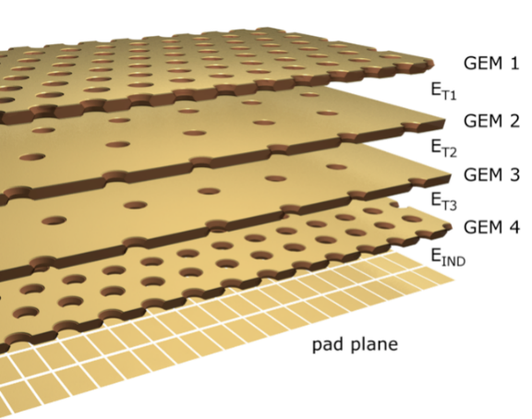
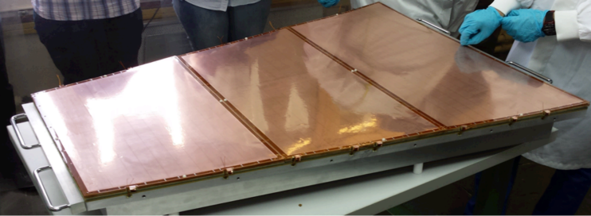
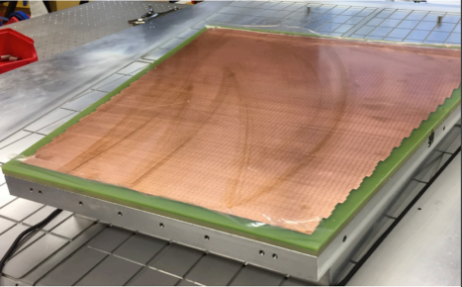
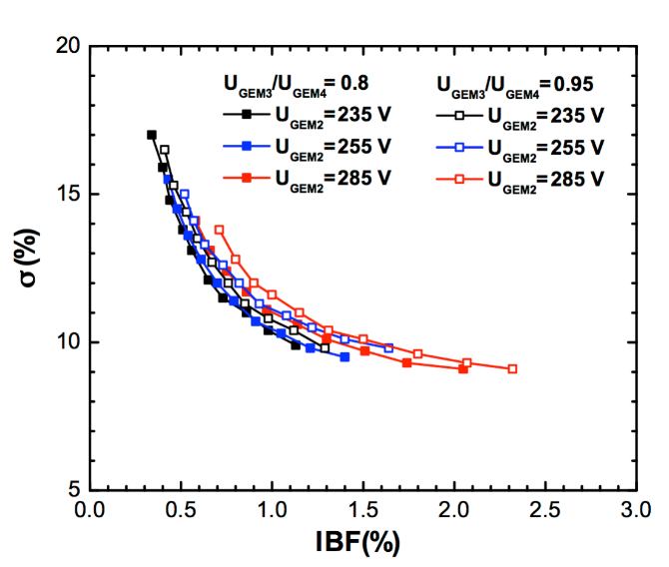
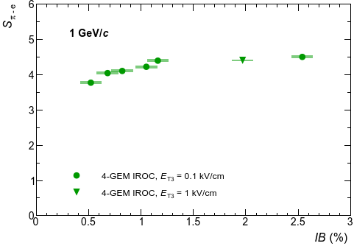
ALICE TPC Upgrade
Courtesy of C. Lippmann
Requirements for GEM readout system:
50 kHz Pb–Pb interaction rate, average event spacing: ~20 μs → average pileup: 5 events
Minimize IBF w/o GG and implement continuous R/O
IBF < 1 %
Energy resolution: σ_{E}/E < 12% for ⁵⁵Fe
Preserve spatial and p resolution
OROC GEM stack
IROC pad plane
(not to scale)
arXiv:1805.03234v2 [physics.ins-det] 17 Jun 2018
Quadruple GEM stack: combination of Standard (140 μm) and Large Pitch (280 μm) GEM foils
New FEE based on ASIC SAMPA
R/O segmentation and # of channels ~ present TPC
extended operation range
conservative operation range

Slide 17
A look beyond the horizon

Slide 18
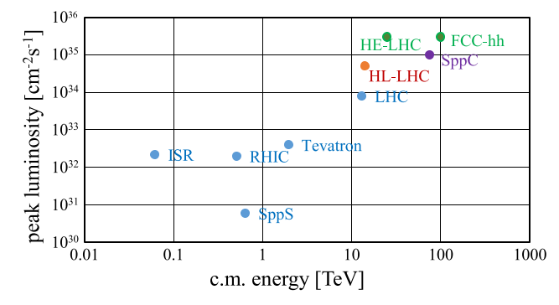
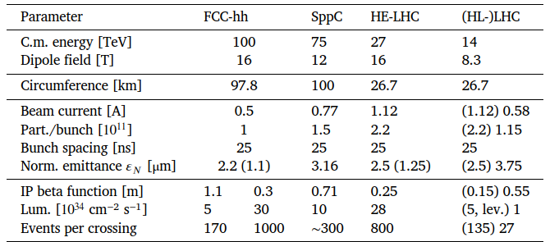
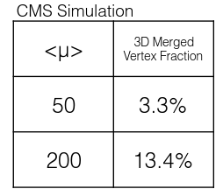
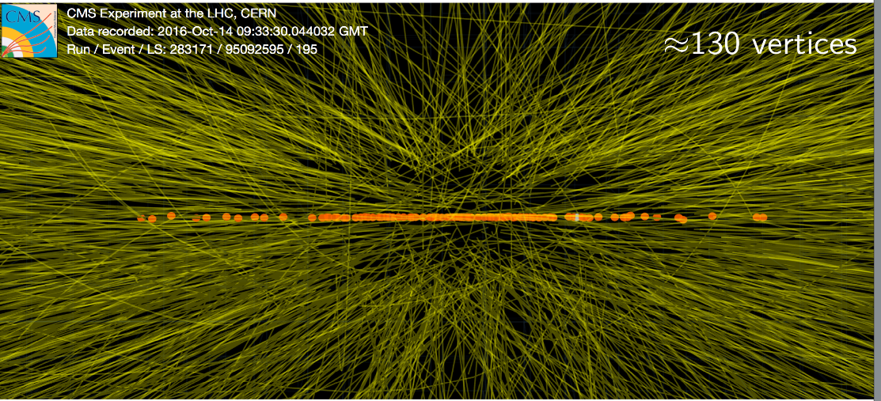
A challenging future
https://doi.org/10.1016/j.nima.2018.03.021
With next generation of colliders probability of merged vertices > 10% →
Timing is the key aspect of R&D for future detectors

Slide 19
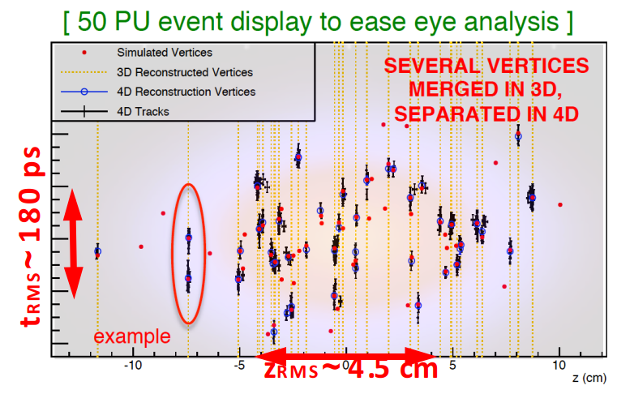
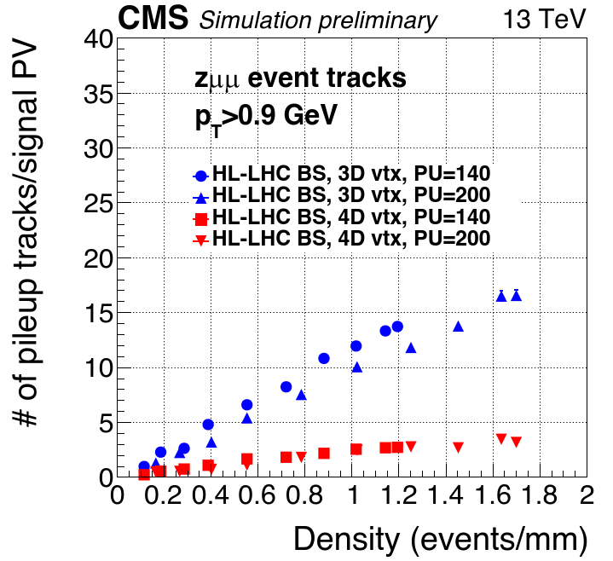
4D tracking
Huge effort from HEP community to reduce pileup adding timing information to tracking
L. Gray, Connecting the Dots - Intelligent Trackers 2017
Beam-spot time spread
Dissect the luminous region to recover the LHC purity of reconstructed primary vertices (PU ~ 40)
→ ~ 10s ps time resolution

Slide 20
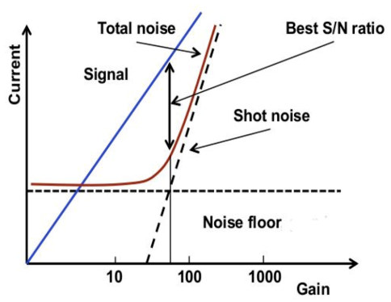
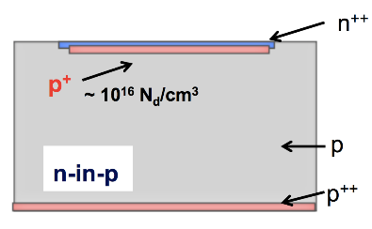
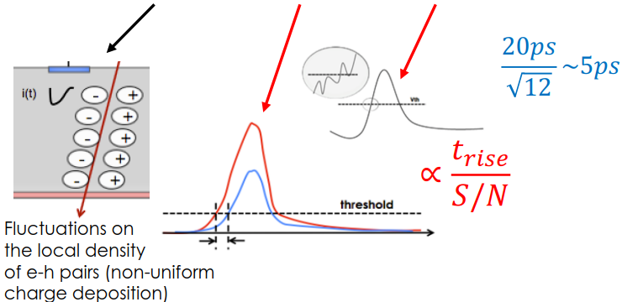
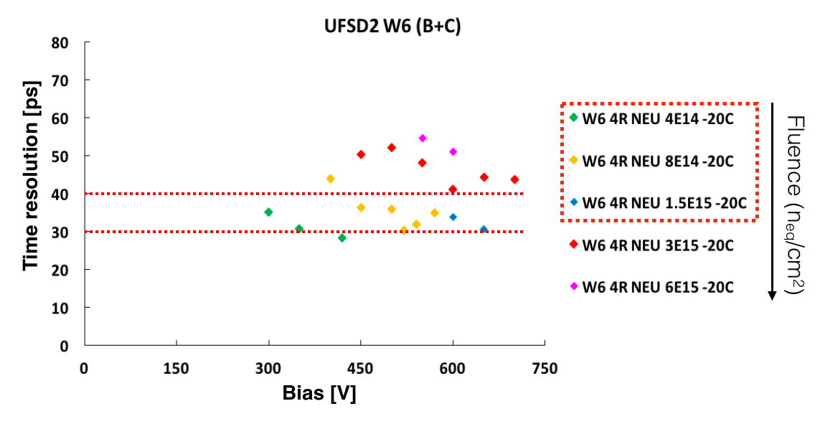
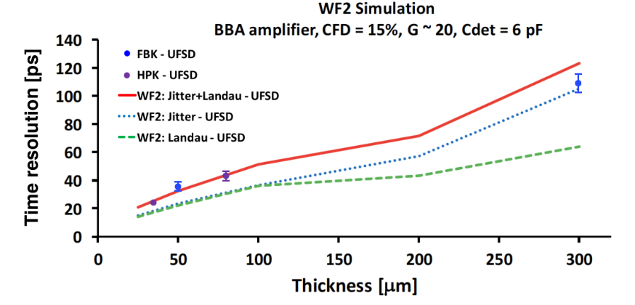
4D Ultra Fast Silicon Detectors
F. Carnesecchi, 14th Pisa Meeting on advanced detectors 2018
Rep. Prog. Phys. 81, 026101 (2018)
Low Gain Avalanche Diode
σ²_{t}= σ²_{Landau} + σ²_{time slewing} + σ²_{jitter} + σ²_{TDC}
Additional doping layer (B or Ga)
Best S/N @ ~ 20-30
High precision timing requires high S/N and fast rise-time
Required radiation hardness ~ 2x10¹⁵ n_{eq}/cm² achieved by C implant to mitigate B deactivation in gain layer
Best thickness ~ 50 μm

Slide 21
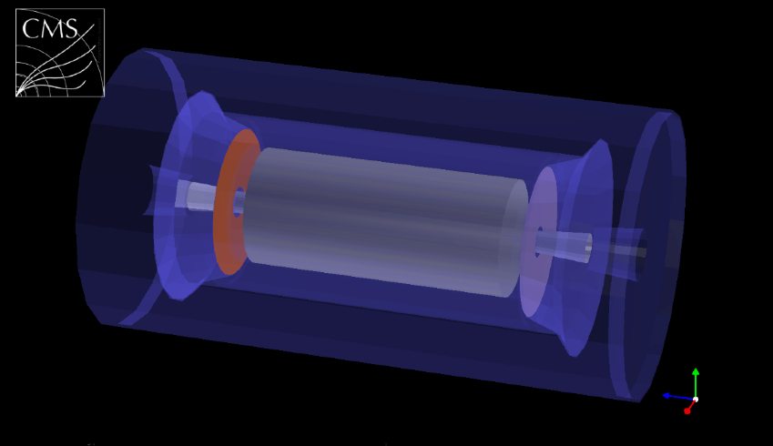
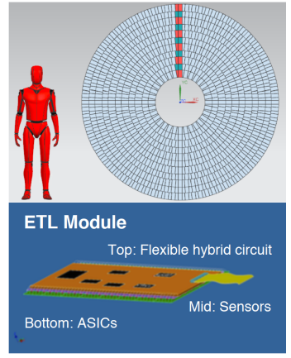
CMS Endcap Timing Layer
Barrel Timing Layer (BTL)
LYSO crystals + SiPM Readout
M. Costa, 14th Pisa Meeting on advanced detectors 2018
(MIP Timing Detector, Phase2 upgrade)
Double disk structure, aluminium wedge with embedded cooling pipes © @ -30 ºC, 42 mm total tickness
2624 sensors of 48 x 96 mm² , each with 1536 pads of 1x3 mm²
12 m², 4M channels
Radiation: 2×10¹⁵ n_{eq}/cm²
Endcap Timing Layer (ETL)
LGAD
Present situation: fill factor 91% → 96% for 30 μm gap (technological limit)
Hermetic MIP timing layer
between tracker and HCAL
“trench” design: Fill factor ~ 100%
INFN+FBK RSD project (Resistive AC coupled Silicon Detector): no segmentation of active area, fill factor 100%
Sensor state of the art
LGAD produced by FBK, CNM, HPK
1/16 of full module in production
Fill factor under optimization

Slide 22
CMS Barrel Timing Layer
Barrel Timing Layer (BTL)
LYSO crystals + SiPM Readout
C. Tully, Academic Training Lectures, CERN 12/05/17
A. Benaglia, Talk at ICHEP 2018
(MIP Timing Detector, Phase2 upgrade)
~10mm x 10mm area LYSO crystals at R=1200mm → Hit occupancy few % at 200 PU
36 trays in ϕ, 72 half trays, 56 modules per half tray, 64 crystals per module
Half-Tray size: 2604 mm x 184.5 mm
40 m², 258048 channels
radiation: 2×10¹⁴ n_{eq}/cm²
Hermetic MIP timing layer
between tracker and ECAL
Endcap Timing Layer (ETL)
LGAD
Target timing resolution demonstrated at beam tests with Hamamatsu and FBK SiPM
However, observed timing dependence on hit position on the tile
Hardware solutions being considered:
tailored SiPM with uniform tile surface coverage (response is uniform by construction, but large Si area)
replace crystal tiles with bars read out on both sides
Operated at -30° C
SiPM active area limited to < 16 mm² (noise and power dissipation)
ASIC: TOFHiR (adapted from commercially-available TOFPET) : leading edge discrimination + amplitude measurement for time-walk corrections

Slide 23
The ATLAS High-Granularity Timing Detector
ATL-LARG-PROC-2018-003
Pseudorapidity coverage: 2.4<|η|<4.0
Radial extension: 12 cm < R < 64 cm
z position: 3.5 m
Thickness in z: 7.5cm
2 double planar layers per endcap
LGAD, 50 μm thick, gain 20 (FBK, CNM)
Low occupancy , Pixel size: 1.3x1.3 mm²
radiation: 4.5×10¹⁵ n_{eq}/cm²
LGAD hit time resolution worsens with radial distance due to larger radiation dose: maintain 30ps/track resolution by increasing the number of hits at low radius → larger overlap of modules at low R

Slide 24
The LHCb TORCH detector
N. Harnew, 14th Pisa Meeting on advanced detectors 2018
MCP by PHOTEK Ltd, 11/module
53x53 mm² active area, 64x8 pads
ALD coating for lifetime > 5 C/cm²
NINO +HPTDC R/O electronics
TOF detector considered for LHCb Upgrade II
PID in 2-10 GeV/c momentum range
Exploit prompt production of Cherenkov light to determine TOF
Single photon σ_{t} ~ 70 ps, track σ_{t} ~ 15 ps
R&D next goals
single photon resolution of ~100ps (including time reference)
improve calibration/ alignment (e.g. charge-to-width calibration of NINO).

Slide 25
The PANDA TOF detector
AntiProton Annihilation at Darmstadt (FAIR)
•Fixed target (cluster-jet or pellet)
•Collision rate ~ 20 MHz
•Free ﬂowing DAQ with continuous R/O
S. Zimmerman, 14th Pisa Meeting on advanced detectors 2018
16 layers PCB of 2460 x 180 x 20 mm³
used as mechanical support and to transmit the signals to FEE
Measured crosstalk and attenuation
Tested various scintillators (EJ-232, EJ-228)
SiPMT (ASD-NUV3S-P by AdvanSiD) connected in series by 4 for lower effective capacitance and faster signal
Requirements:
< 100 ps time resolution
Event timing + PID below DIRC thresh. (0.7 GeV/c)
Radius of 0.5 m and length of 2 m
16 modules, 60x2 scintillating tiles per module
15360 SiPMs (4 per scintillator side)
3840 channels
σ ~ 51 ps

Slide 26
The CBM TOF wall
Compressed Barion Matter @ FAIR
• Au-Au interaction rate ~ 10 MHz
•Free ﬂowing DAQ with continuous R/O
Journal of Physics: Conf. Series 1023 (2018) 012007
M. Petris, ICHEP 2018
Requirements:
80 ps time resolution
Rate up to 30 kHz/cm²
MRPC, double stack , 10 gaps of 140 μm
Low resistivity glass for Inner wall: 10¹⁰ Ω cm
Strip readout (0.254x4.6 cm²)
85% C₂H₂F₄+ 5% i-C₄H₁₀+10% SF₆
R/O: PADI chip + GET4 TDC

Slide 27
Neural networks for MRPC time reconstruction
Typical signal processing by Time-over-Threshold
t_{p} ~ particle arrival time
t_{tot}~ signal amplitude for slewing correction
arXiv:1805.02833v1 [physics.ins-det] 8 May 2018
4-stage MRPC with 8 gaps of 104 μm and 0.5 mm plates +
Real measurement using cosmics:
ToT σ ~ 48 ps
NN σ ~ 27 ps
t_{tot1}
t_{p1}
t_{p2}
t_{tot2}
Neural Network built using as input n equally spaced points along the leading edge →
t_{p} : peak time
t_{l} : length of leading edge
particle arrival time t₀ = t_{p} - t_{l}

Slide 28
TPC for International Large Detector at ILC
Inner/Outer radius | 0.325/1.8 m
Length | 4.7 m
Gas | Ar/CF₄/i-C₄H₁₀ (95/3/2)
Max n. of track samples | 222
B | 3.5 T
Point resolution σ_{rφ} | < 100 μm (1x6 mm² R/O pads)
dE/dx resolution | 5%
dE/dx measurement | Truncated mean 70%
R/O chamber | GEM or MICROMEGAS + pad plane or Timepix
Nucl. Instr. and Meth. A 856 (2017) 109–118
EUDET/AIDA TPC prototype
3 GEM ROC, 70 μm hole, 140 μm pitch, 1.3x5.9 mm pad
Max drift length 57 cm, 28 track samples
77 cm
17 cm
23 cm
Testbeam results , B= 1 T
Extrapolation @ B= 3.5 T and L_{drift}=2.35 m
Intrinsic σ ~ 70 μm

Slide 29
TPC for International Large Detector at ILC
Inner/Outer radius | 0.325/1.8 m
Length | 4.7 m
Gas | Ar/CF₄/i-C₄H₁₀ (95/3/2)
Max n. of track samples | 222
B | 3.5 T
Point resolution σ_{rφ} | < 100 μm (1x6 mm² R/O pads)
dE/dx resolution | 5%
dE/dx measurement | Truncated mean 70%
R/O chamber | GEM or MICROMEGAS + pad plane or Timepix
Gating GEM with hexagonal holes, 25 μm thick
EUDET/AIDA TPC prototype
2 GEM ROC, 70 μm hole, 140 μm pitch, 1.3x5.9 mm pad + 1 gating GEM
Max drift length 57 cm, 28 track samples
arXiv:1712.09777v1 [physics.ins-det] 28 Dec 2017
ILC beam structure
v_{drift} ~ 370 cm/s →
0.4 cm thick ion disc every 75 cm

Slide 30
GEM-TPC with combined electronic and optical R/O
IEEE TNS, VOL. 65, NO. 3 (2018), 913-919
F. Brunbauer, 14th Pisa Meeting on advanced detectors 2018
Exploit CF₄ scintillation for 3D track reconstruction → 2D imaging of projected track using a CCD camera + timing from electronic R/O of signals in transparent Indium Tin Oxide (ITO) strips anode
APV25 R/O time frame of 25 ns, e⁻ drift velocity 8 cm/μs → z resolution ~ 2 mm
Arrival time of the signal on each anode strip determined by CFD with linear interpolation between data points
Proof of principle, large potentialities with different segmentation of ITO anode and faster R/O electronics to improve z resolution
(450 nm ITO film on glass, 48 x 1.5 mm strips by photolithography)
Ar/CF₄ (80/20)
Hamamatsu ImagEM X2, 512x512 pixels of 16x16 μm²

Slide 31
TR “imaging” using silicon sensors
E. Schioppa, 14th Pisa Meeting on advanced detectors 2018
TimePix3
+
500 μm Si
Extend PID to γ>10⁴ using energy and angular dependence of TR
2.2 m He pipe
beam
Radiator
30 Mylar 50 μm,
3 mm gap

Slide 32
PICOSEC
arXiv:1806.04395v1 [physics.ins-det] 12 Jun 2018
F.J. Iguaz, 14th Pisa Meeting on advanced detectors 2018
Radiator window: Cherenkov UV production.
Photocathode: UV -> electrons.
Two-stage Micromegas: drift (pre-amplification) + amplification gaps.
New prototypes implementing:
resistive strips R/O to improve operation stability, up to 10⁶ Hz/cm²
more robust PC (Al, CsI with protective layer, DLC)
multi-pads, 35 mm diam., 19 pads
80%Ne+10%C₂H₆+10%CF₄
Testbeam with 150 GeV μ
1st prototype tests, MgF₂ radiator, CsI PC, single pad (1 cm diam.)
preliminary
σ = 36 ps
σ = 24 ps
Next R&D:
PC robustness and QE
Scalability and R/O electronics

Slide 33
3D Digital SiPM
J.F. Pratte, 14th Pisa Meeting on advanced detectors2018
Stop
Δ time = Δ distance
PET Scanner
Patient
Time-to-digital converter
+
-
Start
10 ps coincidence timing resolution (CTR) →
1.5 mm of precision, real time PET imaging
3D digital SiPM
High fill factor (up to 80%)
Heterogeneous technologies integration:
SPAD array: Teledyne-Dalsa custom process
TSMC CMOS 65 nm - 256 SPAD readout ASIC
Conventional SiPM → array of SPADs (Single Photon Avalanche Diodes) connected in parallel
Main limitations for TOF-PET:
SPAD to SPAD gain and dark count rate variations (response uniformity)
Large output C affects rise-time
timing skew associated to SPAD position
2D Digital SiPM:
↑ each SPAD connected to quenching circuit and TDC → low out C and time skew (individual calibration)
↓ Quite low fill factor
first prototype
1.1x1.1 mm² , 256 pixels
skew corrected
~ 500 ps time skew:
- clock and trigger distr.
- pixel to pixel variations
18 ps jitter
- R&D in progress
- Possible application in nEXO LAr experiment

Slide 34
Conclusions
Experience with existing large systems has shown that the overall PID performance of state of art detectors can be improved as knowledge of detector response becomes more accurate and new signal processing and data analysis techniques can be applied (NN, combined PID, …).
The integration of micropattern gaseous detectors or hybrid solutions makes large TPCs an attractive solution for tracking and PID in future colliders (ILC, CEPC).
Also, MRPCs with improved rate capability (low resistivity glass) represent the best cost effective solution for large TOF systems (CBM).
“Fast timing” is (and will remain) the main R&D topic for upgrades and future applications. Solutions approaching the 10 ps regime are becoming available and implementation in real detectors is under development, although scaling to large systems is not straightforward.

Slide 35
Backup slides

Slide 36
PID basics
PID by interaction differentiation
measurement →
Cherenkov radiation: omitted
Specific ionization loss: $\frac{dE}{dx}∝ \frac{z^{2}}{β^{2}} ln\left(βγ\right)$
N samples of thickness t along track → truncated mean (~0-80%) to cut Landau fluctuations
$σ_{dE/dx}=0.41N^{−0.43}{\left(tP\right)}^{−0.32}$ , 5%-8% at P= 1 atm
Primary collision cluster counting can provide better performance (with proper choice of gas, P, R/O pixel, FEE)
Time of flight: $Δt= \frac{L}{2p^{2}c}\left(m_{1}^{2} −m_{2}^{2}\right)$
Separation power $n_{σTOF}= \frac{∆t}{σ_{TOF}}$ → fast detector, L
Transition radiation: e⁻/π separation
$γ_{th}=\frac{l_{1}ω_{1}}{c} ≅1000;$
$N_{ph}≈\frac{1}{137}$ (/ rad. sheet); $γ_{sat}=0.6 ω_{1}\frac{\sqrt{l_{1}l_{2}}}{c}$
PID by mass measurement →
$m= \frac{p}{cβγ}$ → ${\left(\frac{dm}{m}\right)}^{2}={\left(γ^{2}\frac{dβ}{β}\right)}^{2}$+${\left(\frac{dp}{p}\right)}^{2}$

Slide 37
PID basics
PID detectors dimensions
Nucl. Instr. & Meth. A 686 (2012), 148-172
Particle Data Group, Phys. Rev. D 98, 030001 (2018)., Sect 34.6.6.
Transition radiation
π/K separation > 3σ
e⁻/π separation

