Slide 1
RICH 2018, Moscow, 30 July – 4 August 2018
Cherenkov light imaging in
Astroparticle Physics
Uli Katz
Erlangen Centre for Astroparticle Physics
Friedrich-Alexander University of Erlangen-Nürnberg
30 July 2018

Slide 2
The plan for the next 35+5 minutes
Introduction – setting the scene
Imaging atmospheric Cherenkov telescopes (IACTs)
Timing arrays and hybrid installations
Neutrino telescopes
Conclusion

Slide 3
Introduction – setting the scene

Slide 4
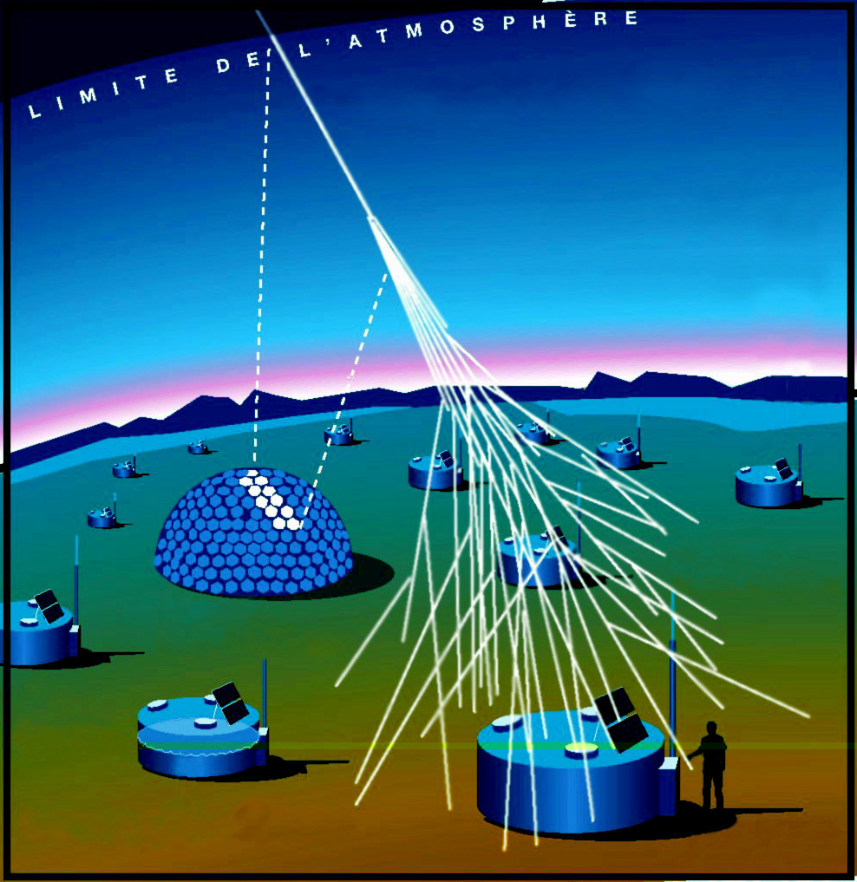
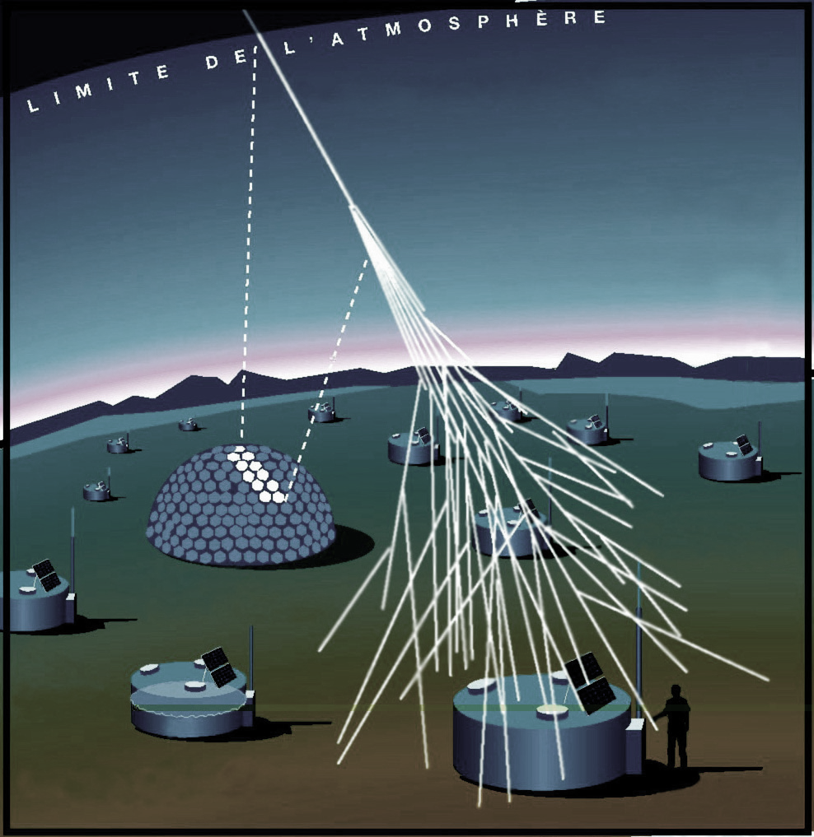
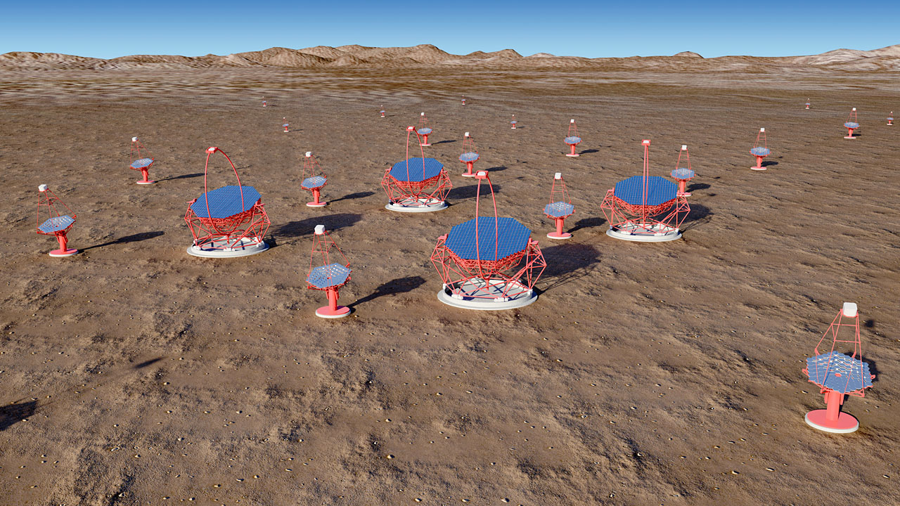
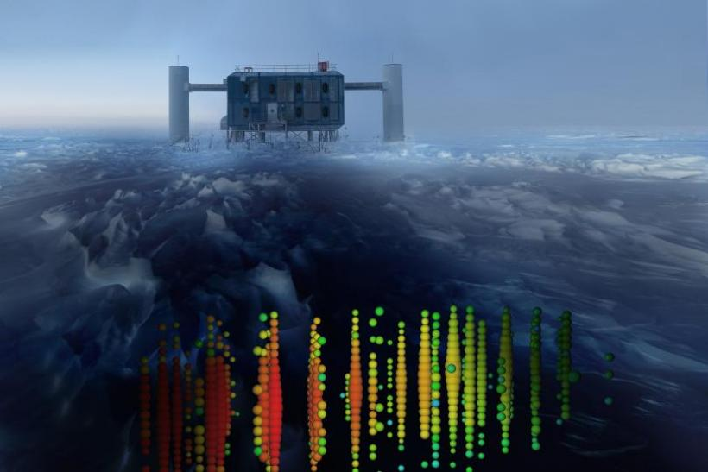
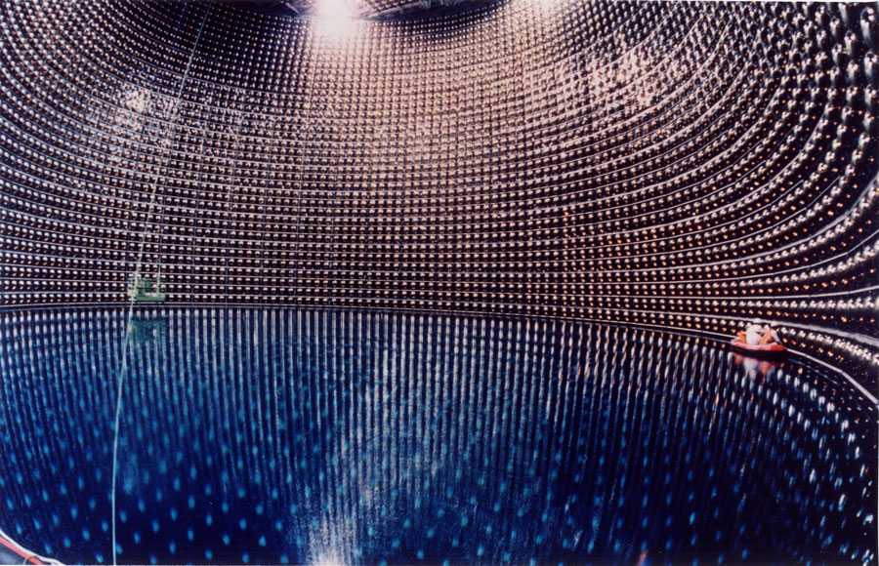
without
Astroparticles with Cherenkov detectors
Cosmic rays
Gamma-rays
Cherenkov detectors are
essential
for astroparticle physics
Cosmic neutrinos
Disclaimer for this talk:
No time to cover all experiments
No time to cover history
No time to go into depth and details
Solar and atmospheric neutrinos

Slide 5
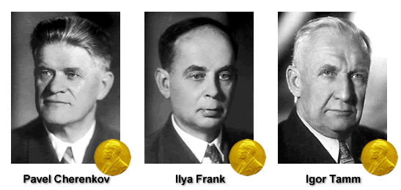
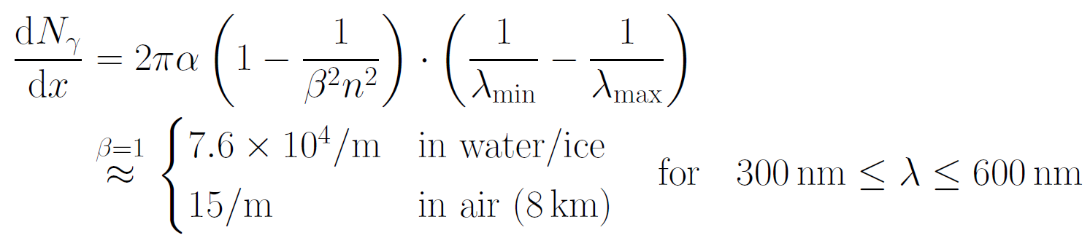
Cherenkov, Frank, Tamm and their radiation

Slide 6
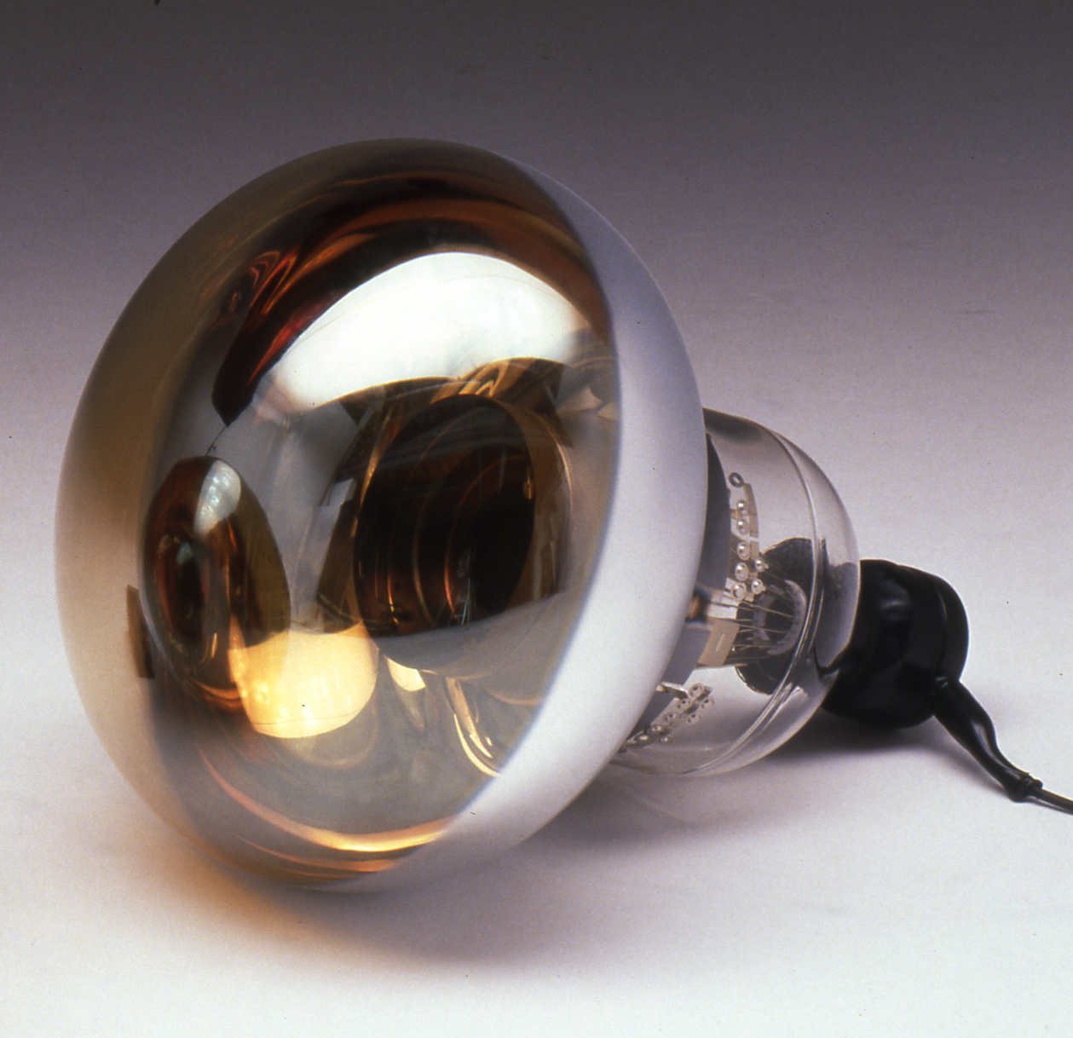
Detection of Cherenkov radiation
Very faint light
Detection requires
    Single-photon detection
    Timing at nanosecond level to suppress backgrounds
Photodetectors = Photomultiplier tubes (PMTs)
or SiPMs
Synchronisation of large detector arrays at
sub-nanosecond precision
Hamamatsu 20-inch PMT

Slide 7
Cherenkov detectors in astroparticle physics
Imaging Atmospheric Cherenkov telescopes (γ-rays)
Timing arrays (γ-rays, cosmic rays)
Hybrid detectors (typically cosmic rays)
Neutrino telescopes (v’s)
… and variants, and more
Radio detection of
particle cascades in
air, water/ice, rock
also involves
Cherenkov effect –
Not discussed here.
In the following, for each of these categories:
How does it work?
What are the main physics questions?
Examples of current and future detectors
Highlight results
Links to specific presentations today & tomorrow

Slide 8
Imaging Atmospheric
Cherenkov Telescopes (IACTs)

Slide 9
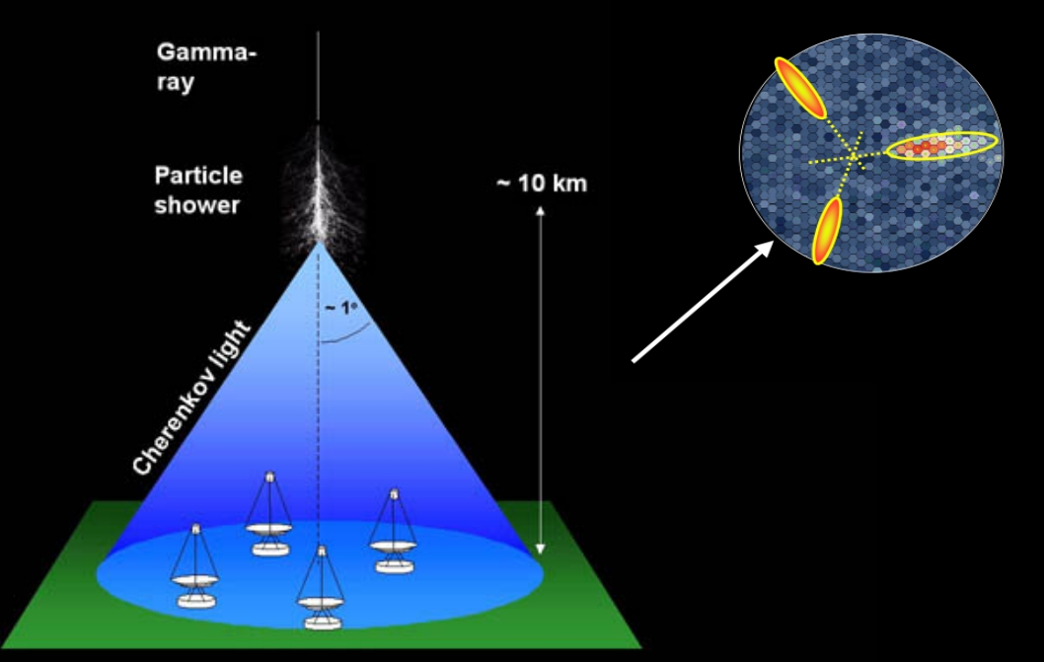
How IACTs work
Source position
Small θ_{C} (early shower)
Large θ_{C}
(late shower)
Direction and gamma/hadron
separation from geometry.
Energy from intensity.
High elevation to reduce atmospheric absorption

Slide 10

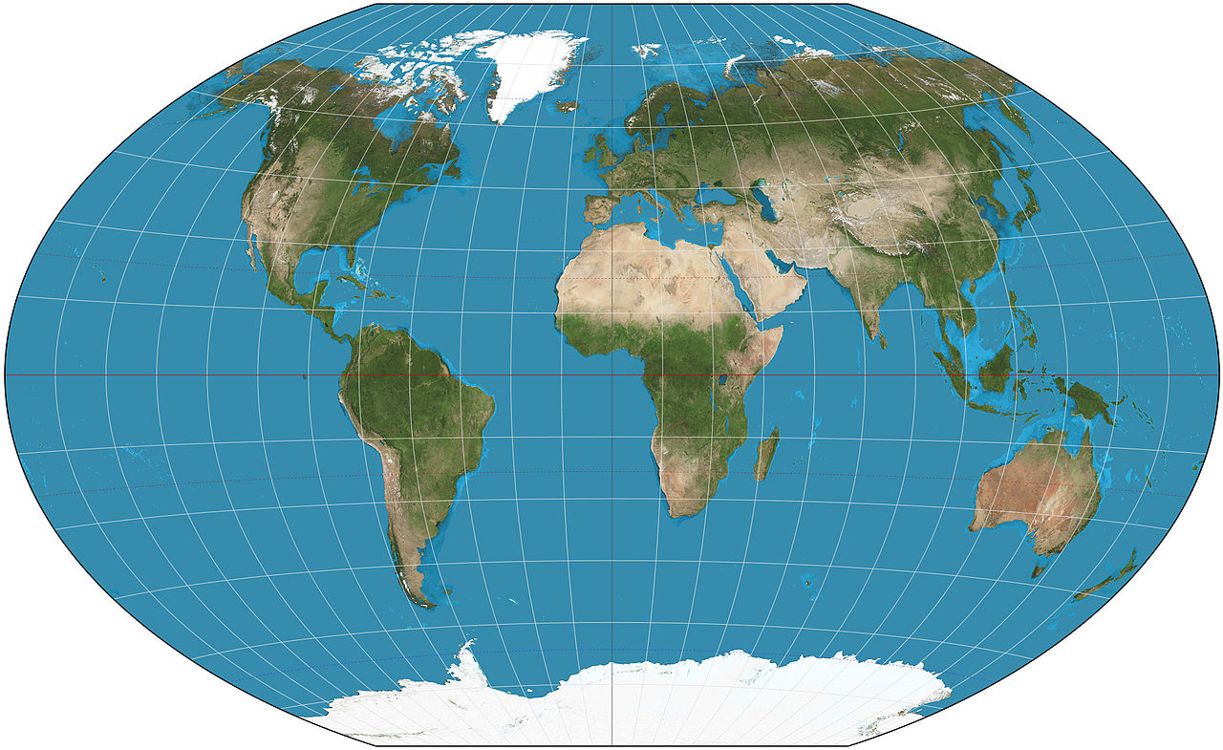

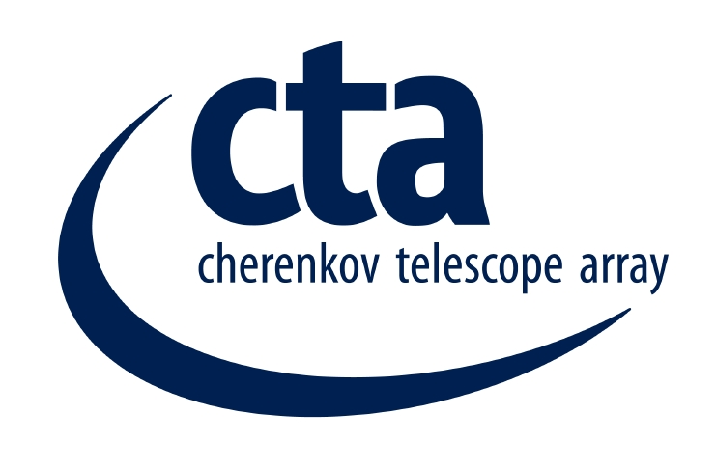

The IACT world map 2018
Veritas
2007 –
Arizona/USA
MAGIC
2004 –
La Palma
Also:
FACT/M@TE: Monitoring
SHALON: v-induced showers
See presentation by V. Sinitsyna
CTA
~2021 –
Chile/Paranal + La Palma
H.E.S.S.
2003 –
Namibia

Slide 11
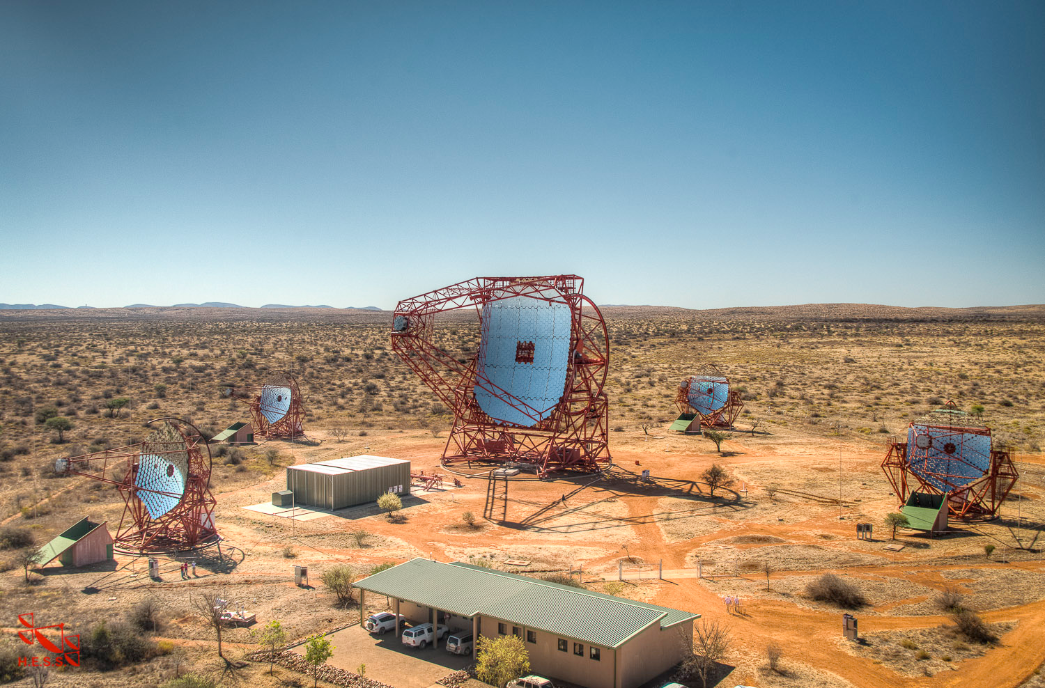
Example: The H.E.S.S. telescope in Namibia
4x 100 m² mirror area (since 2003)
energy threshold ~ 100 GeV
1x 600 m² mirror area (since 2012)
energy threshold ~ 50 GeV
Energy range:
100 GeV – some PeV
(“high-energy”, HE)
120 m

Slide 12
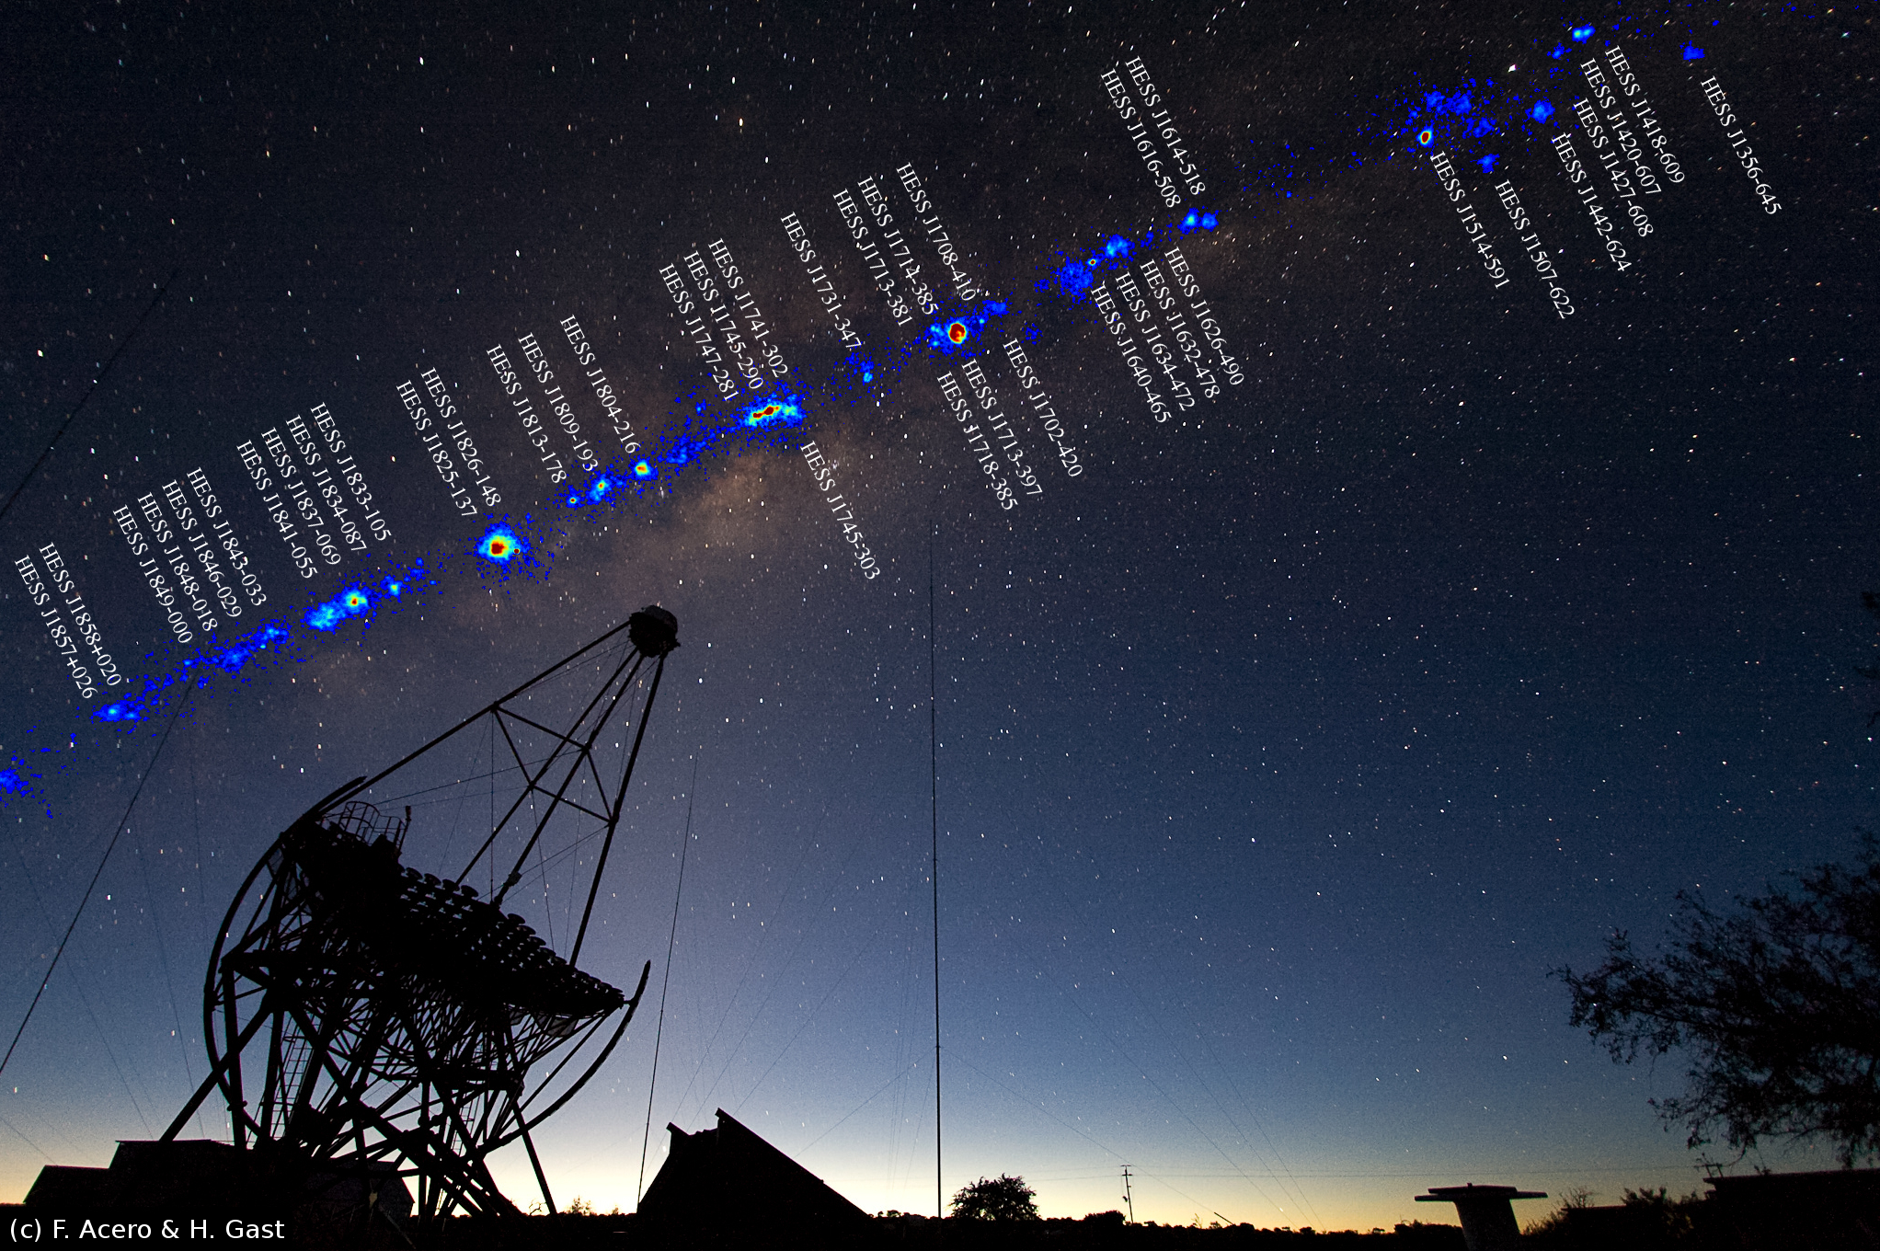
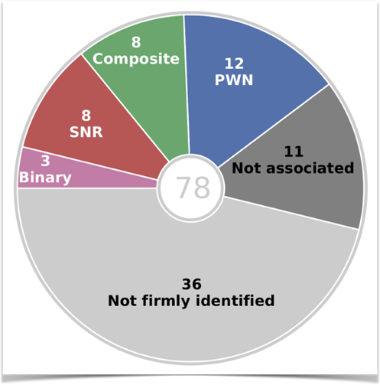
H.E.S.S. survey of the inner Galaxy
Galactic Plane
Galactic Centre
H.E.S.S. legacy project:
3000 h of observations (2004-2013)
survey maps, catalog, population studies
H.E.S.S. Coll. (2018):
Astron. & Astrophys. Special Issue 612 (2018) on
“15 years of H.E.S.S. observations of the Milky Way”
U. Katz: Cherenkov detectors in astroparticle physics RICH 2018, Moscow

Slide 13
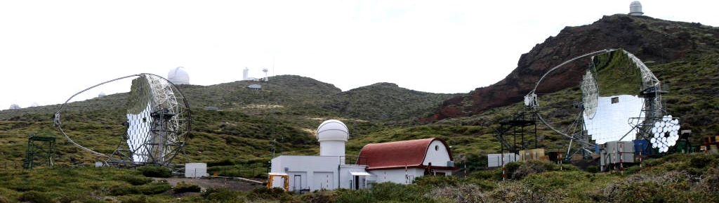
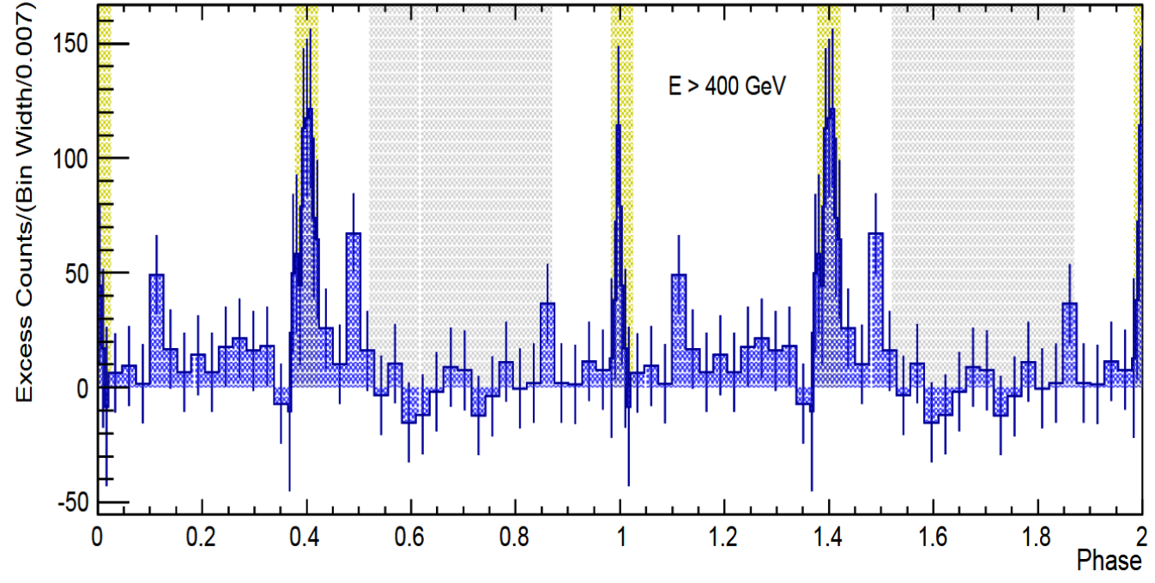
MAGIC on La Palma
Detection of pulsed
TeV gamma-ray
emission from Crab
(2015)
Astron.Astrophys. 585 (2016) A133
See presentation by
R. Mirzoyan

Slide 14
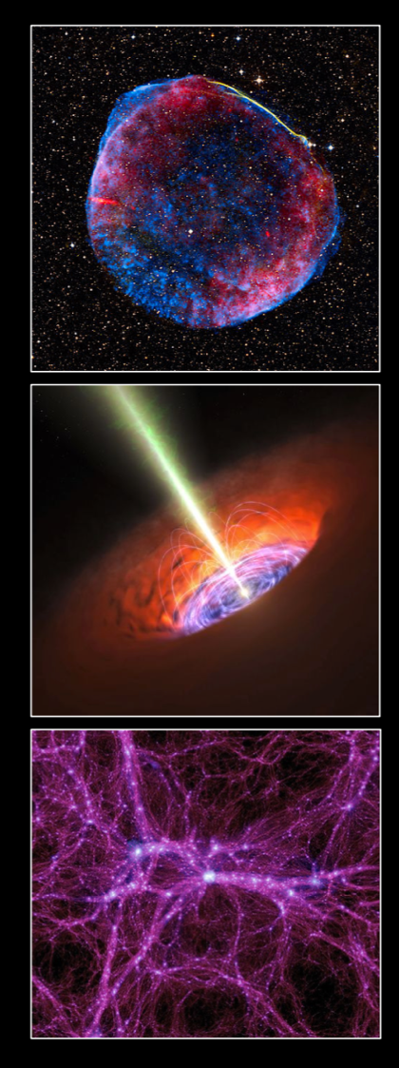
The physics themes to be explored
Key science projects:
Dark Matter Programme
Galactic Centre
Galactic Plane Survey
Large Magellanic Cloud Survey
Extragalactic Survey
Transients
Cosmic-ray PeVatrons
Star-forming Systems
Active Galactic Nuclei
Clusters of Galaxies
Beyond Gamma Rays
Theme 1: Cosmic Particle Acceleration
How and where are particles accelerated?
How do they propagate?
What is their impact on the environment?
Theme 2: Probing Extreme Environments
Close to neutron stars and black holes?
Relativistic jets, winds and explosions?
Cosmic voids
Theme 3: Physics Frontiers
What is the nature of Dark Matter?
Is the speed of light a constant?
Do axion-like particles exist?
Surveys
Key objects

Slide 15
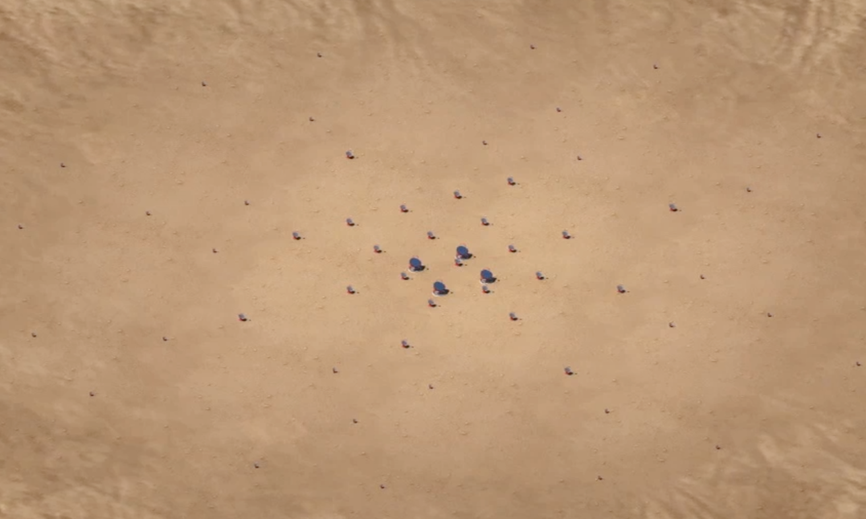
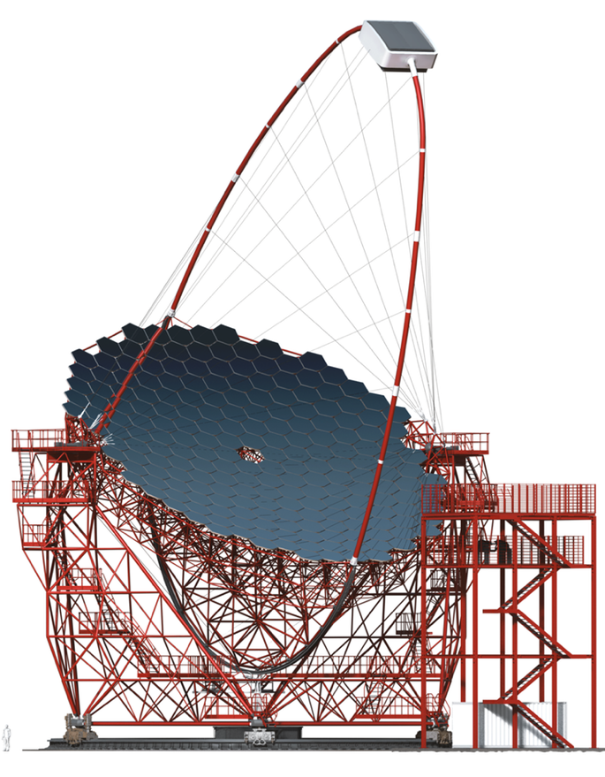
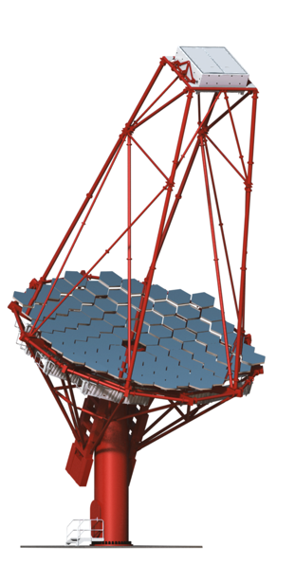
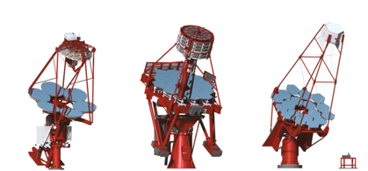
The future: Cherenkov Telescope Array (CTA)
10 GeV 100 GeV 1 TeV 10 TeV 100 TeV
10 GeV 100 GeV 1 TeV 10 TeV 100 TeV
10 GeV 100 GeV 1 TeV 10 TeV 100 TeV
10 GeV 100 GeV 1 TeV 10 TeV 100 TeV
1000 γ / h / km²
10 γ / h / km²
0.1 γ / h / km²
70 x 4 m ∅ Small Size Telescopes (SST) (South only)
25 x 12 m ∅ Medium Size Telescopes (MST) (North: 15)
4 x 23 m ∅ Large Size Telescopes (LST)
See presentations by
J. A. Barrio & M. Heller
Compared to current instruments
up to 10 x better sensitivity
over 4 decades coverage in energy
much larger field of view
better resolution
up to 400 x increased survey speed
Layout optimized
using detailed
simulations –
tens of millions CPU-h
Southern array
of Cherenkov telescopes
- about 3 km across

Slide 16
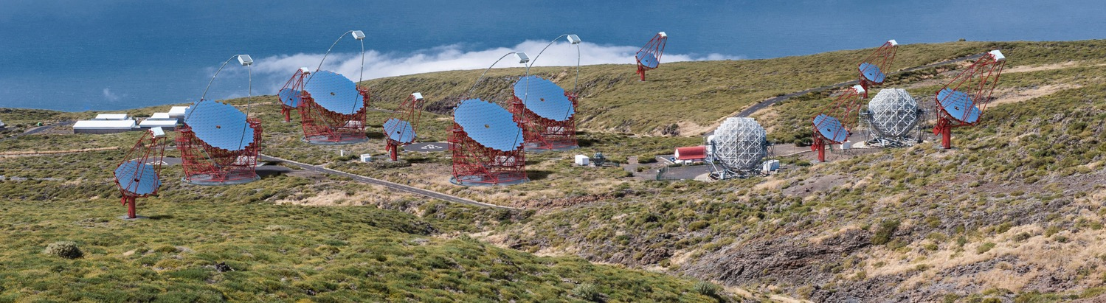
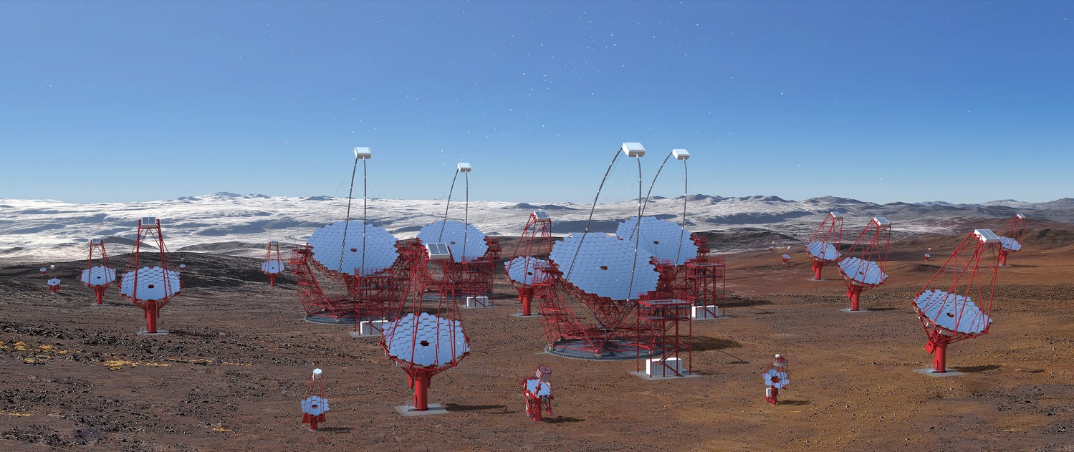
The CTA sites
CTA North (La Palma)
4 LST, 15 MST
CTA South (Chile)
4 LST, 25 MST, 70 SST

Slide 17
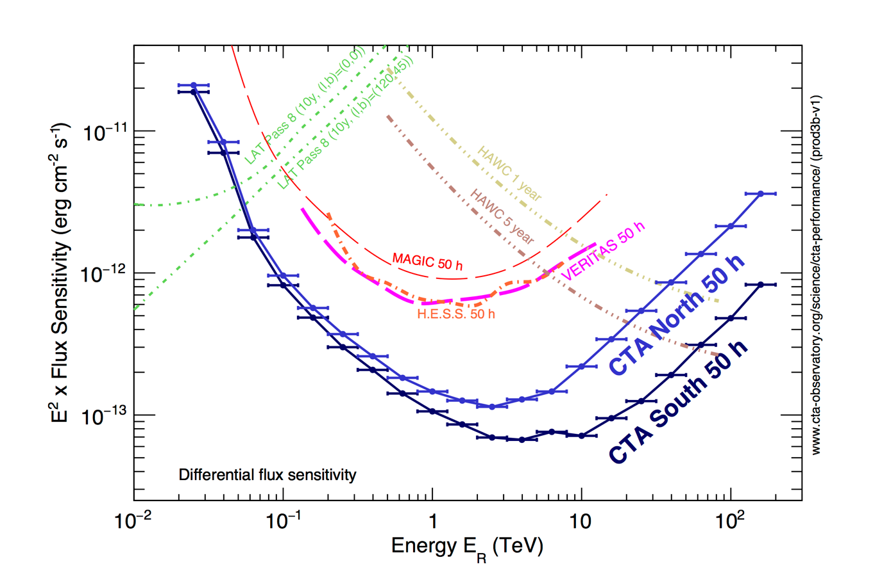
CTA sensitivity (steady sources)

Slide 18
Timing arrays

Slide 19
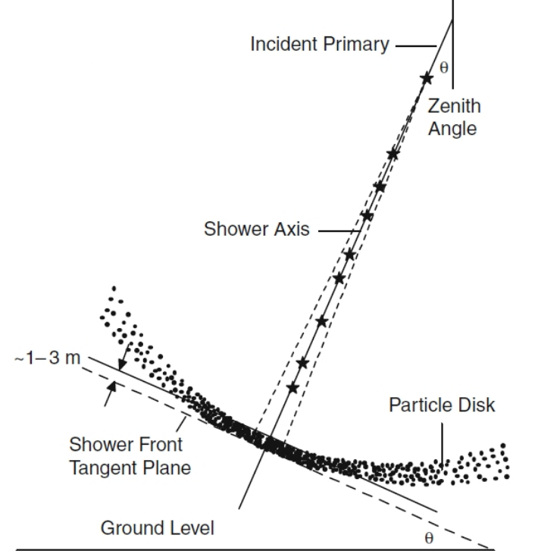
How does a timing array work?
For UHE gamma-ray and cosmic-ray detection
Shower must “survive”
→ (very) high altitude
Measurements:
  Direction from timing
  Energy from footprint size
  Gamma/hadron separation from shower geometry
Often combined with additional
detector elements (telescopes, muon chambers, radio antennas)
→ hybrid detectors
Array of ground-based detectors,
ns-timing (precision, synchronisation)

Slide 20
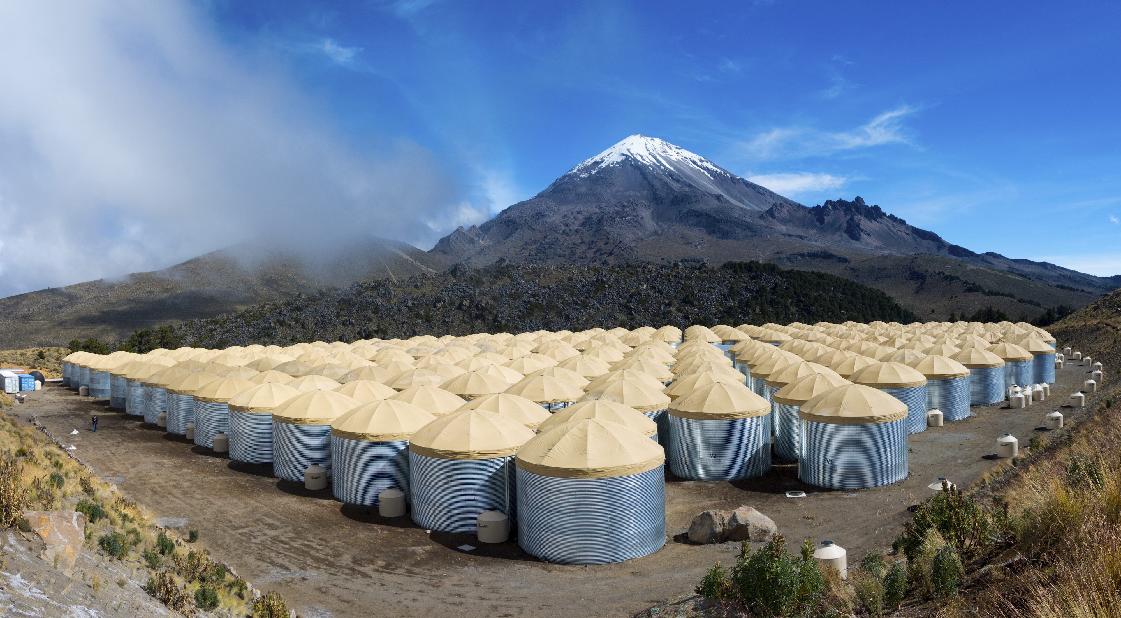
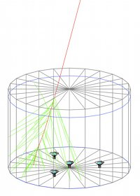
Example: The HAWC detector
50m
7.3m
4100m altitude, near Puebla, Mexico
300 water tanks, 200.000 litres each, observed by 4 PMTs
Direction resolution ~0.1°for E_{γ}>10TeV, good gamma/hadron separation, duty cycle close to 100%.
Wide field of view, but less sensitive than IACTs for any given direction

Slide 21
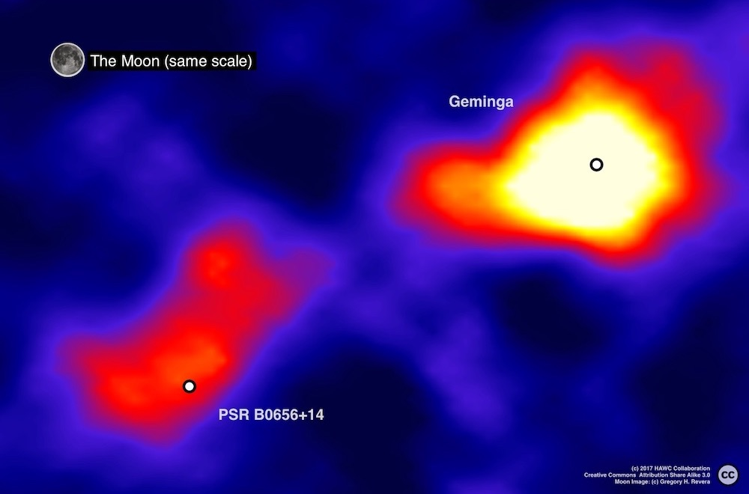
A recent HAWC result
Extended TeV gamma-ray emission from two pulsars
Topology constrains positron diffusion
Observed positron excess unlikely to come from these pulsars

Slide 22
Hybrid detectors

Slide 23
Some hybrids with Cherenkov detectors
NEVOD + DECOR (2001 – )
Surface water Ch. detector,
Streamer tube trackers
Tunka / TAIGA (2009 – )
Cherenkov camera array,
Scintillation detectors,
IACTs, radio detection
Pierre Auger Observatory
(2008 – )
Fluorescence telescopes, Cherenkov timing array
LHAASO (2021 – )
Ch. + Scintillator timing array,
central water Ch. detector
See presentations by
A. Petrukin (NEVOD), L. Kuzmichev (Tunka/TAIGA, I. Maris (PAO)

Slide 24
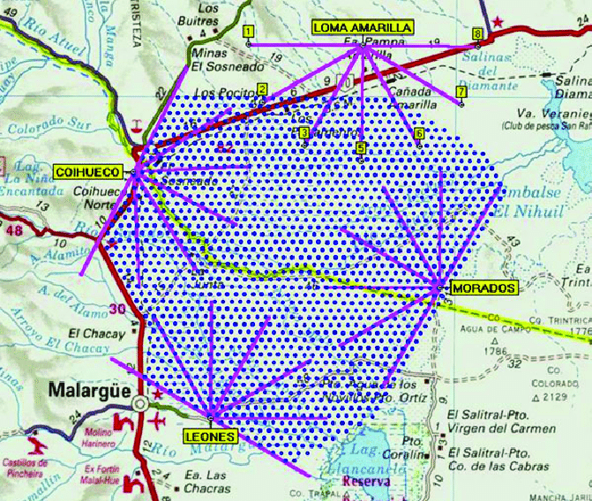
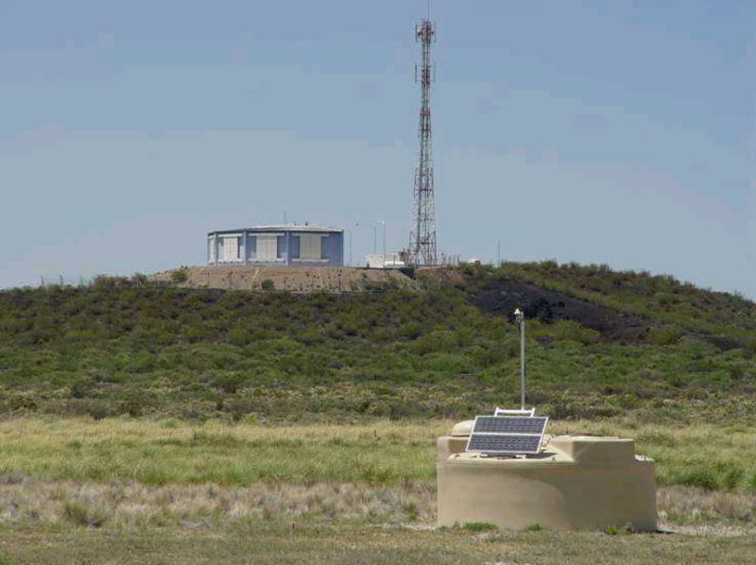
The Pierre Auger Observatory (PAO)
60 km
1600 water tanks, 3000 km²
24 fluorescence telescopes
Radio array
Upgrade ongoing
Hybrid
detection

Slide 25
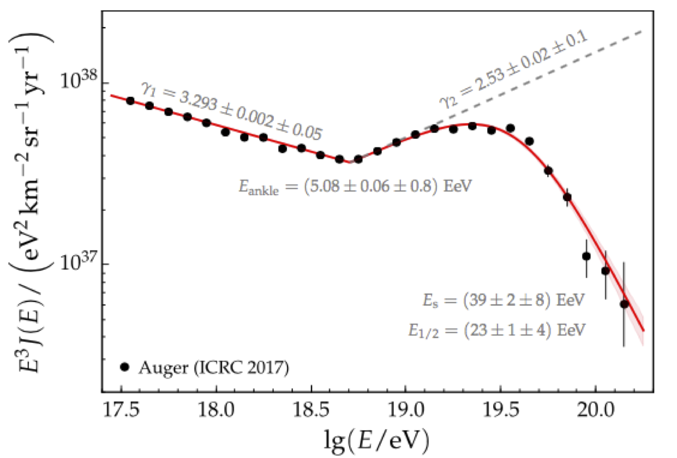
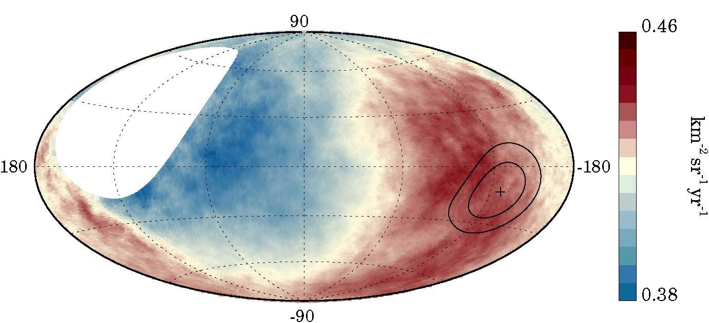
Key results from PAO
Cosmic ray spectrum up to 10^{20.2} eV
Discovery of large-scale anisotropy of cosmic- ray arrival directions
→ UHECRs do not come from Galactic centre
Open questions:
  Chemical composition?
  Origin of anisotropy?
  CR astronomy?
  GZK photons?
  Neutrinos?

Slide 26
Neutrino telescopes

Slide 27
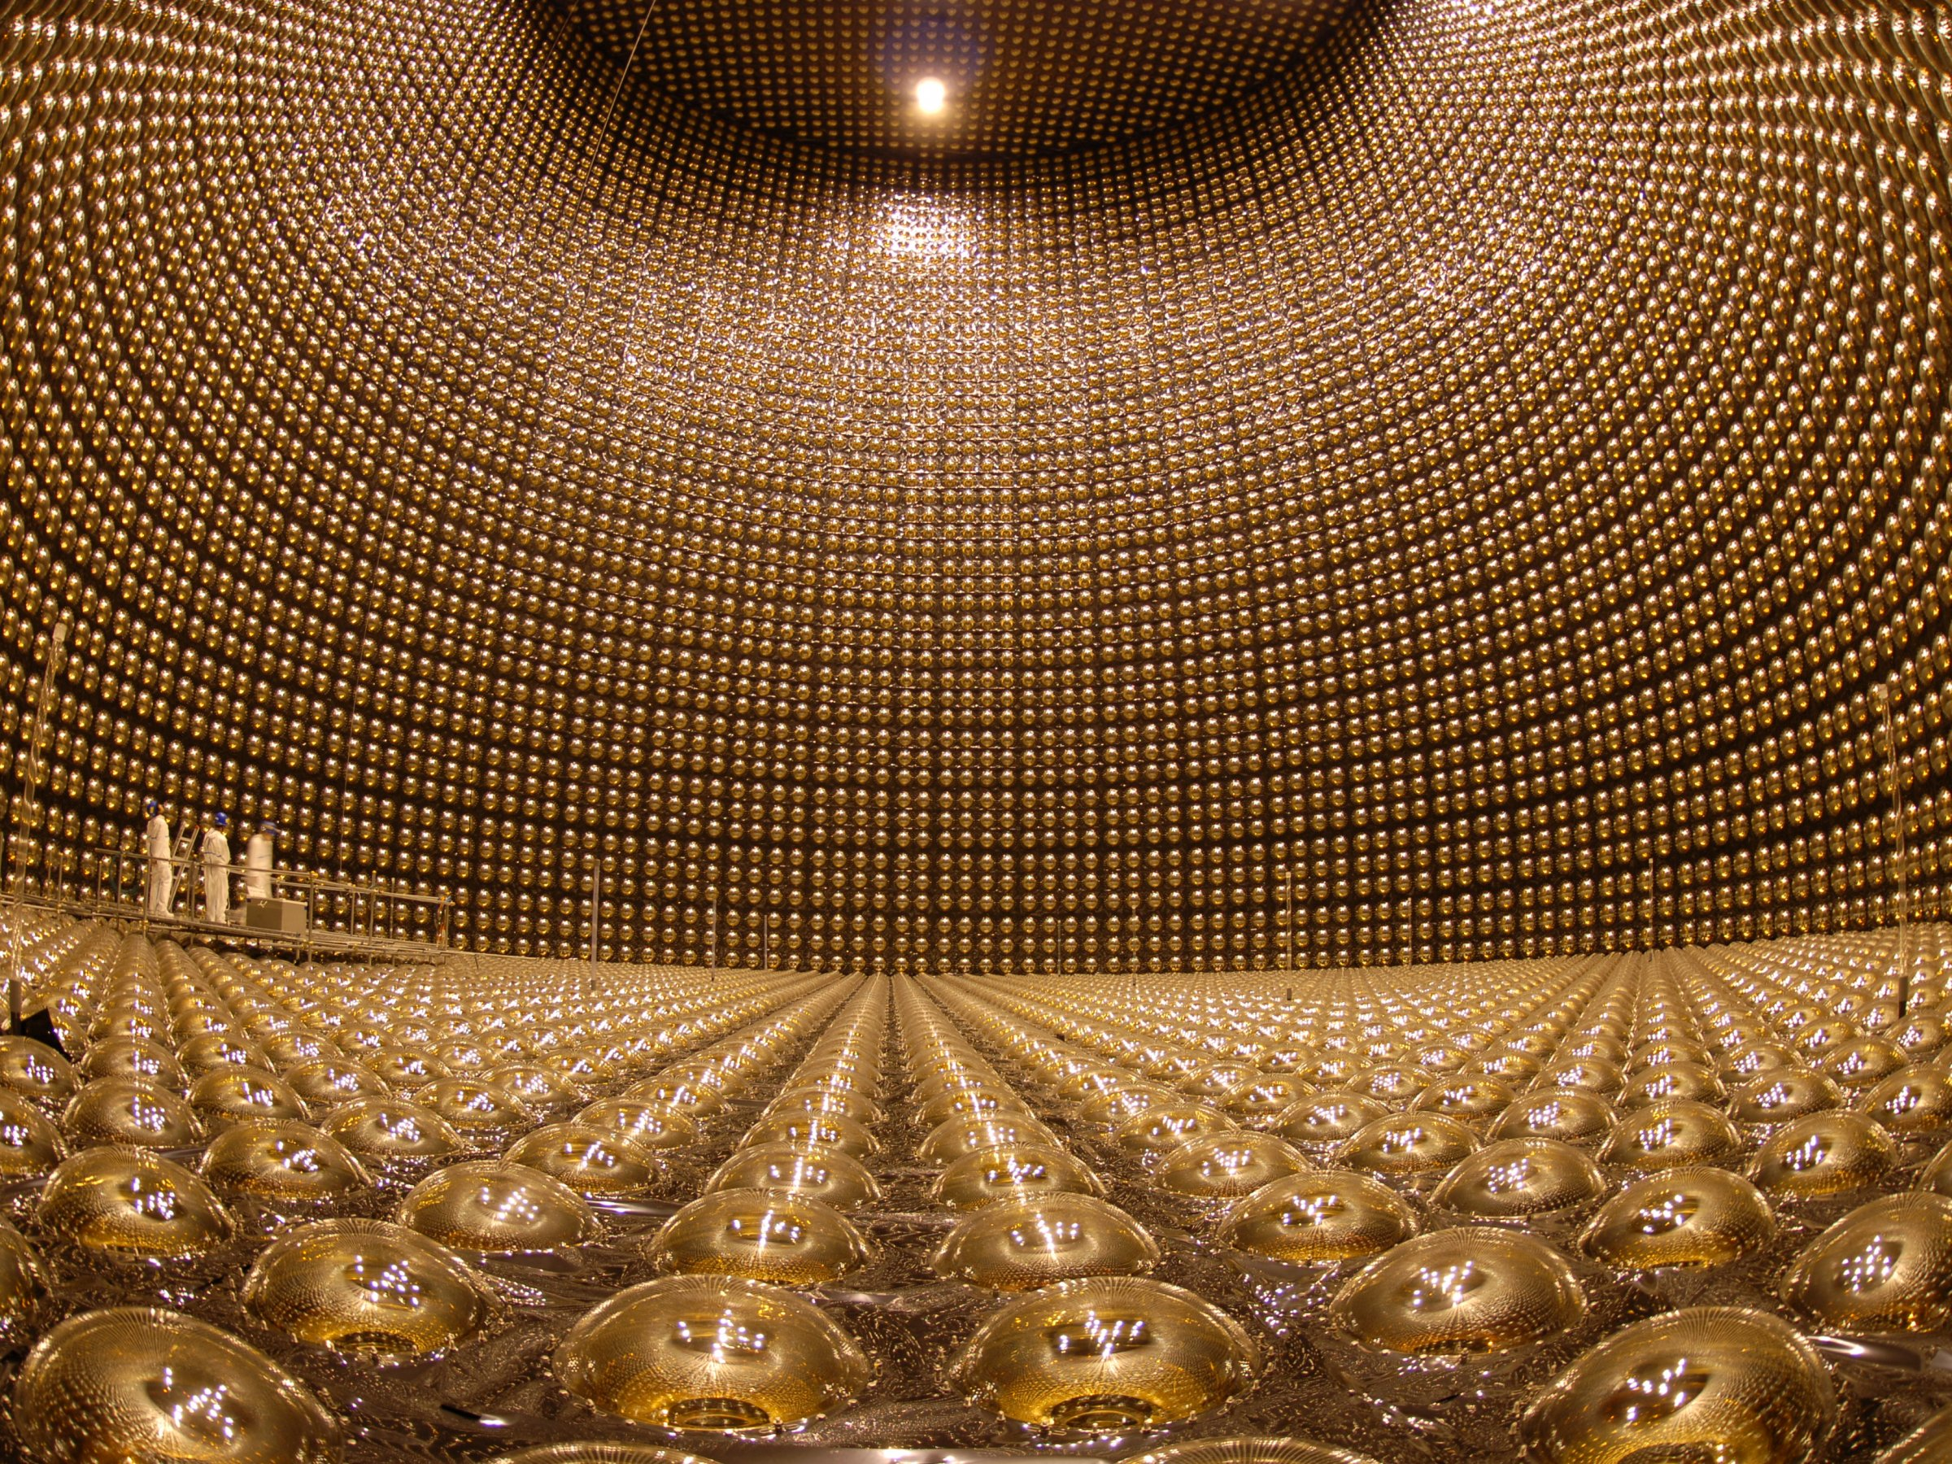
How does a neutrino telescope work?
Neutrino interacts in the
(vicinity of the) telescope
Charged secondaries cross the detector volume (water or ice) and stimulate Cherenkov emission
Recorded by a 3D-array of photo-sensors
Neutrino direction and energy reconstructed from
arrival times of photons at
PMTs, and PMT positions
Energy range:
few MeV – some GeV
(“low-energy”, LE)
µ
Energy range:
100 GeV – some PeV
(“high-energy”, HE)
v

Slide 28
The physics questions
High-energy (HE)
Identify and measure cosmic neutrinos
  What and where are the cosmic-ray accelerators?
  Transient phenomena
  Multi-messenger astronomy
  Can we detect dark matter?
Atmospheric neutrinos
  Oscillations
  Cosmic-ray inhomogeneities
…
Low-energy (LE)
Solar neutrinos
  Oscillations
  Solar standard model
Supernova neutrinos
  Understand supernovae
  Relic neutrinos
Atmospheric neutrinos
  Oscillations
  Sterile neutrinos?
…

Slide 29
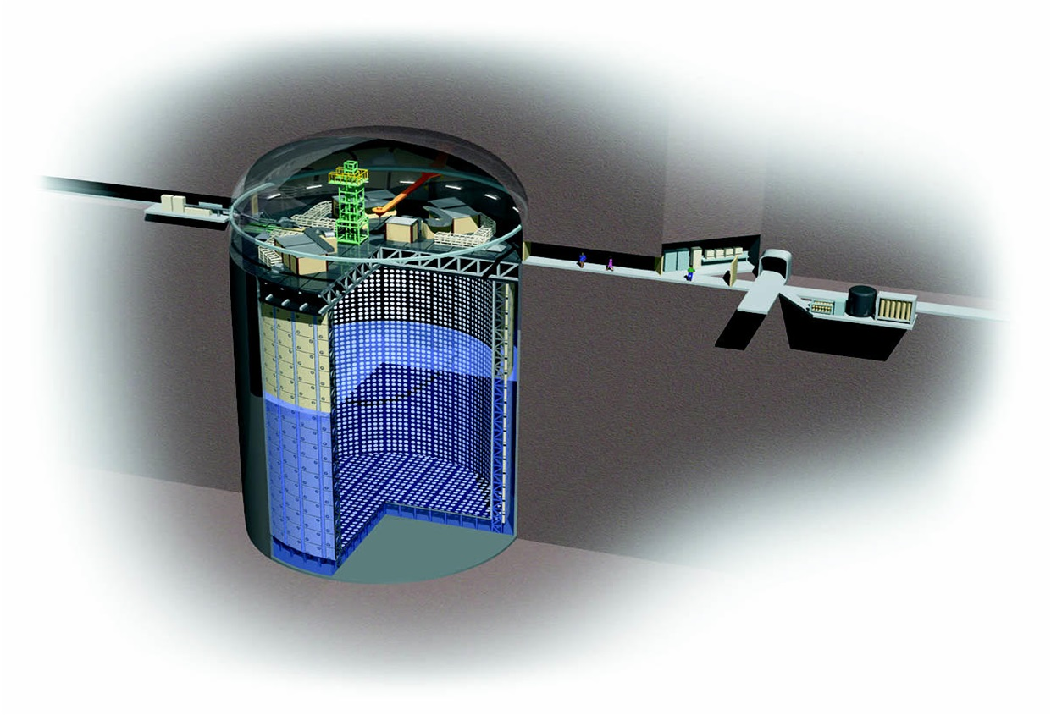
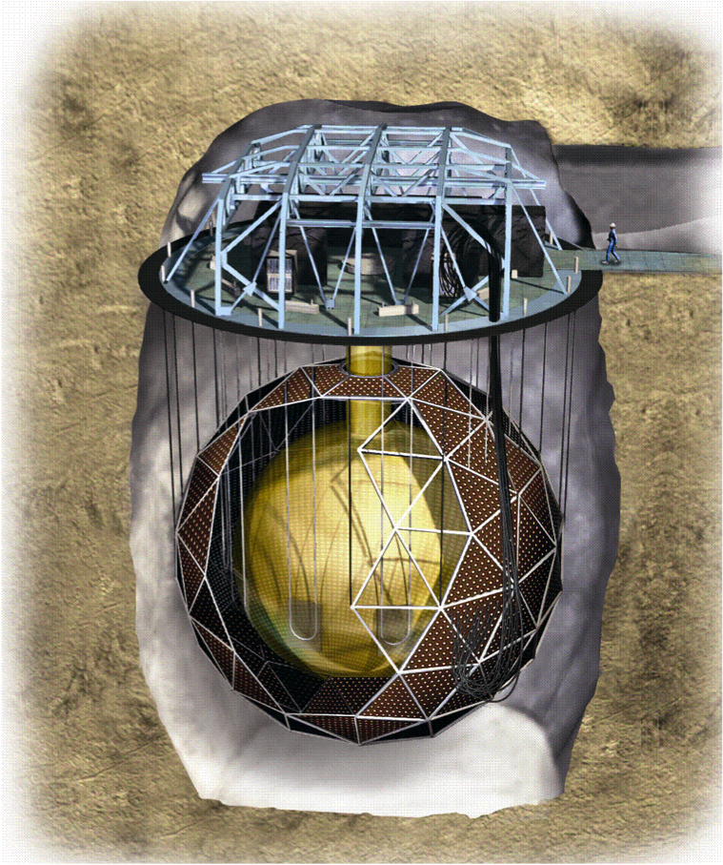
Nobel-winning LE experiments
Super-Kamiokande:
50 kton H₂O
SNO: 1 kton D₂O
See presentation by Y. Takeuchi

Slide 30
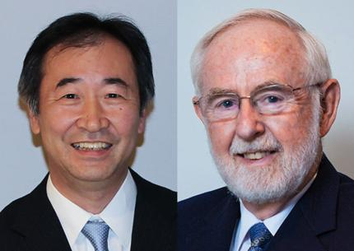
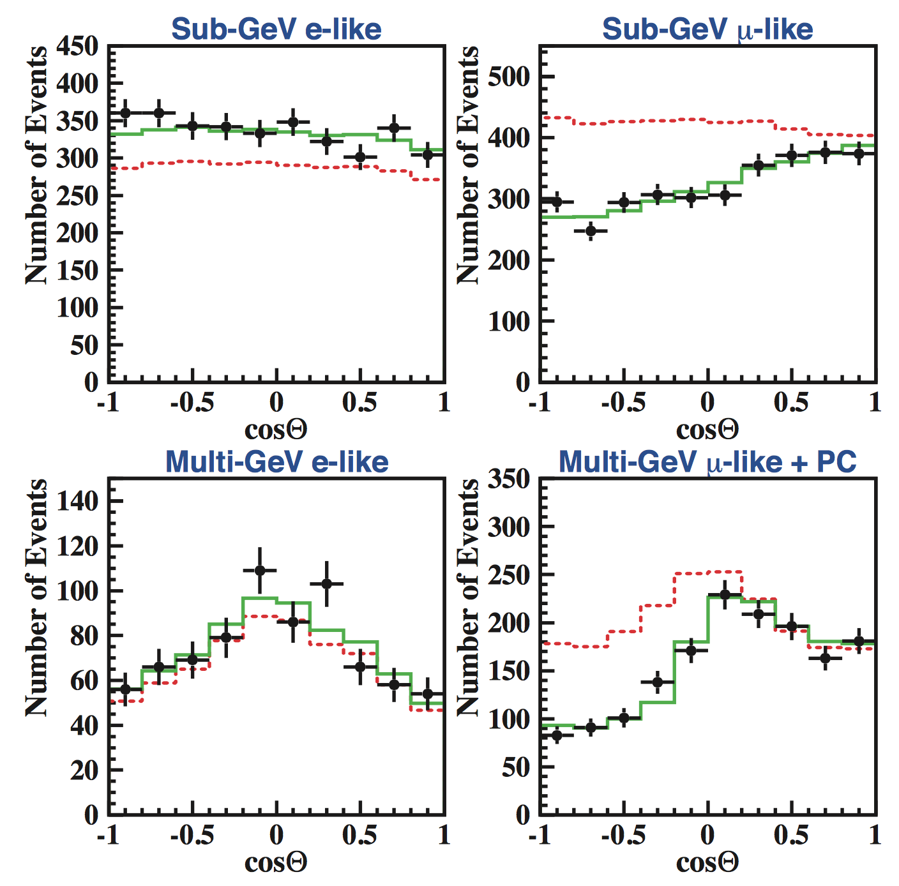
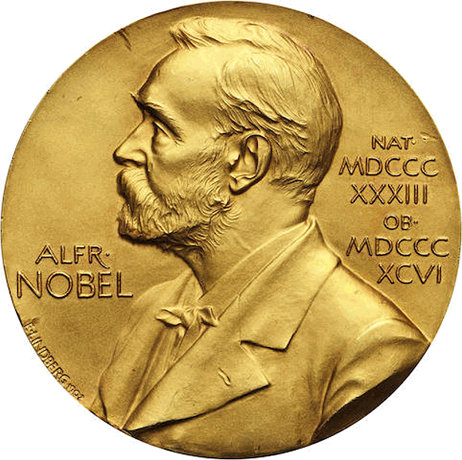
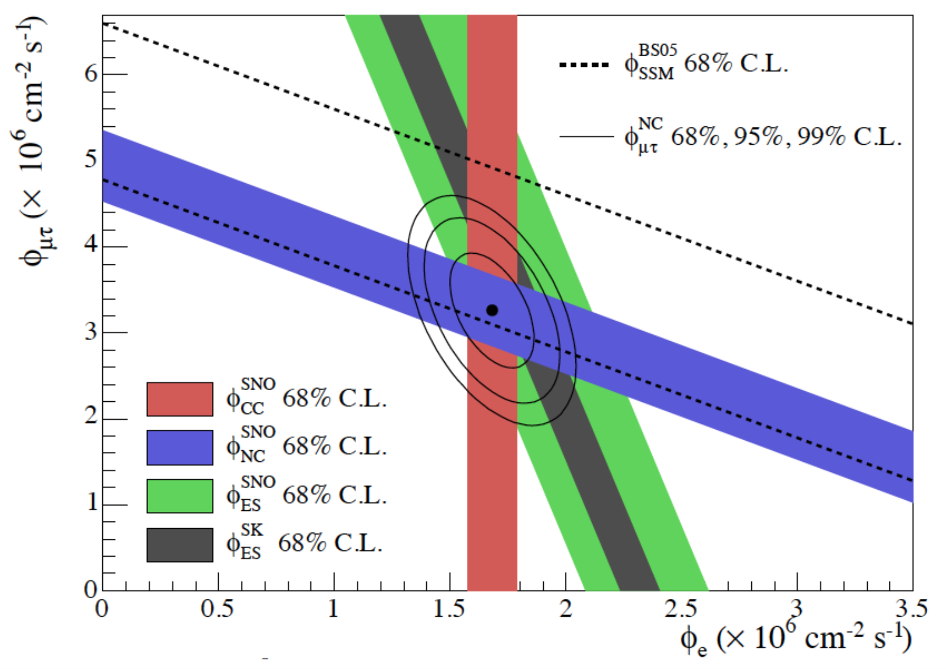
Neutrino oscillations, and more
Future:
Hyper-Kamiokande (“similar” to Super-Kamiokande, but larger)
SNO+: Liquid scintillator + Gd → v-less double beta decay

Slide 31




The HE neutrino telescope world map 2018
ANTARES
Deep water
0.01 km³
2008 – 2019
Baikal/GVD
Deep water
~1 km³
Construction
KM3NeT
Deep water
1 + 0.006 km³
Construction
IceCube
Deep ice
1 km³
2011 –
IceCube-Gen2
Deep ice
~10 km³
Projected, 1st
phase imminent

Slide 32
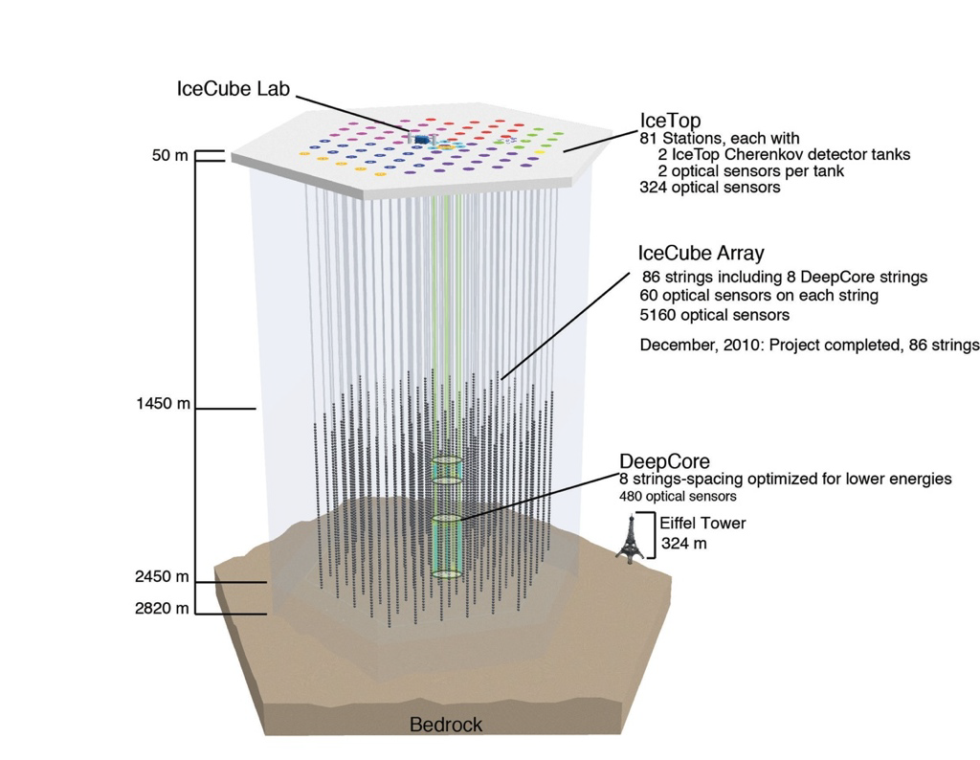
IceCube: Most sensitive v telescope to date
86 strings altogether
  125 m horizontal spacing
  17 m vertical distance
  between Optical Modules
  1 km³ instrumented
  volume, depth 2450m
Deep Core
  densely instrumented
  region in clearest ice
Completed in Dec. 2010
Extremely stable and
efficient operation since then

Slide 33
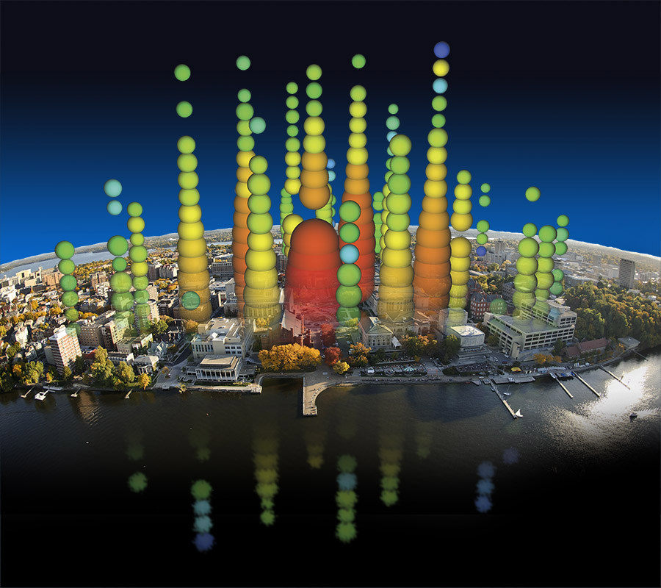
A first glimpse at cosmic ν’s
By Francis Halzen
2013: Discovery of HE cosmic neutrinos
2018: First neutrino source identified
See presentation by D. Williams
Big Bird, 2.0 PeV

Slide 34
The Baikal GVD
First results from 2016+17 data:
→ Understanding atmospheric muons
→ Seeing atmospheric neutrinos
→ Limits on v flux from GW170817
→ A 157 TeV cascade event
525 m
120 m
700 m
Project to construct a Gigaton (=km³) detector in Lake Baikal
Phase 1 (GVD-1): 8 clusters (see figure), 0.4 km³
3 clusters operational, 1-2 more clusters to be deployed per season
Commissioning, calibration, sensitivity studies in progress
Final goal: 27 clusters, 1.5 km³

Slide 35
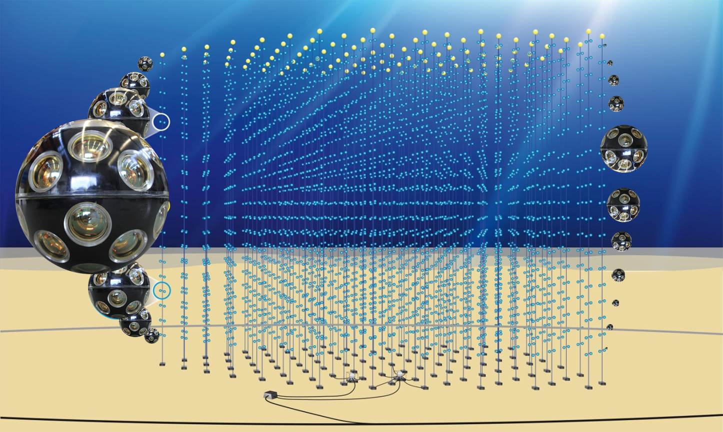
The future in the Mediterranean: KM3NeT
See presentation by T. Chiarusi
31 3’’-PMTs per optical module
18 modules per string
115 DUs per building block
ARCA: 2 blocks for v astronomy
ORCA: 1 block for v oscillations
Deployment
2018-21

Slide 36
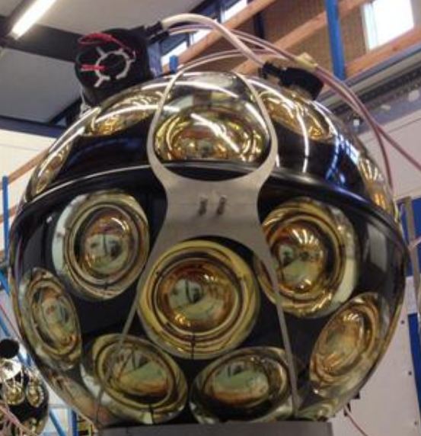
The KM3NeT Digital Optical Module
31 3-inch PMTs in 17-inch glass sphere (cathode area ~3x10-inch PMTs)
Front-end electronics, digitisation,
optical signal → glass fibre
Single penetrator
Advantages:
  Increased photocathode area
  1-vs-2 photo-electron separation
  → better detection of coincidences
  Directionality
  Cost / photocathode area
  Minimal number of penetrations
  → reduced risk

Slide 37
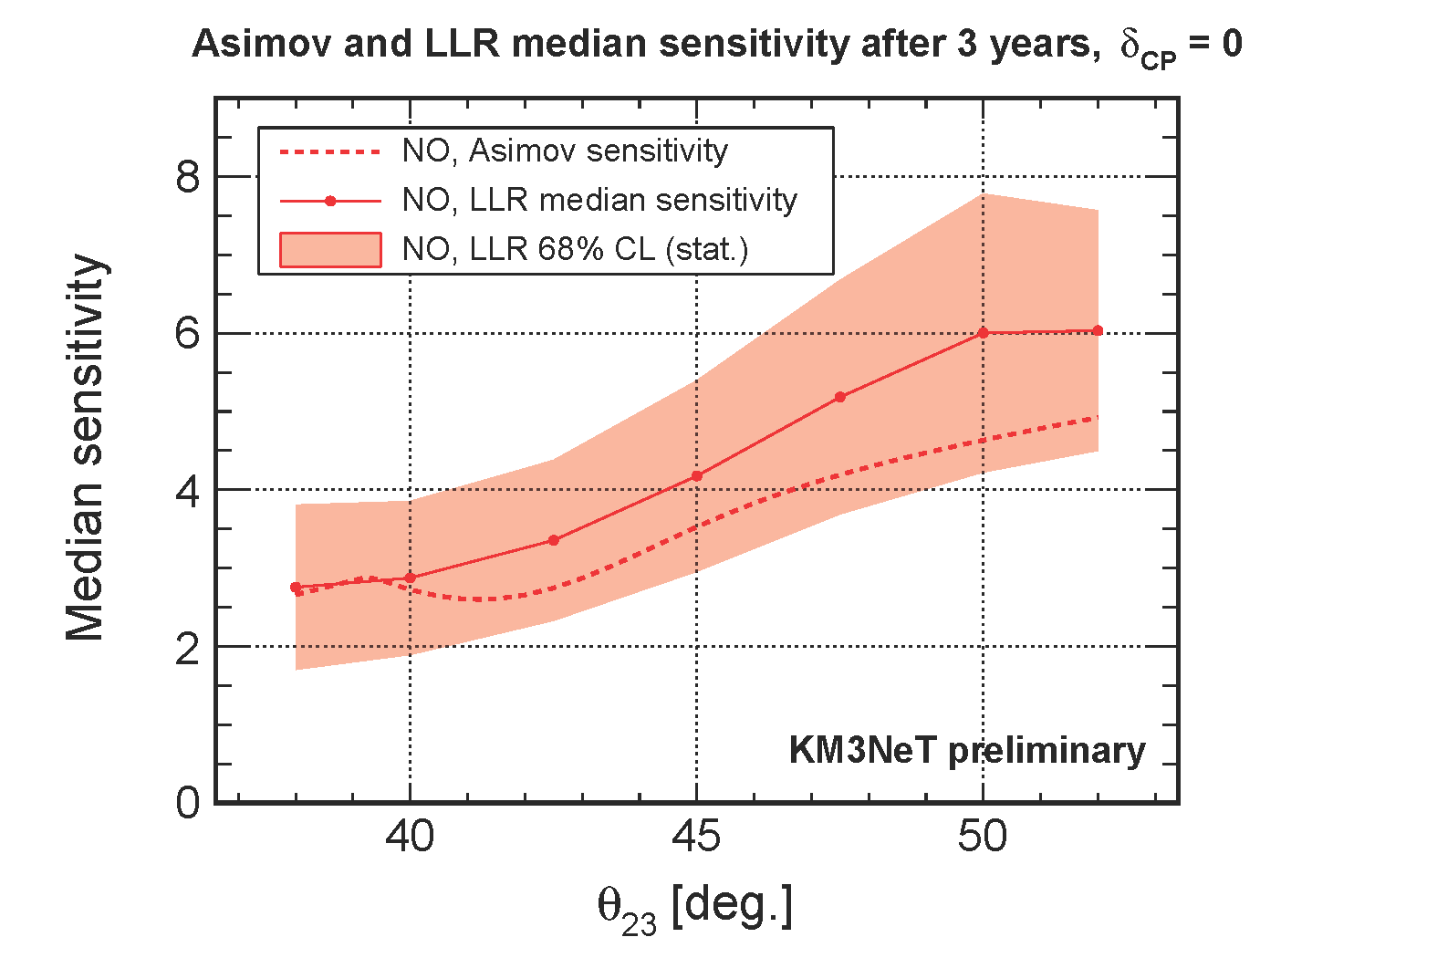
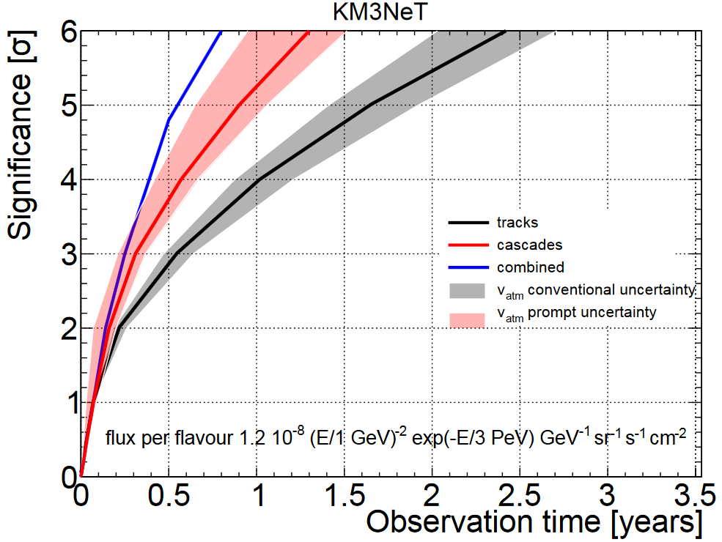
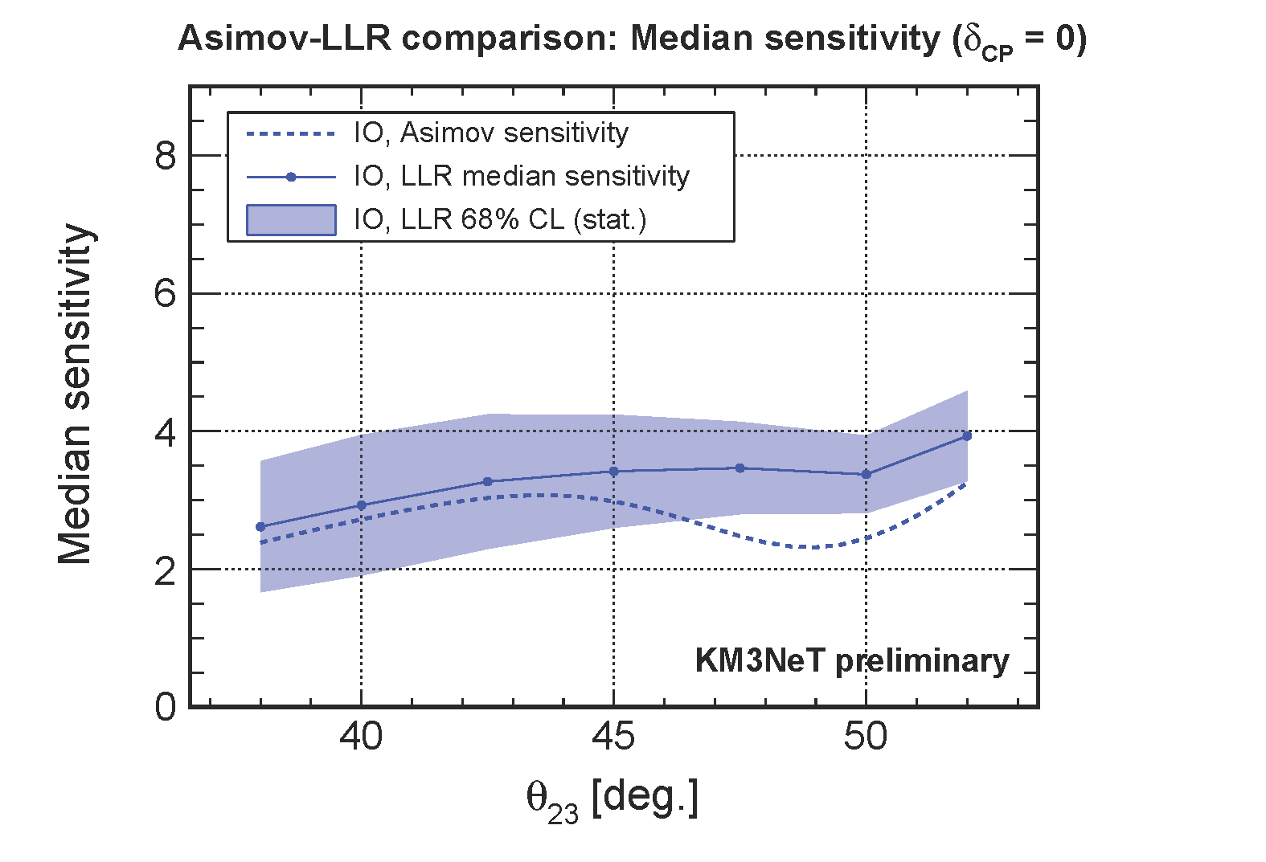
Sensitivities
Diffuse cosmic neutrino flux as measured by IceCube
NO
NOvA preferred. Would yield 5σ with ORCA by 2024/25
IO
Neutrino mass ordering

Slide 38
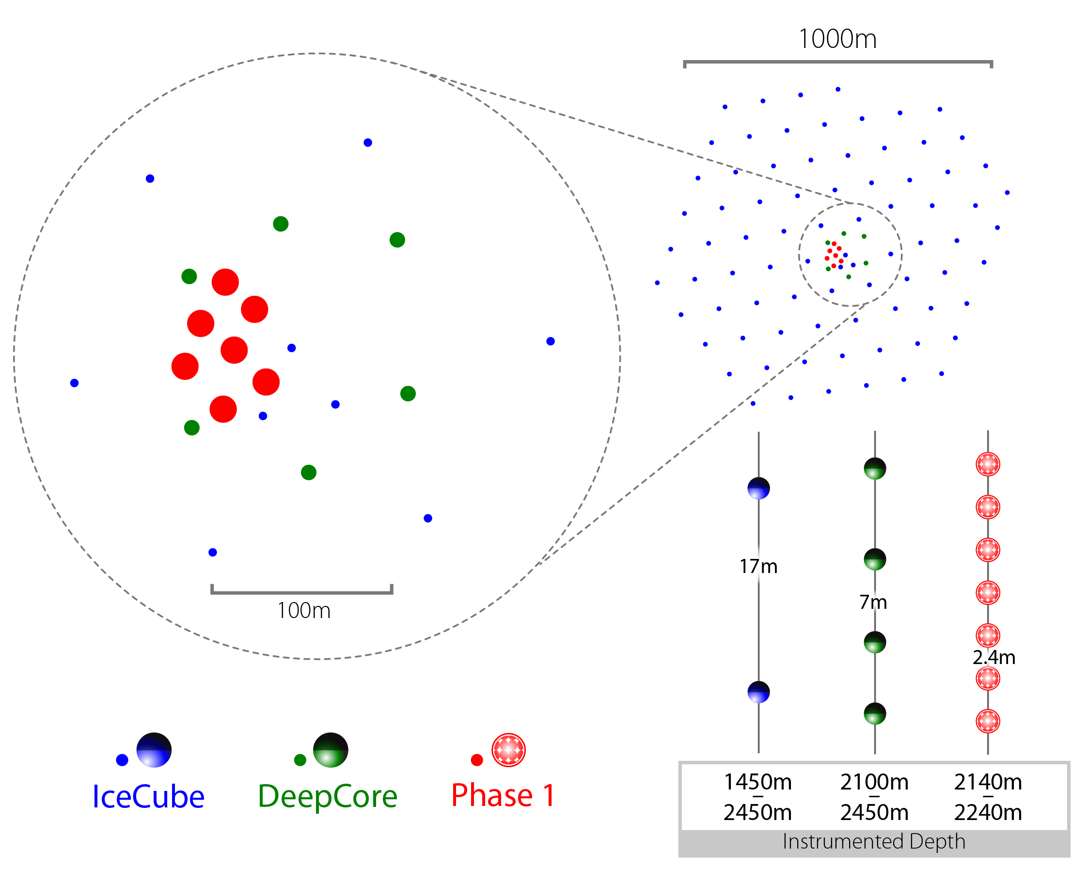
IceCube: next step = Upgrade
IceCube-Upgrade
7 additional strings in Deep Core
domain, densely instrumented
Objectives:
GeV neutrinos:
τ appearance, Dark Matter, …
Improved understanding of ice
properties → better precision, reduced systematic uncertainties
Opportunity to test new
hardware developments
Funding commitment expected
very soon
Array | String Spacing | Module Spacing | Modules / String
IceCube | 125 m | 17 m | 60
DeepCore | 75 m | 7 m | 60
Upgrade | 20 m | 2 m | 125
Deployment
2022/23
time

Slide 39
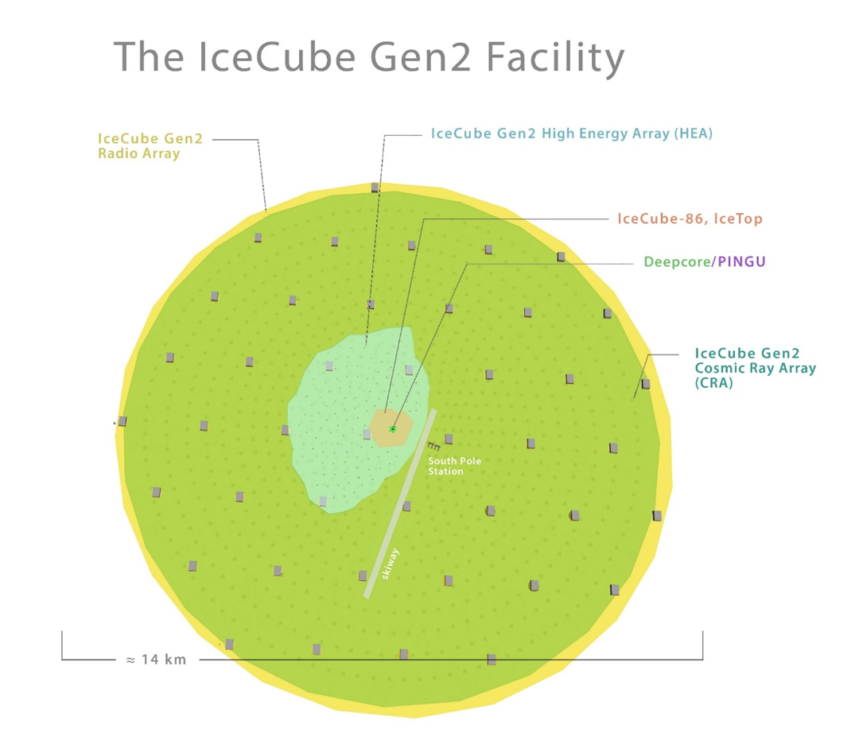
IceCube Gen2
Next-generation neutrino observatory at South Pole, with
High-energy deep-ice detector
(High-energy array, HEA)
Cosmic-ray and veto surface array (CRA)
Radio array (RA)
High-density core for low-energy
neutrinos (PINGU)
Funding application expected
in NSF MREFC scheme
(~2020)
time
14 km
Deployment
2025-31

Slide 40
Conclusions
Large variety of Cherenkov detectors for astroparticle physics
Different techniques, using imaging and/or timing
(truly “ring-imaging” is an exception rather than the rule)
Cherenkov detectors essential for astroparticle physics
Several breakthrough-results achieved
Various new detectors in the pipeline – stay tuned!

Slide 41
Backup

Slide 42
The neutrino telescope timeline
Operation
Construction
ANTARES
KM3NeT/ARCA
KM3NeT/Phase 3
?
KM3NeT/Neutrino astronomy
KM3NeT/ORCA
KM3NeT/Neutrino oscillations
?
IceCube
IC Upgrade
IceCube Gen2
?
IceCube Gen2
Baikal/GVD-1
Baikal/GVD (next steps)
?
Baikal GVD
2015
now
2020
2025
2030

Slide 43
Neutrino astronomy: where are we?
High-energy cosmic neutrinos discovered by IceCube
Recent neutrino/X-ray/gamma-ray coincidence (IceCube):
First hint of a neutrino source?
Neutrinos from Galactic accelerators
“Real neutrino astronomy”
We need more statistics,
increasingly precise data,
and full sky coverage
See talk by
I. Taboada
(We 14:00)
The exploration
of the high-energy
Universe requires
multi-messenger studies
including neutrinos!
Rich science program:
→ Neutrino astronomy
→ Particle physics
→ Dark matter searches
→ Exotics
→ Earth and Sea sciences,
glaciology, …

Slide 44
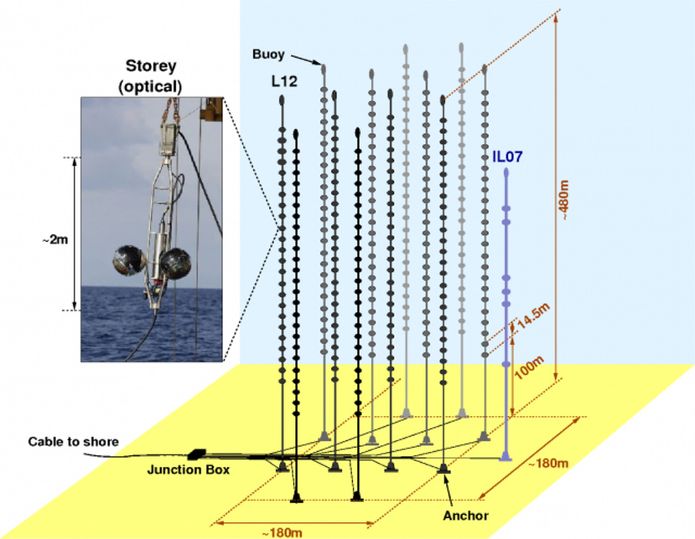
Currently taking data: ANTARES …
The first deep-sea v telescope
Installed near Toulon at a depth of 2475m
12 strings with 25 storeys each,
Instrumented volume ~0.01km³
Data taking in full configuration since 2008
Proof of principle of deep-sea ν telescope
Lots of results – but (too) small for cosmic neutrinos

Slide 45
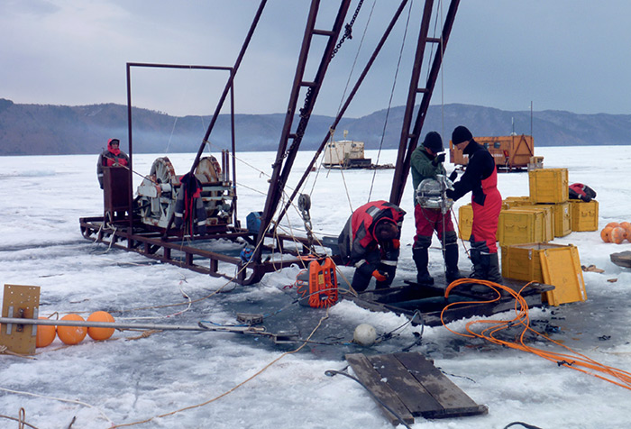

GVD construction
P[1/106] L. Fajt
Deployment in winter from frozen surface of Lake Baikal
Maintenance & repair operations possible
10-inch Hamamatsu PMTs, in situ digitisation, data transfer via Ethernet

Slide 46



GVD: first data analysed, first v’s …
2016 data: select atmospheric muons (≥6 OMs at ≥3 strings)
Apply quality cuts and boosted decision tree for v/µ separation
… and observe first neutrinos!
Preliminary
data
atm. muons
atm. neutrinos
З3.1 live-days
23 selected events
- - Atm. µ
simulation
After detector
response
• Data

Slide 47


… and first results from 2016+2017 data
One high-energy cascade event (157 TeV [reconstr.])
Search for events coincident with GW170817 in time windows of ±500 s and 14 days after NS-NS merger
→ no signal found
→ upper v flux limits for each decade of energy

Slide 48


KM3NeT Deployment
← Deploy
to sea bed
Release
by ROV
Unfurl →
Collect
frame

Slide 49


KM3NeT 2.0 = ARCA and ORCA
ARCA =
Astroparticle
Research with
Cosmics in the
Abyss
500m
500m
+
Vertical DOM
distance = 36 m
Phase 1
Deployment
2018-19
KM3NeT 2.0
Deployment
2019-21
time
ORCA =
Phase 1 (fully funded)
Oscillation
Research with
Cosmics in the
Abyss
Phase 2 partially funded
107m
See below
KM3NeT 2.0 Letter of Intent:
arXiv:1601.07459 and
J.Phys. G43 (2016) 084001
Vertical DOM
distance = 9 m

Slide 50


KM3NeT status
P[2/193] I. di Palma
ARCA
3 strings deployed Dec 2015 & May 2016
2 out of 3 operated, string #3 with short in power system, recovered
Attempt to power the 2 deployed strings later this year
Full restoration of sea-bed network by mid-2019
ORCA
Successful deployment & operation of first string (Sept 2017)
Cable problem, replacement in summer 2018, resume operations thereafter
Construction
DOM and DU assembly proceeding
Deployment after repairs, consistent with schedule on previous slide
Atmospheric muons

Slide 51


KM3NeT/ARCA angular resolutions
Track-like events: Cascades:
ν_{e} CC events
with containment cut
0.1°
2°
Muon energy: d(log10 E)=0.25-0.3 at E > 10 TeV
Cascade energy: 5-10% at E > some 10 TeV
Good angular resolution helps enormously in source associations

Slide 52


IceCube Upgrade: improve data quality
Limiting factor for reconstruction precision and flavour id: Ice properties
Precision calibration with Upgrade (dense instrumentation, additional devices)
Better angular resolution. W/o ice systematics: Cascades 3-5º; tracks 0.1-0.2º
Yields improved multi-messenger capabilities, improved tau identification

Slide 53


IceCube: Sensor developments
  Multi-PMT optical module (mDOM)
  24× 3” PMTs (e.g. Hamamatsu 12199-02)
  14” borosilicate glass vessel rated @ 700 bar
  Based on proven KM3NeT design
  Baseline design for Upgrade
P[1/154] M. Unland
  “D-Egg”
  2 x 8” PMTs
  UV-transparent glass
  and gel
  R&D and production by
  Japanese groups
Further light sensor
technologies under study

Slide 54

IceCube Gen2: high-energy array
  Following up IceCube’s PeV v’s: Detection of neutrinos with 100+ TeV
  Events are huge and produce a vast amount of Cherenkov light
  Sparse instrumentation suffices:
  String distance 240-300 m, 80 DOMs/string, 1.3 km string length
  Test with real IceCube PeV shower event, masking strings:
  Resolution 30º in direction, 10% in energy, 12m in vertex position
PoS(ICRC2017)991
O(10)
PeV events
per year

Slide 55

IceCube Gen2: Radio array
  Detection of neutrinos with 100+ PeV
  Radio technique by far more cost-effective at these energies
  Important input/experience from ARA and ARIANNA projects
  Many open questions on technology and design
  Target: Cosmogenic neutrinos from GZK effect
P[2/172] C. Glaser
See presentation by Amy Connolly (We 14:40)

Slide 56

Example 1: Neutrino mass ordering (NMO)
“normal ordering” or “inverted ordering” ?
(NO) (IO)
Fundamental parameter of particle physics.
→ Knowledge required to investigate neutrino CP violation
→ Important also for cosmology
U. Katz: Future neutrino telescopes Neutrino 2018, Heidelberg
56

Slide 57




NMO from v oscillations in Earth
Earth density 4-13 g/cm³ →
Relevant:
Method complementary to reactor v’s !

