Slide 1



Optical elements for RICH detectors
Miroslav ŠULC
Technical University of Liberec
The Czech Republic
CERN

Slide 2

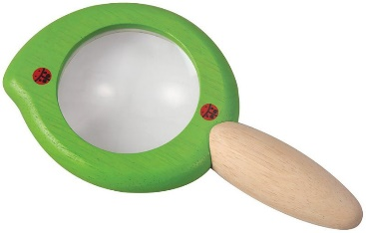
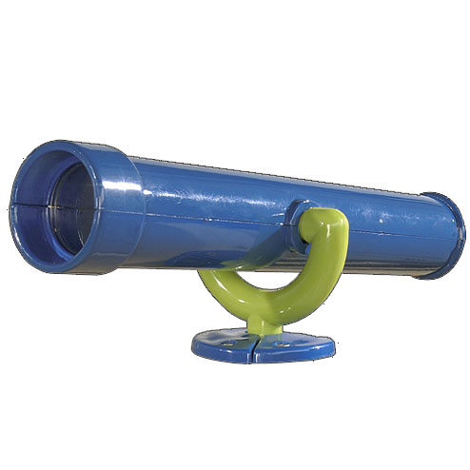

Motivation
How can team of experts in optics to help to PID by Cherenkov radiation detection?
What state-of-art optical elements and methods can be implemented to Cherenkov detectors?

Slide 3
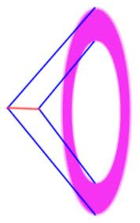
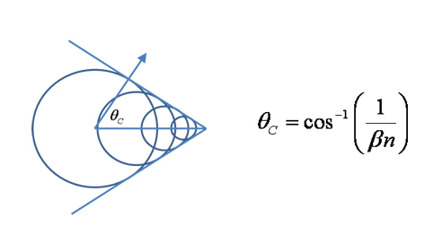
Cherenkov radiation properties
The Cerenkov effect occurs when the velocity of a charged particle traveling through a dielectric medium exceeds the speed of light in the medium
Angle of Cerenkov Radiation
Wavefronts are coaxial cones
Coherent

Slide 4
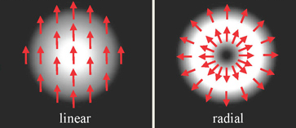
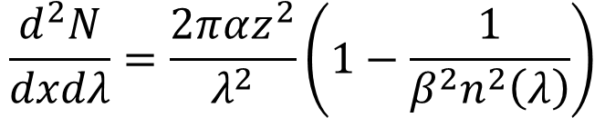
Radial polarization
Spectra and polarization
Polychromatic
$$\frac{d^{2}N}{dxdλ}=\frac{2παz^{2}}{λ^{2}}\left(1−\frac{1}{β^{2}n^{2}\left(λ\right)}\right)$$
Difference between radial and linear polarized beams
Conventional beams – E field has the same polarization at the wavefront (or transversal cross-section)
Vector beams – E vector depends on position at wavefront or transversal cross-section – the singularity is in the center

Slide 5
Optical sources of errors
Chromaticity (physical origin) refractive index decrease with wavelength
There are two opposite tendencies – photons from VIS can fall to near angle, but the number of detected ones is smaller. Photons from UV will be more dissipated and the number of UV photons is higher.
Width of Cherenkov rings for different β, π momentum, C₄F₁₀ radiator
Optical element misalignment (technical problem)
Pixelation (technical problem)
How to suppress or decrease errors?

Slide 6
Steps of PID by Cherenkov radiation detection
Generation of Cherenkov radiation
Collection of photons to the detectors
Photon detection (conversion to electrons)
A/D conversion
DAQ
Pattern recognition
Data analysis and interpretation
Another technological aspects - mounting, alignment, electronic, gas cleaning, etc.
Notes:
Není možné uplně separovat

Slide 7
Steps of PID by Cherenkov radiation detection
Generation of Cherenkov radiation
Collection of photons to the detectors
Photon detection (conversion to electrons)
A/D conversion
DAQ
Pattern recognition
Data analysis and interpretation
Another technological aspects - mounting, alignment, electronic, gas cleaning, etc.
OPTICS
Notes:
Není možné uplně separovat

Slide 8
Steps of PID by Cherenkov radiation detection
Generation of Cherenkov radiation
Collection of photons to the detectors
Photon detection (conversion to electrons)
A/D conversion
DAQ
Pattern recognition
Data analysis and interpretation
Another technological aspects - mounting, alignment, electronic, gas cleaning, etc.
OPTICS
GREAT PROGRESS
Notes:
Není možné uplně separovat

Slide 9
Important steps for Cherenkov detectors R&D from ONLY optical point of view
1934 - P. A. Cherenkov: series of experiments on visible light emitted by Compton electrons produced by bombarding pure liquids with γ rays
1960 - A. Roberts: first conception of Ring Imaging CHerenkov technique
1977 - J. Seguinot and T. Ypsilantis: “imaging” of Cherenkov patterns in a gas detector
1981 - First use of a RICH for high energy PID: E605 Experiment at FNAL
1992: first publication of DIRC concept§.
1993-1996: progression of prototypes and DIRC R&D, decision in favor of DIRC for hadronic PID for BABAR.
1998: installed part of DIRC; start of cosmic ray run, commissioning run.
1999: BABAR moves into beam line, added 4 more bar boxes.
2008: last event recorded with BABAR.

Slide 10
Progress in optics in last 20 years with the relationship to Cherenkov radiation
Software for optical simulation
Aspherical optical surfaces
Reflective layers / mirrors
Photogrammetry
Methods and instruments for very precise measurement of the shape, quality of optical elements, wavefront distortion, alignment control etc.
Bessel and structured beams
Adaptive optics

Slide 11
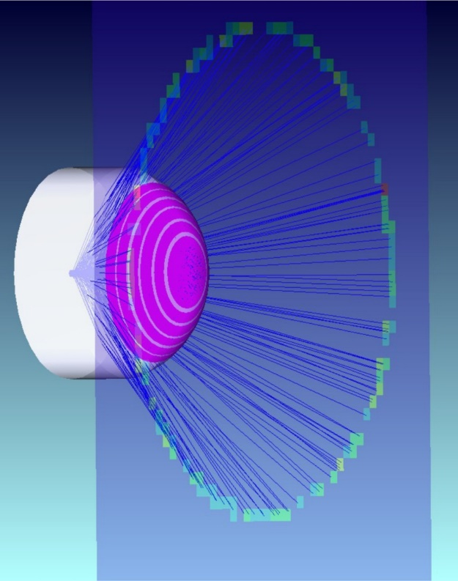
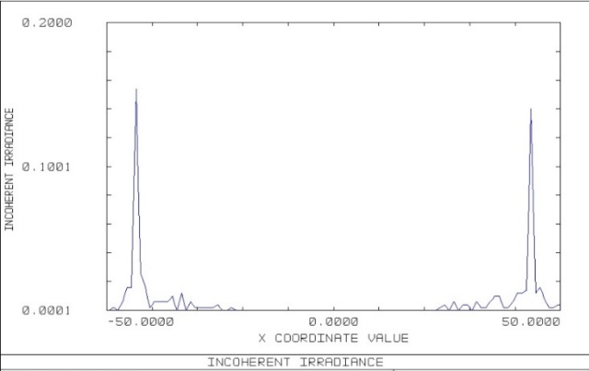
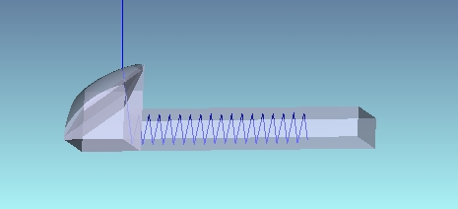
Software for optical simulation of Cherenkov light
Rapid development of optical software based on ray tracing as Zemax, CodeV, Oslo software etc.
It is used to model, analyze, optimize optical systems
But Cherenkov radiation is very exotic source for optics designers so it was not included in this software
Some people at RICH community use Zemax or another optical software for optimization of optical parts of detector
But Cherenkov radiation is generated in GEANT 4 or by Monte Carlo simulations and results are transferred to Zemax as input parameters
Cross view to Cherenkov ring at detector plane

Slide 12
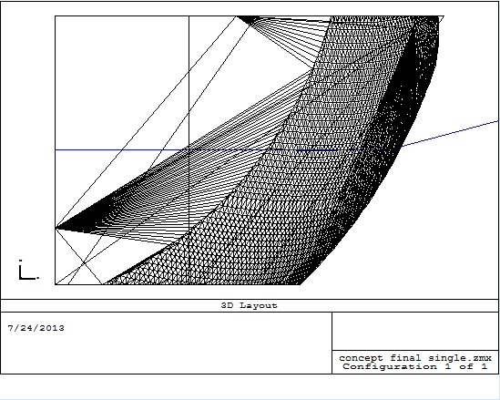
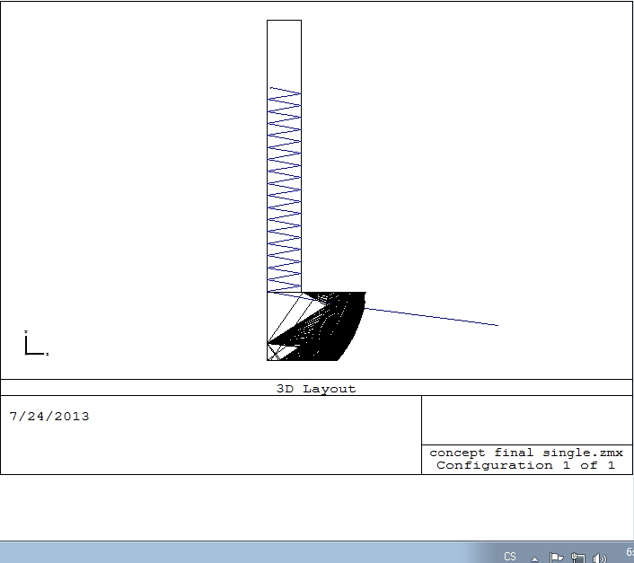
New DLL file for Cherenkov radiator simulation
We are using ZEMAX - Software for Optical System Design.
Bulk scattering DLL file was adapted, changed and implemented to Zemax
It was used both for single piece optical element design as a Cherenkov radiator and complex detector simulation COMPASS RICH-1
It can be very useful to use it for DIRC optimization (temperature, tolerances analysis, etc.)

Slide 13
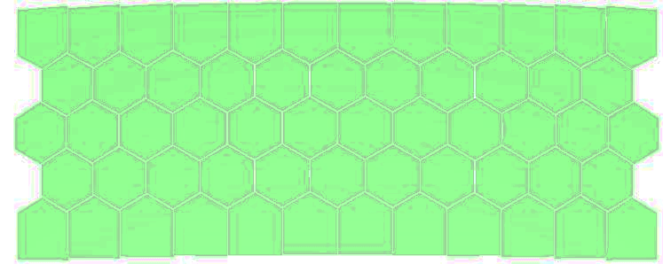
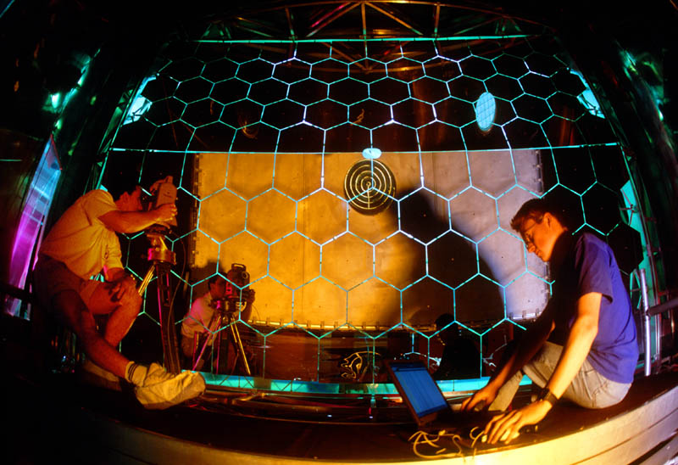
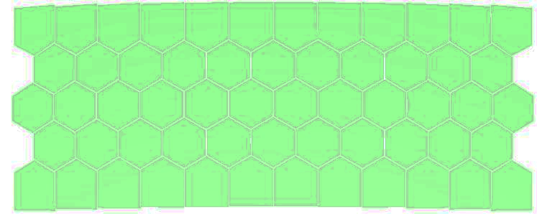
Compass RICH-1 mirror misalignment simulation
All system can be simulated at optical software, as a Compass RICH-1mirror wall

Slide 14
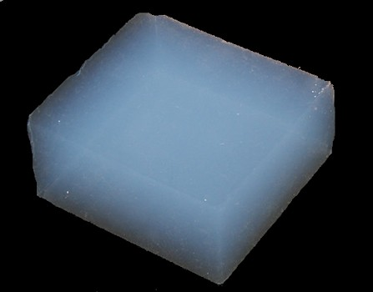
Materials for generation of Cherekov radiation
Fused silica
Aerogel
Liquids
Gasses
Different refractive indexes, Cherenkov angles and different optical requirements

Slide 15
DIRC - fused silica
Detection of Internally Reflected Cherenkov Light
Used for the first time in BABAR as primary hadronic particle ID system, flavor tagging, π/K ID to 4GeV/c.
Big progress at last years, see presentation at Saturday
New aspherical elements can help to receive “sharper” images, but the chromaticity remains problem

Slide 16
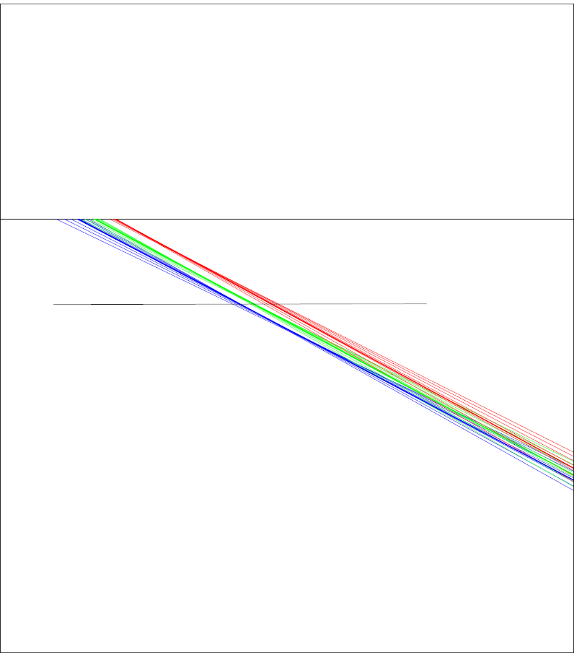
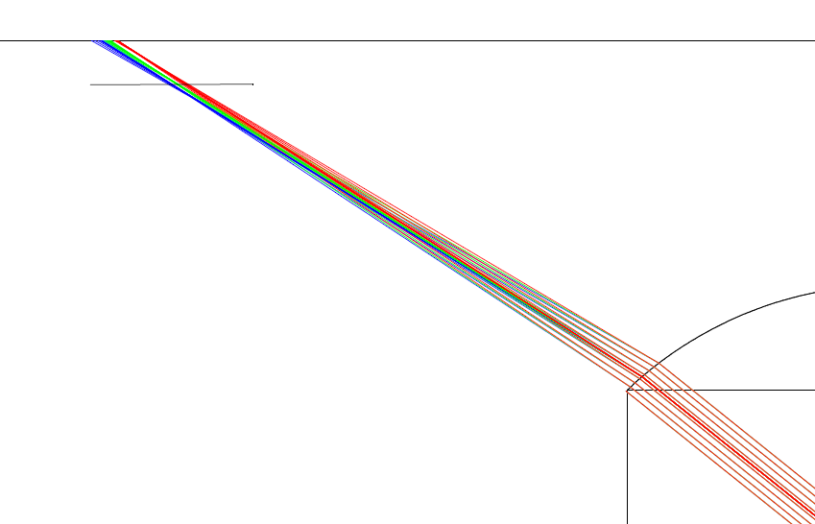
Chromaticity
Cherenkov angles and focal lengths
depend on wavelength
Can be partially reduced transversal chromatic aberration of optical surface
165 nm 175 nm 195 nm
detail
γ
θ

Slide 17
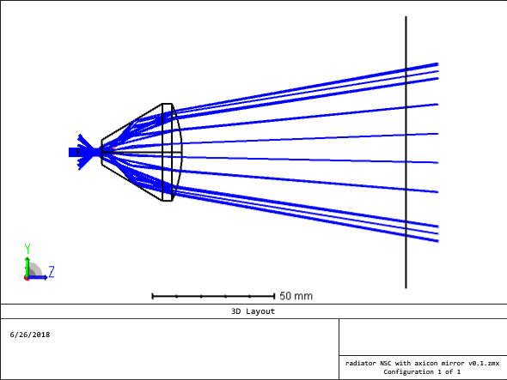
New types of free form radiator for THGEM tests
New design for large diameter Cherenkov ring ~ 200 mm will be not based on spherical surfaces but on the bases of “free form” surface
This type of surfaces is possible to produce only on the state-of-art machines and only small number of producers exist in Europe.
The Toptec workshop, Institute of Plasma Physics AS CR, Czech Republic will have capability to do it
New fused silica radiator with partial compensation of chromaticity by transverse chromatic aberration of lens

Slide 18
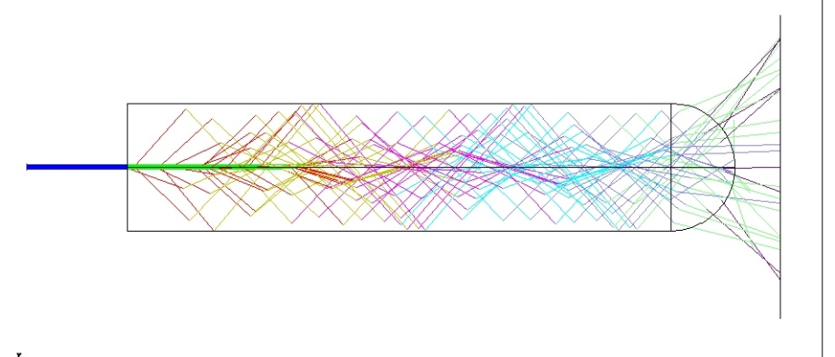
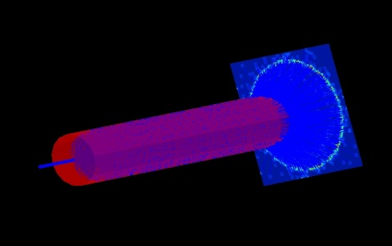
Long radiator
For production of as much as possible photons
Particle beam, going in direction of a cylinder axis, produces Cherenkov photons, fulfill the condition for critical angle of internal transmission
So photons are completely reflected

Slide 19
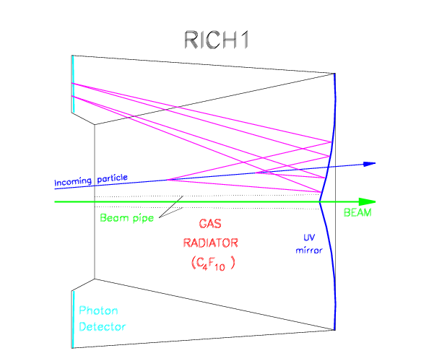
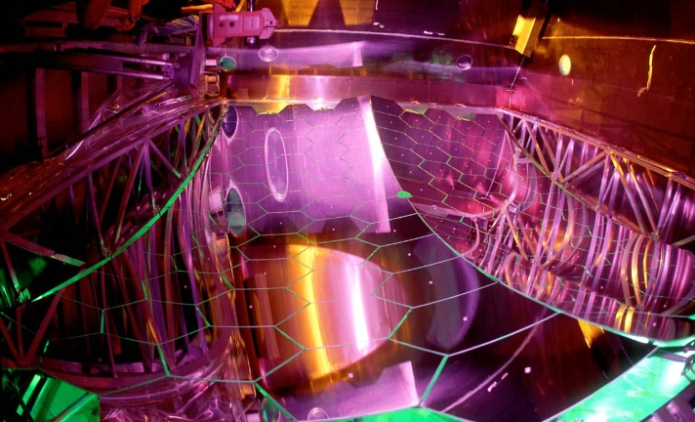
Gaseous RICH detectors
New gasses for RICH detectors
Refractive index on-line measurement
New types of mirrors
Mirror alignment monitoring
Optical systems collecting photons to detectors

Slide 20
New gasses for RICH detectors
Search of more environmental friendly gasses than freons
  A.H.Harvey, E. Paulechka, P.F.Egan, Candidates to replace R-12 as a radiator gas in Cherenkov detectors, NIMB, 425, 15 June 2018, 38-42
  N.Charitonidis, Y.Karyotakis, L.Gatignon, Estimation of the R134a gas refractive index for use as a Cherenkov radiator, using a high energy charged particle beam, NIMB, 410, 1 November 2017, 134-138
But C₄F₁₀ still will be avialble

Slide 21
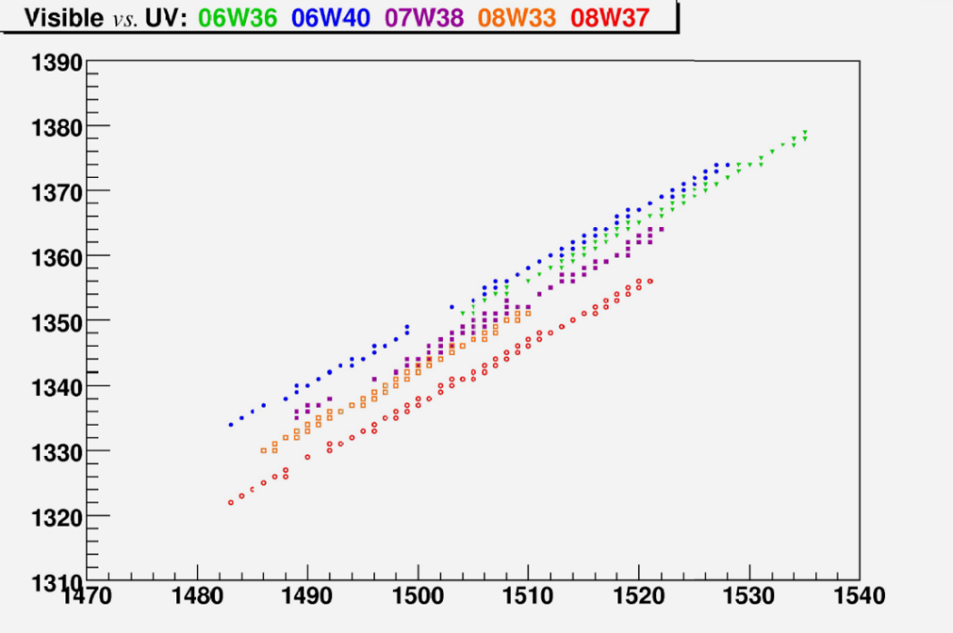
Refractive index measurement
Accurate knowledge of refractive index of C₄F₁₀, with accuracy of better than 10⁻⁵, is essential for the particle identification.
It can be calculated from data analysis, but on-line measurement can react immediately for changes of n
Refractive index depends
on gas density and varies with
  temperature
  pressure
  gas composition
  change of n is about 6∙10⁻⁶ 1/K
(n-1) ∙10⁻⁶ for 310 nm
(n-1) ∙10⁻⁶ for 200 nm

Slide 22

C₄F₁₀ refractive index
Effective index
  CsI 0.00152
  PMT 0.00134
From knowledge of refractive index in 632 nm (He-Ne laser) we can receive indexes for CsI and PMT from Gladstone-Dale equation
$$\frac{n1−1}{n2−1}=\frac{\text{ρ}1}{ρ2}$$

Slide 23
Interferometric measurement of n
Jamin interferometer – classical interferometer for gas refractive index measurement
This Jamin interferometer is insensitive to rotation and translation of its two optical elements.
The modified folded Jamin interferometer was designed, constructed and tested
Vibration-insensitive interferometer, absolute measurement and ability for on-line monitoring

Slide 24
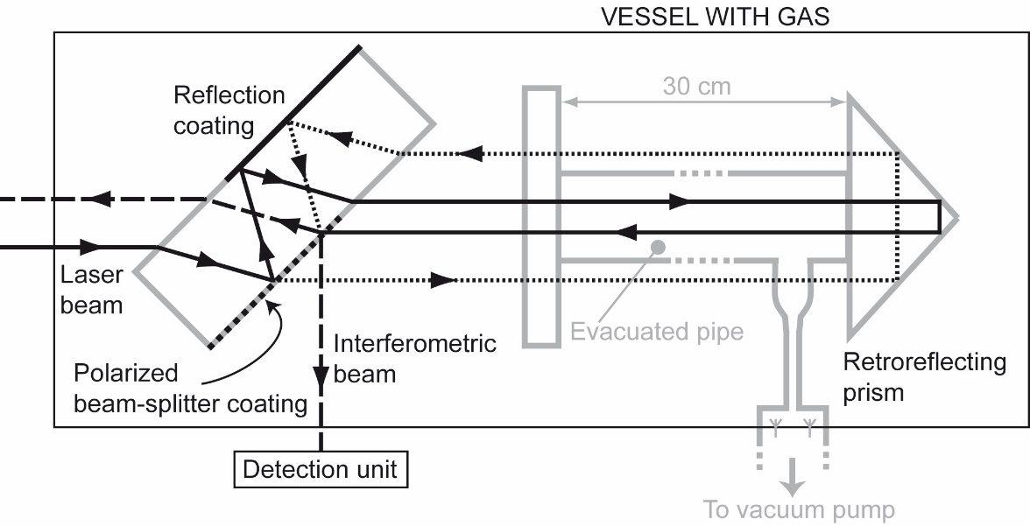
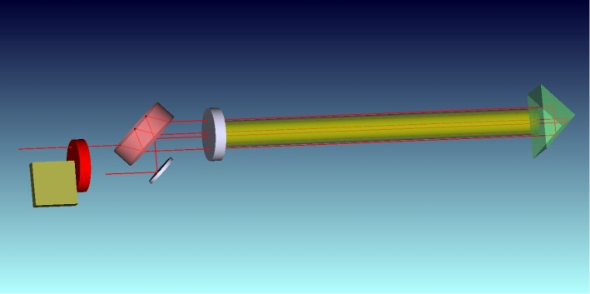
The modified folded Jamin interferometer
An incoming He-Ne laser beam (633 nm) is split by a polarization sensitive partial beam-splitter coating on the second surface of a plane-parallel plate.
One of the resulting beams is reflected by a high-reflectance coating on the first surface. Two parallel beams of equal intensity with orthogonal polarization are generated .
The first one is passing thru evacuated closed fused silica pipe; the second one is passing outside this pipe. Both beams are reflected by retro-reflective 90° prism. Both are passing true the same quartz disk on the end of pipe so the phase difference between beams is induced by refractive index difference only, not by thermal dilatation, mechanical stress etc..

Slide 25
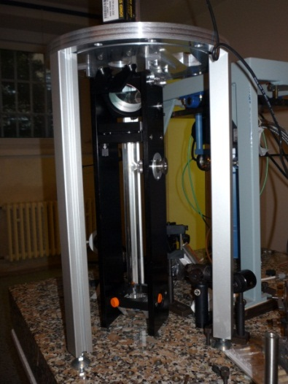
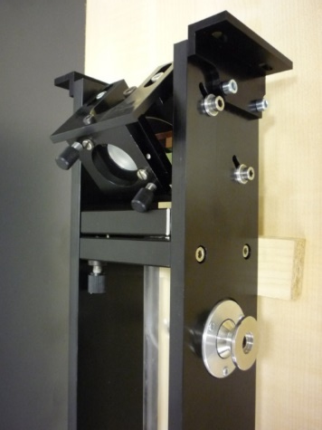
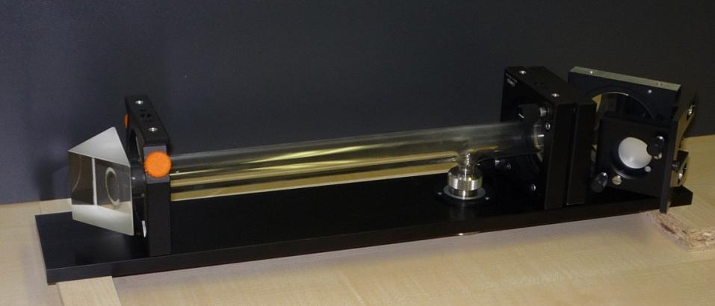
Interferometer with Quadrature Detection unit
DU determines the sense of refractive index change - decreasing or increasing
The accuracy of one fringe movement measurement (equivalent to a 2π phase difference) corresponds to a change of 10⁻⁶ in the refractive index.
A completely automatic driving system is foreseen
This measurement can be further improved by a factor of 100 using the appropriate software

Slide 26
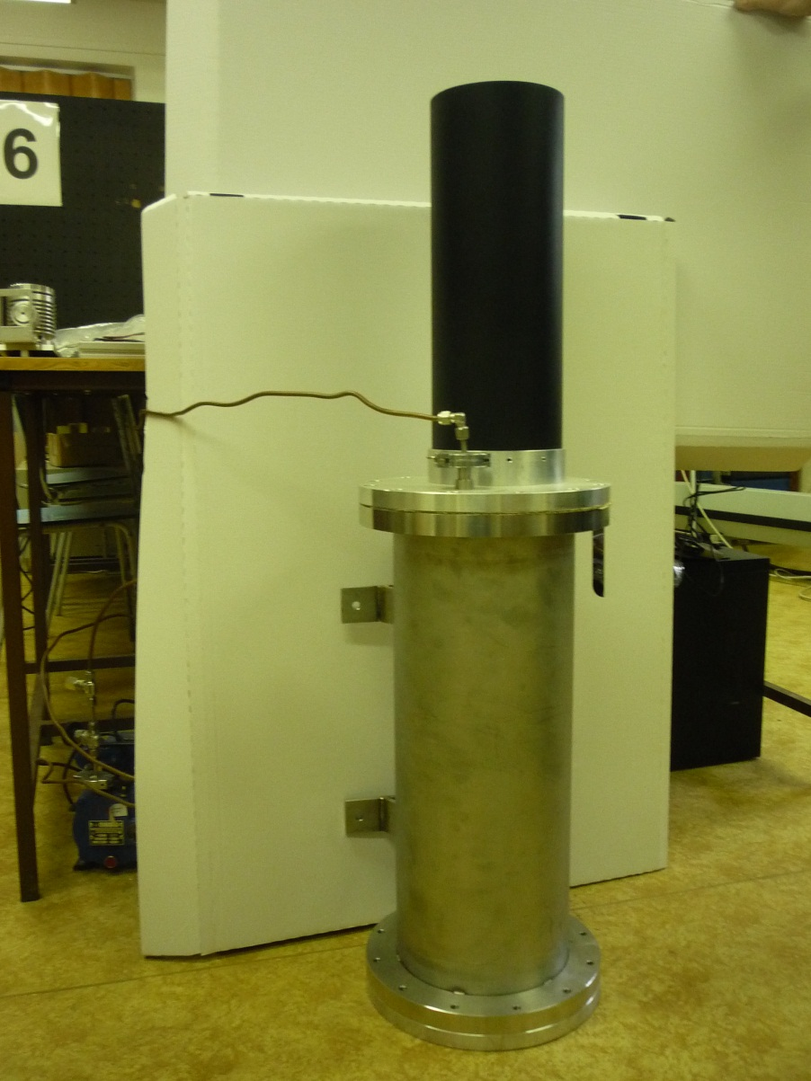
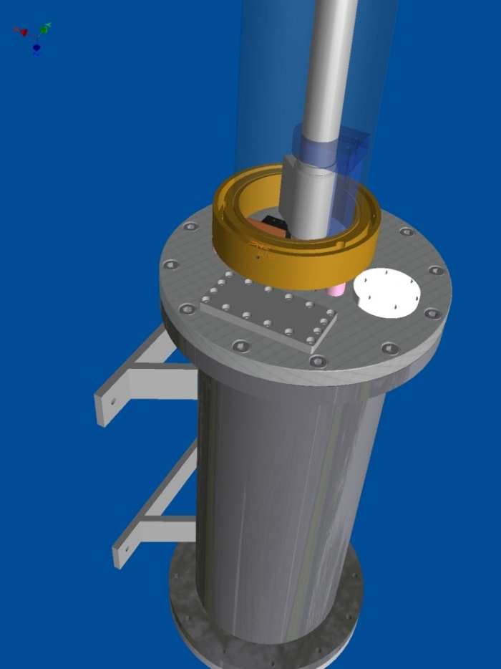
Interferometer chamber
In vertical position, parallel to RICH vessel –gas system
Real photo
He-Ne laser
The interferometer is placed inside a stainless steel chamber to protect the He-Ne laser from the external magnetic field

Slide 27
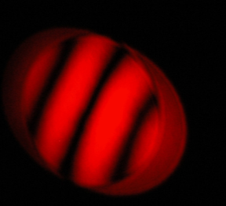
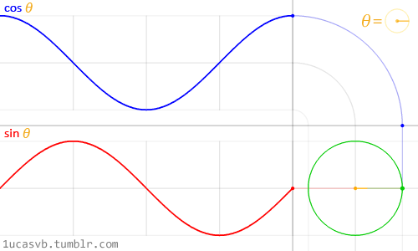
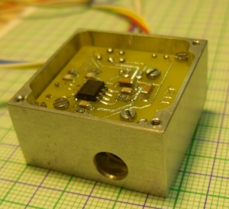
Interferometer with Quadrature Detection unit
QDU determines the sense of refractive index change - decreasing or increasing
A beam-splitter is used to divide the incoming laser beam.
The detection unit is equipped with two sensors for two polarizations –shifted about π/2 each other. providing one voltage output.
The accuracy of one fringe movement measurement (equivalent to a 2π phase difference) corresponds to a change of 10⁻⁶ in the refractive index.
This measurement can be further improved by a factor of 100 using the appropriate software [1]
[1] Kren P. Linearisation of counting interferometers with 0.1 nm precision. Int J Nanotechnol. 2007;4(6):702–11.

Slide 28
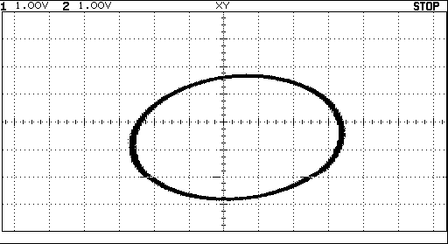
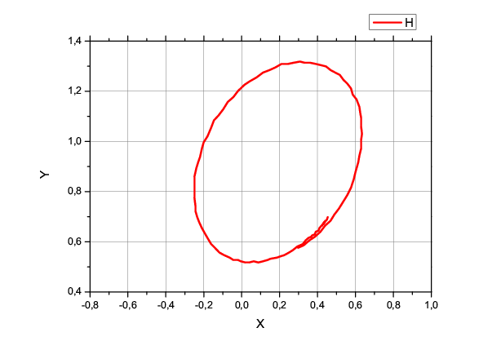
Visualization of refractive index changes
It is possible to observe index changes on the scope in X-Y plugging
Counterclockwise - n increase/clockwise n- decrees
We changed the pressure inside interferometer pipe, and ellipses (circles) appears
But better is to use PLC for data acquisition
A LabView program with high sampling frequency (in kHz) recorded the data from the detection unit.
Allan variance plot to study the time evolution/drift of beam position

Slide 29
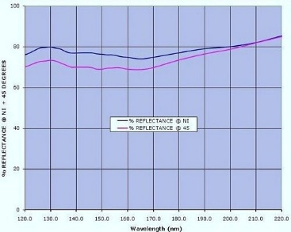
Reflective coatings / mirrors
Mirrors are key optical elements for gaseous RICH detectors
Mechanical properties - thin and rigid
Special glass and Carbon fiber spherical mirrors – CLAS12 RICH
New reflective coatings in DUV were developed for astrophysics due advances in the physical vapor deposition of protective fluoride films. It have raised the far ultraviolet reflectivity of aluminum-based mirrors closer to the theoretical limit.
Some are also available commercially,
eSource Optics offers a variety of High Reflectance broadband metallic Aluminum & Magnesium VUV Mirror Coatings with high reflectivity optimized at specific wavelength
http://www.esourceoptics.com/
BRIAN FLEMING at al. , Advanced Environmentally Resistant Lithium Fluoride Mirror Coatings for the Next-Generation of Broadband Space Observatories, arXiv:1801.03102v1 [astro-ph.IM] 9 Jan 2018

Slide 30
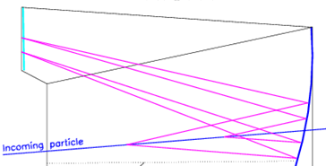
Mirror alignment monitoring
Important for multi-segment mirrors at gaseous detectors
The information about mirror alignment can be used at the reconstruction and analysis package
For COMPASS RICH-1 Cherenkov angle at saturation is around 52 mrad
So only 1, 2, or 3 mirrors can be illuminated by Cherenkov cone
D
M2
M1
E ???
Ideal circle, parts of “real” circle

Slide 31
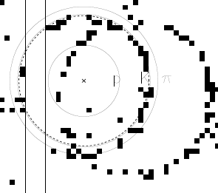
Ring reconstruction tools - implementation
the three concentric circles rings calculated in the hypothesis of proton (p), kaon (K) or pion (π) mass;
the dotted circle is the reconstructed ring; the indication is in favor of the kaon hypothesis
Mirror misalignment correction can be used for first, second mirror
K π

Slide 32
Mirrors misalignment is important source of error
Can be estimated from data analysis but independent optical measurement is useful
Good alignment is no big problem for astrophysical RICH detectors – possibility to aim to far distance star, open area
Problem for closed RICHs, The information about tilt from autocollimator measurement are used in some cases now - need to open RICH vessel, time consuming
LHCb RICH uses laser beam deflection for selected mirrors, Na62 use laser to preliminary alignment, precise alignment based on data analysis
NA62 calculate piezo motor movements
CBM RICH detector want use the CLAM method developed by the COMPASS experiment and a technique inspired from the HERA-B experiment. The correction cycle aims at the automatic detection of misalignments and includes them to correct collected data - See J. Bendarouach’s poster: Developments of a mirror supporting frame, mounting scheme and alignment monitoring system of the CBM RICH detector

Slide 33
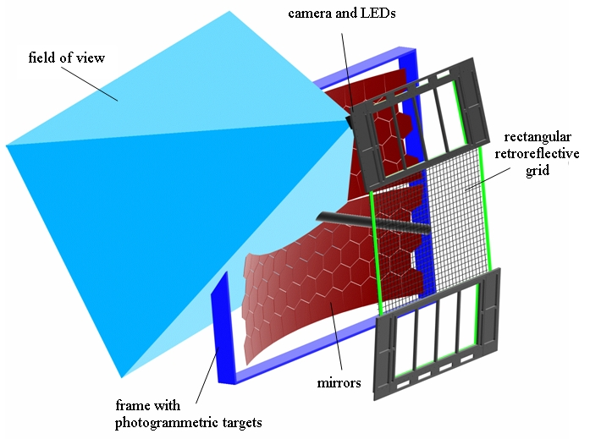
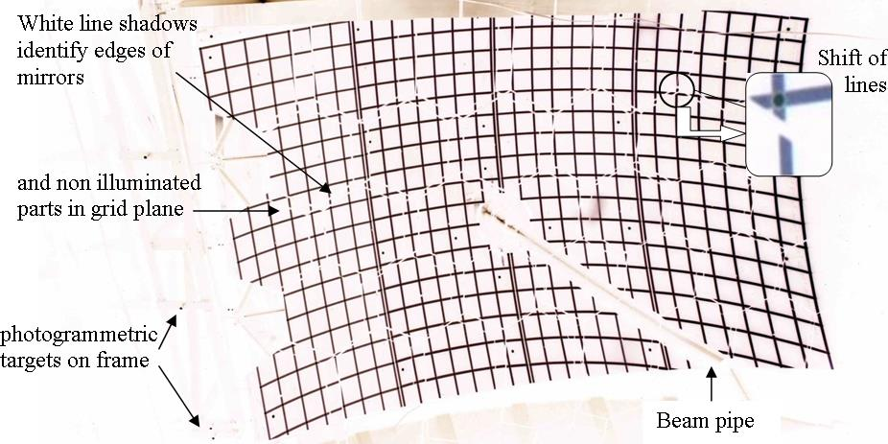
Principle of CLAM
CLAM: Continuous Line Alignment Monitoring method
to observe reflection of rectangular grid on RICH mirrors - Continuous lines reflected by mirrors for aligned mirrors
Small collaboration: INFN Torino, INFN Trieste, CERN and Liberec;
implementation on RICH-1: 2007

Slide 34
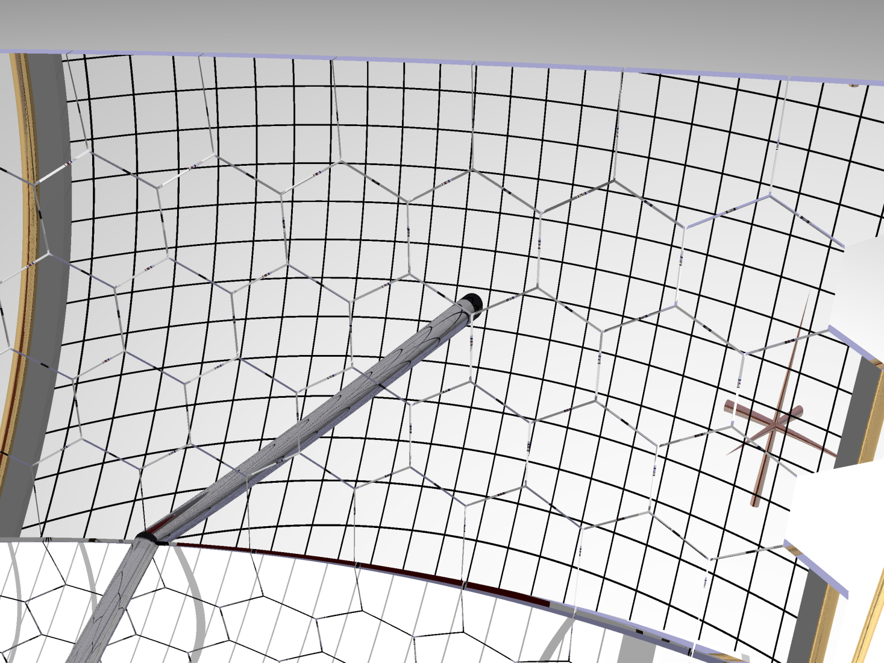
Principe of CLAM – to observe reflection of rectangular grid on RICH mirrors - aligned mirrors
Simulation was made by A.Latina

Slide 35
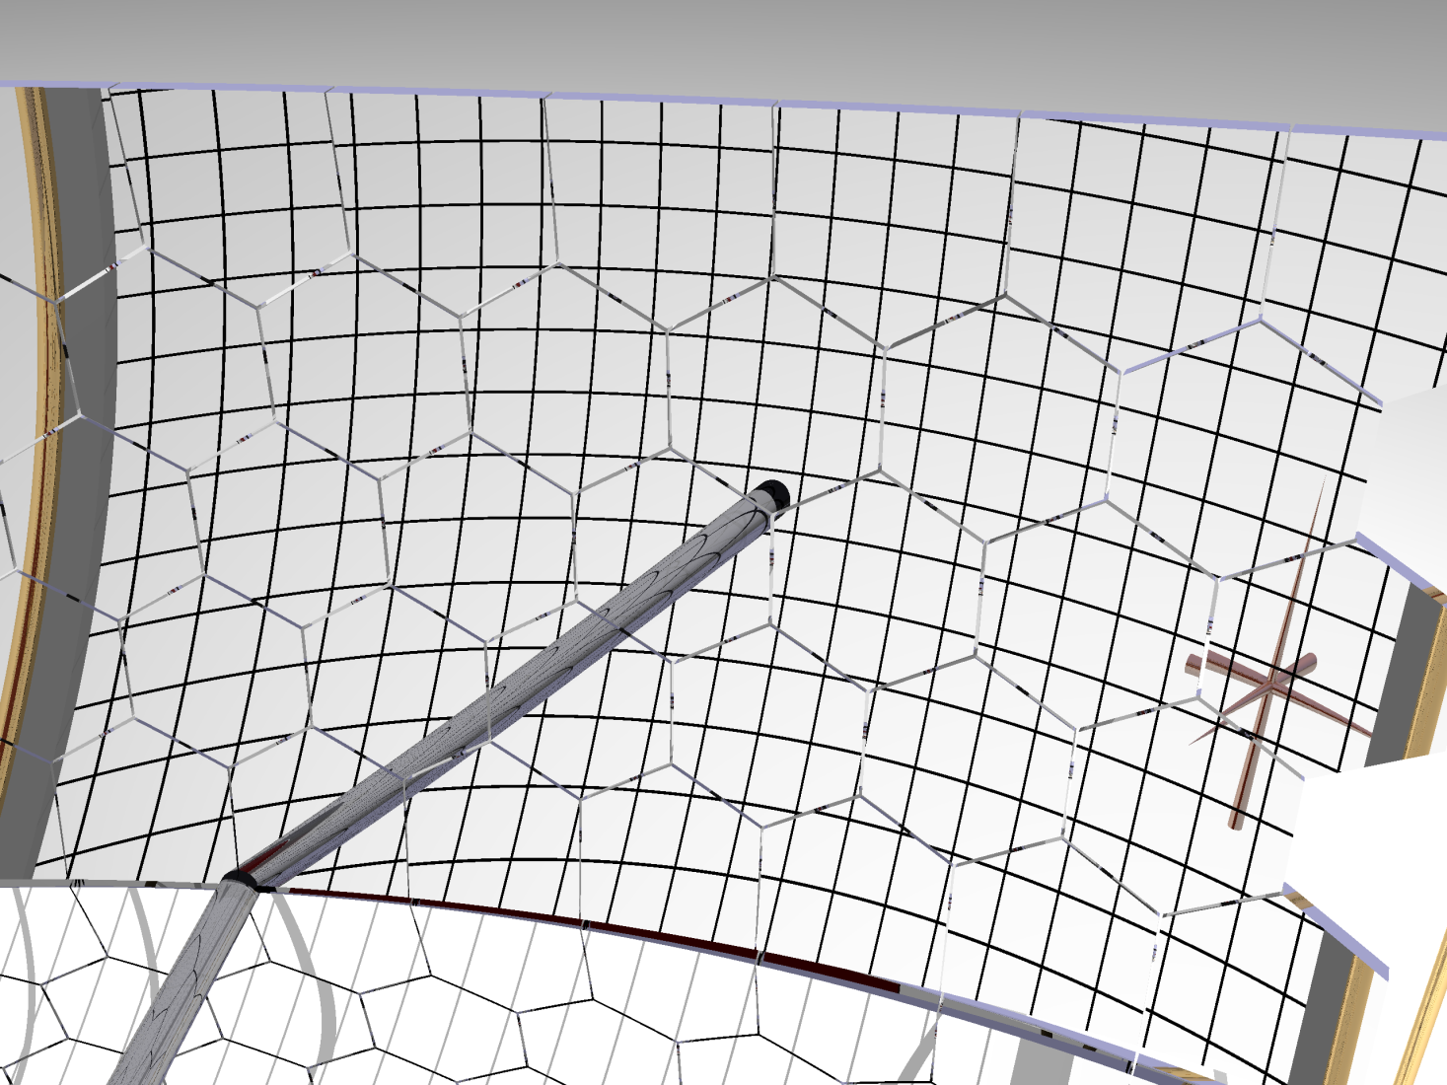
tilted mirrors by 1.5 mrad
Simulation was made by A.Latina

Slide 36

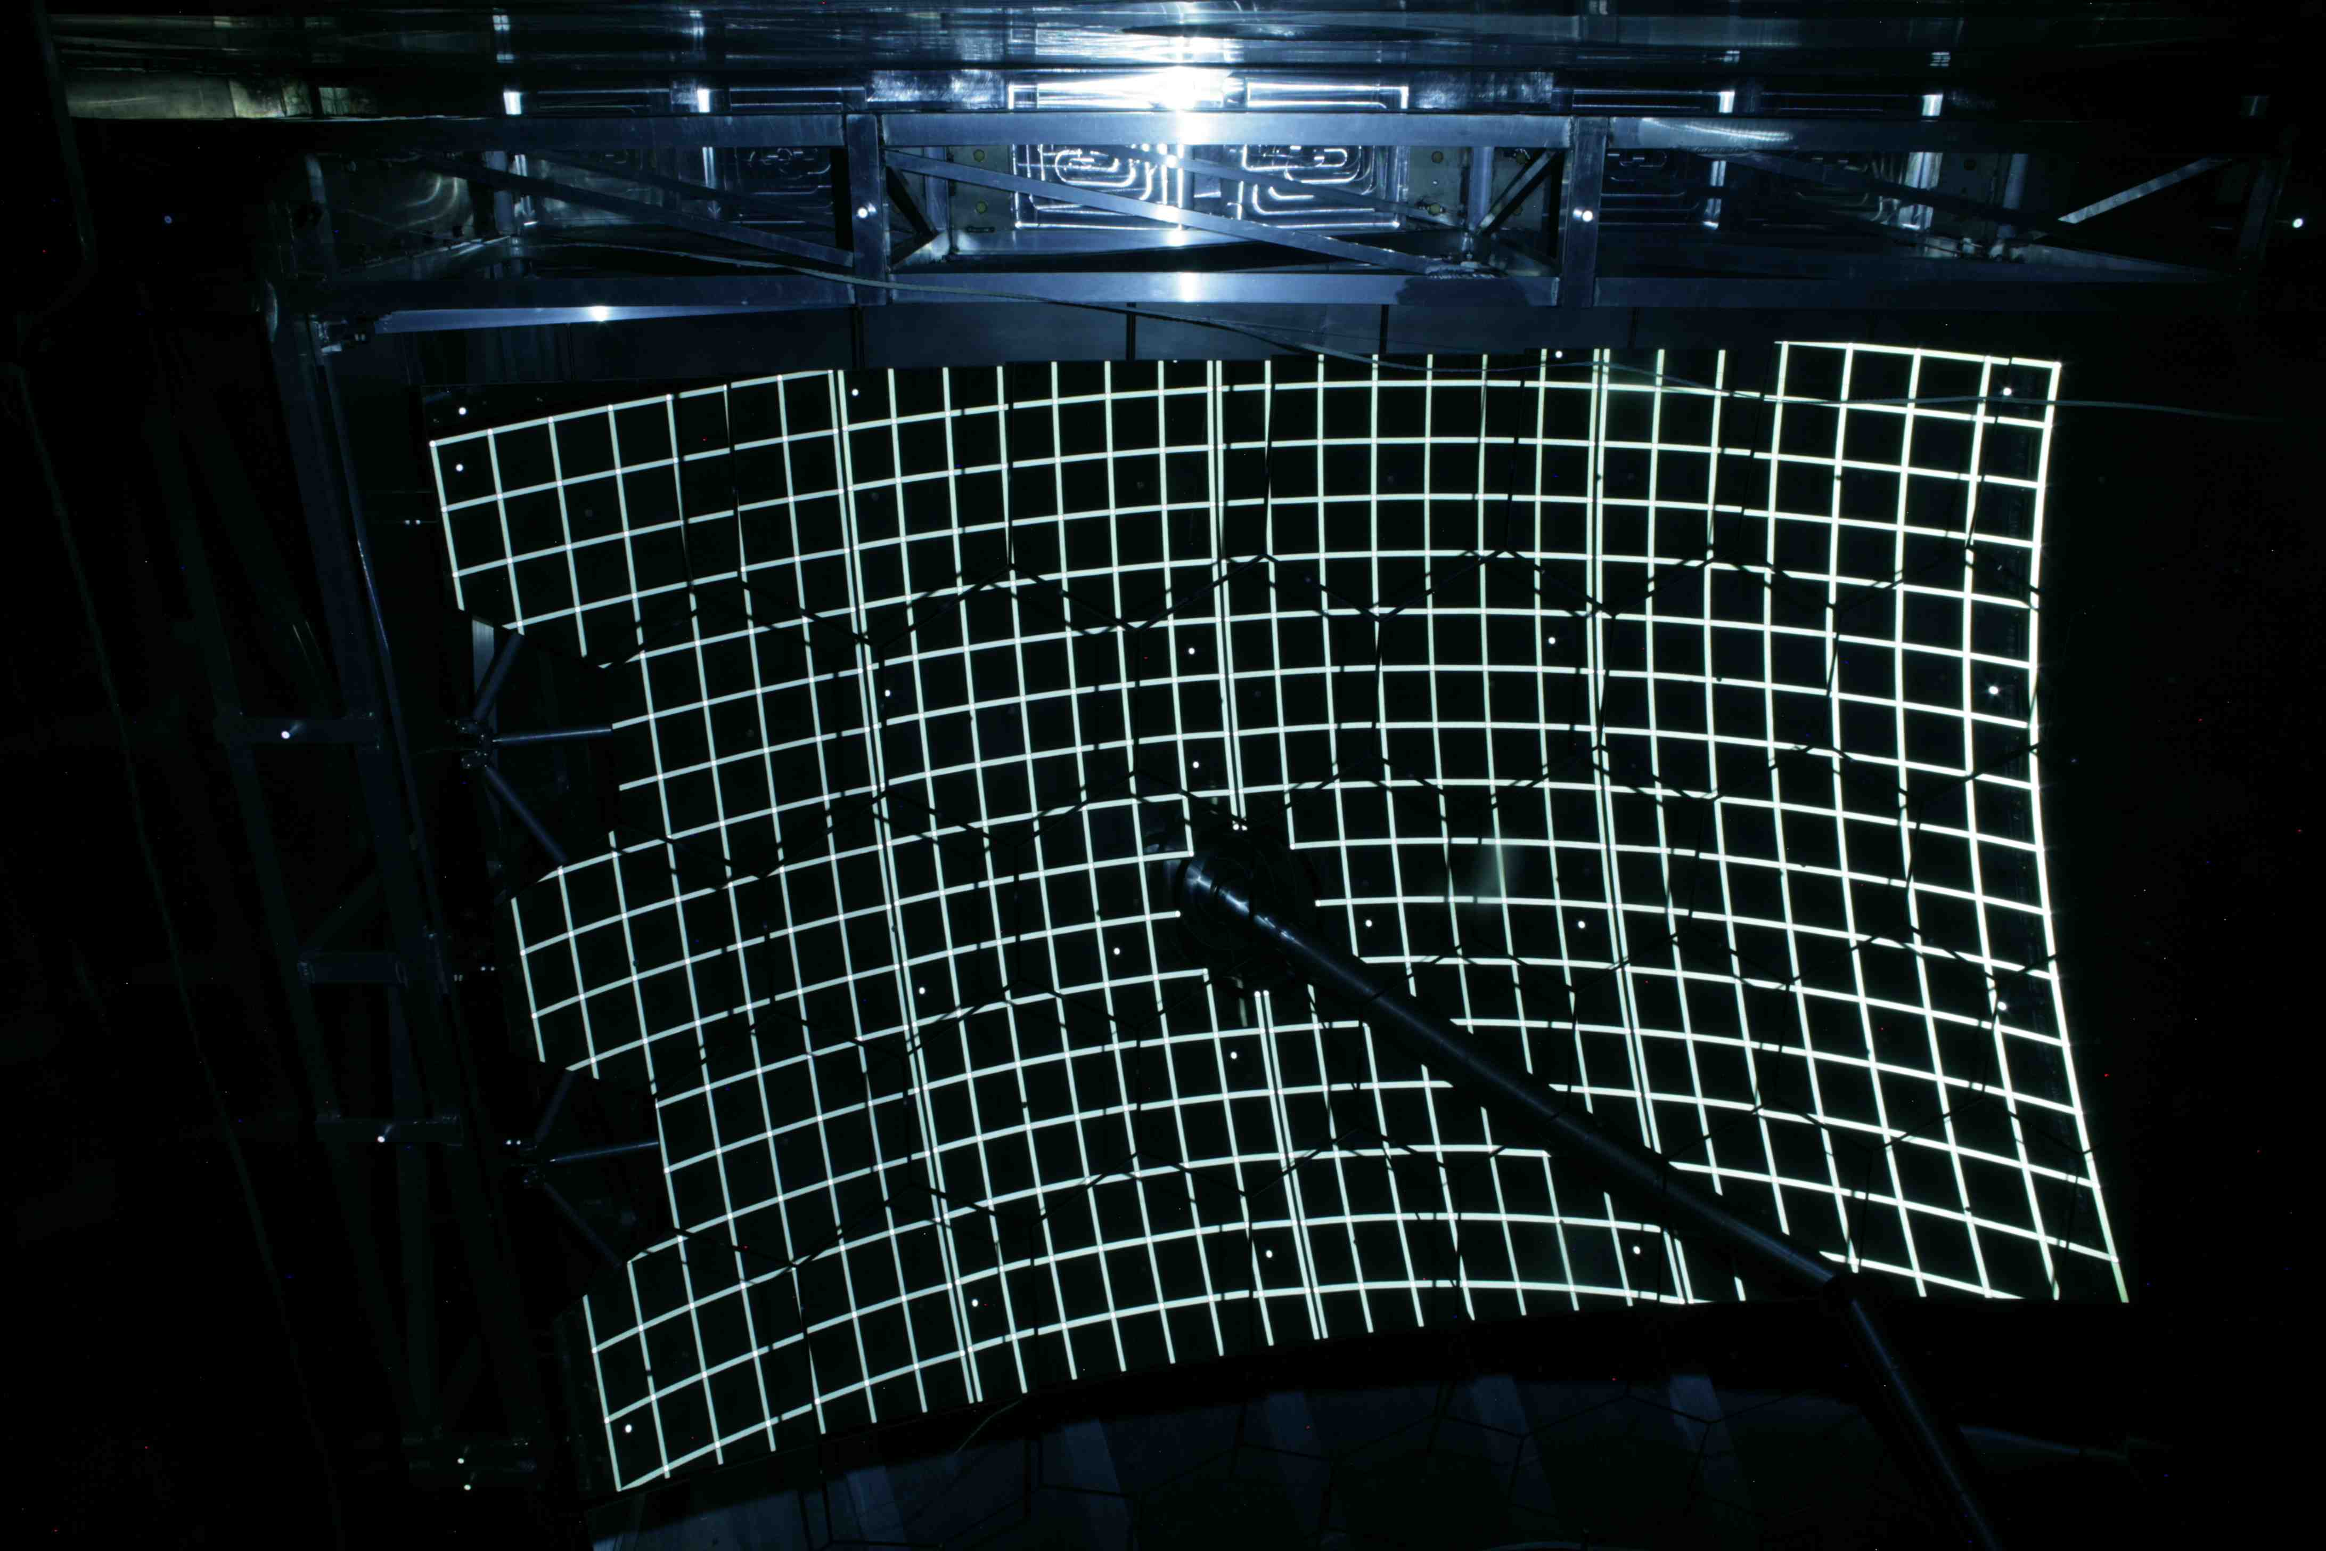
Principe of CLAM– to observe reflection of illuminated rectangular grid on RICH mirrors
Real photo of ¼ of mirror wall (4 cameras used)
Black line shadows identify edges of mirrors
and non illuminated parts in grid plane
5 pixel shift
~ 0.7 mrad tilt
Shift of lines
Beam pipe

Slide 37
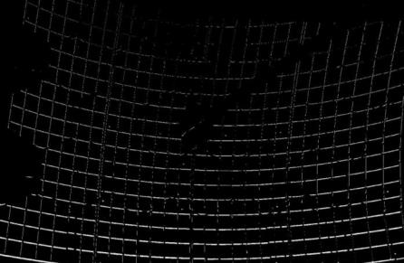
Relative measurement
Mirror monitoring
  Temperature stability
  Temporal stability
  Pressure stability
Illustration picture made by difference / subtraction of two photos
Camera movement during RICH-1 filling
5 pixel shift
~ 0.7 mrad tilt
CLAM was used to check impact of new fast circulation system compressor 20m³/hr) to the mirror wall
NO vibrations detected.

Slide 38
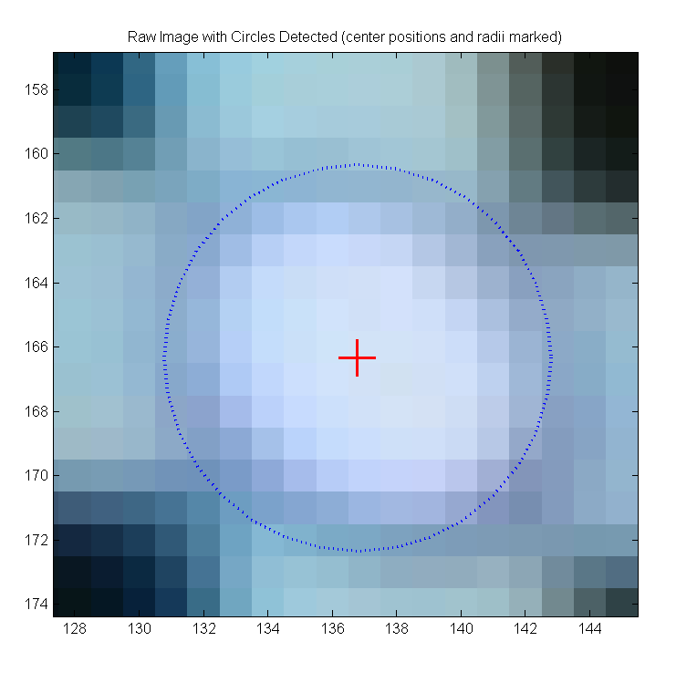
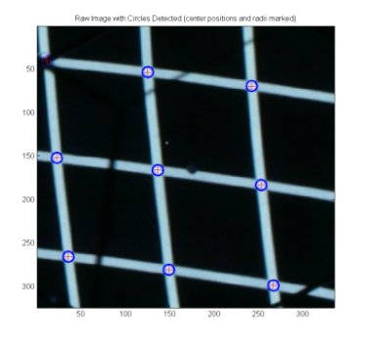
Photogrammetry
Is used for measurements from photographs analysis, especially for recovering the exact positions of surface points - targets. From one photography we know only direction to the target.
For COMPASS RICH-1 we measured the position of virtual image of photogrammetry target, projected by mirror, aiming to receive information about mirror misalignment -absolute measurement

Slide 39
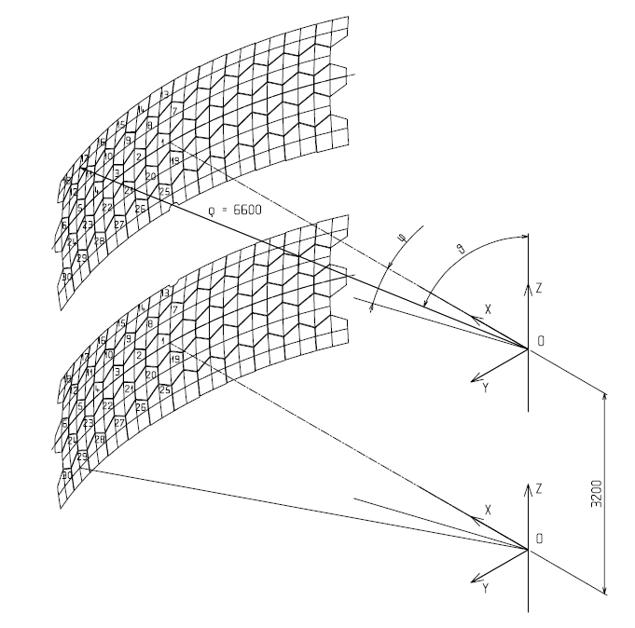
Absolute measurement
Mirror position given by center of curvature in COMPASS coordinate system
The mirror position can be given by
X, Y, Z coordinates of center of curvature
Spherical coordinates R, φ, θ
Difference in spherical coordination can describe polar Δφ and azimuthal Δθ tilts

Slide 40
Determination of mirror orientation
Algorithm to obtain center of curvature for specific mirror
We work in plane DPE
P=[0,0] – coordinate center
is || with the x-axis
=>
C – center of curvature
of mirror
D,P,E,α – known
u=|PS|, β,C,S – not known

Slide 41
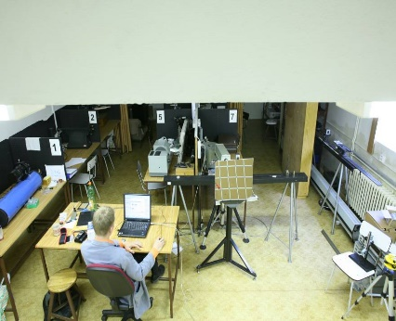
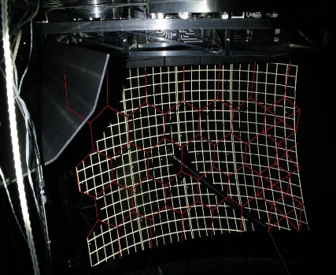
Crosscheck CLAM vs. interferometer
  Excellent correlation between CLAM and interferometry results
The accuracy limits of the CLAM method is about 0.1 mrad, similar to interferometry and theodolite method
Azimuthal angle by CLAM
Azimuthal angle by interferometer
Photogrammetry can be used for solving another alignment problems too.

Slide 42
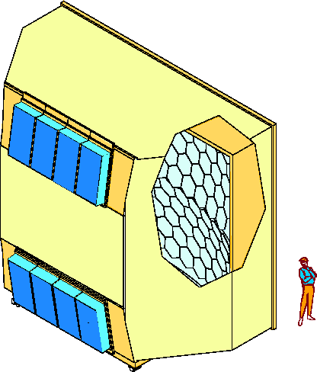
Optical systems collecting photons to detectors
Gaseous RICH - the concept consists of a field lens placed in the focal plane of the mirrors (where the rings are formed) and a condenser lens between the field lens and the MAPMT. The front lens is used to bend the rays towards the condenser lens thus increasing the field of view of the system (image demagnification).
Can be used for all types of RICHs and used photon detectors (with suitable granularity) can be smaller and don’t cover continuously all region of interest.
3m
6m
CsI
MAPMT
detectors
5m
C₄F₁₀ gas
The HERA B RICH system was using injection molded aspheric acrylic lenses
COMPASS RICH-1 upgrade

Slide 43

Optical photon collection system for COMPASS RICH-1 upgrade
PMTs expensive for large surfaces, don’t cover all detector plane
large ratio of the collection and photocathode areas
ratio = 7.3 achieved by
2 LENSES SYSTEM
Field lenses are placed in the RICH mirror focal plane (instead CsI detectors)
Field lens square aperture
PMT window
Condensor lens
Aimed pixel
Target area
48x48 mm²
Telescopes project image with demagnification 7.3

Slide 44
Final nonaxial design by Zemax® software, implemented to COMPASS RICH-1
Good transmission of materials of lenses in deep UV, fused silica used
The total telescope length cannot exceed 15 cm, due to the reduced space available upstream of RICH-1 in the COMPASS spectrometer
The MAPMT has to be oriented at an angle with respect to the telescope entrance axis (compatibility with the existing MWPCs that remain as peripheral photon detectors). It results to condition, that the telescope has to be a non-axial system
It works properly from 2007

Slide 45

Aerogel
It is difficult tot use some new optical element here
Marco Mirazita, The Large-area Hybrid-optics CLAS12 RICH: Assembling, Commissioning and First Data-taking,
Hybrid optics:
proximity
and mirror focusing
E.A.Kravchenko, Cherenkov detectors with aerogel radiators, overview at RICH2018
Proximity focusing with two different refractive indexes
Added lens can be only useful in case almost parallel particle beam

Slide 46

Liquid
Super-Kamiokande
and another experiments
Almost no optical elements used

Slide 47





Producing of free-form optics
Different shapes, materials
Single Point Diamond Turning technology
Precision surface polishing

Slide 48


Optical element measurements
Possible to measure almost all shapes of optical elements by full-aperture aspheric subaperture stitching interferometer.
Exact measurement of surface quality

Slide 49



Shack –Hartmann senzor
It is possibility to measure wavefront of light
Adding of mirror array (to aerogel??)
Detected photon distribution gives unique information obout Cherenkov angle

Slide 50


calculated centres
Hartmann method was used for test of lenses' quality at COMPASS-RICH1 upgrade
Ideal, Zemax® software image, vs. real image
Theoretical reference (central points)
tolerancies
(from Zemax® simulation +/- 0.1 mm)

Slide 51




Radial polarization is a superposition of two orthogonal polarizations
What about using of polarization?
Unreal situation
=
+
Polarized beamsplitter
Maybe it can be used at some special applications

Slide 52
Conclusion
New optical elements, instruments and methods can help to improve particle identification sensitivity of Ring Imaging Cherenkov detectors
There is no general method for all types of RICH detector but there are two important common possibilities
  Using of sophisticated optical software for design and modeling of RICHs
  Using of aspherical optical elements for receiving better accuracy of particle identification

Slide 53
THANK YOU FOR YOUR ATTENTION

