Slide 1
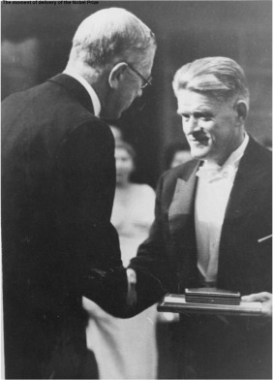
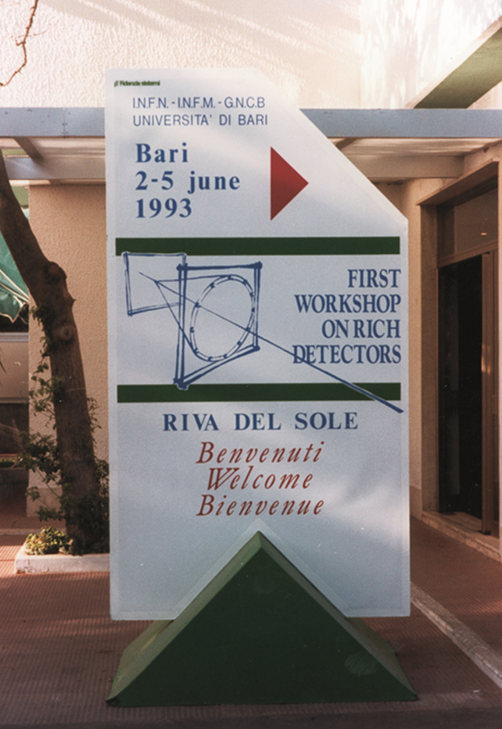

Slide 2
Proceedings
Elsevier/North-Holland Publishing Company will publish the proceedings as a special
issue of Nuclear Instruments & Methods in Physics Research, Section A.
The deadline for the paper submission is October 15, 2018.
The paper must be written in LaTeX or Microsoft Word.
Contributed talks must not exceed 4 pages (5 pages for extended talks).
3 printed ‘NIM A’ pages for posters.
Invited talks must not exceed 8 pages.
Additional costs will be applied by Elsevier to authors wishing “open access” papers and/or colour figures in the printed copy of the Proceedings

Slide 3
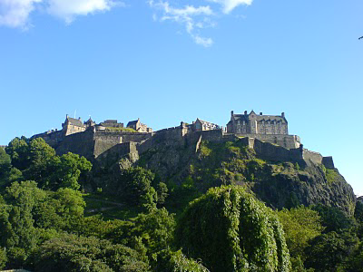
Next RICH Workshop
Edinburgh in 2021
by the Institute for Particle and Nuclear Physics (IPNP) /
Particle Physics Experiment (PPE) group at Edinburgh University
(Stephan Eisenhardt, Silvia Gambetta, Franz Muheim, Matt Needham,
Steve Playfer… )

Slide 4
Acknowledgements
I express my sincere thanks to our hosts, Pasha and his collaborators for having professionally organized and run smoothly the WS.
To the advisory committee members for the qualified support I have received in arranging a fruitful scientific program.
To all the attendees who have come from various countries , some very far. To the speakers and poster contributors, their active participation is the heart of this event.
Once again the purpose of this WS series has been completely accomplished.

Slide 5
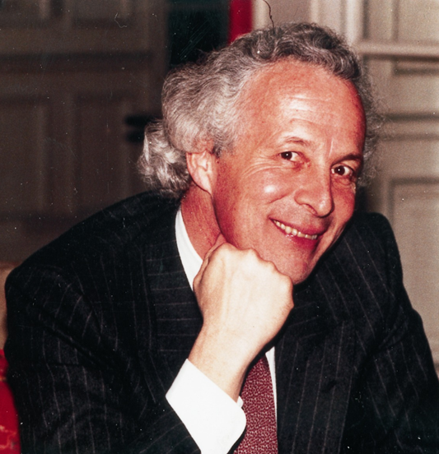
T. Ypsilantis 1928-2000

