Slide 1
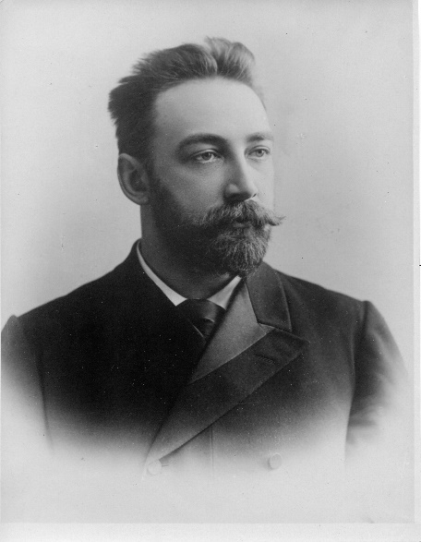
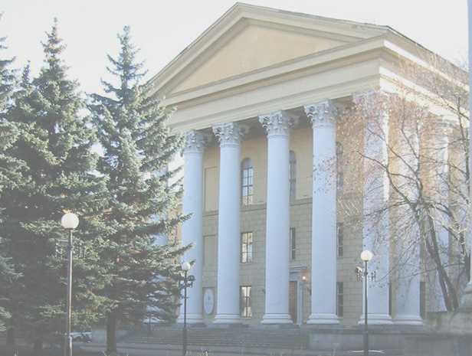
Lebedev Physical Institute
of the Russian Academy of Sciences

Slide 2


Early history
St.-Petersburg period
1725 – 1828 – Cabinet of Physics of the Academy
of sciences (Kunstkamera;
Saint-Petersburg)
1828 – 1912 – transition to the main building of the Academy of sciences (St-Petersburg)
Kunstkamera
(first location of the Cabinet of Physics)
1912 – 1921 – Laboratory of Physics
of the Academy of sciences
1921 – 1934 – Department of Physics in the institute of Physics and Mathematics
of the Academy of sciences
Academy of sciences
(Saint-Petersburg)

Slide 3
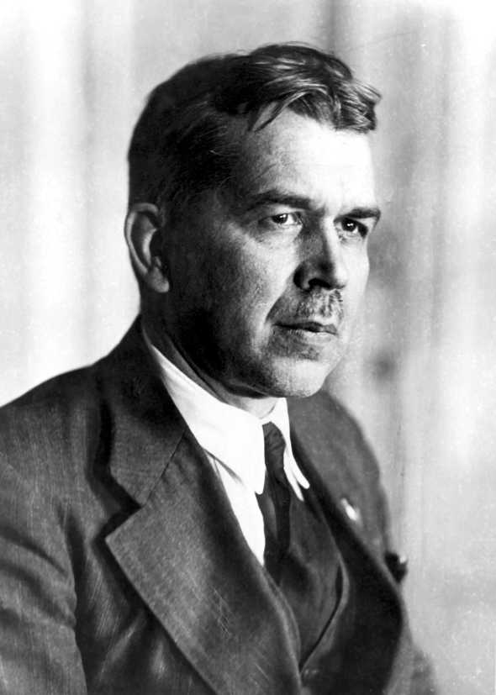
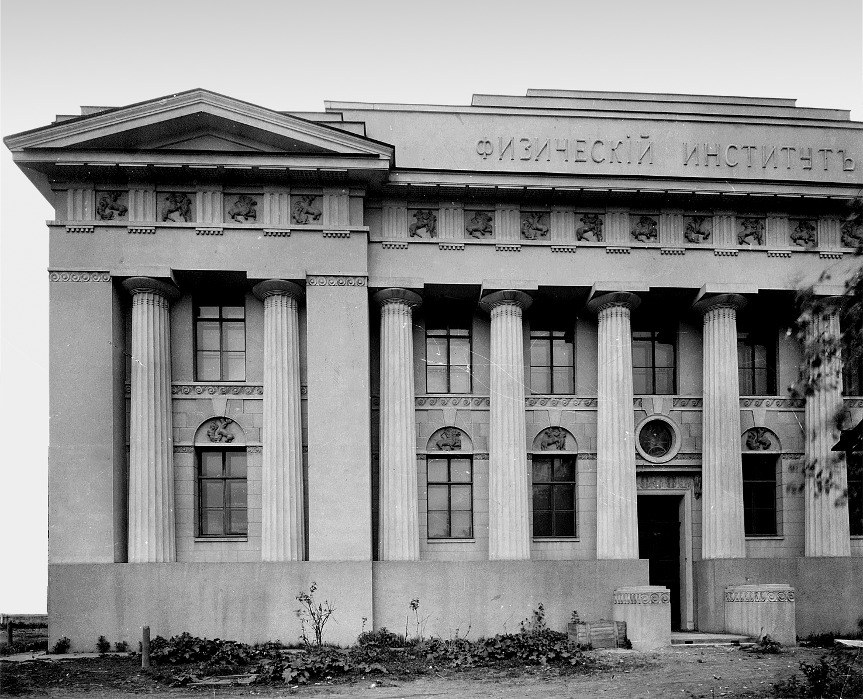
Today’s LPI foundation
1934,
April 28
Resolution of the Academy of Sciences
of the USSR to divide the united Institute
of Physics and Mathematics into two parts: Institute of Physics and Institute of Mathematics
Sergey Vavilov –
the first director of LPI
1934,
midsummer
Changing of LPI from Leningrad (S-Pb.)
to Moscow
The LPI’s first building in Moscow

Slide 4
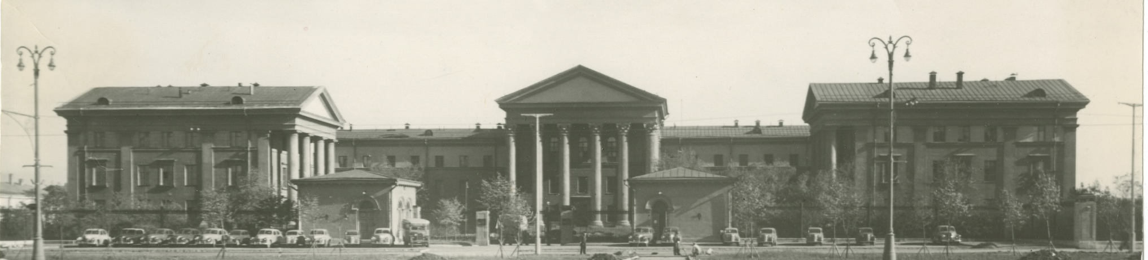
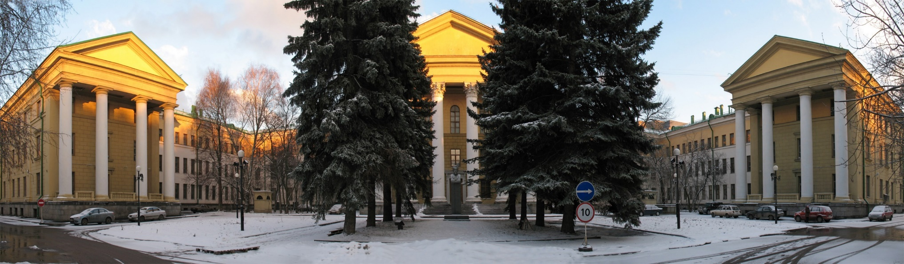
The building of LPI in Moscow
1953
today

Slide 5
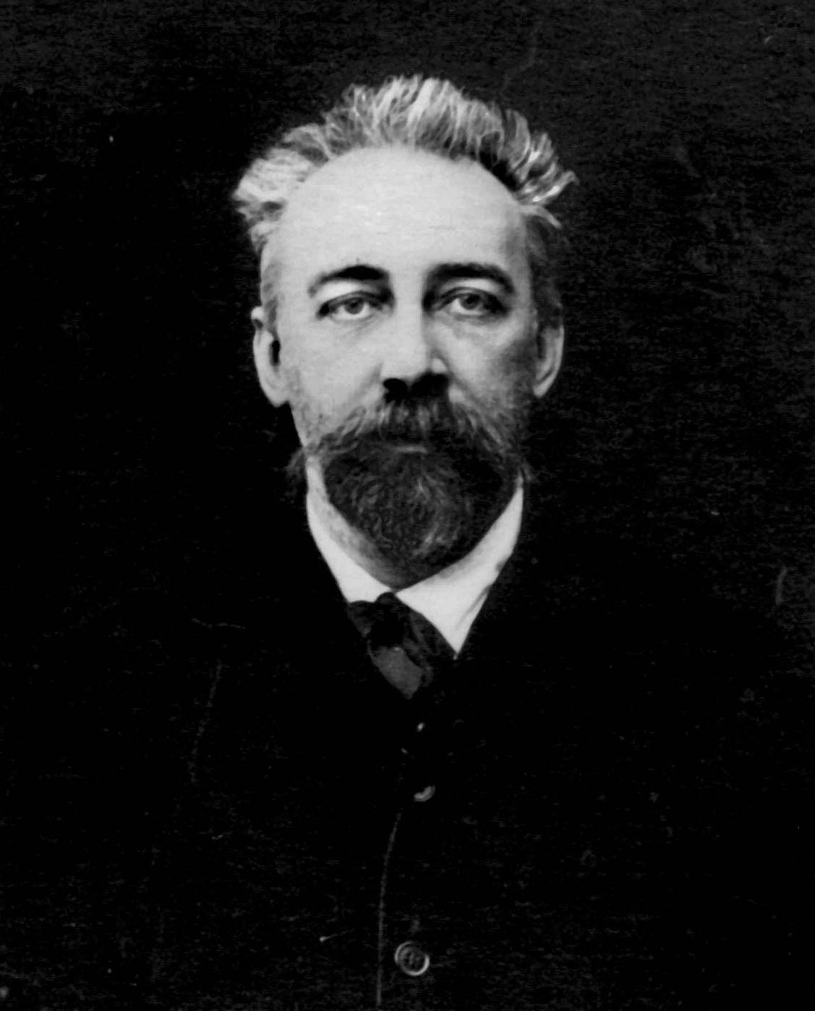
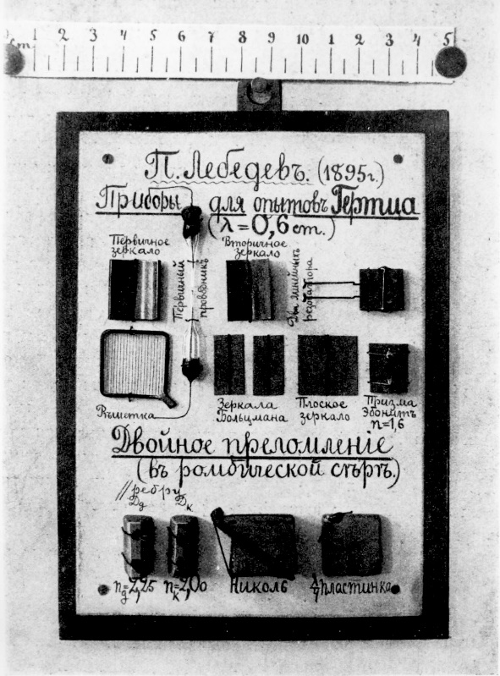
Pyotr Lebedev
The Lebedev Institute is named after Pyotr Lebedev –
outstanding Russian experimental physicist,
the first one who experimentally
proved non-zero
value of the light pressure
P. Lebedev
P. Lebedev’s
“Personal scientific instruments”

Slide 6
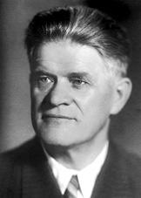
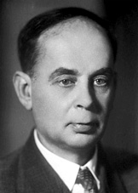
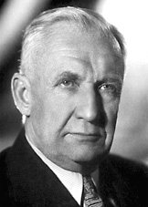
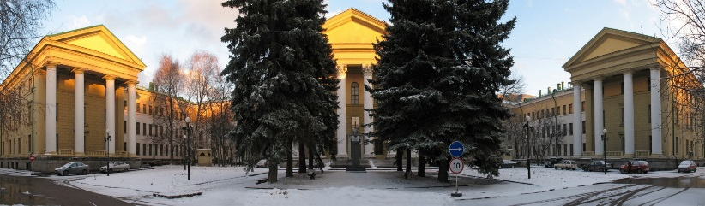
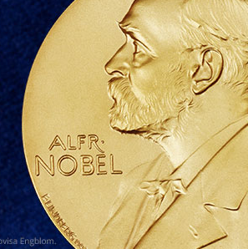
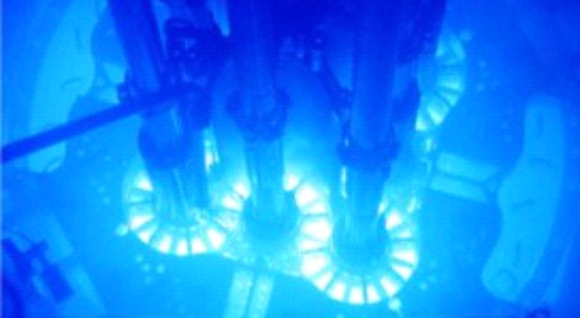
Nobel Prize (1958)
Vavilov-Cherenkov radiation
P.A. Cherenkov
I.M. Frank
I.E. Tamm
Lebedev Physical Institute of the RAS

Slide 7
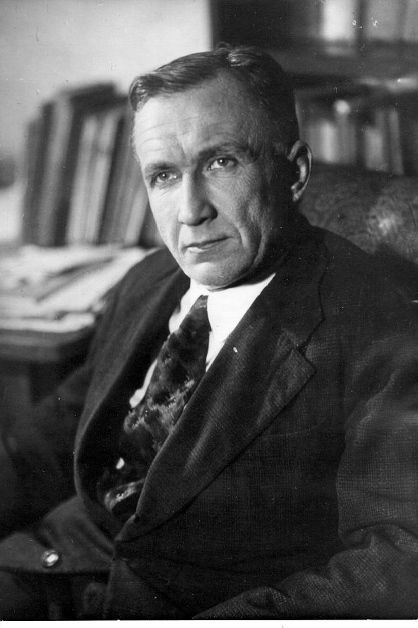
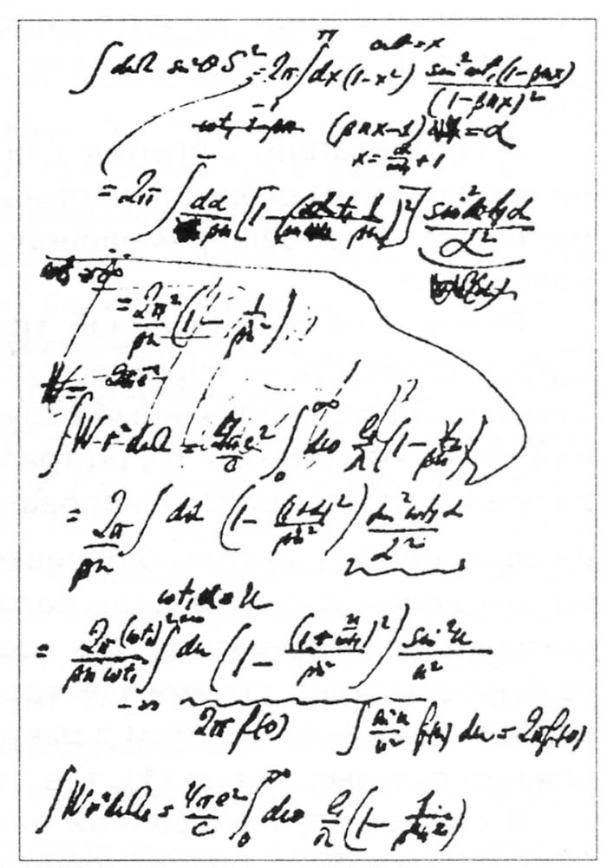
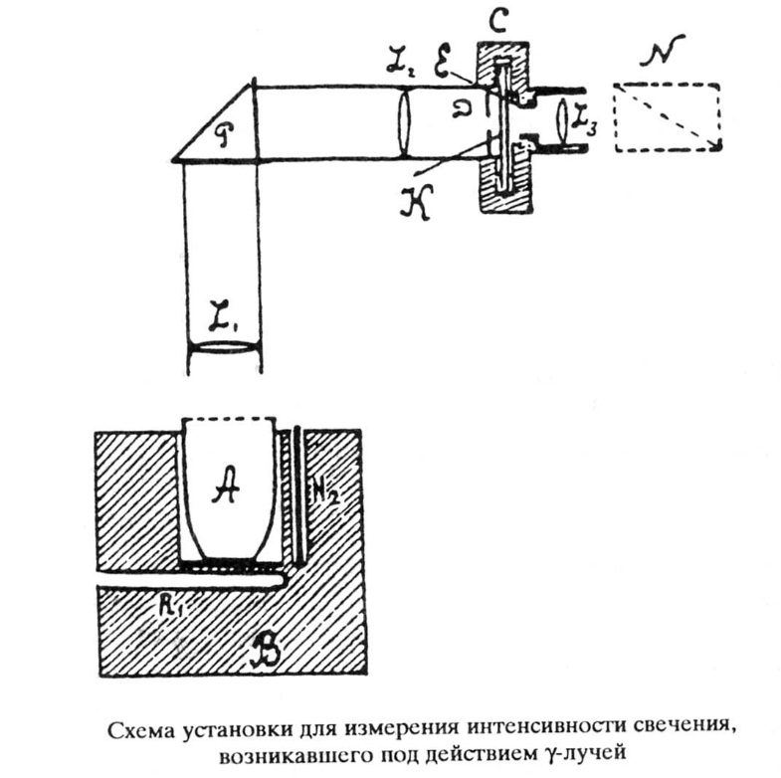
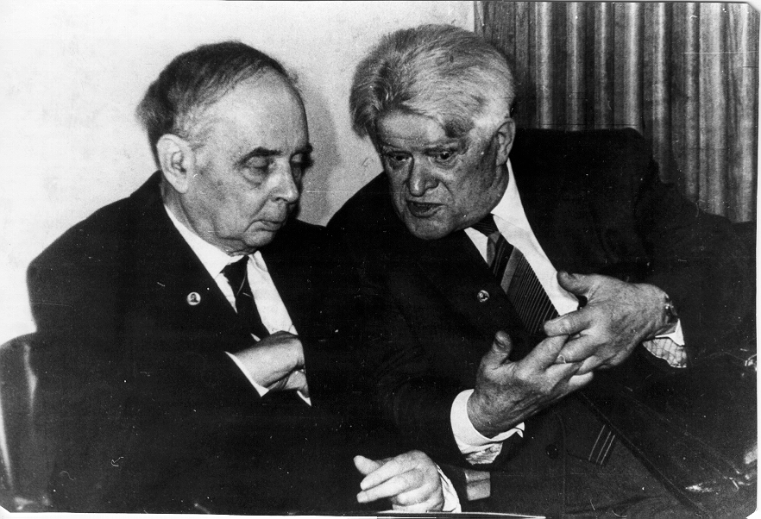
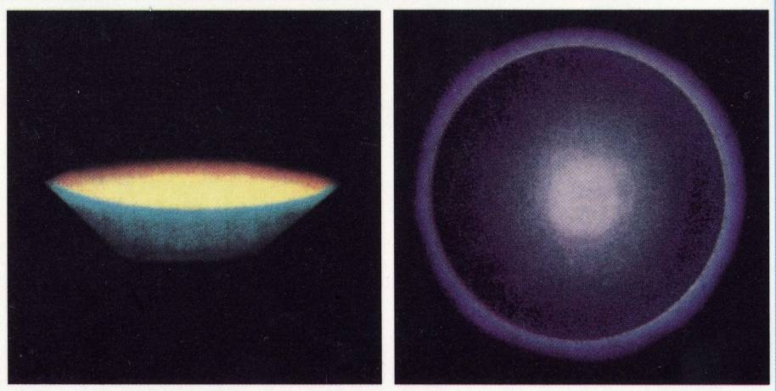
Nobel Prize (1958)
Scheme of installation
for measuring
the intensity of glow
I.E. Tamm
Vavilov-Cherenkov radiation
I.M. Frank
P.A. Cherenkov

Slide 8
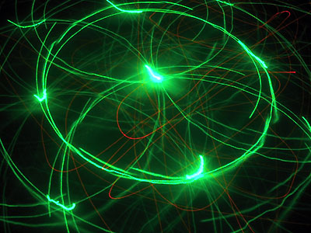
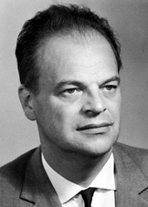
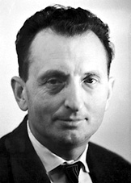
Nobel Prize (1964)
Contributions to fundamental work leading to the development of the maser and laser
N.G. Basov
A.M. Prokhorov
Lebedev Physical Institute of the RAS

Slide 9

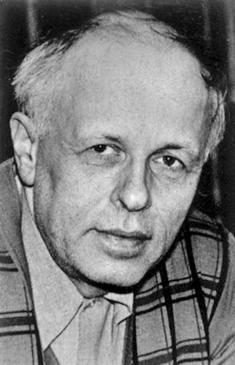
Nobel Prize (1975)
Nobel Peace Prize
A.D. Sakharov
Lebedev Physical Institute of the RAS

Slide 10
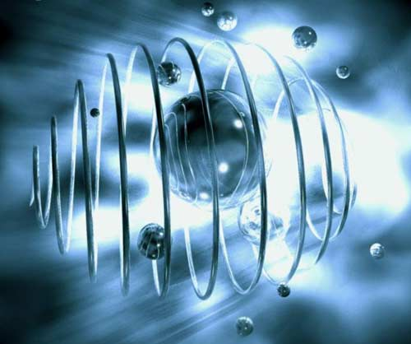
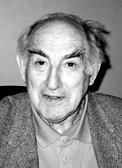
Nobel Prize (2003)
Pioneering contributions to
the theory of superconductors
and superfluids
V.L. Ginzburg
Lebedev Physical Institute of the RAS

Slide 11
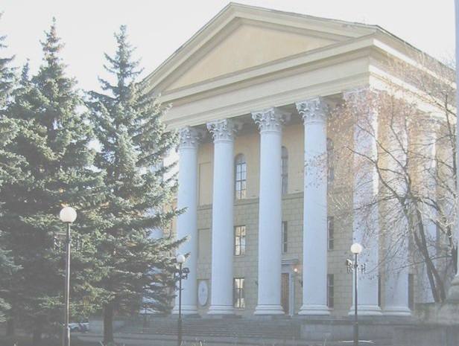
Brief list of scientific discoveries
Brillouin-Mandelstam scattering (Mandelstam,1926)
Hartree–Fock method (Fock,1928-1930)
Raman scattering in crystals (Landsberg and Mandelstam, 1932)
Vavilov-Cherenkov radiation (1934)
Principle of the synchrotron accelerator (Veksler, 1944)
The theory of transition radiation (Ginzburg and Frank, 1946)
Ionization compression of thermonuclear fuel (Sakharov, 1948)
The theory of muon-catalyzed fusion (Sakharov and Frank, 1957)
Ginzburg-Landau Theory for Superconductivity (1950)
Tokamak (Tamm and Sakharov,1951)
Franz–Keldysh effect (Keldysh, 1958)
Supersymmetry (Golfand and Likhtman, 1971 - 1972)
Becchi-Rouet-Stora-Tyutin (BRST) symmetry (Tyutin,1975)
Inflationary universe theory (Linde, 1982)

Slide 12

The Institute today
Wide range of research activities
The staff | Researchers | Members of Academy | Doctors of Sciences | PhDs
1750 | 1000 | 25 | 174 | 432
The LPI has about 20 academic chairs for undergraduate education.
The number of postgraduate students is more than 70.
60-80% of postgraduate students continue to work in LPI as researchers.

Slide 13

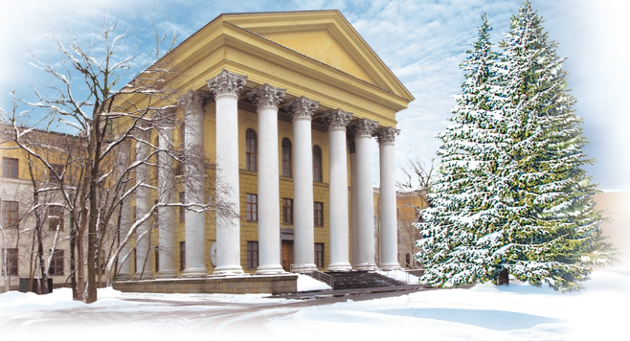
The LPI’s branches
PUSHCHINO
RAO
of ASC LPI
PROTVINO
PTC LPI
SAMARA BRANCH
KYRGYZSTAN
Pamir
expedition
TROITSK BRANCH
KAZAKHSTAN
TShMSS
DOLGOPRUDNY
DSS LPI

Slide 14
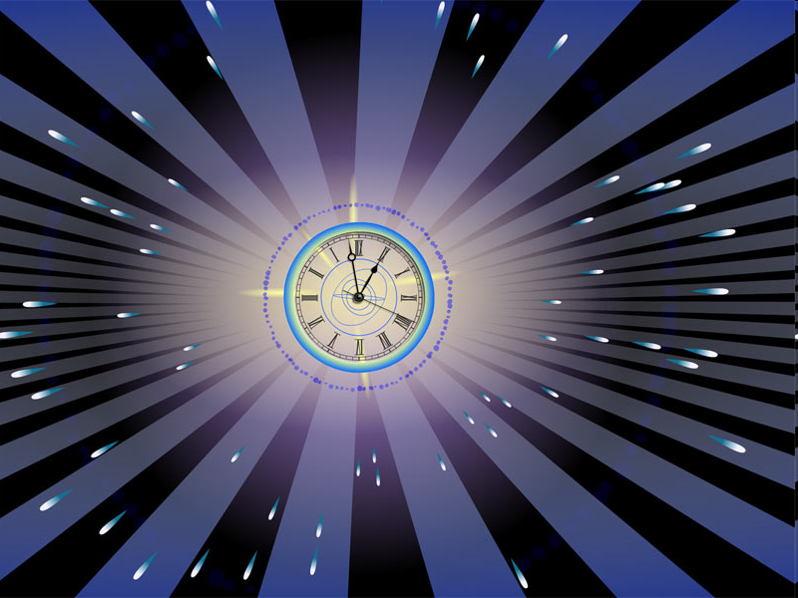
LPI is the birthplace
of 10 scientific organizations
Institute of Physical Chemistry and Electro Chemistry
(1937)
General Physics Institute
(1982)
Institute of nuclear physics MSU
(1946)
Institute for Nuclear Research
(1970)
Radio Engineering laboratory
(1946)
Institute for Spectroscopy
(1968)
Institute for Physics and Power Engineering
(1947)
Institute of Semiconductor Physics
(1962)
Laboratories of neutron physics JINR
(1951, 1956)
Acoustics Institute
(1953)

Slide 15
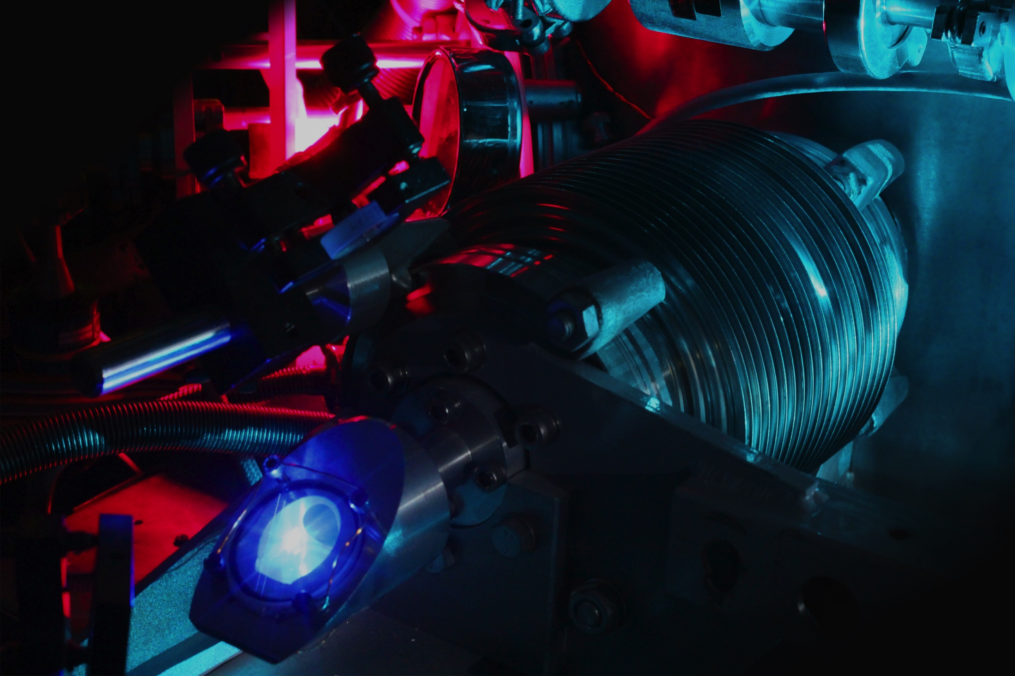
LPI’s fundamental research
Notes:
15

Slide 16
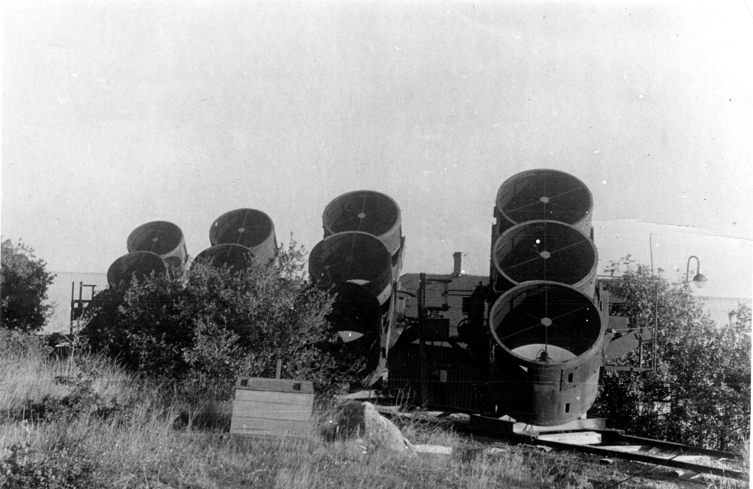
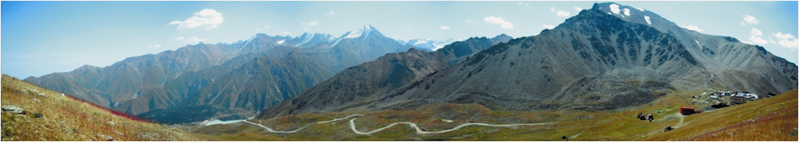
Cherenkov detectors
N_{m}, cm⁻²/s
Murmansk region
Mirny, Antarctica
Almaty
Moscow region
year

Slide 17
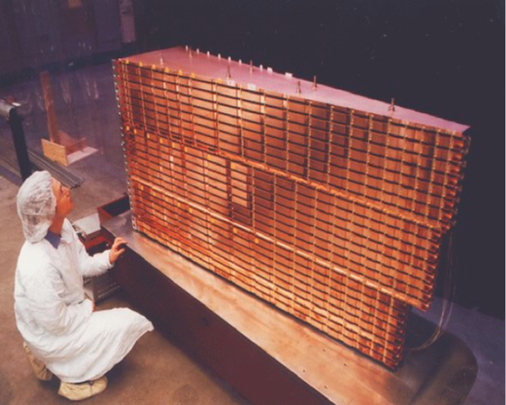
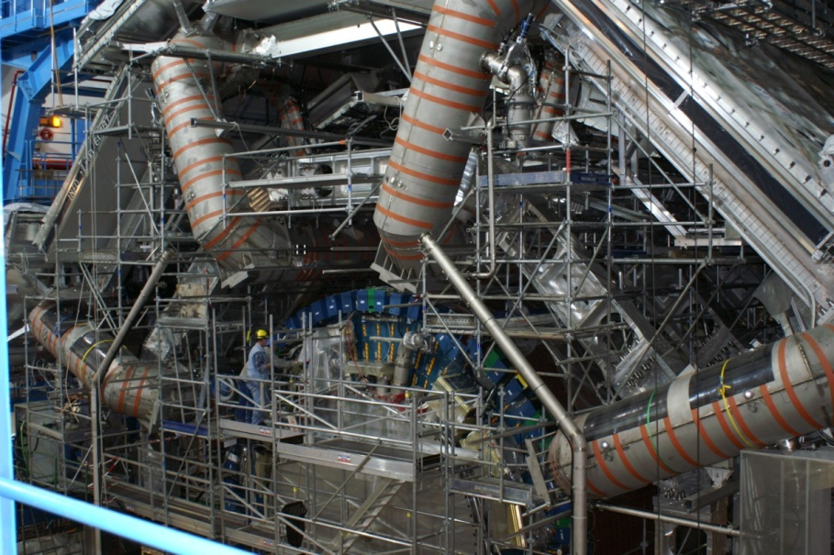
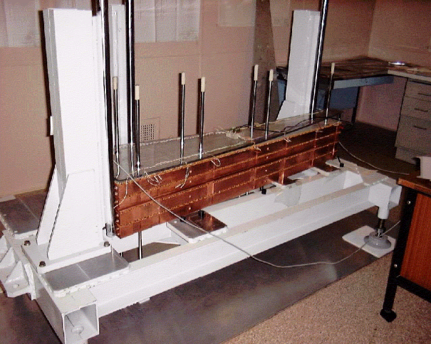
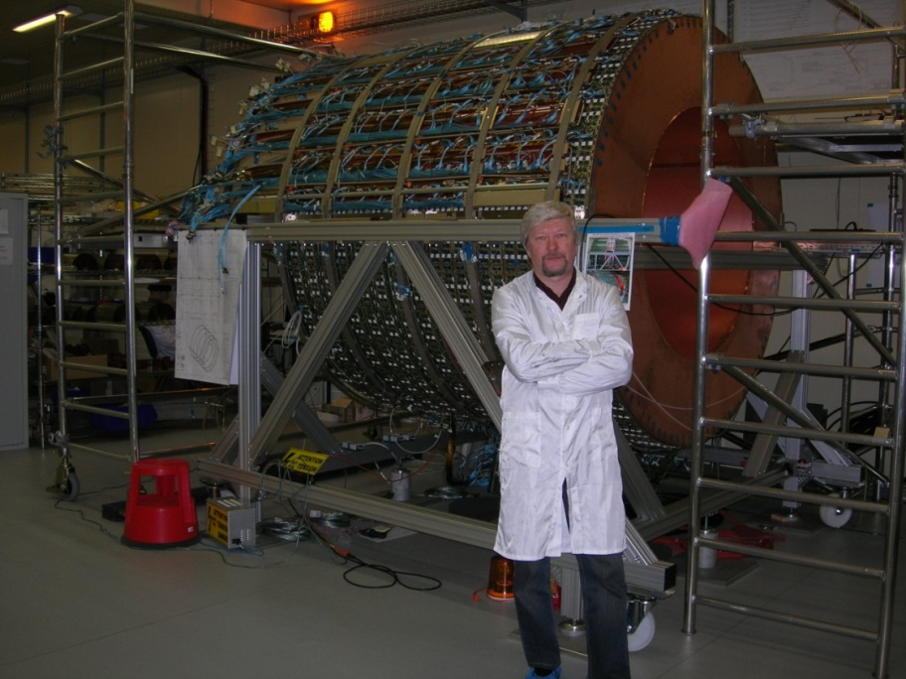
LPI participation in CERN programs
Complete module of calorimeter
Assembly of ATLAS detector
Assembly of end module of calorimeter
Testing of transition radiation detector

Slide 18
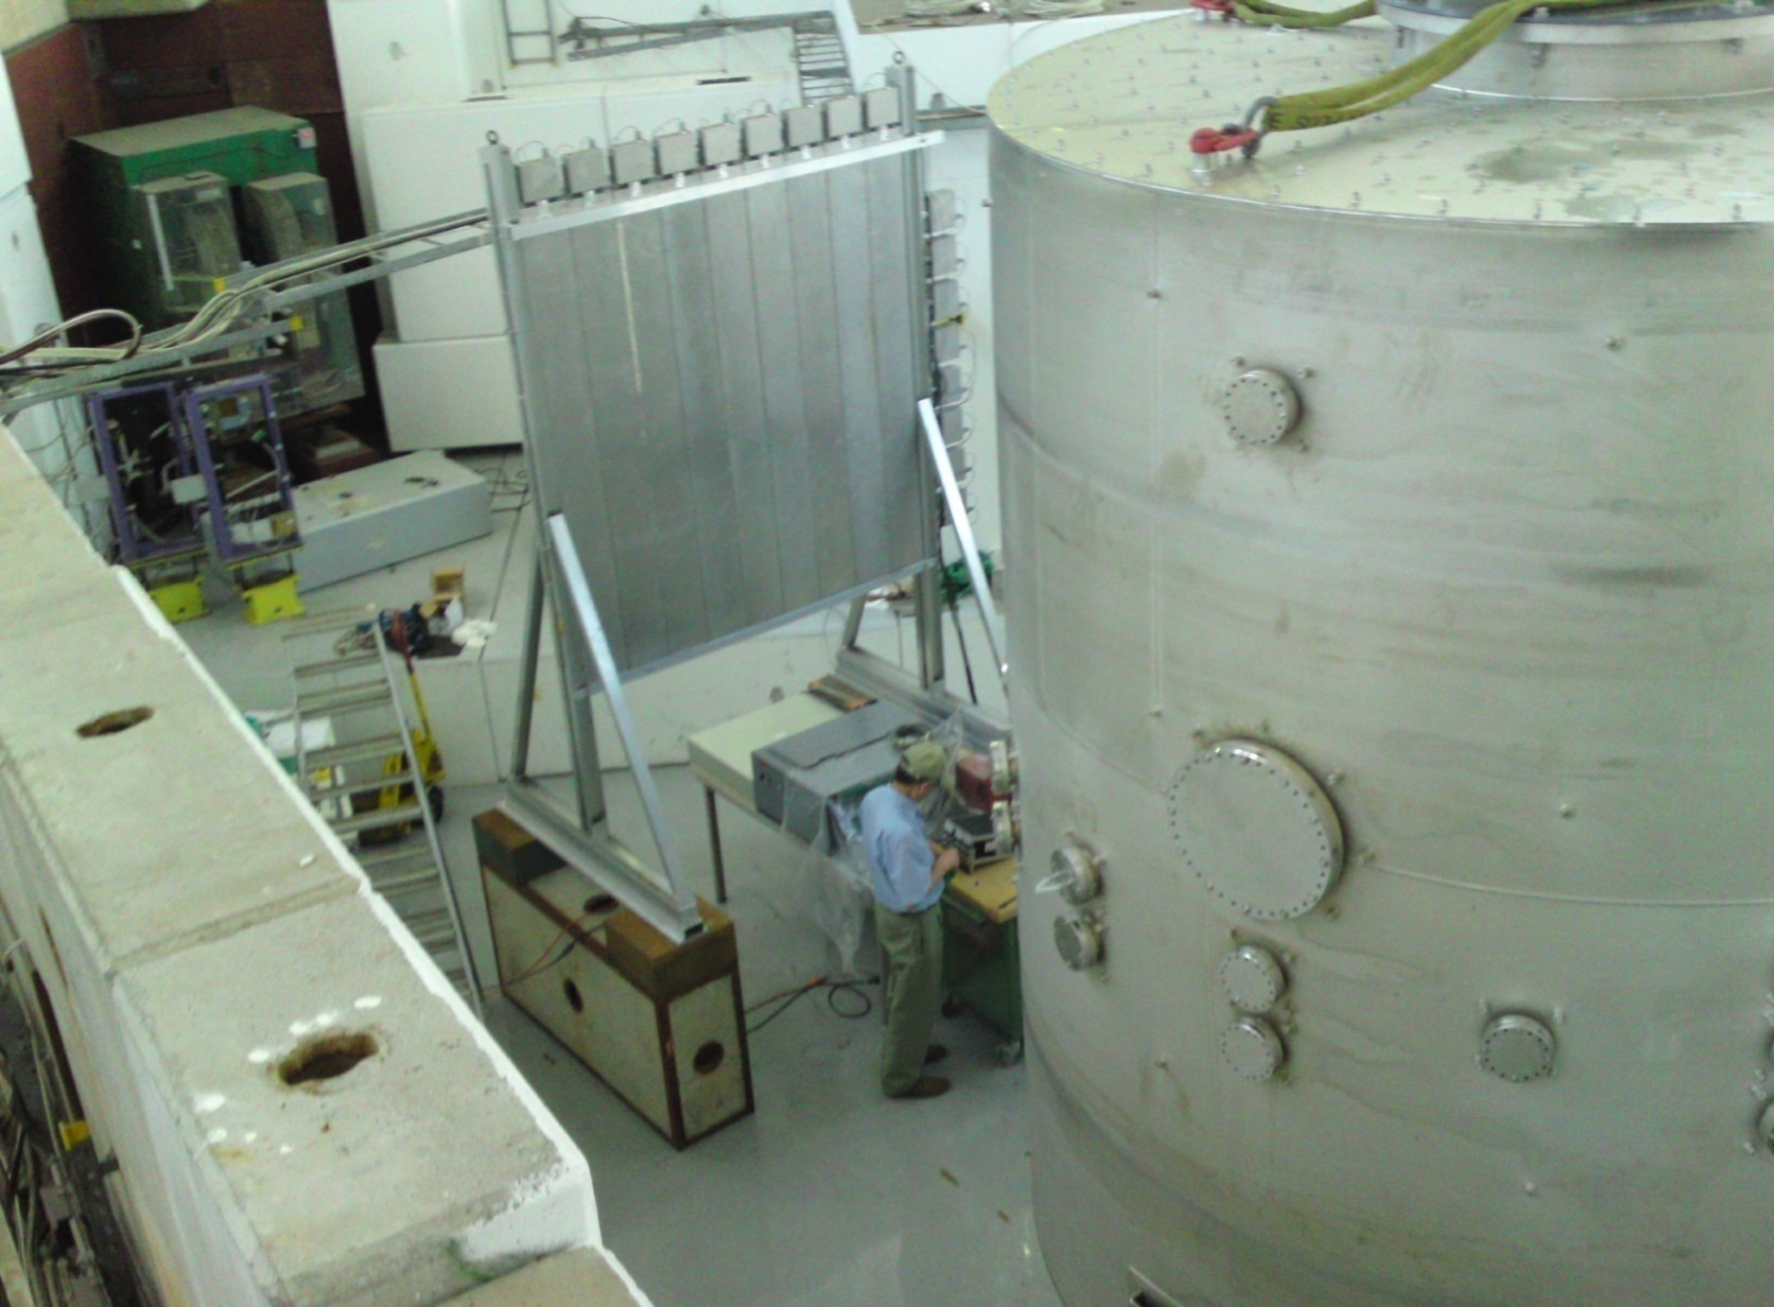
CLOUD experiment at CERN
T11–PS beam
HODOSCOPE
CLOUD CHAMBER
Notes:
18

Slide 19
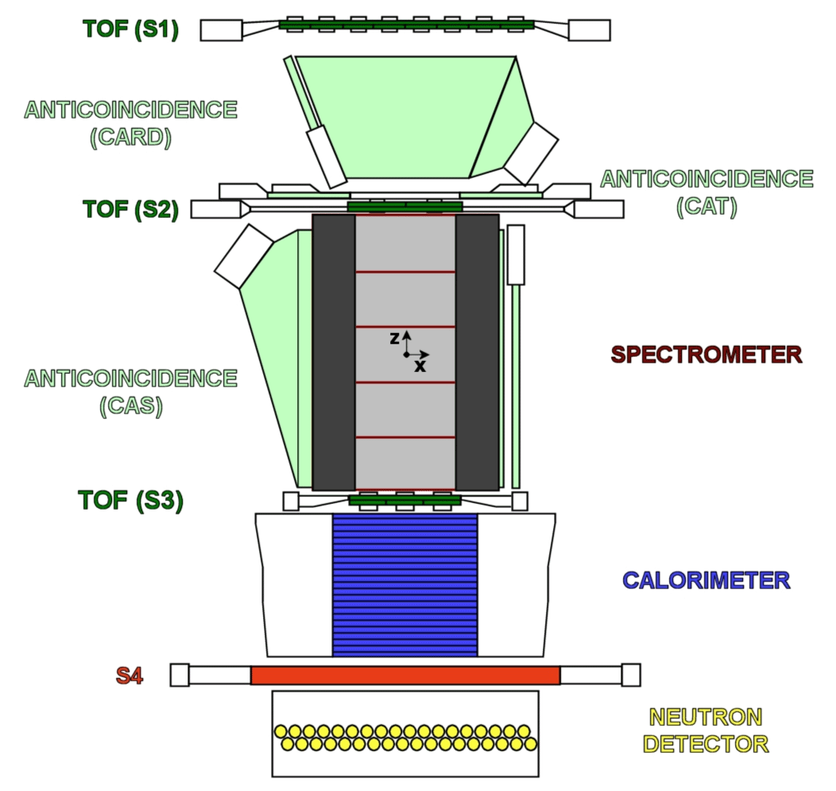
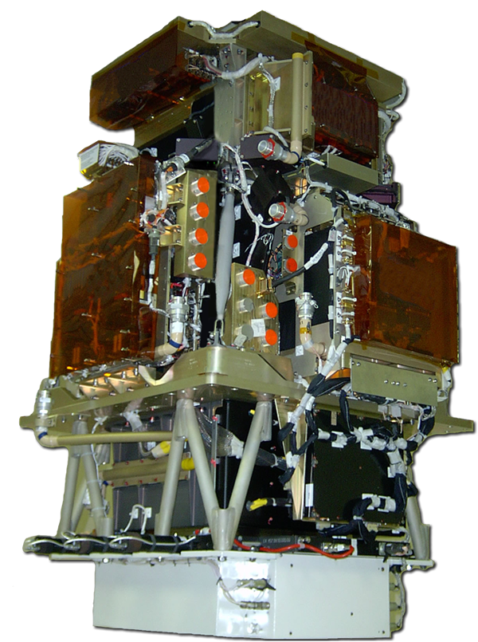
PAMELA detectors
Main requirements: high-sensitivity antiparticle identification & precise momentum measure
+ -
Time-Of-Flight
plastic scintillators + PMT:
Trigger
Albedo rejection;
Mass identification up to 1 GeV;
- Charge identification from dE/dX
Electromagnetic calorimeter
W/Si sampling (16.3 X₀, 0.6 λI)
Discrimination e+ / p, anti-p / e⁻
(shower topology)
Direct E measurement for e⁻
Neutron detector
³He tubes + polyethylene moderator:
High-energy e/h discrimination
GF: 21.5 cm² sr Mass: 470 kg
Size: 130x70x70 cm³
Power Budget: 360W
Spectrometer
microstrip silicon tracking system + permanent magnet
It provides:
  - Magnetic rigidity → R = pc/Ze
  Charge sign
  Charge value from dE/dx
Notes:
Overview of the apparatus

Slide 20
Results of PAMELA

Slide 21
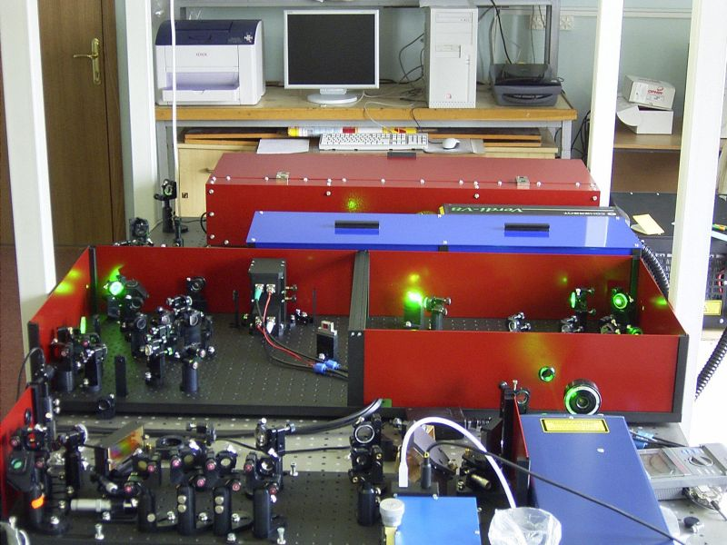
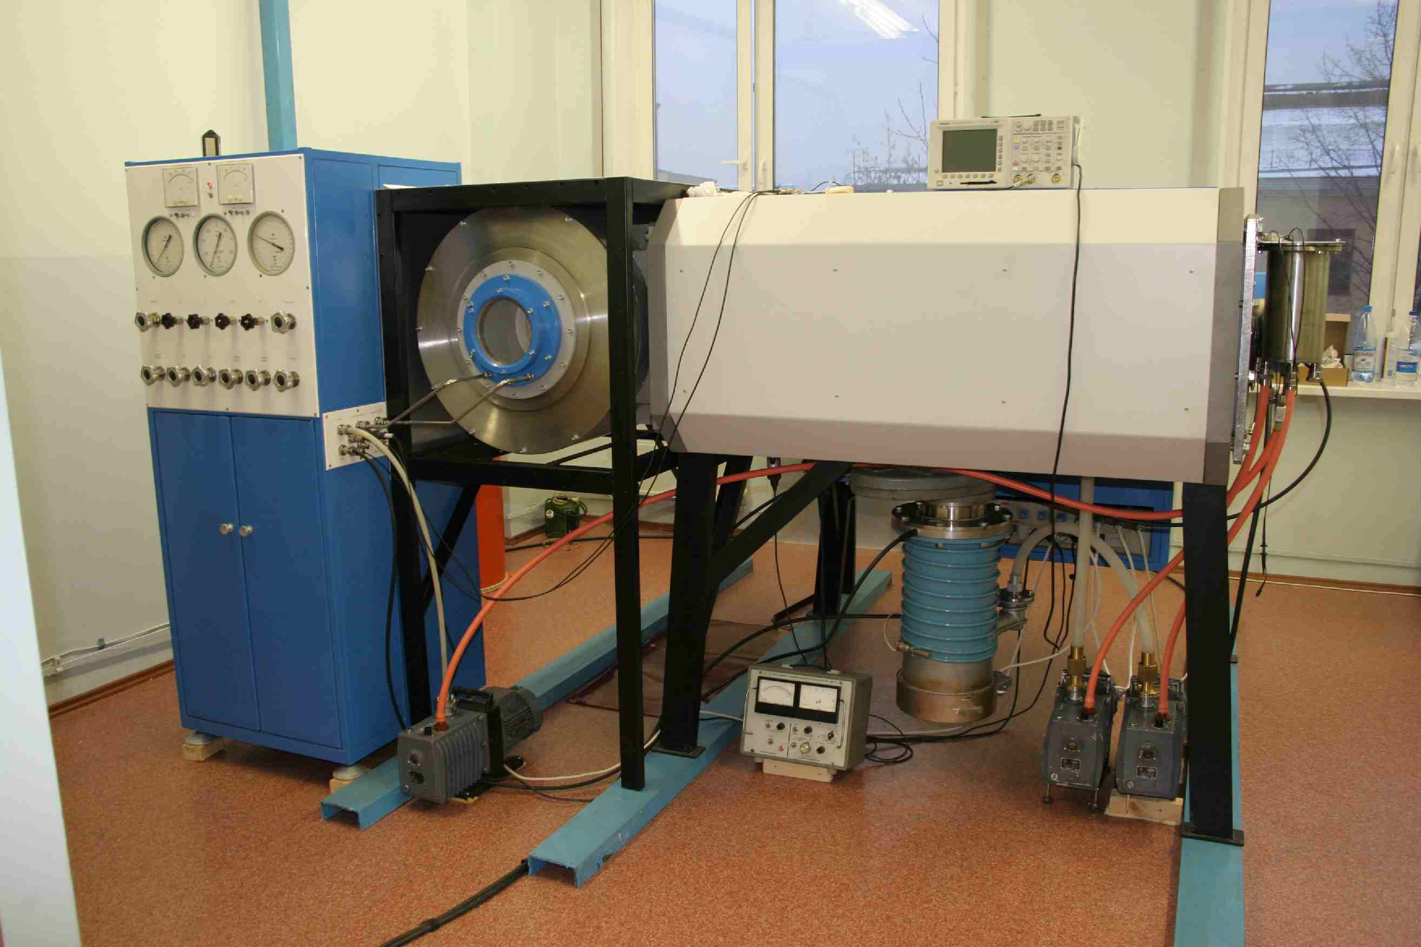
Power = 50 Tw in pulse, duration τ = 50 fs at λ = 475 nm
Joint work with Institute of High Current Electronics (IHCE) SB RAS
Laser research
Solid state system
on the base of Ti:Sa laser
(Avesta-Project, LPI)
Photochemical XeF(C-A) amplifier
with the radiation bumping
from electro-beam convertor
(IHCE SB RAS)

Slide 22
Mechanisms of generation
of penetrating radiation in lightning discharges
The “Storm” installation in the Tyan-Shan Mountain Scientific Station
is the next generation of scientific equipment, which allows
simultaneous recording of all types of radiation

Slide 23
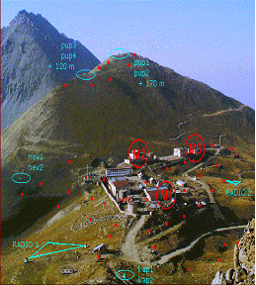
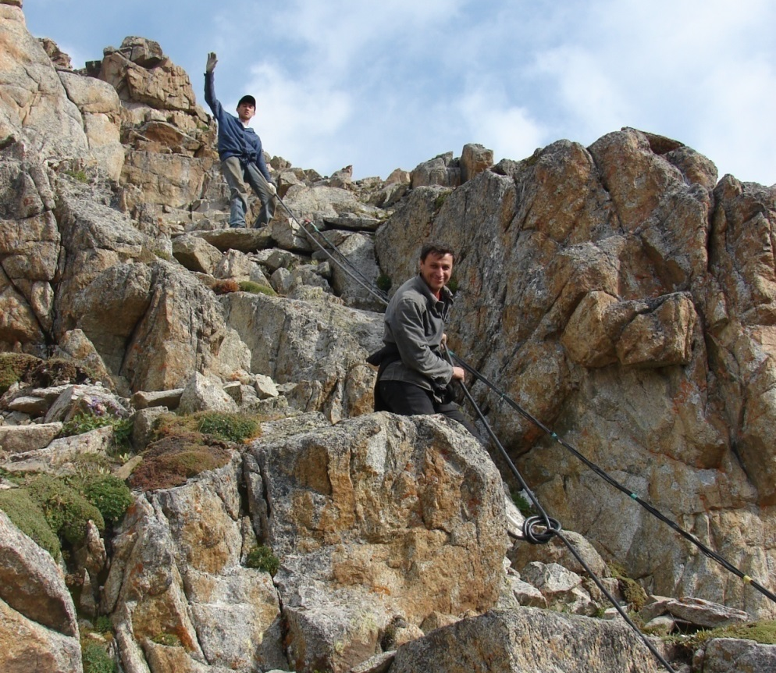

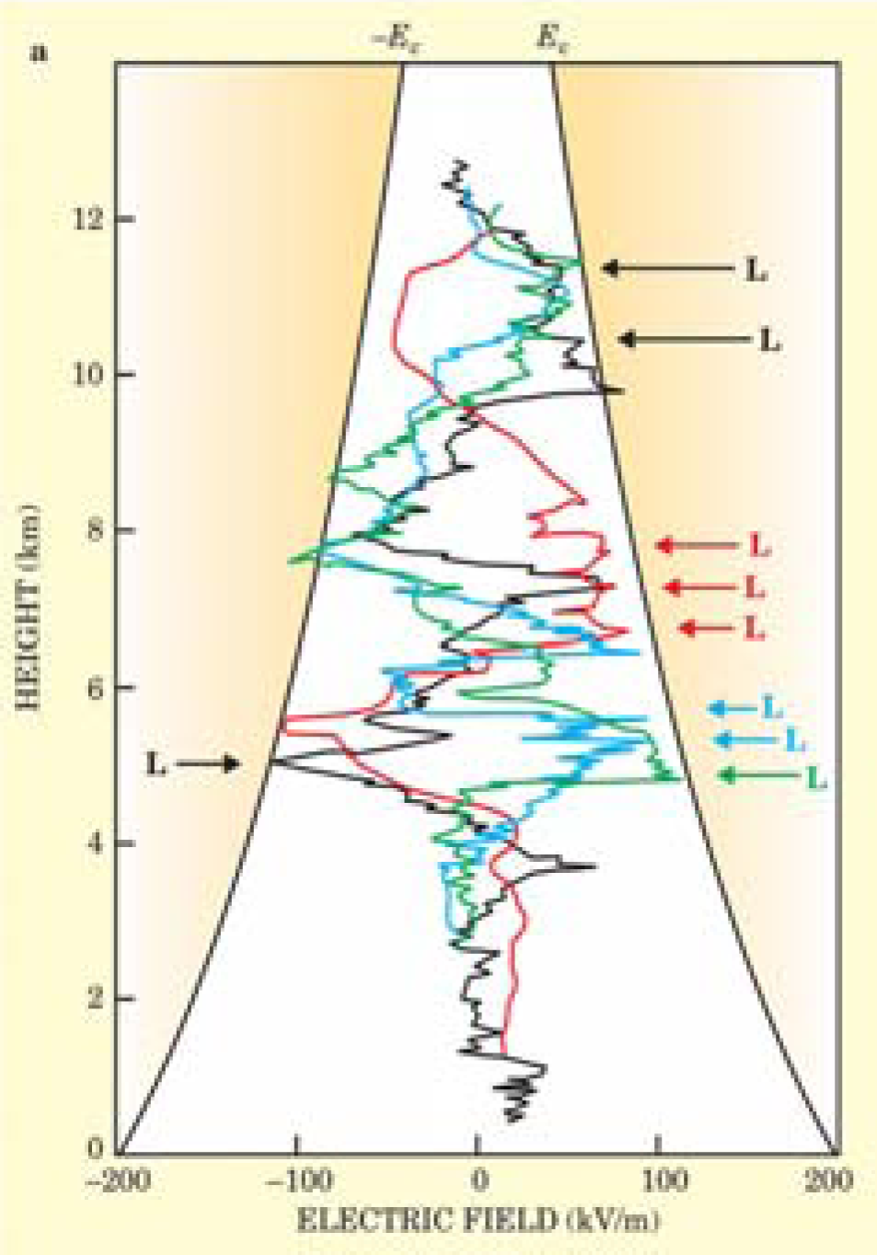
Investigation of mechanisms for generation
of penetrating radiation in lightning discharges
Project “Lightning”
By Division of Theoretical Physics and
Nuclear Physics and Astrophysics Division

Slide 24
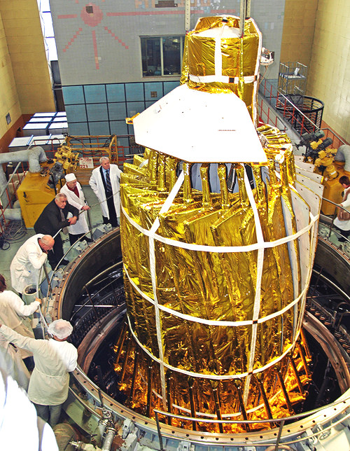
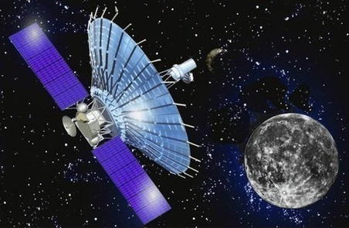
RadioAstron: the Earth-Space Radio Interferometer
The world’s
largest scientific instrument
The maximal apogee is
390,000 kilometers (240,000 mi).
Launch date and time:
02:31 UTC July 18, 2011
The project is funded by the Astro Space Center of LPI

Slide 25
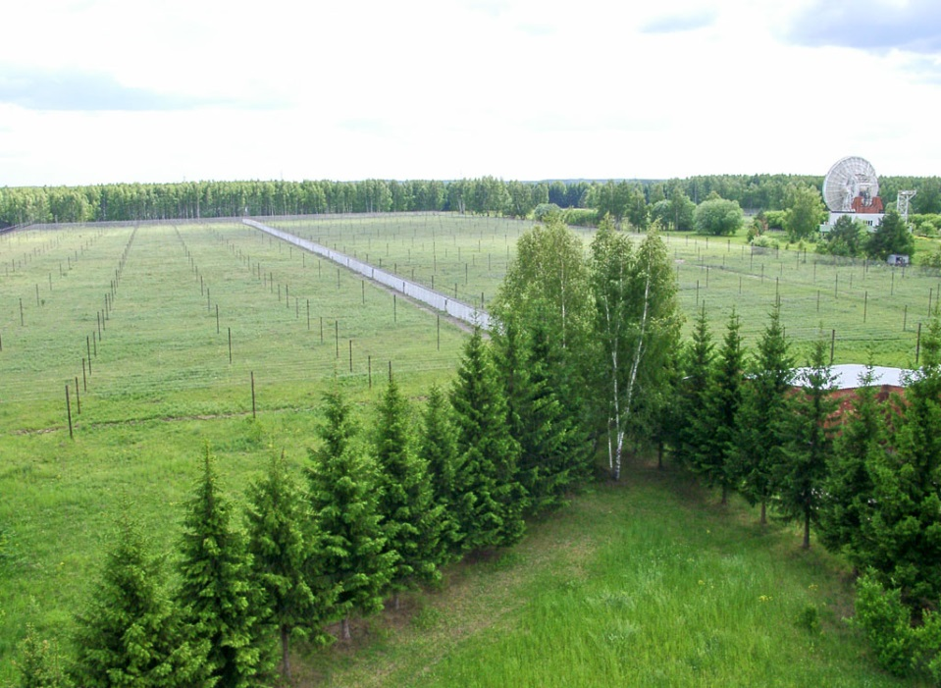
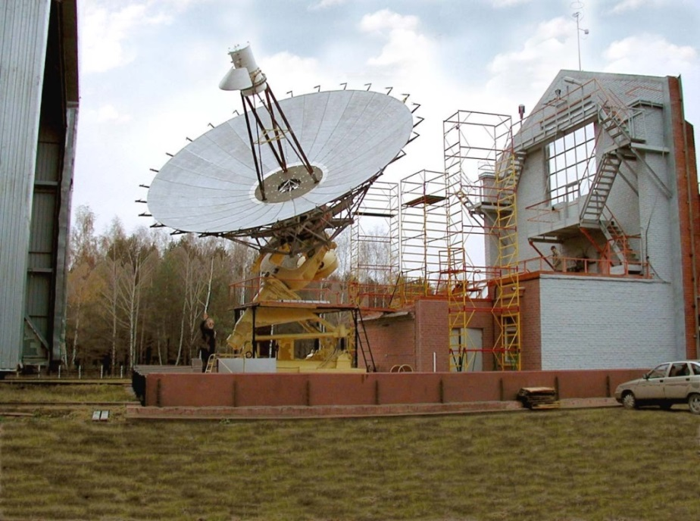
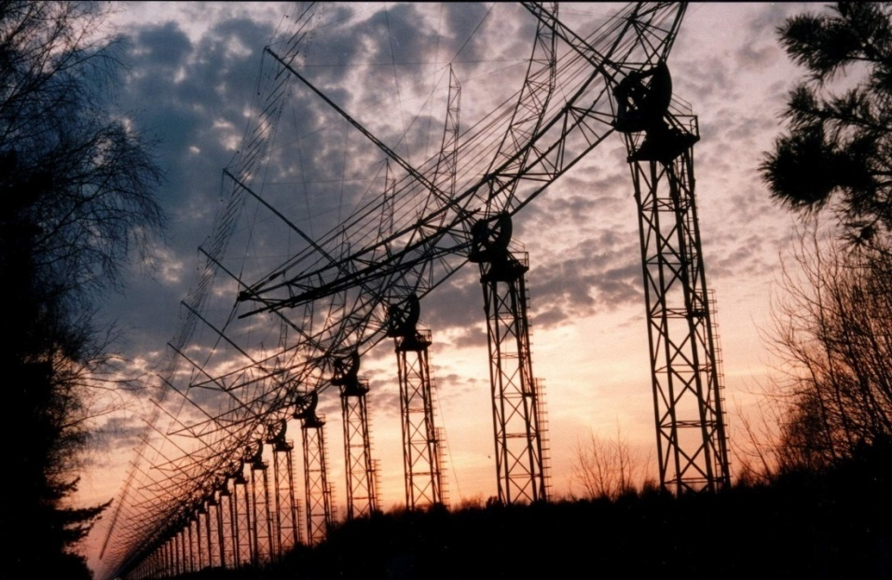
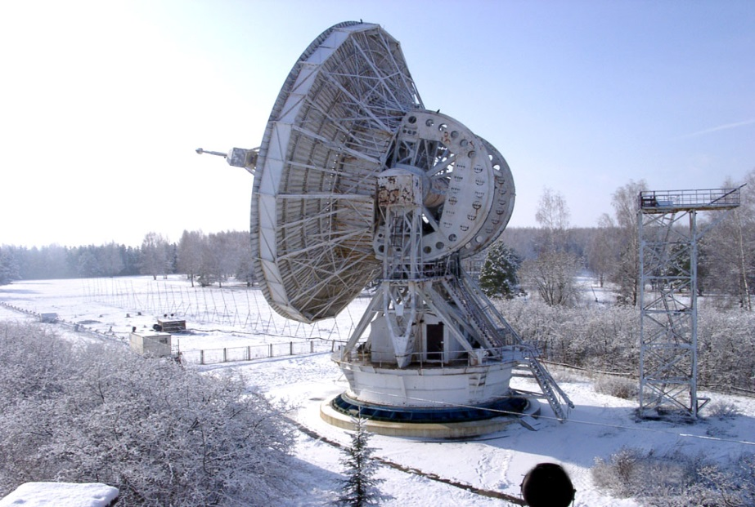
Pushchino Radio Astronomy Observatory
Radio telescope “BSA”
Test station for telescopes
Radio telescope“DKR-1000”
Radio telescope “RT-22”

Slide 26
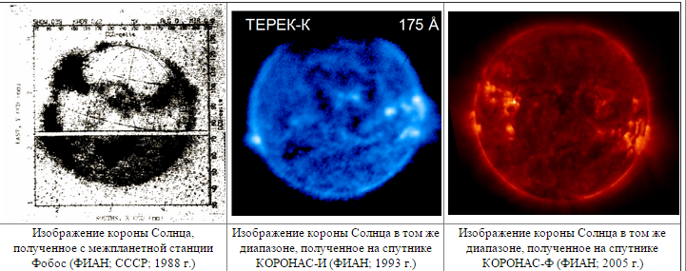
Sun researches from space in UV
Laboratory of X-ray astronomy of the Sun provides
solar researches from space from 1957 (SPUTNIK-2)
The line of experiments from 1988 to 2005
1988
1993
2005
Planned projects:
2024 – ARKA solar telescope with a resolution of 0.1 arcsec.
2026 – INTERHELIOPROBE project

Slide 27




ARKA
2024
The ARKA experiment is the shooting from a small spacecraft of the
solar corona and a transition layer with the highest spatial resolution ever obtained during cosmic solar experiments: 75 km per pixel.
CCD detectors are the largest of detectors ever used for space solar missions.
The launch is scheduled for 2024.

Slide 28



Laboratory of high-temperature superconductivity
The HTSC compounds GdFeAsO(F), DyFeAsO(F) with critical fields value
more than 100 T were synthesized
for the first time
For the first time in Russia, the crystals of new HTSC compounds based
on iron were successfully created
Samples of the wires on the basis of FeSe with steel cover are made

Slide 29


Laser cooling, time and frequency standards
Laser cooled atoms of thulium
The world's first laser cooling of thulium atoms was demonstrated.
The thulium spectrum has a candidate for a stable clock transition
Promising element for the new generation of optical clocks

Slide 30

Applied research and development
Notes:
30

Slide 31




Proton therapy system
It significantly increases the effectiveness of cancer treatment
(from 50% to 90%).
The use of proton therapy “Prometheus” in the clinics
began on March 29, 2016.

Slide 32


Development of domestic MRI scanners
In LPI a first domestic medical MRI scanner is created.
Clinical trials are planned in 2018.

Slide 33



Quantum frequency standards
Super-resonators for stabilization
of laser beam
Modern He-Ne frequency standard
Frequency standards
based on
laser-cooled atoms
and ions

Slide 34




LPI Chamber Music Club
The Club is
a prestigious
music venue

Slide 35

At the Lenin Peak, 7134 m

Slide 36
Thank you
for your attention!

