Slide 1
How can physicists explore the particle world?(I)
Junji Haba (KEK)
Moscow International School of Physics
2019

Slide 2
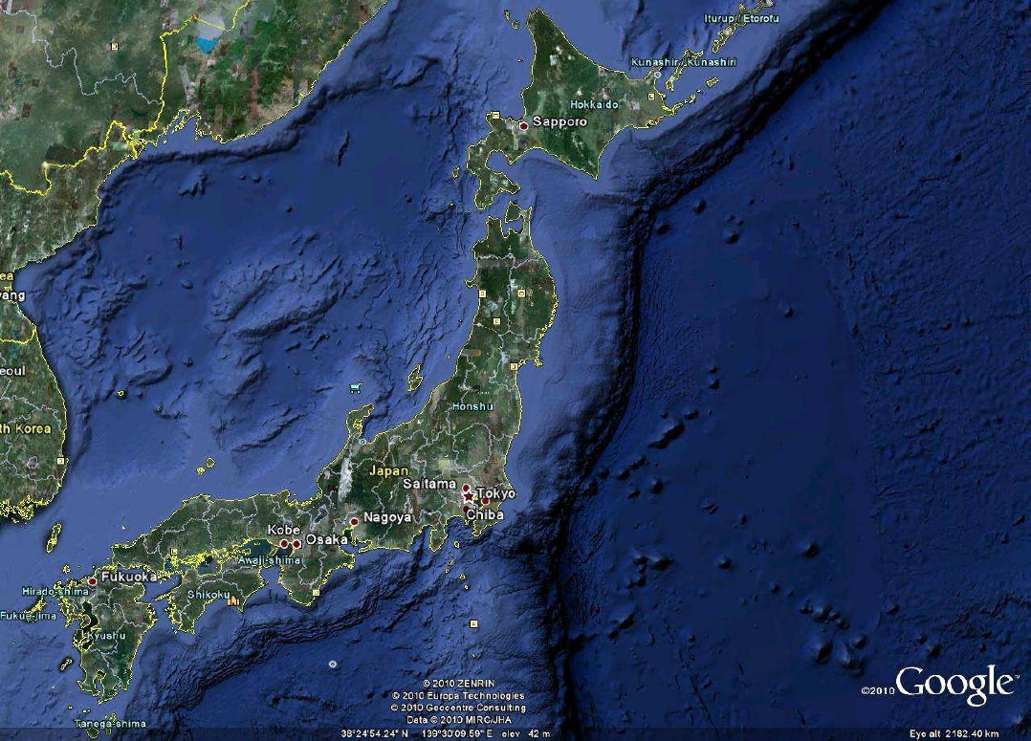
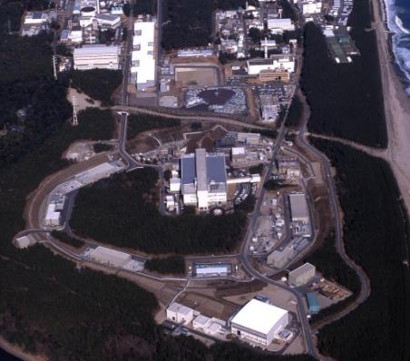
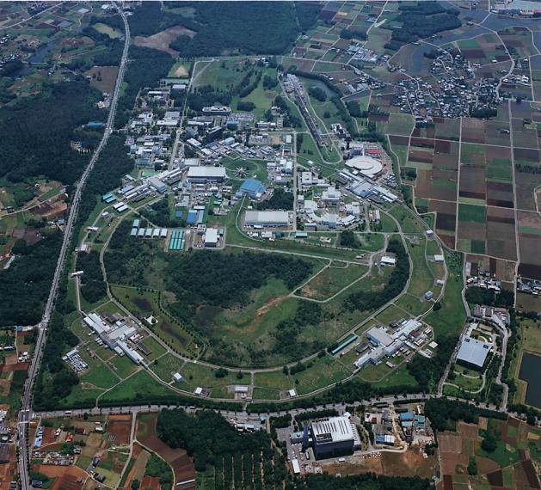
Where and what is KEK?
Electron accelerators in Tsukuba
and proton accelerators in Tokai
J-PARC: high intensity proton accelerator complex jointly operated by KEK and JAEA
KEK Tsukuba: SuperKEKB, PF, ATF
Tokai
Tsukuba

Slide 3
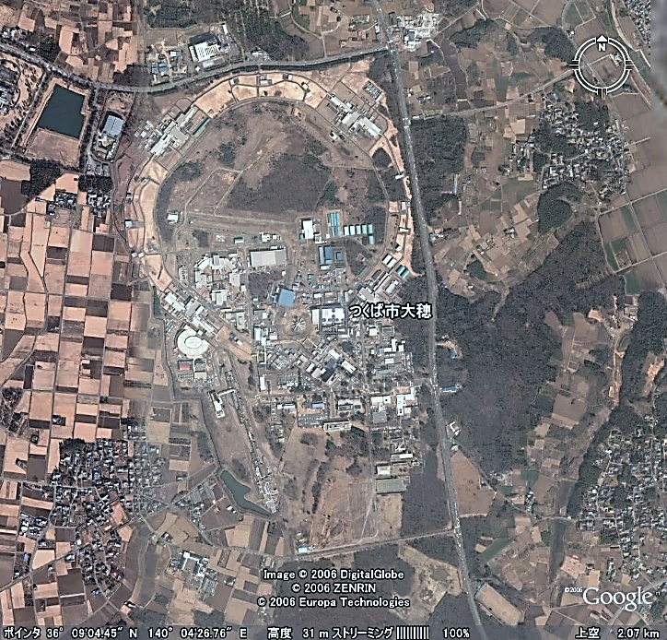
KEK Accelerators
Tsukuaba Electron/Positron
1km diameter
large accelerator ring
10m underground
SuperKEKB/
Belle II
PF PF-AR
(SRF for Life
and Material
Science)

Slide 4
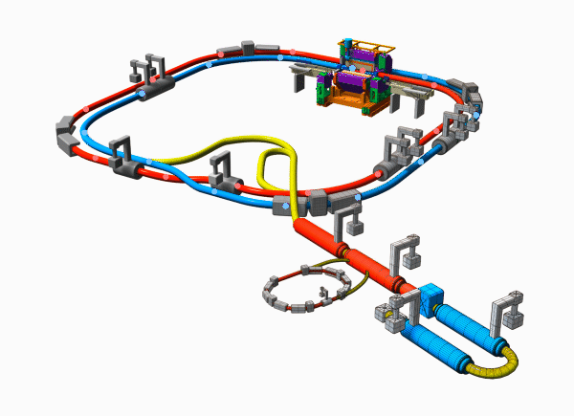

SuperKEKB for HEP (Flavour Factory)

Slide 5
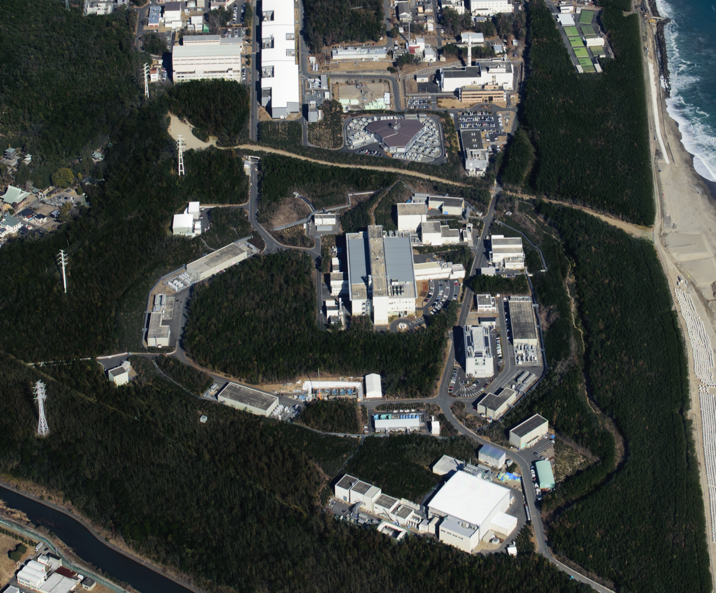

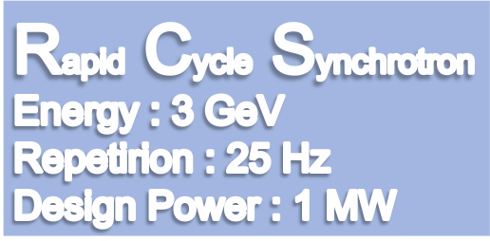




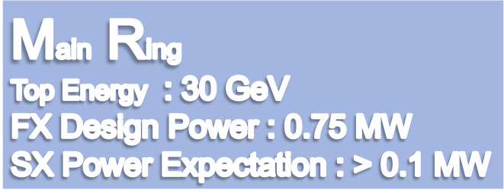
KEK Accelerator
Tokai proton
LINAC
400 MeV
Neutrino Beam to Kamioka
Neutron and muon for
Material and Life Science
Hadron Hall
Notes:
まず、こちらが、J-PARCの加速器複合施設です。陽子ビームを１８１MeVまで加速する（来年度以降４００ MeVになる）線形加速器ライナックがあり、その後、ビームは、40 msという短い時間の間に3 GeVまで加速されます。そのビームのほとんどは、この物質生命科学実験施設で中性子やミュオンを使った実験の為に使われています。

Slide 6
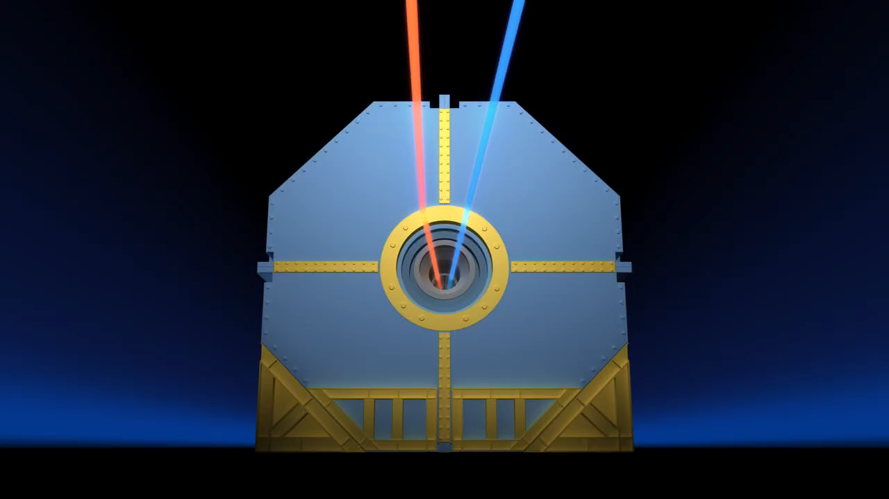
Colliding beams

Slide 7
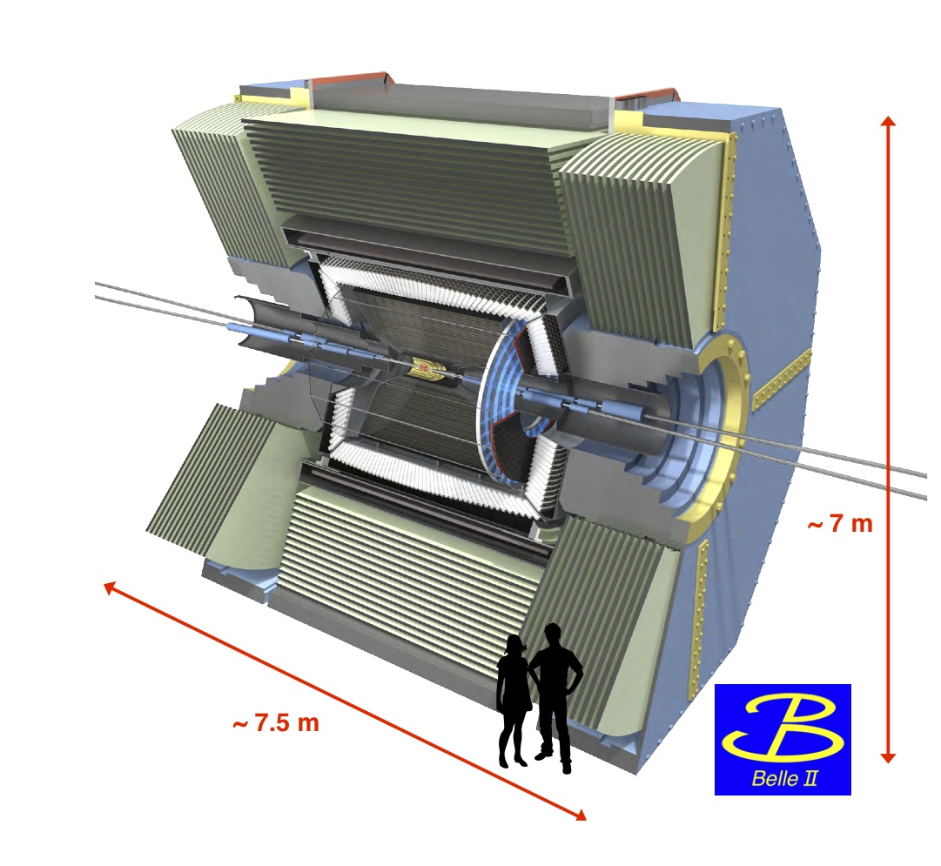
Why do we need this huge equipment?

Slide 8
HEP: High Energy Physics,
To study elementary particles and their interactions through high energy coliisions
Detect the emerging particles
Measure their kinematical quantities
  Momentum, velocity, energy or mass….
  →Four momentum (E,p_{x},p_{y},p_{z}) using Lorentz relations
  Charge
Determine mass/Identify particle species
Reconstruct the particle interactions/decays

Slide 9
Key concept
Four vectors of final particles would be determined.
Four vector of intermediate particles can be calculated through conservation law among any interaction/decay
You can reconstruct
the initial (original interesting)
Particle such as Higgs

Slide 10
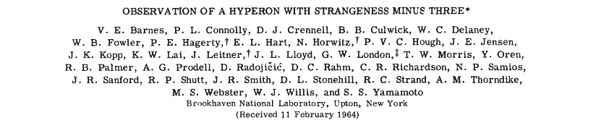
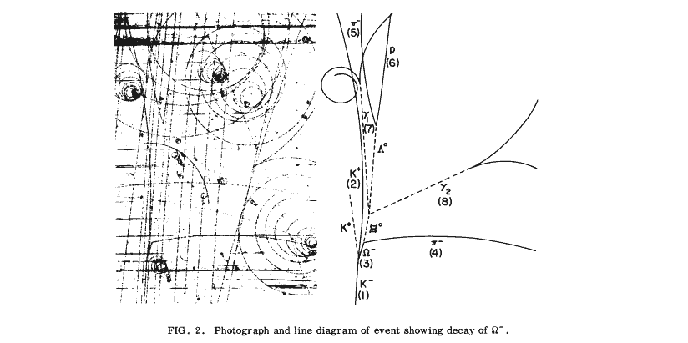
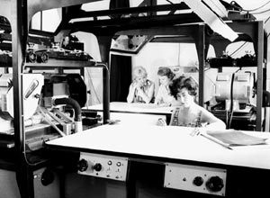
What can we actually do with the detector?
Legacy experiment with Bubble Chamber
Measure Energy/momentum and velocity
Detemine the mass/identify particles
Four vector determined.
Mother particles identified
Interatction reconsructed
Event
Reconstuction
Discovery of Ωˉ

Slide 11
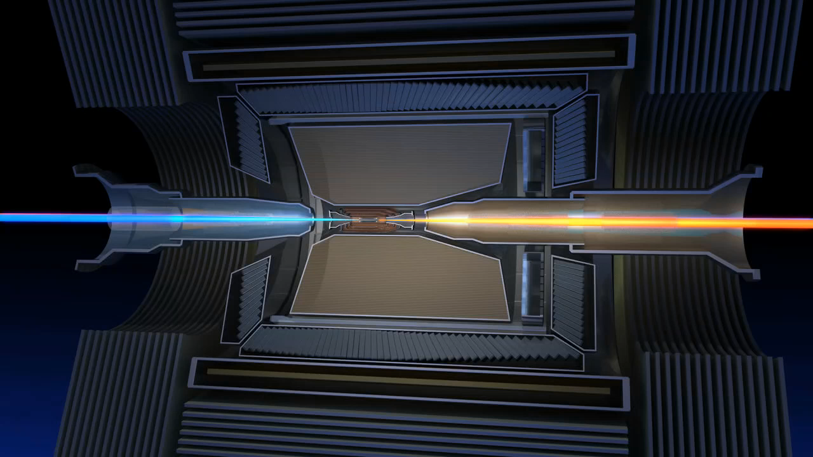
Collider experiment and detector

Slide 12
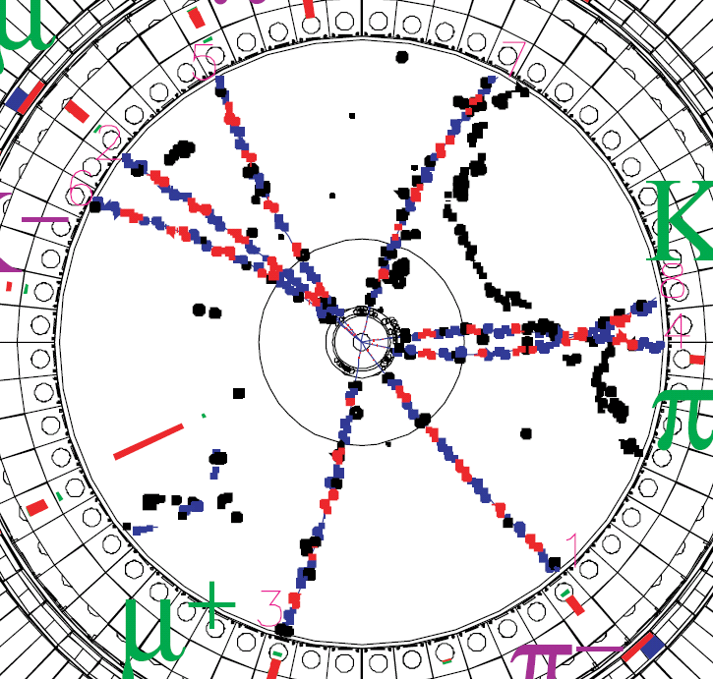
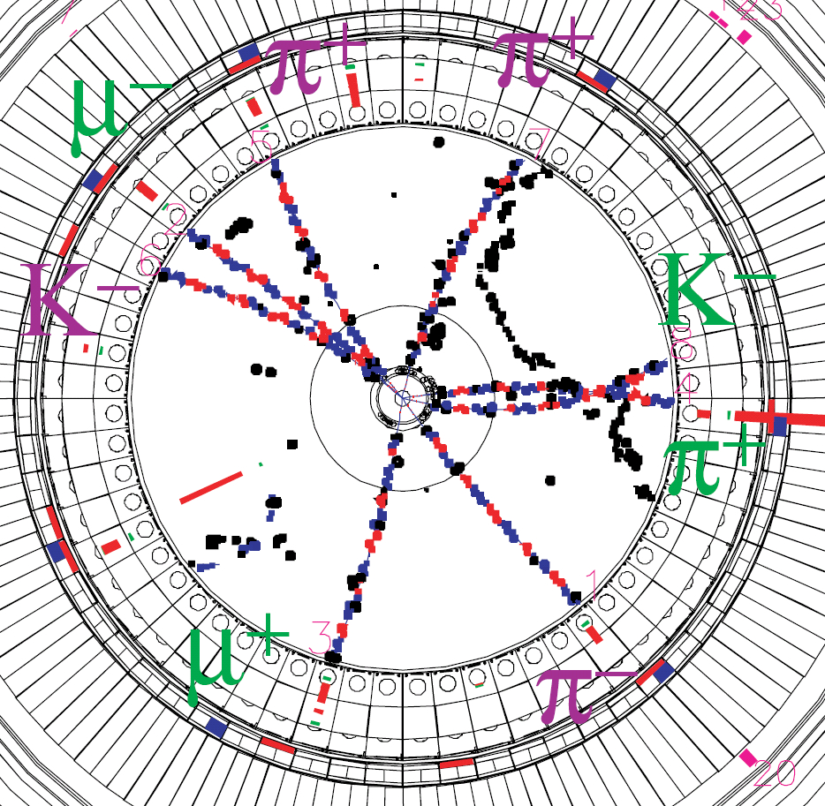
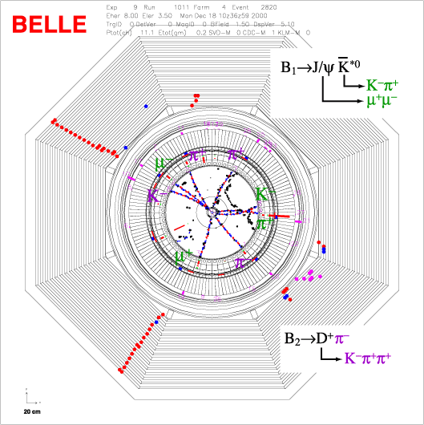
Today, we are using
“Digital bubble chamber”

Slide 13
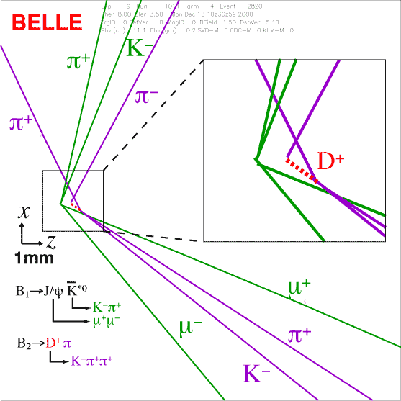
Event reconstruction with computers using signals from millions of sensors in detector system
We can reproduce elementary particle reactions created inside the accelerator vacuum tube..
electron
B₁
B₂
positron

Slide 14
How to detect the particles ?
  Unable to see
  Unable to touch
→Try to find the faint trace of the particles
(Ionization, excitation of molecule)
    Classical: Cloud chamber, bubble chamber, spark chamber, scintillator …..
    Modern：Drift chamber, TPC, silicon detector, scintillator….
→Try to catch the faint light emitted from the particles
    Cherenkov radiation detector, transition radiation detector

Slide 15
Energy loss due to ionization
Similar velocity as atomic orbital electron
Relativistic
rise
No theory

Slide 16
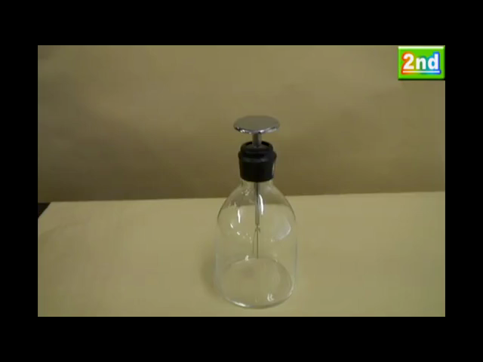
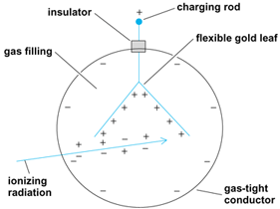
First particle detector using ionization:
Leaf electroscope

Slide 17
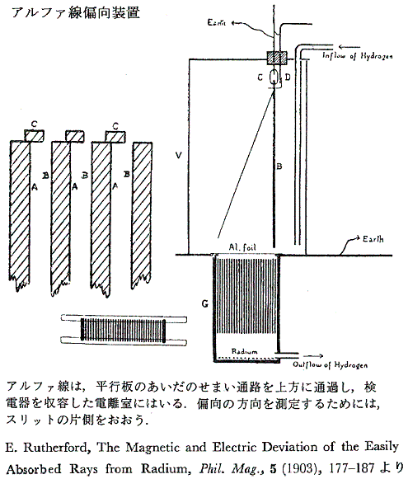
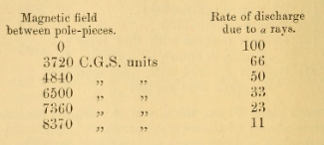
Very early attempt
Rutherford showed that the charge of α from Radium should be opposite to cathode ray (electron)

Slide 18
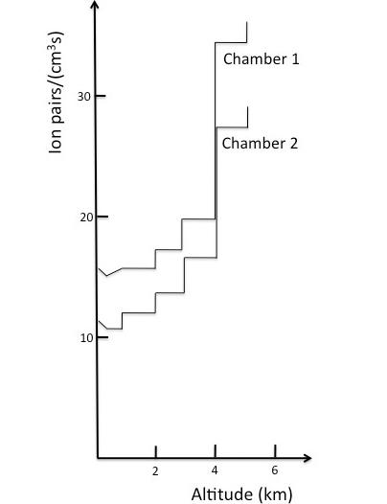
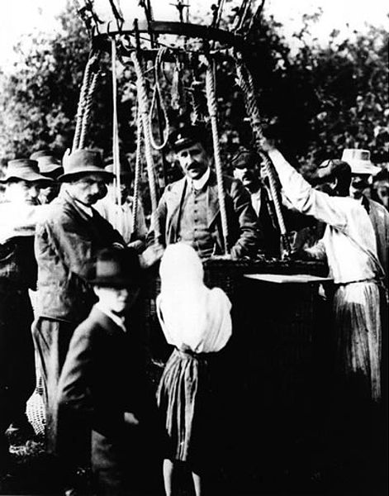
Leaf electroscope carried by balloon to confirm the existence of Cosmic Ray for the first time.
Discharge seems quicker in higher altitude.
Dr. Hess was coming back from the ballon fight in 1912 August
in which he discovered Cosmic ray for the ftirst ime
Source: American Physical Society.

Slide 19
To discover new elementary particle, radiation flux measurement is not sufficient.
Need to observe radiation particle by particle, photon by photon , quanta by quanta ,
It is impossible to see this tiny signal
→Small stimulation (Ionization, emission) may trigger visible large enough effect which make an observation possible.

Slide 20
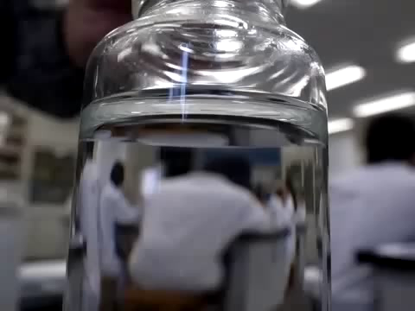
We want to observe any direct sign of particle passing by Eyes.
Tiny effect stimulated by particle (Ionization) may sometime trigger a visible signature in matter
Supersaturated
Water solution of
sodium acetate
http://www.youtube.com/user/ikemonmon

Slide 21
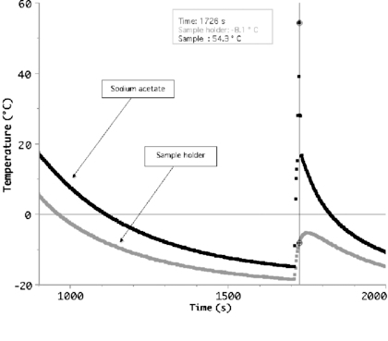
Supercooled solution and sudden crystallization caused by a tiny stimulation
Figure 7 from Using Peltier cells to study solid–liquid–vapour transitions and supercooling
Giacomo Torzo et al 2007 Eur. J. Phys. 28 S13 doi:10.1088/0143-0807/28/3/S02

Slide 22
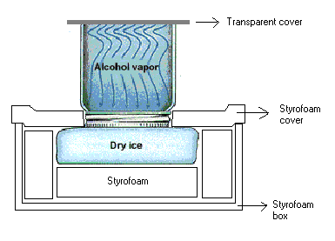

Cloud chamber
Contrail
Generated in super saturated vapor
Particle detector
you can build
at home

Slide 23
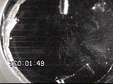
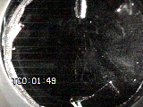
Cloud chamber animation

Slide 24
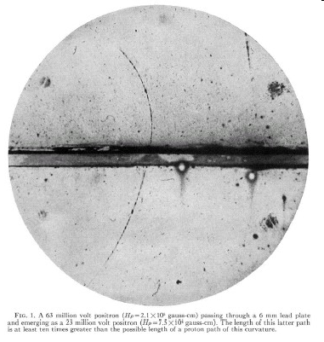
Cloud chamber, energy loss and discovery of positron(1932)
Anderson's cloud chamber picture of cosmic radiation from 1932 showing for the first time the existence of the anti-electron that we now call the positron. In the picture a charged particle is seen entering from the bottom at high energy. It then looses some of the energy in passing through the 6 mm thick lead plate in the middle. The cloud chamber is placed in a magnetic field and from the curvature of the track one can deduce that it is a positively charged particle. From the energy loss in the lead and the length of the tracks after passing though the lead, an upper limit of the mass of the particle can be made. In this case Anderson deduces that the mass is less than two times the mass of the electron. Caption credit: CERN
Q=+1
p and ΔE
❓

Slide 25
What can you tell from the Anderson’s picture?
Momentum of particle?
Mass of particle?
Charge of particle?
Discovery or routine observation?

Slide 26
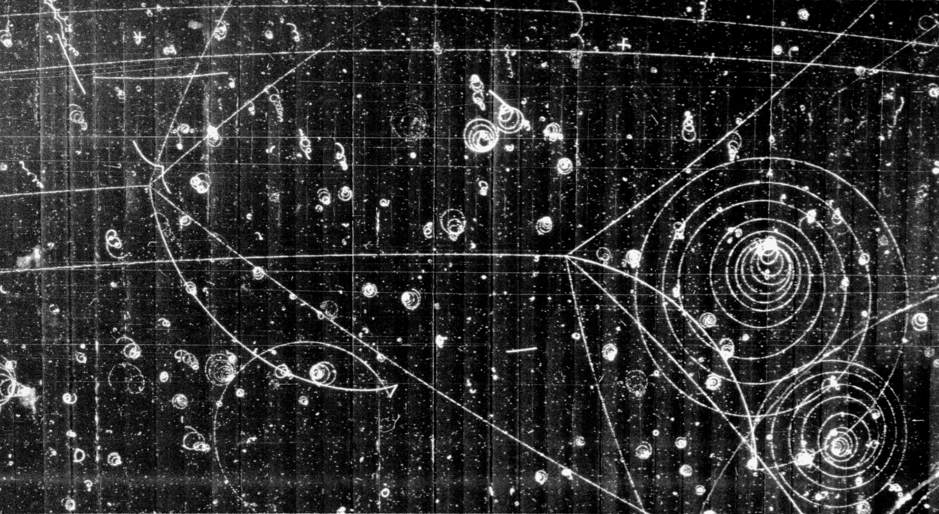
“Cloud” was replaced with “Bubble” shortly

Slide 27
Scintillation
Inorganic crystalline
Organic

Slide 28
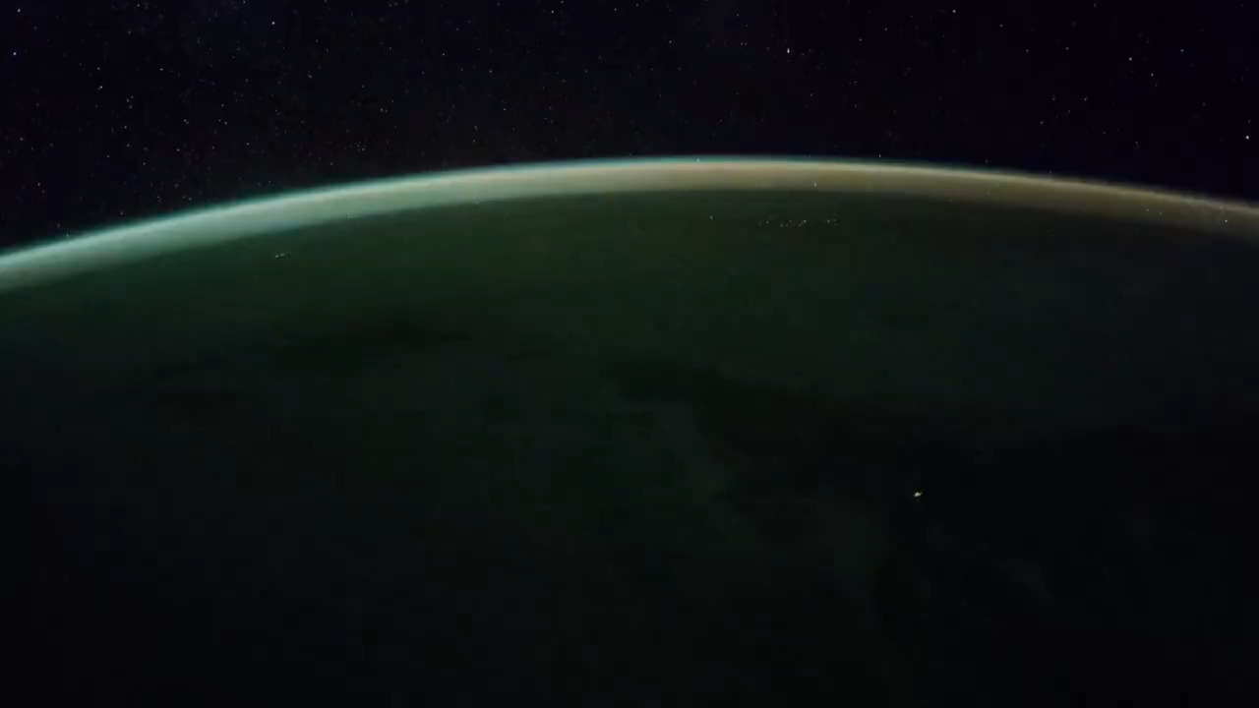
Excitation and scintillation
Aurora is a cosmic ray detector in the skay

Slide 29



Cherenkov Radiation (1)
Moving charge in matter
at rest
slow
fast

Slide 30
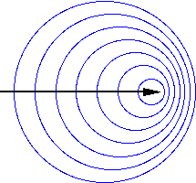
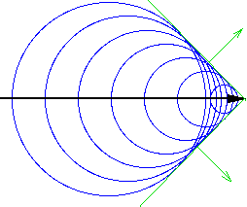
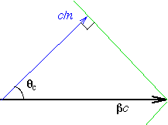
Cherenkov Radiation (2)
Wave front comes out at certain angle
The particle with β<1/n could never emit the radiation

Slide 31
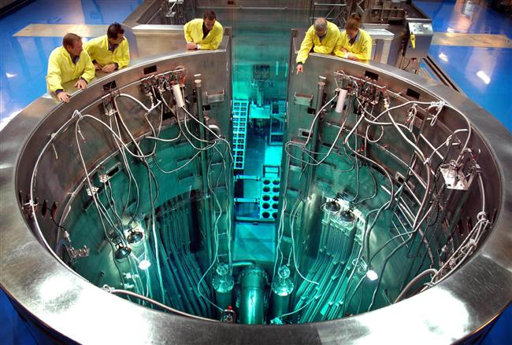
Cherenkov light in reactors
OPAL –
the Open Pool Australian Lightwater reactor

Slide 32
Intreraction of neutral particles
Unable to see their ionizations
Unable to detect their radiation
  Photon, γ, X Electromagnetic interaction
  Neutron strong interaction with nucleus or nucleon
  Neutrino weak interaction with nucleon

Slide 33
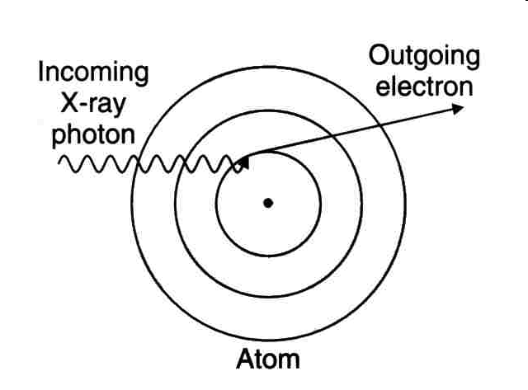
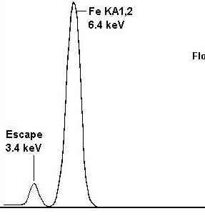
Photoelectric effect
X ray
Absorbed

Slide 34
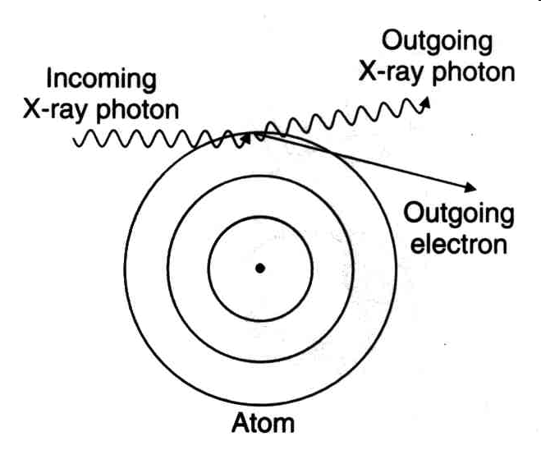
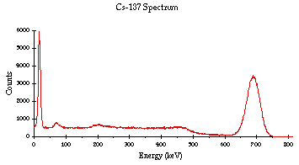
Compton scattering
escaping
absorbed
Maximum energy
transfer

Slide 35
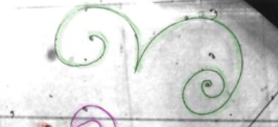
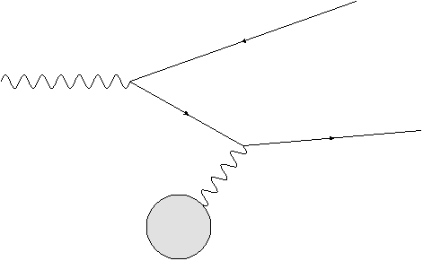
Pair Creation
Postiron
γ
Electron
Nucleus Ｚｅ

Slide 36
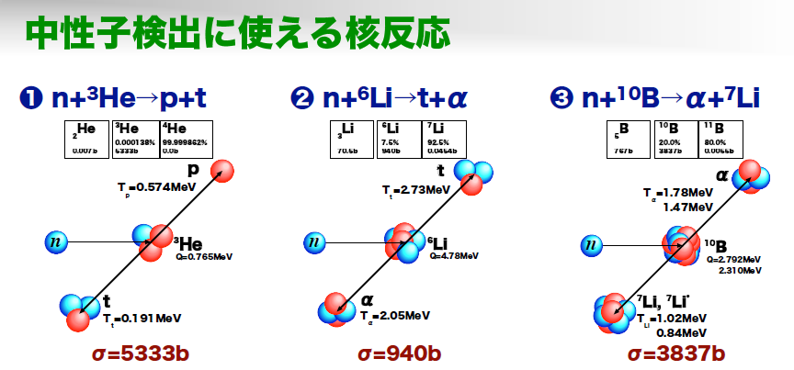
Detection of Neutron
Low energy
Nuclear reaction useful to detect neutrons
Shimizu

Slide 37
Neutron interaction at higher energy

Slide 38
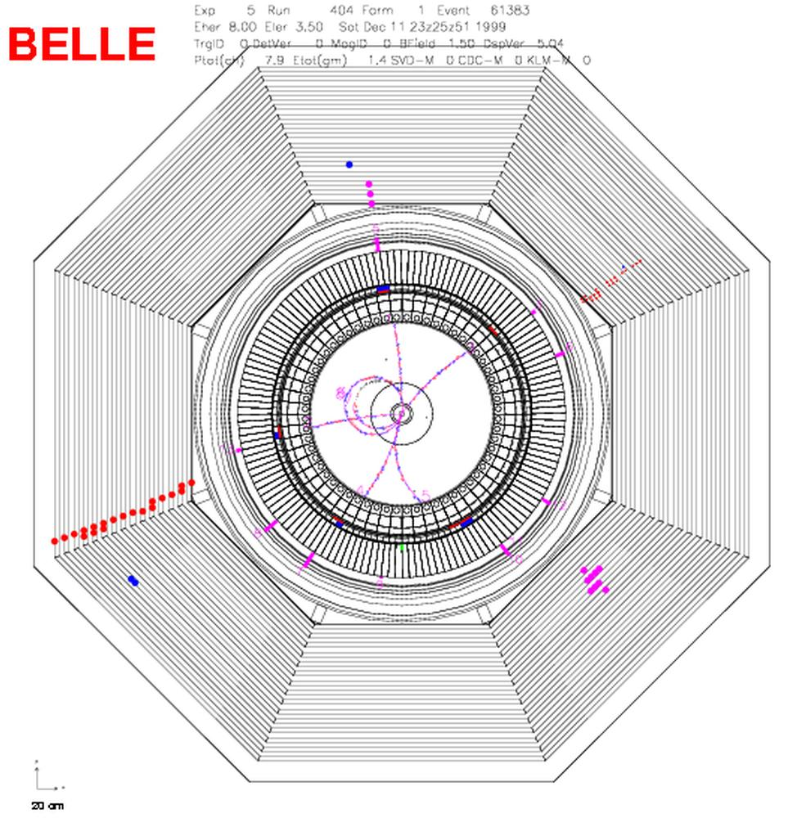
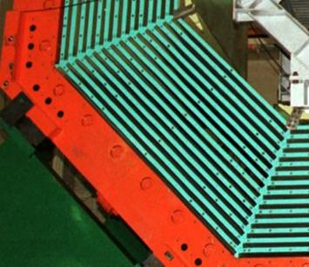
Neutral hadron/K_{L} detection
K_{L}
K_{L} hits

Slide 39
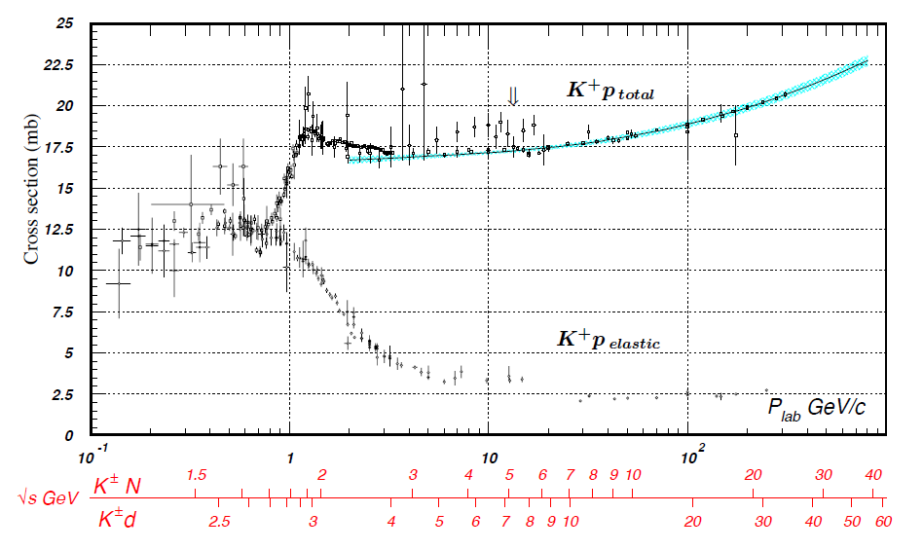
Hadron reaction cross section

Slide 40
Finally neutrino detection..
Exercise What is the detection efficiency of 1m thick iron

Slide 41
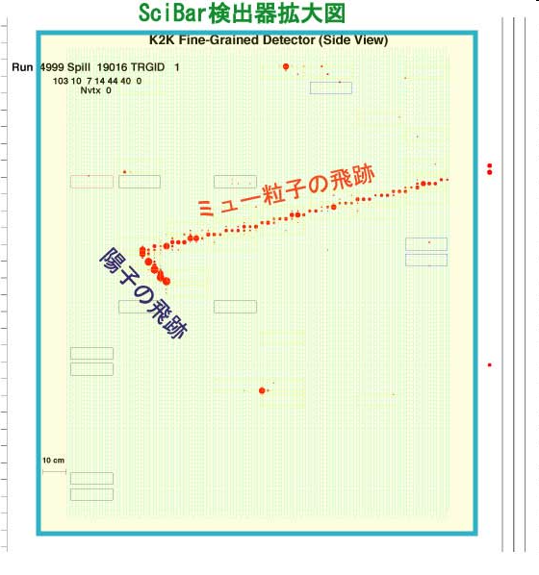
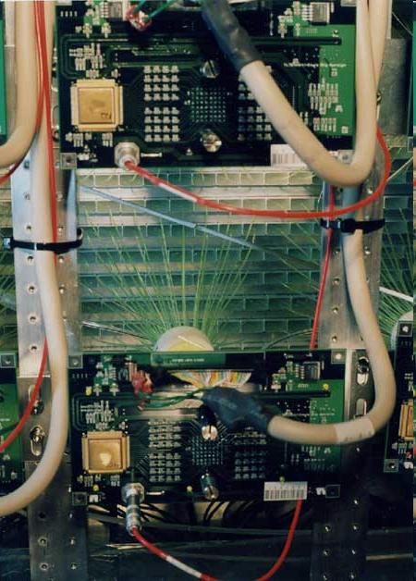
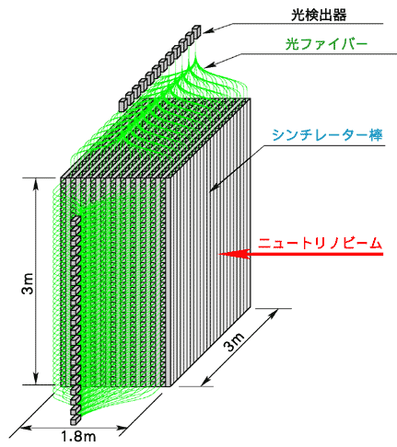
SciBar detector (K2K)
ν
ν ＋ｎ → μ^{ー} ＋ ｐ

Slide 42
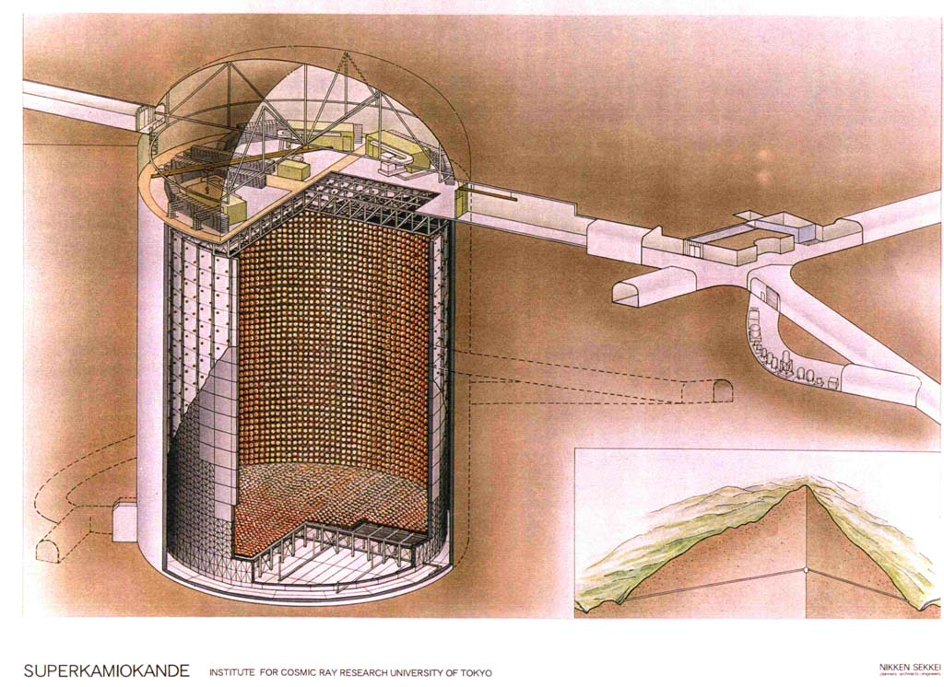
Neutrino detection in Kamiokande

Slide 43


Water Cherenkov Detector

Slide 44
RF Cherenkov

Slide 45



ARA(Askaryan Radio Array)

Slide 46

Status and expected sensitivity
GZK ν

Slide 47


Dark Matter?

Slide 48

A calibration event from PICO-2L shows boiling from multiple recoiling atomic nuclei. PICO-2L is designed to see a recoiling nucleus a from dark matter interaction
Xe 131, Ge 72.6 I 127, Bi 209, Ar 40, Br 80, Hg 200.6

Slide 49

PICO experiment

Slide 50
Summary at this point
Detection of charged particles
  Ionization
  Excitation
  Cherenkov radiation
  Bremsstrahlung (Electron)
Detection of Neutral particles
    Nuclear reaction (Neutron, hadron)
    Weak interaction (Neutrino)
    Photoelectric/Compton scattering (Photon)
    What about dark matter (??) We have to try any type of detection shceme. We don’t know what it is.

