Slide 1
The missing movies in the last class.

Slide 2
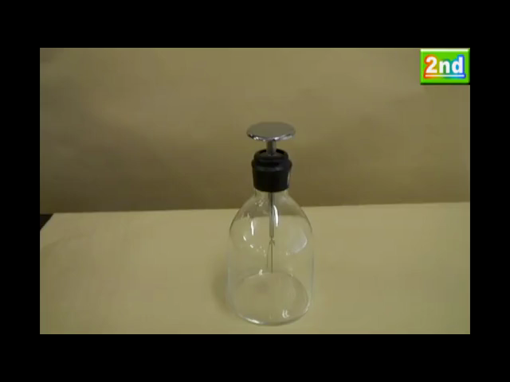
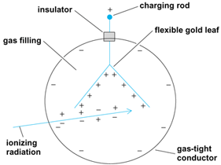
First particle detector using ionization:
Leaf electroscope

Slide 3
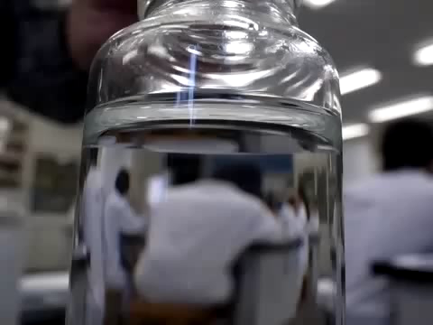
We want to observe any direct sign of particle passing by Eyes.
Tiny effect stimulated by particle (Ionization) may sometime trigger a visible signature in matter
Supersaturated
Water solution of
sodium acetate
http://www.youtube.com/user/ikemonmon

Slide 4
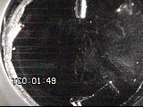
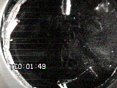
Cloud chamber animation

Slide 5
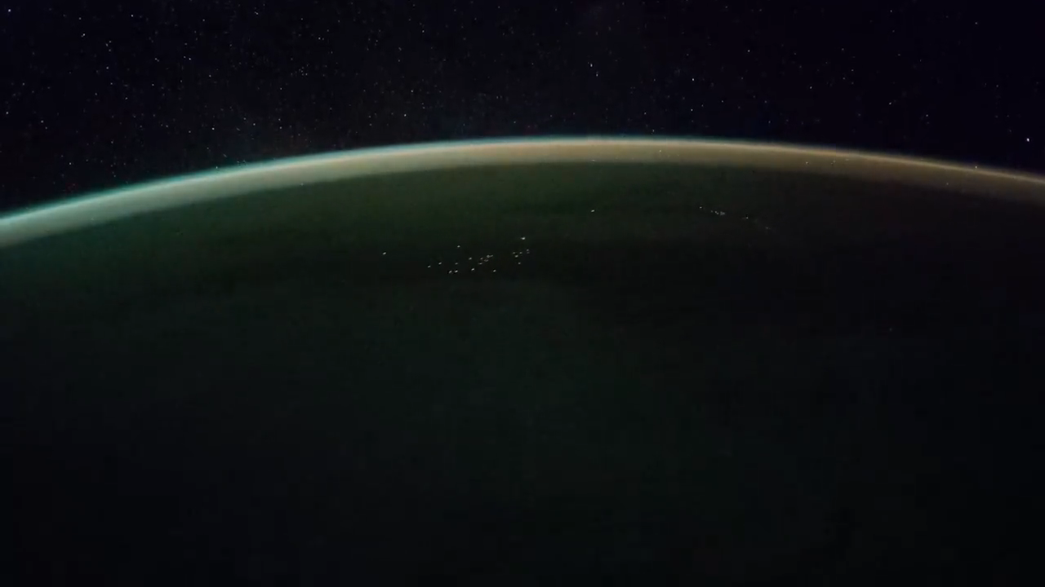
Excitation and scintillation
Aurora is a space plasma detector in the sky

Slide 7
How can physicists explore the particle world? (II)
Junji Haba (KEK)
Moscow International School of Physics 2019

Slide 8
The 2nd step
In the 1st step we review detection of particles through ionization, scintillation, Chrenkov radiation…etc.
Measuring/determining four momentum of particles is to combine the information from detector signals.
  Momentum, Energy, Velocity and more…

Slide 9
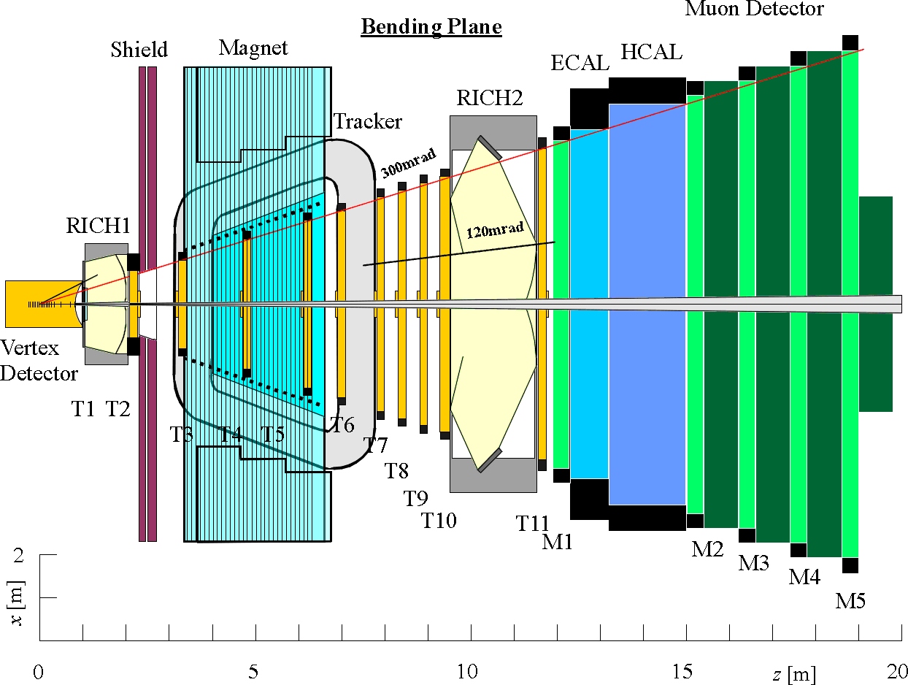
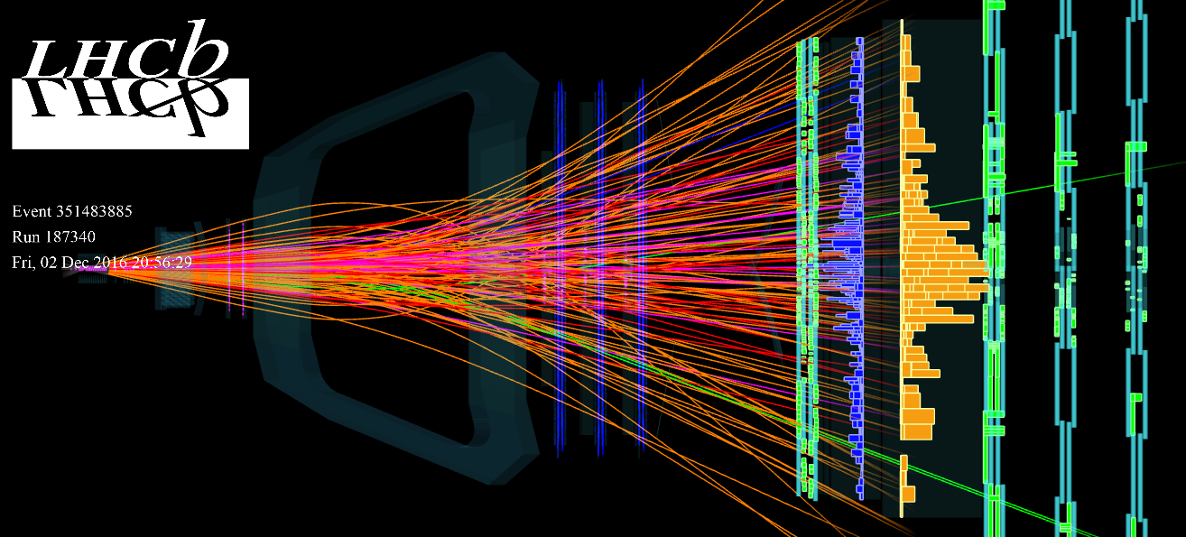

Slide 10
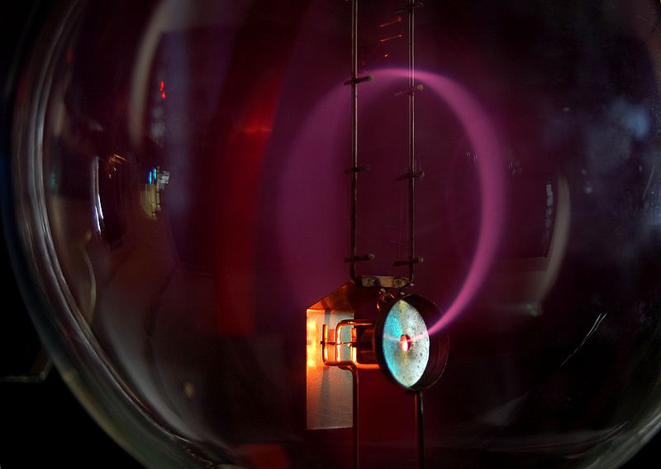
Momentum
Momentum can be measured as a radius of circular motion in a magnetic field
B

Slide 11
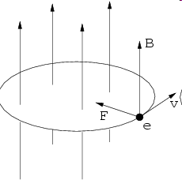
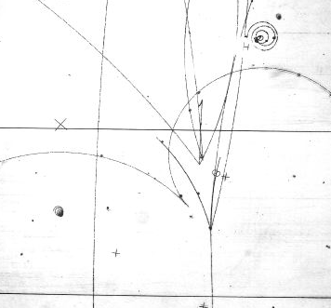
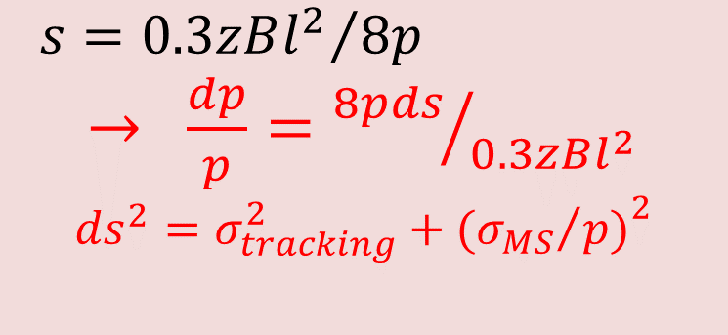
Lorentz force and momentum measurement
sagitta
r
s
p
q or ze
${s=0.3zBl^{2}}/{8p}$
$→ \frac{dp}{p}={8pds}/{0.3zBl^{2}}$
$${ds}^{2}=σ_{tracking}^{2}+{({σ_{MS}}/{p)}}^{2}$$

Slide 12

What is necessary for better momentum measurement?
$\frac{dp}{p}={8pds}/{0.3zBl^{2}}$
${ds}^{2}=σ_{tracking}^{2}+{({σ_{MS}}/{p)}}^{2}$

Slide 13
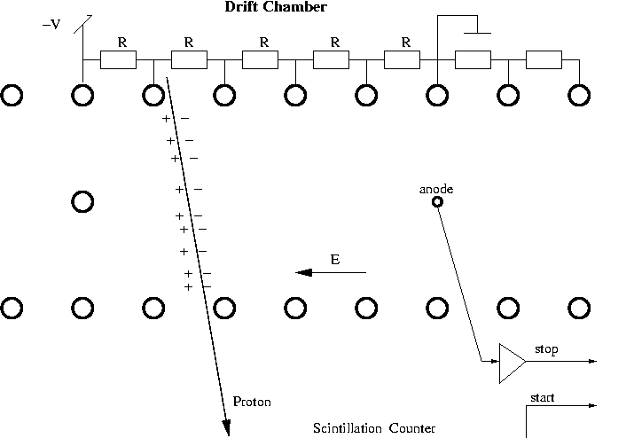
Most popular tracking so far:
Wire chambers invented by Charpak
Ionization

Slide 14
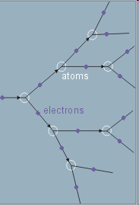
Electron avalanche multiplication
Remember initial ionization is tiny signal

Slide 15
The easiest way to provide high electric field
Electric field around a thin wire is extremly high
b
V
a

Slide 16
Drift velocity

Slide 17
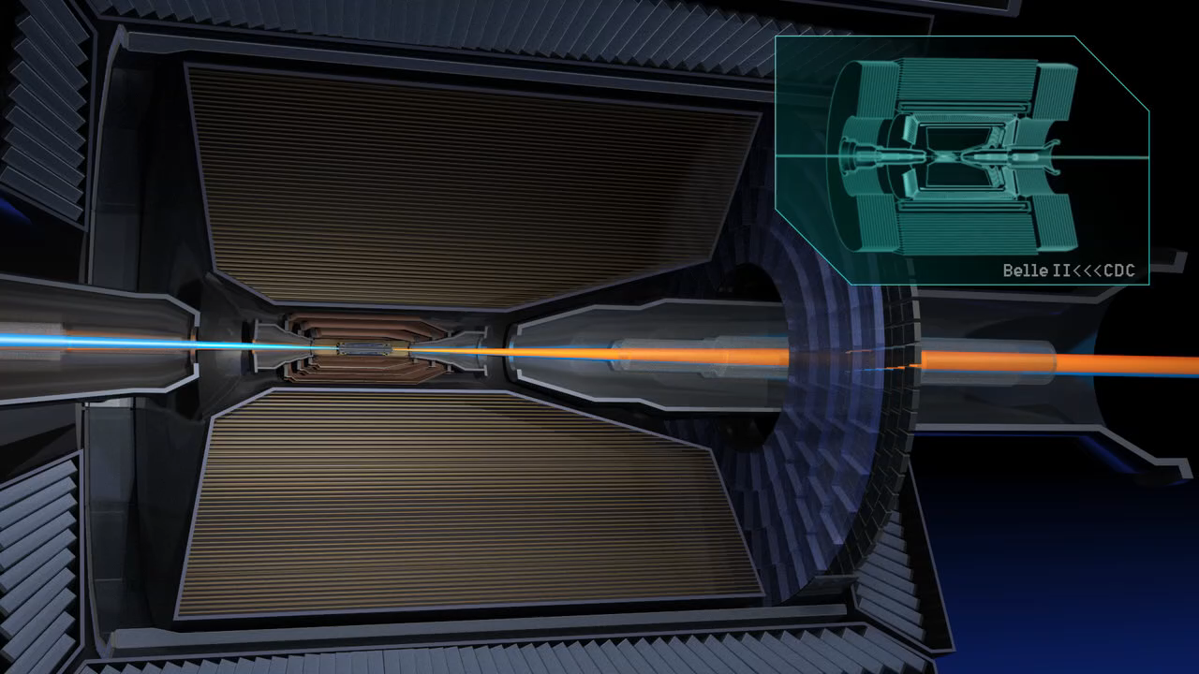
Central Tracker

Slide 18
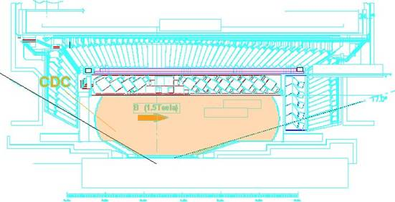
Drift Chamber
(momentum,PID)
Example of previous Belle CDC.
Curved Aluminum enplates for the main part.
  Thickness : 10mm^{t}
Conical endplates for the inner part to give a space for accelerator components.

Slide 19
X-T relation
(drift time vs position)
He(50%)-C₂H₆(50%)
B=1.5Tesla
HV : 2.3KV
Cell Size:18mm
Maximum Drift Time : ~400nsec
+
+
+
+
+
+
cell

Slide 20
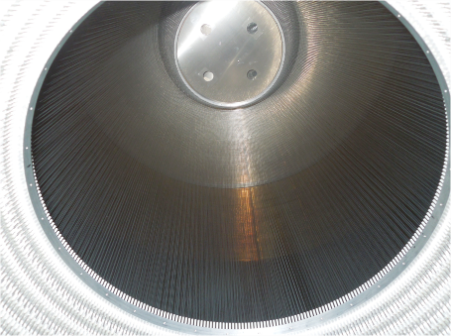
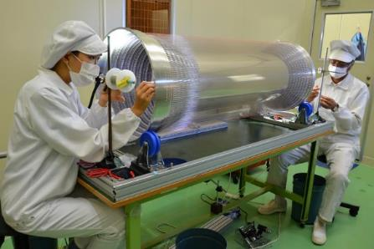
Wire stringing for
BelleII central drift chamber
Inner part
5120 wires
Outer part
43,776 wires
It took more than 5 years to complete

Slide 21
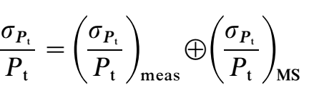
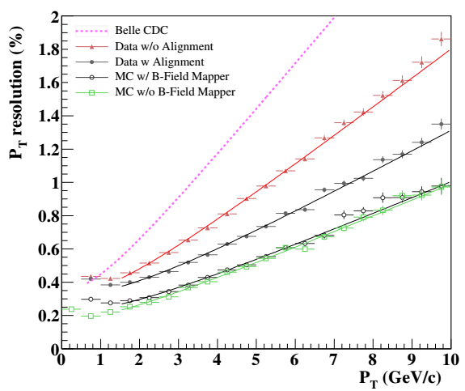
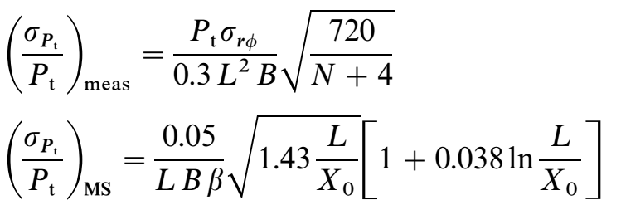
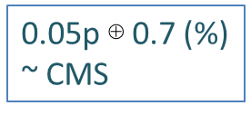

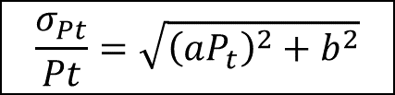
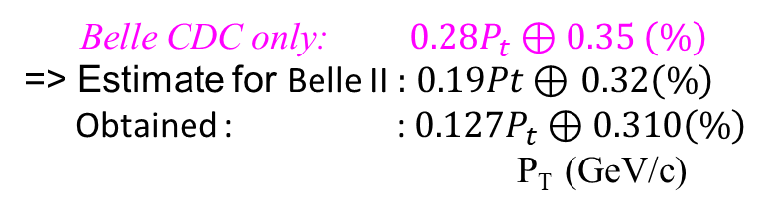
P_{t} resolution of BelleII CDC
Belle CDC
Before Align
σ_{rϕ}: position resolution
B: magnetic field (1.5 T).
Χ_{o}: radiation length.
L: lever arm.
N: number of measurement point
0.05p $\text{⊕}$0.7 (%)
~ CMS
MC
After Align
No B-filed mapper
$after align: 0.127P_{T} \text{⊕ }0.310 (\%)$
$$\frac{σ_{Pt}}{Pt}=\sqrt{{\left(aP_{t}\right)}^{2}+b^{2}}$$
P_{T} resolution is much improved compare with Belle CDC.
Much better than the expectation (extrapolation from Belle CDC)
Observed constant term is not improved as expected because of the multiple scattering on the B-field mapper
Belle → Belle II
L: 77.5 → 94.84 cm
N: 50 → 56
Belle CDC only: $0.28P_{t} \text{⊕} 0.35 \left(\%\right)$
=> Estimate for Belle II :$0.19Pt \text{⊕ }0.32\left(\%\right)$
Obtained : :$0.127P_{t} \text{⊕ }0.310\left(\%\right)$
P_{T} (GeV/c)

Slide 22
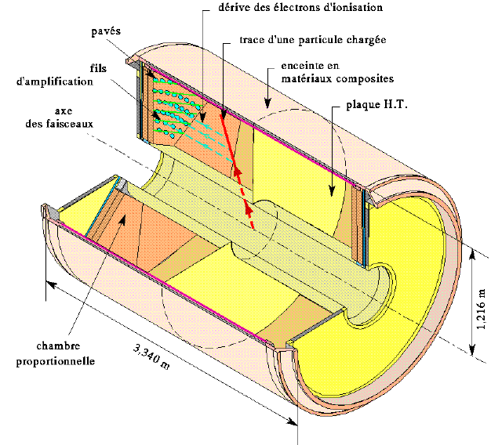
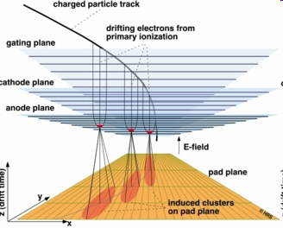
TPC(Time Projection Chamber)
Z-coordinate by drift time
Complete 3D measurement
CERN/ALICE Web page

Slide 23
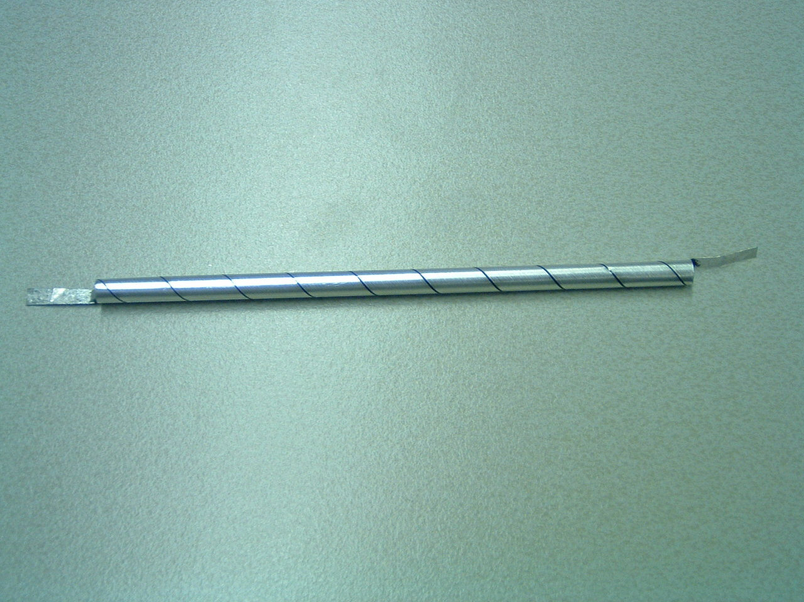
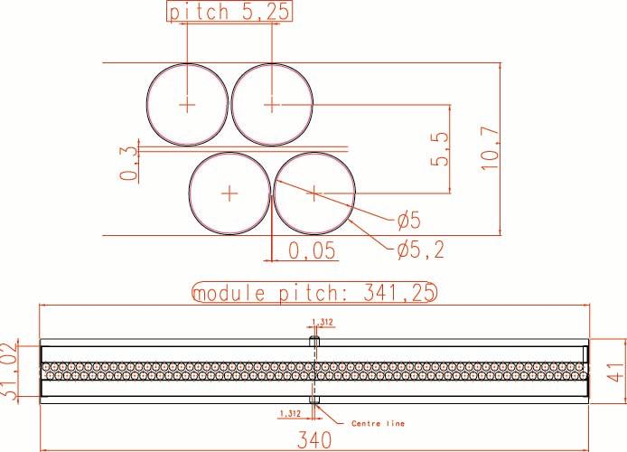
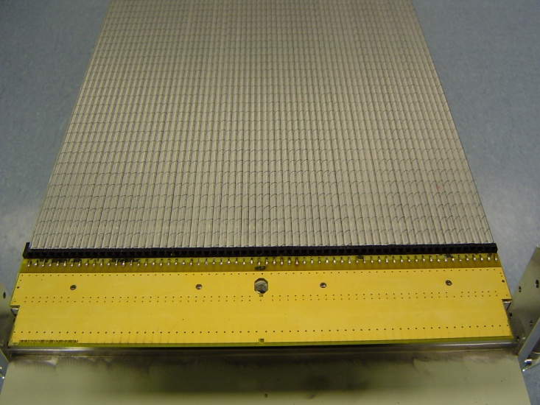
Straw Tubes Modules
Straw Tubes packed in double-layered modules
modules 64-cells wide
modules only ~0.37% of 1 X₀
  “light” panels
  (Rohacell core with carbon fiber skins)
  “light” straws
z
x

Slide 24
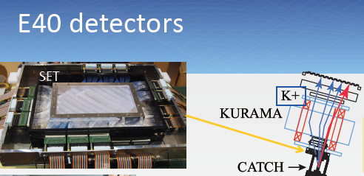
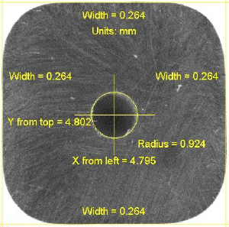
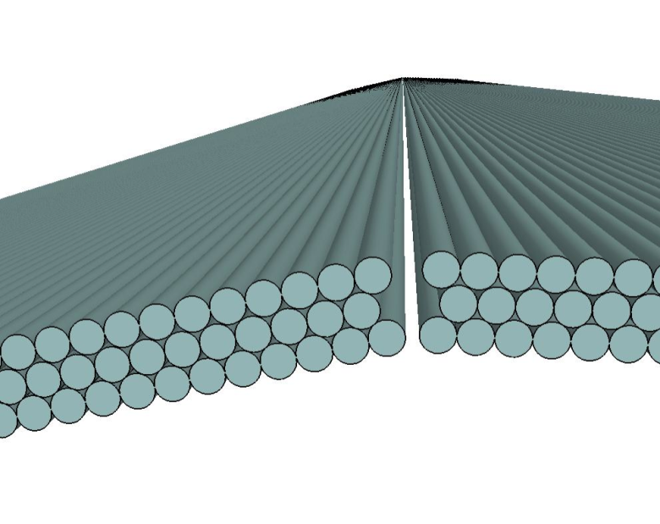
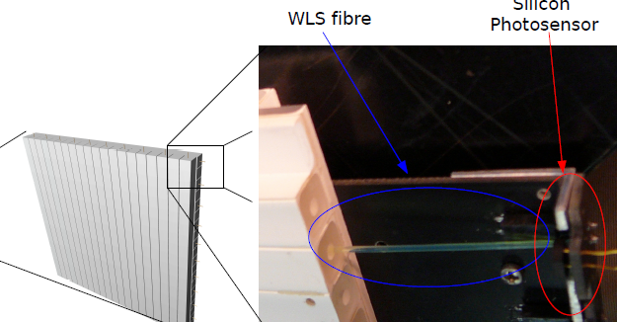
Scintillation strip/fiber tacker
0.5 – 1 mmφ
Mu3e
T2K FGD
0.25 mmφ

Slide 25
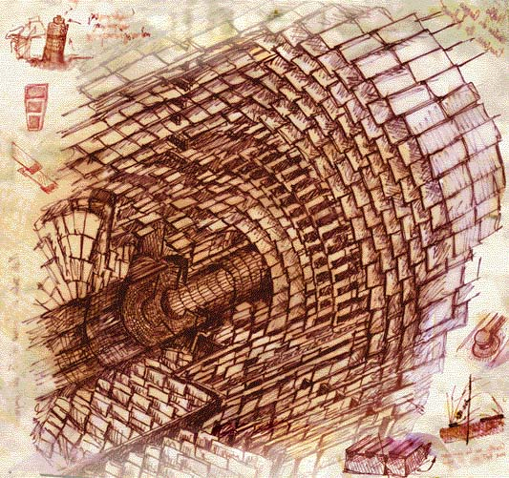
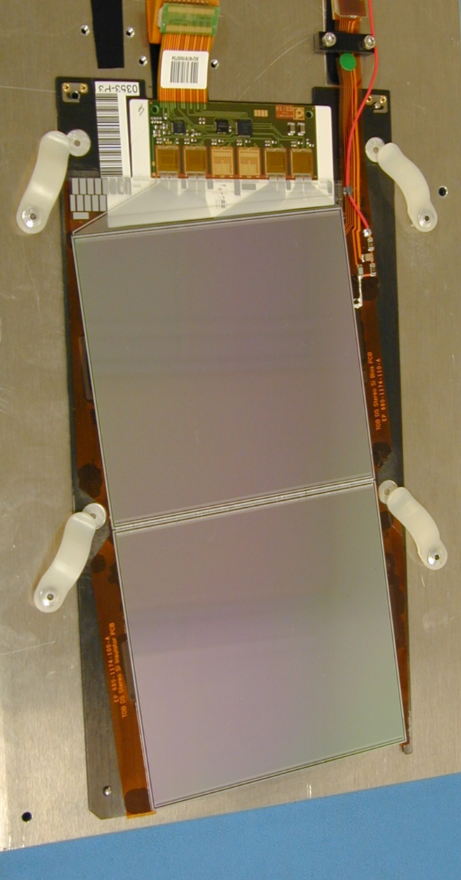
Silicon tracker (LHC and HL-LHC)

Slide 26

Energy measurement
Energy can be measured
by a total absorption calorimeter,
in which all the energy are released
through cascading shower.

Slide 27
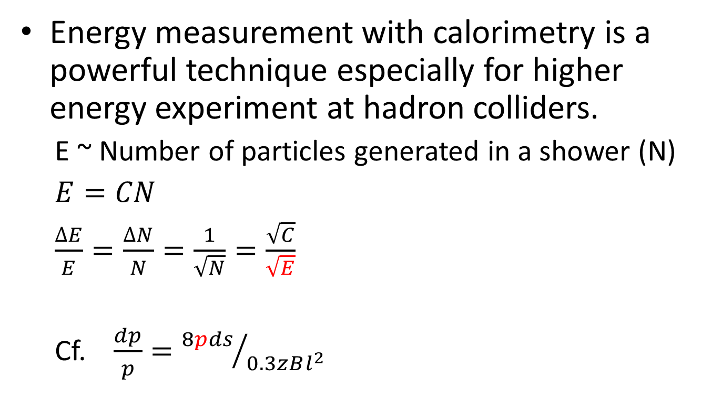
Energy measurement
Energy measurement with calorimetry is a powerful technique especially for higher energy experiment at hadron colliders.
  E ~ Number of particles generated in a shower (N)
  $E=CN$
  $\frac{∆E}{E}=\frac{∆N}{N}=\frac{1}{\sqrt{N}}=\frac{\sqrt{C}}{\sqrt{E}}$
  Cf. $\frac{dp}{p}={8pds}/{0.3zBl^{2}}$
Traditional sampling calorimeter
Klaus Pretzl 2005 J. Phys. G: Nucl. Part. Phys. 31 R133

Slide 28
Particle identification
Particle identification (mass) can be made from its velocity（β=v/c）, which can be measured through time of flight, Cherenkov radiation or energy loss rate.
Life time (flight distance) of particle is another very important characteristics.
 | μ ± | e ± | γ | π ± | K⁰ | K ± | p | n
Mass (MeV/c²) | 106 | 0.511 | 0 | 140 | 498 | 494 | 938 | 940
Detection | Charge | Charge Shower | Shower | Charge Strong | Strong | Charge Strong | Charge Strong | Strong
Life time （cτ m） | 659 | -- | -- | 7.8 | 0.027 (15.3) | 3.7 | -- | 2.7 x10¹¹

Slide 29
Velocity measurement

Slide 30
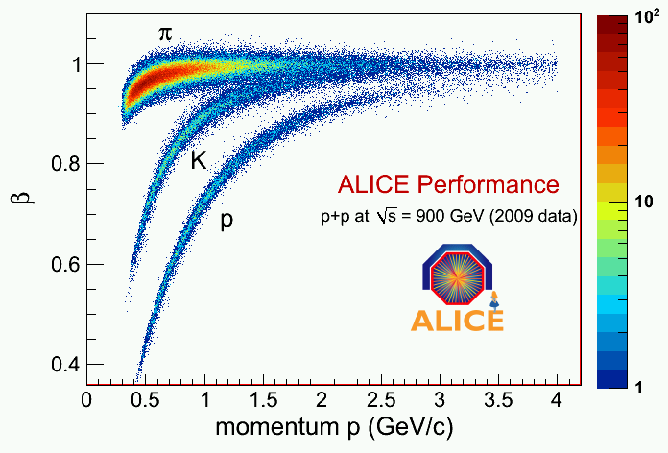
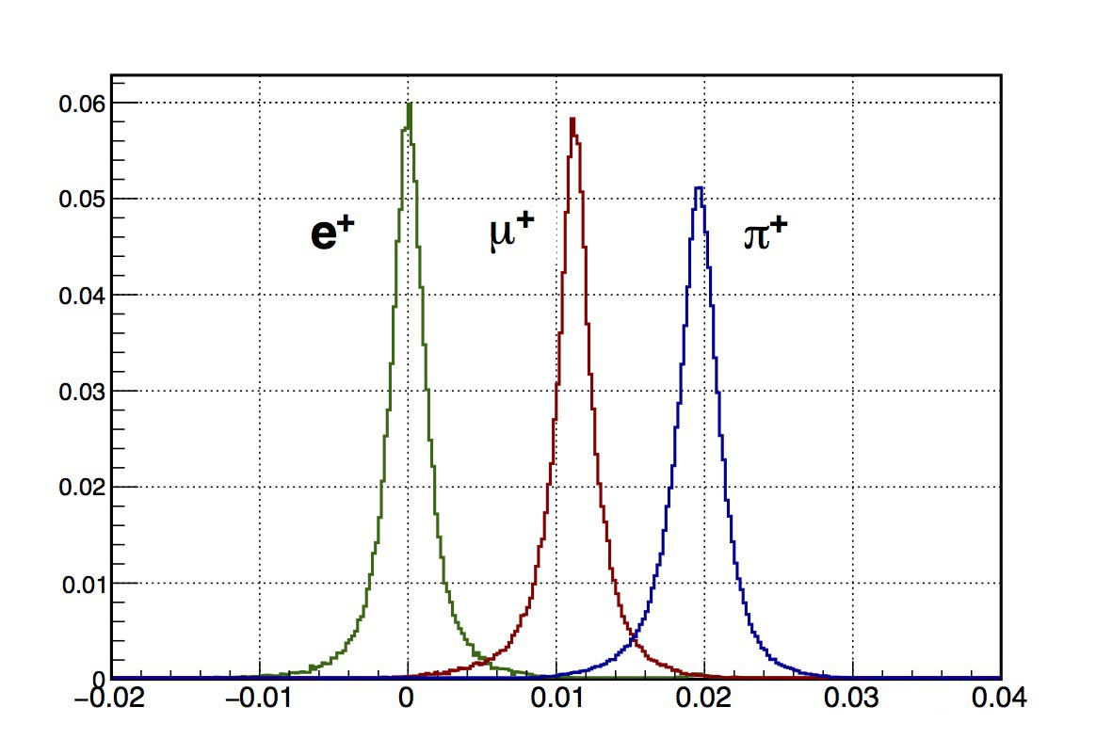

Direct β measurement: ToF
(Time of Flight)
$cβ=\frac{flight distance}{flight time}$

Slide 31
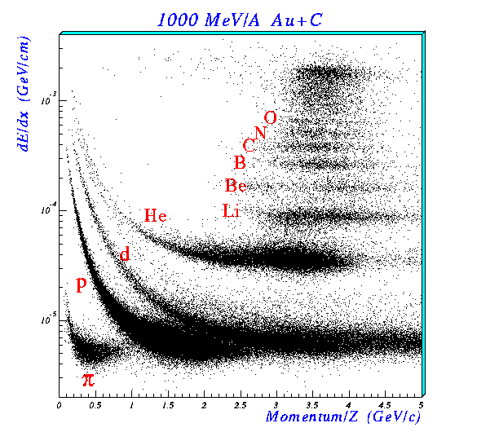
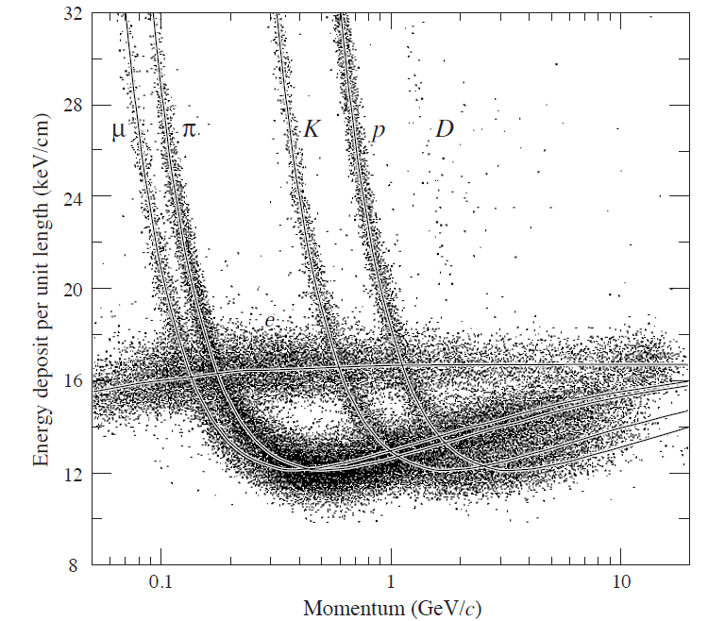
β measurement through energy loss information
Remember Bethe-Bloch formulation
Effective aet low enrgy

Slide 32
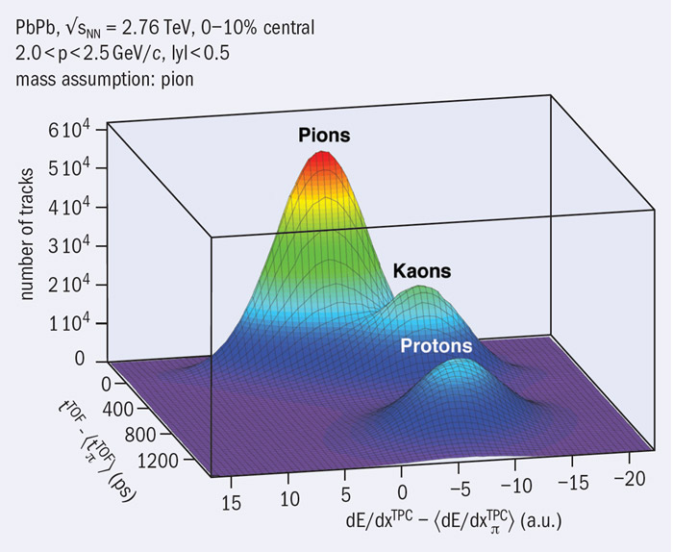
ToF and dE/dx to distinguish π/K/p

Slide 33
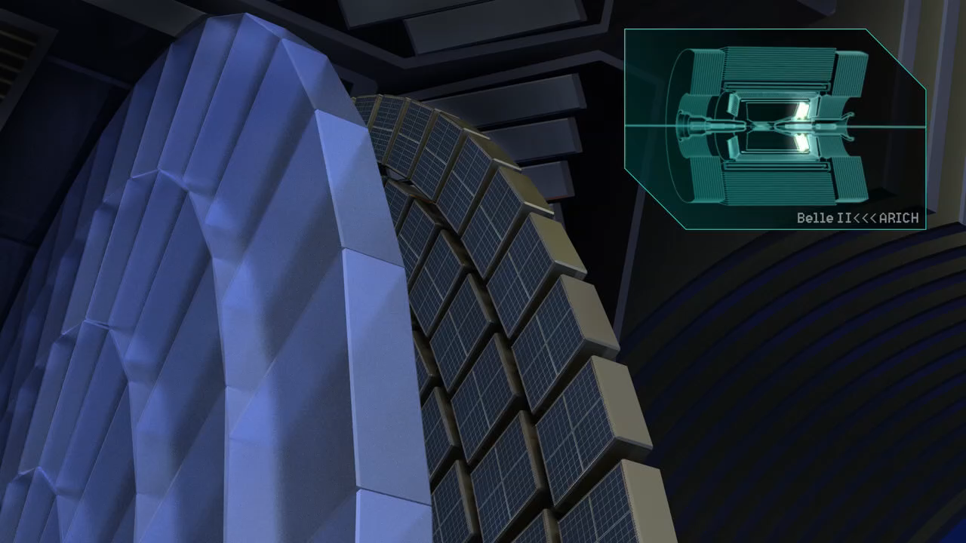
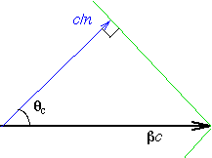
Velocity from Cherenkov radiation

Slide 34
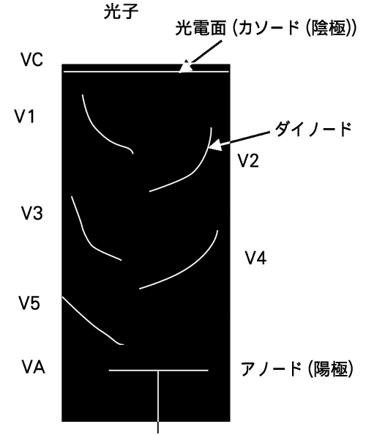
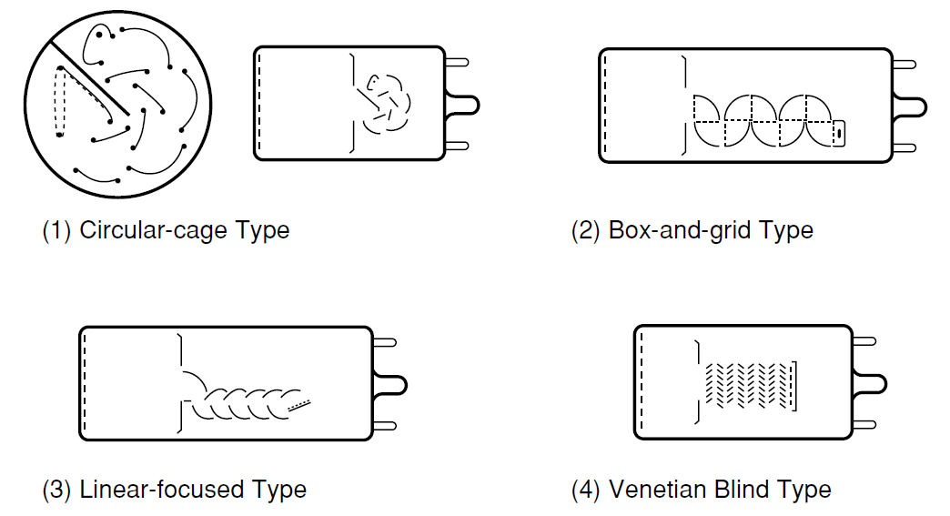
Photomultiplier
High sensitivity
photon sensor Needed!
Vacuum tube surviving even now
Photon
Phocathode
Important notion
Photoelectric effect
Quantum efficeincy
Poisson statistics
Seconary electron
Vulnerable to magnetic field
Dynode
Anode
HPK PMT Handbook

Slide 35
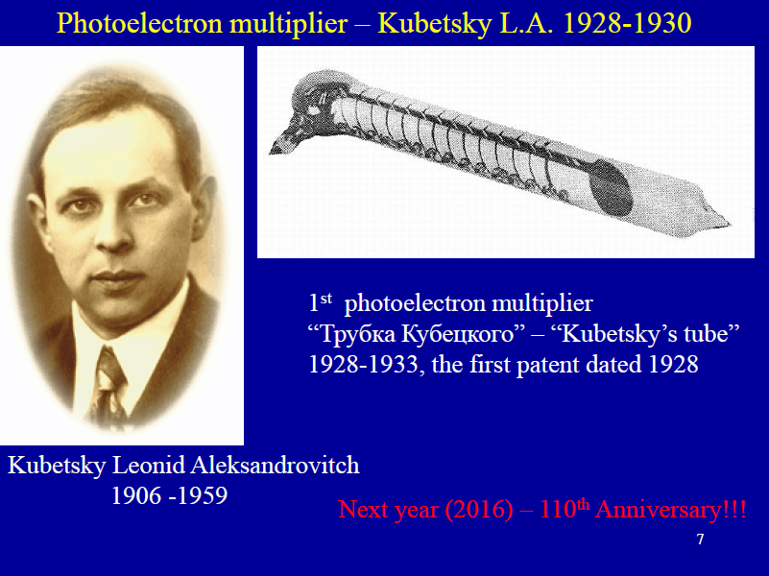
PD15@INR
The first documented photomultiplier demonstration dates to the early 1934 accomplishments of an RCA group based in Harrison, NJ. Harley Iams and Bernard Salzberg were the first to integrate a photoelectric-effect cathode and single secondary emission amplification stage in a single vacuum （Wikipedia)

Slide 36
Hybrid detector
HPD with Multi-pixel Avalanche Diode (AD-HPD)
Photocathode
Avalanche gain (x40)
EB gain (x1200)
Multi-pixel AD
Electron
Output
Photon
Acceleration
Total gain:
5x10⁴
Proximity focus
(8kV)
AD voltage
(-200 to -400 V)

Slide 37
Timing Resolution for small HPD
 | Resolution (σ)
φ8 mm | 21 ps
φ1 mm | 14 ps
including jitter of electronics
Notes:
This figure shows timing resolution of HPD for full illumination on photocathode. The result was 41 ps.
On the other hand, in other measurement system, PLP waveform was measured by a streak-camera having extremely high timing resolution to discuss the limiting factor. The pulse width of PLP was 30 ps in sigma.
There was big difference between PLP pulse width and the result of HPD.
So, we measured the timing resolution for spot illumination on photocathode to investigate the limiting factor.
The result was 31 ps in sigma for the spot illumination of 1 mm in diameter.
As you can see it, It is almost consistent with the PLP waveform.

Slide 38
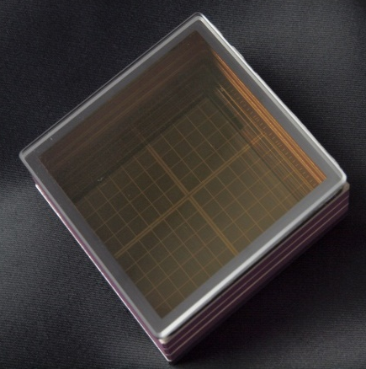
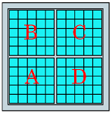

HAPD Belle II
Photo-detector
~5mm pixel size. Large coverage.
Immune to 1.5T magnetic field.
Radiation tolerance (neutron, gamma).
HAPD (Hybrid Avalanche Photo-Detector)
Developed with Hamamatsu Photonics.
144 channels (36-ch APD chip×4).
Gain ≥45000.
Peak QE ~28%
Size 73mm×73mm.
Effective area 63mm×63mm (65%).
Total 420 HAPDs

Slide 39

Belle II A-RICH

Slide 41


Slide 42
PD18 Matsuoka

Slide 43

QE’s of typical photo-cathodes
Bialkali: SbKCs, SbRbCs Multialkali: SbNa₂KCs (alkali metals have low work function)
from T. Gys, Academic Training, 2005

Slide 44
Lesson from HK PMT development

Slide 45



Solid state photosensors:
Photodiode
Inner Photoelectric effect, high QE.
Immune to magnetic field
Very compact in general
Sensitivity not close to 1pe

Slide 46


Avalanche Photodiode,
APD (CMS version)
Photo-conversion electrons from the thin p-layer(δ_{eff} ~ 6 μm) induce avalanche amplification at the p-n junction.
→Impact ionization
Electrons created by ionising particles traversing the bulk are not amplified.

Slide 47


Geiger mode APD multipixel array
Originally invented and developed by Russian researchers, Solid State Photodetectors group led by Dr. V. Shubin, Dr. Z. Sadygov and his colleagues at the INR/MELZ collaboration, the MEPhI/Pulsar collaboration led by Prof. B. Dolgoshein.
Since mid-2000s many companies in the world have started development and improved the technology with various names like ,
  SiPM
  MRS-APD
  SPM
  MPGM APD
  AMPD
  GM-APD
  MPPC

Slide 48

Principle of operation
−V_{bias}
Remember avalanche process for tiny signal
…
…
APD
output
Musienko @PD07

Slide 49
Afterpulsing
Some portion of carriers generated in an avalanche would be trapped in lattice defects and then released with triggering another avalanche.
N_{C} = No. of carriers = Gain
P_{t} = Trap probability
τ = Trap lifetime
P_{av} = Geiger discharge
probability
Low gain, low P_{t}, or long τ gives
low P_{ap}

Slide 50
Reducing after pulses
Thinner epi layer (compromise long λ sensitivity though) contributing to signal
Less defects. Epi quality or gettering technology.

Slide 51

Less crosstalks
Separation trenches can help to reduce crosstalk rate.
Yamamoto@PD07

Slide 53
Recent improvements are dramatic

Slide 54

Photon detection with Gas multiplication
Not yet widely used as standard technique.
IFB is an issue.
  PHOTON DETECTOR
  MWPC with CH₄ at
  atmospheric pressure
  (4 mm sensitive gap)
  analogue pad readout
  (~160 10³ channels)
  reflective layer of CsI
  (QE ≈ 25% @ 175 nm)
ALICE HMPID

Slide 55
CsI+ 2THGEM+MICROMEGAS
COMPASS RICH-1 upgrade
To expect less IFB

Slide 56

CERN NA62

Slide 57

CEDAR Gas Cherenkov
0.55 φ x 4.5 m
45MHz 100psec resolution required

Slide 58


NA62 RICH

Slide 59

NA62 MUV

