Slide 1
How can physicists explore the particle world?(III)
Junji Haba (KEK)
Moscow International School of Physics
2019

Slide 2
Life time measurement using decay vertex
Life time is measured through “decay length “ L,
L= c β γ τ
Useful to identify heavy flavor with longer life
\\\
L
Needs highest precision tracking

Slide 3
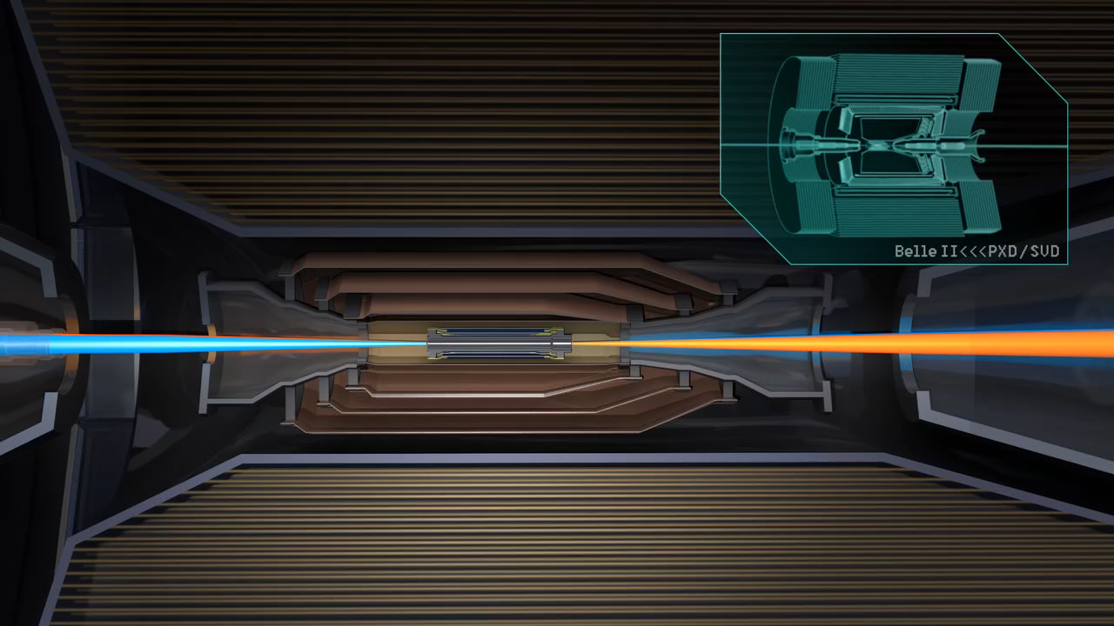
Vertex detector

Slide 4
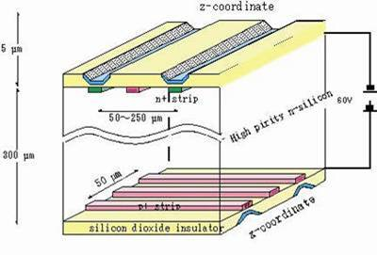
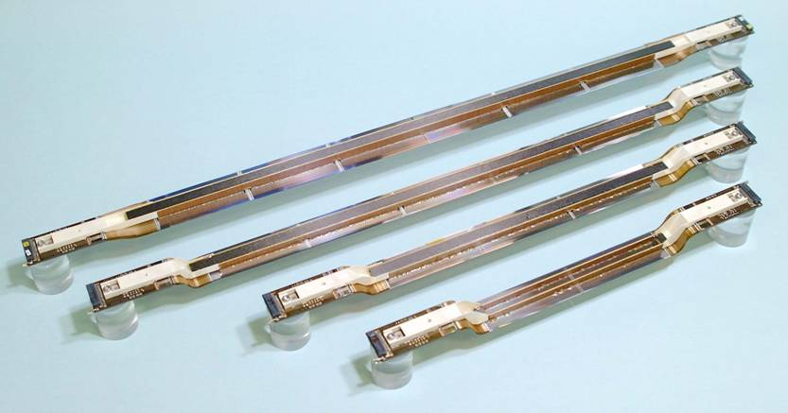
Silicon strip detector

Slide 5
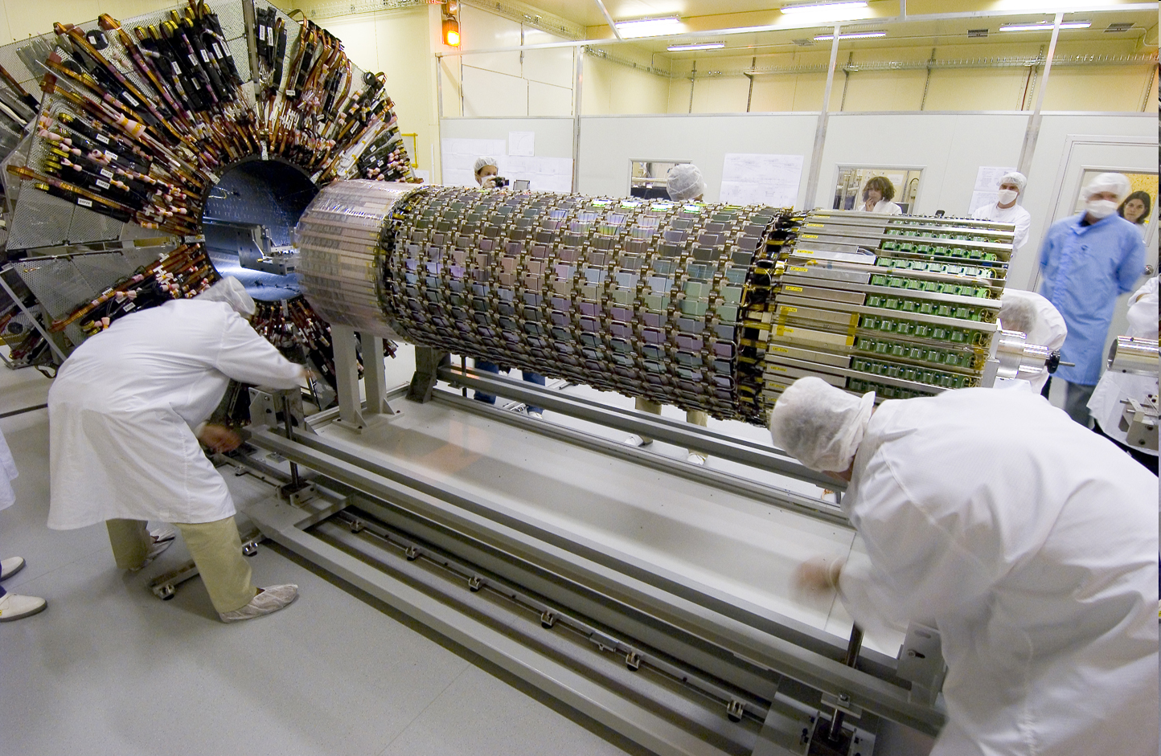
ATLAS SCT
ATLAS
Web page

Slide 6
Principle of semiconductor detector
Depletion layer
－
－
－
－
＋
＋
＋
＋
－
－
－
－
＋
＋
＋
＋
－
－
－
－
＋
＋
＋
＋
P type semiconductor
N type semiconductor
acceptor
donor
－
No recombination
Large signal (~10,000 electron)
thanks to small gap energy
Higher mobility
+
hole
electron
Reverse bias

Slide 7
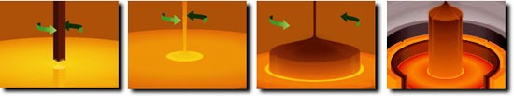
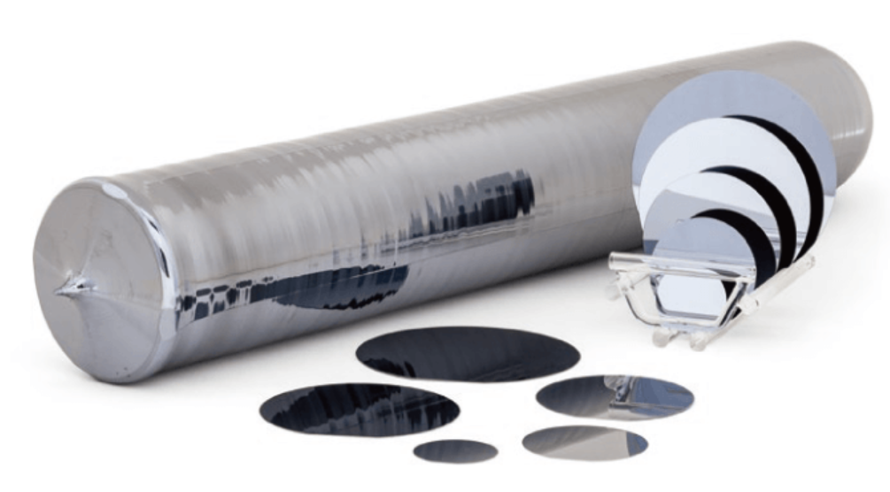
Starting with a silicon wafer
http://ferrotec-global.com/

Slide 8
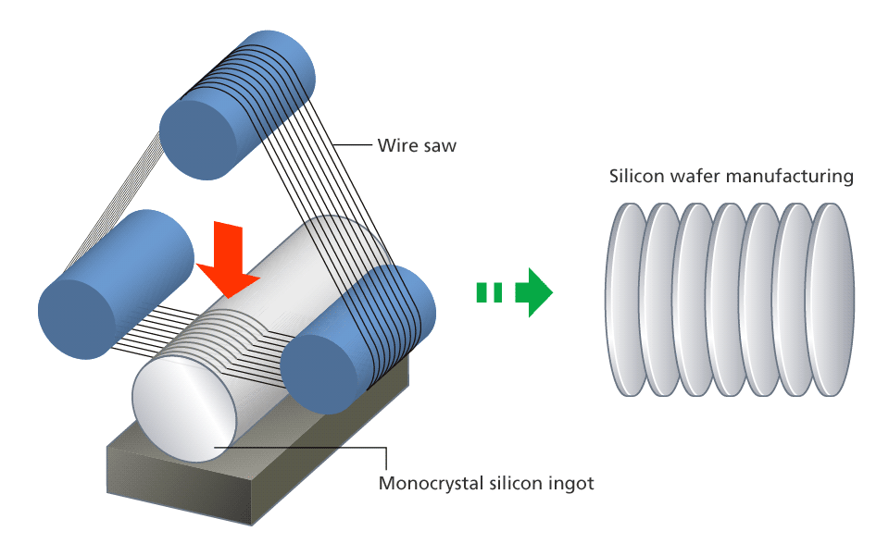
https://www.nikon.com/products/semi/technology/story02.htm

Slide 9
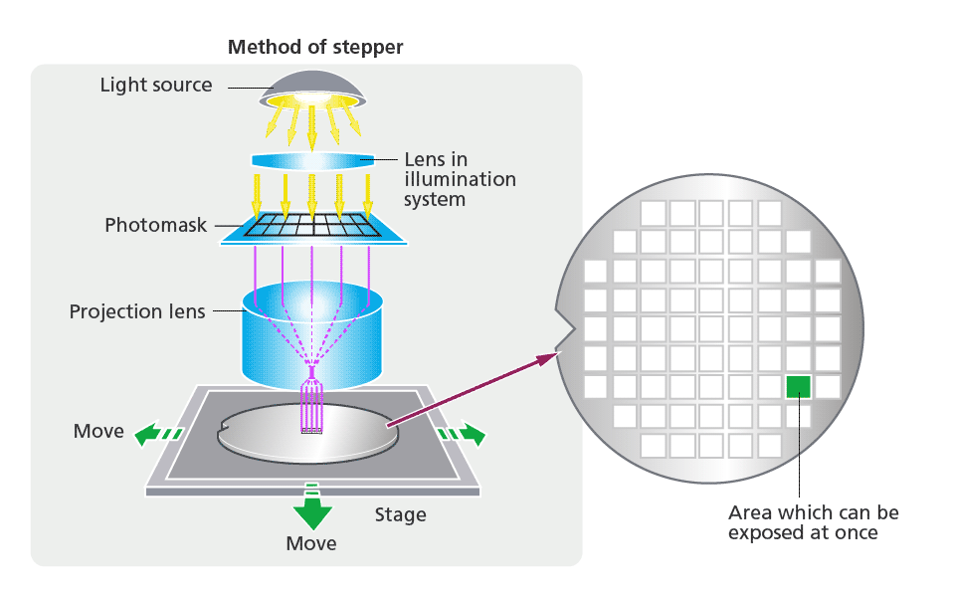
https://www.nikon.com/products/semi/technology/story02.htm

Slide 10
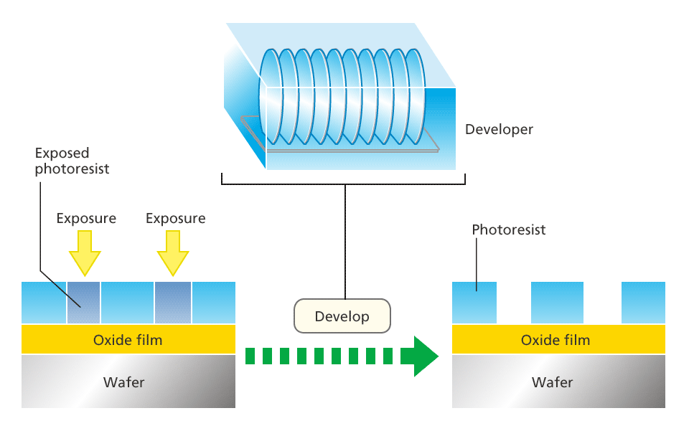
https://www.nikon.com/products/semi/technology/story02.htm

Slide 11
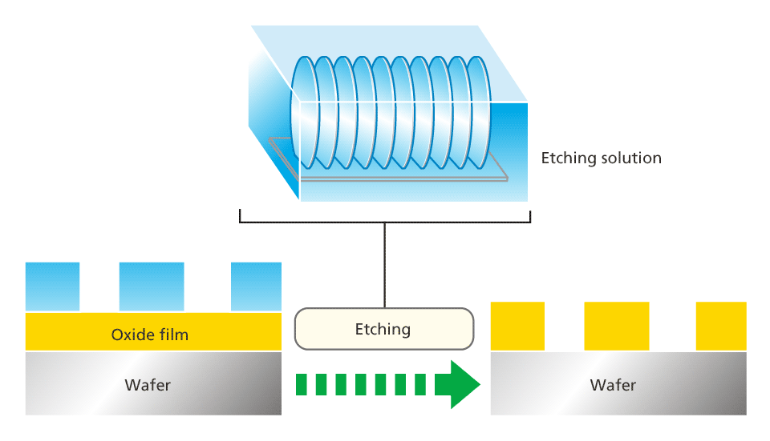
https://www.nikon.com/products/semi/technology/story02.htm

Slide 12
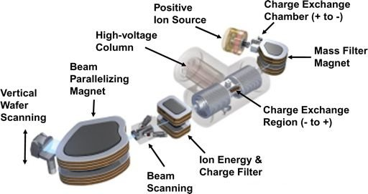
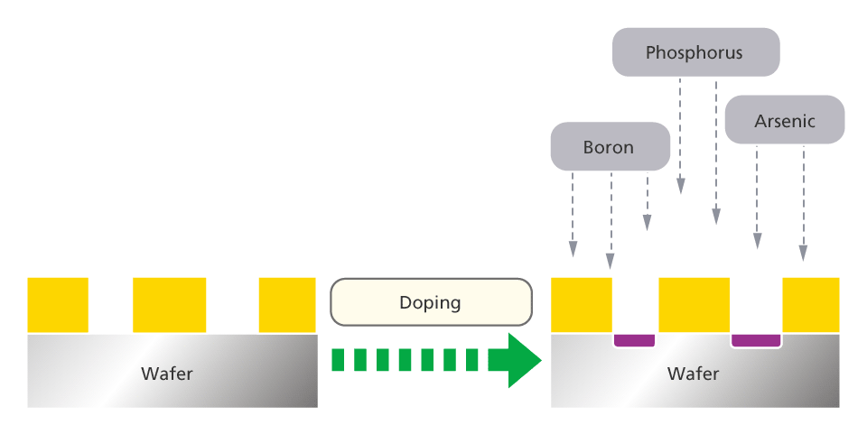
Doping using a small accelerator
n dopant
p dopant
https://www.nikon.com/products/semi/technology/story02.htm

Slide 13
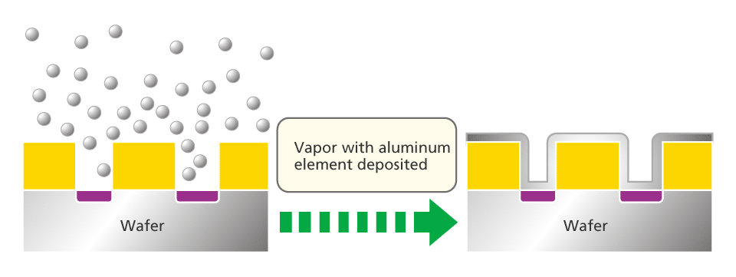
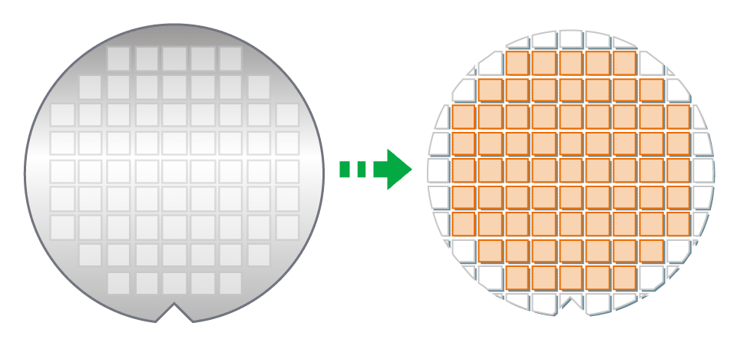
https://www.nikon.com/products/semi/technology/story02.htm

Slide 14
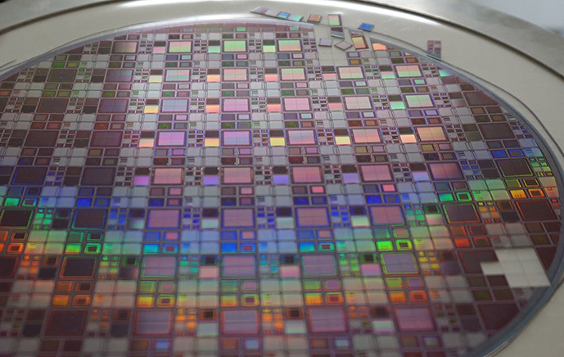

Slide 15
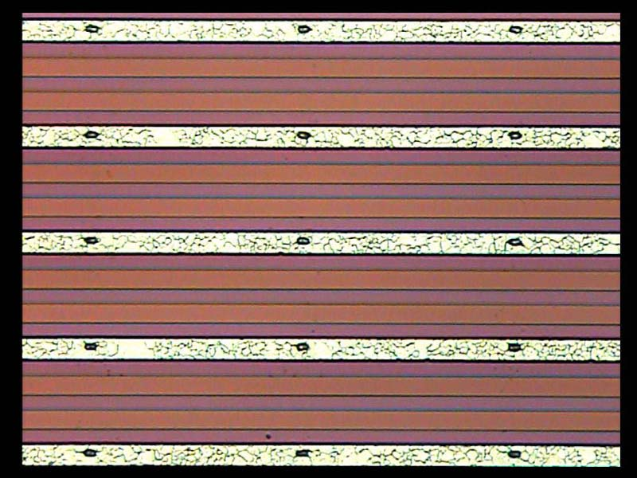
Problem of strip detector/
Occupancy at high luminosity colliders
Higher occupancy means more fakes in the region of interest (ROI) which is defined by outer tracking device with a finite resolution.
Association with fake cause a wrong reconstruction
Occupancy directly relates loss of
sound (useful) sample
Fake by noise or BKG
True signal
Fake
Fake

Slide 16
So many candidate pairs !

Slide 17
Operation under high background

Slide 18
Pixel detector
Occupancy can be reduced dramatically with a pixel detector
Hybrid pixel
  ATLAS, CMS, ALICE
Monolithic pixel
  CCD
  CMOS
  Active pixel
  DEPFET
  SOI

Slide 19
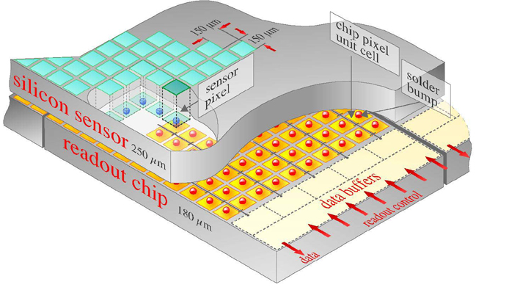
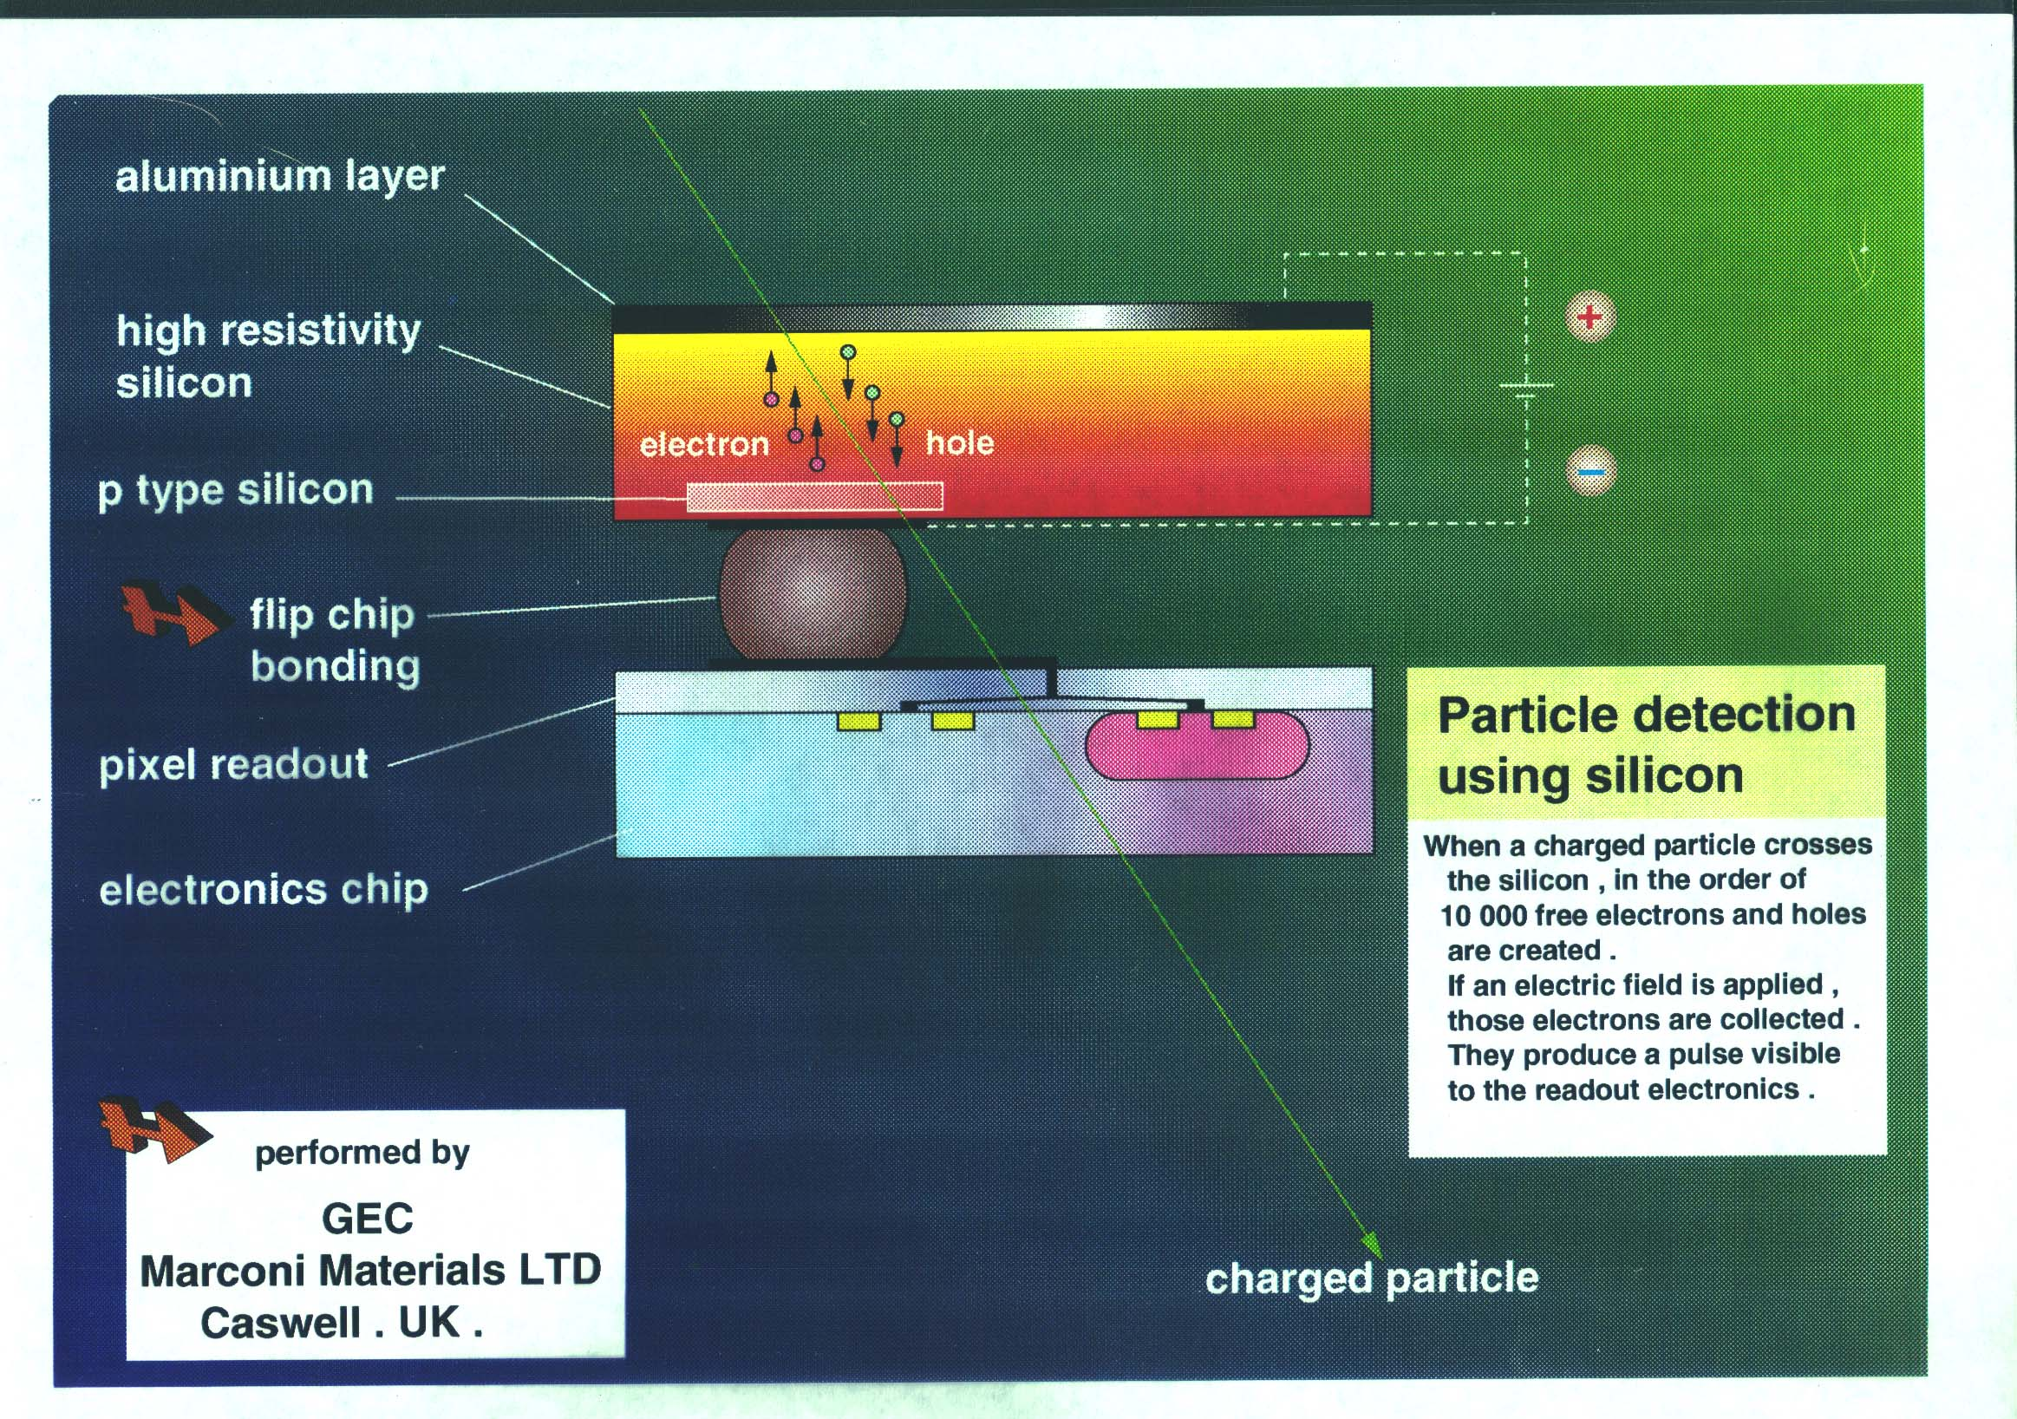
Hybrid pixel
Signal fed vertically
Number of readout~n²
Flip-chip assembly
Pixel detector bump bonded
to a read-out chip
Relatively thick !
F.Riggi, ST-INFN-CERN Workshop, 23-24 October 2002

Slide 20
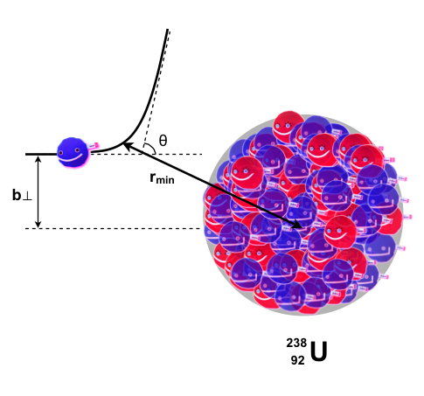
Multiple Coulomb scattering
Multiple scattering deteriorates
precise tracking
e

Slide 21
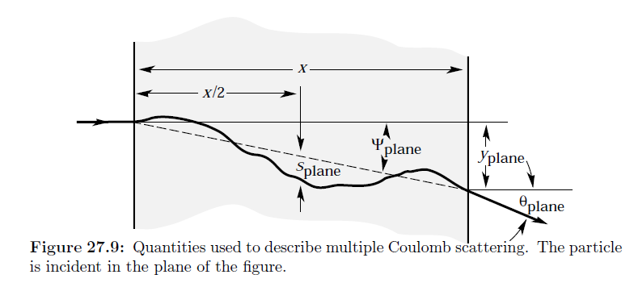
Practical formula

Slide 22
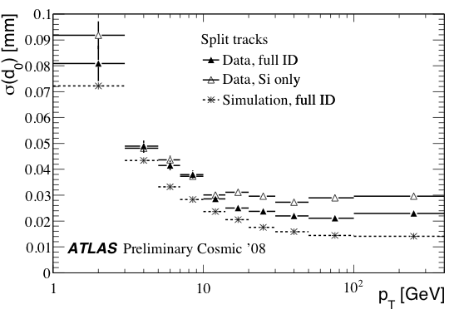
Vertex resolution deteriorated by material
Alice
Belle
ATLAS
LHCb
ILD

Slide 23
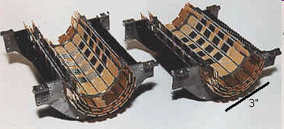
Monolithic pixel for thinner detector
CCD ( realized in the SLD experiment)
Readout electronics built on sensor
No bump bonding over sensing area
SLAC ウェブページより抜粋

Slide 24
CMOS MAPS
Very successful
Not yet satisfactory
STAR PXL detector
•High resistivity p-epi layer
•Rolling shutter readout
•End-of-column discriminators
•MIP Signal ~ 1000 e- - S/N ~ 30
•185.6 μs integration time
•~170 mW/cm² power
•50 μm thick
•~1M pixel on (2×2) cm2
•in-pixel amplifier &
Correlated Double Sampling

Slide 25
One of promising new candidates:
Monolithic pixel sensor using SOI
My very personal view
Monolithic pixel sensor
  Silicon sensor with read out CMOS electronics on chip
SOI: Silicon-On-Insulator

Slide 26
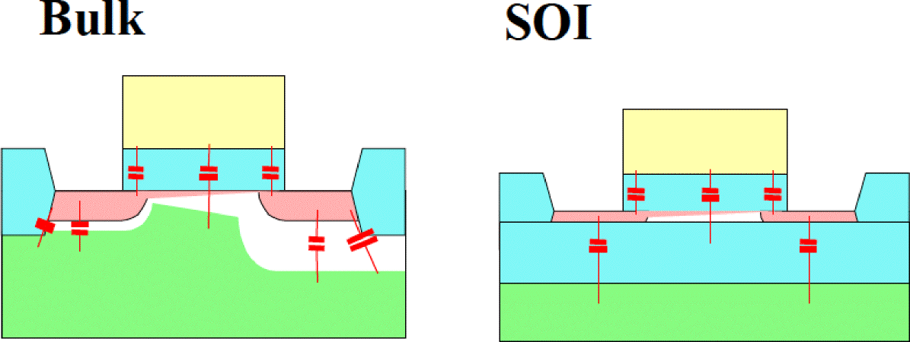
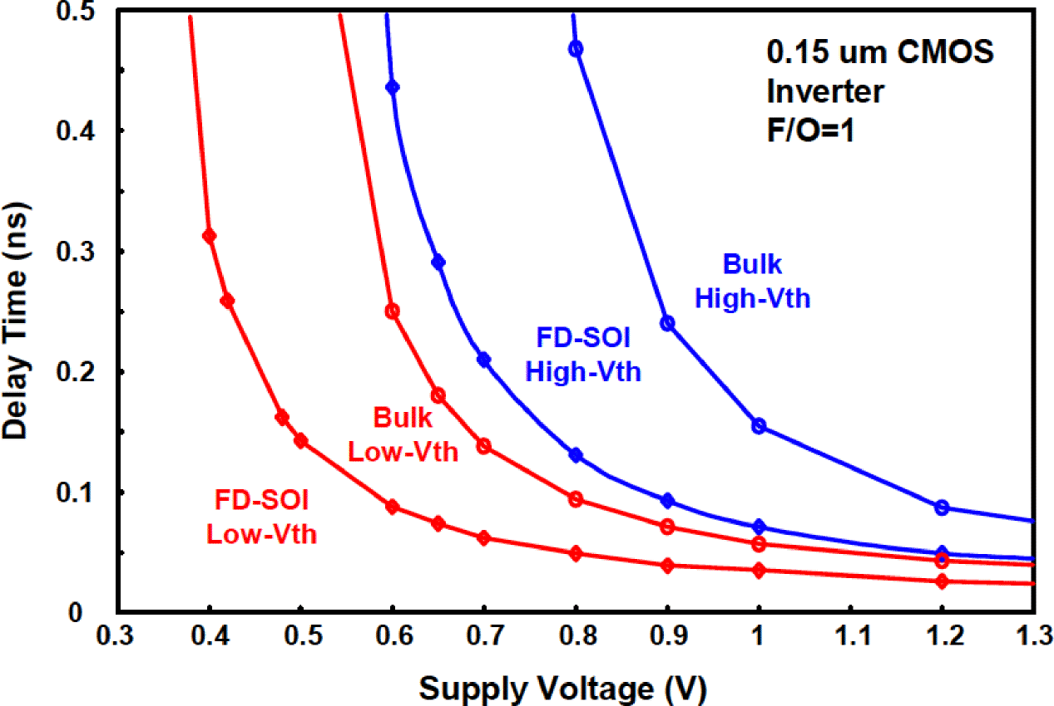
SOI Performance : Smaller Junction Capacitance
Cj is 1/10 of Bulk technology.
Gate Capacitance is 30-40%
Lower.
High Speed / Low Power
26

Slide 27
Thinner than Hybrid pixel applied in the LHC experiment
No bump bonding at all
Hybrid Detector
Silicon-On-Insulator (SOI)
Full Deplete
(Hi-R)
Full Deplete
(Hi-R)

Slide 28
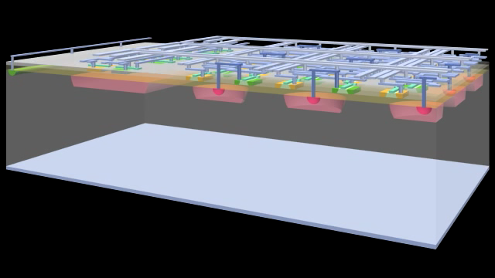
II. SOI Pixel development

Slide 29
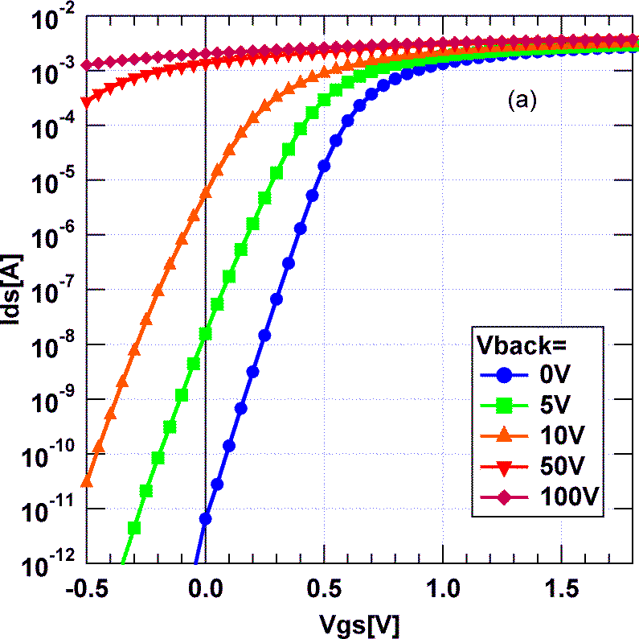
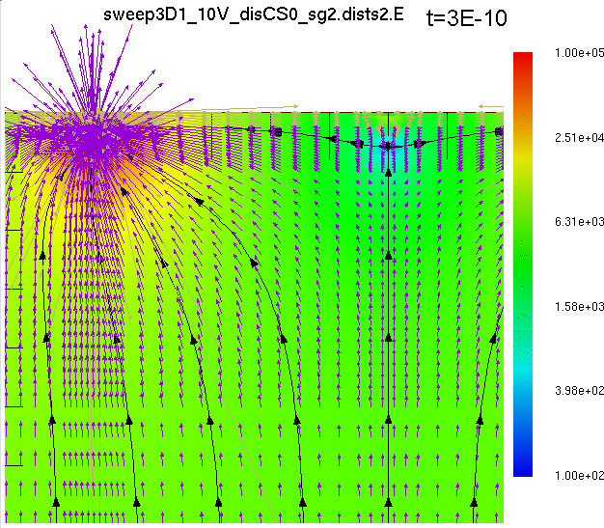
Main Issue in the SOIPIX:
Back-Gate Effect
back channel open
shift
MOS Tr
Detector Voltage act as a Back Gate of the Transistors, and open back channel.

Slide 30
Buried p-Well (BPW)
Substrate Implantation
BPW Implantation
Buried
Oxide
(BOX)
SOI Si
Pixel
Peripheral
P+
BPW
Cut Top Si and BOX
High Dose
Keep Top Si not affected
Low Dose
Suppress the Back Gate Effect.
Shrink pixel size without loosing sensitive area.
Increase break down voltage with low dose region.
Reduce electric field in the BOX which improve radiation hardness.

Slide 31
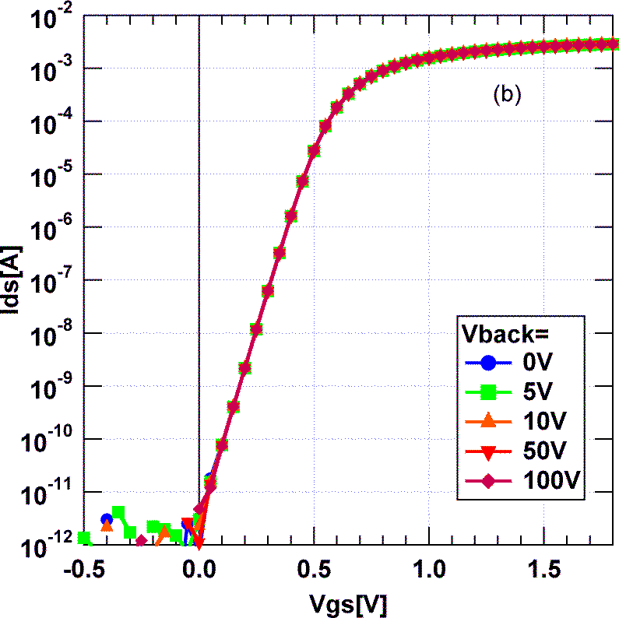
I_{ds}-V_{gs} and BPW
w/o BPW
with BPW=0V
NMOS
back channel open
shift
Back-gate effect is completely suppressed by the BPW.

Slide 32
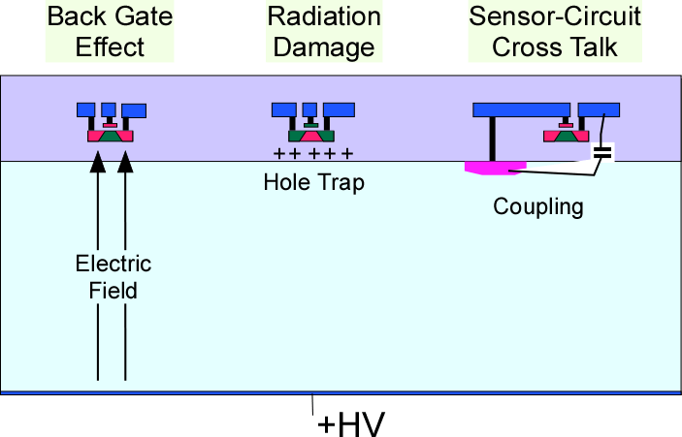
Issues in SOI detector
Sensor and Electronics are located very near. This cause ..
BPW
At first, we successfully introduced BPW layer to remove the back gate effect.
Then we newly introduced additional conductive layer under the transistors to reduce all effects (→ Double SOI).

Slide 33
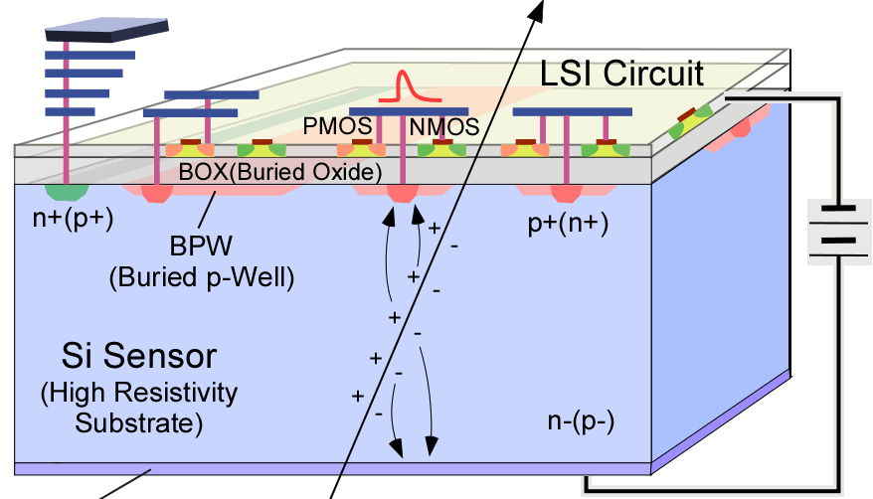
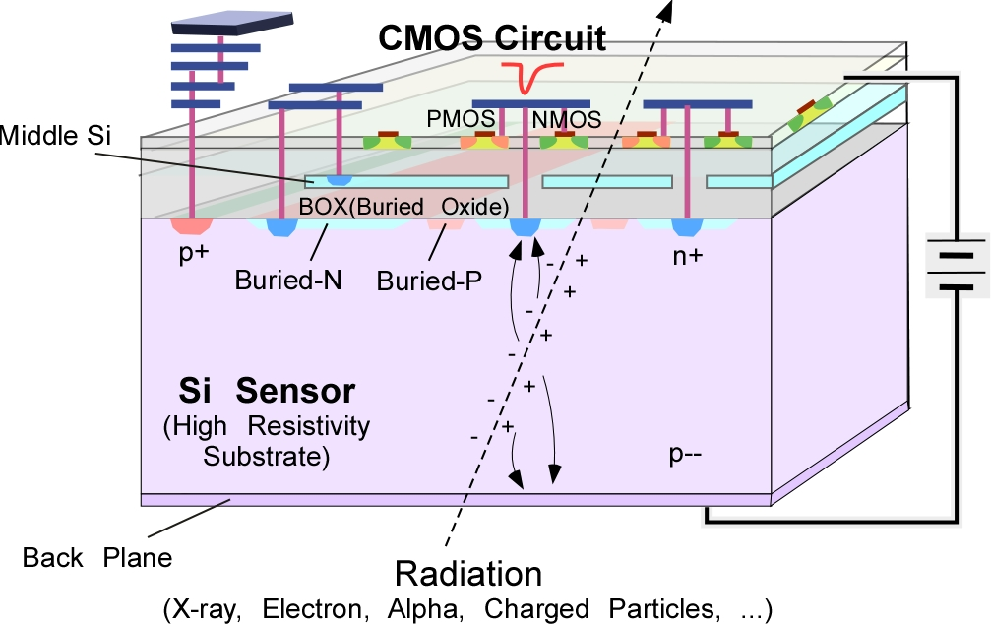
From Single SOI to Double SOI
Double SOI
Single SOI
Shield Crosstalk
Compensate radiation induced oxide charge

Slide 34
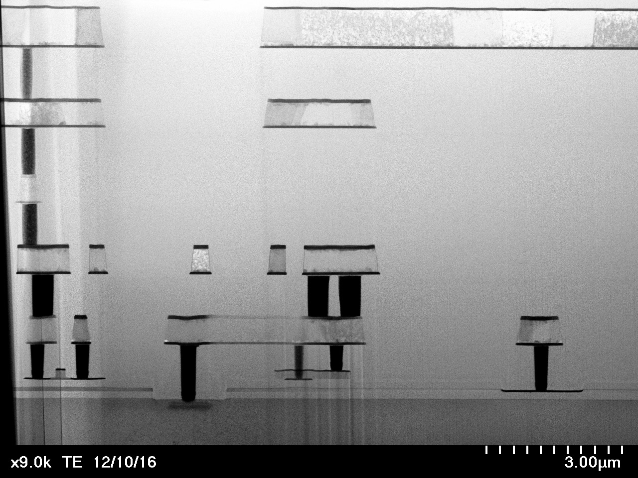
Metal 5
Cross section of the Double SOI Pixel
Middle Si
Middle Si
Contact
Metal 1
Transistor
Sensor
Contact

Slide 35
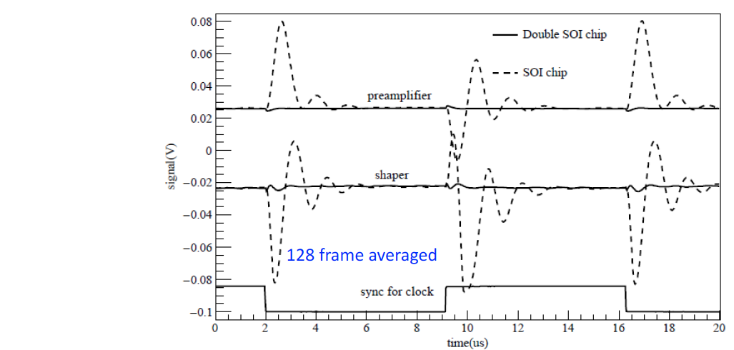
Effect of Double SOI
Cross Talk from Clock line
Single SOI
Double SOI
Shield:
Cross Talk between Circuit and Sensor is reduced to 1/20.
(by Lu Yunpeng (IHEP))

Slide 36
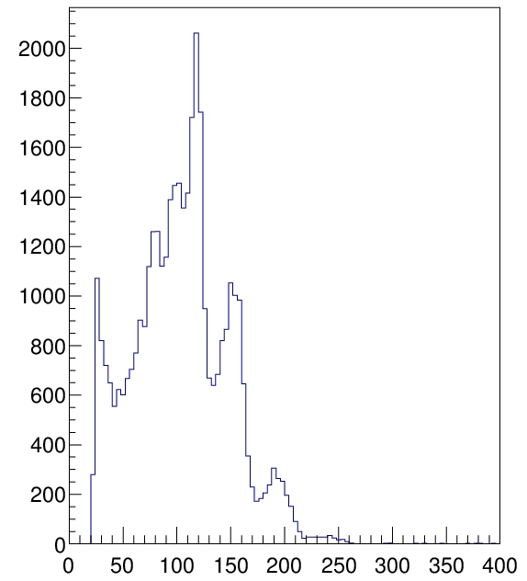
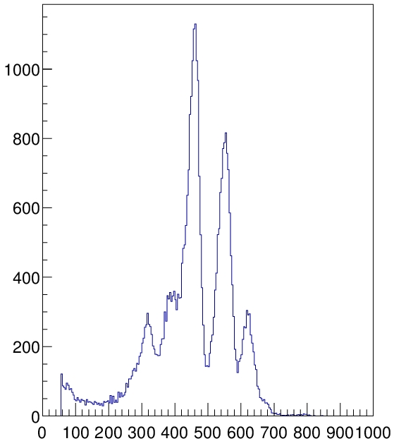
Effect of Double SOI
5fF
5fF
Coupling:
Gain of Charge Amp increases ~3 times by cutting parasitic C.
Single SOI
Double SOI
Am241
Gain
15.3uV/e-
Gain
49.2uV/e-

Slide 37
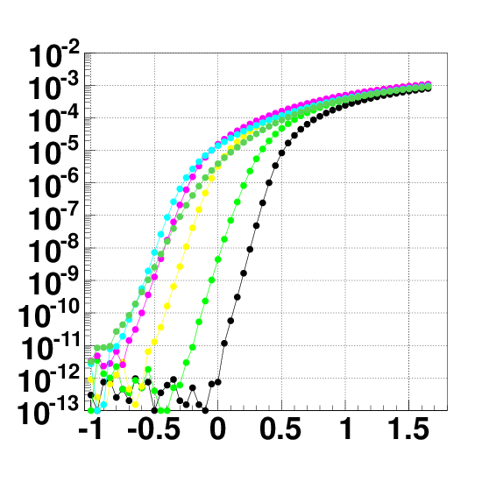
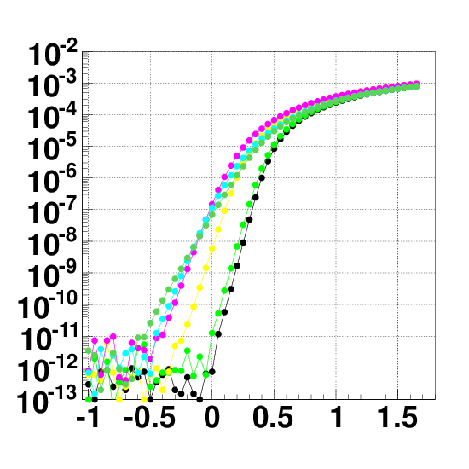
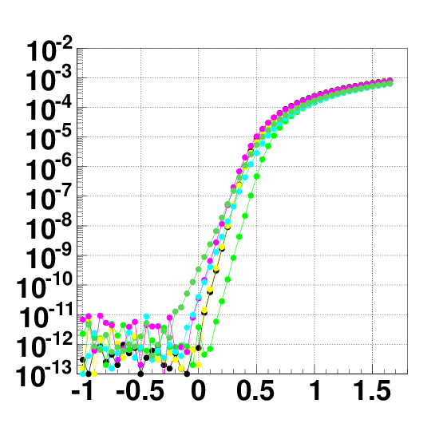
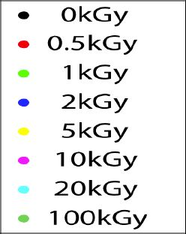
Gamma-ray Irradiation Test
(Id-Vg Characteristics v.s. SOI2 Potential)
I/O normal Vth Source-Tie Tr.
L/W =0.35um/5um
NMOS
V_{SOI2}=0V
V_{SOI2}=-2V
V_{SOI2}=-5V
I_{d}[A]
I_{d}[A]
I_{d}[A]
100 kGy
100 kGy
0 kGy
0 kGy
0 kGy
V_{g}[V]
V_{g}[V]
V_{g}[V]
By setting Middle Si potential (Vsoi2） to -5V, Id-Vg curve returned nearly to pre-irradiation value at 100 kGy(Si) (10 Mrad).
(by U. of Tsukuba)

Slide 38
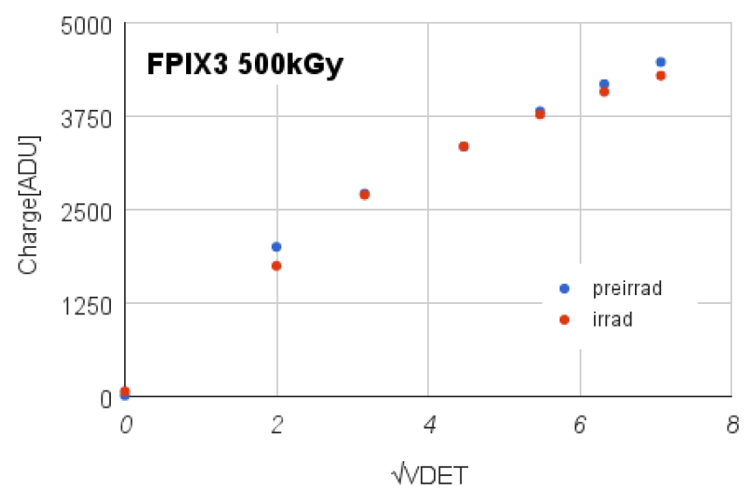
Radiation tolerance up to 500 krad. level
It will survive in e+e- collider like SuperKEKB, ILC

Slide 39
Pix size 8um
No bump bonding
Springer Proc.Phys. 213 (2018) 331-338

Slide 41
High functionality On-Chip

Slide 44
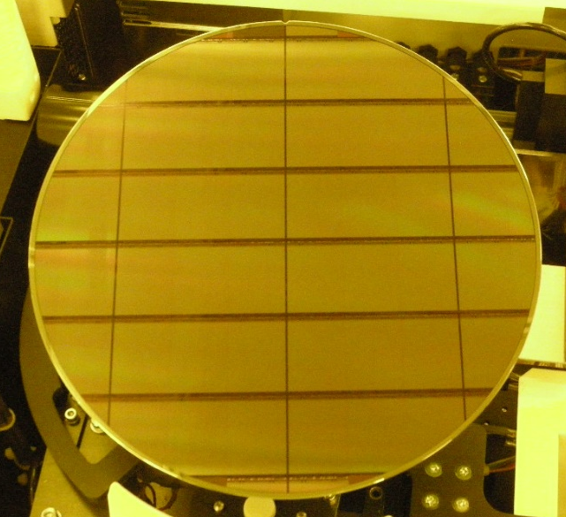
Stitching Exposure for Large Sensor
Mask Layout
Blind
Blind
Exposed Layout
Pixel

Slide 45


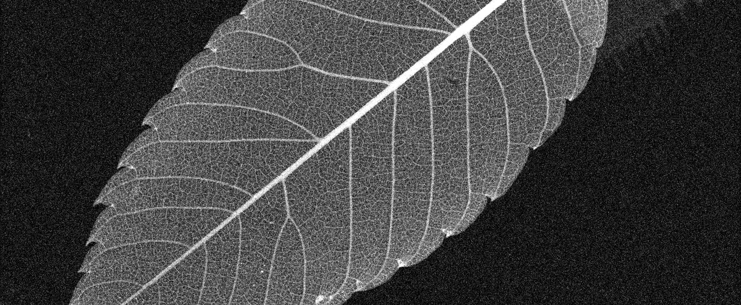
SOPHIAS
Beautiful
High gain Image!
Pix size : 30um×30um
64.8mm (2160 pix)
26.7mm (891pix)
22kV 200uA Target Cu Kα 8keV
1000 shot averaged
0.5 photon/pix/shot
1.9M pixels !!

Slide 46
Monolithic pixel sensor will be a standard tracking device in near future
SOI pixel sensor is one of the most promising technologies among them

Slide 47
How can physicists explore the particle world?(III+)
real

Slide 48
Applications of HEP detector technology to society
At Hospitals…
  X-ray, g-ray, ＰＥＴ diagnosis, Cancer therapy
At Aiports or Boarder gates….
  X-ray inspection
At factories, infrastructures as bridges, power plants….
  X-ray or Neutron Non–destructive defect/damage inspection
At the Fukushima site
  Mapping and Identification of radioactive substances

Slide 49
X-ray

Slide 50
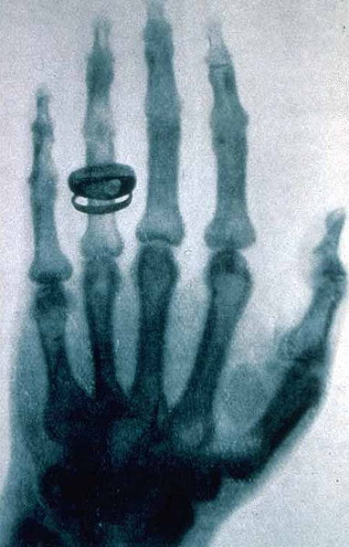
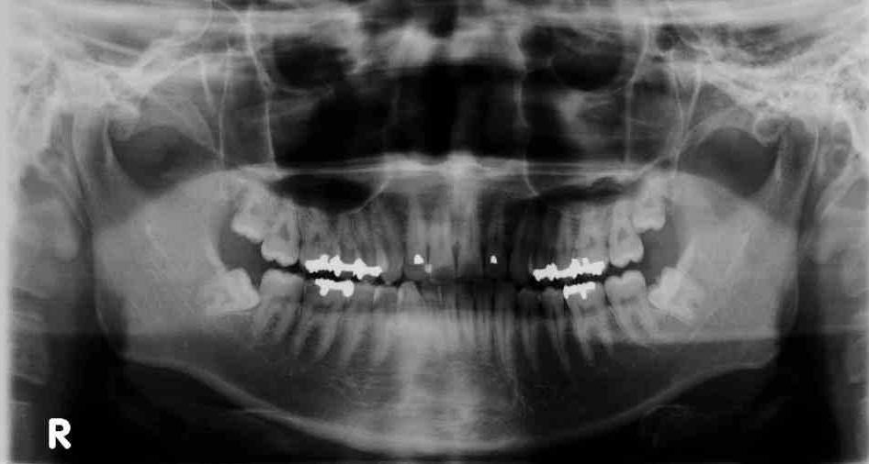
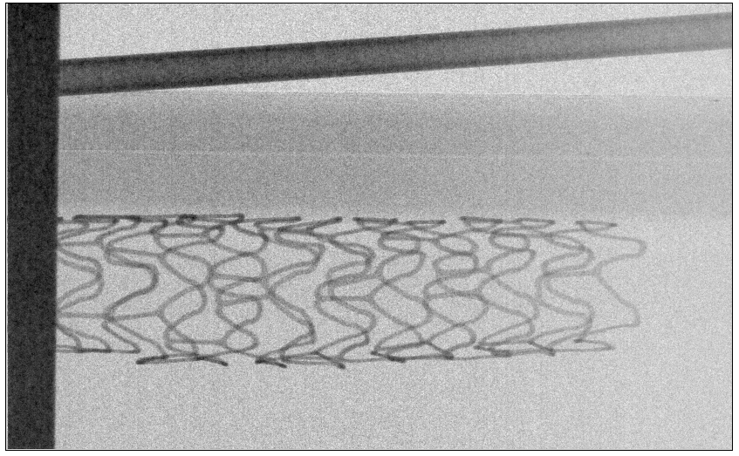
X-ray imaging device with the most advanced technology developped in Particle detectors

Slide 51
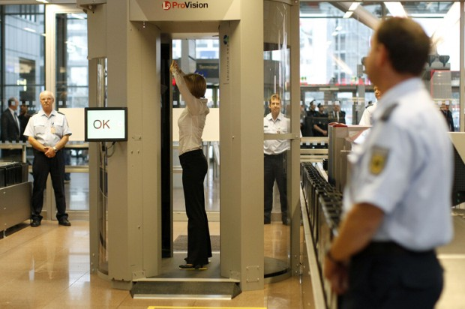

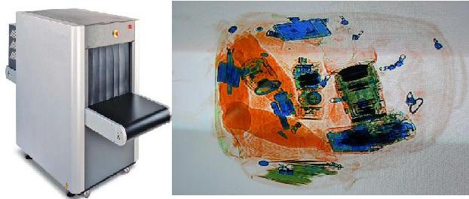
For safety Flights:

Slide 52
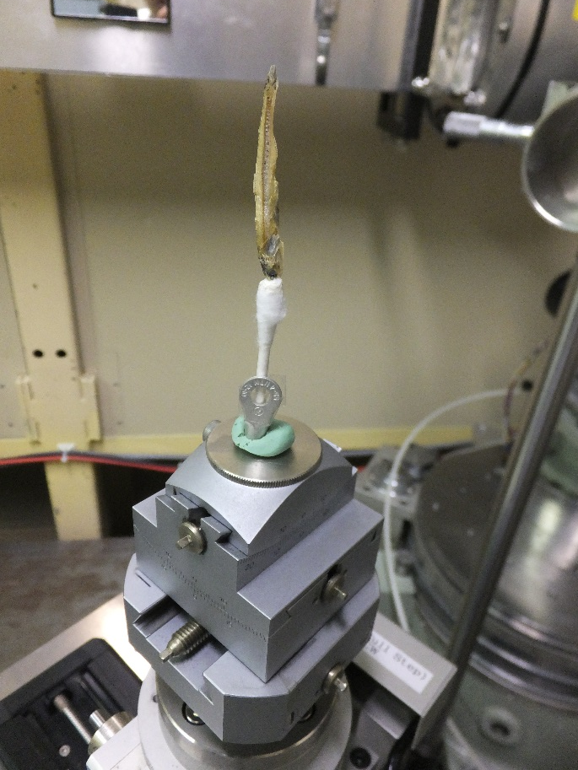
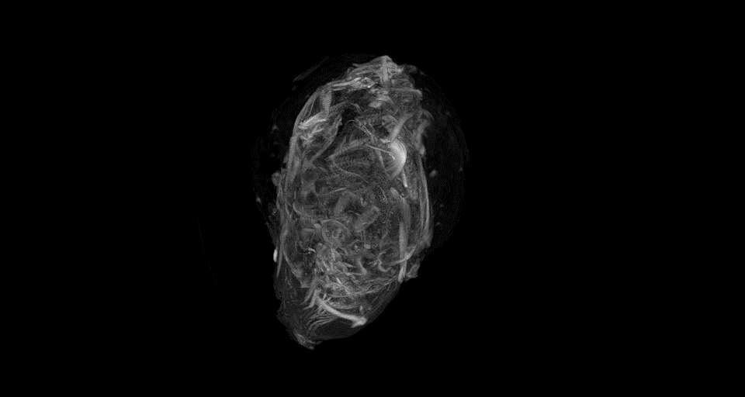
3D X-ray CT
Sensor chip INTPIX4 NFZ (5JA-FZ-1407) Back illumination
HV：200V、integration/frame：1ms、ScanTime：320ns/pix
Calibration：500frame、Event：1000frame
X-ray energy：9.5keV
(by R. Nishimura, K. Hirano)

Slide 53
Gamma Ray

Slide 54
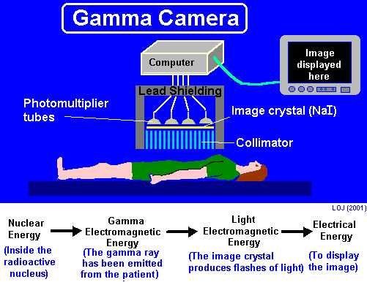

Standard Gamma “camera”
Not very efficient. Most of gamma rays are absorbed in collimators.

Slide 55


Scintigraphy
Blood flow can be observed externally by radio isotope (RI) labelling.
Imaging of radiation from RI by particle detectors.
After exercise
At rest
撮像３０分とのこと

Slide 56

Further attempt: Compton camera

Slide 57


Application of Gamma camera developed for Gamma ray astronomy
to Fukushima NP restoration
平成24年11月15日
宇宙航空研究開発機構
三菱重工業株式会社
国立大学法人 名古屋大学
独立行政法人 科学技術振興機構

Slide 58




Slide 59

Very useful for medical application
ＰＥＴ（Positron Emission Tomography ）
glucose
Cancer
tissue
Normal
tissue

Slide 60




Just like a barrel calorimeter of collider detectors
From the photo gallery cmsinfo.cern.ch
Higher resolution/efficiency can make
exposure dose less.

Slide 61

PET γ detector module
© Siemens AG

Slide 62
Neutron

Slide 63


Imaging with neutron beam
Left: X-ray image
Right: Neutron imaging. Organic material buried inside , invisible with X-ray, can be visualized by neutron.
(photo: example of Sakyamuni, Bhumisparsa Mudra, West-tibet, 14.- 15. century).
Non-invasive studies of objects from cultural heritage

Slide 64


Application to Neutron Detector
Ar-CO₂
Cathode plate
With B10
Expensive ³He Gas is not necessary.
  No pressure vessel
Free readout pattern
High resolution
  Position and Time
Insensitive against g-ray
Capability against high counting rate
B10 coated
GEMs
Normal GEM
Readout board

Slide 65


Pulse neutron and
Energy Selective Neutron Radiography
Resonance absorption region (E>1eV)
Bragg Edge
region
(Thermal and cold)
λ$=\frac{h}{mv}=\frac{h}{m\sqrt{2mE}}=\frac{h}{mL}∆t$

Slide 66



Imaging for bended iron plates at LINAC in Hokkaido University
Sample
90°Bending
and Re-flattening
90°Bend
60°Bend
+Reference
（without bending）
30°Bend
Moderator
Flight tube
Sample
70cm
504cm
100cm
GEM
Detector
674cm

Slide 67

Results
90° Bending
60° Bending
30° Bending
Reference
Re-flattening
Position Y (mm)
Photo of iron plates
Position X (mm)
Two dimensional imaging of crystallite size in the bended iron plates
can be done clearly.
Visualization of microstructure for heavy material can be performed with the gaseous neutron detector.

Slide 68
Others

Slide 69


See through mega structure using cosmic ray muons
K.Morishima (Nagoya U.)
東大地震研HPより

Slide 70

Low energy negative muon can probe inside material
3D imaging of
material
composition

Slide 71
Summary
Huge detector system for HEP is very important tool to investigate Law of Nature together with a large accelerators.
The system is composed of tens of advanced radiation measurement systems.
Breakthrough of new physics will be established by clever physicists taking advantage of the most advanced detector system at the time. Advanced detector might make something impossible possible, infinitely high cost reasonable…

Slide 72
Summary contd.
The advanced detector technology originally developed for particle physics are now being applied to innovate the instrumentations in society like medical or industrial equipment. Higher resolution, higher sensitivity and lower dose exposure for human is expected.
Those “advanced” system enables very quick diagnose with higher precision and much less radiation dose. They are also very useful to visualize the hidden structure /defect /dangerous substance inside material clearly.

