Slide 1



Physics at the LHC
Experimental Techniques
Albert De Roeck
CERN, Geneva, Switzerland
Antwerp University Belgium
UC-Davis California USA
NTU, Singapore
20th February 2019

Slide 2
Lecture Plan
Overview of the 3 lectures in the next days
Lecture 1: Introduction to Experimental Techniques at the LHC
Lecture 2: Measurements and test of the Standard Model, including the Higgs
Lecture 3: Searches beyond the Standard Model and a short Outlook to the future at the LHC

Slide 3
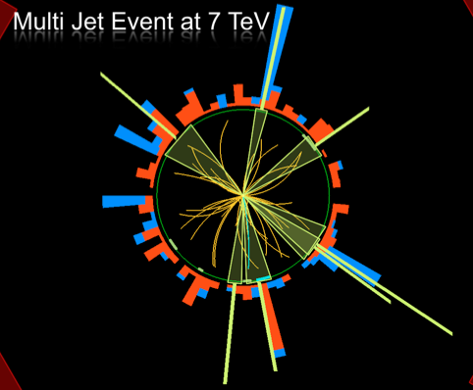
Outline Lecture I
Introduction: Experimental
Particle Physics
The Large Hadron Colider
Experiments at the LHC
Experimental Challenges
Experimental Objects
Basics of experimental pp
collisions
Summary
Disclaimer:
ATLAS & CMS have very
similar results
Typically one chosen
for illustration

Slide 4
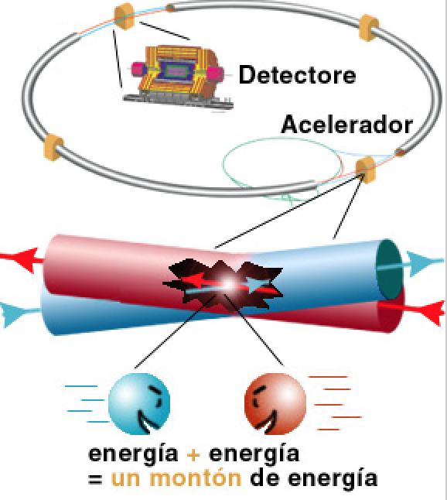
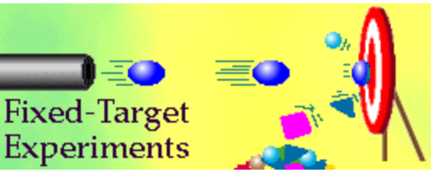
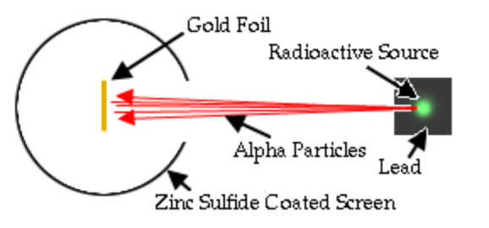
High Energy Physics Experiments
First High Energy Physics
Experiments:
Beam on fixed target!
High Energy Physics
Experiments since mid 70’s:
Colliding beams!
Rutherford experiment (1909)
Centre of mass energy squared s=2E₁m₂
Centre of mass energy squared s=4E₁E₂
…plus secondary beams such as neutrinos…

Slide 5
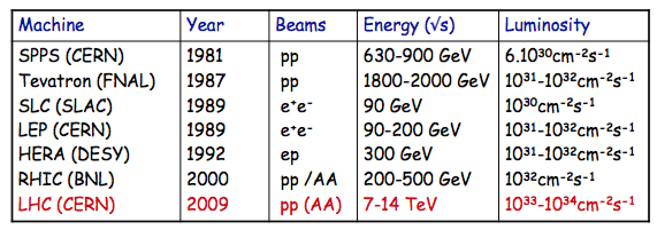
Recent High Energy Colliders
Highest energies can be reached with proton colliders
Luminosity = number of events/cross section/sec
Limits on circular machines
  Proton colliders: Dipole magnet strength →superconducting magnets
  Electron colliders: Synchrotron radiation/RF power

Slide 6
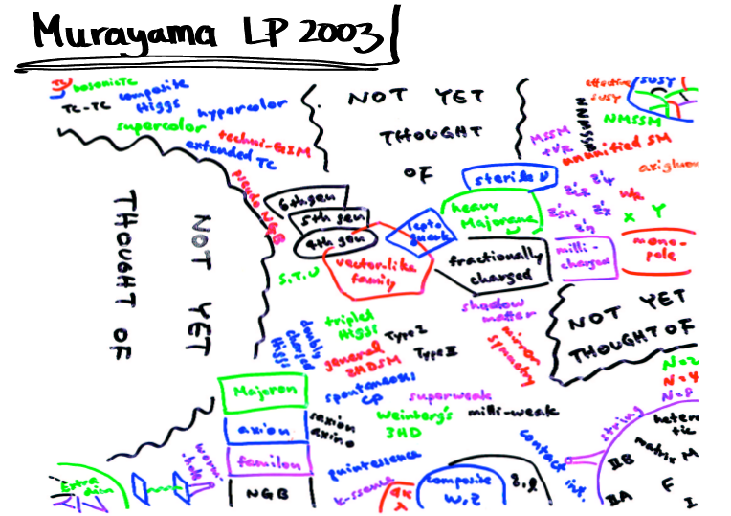
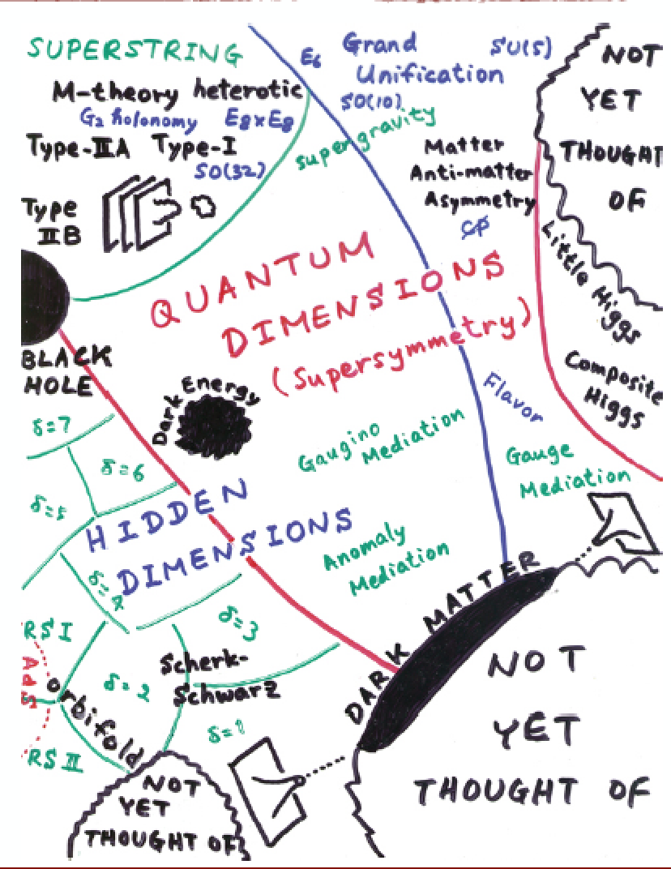
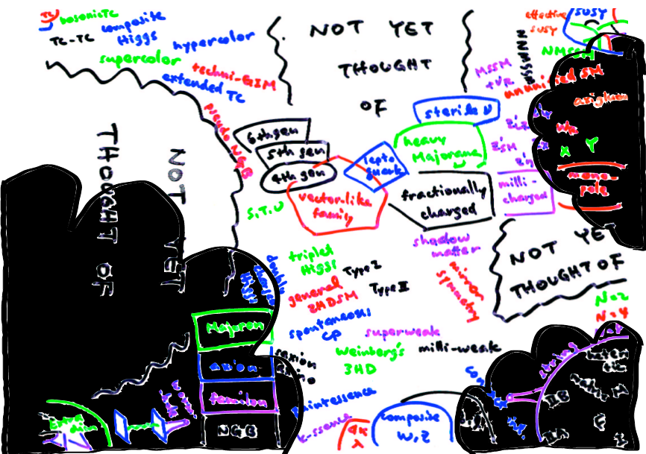

2010-2012: LHC data and Theorists
By 2012..!
M. Schmalz
2010…
New modern version of the
plot, ie the new experimental
targets

Slide 7
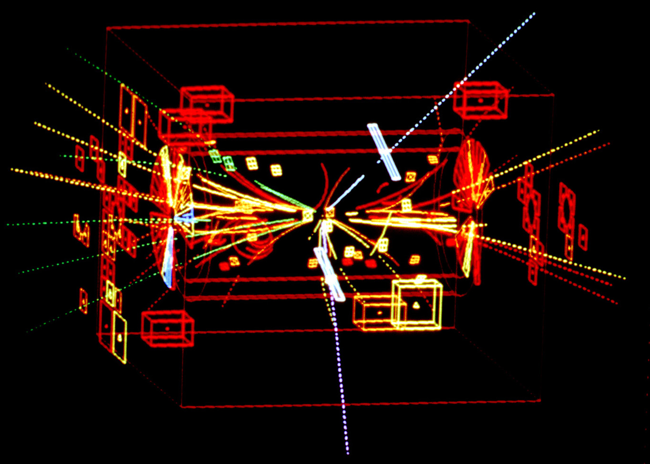
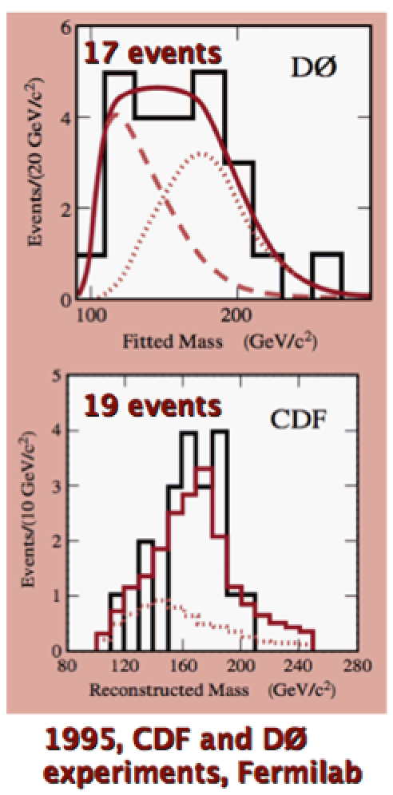
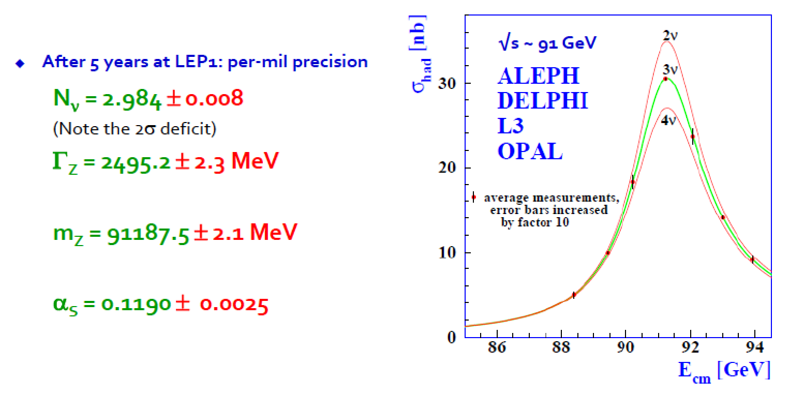
Some Discoveries/Measurements
Discovery of the Z and W
bosons in UA1/UA2 (1983)
pp → Z + X
→ e+e- + X
Discovery of the top
quark in CDF/D0(1995)
Detailed Z-property measurements (1995)

Slide 8
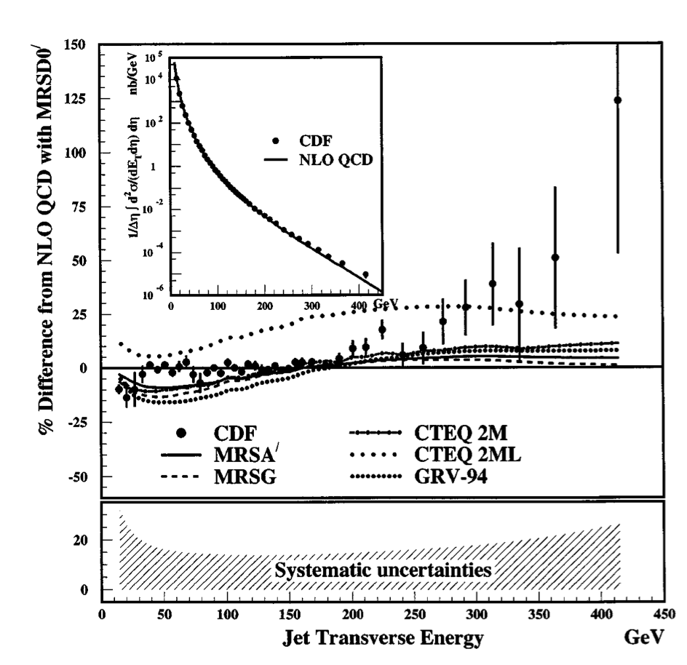
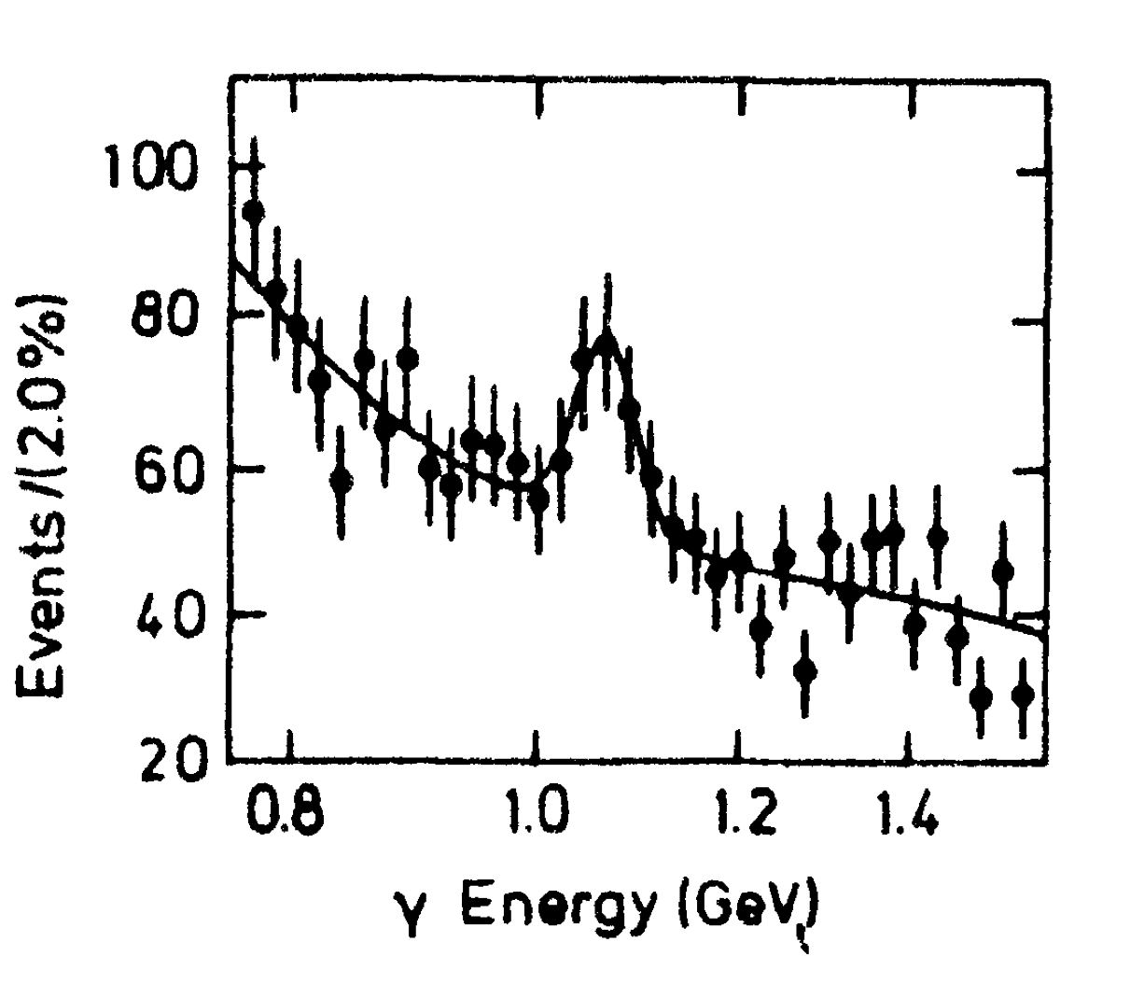
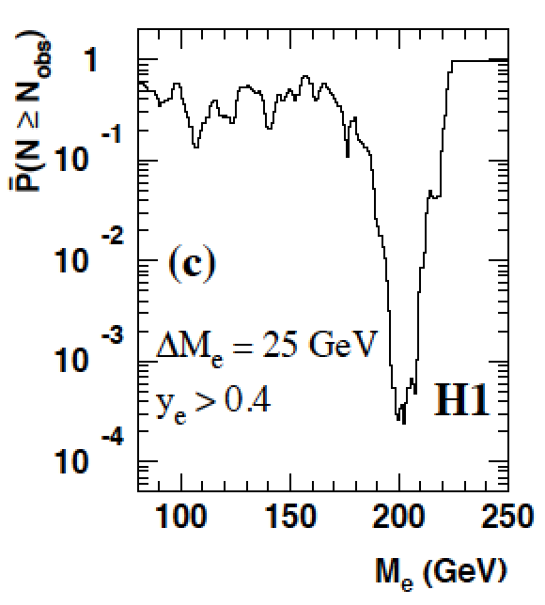
Careful with “Discoveries”!
PDFs/TH
Analysis error!
4σ effect
Statistics!
Excess in inclusive jet
analysis: substructure?
Is the X(8.31 GeV) the
Higgs particle? A lot of
excitement summer 1984
NON of these were
actual discoveries!!
Excess of events at high Q² in ep DIS at HERA, mainly in H1:
•7 events found with an electron-quark mass of ~200 GeV, expected ~1 event
•4 events found with expected 2 events in ZEUS -> Leptoquarks?

Slide 9
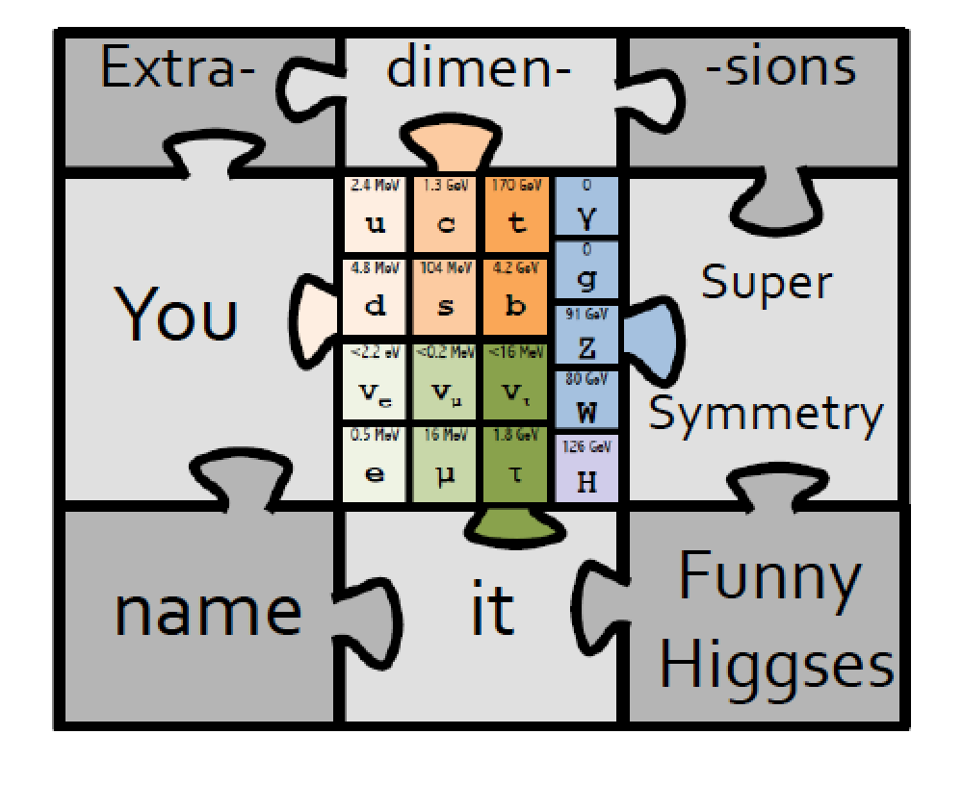
In All: The Standard Model…
And beyond….??? The Experimentalist view ☺

Slide 10
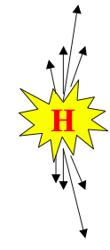
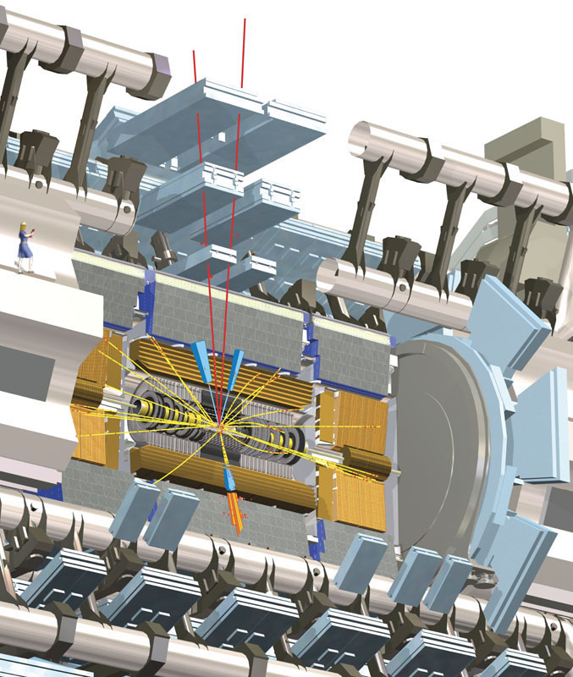
LHC: The Higgs Particle
Technique: Produce and detect Higgs Particles at Particle Colliders
E=mc²
proton
proton
Experimental view…

Slide 11
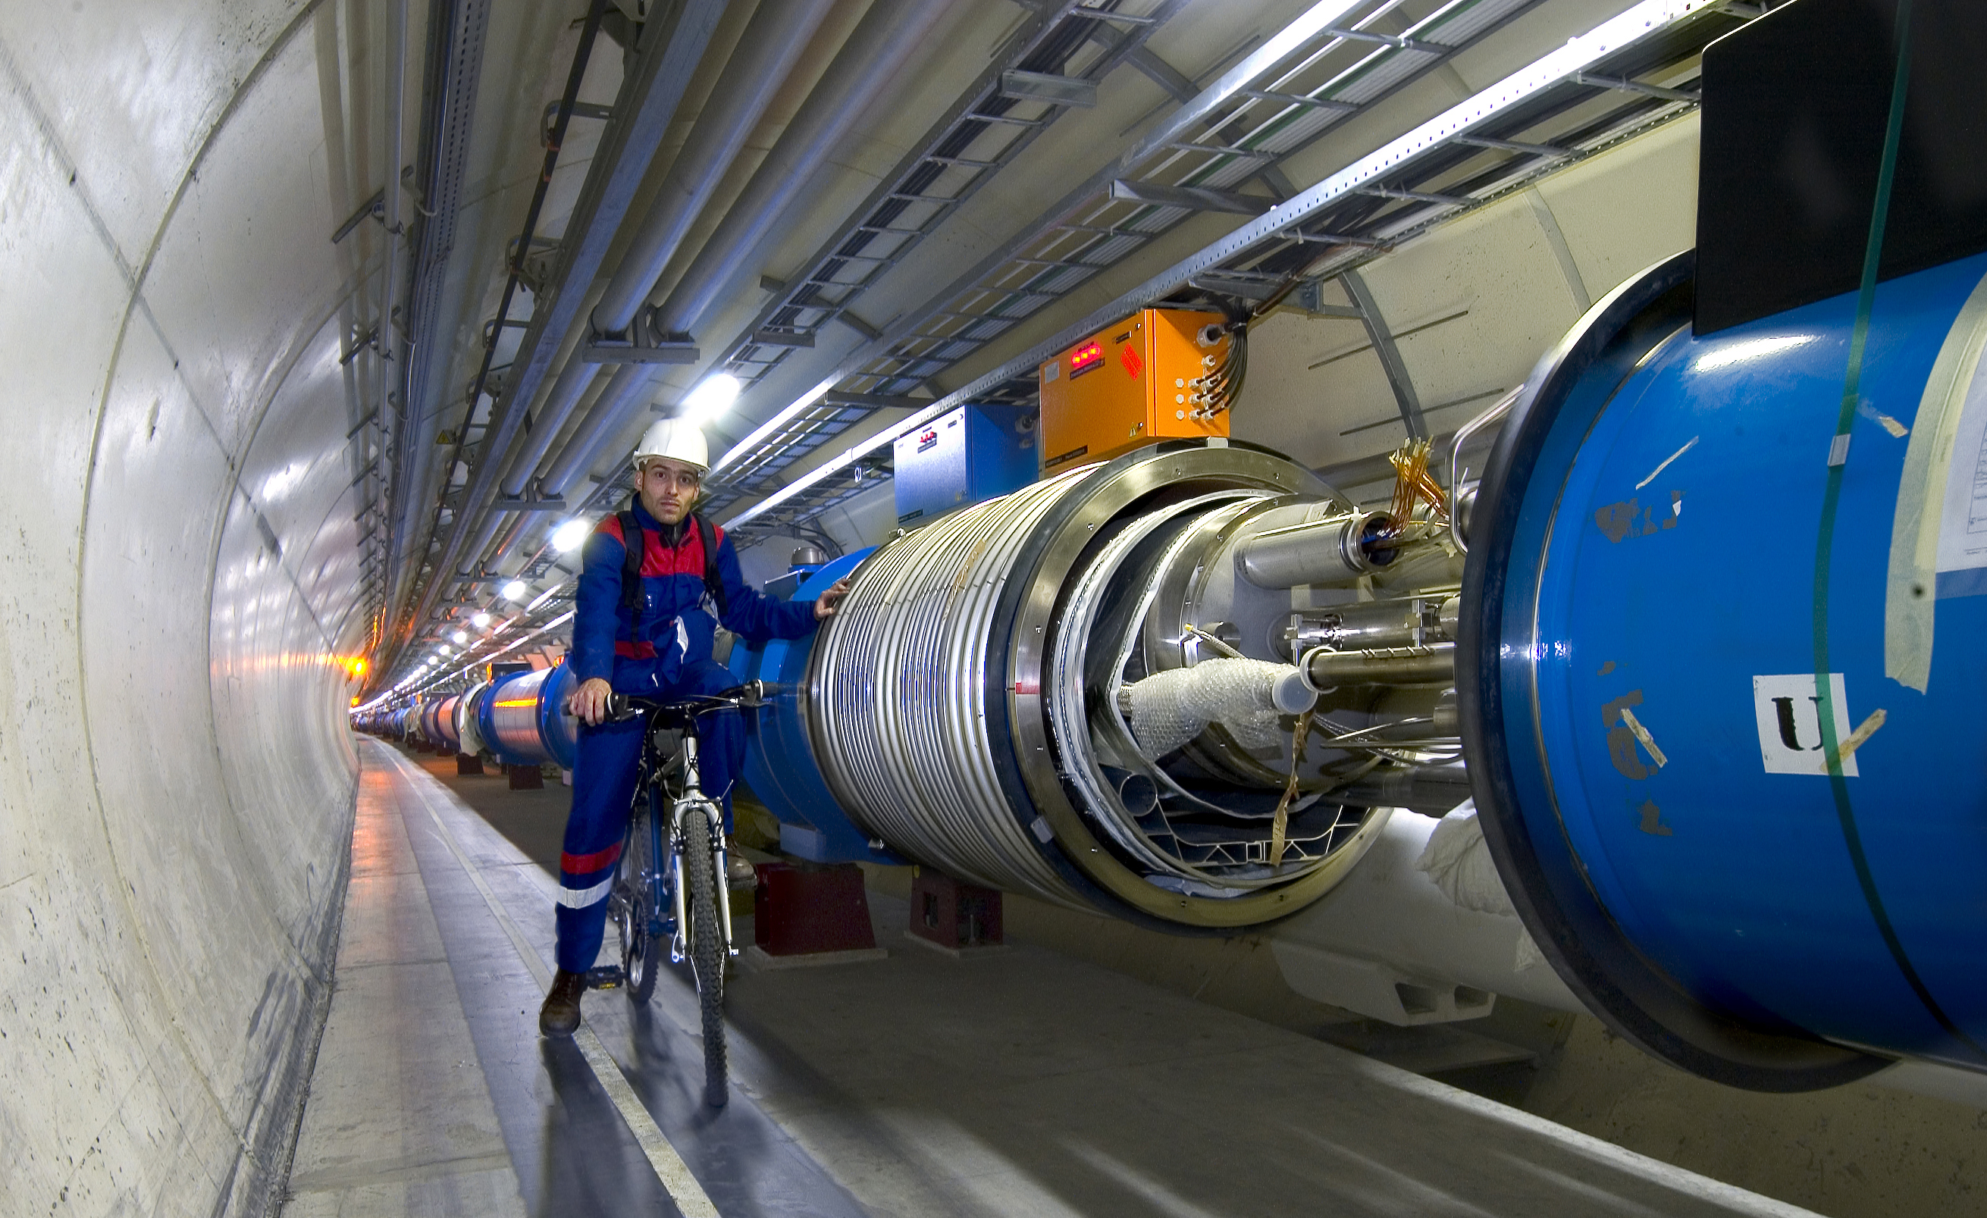
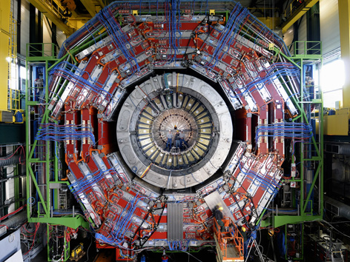

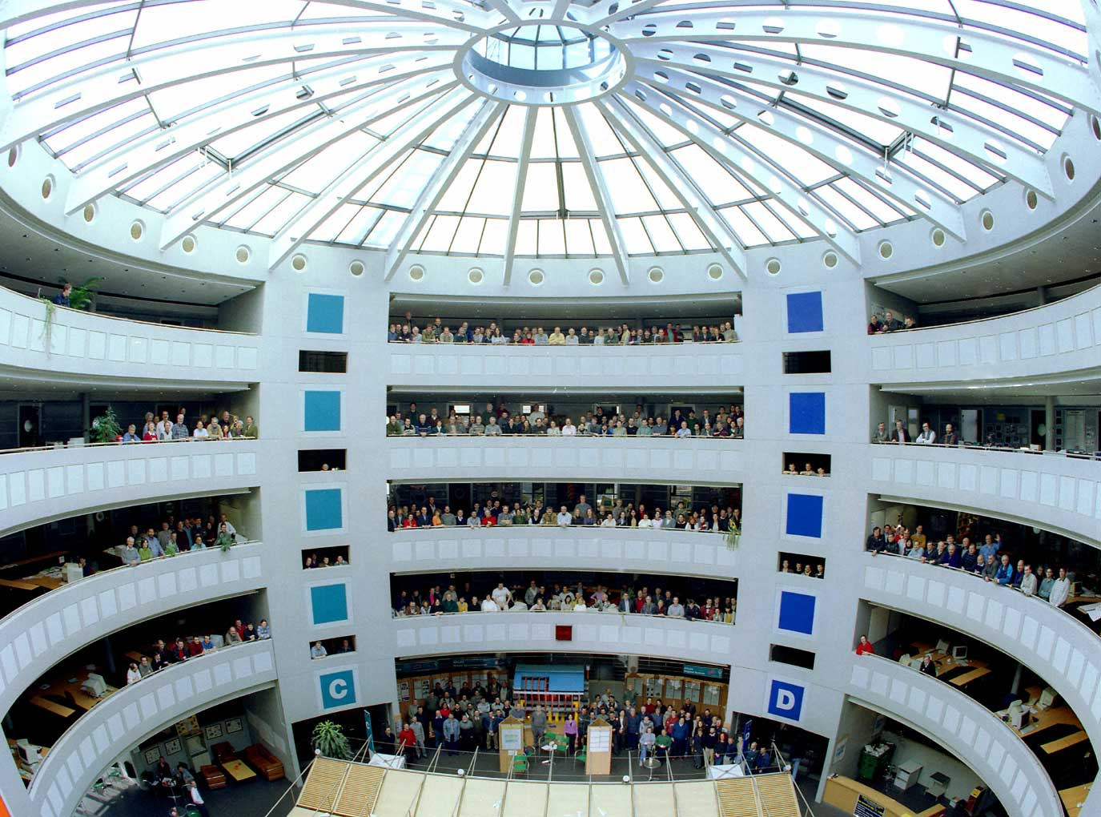
This Search Requires…….
1. Accelerators : powerful machines that accelerate particles to extremely high energies and bring them into collision with other particles
2. Detectors : gigantic instruments that record the resulting particles as they “stream” out from the point of collision.
3. Computing : to collect, store, distribute and analyse the vast amount of data produced by these detectors
4. Collaborative Science on Worldwide scale : thousands of scientists, engineers, technicians and support staff to design, build and operate these complex “machines”.

Slide 12
The Large Hadron Collider…

Slide 13
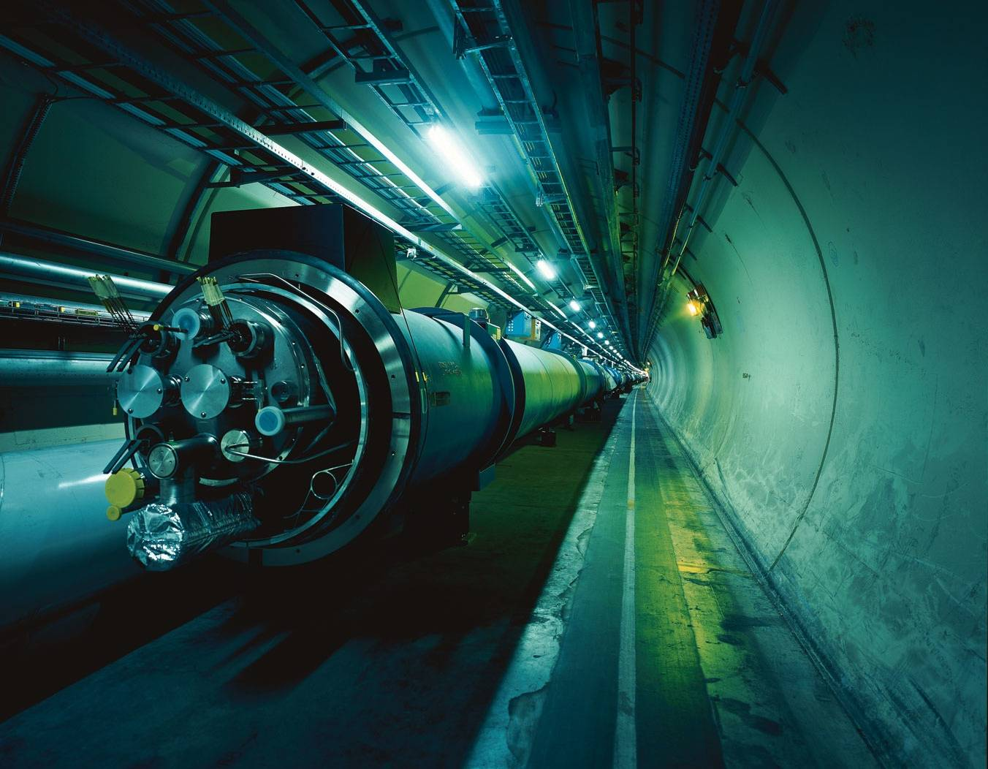

The Large Hadron Collider = a proton proton collider
Can also collide AA
7 TeV + 7 TeV
(3.5/4 TeV + 3.5/4 TeV)
1 TeV = 1 Tera electron volt
= 10¹² electron volt
Primary physics targets
• Origin of mass
• Nature of Dark Matter
• Understanding space time
• Matter versus antimatter
• Primordial plasma
The LHC produced collisions from 2010 till beginning of 2013
LHC restarted in 2015 with collisions at an energy of 13 TeV
Notes:
.999999991 % speed of light
At near light-speed, a proton in a beam will make 11 245 turns per second. A beam might circulate for 10 hours, traveling more than 10 billion kilometers – far enough to get to the planet Neptune and back again.

Slide 14
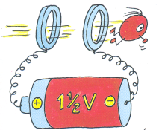
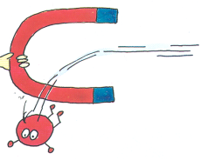
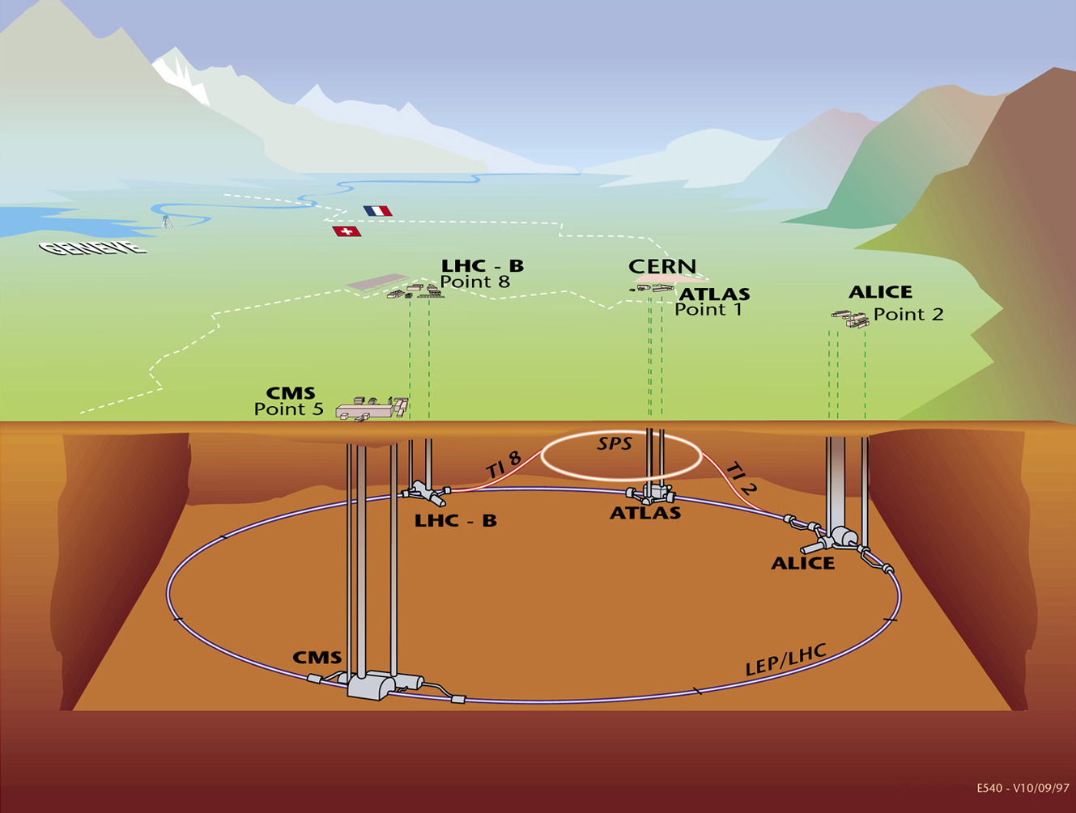
The LHC Machine and Experiments
LHC is 100m underground
LHC is 27 km long
Magnet Temperature is 1.9 Kelvin = -271 Celsius
LHC has ~ 9000 magnets
LHC: 40 million proton-proton collisions per second
LHC: Luminosity 10-100 fb⁻¹/year (after start-up phase)
moedal
LHCf
totem
•High Energy ⇒ factor 7 increase w.r.t. past accelerators
•High Luminosity (# events/cross section/time) ⇒ factor 100 increase

Slide 15
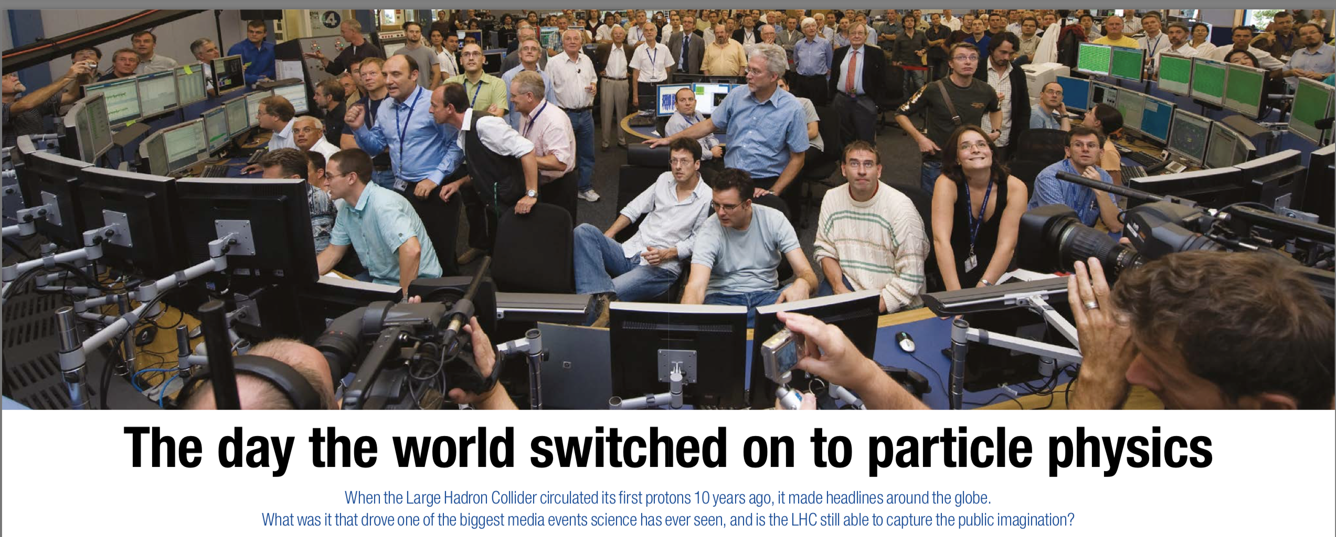
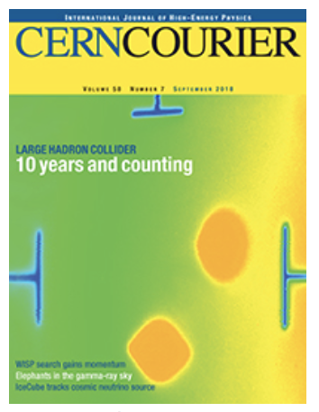
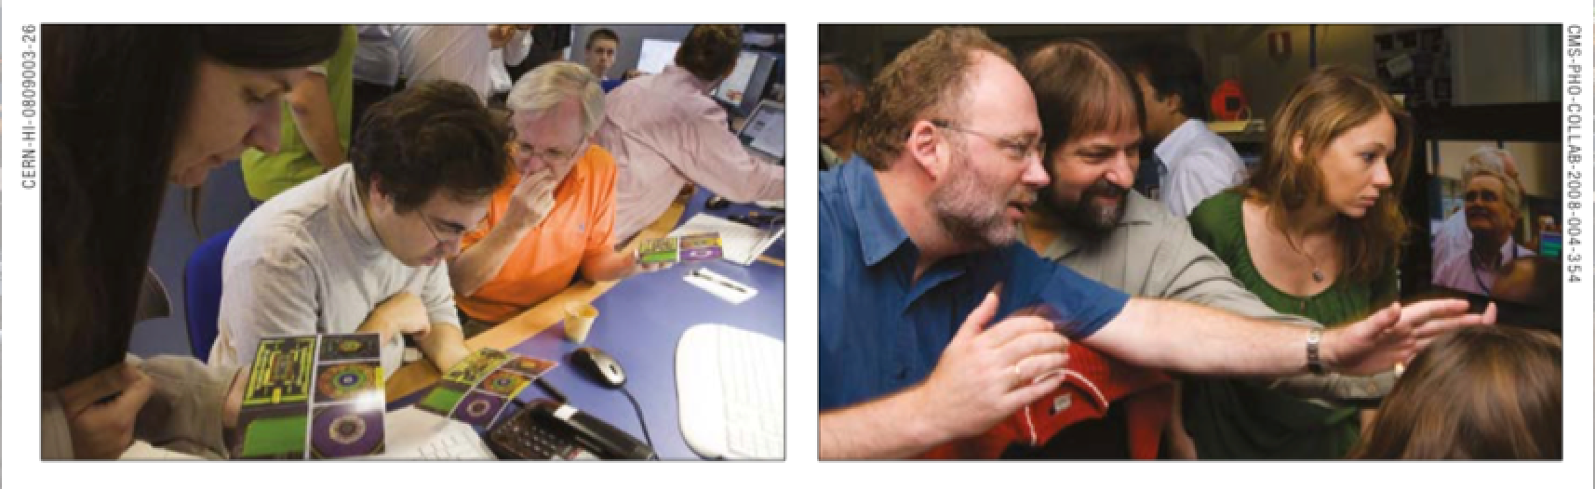
It Started (first attempt) in September 2008!
Cern Courier September 2018
…but a problem after 9 days damaged the machine ☹

Slide 16
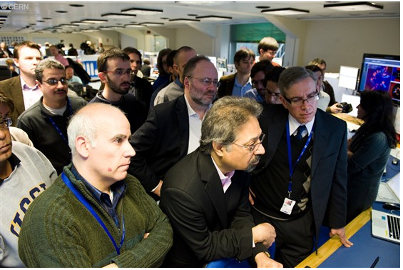
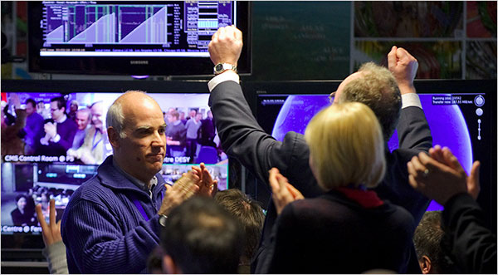
LHC Highlights
LHC switched on at 7 TeV in March 2010
->The highest energy in the lab!
LHC @ 13 TeV from 2015 onwards
Most important highlight so far:
The discovery of a Higgs boson
Many results on Standard Model process measurements, top-physics, b-physics, heavy ion physics, searches, Higgs physics
Waiting for the next discovery… -> Searching beyond the Standard Model
March 30 2010 …waiting..
…since 4:00 am
12:58 7 TeV collisions!!!

Slide 17
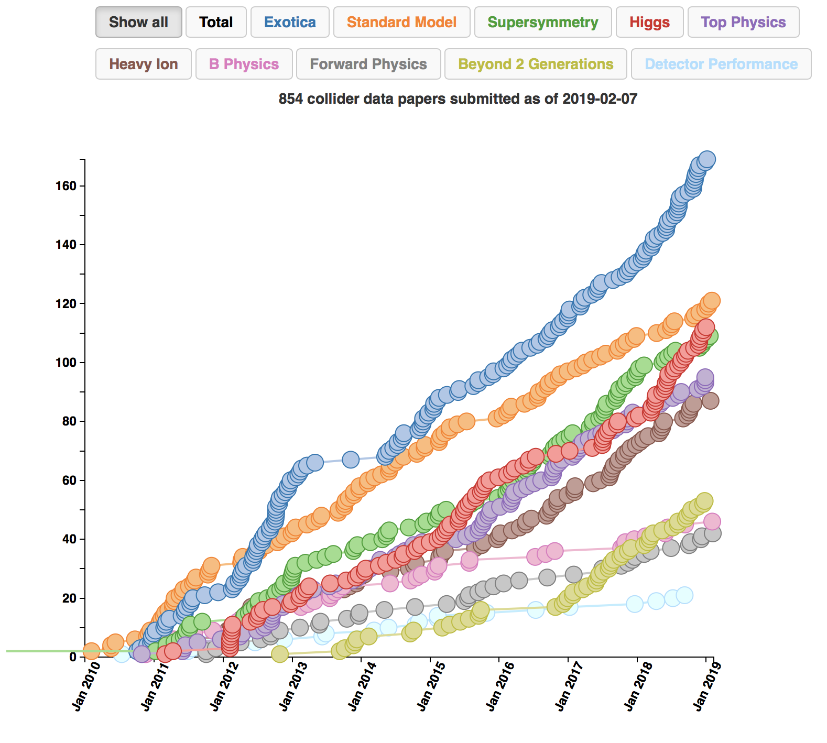
LHC Publications: Example CMS
> 850 publications on
pp (and pPb/PbPb)
physics since 1/2010
About 100 papers on
Higgs studies!!
Paper 16 was the
discovery paper!
http://cms-results.web.cern.ch/cms-results/public-results/publications-vs-time/
>9000 citations

Slide 18
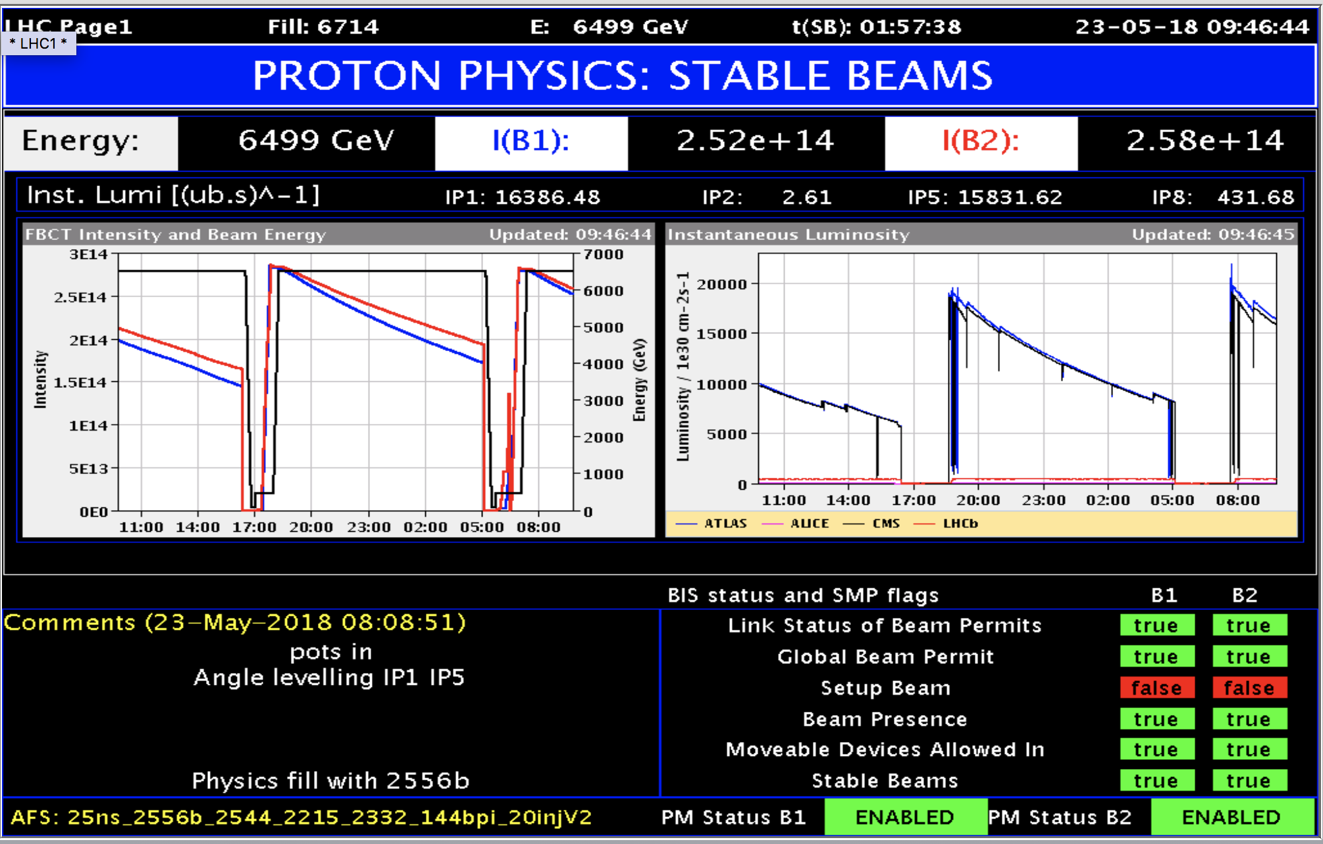
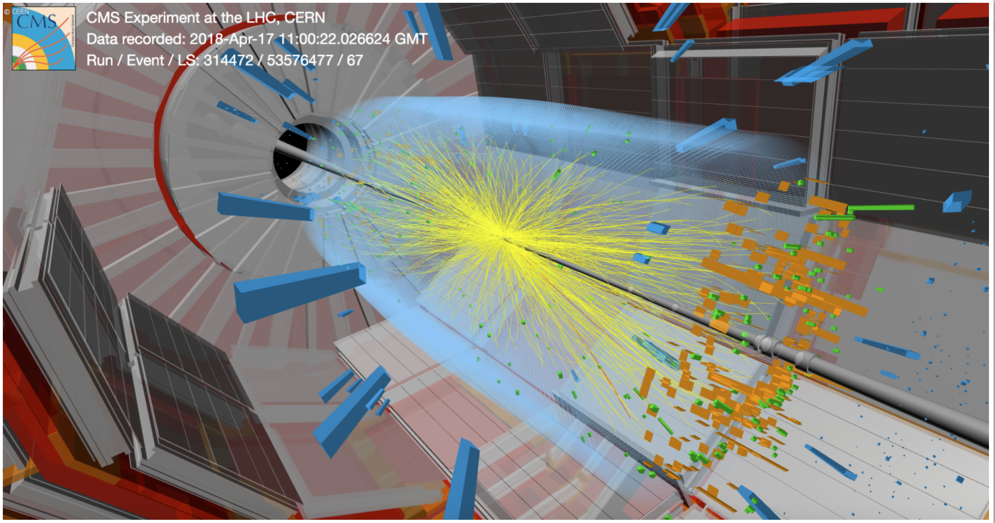
Example: LHC Operation 2018:

Slide 19
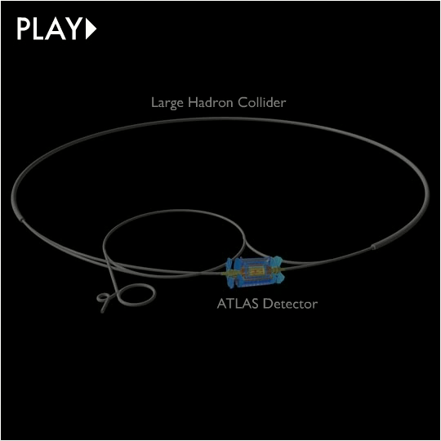

Slide 20
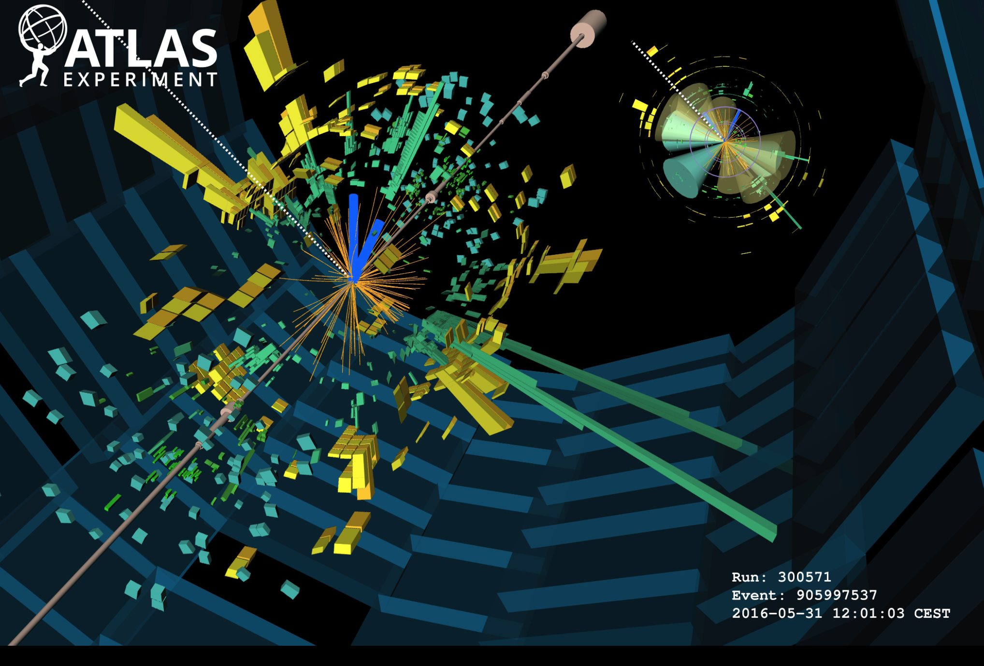
Collision in the ATLAS Detector

Slide 21
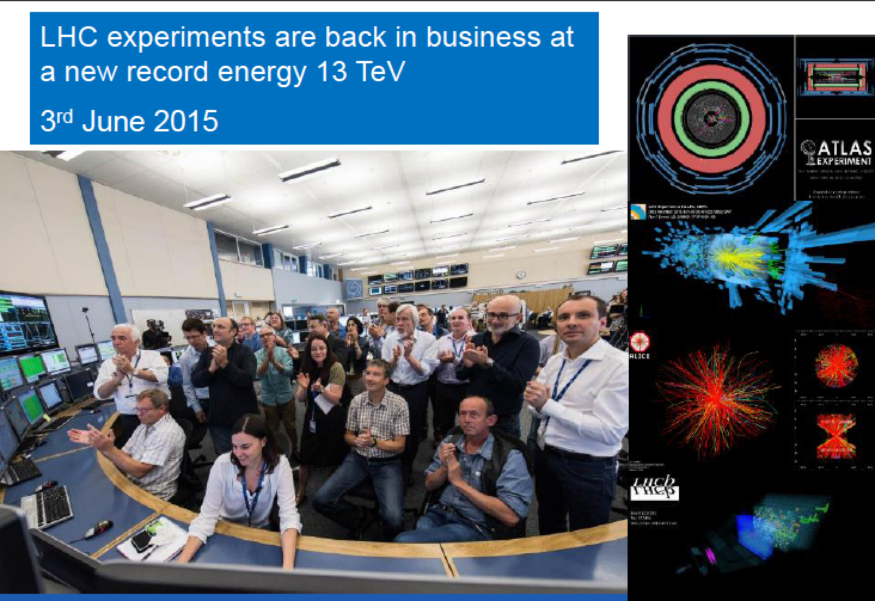
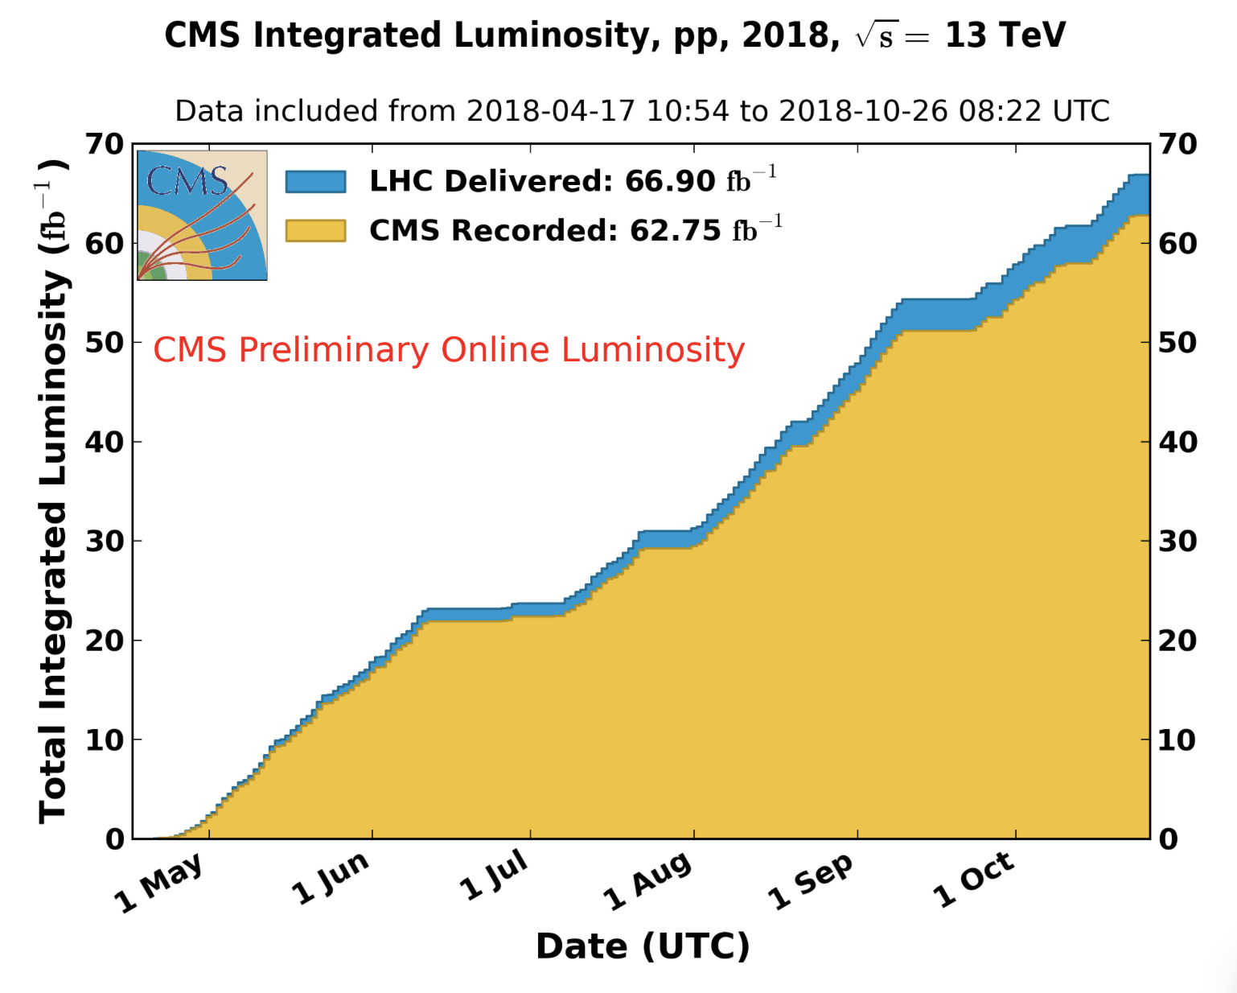
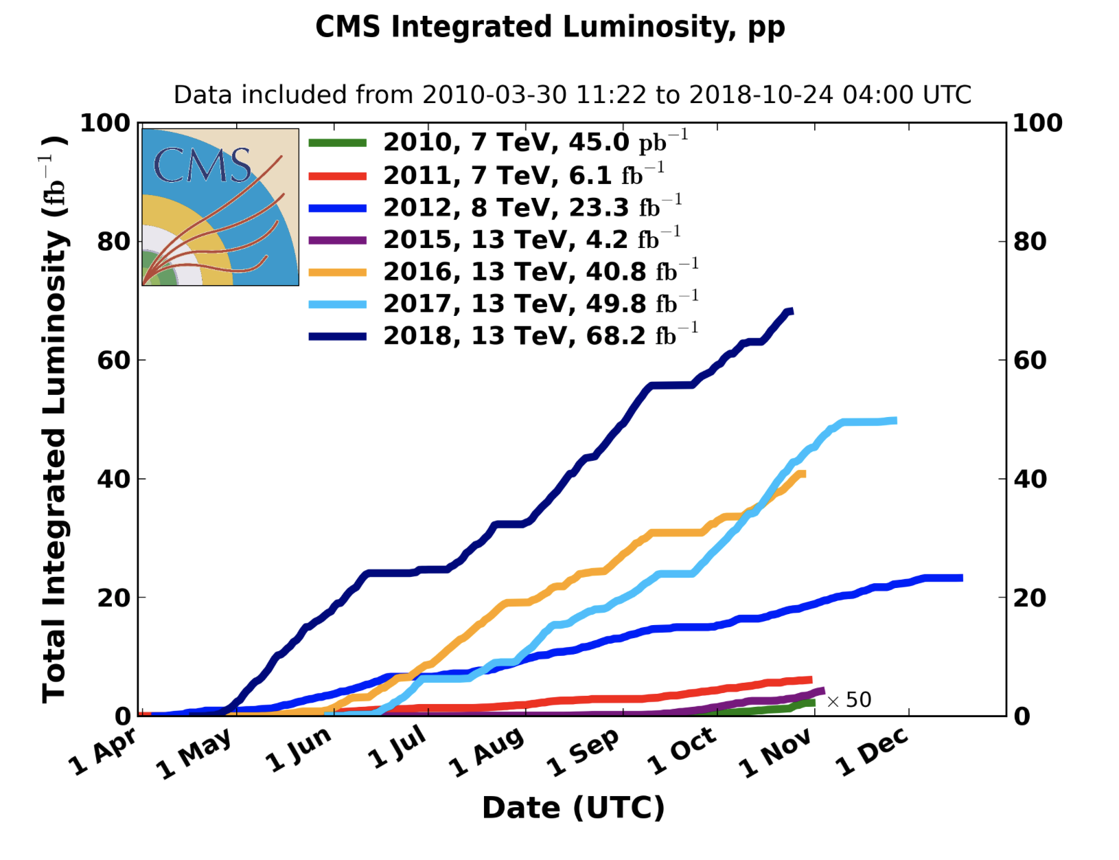
Run-2 starts
proton-proton Run-2 finished 24/10 6:00am
2018
•2010-2012: Run-1 at 7/8 TeV CM energy
•Collected ~ 27 fb⁻¹
•2015-2018: Run-2 at 13 TeV CM Energy
•Collected ~ 150 fb⁻¹

Slide 22
Data and Theories
By 2012..!
M. Schmalz
Before LHC
With LHC
March 2010

Slide 23
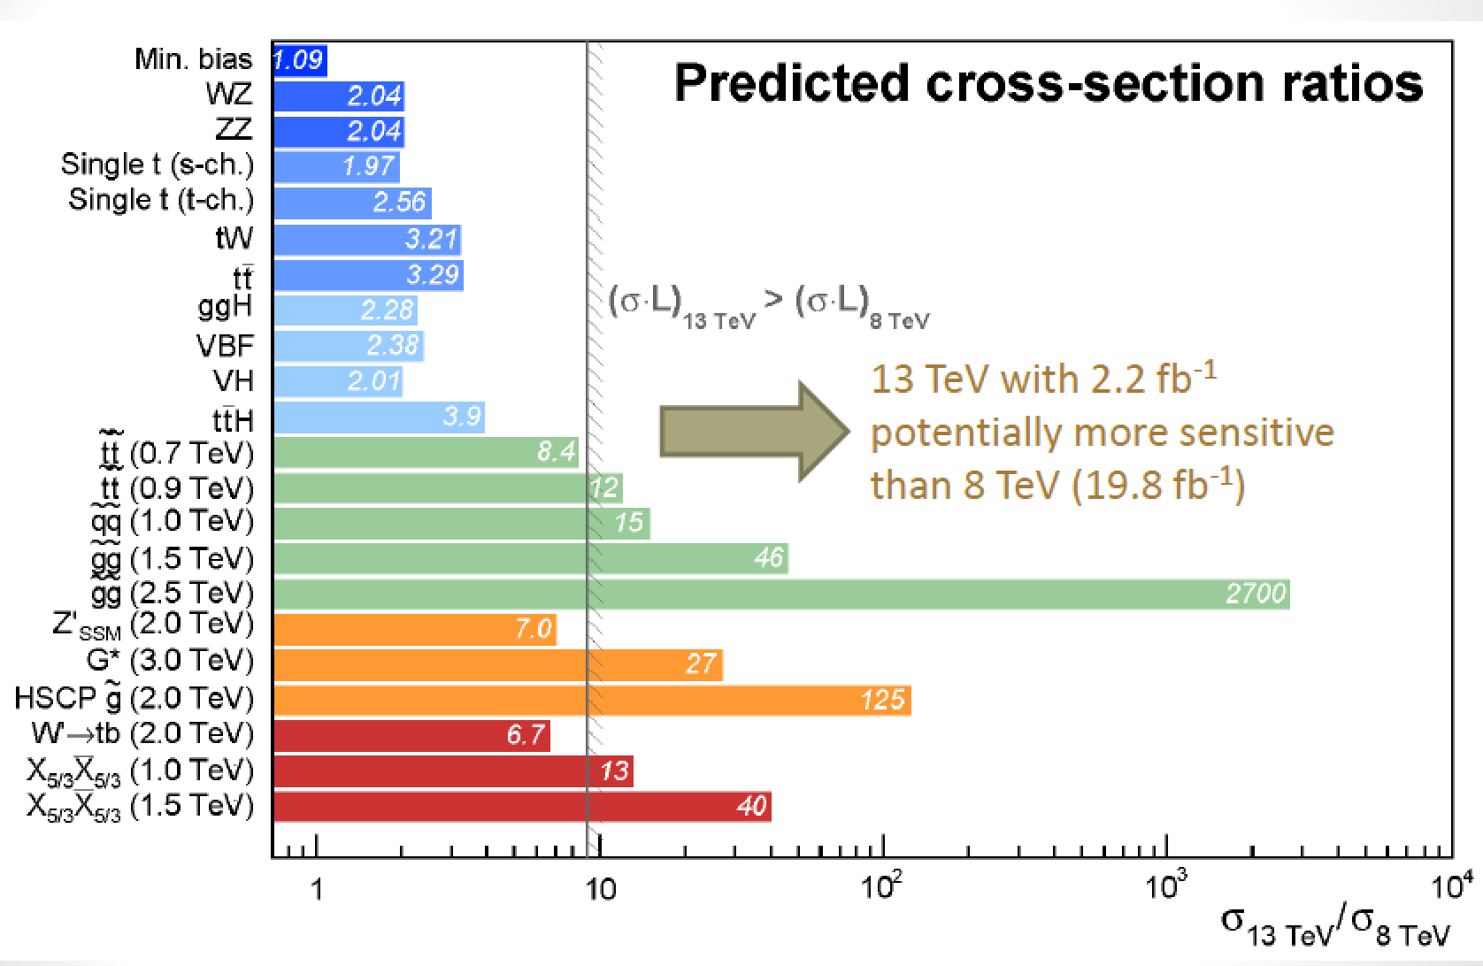
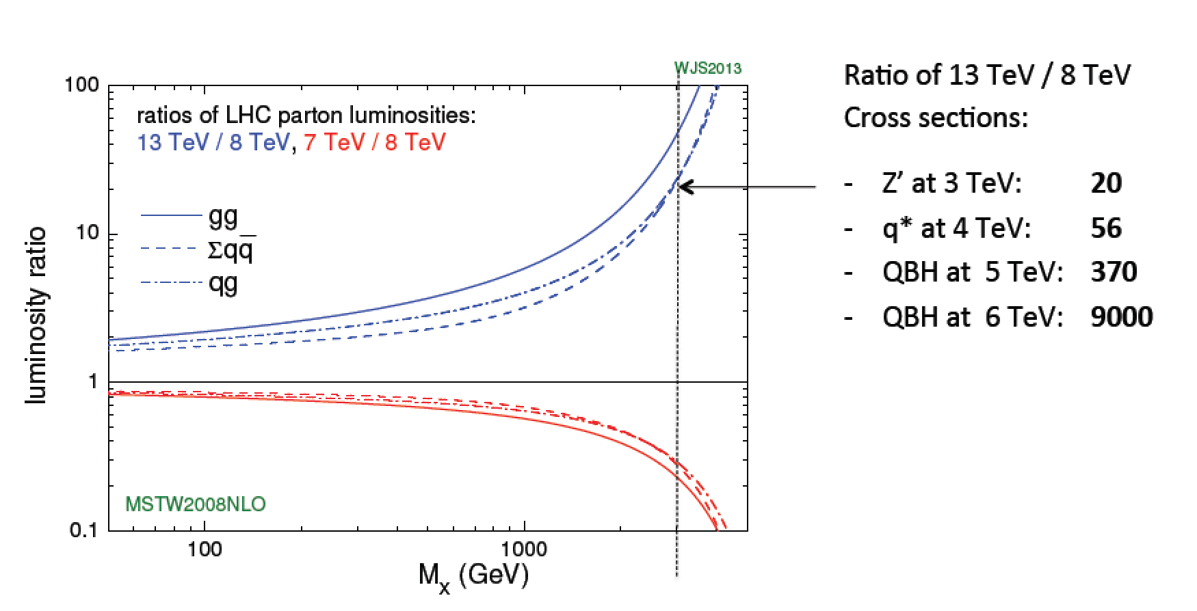
Run-II: From 8 TeV to 13 TeV

Slide 24








Experiments at the LHC

Slide 25
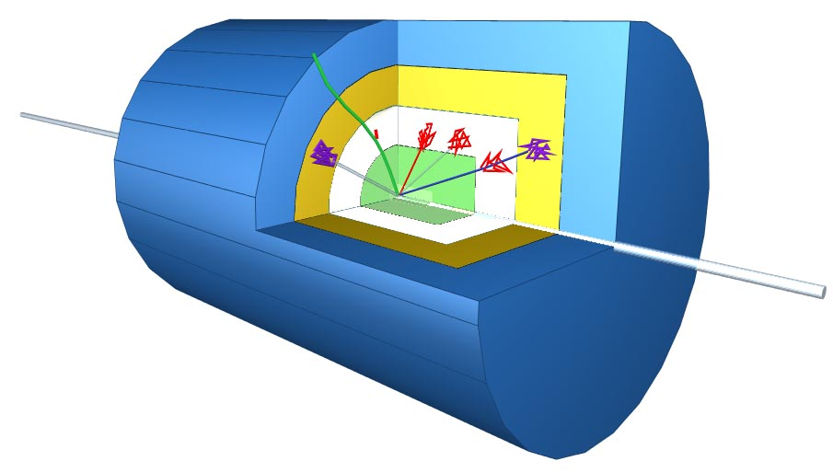
Schematic of a LHC Detector
Physics requirements drive the design!
Analogy with a cylindrical onion:
Technologically advanced detectors comprising many layers, each designed to perform a specific task.
Together these layers allow us to identify and precisely measure the energies and directions of all the particles produced in collisions.
Such an experiment
has ~ 100 Million
read-out channels!!

Slide 26

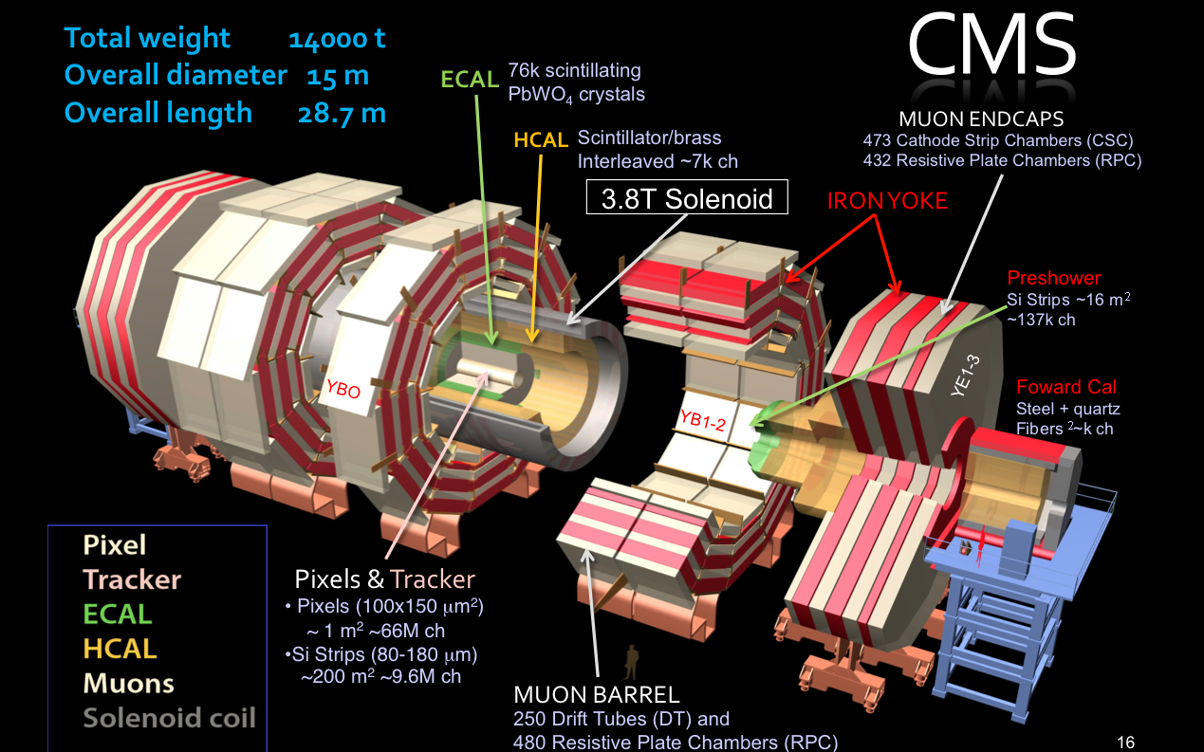
The Higgs Hunters @ the LHC
The ATLAS experiment
The CMS experiment
These experiments use different
technologies for their detector
components

Slide 27
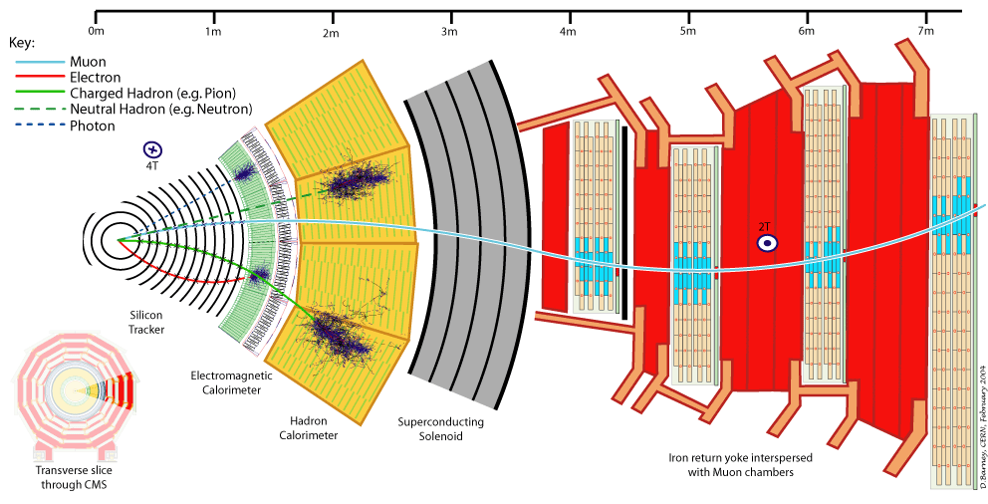
Particles in Detectors
Electromagnetic Calorimeter
Muon Spectrometer
Hadron Calorimeter
Inner Tracker
Magnet
Return flux
26
Notes:
26

Slide 28
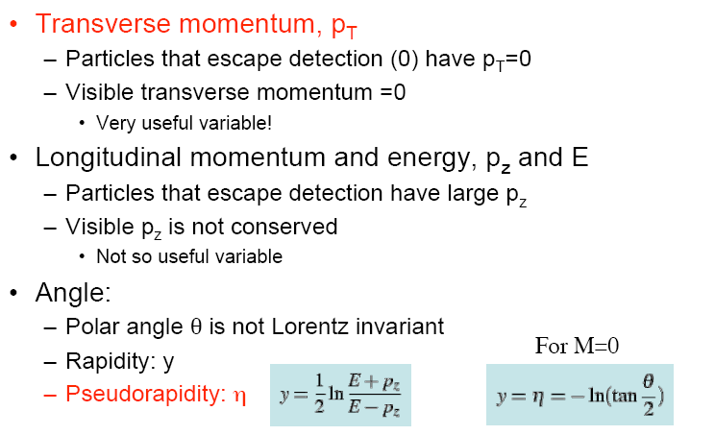
Kinematic Variables for pp Scattering
and E_{T}=E sinθ
p
p_{T}
θ
• Missing E_{T} and P_{T:} : Vectorial sum of all transverse momenta

Slide 29


Slide 30
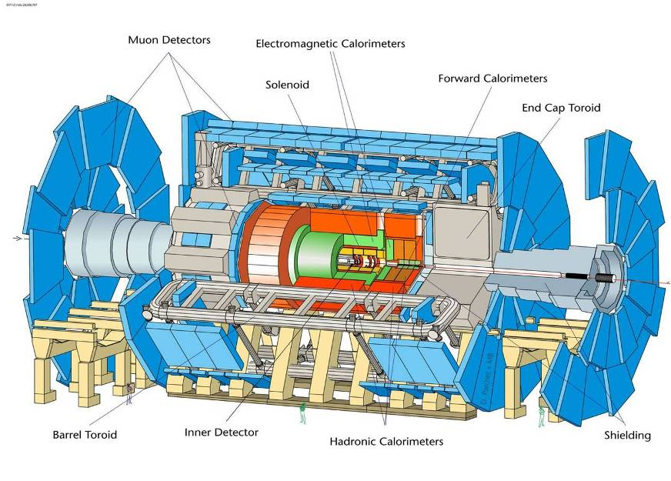
Length = 55 m; Width = 32 m; Height = 35 m; but spatial precision ~ 100 μm

Slide 31
CMS Detector Design Priorities
Expression of Intent (EOI): Evian 1992
1. A robust and redundant Muon system
2. The best possible e/γ calorimeter consistent with 1.
3. A highly efficient Tracking system consistent with 1. and 2.
4. A hermetic calorimeter system.
5. A financially affordable detector.

Slide 32
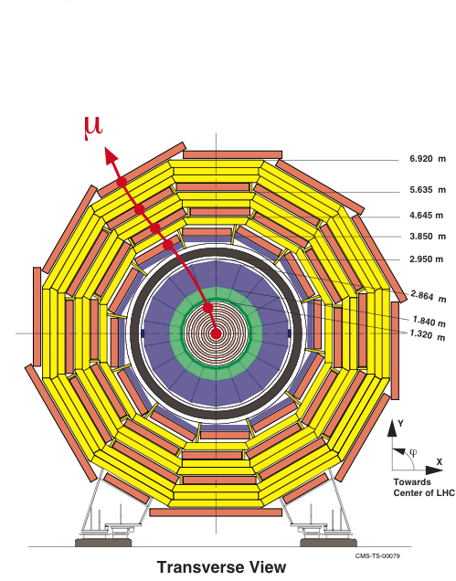
Compact Muon Solenoid (CMS)
Letter of Intent (LOI): LHCC, TDR in 1994
Strong Field 4T
Compact design
Solenoid for Muon P_{T} trigger in transverse plane
Redundancy: 4 muon stations with 32 R-phi measurements
ΔP_{t}/P_{t} ~ 5% @1TeV for reasonable space resolution of muon chambers (200μm)

Slide 33
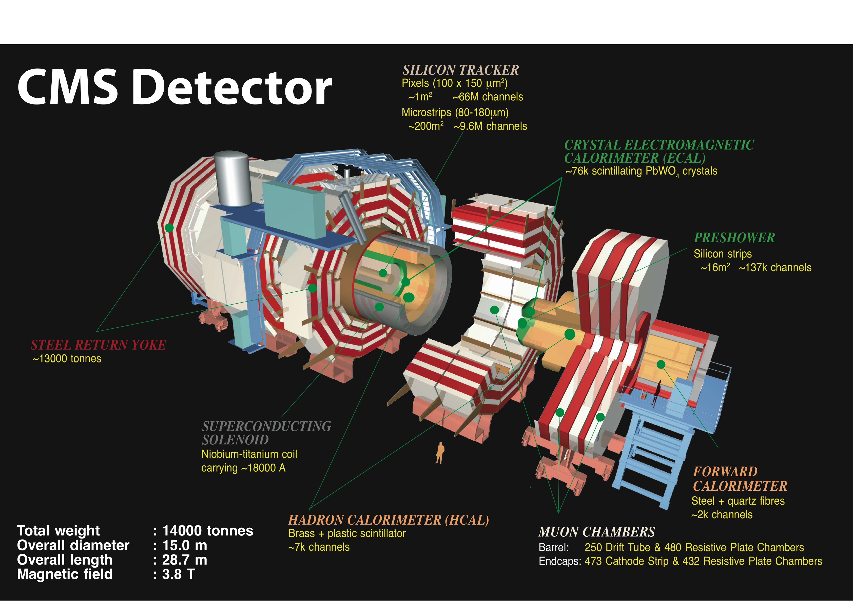
Compact Muon Solenoid
Total weight:
14000 tons
Overall diameter:
15 m
Overall length:
28.7m

Slide 34
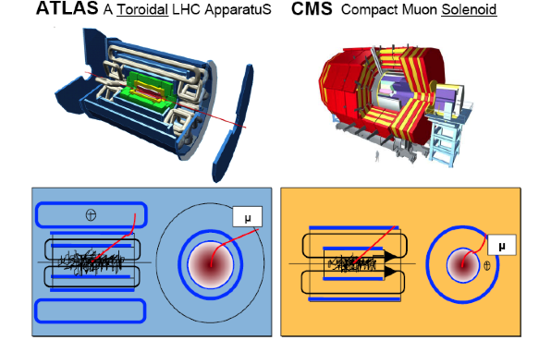
General Purpose Detectors at LHC
In total about
~100 000 000 electronic channels
Each channel checked
40 000 000 times per second (collision rate is 40 MHz)
Amount of data of just one collisions
~1 000 000 Bytes
Trigger (online event selection)
Reduce 40 MHz collision rate to ~1 kHz data recording rate
Readout to disk
O(1000) collisions/sec ⇒ petaBytes of data/year

Slide 35
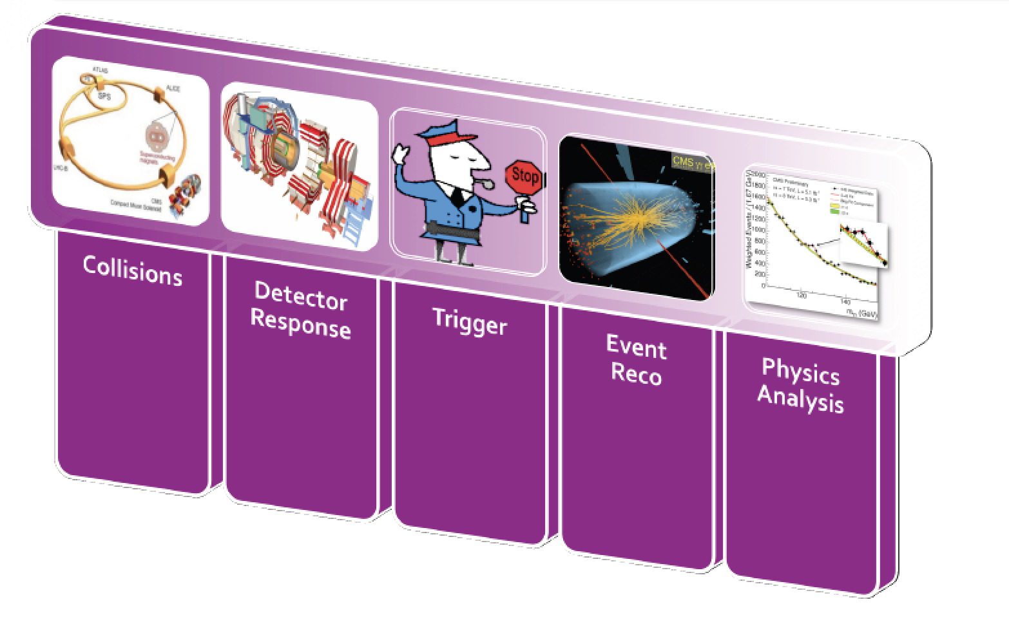
From Collisions to Papers…

Slide 36
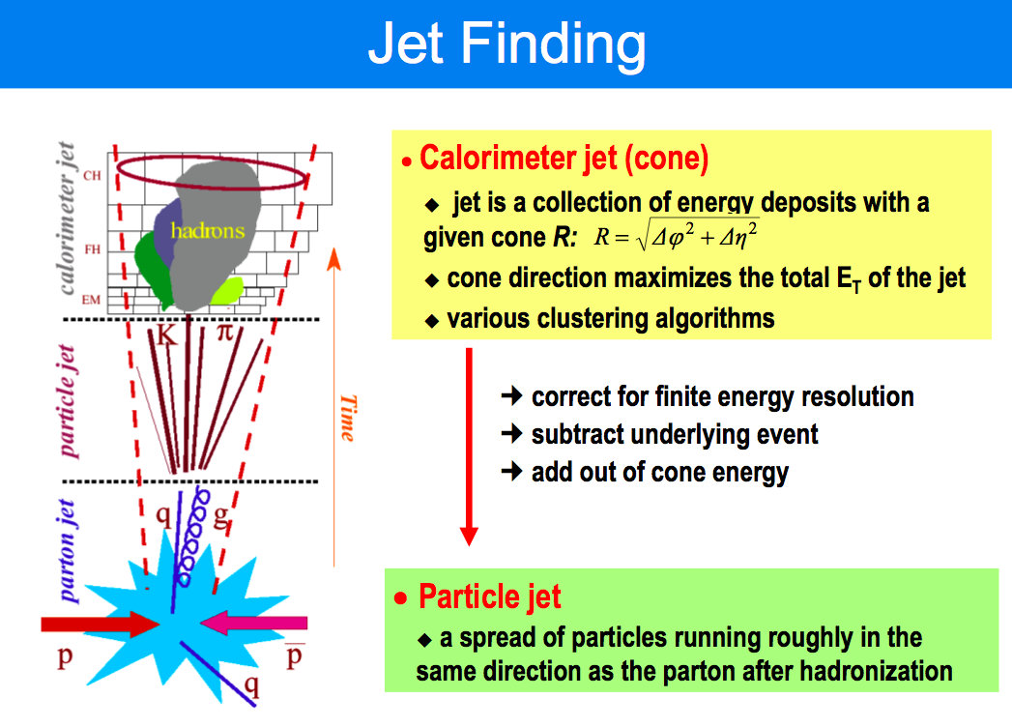

Slide 37
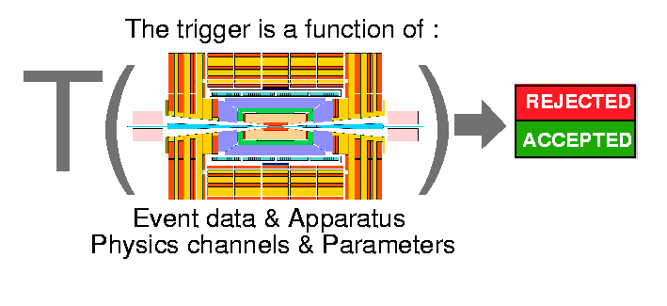
Event Filtering: the Trigger System
Bunch crossing rate is 40 MHz Event size ~1 Mbyte
2007 technology (and budget) allows only to write a ~1 kHz
of events to tape
need a factor ~10⁵ online filtering!!
lost forever!!
written to disk for
offline analysis
The event trigger is one of the biggest challenges at the LHC
⇒ Based on hard scattering signatures: jets, leptons, photons,
missing E_{T},…

Slide 38

The LHC Data Challenges
Experiments were anticipated to produce about 15 Million Gigabytes of data each year (~20 million CDs!)
The total volume in eg ATLAS is 5 billion detector events and several billion Monte Carlo events amounting to 100 Million Gigabytes of data in 3 years
LHC data analysis requires a computing power equivalent to ~100,000 of today's fastest PC processors
=> Requires many cooperating computer centres, as CERN can only provide ~20% of the capacity
GRID Computing
Notes:
37

Slide 39

ATLAS & CMS Experiments in 2018/17

Slide 40





Detector Performance @ 13 TeV
Some examples from the Run-2 data
CMS and ATLAS continue to
have an excellent performance

Slide 41

Global Event Reconstruction
Using all information of the detector together for optimal measurement
Adapted in CMS

Slide 42


B-quark Tagging
Generally: look for jets with displaced vertices (or leptons) from B-meson decays
New: Deep Learning NNs..

Slide 43

Tau-finding
Hadronic tau decays are narrow low multiplicity ‘jets’
All di-tau final states used in Higgs search

Slide 44

The New Wave: Machine Learning
M. Pierini et al.

Slide 45

The New Wave: Machine Learning

Slide 46

The New Wave: Machine Learning

Slide 47

The New Wave: Machine Learning

Slide 48


The New Wave: Machine Learning
Example:
Boosted jets
Heavy flavor tagging

Slide 49

The New Wave: Machine Learning

Slide 50

The New Wave: Machine Learning
Gated
Recurrent
Unit

Slide 51

The New Wave: Machine Learning

Slide 52

The New Wave: Machine Learning

Slide 53

The New Wave: Machine Learning

Slide 54

The New Wave: Machine Learning
GAN: Generative Adversarial Network

Slide 55
Other Experiments at the LHC

Slide 56



LHCb: Bottom and Charm Physics

Slide 57


ALICE: Heavy Ion Physics at the LHC

Slide 58





A Few Smaller Experiments: TOTEM & LHCf
TOTEM: measuring the total, elastic and
diffractive cross sections
Add Roman pots (and inelastic telescope)
to CMS interaction regions (200 m from IP)
Common runs with CMS planned
TOTal and Elastic cross
section Measurement
LHCf: measurement of
photons and neutral pions
in the very forward region
of LHC
Add a EM calorimeter at
140 m from the Interaction
Point (of ATLAS)
Connection with
cosmic rays

Slide 59






MoEDAL: Monopole and Exotics Detector at the LHC
Heavy particles which carry “magnetic charge”
Could eg explain why particles have “integer
electric charge”
Monopole production
Remove the sheets after some
running time and inspect for ‘holes’

Slide 60



The LHC Detectors are Major Challenges
• CMS/ATLAS detectors have about 100 million read-out channels
• Collisions in the detectors happen every 25 nanoseconds
• ATLAS uses over 3000 km of cables in the experiment
• The data volume recorded at the front-end in CMS is 1 TB/second
which is equivalent to the world wide communication network traffic
• Data recorded during the 10-20 years of LHC life will be about all the
words spoken by mankind since its appearance on earth
• A worry for the detectors: the kinetic energy of the beam is that of
a small aircraft carrier of 10⁴ tons going 20 miles/ hour
>200 m² of silicon
ATLAS pixel detector
CMS silicon tracker

Slide 61
A Proton-Proton Collider…

Slide 62





pp-Collisions : Complications
Protons have structure
Parton
distributions
Underlying event
Pile-up: approximate 40 collisions per
bunch crossing in 2017 (more in future)
Z→ μμ event with ~20 reconstructed vertices (2012)

Slide 63




Proton-proton collisions and PDFs
Parton Distribution Functions: the probability of finding
a parton with momentum fraction x in the proton
Structure function
measurements eg
from HERA
Simple spread of existing PDFs gives
up to 10% uncertainty on Higgs cross
section. Possible gain ~ factor of 2
with final HERA data (PDF4LHC)
Using also input from LHC data in new fits
Now also LHC pp
data used to
constrain PDFs

Slide 64

Proton-Proton Collisions

Slide 65
Proton-proton Collisions
Most interactions due to collisions at large distance between incoming
protons where protons interact as “ a whole ”
→ small momentum transfer (Δp ≈  /Δx )
particles in final state have large longitudinal momentum but small
transverse momentum (scattering at large angle is small)
< p_{T} > ≈ 500 MeV of charged particles in final state
Most energy escapes down the beam pipe.
These are called soft events…
A minimum bias data event sample is dominated by soft events

Slide 66

Cross sections at the LHC
“Well known” processes, don’t need to keep all of them …
New Physics!!
This we want to keep!!

Slide 67
Summary: Challenges@ LHC
High event rate and pile-up
  High granularity: typically 10x more channels compared to detectors before the LHC
Timing/synchronization of 10⁸ channels is non trivial
Event size (> 1 Mbyte)/Computing
  Limit event rate to a few 100 Hz, use the Grid
Trigger reduce event rate from 40MHz to a few 100 Hz
  Multi-layered trigger system and pipelined electronics
Detectors need excellent hermeticity (missing E_{T}), lepton identification, B & Tau identification, jet measurements…
Detectors must be radiation hard and reliable for ~ 10-20 years…
We have these detectors: Let’s look at measurements in Lecture II

Slide 68

The New Wave: Machine Learning

Slide 69

The New Wave: Machine Learning

Slide 70

The New Wave: Machine Learning

Slide 71

The New Wave: Machine Learning

