Slide 1



Physics at the LHC
Standard Model Measurements
Albert De Roeck
CERN, Geneva, Switzerland
Antwerp University Belgium
UC-Davis California USA
NTU, Singapore
21st February 2019

Slide 2
Lecture Plan
Overview of the 3 lectures in the next days
Lecture 1: Introduction to Experimental Particle Physics: LHC as main example
Lecture 2: Measurements and test of the Standard Model, including the Higgs
Lecture 3: Searches beyond the Standard Model and a short Outlook to the future at the LHC

Slide 3
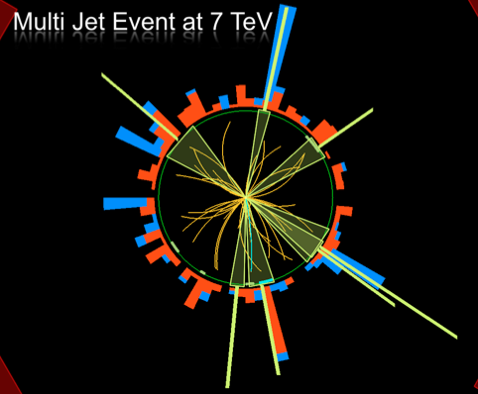
Outline Lecture II
Soft pp collisions and multi-
particle production
QCD hard scattering
Electroweak processes
Top production
The Higgs particle
Summary

Slide 4
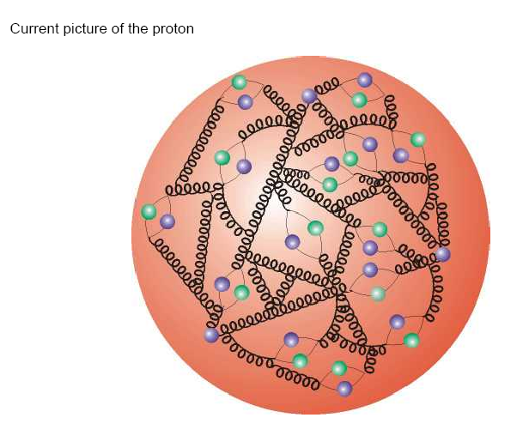
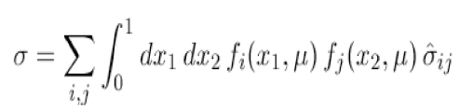
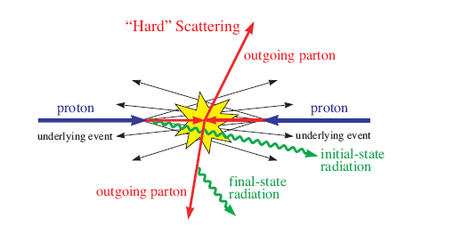
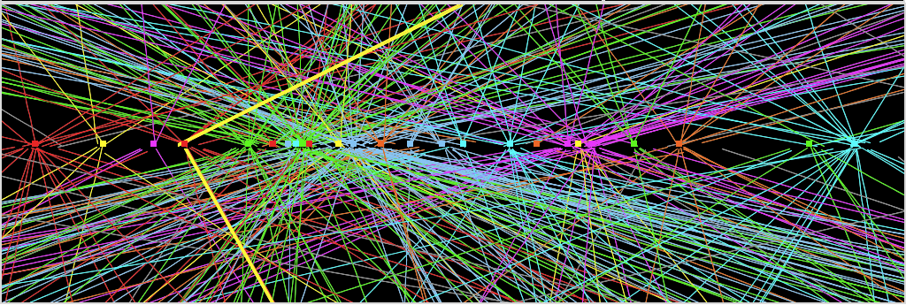
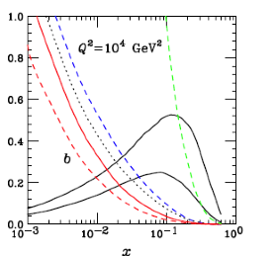
pp-Collisions : Complications
Protons have structure
Parton
distributions
Underlying event
Pile-up: approximate 40 collisions per
bunch crossing in 2018 (more in future)
Z→ μμ event with ~20 reconstructed vertices (2012)

Slide 5
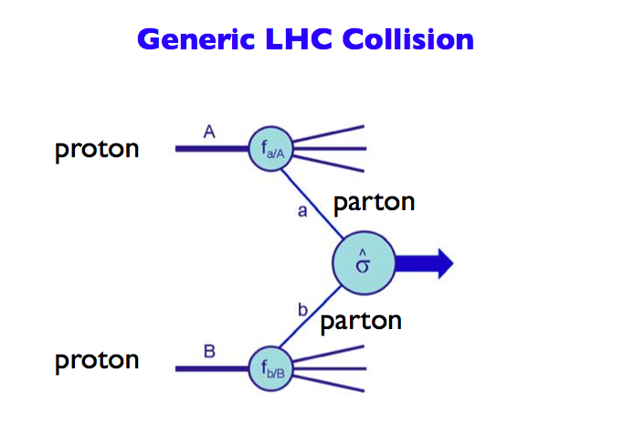
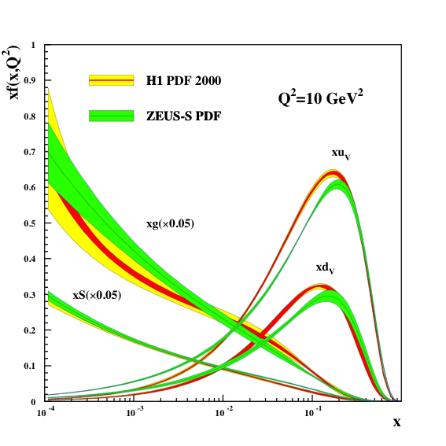
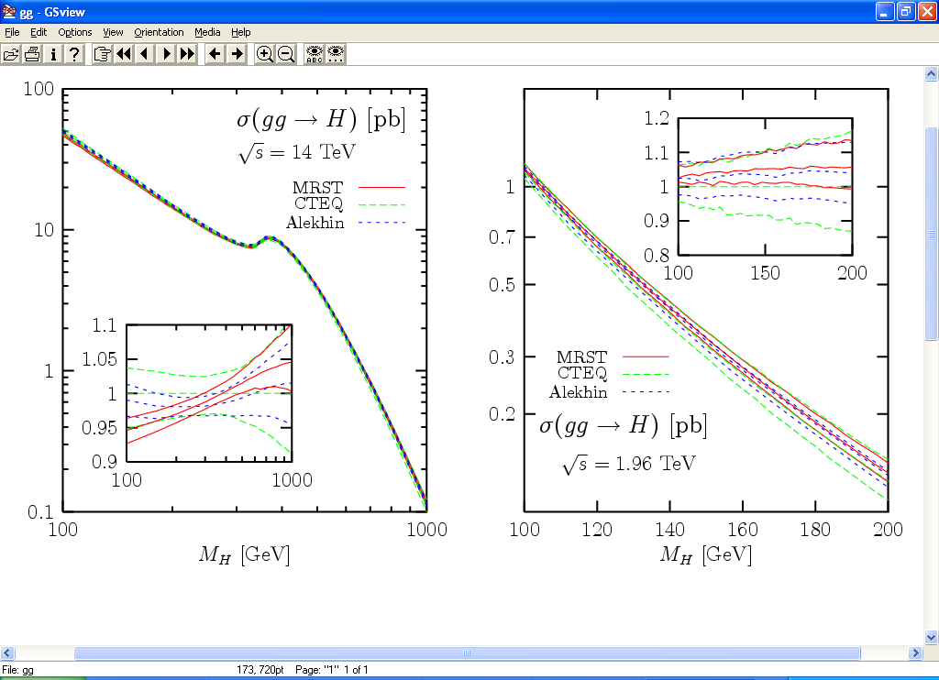
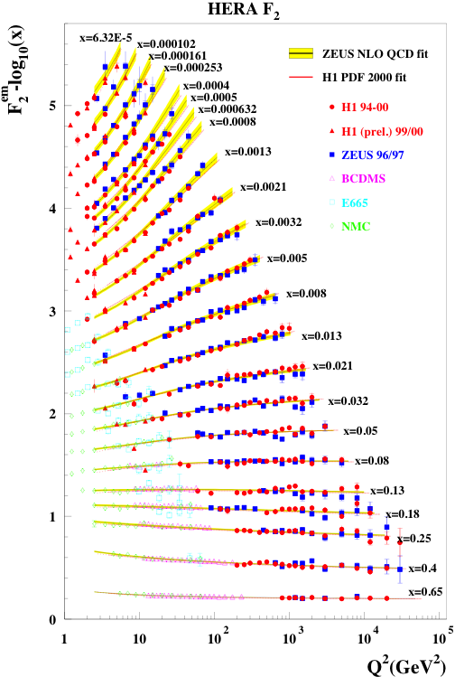
Proton-proton collisions and PDFs
Parton Distribution Functions: the probability of finding
a parton with momentum fraction x in the proton
Structure function
measurements eg
from HERA
Simple spread of existing PDFs gives
up to 10% uncertainty on Higgs cross
section. Possible gain ~ factor of 2
with final HERA data (PDF4LHC)
Using also input from LHC data in new fits
Now also LHC pp
data used to
constrain PDFs

Slide 6
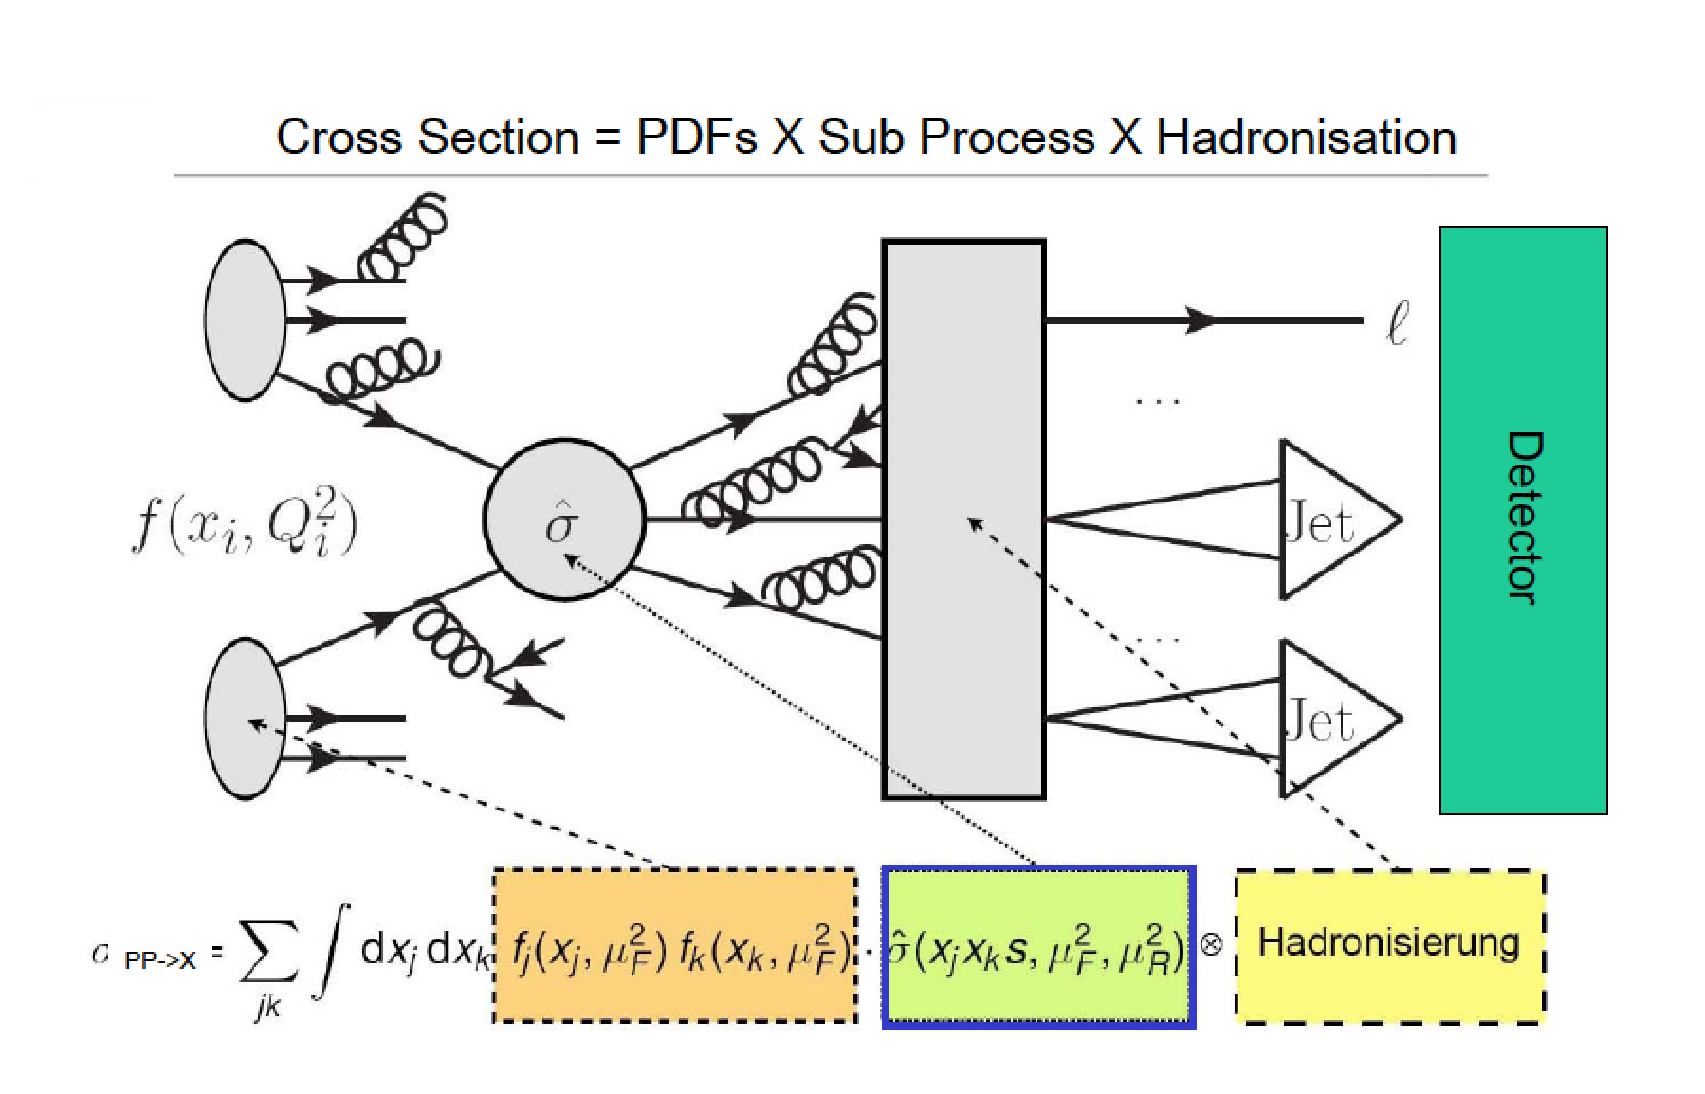
Proton-Proton Collisions

Slide 7
Proton-proton Collisions
Most interactions due to collisions at large distance between incoming
protons where protons interact as “ a whole ”
→ small momentum transfer (Δp ≈  /Δx )
particles in final state have large longitudinal momentum but small
transverse momentum (scattering at large angle is small)
< p_{T} > ≈ 500 MeV of charged particles in final state
Most energy escapes down the beam pipe.
These are called soft events…
A minimum bias data event sample is dominated by soft events

Slide 8
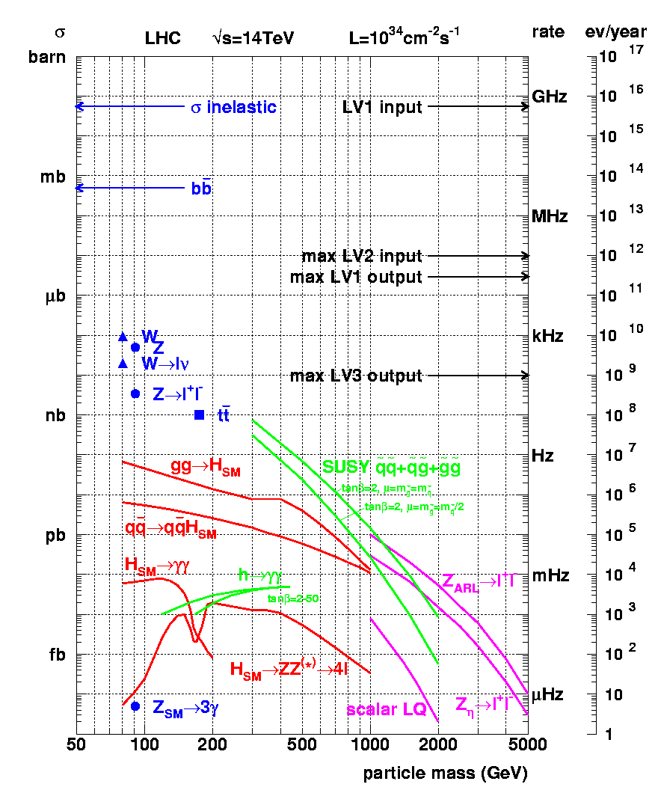
Cross sections at the LHC
“Well known” processes, don’t need to keep all of them …
New Physics!!
This we want to keep!!

Slide 9
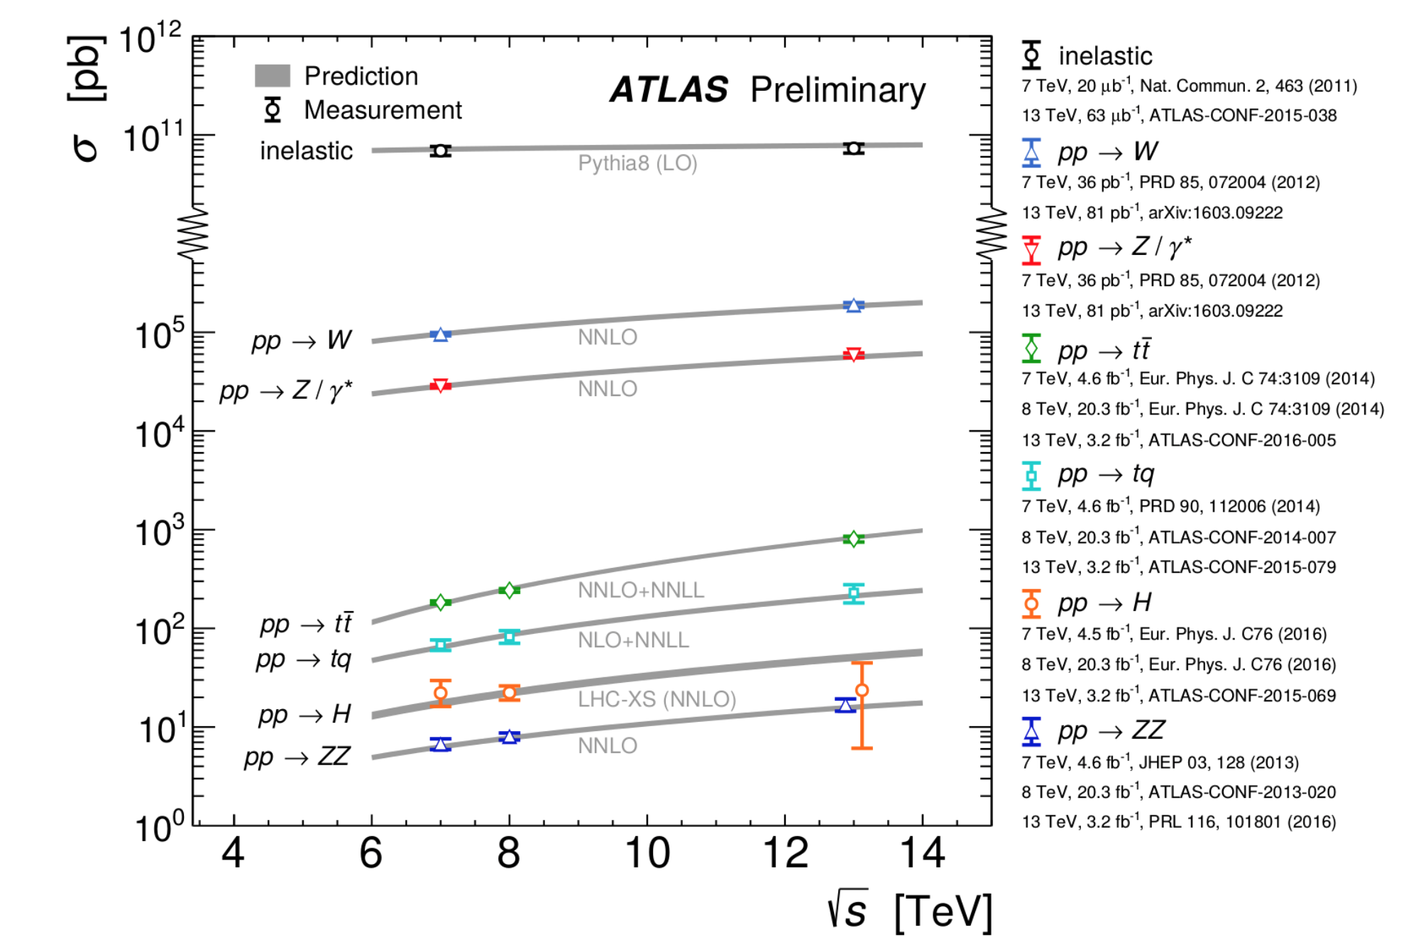
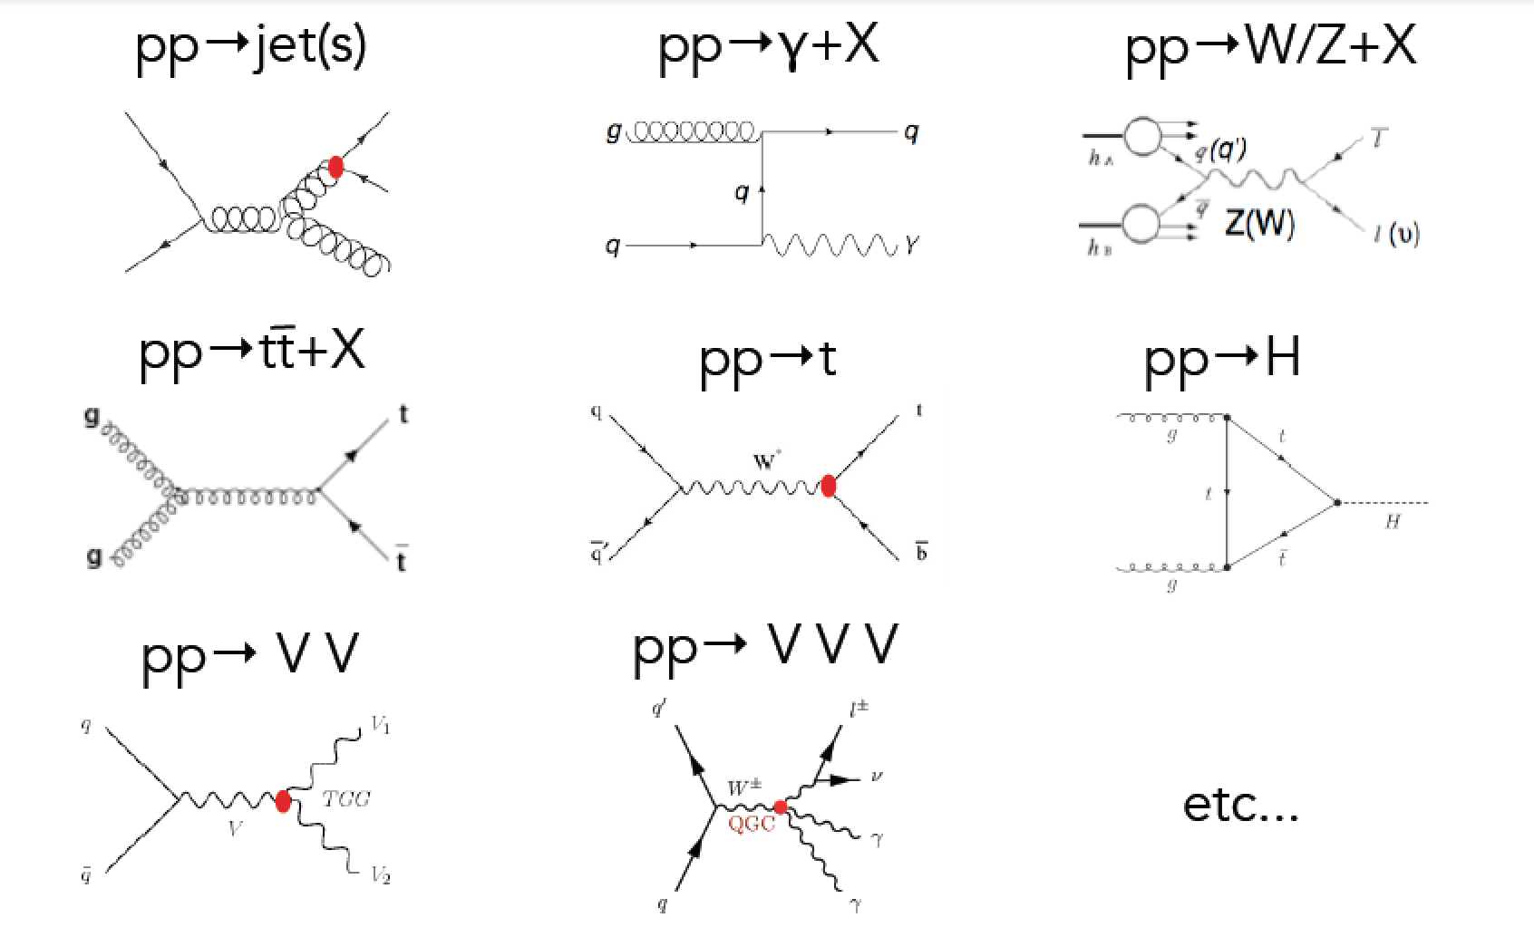
Standard Model Measurements
Standard Model measurements form an integer part of the physics program of the LHC
Precision measurements allow test for a wide range of SM predictions, and extract fundamental parameters (eg α_{s})
  Requires matching precision at theory prediction side
Important to understand backgrounds for searches for new physics
Cross Sections
Many processes studied: Examples

Slide 10
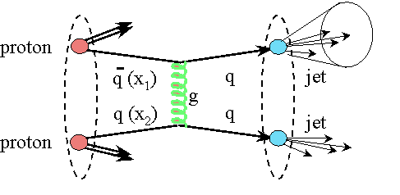
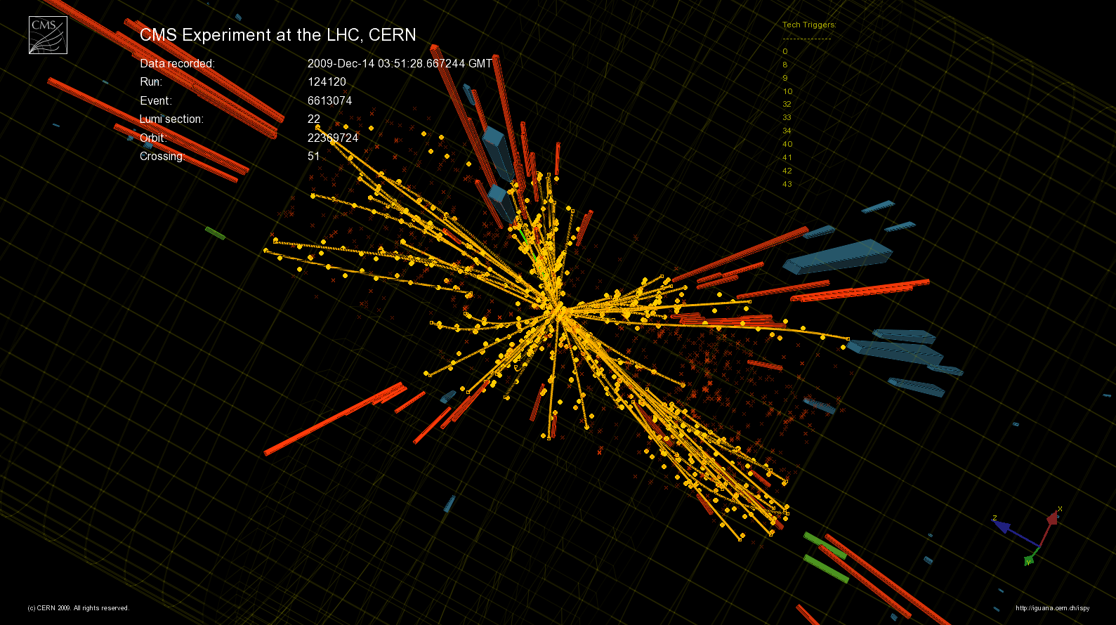
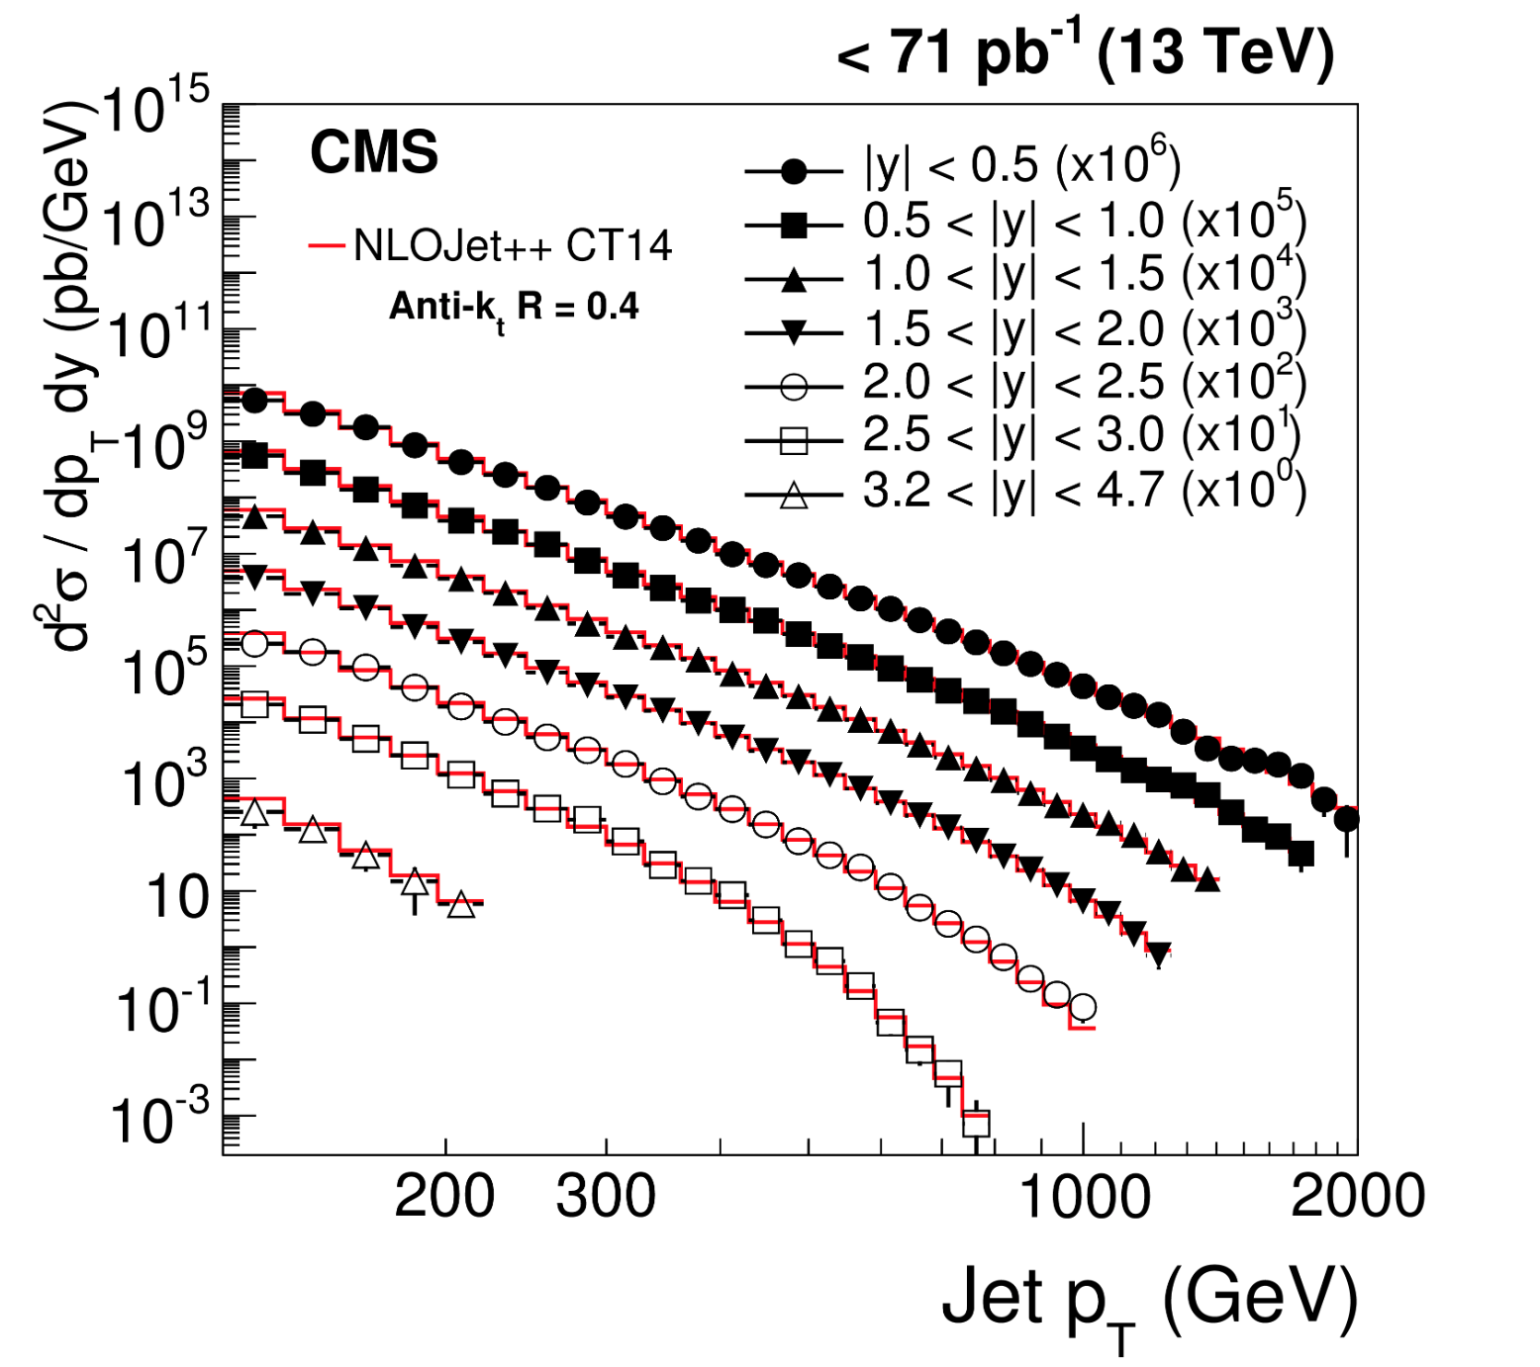
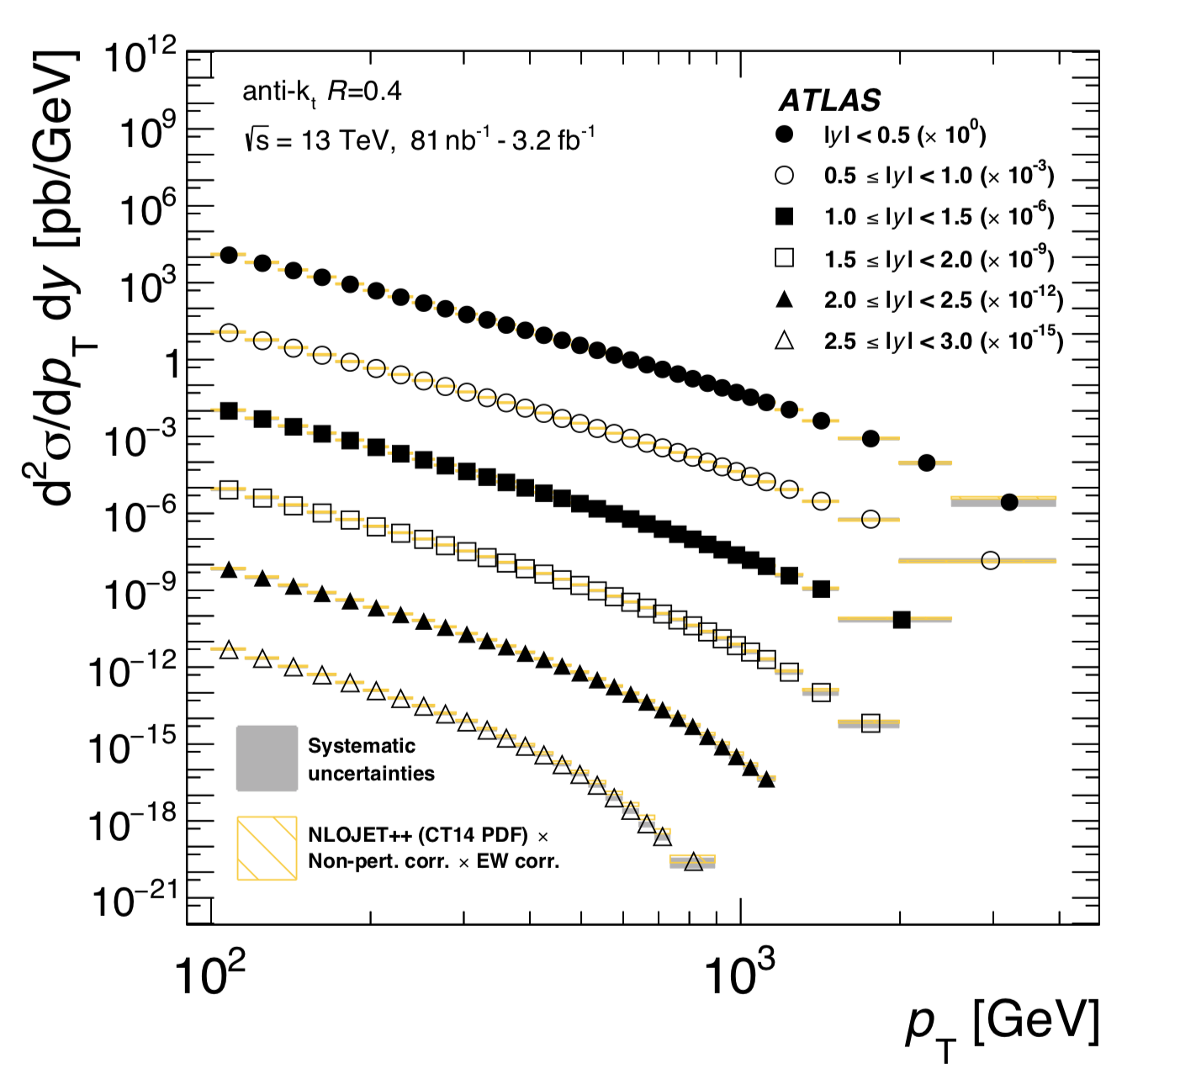
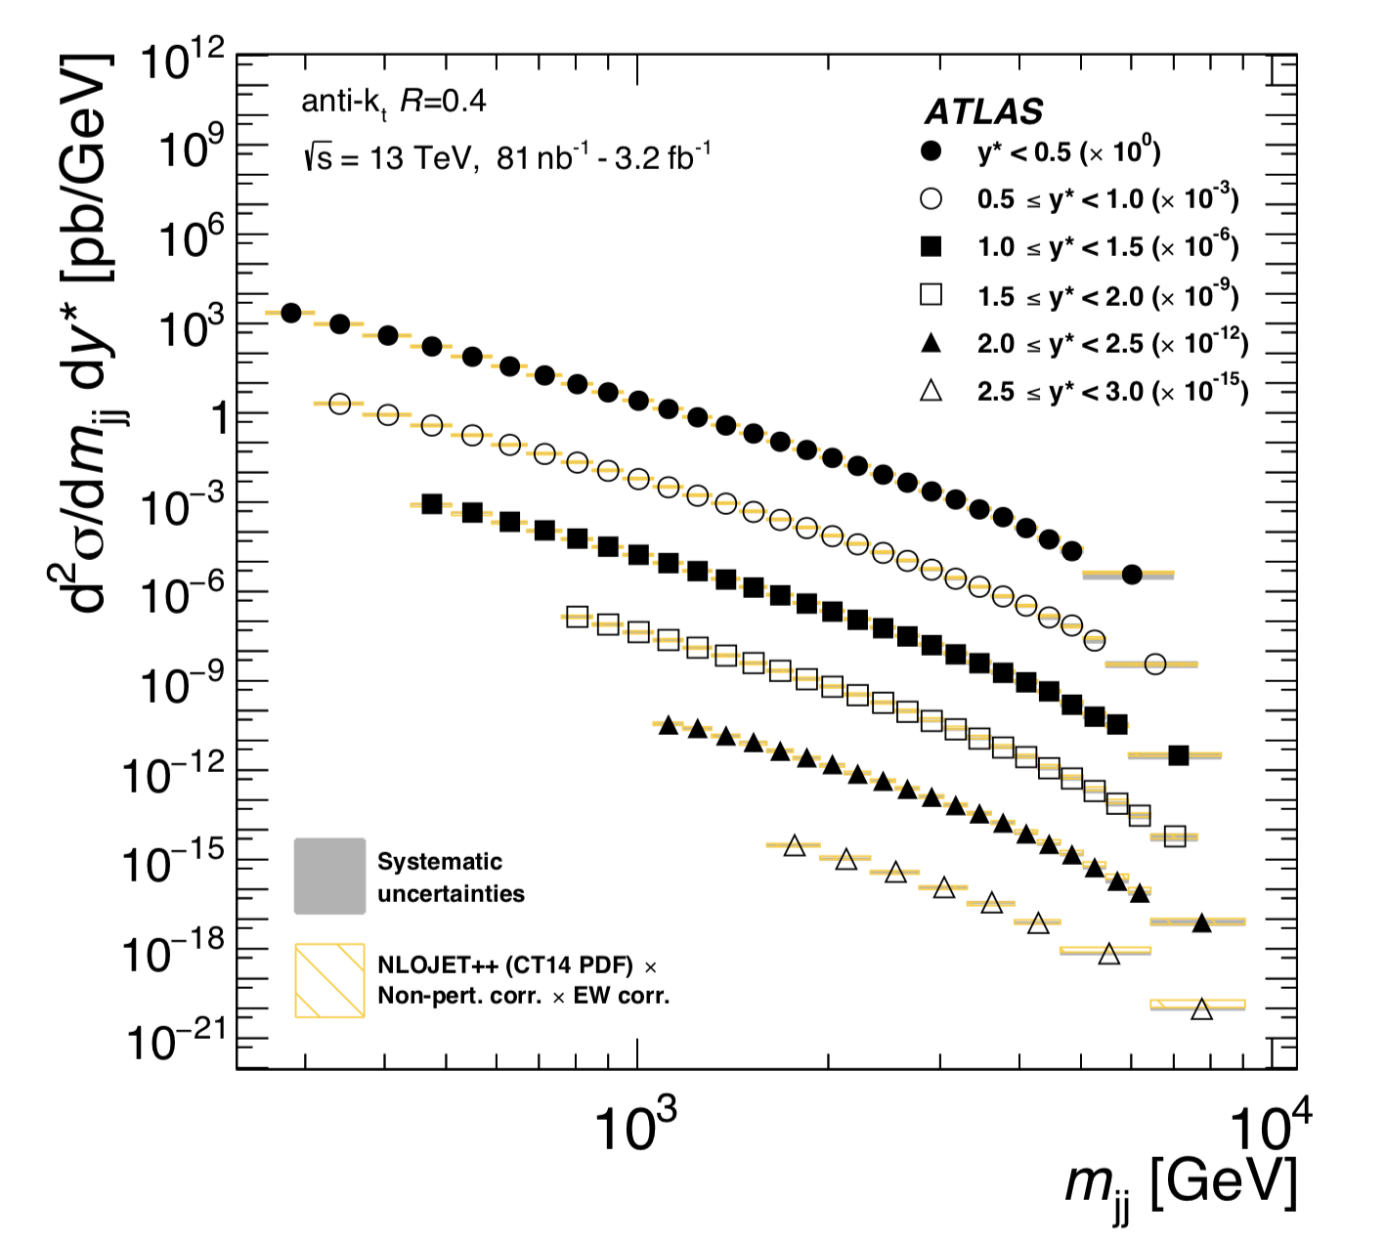
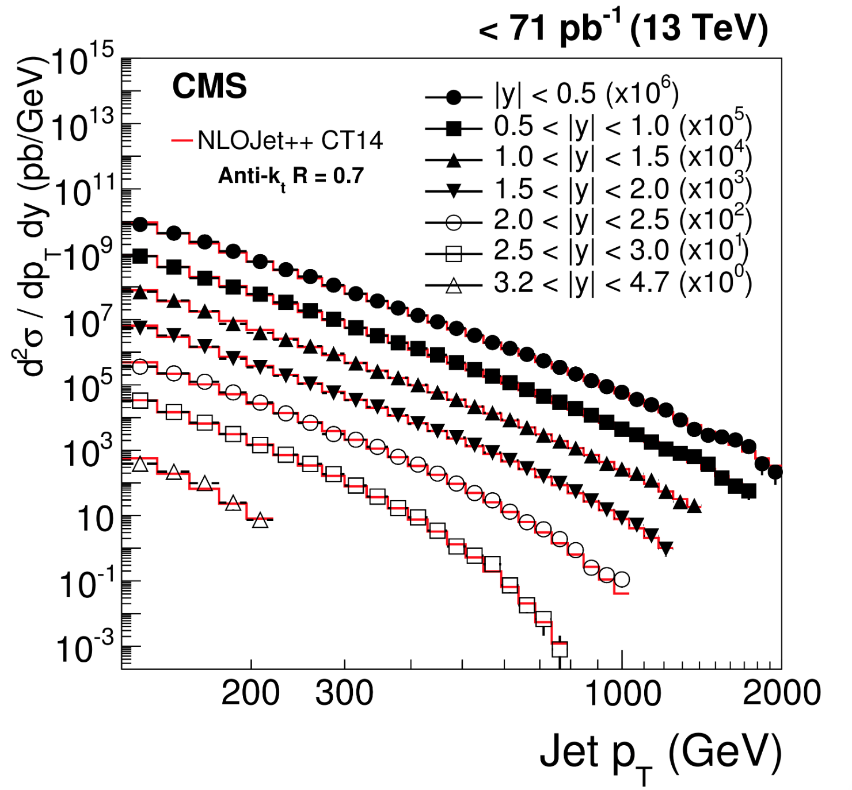
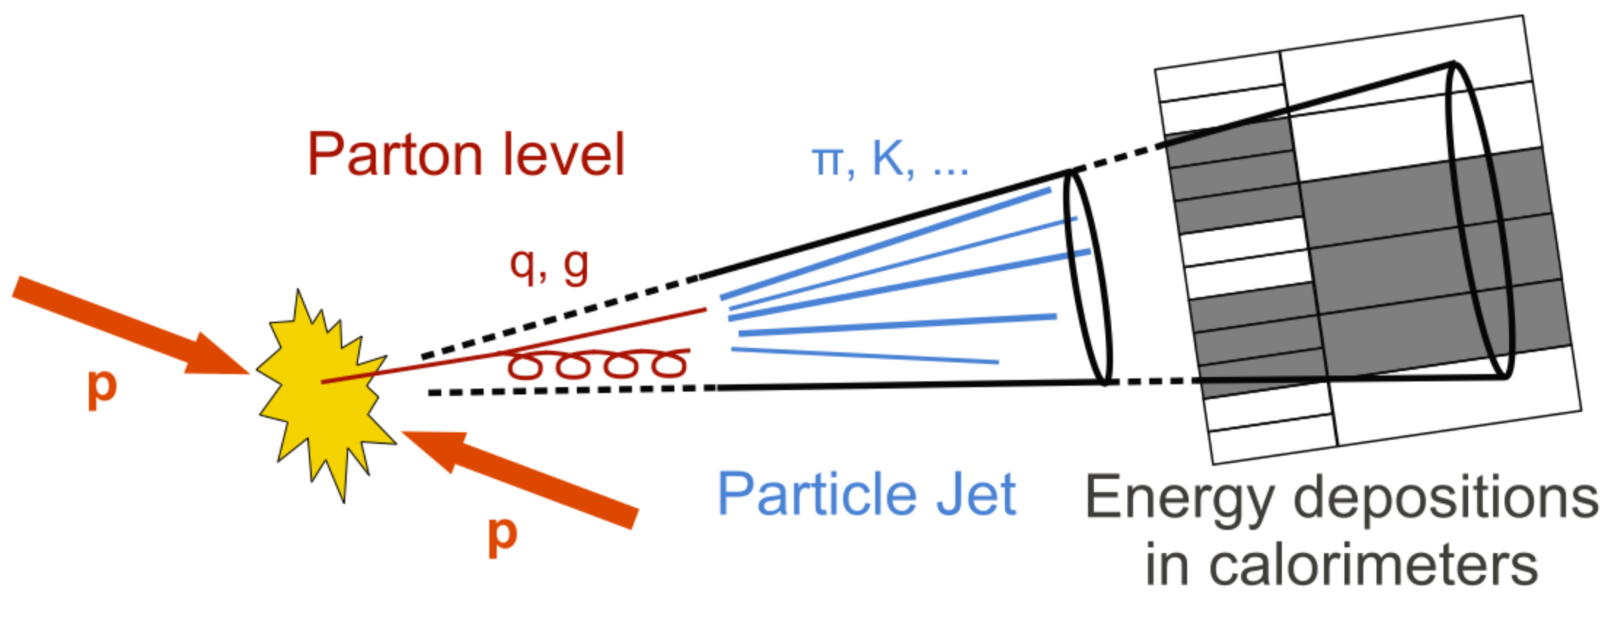
Inclusive Jet Production (13 TeV)
arXiv:1711.02692
Differential cross sections with R=0.4
Jet p_{T} spectrum consistent with predictions
from NLOJET++
Agreement with NLO calculations over the full range, up to and beyond
2 TeV p_{T} jets… QCD predictions work well over a large range…

Slide 11
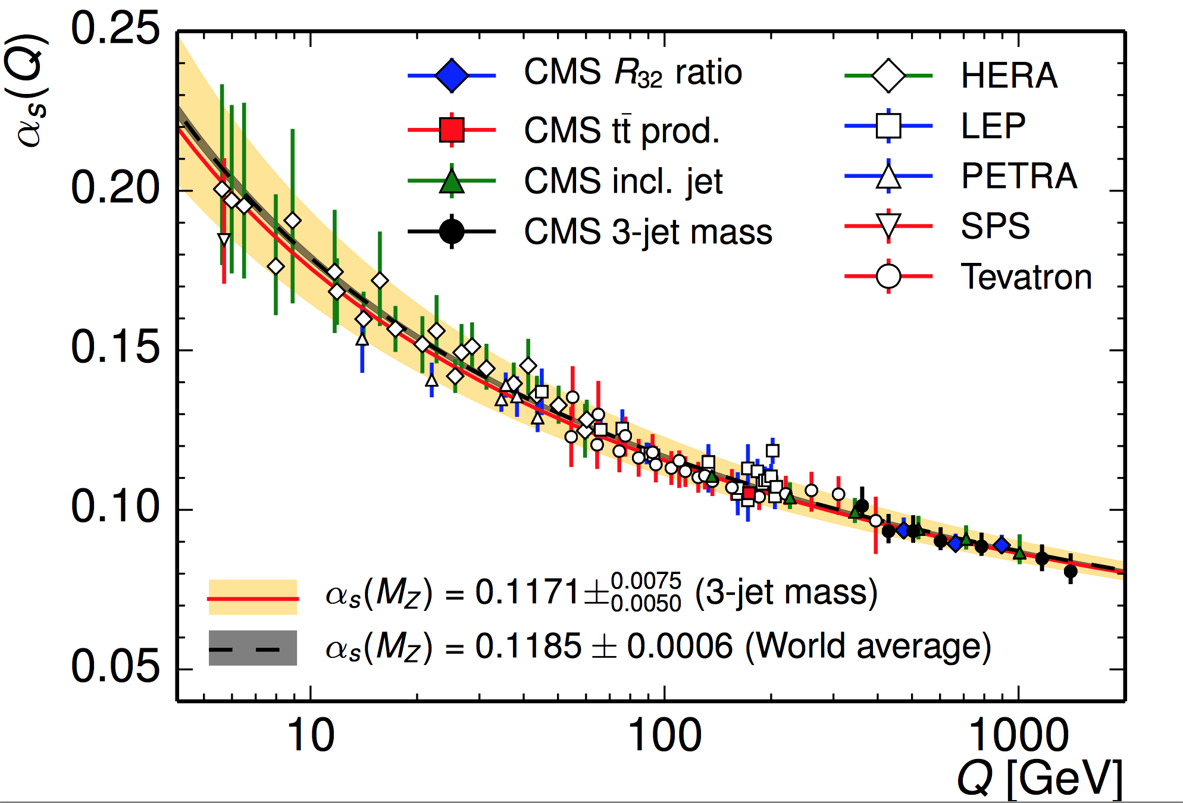


Determination of α_{s}
Several processes
used to extract α_{s}
•7 TeV analysis
•NLO extractions
•Theory uncert.
dominate
arXiv:1304.7498
arXiv:1412.1633
arXiv:1410.6765
arXiv:1307.1907
→R32 jet ratios
→Inclusive jets
For CTNLO PDFs
→Top production
NNLO & Assuming 173.2 top poles mass

Slide 12
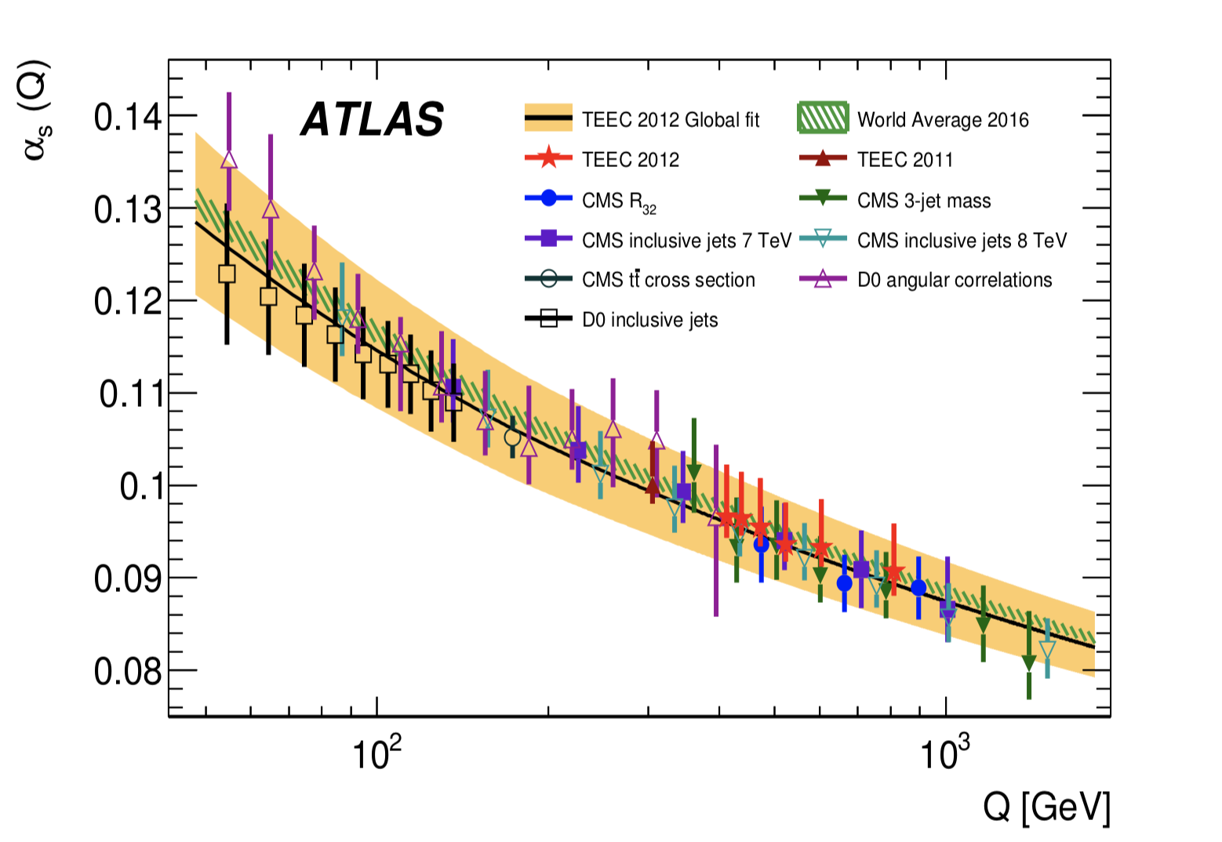
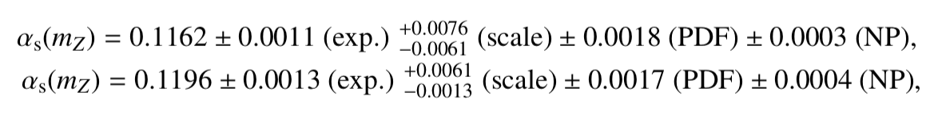
Determination of alpha_s
Many ways to extract alpha_s : 3/2 jet ratios, inclusive jets, tt-cross section..
Here: transverse energy-energy correlations and associated asymmetries
in multi-jet events. Select events with 2 leading jets with total H_{T}> 800 GeV
arXiv:1707.02562
• 8 TeV analysis
•NLO extractions
•Theory uncert.
dominate
ATEEC is the
difference between
the forward and
backward TEEC
TEECs
ATEECs

Slide 13
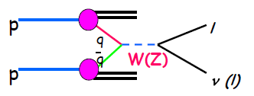
W, Z Production

Slide 14
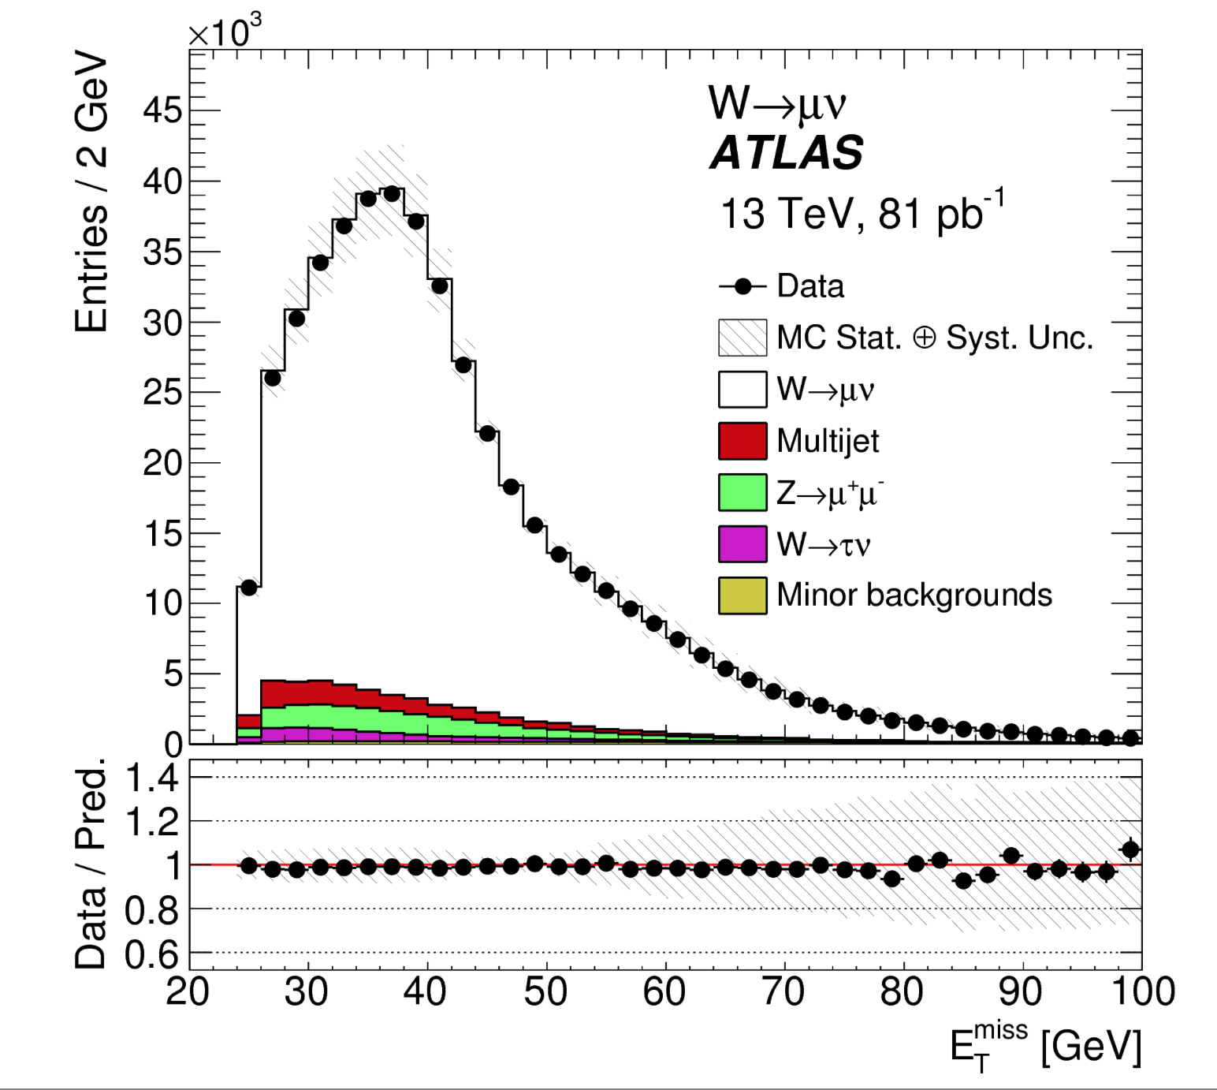
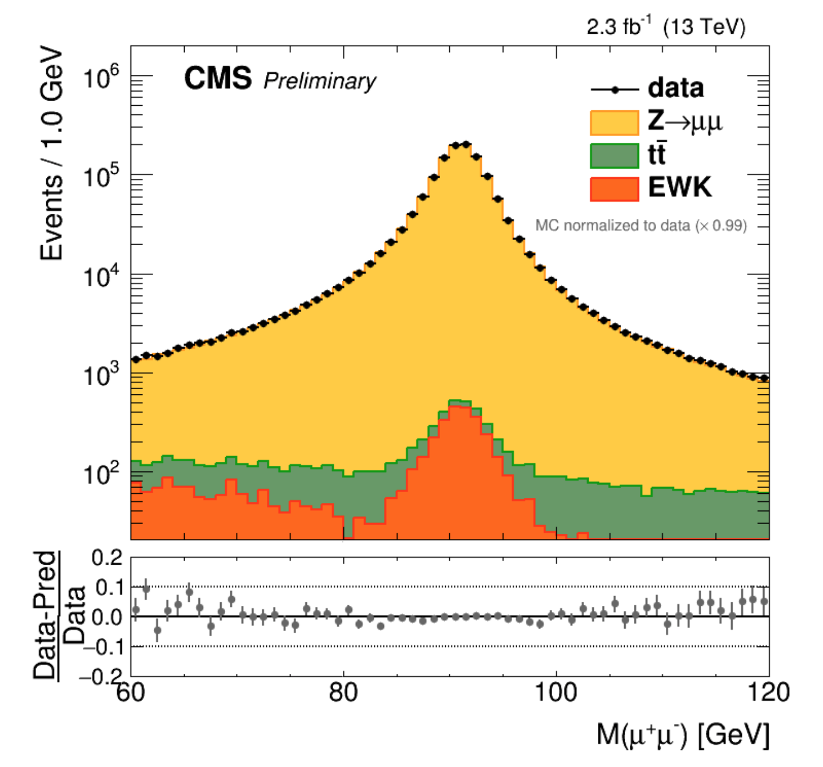
W and Z Boson Production
Select final states with leptons
arXiv:1603.09222
CMS-PAS-SMP-15-011
Missing transverse energy
from the W → μ+ν decays
Z peak (di-muon pair
mass distributions)

Slide 15
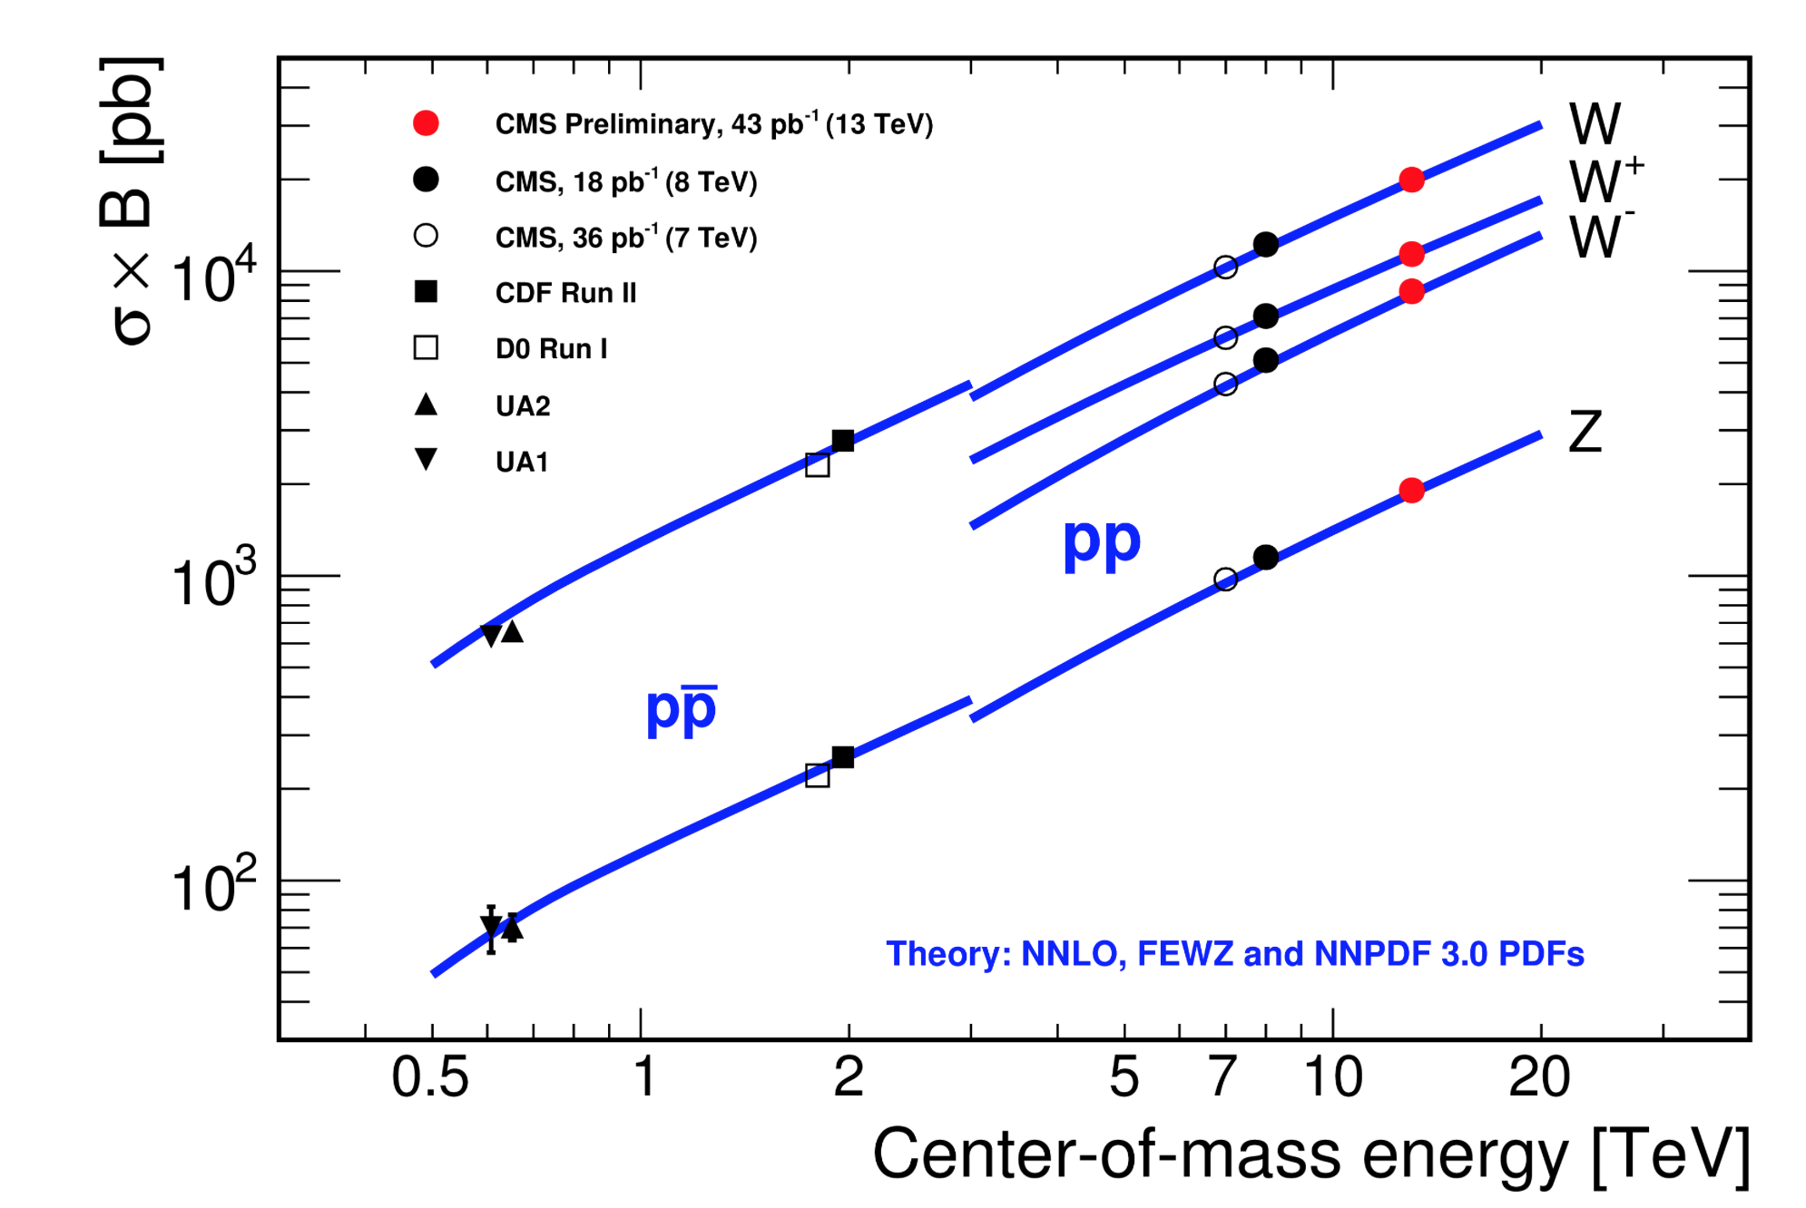
W and Z Boson Production
Measurements at 7/8/13 TeV with a precision of 3-4% ->dominated by the luminosity uncertainty!
CMS-PAS-SMP-15-004
Many detailed EWK studies possible –and done-- with the large Z,W samples

Slide 16
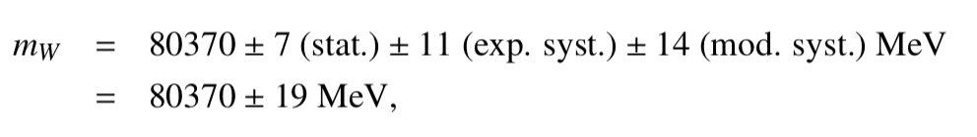
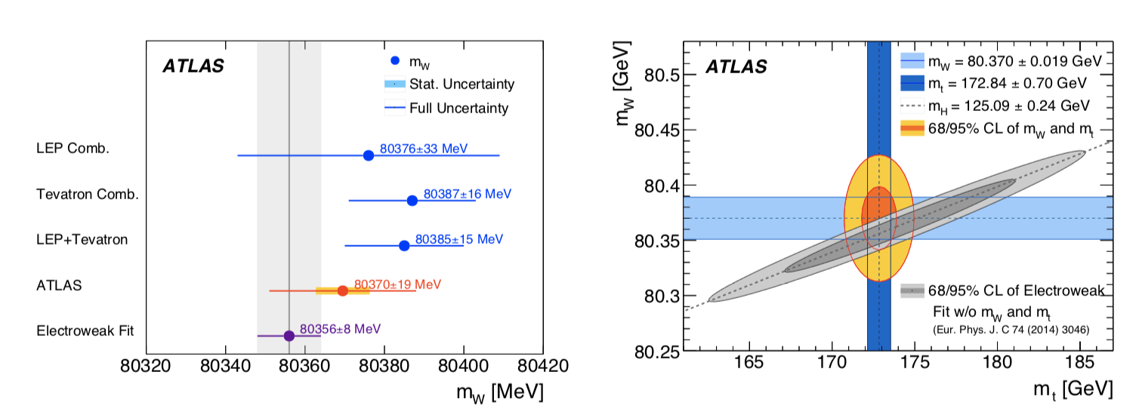
W-Mass Determination
Measurement based on 7 TeV data (4.6 fb⁻¹). It takes time to get the systematic uncertainties under control for precision!!
Included ~14.10⁶ W leptonically decaying W candidates
Technique uses template fits to the W p_{T} and m_{T} predictions
Calibration of energy scale, recoil response and efficiency studies using the large Z sample. Modelling of helicity effects constrained by W and Z data.
arXiv:1701.07240

Slide 17
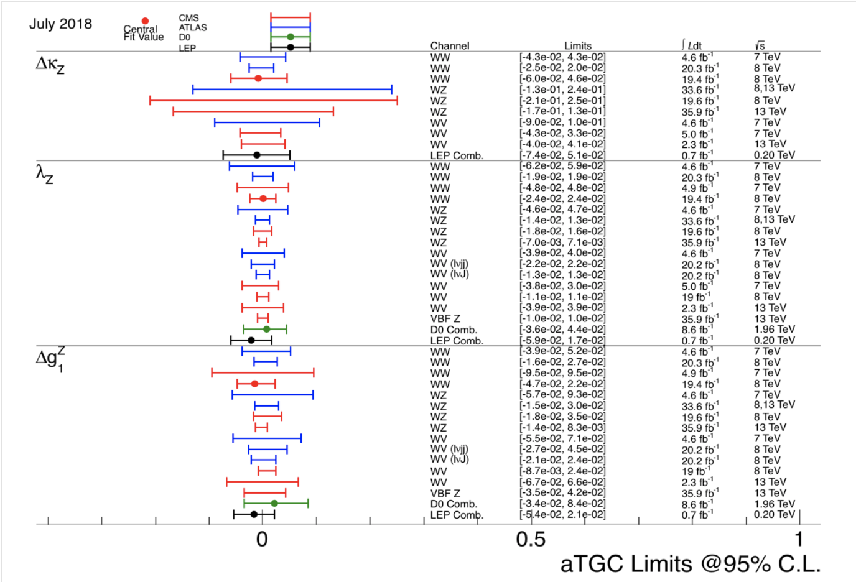
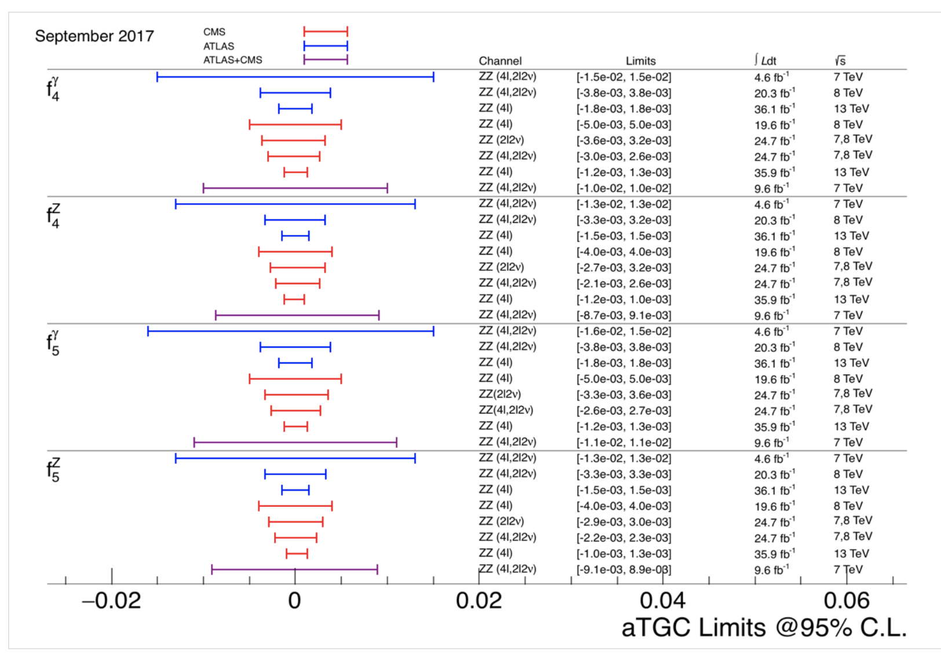
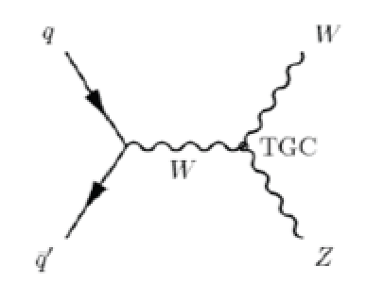
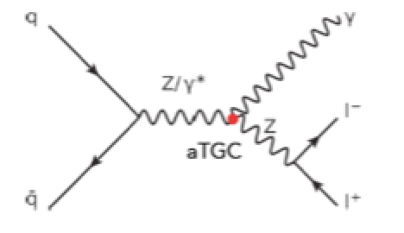
Multi-Boson Production
WWZ
…and examples of anomalous
triple gauge coupling limits
ZZZ and ZZγ

Slide 18
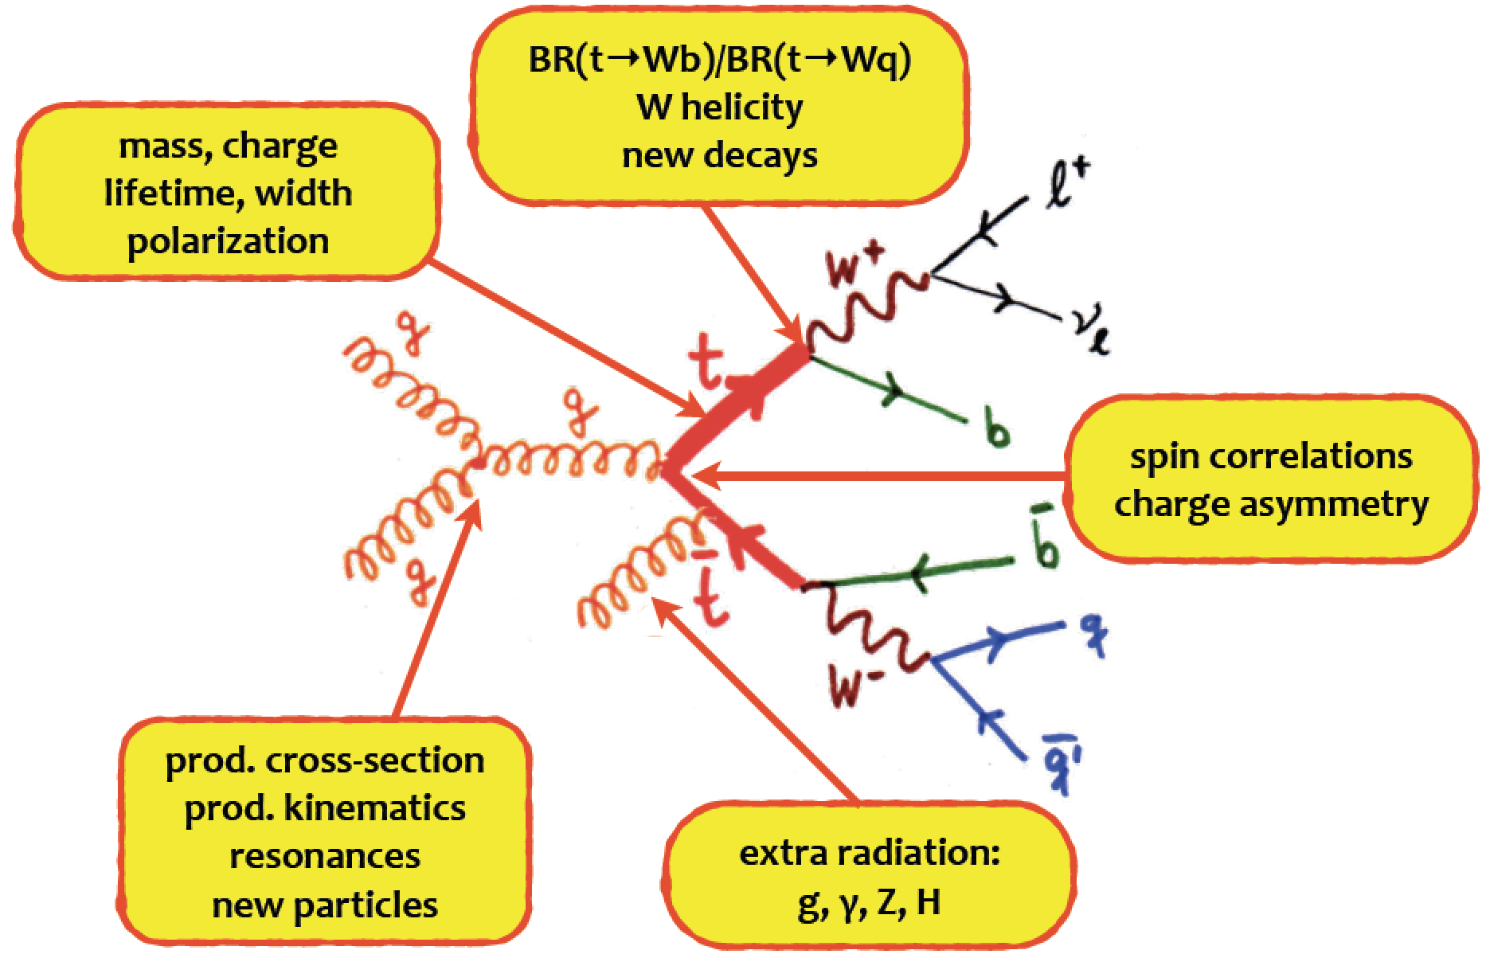
Top Production
•The heaviest known elementary particle: ~173 GeV
•Coupling to the Higgs ~1 → Special role in EWK symmetry breaking?
LHC is a top factory with ~5.10⁶ produced tt-pairs (run-1)
~ 10⁸ produced tt-pairs (run-2)

Slide 19
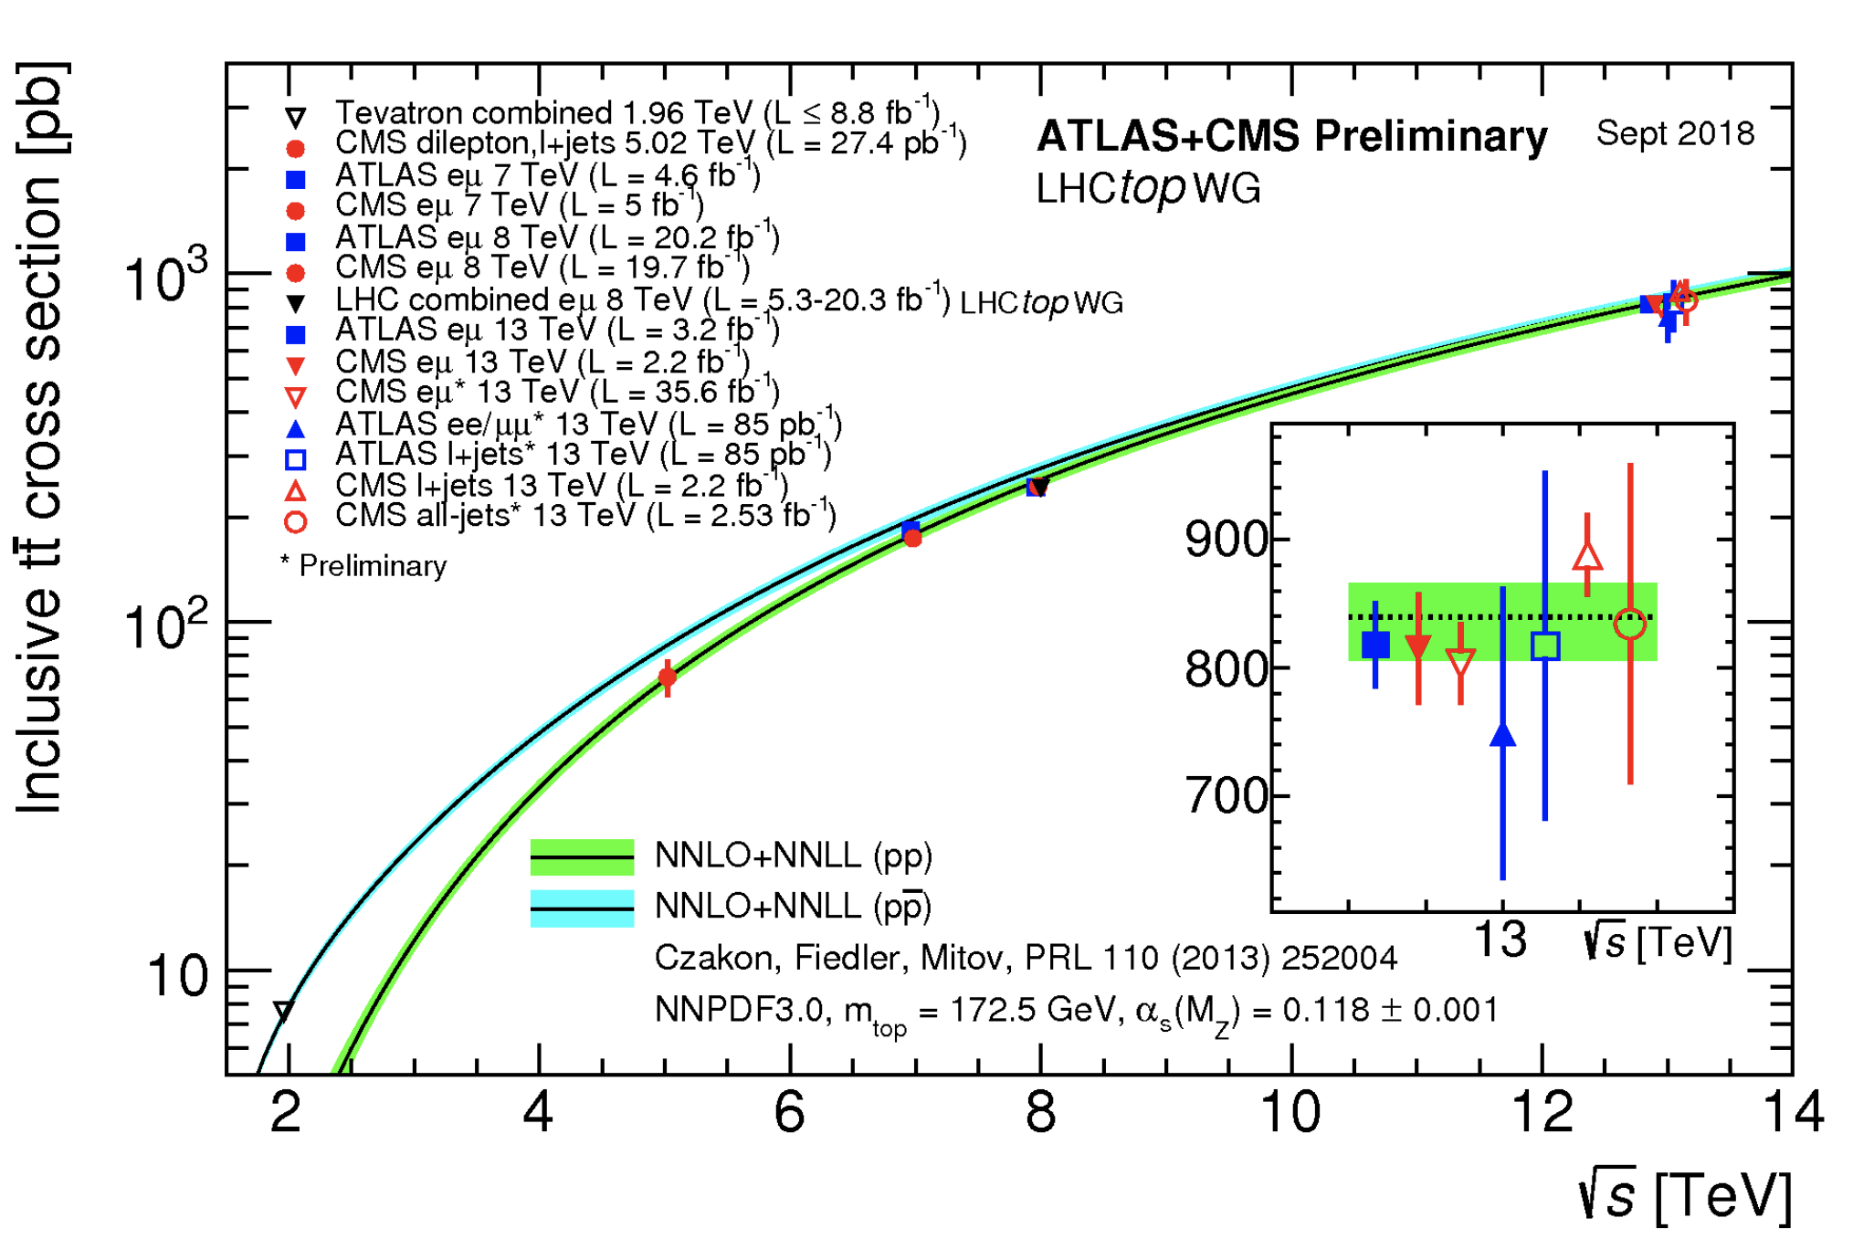
Top Quark Cross Sections
Good agreement with the SM predictions up to the 13 TeV

Slide 20
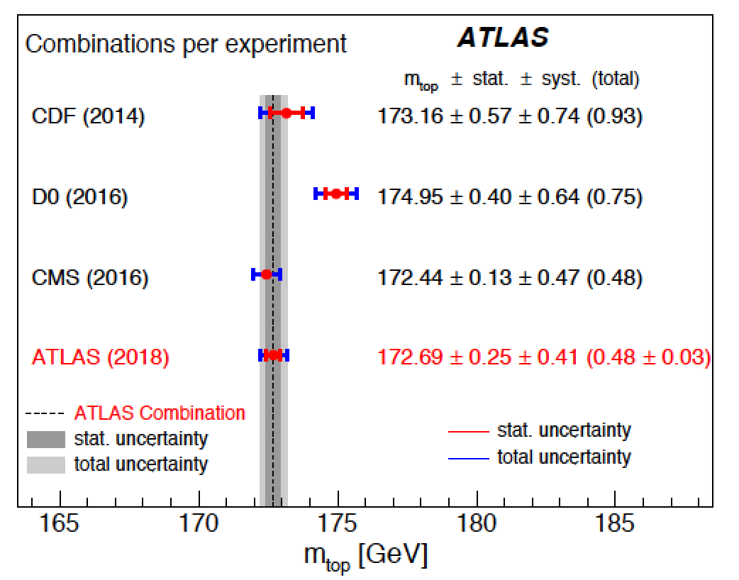
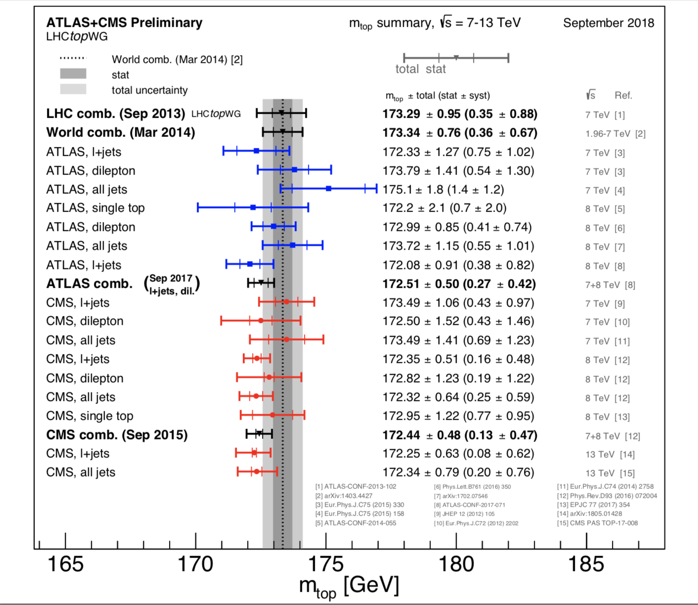
Top Mass Determination
Steady improvements during run-1 and run-2
Precision reached now ~0.3%
Hadronization model uncertainties
one of the main limitations
Several alternative methods have
been and are being explored
using J/ψ, secondary vertices,…
This is not the final word yet
Experiment combination under way
Note: the average value LHC
somewhat lower than Tevatron
one: 174.34 ± 0.64 GeV

Slide 21
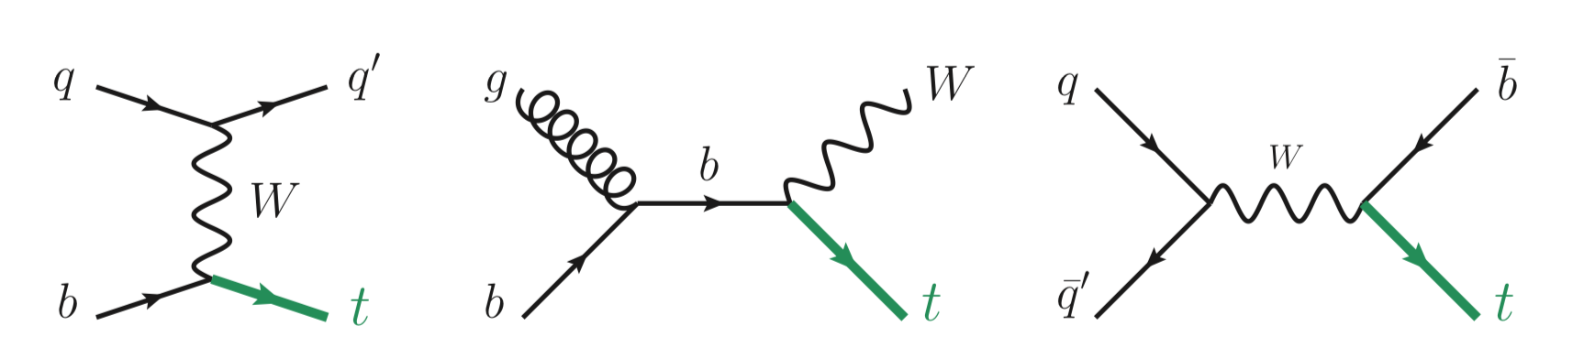
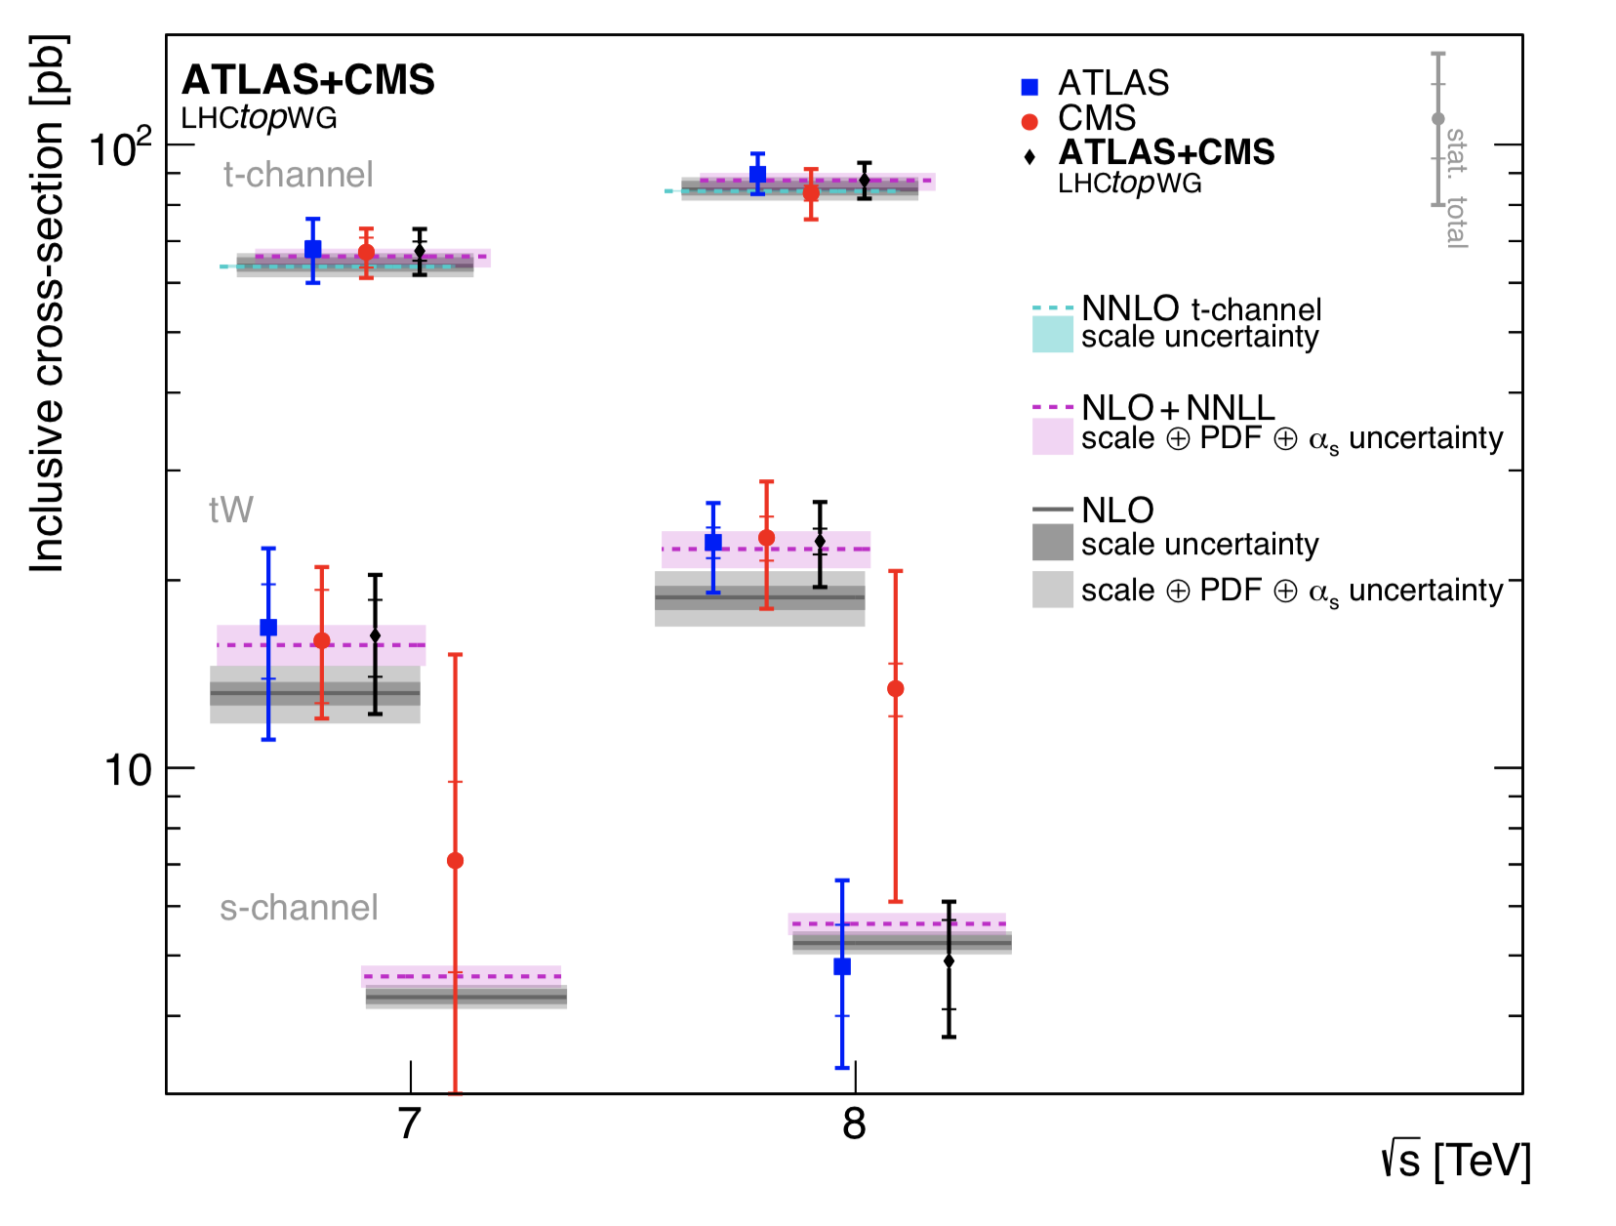
Single Top Production
arXiv:1902.07158
Most single top processes have been studied in run-1 and run-2
by CMS and ATLAS.

Slide 22
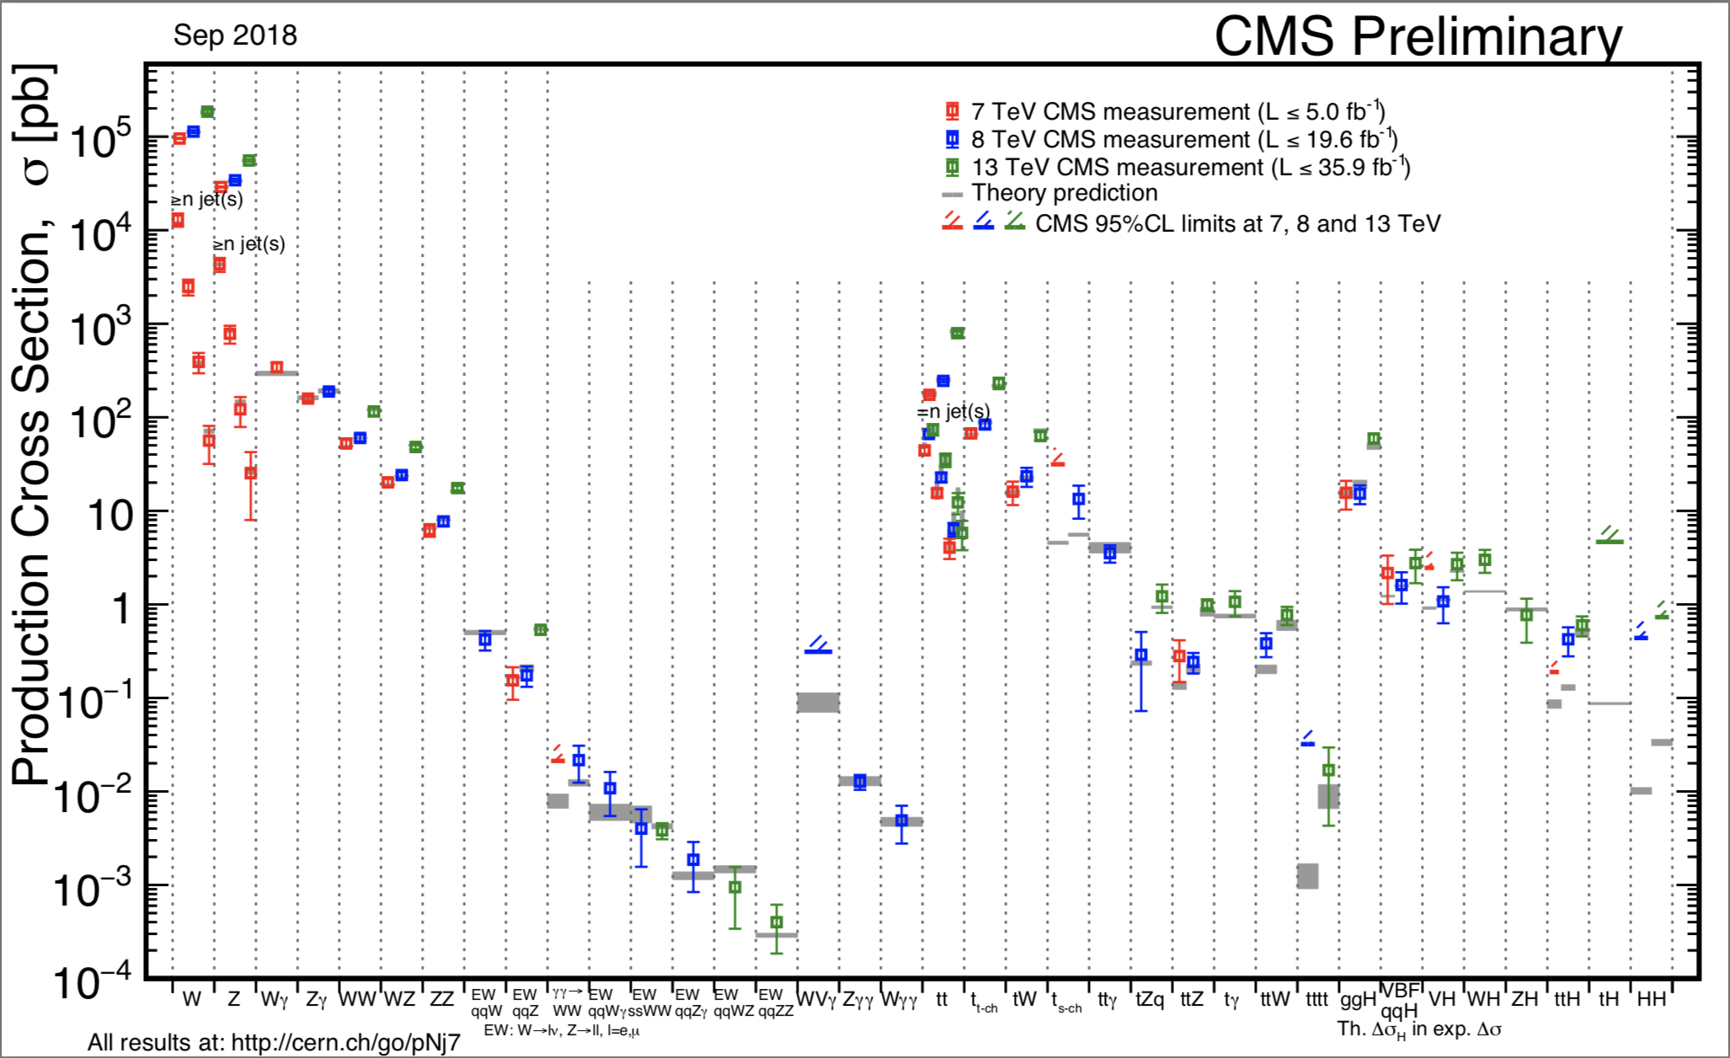
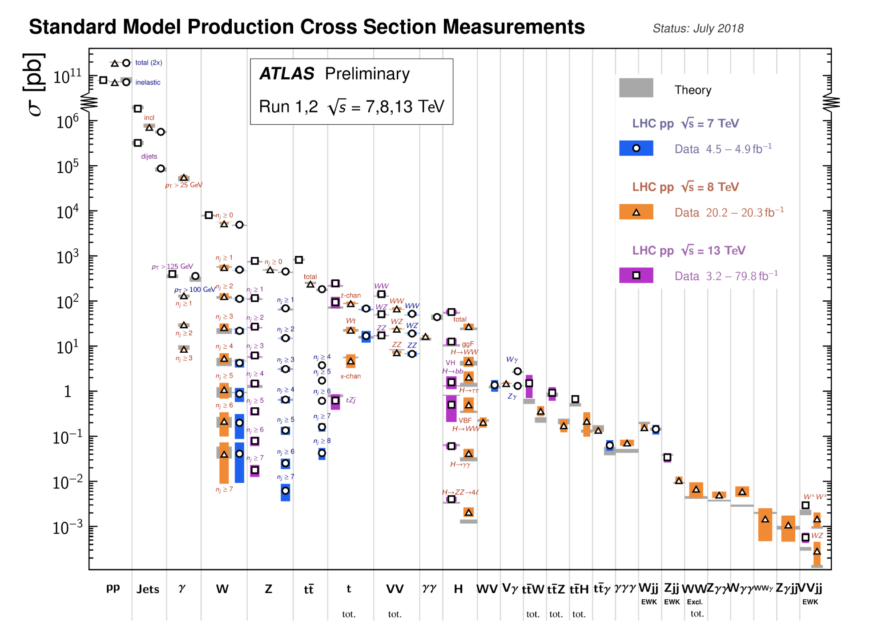
Summary: Cross Sections 7/8/13 TeV
All measurements in good agreement with the Standard Model predictions!!

Slide 23
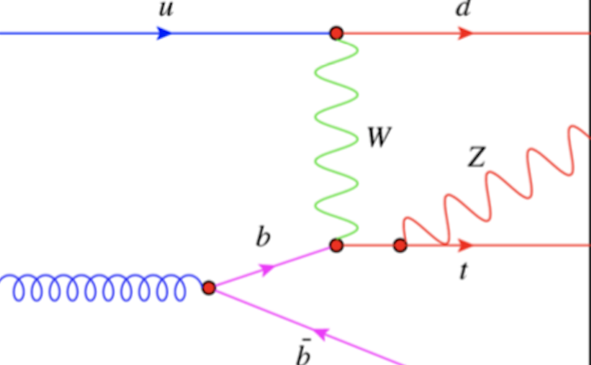
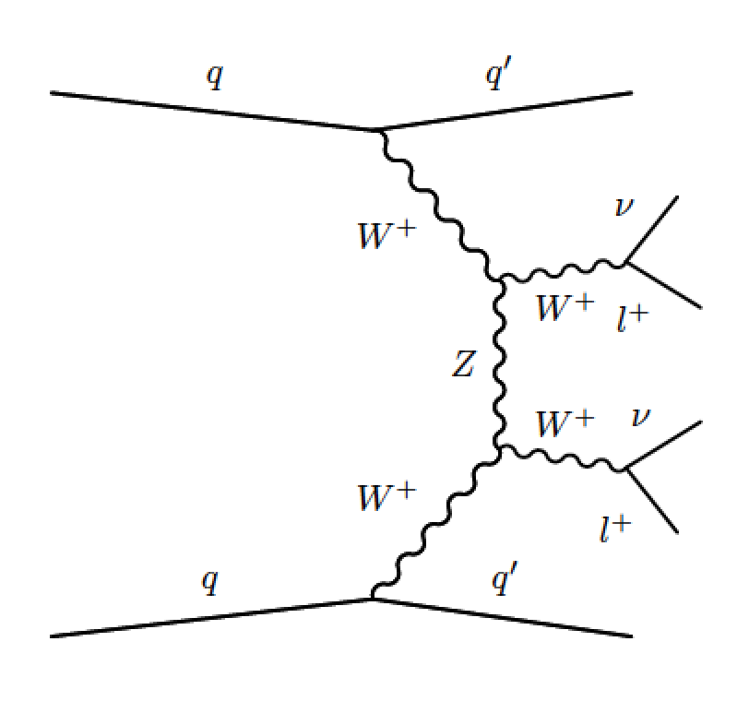
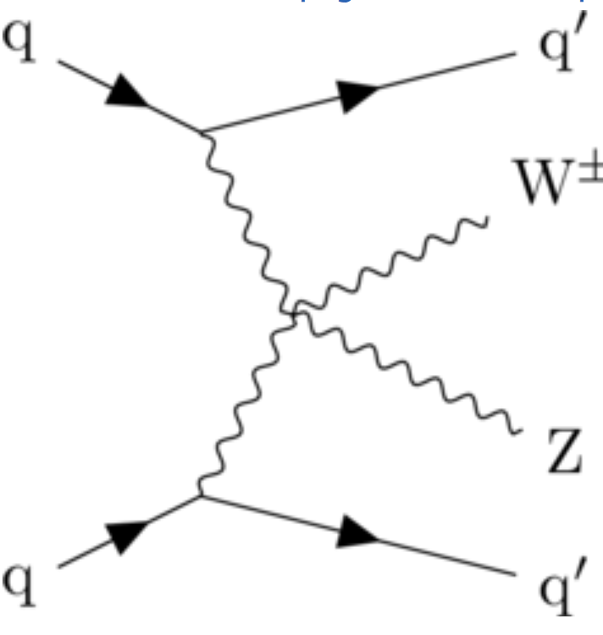
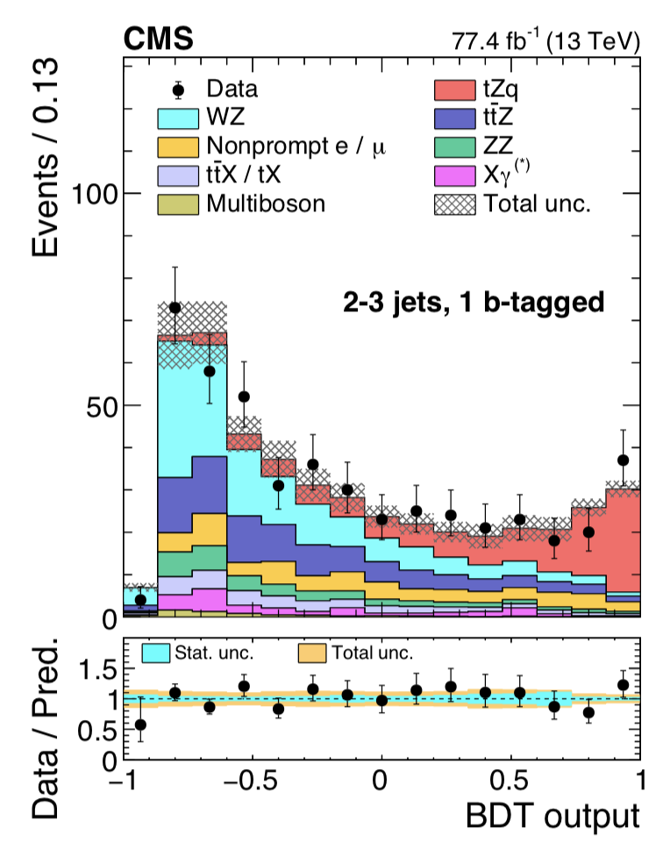
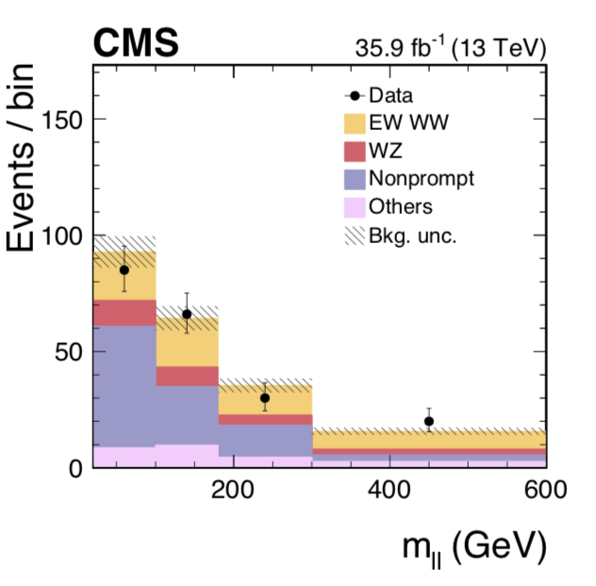
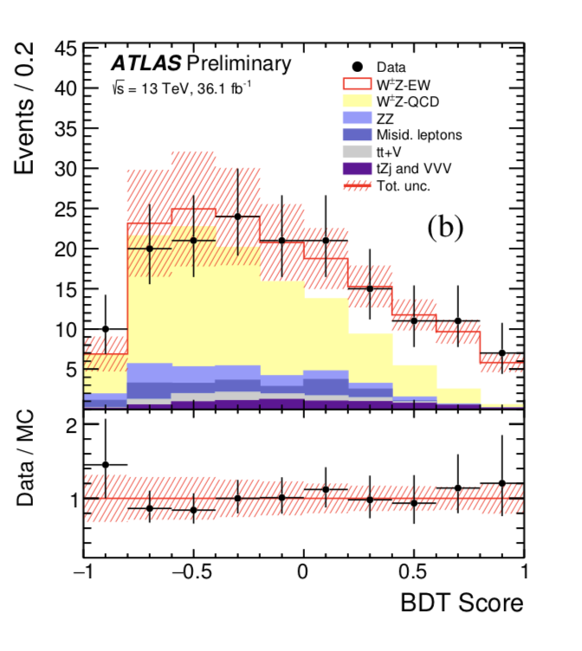
Measurements of New SM Processes at LHC
Examples
tZ production
EWK WWjj production
EWK WZjj production
arXiv:1812.0500
arXiv:1709.05822
ATLAS-CONF-2018-033
Many other processes eg in top sector: ttW, ttγγ, ttbb,…

Slide 24
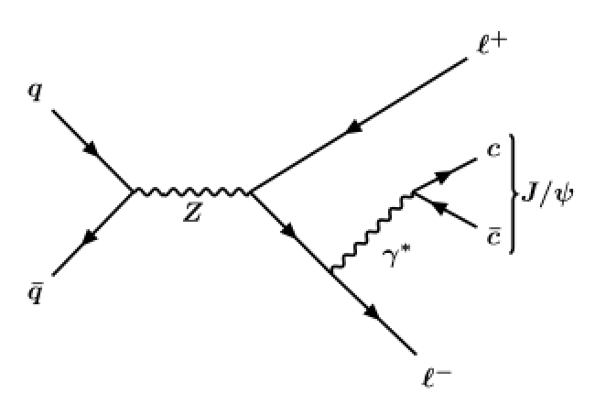
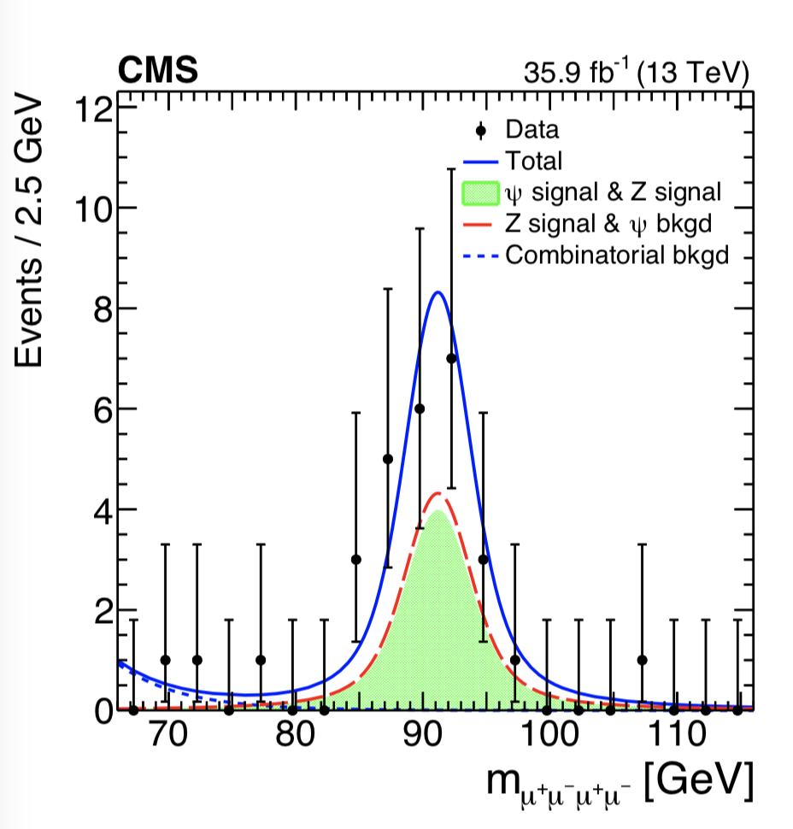


Rare Processes
Large Z samples at the LHC allow for study of rare Z decays (eg not observed at LEP): Z-> 2 leptons + J/ψ
SM expected Branching Ratio 6.7-7.7x10⁻⁷
Observed 24 events -> Branching Ratio 8x10⁻⁷
arXiv:1806.04213
Further:
This is the rarest Z decay channel
observed up to date.
Background for rare Higgs decays

Slide 25




Correlations Between Produced Particles
•Study the correlation between two charged particles in the angles φ (transverse): Δφ and θ (longitudinal): Δθ in PbPb, pPb and pp
Heavy Ions @LHC!
High multiplicity events
JHEP 1009 (2010) 091
High multiplicity events
A new phenomenon
in the ‘stronge force’?
•Multiple interactions?
•Glass condensates?
•Hydrodynamic models?
…

Slide 26




Light-by-light Scattering
arXiv:1810.04602
Select ultra-peripheral collisions in PbPb
Exclusive 2-photon final state selection
Small acoplanarity (< 0.01)
Small diphoton p_{T} (< 1 GeV)
14 events found, 3.8 background events est.
Similar to ATLAS result: arXiv:1702.01625
TH

Slide 27




Measurements of B_{s(d)} →μμ
arXiv:1411.4413
Published in Nature
•Three B_{s} particles in a billion will decay into two
muons. This decay has been chased for 30 years!!
arXiv:1703.05747
Present most precise results
Significance for B_{s} to muon
decay is 7.8σ
4.4 fb⁻¹

Slide 28





Total and Elastic Cross Sections
TOTEM experiment: Total cross section and elastic/diffractive scattering
New measurements at 13 TeV
arXiv:1712.06153
CERN-EP-2017-335
𝝆: the ratio of the real to imaginary part of the nuclear elastic scattering amplitude at t=0, is lower that expected
First direct evidence for “odderon” exchange in elastic scattering??
+?

Slide 29



Forward Particle Production
arXiv:1808.09877
Forward neutrons
𝜼>10.78
arXiv:1703.07678
Forward Photons
LHCf experiment:
Forward measurements compared to Monte Carlos for Cosmic Ray studies
No model reproduces the data well !!

Slide 30


Higgs
The party 6 years ago
What happened since?

Slide 31






2012: A Milestone in Particle Physics
Observation of a Higgs Particle at the LHC, after about 40 years
of experimental searches to find it
proton
proton
The mass of the Higgs particle is
following the Run-1 ATLAS+CMS combination arXiv:1503.07589

Slide 32


Slide 33







Tuesday 8 October 2013
Francois Englert
Peter Higgs
Congratulations!!!!

Slide 34



Higgs Production & Decay
Processes
•Gluon fusion
•Vector Boson Fusion
•W/Z associated prod.
•Top associated prod
•B-quark associated prod?
Numbers taken from the
LHC Higgs Cross Section WG
See CERN yellow reports:
YR1: Inclusive cross sections
YR2: Differential cross sections
YR3: Properties
YR4: Deciphering the nature of the
Higgs sector

Slide 35

Higgs Production and Decay
Not observed in run-1

Slide 36





2012: A Milestone in Particle Physics
Observation of a Higgs Particle at the LHC, after
about 40 years of experimental searches to find it
2014: Higgs Boson
well established.
Most accessible
channels studied
Observation in WW,
ZZ and γγ channels
⋅tau tau at the limit
bb and ttH not
observed in Run-1
ggF
2018

Slide 37






Brief Higgs Summary from Run-1
We know already a lot on this brand New Higgs particle!!
Mass = CMS+ATLAS
125.09 ±0.21(stat)
±0.11(syst) GeV
Width
< 24 MeV
(95%CL)
Couplings are
within ~20% of
the SM values
Spin =
0⁺⁽⁺⁾ preferred
over 0⁻,1,2
We continue to look for anomalies, i.e. unexpected decay modes or couplings,
multi-Higgs production, heavier Higgses, charged Higgses…

Slide 38




Higgs: ATLAS+CMS Combination
The Run-1 Higgs Legacy!
arXiv:1606.02266 /
JHEP 1608 (2016) 045
5153 authors!!
The newly found boson has
properties as expected for
a Standard Model Higgs
Signal strength/SM:

Slide 39



Higgs @ 13 TeV in Run 2
Higgs particle is still there ! ☺
The mild deviations seen in Run-1 seem to be gone ☹
Observation of H→bb in the associated production channel
Direct observation of ttH production
No deviations from Standard Model Higgs expectations yet!!
H→ ZZ
H→ γγ
The Higgs Boson is still very
much Standard Model-like!

Slide 40

Higgs Cross Sections

Slide 41


Higgs Results @ 13 TeV
Higgs kinematics differential distributions
arXiv:1805.10197
H→γγ and
H→ZZ→4 leptons
Total Higgs cross section
Results in agreement with the
Standard Model

Slide 42



A lot happened recently…
CERN Press Release 4/6/2018

Slide 43





Higgs Results @ 13 TeV
ttH production: Combination of all Higgs decay channels
and combination with the 7/8 TeV data of Run-1
arXiv:1804.0261
arXiv:1806.0425
7+8+13 TeV data
Observation of ttH!
Results in agreement with the Standard Model
Significance = 5.9σ (exp 4.2σ )

Slide 44


Slide 45


A lot happened recently…
CERN Press Release 28/8/2018

Slide 46




Higgs to bb Decay
H->bb decay: Combination of all Higgs decay channels
and combination with the 7/8 TeV data of Run-1
H->bb observed
with more than
5σ in both
experiments
arXiv:1808.08238
arXiv:1808.08242

Slide 47


Higgs Mass Revisited
Use the 2 photon and 2 Z to lepton decay channels to determine the mass
Run 2 data not yet combined among the experiments
Full run 2 still being analysed
arXiv:1806.00242

Slide 48




Narrowing Down on the Higgs Width
New estimation on the Higgs Width of the Higgs based on comparing the off-shell and on-shell signal strength
SM width at 125 GeV is 4.1 MeV
Off-shell channels: H-> ZZ 4leptons and H->ZZ-> 2l 2ν with H mass above 220 (250) GeV
arXiv:1808.01191
observed Higgs total width limit < 14.4 MeV obs.
(15.2 MeV exp.)

Slide 49





More Higgs Studies…
arXiv:1802.04329
Higgs decay to invisible
Higgs decay to charm search
HIG-17-023
95% upper limit
Higgs decay to ργ and φγ search
arXiv:1712.02758

Slide 50

More Higgs Studies…

Slide 51

More Higgs Studies…
H->cc within reach with
HL-LHC data using ML??

Slide 52


Decay of H-> 2 Muons
Search for 2 muons that reconstruct to the invariant mass of the Higgs
Signal limit < 2 x SM cross section @ 95% CL
No observation of this decay channel yet!
Wait for run 3? (or ATLAS/CMS run 2 combination)
ATLAS-CONF-2018-026

Slide 53



Higgs Results @ 13 TeV
Combination of all Higgs production/decay channels at 13 TeV
Check overall consistency of the couplings
ATLAS-CONF-2018-031
CMS: arXiv:1809.10733
Results in agreement with
the Standard Model

Slide 54


Higgs Results @ 13 TeV
Combination of all Higgs production/decay channels at 13 TeV
Check overall consistency of the couplings (CMS only)
2016<->run-1 data:
Cross section ~ x 2
Luminosity ~ x 1.5
Results in agreement with
the Standard Model

Slide 55


Higgs Results @ 13 TeV
Results from combining all channels

Slide 56


Higgs Results @ 13 TeV
Results from combining all channels

Slide 57



Search for LFV Decays: H →μτ
arXiv:1502.07400
Results from the 8 TeV
Mild excess giving a 2.4σ effect in Run-1… What about 2016 data?

Slide 58


Search for LFV Decays: H →μτ, eτ
The 2016 data does NOT show an excess
arXiv:1712.07173
It would
Have been
Nice…

Slide 59

The Higgs Story So Far..
The Higgs Boson is still very much Standard Model-like!
But let’s not forget: The Higgs boson is a totally new type of fundamental
particle (or is it composite?) that allows unprecedented tests of electroweak
symmetry breaking!
-> It is a novel microscope to probe the universe at the smallest scales
It has all the chances to be a portal to new physics, eg dark sectors…
We only know it since 6 years!
The SM works. What about BSM searches? -> Lecture III

