Slide 1
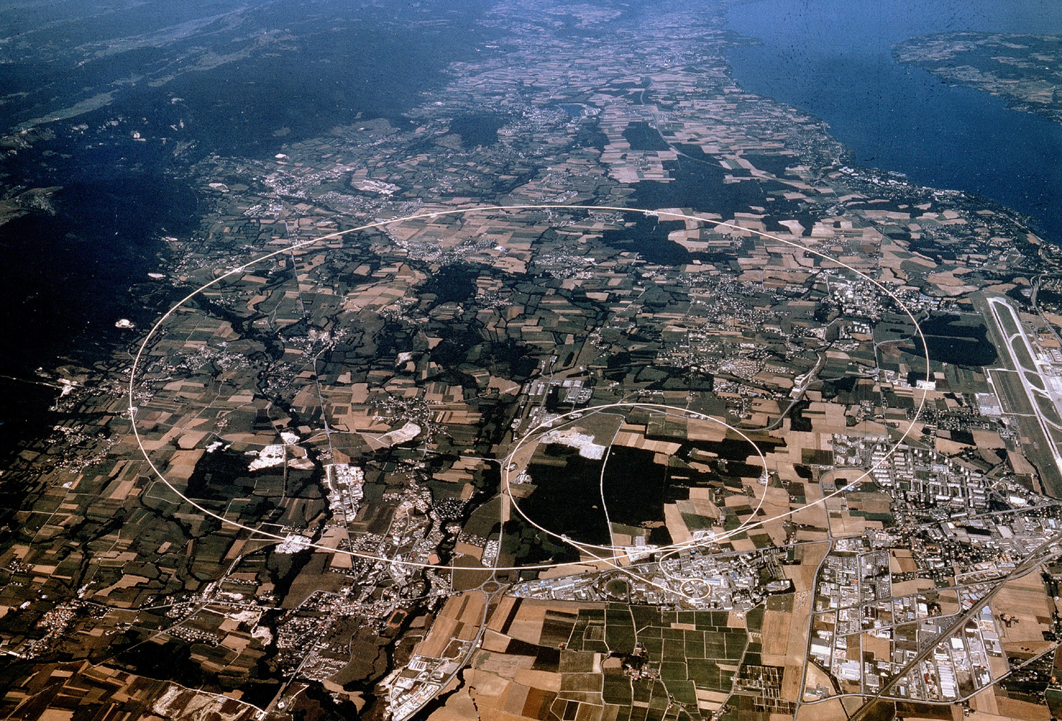
Physics at the LHC Beyond the Standard Model
Albert De Roeck
CERN, Geneva, Switzerland
Antwerp University Belgium
UC-Davis California USA
NTU, Singapore
22nd February 2019

Slide 2
Lecture Plan
Overview of the 3 lectures in the next days
Lecture 1: Introduction to Experimental Particle Physics: LHC as main example
Lecture 2: Measurements and test of the Standard Model, including the Higgs
Lecture 3: Searches beyond the Standard Model and a short Outlook to the future at the LHC

Slide 3
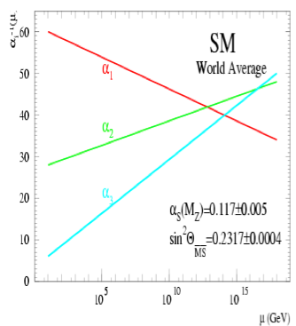
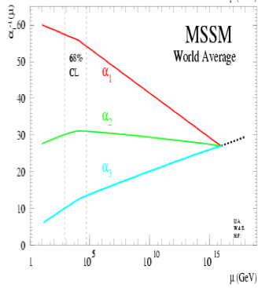
Physics case for new High Energy Machines
Understand the mechanism Electroweak Symmetry Breaking
Discover physics beyond the Standard Model
Reminder: The Standard Model
- tells us how but not why
3 flavour families? Mass spectra? Hierarchy? 19 parameters!
- needs fine tuning of parameters to level of 10⁻³⁰ !
- has no connection with gravity
- no unification of the forces at high energy
- Supersymmetry
- Extra space dimensions
Many other ideas: More symmetry and gauge bosons, composite
Higgs models, L-R symmetry, quark & lepton substructure,
Little Higgs models, Technicolor, Hidden Valleys, 4th generation…
Most popular extensions since 2000
Higgsless models “disfavoured” these days

Slide 4
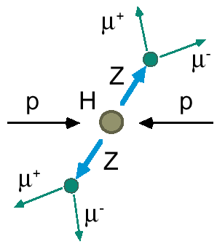
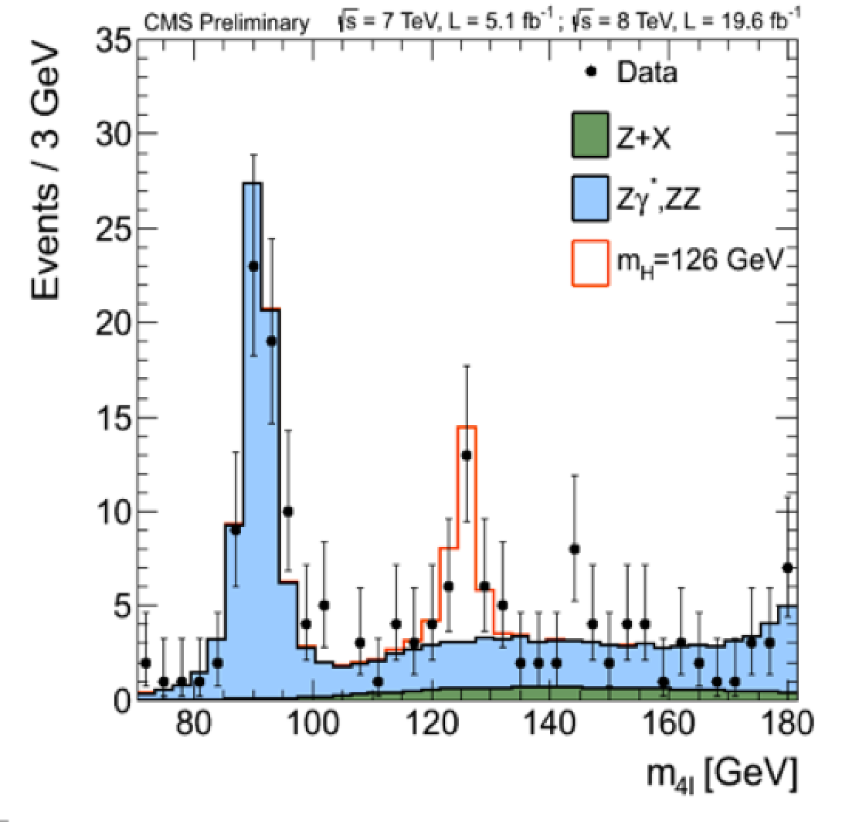
2012: A Milestone in Particle Physics
Observation of a Higgs Particle at the LHC, after about 40 years
of experimental searches to find it
proton
proton
2013
The Higgs particle was the last missing particle in the Standard Model
and possibly our portal to physics Beyond the Standard Model

Slide 5
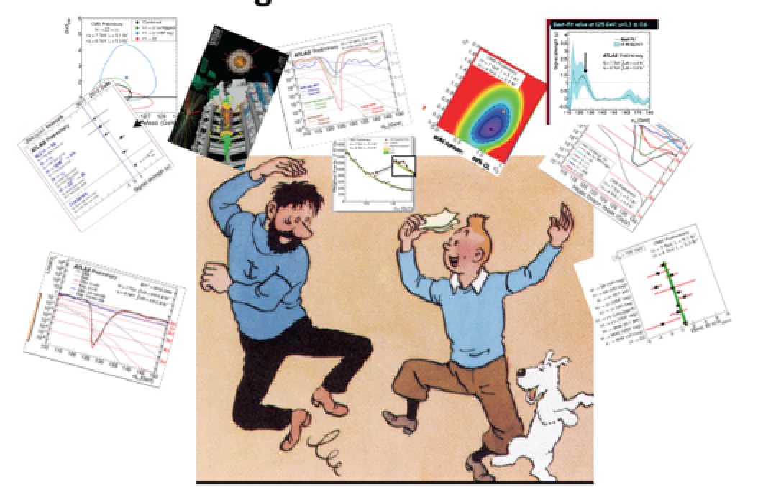
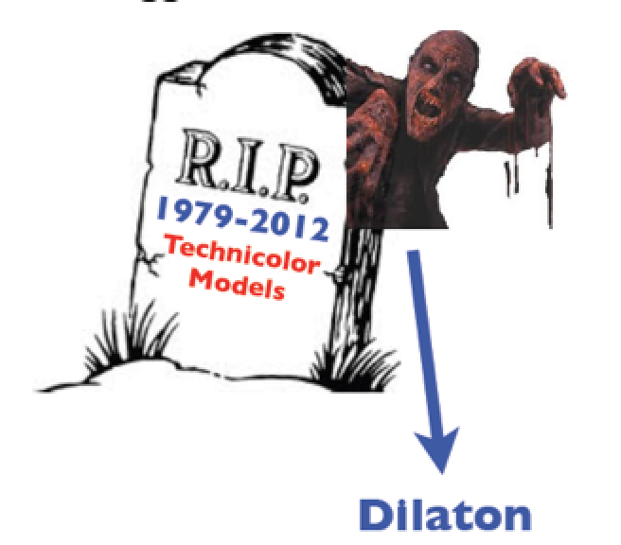
The Theorist and Experimentalists
The party in 2012!
Not everybody at the party
eg higgsless models…
A. Pomarol ICHEP2012
But careful about resurrections, Higgs imposters…

Slide 6
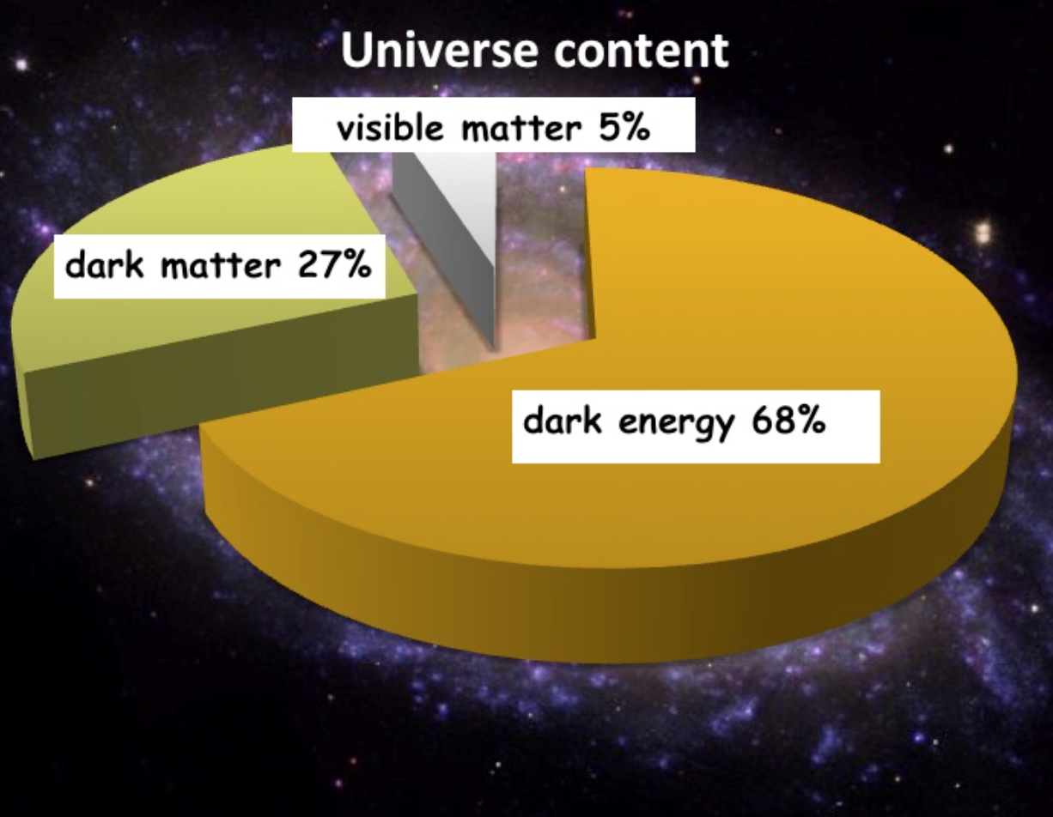
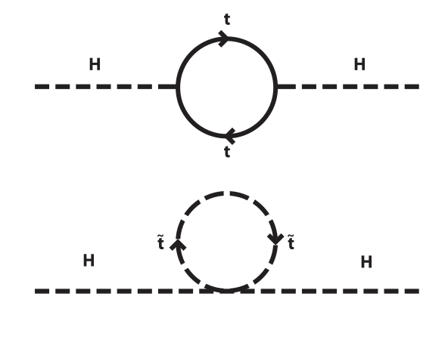
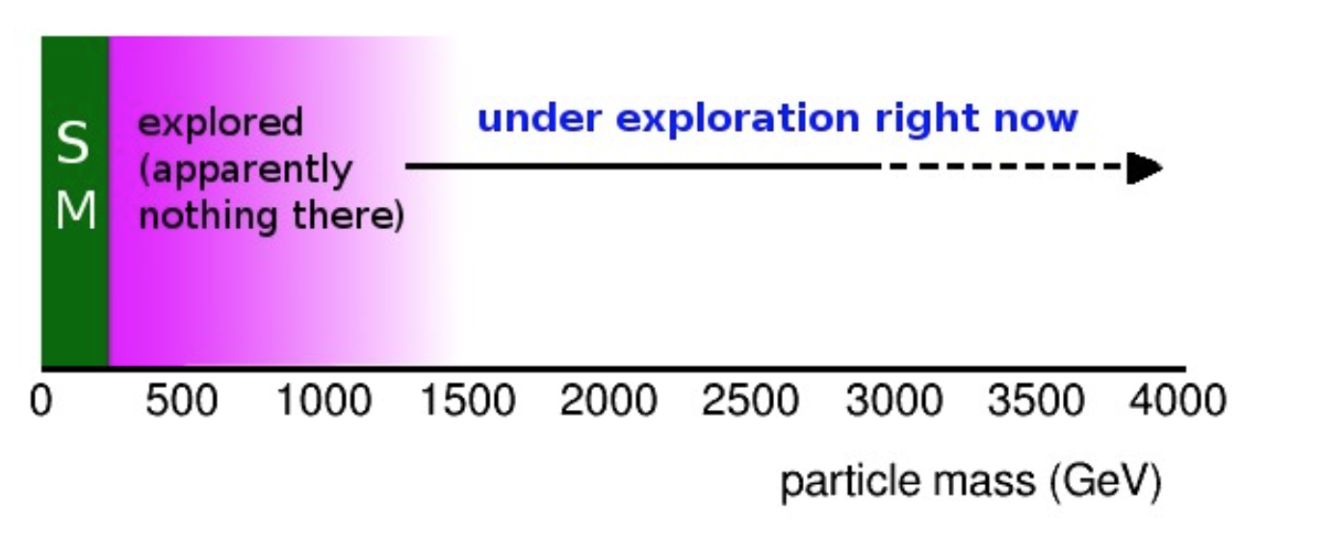
Physics Beyond the Standard Model?
A Higgs at 125 GeV
Precise measurements of the top quark and the Higgs mass
arXiv:1403.6535
We also know that:
New Physics inevitable?
But at which scale/energy?
fermion
Searches!!
boson
N. Arkani-Hamed

Slide 7
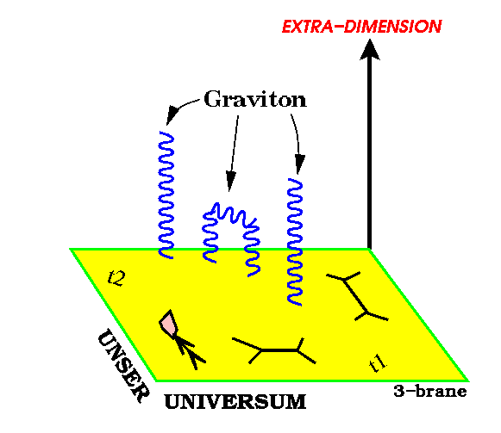
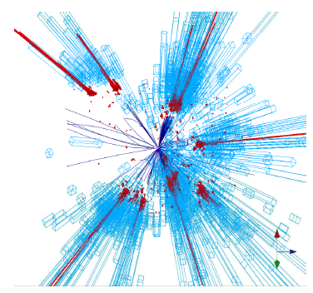
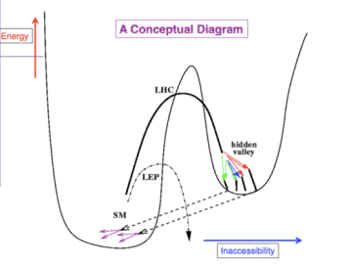
New Physics?
New Gauge Bosons?
Supersymmetry
ZZ/WW resonances?
Technicolor?
Little Higgs?
Extra Dimensions?
Hidden Valleys?
Black Holes???
What stabelizes the Higgs Mass? Many ideas, not all viable any more
A large variety of possible signals. We have to be ready for that
Notes:
6

Slide 8
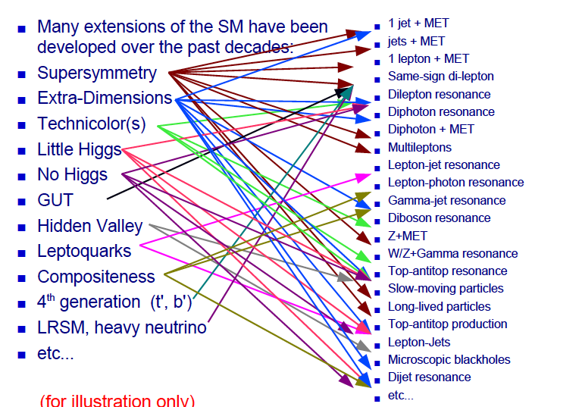
Beyond the SM Signatures

Slide 9
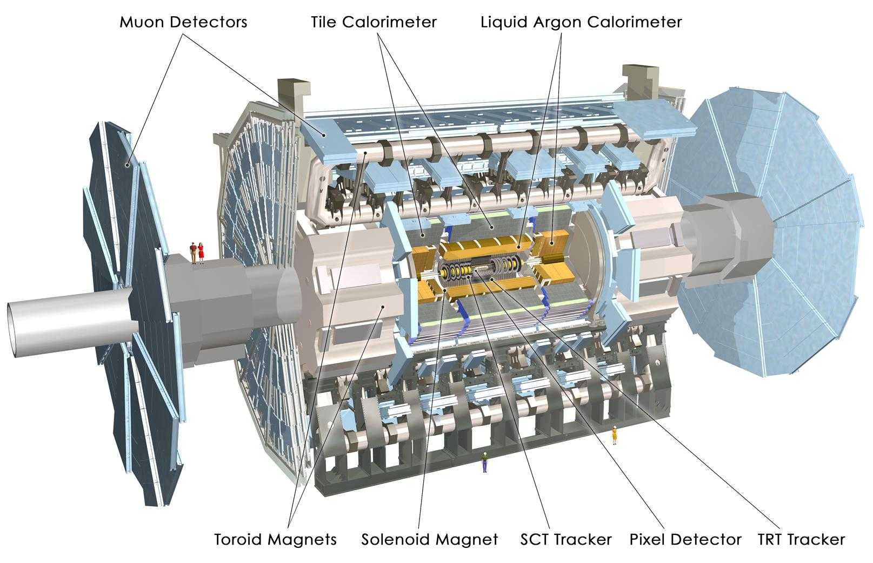
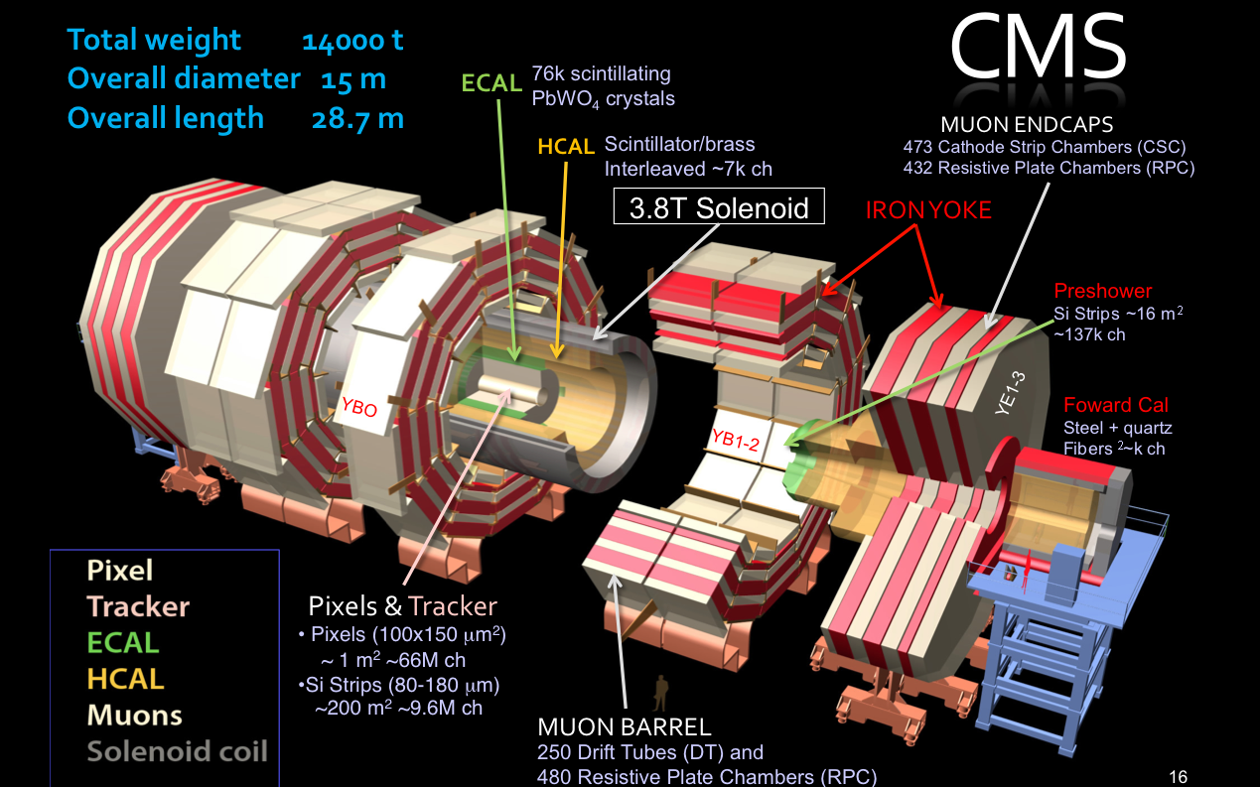
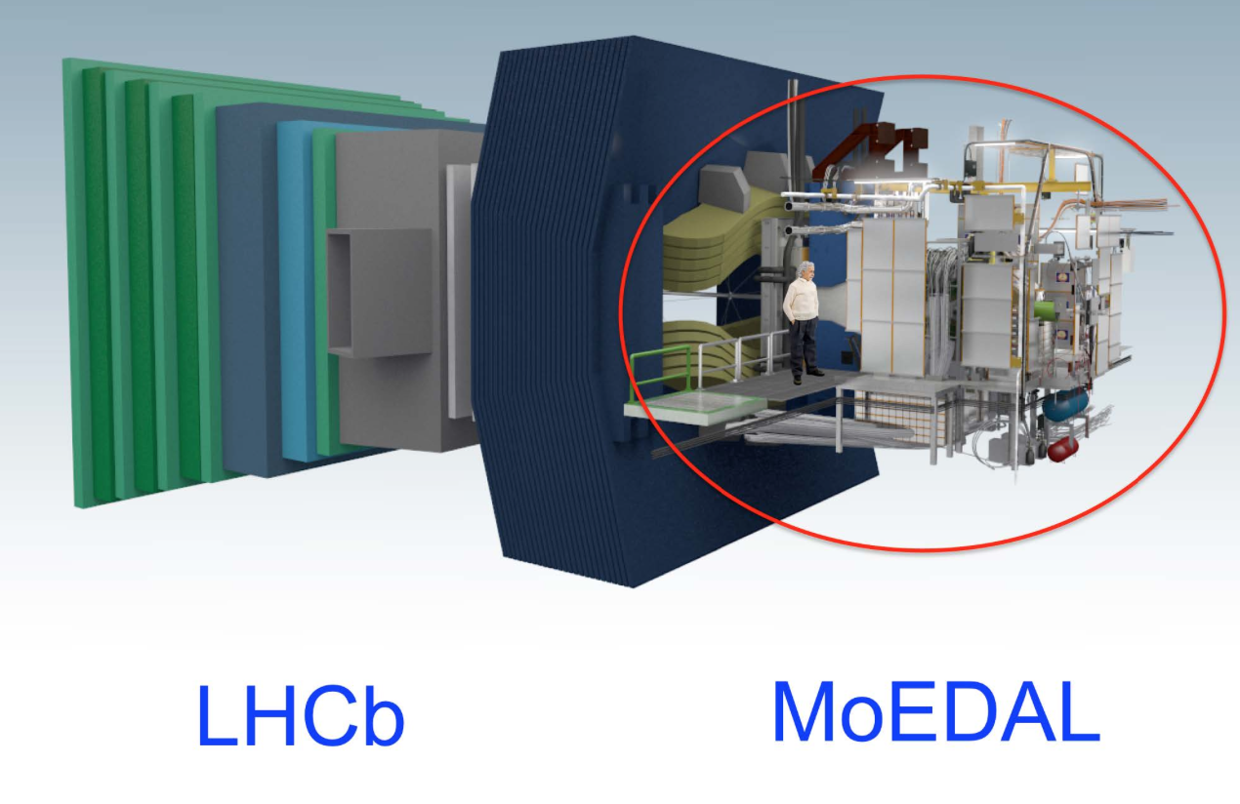
New Physics Hunters @ the LHC
The ATLAS experiment
The CMS experiment
…And also LHCb and MoEDAL

Slide 10
Searches for BSM Physics
First Searches at the LHC (2010-2012)
Supersymmetry with MET plus jets, lepton(s), photons
Extra Dimensions and black holes, heavy resonances (in electrons, muons, taus, jets), leptoquarks, excited leptons and quarks, 4th generation, a few very exotic signatures (R-hadrons)…
Evolved Searches (2013-…)
Supersymmetry on third generation squarks, compressed spectra, stealth SUSY, EWKinos, VBF processes…
Higgs in decays or as study object, vector-like quarks, boosted objects, long lived particles, fractional charges…
More dedicated Dark Matter searches!
We are now are at 13/14 TeV…
Back to the basics or do we change paradigm?

Slide 11
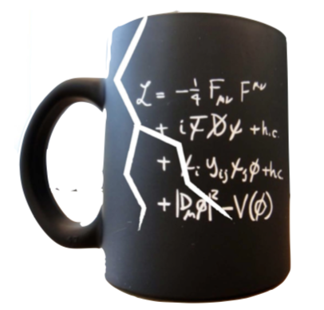
Searches for BSM Physics

Slide 12
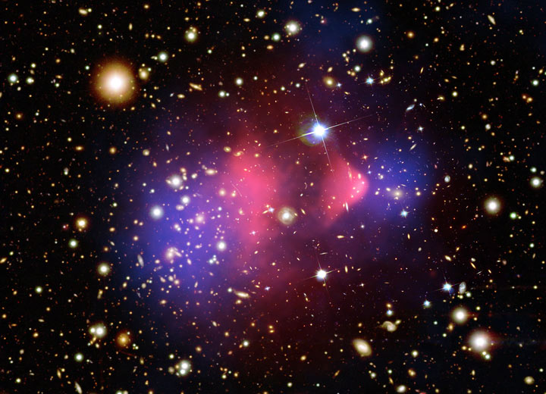
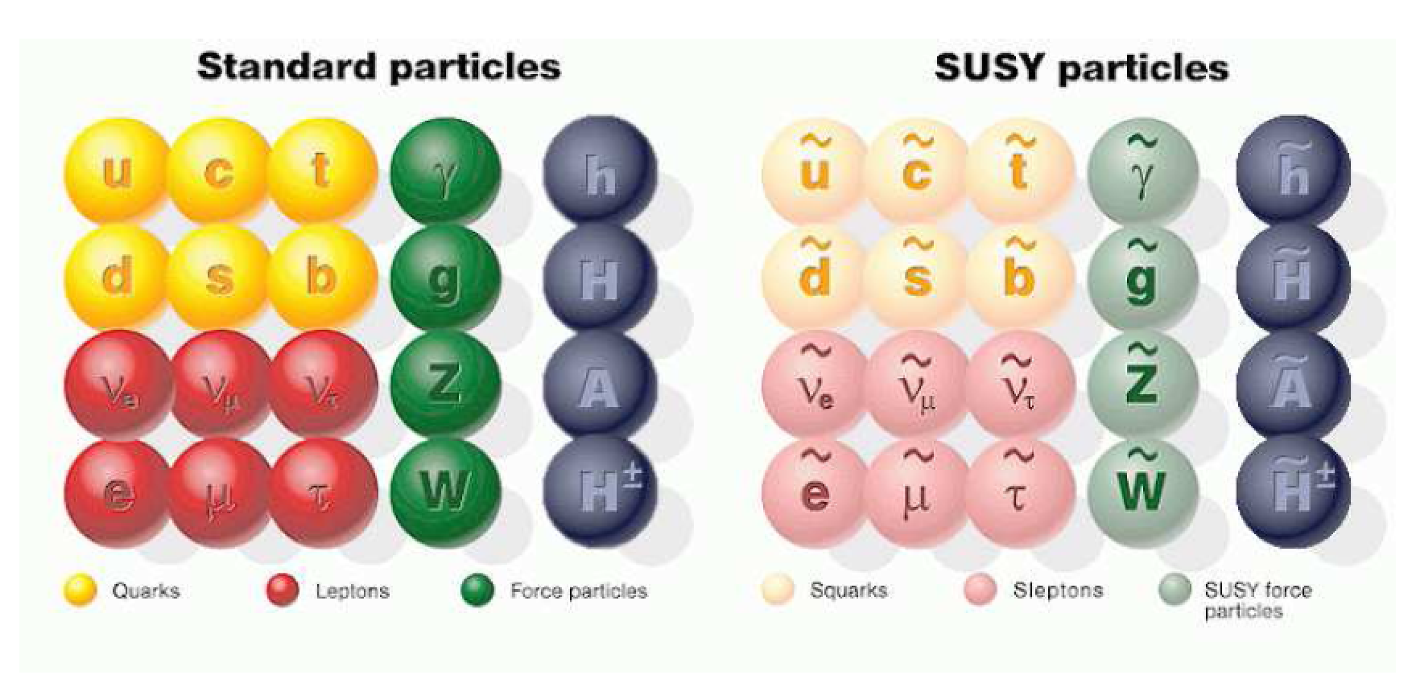
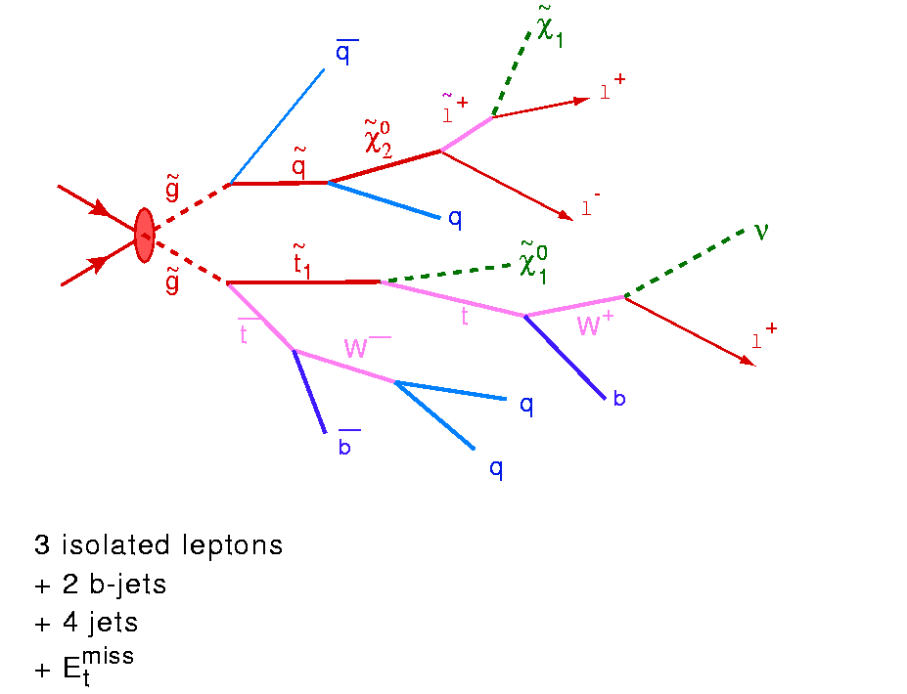
Beyond the Higgs Boson
Supersymmetry: a new symmetry in Nature?
Candidate particles for Dark Matter
⇒ Produce Dark Matter in the lab
SUSY particle production at the LHC
Picture from Marusa Bradac

Slide 13
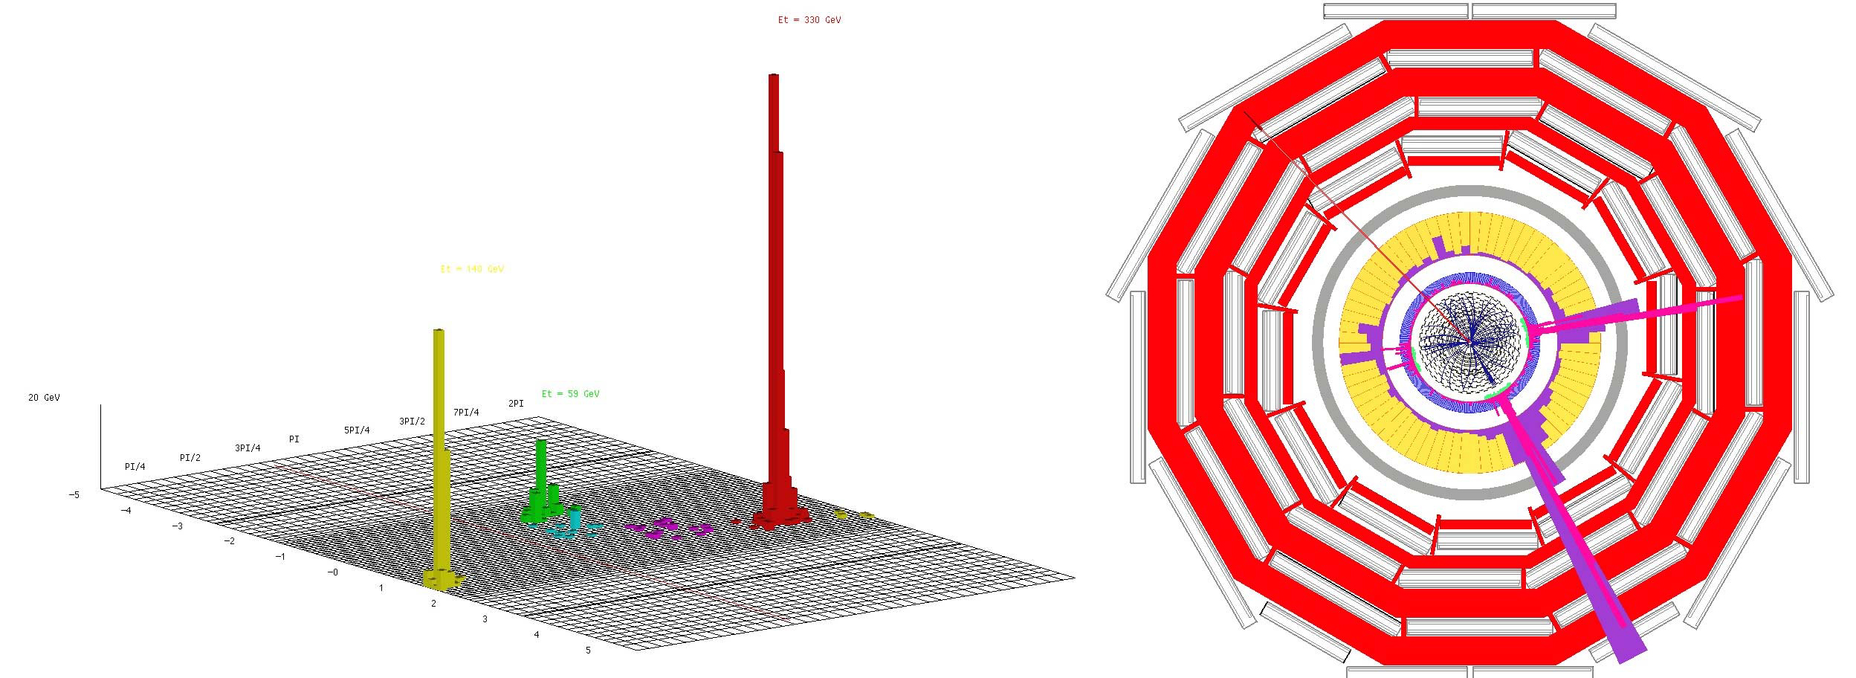
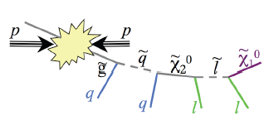
Detecting Supersymmetric Particles
simulation
Energy produced in the detector
θ
φ
Supersymmetric particles decay and produce a cascade of jets, leptons and missing transverse energy (MET) due to escaping ‘dark matter’ particle candidates
Very prominent signatures in CMS and ATLAS

Slide 14
Why SUSY is good for you!!

Slide 15
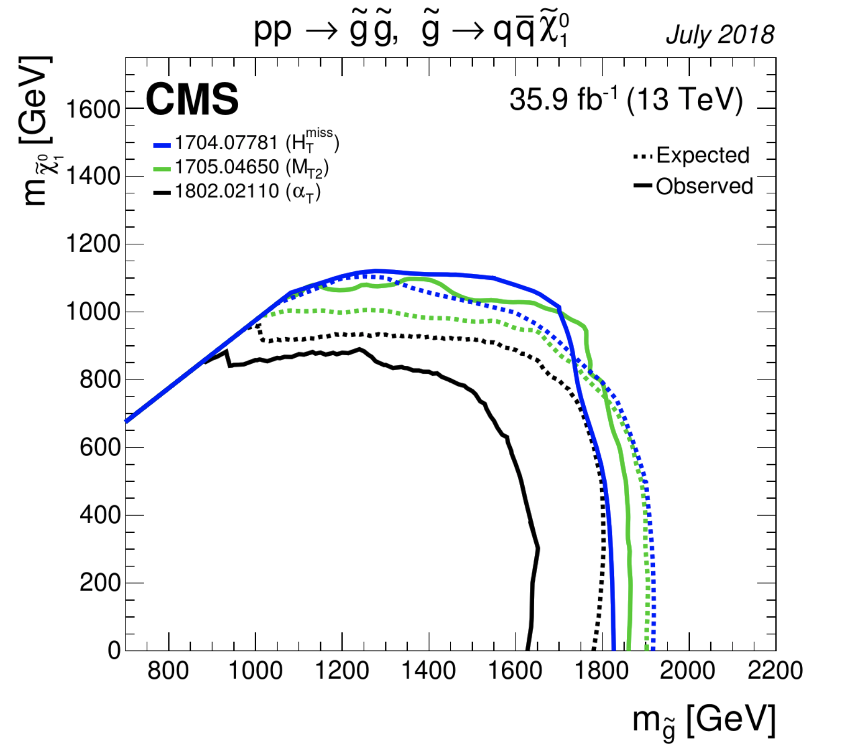
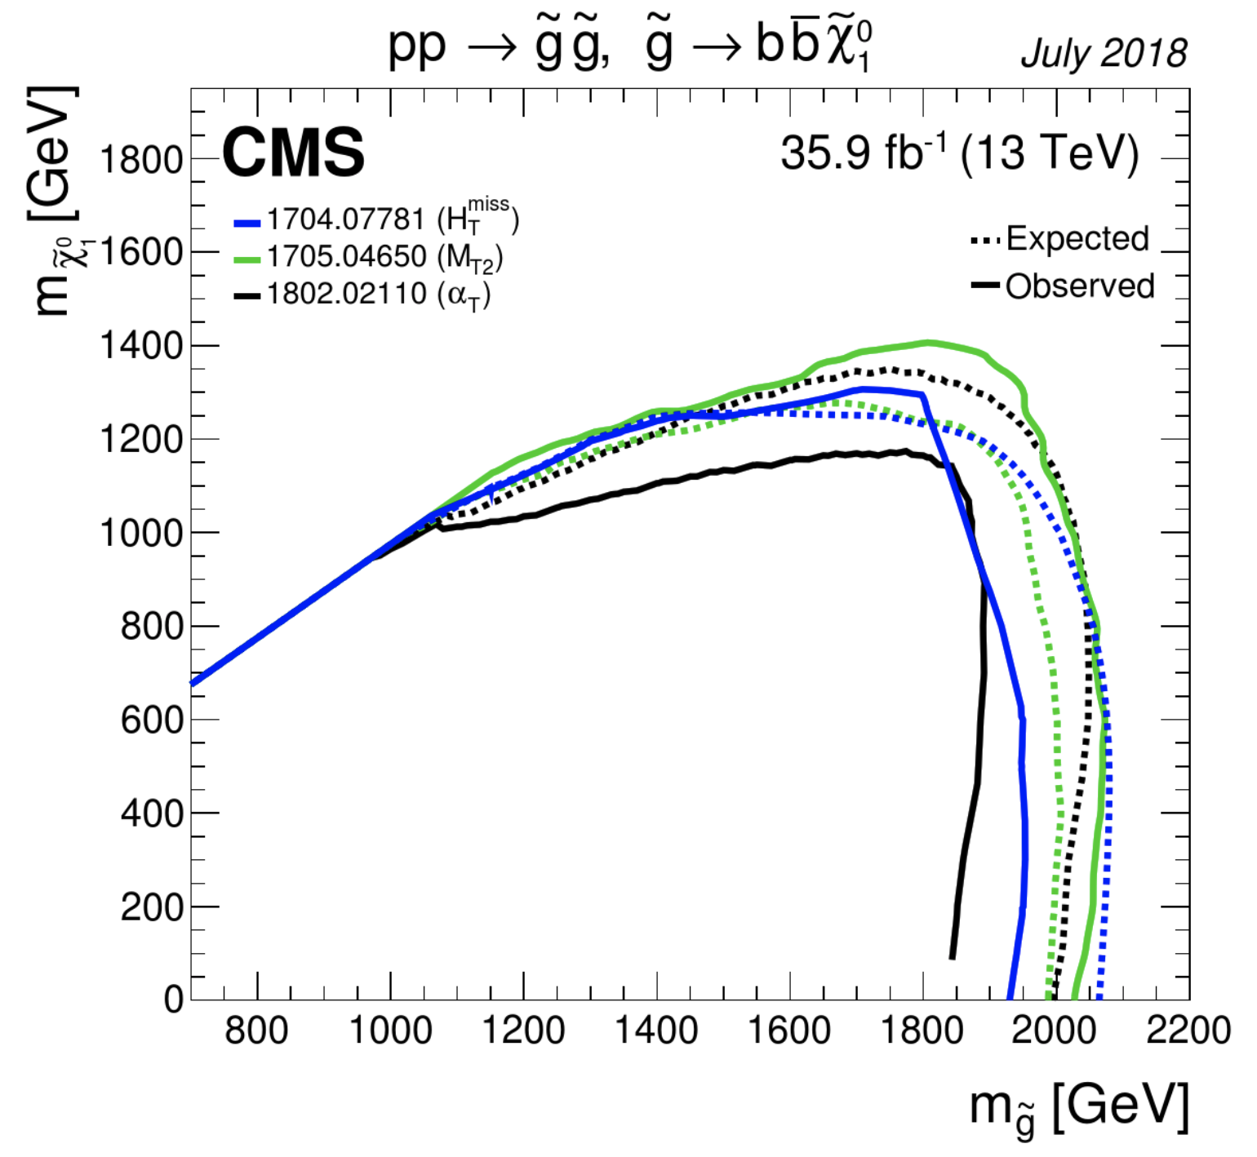
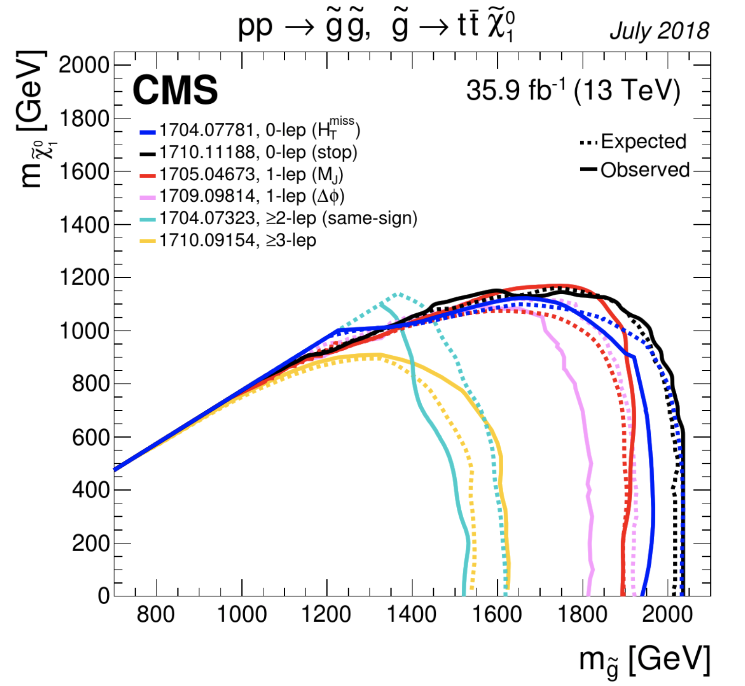
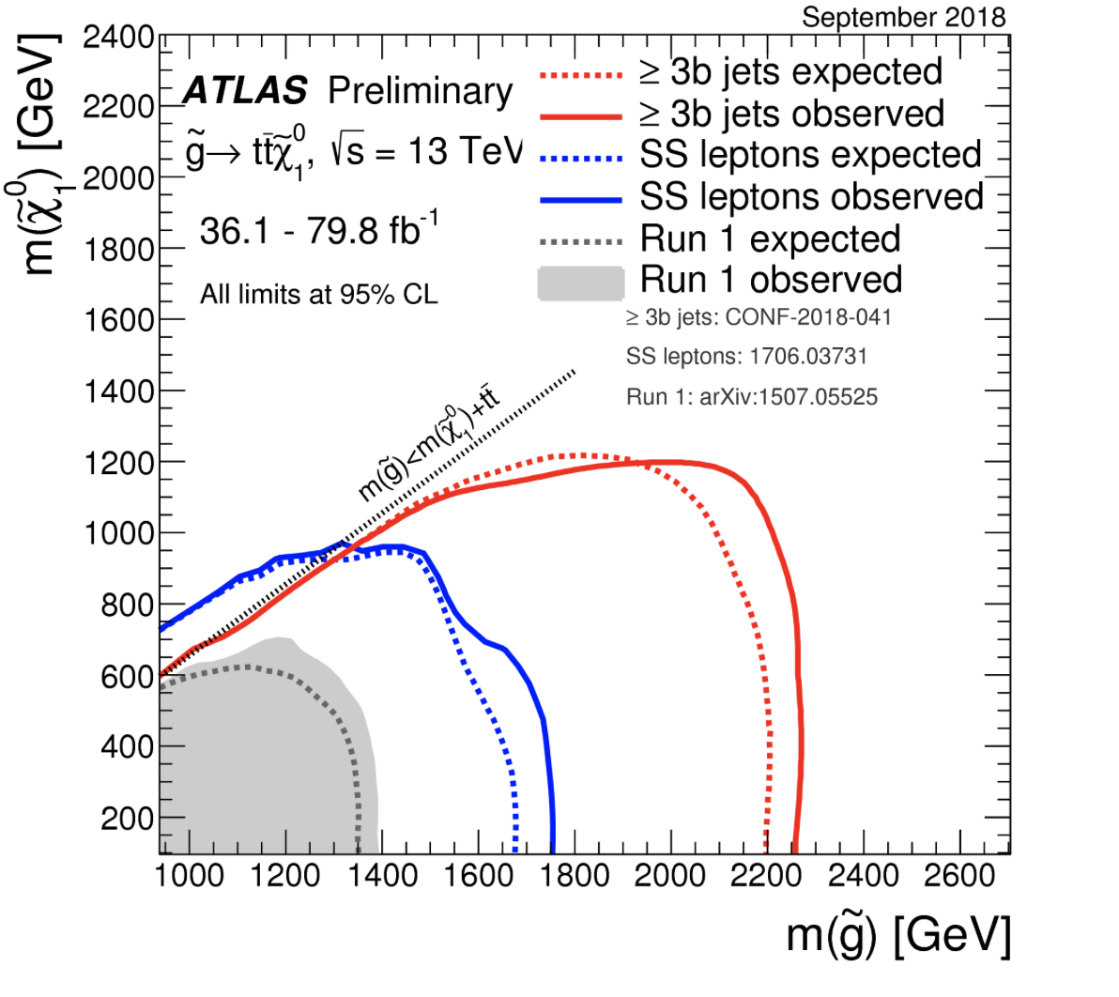
Supersymmetry: Gluinos
Interpretation in simplified models (SMS)
No significant signal to date
Within the context of the SMS:
Exclude with gluino masses ~ 2200 GeV for neutralino masses up to 800 GeV

Slide 16
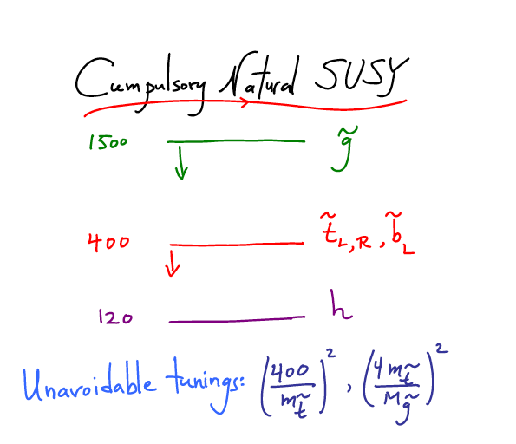
What is really needed from SUSY?
End 2011: Revision!
N. Arkani-Ahmed
CERN Nov 2011
Papucci, Ruderman,
Weiler arXiv:1110.6926
LHC data end 2011
Stops > 200-300 GeV
Gluino > 600-800 GeV
Moving away from
constrained SUSY models
to ‘natural’ models
Natural SUSY survived
LHC so far, but we
are getting close to
push it to its limits!

Slide 17
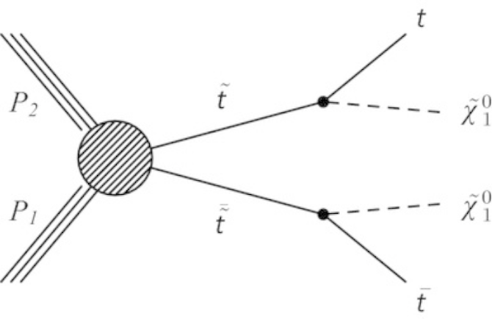
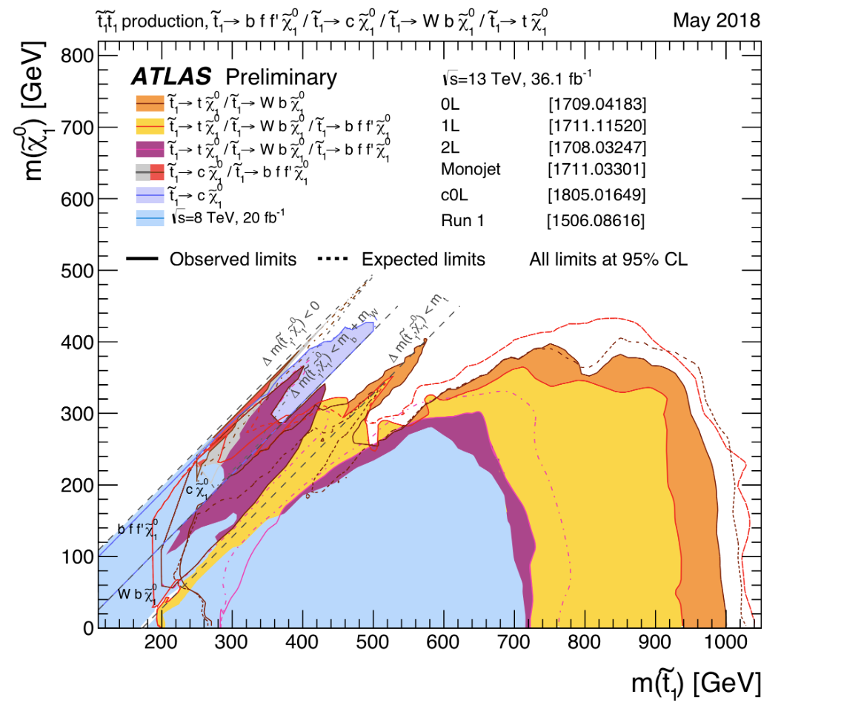
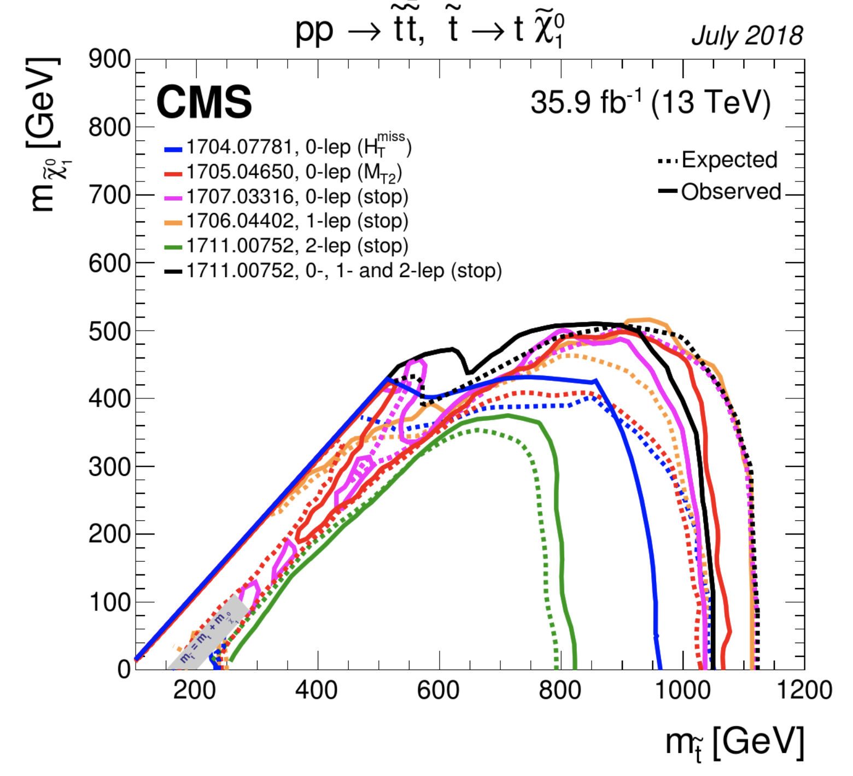
Top Squark Search Summaries
Partner of the top quark – the stop– plays
a prominent role in Natural Models
Within the context of the SMS:
Exclude with masses up to 1100 GeV for neutralino masses up to 500 GeV
Is this getting critical for Natural Models??

Slide 18
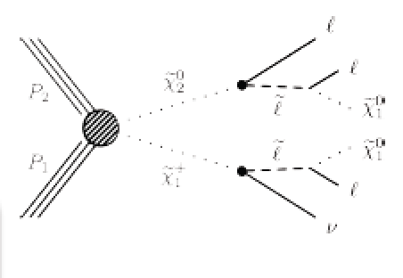
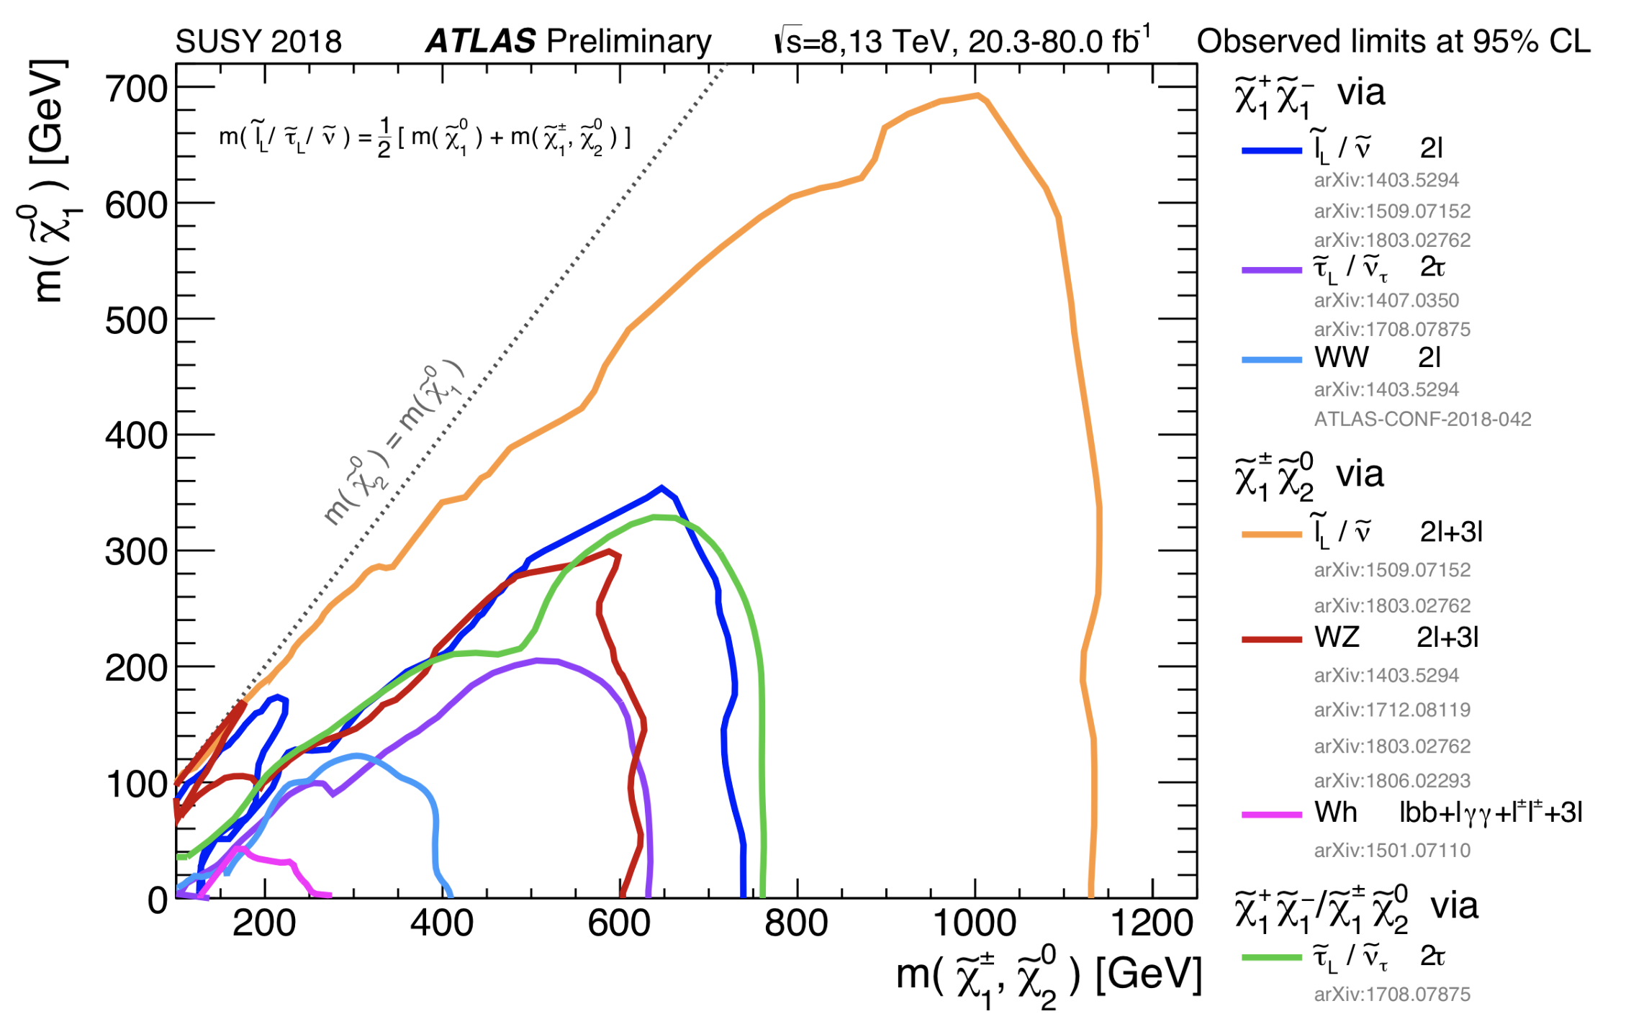
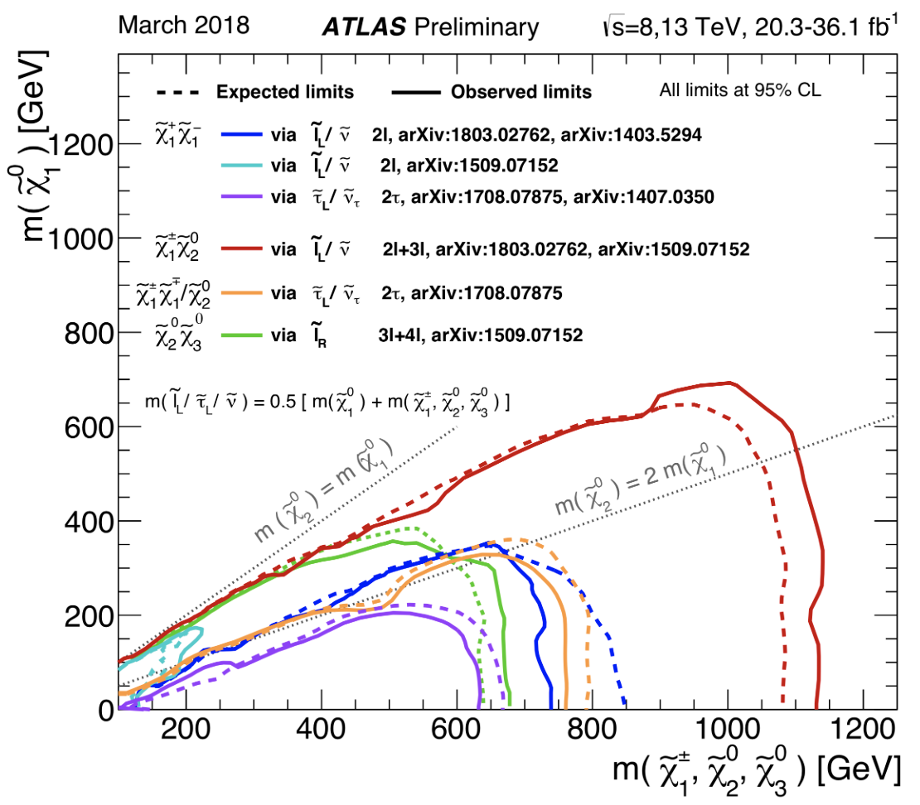
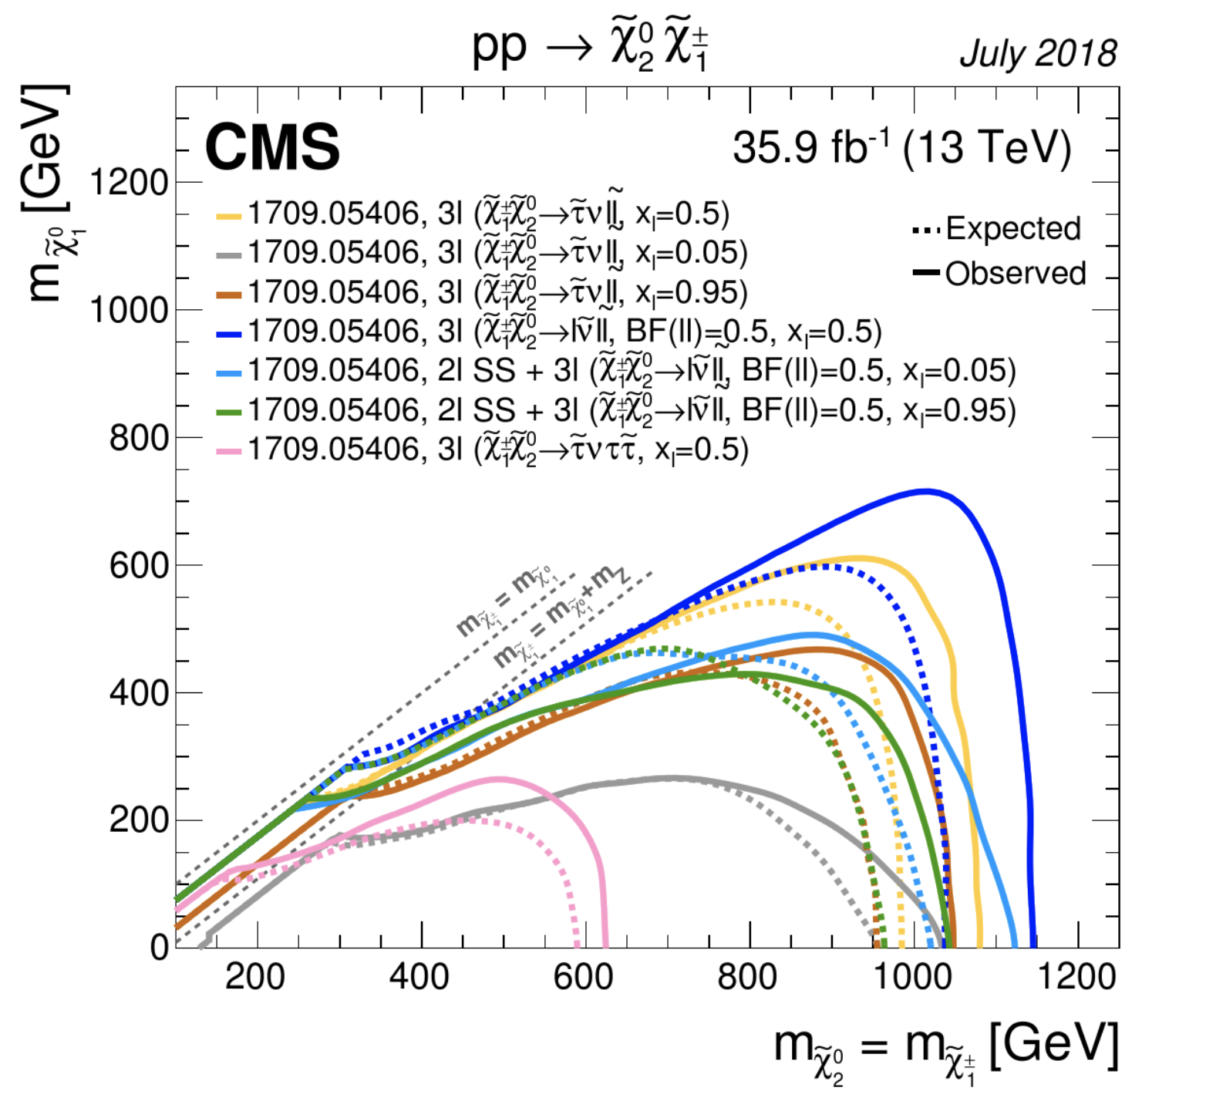
Chargino and Neutralino Production
Direct production of “electro-weakino pairs
•Decays via sleptons /sneutrinos
•Using benchmarks to illustrate different scenarios
•Multilepton searches (incl. taus)
Exclude masses up to 1100 GeV for neutralino masses up to 700 GeV

Slide 19
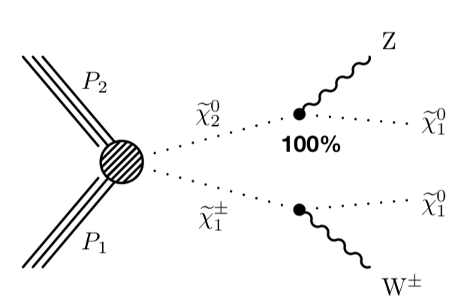
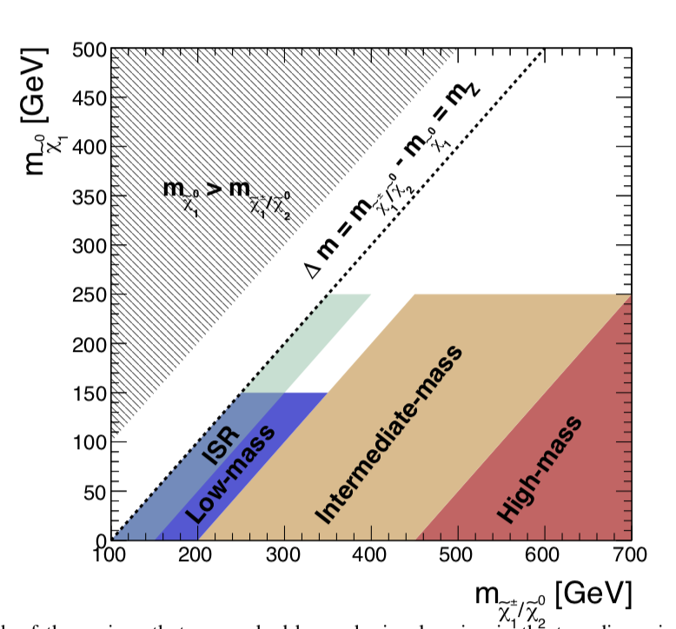
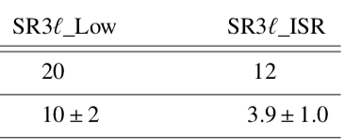
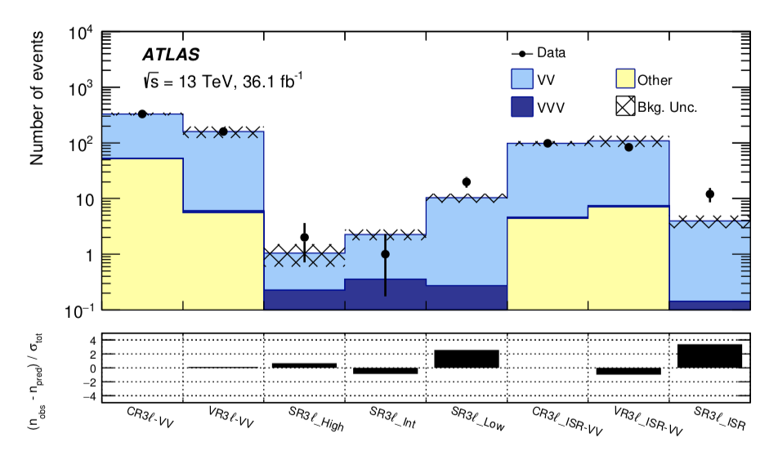
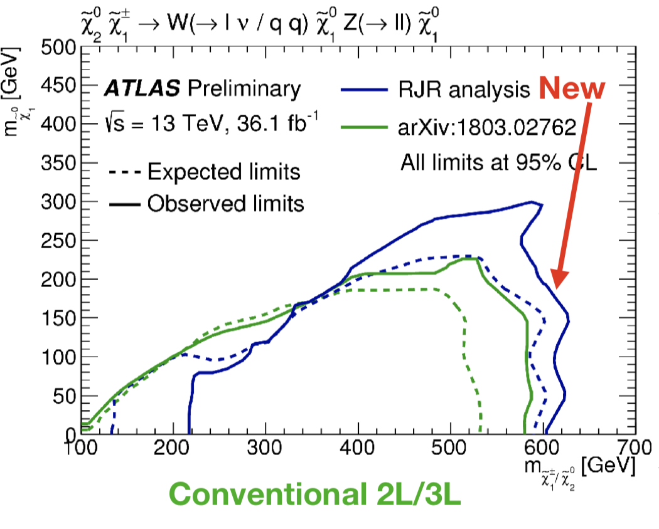
Chargino and Neutralino Production
Chargino–neutralino pair production in WZ +MET channel
•Address scenarios with small mass-splittings between
the parent particle and lightest SUSY particle plus Z
•Use a new reconstruction technique: Recursive Jigsaw Reco
Excess observed in 4 low ΔM regions ranging from 1.5σ->3σ
arXiv:1806.02293
Compatible with
previous studies?
To be watched…
But “3σ”s have
come and gone..

Slide 20
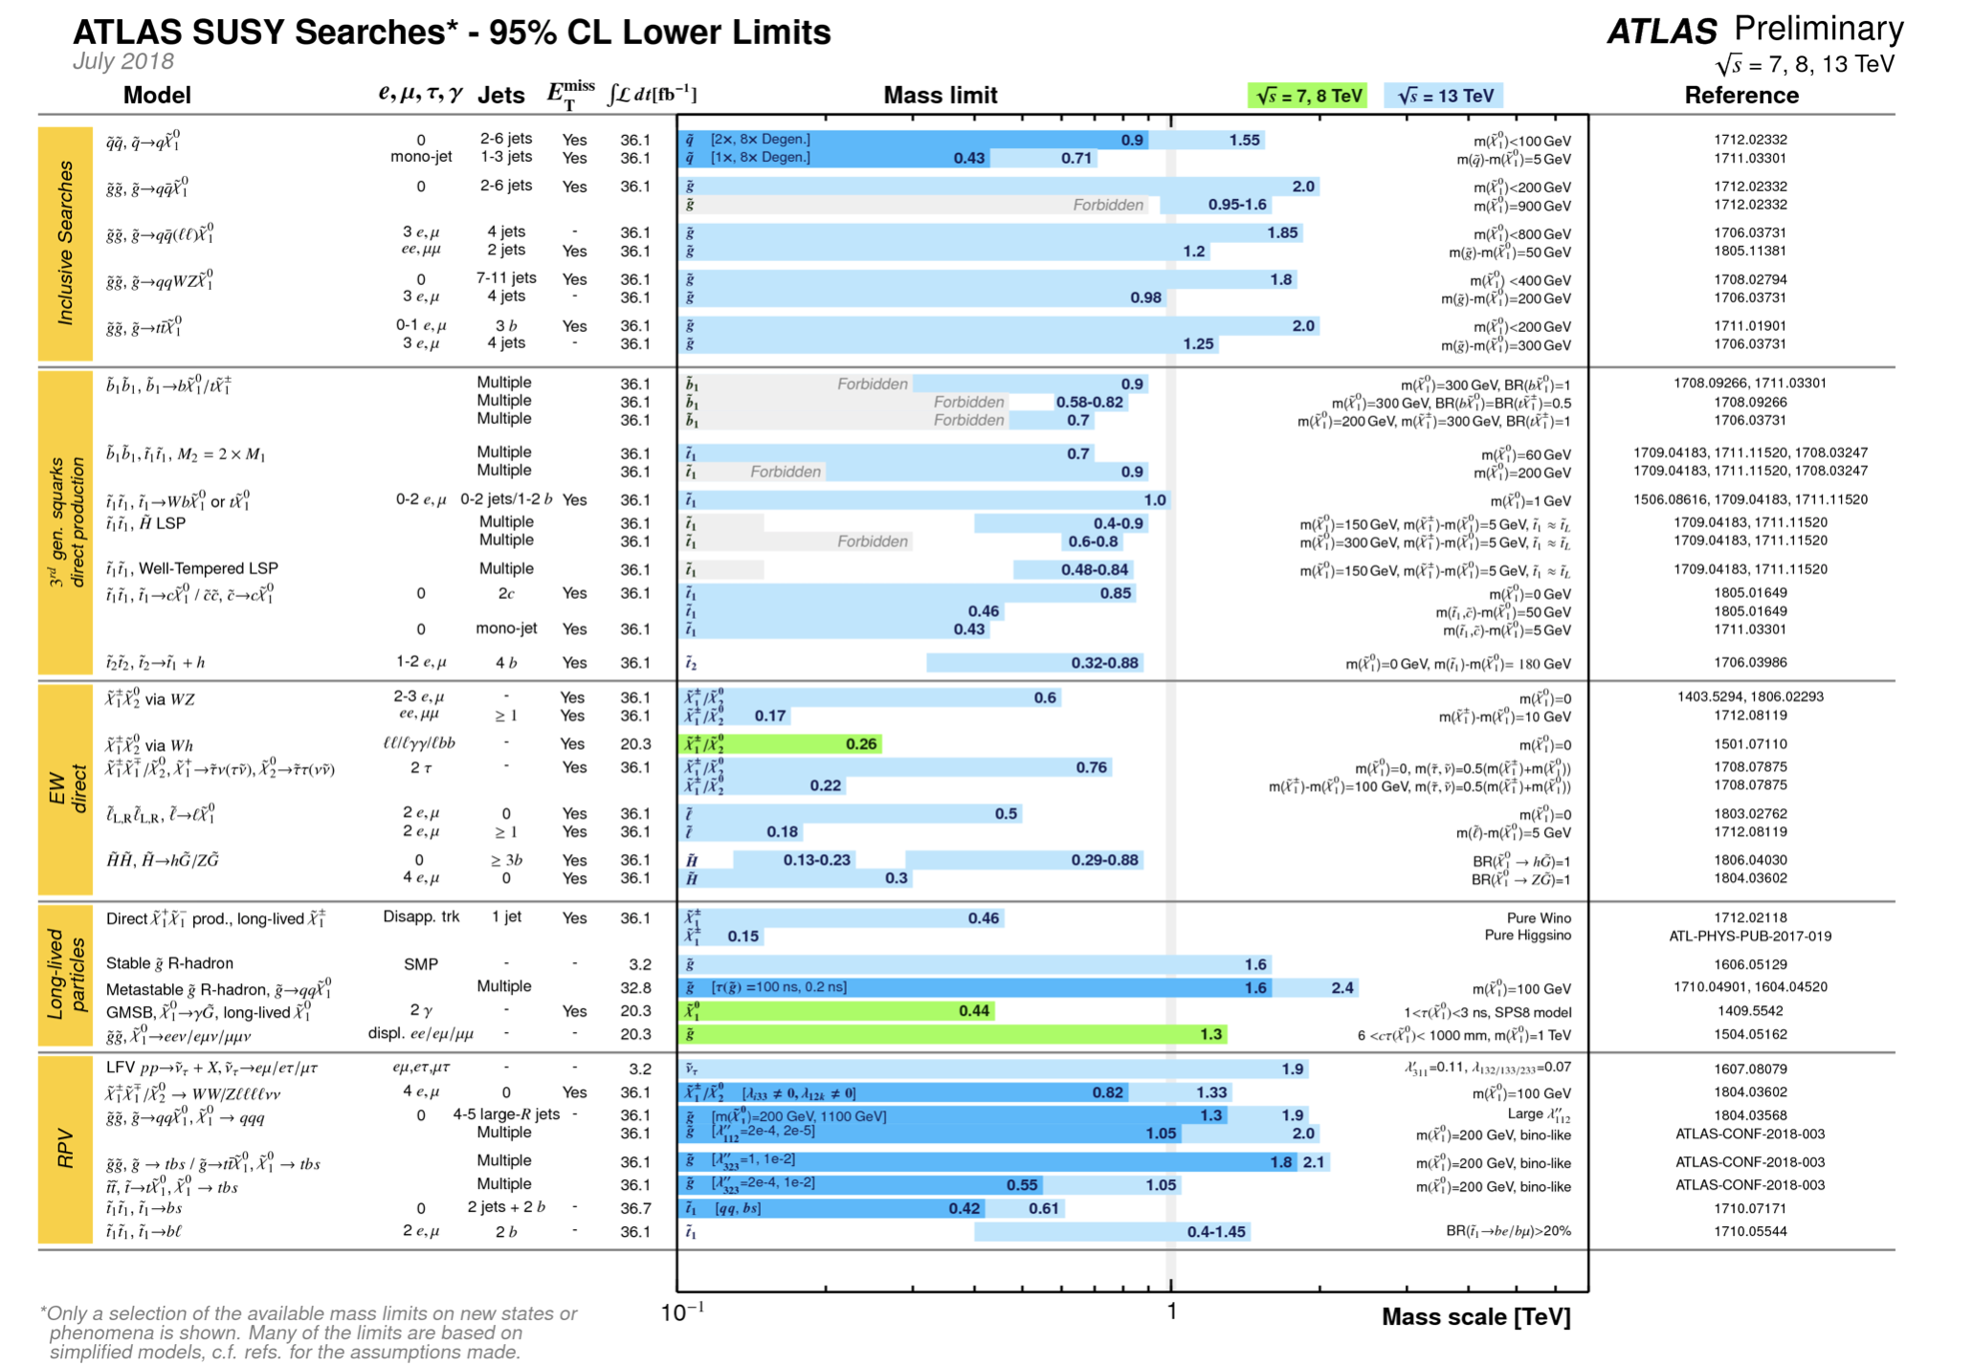
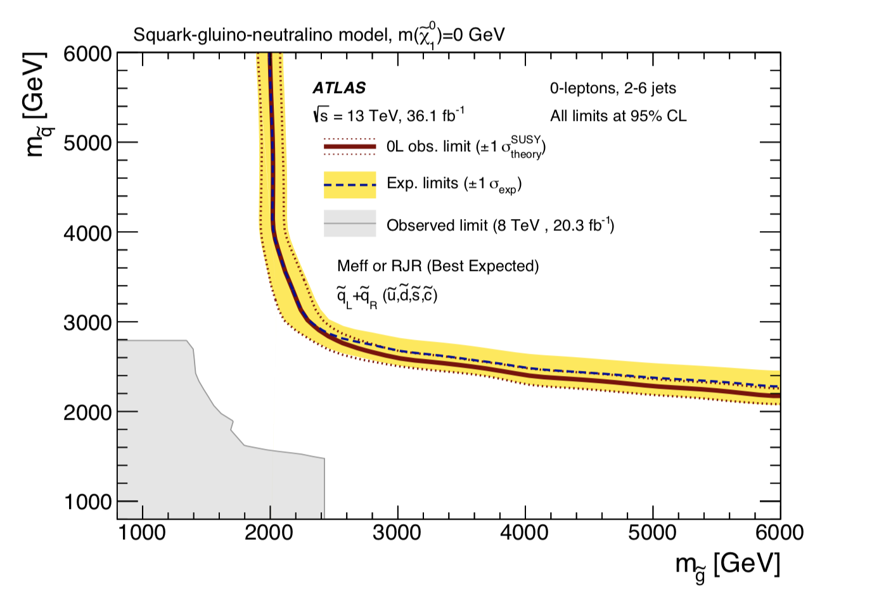
The SUSY SEARCH Chart So Far…
Limits from individual
analyses
Excluded squark and
gluino mass region
excluded

Slide 21
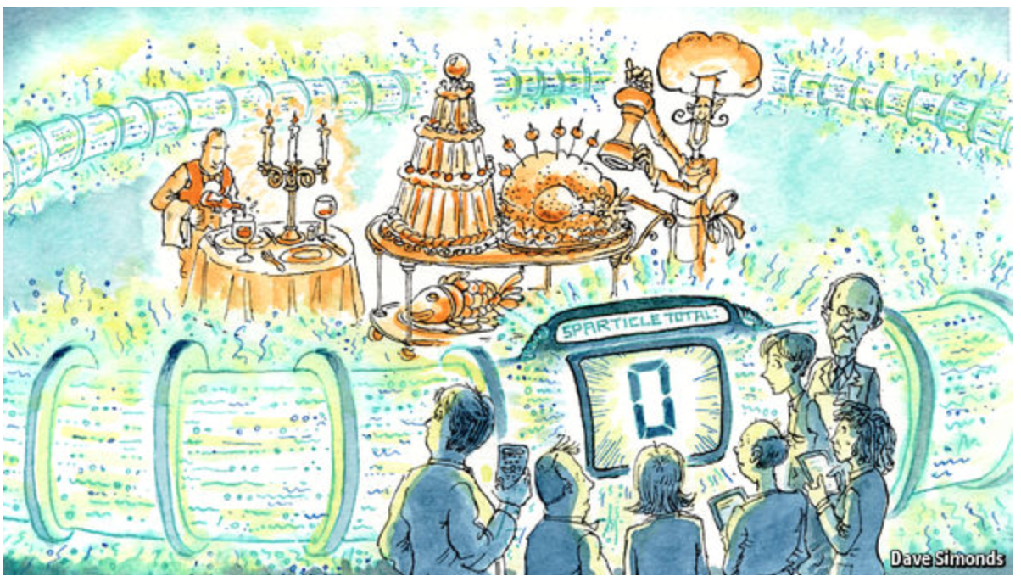
SUSY (as seen from outside HEP…)
But not giving
up as yet!!!
Keep the party
ready..
So far 2016
data analysed
2017+2018
(4x increase of
statistics) is
coming
November ‘16 reported by The Economist (!?!):
http://www.economist.com/news/science-and-technology/21709946-supersymmetry-beautiful-idea-there-still-no-evidence-support-it

Slide 22
J. Ellis

Slide 23
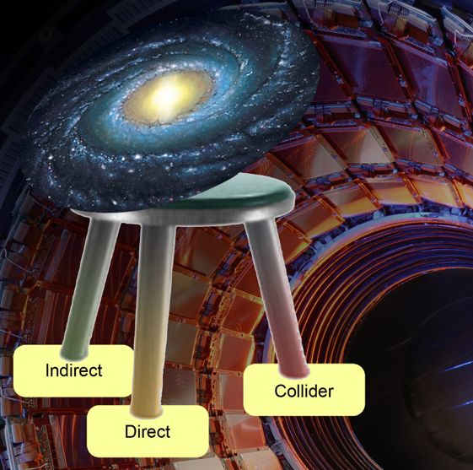
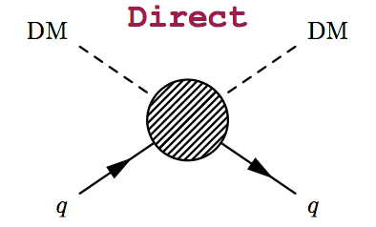
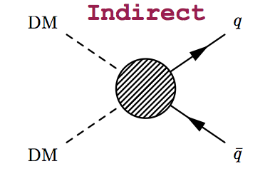
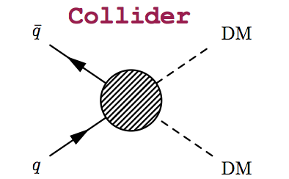
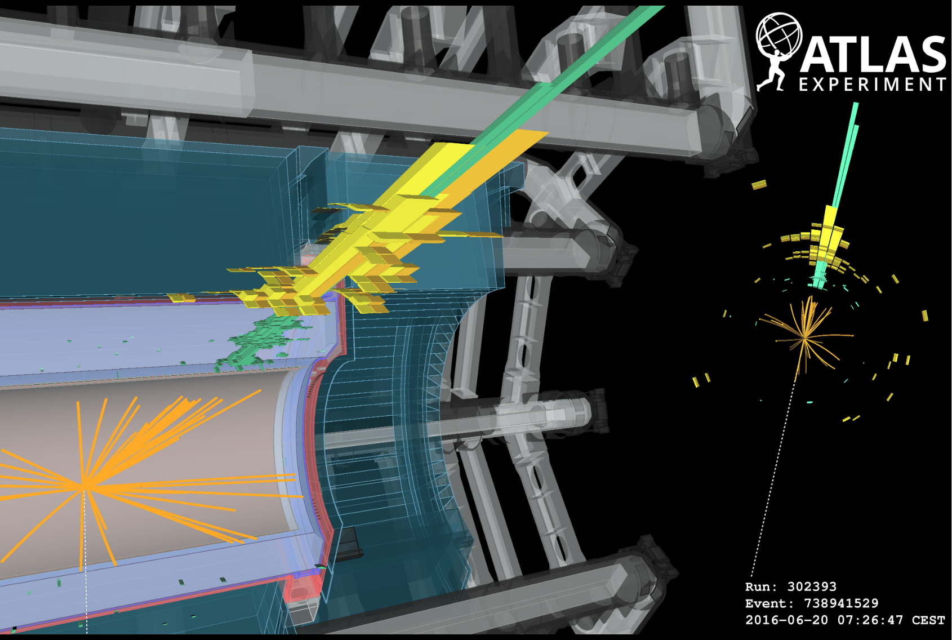
Dark Matter Searches at the LHC
•Identifying Dark Matter is one of the most important questions in physics today!
•It is likely a new as yet undetected particle
•Can it be produced
at the LHC?
Is Dark Matter
a new weakly
interacting particle?

Slide 24
A High p_{T} Mono-jet event

Slide 25
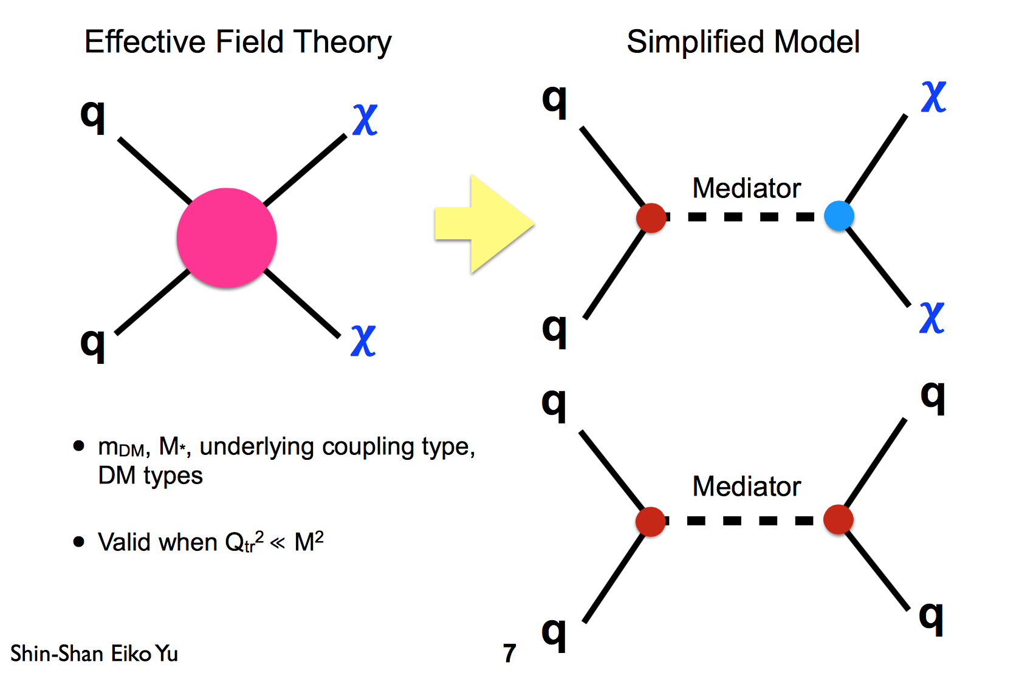
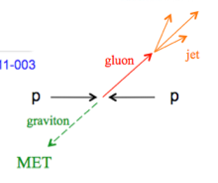
Mono-object Searches in CMS
Mono-jets: Generally the most powerful
Mono-photons: First used for dark matter Searches
Mono-Ws: Distinguish dark matter couplings to u- and d-type of quarks
Mono-Zs: Clean signature
Mono-Tops: Couplings to tops
Mono-Higgs: Higgs-portals
Higgs Decays?
Are Dark Matter weakly interacting
massive particles (WIMPs?)
Example Monojets
Dark Matter?

Slide 26
Comparison with Direct Detection
No signal seen in any of the “mono”-signals so far
Extend limits by search for the mediator
Axial-vector mediator and
Spin-dependent direct limits
Vector mediator and
Spin-independent direct limits
90% CL limits
Mono-jet/V & Dijet searches are typically the most sensitive ones

Slide 27
Extra Space Dimensions
Problem:
arXiv:1712.02345
Search for monojets
No signal found yet
New Planck scale is
larger than 6-10 TeV
The Gravitational force can become strong!

Slide 28
Search for Micro Black Holes
Extra Dimensions!
2015: 12 jet event with S_{T}=5.4 TeV
Planck scale
a few TeV?
arXiv:1805.06013
Look for the decay producs
of an evaporating black hole
-Define S_{T} to be the scalar
sum of all high p_{T} objects
found in the event
-Look for deviations
at high S_{T}
Black hole mass excluded up to ~10 TeV depending on model assumptions

Slide 29
Dijet Resonance Searches @13TeV

Slide 30
Search for Di-jet Resonances
Search for dijet
resonances based
on 2016+2017
data sample
PAS EXO-17-026
Slow increase in
mass reach of ~ few
100 GeV
More Luminosity
-> test smaller
couplings

Slide 31
Search for Di-jet Resonances
Searches in the low di-jet mass region
Problem is the high trigger rate for low thresholds
-> Use high p_{T} initial state radiation jet for trigger

Slide 32
Are Quarks Elementary Particles?
Rutherford experiment:
Unexpected backscattering
of α-particles:
Evidence for the structure
of atoms !! (1911)

Slide 33
Are Quarks Elementary Particles?
CONF-2016-069
Measurement of the production angle
of the jet with respect to the beam
-> High Energy Rutherford Experiment
Quarks remain elementary particles after these first results

Slide 34
E.g. Di-lepton Resonance
Example
pp→μμ +X
Plot the di-lepton
invariant mass
A peak!!
A new particle!!
A discovery!!
G ?
μ
μ
If we are lucky:
a signal could be
seen very early on

Slide 35
Lepton+MET/Dilepton Searches
Search for dilepton resonances (Z’…) or lepton+MET (W’…) searches
EXO-18-006
e
e
ATLAS-2018-17
Analyses that include
2017 data!
W’ in context of sequential SM excluded
up to 5.5 TeV wth 80 fb⁻¹
Extended from 5.2 TeV (36 fb⁻¹)

Slide 36
Searches for Heavy Resonances
Decays into bosonic and leptonic final states: combined results
Heavy vector-boson triplet and KK graviton models for interpretation
arXiv:1808.02380
No Excess: Limits in the
range of 4.5 -5.5 TeV
2.3 for KK gravitons
arXiv:1808.02380

Slide 37
Search for Heavy Neutrinos
Results interpreted
in left-right
symmetric models
Like-sign and
opposite-sign
lepton pairs
Similar limits for
Dirac and Majorana
arXiv:1809.11105

Slide 38
Low Mass Diphoton Spectrum
A search for X->γγ at low mass
An excess is observed in the 8 TeV data (2σ at 97.6 GeV) and 13 TeV
(2.9σ at 95.3 GeV) -> Combined gives a 2.8σ local excess at 95.3 GeV
CMS-HIG-17-013
ATLAS-CONF-2018-025
Probably not ☹ … ATLAS does not see the same size of effect…
Let’s see with more data in future…
What does ATLAS say?

Slide 39
Search for New Resonances
arXiv:1808.01890
NMSSM Higgs inspired search in mass range 12-70 GeV
-Search for bump in muon pair mass spectrum with associated b-jets
-SR1: 2 muons + one central and one forward jets (|η| >2.4), at least 1 b
-SR2: 2 muons + 2 central and no forward jets, at least 1 b
8 TeV Data
Both regions are independent
Excess seen in the both
regions around 28 GeV
SR1: 4.2σ local significance
(~3.0σ global sign.)
SR2: 2.9σ local significance
The Guardian
31/10/2018

Slide 40
Search for New Resonances
13 TeV Data
….No significant deviation..
Fiducial cross
section and
‘prediction’
for 13 TeV
Are the 13 TeV data a killjoy? ☺ ATLAS results @ 8 TeV?…

Slide 41
How to Become an Ambulance Chaser?
Remember the 750 GeV bump in CMS and ATLAS??
-> End of 2015/early 2016

Slide 42
Exotica Searches: Limits

Slide 43
Vector-Like Quarks
✱
VLQs to tame the
quantum corrections
VLQs: Lower limits
presently in the
800-900 GeV range
✱ Composite Higgs
CMS

Slide 44
A Global View! Generic Searches
arXiv:1807.07447
Model independent search
•Divide events into exclusive classes
•Study deviations from SM predictions
in a statistical way
CMS-EXO-10-021
example
2.5 fb^{-1/}13 TeV (>700 classes)
Checking for bumps in invariant
and effective mass of objects
No significant deviation found
Beyond what is expected from statistics

Slide 45
Are we leaving no stone unturned?
The LHC BSM searches are indispensable and should be continued in the new energy regime and with increasing statistics (higher mass, lower couplings)
But if we still do not see more than a 2 sigma at the end of run-3, the HL-LHC will be likely mostly a precision physics machine, searching for subtle deviations
Are we looking at the right place? Time for more effort in thinking of complementary searches?
Are we looking at the right place?
Leave no stone unturned!!

Slide 46
Searches for Long Lived Particles
Increasing interest and effort:
Look for unusual signals in the
detector from long-lived particles
•Example disappearing tracks ->
•Search for charginos, almost
degenerate with neutralinos
(eg AMSB models)
Present coverage?
arXiv1712.02118
LHC-wide organized study ->
https://indico.cern.ch/e/LHC_LLP_October_2017

Slide 47
Search for Heavy Neutral Leptons
Neutrino portal: νMSM (Neutrino Minimal Standard Model)
Minimal extension of the SM fermion sector by Right Handed HNLs: N1, N2, N3.
arXiv:1802.02965
-> HNL hunting also focus of the SHIP experiment proposal

Slide 48
Multi Charged Particles
Pixel tracker
Use central tracker and de/dx measurement
to search for particles with electric charges
of 2e to 7e
arXiv:1812.03673
TRT tracker
Exclusion between 50 GeV and 980-1220 GeV

Slide 49
Long Lived Particle Searches

Slide 50
Long Lived Particle Searches
arXiv:1810.12602
Summary plots
from the above
reference, on
the present
coverage

Slide 51
LHC White Paper in Preparation
Web page: https://indico.cern.ch/event/649760
White Paper being finalized
Input from ATLAS, CMS,
LHCb, proposed specialized
experiments and theory
Complete by spirng of 2019
(~ 200 pages)
Also meetings with
LHC Dark Matter group

Slide 52
LHCb: Tests of Lepton Universality
A few puzzling results from the LHCb experiment…
If confirmed, independent checks
will become very important.
Belle II? ->in a few years form now
CMS has installed a special trigger to collect an unbiased b-sample which is active since 2018
-> about 10¹⁰ b-pairs collected
during 2018 via parked data stream
?
LHCb Update eagerly awaited ☺ !!!
Also:
?

Slide 53
Third Generation Leptoquarks
Candidate explanation: Leptoquarks with
couplings to second/third generation.
-> Check in ATLAS and CMS
Example search in the
tau-b final state
EXO-17-029
Blue region is preferred by the B-anomalies…

Slide 54
Monopole Searches: MoEDAL @ 13TeV
2016 data analysis base on 222 kg Aluminium to “stop” the monopoles and
search for them with a SQUID precision magnet (2.11fb⁻¹) arXiv:1712.09849
•Limits for different
monopole charges
•First monopole search
result @LHC at 13 TeV
No signal (yet)..

Slide 55
Proposals for New Experiments @LHC
MilliQan: searches for
millicharged particles
CODEX-b: searches for long lived
weakly interacting neutral particles
MATHUSLA: searches for long lived
weakly interacting neutral particles
FASER: searches for long lived
dark photons-like particles
Recent also AL3X (re-use of ALICE for LLP)…

Slide 56
LHC Outlook and Plans
All LHC experiments plan upgrades
for either 2019-2020 or 2024-2026
for the High Luminosity LHC upgrade
(ATLAS, CMS and LHCb, ALICE)
Approved LHC program to collect 3000 fb⁻¹
in total with the LHC (HL-LHC)
Maximize the reach for searches and for
precision measurements (eg Higgs)
LHC will run till ~2037
Only ~5% of the collisions delivered
so far…
Then a high energy LHC (28 TeV)?
This option is discussed @ CERN..

Slide 57
High-Energy LHC??
F. Gianotti
FCC meeting
Rome April 2016
16 TeV vs 14 TeV
28 TeV vs 14 TeV
WG set up to explore technical feasibility of pushing LHC energy to:
design value: 14 TeV
ultimate value: 15 TeV (corresponding to max dipole field of 9 T)
beyond (e.g. by replacing 1/3 of dipoles with 11 T Nb₃Sn magnets)
Identify open risks, needed tests and technical developments, trade-off
between energy and machine efficiency/availability
Report on 1) end 2016, 2) end 2017, 3) end 2018 (in time for ES)
Various options,
with increasing
amount of HW
changes, technical
challenges, cost,
and physics reach
HE-LHC (part of FCC study): ~16 T magnets in LHC tunnel (→ √s~ 30TeV)
uses existing tunnel and infrastructure; can be built at fixed budget
strong physics case if new physics from LHC/HL-LHC
powerful demonstration of the FCC-hh magnet technology

Slide 58
HL-LHC and HE-LHC

Slide 59
HL-LHC: examples
Higgs decay in 2 muons
W-mass precision
Using low pile-up runs
~ 8-10 MeV possible
if PDFs improve
SM HH sensitivity
Disappearing tracks
Higgs coupling sens.

Slide 60
Summary
Measurements of Standard Model processes show good agreement with predictions. Precise measurements require precise calculations.
New Higgs measurements at 13 TeV. So far the Higgs is very consistent with Standard Model expectations. All main decay and production channels now observed
No sign of new physics in the 13 TeV data so far… This starts to cut into the ‘preferred regions’ for a large number of models, like SUSY. Naturalness? …There are a few 3-sigma effects…
Dark Matter searches are being explored in a systematic way.
New physics in the flavour sector? New TH paradigms?
The LHC is continuing to explore the Terascale. It takes on significant deviation to show the way!! Collected ~ 150 fb⁻¹@ 13 TeV . …And hopefully one day soon now:

Slide 61
Neutral Long Lived Particles
Decaying into a displaced hadronic jet in the calorimeter
and the muon system
arXiv:1811.07370
No excess over
background seen
Exclusion limits

Slide 62
Dijet Resonance Searches @13TeV

Slide 63
Comparison with Direct Detection
No signal seen in any of the “mono”-signals so far
Extend limits by search for the mediator
Axial-vector mediator and
Spin-dependent direct limits
Vector mediator and
Spin-independent direct limits
95 % CL limits
Mono-jet/V & Dijet searches are typically the most sensitive ones

Slide 64
Phenomenological MSSM analysis
SMS don’t always fully cover signatures
-> the 19 parameter phenomenological MSSM (pMSSM) analyses
arXiv:1606.03577
ATLAS: arXiv: 1508.06608
gluinos
squarks
stop
Based on
8 TeV data
limits
10⁸ points sampled: Leads to softer limits on the sparticles masses
Gluinos > 500 GeV, stops > 250 GeV => there is still low mass phase space left!

Slide 65
Supersymmetry: Gluinos
Gluino production with decay chains with direct decay to the lightest SUSY
particle or via cascade chains.
No significant signal to date
Within the context of the SMS: Exclude with gluino masses ~ 2000 GeV

