Slide 1
Superconducting magnets of the final focus
I.Okunev, A. Bogomyagkov, A. Krasnov, E. Levichev, S. Pivovarov,
T. Rybitskaya, K. Ryabchenko, S. Sinyatkin (BINP)

Slide 2
Final focus requirements
Due to the small vertical beta function in IP, the final lenses should be placed as close as possible to IP (in our case L * = 900 mm) inside the detector.
Strong focusing requires a large lens gradient (up to 100 T / m),
The entire system, including the cryostat, must be very compact.
Two independent lenses are required for independent beam tuning.
A full intersection angle of 60 mrad gives a horizontal separation of 54 mm orbits at the beginning of the first lens.
It is necessary to compensate the longitudinal field of the detector and to shield from the detector field the lenses of the final focus,
Due to the large beta functions, small errors in the magnetic field of the lenses (edge ​​fields, inaccuracies in manufacturing and installation, etc.) strongly affect the dynamics.
It is necessary to provide for the appropriate correction elements - linear and non-linear.

Slide 3

The final focus is …
The final focus is not only a set of individual magnets.
The final focus is a ystem providing
focusing of a charged particle beam,
detector field compensation and screening of the FF quadrupoles,
mechanical alignment and stability of the elements axis,
linear and non linear correction
vacuum, cooling and diagnostic.

Slide 4
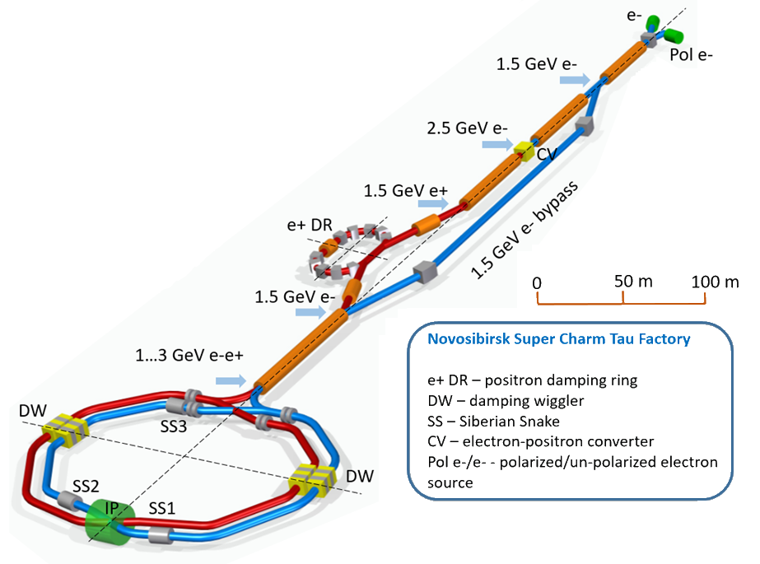
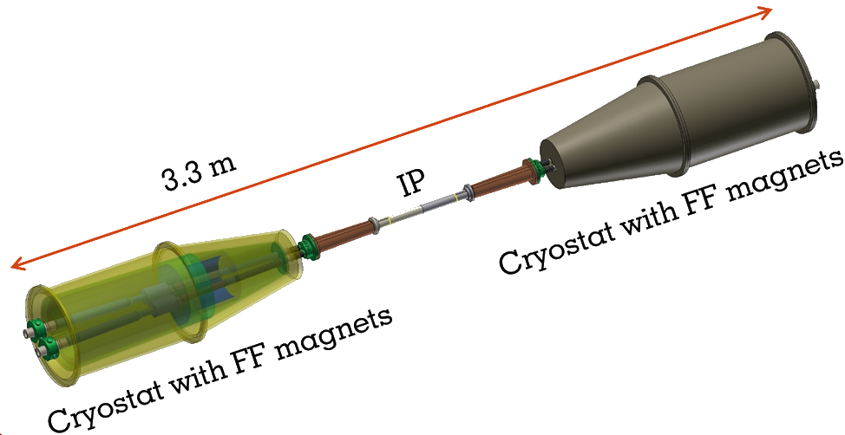
Novosibirsk Super Charm Tau Factory

Slide 5
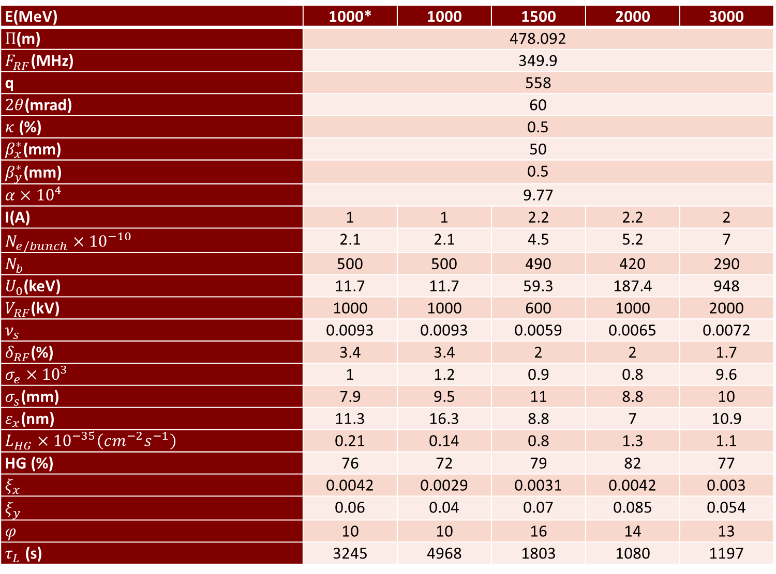
SCTF Lattice and parameters

Slide 6
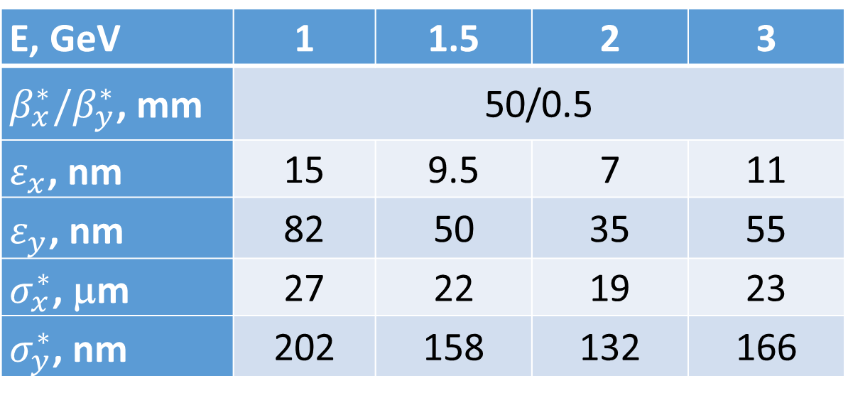
SCTF Beam parameters at the meeting point
Е, GeV | 1 | 1.5 | 2 | 3
$β_{x}^{∗}/β_{y}^{∗}$, mm | 50/0.5
$ε_{x}$, nm | 15 | 9.5 | 7 | 11
$ε_{y}$, nm | 82 | 50 | 35 | 55
$σ_{x}^{∗}$, μm | 27 | 22 | 19 | 23
$σ_{y}^{∗}$, nm | 202 | 158 | 132 | 166
 | L*, mm | L, mm | G₀, T/m | ∅_{beam}, mm
QD0 | 900 | 200 | –97.7 | 38
QF1 | 1400 | 300 | 45.0 | 50

Slide 7
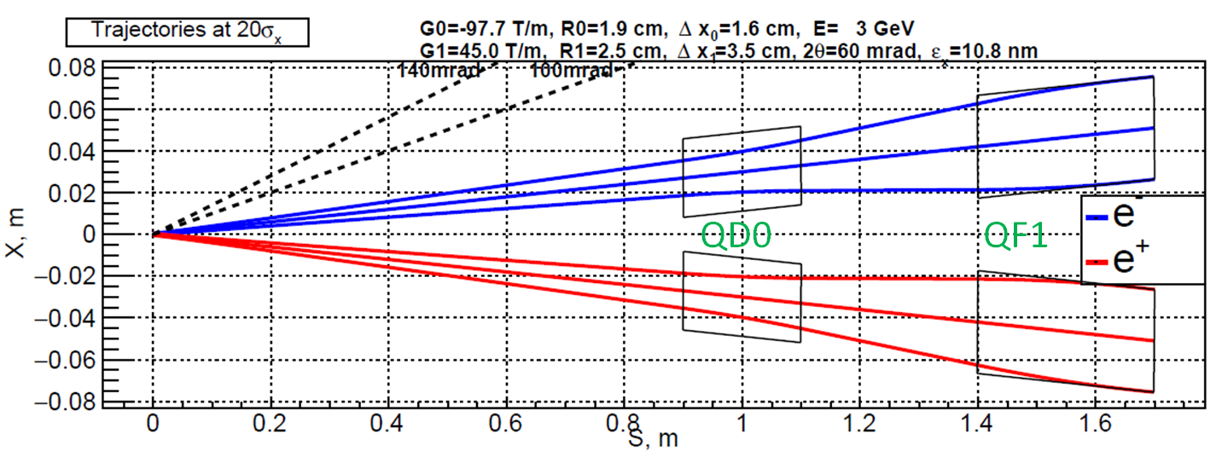
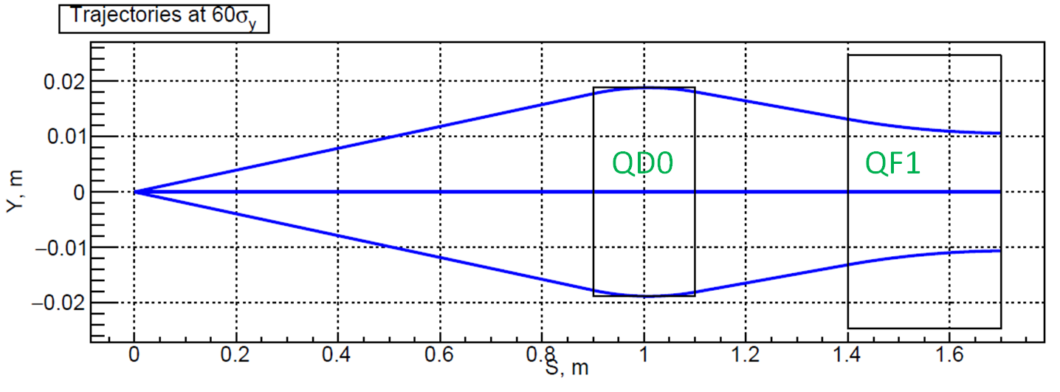
SCTF FF trajectories
The figure schematically shows the placement of the doublet of the final focus lenses and the envelope of the incoming and outgoing beams. Horizontal trajectories are limited by a deviation of ±20σ_{x}, vertical ±60σ_{y}

Slide 8
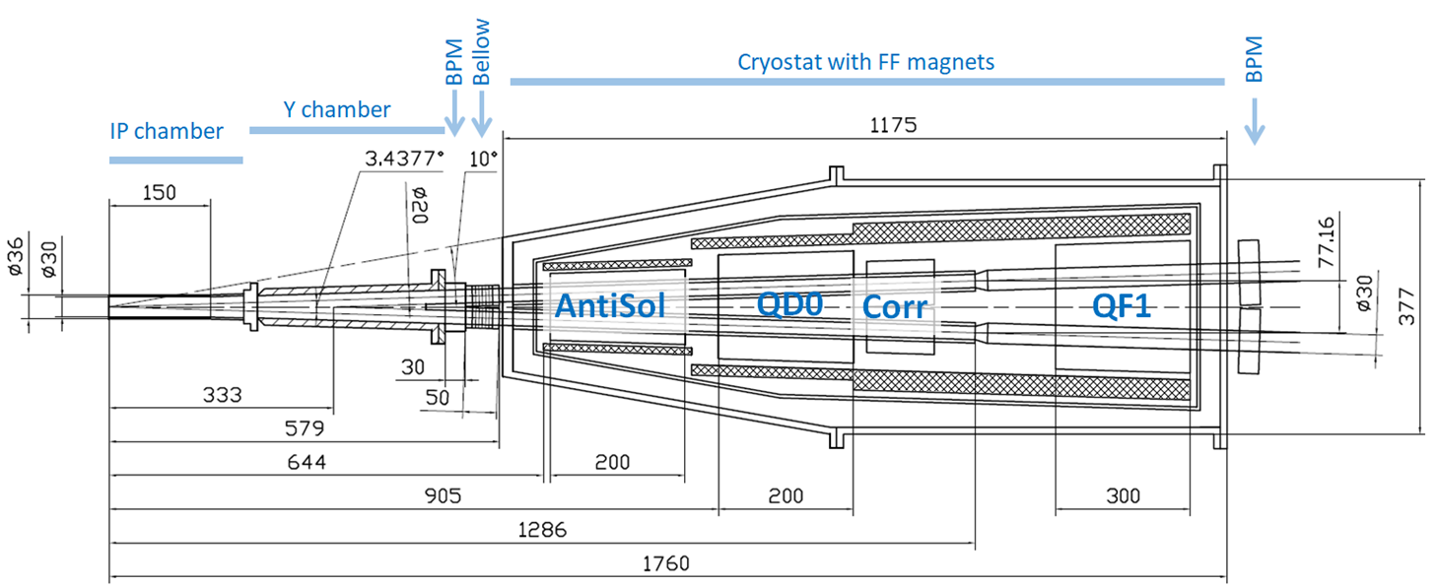
Layout of the final focus area for SCTF
Notes:
Финальный фокус С-Тау фабрики состоит из охлаждаемой Be вакуумной камеры, BPM, фланца, и криостата со сверхпроводящими магнитами.
По порядку анти соленоид, первая дефокусирующая линза финального фокуса, корректирующий магнит и вторая фокусирующая линза, при этом все эти линзы и корректор находятся внутри детектора.
Для компенсации поля детектора используется экранирующий соленоид

Slide 9
Machine-detector interface

Slide 10
IP camera
Notes:
Финальный фокус С-Тау фабрики состоит из охлаждаемой Be вакуумной камеры, BPM, фланца, и криостата со сверхпроводящими магнитами.
По порядку анти соленоид, первая дефокусирующая линза финального фокуса, корректирующий магнит и вторая фокусирующая линза, при этом все эти линзы и корректор находятся внутри детектора.
Для компенсации поля детектора используется экранирующий соленоид

Slide 11
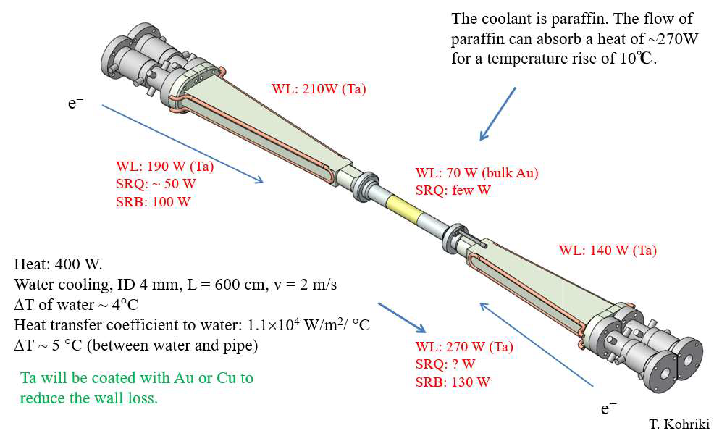
IP camera
The transverse dimensions of the cameras for SuperKEKB, FCC-ee and Super C-τ about the same – we try to use KEK solutions
Notes:
As an example of the arrangement of the meeting site, we consider such an electron-positron collider Super KEKB (Japan). Different types of this section are shown in the figure. The central part of the meeting area is a beryllium pipe with a double wall (0.4 mm and 0.6 mm thick) separated by a gap of 1 mm, in which coolant flows. In order to avoid beryllium corrosion, paraffin was chosen as the heat carrier. The fork area is made of copper and is cooled by water. In the lower figure, the connections of both the water and paraffin cooling circuits are clearly visible.

Slide 12
SuperKEKB (Be beam pipe)
https://indico.cern.ch/event/803859/contributions/3343825/attachments/1807047/2949675/Bepipe_190307_Oide.pdf

Slide 13
SuperKEKB

Slide 14
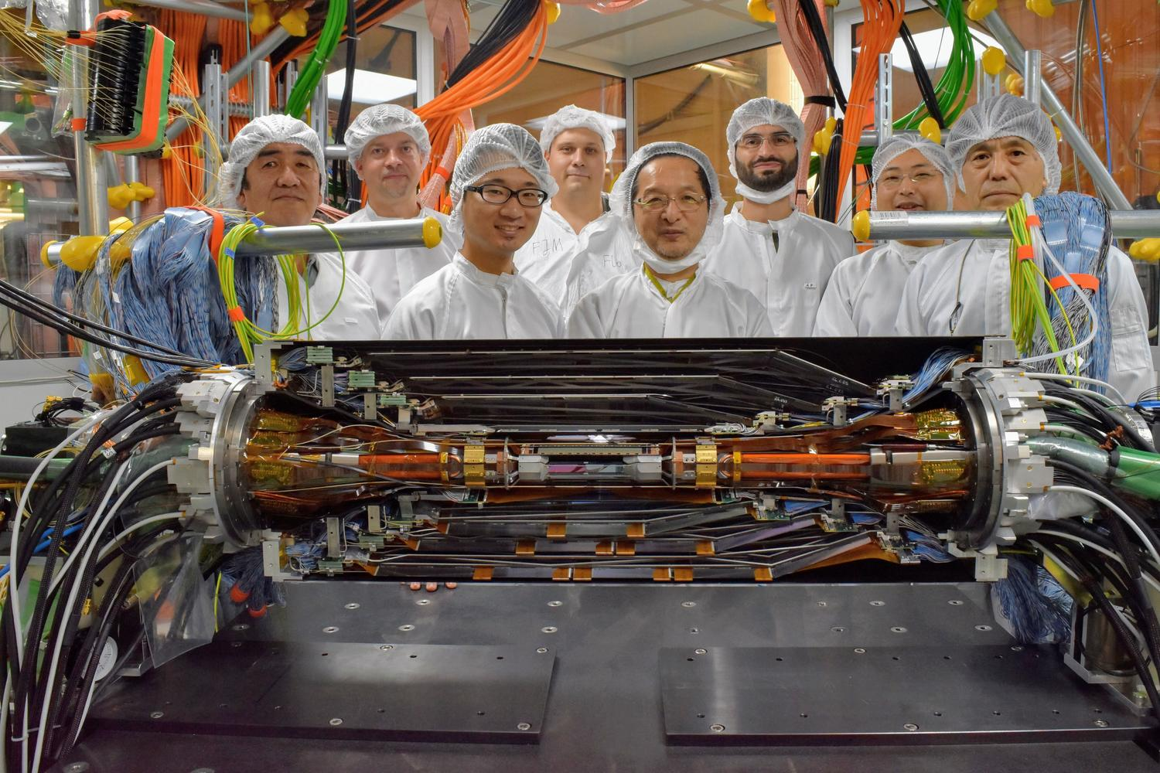
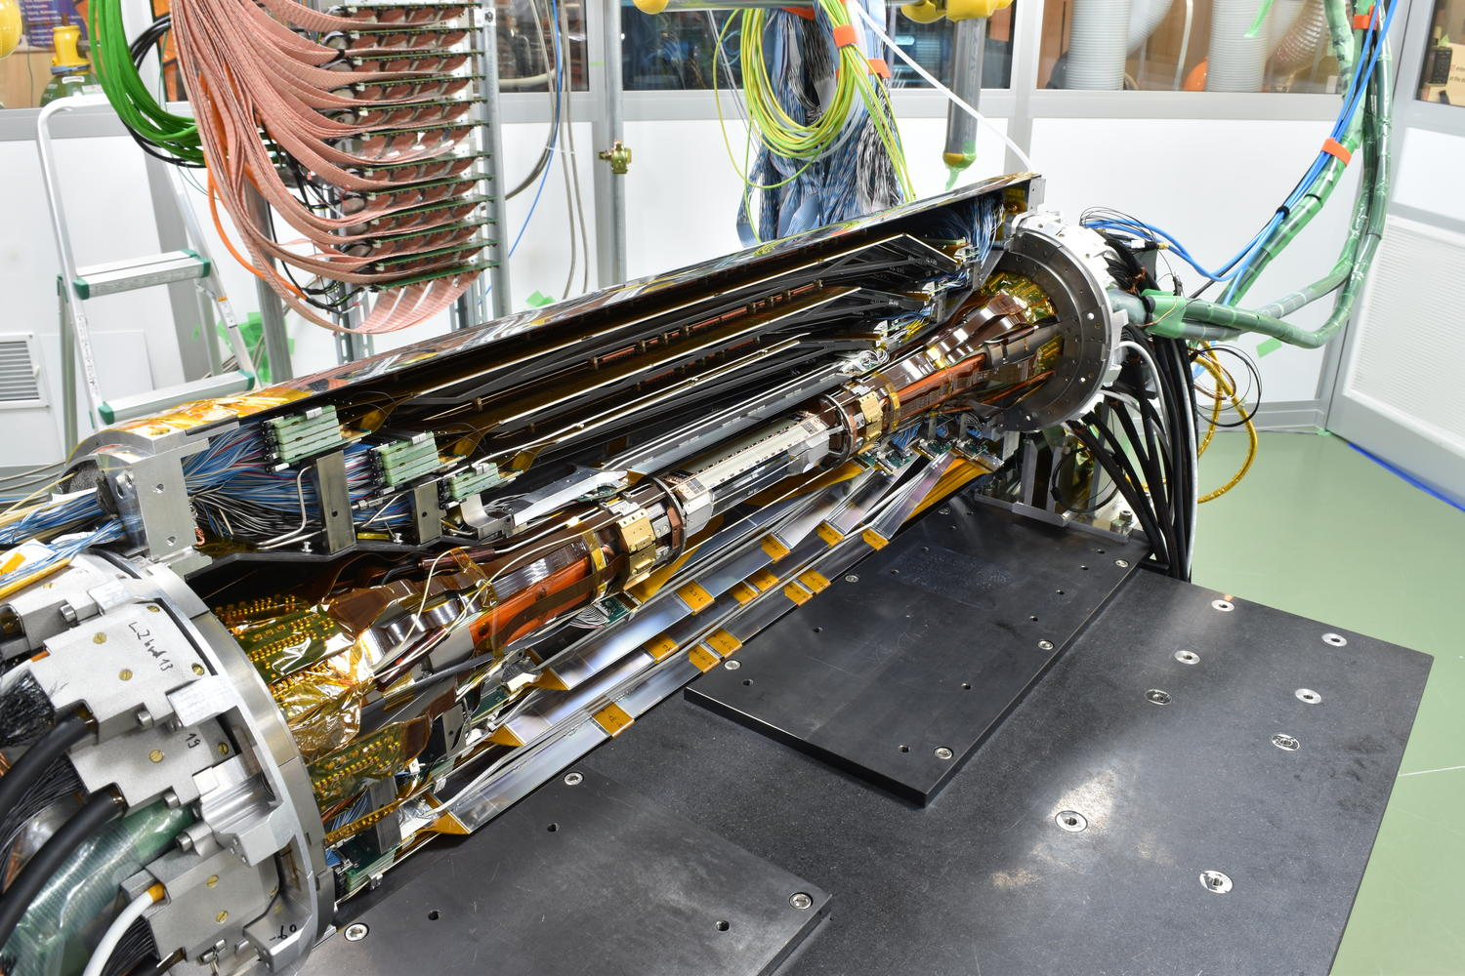
Construction of the Vertex Detector Belle II

Slide 15
Solenoidal field on the beam path
Notes:
Финальный фокус С-Тау фабрики состоит из охлаждаемой Be вакуумной камеры, BPM, фланца, и криостата со сверхпроводящими магнитами.
По порядку анти соленоид, первая дефокусирующая линза финального фокуса, корректирующий магнит и вторая фокусирующая линза, при этом все эти линзы и корректор находятся внутри детектора.
Для компенсации поля детектора используется экранирующий соленоид

Slide 16
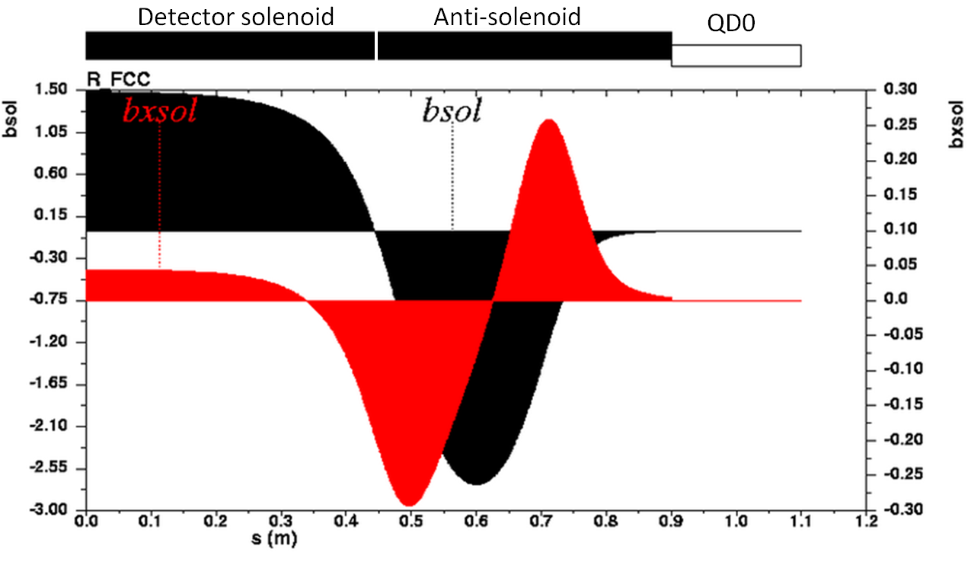
Solenoidal field on the beam path
Profile of the solenoidal field along the beam path (shown in black).
The horizontal field on the axis of the beam (in red).

Slide 17
Twin-aperture SC quadrupole
Notes:
Финальный фокус С-Тау фабрики состоит из охлаждаемой Be вакуумной камеры, BPM, фланца, и криостата со сверхпроводящими магнитами.
По порядку анти соленоид, первая дефокусирующая линза финального фокуса, корректирующий магнит и вторая фокусирующая линза, при этом все эти линзы и корректор находятся внутри детектора.
Для компенсации поля детектора используется экранирующий соленоид

Slide 18
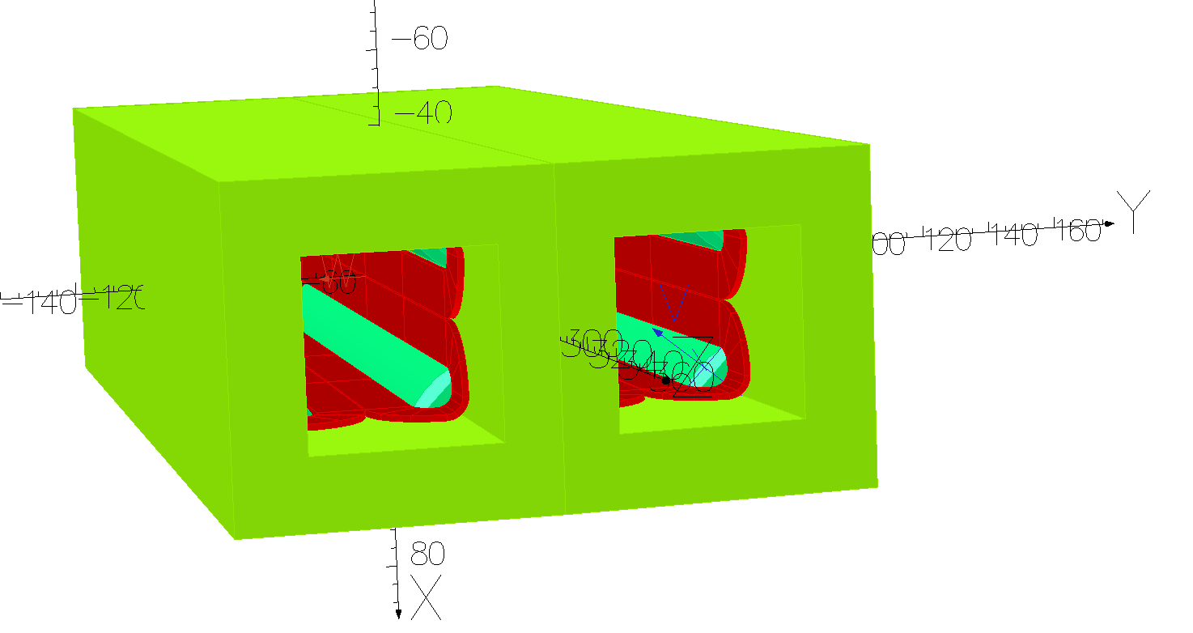
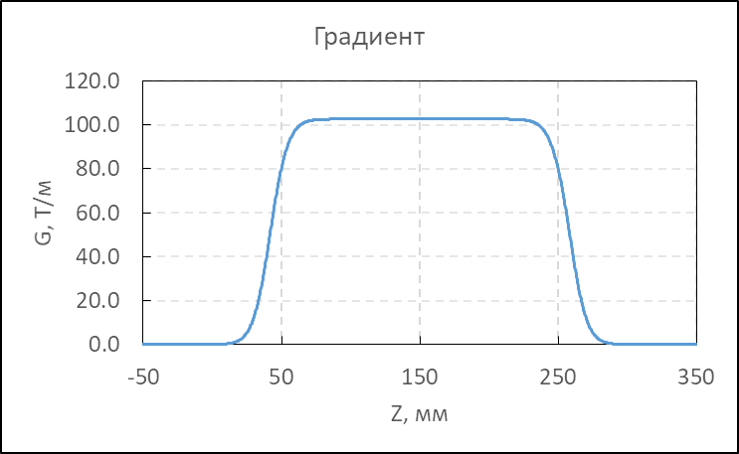
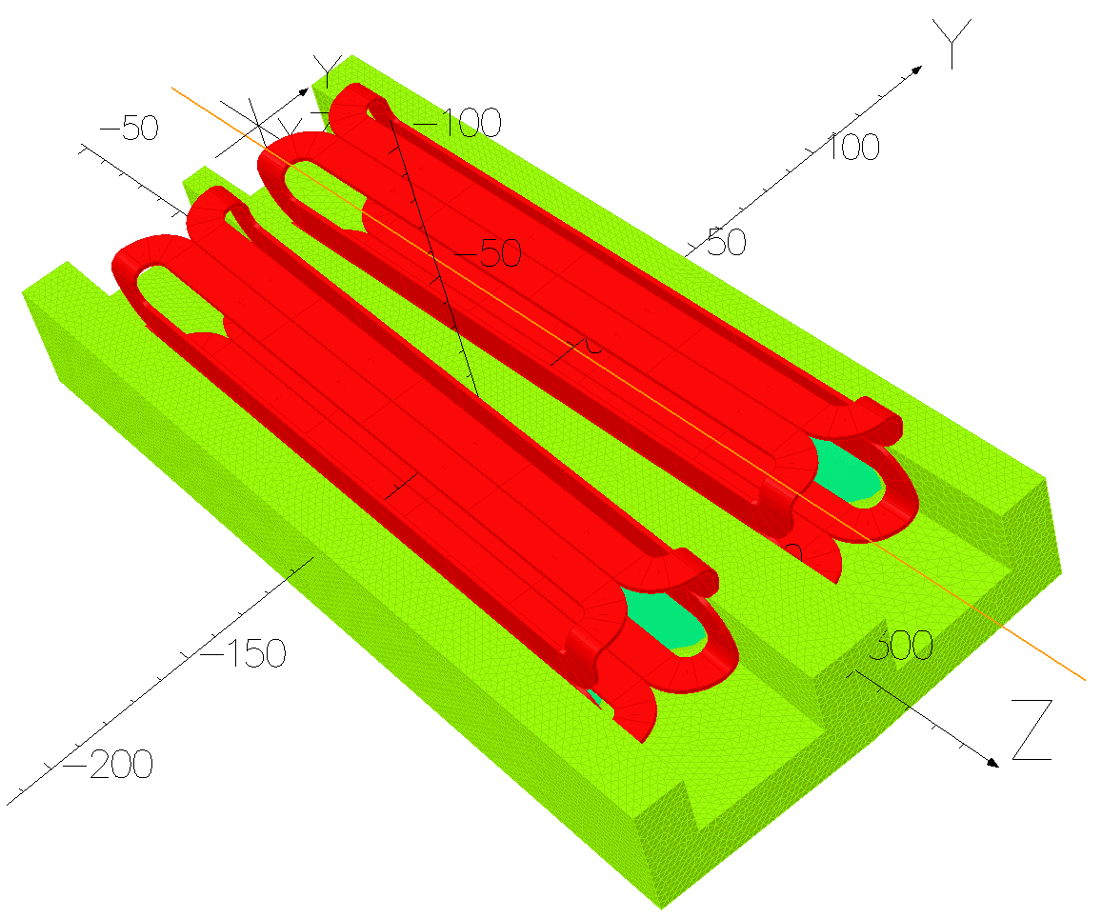
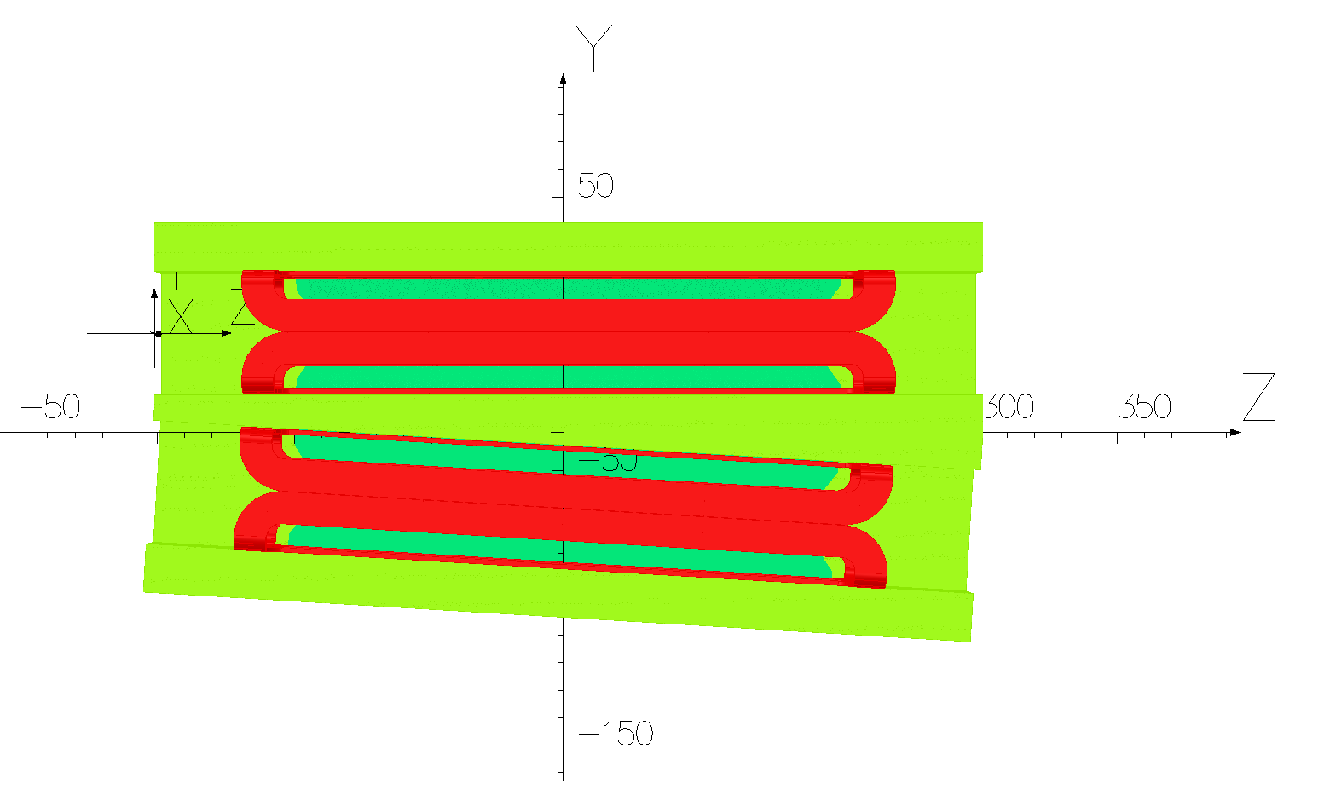
Iron yoke twin-aperture SC quadrupole

Slide 19
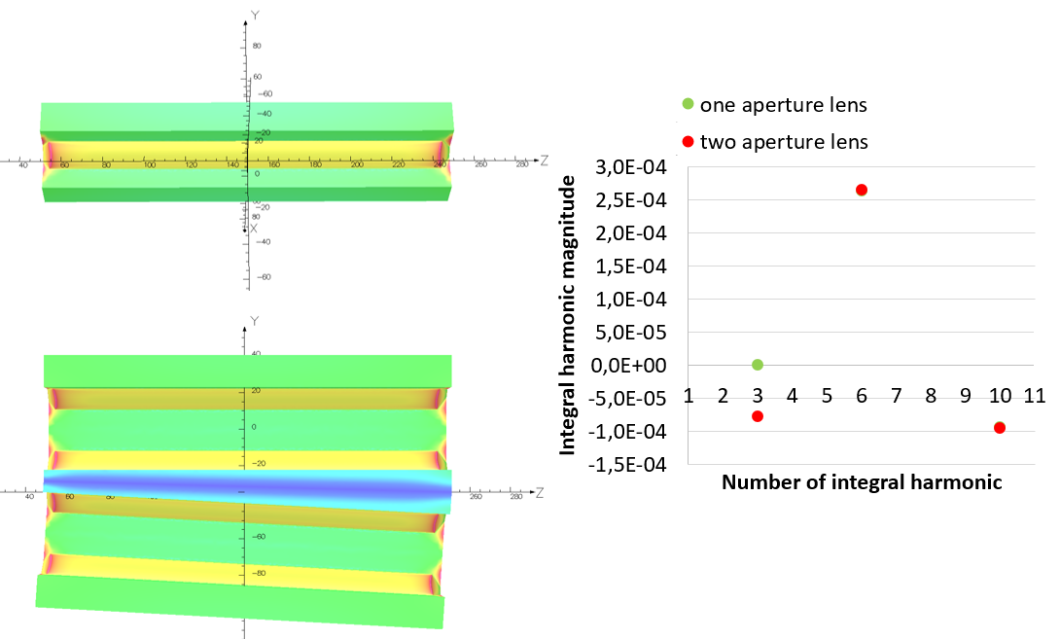
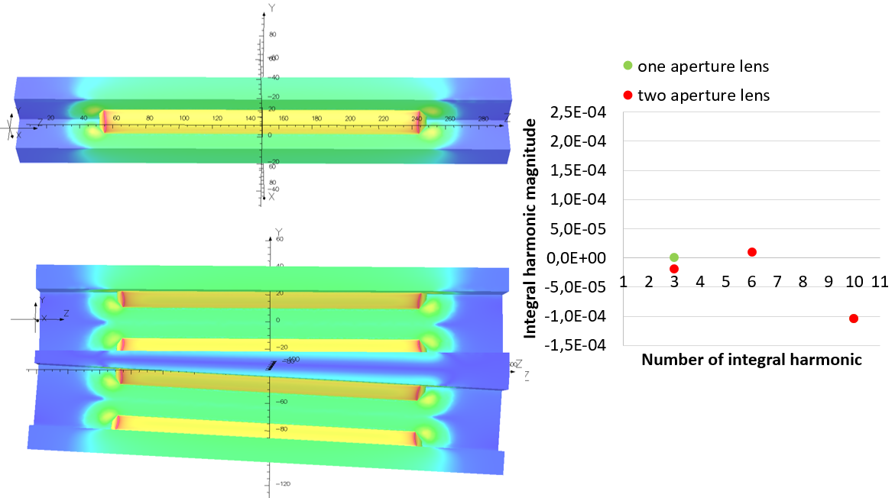
Iron yoke twin-aperture SC quadrupole
Yoke extension reduces the third integral (skew sextupole) harmonic from $−{8×10}^{−5}$ to $−2×{10}^{−5}$. End pole chamfers reduce the sixth harmonic from $2.7×{10}^{−4}$ to $1.8×{10}^{−5}$.
We started detailed manufacturing design of the twin-aperture quadrupole and the Hall probe magnetic measurement equipment for a full scale magnetic measurement.

Slide 20
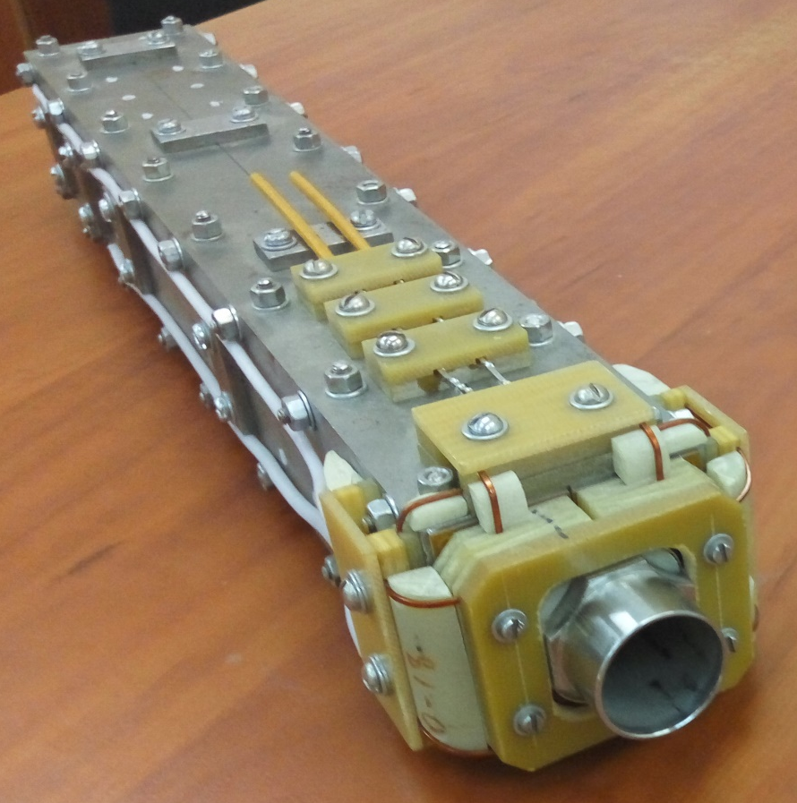
Iron yoke twin-aperture SC quadrupole
Cu/Sc Ratio (nom) | Bare Size (mm) | Ins. Size (mm) | RRR | Ic Amps (min) | Length (m) | Spool ID
1.35:1 | 1.20x0.75 | 1.28x0.83 | >70 | 510@7T | 2,730 | 917

Slide 21
Iron yoke twin-aperture SC quadrupole

Slide 22
Iron yoke twin-aperture SC quadrupole
General view drawing of the iron yoke quadrupole. Technical design is in progress.

Slide 23
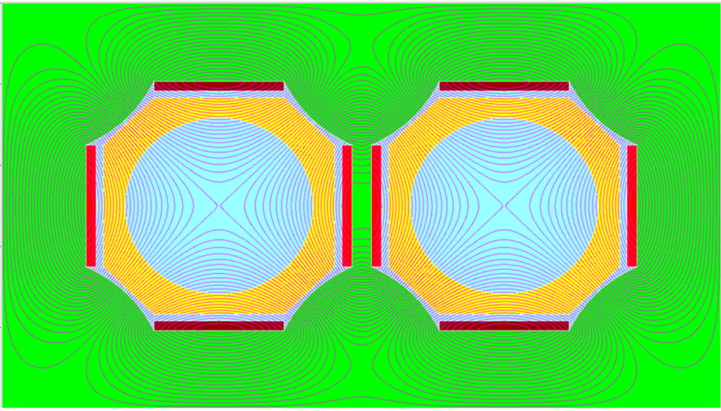
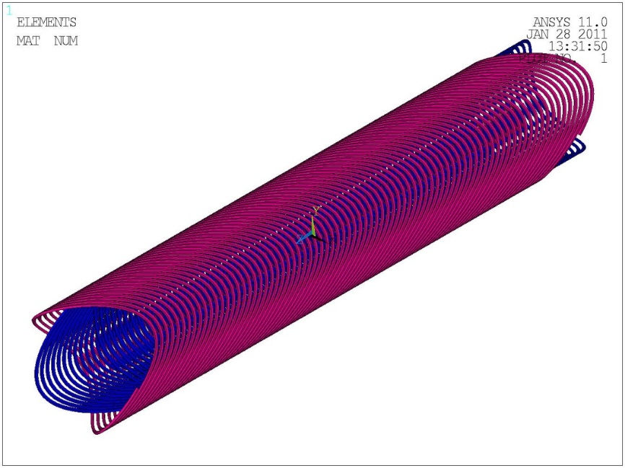
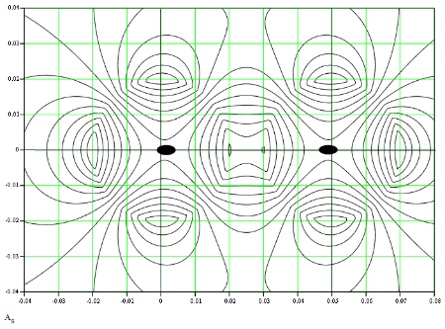
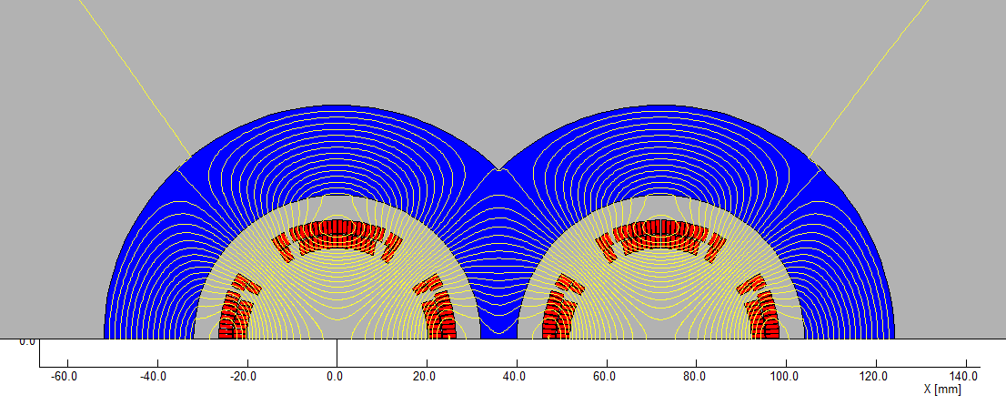
Features of different types of two aperture lenses
Notes:
Modified Panofsky quadrupole (BINP)
Cosine quadrupole with yoke (CEPC)

Slide 24
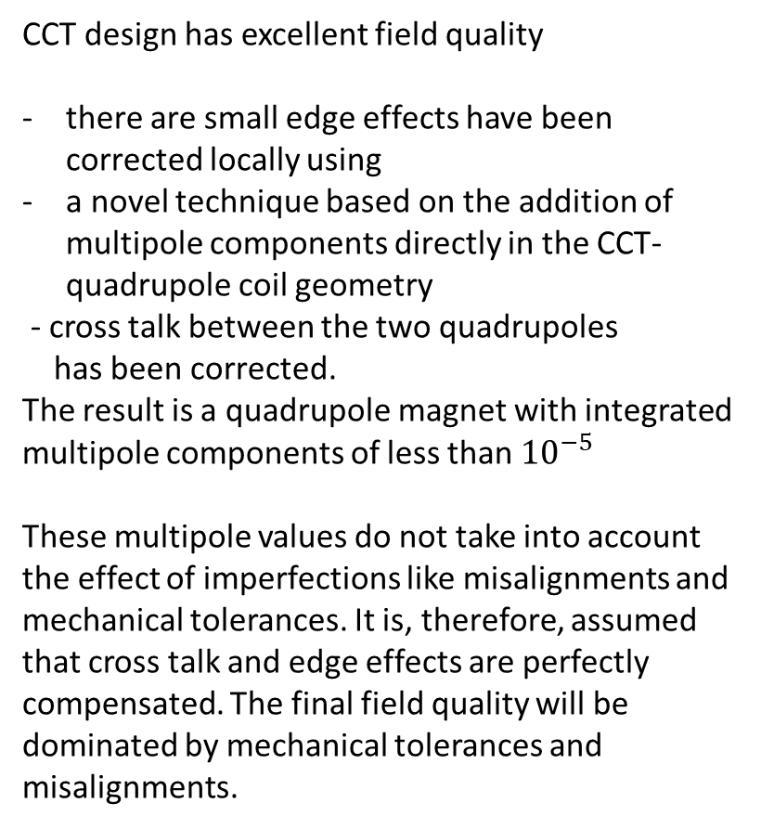
The Canted Cosine Theta (CCT) technology
CCT design has excellent field quality
there are small edge effects have been corrected locally using
a novel technique based on the addition of multipole components directly in the CCT-quadrupole coil geometry
- cross talk between the two quadrupoles
has been corrected.
The result is a quadrupole magnet with integrated multipole components of less than ${10}^{−5}$
These multipole values do not take into account the effect of imperfections like misalignments and mechanical tolerances. It is, therefore, assumed that cross talk and edge effects are perfectly compensated. The final field quality will be dominated by mechanical tolerances and misalignments.
Notes:
The field quality requirements become less stringent as one moves further away
from the IP. It is planned to use the same technology for all elements. The following
paragraphs concentrate on the most critical elements, QC1L1. These magnets are
1.2m long. At the tip they are 66mm from their counterpart for the other beam;
at the far end they are 102mm apart. The magnet has an inner aperture of 40mm
diameter and an outer diameter of 64mm. The beam pipes for both electrons and
positrons have an inner diameter of 30mm in the vicinity of QC1L1. A traditional
CCT design has excellent field quality, but there are small edge effects, which cancel
out if one integrates over the whole length of the magnet. However, in a region of
rapidly varying beta function and dispersion, this cancellation alone does not ensure
excellent performance. Therefore, the edge effects have been corrected locally using
a novel technique based on the addition of multipole components directly in the
CCT-quadrupole coil geometry [289].
Furthermore, the significant amount of cross talk between the two quadrupoles
which are sitting in close proximity has been corrected. The result is a quadrupole
magnet with integrated multipole components of less than 10􀀀5, as can be seen in
Table 3.6. It should be noted that these multipole values do not take into account the
effect of imperfections like misalignments and mechanical tolerances. It is, therefore,
assumed that cross talk and edge effects are perfectly compensated. The final field
quality will be dominated by mechanical tolerances and misalignments.
A misalignment analysis has also been performed. Mechanical alignment of the
two quadrupoles (QC1L1E and QC1L1P) should be better than 30 m (a strict but
achievable requirement for objects a few centimeters apart). The multipoles affected
by a misalignment in x are B3 (0.8 units for a misalignment in x of 100 m). For

Slide 25
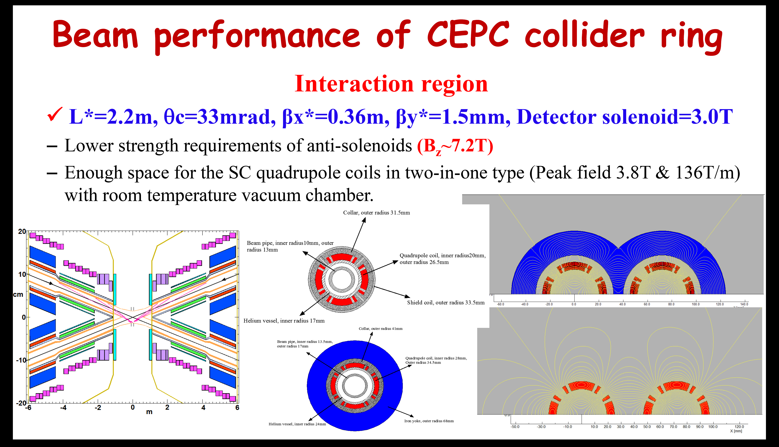
CEPC (IPAC19)

Slide 26
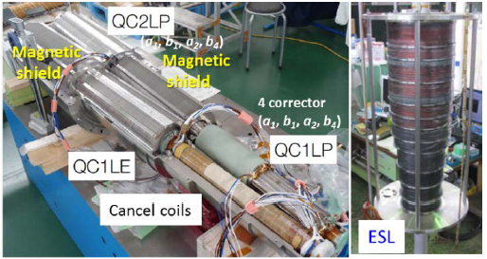
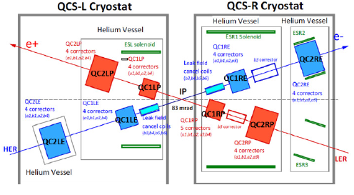
SuperKEKB IR design
IR superconducting magnets
Layout of Final Focus superconducting magnets

Slide 27
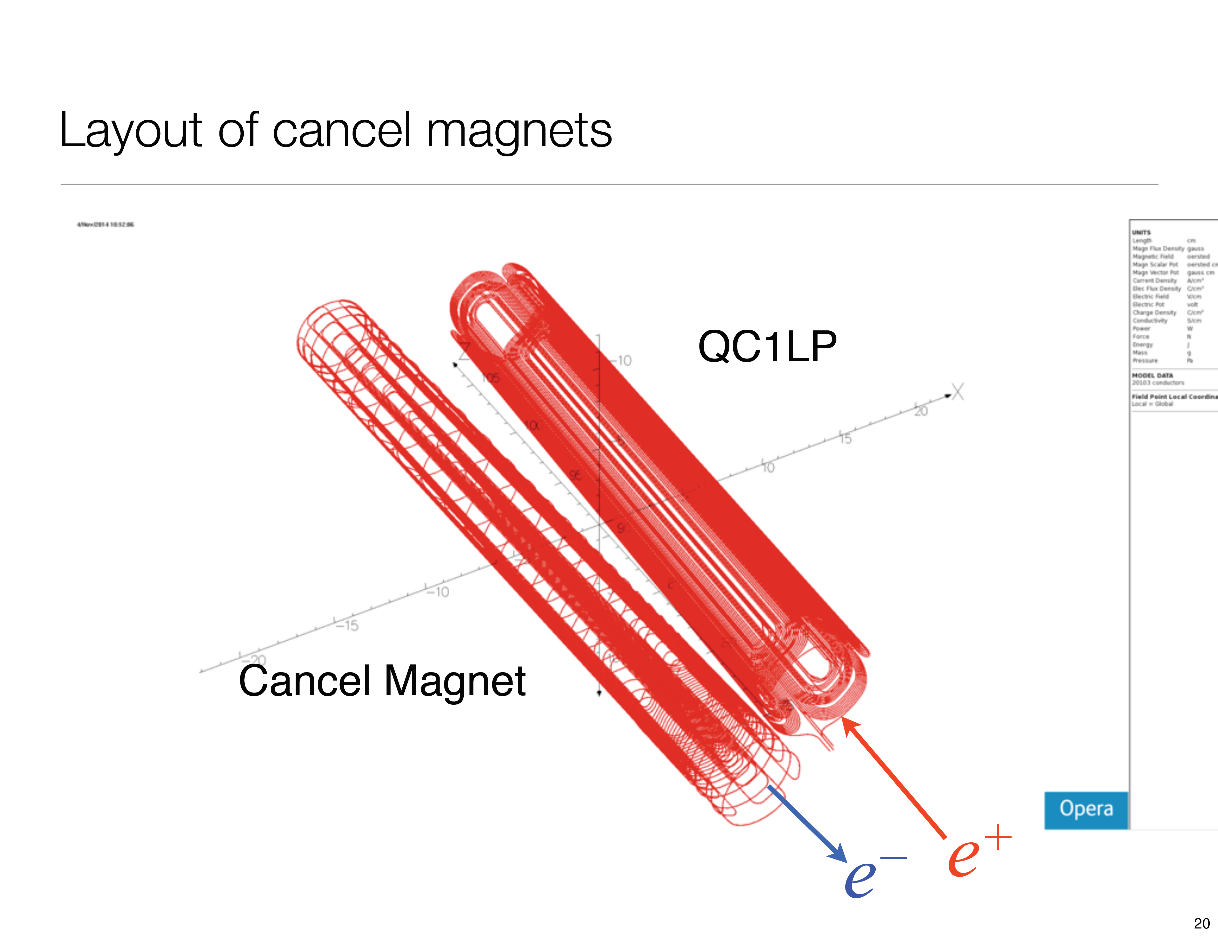
SUPER KEKB

Slide 29
Iron yoke twin-aperture SC quadrupole
BINP: iron yoke twin-aperture SC FF quadrupole (Pavel Vobly)
FCC-ee: CCT technology (Eugenio Paoloni/Mike Koratzinos)
CEPC: cosine-theta regular technology
Advantages of our design (our vision):
Iron yoke prevents field cross-talk between apertures
High field quality (both local and integral) can be achieved
Relative position of the apertures is of high precision
Quadrupoles block is rigid and can be easily aligned
Well proven technology
Simple and cheap
Disadvantage: no additional coils can be inserted; separate correctors are needed before/after the quad (not a big problem)

Slide 30
Vacuum chamber inside the cryostat
Notes:
Финальный фокус С-Тау фабрики состоит из охлаждаемой Be вакуумной камеры, BPM, фланца, и криостата со сверхпроводящими магнитами.
По порядку анти соленоид, первая дефокусирующая линза финального фокуса, корректирующий магнит и вторая фокусирующая линза, при этом все эти линзы и корректор находятся внутри детектора.
Для компенсации поля детектора используется экранирующий соленоид

Slide 31
Vacuum chamber inside the cryostat
By the analogy with BELLE II, we have room temperature in the beam chamber inside the cryogenic magnetic elements. This minimizes the number of bellows assemblies, high-frequency contacts, eliminates cold-warm transitions and simplifies the task of removing heat load from the beam chamber.
The thermal load on the camera due to the presence of specular current and high-frequency electromagnetic radiation is 100 W / m
Objective: To minimize technological gaps in the multilayer chamber, without exceeding the permissible level of heat inflow to the cryogenic system
0.7 mm thick copper coated inner chamber, T = 300K
0.7 mm clearance with water flow to relieve heat load from HOM & IC
0.7 mm thick pipe with mirror coating Cu or Au, T = 300K
Vacuum clearance 0.9 mm with distance heat insulators
External pipe 1 mm thick, with inner coating Cu, T = 4.2K
Superconducting coil

Slide 32
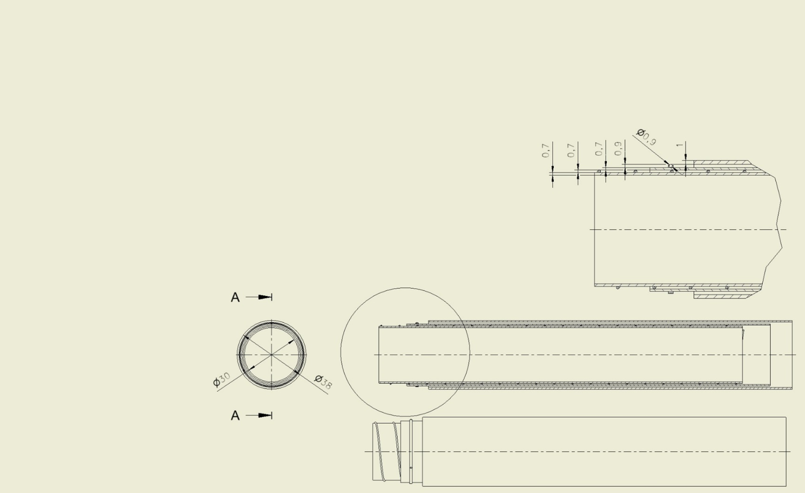
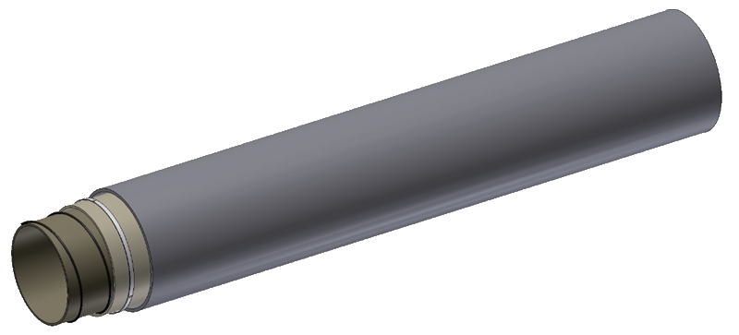
Three-layer beam chamber design
Heat insulator
(0.9 mm)
Wire
(0.7 mm)
Outer pipe (1 mm)
Thin-walled pipes
(0.7 mm)

Slide 33
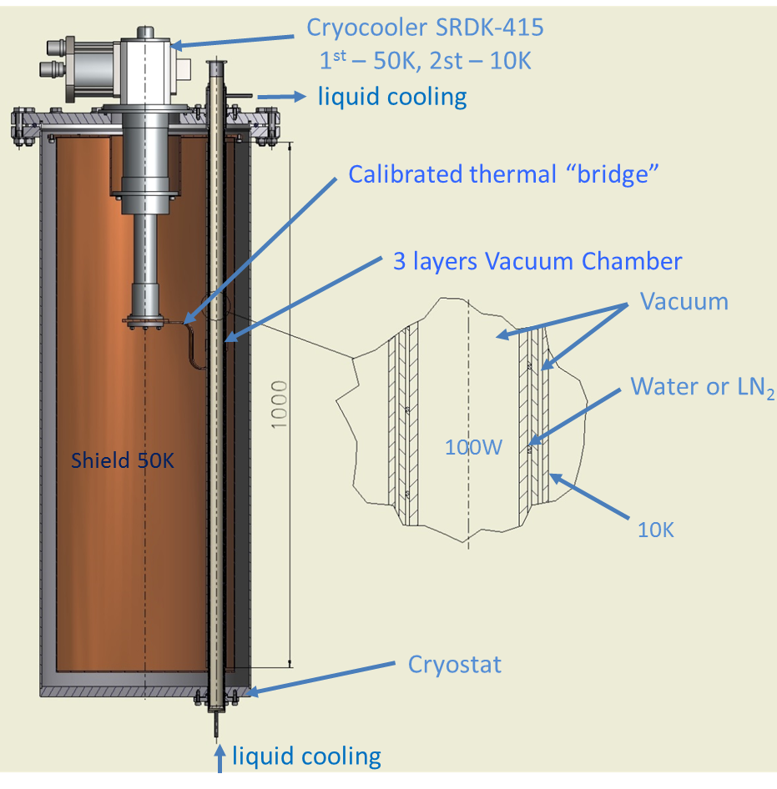
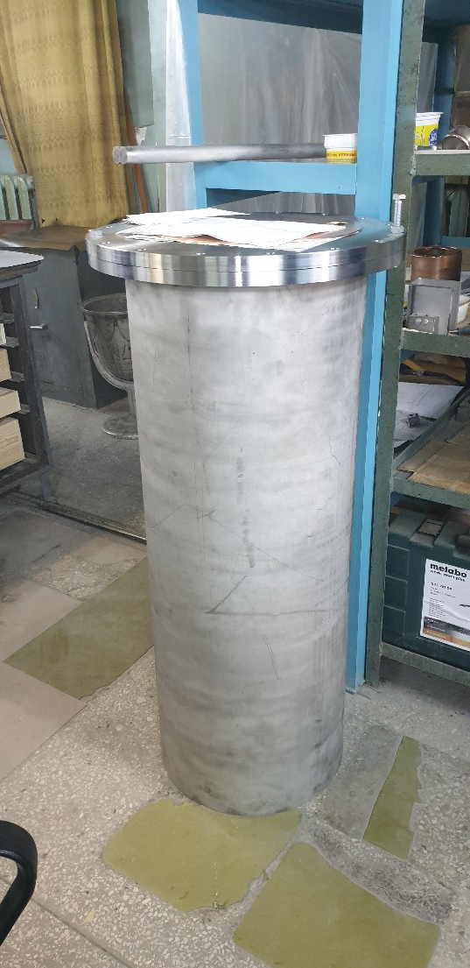
Vacuum chamber prototype
Stand for measuring heat gain in a three-layer vacuum chamber
The thermal load on the cryogenic system will be determined in two ways: by changing the temperature of the liquid coolant and by the temperature difference on the thermal bridge between the cryo-cooler and the vacuum chamber.

Slide 34
Further goals and plans
Create a model of our own IP camera
Develop HOM absorber(?)
Develop the stabilization and alignment system for the cryostat inside the detector
Start designing the entire final focus as a single system
Develop a system of magnetic measurements allowing to measure the magnetic field map inside the vacuum chamber of the cryostat in three planes

Slide 35
Thanks for your attention

Slide 36
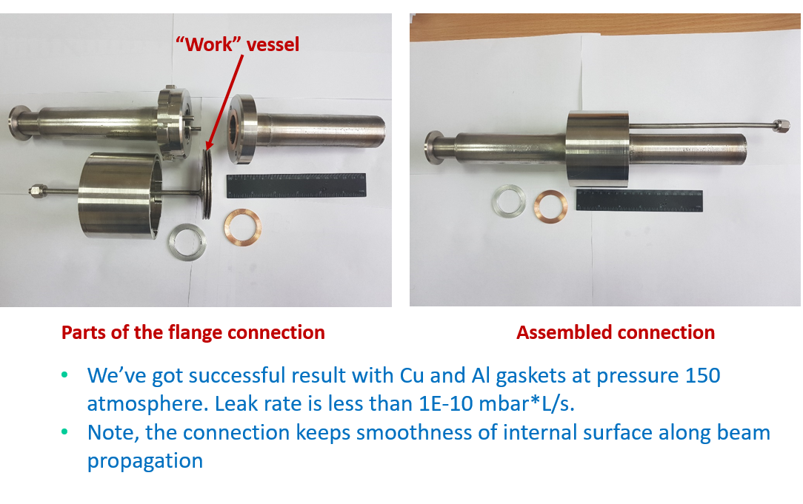
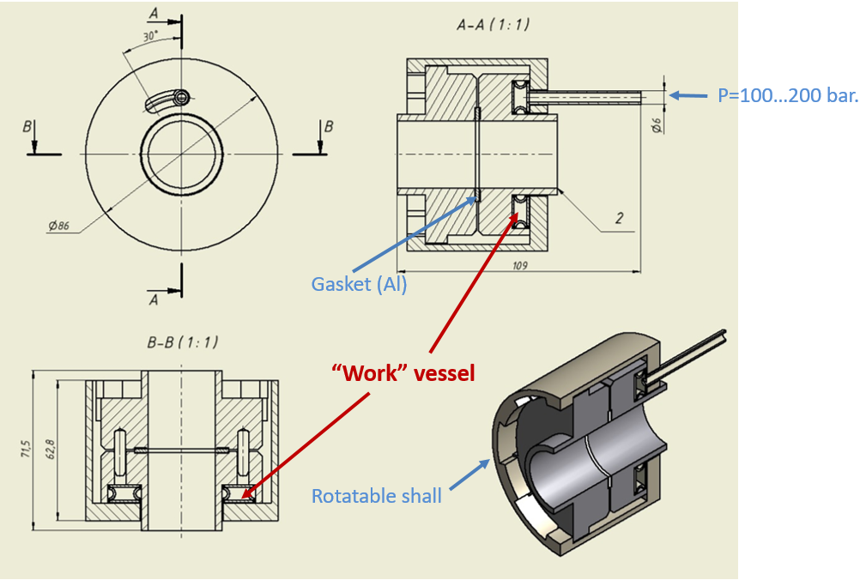
BINP remote flange
Single aperture design works.

Slide 37
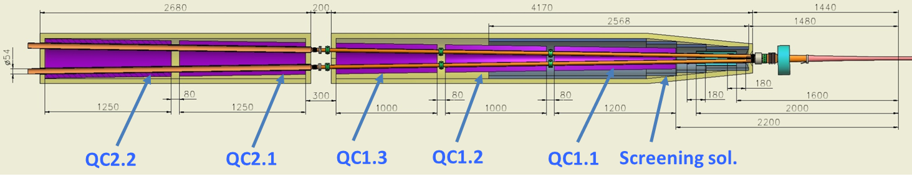
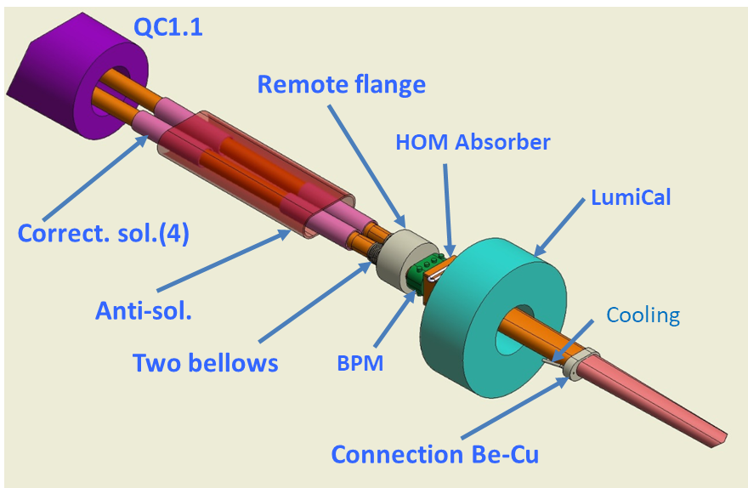
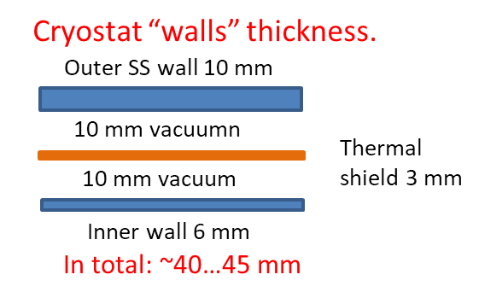
BINP alternative

Slide 38
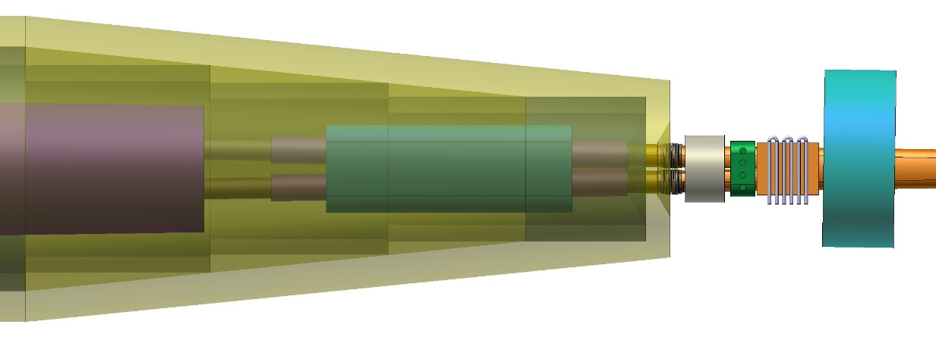

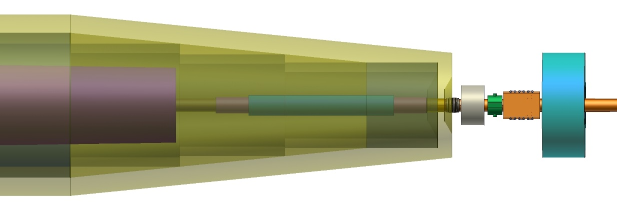
BINP alternative
Top view
QD0
Anti-sol
HOM abs
Flange
Side view
BPM
LumiCal

Slide 40
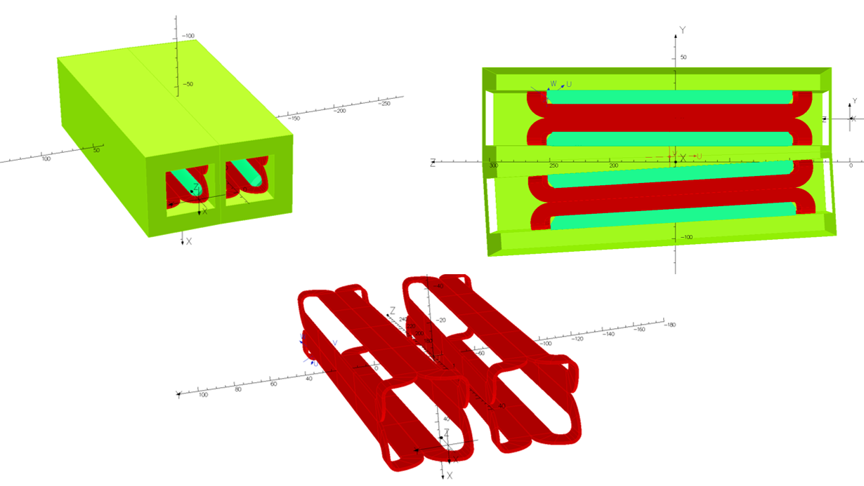
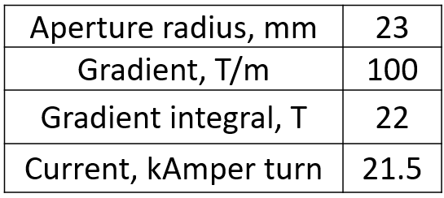
Iron yoke twin-aperture SC quadrupole
Intensive simulation of the twin-aperture magnetic field is underway (field distribution, field quality, influence of manufacture and assembly tolerance, etc.)
3D quadrupole model
Yoke extension to reduce the apertures cross-talk

