Slide 1

Deep Learning 101
Alexander Panin, Andrey Ustyuzhanin
MISP, 4 March 2020

Slide 2
Recap of the previous day
Linear Prediction model
Loss function
Figures of Merit
  Accuracy
  ROC curve, AUC
  Precision, Recall
Overfitting fighting
  X-validation
  Regularization
Logistic Regression
Feature Engineering
LHCb PID
Learning as loss minimization problem
Learning as likelihood maximization problem

Slide 3
Overview
Introduction into Neural Networks
Deep Learning Frameworks
Outlook: HEP challenges for ML

Slide 4
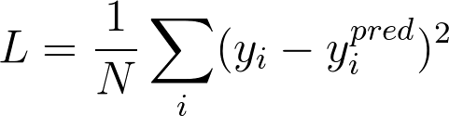

Linear Regression
Model:
Objective function:
Optimization (exact):
pred
x
wx +b
y

Slide 5
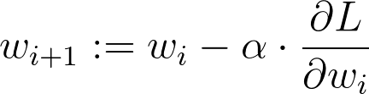
Linear Regression
Model:
Objective function:
Optimization (iterative):
pred
x
wx +b
y

Slide 6
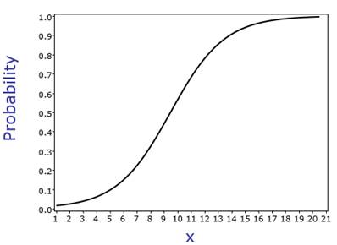
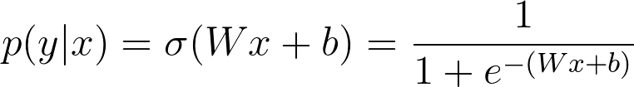
Logistic Regression
X
wx +b
p(y|x)
Objective function ?

Slide 7
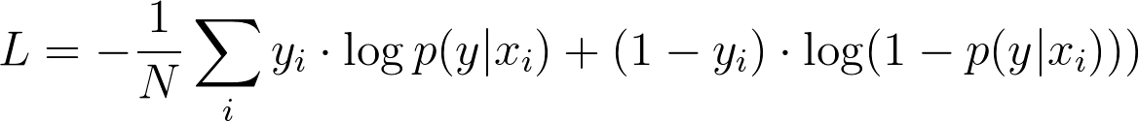
Logistic Regression
Model:
Objective function:
Optimization(iterative): same as linear regression
X
wx +b
P(y)

Slide 8
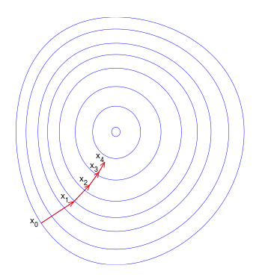
Recap: Gradient Descent
Update:
a – learning rate a<<1
L – loss function

Slide 9
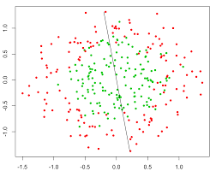
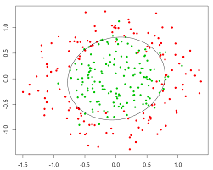
Nonlinear dependencies
What we have What we want
How to learn that?

Slide 10

Feature extraction
Loss: same as linear/logistic regression
Model:
Feature
Extractor
(manual)
Classifier
Ɵ1~W,b
X
Prediction
Training:

Slide 11

What if...
Features would tune to your problem automagically!

Slide 12
What do we want, exactly?
Model:
Feature
Extractor
Ɵ2
Classifier
Ɵ1~W,b
X
Prediction
?
Objective:

Slide 13

What do we want, exactly?
Model:
Feature
Extractor
Ɵ2
Classifier
Ɵ1~W,b
X
Prediction
Joint training:

Slide 14
Okay, how do we extract features?

Slide 15
Try linear
Model:
Linear
model
Logistic
Regres-
sion
X
Prediction

Slide 16
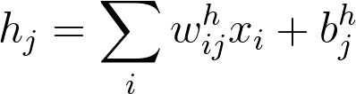
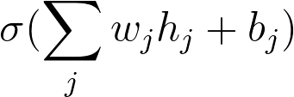
Try linear
Model:
Linear
model
Logistic
Regres-
sion
X
Prediction

Slide 17
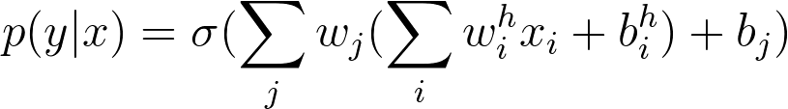
Try linear
Model:
Linear
model
Logistic
Regres-
sion
X
Prediction
Output:
Is it any better than logistic regression?

Slide 18
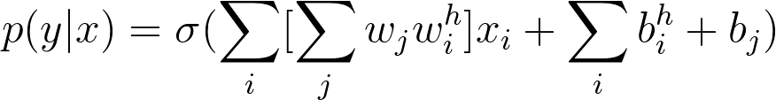
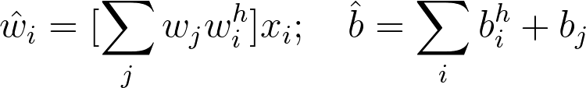
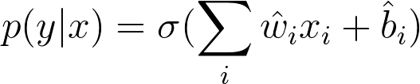
Try linear

Slide 19
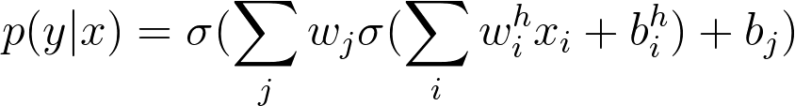
Add nonlinearity
Model:
Linear
model
σ(h)
Logistic
Regres-
sion
X
Prediction

Slide 20
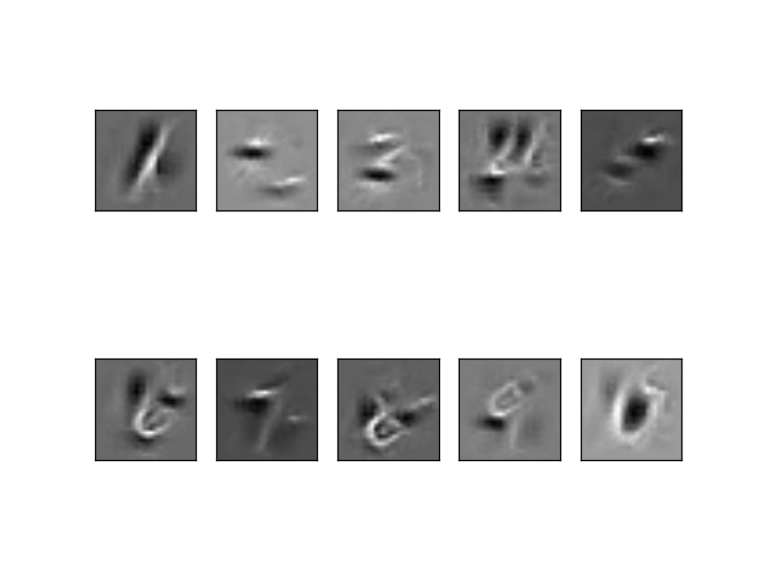
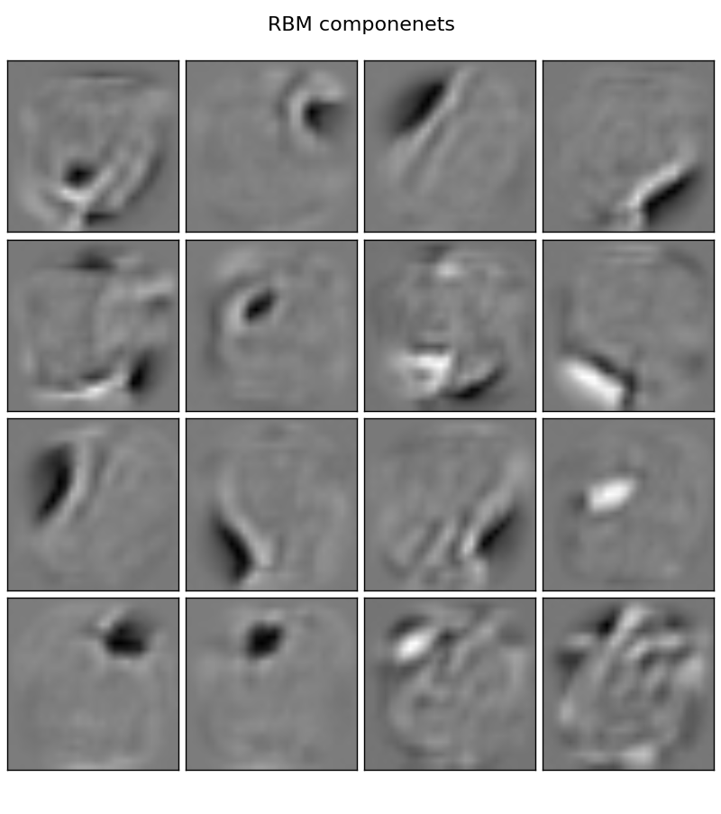

Add nonlinearity
Model:
Linear
model
σ(h)
Logistic
Regres-
sion
X
Prediction
P(“1”)
P(“2”)
...
P(“9”)

Slide 21
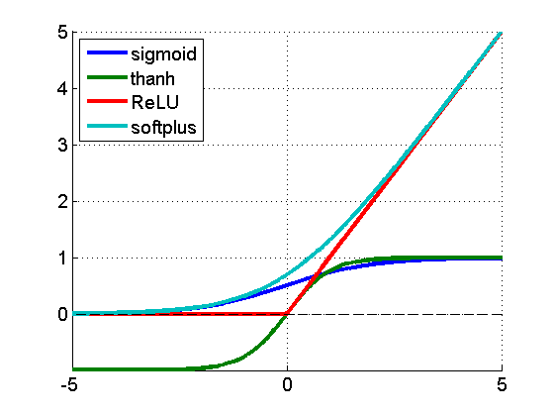
Add nonlinearity
f(a) = 1/(1+e^{-a})
f(a) = tanh(a)
f(a) = max(0,a)
f(a) = log(1+eª)
f(a)
a

Slide 22
Training the monster
Model:
Linear
model
σ(h)
Logistic
Regres-
sion
X
Prediction
Output:
Training: ?!

Slide 23
Training the monster
Model:
Linear
model
σ(h)
Logistic
Regres-
sion
X
Prediction
Output:
Training: gradient descent!

Slide 24
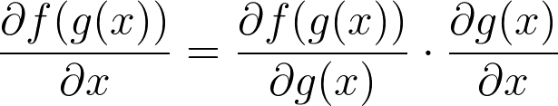
Backpropagation
TL;DR: backprop = chain rule*

Slide 25

Backpropagation
TL;DR: backprop = chain rule*
* g and x can be vectors/vectors/tensors

Slide 26
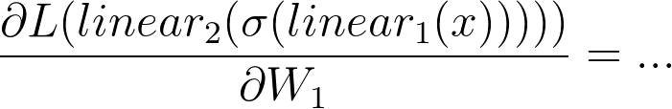
Backpropagation
linear
h units
W1,b1
σ(h)
linear
1 unit
W2,b2
σ(h)
X
Prediction
Y
L

Slide 27
Backpropagation
linear
h units
W1,b1
σ(h)
linear
1 unit
W2,b2
σ(h)
X
Prediction
Y
L

Slide 28
Backpropagation
linear
h units
W1,b1
σ(h)
linear
1 unit
W2,b2
σ(h)
X
Prediction
Y
L

Slide 29
Backpropagation
linear
h units
W1,b1
σ(h)
linear
1 unit
W2,b2
σ(h)
X
Prediction
Y
L

Slide 30
Backpropagation
linear
h units
W1,b1
σ(h)
linear
1 unit
W2,b2
σ(h)
X
Prediction
Y
L

Slide 31
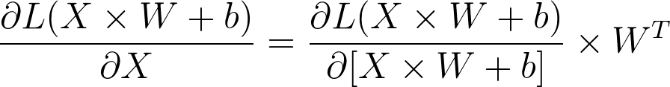


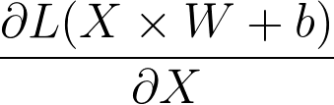
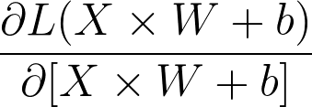
Matrix derivatives
Let’s compute:
What?
Variable shapes:
[batch size, features]
[features, outputs]
[outputs]
[batch size, features]
[batch size, outputs]

Slide 32
Matrix derivatives
Hint: 1. figure out scalar case,
2. match shapes for matrices
Let’s compute:
What?
Variable shapes:
[batch size, features]
[features, outputs]
[outputs]
[batch size, features]
[batch size, outputs]

Slide 33
Matrix derivatives
Let’s compute:
Variable shapes:
[batch size, features]
[features, outputs]
[outputs]
[batch size, features]
[batch size, outputs]

Slide 34
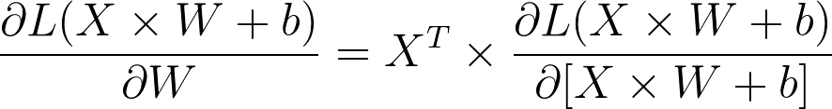
Matrix derivatives
Let’s compute:
What?
Variable shapes:
[batch size, features]
[features, outputs]
[outputs]
[batch size, features]
[batch size, outputs]

Slide 35
Matrix derivatives
Let’s compute:
Variable shapes:
[batch size, features]
[features, outputs]
[outputs]
[batch size, features]
[batch size, outputs]

Slide 36
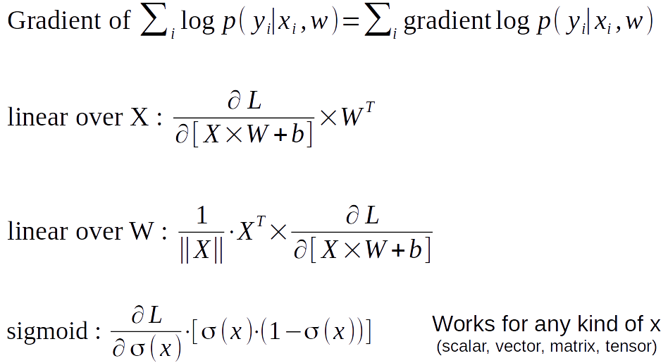
Cheat sheet for seminar

Slide 37
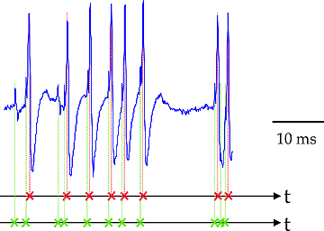
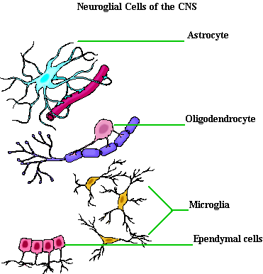
Not actual neurons :)
Neurons output in “spikes”,
not real numbers
No one knows for sure
how they “train”
There are other cell types
e.g. neuroglial cells

Slide 38
Connectionist phrasebook
Layer – a building block for NNs :
    “Dense layer”: f(x) = Wx+b
    “Nonlinearity layer”: f(x) = σ(x)
    Input layer, output layer
    A few more we gonna cover later
Activation – layer output
    i.e. some intermediate signal in the NN
Backpropagation – a fancy word for “chain rule”

Slide 39
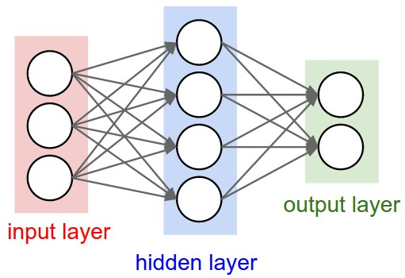
Connectionist phrasebook
“Train it via backprop!”

Slide 40
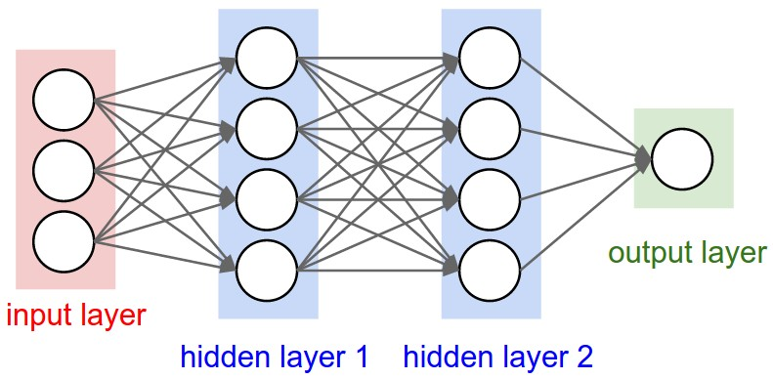
Connectionist phrasebook
How do we train it?

Slide 41
Potential caveats?

Slide 42
Problems with deep learning
Hardcore overfitting
No “golden standard” for architecture
Computationally heavy

Slide 43

Back to neural networks
Model:
linear
h units
W1,b1
σ(h)
linear
1 unit
W2,b2
σ(h)
X
Prediction
Training: see the demo

Slide 44
Gradient Descent
Update:
a – learning rate a<<1
L – loss function
Can we do better?

Slide 45
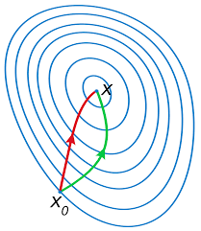
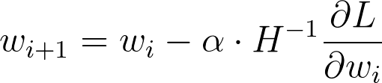
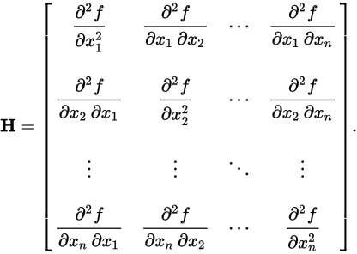
Newton-Raphson
Parameter update
Hessian:
Green: Gradient Descent
Red: Newton-Raphson
Any drawbacks?

Slide 46
Newton-Raphson
Parameter update
Hessian:
Green: Gradient Descent
Red: Newton-Raphson
Inverting H might
be infeasible

Slide 47
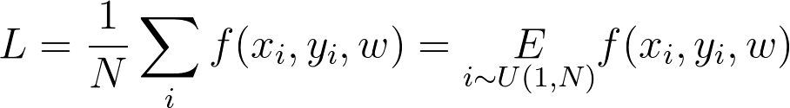

Stochastic gradient descent
Approximate objective with samples
sgd
gd

Slide 48
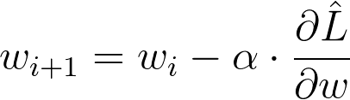

Stochastic gradient descent
Approximate objective with samples
Update:
sgd
gd
where

Slide 49

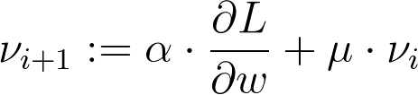
SGD with momentum
Idea: average gradient over consecutive steps
aka “add inertia”

Slide 50
SGD with momentum
Idea: average gradient over consecutive steps
aka “add inertia”
// reuse gradient from
previous steps

Slide 51
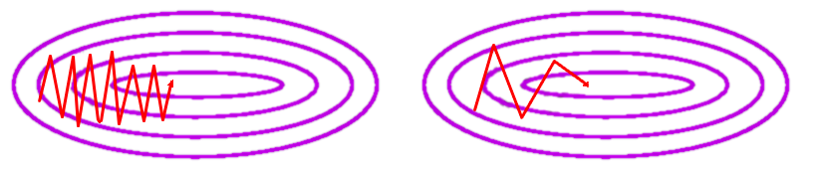
SGD with momentum
Idea: average gradient over consecutive steps
(see this demo)

Slide 52

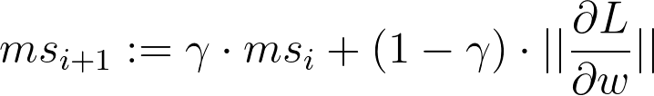
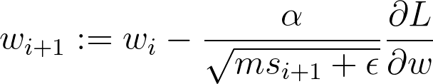
RMSProp
Idea: adapt learning rate to the slope of objective function
large gradient = go slower, small gradient = go faster

Slide 53
RMSProp
Idea: adapt learning rate to the slope of objective function
large gradient = go slower, small gradient = go faster
moving average norm^2

Slide 54
Adam
Idea: combine momentum and rmsprop in one method
the “default” optimizer, see the paper for details
moving average norm^2

Slide 55
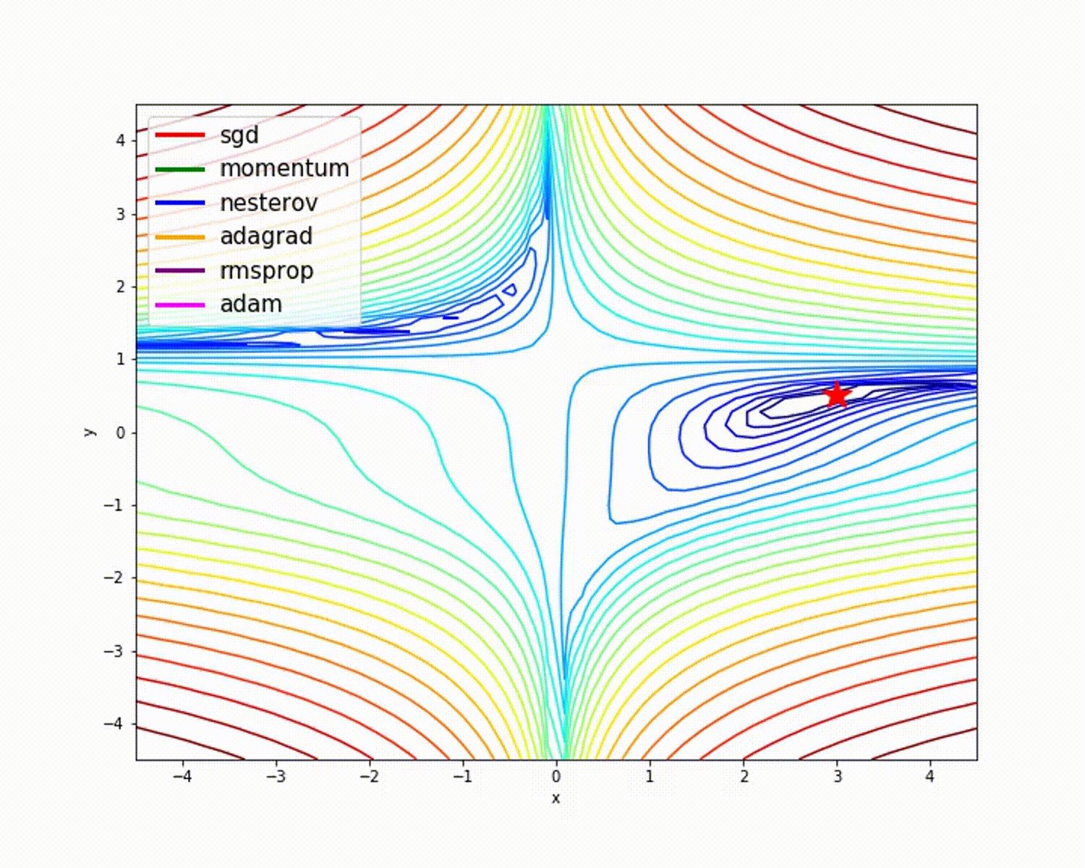
TL;DR stochastic optimization
Tips & tricks
Adam works fine
out of the box
One can usually beat adam with tuned sgd+momentum
Tuning may take long
Everyone has his favorite optimizer :)

Slide 56
Stuff we won’t cover
First order
Adam flavors: NAdam, Adamax, QHAdam
Adagrad, Radagrad, Adadelta - alternative adaptive lr
Approx second order
BFGS, L-BFGS
K-FAC

Slide 57
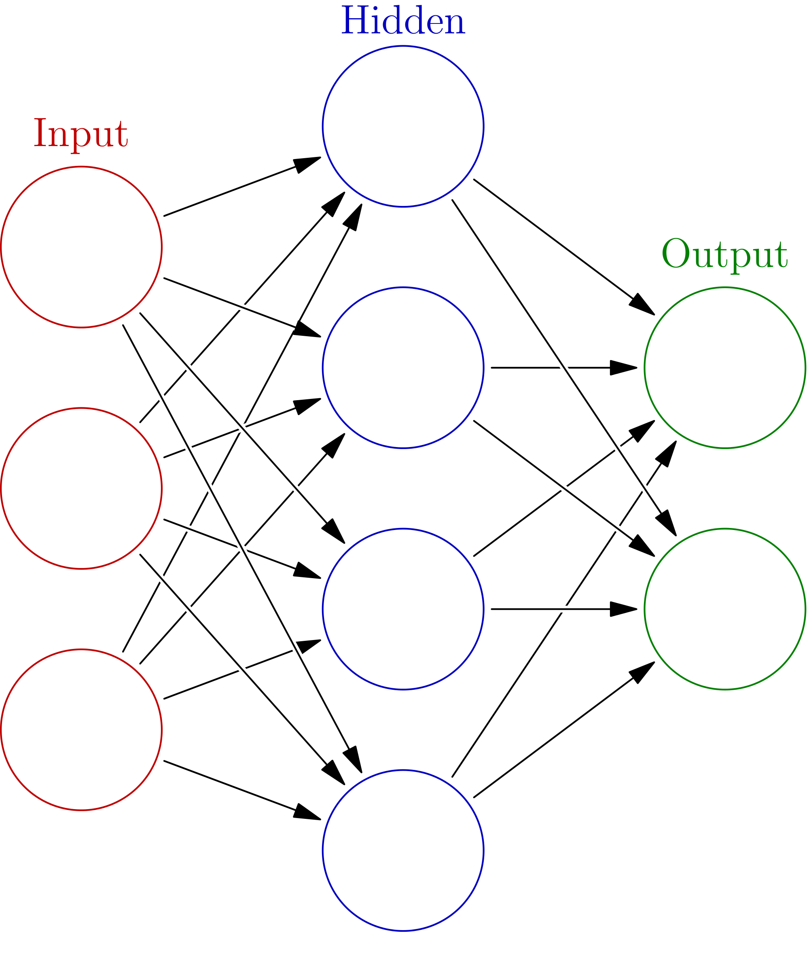
Initialization, symmetry problem
h0
Initialize with zeros
W := 0
What will the first step look like?
x0
h1
y0
x1
h2
y1
h2
x2
h3

Slide 58
Initialization, symmetry problem
Break the symmetry!
Initialize with random numbers!
W := N(0,0.01)?
W := U(-0.1,0.1)?
read more
h0
x0
h1
y0
x1
h2
y1
h2
x2
h3

Slide 59
Recap
Pipeline of linear and non-linear transformation
Loss function
Back propagation
Gradient descent-based optimizer
Tons of hacks & tweaks

Slide 60

Nuff said
Let's go implement that!

Slide 61
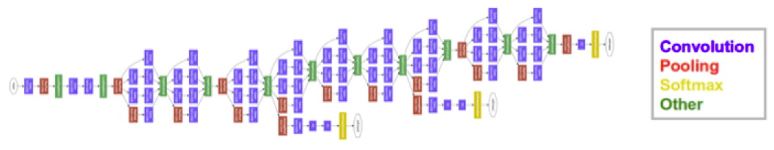
And now let's differentiate
near state-of-the-art in image classification
5+ types of layers
parallel branches with independent losses
few hundred megabytes of weights

Slide 62

And now let's differentiate
near state-of-the-art in image classification
5+ types of layers
parallel branches with independent losses
few hundred megabytes of weights

Slide 63
Deep learning frameworks
near state-of-the-art in image classification
5+ types of layers
parallel branches with independent losses
few hundred megabytes of weights

Slide 64
Deep learning frameworks
Core idea: helps you define and train neural nets
Keras, Lasagne, Pyro
& many more
High-level
Caffe, Theano, TF, Torch, ...
Low-level libraries
CUDNN, cuSparse, ...
Low-level
CUDAC++, CUDA*
Low-level
CUDAC++, CUDA*
Hardware
(CPU/GPU/TPU/FPGA)

Slide 65
Deep learning frameworks
Core idea: helps you define and train neural nets
We'll spend next K slides here
Keras, Lasagne, Slim
& many more
High-level
Caffe, Theano, TF, Torch,...
Low-level libraries
CUDNN
Low-level
CUDAC++, CUDA*
Low-level
CUDAC++, CUDA*
Hardware
(CPU/GPU/TPU/FPGA)

Slide 66
Deep learning frameworks
Layer-based frameworks:
  Same idea as in our hand-made neural net

Slide 67
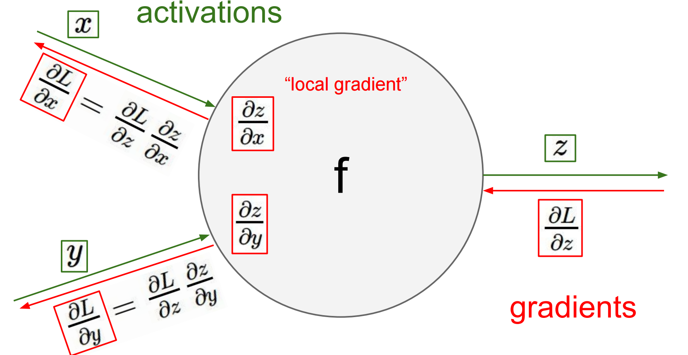

Deep learning frameworks
Layer-based frameworks:
  Same idea as in our hand-made neural net
  this one - http://bit.ly/2w9kAHm
Layer

Slide 68

Deep learning frameworks
name: "LeNet"
layer {
name: "conv1"
type: "Convolution"
bottom: "data"
top: "conv1"
param {lr_mult: 1}
param {lr_mult: 2}
convolution_param {
num_output: 20
kernel_size: 5
stride: 1
weight_filler {
type: "xavier"
}}}
….
You define model in config file
by stacking layers (left)
Then run train script:
caffe train -solver examples/mnist/lenet_solver.prototxt
130 lines

Slide 69
Deep learning frameworks
name: "LeNet"
layer {
name: "conv1"
type: "Convolution"
bottom: "data"
top: "conv1"
param {lr_mult: 1}
param {lr_mult: 2}
convolution_param {
num_output: 20
kernel_size: 5
stride: 1
weight_filler {
type: "xavier"
}}}
….
+ Easy to deploy (C++)
+ A lot of pre-trained models
(model zoo)
- Model as protobuf
- Hard to build new layers
- Hard to debug
Still used for
computer vision
130 lines

Slide 70
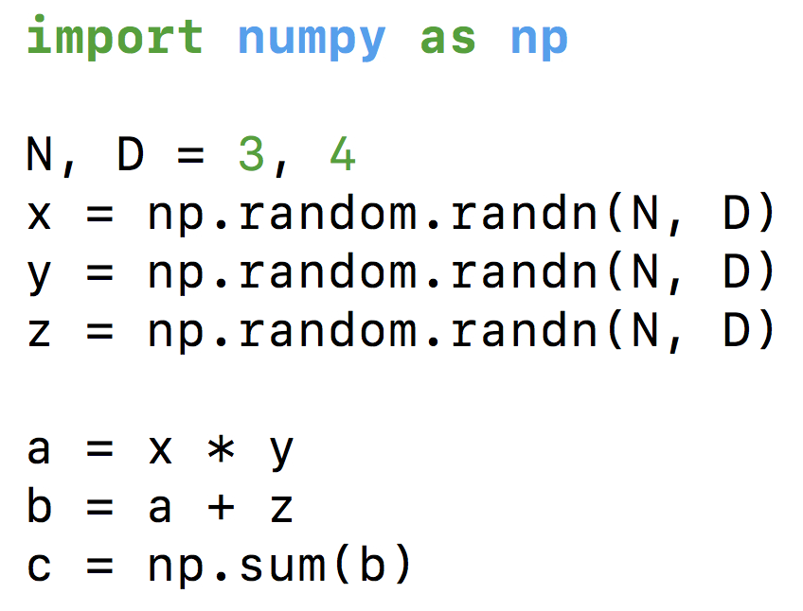
Computation graphs
What does your CPU do
when you write this?
This many further slides taken from Ars Ashukha @deepbayes2017

Slide 71
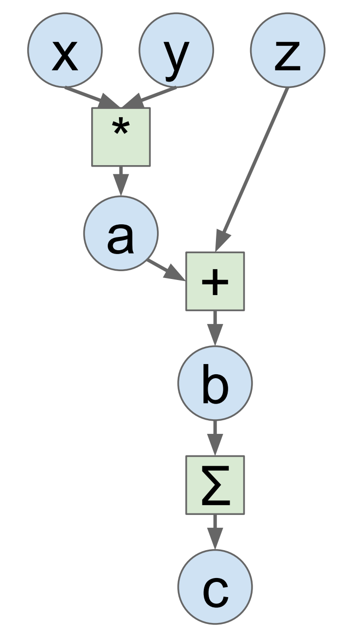
Computation graphs
Idea: let's define
this graph explicitly!
This many further slides taken from Ars Ashukha @deepbayes2017

Slide 72

Computation graphs
+ Automatic gradients!
+ Easy to build new layers
+ We can optimize the Graph
- Graph is static during training
- Need time to compile/optimize
- Hard to debug
Grads
This many further slides taken from Ars Ashukha @deepbayes2017

Slide 73
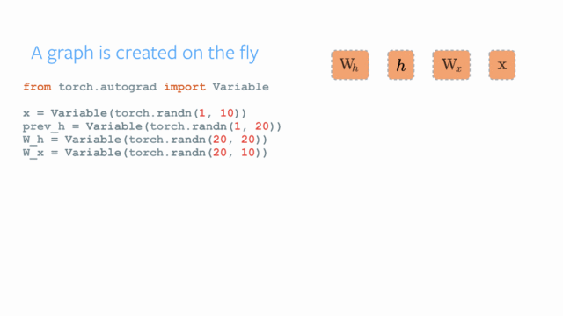
Dynamic graphs
Chainer, DyNet, Pytorch

Slide 74


Dynamic graphs
Chainer, DyNet, Pytorch
+ Can change graph on the fly
+ Can get value of any tensor at any time
(easy debugging)
- Hard to optimize graphs
(especially large graphs)
- Still early development
Researchers love these!

Slide 75
PyTorch examples
Builder-style definition
m = nn.Sequential()
m.add_module(‘L1’,
nn.Linear(784, 1))
m.add_module(‘L2’,
nn.Sigmoid())
Class-based definition
import torch.nn as nn
import torch.nn.functional as F
class Model(nn.Module):
def __init__(self):
super(Model, self).__init__()
self.linear = nn.Linear(784, 1)
self.sigmoid = nn.Sigmoid()
def forward(self, x):
return nn.Sigmoid(self.linear(x))

Slide 76
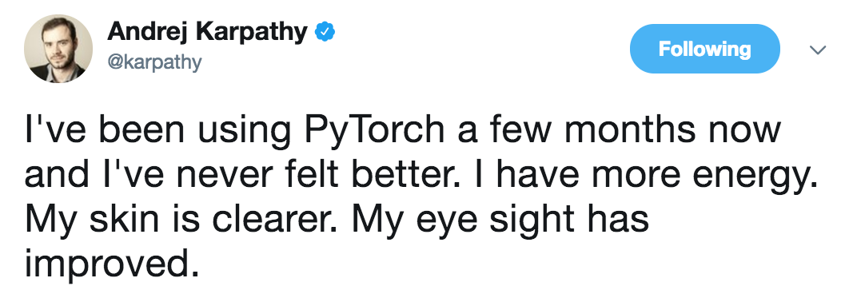
Dynamic graphs
Researchers love them!

Slide 77
Outlook

Slide 78
Can NN be useful in HEP (recap)?
Real-time event reconstruction
Real-time event selection
Data acquisition quality certification and anomaly detection
Fast simulation of events
Detector optimization
AI Physicist
http://bit.ly/2woj0Cd

Slide 79

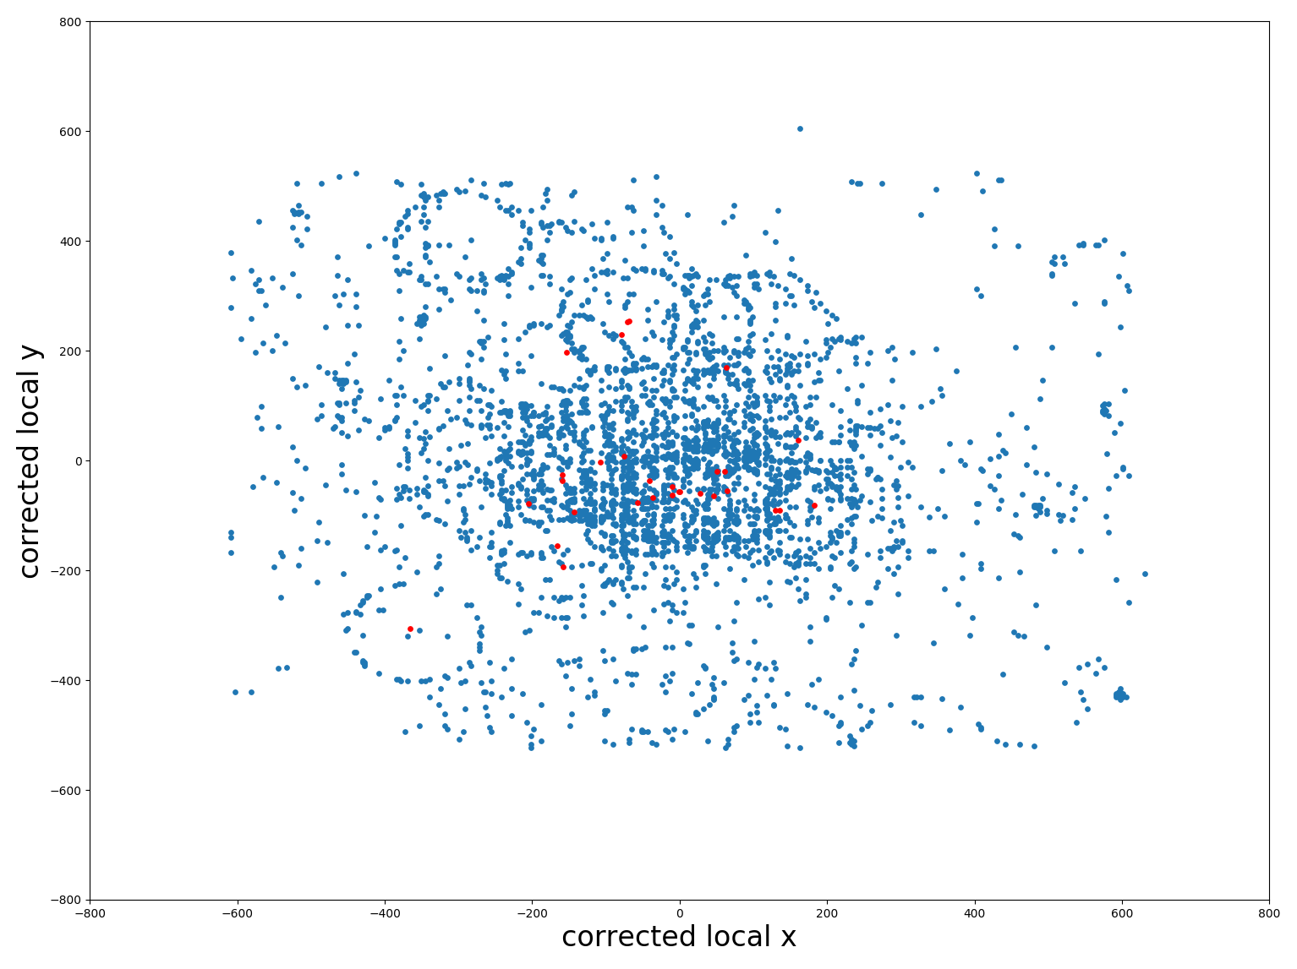




RICH PID using convolutional neural networks
Michele Blago, Daniel Campora, Chris Jones
MC data from LHCb reconstruction:31K events in current dataset.
Region around track centres (depending on momentum range) translated into polar coordinate 64 x 64 binary pixel images.
Labelled images used to train CNN.
Polar coordinates
64 x 64
RICH 1
r
$$φ$$
$$φ$$
r
CNN
Pion
Prediction

Slide 80
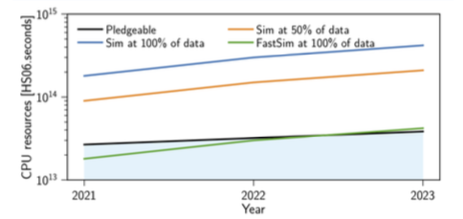
Fast Simulation
Number of events to be simulated scales with the luminosity, and that the simulation time scales with pile-up, the CPU requirements will scale accordingly.
  ReDecay: only the signal part is simulated, while the same underlying event(s) are re-used several times
  Shower library, https://bit.ly/2TPM0MG
  Generative models: use NN-based simulation

Slide 81
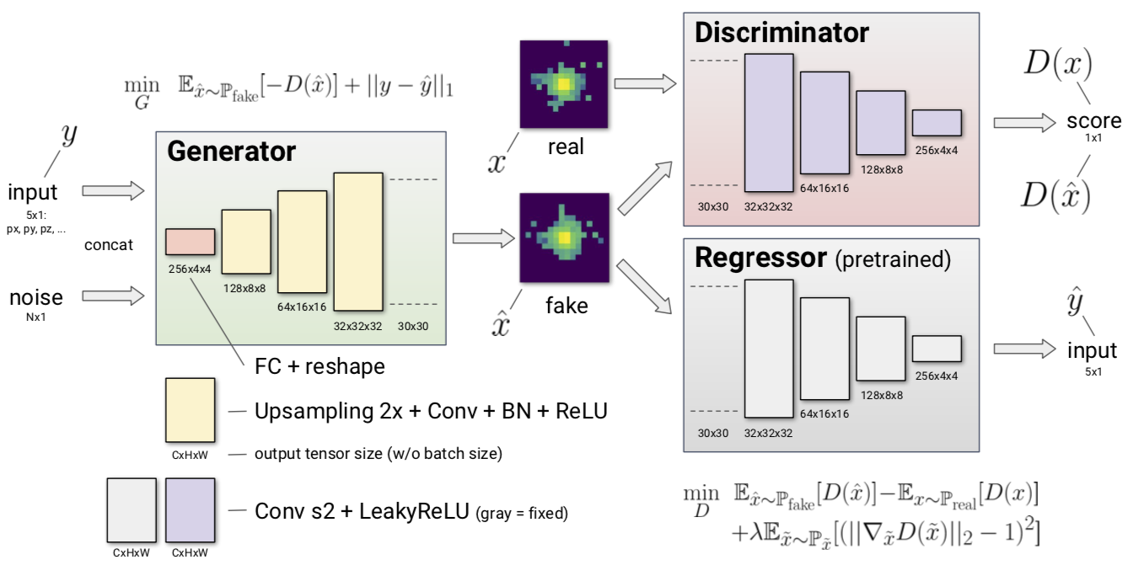
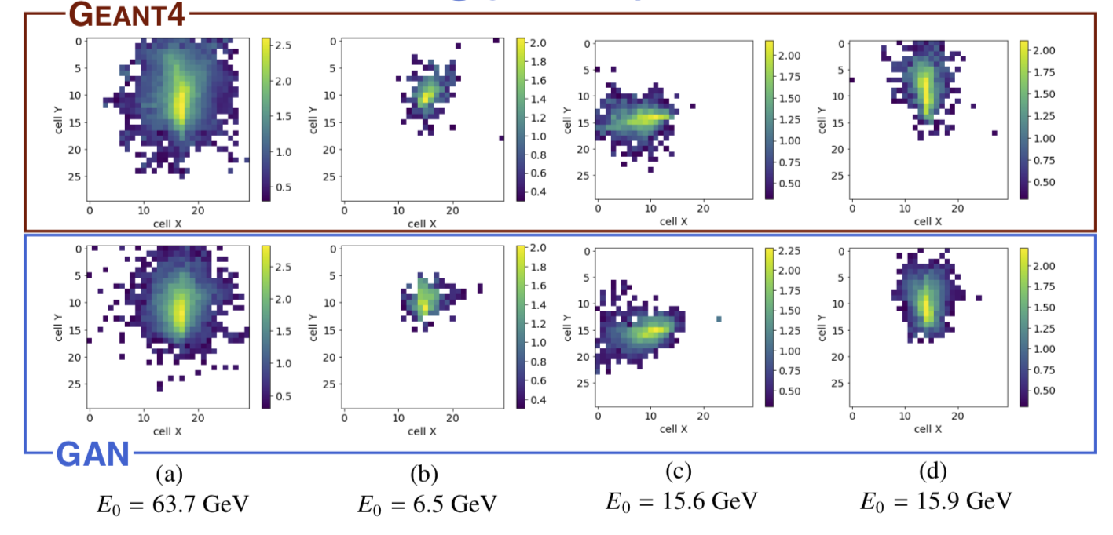
Fast Calorimetry Simulation
  LHCb-like calorimeter 30x30
  5 conditional parameters per particle (3D momentum, 2D coordinate)
  Electrons from particle gun shot at 1x1 cm square at the center of the calorimeter face
  Approach: use GANs

Slide 82

Typical simulation workflow
Derkach et al, NIMA 2019 (01) 031

Slide 83

Quality assessment and open questions
  Visual similarity of raw features does not guarantee the similarity of higher-level characteristics
  How can we make sure tails of distribution are reproduced carefully enough?
  How can we estimate statistic and systematic uncertainty of such a model?

Slide 84

Machine Learning for HEP 2020 Summer School
Sixth summer school
EPFL, Lausanne
16-30 July
https://bit.ly/mlhep2020
Registration closes 17/03

Slide 85
Research at Lambda Lab

Slide 86

Co-research holistic view

Slide 87
Co-Research Platform - Coopetition
Co-research coopetition platform
AI
Researchers
Students
Universities
Industry
Accelerate research by ML
Solve scientific challenges
Improve practical skills
Learn to collaborate
Learn about new domains
Evaluate student skills more accurately
Personalize education
Improve level of graduates at scale (reduce per student expense)
Get more qualified employees
Solve practical challenges

Slide 88

Project big lifecycle (co-research)
Inception stage
Learning: doing papers review, study of «state-of-the-art» methods
individual solution: iterative search, model understanding and improvement
Writing final report, slides and paper
NB: iterations may be nested on every stage.

Slide 89
Our Lab Project Highlights 2019/20
X-ray tomography
DUNE event reconstruction speed-up by deep neural architectures
X-ray Laser simulation and tuning
Estimation of population size by genomes analysis
Study of community polarization by search/recommendation output system analysis
Leadership style identification by social network profile
AI Researcher
Natural Language to Machine Learning corpus assembly
Improving Earth satellites position prediction by simulation tuning
Galaxy cluster mass estimation and registry update
Warm and cold dark matter hypothesis comparison
http://bit.ly/2VNGoll

Slide 90

Conclusion
Huge demand for collaboration between ML & Physics
  Plenty of exciting challenges
  but it requires deeper understanding of generic methods
  to adapt to HEP specifics
We are open for collaboration with your group or University
hse_lambda
anaderiRu
austyuzhanin@hse.ru

