Slide 1

Overview of Science-Informed ML
Dr. Sci., Prof. Evgeny Burnaev
Head of Applied AI Center, Skoltech
Head of Research Group, AIRI

Slide 2
Outline
“Biases” in ML
Sci-ML Approaches
Challenges of Sci-ML
What’s next

Slide 3
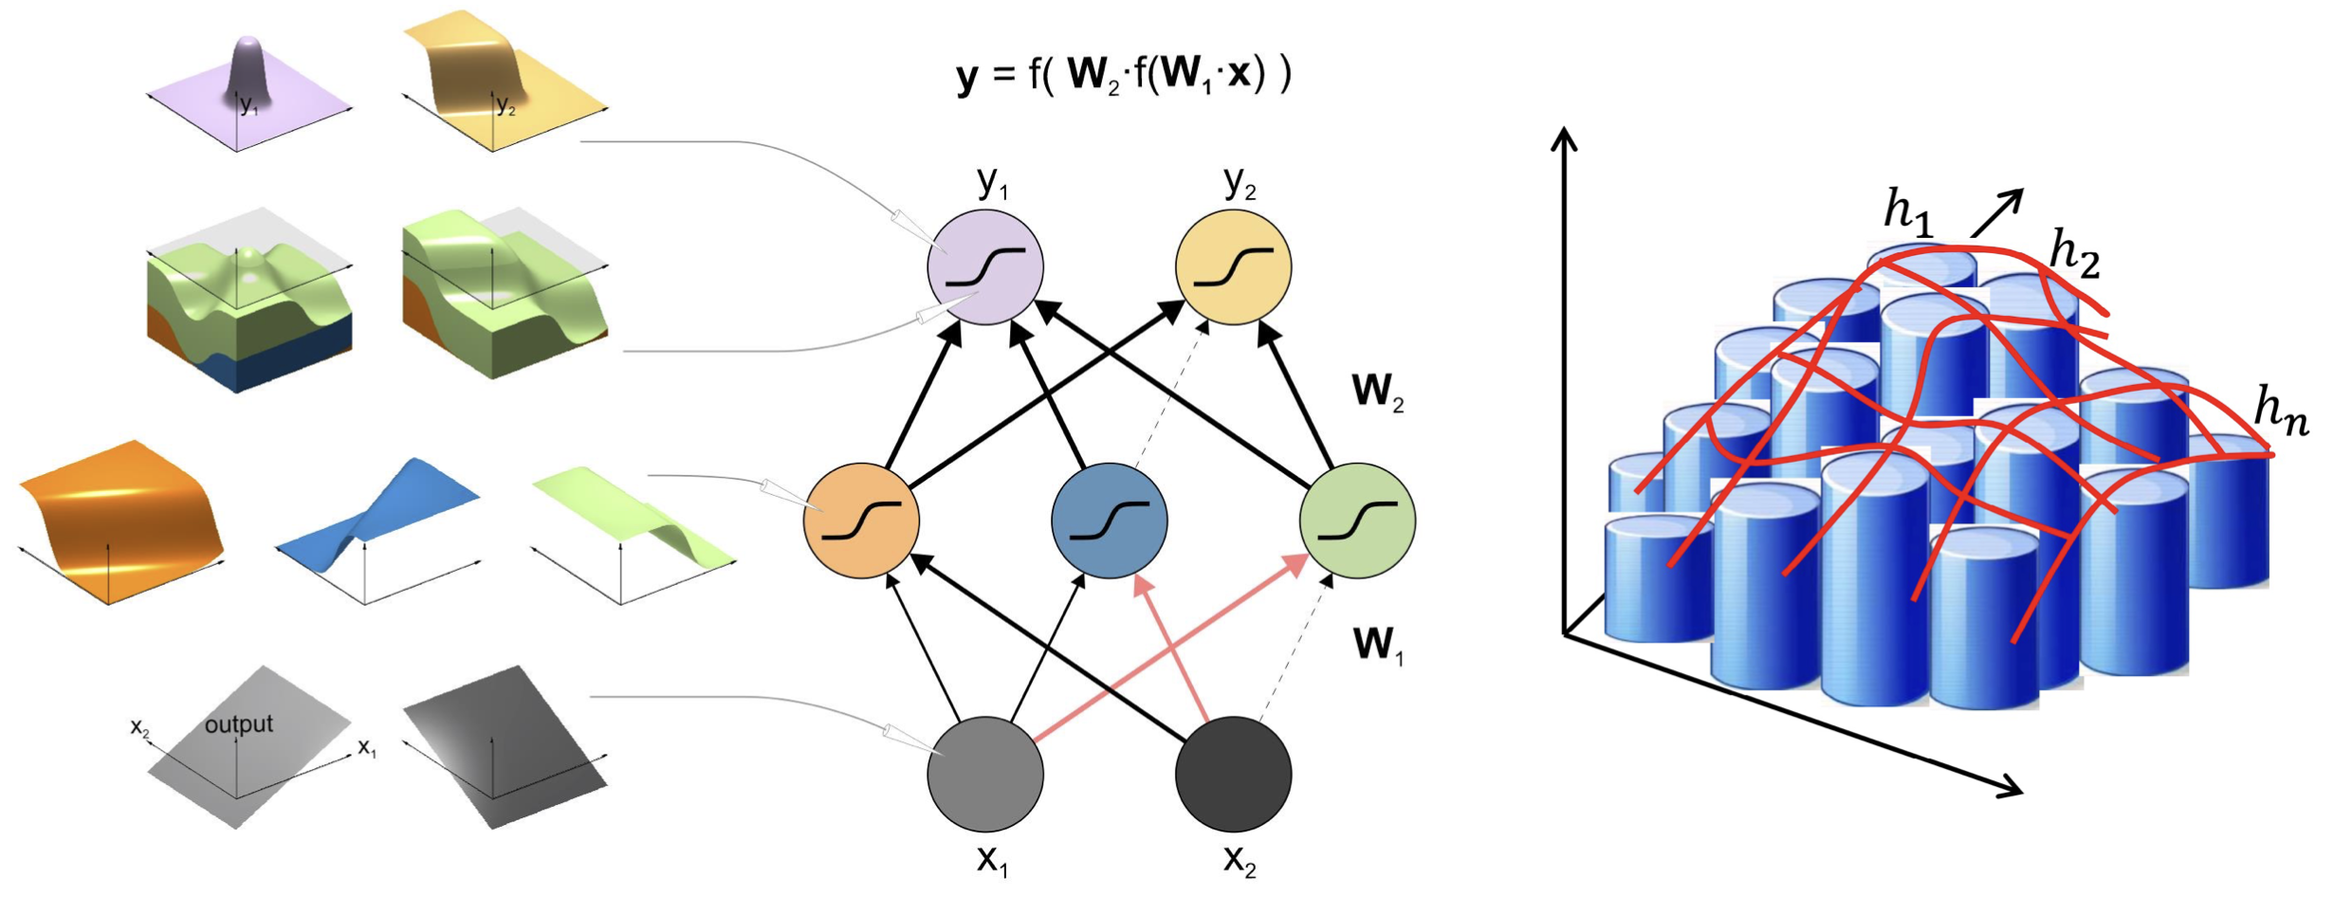
MLPs and Universal Function Approximators
Theorem: There exists a Boolean function of
d > 2 variables that requires at least 2^{d}/d Boolean gates, regardless of depth!
G. Cybenko. Approximation by superpositions of a sigmoidal function. Mathematics of Control, Signals and Systems, 2(4):303–314, 1989.
K. Hornik, M. Stinchcombe, and H. White. Multilayer feedforward networks are universal approximators. Neural Networks, 2(5):359–366, 1989.
Kriegeskorte N, Golan T. Neural network models and deep learning-a primer for biologists. arXiv preprint arXiv. 1902.

Slide 4
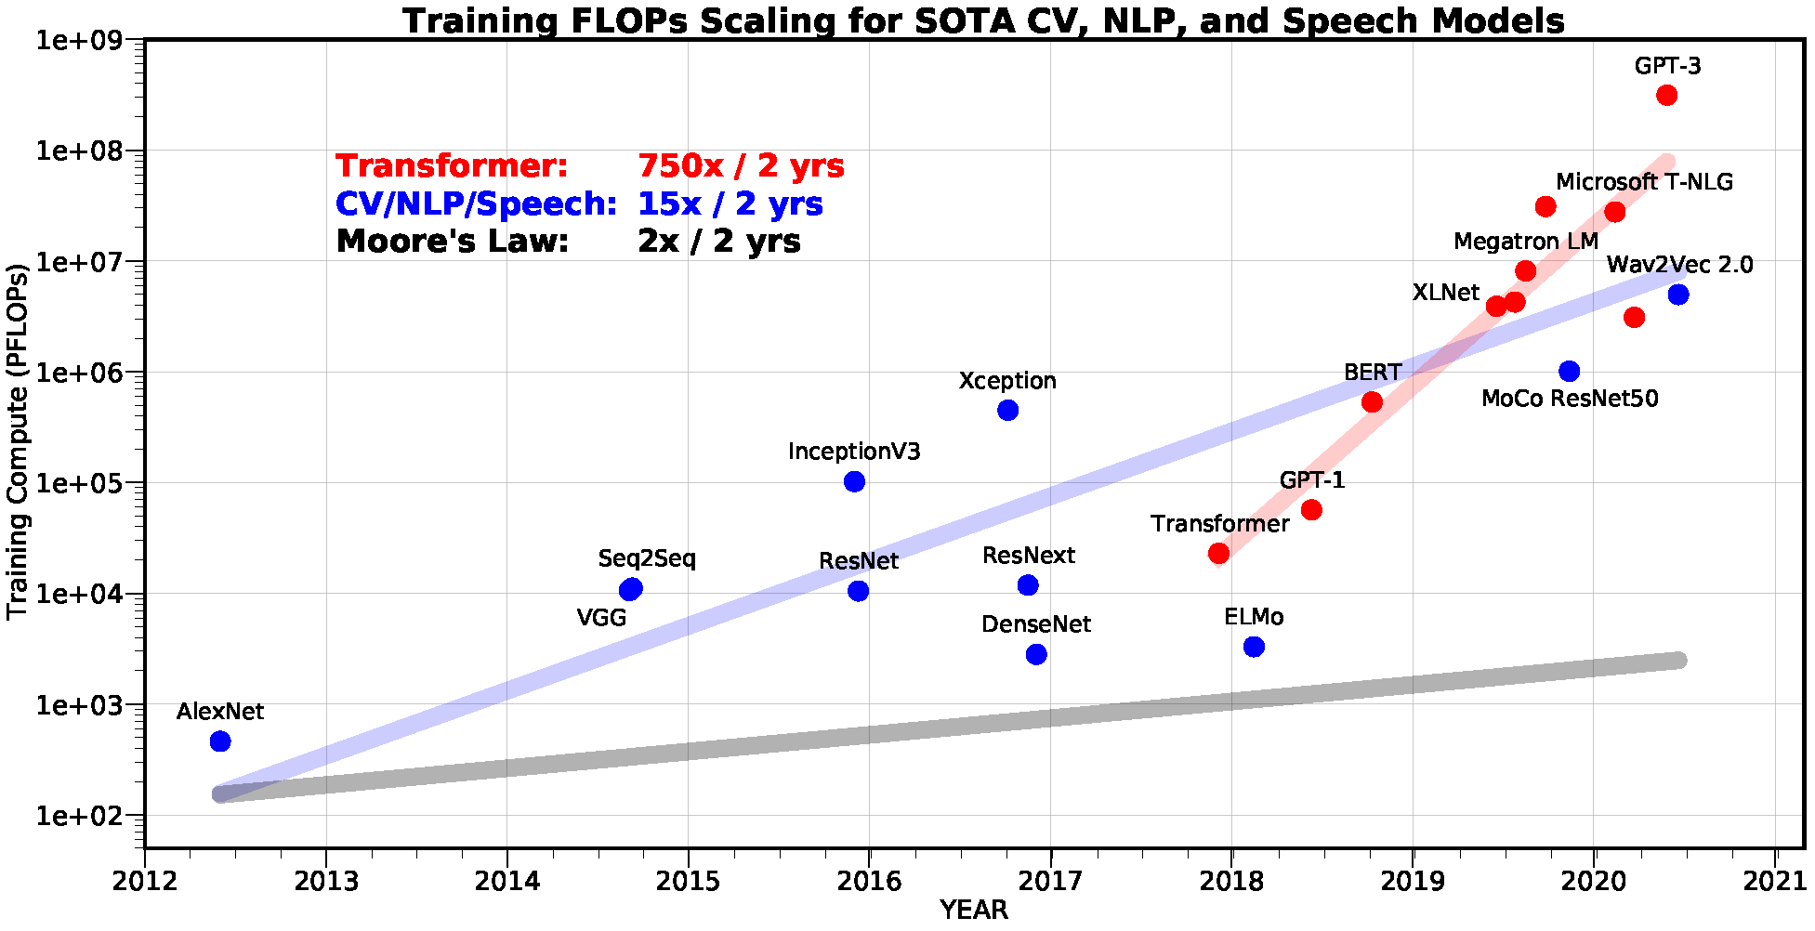
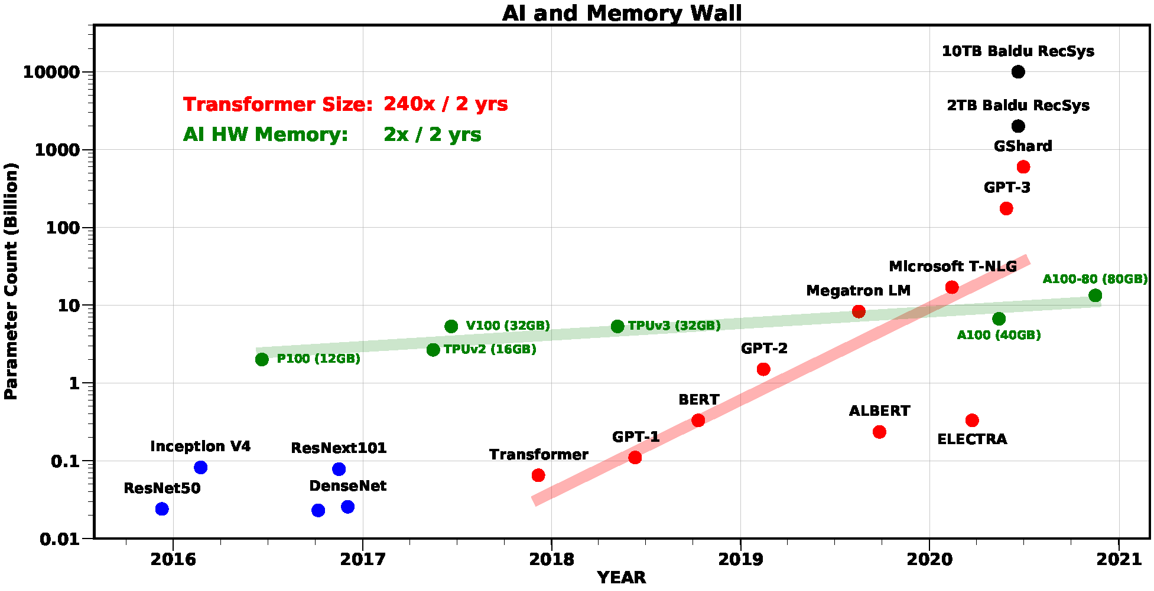
What works in practice?
Exponentially Expensive Models to Train
Biases are important!!!
Extremely Overparameterized Models
Amir Gholami, Zhewei Yao, Sehoon Kim, Michael W. Mahoney, Kurt Keutzer, AI and Memory Wall, Riselab Medium Blogpost, 2021.

Slide 5
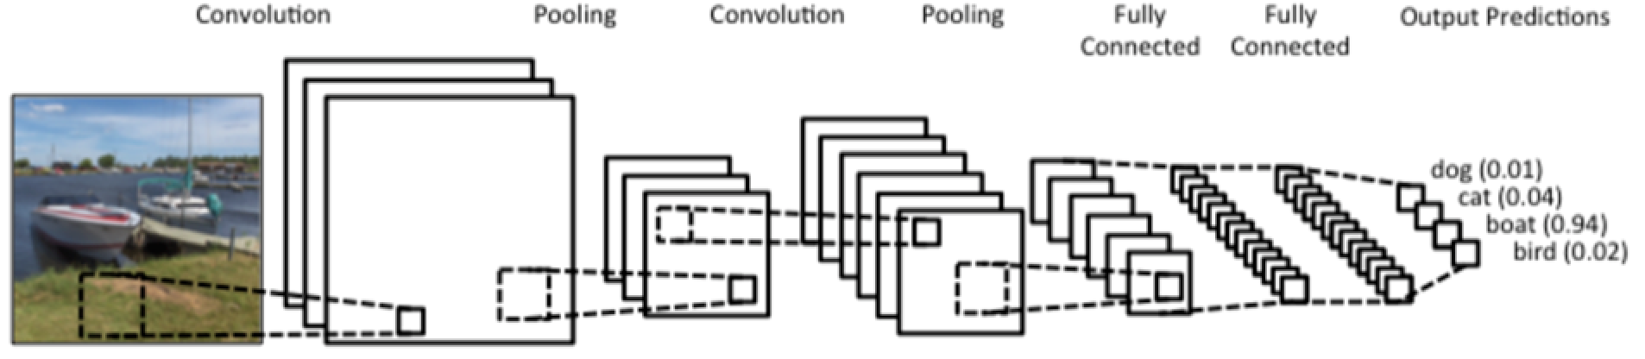
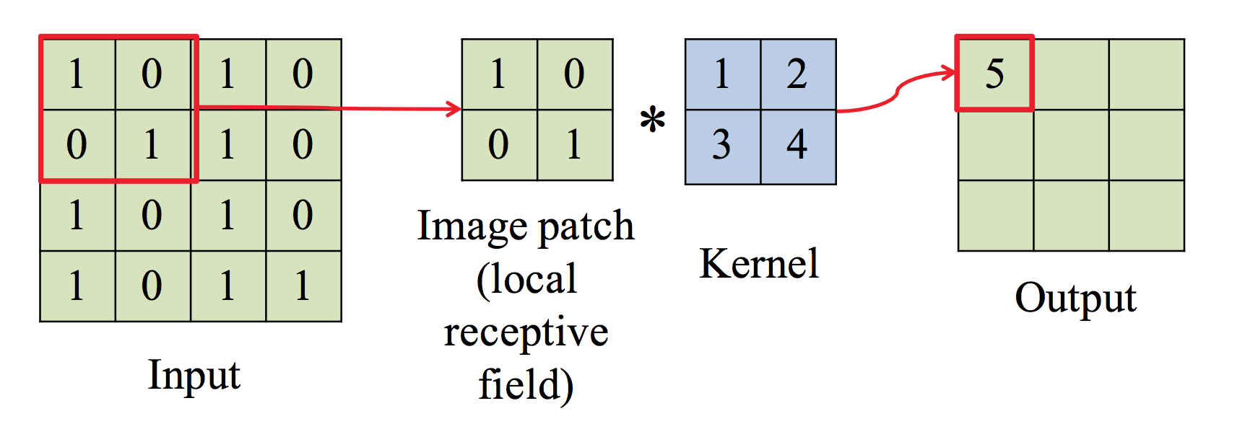
Convolutional Neural Networks for Image Processing

Slide 6
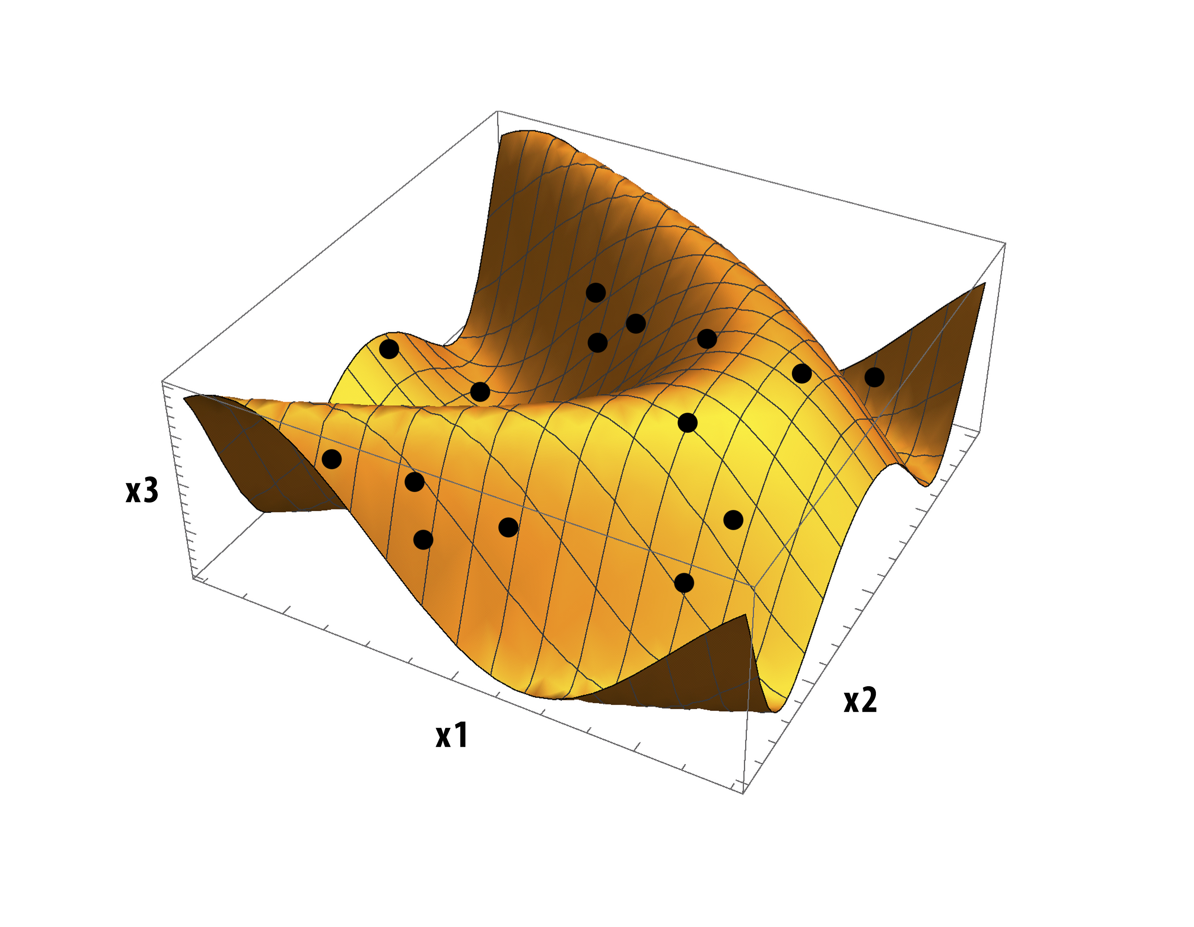

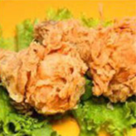

Slide 7
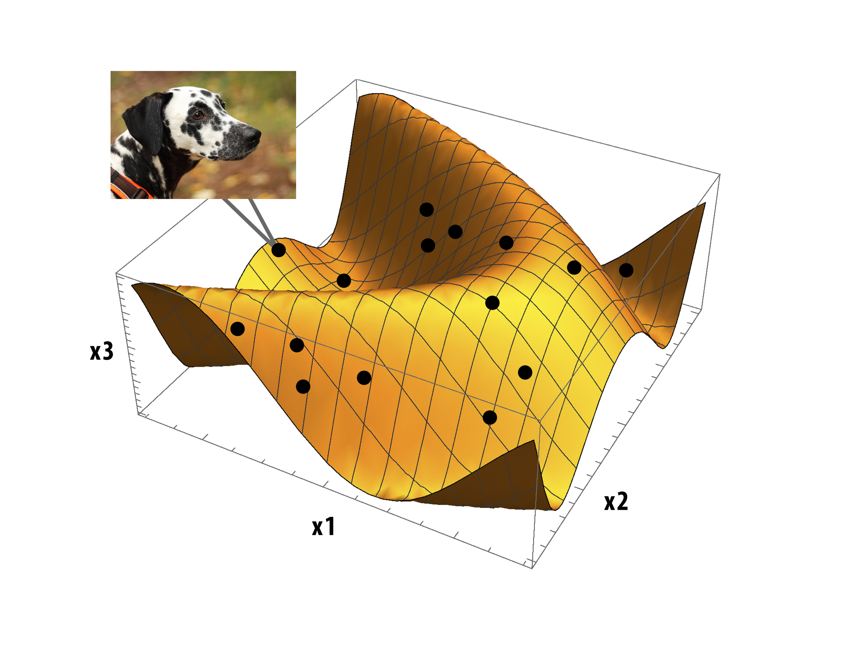

Slide 8
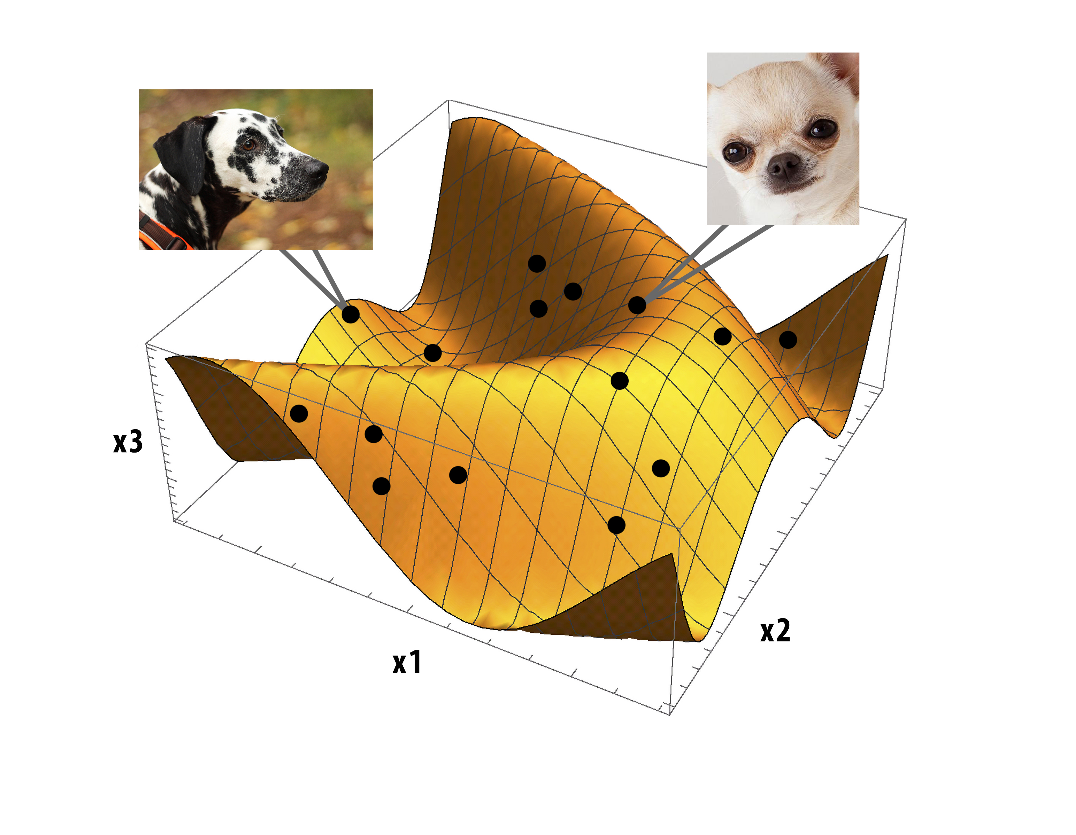

Slide 9
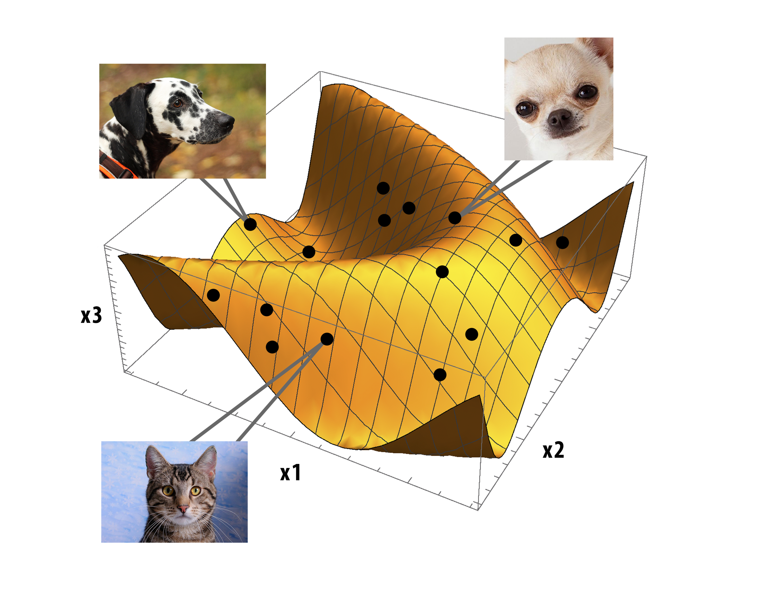

Slide 10
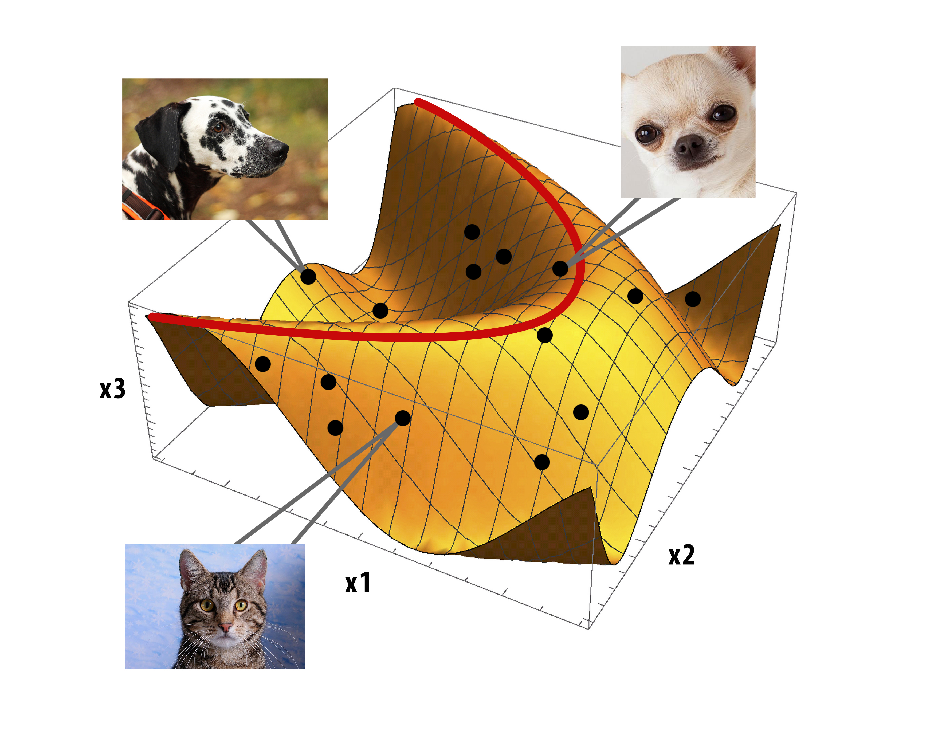

Slide 11
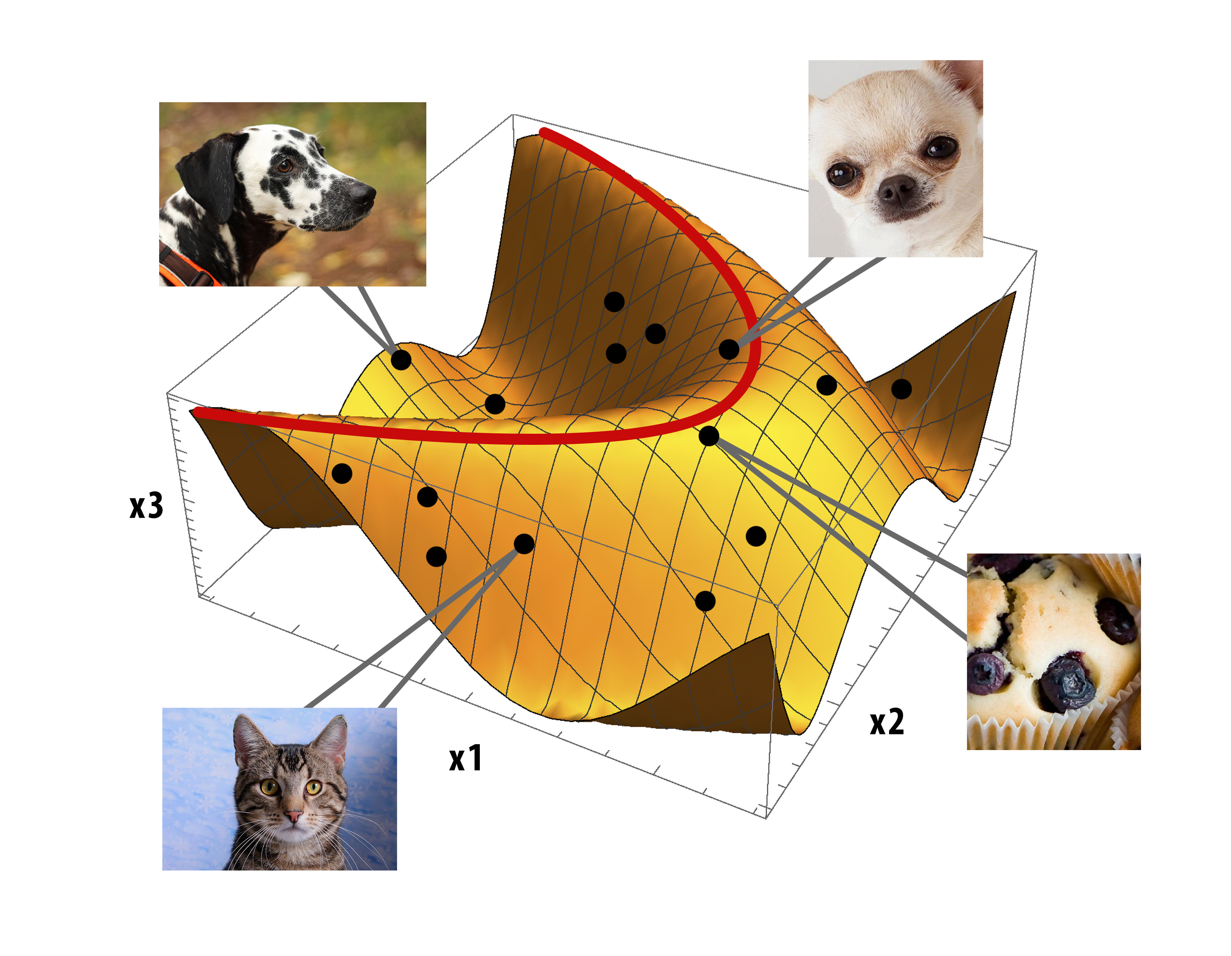

Slide 12

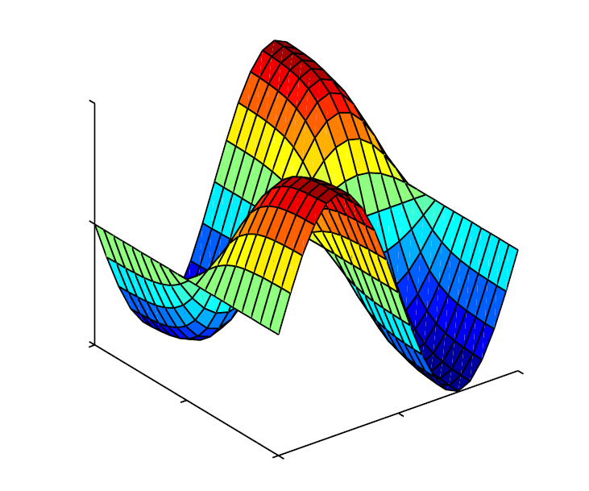
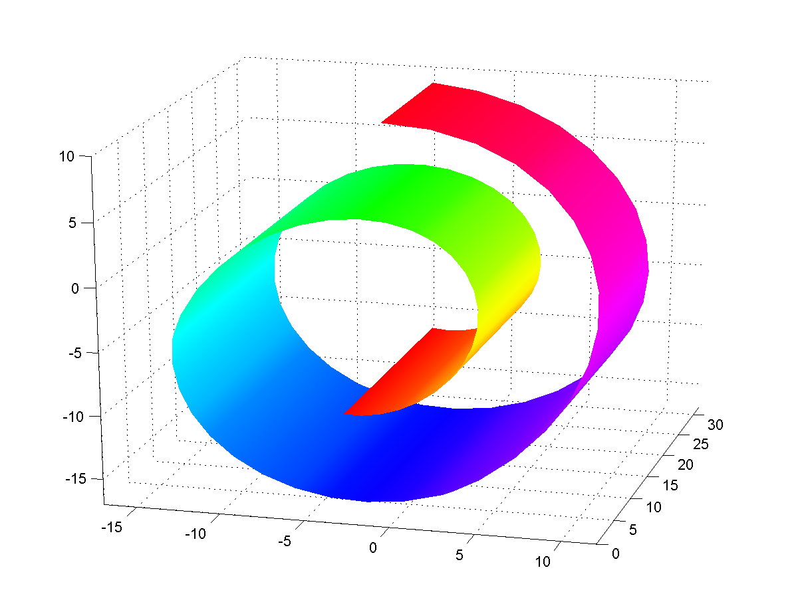
Manifold Learning
Manifold covered by a single chart (surface in )
unknown -dimensional surface – Data manifold
covered by single chart defined on Coordinate space

Slide 13

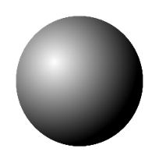

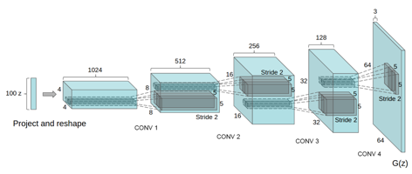
Latent Generative Model

Slide 14

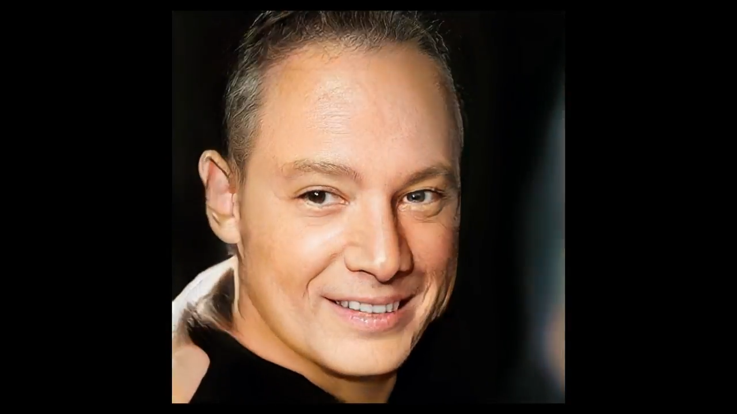
Latent Generative Model

Slide 15
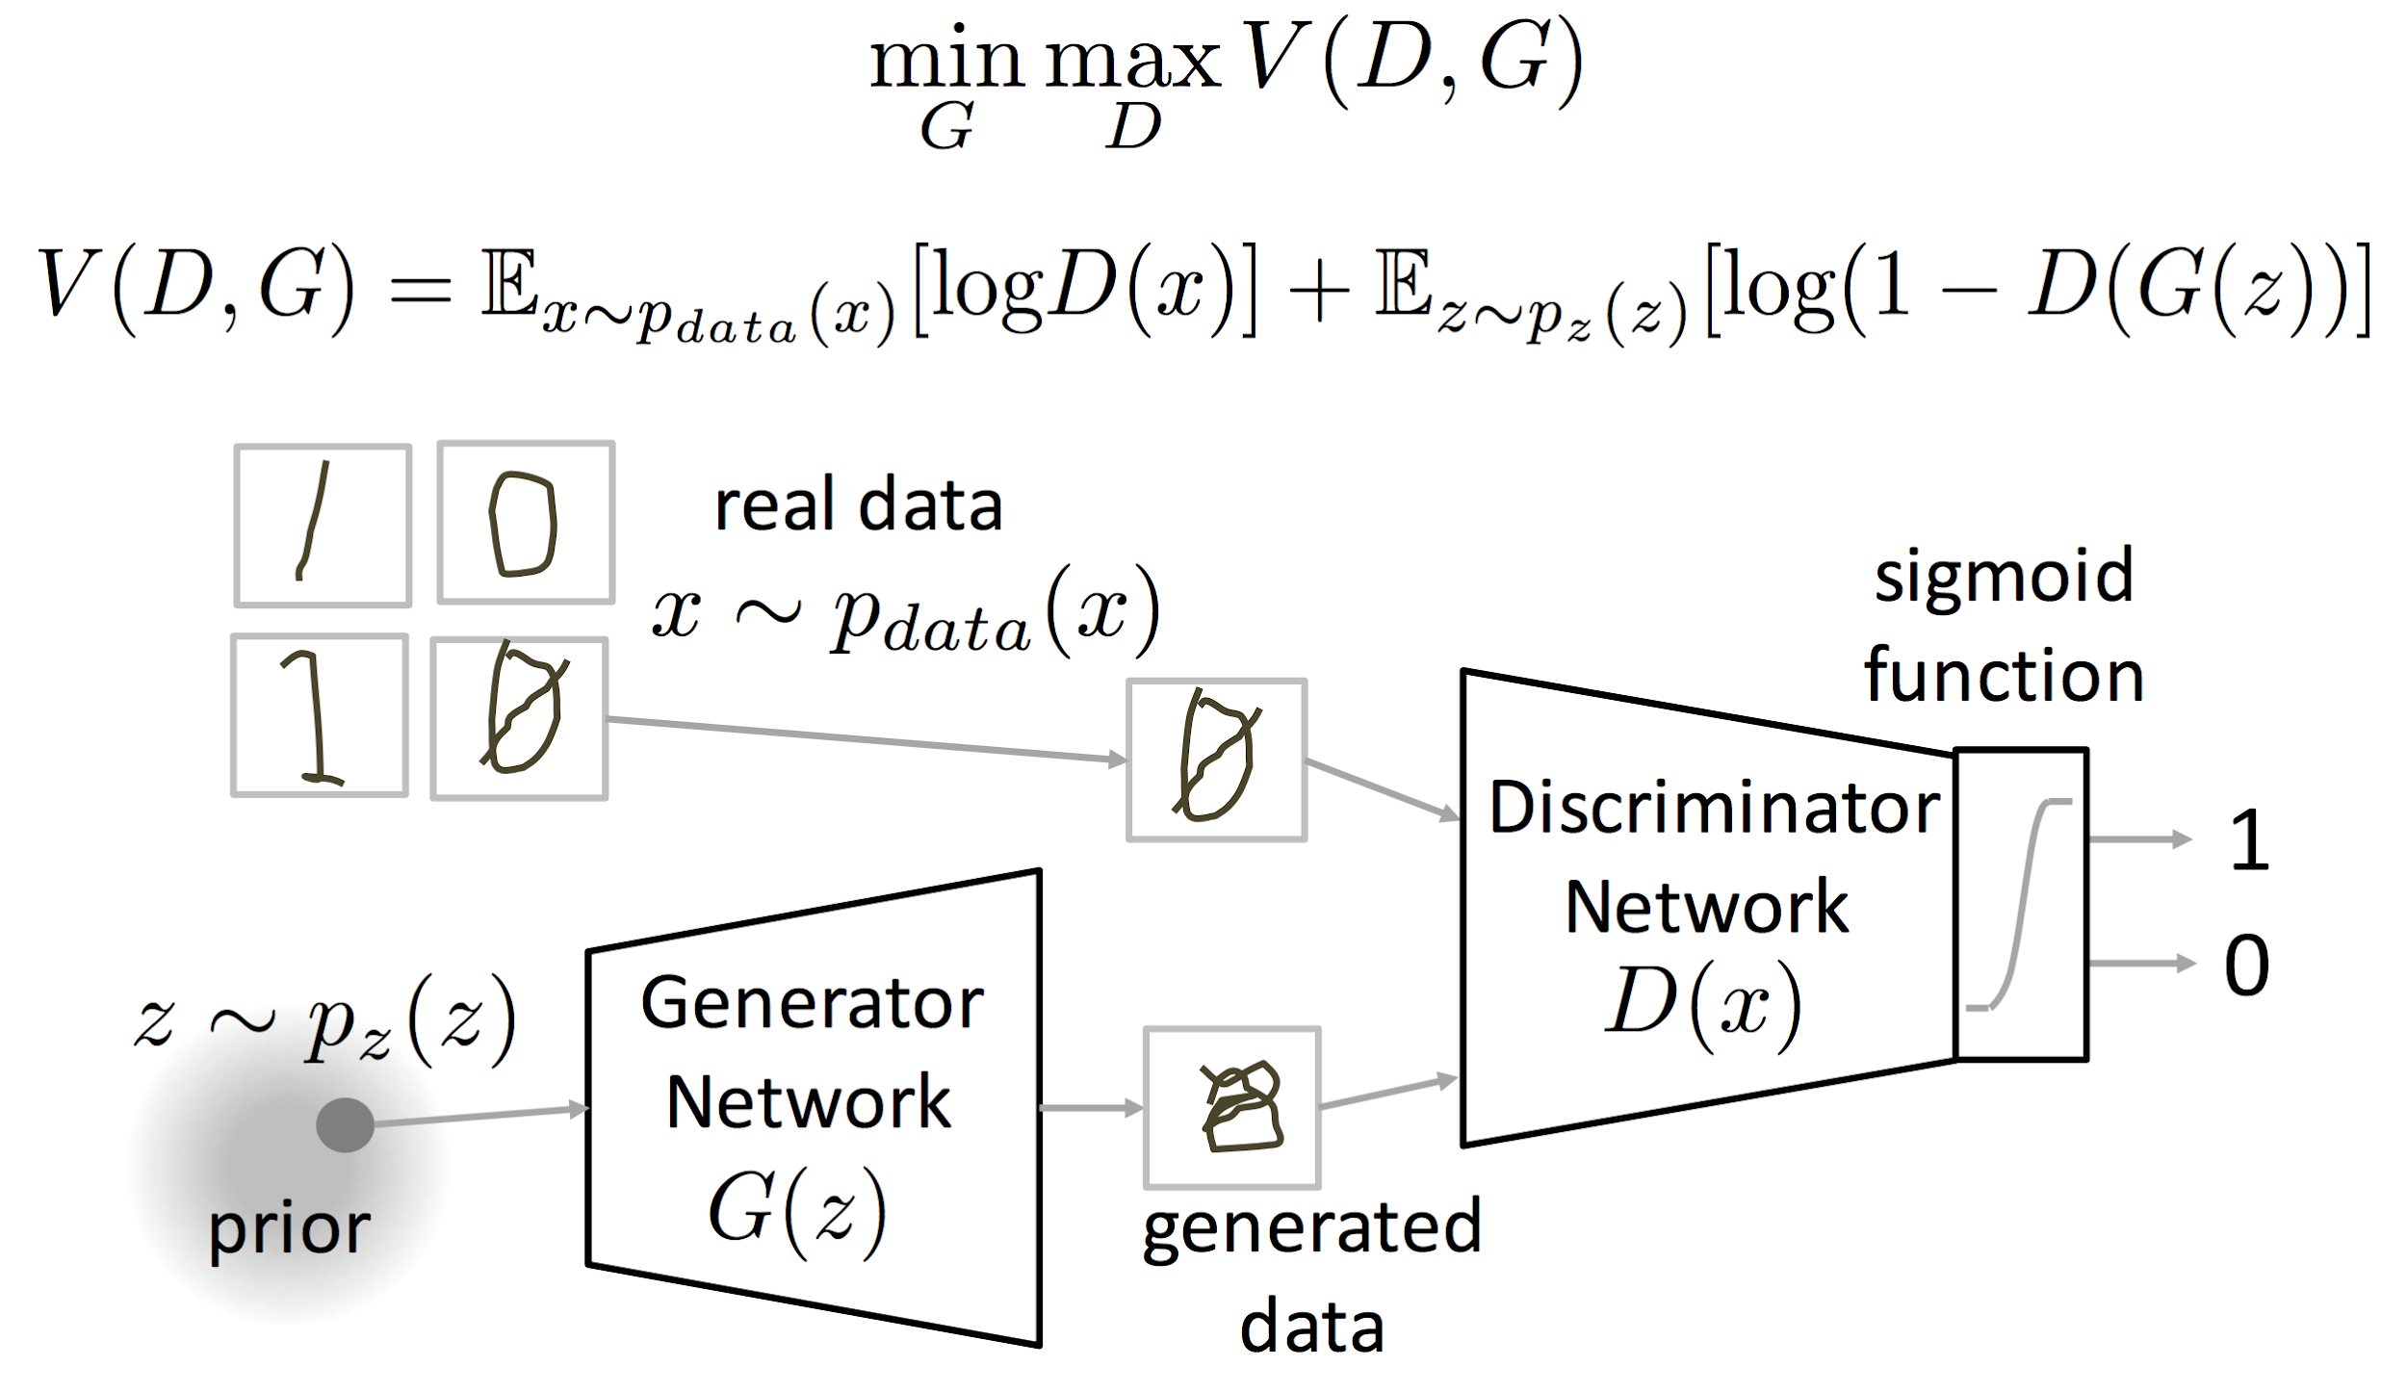
Generative Adversarial Network

Slide 16
Generative Adversarial Network

Slide 17
Generative Adversarial Network

Slide 18
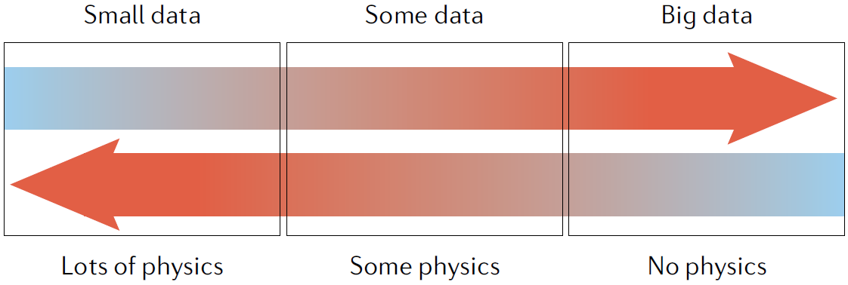
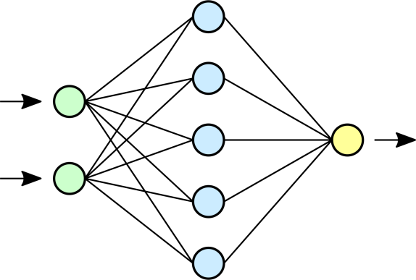
Pros and cons of ML models
Universal approximator
Fast on inference
Differentiable
Slow on training
Huge datasets
Vulnerable to attacks
Sea waves

Slide 19
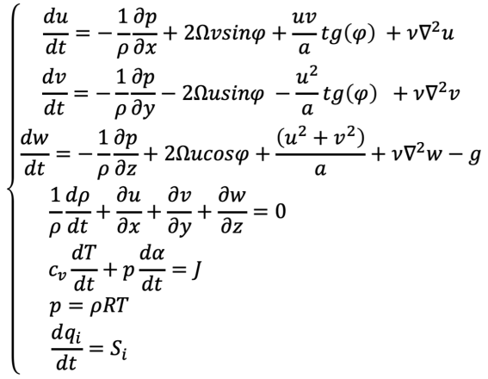
Pros and cons of scientific models
Good precision
No data needed
Interpretable
Intrinsic model errors
Costly simulations
Sea waves

Slide 20

Why and When – always when you can!

Slide 21
Outline
“Biases” in ML
Sci-ML Approaches
Challenges of Sci-ML
What’s next

Slide 22
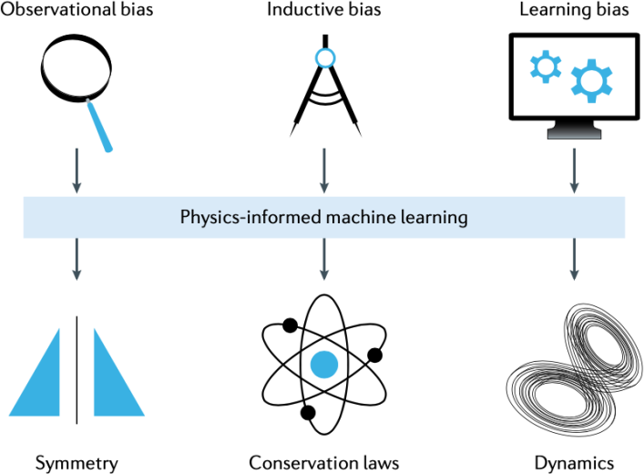
Classification of approaches
Learn from data
Incorporate biases into a model structure
Incorporate biases into a model loss function
Karniadakis, George Em, et al. "Physics-informed machine learning." Nature Reviews Physics 3.6 (2021): 422-440.

Slide 23
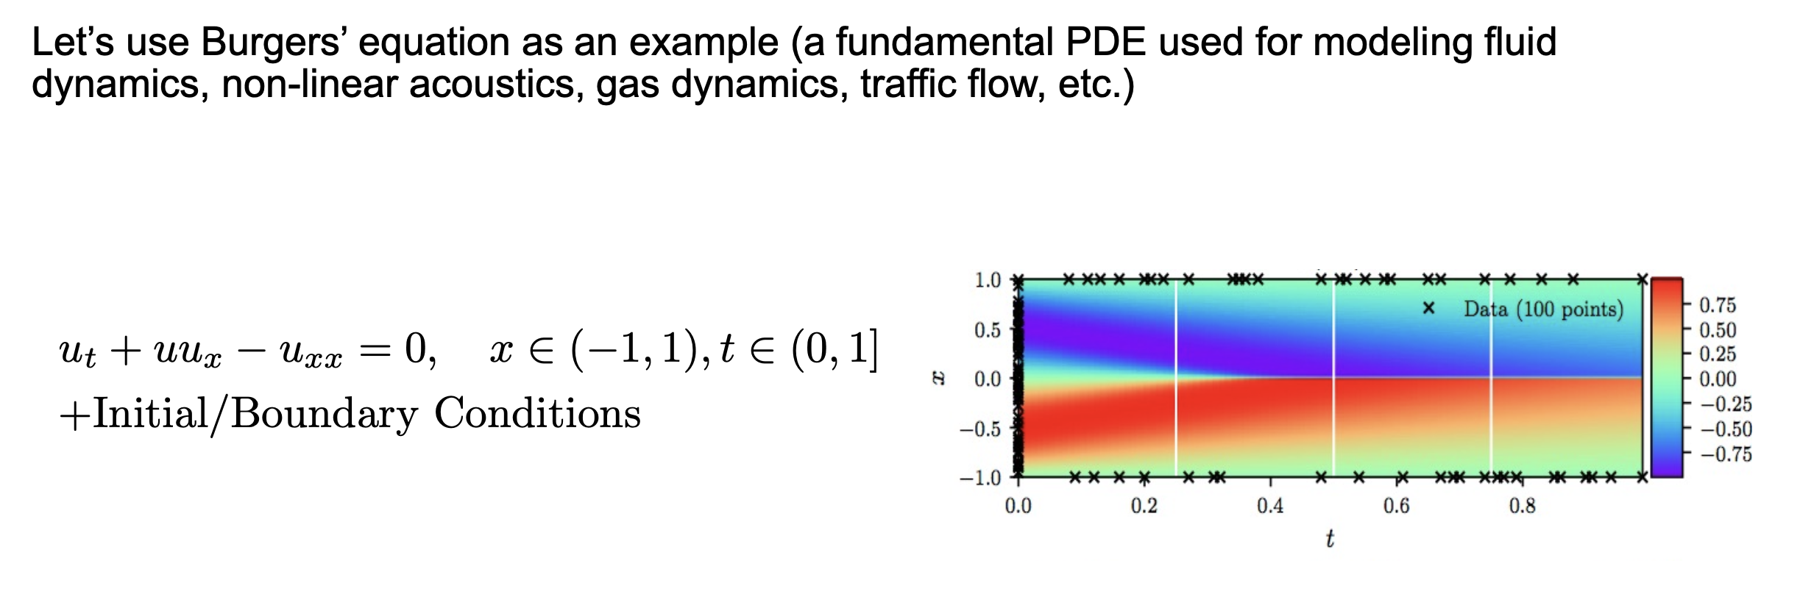
1. Physics learned from data
Train on massive amount of data (and hope) that the NN trains with good performance/generalization
[1] Raissi M, Perdikaris P, Karniadakis GE. Physics-informed neural networks: A deep learning framework for solving forward and inverse problems involving nonlinear partial differential equations. Journal of Computational Physics. 2019 Feb 1;378:686-707.
[2] Lagaris IE, Likas A, Fotiadis DI. Artificial neural networks for solving ordinary and partial differential equations. IEEE transactions on neural networks. 1998 Sep;9(5):987-1000.

Slide 24
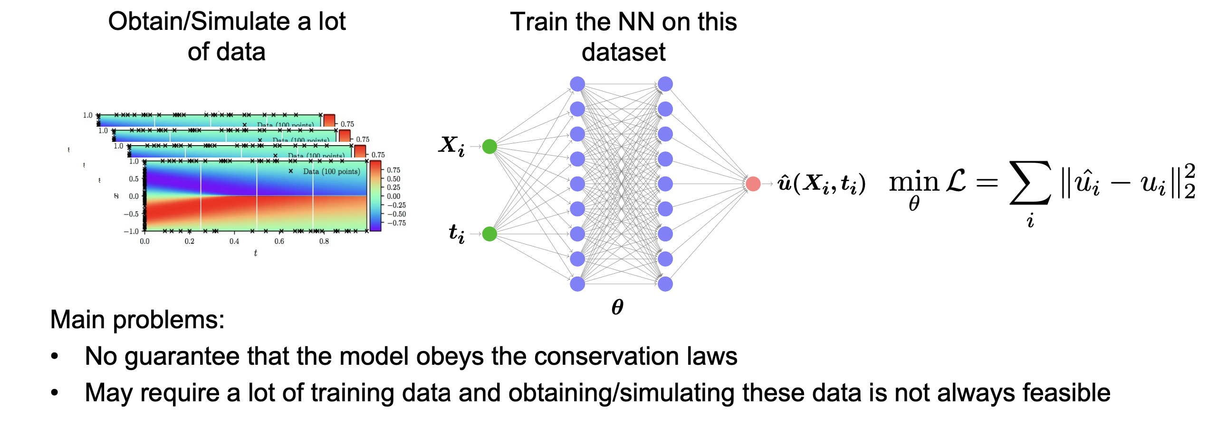
1. Physics learned from data

Slide 25
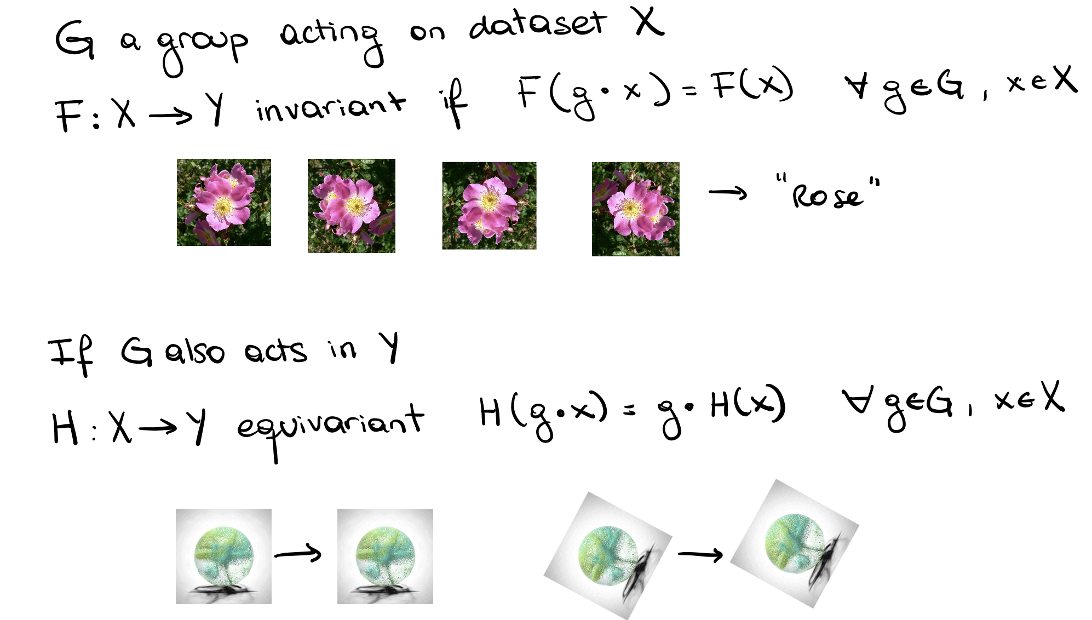
2. Model structure: Invariance / Equivariance

Slide 26
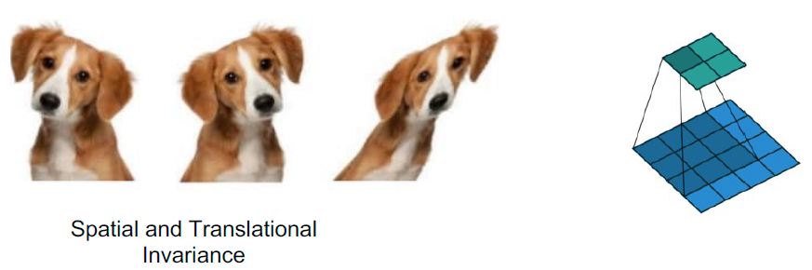
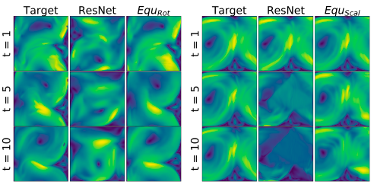
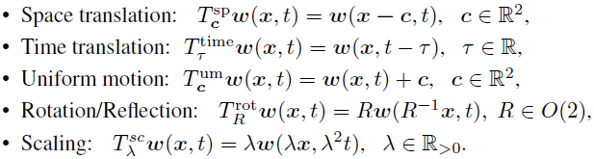
2. Model structure
Simplest example – CNNs + data augmentation
Equiavariant nets
Specific solutions in each case
NS-equations symmetries
Wang, Rui, Robin Walters, and Rose Yu. "Incorporating symmetry into deep dynamics models for improved generalization." ICLR 2021

Slide 27
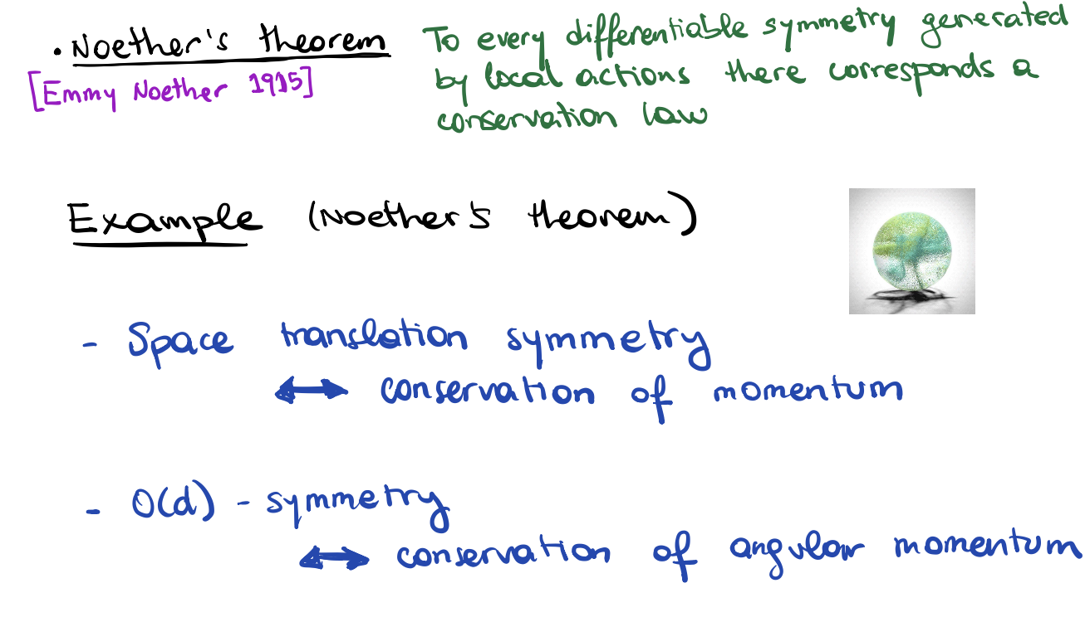
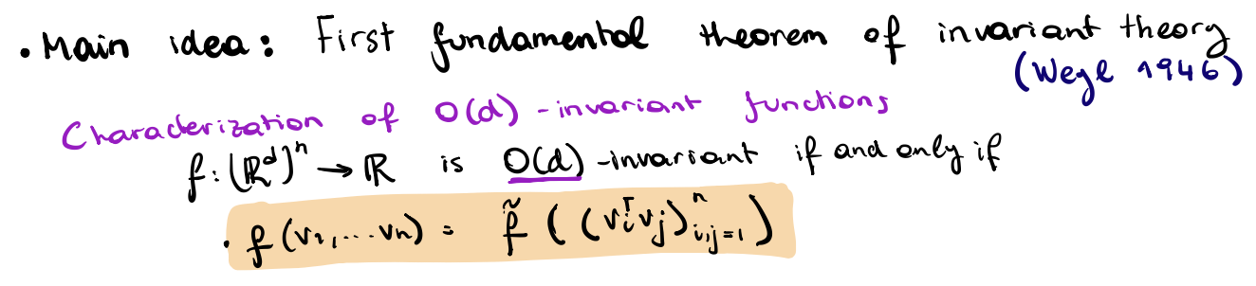
2. Model structure: special layers
Notes:
group of distance-preserving transformations of a Euclidean space of dimension d that preserve a fixed point

Slide 28
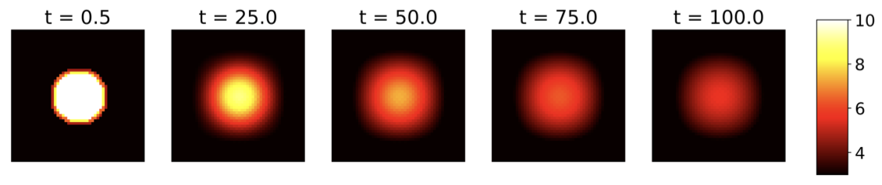
2. Model structure: Equivariant Nets
Fig. Five snapshots in heat diffusion dynamics. The spatial resolution is 50×50 pixels
Wang, Rui, Robin Walters, and Rose Yu. "Incorporating symmetry into deep dynamics models for improved generalization." ICLR 2021

Slide 29
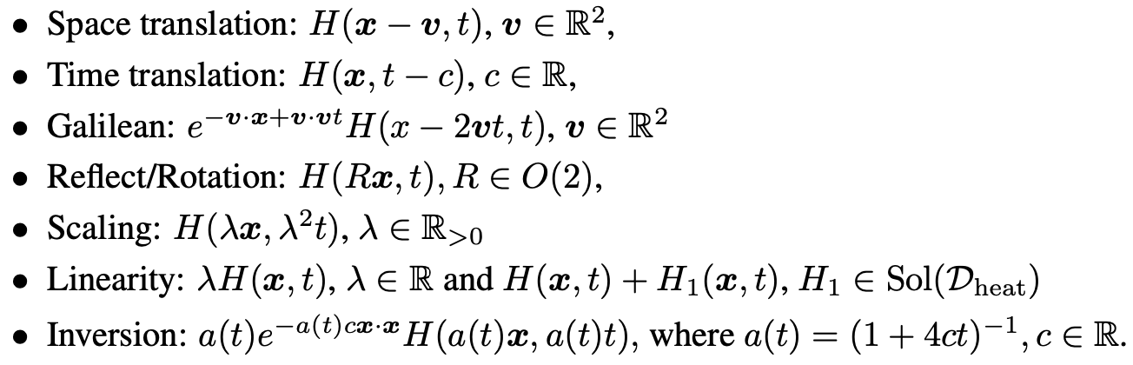
2. Model structure: Equivariant Nets
Fig. Five snapshots in heat diffusion dynamics. The spatial resolution is 50×50 pixels
Heat equations symmetries
Wang, Rui, Robin Walters, and Rose Yu. "Incorporating symmetry into deep dynamics models for improved generalization." ICLR 2021

Slide 30
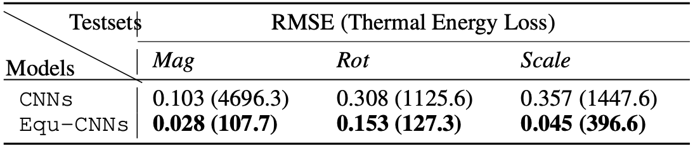
2. Model structure: Equivariant Nets
Fig. Five snapshots in heat diffusion dynamics. The spatial resolution is 50×50 pixels
Heat equations symmetries
The prediction RMSE and thermal energy L1 loss of the CNNs and three Equ-CNNs on three transformed test sets
Wang, Rui, Robin Walters, and Rose Yu. "Incorporating symmetry into deep dynamics models for improved generalization." ICLR 2021

Slide 31
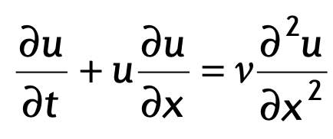
3. Physics informed neural networks (PINNs): biases in a loss function
Use penalty methods and add the PDE residual to the loss as a soft constraint

Slide 32
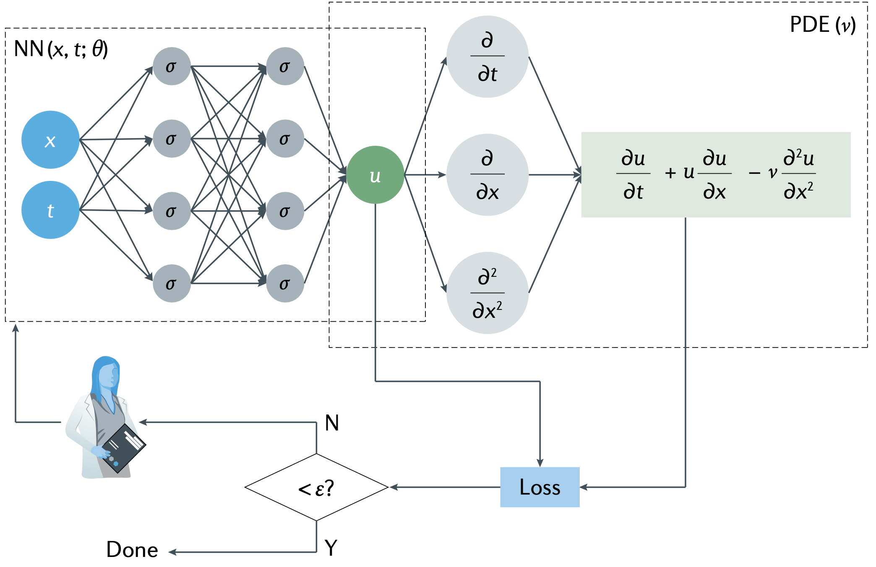
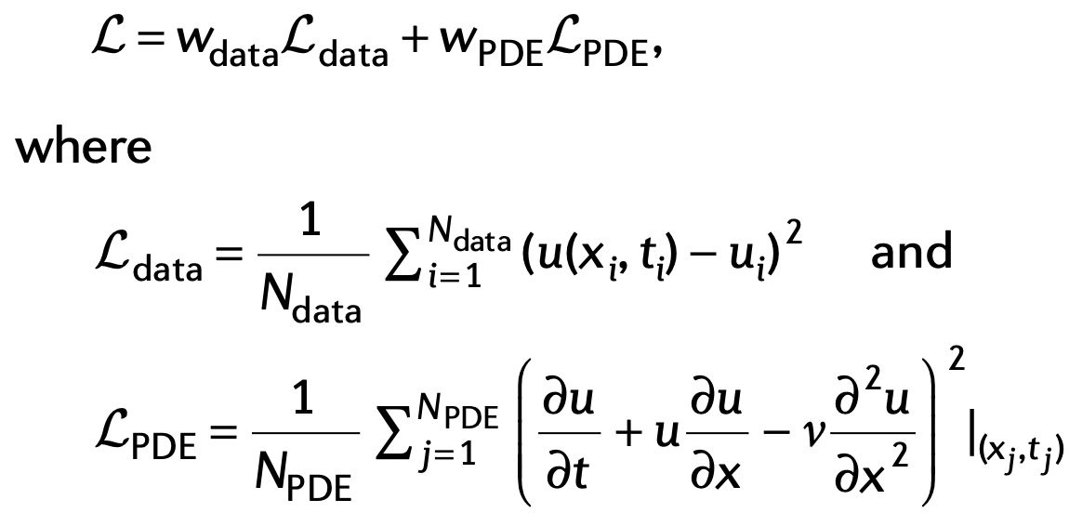
3. Physics informed neural networks (PINNs): biases in a loss function
Use penalty methods and add the PDE residual to the loss as a soft constraint

Slide 33
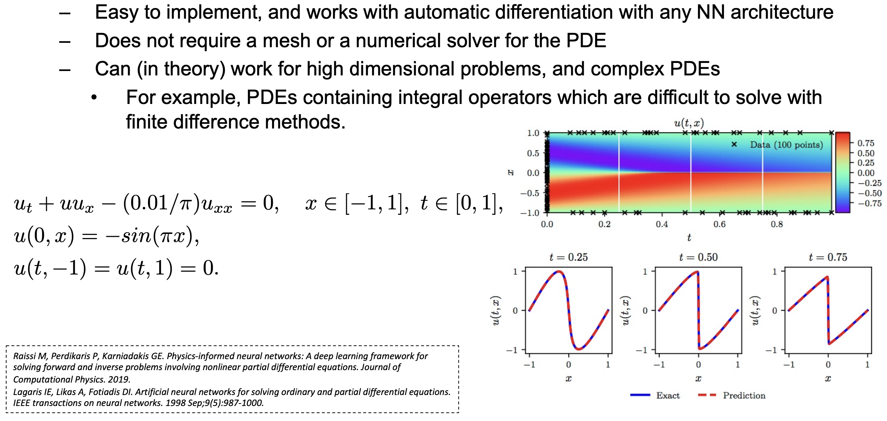
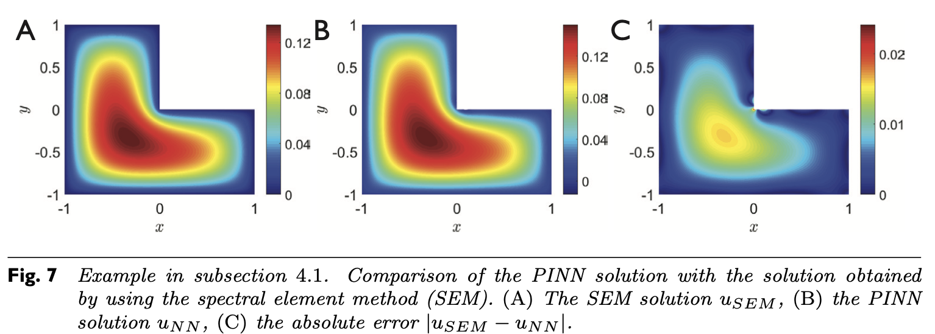
3. Physics informed neural networks (PINNs): biases in a loss function
Sea waves
1) Raissi M, Perdikaris P, Karniadakis GE. Physics-informed neural networks: A deep learning framework for solving forward and inverse problems involving nonlinear partial differential equations. Journal of Computational Physics. 2019. 2) Lagaris IE, Likas A, Fotiadis DI. Artificial neural networks for solving ordinary and partial differential equations. IEEE transactions on neural networks. 1998 Sep;9(5):987-1000. 3) Karniadakis, George Em, et al. "Physics-informed machine learning." Nature Reviews Physics 3.6 (2021): 422-440. 4) Lu, Lu, et al. "DeepXDE: A deep learning library for solving differential equations." SIAM Review 63.1 (2021): 208-228.

Slide 34
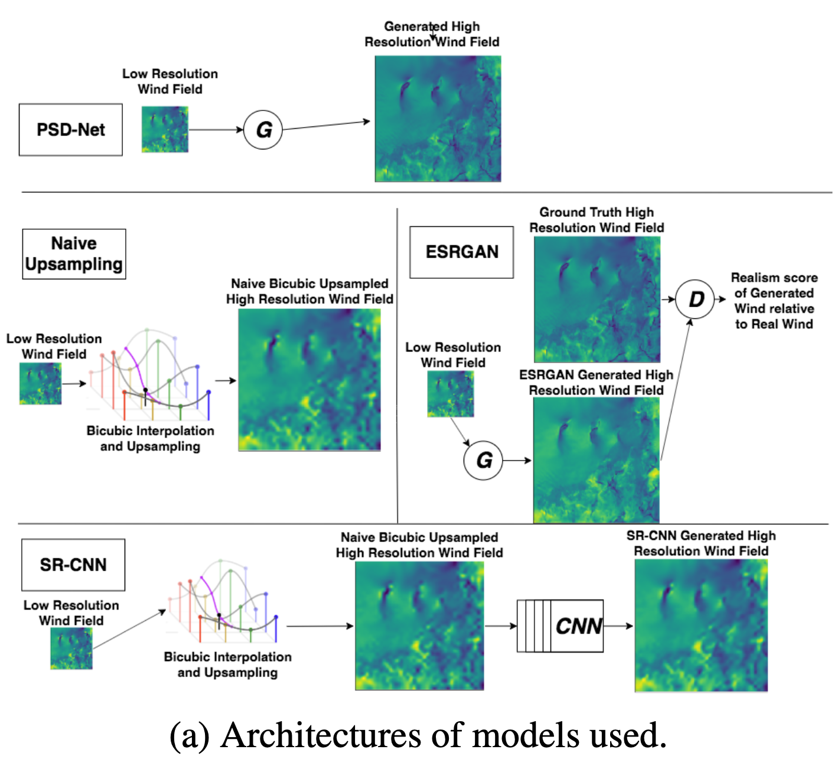
3. Physics informed neural networks (PINNs): 2nd order statistics
Regularization
Even softer
Need specific knowledge
Example: FFT-loss
Singh, Alok, Brian White, and Adrian Albert. "Numerical Weather Model Super-Resolution." (2019)

Slide 35
3. Physics informed neural networks (PINNs): 2nd order statistics
Regularization
Even softer
Need specific knowledge
Example: FFT-loss
Singh, Alok, Brian White, and Adrian Albert. "Numerical Weather Model Super-Resolution." (2019)

Slide 36
3. Physics informed neural networks (PINNs): 2nd order statistics
Regularization
Even softer
Need specific knowledge
Example: FFT-loss
Singh, Alok, Brian White, and Adrian Albert. "Numerical Weather Model Super-Resolution." (2019)

Slide 37
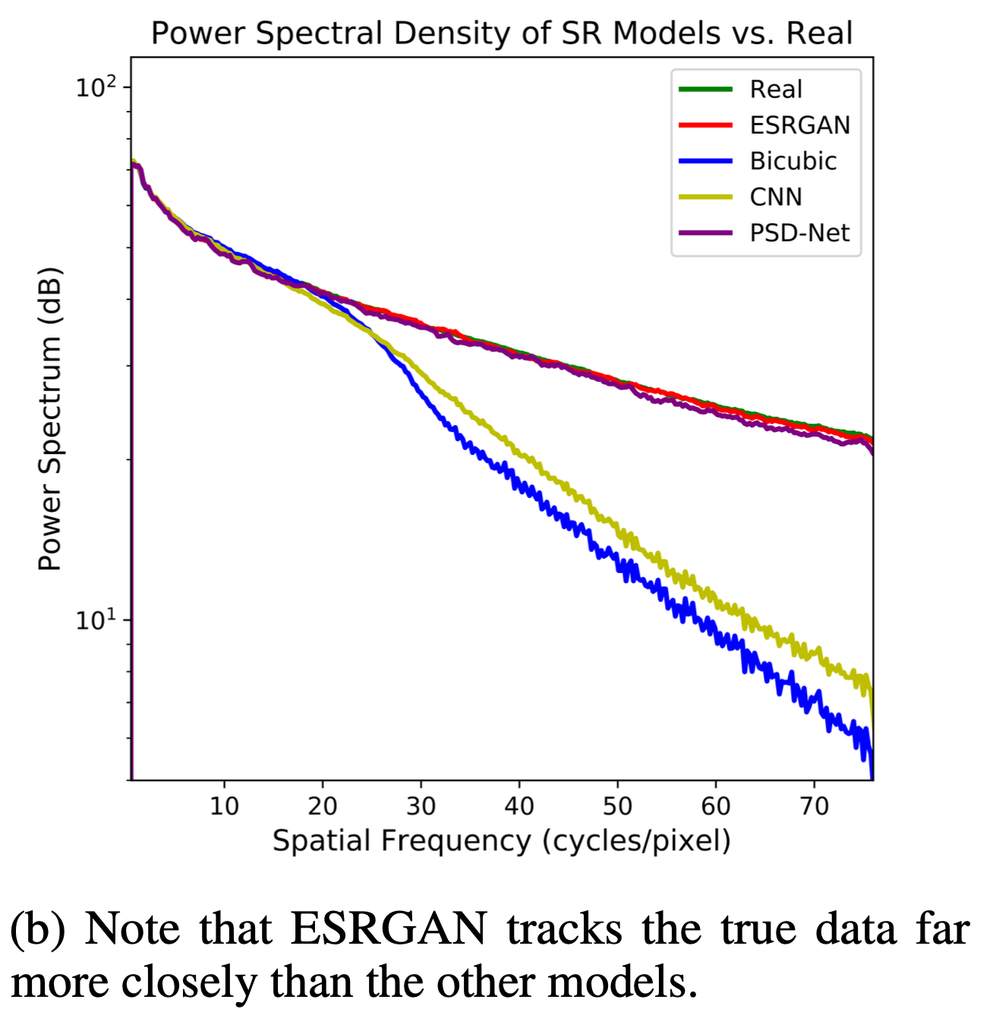

3. Physics informed neural networks (PINNs): 2nd order statistics
Regularization
Even softer
Need specific knowledge
Example: FFT-loss
Singh, Alok, Brian White, and Adrian Albert. "Numerical Weather Model Super-Resolution." (2019)

Slide 38
Outline
“Biases” in ML
Sci-ML Approaches
Challenges of Sci-ML
What’s next

Slide 39


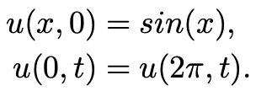

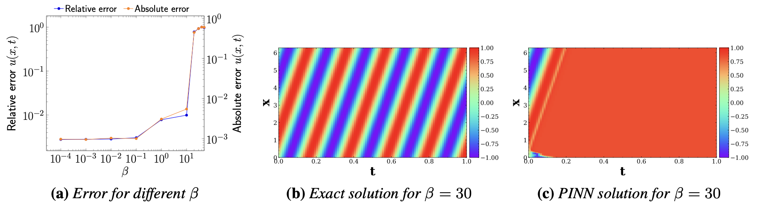
3. PINNs: Failure modes
Unstable training for complex problems
Big errors
Krishnapriyan* AS, Gholami* A, Zhe S, Kirby RM, Mahoney MW. Characterizing possible failure modes in physics-informed neural networks. NeurIPS, 2021.

Slide 40
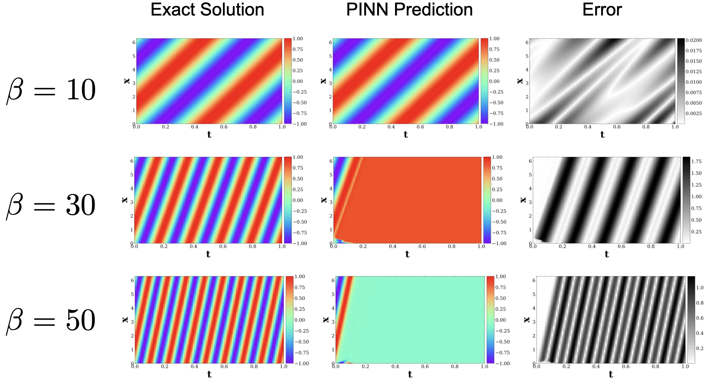
3. PINNs: Failure modes
Krishnapriyan* AS, Gholami* A, Zhe S, Kirby RM, Mahoney MW. Characterizing possible failure modes in physics-informed neural networks. NeurIPS, 2021.

Slide 41
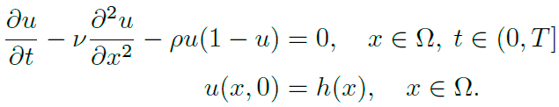
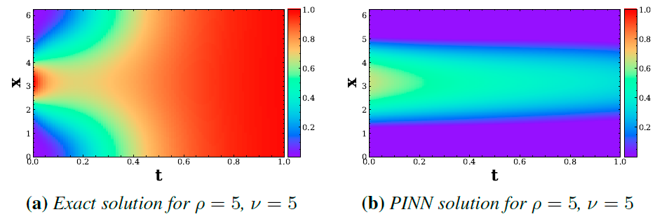
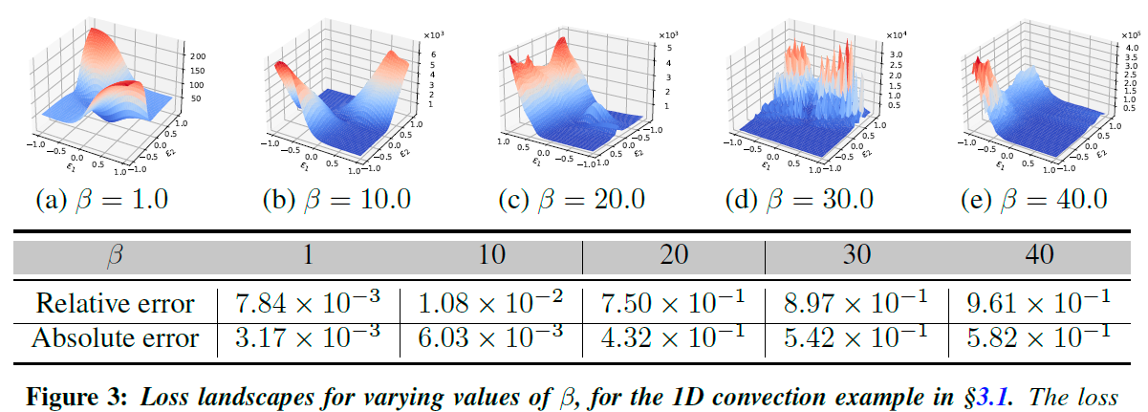
3. PINNs: Reasons for Failure modes
Nonsmooth loss landscapes
Big terms
Bad derivative approximation

Slide 42
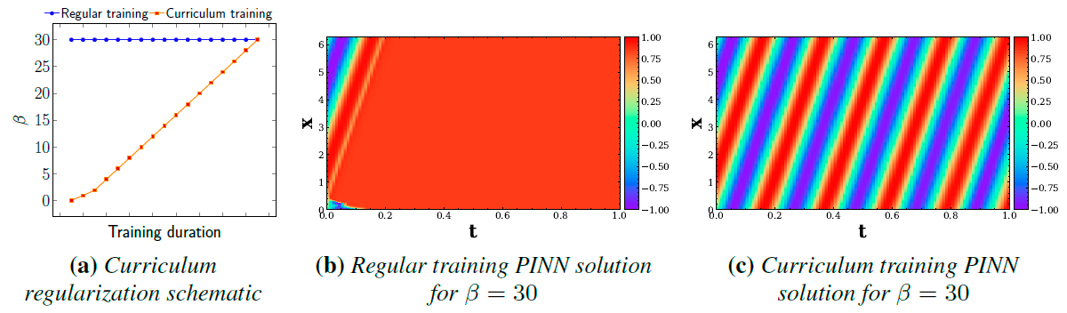
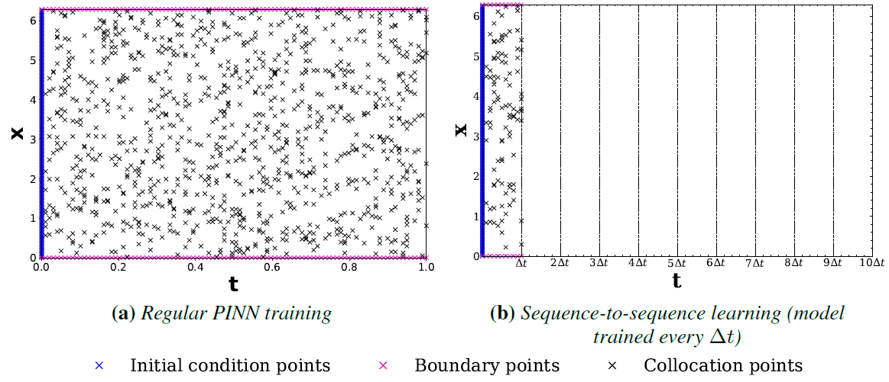
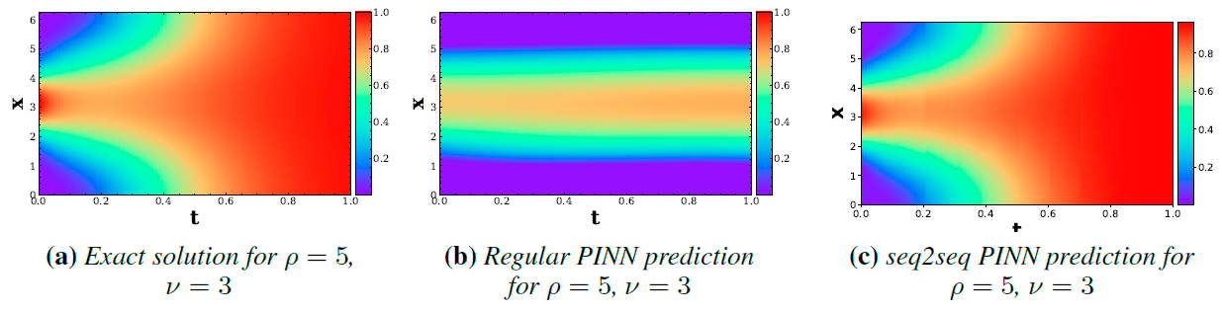
3. PINNs: Solutions
Curriculum training
Seqtoseq
Regularizations

Slide 43
Outline
“Biases” in ML
Sci-ML Approaches
Challenges of Sci-ML
What’s next

Slide 44
What’s next?
Seminar based on Sci-ML problem
Lecture on Applied Use-Cases of Sci-ML
  Super-resolution of weather forecasts
  Sea Ice Regional Forecasting
  Fusion of heterogeneous data for modeling of oil-fields. Geological realism

Slide 45
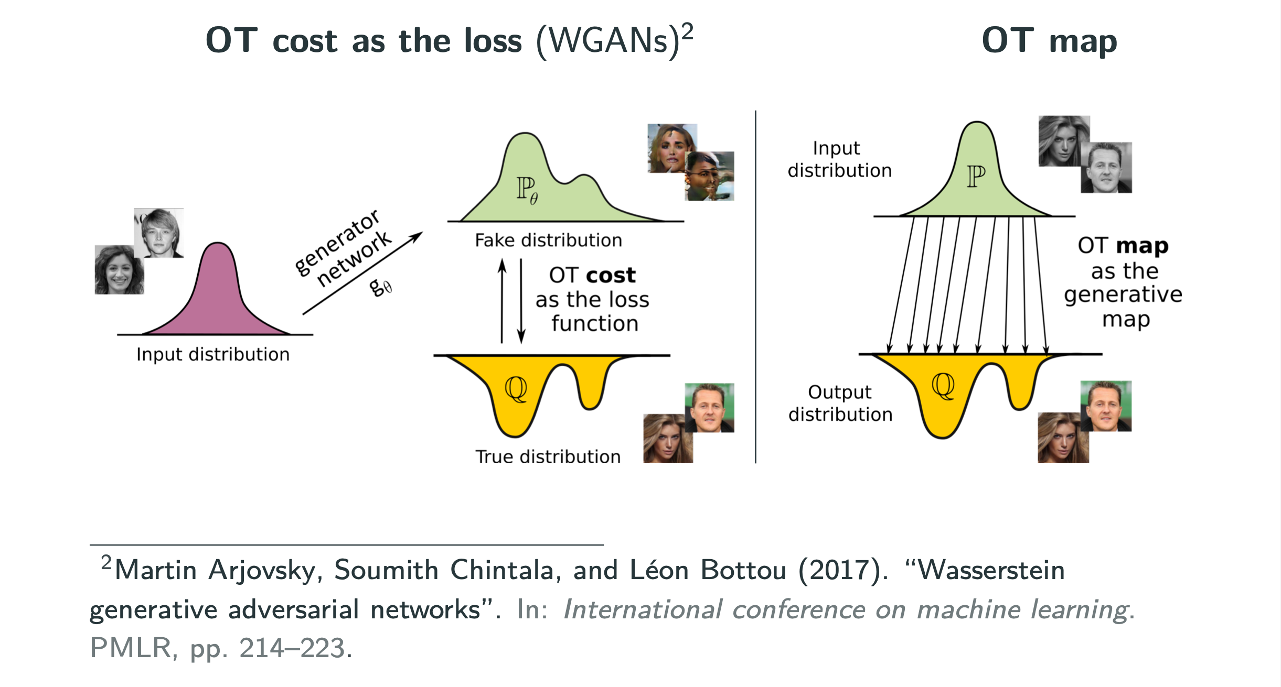
Advanced Techniques: Optimal Transport for Generative Models

Slide 46

Advanced Techniques: OT

Slide 47






Advanced Techniques: Topological Data Analysis and OT
Topological Data Analysis (TDA)
Optimal Transport (OT)
To work with high-dimensional manifolds
To handle probability distributions on them

Slide 48
Questions?
Additional references used when preparing the slides:
Rethinking Physics Informed Neural Networks Amir Gholami, Research scientist, UC Berkeley
Physics-inspired equivariant machine learning. Dr. Soledad Villar, Prof. Mathematical Institute for Data Science at Johns Hopkins University (USA)
Physics-Informed Neural Networks (PINNs). George Em Karniadakis, Division of Applied Mathematics, Brown University (also @MIT & PNNL)
A short intro to Physics-informed Machine Learning. Andrea Panizza
CS598: Physics-Informed Neural Networks: A deep learning framework for solving forward and inverse problems involving nonlinear PDEs. M. Raissi, P. Perdikaris, GE. Karniadakis

