Slide 1

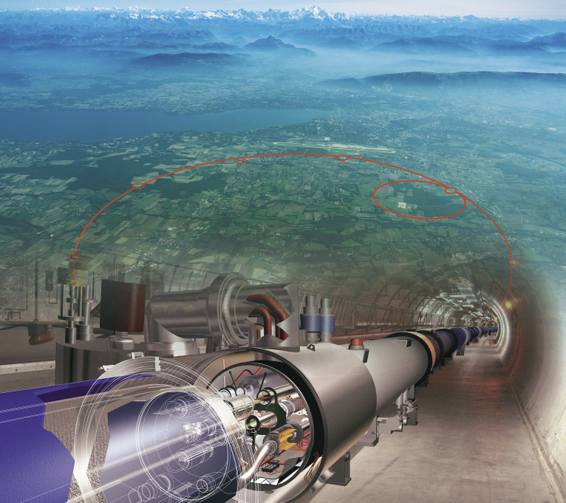

Physics at Energy Frontier
Sergei Shmatov (LHEP JINR, Dubna)
shmatov@cern.ch shmatov@jinr.ru
MISP2022
24 July - 2 August

Slide 2
Content
Lecture 1
HEP Experiments at accelerator facilities
  Why we need accelerator facilities?
  Do we need more and more new accelerator facilities?
LHC and Experiments at the LHC
  Hot points of particle physics vs LHC
  Conception, design, construction
  Challenges and solutions
Lecture 2 (recent experimental results)
Standard Model
Higgs Physics
Lecture 3 (recent experimental results)
  Physics beyond the SM
  LHC Prospects and Plans
  Beyond the LHC

Slide 3
Lecture 1
Why we need accelerator facilities?
  HEP experiments
  accelerators types
Do we really need new accelerator facilities?
  legacy of pre-LHC era and brief motivations for New Physics
  machine of discovery
What do we hope to see beyond the SM?
How do we intend to observe all this?
  LHC and LHC experiments
  physics objects
  How do we get data?
    Rates and trigger, data flows

Slide 4
WHAT DO PARTICLE PHYSICISTS DO?
Some eternal questions
People have long asked,
"What is the world made of?”
"What holds it together?”
Physicists hope to fill in their answers to these questions through the analysis of data from High Energy Physics experiments

Slide 5
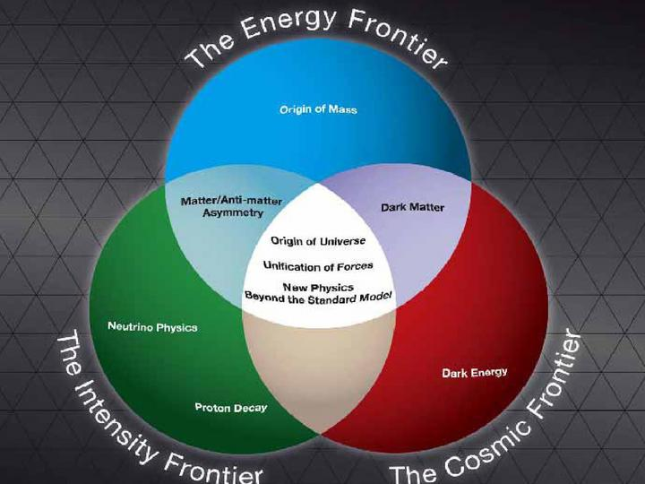
WHAT DO PARTICLE PHYSICISTS DO?
HEP frontiers
The Energy Frontier, using high-energy colliders to discover new particles and directly probe the architecture of the fundamental forces.
The Intensity Frontier, using intense particle beams to uncover properties of neutrinos and observe rare processes that will tell us about new physics beyond the Standard Model.
The Cosmic Frontier, using underground experiments and telescopes, both ground and space based, to reveal the natures of dark matter and dark energy and using high-energy particles from space to probe new phenomena.

Slide 6
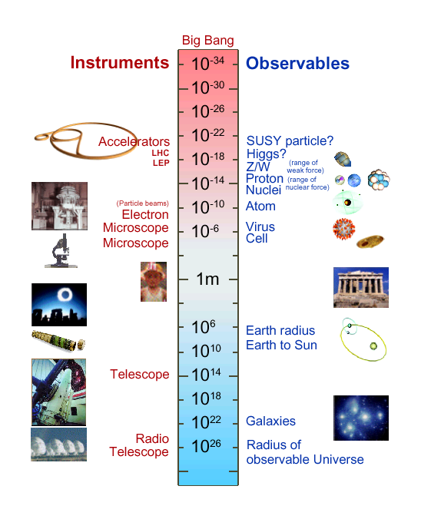
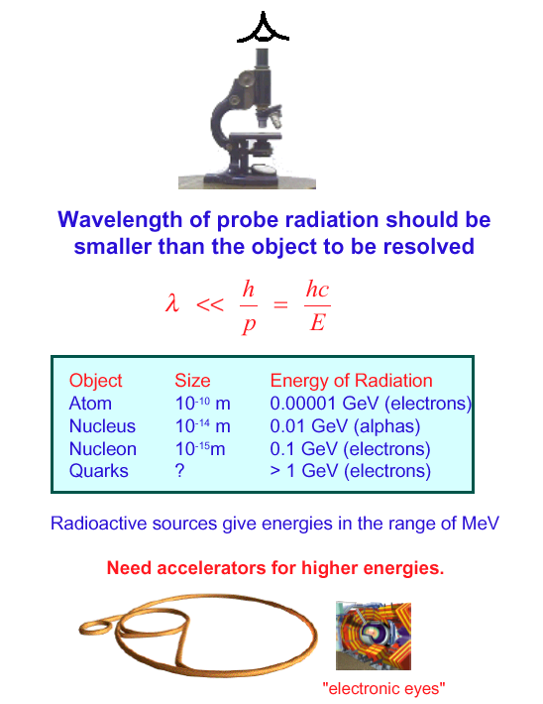
Why Need High Energy ?
Particle physics have focused on the inner space frontier, pursuing the questions of the construction of matter and the fundamental forces at the smallest scale accessible.

Slide 7
Energy and Intensity
Luminosity L is a measure of how many interactions of cross section s can be created per unit time
  L_{int} is integrated luminosity, an important factor of production for colliders
  [L] = cm⁻² s⁻¹, [L_{int}] = cm⁻² (1 barn =10⁻²⁴ cm; 1 pb⁻¹=10³⁶ cm⁻²)
For equal-sized head-on Gaussian beams in a collider
  σ_{x,y} are rms beam sizes, h is number of bunches
Colliding 100 mm 7.5×10⁹ proron bunches at 100 kHz for 1 year gives about 1 pb⁻¹ of integrated luminosity

Slide 8
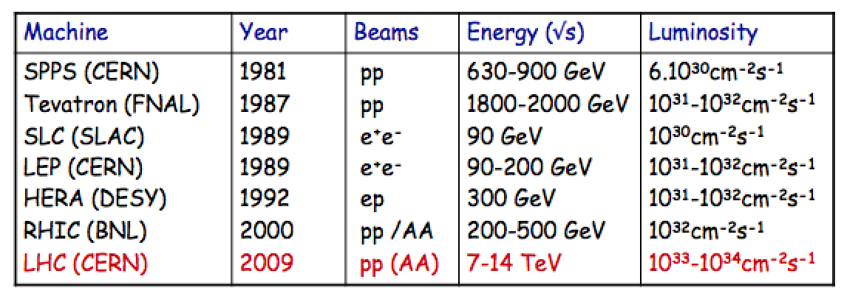
Past and Recent Colliders
Highest energies can be reached with proton colliders
Luminosity = number of events/cross section/sec
Limits on circular machines
  Proton colliders: Dipole magnet strength →superconducting magnets
  Electron colliders: Synchrotron radiation/RF power

Slide 9
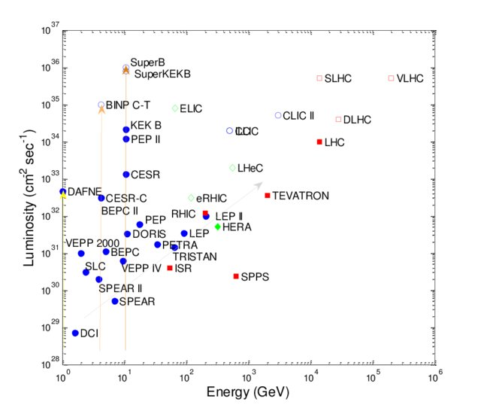
Luminosity vs Energy

Slide 10
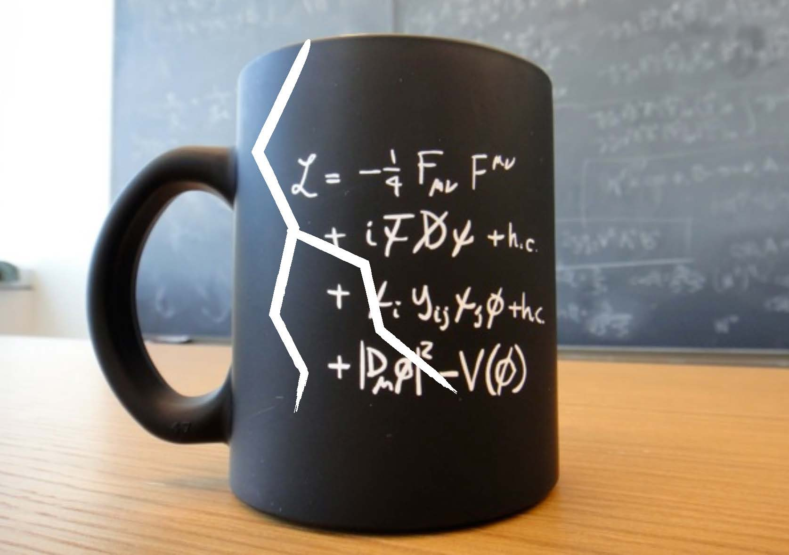
Do we really need
more and more accelerator facilities?

Slide 11
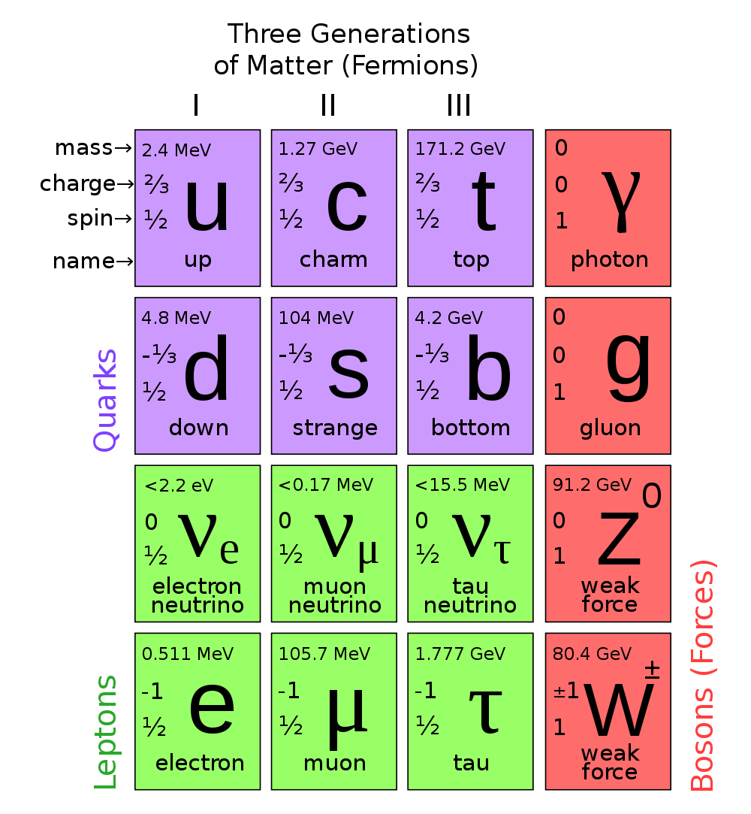
What we had before LHC?
SM is fully completed, expect for Higgs boson

Slide 12
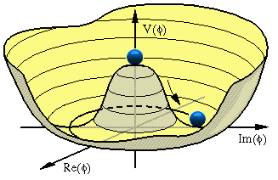

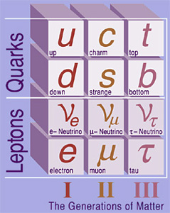
Is the Standard Model as Good as it Looks? or…
What about a mass generation mechanism?
  Higgs bosons? (Now – Yes)
Three generation of particles:
  why 3 (they can not be fixed in the framework of SM)?
  why do we need all of them?
Yukawa hierachy (explanation of mass patterns for quarks and leptons)
A lot of free parameters: gauge couplings, Yukawa coupling constants, CKM-mixing angles, Higgs vacuum expectation value, etc (in total, 26)

Slide 13
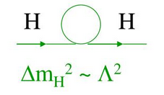
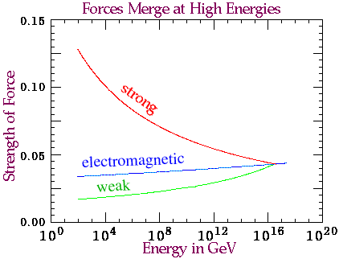
… why do we believe in something
beyond Standard Model?
Where is a gravity?
Hierarchy problem
  fine tuning of higgs mass is needed to “neutralize” contribution from high order corrections
  huge gap between Electroweak (10² GeV) and Planck scale (10¹⁹ GeV) scales), Gravity/EW ~ 10¹⁹/10² GeV?
Unification of Forces

Slide 14
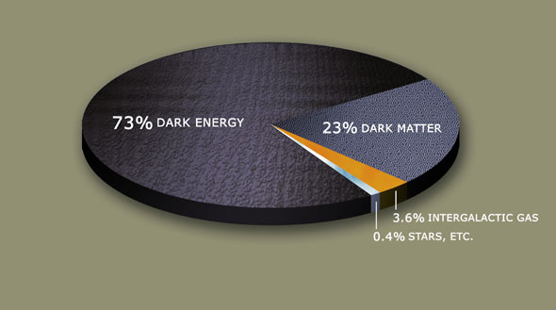
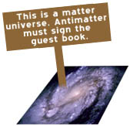
Related Сosmological and Astrophysical Problems
Dark Matter: what does it consist of?
CP-violation in Early Universe
Well, the Standard Model is not a ultimate theory!

Slide 15

The 11 Greatest Unanswered Questions of Physics (Discover, 2002) -6 are LHC related
What is dark matter ?
What is dark energy ?
How were the heavy elements from
iron to uranium made ?
Do neutrinos have mass ?
Where do ultrahigh-energy particles
come from ?
Is a new theory of light and matter needed
to explain what happens at very high
energies and temperatures ?
7. Are there new state of matter at ultrahigh
temperate and dentisity ?
8. Are protons unstable ?
What is gravity ?
Are there additional dimensions ?
How did the universe begin ?

Slide 16

What do we hope to see
beyond the SM?

Slide 17
How we can escape beyond the Standard Model
SU(3)_{с}×SU(2) ×U(1)?
Simplest extension of SM (based on SM gauge group)
  4 generation of fermions, q*, l*…
Extended gauge sector
  ExQCD (colorons, axigluons, diquarks etc)
  ExEW (W’, Z’, …)
  GUT (leptoquarks)
Extended Higgs Sector
  Higgs Doublet Models (HDM)
  Higgs in ED, Higgs-Radion mixing, composite Higgs (RS type)
Hierarchy problem
  SUSY (s-particles, LSP из RPV/split/GM SUSY…)
  Extra dimensions (ED)
    КК-modes of particles SM, KKPV, FCNC…
    microscopic black holes (semi-classical, string balls, quantum black holes)
  Technicolor (technibosons and technifermions, leptoquarks …)
  Compositeness
Dark Matter (EFT)
Will be discussed after tomorrow

Slide 18
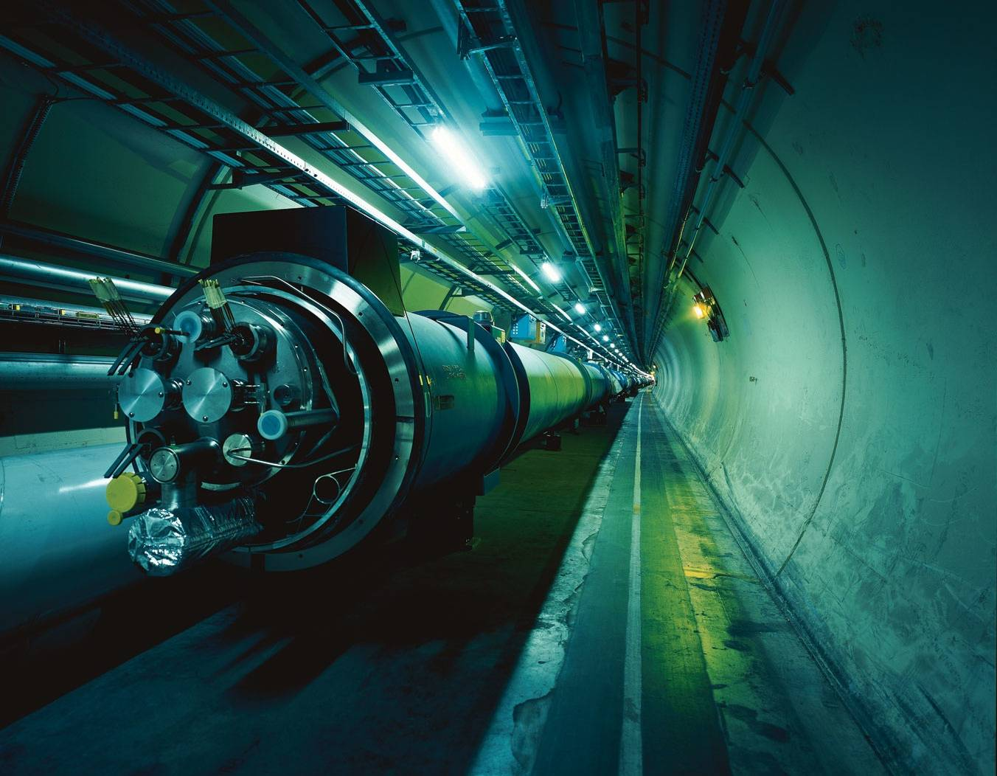
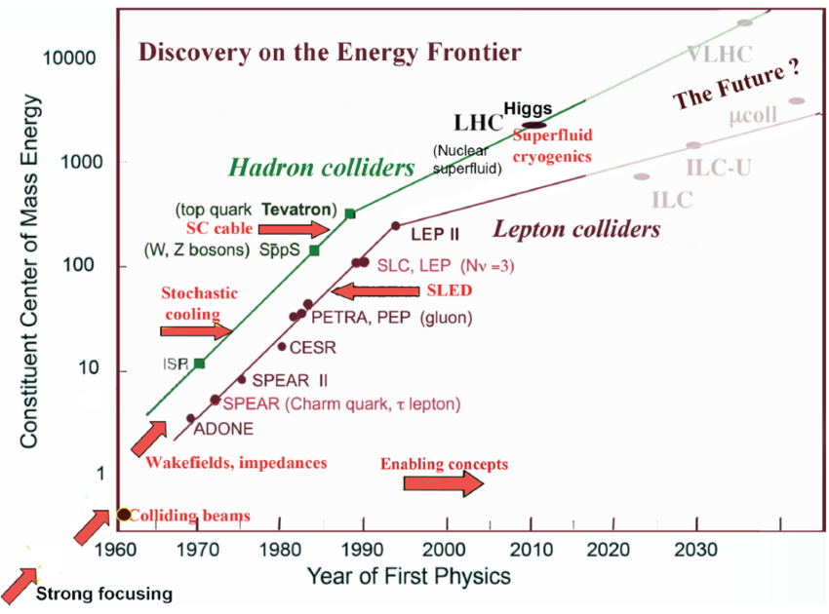
How do we intend to observe
all this?

Slide 19
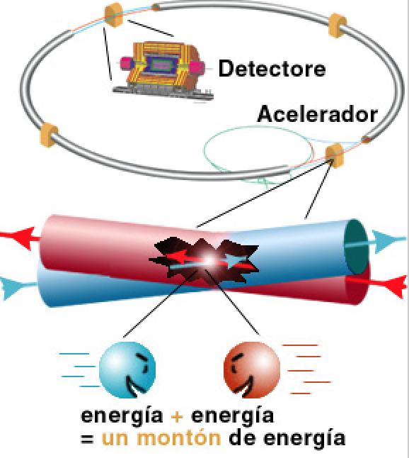

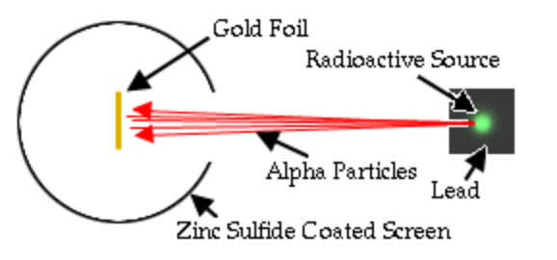
Fixed Target or Colliders?
First High Energy Physics
Experiments:
Beam on fixed target!
High Energy Physics
Experiments since mid 70’s:
Colliding beams!
Rutherford experiment (1909)
Centre of mass energy squared s=2E₁m₂
Centre of mass energy squared s=4E₁E₂
…plus secondary beams such as neutrinos…

Slide 20
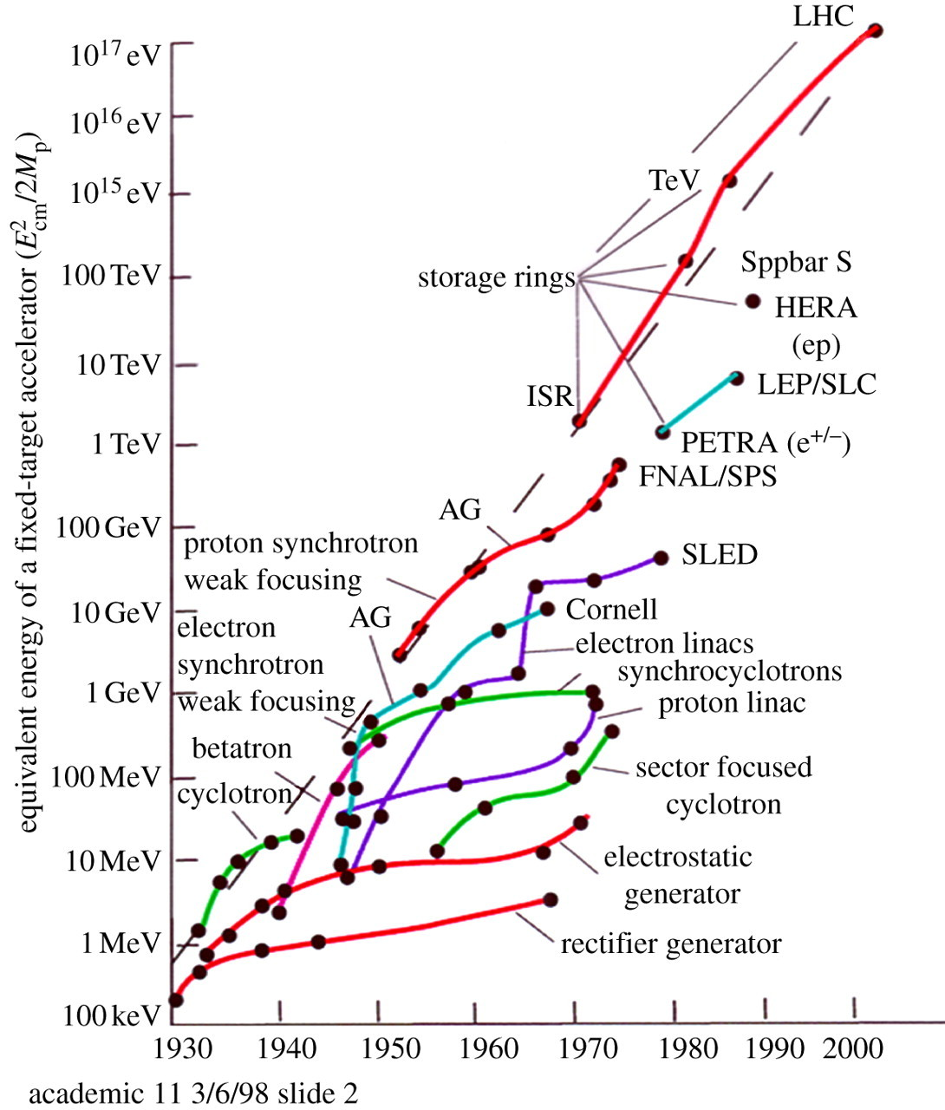

Slide 21
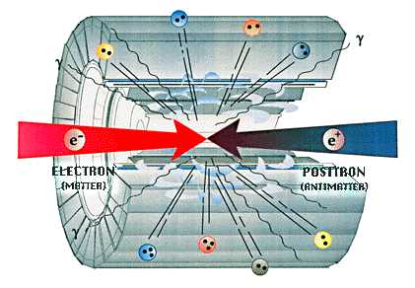
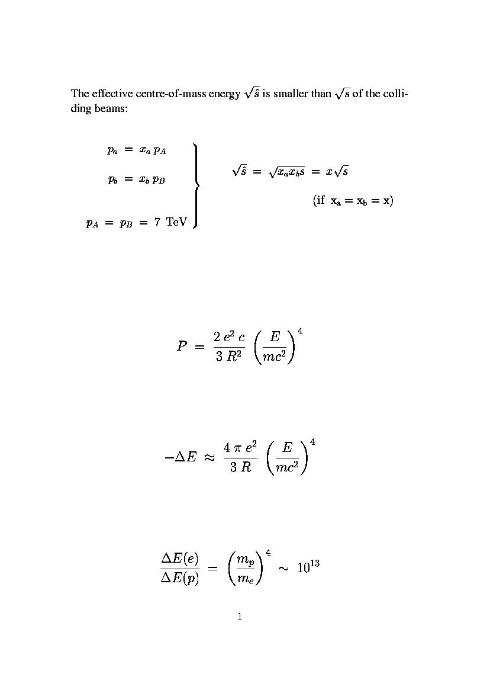
Why Hadron (pp) Collider?
Electron-Position Collider: clean signature
Synchrotron Radiation:
CERN LEP ：R=4.5km, E_{beam} ~ 100 GeV
CERN LHC：R=4.5km, E_{beam} ~ 7000 GeV

Slide 22
How much energy do we really need?
The simplest answer is .. as much as possible (construction restriction, technologies, price..)
Different approach is .. more than Tevatron energy of 1.8 TeV (vague claim)
Real life
  Higgs boson
    m_{H} < 1 TeV from theory (SM unitarity requires)
    m_{H} > 114.1 GeV from LEP
    156 < m_{H} < 177 GeV from Tevatron
  m_{SUSY} ∼ TeV
  m_{BSM} > 0.5 TeV from theory and from Tevatron
need a machine to discover/exclude Higgs from ≈ 120 GeV to 1 TeV
need a machine to explore a range of of up a several TeV
need a transverse energy scan

Slide 23
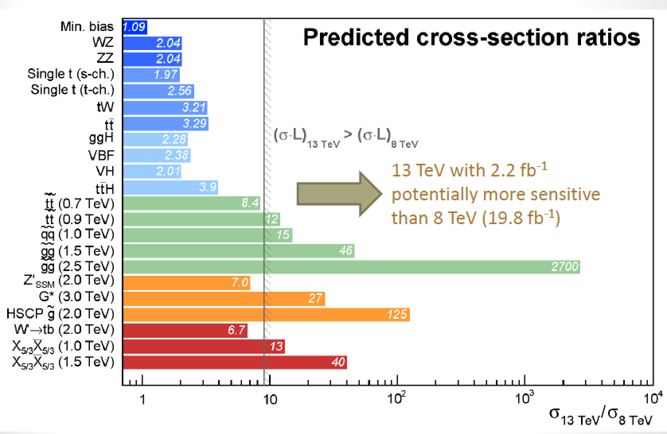
BSM cross sections @ LHC from 8 TeV to 13 TeV

Slide 24
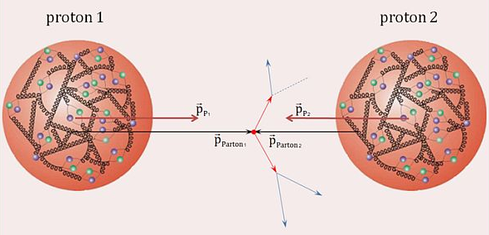
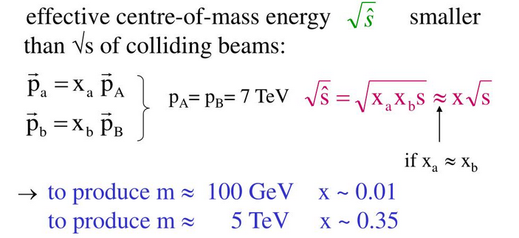
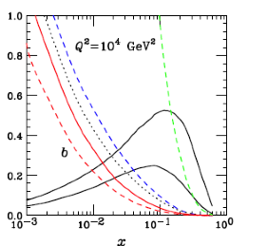
Machine of Discovery
Factorization hypothesis
Fragmentation function
Fragmentation function
Parton density functions
(PDFs)
cross section of
hard processes
Parton
distributions

Slide 25
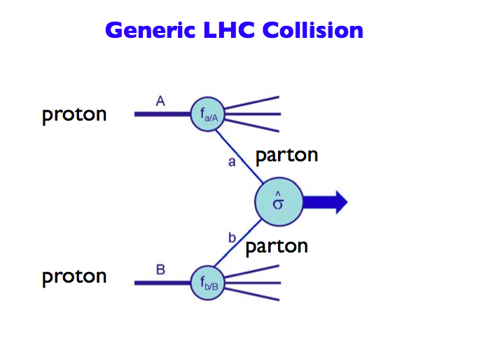
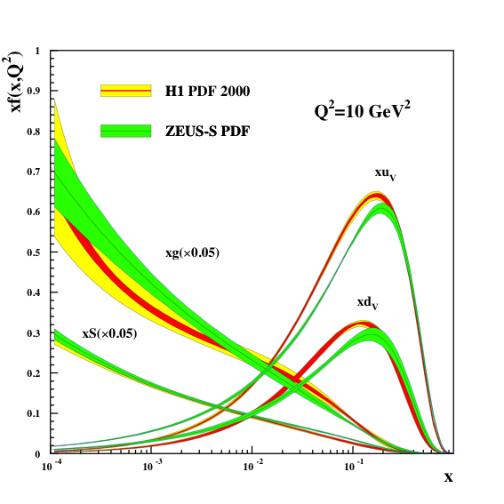
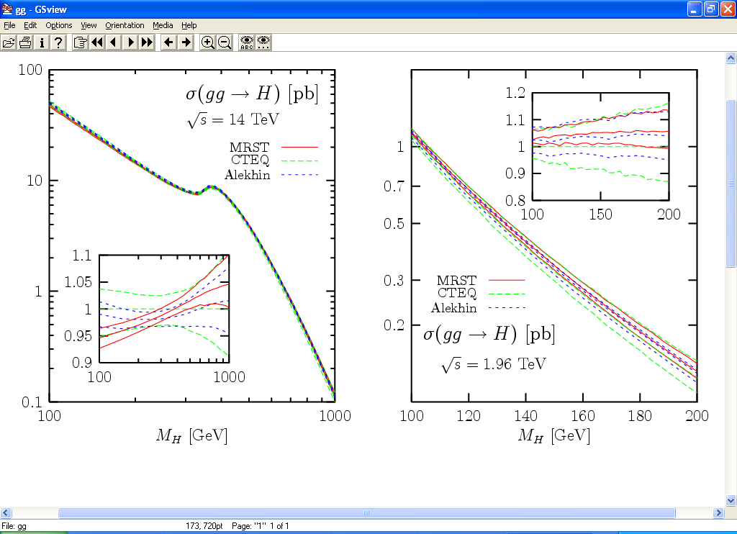
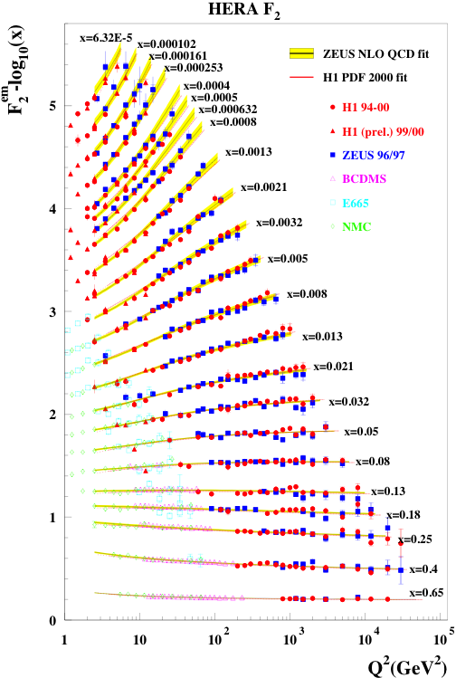
Parton Distribution Functions (1)
Parton Distribution Functions: the probability of finding
a parton with momentum fraction x in the proton
Structure function
measurements eg
from HERA
Simple spread of existing PDFs gives
up to 10% uncertainty on Higgs cross
section. Possible gain ~ factor of 2
with final HERA data (PDF4LHC)
Using also input from LHC data in new fits
Now also LHC pp
data used to
constrain PDFs

Slide 26
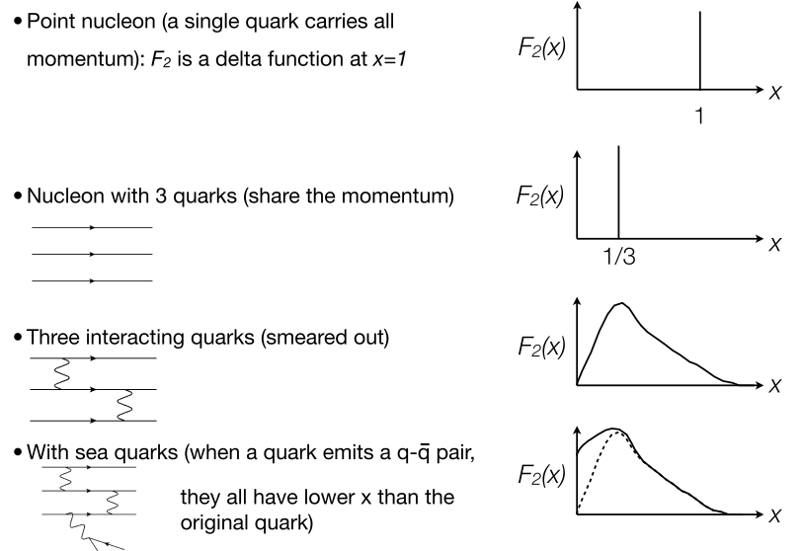
Parton Distribution Functions (2)

Slide 27
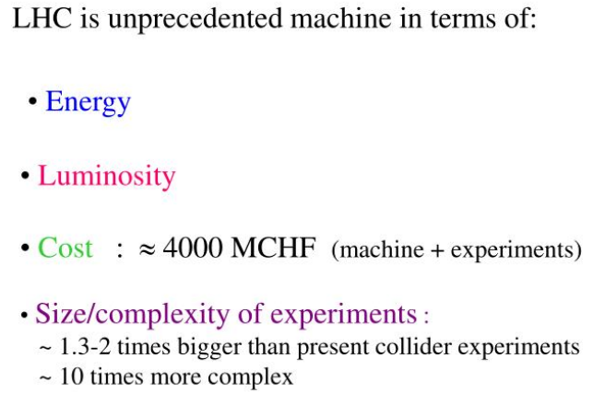
Large Hadron Collider at CERN (1)
The Large Hadron Collider has good chance to answer some of these questions, however the history has shown that the greatest advances in science are often unexpected.
The LHC will change our view of the Universe

Slide 28
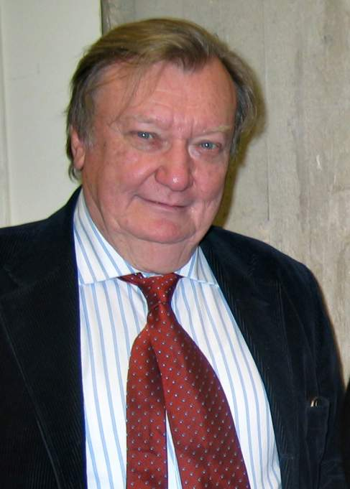

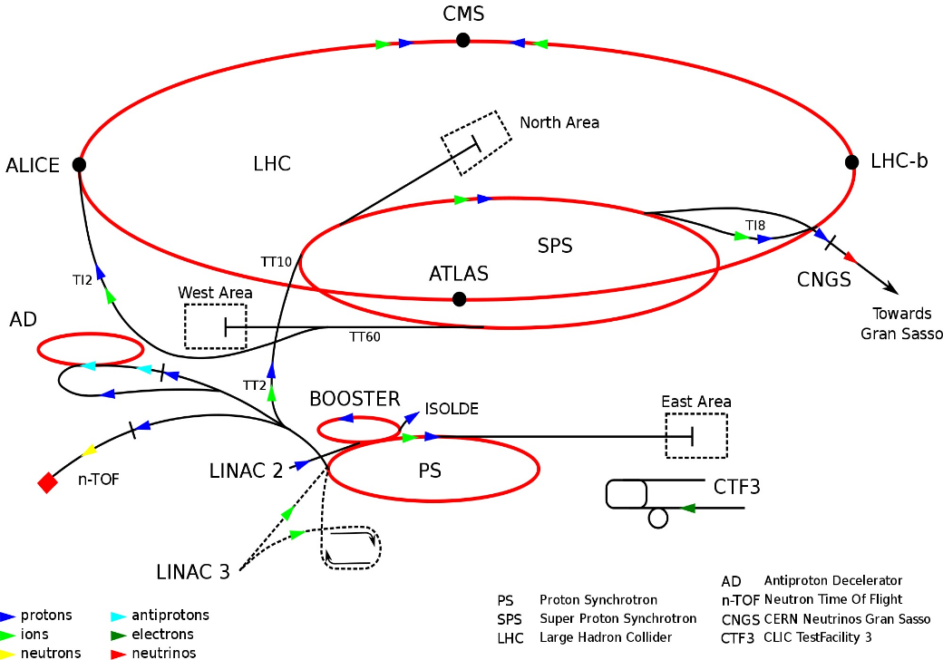
Large Hadron Collider at CERN (2)
Carlo Rubbia
Giorgio Brianti
1984 (Lausanne): the fist LHC Working Group for LHC conception
December 16, 1991: LHC Project was
approved by CERN Council
• High Energy ⇒ factor 7 increase w.r.t. past accelerators
• High Luminosity (# events/cross section/time) ⇒ factor 100 increase
Linac: 50 MeV → PSB: 1.4 GeV → PS: 28 GeV
→ SPS: 450 GeV → LHC: 7 TeV

Slide 29
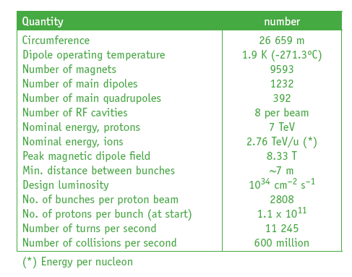
LHC Parameters
LHC is 100m underground
LHC is 27 km long
Magnet Temperature is 1.9 Kelvin = -271 Celsius
LHC has ~ 9000 magnets
LHC: 40 million proton-proton collisions per second
LHC: Luminosity 100 fb⁻¹/year (after start-up phase)

Slide 30
LHC Magnets
Dipoles for bending the beams
Quadrupoles for strong focusing in the IP (223 T/m)
LHC: E = 7 TeV, ρ = 2.8 km ➔ B = 8.3 T
Technology constraint. Dipole magnetic field B
  B_{t} <2 T for iron magnets
  B_{t} <13 T for Nb-Ti superconducting magnets (10 T)
  B_{t} <25 T for Nb₃Sn superconducting magnets (16-17 T)

Slide 31
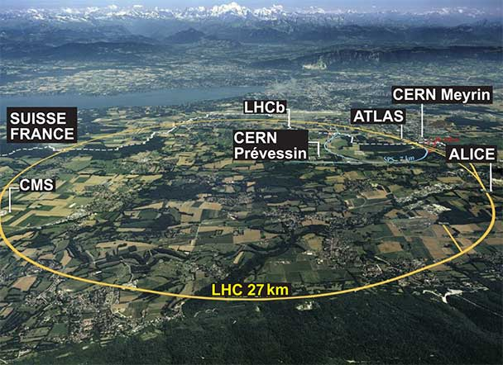
The LHC Experiment at CERN

Slide 32
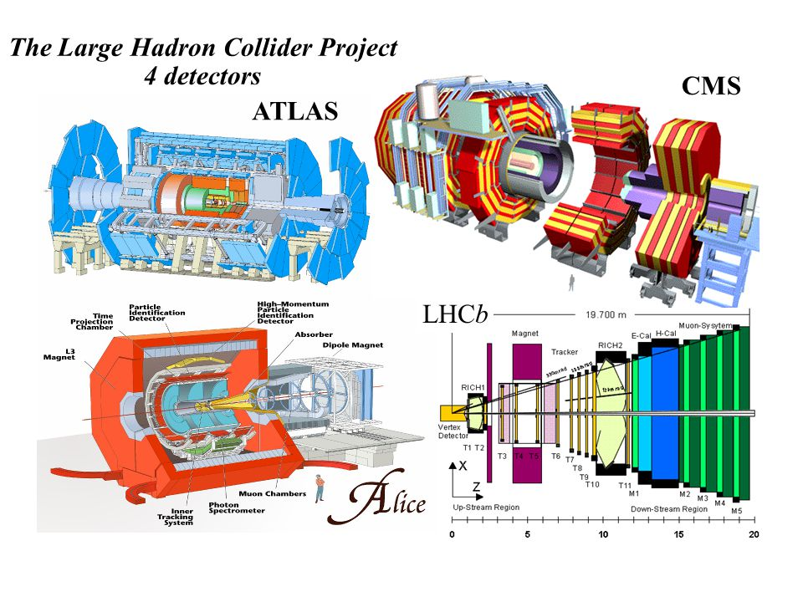
Experimental Facilities

Slide 33
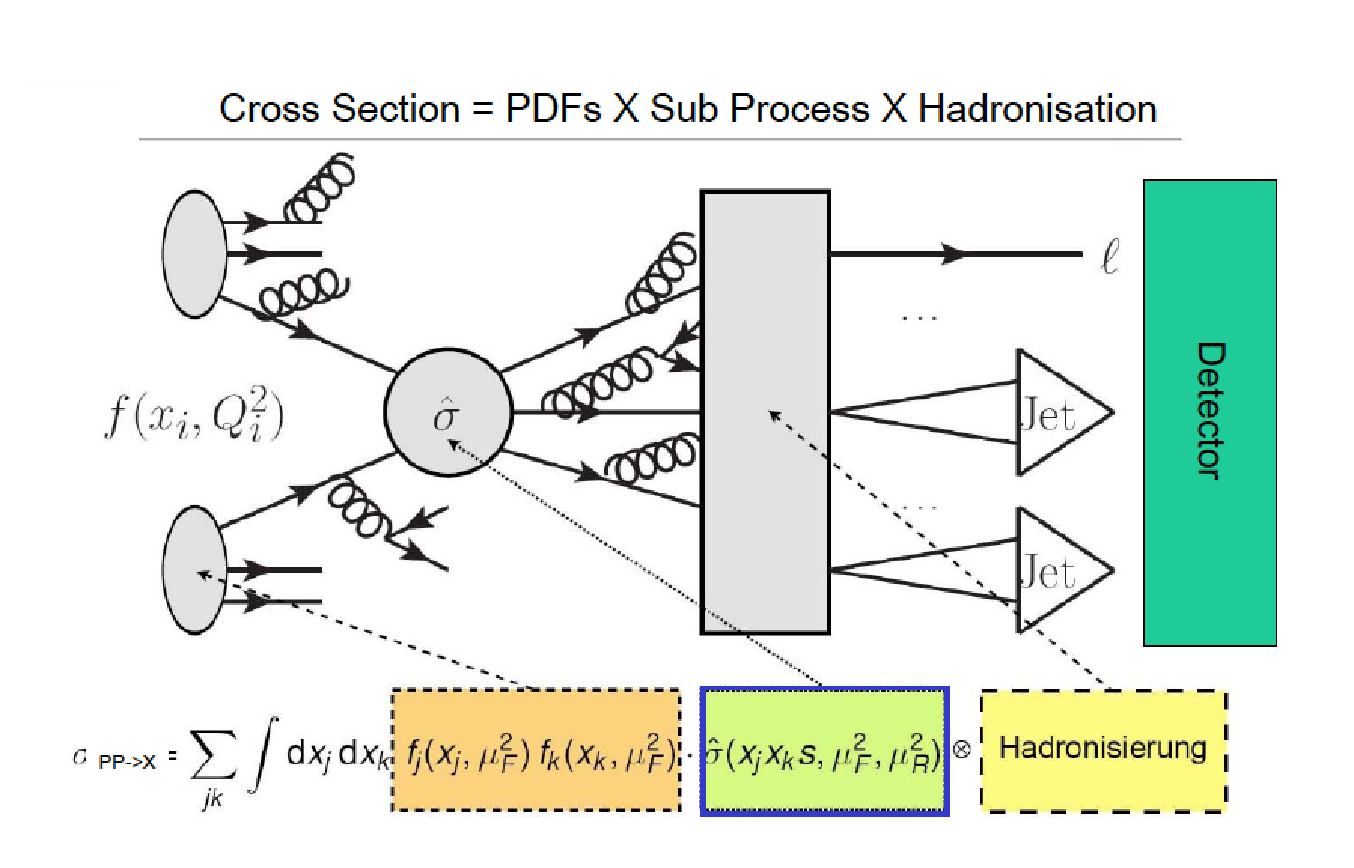
pp Collisions

Slide 34
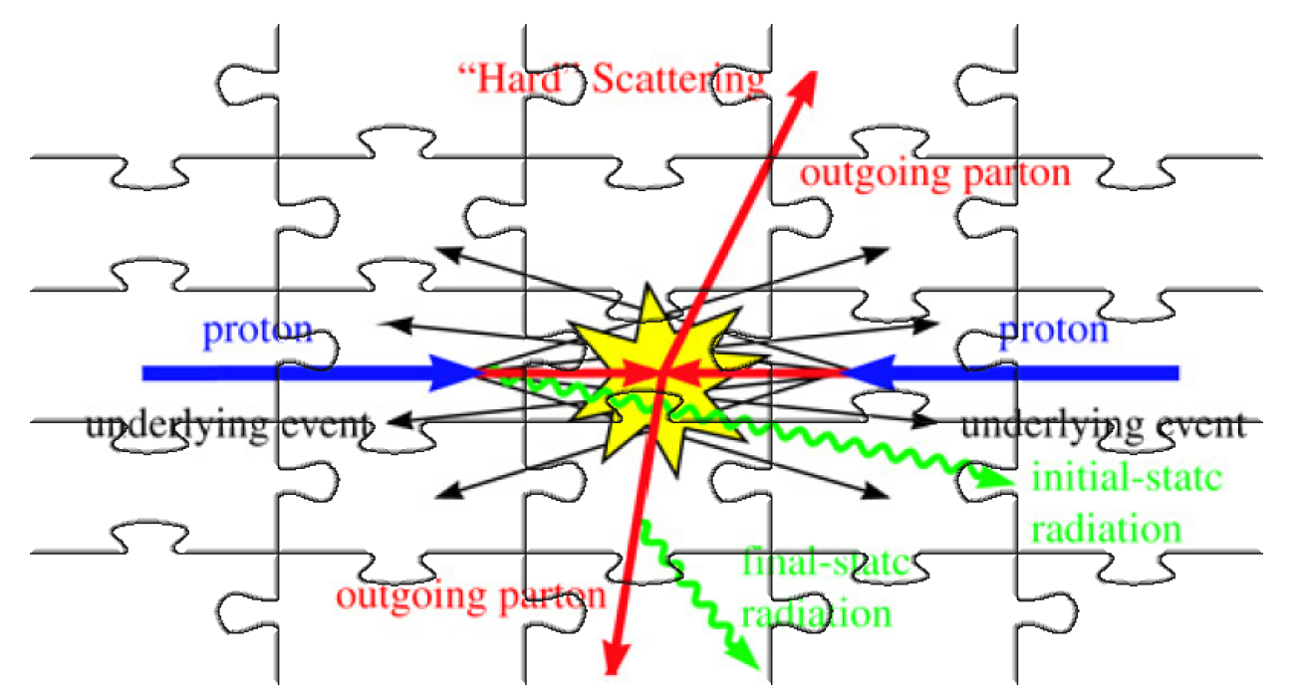
Mosaic of Collisions

Slide 35
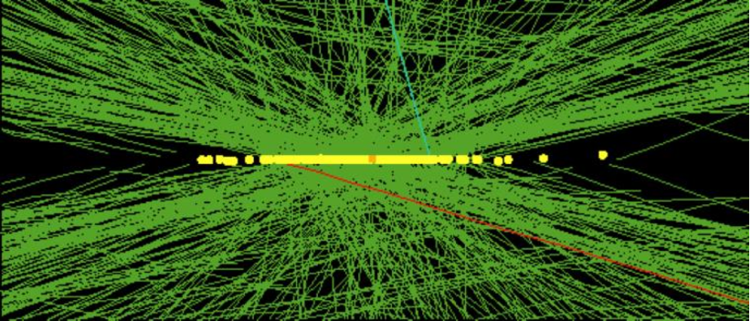
Real CMS Event with High Pile-up
High pileup event with 78 reconstructed vertices taken in 2012 by CMS

Slide 36
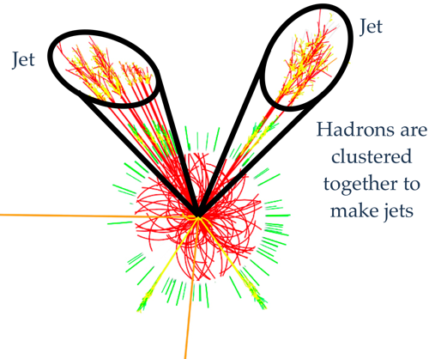
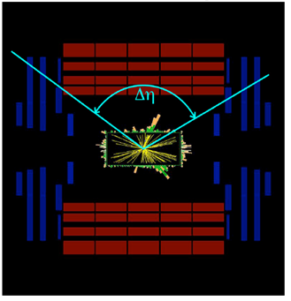
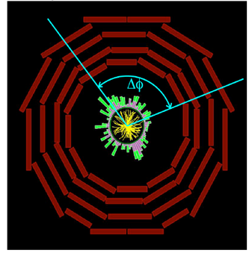


Physics Objects
Muons (transverse momentum p_{T})
Electrons (energy and tr. momentum p_{T})
Photons (energy)
Jets (energy and )
Missing energy and p_{T}
  vectorial sum of all transverse momentum
Kinematic Variables
Transverse momentum p_{T} (energy)
  particles that escape detection have p_{T}=0
  total visible p_{T} = 0
p
p_{T}
θ
Longitudinal momentum p_{Z} and energy E_{Z}
  particles that escape detection have p_{T}=0
  visible p_{Z} is not conserved (not so usefull variable)
Angles
  azimuthal and polar angles
  polar angle θ is not Lorenz invariant ⇒
  rapidity y
  or (or m=0) pseudorapidity η
4π-experiments cover
360⁰ over φ and large
pseudorapidity range,
|η| ≤ 5.0 (0.8⁰)

Slide 37
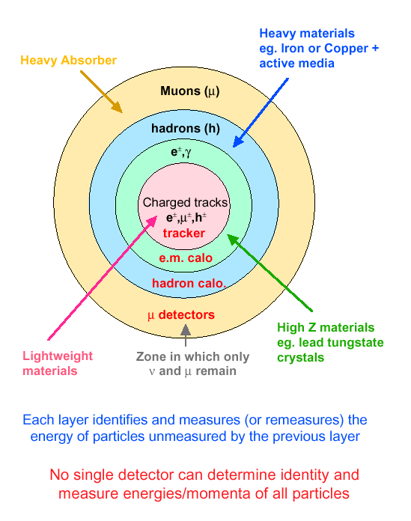
Modus Operandi for Experiments
Onion structure of detector layers placed in B-field

Slide 38
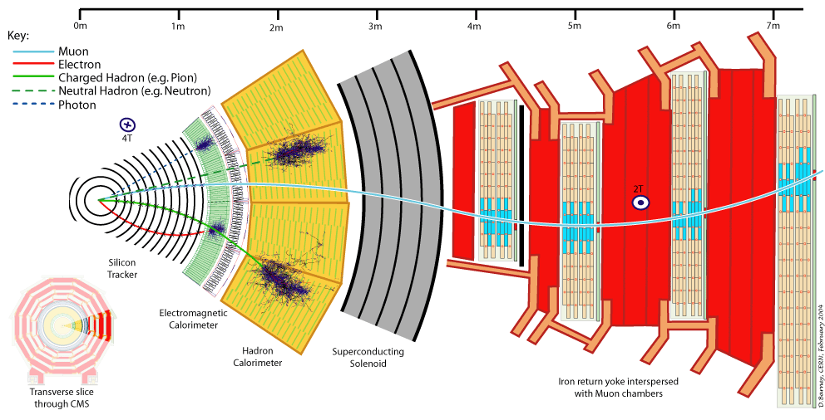
Particles in Detectors
Electromagnetic Calorimeter
Muon Spectrometer
Hadron Calorimeter
Inner Tracker
Magnet
Return flux

Slide 39
Challenge to the Detector
LHC detectors must have
Fast response, otherwise too large pile-up. Typical response time 20-50 ns
  pile-up of 25-50 minimum bias events
→ very challenging readout electronics
high granularity to minimize probability that pile-up particles be in the same detector element as interesting object
→ large number of electronic channels, high cost
a robust and redundant Muon system
the best possible e/g calorimeter ECAL that consistent with Muon System
a highly efficient Tracking system consistent that with Muon System and ECAL
a hermetic calorimeter system
high radiation resistant e.g. in forward calorimeters: up to 10¹⁷ n/cm² in 10 years of LHC operation
good PID (particle identification)
good E, p_{T} resolution
Precision Muon Spectrometer
Fast response for trigger
Good p resolution (e.g., A/Z’ → μμ, H -> 4μ)
EM Calorimeters
excellent electron/photon identification
Good E resolution (e.g., H→γγ)
Hadron Calorimeters
Good jet and E_{T} miss performance
(e.g., H →ττ)
Inner Detector
Good impact parameter res.
(e.g., H → bb)

Slide 40
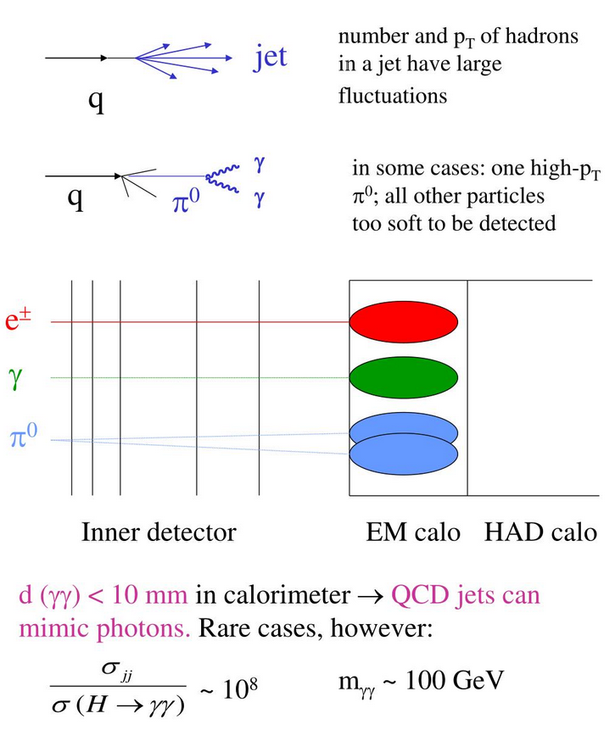
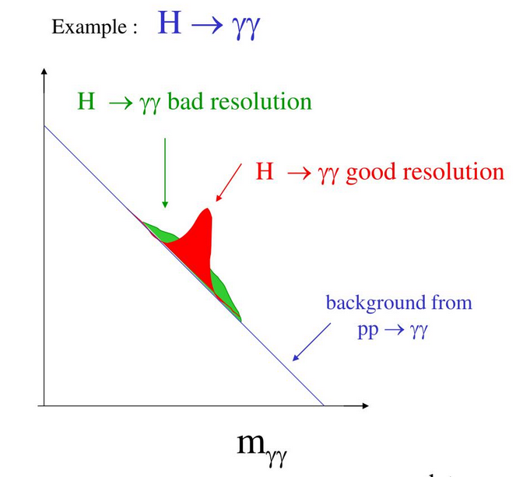
Challenge to the Detector (Example)

Slide 41
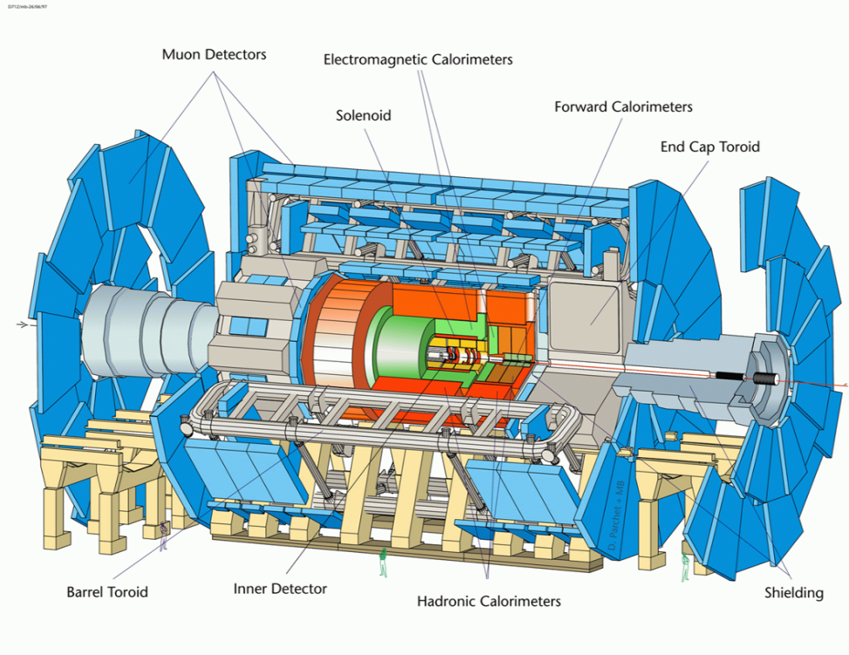
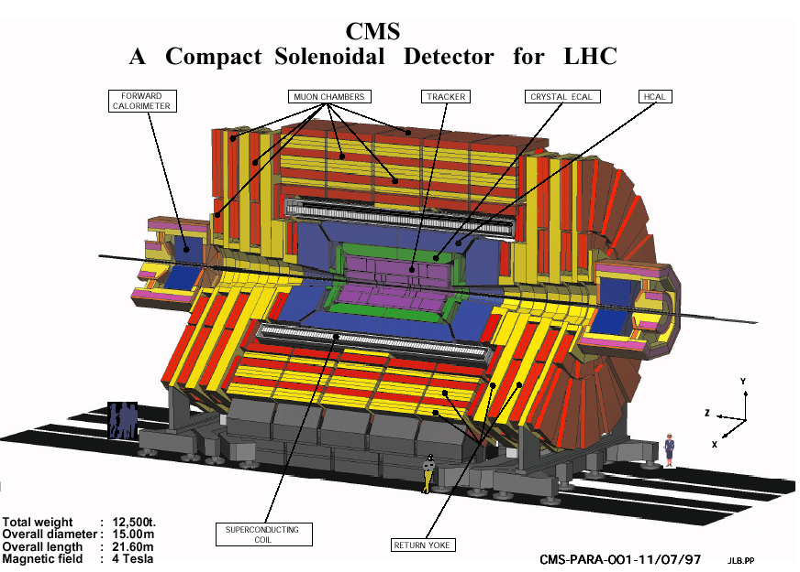
ATLAS and CMS Experiments
CMS
ATLAS
Weight 7000 t
Diameter 25 m Length of toroid 26 m
Total Length 46 m
B-field 2 Tesla
Weight 12 500 t
Diameter 15 m
Length 21.6 m
B-field 4 Tesla
Detector systems are designed to measure:
energy and momentum of photons, electrons, muons, and jets up to a few TeV

Slide 42

The ATLAS Experiment
EM Calorimetry
Pb-LAr
σ/E ~ 10%/√E(GeV)⊕1%
|η|<3.2, |η| < 2.5 (fine granularity)
Muon Detector
air-core toroids,
MDT+RPC+TGC
σ/p_{T} ~ 2-7 %
|η| < 2.7,
|η|<2.5
Length : ~ 46 m
Radius : ~ 12 m
Weight : ~ 7000 tons
Channels: ~ 10⁸
L_{cable}: ~ 3000 km
Inner detector
Si pixels and strips
Transition Radiation Detector
(e/π separation)
σ/p_{T} ~ 0.05% p_{T}(GeV)⊕0.1%;
|η| < 2.5, B=2 T(central solenoid)
Hadron Calorimeter
Fe/scintillator (central), Cu/W-LAr (fwd)
σ/E ~ 50%/√E(GeV)⊕3%
|η|<3

Slide 43
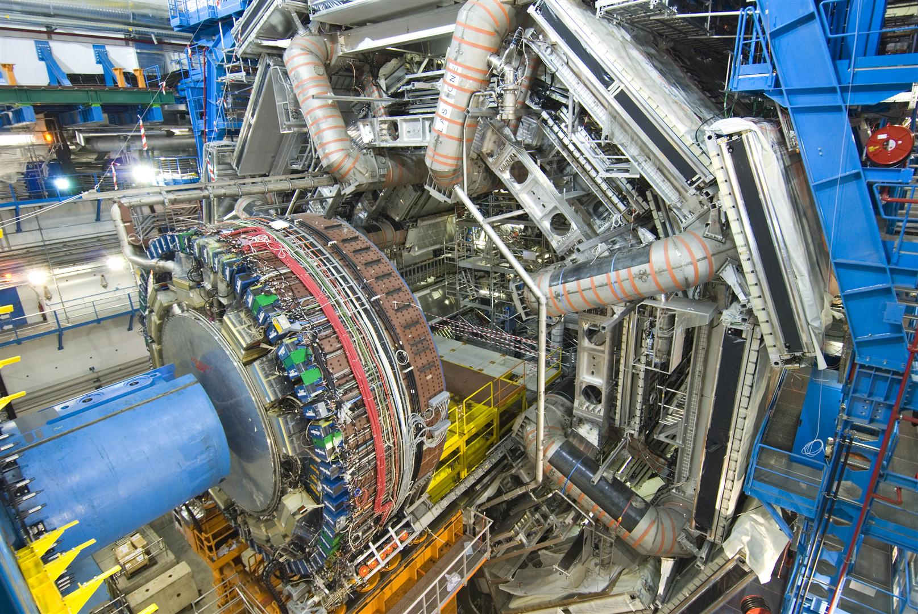

Slide 44
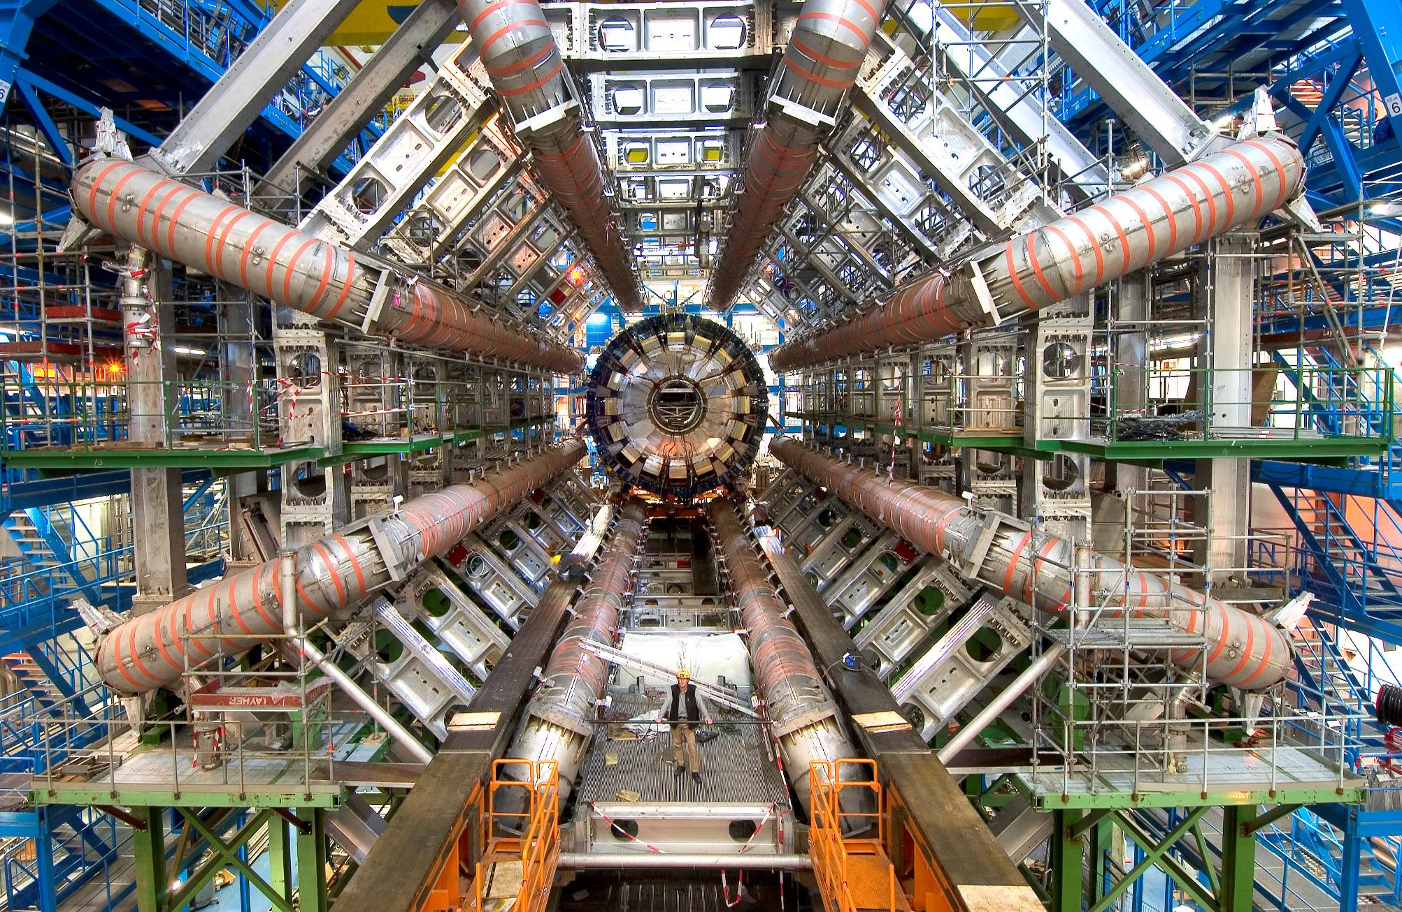
Average deformation since release (Sept) = 24.3 mm (expected 27 mm, still ~20% of muon spectrometer weight to go)

Slide 45

The CMS Experiment
Letter of Intent (LOI): LHCC, TDR in 1994
Strong Field 4T
Compact design
Solenoid for Muon P_{T} trigger in transverse plane
Redundancy: 4 muon stations with 32 R-phi measurements
ΔP_{t}/P_{t} ~ 5% @1TeV for reasonable space resolution of muon chambers (200μm)

Slide 46

The CMS Experiment

Slide 47

Why Need High Energy ?

Slide 48

Open CMS

Slide 49


The LHC-B Experiment

Slide 50

The ALICE Experiment

Slide 51
Essential Parts of the Success
Accelerators : powerful machines that accelerate particles to extremely high energies and bring them into collision with other particles
Detectors : gigantic instruments that record the resulting particles as they “stream” out from the point of collision.
Computing : to collect, store, distribute and analyse the vast amount of data produced by these detectors
Collaborative Science on Worldwide scale : thousands of scientists, engineers, technicians and support staff to design, build and operate these complex “machines”.

Slide 52






MoEDAL: Monopole and Exotics Detector at the LHC
Heavy particles which carry “magnetic charge”
Could eg explain why particles have “integer
electric charge”
Monopole production
Remove the sheets after some
running time and inspect for ‘holes’

Slide 53






A Few Smaller Experiments: TOTEM & LHCf
TOTEM: measuring the total, elastic and
diffractive cross sections
Add Roman pots (and inelastic telescope)
to CMS interaction regions (200 m from IP)
Common runs with CMS planned
TOTal and Elastic cross
section Measurement
LHCf: measurement of
photons and neutral pions
in the very forward region
of LHC
Add a EM calorimeter at
140 m from the Interaction
Point (of ATLAS)
Connection with
cosmic rays

Slide 54


10 September 2008, 9:50, the first LHC beam event was recorded by CMS
LHC Start Up

Slide 55


The First Collisions @ 7 TeV
The first collisions (3.5 TeV + 3.5 TeV) were happen on March 30th, 2010, at 13-00 (Geneve)
12:52 – CMS, 12:58 – ATLAS, 12:59 – LHCb, 13:01 – ALICE
14:30 Neutral pion decay was detected by CMS

Slide 56






LHC Timeline and Data That We Have
We are here
  @ 7 TeV in 2010 and 2011 (6.1 fb-1)
  ~30 fb⁻¹ @ 7-8 TeV in 2012 (23.3 fb-1)
~160 fb⁻¹ of proton-proton collisions @ 13 TeV delivered during RUN2
~260 fb⁻¹ it is expected @ 13.6 TeV for the end of the RUN3
450 fb⁻¹, in total for all RUNs

Slide 57


LHC Luminosity
Hz/μb = 10³⁰ cm⁻²c⁻¹

