Slide 1

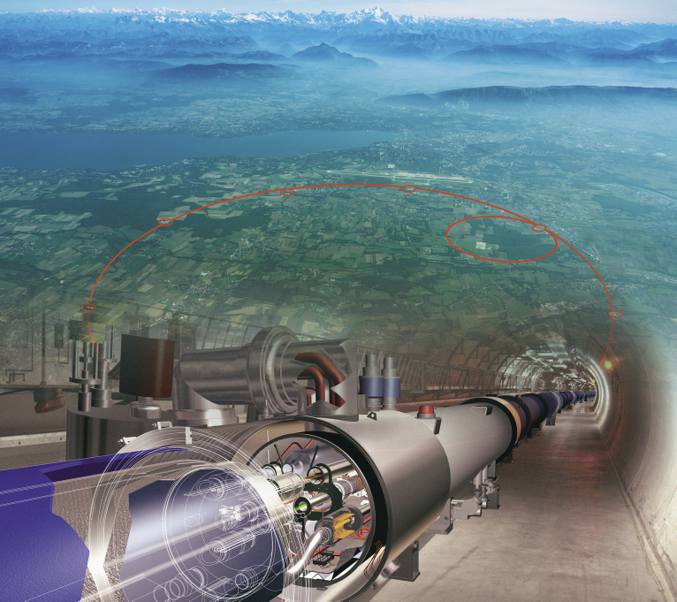

Physics at Energy Frontier
Sergei Shmatov (LHEP JINR, Dubna)
shmatov@cern.ch shmatov@jinr.ru
MISP2022
24 July - 2 August

Slide 2
Content
Lecture 1
HEP Experiments at accelerator facilities
  Why we need accelerator facilities?
  Do we need more and more new accelerator facilities?
LHC and Experiments at the LHC
  Hot points of particle physics vs LHC
  Conception, design, construction
  Challenges and solutions
Lecture 2 (recent experimental results)
Standard Model
Higgs Physics
Lecture 3 (recent experimental results)
  Physics beyond the LHC
  LHC Prospects and Plans
  Beyond the LHC

Slide 3
Lecture 2
  How do we get data?
    Rates and trigger, data flows
Rediscovery of Standard Model (tests of detector systems, software validation, MC tunes, ..)
  Physics of Higgs bosons
    discovery of new bosons
    evidences of its nature
    measurements of its properties
Standard Model
  precision tests (in new kinematic region)
  observations of rare processes

Slide 4
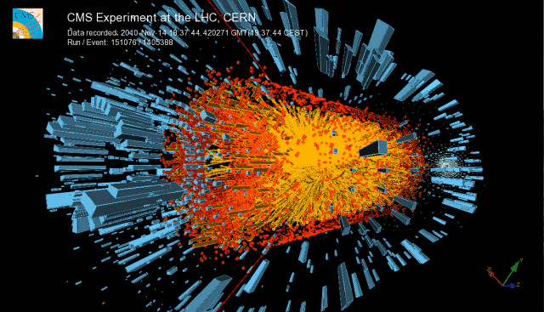
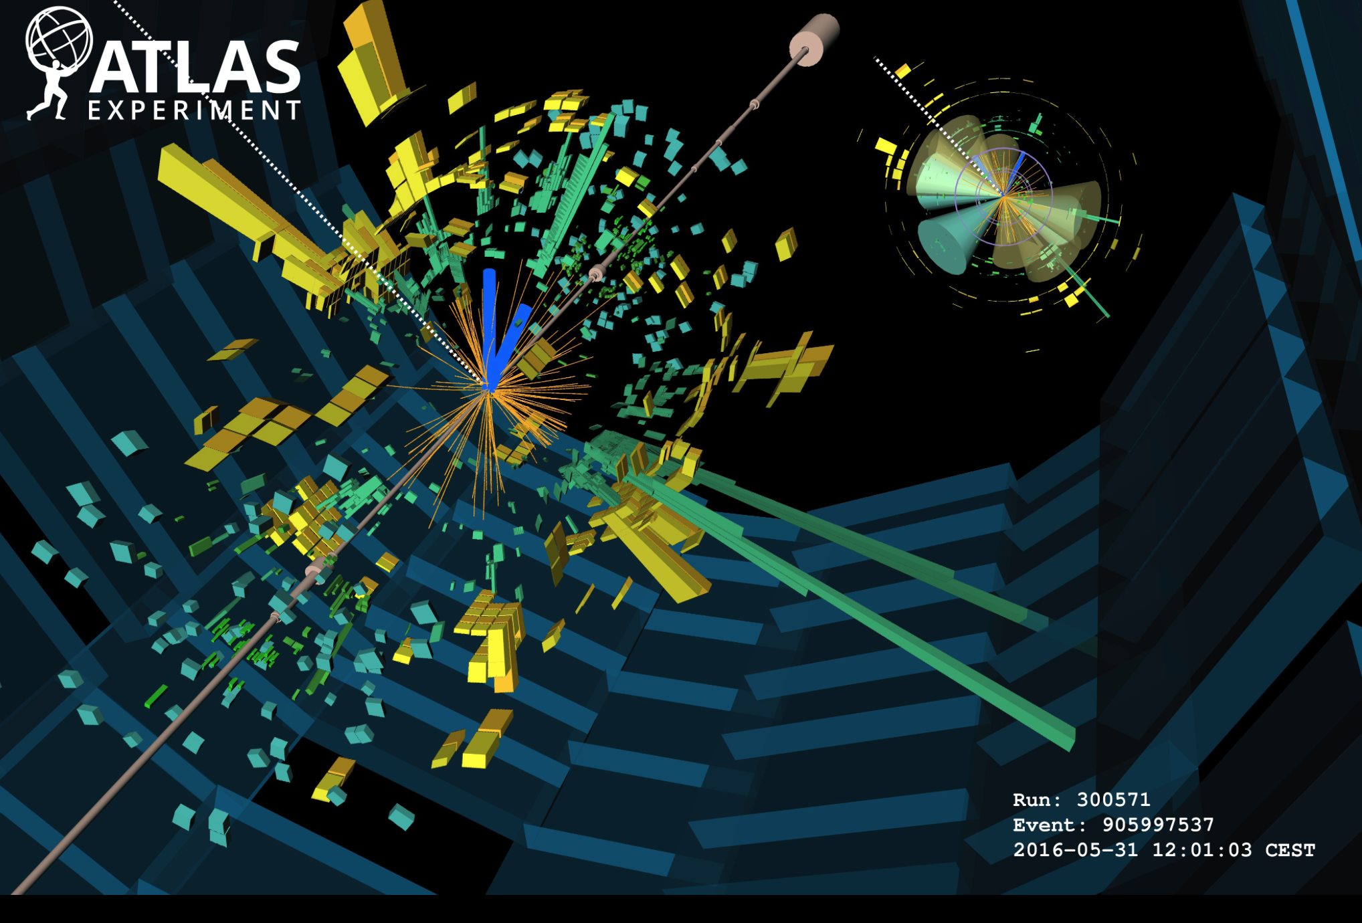
How do we get data?

Slide 5
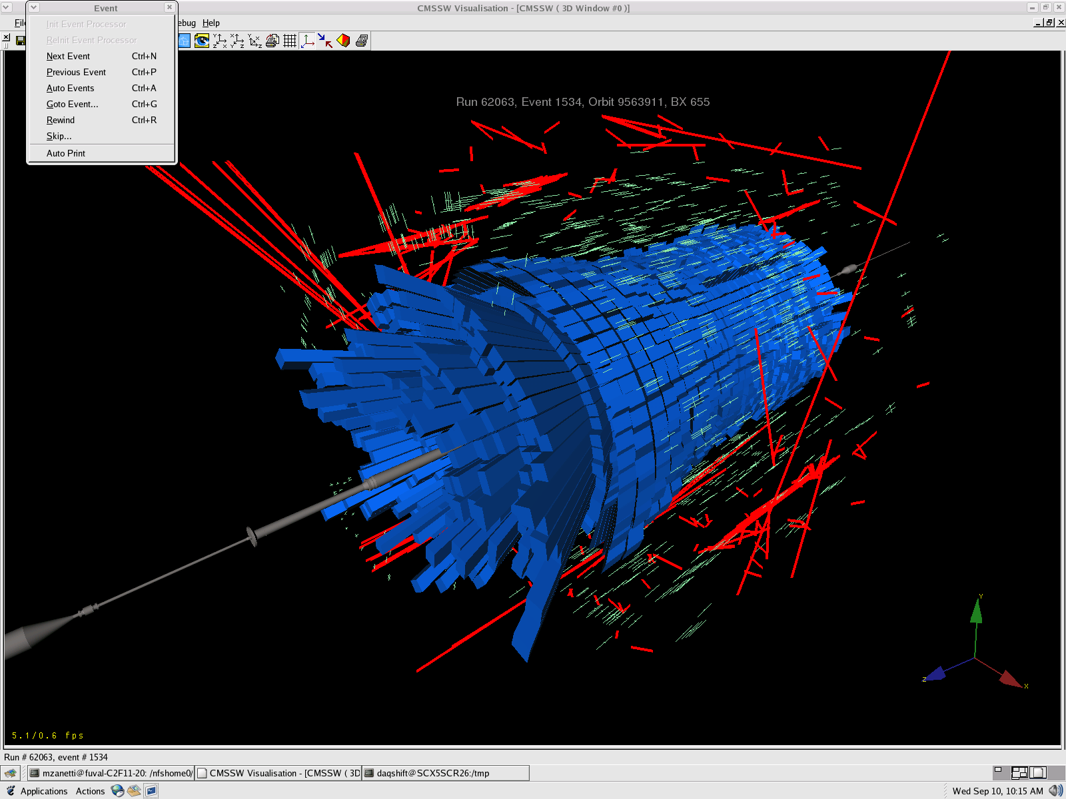

10 September 2008, 9:50, the first LHC beam event was recorded by CMS
LHC Start Up

Slide 6
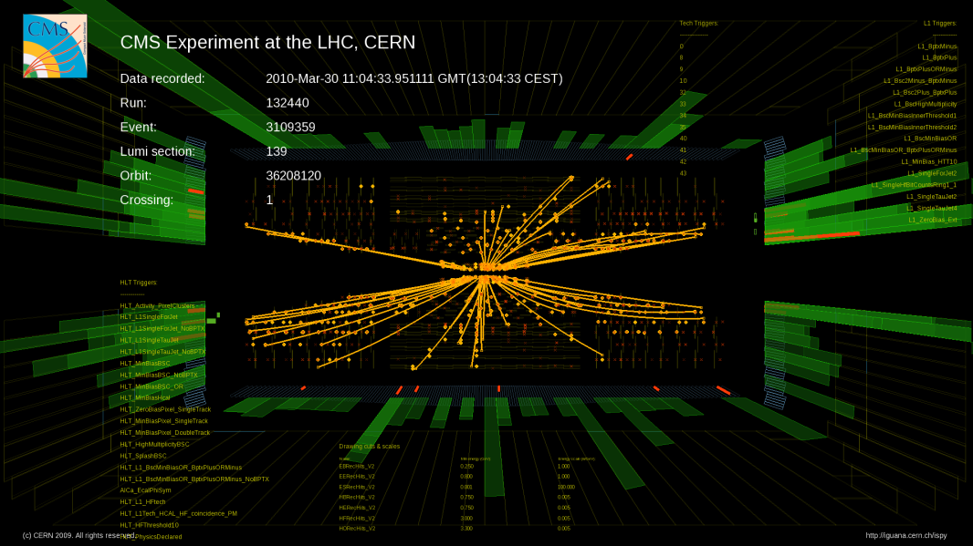
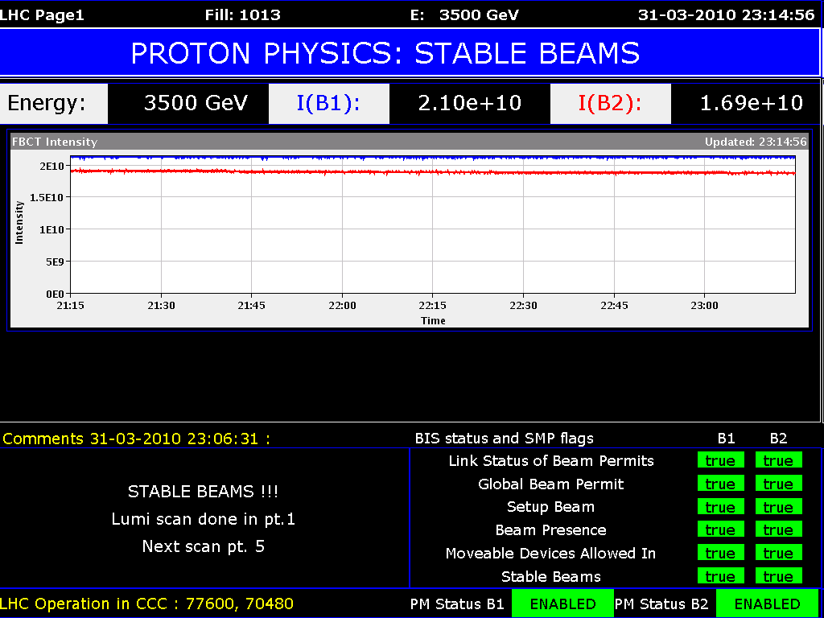
The First Collisions @ 7 TeV
The first collisions (3.5 TeV + 3.5 TeV) were happen on March 30th, 2010, at 13-00 (Geneve)
12:52 – CMS, 12:58 – ATLAS, 12:59 – LHCb, 13:01 – ALICE
14:30 Neutral pion decay was detected by CMS

Slide 7
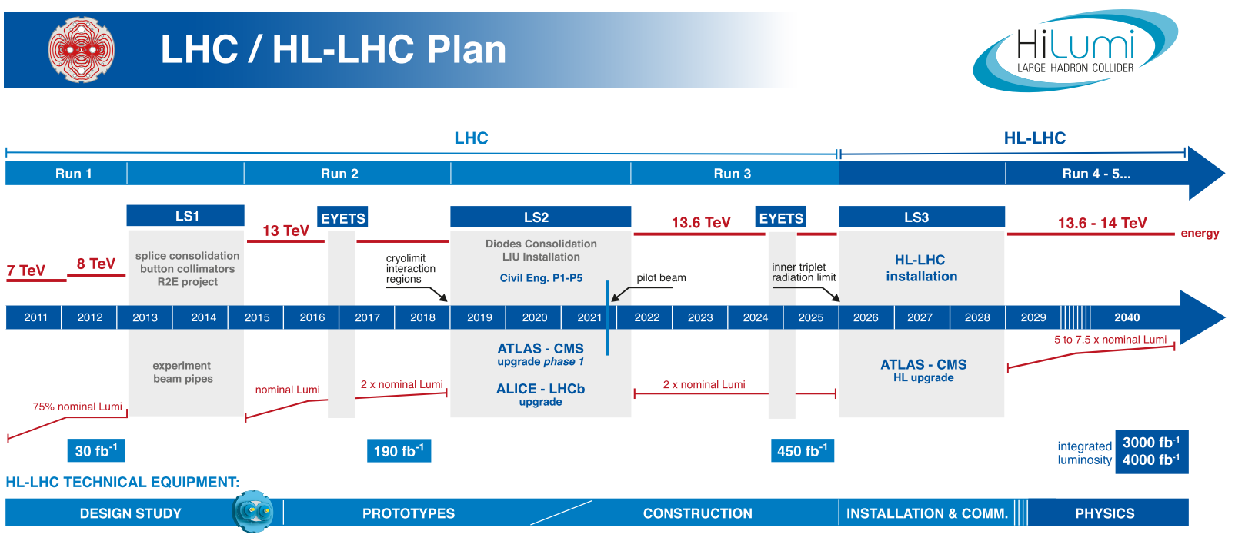
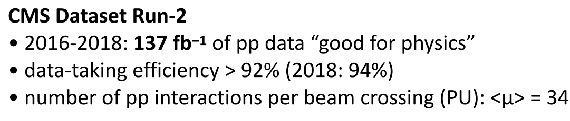
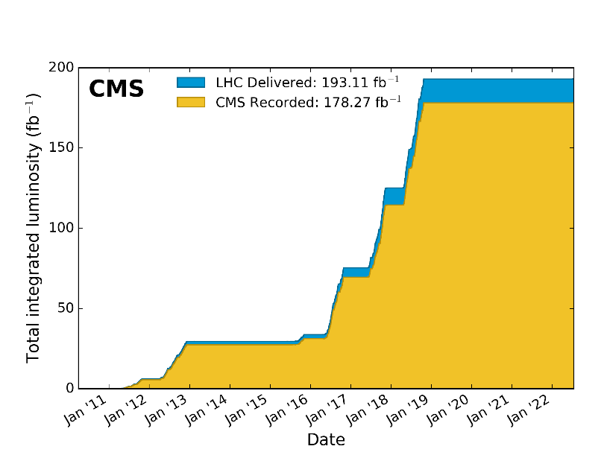


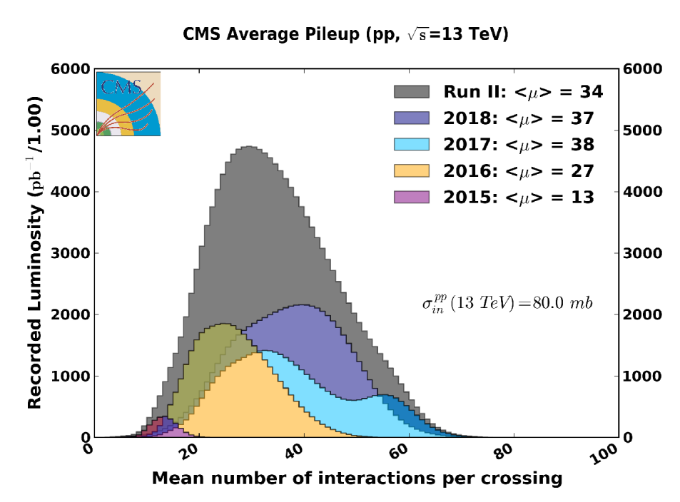
LHC Timeline and Data That We Have
We are here
  @ 7 TeV in 2010 and 2011 (6.1 fb-1)
  ~30 fb⁻¹ @ 7-8 TeV in 2012 (23.3 fb-1)
~160 fb⁻¹ of proton-proton collisions @ 13 TeV delivered during RUN2
~260 fb⁻¹ it is expected @ 13.6 TeV for the end of the RUN3
450 fb⁻¹, in total for all RUNs

Slide 8
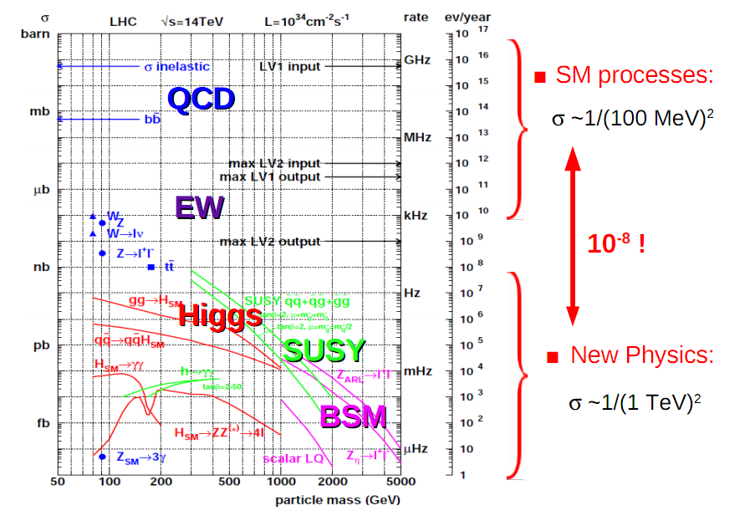
Physics Processes at LHC

Slide 9
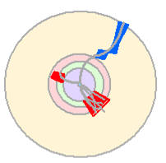

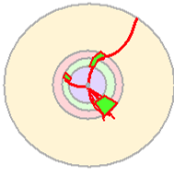
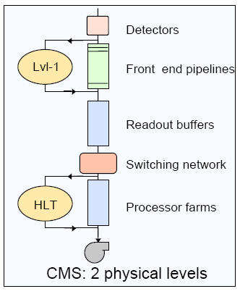
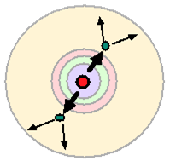
Data Selection/Trigger
Level-1:
Hardware selection is comprised
of custom electronics that process
data from detectors, rough cutoffs
High Level Trigger:
Software selection based on
reconstruction of physics objects,
event topology

Slide 10
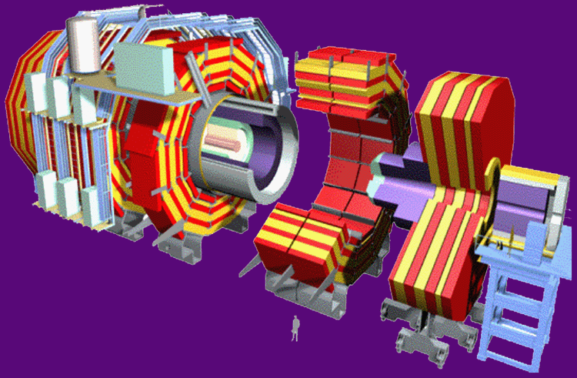
Trigger Rates
40 MHz (1000 TB/sec)
Level 1 - Special Hardware
75 KHz (75 GB/sec)
Level 2 - Embedded Processors
5 KHz (5 GB/sec)
Level 3 – Farm of commodity CPUs
100 Hz (100 MB/sec)
Data Recording &
Offline Analysis

Slide 11
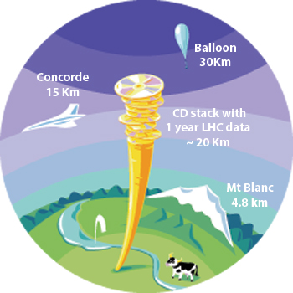
Data Flows
~ 3PB/year
~ 3PB/year
Big Data/GRID Computing

Slide 12

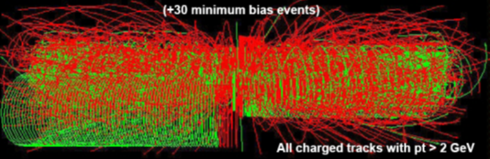
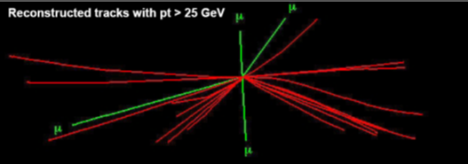

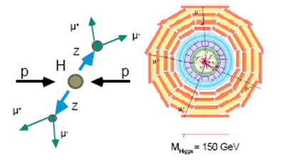
Data Processing and Analysis
RAW Data
Reconstruction
Event Selection
Calibration
Data Base
Theory/
Monte Carlo Simulation

Slide 13
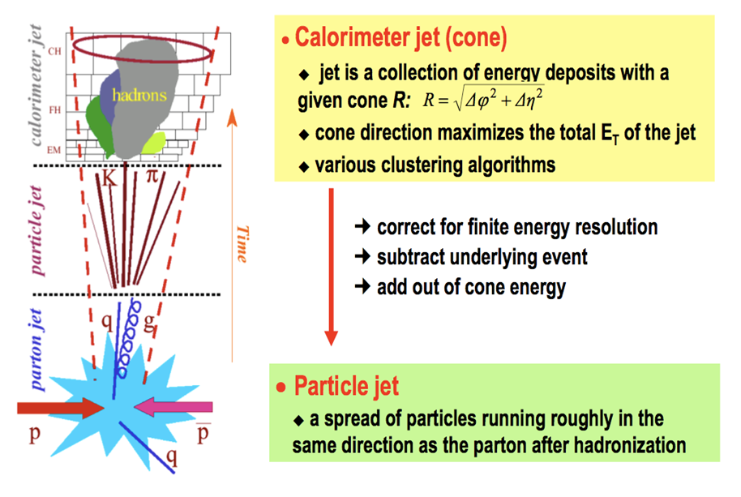
Jet Finding

Slide 14
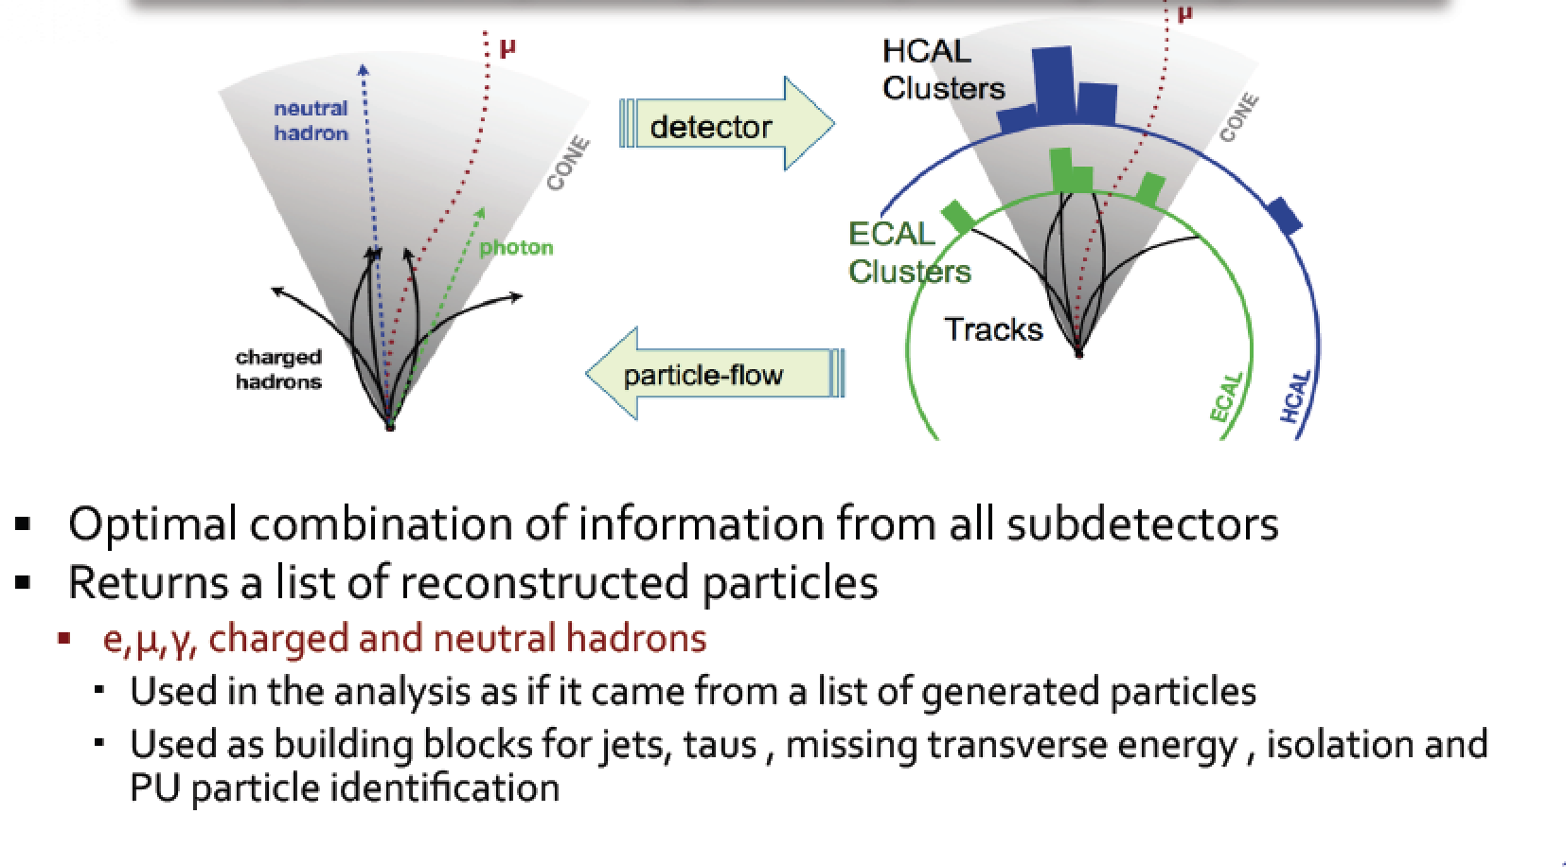
Global Event Reconstruction
Using all information of the detector together for optimal measurement

Slide 15
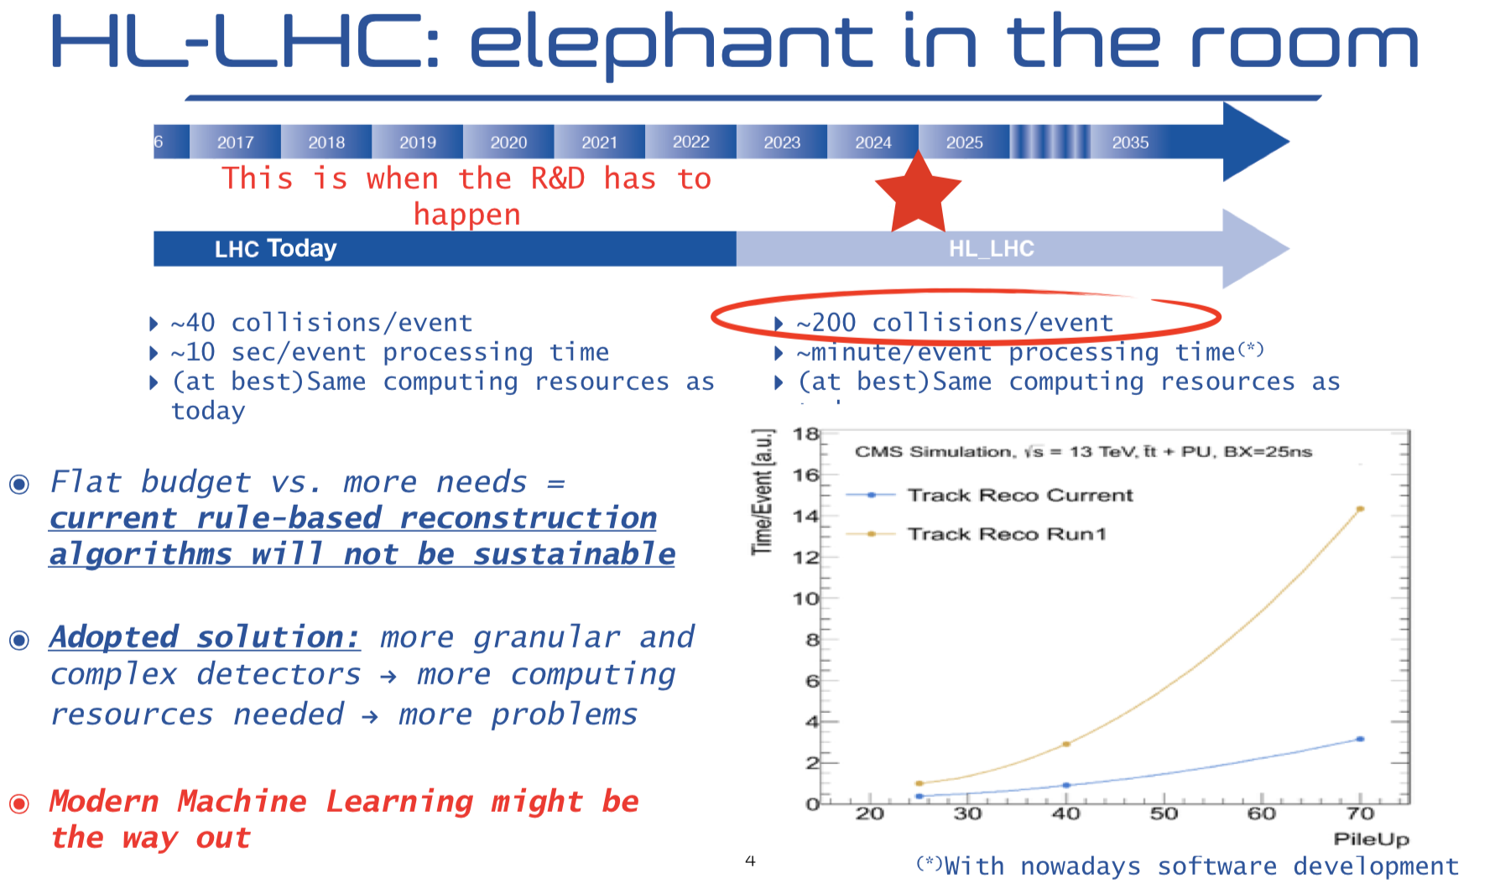
The New Wave: Machine Learning (1)

Slide 16
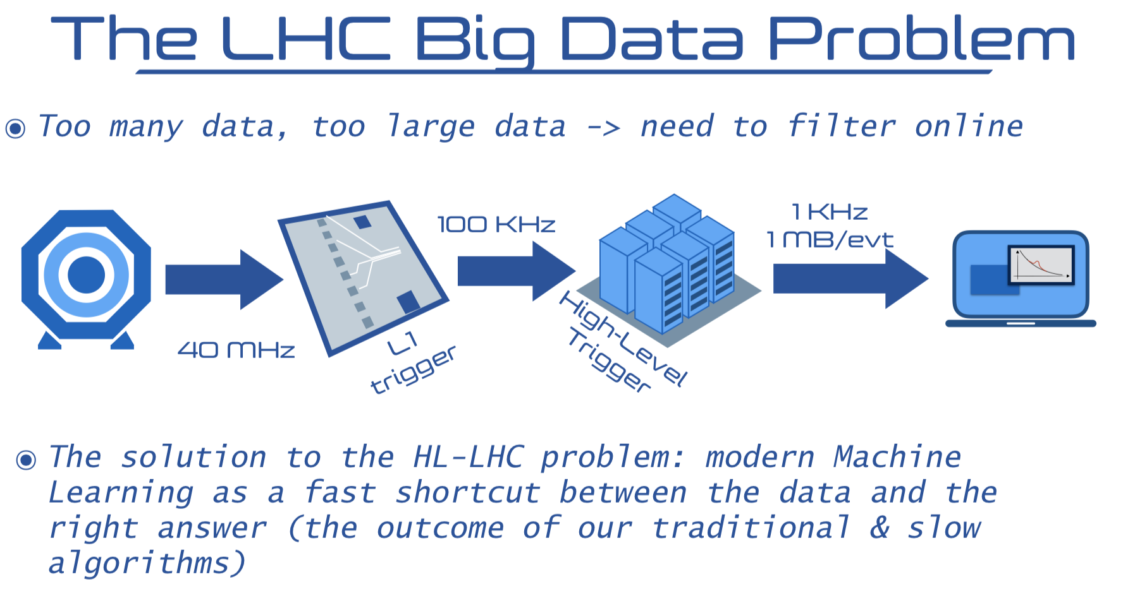
The New Wave: Machine Learning (2)

Slide 17
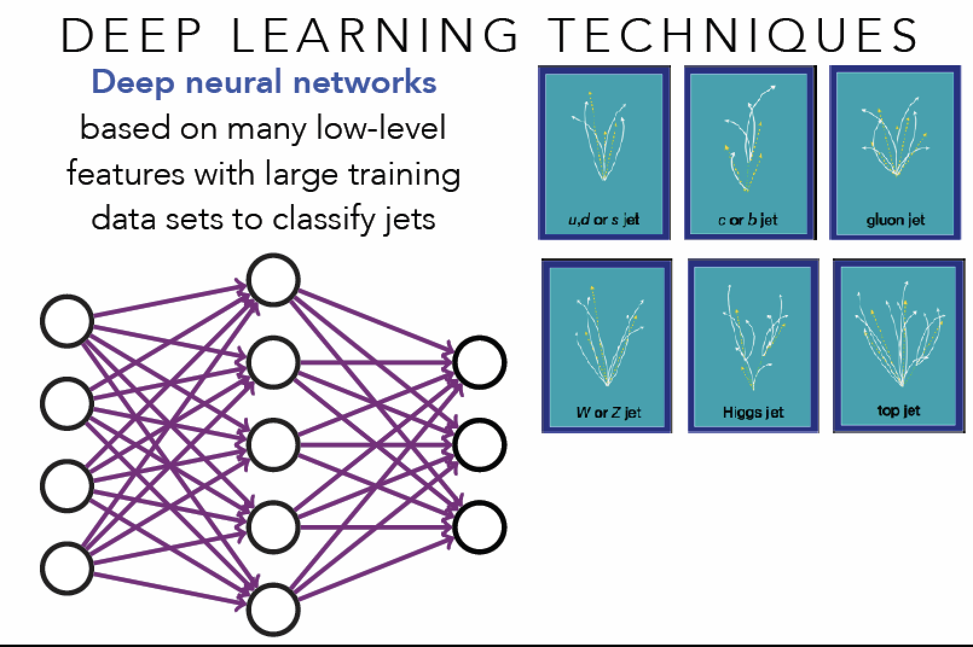
The New Wave: Machine Learning (3)
From cut-based analysis to ML

Slide 18
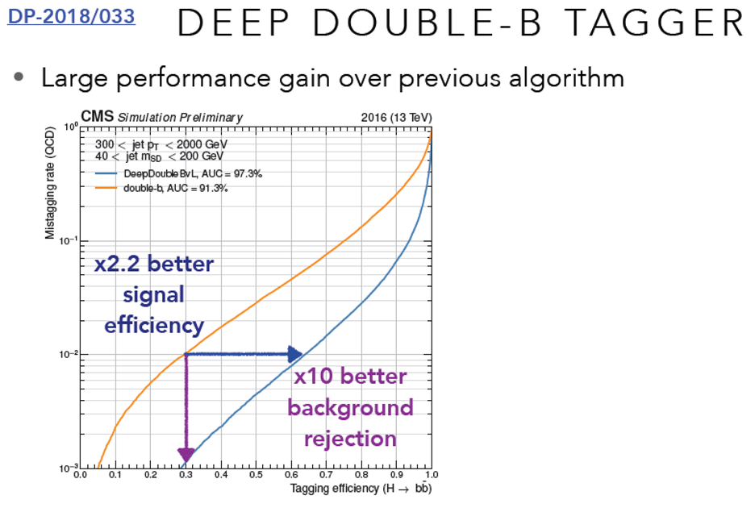
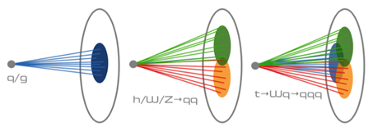
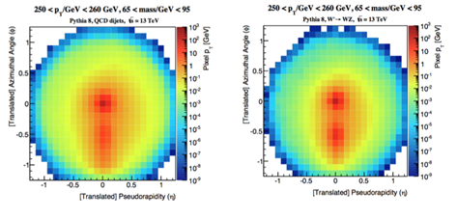
The New Wave: Machine Learning (Example)

Slide 19
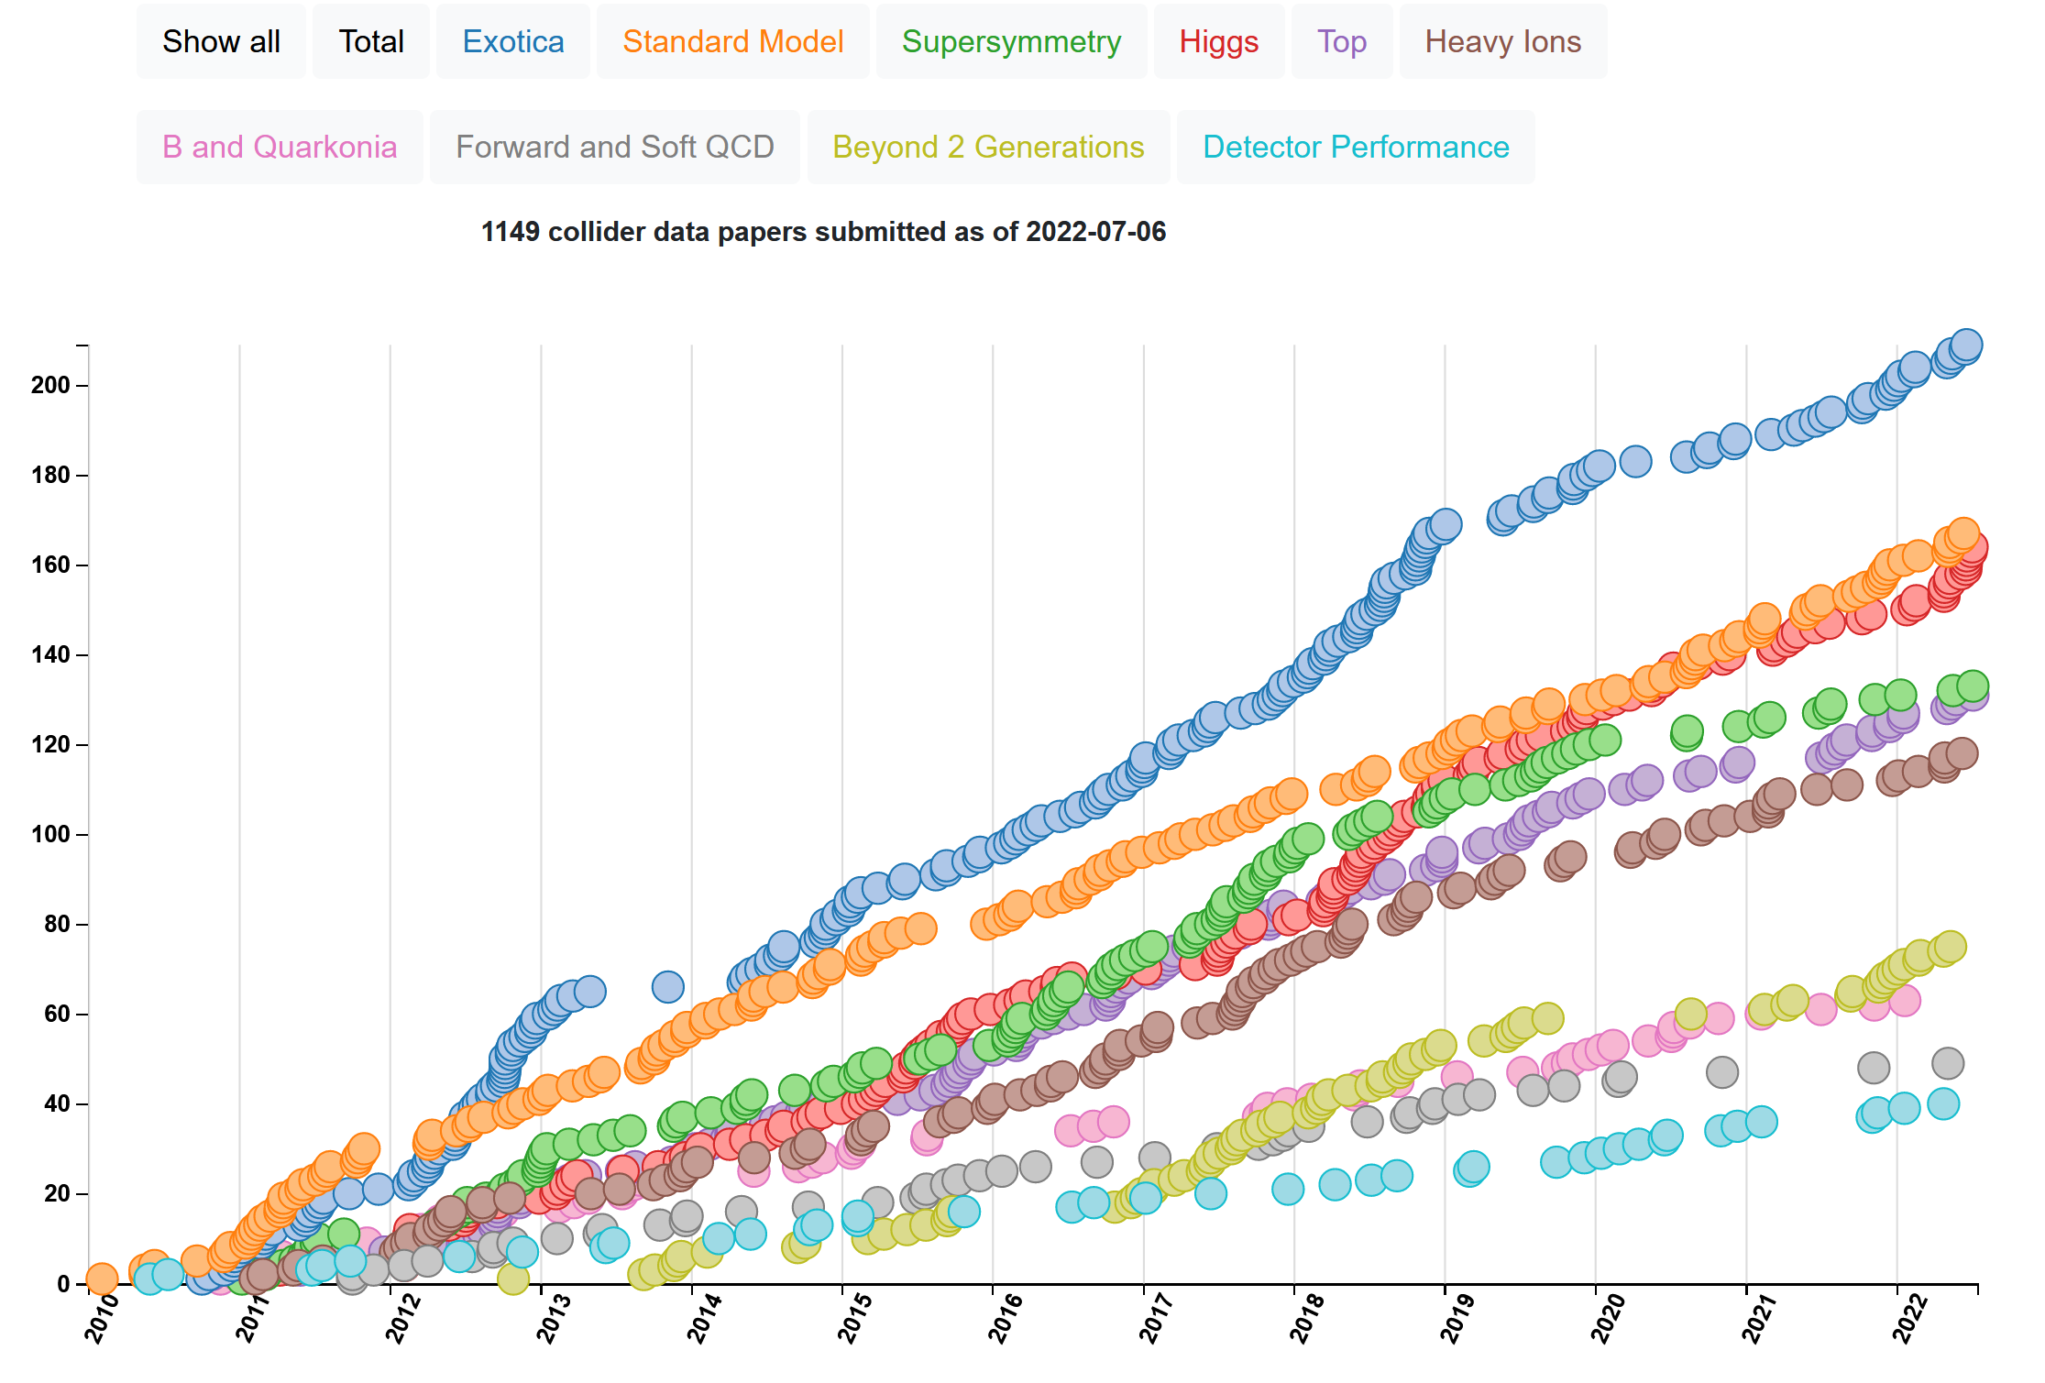
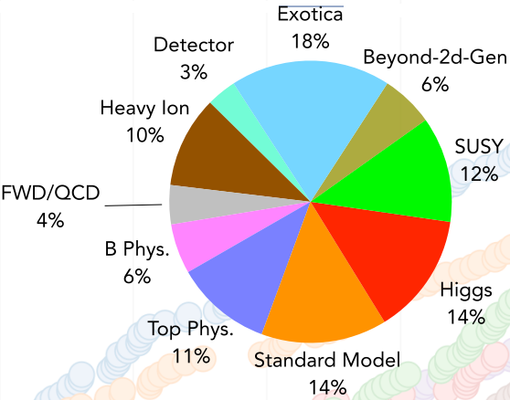
Some Statistics (example from CMS)
CMS Publications Page
https://cms-results.web.cern.ch/cms-results/public-results/publications/
CMS Public Results (newest)
https://cms-results-search.web.cern.ch/
1149 papers based on
collision data
(+25 on cosmic data)
http://cern.ch/cms-results/public-results/publications-vs-time/

Slide 20
Re-discovery of Standard Model

Slide 21

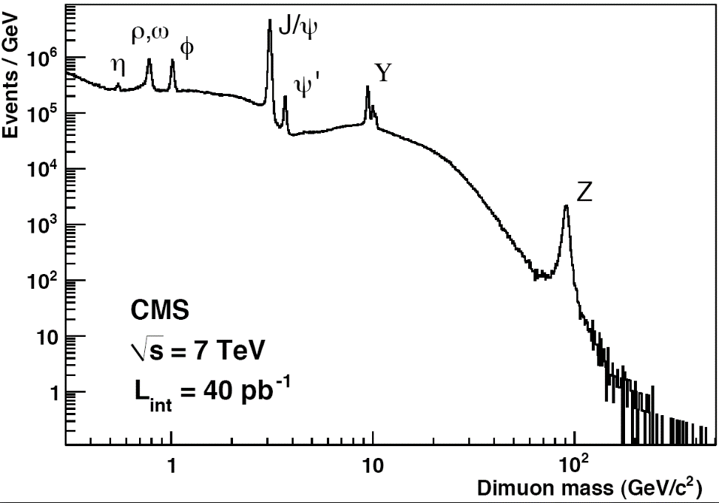
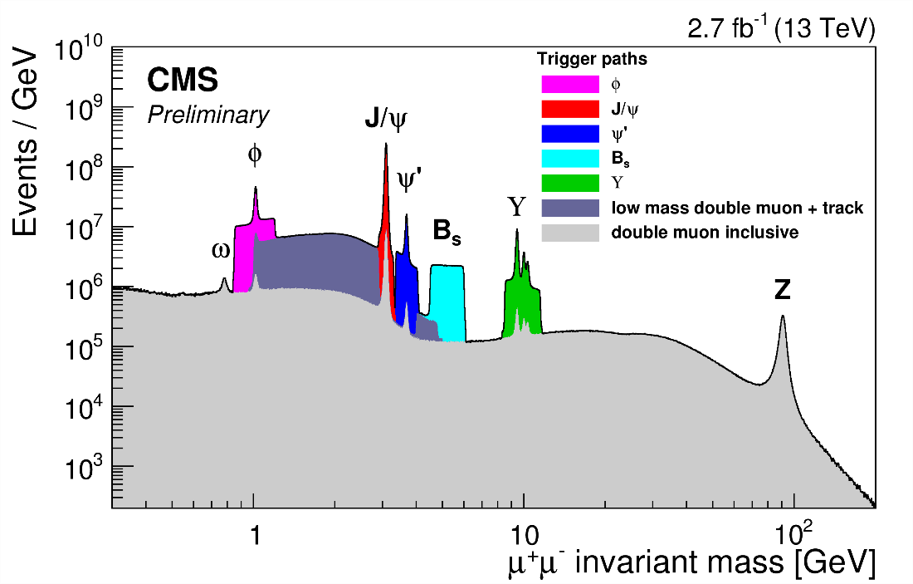
Re-discovery of the Standard Model
Observation of well-known SM objects and processes
  tests of detector systems
  software validation
  MC tunes, ..
Detected objects
  Muons (transverse momentum p_{T})
  Electrons (energy and tr. momentum p_{T})
  Photons (energy)
  Jets (energy)
  Tracks from charged particles (p_{T})
Dec 2010
Reconstructed objects
  Missing energy and p_{T}
    vectorial sum of all transverse momentum
  Resonances (W/Z, B-hadrons, etc)
  Tau-leptons
  b-jets
  t-quarks
  etc
+ well-know processes in SM
https://twiki.cern.ch/twiki/bin/view/CMSPublic/PhysicsResultsMUO

Slide 22
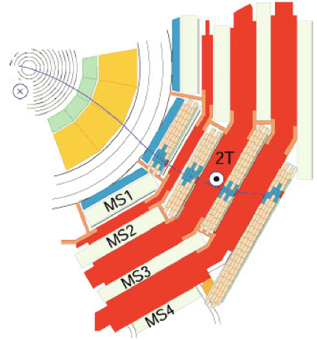
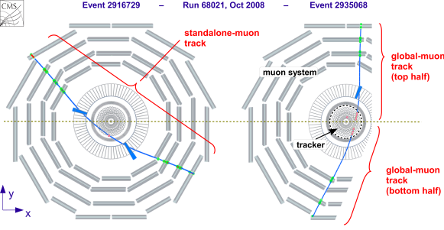

Example of SM Physics Objects 2010-2015
CMS Muon System shows a excellent performance to detect different resonances
Dec 2010
https://twiki.cern.ch/twiki/bin/view/CMSPublic/PhysicsResultsMUO

Slide 23
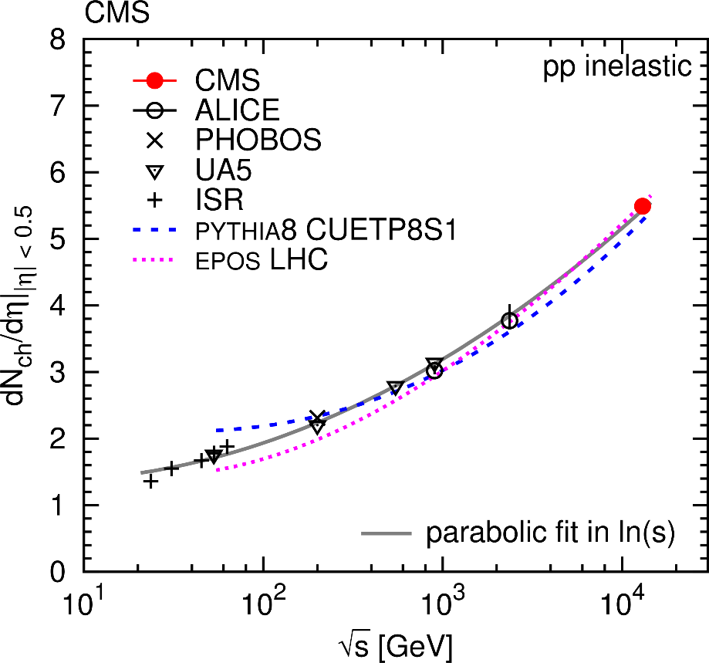
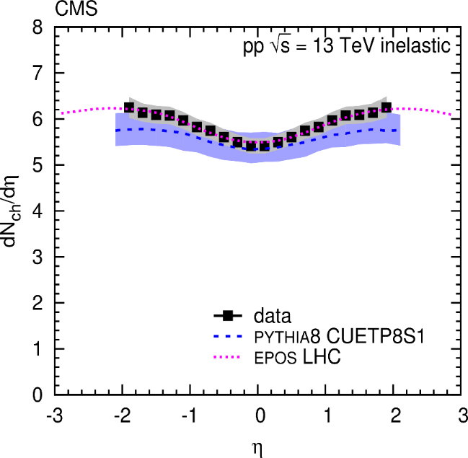

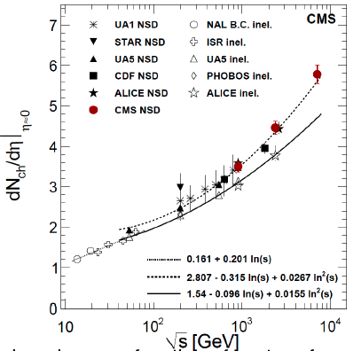
MC Tunes: Example with Charged Multiplicity
2009: the first CMS results @ 0.9-2.36 TeV
2010: the first CMS results @ 7 TeV
2015: the first CMS results @ 13 TeV
PLB 751, 143, 2015
0.9-7 TeV
13 TeV
fast growth → MC tunes
In the central region, the measured dNch/dη distribution is consistent with predictions of the PYTHIA8 (with the CMS underlying event tunes CUETP8S1 and CUETP8M1) and EPOS LHC (LHC tune) event generators
recheck the Monte-Carlo tunes

Slide 24
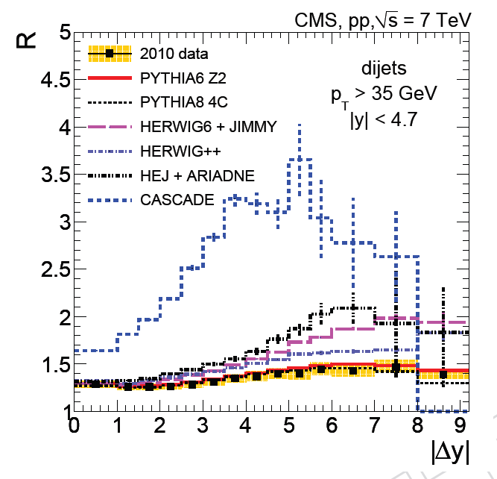
Monte Carlo Tunes: Rapidity Gap

Slide 25

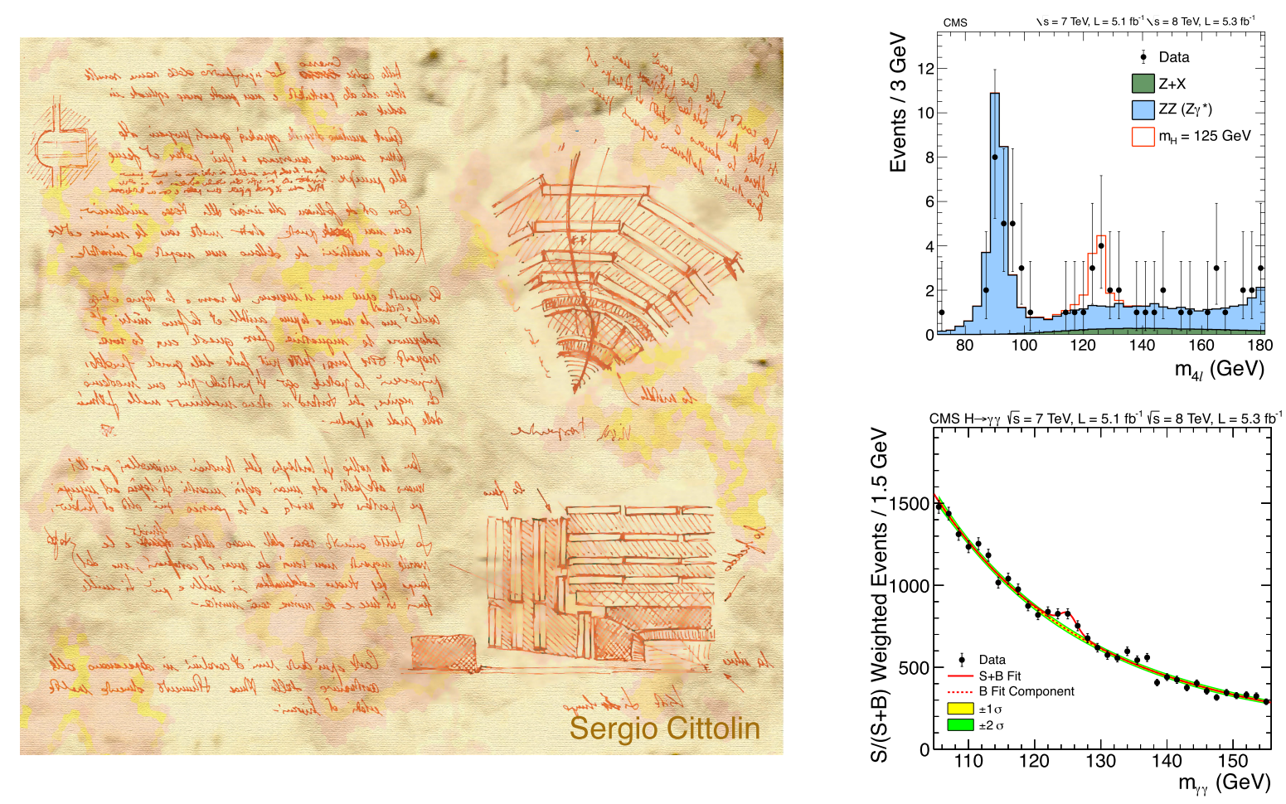
Physics of the Higgs Boson
10th anniversary of the Higgs boson discovery, Monday Jul 4, 2022

Slide 26
The ﬁngerprint of a Higgs boson
What do we expect from the SM for a Higgs boson?
  elementary particle with spin 0 (scalar)
  strength of interaction with other particles related to their mass
    the only interaction that distinguishes between the fermion generations ⇒ important to study interactions with second generation fermions
  interacts also with itself, related to vacuum
  no other such particle in the SM
SM does not predict mass
  at LHC start Higgs mass was the only missing SM parameter to predict production and decay rates
    m_{H} < 1 TeV from theory (SM unitarity requires)
    m_{H} > 114.1 GeV from LEP
    156 < m_{H} < 177 GeV from Tevatron
We need to study all the aspects of the new particle to understand what we found

Slide 27
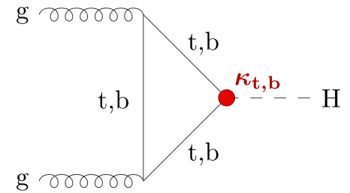
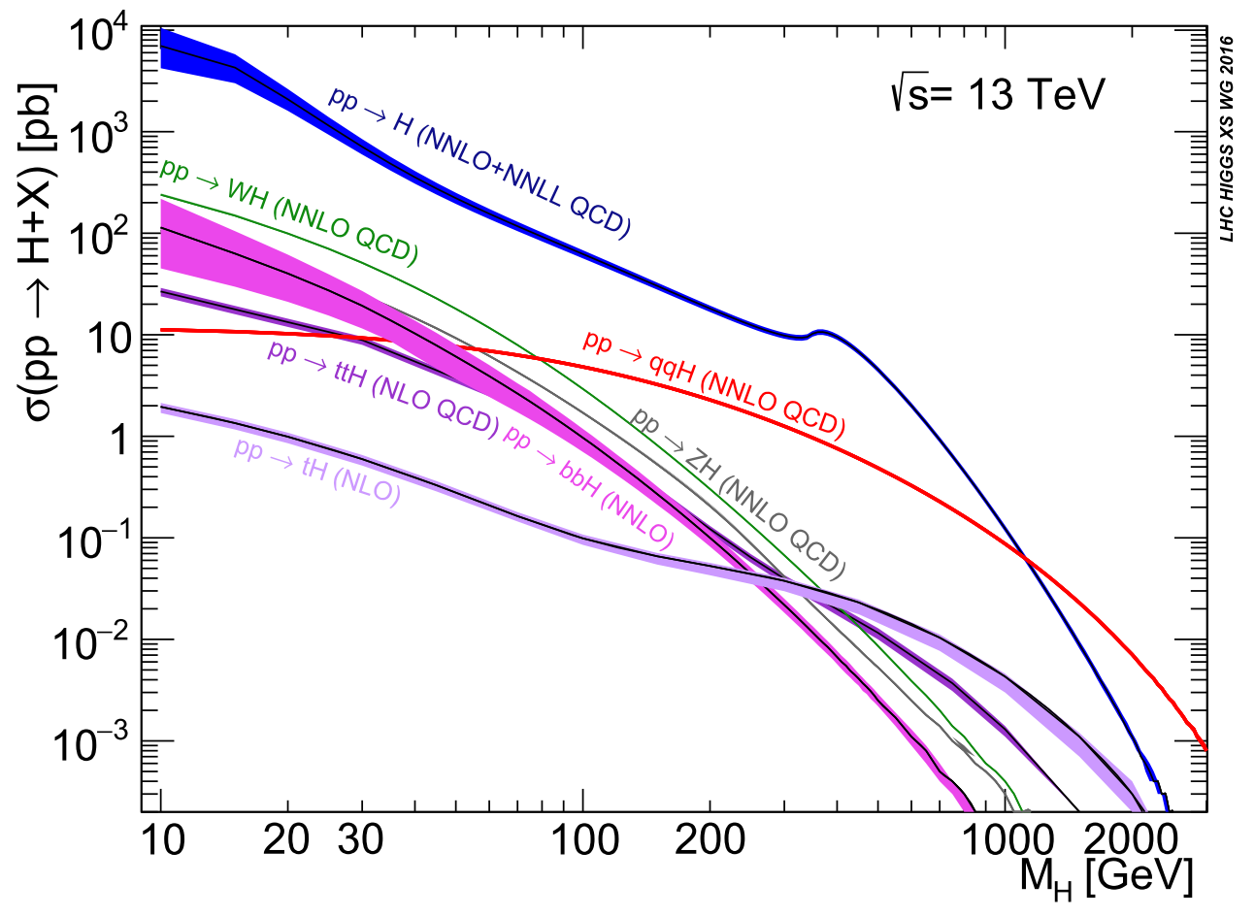
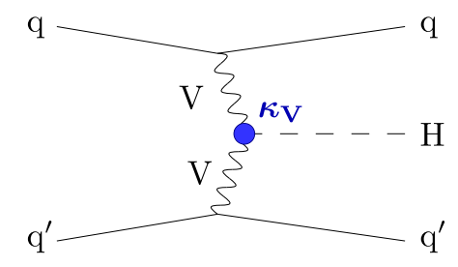
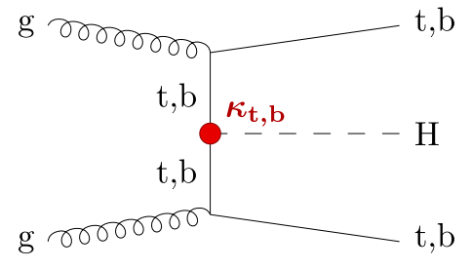
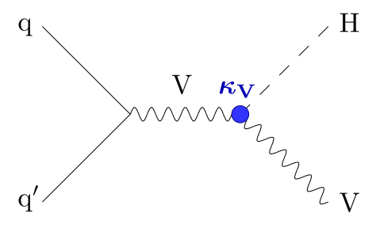
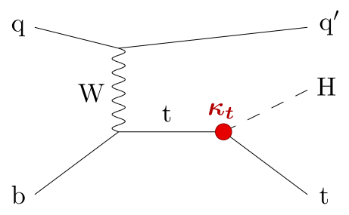
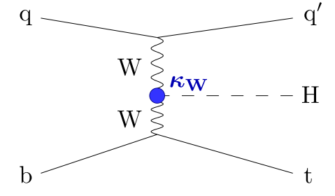
Production of SM Higgs boson
N(N)LO QCD + NLO EWK
ggH
43.9 pb⁻¹, ggH, 7M
3.77 pb⁻¹, VBF, 600K
1.36 pb⁻¹, WH, 200K
0.88 pb⁻¹, ZH, 140K
0.5 pb⁻¹, ttH, 80K
0.48 pb⁻¹, bbH, 77K
0.08 pb⁻¹, tH, 13K
@ m_{H} =125.38 GeV
VBF
tt/bbH
https://twiki.cern.ch/twiki/bin/view/LHCPhysics/CERNYellowReportPageBR
VH
tH

Slide 28
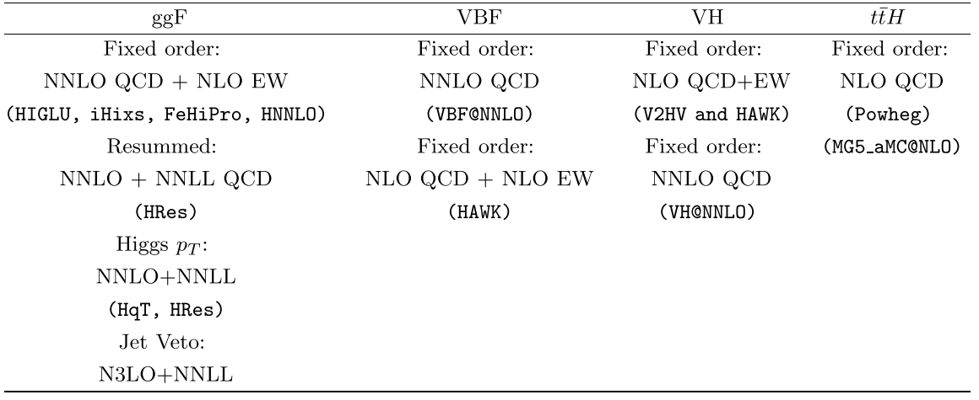
State-of-the-art of the theoretical calculations

Slide 29
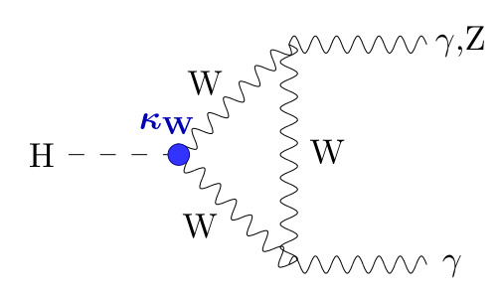
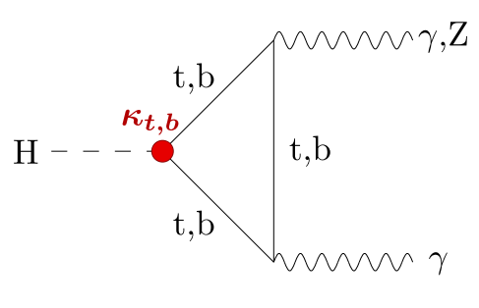
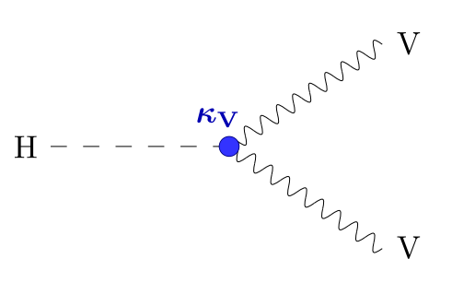



Decays of SM Higgs boson
h → Gauge Bosons
h → Fermions

Slide 30

Peter Higgs @ CMS, 2007

Slide 31



Higgs “Gold: Decays
H → γγ
small branching ratios
more clear signals
  S/B raio is optimal
  ATLAS and CMS have excellent ECALs and Muon Systems with perfect mass resolution
  lepton/photon reco vs (b-)jet reco
H → ZZ* → 4l
@ m_{H} =125.38 GeV

Slide 32






Discovery of a New Boson: Mass Spectra
Searches for a Higgs boson have been resulted in 2011-2012 to
discovery of a boson with m = 125.3 ± 0.4 (stat.) ± 0.5 (syst.) GeV
Higgs Seminar at CERN - 4 July 2012
Local significance of excess (γγ and ZZ) is
5.9 σ for Atlas and
5.0 σ for CMS

Slide 33


Discovery of a New Boson: Significance
The probability that an observed excess was a statistical fluctuation of the background (p-value)
Notable values for an excess in particle physics are 3σ, or p-value = 0.0013; and 5σ, or p-value = 2.87 x 10⁻⁷. When we have an excess of 3σ we talk about an evidence, and when we have an excess of 5σ, we are facing a discovery.

Slide 34

Significance in Numbers

Slide 35





Story at Higgs Discovery

Slide 36



What had we got promptly?
A new boson (spin: 0 or 2) (Landau–Yang rule is true)
  γγ: 4.5 σ for Atlas and 4,1 σ for CMS (spin ≠ 1)
  ZZ: 3.6 σ for CMS and 3,2 σ for CMS
  WW: 2.8 σ for CMS and 1,5 σ for CMS
  bb and ττ decays are not found
Strengths of signal σ/σ_{SM} is close to those in SM
coupling with gauge bosons
coupling with fermions?
$$μ=\frac{σ}{σ_{SM}}=1.4±0.3$$

Slide 37

Is it Higgs or not? SM Higgs or not?
Evidence of decays into fermions
All main production mechanisms need to be observe
Decay branching ratios
Precision measurements in partial and combined channel
  cross sections
  signal strength
  mass and width
Spin, parity
Higgs differential distributions
Search for rare decays
Search for extra boson states
couplings

Slide 38



Higgs Story at the LHC
Era of precision measurements
of Higgs boson

Slide 39



A year later: That is Higgs!

Slide 40


The measured fiducial cross section
LHC Higgs Cross Section Working Group
JHEP 11 (2017) 047
К концу Run 2 интегральная светимость
(delivered by LHC) увеличена в 7 раз
(до ~160 фб⁻¹)!

Slide 41

Landscape of Higgs Production/Decay Modes

Slide 42


Higgs coupling to τ leptons
PLB 779 (2018) 283

Slide 43








Higgs coupling to top quark
Coupling to t-quark
Yukawa coupling proportional to fermion mass → largest couplings to t-quark
Sensitivity to new physics
PRD 97 (2018) 072003, PRL 120 (2018) 231801, PRL 125 (2020) 061802
Observation of ttH with 2011-2016(2017) data!

Slide 44




VH production and H→bbar
Largest branching ratio (58%), but challenging final state with large backgrounds
  use VH production with clean trigger signature and to reduce QCD backgroundsу
  best decay channel to observe V H production
PRL 121 (2018) 121801
PLB 786 (2018) 59
Observation of H → bbar with
2011-2017 data
Completes observation of
couplings to 3rd generation
fermions

Slide 45



b-quark tagging
Generally: look for jets with displaced vertices (or leptons) from B-meson decays

Slide 46





tH production
tHq (71 fb)
tHq (16 fb)
tHW (2.9 fb)
the final states
low probability in SM
BSM enchancment (ex, in 2HDM)
ttH
WWH
ttH
vertex
Limits on cross sections, 95% СL
PRD 99 (2019) 092005

Slide 47
Higgs Rare Decays

Slide 48


H→ 2nd Generation (H→μμ)
large SM irreducible DY → μμ background − S/B ~ 0.1% for inclusive events at 125 GeV
targeting all production modes
MVA categorisation to select events at high S/B, e.g. from VBF
𝛾-FSR recovery to improve σ(mμμ)
Observed (expected)
significance is 2(1.7) σ
For CMS, observed (expected) significance is 3 (2.5) σ

Slide 49
H→ 2nd Generation (H→ccbar)
CMS-HIG-21-008
CERN-EP-2022-0811
arXiv:2201.11428

Slide 50
Higgs Boson Pair Production (1)

Slide 51

Higgs Boson Pair Production (2)

Slide 52




Signal Strengths
Nature 607, 52–59 (2022)
Nature 607, 60-68 (2022)
Strengths of production and decays (..and combined)
Signal strength is fully compatible with SM

Slide 53




Higgs Couplings
After 10 years, five main production channels and five main decay channels observed and being used for measurements
Nature 607, 52–59 (2022)
Nature 607, 60-68 (2022)
Relationship between mass and coupling as predicted by SM within current uncertainties and assuming total width dominated by SM decays

Slide 54



Higgs Mass
Two “gold” decays (γγ and ZZ)
  high statistics
  systematic effects are under control
  optimal S/B ratio
PLB 805 (2020) 135425
JHEP 11 (2017) 047
The recent accuracy is ~0.1% (!).

Slide 55







Higgs Width
On-shell measurements in γγ and ZZ (4l)
  total Higgs width of 4.1 MeV unmeasurably small, limited by
  detector resolution
  in assumption the lack of signal-background interference
  Γ_{H} < 1.1 GeV @ 95% CL in 4l
Off-shell measurements in ZZ for gg-production
  for
    on-shell (NWA) depends on Γ_{H}
    off-shell does not depend
PRD 99 (2019) 112003

Slide 56



Spin-Parity from Di-boson Decays

Slide 57


Differential Cross Sections
In addition to looking at total rates, study kinematics in Higgs production
Effects of physics beyond the SM can be enhanced in tails of distributions
CMS-PAS-HIG-19-016
ATLAS-CONF-2022-002
CERN-EP-2022-143
PRL 118, 121801
PLB 792 (2019) 369
Agreement with SM!
couplings with b- and t-quarks were measured before
contribution from c-quark

Slide 58




Higgs Portrait after 10 Years
During Run 2 of the LHC the experimental collaborations started to employ the combined data for precision measurements of Higgs properties (mass, width, couplings, CP, rare decays)
All main production mechanisms are observed, including h → bbar, ttH, VH
Mass of Higgs boson m_{h} is measured with an accuracy of 0.1% (!)
Precisions of cross section and branching ratio measurements in combined channel are down to 8.5% level
We have ~6-30% accuracy for measurements of couplings
The absolute value of a width is getting closer to the SM expectations (4.1 MeV). We still need to improve an accuracy.
Spin, parity, differential distributions do not contradict the SM

Slide 59

Higgs Boson: Legacy of RUN1/RUN2
В.А. Рубаков (2013, Протвино)

Slide 60

Physics of Standard Model

Slide 61

SM & Higgs boson production from CMS
fully compatible with SM

Slide 62

Main SM processes and measured X-sec from ATLAS
fully compatible with SM

Slide 63




Rare processes in SM
the first obsrervation tW: Vtb ~ 1
Z production in WW fusion
σ = 226 ± 26 ± 35pb
https://twiki.cern.ch/twiki/bin/view/CMSPublic/PhysicsResultsCombined

Slide 64




Multi-boson production
Challenging analysis, benchmark for H→WW search
Limits to anomalous WWγ and WWZ couplings set
JHEP 04 (2019) 122

Slide 65






EWK Self Couplings: Multi-bosons
Triple gauge couplings
(di-boson production)
Quartic gauge couplings
(tri-boson production)
PRD 90, 032008, 2014
CMS-PAS-SMP-16-002
PRL 114, 051801, 2015
Contributions from aTGC and aQGC are not observed

Slide 66



LHC is a “top” factory

Slide 67


Mass of “top”: Legacy of Run 1/2
precision ~0.3%
67

Slide 68





Running of the top quark mass
Beyond leading order in perturbation theory the strong coupling constant and the quark masses are subject to renormalization
In the modified minimal subtraction (MS) renormalization scheme, the dependence of a quark mass m_{t} on the scale μ is described by the renormalization group equations
σ_{tt} = f(m_{tt}) → the running of m_{t}
The running of m_{t} is found to be in agreement
with the RGE prediction within 1.1 σ
The no-running hypothesis is excluded at above 95% confidence level
PLB 803 (2020) 135263

Slide 69




Vtb Measurements
Non-prompt V_{tb} measurements V_{tb}
from B-hadron and t-quark decays (ass. CKM unitarity and fixed number of generations = 3)
|V_{tb}| > 0.78 (CDF), 0.99 >|V_{t}b| > 0.9 (D0)
JHEP 05, 088 (2019)
Prompt V_{tb} measurements
from single t-top production
in t-, Wt, s-channels (σ ~ V_{tb}²)
ass.: Br (t → Wb) ≈ 1, f_{LV} =1 (SM,
no NP contributions to Wtb vertex)
LHC + Tevatron:

Slide 70

What do we have as a result?

Slide 71
Why we are still expecting the New Physics?

Slide 72
THANK YOU FOR YOUR ATTENTION!

Slide 73


Рождение струй на LHC
p_{T} < 800 ГэВ: доминируют процессы с участием глюонов, qg
p_{T} > 800 ГэВ: доминируют процессы с участием кварков, qq
Рождение жестких струй на LHC является
пробником КХД в области больших x и Q²
PARTON LUMINOSITY AND CROSS SECTION PLOTS, James Stirling
http://www.hep.ph.ic.ac.uk/~wstirlin/plots/plots.html

Slide 74







PDF Constraints with Di-Jets (1)
The fit is performed with the open-source fitting framework XFITTER version 1.2.2 (NNPDF, CT10)
S. Alekhin et al., “HERAFitter”, Eur. Phys. J. C75(2015) 304
The PDF evolutionis based on the DGLAP evolution equations as implemented in the QCDNUM 17.01.12 package.
To ensure consistency between the HERA DIS and the dijet cross section calculations, the fits are performed at NLO.
Eur. Phys. J. C 77 (2017) 746

Slide 75

PDF Constraints with DiJets (2)
Eur. Phys. J. C 77 (2017) 746

Slide 76

PDF Constraints: DiJets vs Jets
Dijets: Eur. Phys. J. C 77 (2017) 746
Jets: JHEP 03 (2017) 156

Slide 77






PDF Constraints with Lepton Charged Asymmetry in W decay (1)
Eur. Phys. J. C 76 (2016) 469
Небольшие теоретические ошибки
Большая статистика (10⁶ событий при 50 пб⁻¹)
Небольшая экспериментальная систематика (низкий фон, большая эффективность, высокая точность)
Чувствительность к тяжелым кваркам (ud, cs → W±)

Slide 78

PDF Constraints with Lepton Charged Asymmetry in W decay (2)
Eur. Phys. J. C 76 (2016) 469
Объединение данных CMS по LCA в распадах W и данных ГНР HERA
Улучшения точности PDF для валентных кварков и изменение формы PDF

Slide 79







PDF Constraints with W + charm (1)
Полное и дифференциальное сечение (как функция псевдобыстроты лептоны) процесса pp → W± + c(cbar) + X
Чувствительность к s-кварку (dg → W кабиббо-подавлен) в
области Q² ~ (100 ГэВ)²
В конечном состоянии W →lν + лидирующая с-струя
С-струи идентифицируются по наличию распадов
Eur. Phys. J. C 79 (2019) 269

Slide 80




PDF Constraints with W + charm (2)
Eur. Phys. J. C 79 (2019) 269
Результаты сравниваются с результатами извлечения PDF из данных по асимметрии заряженных лептонов в распадах W
Гипотеза превышения вклада
морских кварков не подтверждена (ATLAS)
Величина подавления странности согласуется с
предыдущими нейтринными
экспериментами (NuTeV, CCFR, NOMAD)

Slide 81


PDF Constraints with Prompt Photons (1)
Chiara La Licata, SM@LHC 2014, Madrid

Slide 82

PDF Constraints with Prompt Photons (2)
Chiara La Licata, SM@LHC 2014, Madrid

Slide 83


PDF Constraints with Dell-Yan (проверка PDF)
Сечение процесса Дрелл-Яна = f(m_{inv}, y_{Z})
EPJ C 75 (2015) 147, arXiv:1412.1115
POWHEG (NLO) + FEWZ (NNLO)+
Pythia (hadron. + under.)
Только проверка PDF! Без глобального фита!

Slide 84

PDF Constraints with Dell-Yan (глобальный фит)
Стандартный NNPDF vs NNPDF + DY LHC (дважды дифференциальные сечения)
Морские кварки, small-x область!
Нет in situ фита!

Slide 85



PDF Constraints with Dell-Yan (Atlas)
ATL-PHYS-PUB-2018-004
https://cds.cern.ch/record/2310738
Набор PDF
ATLAS epWZ16 PDF
не согласуется с другими PDF

Slide 86

Проверка PDF: W/Z

Slide 87


PDF Constraints with Z+jet
Chiara La Licata, SM@LHC 2014, Madrid

Slide 88





PDF vs ttbar Cross Section
Первые данные по измерению σ_{tt} = f(N_{jet}, m_{tt}, y_{tt})
POWHEG (NLO) + PYTHIA 8.2 (parton showering ) +
CUETP8M2T4 (underlying events) vs TOP++ 2.0
Фон
  tW, Z/γ + jets (POWHEG v2 + NNPDF3.0 PDF + PYTHIA 8.202
  + UE tune CUETP8M2T4)
  W+jets (MadGraph5_aMC@NLO 2.2.2 + NNPDF3.0 PDF +
  PYTHIA 8.2 + UE CUETP8M1)
  VV (PYTHIA 8.2 + NNPDF2.3 PDF + CUETP8M1 tune.)
arXiv:1904.05237, Sub. to EPJC
Eur. Phys. J. C 79 (2019) 368

Slide 89



PDF и α_{S} vs ttbar Cross Section (1)
α_{S} и m_{t} фит
arXiv:1904.05237,
Sub. to EPJC
Хорошая точность измерений
НО!
Наблюдаются расхождения
с мировыми данными и
сильная зависимость PDF
Необходим учет PDF в
глобальном фите

Slide 90


PDF и α_{S} vs ttbar Cross Section (2)
Одновременный (PDF, α_{S} и m_{t}) фит
arXiv:1904.05237,
Sub. to EPJC
Значительное улучшение точности глюонной PDF
Необходимо учитывать NNLO вклады

Slide 91

Измерения α_{S}
http://cms-results.web.cern.ch/cms-results/public-results/publications/SMP/ALPHAS.html

Slide 92





Измерение α_{S}: инклюзивное рождение струй (1)
Дважды дифференциальное сечение = f(p_{T}^{jet}, |y^{jet}|)
Дважды
JHEP 03 (2017) 156
pQCD NLO: NLOJET++ + fastNLO + PDF
7 TeV/8 TeV ratio
в разных
интервалах |y^{jet}|

Slide 93




Измерение α_{S}: инклюзивное рождение струй (2)
JHEP 03 (2017) 156

Slide 94




Измерение α_{S}: отношение 3/2 струй
Ratio of 3-jets of 2-jets, 3-jet mass & inclusive jets x-sections constrain αs (NLO only) up to so-far unprobed scales Q ~ 1.4 TeV
3/2 jets: Eur. Phys. J. C 73 (2013) 2604
Incl. jets: JHEP 03 (2017) 156

Slide 95





Измерение α_{S}: W/Z
Инклюзивное рождение W/Z
Вклад NNLO (MCFM v.8.0)
JHEP 06 (2020) 018

Slide 96


Измерение α_{S}: W/Z (кинематика и систематика)
JHEP 06 (2020) 018

