Slide 1

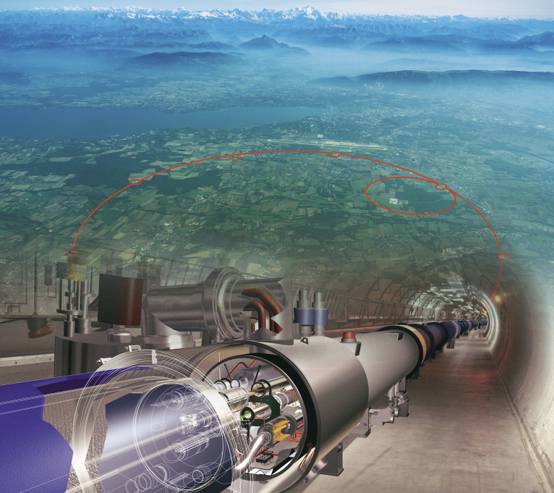

Physics at Energy Frontier
Sergei Shmatov (LHEP JINR, Dubna)
shmatov@cern.ch shmatov@jinr.ru
MISP2022
24 July - 2 August

Slide 2
Content
Lecture 1
HEP Experiments at accelerator facilities
  Why we need accelerator facilities?
  Do we need more and more new accelerator facilities?
LHC and Experiments at the LHC
  Hot points of particle physics vs LHC
  Conception, design, construction
  Challenges and solutions
Lecture 2 (recent experimental results)
Standard Model
Higgs Physics
Lecture 3 (recent experimental results)
  Physics beyond the SM
  LHC Prospects and Plans
  Beyond the LHC

Slide 3
Lecture 3
  Physics beyond the SM
  LHC Prospects and Plans
  Beyond the LHC

Slide 4
Why we are still expecting the New Physics?

Slide 5
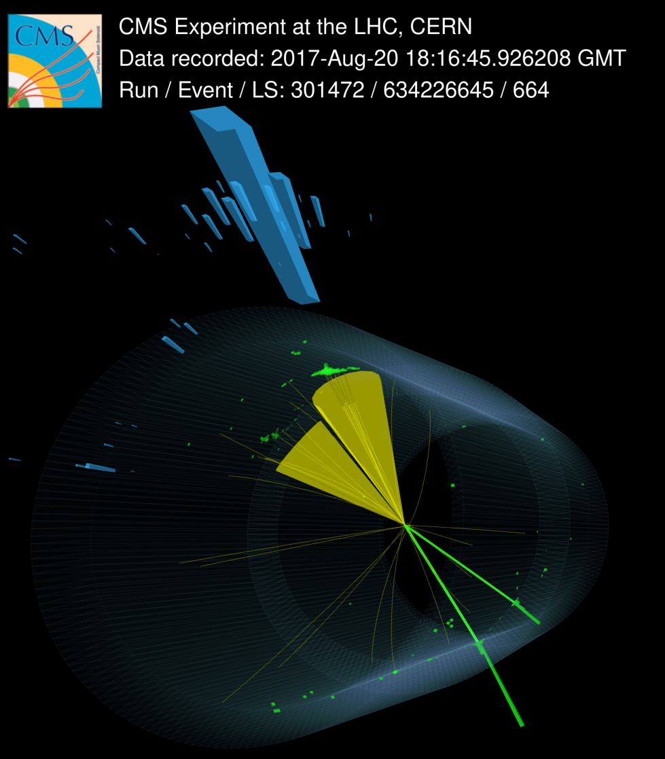
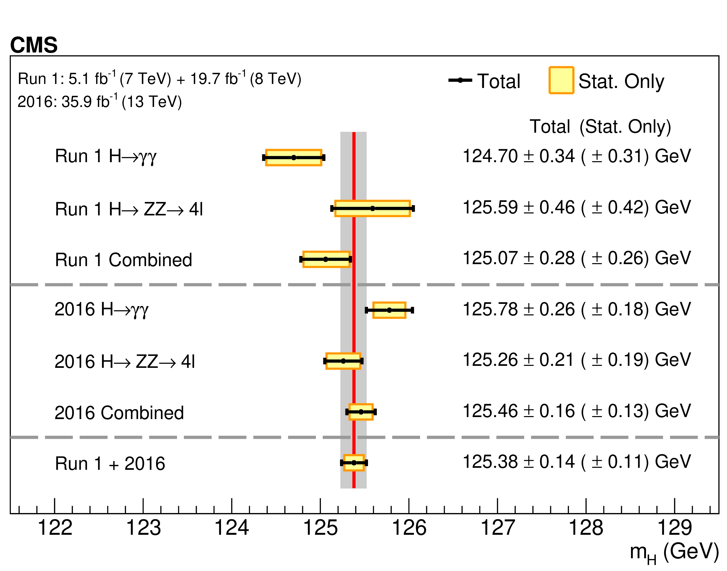
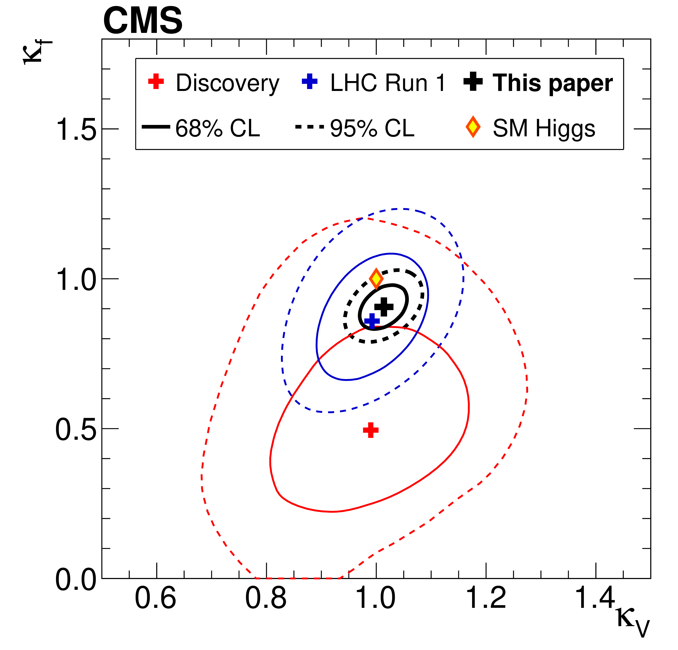

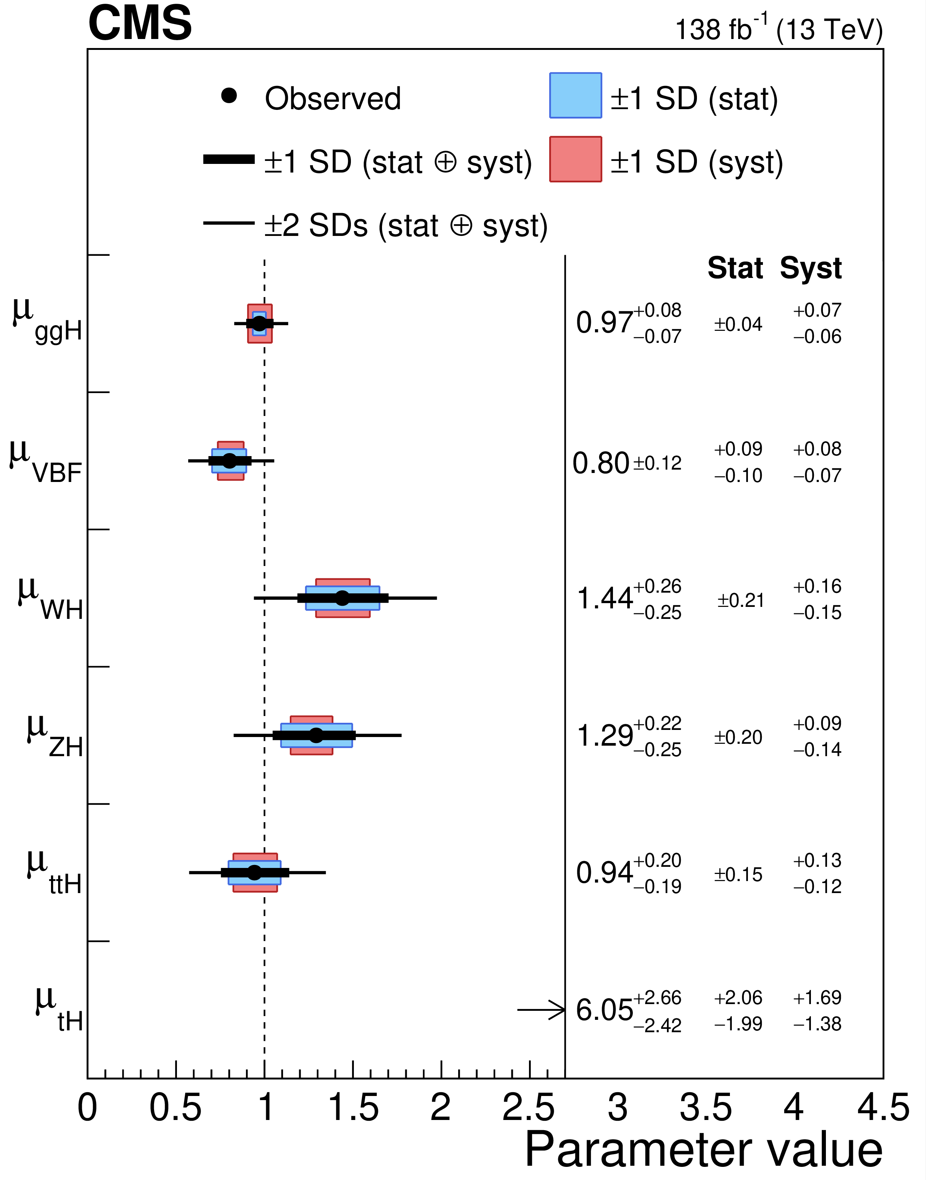


Higgs Portrait after 10 Years
During Run 2 of the LHC the experimental collaborations started to employ the combined data for precision measurements of Higgs properties (mass, width, couplings, CP, rare decays)
All main production mechanisms are observed, including h → bbar, ttH, VH
Mass of Higgs boson m_{h} is measured with an accuracy of 0.1% (!)
Precisions of cross section and branching ratio measurements in combined channel are down to 8.5% level
We have ~6-30% accuracy for measurements of couplings
The absolute value of a width is getting closer to the SM expectations (4.1 MeV). We still need to improve an accuracy.
Spin, parity, differential distributions do not contradict the SM

Slide 6
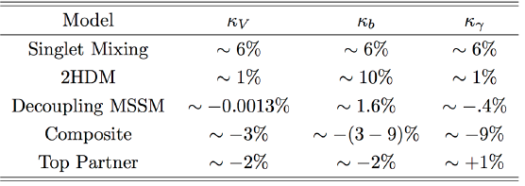
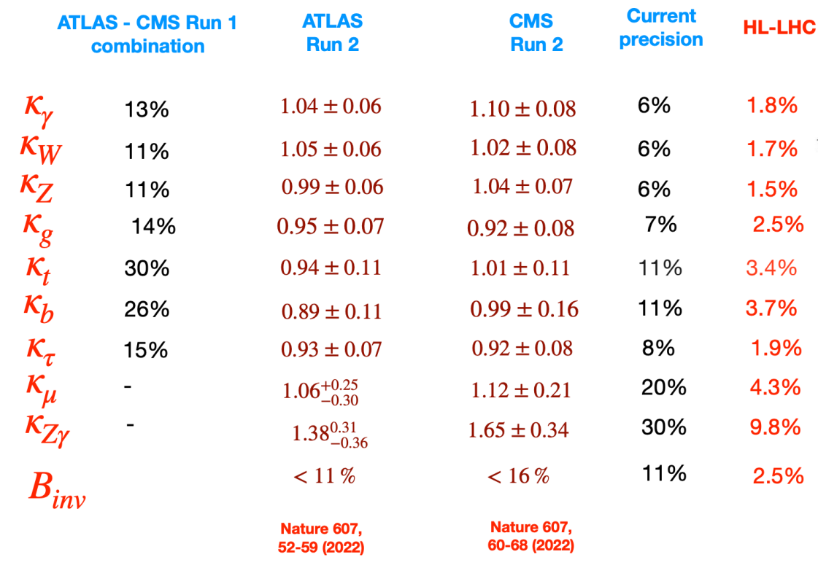
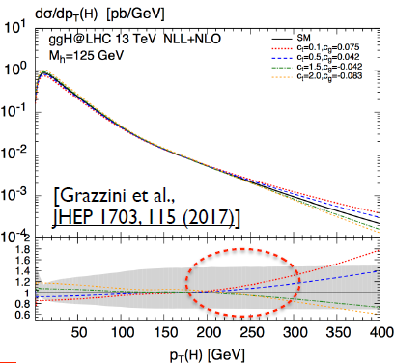
A room in Higgs Sector
… but the current accuracy of Higgs coupling measurements is still insufficient to reject BSM Higgs hypothesis
EPJC 79 (2019) 421
Summary of Higgs Couplings Measurements
Br(h₁₂₅→inv) < 0.11
Measurements precision continuous increasing
Search for new higgs states and other BSM
  BSM effects on in the differential distributions

Slide 7
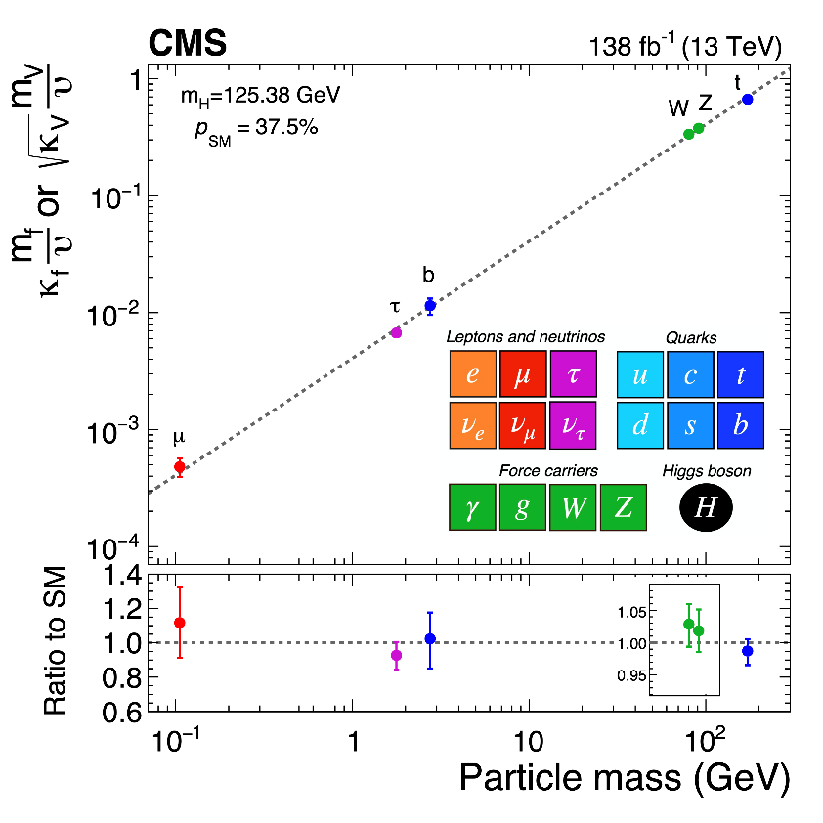
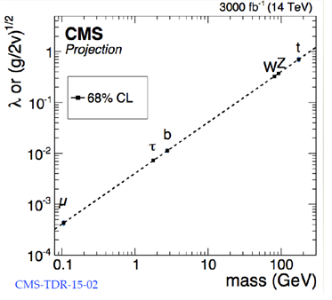
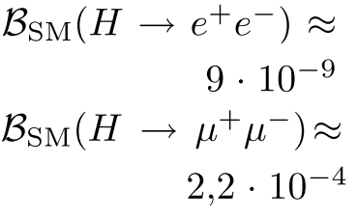


Another Hint from the Higgs: Flavour Universality
The properties of the Higgs h₁₂₅ agree fully with SM in decay into
gauge bosons
3rd generation fermions (t/b/τ)
and do not conflict with results for the 2nd generation (no deviations in cc/μμ decays after RUN2)
μμ: 3σ
CMS HL-LHC Projection
JHEP 01 (2021) 148
We do not know and will not know until the end of the LHC whether the coupling of the Higgs h₁₂₅ to 1st generation fermions is in a “standard” way or not.
If we have no Extra Higgses! (rare decays are enhanced within Extended Higgs Sectors)

Slide 8
Lepton universality in beauty-quark decays
SM
NP
arXiv:2103.11769 Nature 18, 277 (2022)
3.1 σ

Slide 9
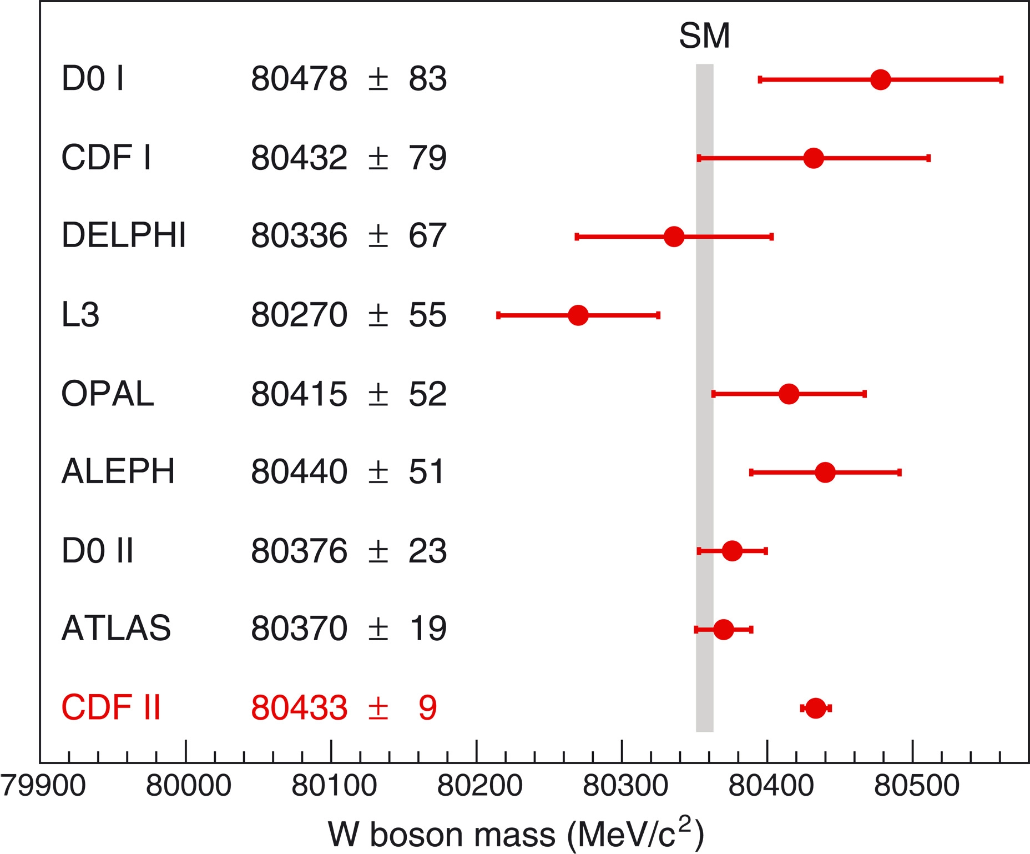
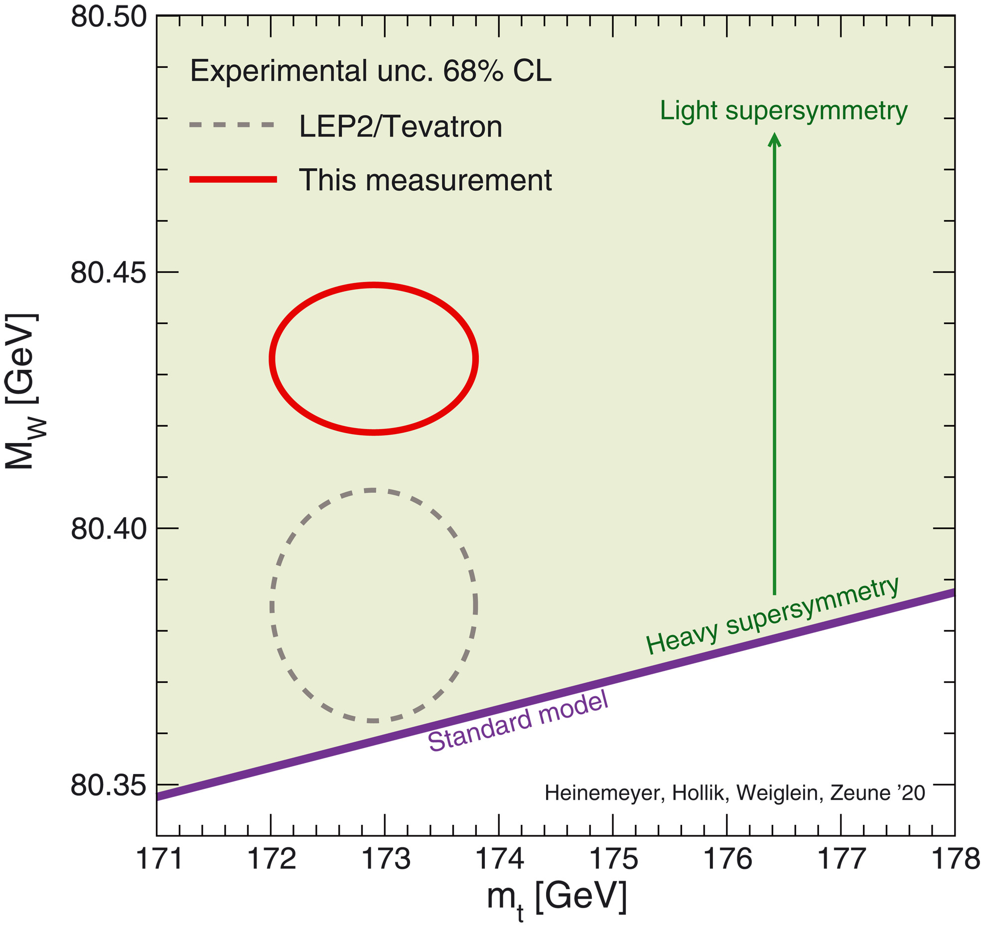
W boson mass with the CDF II detector
7 σ, 8.8 fb⁻¹
Science Vol 376, 170-176 (2022)

Slide 10
How we can escape beyond the Standard Model
SU(3)_{с}×SU(2) ×U(1)?
Simplest extension of SM (based on SM gauge group)
  4 generation of fermions, q*, l*…
Extended gauge sector
  ExQCD (colorons, axigluons, diquarks etc)
  ExEW (W’, Z’, …)
  GUT (leptoquarks)
Extended Higgs Sector
  Higgs Doublet Models (HDM)
  Higgs in ED, Higgs-Radion mixing, composite Higgs (RS type)
Hierarchy problem
  SUSY
  Technicolor (technibosons and technifermions, leptoquarks …)
  Extra dimensions (ED)
    КК-modes of particles SM, KKPV, FCNC…
    microscopic black holes (semi-classical, string balls, quantum black holes)

Slide 11
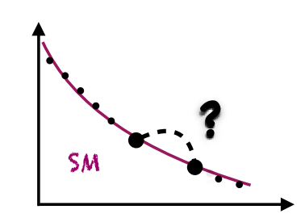
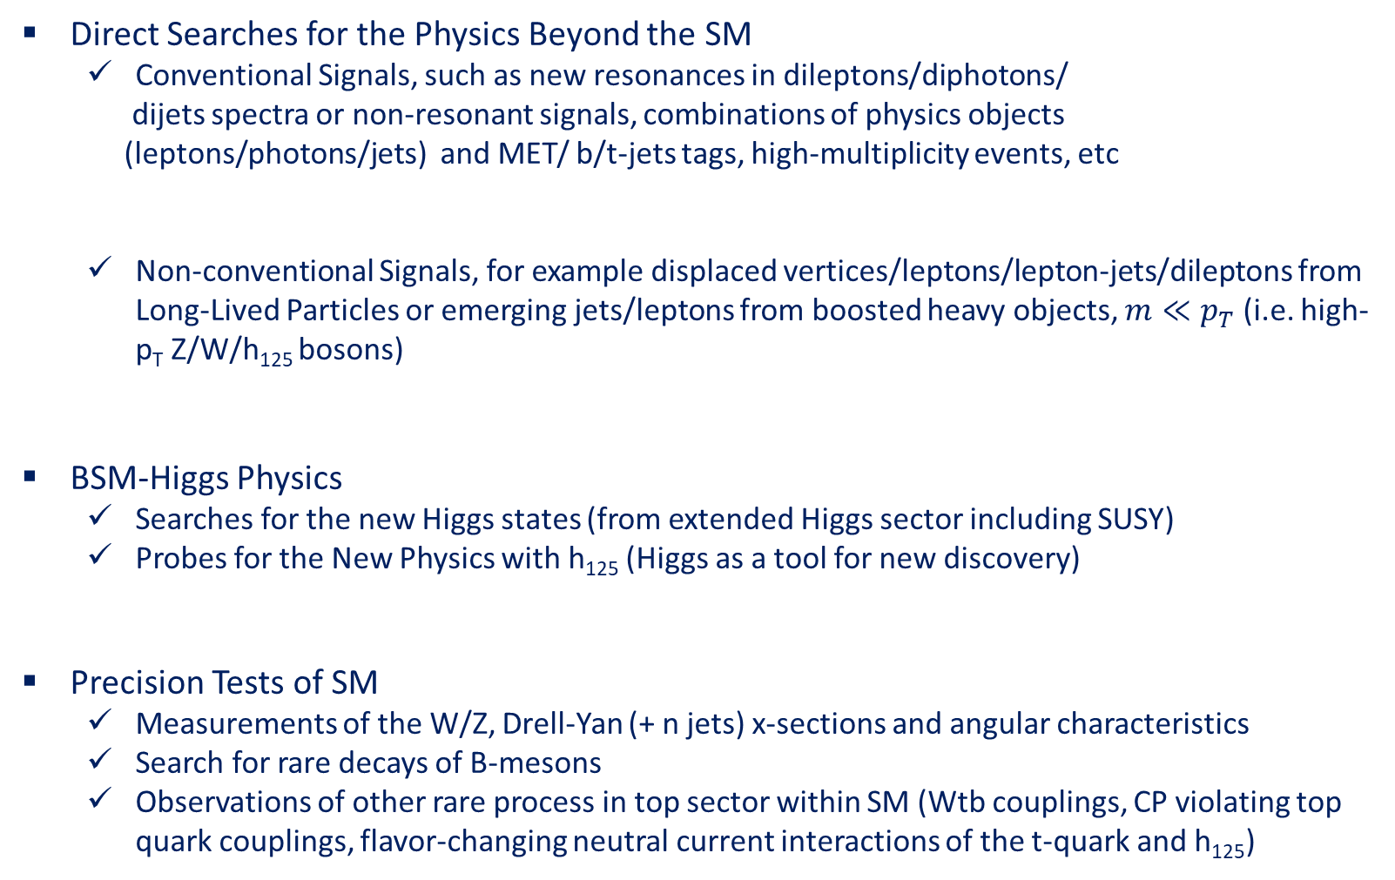
BSM Analyses in the LHC Collaborations
Direct Searches for the Physics Beyond the SM
  Conventional Signals, such as new resonances in dileptons/diphotons/
  dijets spectra or non-resonant signals, combinations of physics objects
  (leptons/photons/jets) and MET/ b/t-jets tags, high-multiplicity events, etc
  Non-conventional Signals, for example displaced vertices/leptons/lepton-jets/dileptons from Long-Lived Particles or emerging jets/leptons from boosted heavy objects, $m≪p_{T}$ (i.e. high-p_{T} Z/W/h₁₂₅ bosons)
BSM-Higgs Physics
  Searches for the new Higgs states (from extended Higgs sector including SUSY)
  Probes for the New Physics with h₁₂₅ (Higgs as a tool for new discovery)
Precision Tests of SM
  Measurements of the W/Z, Drell-Yan (+ n jets) x-sections and angular characteristics
  Search for rare decays of B-mesons
  Observations of other rare process in top sector within SM (Wtb couplings, CP violating top quark couplings, flavor-changing neutral current interactions of the t-quark and h₁₂₅)
SUSY
Extended Gauge Sector
Extra Dimensions
CI/Excited Fermions/B3G
Leptoquarks
Long-Lived Particles (Dark Matter/Non-standard SUSY/Neutrino Masses/etc)
Extended Higgs and Dark Matter Sectors
Extra Higgses, Dark Matter, Flavour Universality Violation

Slide 12
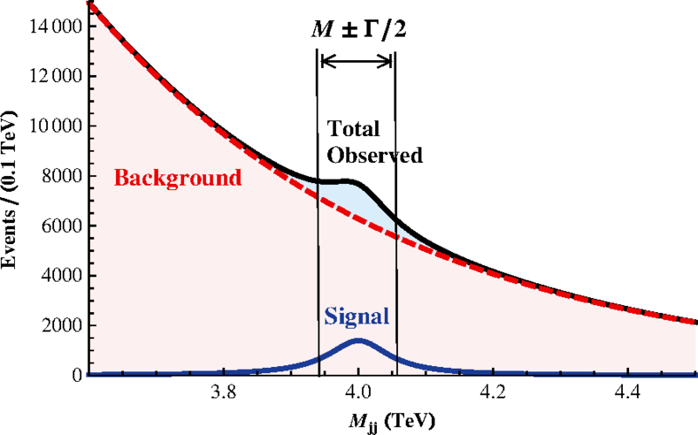
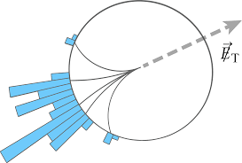
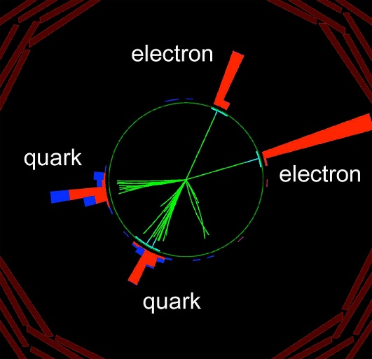
Conventional Signals
Heavy Resonances (extended gauge models, extra dimensions, technicolor) ⇒ dileptons, dijets, diphotons, ttbar, WZ
Non-Resonant Signals
Mono-particle + Missing ET (extended gauge models, extra dimensions, technicolor, SUSY) ⇒ mono-jet + MET, mono-photon + MET, mono-lepton + MET
Microscopic Black Holes (extra dimensions) ⇒ high-multiplicity events
Leptoquarks ⇒ lepton + jet
4th Generation ⇒ leptons/jets, dilepton

Slide 13
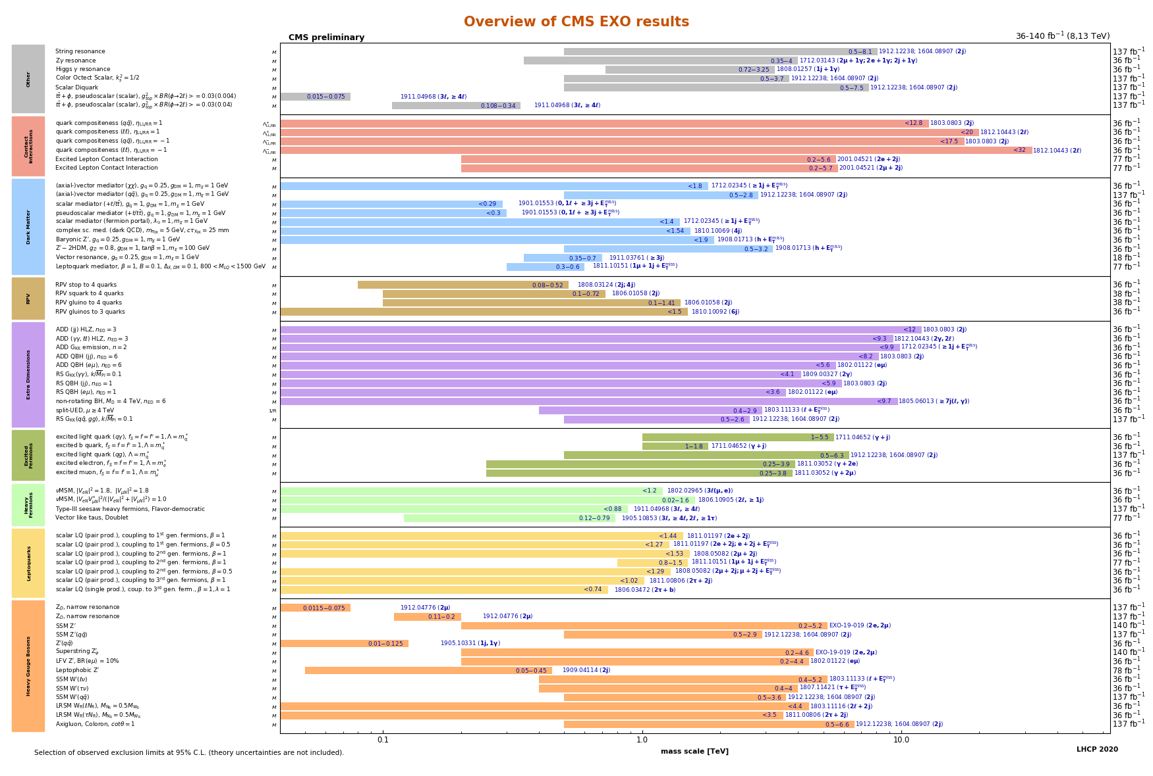
Direct Search for BSM: Conventional Signals
CI
Dark Matter
RPV SUSY
Extra Dimensions
Excited Fermions
Heavy Fermions
Leptoquarks
Heavy Gauge Bosons
1 TeV
10 TeV
30 TeV
https://twiki.cern.ch/twiki/bin/view/CMSPublic/SummaryPlotsEXO13TeV

Slide 14
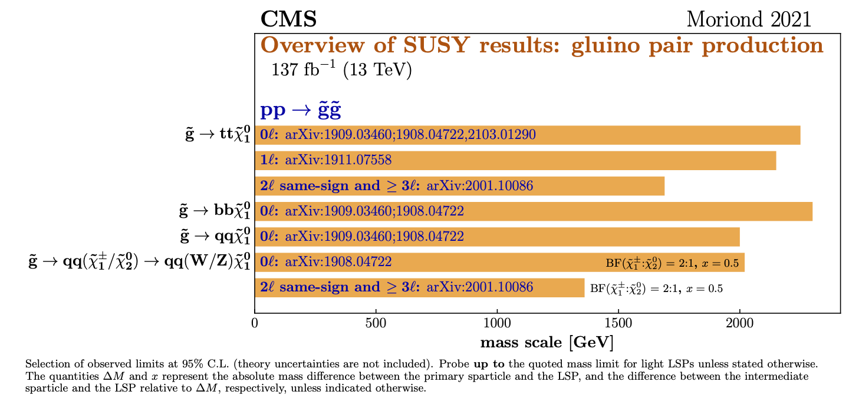
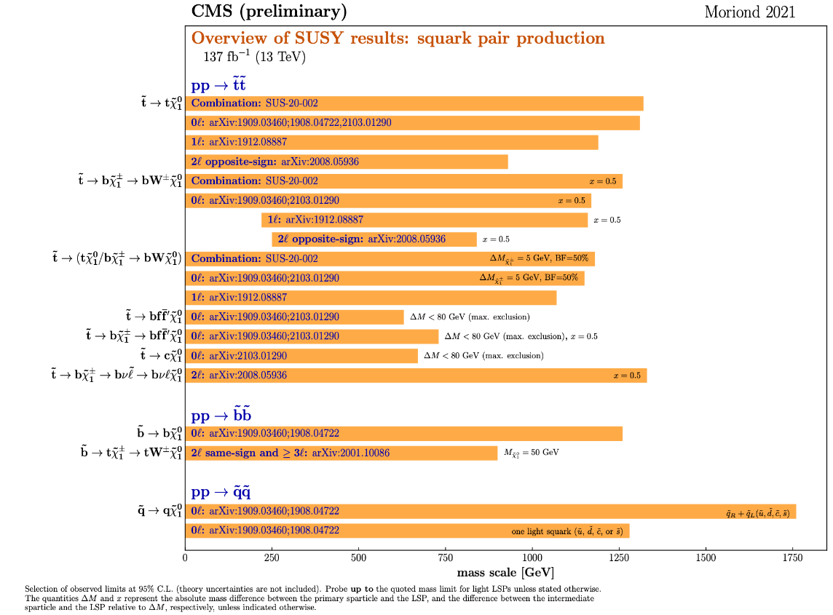
Direct Search for BSM: SUSY Signals
https://twiki.cern.ch/twiki/bin/view/CMSPublic/PhysicsResultsSUS#Run_2_Summary_Plots_13_TeV

Slide 15
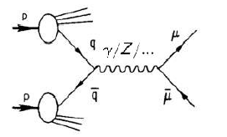

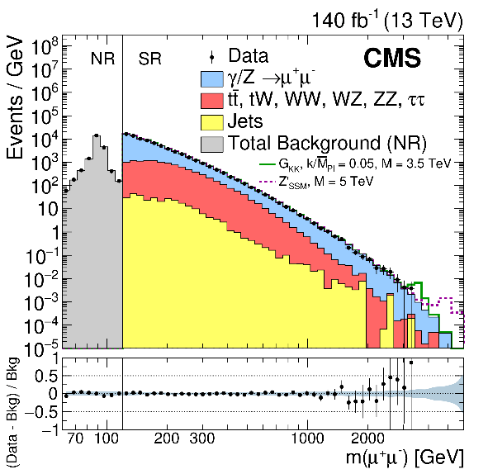
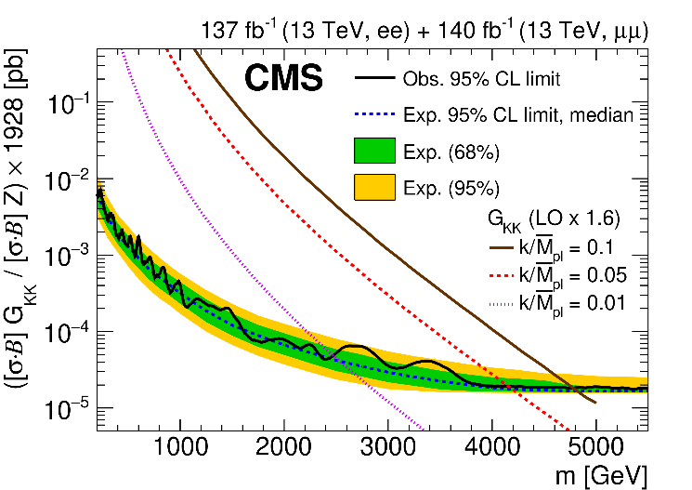
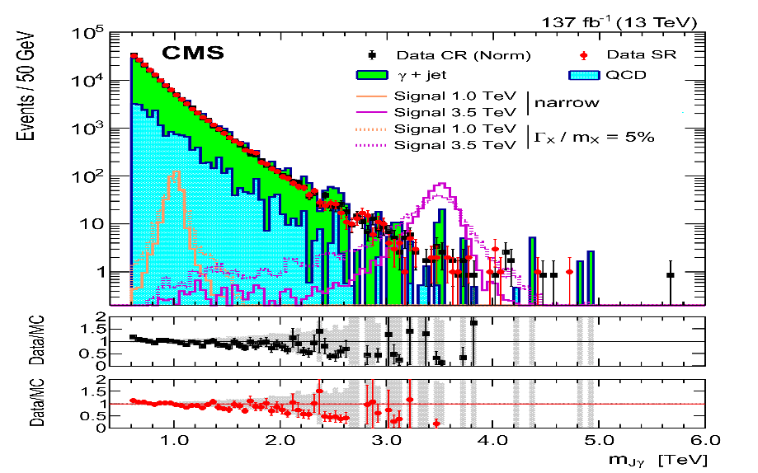
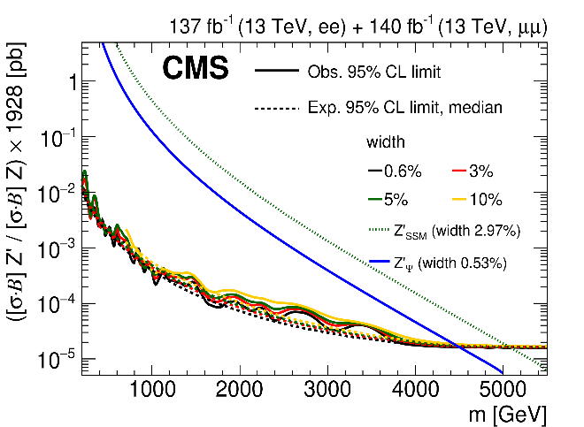
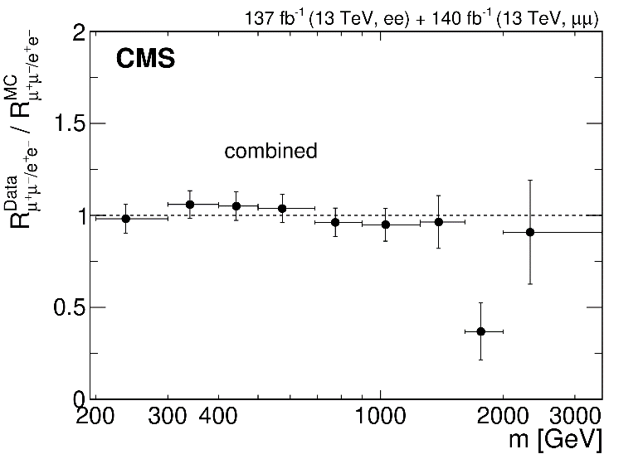
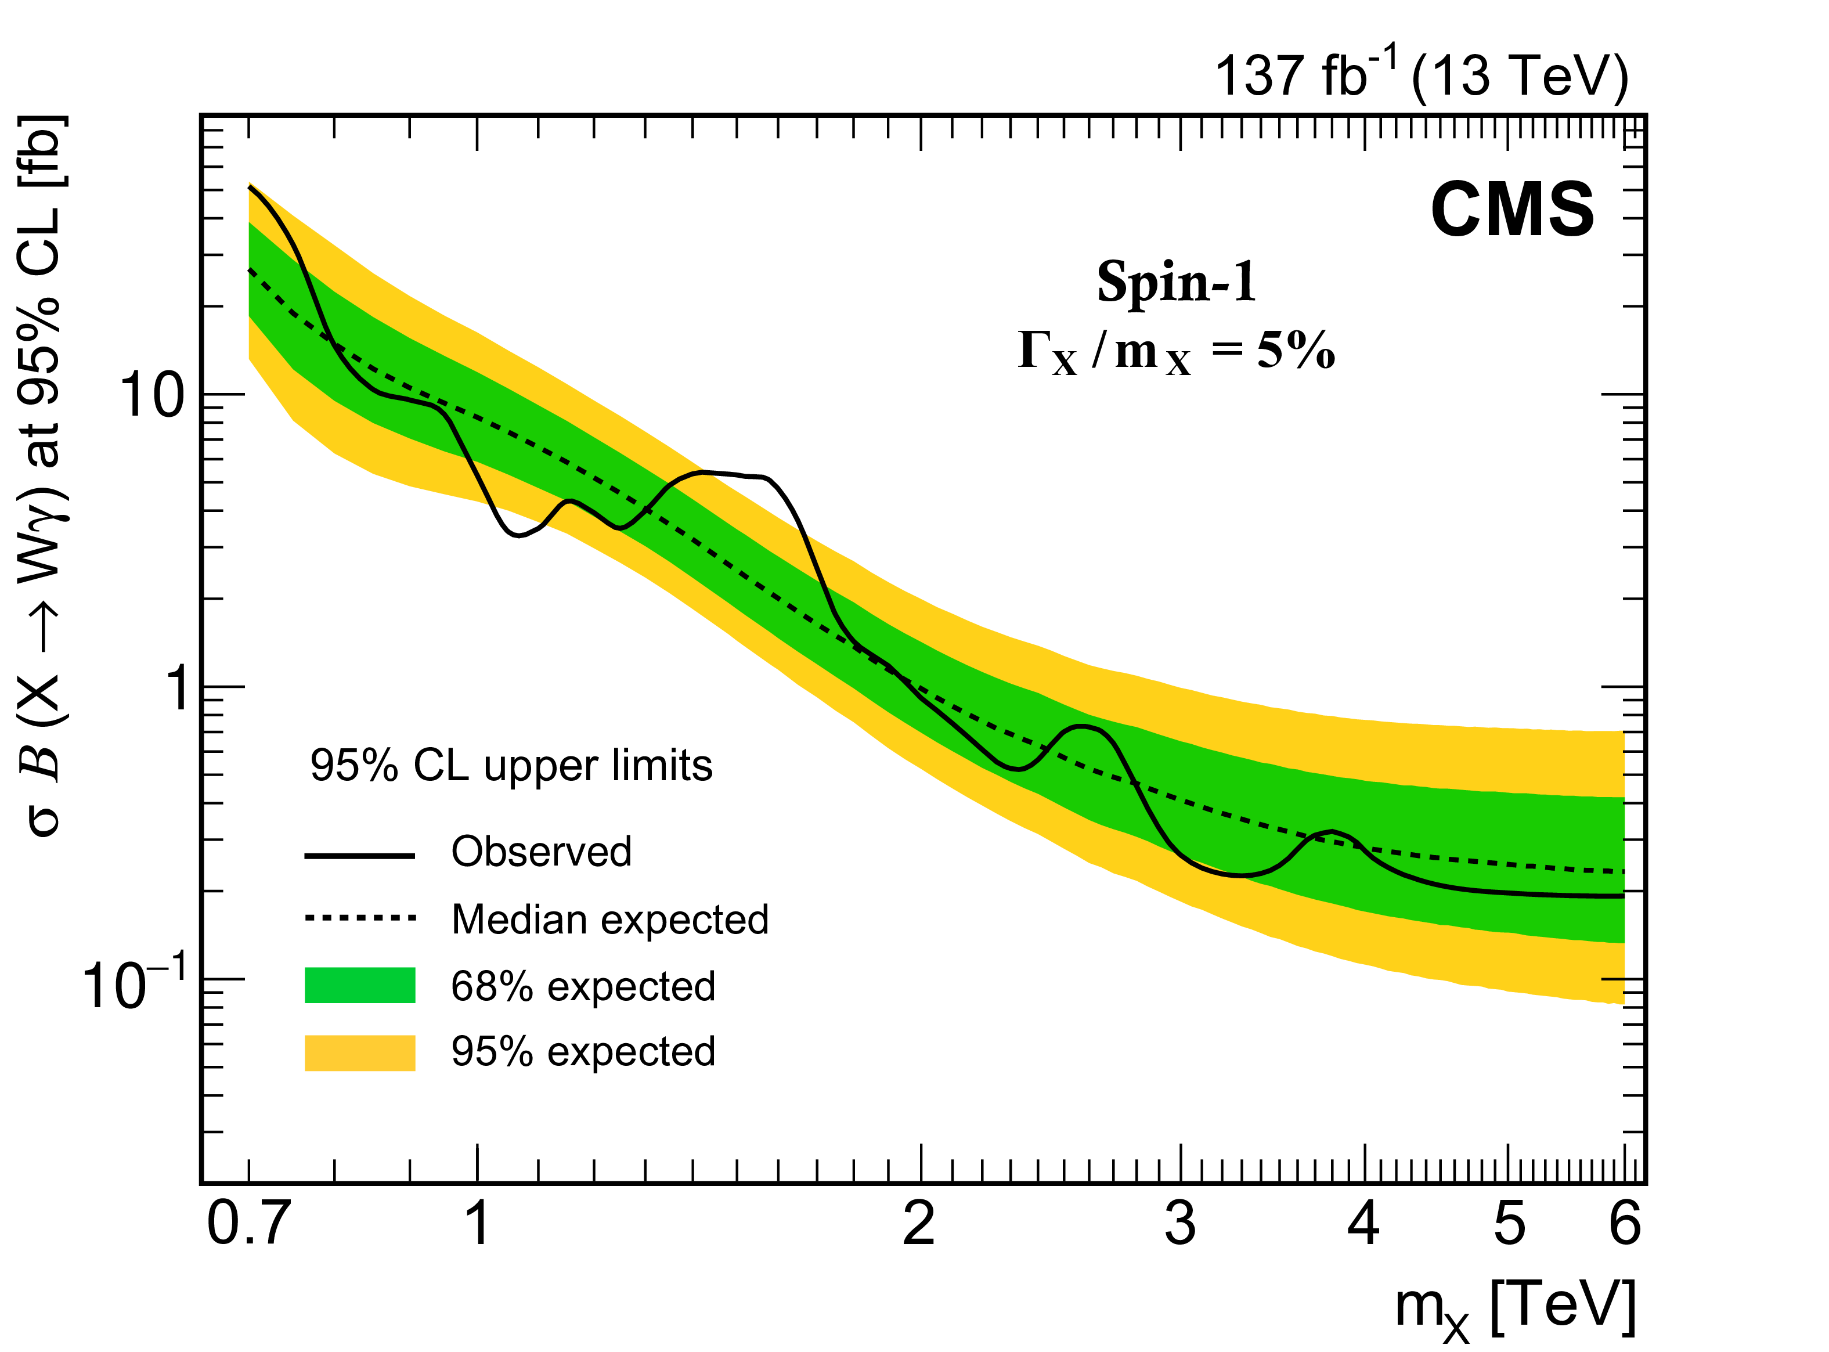
Searches for Heavy Resonances
New Physics (Z′/Z_{KK}/G_{KK}) contributions to SM processes
Dileptons, full RUN2 data
JHEP 07 (2021) 208
Wγ, full RUN2 data
PLB 826 (2022) 136888
RS1 graviton
Lepton flavor universality
Z’ boson
benchmark heavy scalar (vector) triplet bosons with masses between 0.75 (1.15) and 1.40 (1.36) TeV are excluded at 95% CL

Slide 16
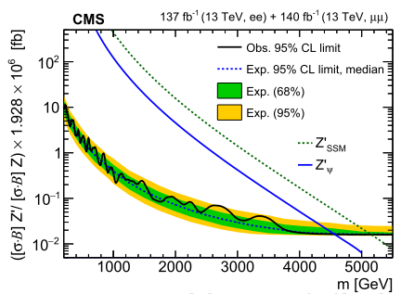
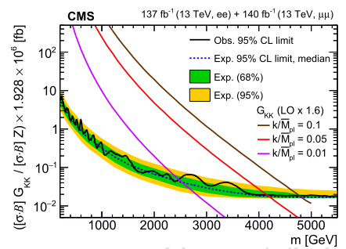
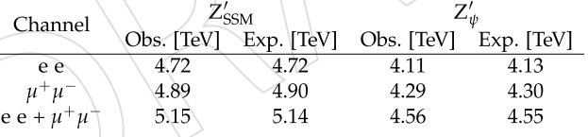
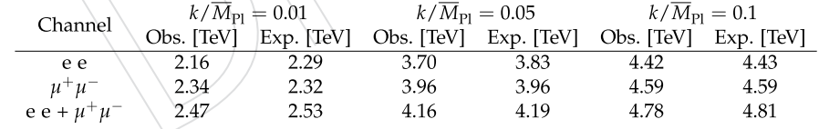
What does Brazilian Flag mean?
Dimuon example
Extended gauge models
Models of low-energy gravity (RS1-type scenario of ED)
SM predictions
BSM predictions
SM predictions
Mass limit
Model-independent limits on cross section (in narrow width approximation, NWA)

Slide 17
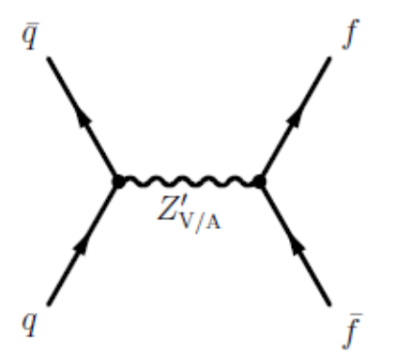
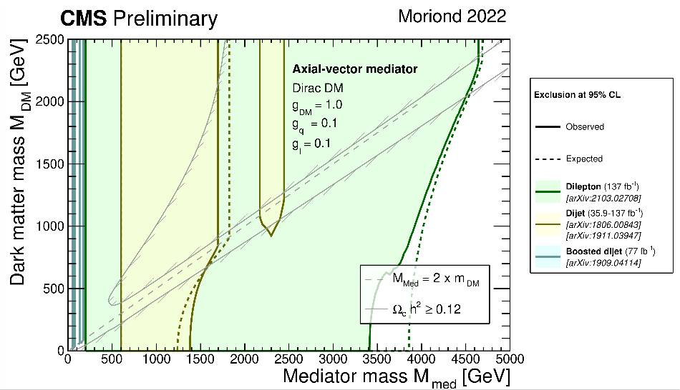
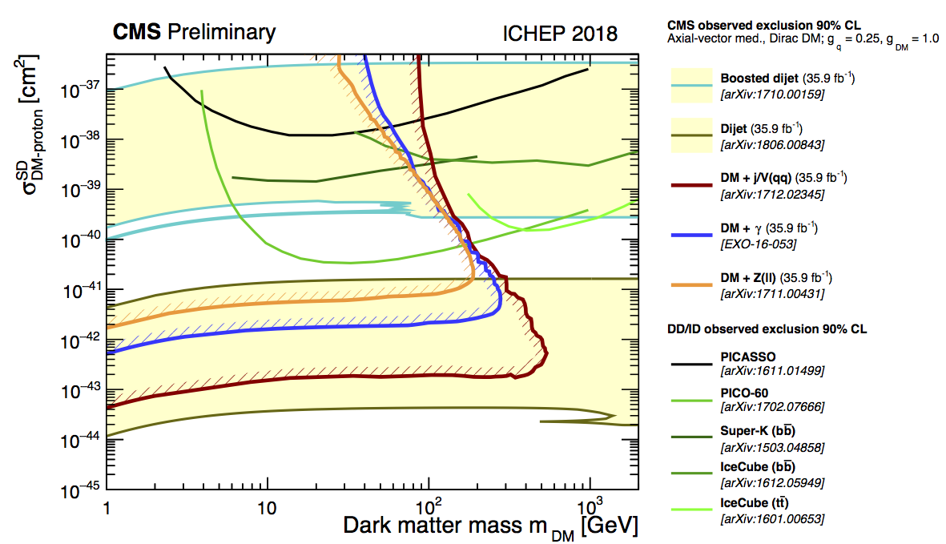
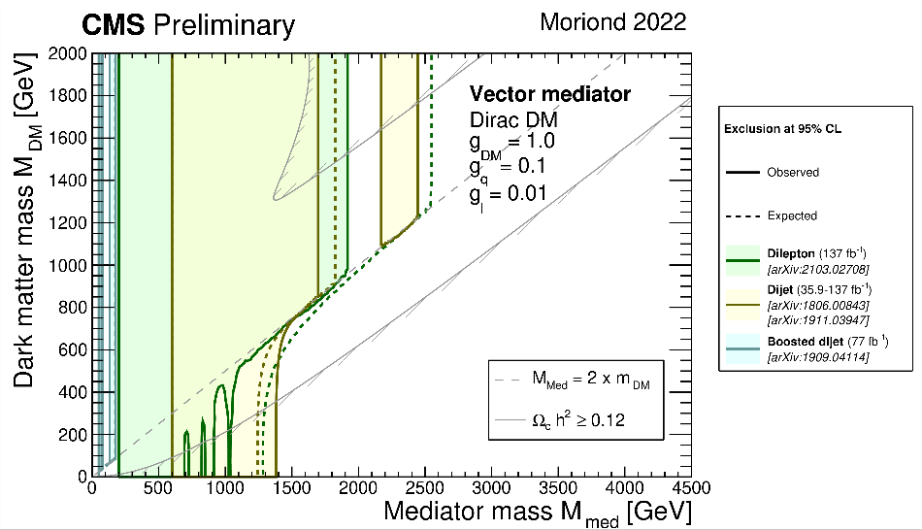
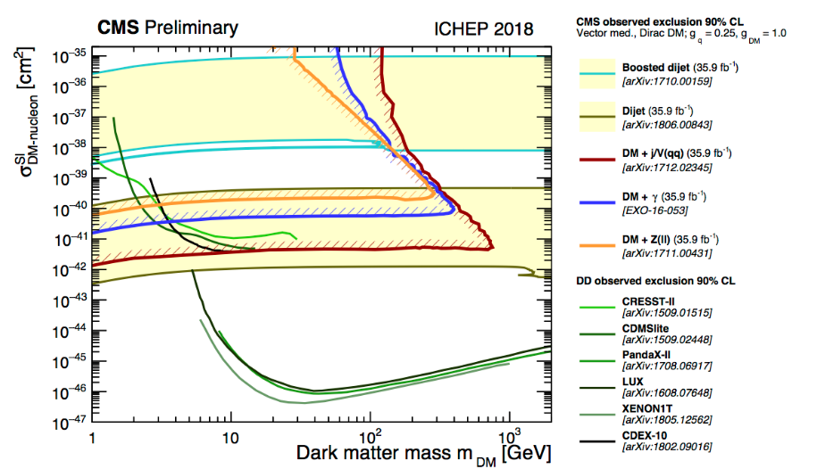
Example of Dark Matter Searches in Dijets+Dileptons
We consider a model that assumes the existence of a single DM particle that interacts with the SM particles through a spin-1 mediator, which can be either a vector or axial-vector boson.
V/VA
vector mediator with small couplings to leptons, g_{DM} = 1.0, g_{q} = 0.1, g_{l} = 0.01
axial-vector mediator with equal couplings to quark and leptons: g_{DM} = 1.0, g_{q} = g_{l}= 0.1
g_{q}
g_{q}
5 parameters:
m_{DM}, m_{Med}, g_{DM}, g_{l}, g_{q}
DM-nucleon upper limits on the cross section

Slide 18
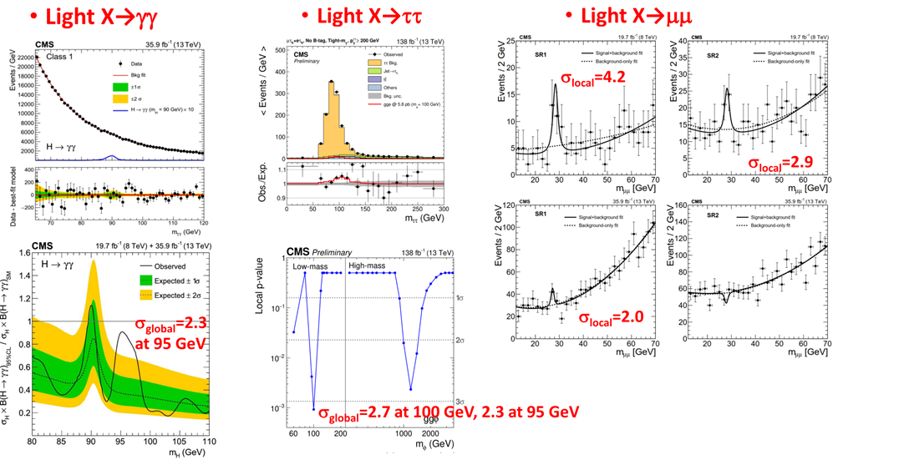


Some Selected Recent Excitements from LHC
RUN3 is a perfect judge for these challenges!

Slide 19
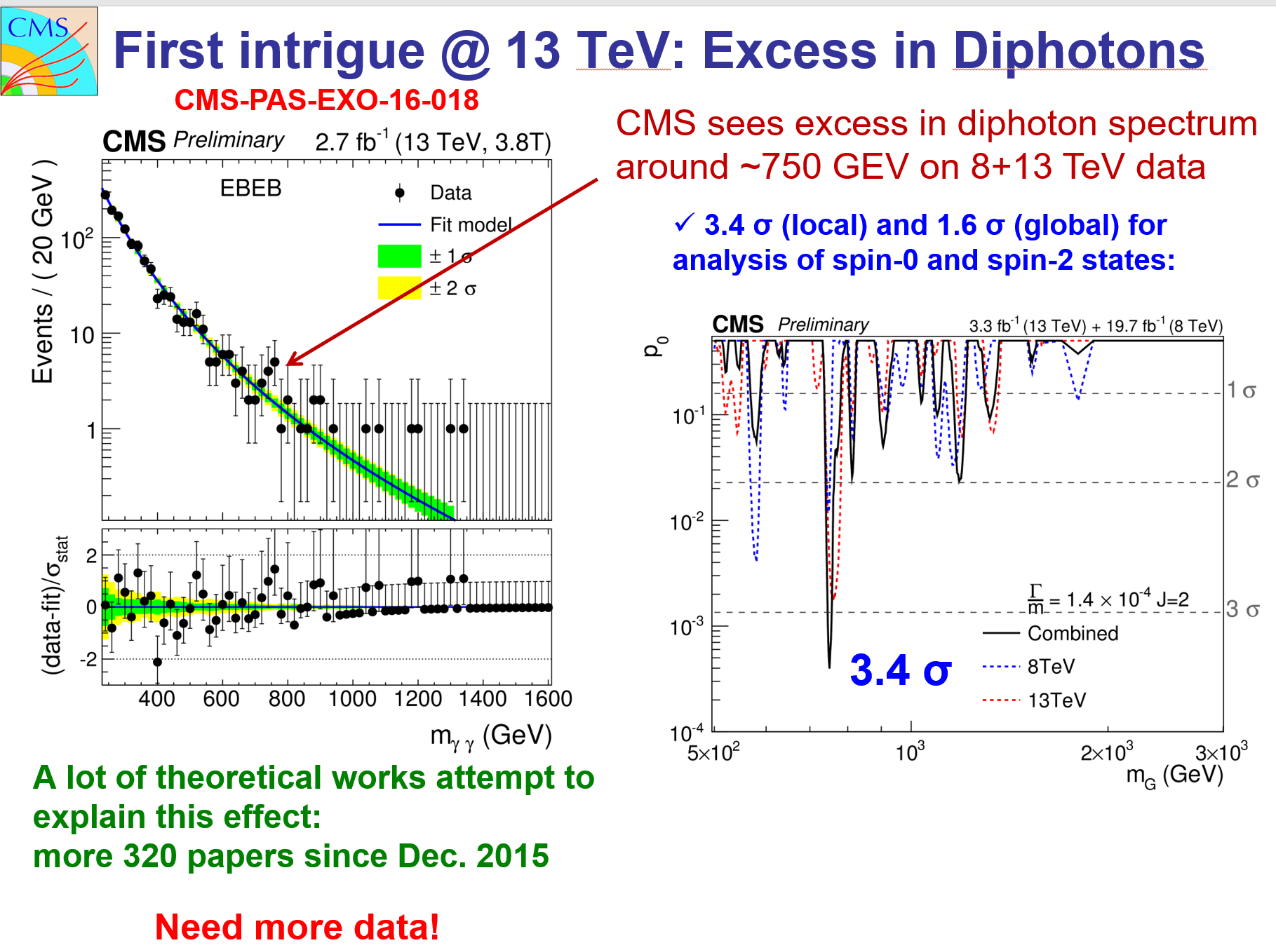
The case of the past days (γ γ excess in LHC data)

Slide 20
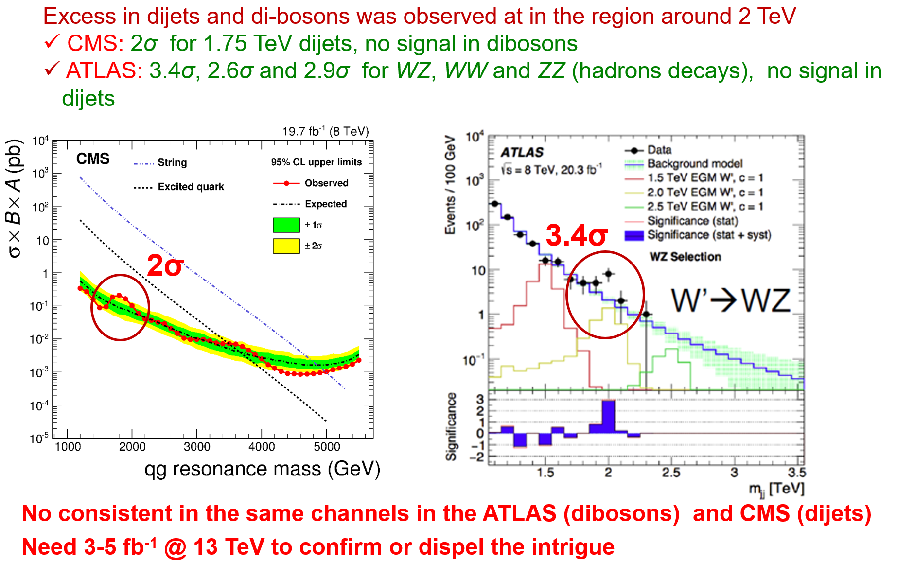
The case of the past days (excess in dijets and WZ)

Slide 21
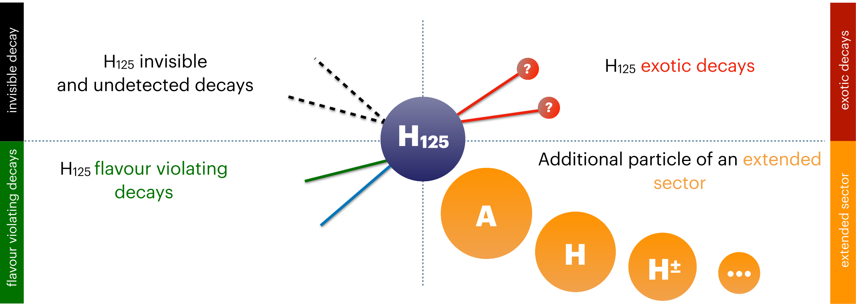

Higgs Boson as a Tool to Search for the New Physics

Slide 22
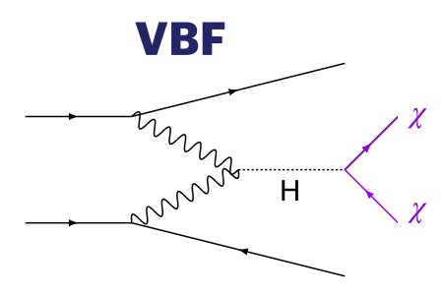
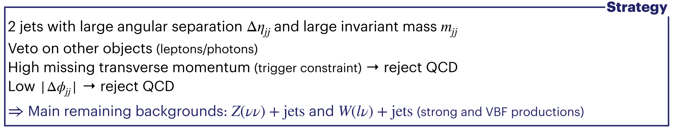
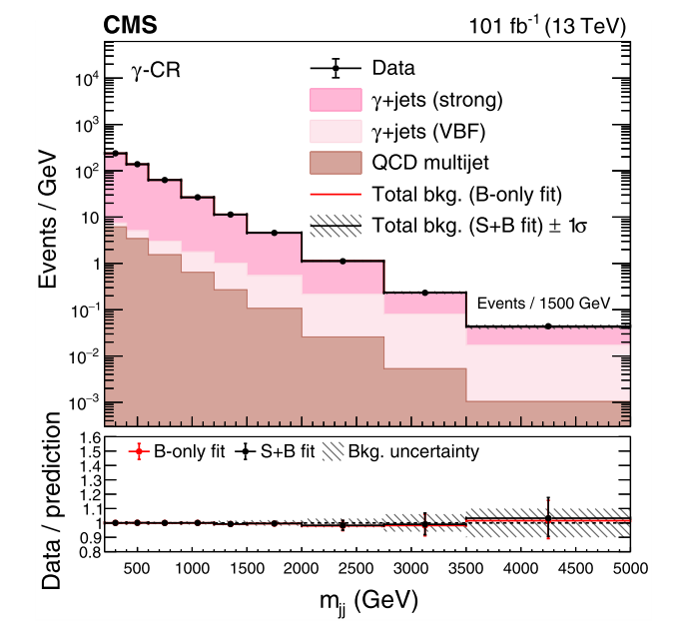
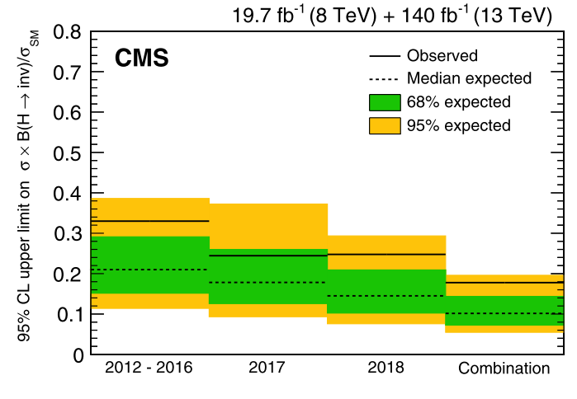
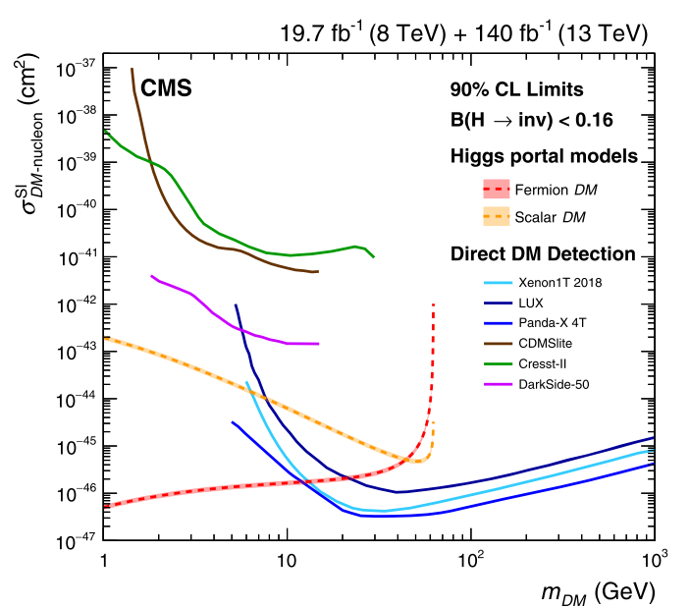


Higgs Invisible Decays
The expected in SM h₁₂₅ the branching fraction h₁₂₅ → inv
$$ℬ(h_{125}{ZZ}^{∗}4)=0.12\%$$
Several BSM scenario anomalous and sizeable values, ℬ is significantly enhanced
a simple extension of the SM to provide a Dark Matter (DM) candidate and are able to predict the observed relic DM density vis s-channel $χχ→f\overline{f}$
PRD 105 (2022) 092007
0.18 (0.12)
Low-mass region in the spin-independent dark-matter-nucleon scattering cross section

Slide 23
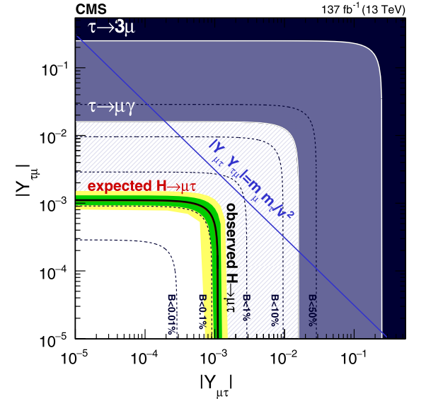
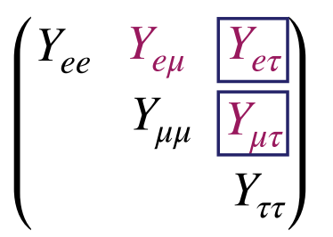



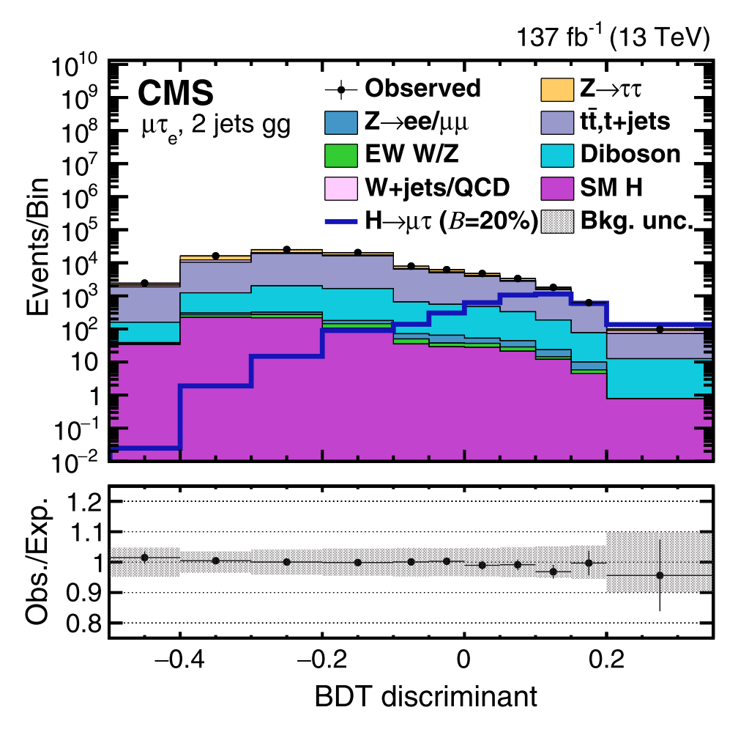
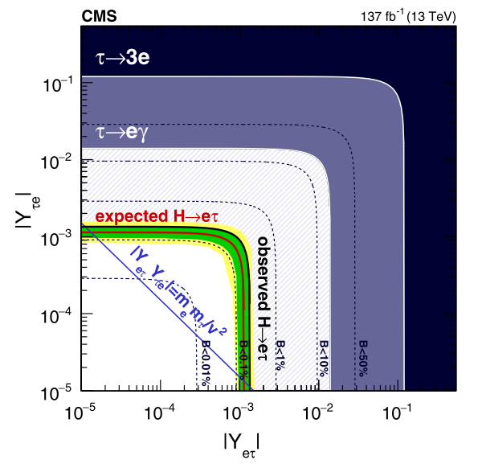



Lepton Flavour Violation Higgs Decays (1)
The decays $H$ $eμ/μτ/eτ$ trough the LFV Yukawa couplings arising in two Higgs doublet models, extra dimensions, models with flavor symmetries, models of compositeness, etc
  to verify h₁₂₅ hypothesis, $m_{ll}= m_{h_{125}}$ (type 1)
  to search for new higgs states, $m_{ll}≠m_{h_{125}}$ ⇒ broad invariant mass region (type 2)
type 1, ggH, VBF
PRD 104 (2022) 032013

Slide 24







Lepton Flavour Violation Higgs Decays (2)
The ﬁrst direct search for LFV $H→μτ/eτ$ decays for an Extra Higgs mass in the range $200 GeV<m_{H}$< 900 GeV (neutral heavy Higgs boson)
type 2, ggH, τ lepton decay products are highly boosted
ε_{τ} ≈ 70% (DNN)
The observed (expected) upper
limits (95% CL) is
µτ: 51.9 (57.4) fb to 1.6 (2.1) fb
eτ: 94.1 (91.6) fb to 2.3 (2.3) fb
JHEP 03 (2020) 103

Slide 25





Searches for Low-Mass BSM Higgses/DM in h₁₂₅ Decays
If m_{H} > 2m_{X}, some BSM scenarios allow Higgs bosons decays via one or two hypothetical on-shell new (pseudo)scalar(s) decaying to a pair of SM particles.
$$h_{125}→ZZD/ZDZD/ss/aa→4l$$
$$h_{125}→AA→4γ$$
CMS PAS HIG-21-016
EPJ C 82 (2022) 290
ex. 2HDM, 2HDM+

Slide 26

Summary of 2HDM+S searches at 13 TeV
https://twiki.cern.ch/twiki/bin/view/CMSPublic/Summary2HDMSRun2

Slide 27
BSM Higgs/V′ in Decays into h₁₂₅(+X)
If m_{H} < 2m_{X} , the finals states are possible with h₁₂₅ and SM gauge bosons
PRD 105 (2022) 032008
EPJ C 81 (2021) 688

Slide 28


High-mass BSM Higgs/X in Decays into 2h₁₂₅

Slide 29






BSM Higgs/X in Decays into BSM Particles
$$X→aa→4b$$
CMS-PAS-B2G-20-003
A $→a\left(→χ\overline{χ}\right)h125→MET+$ $h125$
EPJC 79 (2019) 280
JHEP 03 (2020) 25
2HDM+a
h→ $b\overline{b},$new pseudoscalar in
invisible mode
Free parameters: m_{A}, m_{H}, m_{S}, mixing angle between a and A $sinθ$, VEV ratio for two higgs doublets $tanβ$, couplings to SM and DM particles
The analysis is restricted to the mass ranges m_{a} from 25 to 100 GeV and m_{X} from 1 to 3 TeV.

Slide 30


BSM Higgs/X in Decays into SM Particles
VBF tag, Charged Higgs boson mass explored: 200 – 3000 GeV
EPJC 81 (2021) 723

Slide 31


Direct Search for BSM: LLP Non-conventional Signals
a proper lifetime cτ₀ is greater than or comparable to the characteristic size of the (sub)detectors
small cτ₀ that comparable to the inner tracker size, no displaced tracks → “standard” prompt decay
intermediate cτ₀ → LLP
very large/infinite large cτ₀ → stable particles, “standard” MET signatures

Slide 32

Inelastic dark matter at the LHC/LLP
https://arxiv.org/abs/1901.04040

Slide 33

Overview of CMS Exotica LLP Searches
https://twiki.cern.ch/twiki/pub/CMSPublic/SummaryPlotsEXO13TeV/barplot_RPV_RPC_OLL.svg
RPV SUSY
RPC SUSY
to be presented
today!
Other
33
More results:
http://cms-results.web.cern.ch/cms-results/public-results/publications/EXO/LLP.html

Slide 34







Displaced Dimuons
arXiv:2205.08582
Dark photon and Scalar BSM Higgs
BSM Higgs
boson
Dark photon
LLP
SM Higgs boson mixes with the dark-sector Higgs boson
Three categories of events:
STA-STA, TMS-TMS, and STA-TMS
  No significant excess of events above the standard model background is observed. The results are interpreted as limits on the parameters of a these two models

Slide 35

Displaced Leptons
EPJC 82 (2022) 153
RPV SUSY, GMSB, and BSM Scalar Higgs
Leptons could have common or different vertexes
μμ, ee and eμ final states were used
Trigger and event selection exclusively on displaced leptons
leptons |d0| is the main discriminating variable (up to 10 cm)
Data driven background estimation
DL+b-jets
DL+jets
DL+MET
DL+DL
RPV SUSY
GMSB
BSM Scalar Higgs

Slide 36





Displaced Jets
the dark sector particles continue traveling for a long time and traverse several meters (Long-Lived Particles) before tunneling back into our visible universe (quarks or leptons)
the Higgs is likely to be one of the candidates for a messenger role
displaced jets
“muon” jets
$$h →SS→4l or 4q$$
PRL 127 (2021) 261804
CMS Physics Briefings
This exciting tool opens up a new program of searches for LLP in a wide variety of theoretical models

Slide 37






LPP + Z bosons
JHEP 03 (2022) 160
Used as a spectator in the event
The multiplicity of displaced jets $N_{j}^{dis}$ is the the main discriminator variable. Signal region is $N_{j}^{dis}$≥ 2
No excess over the expected SM event rate is observed.
New limits on branching Higgs to LLP scalar particles (S) are reached

Slide 38
DM Searches: Comparison with Higgs Portal

Slide 39

LHC Prospects and beyond
“The New Accelerator”
by H. G. Wells

Slide 40

LHC/High-Luminosity Timescale

Slide 41

HL-LHC Detector Upgrades

Slide 42

Data “Scouting”

Slide 43
RECAST в “black box”
Data from cosmic experiments
LHC data @ Collison
Ponits (different topolgies)
Artificial Intelligence (AI) based on Machine Learning (ML)
LHC data @ Further
Experiments (MATHUSLA, CODEX, FASER, etc)
Limits on model parameters
(masses of new particles, couplings, mixing parameters, etc.)
Fix-target experiments
(SHiP, NA64, etc)
Future Experiments
(@FCC)
Theoretical models

Slide 44


Run-3 High-Mass Reach

Slide 45


HL- LHC Projects (Higgs)

Slide 46



LHC Satellite Experiments
CMS/ATLAS
CMS
Phys. Rev. D 99 (2019) 015021
https://arxiv.org/abs/1901.04040
LHCb
ATLAS

Slide 47
LLP Lifetime

Slide 48


Slide 49





Future Circular Colliders (100 TeV pp)
The launch
point is 2020
Nature Physics 16, 402–407 (2020)

Slide 50


FCC Projections
Reach on the Higgs and anomalous gauge couplings
Constraints on the energy scale of effective field theory operators
Nature Physics 16, 402–407 (2020)

Slide 51

Precisions achievable at FCC-ee

Slide 52




e+e- Colliders

Slide 53


Higgs boson is found
Standard Model works
Extensive Searches for New Physics
  No significant signals
  A set of hints
  A number of future projects

Slide 54

Particle physics isn’t going to die — even if the LHC finds no new particles
Anyway…

Slide 55

The Hitchhiker's Guide to the Galaxy
by Douglas Adams

Slide 56

Оорт первый взглянул на звездное небо и заметил, что Галактика вращается
(с) Г. Проницательный

Slide 57

THANK YOU FOR YOUR ATTENTION!

Slide 58





Статистический анализ
Событие (результат) называется “статистическими значимым”, если оно вряд
ли произошло случайно
p-valuе - вероятность получить результат, такой как наблюдается (или выше)
в предположении, что нуль-гипотеза верна
⇒ в нашем случае вероятность, того, что флуктуация фона достигли (или превысили) наблюденное значение
Нуль-гипотеза – основная проверяемая гипотеза (фон)
⇒ Нулевая гипотеза отвергается, когда значение p-value
меньше уровня стат. значимости α (по соглашению <0.05)
Масштабный фактор (strength factor)
σ_{SM} – сечение бозона Хиггса в CM, σ - гипотетическое сечение бозона Хиггса

Slide 59


Slide 60


Slide 61


Slide 62


Slide 63


Look Elsewhere Effect
@ A.Korytov

Slide 64


.
“Охота на Хиггса” в 2011 г
В 2011 эксперимент CMS исключает существование бозона Хиггса в диапазоне масс: 127-600 ГэВ при 95% C.L. (128-525 ГэВ при 99% C.L. )
ожидаемый предел в случае
отсутствия бозона Хиггса
зеленые и желтые области
соответствуют 68% и 95%
стандартным отклонениям от
ожидаемого предела
CMS-PAS-HIG-11-032
Публичные результаты совместного анализ данных экспериментов ATLAS и
CMS использовали меньшую статистику (до 2.3 фбн-1) и поэтому исключили
меньший диапазон возможных масс (141-476 ГэВ)

Slide 65



Обнаружение нового бозона в 2012 г.
Поиски бозона Хиггса в 2011-2012 гг. привели к открытию нового бозона
с массой 125.3 ± 0.4 (stat.) ± 0.5 (syst.) ГэВ (объявлено 4 июля 2012 г.)
Вероятность (р-value)
флуктуации фона до
наблюдаемого количества
событий в данных CMS.
Статистическая значимость превышения сигнала над уровнем фона составляет 4,9 сигма.
Совместный анализ только по наиболее чувствительным и высокоточным каналам (γγ и ZZ) дает 5,0 сигма.
Вероятность флуктуации фона на такую величину оценивается как 1/3000000.
σ/σ_{SM} = 0.87 ± 0.23
канал WW: наблюдается широкое
превышение событий над фоном в
массовом распределении на уровне
1,5 стандартных отклонений.
канал bb и канал ττ: не наблюдается превышения событий.

Slide 66


Two doublet Higgs Model (2HDM)
Способ организации хиггсовского и юкавского секторов без привязки к
остальным свойствам модели и даже без фиксации полной модели
4 варианта конструкции без FCNC (2HDM type II ↔ хиггсовский сектор MSSM)
2HDM: два комплексных скалярных дублета
⇒ 5 физических (наблюдаемых) состояний
нейтральные CP-четные h, H (смешивание с
углом α, настроечный предел: h ≡ h₁₂₅ без примеси H)
нейтральное CP-нечетное A
заряженные H⁺, H⁻
$v_{1}^{2}$+$v_{2}^{2}=v^{2}≡{\left(246 GeV\right)}^{2}, \frac{v_{1}}{v_{2}}≡tanβ$
MSSM
Параметры: $tanβ$, sinα, массовые параметры
Расширения: 2HDM+S (2HDM+a в контексте ТМ), 2HDM+Z’_{V}…

Slide 67

Portals to Dark Sector

Slide 68

The simplest DM: one DM particle + one mediator

Slide 69

Higgs Portal

Slide 70
Fermilab Muon g − 2 Experiment
for J=1/2

Slide 71

MAssive Timing Hodoscope for Ultra-Stable neutraLpArticles
The full-scale detector could then become
operational by 2025-26.
CMS
https://arxiv.org/abs/1901.04040

Slide 72

Projected MATHUSLA sensitivity at the HL-LHC (1)
Exotic Higgs decays to LLPs
https://arxiv.org/abs/1901.04040

Slide 73


Projected MATHUSLA sensitivity at the HL-LHC (2)
“Dark Scalar” LLPs in the minimal SM+S extension where a scalar of mass mS mixes has mixing angle sin θ with the 125 GeV Higgs boson.
Right-Handed Neutrino LLP simpliﬁed model where the mixing with active neutrinos is dominated by the 2nd generation.
https://arxiv.org/abs/1901.04040

Slide 74


Простая реинтерпретация результатов
используем имеющиеся каналы наблюдения
доступны публичные результаты
топологии практически независимы
можно создать новые топологии событий
результаты могут быть абсолютно новыми
в перспективе возможность глобального фита по топологиям

Slide 75



Классические дилептоны: реинтерпретация EGM
Пример типичной реинтерпретации результатов поиска новых тяжелых резонансов
в рамках новых моделей BSM: использование модельно–независимый предела на
сечение для установления ограничений на массу новых узких резонансов со спином 1
и спином 2. Например, для расширенных калибровочных моделей GSM, LR и E₆
В приближении узкого резонанса NWA
EXO-19-019,
rev. 2021
коэффициенты, связанные с СФ
(модельно-независимые)
Первая реинтерпретация в данном канале,
начиная с RUN1
Позволяет в случае экспериментального обнаружения Z′ произвести отбор соответствующей ему модели

Slide 76



Темная материя на LHC: классические дилептоны
Максимально простая модель ТМ (Simplest DM model)
один векторный или аксиально-векторный переносчик (спин 1) взаимодействия СМ-ТМ (V/AV)
взаимодействие в s-канале (ДЯ-тип)
5 параметров:
m_{DM}, m_{Med}, g_{DM}, g_{l}, g_{q}
Два сценария (набора параметров)
векторный переносчик с подавленным лептонным сектором: g_{q} = 0.1, g_{DM} = 1.0, g_{l} = 0.01
аксиально-векторный переносчик с одинаковым взаимодействием с лептонами и кварками: g_{DM} = 1.0, g_{q} = g_{l} = 0.1
интерференция c переносчиками ДЯ (gamma/Z⁰) полагается несущественной (<5%)
JHEP 06 (2018) 120,
EXO-19-019, rev. 2021
M_{med} < 1.92 (4.64) TэВ при больших m_{DM} для векторного (аксиально-векторного) переносчика
M_{med} < 1.04 (3.41) TэВ при m_{DM} = 0

Slide 77






Сигнал типа 1: μ⁺e⁻ @ high-mass (1)
Дрелл-Ян-подобные процессы в s-канале
RPV SUSY
QBH
LFV EGM
JHEP 04 (2018) 073

Slide 78



Сигнал типа 1: μ⁺e⁻ @ high-mass (2)
Не избавляет от кинематического предела для резонансов! Но интересно =))
+ новые модели, выход за пределы квазиклассического приближения для МЧД
Z' gauge bosons with LFV transitions are excluded for masses up to 4.4 TeV
QBH limits are found between 3.6 and 5.6 TeV
resonant τ-sneutrino (can be LSP) production in R-parity violating supersymmetric models is excluded for masses below 1.7 TeV, for couplings λ₁₃₂=λ₂₃₁=λ′₃₁₁= 0.01.
JHEP 04 (2018) 073

