Slide 1
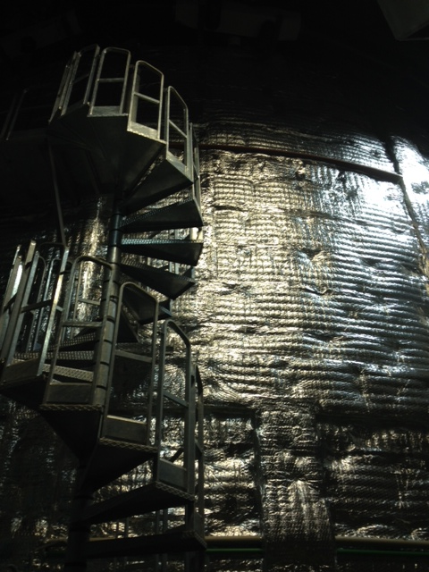
Neutrino physics:
Basics and
Developments
A. Yu. Smirnov
International Centre for
Theoretical Physics, ICTP
Moscow International School of Physics
February 28 - March 6, 2024

Slide 2
What neutrino physics is about?
Three aspects
Study of objects in which neutrinos play important or
dominant role in dynamics
Study of neutrino properties, their interactions and propagation
Stars, galaxies,
Universe
Interactions,
masses, magnetic moments, nature,
NSI, unitarity breaking
Neutrinos as a tool of studies of other particles and objects,
sources of neutrinos
Searches for BSM

Slide 3
Lectures on neutrinos
Standard Model, neutrino interactions and neutrino mass
Propagation, Oscillations and flavor conversion
Sources, fluxes, experiments, anomalies
Theoretical aspects

Slide 4
Δm₄₁² = 1 - 2 eV²
Standard model
Neutrino Interaction
LSND
and masses
Flavor, mass and mixing

Slide 5
Neutrinos in the SM
Chiral components
ν_{e}
e
ν_{μ}
μ
ν_{τ}
τ
I_{W} = 1/2
I_{3W} = 1/2
ν _{L} = ½(1 - γ₅) ν
L
L
L
ν _{R} = ½(1 + γ₅) ν
?
ν_{e} ν_{μ} ν_{τ}
neutrino flavor states, form EW doublets
(charged currents) with definite charged leptons,
ν_{l}
l
ν_{l}
ν_{l}
l = e , μ , τ
neutral
current
interaction
W
Z
g
2 2
g
4
l γ^{μ}(1 - γ₅) ν_{l} W⁺_{μ} + h.c.
ν_{l} γ^{μ} (1 - γ₅)ν_{l} Z_{μ}
Conservation of lepton numbers L_{e}, L_{μ}, L_{τ}

Slide 6
Flavor neutrinos
Flavor neutrinos:
ν_{e}
ν_{μ}
ν_{τ}
are neutrinos associated with or
correspond to certain charged leptons
The correspondence is established
by the charged current weak interactions
e
μ
τ
Flavor is characteristic of interactions
Flavor states -- Weak interaction states
In the presence of vacuum mixing (masses) - ambiguity :
Two ways to determine flavor states
Theoretically
Phenomenologically
at the Lagrangian
(weak current) level

Slide 7
Production of flavor states
Elementary interactions
Determine processes of
neutrino production,
Scattering, absorption
Charged current weak interactions
ν_{e}
β− decays,
(A, Z) → (A, Z + 1) + e⁻ + ν_{e}
ν_{μ}
π − decays, due to
chirality suppression
π → ν_{μ} + μ
ν_{τ}
D_{s} – decay, beam dump
Z is flavor blind

Slide 8
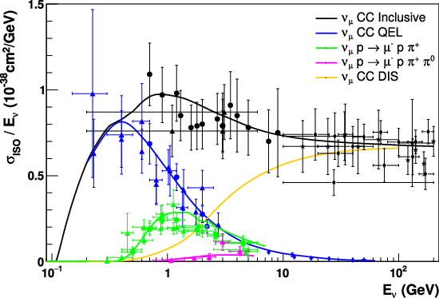
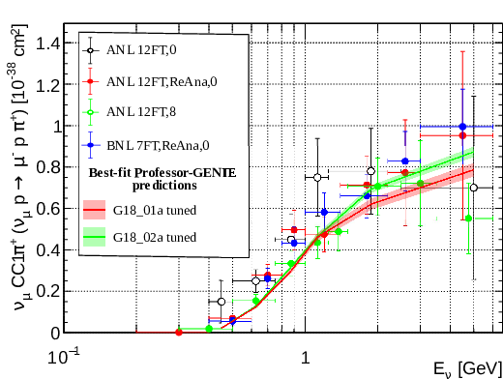
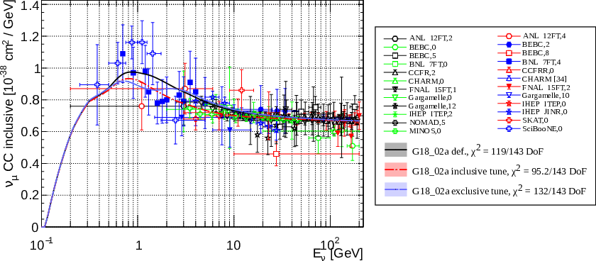
Neutrino Interactions
E² resonances E

Slide 9
Coherent elastic neutrino-nucleus scattering, CEνNS
ν_{α}
q = p – p’
ν_{α}
q 3 momen-
tum of Z
Z⁰
λ_{ν} << r_{N}
λ_{ν} > r_{N}
N
N
|q|⁻¹ > r_{N}
T –recoil energy
of nucleus
Neutrino microscope
can resolve
can not
resolve
|q|² = 2MT
nuclear structure
M- mass of nucleus
coherence
Coherence of scattering:
Difference of phases of waves from scattering on different nucleons in nuclei is much smaller than 2π → constructive interference , no cancellation

Slide 10
CEνNS
D.Z. Freedman, Phys.Rev. D9 (1974) 1389
Cross-section of ν- scattering on nucleus N with spin 0
dσ
dT
G_{F}²M
π
MT
2E_{ν}²
= 1 - [Q_{W}^{N} (|q|)]²
Strength, radius
squared of
interactions
Kinematic
factor
weak charge
of the nucleus
|q|²
|q_{max}|²
1 -
Q_{W}^{N} (|q|) = g_{V}^{n} n_{n}^{N} F_{n}^{N} (|q|) + g_{V}^{p} n_{p}^{N} F_{p}^{N} (|q|)
g_{V}^{n} = - ½, g_{V}^{p} = ½ - 2 sin² θ_{W} = 0.022 are Z⁰ couplings with neutron
and proton
n_{n}^{N} and n_{p}^{N} - numbers of neutrons and protons in nucleus N
F_{n}^{N} and F_{p}^{N} - form factors of n and p in the nucleus
For |q| << r_{N}⁻¹ : F_{n}^{N} , F_{p}^{N} → 1
Q_{W}^{N} (|q|) → g_{V}^{n} n_{n}^{N}
dσ /dT → (n_{n}^{N})²
→ enhancement

Slide 11
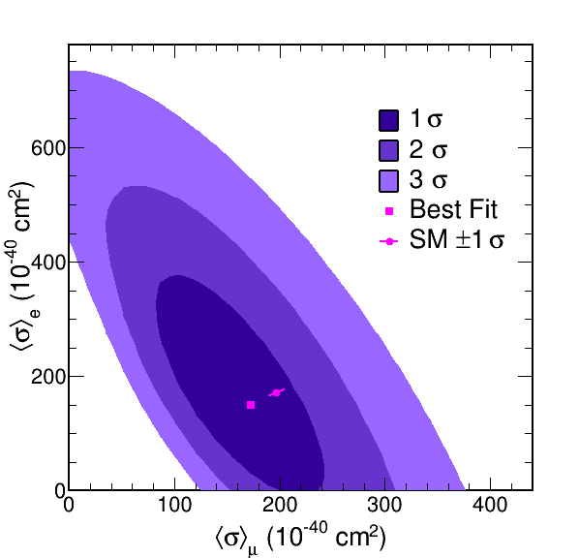
CEνNS on CsI
COHERENT Collaboration
D. Akimov , et al. PRL 129 (2022) 8, 081801 2110.07730 [hep-ex]
Neutrinos from π and μ decay at rest
→ scatt. not completely coherent
Target: Cesium-Iodine
Very good agreement with SM predictions

Slide 12
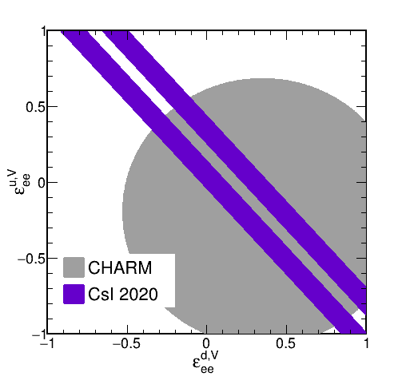
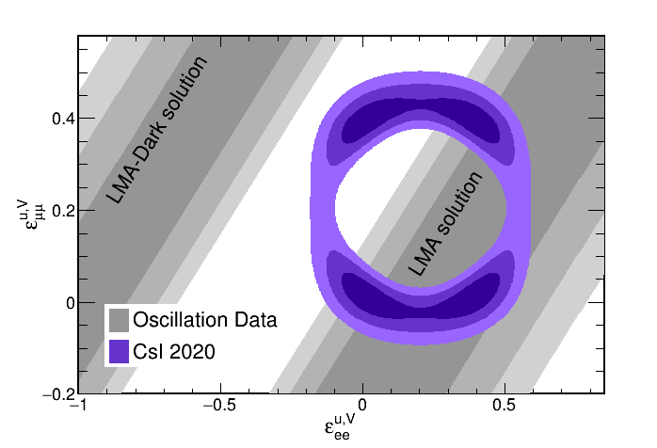
via
CEνNS: implications
Nuclear structure – distribution of neutron density
Precise measurements of NC interactions at low energies → determination of the weak mixing angle
Bound on neutrino non-standard interactions
ε_{ee}^{u,V}
Excluding the Dark solution of the solar neutrino problem → m₁ < m₂
- NSI coupling for
ν_{e} + u → ν_{e} + u
via vector current, etc.

Slide 13
Ultra HE neutrino interactions
Keping Xie, Jun Gao, T.J. Hobbs,
Daniel R. Stump, C.-P. Yuan,
2303.13607 [hep-ph]
For running astrophysical neutrino observatories, such as IceCube,
and future proposed experiments. Predictions for cross sections of neutrino DIS for energies from 100 GeV to 10¹² GeV (1000 EeV).
1. Used the latest CT18 NNLO parton distribution functions (PDFs)
and their associated uncertainties.
2. For ultra HE the PDFs were extrapolated to small x according to several procedures and assumptions → uncertainties corresponding to various choices.
3. The uncertainties introduced by the nuclear corrections which are required to evaluate neutrino-nuclear cross sections for neutrino telescopes.

Slide 14
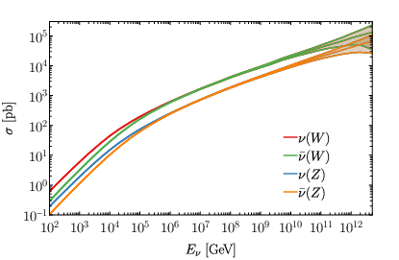
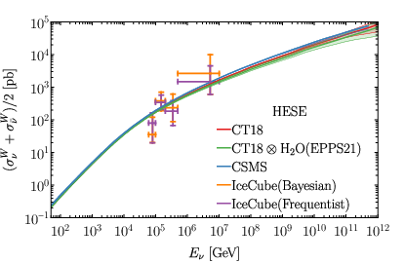
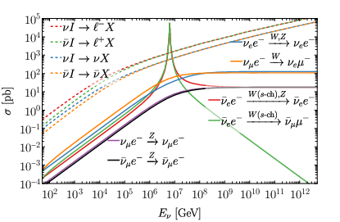
Ultra HE neutrino interactions
Keping Xie, Jun Gao, T.J. Hobbs,
Daniel R. Stump, C.-P. Yuan,
2303.13607 [hep-ph]
10⁻³¹cm²
s_{q} = xS
x - fraction of nucleon momentum carried by q
g⁴
32πm_{W}²
xS
xS + m_{W}²
σ = dx n(x)
parton number density
Glashow resonance
For partons with x < m_{W}² /S linear increase of cross-section with S continues

Slide 15
Δm₄₁² = 1 - 2 eV²
Neutrino masses
LSND

Slide 16
EFT and the neutrino mass
S. Weinberg
Only observed SM particles (multiplets) are involved.
New physics should be parametrized by high dimensional
(non-renormalizable) operators in the Hamiltonian.
Analogy with Fermi theory of WI at low energies
Next to the SM operators (D4) is the D5 operator
1
generates the Majorana neutrino mass
LLHH
Λ
<H>²
Λ
Large scale
of new physics
Other new physics appears in order Λ² → strongly suppressed
That’s all?
Will we learn more?
Violation of universality, unitarity

Slide 17
Right handed neutrinos are the key!
Their existence and properties play fundamental role
in understanding of masses and mixing of neutrinos .
Formally, they do not exist in the SM and their appearance is considered as physics BSM
Reasons:
- they do not have electroweak gauge interactions in the SM
- automatically explain zero mass of neutrino - dominant idea in early days
- Aesthetics: why not, if other SM fermions have?
- Justified in plausible gauge extensions of SM: B – L and L - R symmetric models
U(1)_{B-L} → SU(2)_{L} x SU(2)_{R} x U(1)
- Gravitational anomaly cancellations

Slide 18
RH neutrinos and neutrino mass
RH neutrinos
ν _{R} = ½(1 + γ₅) ν
singlets of gauge symmetry = have zero EW charges:
I_{W} = I_{3W} = Y = 0
Q_{EM} = 0
→ no gauge interactions in the SM
can have Yukawa interactions with Higgs doublet:
h ν_{R} L_{L} iτ₂ H + h.c. = h ν_{R} (ν_{L} H⁰ – l_{l} H⁺) + h.c.
After spontaneous symmetry breaking this interactions generate Dirac neutrino mass term
h <H⁰ > ν_{R} ν_{L} + h.c.
m_{D} = h <H⁰ >
Notice – mass is not bare parameter, it is effect of interactions with classical scalar field (in it lowest energy state)

Slide 19
Dirac mass terms
L = … - m_{D} ν_{R} ν_{L} + h.c.
4 component → Dirac equation
connects left and right
Electroweak
properties:
(I, I₃, Y) = ( ½, ½, -1 )
Should appear as result of EW symmetry breaking
Invariant under
transformation
ν_{L} → e^{iα} ν_{L}
U(1) symmetry – lepton number
ν_{R} → e^{iα} ν_{R}
Neutrino portal

Slide 20
As other fermions in SM?
m = h <H>
h is constant yukawa coupling
Confirmed by LHC with single Higgs boson
Why not the same for neutrinos?
h ~ 2 10⁻¹³
Still OK
In the first approximation in SM m_{ν} = 0.
Neutrino mass as correction to (perturbation of) the SM ?
Weinberg approach

Slide 21
Smallness of mass
Small coupling or
Something is wrong with RH neutrinos related to their neutrality?
Have large Majorana mass?
→ seesaw
Special localization in extra dimensions?
Overlap suppression
Many RH neutrinos
Special symmetries - why for RH neutrinos?
Neutrino portal
Operator
LH
Singlet of SM symmetry group
Anything fermionic operator can couple to this portal

Slide 22
Majorana mass term
Instead of independent RH component
ν_{R} → ν_{L}^{C}
charge conjugation:
ν_{L}^{C} = C (ν_{L})^{T}
C = iγ₀ γ₂
L = … - ½ m_{L} ν_{L}^{T}Cν_{L} + h.c.
→ two component massive neutrino
Electroweak properties
of the mass term
(I, I₃, Y) = ( 1, 1, - 2 )
No invariance under
ν_{L} → e^{iα} ν_{L}
Lepton number of the mass operator: L = 2 and - 2 (for h.c.)
mass term violates lepton number by |ΔL| = 2
Processes with lepton number violation
by |ΔL| = 2 with probabilities
Γ ~ m_{L}²
ββ_{ον}

Slide 23
Majorana mass and Majorana neutrino
Truly neutral
particle = antiparticle
ν_{M}^{C} = ν_{M}
Majorana condition
In general:
ν_{M}^{C} = e^{iβ} ν_{M}
β is the Majorana phase
In terms of chiral
components:
ν_{M} = ν_{L} + e^{iβ} ν_{L}^{C}
L = … - ½ m_{M} ν_{M} ν_{M} = - ½ m_{M} e^{iβ} ν_{L}^{T} C ν_{L} + h.c.
The Majorana phase can be attached to the mass
Majorana phase does not enter dispersion relation → oscillations

Slide 24
Double beta decay
p
m_{ee} - effective Majorana mass
of the electron neutrino
(ee – element of the mass matrix)
n
W
e
ν
ΔL = 2
x
m_{ee}
ν
Long range contribution
to the decay r_{N}
e
W
In terms of mass eigenstates
n
p
m_{ee} = U_{e1}² m₁ + U_{e2}² m₂ e^{ια} + U_{e3}² m₃ e^{ιβ}
α, β - Majorana phases
The only experimentally feasible possibility

Slide 25
Majorana vs Dirac and statistics
Other differences from Dirac, Weyl neutrinos apart from mass?
Can nature of neutrino be established in other ways apart from neutrinoless double beta decay, i.e. |ΔL| = 2 processes?
Does difference between Majorana and Dirac neutrinos disappears in the limit of zero mass?
Recent discussion:
C. W. Kim, M.V.N. Murthy, D.Sahoo,
Phys. Rev. D 105 (2022) 113006 [2106.11785]
E. Akhmedov and A Trautner, 2402.05172 [hep-ph]

Slide 26
Majorana vs Dirac and statistics
Majorana condition
Statistics – antisymmetrization of amplitudes not interaction terms in the Lagrangian
Before computing processes: Lagrangian
Dirac: 2 spinors ν_{L} , ν_{R} Dirac mass term
Majorana: spinor ν_{L} , Majorana mass term mass term.
Limit m → 0
In the limit m → 0, ν_{R} decouples (in SM), so in both cases we have single Weyl spinor no difference.
The difference is proportional to m.
In BSM where ν_{R} has interactions, the differene does not disappear even in massless case

Slide 27
Dirac + Majorana
If right components exist, the Majorana mass terms for them:
L = … - ½ M_{R} ν_{R}^{T}Cν_{R} + h.c.
(I, I₃, Y) = (0, 0, 0)
→ mass term does not violate the EW symmetry
|ΔL| = 2
General form of mass
terms (matrix)
m_{L} m_{D}
m_{D}^{T} M_{R}
ν_{L}
N_{L}
N_{L} = ν_{R}^{C}
Limits:
m_{L} = M_{R} = 0
Dirac neutrino = two Majorana neutrinos
with equal but opposite sign masses +/- m_{D}
m_{L} = M_{R} << m_{D}
Pseudo Dirac neutrino
M_{R} >> m_{D}
Seesaw

Slide 28
See-saw
P. Minkowski
T. Yanagida
M. Gell-Mann, P. Ramond, R. Slansky
S. L. Glashow
R.N. Mohapatra, G. Senjanovic
x
H
H
x
m_{ν}
ν
M_{R}
Y
>
x
<
Y
m_{D} = Y<H>
m_{D}
N
N
ν
ν
N
M_{R}
Mass matrix:
M_{R}
ν N
ν
N
0 m_{D}
m_{D}^{T} M_{R}
- Minimal in terms of new particles and assumptions,
- natural extension of SM,
- employing properties
(neutrality) of neutrinos and symmetries
1
M_{R}
if M_{R} >> m_{D}
m_{ν} = - m_{D}^{T} m_{D}

Slide 29
Scale of seesaw
1
m_{ν}
q – l similarity: m_{D} ~ m_{q} ~ m_{l}
M_{R} = - m_{D}^{T} m_{D}
for the third generations
M_{R} ~ 2 10¹⁴ GeV
M_{GUT} ~ 10¹⁶ GeV
for the heaviest in the presence of mixing
M_{GUT}²
M_{Pl}
M_{R} ~ 10⁸ - 10¹⁴ GeV
double seesaw
10¹⁶ - 10¹⁷ GeV
many heavy singlets (RH neutrinos)
…string theory
N ~ 10²
Also in favor of high scale:
Gauge coupling unification
Leptogenesis
UV completion of the Weinberg operator: Λ ~ M_{R}

Slide 30
See-saw and L-R
ν_{L}
ν_{R}
m_{D}
M_{R}
Naturally embedded into SU(2)_{L} x SU(2)_{R} x U(1)_{B-L}
Φ
ν_{L}
ν_{R}
Δ_{R}
M_{R}
Δ_{L}
< Δ_{R}>
m
W_{R}
Seesaw scale is determined by the scale of L- R symmetry violation
< Δ_{L}> = 0
→ type II
Type I + II

Slide 31
Neutrino mass and EW Symmetry breaking
x
H
Higgs doublet
Dirac
m_{D} = h <H>
>
>
ν_{L}
ν_{R}
x
Majorana
Δ
Higgs triplet
m_{L} = f <Δ >
>
<
Elementary or composite
higgs with I_{W} = 1
ν_{L}
ν_{L}
x
x
H
H
m_{L} = f <H> <H>
>
<
ν_{L}
ν_{L}

Slide 32
ν- mass and Higgs physics
other consequences
J Elias-Miro et al,
1112.3022 [hep-ph]
introduces new mass scale
<< M_{Pl}
Renormalization of quartic Higgs coupling λ (making it more negative)
H
ν_{L}
F. Vissani
hep-phl9709409
ν_{L}
ν_{R}
H
H
H
H
ν_{R}
ν_{R}
ν_{L}
y²
(2 π )²
δm_{H}² ~ M_{R}² log (q /M_{R})
M_{R}³ m_{ν}
(2 π v)²
Affects stability and lifetime
of the EW vacuum
~ log (q /M_{R})
M_{R} < 10⁷ GeV
M_{R} < 10¹³ - 10¹⁴ GeV

Slide 33
Neutrino option?
Brivio, M. Trott,
1703.10924 [hep-ph]
Both Higgs mass term and quartic
coupling (absent at tree level)
are generated by neutrino loops
RH neutrino masses is the origin
of the EW scale
M_{R} = 10⁷ - 10⁹ GeV
y = 10⁻⁶ - 10^{-4.5}
Dirac Yukawa coupling

Slide 34
Standard
“m ”
Oscillations
Adiabatic conversion
+
Model
ν
Physics BSM responsible for m_{ν}
can be introduced in such a way that feedback on SM is negligible
Dirac mass
Majorana mass
Effective mass
1
Λ
Y Lν_{R} H
LL HH
m_{ν} (E, n, ..)
generated by interactions with medium, e.g. DM
D5 Weinberg operator

Slide 35
Δm₄₁² = 1 - 2 eV²
Neutrino mixing
LSND

Slide 36
Flavors and mixing
Flavor neutrino states:
Mass eigenstates
ν_{e}
ν_{μ}
ν_{τ}
ν₁
ν₂
ν₃
m₁
m₂
m₃
e
μ
τ
Mixing
Flavor states – Weak
interaction states
Flavor
states
Mass
eigenstates
Combinations of mass
states described by mixing matrix U_{PMNS}
ν_{f} = U_{PMNS} ν_{mass}

Slide 37
Mixing: dual role
ν_{e}
ν_{μ}
ν_{τ}
|U_{μ3}|²
|U_{τ3}|²
ν₃
|U_{e3}|²
mass
|U_{e2}|²
ν₂
ν₁
|U_{e1}|²
ν_{e}
ν_{μ}
ν_{τ}
Flavor content of the mass states
Mass content of
the flavor states
ν_{mass} = U_{PMNS} ⁺ ν_{f}
ν_{f} = U_{PMNS} ν_{mass}

Slide 38
Mixing angles
ν_{e}
ν_{μ}
ν_{τ}
|U_{μ3}|²
|U_{τ3}|²
Mixing parameters
ν₃
tan²θ₁₂ = |U_{e2}|² / |U_{e1}|²
|U_{e3}|²
sin²θ₁₃ = |U_{e3}|²
MASS²
tan²θ₂₃ = |U_{μ3}|² / |U_{τ3}|²
Δm²₃₁
|U_{e2}|²
ν₂
ν₁
Δm²₂₁
|U_{e1}|²
Mixing matrix:
FLAVOR
ν_{f} = U_{PMNS} ν_{mass}
Normal mass hierarchy
ν_{e}
ν_{μ}
ν_{τ}
ν₁
ν₂
ν₃
Δm²₃₁ = m²₃ - m²₁
= U_{PMNS}
Δm²₂₁ = m²₂ - m²₁
U_{PMNS} = U₂₃I_{δ} U₁₃I_{−δ} U₁₂

Slide 39
Neutrino mass ordering
ν_{e}
ν_{μ}
ν_{τ}
Normal ordering
Inverted ordering
Δm₃₂²
ν₃
ν₂
ν₁
MASS
Δm₃₂²
Δm₃₁²
ν₂
Δm₃₁²
ν₁
ν₃

Slide 40
Vacuum mixing
ν_{f} = U_{PMNS} ν_{m}
ν_{e}
ν_{μ}
ν_{τ}
U_{e1} U_{e2} U_{e3}
U_{μ1} U_{μ2} U_{μ3}
U _{τ1} U_{τ2} U_{τ3}
ν₁
ν₂
ν₃
=

Slide 41
Standard parametrization
U_{PMNS} = U₂₃I_{δ} U₁₃I_{−δ} U₁₂
I_{M}
I_{δ} = diag (1, 1, e^{iδ})
Dirac phase matrix
1 0 0
0 c₂₃ - s₂₃
0 -s₂₃ c₂₃
c₁₃ 0 s₁₃e^{-iδ}
0 1 0
-s₁₃e^{iδ} 0 c₁₃
c₁₂ s₁₂ 0
-s₁₂ c₁₂ 0
0 0 1
I_{M}
iα₂₁ /2
iα₃₁ /2
I_{M} = diag (1, e , e )
- matrix of Majorana phases
Not unique parametrization
Convenient for phenomenology, especially for oscillations in matter
Insightful for theory?

Slide 42
Mixing and mass matrices
Origin of mixing:
off-diagonal mass matrices in basis of flavor states
M_{l} = M_{ν}
Mixing matrix
Diagonalization:
Mass spectrum
for Majorana
neutrinos
M_{l} = U_{lL}m_{l}^{diag} U_{lR}⁺
M_{ν} = U_{νL}m_{ν}^{diag} U_{νL}^{T}
m_{l} ^{diag} = (m_{e}, m_{μ}, m_{τ})
m_{ν}^{diag} = (m₁, m₂, m₃)
CC in terms of mass eigenstates:
l γ ^{μ} (1 - γ₅) U_{PMNS}ν_{mass}
U _{PMNS} = U_{lL}⁺ U_{νL}
Flavor basis:
M_{l} = m_{l}^{diag}
U _{PMNS} = U_{νL}

Slide 43
Decoupling of masses and mixing
Shape invariance
equalities,
zeros
Relations
between
elements
Mass matrix
Mixing
of neutrinos
Absolute values of matrix elements
(in the flavor basis)
Masses
Relative masses in
the relations
Opens up a possibility that symmetry is behind TBM
Decoupling is always possible, but the key is that relations should be simple to be consequences of simple symmetries

Slide 44
Relations and symmetries
Mixing: very special structure which is not related to mass ratios
For TBM: m₁₂ = - m₁₃ , m₂₂ = m₃₃ , m₁₁ + m₁₃ = m₂₂ + m₂₃
S₄
,
sin θ_{C}
1 – 2 sin² θ_{C}
For Cabibbo mixing:
m₁₂ = (m₁₁ - m₂₂)
~ 1/4
Relation between matrix elements which
leads to Cabibbo mixing independently of values of matrix elements
symmetry which produces the relation dihedral D14
C. Hagedorn, 1204.0715

Slide 45
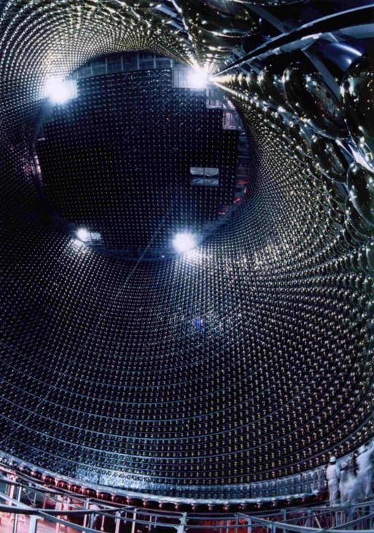
Oscillations

Slide 46
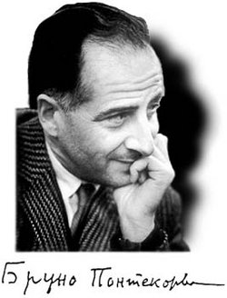
Neutrino oscillations
periodic transformation of one neutrino species (flavor) into another
Consequence of mixing:
production of mixed states
- effect of propagation
of mixed states
- interference effect
coherence, quantumness
- effect of the relative phase increase with time / distance
B. Pontecorvo, 1957
“Mesonium and antimesonium’’
Zh. Eksp.Teor. Fiz. 33, 549 (1957)
[Sov. Phys. JETP 6, 429 (1957)]

Slide 47
Oscillation set-up: localization
External
particles
E. Akhmedov, A.S.
ν_{i}
S
D
baseline L
production
region
detection
region
Finite space and time phenomenon
Two interaction regions in contrast to usual scattering problem: wave packets (wave functions) of external particles (e.g. nuclei) determine localization of thee regions
Interference of two
amplitudes with
intermediate ν₁ and ν₂
Neutrinos: propagators for mass states
or as real particles on mass shell

Slide 48
In terms of mass eigenstates
Without flavor states
g
2 2
ν_{i}
U^{PMNS}_{li} l γ^{μ} (1 - γ₅) ν_{i} W_{μ} + h.c.
l
Scattering
W
Eigenstates of
the Hamiltonian
in vacuum
interaction constant
N
ν_{i}
π
Lagrangian
of interactions
wave functions
of accompanying
particles
π ◊ μ ν_{i}
μ
compute the wave functions
of neutrino mass eigenstates
wave packets

Slide 49
Oscillations in vacuum
Wave packets of
the eigenstates of propagation ν_{i}
production
ν₁
detection
ν₂
h
x
x
x
x
V
Entanglement with accompanying
particles
Vacuum : VEV V(x,t),
interactions of ν with VEV h V → m, θ, h = h(< τ >)
Interference:
coherence at production
propagation, detection
ν oscillations:
effect of propagation in space - time
Modification of geometry of x-t, metrics, GR, NO in the GW background
Quantum mechanical effect (superposition, interference)
Tests of QM, modification of QM, evolution equation..

Slide 50
Factorizations
ν_{i}
S
D
baseline L
production
region
detection
region
If oscillation effect in
production/detection
regions can be neglected
factorization
r_{D} , r_{S} << l_{ν}
Production, propagation and
detection can be considered
as three independent processes
Still the regions are large
enough to compute mass states
as asymptotic states

Slide 51
Wave packets and oscillations
Suppose ν_{α} is produced in the source centered at x = 0, t = 0
After formation of the wave packet (outside the production region)
|ν_{α} (x,t)> = Σ_{k} U_{αk}* Ψ_{k}(x, t)|ν_{k}>
Ψ_{k} ~ dp f_{k}(p – p_{k}) e
ipx – iE_{k}(p)t
WF of k-mass state
E_{k}(p)= p² + m_{k}²
- dispersion relation
f_{k}(p – p_{k}) - the momentum distribution function peaked at
p_{k} - the mean momentum
describes spread of the wave packets
Expanding E_{k}(p) around mean momentum p_{k} :
E_{k}(p) = E_{k}(p_{k}) + (dE_{k}/dp) (p - p_{k}) + (dE_{k}²/dp²) (p - p_{k})² + …
p_{k}
p_{k}
v_{k}= (dE_{k}/dp) = (p/E_{k})
- group velocity of ν_{k}
p_{k}
p_{k}

Slide 52
Shape and phase factors
Neglect spread of the wave packets:
E_{k}(p) = E_{k}(p_{k}) + v_{k}(p - p_{k})
Insert into
Ψ_{k} ~ dp f_{k}(p – p_{k}) e
ipx – iE_{k}(p)t
ip_{k}x – iE_{k}(p_{k})t
Ψ_{k} ~ e g_{k}(x – v_{k}t)
Phase factor
Shape factor
iφ_{k}
ip(x – v_{k}t)
e
g_{k}(x – v_{k}t) = dp f_{k}(p) e
φ_{k} = p_{k} x – E_{k} t
depends on x and t in combination
(x – v_{k}t) only and therefore
describes propagation of the wave packet with group velocity v_{k} without change of the shape
depends on mean characteristics: p_{k} and corresponding energy:
E_{k}(p_{k}) = p_{k}² + m_{k}²

Slide 53
Δm₄₁² = 1 - 2 eV²
Back-up
LSND

Slide 54
Phenomenological flavor states
Flavor neutrino state ν_{α} is the state which is
produced together with charged lepton l_{α} or
produced when l_{α} is captured, or
itself produces l_{α} in interactions (scattering)
n → p + e⁻ + ν_{e}
π → μ + ν_{μ}
In general, the produced neutrino state depends on the process (its kinematics) and differ from the state that
appear in the Lagrangian
The neutrino state should be computed

Slide 55
Computing flavor states
Lagrangian in terms of mass states
g
2 2
A_{li} (m_{νi}) = U^{PMNS}_{li} ψ_{li}(m_{νi})
U^{PMNS}_{li} l γ ^{μ} (1 - γ₅)ν_{i} W⁺_{μ}
- ½ m_{νi} ν_{i}^{T}Cν_{i}
amplitude of probability to
produce a given mass state ν_{i} in a process with charged lepton l
- l_{L} m_{l} l_{R} + h.c.
Mass states can be considered as the asymptotic states,
and A_{li} can be computed using standard QFT techniques
Then the neutrino state produced with (by) l can be presented as superposition of the produced mass states:
ν_{l} = n Σ_{i} U^{PMNS}_{li} ψ_{li}(m_{νi}) ν_{i}
n is the normalization factor
ψ_{li}(m_{νi}) is the wave function of the produced ν_{i}

Slide 56
Current and phenomenological flavor states
are in general different
ν_{l} = n Σ_{i} U^{PMNS}_{li} ψ_{li}(m_{νi}) ν_{i}
For usual light neutrinos dependence of ψ_{li} on m_{νi} is very weak being suppressed by (m_{νi} /E)²
If neglected, ψ_{li} = ψ_{l} - the same for all ν_{i}
ν_{l} = Σ_{i} U^{PMNS}_{li} ν_{i}
- coincides with the charged current state
If new neutral leptons N mixes with neutrinos the current state
ν_{l} = Σ_{i} U_{li} ν_{i} + U_{lN} N
and if N is heavy m_{N} > Q (energy release), not produced in a process, the pheno. neutrino state
ν_{l} = n Σ_{i} U_{li} ν_{i}
Breaking of unitarity:
Σ_{i=1,2,3} |U_{li}|² = 1 - |U_{lN}|² = 1
Zero distance L violation:
< ν_{l}|ν_{l’} > = Σ_{i} U_{li}* U_{l’i} = - U_{lN}*U_{lN}

Slide 57
“Who mixes neutrinos?”
i.e. creates certain (coherent) combinations of mass states
Mixing in CC → mixing in produced states
Non-trivial interplay of
Charged current
weak interactions
Kinematics of
Specific reactions
Difference
of the charged
lepton masses
ν_{e}
β− decays, small Q ,
energy conservation
ν_{μ}
π− decays,
chirality suppression
ν_{τ}
Beam dump, enrich D - decay
with energy interval selection,
loss of coherence
If two different charged leptons are produced in the same decay?
What about neutral currents?

Slide 58
Smallness of mass
m₃
<H>
~ 2 10⁻¹³
Special
comparing within generation:
m₃
m_{τ}
~ 3 10⁻¹¹
Similar for other generations
if spectrum is hierarchical
Normal?
Neutrinos: no clear generation structure and correspondence light flavor – light mass, especially if the mass hierarchy is inverted or spectrum is quasi-degenerate
Mass gap
m₃
m_{e}
m_{e}
m_{t}
~ 3 10⁻⁶
~ 3 10⁻⁶
gap
10⁻³
10⁰
10³
10⁶
10⁹
10¹²
mass, eV

Slide 59
Two aspects of smallness
Suppression wrt. the EW scale
Finite value
Why there is no usual scale Dirac masses?
Mechanisms unrelated
to suppression of usual Dirac masses
1. No RH component → Dirac mass can not be formed
Seesaw type II,
Radiative mechanisms
2. Symmetry forbids
Dirac mass term
3. Some mechanisms
of suppression of mass,
finite value of m is negligible
See-saws type-I does
both things simultaneously: incomplete suppression

Slide 60
Origins of (finite) mass
x
x
Hard mass related to the EW scale
H
H
Gauge
invariance
small effective coupling
ν
ν
small induced VEV formed
by large VEV’s (seesaw II)
…
x
x
Soft mass
VEV created at
small scales
x
Δ
x
melting at T ~ VEV
ν
ν
MAVAN
Environment dependent
masses; relic neutrinos
…
x
x
Gravitationally induced mass
x
Melting couplings
Similarly for Dirac neutrinos

Slide 61
Higher dimension operator
D=5 operator can be suppressed by symmetry
H → i H
H_{n-1}
1
Λ^{n-1}
H₂
. . .
L L H^{n}
H₁
H_{n}
allows to reduce the scale of new physics
responsible for neutrino mass generation
<H> ^{n}
Λ^{n-1}
m_{ν} =
ν
ν
1
Λ^{n-1}
m_{ν} = Π_{i = 1…n} <H_{i}>

Slide 62
ν- mass and Higgs physics
Simplest seesaw implies new physical scale
M_{R} ~ m_{D}² /m_{ν} ~ 10¹⁴ GeV
<< M_{Pl}
F. Vissani
hep-phl9709409
ν_{L}
H
H
J Elias-Miro et al,
1112.3022 [hep-ph]
ν_{R}
y²
(2π )²
δm_{H}² ~ M_{R}² log (q/M_{R})
M_{R}³ m_{ν}
(2π v)²
M. Fabbrichesi
~ log (q /M_{R})
Cancellation?
New physics below Planck scale
Small Yukawas,
Leptogenesis ?
M_{R} < 10⁷ GeV
“Partial” SUSY?

Slide 63
What is the mass?
Mass term changes of chirality of fermion:
ν_{L}
ν_{R}
x
In the SM mass generated due to coupling with classical scalar field in its lowest energy state, Vacuum expectation value VEV of the Higgs field:
m = h <H₀>
= value of the field in the minimum of potential
Variations:
m = h <Δ₀>
triplet for Majorana
m = h² <H₀>² /M_{R}
Seesaw
In oscillations: no change of chirality: (spin state does not change)
ν_{L}
ν_{R}
ν_{L}
x
x
effects ~ m²
m
m

Slide 64
Seesaw mechanism
m_{ν} = - m_{D} (M_{R} )⁻¹ m_{D} ^{T}
m_{D} = U_{L} (m_{D} ^{diag}) U_{R}⁺
B Dasgupta A.S
In the simplest SO(10): U_{L} = V_{CKM}*
then U_{x} is the matrix which diagonalizes
M_{X} = - m_{D}^{diag} U_{R}⁺ (M_{R})⁻¹ U_{R}* m_{D}^{diag}
that is
M_{X} = U_{X} M_{X}^{diag} U_{X}^{T} = U_{X} m_{ν}^{diag} U_{X}^{T} ~ m_{TBM}
M_{R} = - m_{D}^{diag} (m_{TBM})⁻¹ m_{D}^{diag}
very hierarchical, generated by seesaw itself?
→ Double seesaw

Slide 65
“Usual” mass?
In vacuum:
In presence of interactions:
- appears in equation of motion
- decays
in propagator,
dispersion relation
- resonances
- affects kinematics
of processes
Lorentz invariant
- oscillations
Determines the group velocity
- ββ_{ον} –decays if
L number is broken
Energy dependence of mass due to radiative corrections , RGE effect
For fermions, mass term connects their left and right components
Cosmology: non-relativistic neutrinos, structure formation
Refractive mass?

Slide 66
D5 operator and UV-completion
S. Weinberg
If no new particles at the EW scale, after decoupling of
heavy degrees of freedom →
set of non-renormalizable operators
1
Λ
L L H H
H
H
x
ν
ν

Slide 67
Neutrinos:
1. neutral
Q_{γ} = 0, Q_{c} = 0
2. extremely light
~ 10⁻⁷ m_{e} , ~ 10⁻¹⁰ m_{p}
3. elusive
weak and gravitational
interactions
fermions: spin ½
One of the most abundant components
of the Universe. They are everywhere
play special and not completely understood
role in evolution of the Universe being
probably connected to its ``Dark sector’’
(Dark matter and Dark energy)

Slide 68
At one glance
Sources:
All well established/confirmed results
are described by
The Sun
Atmosphere
Standard
Mass and
The Earth
Model
Mixing
SN1987A
of three neutrinos with
rather peculiar pattern
Universe
AGN, Blazars,
and nothing more?
γ- bursters
Accelerators
Introduction of neutrino mass and mixing
may have negligible impact on the rest of SM
Reactors
1
Λ
Mass are generated by L L H H
Rad. Sources

Slide 69
Interactions: expanding energy frontiers
Neutrinos from real W- , Z- decays
Glashow resonance, IceCube event
W-decay: LHC, Faser
Second order, corrections
10⁵ - 10²¹ eV

