Slide 1
Δm₄₁² = 1 - 2 eV²
Neutrino mixing
LSND
and oscillations

Slide 2
Flavors and mixing
Flavor neutrino states:
Mass eigenstates
ν_{e}
ν_{μ}
ν_{τ}
ν₁
ν₂
ν₃
m₁
m₂
m₃
e
μ
τ
Mixing
Flavor states – Weak
interaction states
Flavor
states
Mass
eigenstates
Combinations of mass
states described by mixing matrix U_{PMNS}
ν_{f} = U_{PMNS} ν_{mass}

Slide 3
Mixing: dual role
ν_{e}
ν_{μ}
ν_{τ}
|U_{μ3}|²
|U_{τ3}|²
ν₃
|U_{e3}|²
mass
|U_{e2}|²
ν₂
ν₁
|U_{e1}|²
ν_{e}
ν_{μ}
ν_{τ}
Flavor content of the mass states
Mass content of
the flavor states
ν_{mass} = U_{PMNS} ⁺ ν_{f}
ν_{f} = U_{PMNS} ν_{mass}

Slide 4
Mixing angles
ν_{e}
ν_{μ}
ν_{τ}
|U_{μ3}|²
|U_{τ3}|²
Mixing parameters
ν₃
tan²θ₁₂ = |U_{e2}|² / |U_{e1}|²
|U_{e3}|²
sin²θ₁₃ = |U_{e3}|²
MASS²
tan²θ₂₃ = |U_{μ3}|² / |U_{τ3}|²
Δm²₃₁
|U_{e2}|²
ν₂
ν₁
Δm²₂₁
|U_{e1}|²
Mixing matrix:
FLAVOR
ν_{f} = U_{PMNS} ν_{mass}
Normal mass hierarchy
ν_{e}
ν_{μ}
ν_{τ}
ν₁
ν₂
ν₃
Δm²₃₁ = m²₃ - m²₁
= U_{PMNS}
Δm²₂₁ = m²₂ - m²₁
U_{PMNS} = U₂₃I_{δ} U₁₃I_{−δ} U₁₂

Slide 5
Neutrino mass ordering
ν_{e}
ν_{μ}
ν_{τ}
Normal ordering
Inverted ordering
ν₃
ν₂
Δm₂₁²
ν₁
MASS
Δm₃₂²
Δm₃₂²
Δm₃₁²
ν₂
Δm₃₁²
ν₁
Δm₂₁²
ν₃
Preferable by global fit of
oscillation data

Slide 6
Vacuum mixing
ν_{f} = U_{PMNS} ν_{m}
ν_{e}
ν_{μ}
ν_{τ}
U_{e1} U_{e2} U_{e3}
U_{μ1} U_{μ2} U_{μ3}
U _{τ1} U_{τ2} U_{τ3}
ν₁
ν₂
ν₃
=

Slide 7
Standard parametrization
U_{PMNS} = U₂₃I_{δ} U₁₃I_{−δ} U₁₂
I_{M}
I_{δ} = diag (1, 1, e^{iδ})
Dirac phase matrix
1 0 0
0 c₂₃ - s₂₃
0 -s₂₃ c₂₃
c₁₃ 0 s₁₃e^{-iδ}
0 1 0
-s₁₃e^{iδ} 0 c₁₃
c₁₂ s₁₂ 0
-s₁₂ c₁₂ 0
0 0 1
I_{M}
iα₂₁ /2
iα₃₁ /2
I_{M} = diag (1, e , e )
- matrix of Majorana phases
Not unique parametrization
Convenient for phenomenology, especially for oscillations in matter
Insightful for theory?

Slide 8
Mixing and mass matrices
Origin of mixing: off-diagonal neutrino mass matrix
in basis of flavor states
M_{l} = M_{ν}
Mixing matrix
Diagonalization:
Mass spectrum
(Elements of diagonalized
Matrix)
M_{l} = U_{lL}m_{l}^{diag} U_{lR}⁺
M_{ν} = U_{νL}m_{ν}^{diag} U_{νL}^{T}
m_{l} ^{diag} = (m_{e}, m_{μ}, m_{τ})
m_{ν}^{diag} = (m₁, m₂, m₃)
for Majorana
neutrinos
CC in terms of mass eigenstates:
L γ ^{μ}(1 - γ₅) U_{PMNS}ν_{mass}
U _{PMNS} = U_{lL}⁺ U_{νL}
Flavor basis:
M_{l} = m_{l}^{diag}
U _{PMNS} = U_{νL}

Slide 9
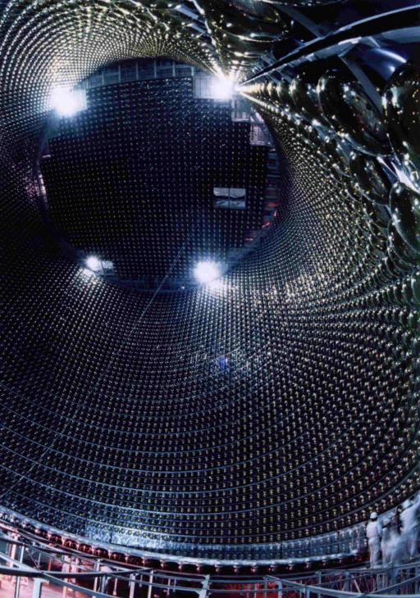
Oscillations

Slide 10
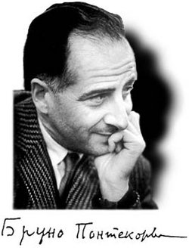
Neutrino oscillations
periodic transformation of one neutrino species (flavor) into another
Consequence of mixing:
production of mixed states
- effect of propagation
of mixed states
- interference effect
coherence, quantumness
- effect of the relative phase increase with time / distance
B. Pontecorvo, 1957
“Mesonium and antimesonium’’
Zh. Eksp.Teor. Fiz. 33, 549 (1957)
[Sov. Phys. JETP 6, 429 (1957)]

Slide 11
Oscillation set-up. Localization
External
particles
E. Akhmedov, A.S.
ν_{i}
S
D
baseline L
production
region
detection
region
Finite space and time phenomenon
Two interaction regions in contrast to usual scattering problem: wave packets (wave functions) of external particles (e.g. nuclei) determine localization of these regions
Interference of
i- amplitudes with
intermediate ν_{i}
Neutrinos: propagators for mass states
or as real particles on mass shell

Slide 12
Oscillations vs. scattering
Scattering set-up
- Single interaction region
- Asymptotic states described by plane waves
- Integration over infinite space-time
Enormous simplification:
Integration gives delta functions which reflect exact enrgy- momentum conservation, etc

Slide 13
Propagation in terms of mass eigenstates
Without flavor states
(Eigenstates of propagation)
g
2 2
ν_{i}
l
U^{PMNS}_{li} l γ^{μ} (1 - γ₅) ν_{i} W_{μ} + h.c.
Scattering
W
Eigenstates of
the Hamiltonian
in vacuum
interaction constant
N
X
ν_{i}
π
Lagrangian
of interactions
wave functions
of accompanying
particles
π ◊ μ ν_{i}
μ
compute the wave functions
of neutrino mass eigenstates
= wave packets

Slide 14
Factorizations
ν_{i}
S
D
baseline L
production
region
detection
region
If oscillation effect in
production/detection
regions can be neglected
factorization
r_{D} , r_{S} << l_{ν}
Production, propagation and
detection can be considered
as three independent processes
Still the regions are large
enough to compute mass states
as asymptotic states

Slide 15
Wave packets and oscillations
Suppose ν_{α} is produced in the source centered at x ~ 0, t ~ 0.
After formation of the wave packet (i.e., outside the production region):
|ν_{α} (x,t)> = Σ_{k} U_{αk}* Ψ_{k}(x, t)|ν_{k}>
in general
Ψ_{k} ~ dp f_{k}(p – p_{k}) e
ipx – iE_{k}(p)t
- wave function of k-mass state
E_{k}(p) = p² + m_{k}²
- dispersion relation
f_{k}(p – p_{k}) - the momentum distribution function peaked at
p_{k} - the mean momentum
describes spread
of wave packets
Expanding E_{k}(p) around mean momentum p_{k} :
E_{k}(p) = E_{k}(p_{k}) + (dE_{k}/dp) (p - p_{k}) + (dE_{k}²/dp²) (p - p_{k})² + …
p_{k}
p_{k}
v_{k}= (dE_{k}/dp) = (p/E_{k})
- group velocity of ν_{k}
p_{k}
p_{k}

Slide 16
Shape and phase factors
Neglect spread of the wave packets:
E_{k}(p) = E_{k}(p_{k}) + v_{k}(p - p_{k})
Insert into
Ψ_{k} ~ dp f_{k}(p – p_{k}) e
ipx – iE_{k}(p)t
ip_{k}x – iE_{k}(p_{k})t
Ψ_{k} ~ e g_{k}(x – v_{k}t)
Phase factor
Shape factor
iφ_{k}
ip(x – v_{k}t)
e
g_{k}(x – v_{k}t) = dp f_{k}(p) e
φ_{k} = p_{k} x – E_{k} t
depends on x and t in combination
(x – v_{k}t) only and therefore
describes propagation of the wave packet with group velocity v_{k} without change of the shape
depends on mean characteristics: p_{k} and corresponding energy:
E_{k}(p_{k}) = p_{k}² + m_{k}²

Slide 17
Mixing & mixed states
One needs to compute the produced state, i.e.
the shape factors, g_{k}(x – v_{k}t)
mean momenta p_{k}
taking into account
- fundamental interactions
kinematics
characteristics of parent and accompanying particles
Produced state is process-dependent
If heavy neutrinos are present but can not be produced for kinematical reasons, flavor states in Lagrangian differ from
the produced states, etc..

Slide 18
Example of neutrino wave packets
*
p
π
ν
l_{p}
L
target
decay tunnel
absorber
detector
D. Hernandez, AS
E. Kh Akhmedov,
D. Hernandez, AS
arXiv:1110.5453
ν wave packet
x
The length of ν WP emitted
in the forward direction:
v – v_{π}
v_{π}
σ = l_{p}
Doppler effect

Slide 19
Description of neutrino state in terms of WP
φ
ν_{μ}
ν_{μ} = cosθ ν₂ + sinθ ν₃
0
Ψ₂
cosθ
ν_{τ} = - sinθ ν₂ + cosθ ν₃
π
iπ
e
σ_{x}
- mass content
- phase difference
ν₂
differ by
φ = 0
Inverting
Ψ₃
sinθ
ν₂ = cosθ ν_{μ} - sinθ ν_{τ}
ν₃
ν₃ = cosθ ν_{τ} + sinθ ν_{μ}
x
Interference of the same
flavor parts of the WP which depends on phase
iφ_{k}
Ψ_{k} = g_{k}(x – v_{k} t) e
Shape factor
Phase factor
v_{k} - group velocity
φ_{k} = p_{k} x – E_{k} t
k = 2,3

Slide 20
Propagation
Additional phase difference due to different masses
iφ
|ν (x,t)> = cosθ g₂(x – v₂ t) |ν₂> + sinθ g₃(x – v₃t) e |ν₃ >
φ = φ₃ – φ₂
- oscillation phase changes with (x,t)
for φ = 0 components ν_{τ} in originally produced ν_{μ} will not cancel → appearance of ν_{τ}
Interference depends on phase difference

Slide 21
Oscillations
Difference of masses
of ν₂ and ν₃
Difference of phase velocities
Phase difference
increases with
distance
Δm² L
2E
φ =
Δm² = m₃² - m₂²
ν₂
ν₃
distance
L
φ = 0
shift of oscillatory patterns
ν_{μ}

Slide 22
Oscillation phase
φ = φ₃ - φ₂
φ_{i} = - E_{i} t + p_{i} x
p_{i} = E_{i}² – m_{i}²
E_{i} and p_{i} are the averaged characteristics of WP
φ = φ₃ - φ₂ = ΔEt - Δpx
(*)
where
Δp = (dp/dE)ΔE + (dp/dm²)Δm² = 1/v_{g} ΔE + (1/2p) Δm²
group velocity
Insert into (*)
Δm²
2E
φ = (ΔE/v_{g}) (v_{g}t - x) + x
ΔE ~ Δm²/2E
< σ_{x}
standard oscillation phase
(difference of
average energies)
usually- small
The first term:
< σ_{x}Δm²/2E
is oscillation phase over the size of WP
Phase difference along the wave packets is nearly the same

Slide 23
Oscillations
ν_{μ}
cos θ
σ_{x}
ν₂
- Destructive interference
of the tau parts
- Constructive interference
of muon parts
φ = 0
sin θ
ν₃
x

Slide 24
Oscillations
ν_{τ}
cos θ
σ_{x}
ν₂
- Destructive interference
of the muon parts
- Constructive interference
of tau parts
φ = π
sin θ
ν₃
x

Slide 25
Detection
As important as production for computing observable effects and should be considered
“symmetrically” with production
Detection effect can be included in the generalized shape factors
g_{k}(x – v_{k}t) → G_{k}(L – v_{k}t)
x → L - distance between central points of the production and detection regions

Slide 26
Oscillation amplitude
ν_{μ} - ν_{μ}
|ν_{μ} > = cosθ |ν₂> + sinθ |ν₃>
iφ
|ν (x,t) > = cosθ g₂(x – v₂t)|ν₂ > + sinθ g₃(x – v₃t)e |ν₃ >
ν_{μ} – survival amplitude
A(ν_{μ} ) = <ν_{μ} |ν (x,t)> =
= cos²θ g₂(x – v₂t) + sin²θ g₃(x – v₃t) e
iφ
Used that mass states are orthogonal and normalized:
<ν_{i} | ν_{k}> = δ_{ik}
WF of detected state – does not depend on time

Slide 27
Oscillation probability
Probability to find ν_{μ} in the moment of time t
P(ν_{μ} , x) = dx |<ν_{μ}|ν (x,t)>|²
= cos⁴θ + sin⁴θ + 2sin²θ cos²θ cos φ dx g₂(x – v₂t) g₃(x – v₃t)
since dx|g|² = 1
interference term
(similarly one can integrate over time for fixed x)
If g₃ = g₂ (separation is negligible)
P(ν_{μ} , x) = 1 - 2 sin²θ cos²θ (1 - cos φ)
= 1 - sin² 2θ sin² ½φ
Δm² x
2E
2 π x
l_{ν}
depth of oscillations
φ = =
l_{ν} =
4 π E
Δm²
- oscillation length

Slide 28
Loss of propagation coherence
ν_{2m}
ν_{1m}
x
Separation of the WP due to different group velocities

Slide 29
Propagation coherence
In the configuration space: separation of the wave packets due to
difference of group velocities
Δv_{gr} = Δm² /2E²
σ_{x}
Separation after
propagation of distance L:
ν₁
ν₂
Δv_{gr} L = Δm² L/2E²
x
No overlap when:
Δv_{gr} L > σ_{x}
Coherence length –distance at which overlap disappears
L_{coh} = σ_{x} E²/Δm²

Slide 30
Coherence in the energy space
In the energy space: separation of WP is equivalent to averaging
of oscillations over energy
f(E)
energy resolution function
Oscillatory period in the E space
is determined by the
condition Δφ (E^{T}) = 2π
σ_{E}
E^{T} = 4π E²/(Δm² L)
E
E^{T}
Averaging (= loss of coherence) if energy resolution σ_{E} is
E^{T} < σ_{E}
this leads to the same coherence length if σ_{E} ~ 2π /σ_{x}
L_{coh} = σ_{x} E²/Δm²
If E^{T} > σ_{E} – (good energy resolution) the restoration of coherence
occurs even if the wave packets separated

Slide 31
Equivalence of considerations in p- and x- spaces
Averaging over energy – loss of coherence due to separation of WP
L. Stodolsky
in stationary state approximation
Wave packets are unnecessary
for computation
of observable effects
or if there is no
time tagging
The only what is needed is to make
correct integration over
Production
energy spectrum
Energy resolution
of a detector
But this is nothing but WP in the energy space

Slide 32
Observing propagation decoherence
x –t space: separation of wave packets of mass states due to difference of group velocities
equivalent to integration over the energy uncertainty
Ψ
f(E)
σ_{x}
σ_{E} ~ 1/ σ_{x}
x
E
Suppression of interference → damping of oscillations
Survival probability :
P_{ee} = P_{ee} + ½ D(E, L) sin² 2θ cos φ
Damping factor for Gaussian WP (proportional to overlap of WP)
D(E, L) = exp [- ½(L/L_{coh})²]
Coherence length
L_{coh} = σ_{x}
E²
Δm²
Information is not lost
and can be restored at detection

Slide 33
Spread of wave packets
Due to presence of waves with different energies in the packet
dispersion of the velocities with energy
J. Kersten, AYS
1512.09068 [hep-ph]
m²
E³
σ_{spread} = σ_{E} L
x
Beryllium
neutrinos
σ_{spread} ~ 4 10⁻⁶ cm
σ_{x} = 2π /Γ_{Be} = 6 10⁻⁸ cm
Δx_{sep}^{S} ~ 2 10⁻³ cm
Δx_{sep}^{S} >> σ_{spread}
Oscillations of mass states
in the Earth
Δx_{sep}^{E} ~ 5 10⁻⁸ cm
σ_{x} ~ Δx_{sep}^{E} << σ_{spread}
Loss of coherence:
YES
NO?

Slide 34
Spread of the wave packets and coherence
J. Kersten, AYS
1512.09068 [hep-ph]
σ_{spread}
ν₂
p_{j}
Δx_{j}
Δx_{shift}
ν₁
p_{k}
ν₁
Δx_{k}
distance
Averaged (effective) momenta in overlapping parts are different
averaging

Slide 35
Spread of wave packets
Coherent parts (same color)
– stop to overlap
x
Loss of coherence between overlapping parts of the WP
WP becomes “classical”: describing that the highest energy neutrinos arrive first
No effect on coherence if considered in the p-space

Slide 36
Propagation of wave packets
What happens?
Phase difference
Due to different masses (dispersion relations) → phase velocities
Oscillations
change
Separation of
Loss of
Due to different group velocities
wave packets
coherence
Spread of individual
Due to presence of waves with different momenta and energy in the packet
Loss of coherence
wave packets
within WP

Slide 37
Evolution equation
If loss of coherence and other complications related to WP picture are irrelevant – `` point-like’’ picture
ψ_{e}
= ψ_{μ}
ψ_{τ}
d Ψ
d t
i = H Ψ
What is H?
For ultra relativistic ν
m²
2E
omit p, substitute m² → M M⁺
H = E ~ p +
M is the 3x3 mass matrix
M M⁺
2E
H =
M M⁺ = U M_{diag}² U⁺
U - mixing matrix
M_{diag}² = diag (m₁², m₂², m₃²)

Slide 38
Hamiltonian for 2ν
In the flavor basis
ν_{f} = (ν_{e} , ν_{τ})^{T}
M M⁺
2E
H_{tot} =
cos θ sin θ
- sin θ cos θ
M M⁺ = U M_{diag}² U⁺
U =
M_{diag}² = diag (m₁², m₂²)
Δm²
4E
- cos 2θ sin 2θ
sin 2θ cos 2θ
H_{tot} =

Slide 39
Neutrino polarization vector
in the flavor space
ν_{e}
ν_{τ}
Def. polarization vector:
ψ =
Re ν_{e}⁺ ν_{τ}
P = Im ν_{e}⁺ ν_{τ}
ν_{e}⁺ ν_{e} - 1/2
P = ψ⁺ σ/2 ψ
(*)
Pauli matrices
Evolution equation:
elements of density matrix
d Ψ
d t
d Ψ
d t
i = H Ψ
i = - (B σ/2 ) Ψ
where
2π
l_{ν}
B = (sin 2θ, 0, cos2θ)
Differentiating P from (*) and using equation of motion for Ψ
d P
dt
= - [B x P]
Coincides with equation for the electron spin precession
in the magnetic field

Slide 40
Graphic representation
of oscillations with the electron spin precession in the magnetic field
| P | = ½
polarization vector
ν_{e}
2π
l_{ν}
P_{z}
B = (sin 2θ, 0, cos2θ )
B_{m}
P_{ee} = ν_{e}⁺ν_{e} = P_{Z} + 1/2
φ_{m}
φ = 2πt/l_{ν}
oscillation phase
ν_{τ}
θ_{cone}
P
In general, degrees of freedom:
2θ_{m}
Neutrino polarization
vector in the flavor space
θ_{m} (n, E) - mixing angle
φ_{m} (n, E) - phase
P_{y}
θ_{cone} (dn/dx) - cone angle
P_{x}

Slide 41
Δm₄₁² = 1 - 2 eV²
Decoherence
Correlations
LSND
Entanglment

Slide 42
Space-time localization diagram
E.Kh. Akhmedov,
D. Hernandez, A.Y.S.
1201.4128 [hep-ph]
Reflects computations of oscillation amplitude in QFT,
Produced and propagated neutrino state
see slide 14, phase
factors omitted
|ν^{P}> = ψ₁^{P}|ν₁ > + ψ₂^{P}|ν₂ >
ψ_{i}^{P} = ψ_{i}^{P}(x – v_{i}t), produced WP, width σ_{t}^{P} , v_{i} - group velocities, i = 1,2
Detected state
|ν^{D}> = ψ₁^{D}|ν₁ > + ψ₂^{D}|ν₂ >
ψ_{i}^{D} = ψ_{i}^{D}(x – x_{D}, t – t_{D}) - the detection WP with width σ_{t}^{D}
Amplitude = projection of propagated state onto detection state:
A (L, t_{D}) = <ν^{D}|ν^{P}> = Σ_{i} dt ψ_{i}^{D*} (t –t_{D}) ψ_{i}^{P}(L – v_{i}t)
L- baseline
where for simplicity ψ_{i}^{D}(x – x_{D}, t – t_{D}) = δ (x – L) ψ_{i}^{D}(t –t_{D}),
and integration over x is removed
(x_{D} = L )

Slide 43
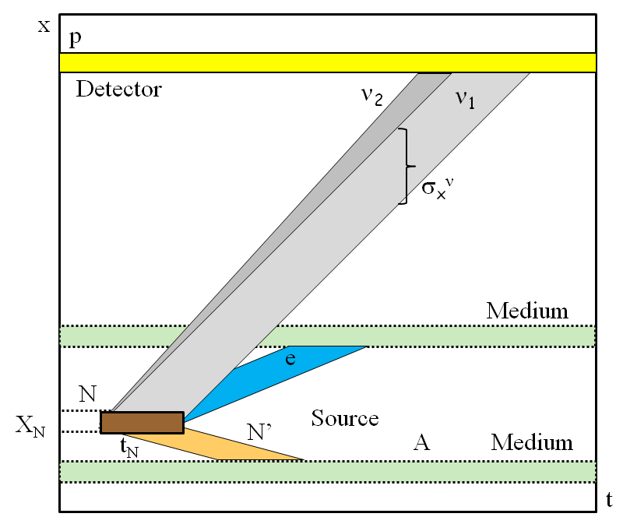
Space-time localization diagram
E.Kh. Akhmedov and A.Y.S. JHEP 11 (2022) 082, 2208.03736 [hep-ph]
Oscillation probability
P (L) = dt_{D}|A(L, t_{D})|² =
dt_{D} [|A₁(L, t_{D})|² + |A₂(L, t_{D})|²]
+ 2Re dt_{D} A₁(L, t_{D})*A₂(L, t_{D})
interference
A₁(L, t_{D}) – essentially the generalized WP
Further integration over interval of baseline L due to finite sizes of the source and detector
The slopes of bands are determined by group velocities

Slide 44
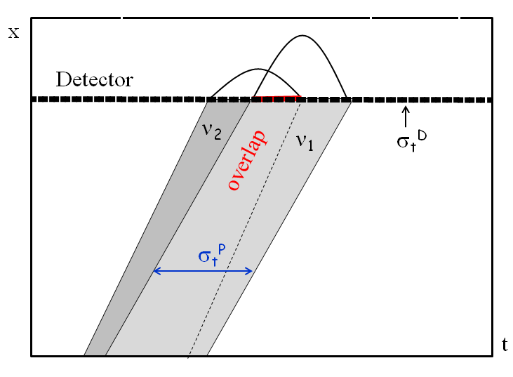
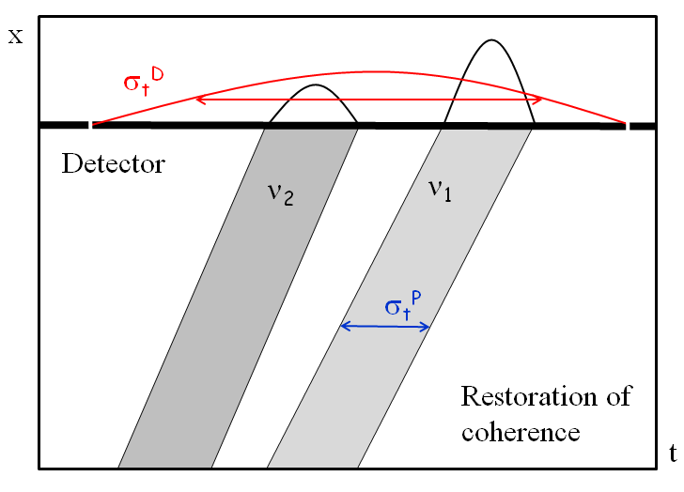
A Y Smirnov,
2212.10242 [hep-ph]
Detection
two extreme cases
σ_{t}^{D} << σ_{t}^{P}
σ_{t}^{D} >> σ_{t}^{P}
short detection coherence time
long detection coherence time
ψ_{i}^{D} (t – t_{D}) ~ δ (t –t_{D})
ψ_{i}^{p} (t – t_{D}) ~ δ (L – v_{i}t)
A_{i}(L, t_{D}) ~ ψ_{i}^{P}(L – v_{i}t_{D})
A_{i}(L, t_{D}) ~ ψ_{i}^{D}(L/v - t_{D})
Interference is determined by overlap of produced WP
restoration of coherence if
σ_{t}^{D} >> t_{sep}

Slide 45
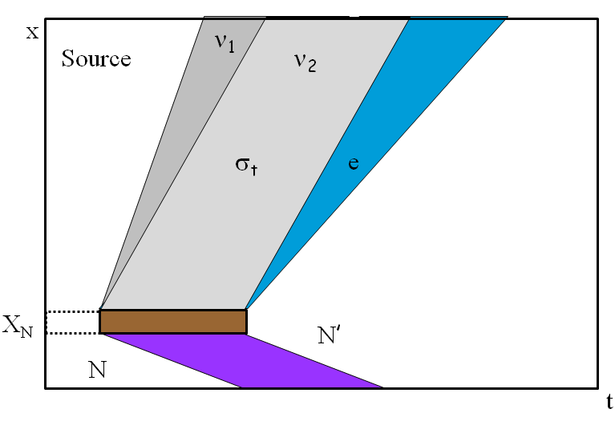
Production
A Y Smirnov,
2212.10242 [hep-ph]
WP’s are determined by localization region of the production process: overlap of localization regions of all particles involved but neutrinos.
E.g. in the β decay,
N → N’ + e⁻ + ν
If N’ and e⁻ are not detected or
their interactions can be neglected
localization of process is given by localization of atom N
distance
The latter is determined by time
between two collisions of N, t_{N}
σ_{x} ~ v_{ν}t_{N} ~ X_{N} c/v_{N}
time
enhancement factor

Slide 46
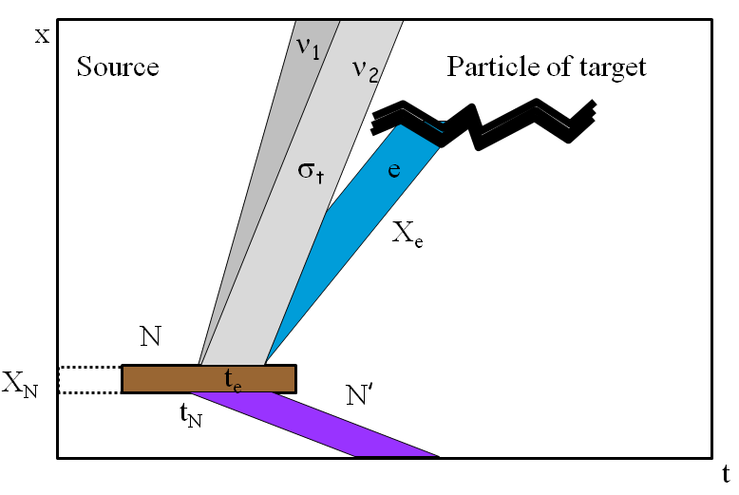
Entanglement and correlations
If N’ or/and e⁻ are detected or interact, this may narrow their WP’s
and therefore the neutrino WP. Consequently, enhance decoherence
If e⁻ is detected during time interval t_{e} < t_{N}, the size of ν WP
will be determined by t_{e}
t_{coll}
If e⁻ interacts with particles of medium which have very short time between collisions t_{coll}, then σ_{x} ~ ct_{coll}
distance
Similar to the EPR paradox
time
Consider ν emission and interactions of e⁻ as unique process;
contributions to its amplitude from different interactions regions of e
appear with random phases ξ_{k} - incoherent
A_{tot} = A_{k} e^{i}
ξ_{k}

Slide 47
Effect of accompanying particles
Duration of ν production process
is given by the shortest mean free time among particles involved
Consideration of x-t localization
of interactions of accompanying particles.
Electrons have the shortest
Chain of k processes of secondary interactions till equilibration (thermalization)
σ_{t} = t_{e} = X_{e}/v_{e}
X_{e} is determined by ionization
of uranium, σ_{eU}
...
e + A → e’ + A’
A
ν_{i}
X_{e} = (n_{U} σ_{eU})⁻¹
t_{e}
N
σ_{x} = 2 x 10⁻⁵ cm
σ_{t} ~ t_{N} /2^{k}
“short cut” estimation: can be considered as the upper bound
σ_{x} = (5 – 10)x 10⁻⁵ cm

Slide 48
Oscillations in vacuum
Wave packets of
the eigenstates of propagation ν_{i}
production
ν₁
detection
ν₂
h
x
x
x
x
V
Entanglement with accompanying
particles
Vacuum : VEV V(x,t),
interactions of ν with VEV h V → m, θ, h = h(< τ >)
Interference:
coherence at production
propagation, detection
ν oscillations:
effect of propagation in space - time
Modification of geometry of x-t, metrics, GR, NO in the GW background
Quantum mechanical effect (superposition, interference)
Tests of QM, modification of QM, evolution equation..

Slide 49
Based on
[1] Neutrino production coherence and oscillation experiments.
E. Akhmedov, D. Hernandez, A. Smirnov, JHEP 1204 (2012) 052,
arXiv:1201.4128 [hep-ph]
[2] Neutrino oscillations: Entanglement, energy-momentum conservation and QFT.
E.Kh. Akhmedov, A.Yu. Smirnov, Found. Phys. 41 (2011) 1279-1306
arXiv:1008.2077 [hep-ph]
[3] Paradoxes of neutrino oscillations.
E. Kh. Akhmedov, A. Yu. Smirnov Phys. Atom. Nucl. 72 (2009) 1363-1381
arXiv:0905.1903 [hep-ph]
[4] Active to sterile neutrino oscillations: Coherence and MINOS results.
D. Hernandez, A.Yu. Smirnov, Phys.Lett. B706 (2012) 360-366 arXiv:1105.5946 [hep-ph]
[5] Neutrino oscillations: Quantum mechanics vs. quantum field theory.
E. Kh. Akhmedov, J. Kopp, JHEP 1004 (2010) 008
arXiv:1001.4815 [hep-ph]

Slide 50
Δm₄₁² = 1 - 2 eV²
Back-up
LSND

Slide 51
In principle:
Starting from the first principles
Lagrangian
g
2 2
l γ ^{μ} (1 - γ₅)ν_{l} W⁺_{μ}
Amplitudes, probabilities
of processes
- ½ m_{L} ν_{L}^{T}Cν_{L}
- l_{L} m_{l} l_{R} + h.c.
QFT
QM
Observables,
number of events, etc..
Actually not very simple
Quantum mechanics at macroscopic distances

Slide 52
What is the problem?
Set-up
Approximations
Approximations, if one does
not want to consider whole
history of the Universe to
compute e.g. signal in Daya Bay
Formalism should be adjusted
to specific physics situation
Initial conditions
Truncating the process
Recall, the usual set-up
asymptotic states
described by plane waves
Localizations
enormous
simplification
of some initial and final particles
single interaction
region

Slide 53
… for maximal mixing
**
θ = π/4
ν_{μ} = ( ν₂ + ν₃ ) / 2^{1/2}
ν_{τ} = ( - ν₂ + ν₃ ) / 2^{1/2}
The difference in phase only, mass composition is the same!
Interaction of neutrino state depends on the phase difference
between mass eigenstates
iφ
ν (φ) =(e ν₂ + ν₃ )/2^{1/2}
ν_{μ} φ = 0
Flavor composition (interaction properties) depends on φ
ν (φ) = ν_{τ} φ = π
ν_{μ} , ν_{τ} 0 < φ < π

Slide 54
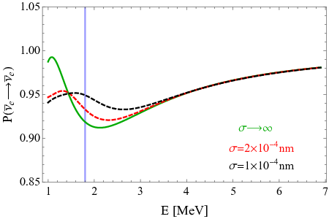
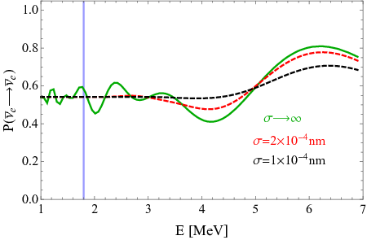
Decoherence of reactor neutrinos
A de Gouvea, V De Romeri,
C.A. Termes, 2104.05806
[hep-ph]
Bound on size of the WP
Daya Bay, RENO
KamLAND
Expected
damping effect
Absence of decoherence (damping) effect means
Δm²
2E²
L << L_{coh}
σ_{x} > L
Analysis of data:
σ_{x} > 2.1 x 10⁻¹¹ cm (90% C.L.)
The bound corresponds to the energy resolution of detectors δ_{E}
σ_{x} ~ 1/δ_{E}

Slide 55
Other studies
Daya Bay: decoherence due to finite momentum spread σ_{p}
σ_{p} /p < 0.23 (95% C.L.)
F.P. An, et al,
1608.01661 [hep-ex]
for p = 3 MeV: σ_{x} ~ 1/σ_{E} = 2.8 x 10⁻¹¹ cm
JUNO in future may set the limit
J. Wang et al.
2112.14450 [hep-ex]
σ_{p} /p < 10⁻² (95% C.L.)
→ σ_{x} > 2.3 x 10⁻¹⁰ cm
Decoherence in oscillations active – eV scale sterile
C.A.Arguelles et al,
2201.05108 [hep-ph]
Damping effects in various experiments computed
for σ_{x} = 2.1 x 10⁻¹¹ cm (as found in A de Gouvea et al).
Claims:
- decoherence allows to reconcile BEST result with reactor bounds;
- results of analysis should be presented in two forms: with and without decoherence

Slide 56
Propagation decoherence and energy resolution
integration over the energy resolution of setup – another sources of damping
E.Kh. Akhmedov and A.Y.S.
2208.03736[hep-ph]
R(E_{r} , E) energy resolution in experimental set-up (width δ_{E} ):
- spectrum of produced neutrinos (line), or
- energy resolution of a detector
f(E, E) – WP of produced neutrino in energy representation
acts on oscillations, as R does, and can be attached to R(E_{r}, E)
Effective resolution function
R_{eff} (E_{r} , E) = dE R(E_{r} , E) |f(E, E)|²
For Gaussian f and R, R_{eff} is also Gaussian with width
δ_{E}² + σ_{E}²
The problem: to disentangle the two contributions

Slide 57
WP’s of reactor neutrinos
Source: β-decays of fragments N of nuclear fission
N → N’ + e⁻ + ν
N quickly thermalise → in equilibrium with medium in the moment of decay → the average velocity:
v_{N} ~ [3T/ m_{N}]^{-1/2}
If N’ and e⁻ are not detected or their interactions can be neglected,
localization of ν production process is given by localization of N.
σ_{x} ~ v_{ν}t_{N} ~ X_{N} c/v_{N}
t_{N} - time between two collisions of N with other atoms
t_{N} ~ [σ_{AA} n_{U} v_{N}]⁻¹
σ_{AA} geometric cross-section σ_{AA} ~ π(2r_{vdW}) ²
Van der Waals radius
n_{U} - number density of Uranium
σ_{x} = 2.8 x 10⁻³ cm

Slide 58
Implications
1.
σ_{x} / σ_{x}^{exp} = 10⁵ - 10⁶
σ_{x} >> σ_{x}^{exp}
2.
Corresponding energy uncertainty
σ_{E} ~ 1 eV
while energy resolution δ_{E} ~ 10⁵ eV
To be sensitive to WP separation energy resolution function should be known with better that 10⁻⁵ accuracy
3.
For Cr source:
σ_{x} = 1.4 x 10⁻⁴ cm
4.
Large Δm² does not help since oscillatory pattern shows up at L ~ l_{ν}
but L_{coh} ~ l_{ν} ~ 1/Δm²
→ Δm² cancels in damping factor
5.
If some additional damping is found, it is due to some new physics and not due to WP separation
6.
Experiments with L ~ L_{coh} ? Lower energies? Widening lines?

Slide 59
Neutrino oscillations
**
Simple but not as simple as in many
textbooks (pointlike or plane wave)
Conceptually wrong but gives correct final
results for physically relevant situations
Wave packet picture (or QFT) should be used to avoid misconception. Complications related to WP disappear in final result in physically relevant cases
…disappear in normalization

Slide 60
Introduction
Theory and observations of the neutrino flavor transformations
play the key role in developments of neutrino physics with applications to the Earth based neutrino experiments, to solar,
atmospheric and supernova neutrinos, to cosmic neutrinos of high energies.
Theory of neutrino flavor transformations in vacuum and
various media will be presented in systematic way. That includes oscillations, adiabatic conversion in matter, parametric effects, transformations in multi-layer media, collective transformations. Physics derivations of the results will be given, and various subtle aspects discussed. Some applications and possible manifestations of physics beyond the standard model will be outlined.

Slide 61
Physics summary
Appearance probability
πx
l _{ν}
P(ν_{μ})
= sin²2θ sin²
All complications are “absorbed” in normalization
or reduced to partial averaging of oscillations
or lead to negligible corrections of order m/E << 1
Oscillations - effect of the phase difference
increase between mass eigenstates
Admixtures of the mass eigenstates ν_{i} in a given
neutrino state do not change during propagation
Flavors (flavor composition) of the eigenstates
are fixed by the vacuum mixing angle

Slide 62
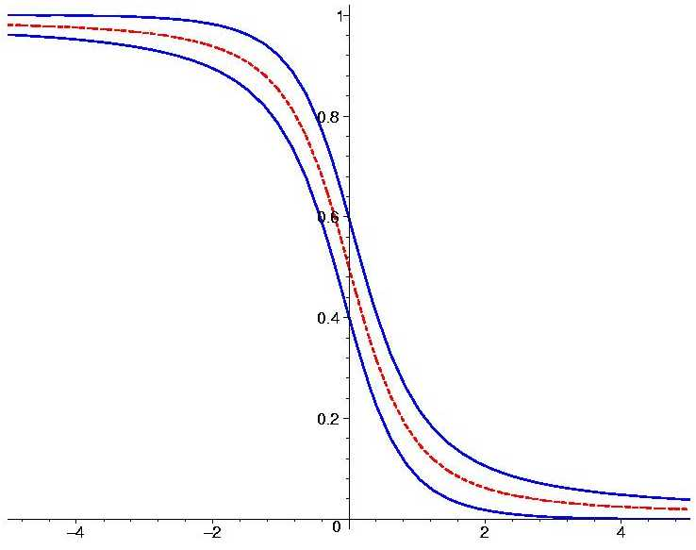
Measurements
MINOS
T2K
NOvA
MSW-effect
Solar
neutrinos
2
KamLAND
Δ
m
Double Chooz
θ
Daya Bay
RENO
NEOS
Atmospheric
Oscillations
Can be resonantly
enhanced in matter
neutrinos
SK
Antares
DeepCore

Slide 63
Theory and observations of the neutrino flavor transformations
play the key role in developments of neutrino physics with applications to the Earth based neutrino experiments, to solar,
atmospheric and supernova neutrinos, to cosmic neutrinos of high energies.
Theory of neutrino flavor transformations in vacuum and
various media includes oscillations, adiabatic conversion in matter, parametric effects, transformations in multi-layer media, collective transformations.
Physics derivations of the results are given. Some applications and possible manifestations of physics beyond the standard model will be outlined.
My “short cut” way to get results and understand things

Slide 64
Plane wave and point-like descriptions
- in many presentations leading to confusion
Infinite space, but
neutrino oscillations are finite space phenomenon
Mass states have different velocities, separate in space interference is not possible
Additional constraints required
Wave packets treatment
intermediate between
the two above cases
Leo Stodolsky:
In most of the cases from practical point of view consideration in terms of spatial WP is not necessary
But WP consideration allows to avoid various misconceptions

