Slide 1
Flavor evolution
equation

Slide 2
Flavor evolution equation
If loss of coherence and other complications related to WP picture are irrelevant – `` point-like’’ picture
ψ_{e}
= ψ_{μ}
ψ_{τ}
d Ψ
d t
i = H Ψ
What is H?
For ultra relativistic ν
m²
2E
omit p, substitute m² → M M⁺
H = E ~ p +
M is the 3x3 mass matrix
M M⁺
2E
M M⁺ - no chirality flip,
1/E leads to L/E dependence of oscillation effects
H₀ =
M M⁺ = U M_{diag}² U⁺
U - mixing matrix
M_{diag}² = diag (m₁², m₂², m₃²)

Slide 3
Hamiltonian for 2ν
In the flavor basis
ν_{f} = (ν_{e} , ν_{τ})^{T}
cos θ sin θ
- sin θ cos θ
U =
M M⁺ = U M_{diag}² U⁺
M_{diag}² = diag (m₁², m₂²)
Δm²
4E
- cos 2θ sin 2θ
sin 2θ cos 2θ
H₀ =

Slide 4
Neutrino polarization vector
in the flavor space
ν_{e}
ν_{τ}
Def. polarization vector:
ψ =
Re ν_{e}⁺ ν_{τ}
P = Im ν_{e}⁺ ν_{τ}
ν_{e}⁺ ν_{e} - 1/2
P = ψ⁺ σ/2 ψ
(*)
Pauli matrices
Evolution equation:
elements of density matrix
d Ψ
d t
d Ψ
d t
i = H Ψ
i = - (B σ/2 ) Ψ
where
2π
l_{ν}
B = (sin 2θ, 0, cos2θ)
Differentiating P from (*) and using equation of motion for Ψ
d P
dt
= - [B x P]
Coincides with equation for the electron spin precession
in the magnetic field

Slide 5
Graphic representation
of oscillations with the electron spin precession in the magnetic field
| P | = ½
polarization vector
ν_{e}
2π
l_{ν}
P_{z}
B = (sin 2θ, 0, cos2θ )
B
P_{ee} = ν_{e}⁺ν_{e} = P_{Z} + 1/2
φ
φ = 2πt/l_{ν}
oscillation phase
ν_{τ}
θ_{cone}
P
In general, degrees of freedom:
2θ
Neutrino polarization
vector in the flavor space
θ_{m} (n, E) - mixing angle
φ_{m} (n, E) - phase
P_{y}
θ_{cone} (dn/dx) - cone angle
P_{x}

Slide 6
Flavor
transformations
in matter

Slide 7
Refraction
L. Wolfenstein, 1978
for ν_{e} ν_{μ}
at low energies Re A >> Im A
inelastic interactions can be neglected
ν_{e}
e
Elastic forward
scattering
V_{e}, V_{μ}
W
potentials
e
ν_{e}
Refraction index:
n - 1 = V / p
difference of potentials
V = V_{e} - V_{μ} = 2 G_{F} n_{e}
for E = 10 MeV
n – 1 =
~ 10⁻²⁰ inside the Earth
V ~ 10⁻¹³ eV inside the Earth
< 10⁻¹⁸ inside the Sun
l₀ =
2π
V
Refraction length:
Relic neutrinos in
the Earth n-1 ~ 10⁻⁹

Slide 8
Matter potential
derivation
H_{int}(ν) = < ψ | H_{int} | ψ > = V ν ν
ψ - wave function of medium
after Fierz transformation
G_{F}
2
H_{int} = ν γ^{μ}(1 − γ₅)ν eγ_{μ}(1 − γ₅)e
ν_{e}
e
CC interactions with electrons |ψ > = |e >
W
Matrix elements:
e
ν_{e}
< e γ₀ (1 - γ ₅ ) e> = n_{e}
electron number density
For unpolarized
medium at rest:
< e γ e> = n_{e} v
- velocity of electrons
< e γ γ₅ e > = n_{e} λ_{e}
averaged polarization vector
of electrons
V = 2 G_{F}n_{e}

Slide 9
Matter potential
Essentially classical consideration, electrons generate classical field
interacting with neutrinos (mean field approximation)
Potential can be derived by summation (integration) of Yukawa potentials with radius 1/m_{W} produced by individual electrons
8
g²
8
1
4π |r - x|
- m_{W} |r - x|
V(r) = 2 dx n_{e}(x) e
0
For uniform density distribution after integration over angular variables
8
g²
8r
- m_{W} r
V = 2 dr r² n_{e} e
0
This requires uniform distribution n_{e} in the radius (several x 1/m_{W} )
The integration gives
V_{e} = 2 G_{F}n_{e}

Slide 10
From micro to macro picture
From interactions with individual scatteres to effective potential → smearing (mean field approximation)
E.Kh. Akhmedov
2010.07847 [hep-ph]
Point-like scatterers, a coarse graining – coordinate space averaging over macroscopic volumes with large number of particles
A. Y.S. , Xun-jie Xu
Summation of potentials produced by individual scatteres.
e.g., G Fantini,
A.G. Rosso, F. Vissani 1802.05781
For short range interactions r_{WI}, localization of scatterers should be taken into account
X_{e} >> r_{WI} , e.g. localization of e in atom
since λ_{ν}~ 1/p_{ν} << X_{e}
→ make sense to consider propagation of neutrino inside atom

Slide 11
Hamiltonian in matter
Add to energy in vacuum the potential which describes interaction of neutrino with matter
in the flavor basis
H (n_{e}, E ) = H₀ + V
V = diag (V_{e}, 0, 0 )
Vacuum Hamiltonian
V_{e} = 2 G_{F}n_{e}
H (n_{e}, E )
eigenstates ν_{m}
eigenvalues H_{im}
which differ from mass states and masses
and depend on n_{e} and E because of presence of V

Slide 12
Mixing in matter
Mixing in matter is determined with respect to eigenstates in matter
Mixing matrix in matter connects the flavor states with eigenstates in matter
ν_{f} = U^{m} ν_{m}
in the same way as in vacuum the PMNS matrix connects the flavor states with mass states:
U_{PMNS} → U^{m}(n_{e}, E)
Formally U^{m} diagonalizes the Hamiltonian in matter
U^{m+} H U^{m} = H^{diag}
H^{diag} = diag(H_{1m}, H_{2m}, H_{3m})
eigenvalues of the Hamiltonian

Slide 13
Why notion of the eigenstates is important?
The best way to understand flavor evolution
ν_{m1}
ν_{m1}
ν_{produced}
ν_{m2}
ν_{m2}
ν_{detected}
ν_{m3}
ν_{m3}
Decompose
initial state into eigenstates of
propagation
By definition they propagate independently
Projection onto detected state
Transitions between them are negligible or small
Still properties (flavors ) of
the eigenstates may change
if density varies

Slide 14
Mixing in matter
in vacuum:
ν_{f}
ν_{e} ν_{μ}
in matter:
H₀
θ
H (n_{e}, E ) = H₀ + V
θ_{m}
ν_{mass}
ν_{H}
ν₁ ν₂
ν_{1m} ν_{2m}
Eigenstates of H₀ in vacuum
Eigenstates of H in medium
θ_{m} depends on n_{e}, E
Mixing angle determines flavor content of eigenstates of propagation
ν_{2m}
High density
mixing suppressed
Resonance:
- maximal mixing
l_{ν} = l₀ cos2θ
Low density
Vacuum mixing

Slide 15
Hamiltonian, eigenstates and eigenvalues
H (n_{e}, E ) = H + V
V = diag (V_{e}, 0)
In the flavor basis, (ν_{e} , ν_{μ})^{T}
- cos 2θ + ξ sin 2θ
sin 2θ cos 2θ
ν_{e}
ν_{μ}
Δm²
4E
H_{tot} =
4V_{e} E
Δm²
ξ =
V_{e}= 2 G _{F}n_{e}

Slide 16
Mixing in matter
Diagonalization of the Hamiltonian:
sin²2θ
sin²2θ_{m} =
( cos2θ − 2EV/Δm²)² + sin ²2θ
V = 2 G_{F} n_{e}
Mixing is maximal if
Δm²
2E
Resonance
condition
V = cos 2θ
H_{e} = H_{μ}
sin²2θ_{m} = 1
Difference of the eigenvalues
Δm²
2E
H_{2m} - H_{1m} =
( cos2θ − 2EV/Δm²)² + sin²2θ

Slide 17
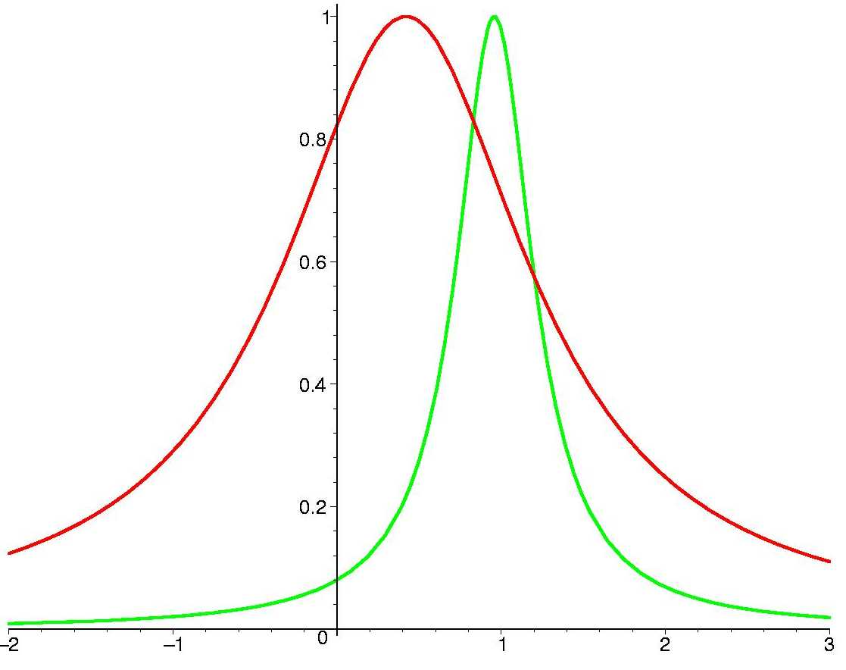
Resonance
Dependence of mixing on density,
energy has a resonance character
sin² 2θ_{m}
ν
ν
In resonance: sin² 2θ_{m} = 1
sin²2θ₁₂ = 0.825
sin²2θ₁₃ = 0.08
→ flavor mixing is maximal
l_{ν} = l₀ cos2θ
Vacuum
oscillation
length
~
Refraction
length
~
Resonance width: Δn_{R} = 2n_{R} tan2θ
density
l_{ν} / l₀
~ n E
θ_{m} → 0
θ_{m} = θ
θ_{m} = π/4
θ_{m} → π/2
Mixing is suppressed
at high densities
Δm²
2E
Flavor states coincide with eigenstates and vice versa
|V| >>

Slide 18
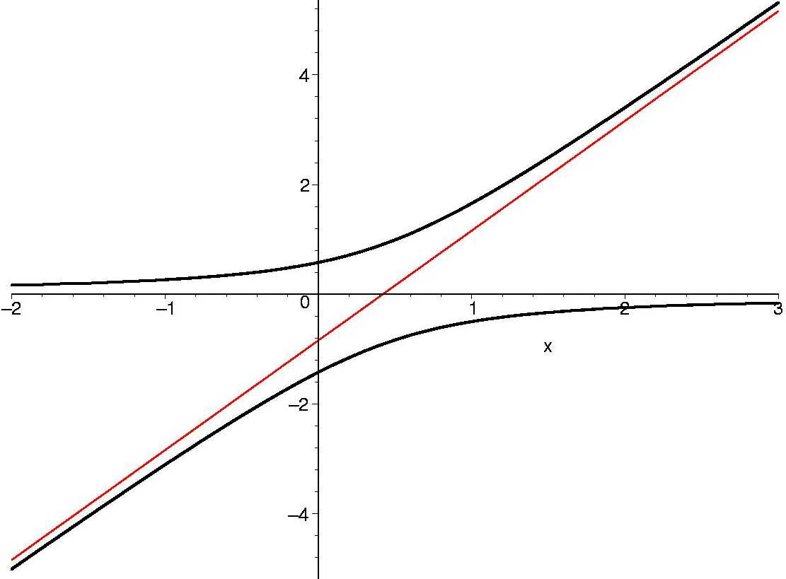
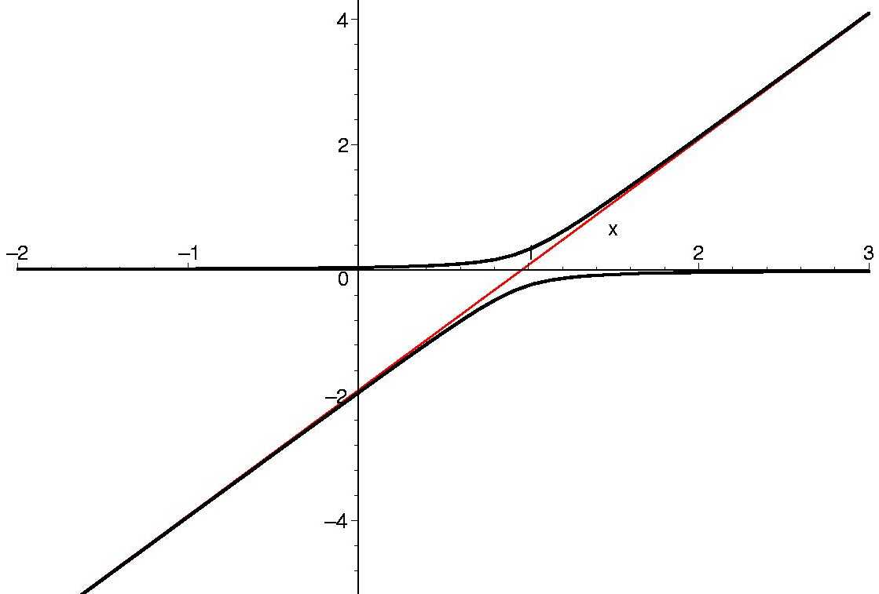
Level crossing
H_{im}
resonance
sin² 2θ₁₂ = 0.825
V. Rubakov, private comm.
N. Cabibbo, Savonlinna 1985
H. Bethe, PRL 57 (1986) 1271
ν_{2m}
ν_{e}
ν_{μ}
Dependence of the eigenvalues
on the matter potential (density):
ν_{1m}
l_{ν} / l₀
l_{ν}
l₀
2E V
Δm²
=
Large
mixing
Crossing point - resonance
sin² 2θ₁₃ = 0.08
ν_{e}
l_{ν}
l₀
= cos 2θ
ν_{3m}
ν_{τ}
l_{ν} / l₀
In the crossing point
- the level split is minimal
- the oscillation length is maximal
ν_{2m}
Small
mixing

Slide 19
Oscillation length in matter
Oscillation
length in vacuum
4π Ε
Δm²
l_{ν} =
Refraction
length
l₀ =
2π
2 G_{F}n_{e}
- determines the phase produced
by interaction with matter
l_{m}
l_{ν} /sin2θ
(maximum at
l_{ν} = l ₀ /cos2θ)
shifts with respect
resonance energy:
2π
H_{2m} - H_{1m}
l_{m} =
l_{ν} (E_{R}) = l ₀ cos2θ
l₀
converges to the refraction length
~ l_{ν}
E_{R}
E

Slide 20
Level crossings
Normal mass ordering
E_{L}
E_{H}
E
0.1 GeV
6 GeV
Resonance region
High energy range

Slide 21
Flavor in matter
ν_{e}
ν_{μ}
ν_{τ}
Density increase →
Normal mass hierarchy, neutrinos
ν_{3m}
ν_{2m}
ν_{1m}
1-2 resonance
1-3 resonance

Slide 22
Oscillations
in matter

Slide 23
Oscillations in matter
Constant density medium:
the same dynamics as in vacuum
ν_{k} → ν_{mk}
ν_{1m}
Mixing changed
θ → θ_{m}(n)
Difference of eigenvalues
changed
ν_{2m}
x
Δm²
2E
→ ΔH
difference of phase
velocities changed
Δm²
2E
V = cos2θ

Slide 24
Oscillations in matter
Probability in
constant density
πL
l_{m}
P(ν_{e} ◊ ν_{a}) = sin²2θ_{m} sin²
depth of
oscillations
oscillatory
factor
half-phase φ
θ_{m}(E, n )
- mixing angle in matter
l_{m}(E, n )
– oscillation length in matter
l_{ν} → l_{m}
l_{m} = 2 π/(H_{2m} – H_{1m})
Maximal effect:
sin ²2θ_{m} = 1
MSW resonance condition
φ = π/2 + πk

Slide 25
Resonance enhancement
Constant density
ν
ν_{e}
ν_{e}
Source
Detector
layer of length L
F₀(E)
F(E)
Depth of oscillations determined by sin²2θ_{m}
the oscillation length, l_{m}
depends on neutrino energy
For neutrinos propagating in the mantle of the Earth

Slide 26
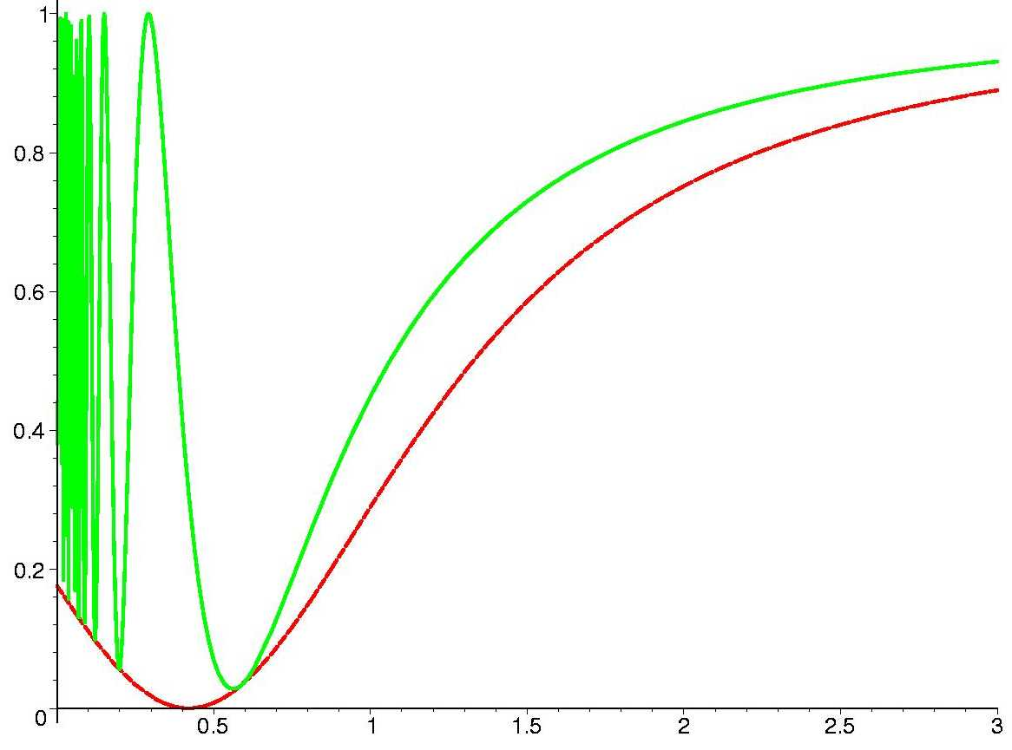
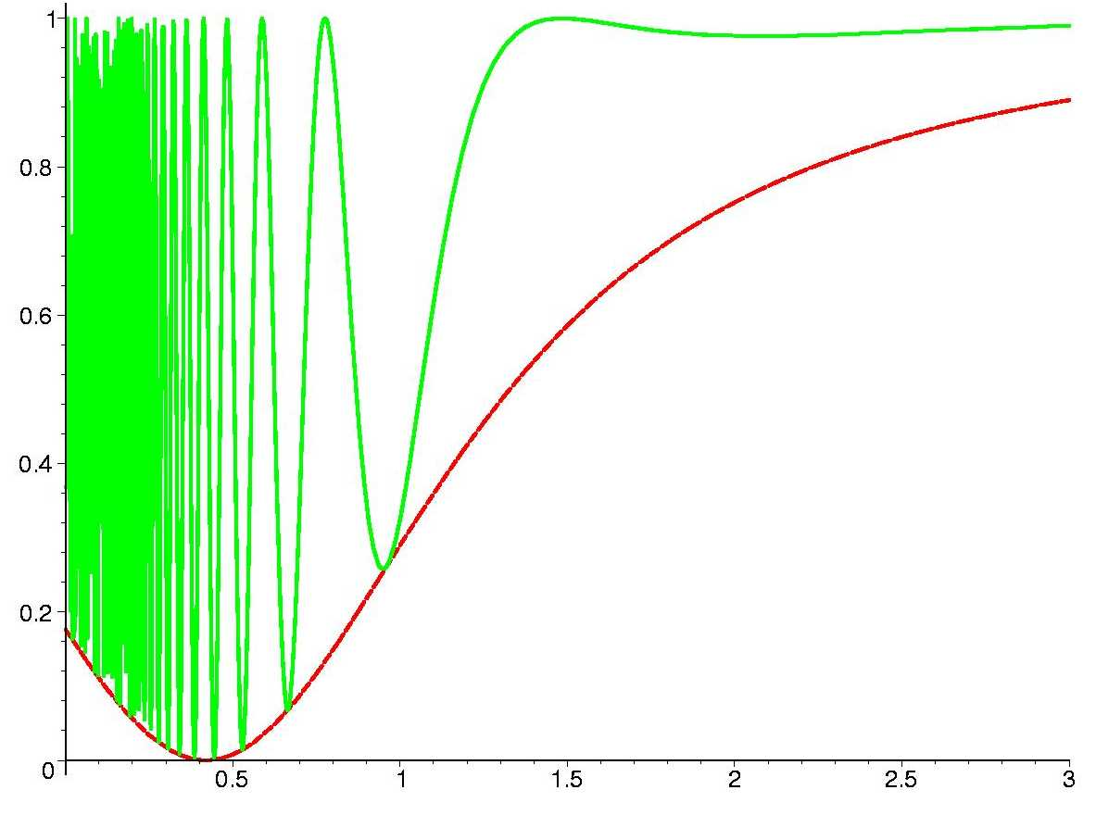
Survival probability
Large mixing sin²2θ = 0.824
Layer of length L
k = πL / l₀
ν
thin layer
k = 1
thick layer
k = 10
F (E)
F₀(E)
sin² 2θ_{m}
E/E_{R}
E/E_{R}

Slide 27
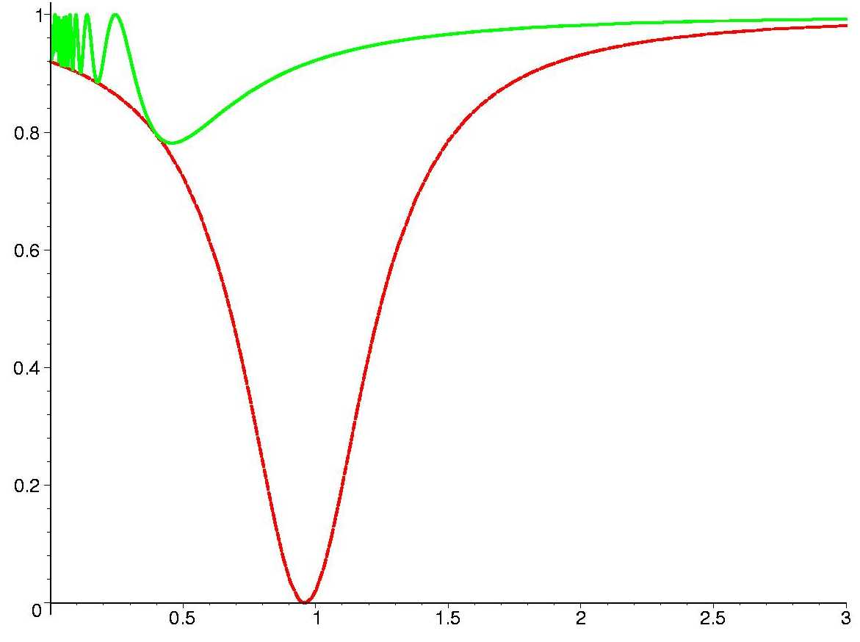
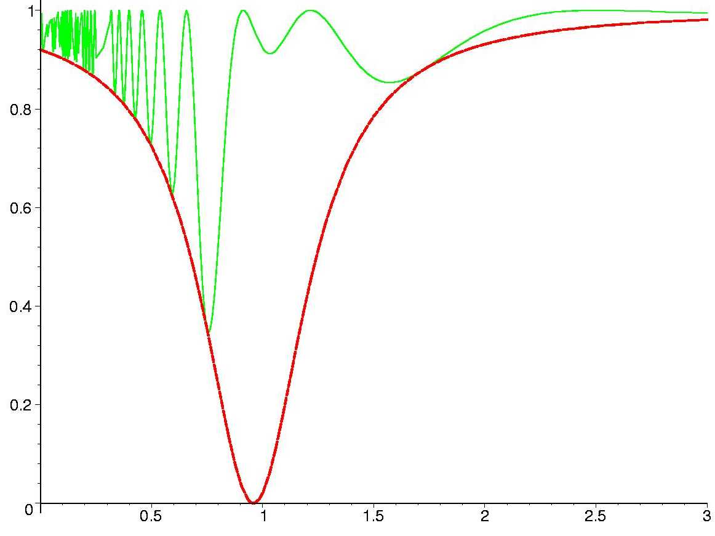
Oscillation in the Earth, ORCA
Small mixing sin²2θ = 0.08
thin layer
k = 1
thick layer
k = 10
F (E)
F₀(E)
sin² 2θ_{m}
E/E_{R}
E/E_{R}

Slide 28
Resonance enhancement
In maximum
1
B
1
2
2

Slide 29
Graphic representation
E₁ < E₂ < E₃ < E₄
E₁
E₂
E₃
Precession on the surface of the cone
E₄
~ E_{R}
Resonance enhancement

Slide 30
Adiabatic
conversion

Slide 31
The MSW effects
- the flavor transformations driven by dependence of the mixing in matter on density or/and energy of neutrino.
ν_{f} = U^{m}(E, n) ν_{H}
Flavor states
Mixing matrix
in matter
Eigenstates of Hamiltonian in mater -
Eigenstates of propagation
Mixing angles
θ^{m}(E, n)
become dynamical variables
in contrast, to mixing in vacuum
Dependence of sin²2θ^{m} on E and n has resonance character

Slide 32
Evolution equation for eigenstates. Adiabaticity
Varying density
Inserting in evolution equation for the flavor states
ν_{f} = U^{m} ν_{m}
dν_{m}
dt
dU^{m}
dt
i = H^{diag} + i U^{m+} ν_{m}
H^{diag} = diag(H_{1m}, H_{2m}, H_{3m})
off - diagonal
If density changes slowly enough, so that
dU^{m}
dt
U^{m+} << H_{im} - H_{jm}
adiabaticity condition
ij
equation for the eigenstates splits:
dν_{m}
dt
i = H^{diag} ν_{m}
ν_{im} ν_{jm}
The eigenstates evolve independently, transitions are absent
as in constant density
In contrast to constant density case the flavors of ν_{im} change according to density change

Slide 33
Equation for eigenstates for 2ν
Explicitly for 2ν mixing
dν_{f}
dt
ν_{e}
ν_{μ}
ν_{1m}
ν_{2m}
i = H_{tot} ν_{f}
ν_{f} =
ν_{m} =
Inserting ν_{f} = U(θ_{m}) ν_{m}
θ_{m} = θ_{m}(n _{e}(t))
dθ_{m}
dt
ν_{1m}
ν_{2m}
off-diagonal
terms imply
transitios
ν_{1m}
ν_{2m}
0
Η_{2m} - H_{1m}
d
dt
i
i =
dθ_{m}
dt
-i
ν_{1m} ν_{2m}
off-diagonal elements can be neglected
no transitions between eigenstates
propagate independently
dθ_{m}
dt
if
<< H_{2m} - H_{1m}

Slide 34
Adiabaticity
External conditions
(density) change slowly
the system has time to
adjust them
dθ_{m}
dt
Adiabaticity condition
<< H_{2m} - H_{1m}
transitions between
the neutrino eigenstates
can be neglected
The eigenstates
propagate independently
ν_{1m} ←→ ν_{2m}
Shape factors of the eigenstates do not change
Crucial in the resonance layer:
- the mixing changes fast
- level splitting is minimal
Adiabaticity condition
Δr_{R} > l_{R}
if vacuum mixing is small
Δr_{R} = n_{R} tan2θ / (dn/dx)_{R}
l_{R} = l_{ν} / sin2θ
width of the resonance layer
oscillation length in resonance

Slide 35
Adiabatic parameter
**
dθ_{m}
dt
Adiabaticity condition:
γ << 1
γ =
H_{2m} - H_{1m}
most crucial in the resonance where
the mixing angle in matter changes fast
l_{R}
2π Δr_{R}
γ_{R} =
Δr_{R} = h_{n} tan2θ
is the width of the resonance layer
n
dn/dx
h_{n} =
is the scale of density change
l_{R} = l_{ν}/sin2θ
is the oscillation length in resonance
Explicitly:
γ_{R} =
4πΕ cos2θ
Δm² sin²2θ h_{n}

Slide 36
Adiabatic conversion
ν_{2m}
ν_{1m}
resonance
x
if density
changes
slowly
- the amplitudes of the wave packets do not change
flavors of the eigenstates being determined by mixing
angle follow the density change

Slide 37
Non-oscillatory transition
resonance
vacuum
ν_{e}
ν_{2m}
ν₂
sin θ
<ν_{e}|ν₂> = sinθ
x
Single eigenstate:
no interference
no oscillations
phase is irrelevant
Survival probability
P_{ee} = sin²θ
if density changes slowly (adiabatically)
→ no other eigenstate appear
This happens when mixing is very small
in matter with very high density
ν_{2m}→ν₂
Mixing and therefore the flavor content
changes according to density change

Slide 38
Non-oscillatory transition
High density
resonance
vacuum
ν_{e}
~ ν_{2m}
ν₂
sin θ
<ν_{e}|ν₂> = sinθ
x
mixing is very small
Survival probability
Single eigenstate:
no interference
no oscillations
phase is irrelevant
P_{ee} = sin²θ
if density changes slowly (adiabatically)
→ no other eigenstate appear
ν_{2m}→ν₂
Mixing and therefore the flavor content
changes according to density change

Slide 39
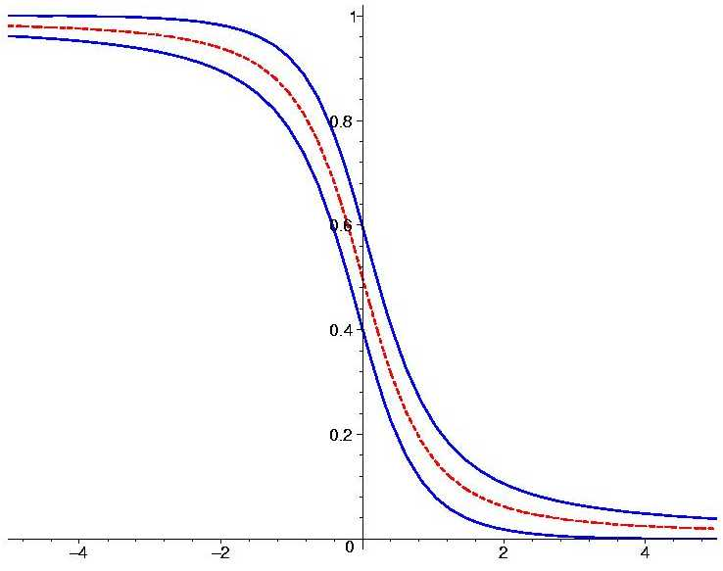
Spatial picture
Adiabatic conversion
interplay of adiabatic
conversion and oscillations
survival probability
Non-oscillatory transition is modulated by oscillations
distance

Slide 40
**
Spatial picture
The picture is universal in terms of variable y = (n_{R} - n ) / Δn_{R}
no explicit dependence on oscillation parameters, density distribution, etc.
only initial value y₀ matters
resonance layer
production
point
y₀ = - 5
resonance
survival probability
oscillation
band
averaged
probability
(n_{R} - n) / Δn_{R}
(distance)

Slide 41
Adiabatic conversion probability
Sun, Supernova
Initial state:
ν(0) = ν_{e} = cosθ_{m}⁰ ν_{1m}(0) + sinθ_{m}⁰ ν_{2m}(0)
Mixing angle in matter
in production point
Adiabatic evolution
to the surface of
the Sun (zero density):
ν_{1m}(0) → ν₁
ν_{2m}(0) → ν₂
iφ
Final state:
ν(f) = cosθ_{m}⁰ ν₁ + sinθ_{m}⁰ ν₂ e
Probability to find
ν_{e} averaged over
oscillations
P_{ee} = |<ν_{e}|ν(f)>|² = (cosθ cosθ_{m}⁰)² + (sinθ sinθ_{m}⁰)²
= 0.5[ 1 + cos2θ_{m}⁰ cos2θ ]
or
P_{ee} = sin²θ + cos 2θ cos²θ_{m}⁰

Slide 42
Oscillations vs. adiabatic conversion
Different
degrees of
freedom
Oscillations
Adiabatic conversion
Vacuum or uniform medium
with constant parameters
Non-uniform medium or/and medium
with varying in time parameters
Phase difference increase
between the eigenstates
Change of mixing in medium =
change of flavor of the eigenstates
φ(t)
θ_{m} (t)
Mixing
does not change
Phase is irrelevant
θ_{m} (E)
In non-uniform medium:
interplay of both processes

Slide 43
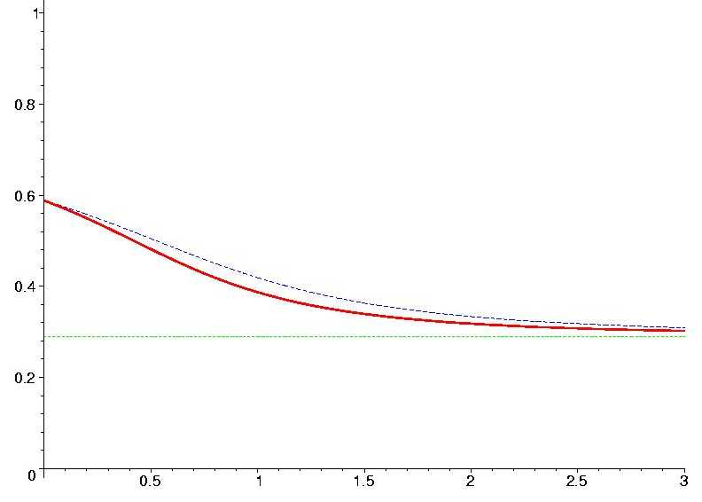
Resonance oscillations vs. adiabatic conversion
Passing through the matter filter
ν
F (E)
F₀(E)
Constant density
Monotonously changing
density
k = π L/ l₀
E/E_{R}
E/E_{R}

Slide 44
Adiabaticity violation
dθ_{m}
dt
If density n_{e}(t) changes fast
~ |H_{2m} - H_{1m} |
the off-diagonal terms in the Hamiltonian can not be neglected
transitions
ν_{1m} ν_{2m}
ν_{1m} ν_{2m}
Admixtures of in a given propagating neutrino state change
ΔH
E_{n}
``Jump probability’’
= penetration under barrier:
P₁₂ = e
H
H_{2m}
E_{n} = dθ_{m}/dt ~ 1/h_{n}
is the energy associated
to change of density
ΔH
H_{1m}
- 2π /γ_{R}
Landau-Zenner
P₁₂ = e
n
γ_{R} - adiabaticity parameter

Slide 45
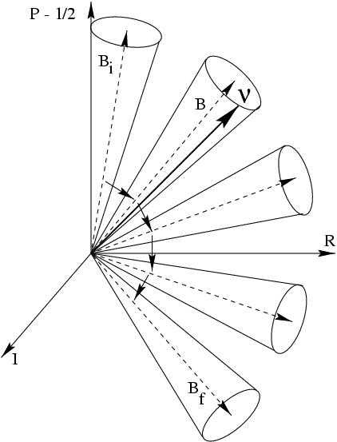
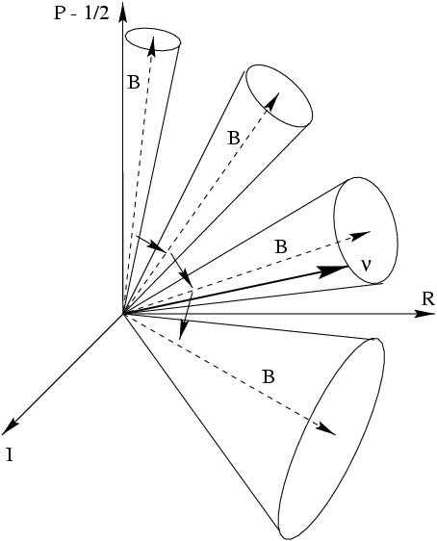
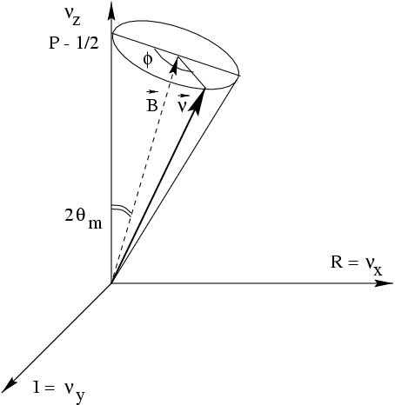
Adiabatic conversion
Pure adiabatic conversion
Partially adiabatic conversion
ν _{e}
ν_{μ}

Slide 46
Parametric
effects
Propagation on the Earth
Wavy field
In central parts of SN
in neutrino field –collective oscilations

Slide 47
Parametric enhancement
V. Ermilova ,V. Tsarev, V. Chechin,
Krat. Soob. Fiz. # 5, 26, (1986)
Strong transition if there is a harmonic modulation of density profile
n (x) = <n> + n₁ cos ω_{d} x
Parametric resonance condition:
k ω_{d} = Δ_{m}(<n>) , k = 1, 2 …
Δm²
2 E
Δ_{m}(<n>) = [(cos2θ – 2VE/Δm²)² + sin²2θ ]^{½}
is frequency of oscillations for
the average density
P
With modulations
Realized in astrophysical objects?
Without modulations
x

Slide 48
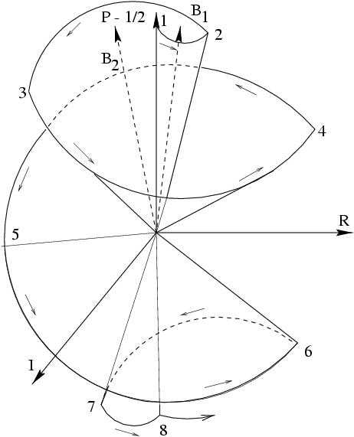
Parametric enhancement of oscillations
Parametric oscillations
E. Kh. Akhmedov , 1988
Φ₁ = Φ₂ = π
2θ₂^{m}
2θ₁^{m}
``Castle wall profile’’
V
Φ₁
Φ₂
θ₁^{m}
θ₂^{m}
1 2 3 4 5 6 7
``Castle wall profile’’

Slide 49
Parametric enhancement in the Earth, 1-3 mode
1
In the Earth
mantle
2 3
1
4
core
2
mantle core mantle
3
mantle
4

Slide 50
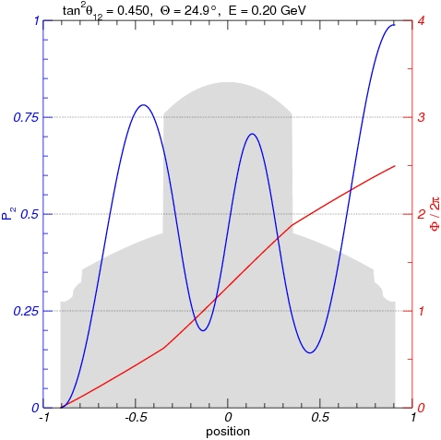
Parametric enhancement in the Earth,1-2 mode
mantle
1
core
3
4
2
2
mantle
4
3
1

Slide 51
Fuzzy dark matter
A. Berlin, 1608.01307 [hep-ph]
Modulating mass?
Ultra-light scalar DM
2 ρ (x)
m_{φ}
φ (t, x ) ~ cos (m_{φ} t )
Couples to neutrinos
g_{φ} φ ν_{i} ν_{j} + …
→ mass states oscillate
give contribution to neutrino mass and modifies mixing
δm (t) = g_{φ} φ (t)
Δθ_{m} (t) = g_{φ} φ (t) / Δm_{ij}
Neutrinos propagating in this field will experience variation of mixing with frequency given by m_{φ}
For m_{φ} = 10⁻²² eV, the modulation length l_{mod} = 2π/m_{φ} = 10¹⁷ cm
Parametric resonance: l_{mod} = l_{ν}
For solar mass splitting
E_{res} = 3 x 10³ PeV (10⁻²² eV/m_{φ} )
E_{res} = 3 PeV for m_{φ} = 10⁻¹⁹ eV

Slide 52
Neutrino-neutrino
scattering
and collective
transformations

Slide 53
νν
-scattering
ν_{e}
ν_{e}
Refraction in
neutrino gases
ν_{e}
ν_{b}
Z⁰
Z⁰
ν_{b}
ν_{b}
ν_{b}
ν_{e}
t-channel
ν_{e}
(p)
elastic forward scattering
→ coherent
ν_{b}
ν_{b}
(q)
V = 2 G_{F} (1 – v_{e} v_{b} ) n_{b}
ν_{e}
velocities
u-channel
ν_{e}
(p)
J. Pantaleone
Momentum exchange = flavor exchange
ν_{e}
(q)
ν_{b}
→ flavor mixing
ν_{b}
Can it be coherent?

Slide 54
Coherence of flavor exchange
J. Pantaleone
S. Samuel
V.A. Kostelecky
ν_{e}
Coherence if the background
is a mixture of flavor states:
projection
Φ_{ie}*
ν_{a}
for ith particle of background
ν_{e}
ν_{b}
|ν_{ib} = Φ_{ie} |ν_{e} + Φ_{iτ} | ν_{τ}
coherent
Φ_{ie} - (Φ_{iτ} -) amplitude to find ν_{e} ( ν_{τ} ) in ith bkgr. neutrino
ν_{b}
background
ν_{e}
Inverting
ν_{τ}
projection
Φ_{iτ}
|ν_{e} = Φ_{ie}* |ν_{b} + Φ_{iτ}* | ν_{a}
transition
ν_{e} + ν_{b} → ν_{τ} + ν_{b}
with amplitude ~ Φ_{ie}*Φ_{iτ} and unchanged background
→ summation over background neutrinos is coherent
This generates flavor non - diagonal potential
V_{eτ} ~ Σ_{i} Φ_{ie}*Φ_{iτ}
also diagonal

Slide 55
Neutrino term in the Hamiltonian
Contribution to the Hamiltonian in the flavor basis
|Φ_{ie}|²
Φ_{ie}*Φ_{iτ}
ν_{e}
ν_{τ}
H_{νν} =
2 G_{F} Σ_{i} (1 – v_{e} v_{b} )
Φ_{ie}Φ_{iτ} *
|Φ_{iτ}|²
where
Φ_{ie} = P_{be}
Φ_{iτ} = P_{bτ}
The Hamiltonian in symmetric form:
V_{ν} 2V_{ν} e^{iφ}
2V_{ν} e^{-iφ} - V_{ν}
H_{νν} = ½
where
V_{ν} ~ 2 G_{F} n(1 – v_{e} v_{b}) P_{be}
V_{ν} ~ 2 G_{F} n(1 – v_{e} v_{b}) P_{be}P_{bτ}
The effective coupling constants in V include probabilities

Slide 56
Total Hamiltonian
cos2θ ω_{p} + V_{e} + V_{ν} sin2θ ω_{p} + 2V_{ν} e^{iφ}
sin2θ ω_{p} + 2V_{ν} e^{-iφ} cos2θ ω_{p} - V_{e} - V_{ν}
ν_{e}
ν_{τ}
H = ½
includes the vacuum contribution: ω_{p} = Δm²/2E and
usual matter potential V_{e}
Neutrino potentials
V_{ν} ~ V_{ν}⁰ (1 – P^{B}_{eτ} )
if ν_{e} is produced
V_{ν} ~ V_{ν}⁰ P^{B}_{eτ} (1 – P^{B}_{eτ} )
φ = Arg [Φ_{e} Φ_{τ} *]
P^{B}_{eτ} (x) – effective transition probability of the background neutrinos
In the central parts of collapsing star
V_{e} >> V_{ν} >> ω

Slide 57
Evolution equation
Ensemble of neutrino polarization vectors P_{ω}
Negative frequencies
for antineutrinos
d_{t} P_{ω} = (- ωB + λL + μP) x P_{ω}
Vacuum mixing term
Usual matter
potential
Collective vector
+ inf
- inf
B = (sin 2θ , 0, cos2θ)
L = (0, 0, 1)
P = dω P_{ω}
ω = Δ m² /2E
λ = V = 2 G_{F} n_{e}
μ = 2 G_{F} n_{ν} (1 – cos θ_{νν})
The term describes
collective effects

Slide 58
Effective theory of collective oscillations
Difficult to solve although
Some results can be seen from general form of the evolution equation
effects which can lead to
strong flavor transformations
Conditions for these effects
problems of realizations of these conditions in realistic supernova

Slide 59
Total Hamiltonian and potentials
cos2θ ω_{p} + V_{e} + V_{ν} sin2θ ω_{p} + 2V_{ν} e^{iφ}
sin2θ ω_{p} + 2V_{ν} e^{-iφ} cos2θ ω_{p} - V_{e} - V_{ν}
ν_{e}
ν_{τ}
H = ½
Potentials
V_{ν} ~ V_{ν}⁰ (1 – P^{B}_{eτ} )
P^{B}_{eτ} = P_{eτ}
V_{ν} ~ V_{ν}⁰ P^{B}_{eτ} (1 – P^{B}_{eτ} )
non-linearity
P^{B}_{eτ} (x) – effective transition probability of the background neutrinos
V_{e} >> V_{ν} >> ω
H^{diag} ~ V_{e}
H^{non-diag} ~ V_{ν}⁰ P^{b}_{eτ} < V_{ν}⁰
φ ~ dt ΔH
ΔH ~ V_{e}
dφ/dt ~ V_{e}
if ω << V_{ν} , H depends on potentials only – evolution of neutrinos and antineutrinos is the same → bi-polar oscillations

Slide 60
Properties of potentials
Potentials are integrals of oscillation amplitudes which have oscillatory dependence on time.
Therefore potentials are also expected to be oscillatory functions of time determined by intrinsic frequencies
of the system
V_{e} , V_{ν}, ω_{p}, ω_{k}
Furthermore, there is the hierarchy of frequencies
V_{e} > V_{ν} >> ω

Slide 61
Two effects of enhancement
Phase velocity cancellation
Rotation of the fields that eliminates the phase from the off-diagonal terms leads to appearance of phase velocity in the diagonal terms
V^{r}(t) = V_{e} + V_{ν} - cos2θ ω_{p} - dφ/dt
if dφ/dt ~ V_{e} + V_{ν}
strong cancellation → matter suppression is removed
Oscillations with maximal depth and frequency 1/V_{ν}
Parametric enhancement
V_{ν} and V_{ν} - periodic functions
Parametric resonance if the frequency of modulations of potentials coincides with eigenfrequency of the probe neutrino

Slide 62
Instabilities and fast transition
in the flavor field
Exponential grow of the transition probabilities
Two conditions:
2θ_{m}
P_{eτ} ~ (2θ_{m})²
1. Phase velocity cancellation
2. Parametric enhancement
induced by modulations of
the neutrino potentials with
growing amplitude
V_{ν}
Δθ_{m} /Δt ~ θ_{m}
The cone angle and transition
probability increase exponentially
x

Slide 63
Backup

Slide 64
Modeling with castle wall profile
**
n
b
a
x
V_{a} V_{b}
Half – phases:
φ_{a} φ_{b}
L_{a} L_{b}
Mixing angles:
θ_{a} θ_{b}
Oscillation probability
E. Kh. Akhmedov
P = [1 - I²/(1 – R² )] sin² (n ζ)
ζ = arcos R
n – number of periods
x
I = I(φ_{a} , φ_{b}, θ_{a}, θ_{b} ) , R = R(φ_{a}, φ_{b}, θ_{a}, θ_{b} )
For φ_{a} φ_{b} << 1 the probability can be reduced to
P = sin ²2θ_{m}(V) sin² ½φ(V)
V_{a} L_{a} + V_{b} L_{b}
L_{a} + L_{b}
- averaged potential
V =

Slide 65
**
Conditions for strong transformations
1. Resonance oscillations
V^{r} << V’
V_{e} + V_{ν} + dφ‘/dt - cos2θ ω_{p} ~ 0
or dφ‘/dt ~ - V_{e} - V_{ν}
The system oscillate with maximal depth and frequency ~ V’
If there is no significant modulations of the non-diagonal element
2. Adiabatic conversion
Performing series of transformations of fields - exclude fast time variations in V^{r} and V’
~ ~
In new frame V^{r} and V’ may satisfy adiabatic condition →
strong transition if V^{r} changes from V^{r} >> V’ to V^{r} << V’
~ ~
~ ~

Slide 66
… continued
**
3. Parametric enhancement, resonance
Potentials are modulated by periodic functions, so that the mixing angle in medium tan2θ_{m} = - V’/ V^{r} varies with a period T_{θ}
Parametric enhancement if the frequency of modulations coincides with eigenfrequency of the system 1/T_{p}
T_{θ} = T_{p}
T_{p} =
2π
<V^{r} >² + <V’>²
<V^{r} > , <V’> - potentials averaged over modulations
Large transition probability develops over many periods

Slide 67
Summation over background neutrinos
Production region
interaction point
.
probe neutrino
p, ω_{p}
(x, t)
dx
k, ω_{k}
l
.
background neutrino
(x₀, t₀)
a = e, τ -flavor at the production
k - 3 momentum
l – length of trajectory from production
(x₀, t₀) to interaction point (x, t)
Production point - the point of last inelastic collision
→ (a, l, k) characterize a given mode
(x, t), k and l determine (x₀, t₀)

Slide 68
Total Hamiltonian and potentials
After integration
cos2θ ω_{p} + V_{e} + V_{ν} sin2θ ω_{p} + 2V_{ν} e^{iφ}
sin2θ ω_{p} + 2V_{ν} e^{-iφ} cos2θ ω_{p} - V_{e} - V_{ν}
ν_{e}
ν_{τ}
H = ½
Potentials
V_{ν} = dk dl [V_{ν}^{e} (k, l) - V_{ν}^{τ} (k, l)] (1 – P_{eτ} (k, l) )
V_{ν} e^{iφ} = dk dl [V_{ν}^{e} (k, l) - V_{ν}^{τ} (k, l)] e^{iφ(k,l)} P_{eτ} (k, l) (1 – P_{eτ} (k, l))
where
V_{ν}ª (k, l) = 2 G_{F} n_{ν}ª (k, l) (1 – v_{p} v_{k} )
a = e, τ
n_{ν}ª (k , l) - number density of neutrinos emitted from (x₀, t₀)
and arriving at the point (x, t)

Slide 69
Removing the phase
Off-diagonal term: introduce real V’ and the phase φ‘ as
sin2θ ω_{p} + 2V_{ν} e^{iφ} = V’ e^{-iφ}’
(*)
Transformation of the fields
ψ = Uψ’
U = diag (e ^{0.5 iφ}’, e^{-0.5iφ}’ )
it does not change flavor probabilities.
Hamiltonian for ψ’
H = ½
V^{r}(t) V’ (t)
V’(t) - V^{r}(t)
V^{r}(t) = V_{e} + V_{ν} - cos2θ ω_{p} + dφ‘/dt
V’ (t) is def. in (*)
Probe neutrino propagation in external neutrino potentials
(as in the case of NSI but) with non-trivial time dependence

Slide 70
The problem
Evolution equation for the probe particle
d Φ_{p}
d t
x = ct – point along the ν_{p} trajectory
i = H (Φ_{ib}^{x}) Φ_{p}
Total Hamiltonian depends on the wave functions of all background neutrinos Φ_{ib}^{x} which cross the probe neutrino trajectory in a point x
To find Φ_{ib}^{x} one needs to solve the corresponding evolution equation for each ν_{ib}
d Φ_{ib}
d t
i = H (Φ_{jb}^{y}) Φ_{ib}
y = ct along the ν_{ib} trajectory
Here H depends on the wave functions of all background neutrinos Φ_{jb}^{y} which cross the ν_{ib} trajectory in a point y
The equation should be integrated over y from the ν_{ib} production
point to x
→ Huge number of coupled equations

Slide 71
The problem
x
Stationary case: pattern does not depend on time
ν_{p}
Modes involved are characterized by (x₀, k, a)
ν_{ib}
a = e, τ -flavor at production
x₀ - production point
k - momentum
ν_{jb}
y
Specific limits of integration for each point
Modes with the same set (x₀, k, a) evolve in the same way
Discretize parameters – numerical solutions

Slide 72
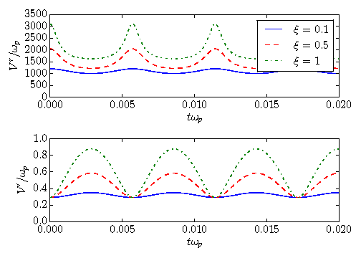
Potentials: time dependence
Combining different terms in the
Hamiltonian (in rotating frame)
V^{r}(t) V’ (t)
V’(t) - V^{r}(t)
H = ½
including usual matter potential
V_{e} which dominates
V_{e} = 10³ ω_{k}
and vacuum terms
Neutrino to matter potential ratio
V_{ν}⁰
V_{e}
ξ =
V_{r} and V’ as functions of the time for different values of ξ. A_{β} = 1.1001, ω_{p} = ω_{k}

Slide 73
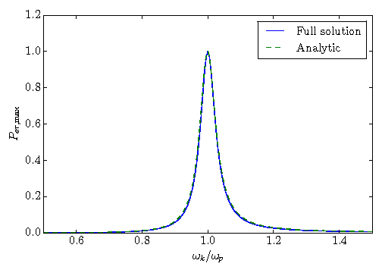
Parametric resonance
Dependence of the depth of parametric oscillations on ω_{k} /ω_{p}
A_{β} = 1.1001, V_{ν}⁰ = 100 ω_{p}
V_{ν}⁰ = 100 ω_{p}
Parametric resonance condition:
- cos2θ ω_{p} + V_{e} + V_{ν}⁰ = A_{β} Δ_{m}
Frequency of oscillations of the probe neutrino
determined by the averaged density
Frequency of modulations
of the potentials
Width of the resonance
Γ / ω_{k} = sin 2θ ξ (1 + A_{β} )
proportional to ξ

Slide 74
Inverse problem:
Find potentials and their time dependences or general conditions for potentials which can lead to effects found in certain simplified models
Synchronized oscillations
Fast flavor transitions
As parametric effect with increasing amplitude of periodic modulations
Bi-polar oscillations
As parametric effect for negligible ω → transition is the same for neutrinos and antineutrinos
Spectral splits
Check how realistic are these conditions in realistic supernova

Slide 75
Mixing in matter – dynamical variable
S.P. Mikheyev, A.Y.S. 1985
Since
H (n_{e}, E) = H₀(E) + V(n_{e})
the mixing matrix in matter which diagonalizes H (n_{e}, E )
U^{m} = U^{m}(n_{e}, E)
depends on energy and density → becomes dynamical variable in non-uniform medium
in contrast to vacuum mixing which is constant
Inverting relation:
ν_{m} = U^{m+}(n_{e}, E) ν_{f}
which means that flavor composition of eigenstates depends on n_{e} and E

Slide 76
Eigenstates in matter
Eigenstates of the Hamiltonian in matter:
H (n_{e}, E ) = H₀ + V (n_{e})
Play the same role as mass states in vacuum
ν_{k} → ν_{mk}
k = 1, 2, 3
In matter with constant density ν_{mk} propagate independently.
The Hamiltonian H in basis of ν_{mk} is diagonal.
Consequently, equation of motions for them split.

