Slide 1
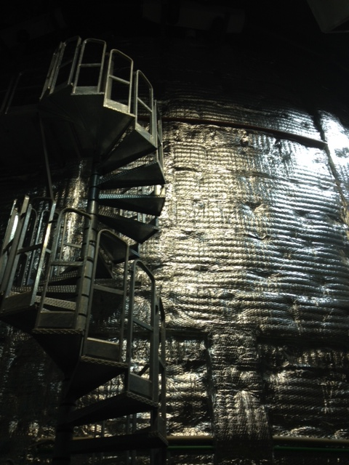
III. Sources,
Experiments,
Anomalies

Slide 2
Set-up
Continuous sources
ν
ν_{α}
medium
source
medium
detector
ν - production
Vacuum, VEV
matter
Detection of
ν - signal
Elementary processes
Medium effect,
physical conditions ,
parameters of
medium
Probe properties
of space, medium
- interactions,
probe of target
(nuclei, nucleons ...)
Fluxes
Energy spectra
Flavor and
Charge -content
Info about sources

Slide 3
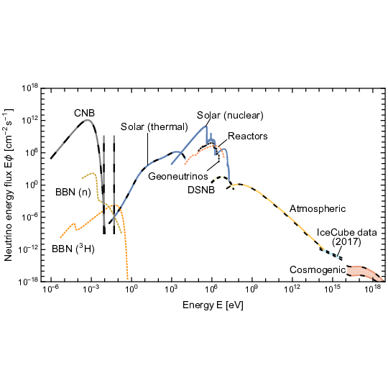
Grand Unified neutrino spectrum at the Earth
E.Vitagliano, I. Tamborra , G.Raffelt
Rev.Mod.Phys. 92 (2020) 45006
1910.11878 [astro-ph.HE]
accelerators

Slide 4
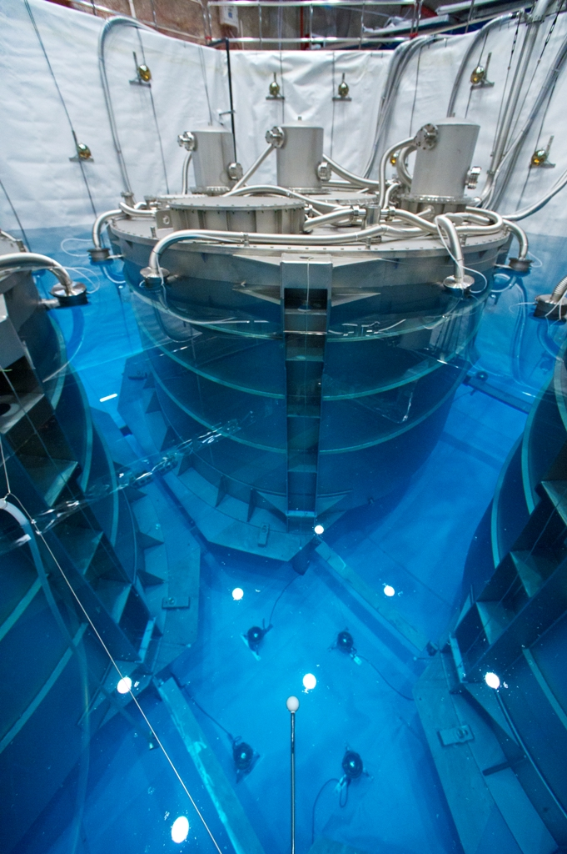
Reactor
neutrinos
ν_{e} + p → e⁺ + n

Slide 5
Source and fluxes
Atomic rectors: commercial, research
Fission of Uranium and Plutonium nuclei by neutrons
Neutron-rich secondary nuclei → beta decays → electron antineutrinos
About 6 ν per fission
Total flux related to thermal power
Computations of spectra
Ab initio,
inversion of spectrum of electrons

Slide 6
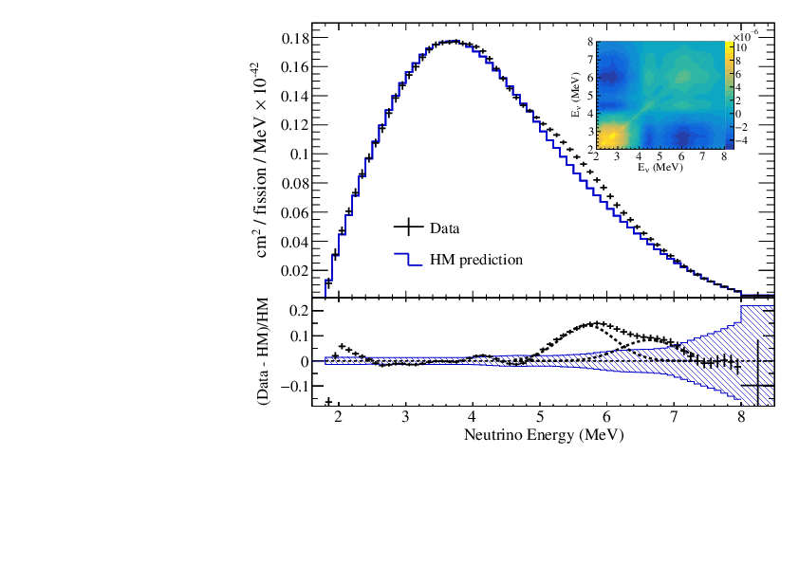
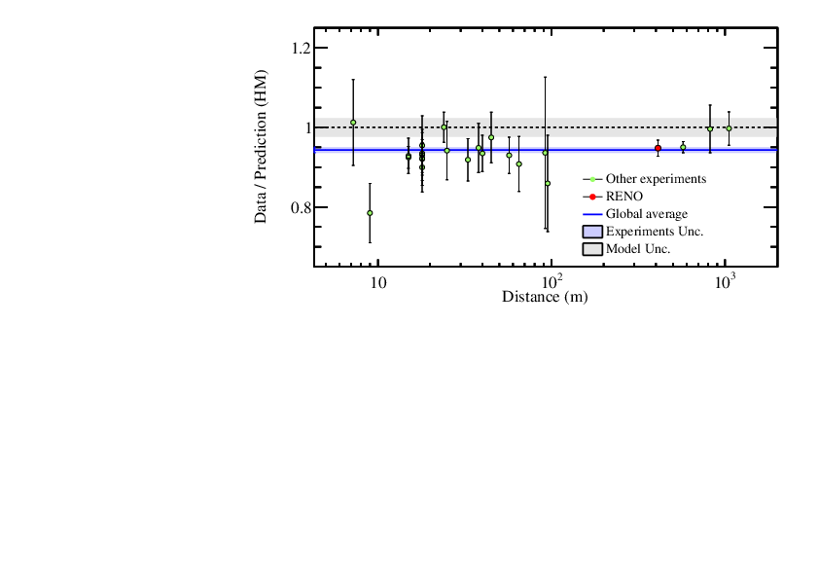
Spectrum
Hanbit Nuclear
Power Plant: 6 reactors
RENO Collaboration,
2010.14989 [hep-ex]
ν_{e} spectrum from unfolding:
a measured IBD prompt spectrum
vs. Huber-Mueller (HM) prediction
The oscillation effect is removed using the measured θ₁₃ to obtain
the spectrum at reactor.
The ν_{e} event rates as a function
of the distance from a reactor,
relative to the HM
(Huber Mueller) prediction.
RAA
IBDyield/HM
0.941 ± 0.019

Slide 7
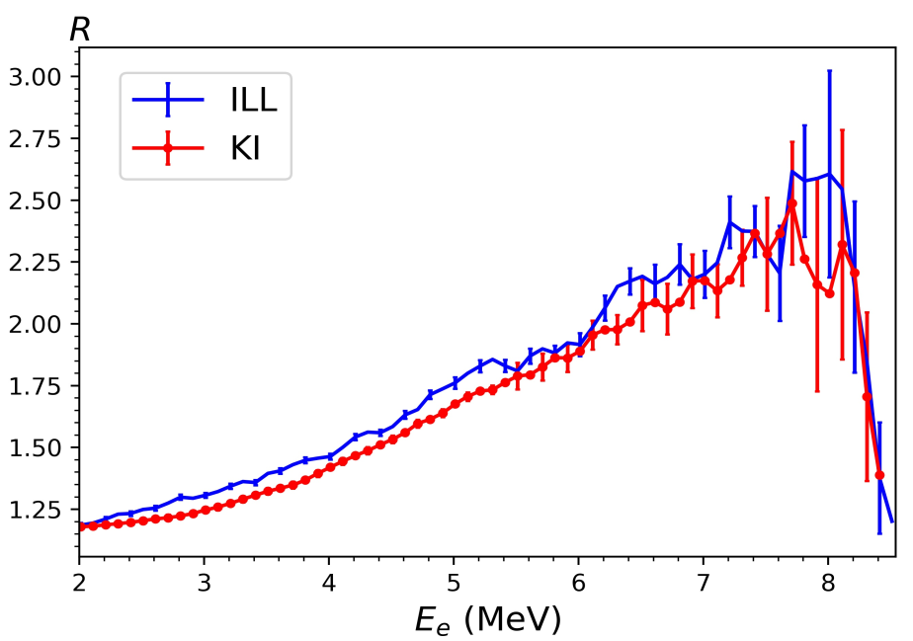
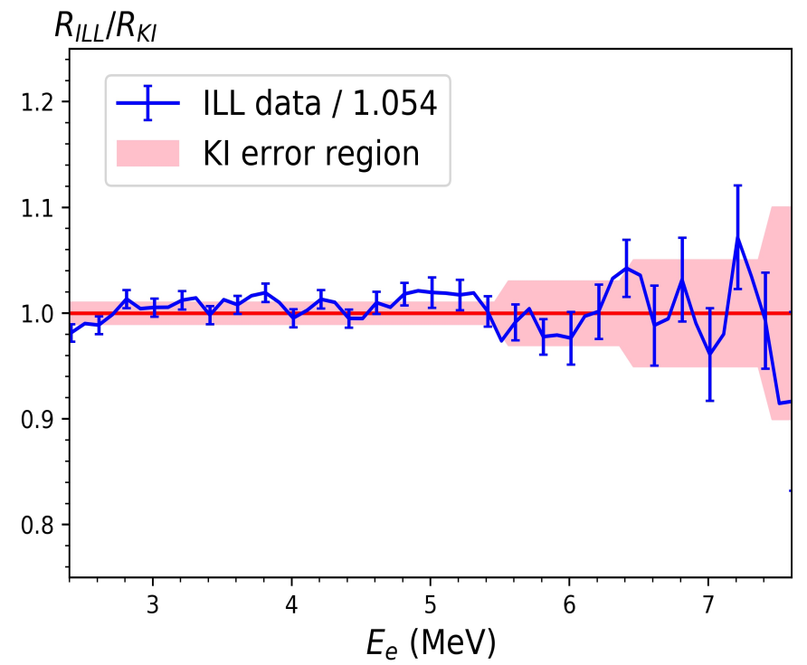
Re-evaluation of RAA
**
V. Kopeikin, et al.
2103.01684 [nucl-ex]
Re-evaluating reactor antineutrino spectra with new measurements of the ratio between 235U and 239Pu spectra
RAA
ILL measurements of IBD spectrum, inversion → ν – spectrum,
with various corrections 5 -10% up
KI – Kurchatov institute
Ratio of cumulative spectra
R = S₅ /S₉
If correct - RAA disappears
R(ILL) = 0.959 R(KI)

Slide 8
Propagation
Nearly vacuum oscillations ν_{e} → ν_{μ}, ν_{τ}
Matter effects in KamLAND < 1%
Propagation decoherence effect is negligible
Oscillation effect: disappearance of ν_{e} –flux
Which depends on energy and distance

Slide 9
Reactor neutrino legacy
Discovery of neutrinos 1953 – 56 Reines-Cowan
Study of neutrino interactions
Discovery of oscillations with LMA (solar) parameters KamLAND
Discovery of 1-3 mixing Double CHOOZ RENO Daya Bay
Bounds on new physics (magnetic moments, NSI, etc)
Searches for (bounds on) sterile neutrinos (NEOS, PROSPECT, DANSS, STEREO)

Slide 10
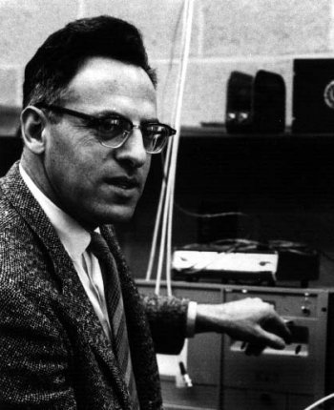
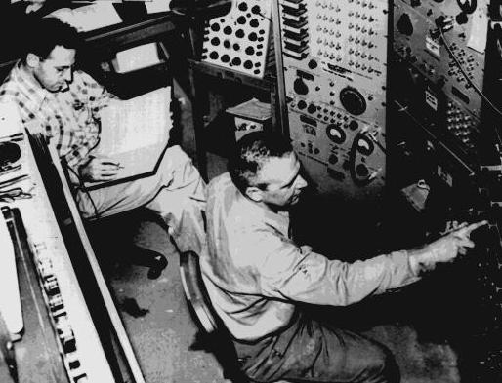
Discovery of neutrinos
**
F. Reines and S. L. Cowan
F. Reines

Slide 11
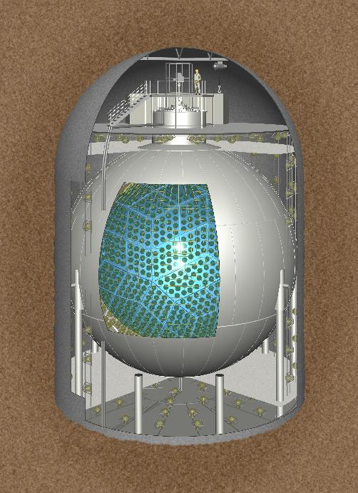
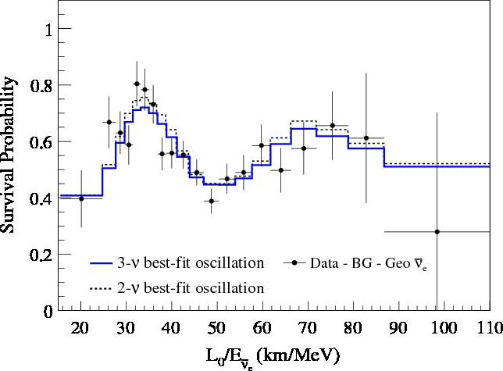
KamLAND
Kamioka Liquid Anti Neutrino Detector
53 atomic reactors
< L> ~ 180 km
Scintillator detector
1000 ton of mineral oil
D = 18 m 1879 PMT
ν_{e} + p → e⁺ + n

Slide 12
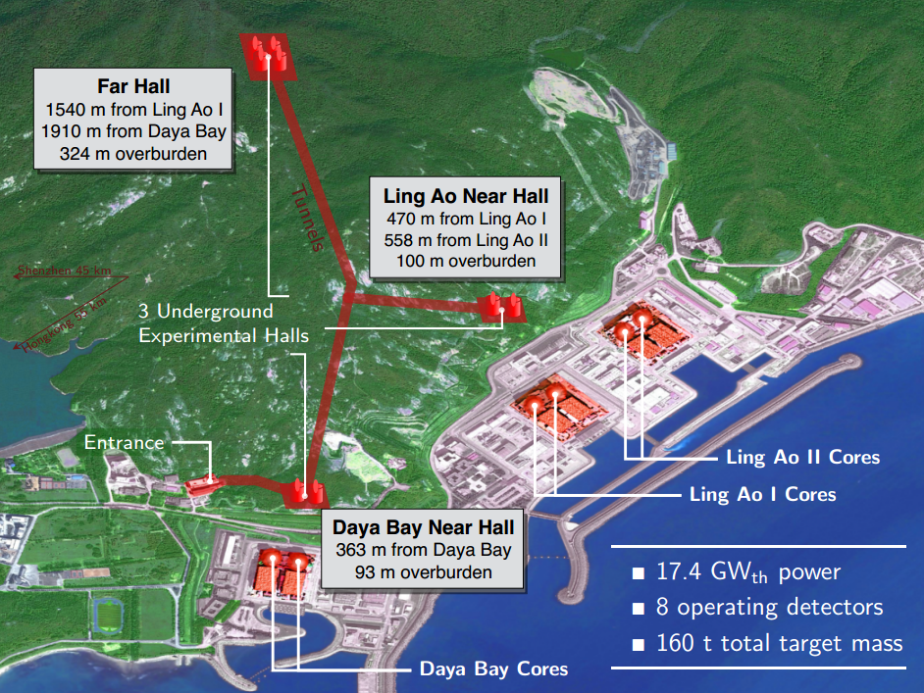
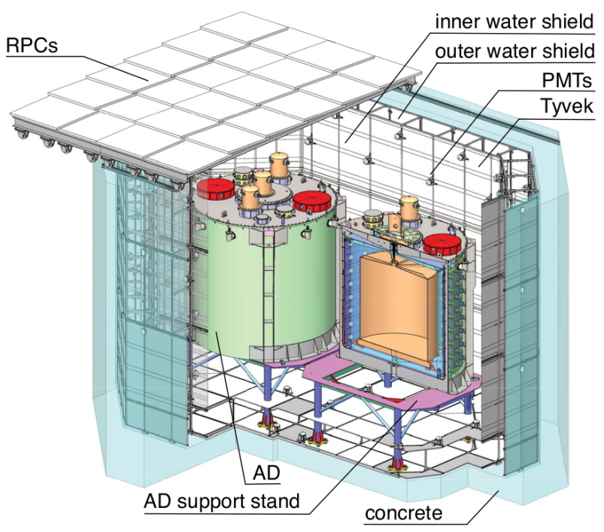
Daya Bay experiment
Daya Bay Collaboration, F.P. Ann et al,
Phys.Rev.Lett. 130 (2023) 16, 161802
2211.14988 [hep-ex]
and 1-3 mixing
Eight identical gadolinium-doped liquid scintillator detectors.
Shutdown at the end of 2020.
Acquired nearly 10⁶ candidates with neutron captured on gadolinium.

Slide 13
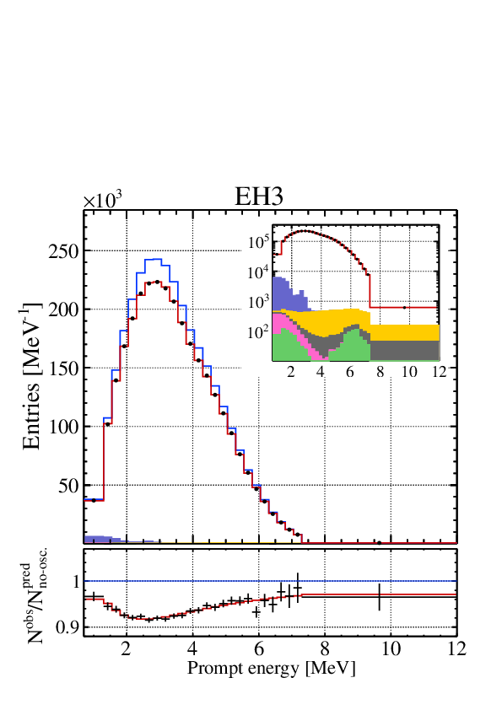
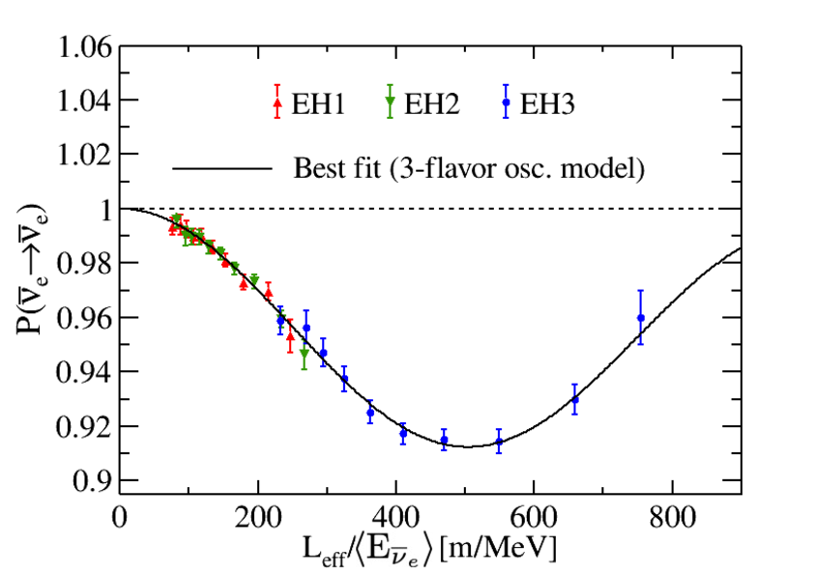
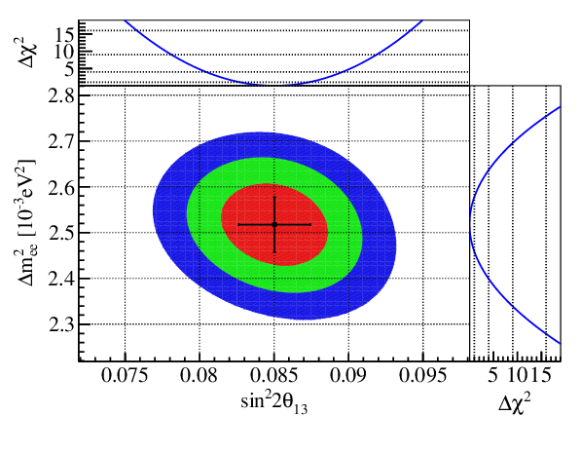
Daya Bay results
Daya Bay Collaboration, F.P. Ann et al,
Phys.Rev.Lett. 130 (2023) 16, 161802
2211.14988 [hep-ex]
sin⁡² 2θ₁₃ = 0.0851 ± 0.0024,
Δm₃₂² = (2.466 ± 0.060) 10⁻³ eV²(NO)
Δm₃₂² = - (2.571 ± 0.060) 10⁻³ eV² (IO)

Slide 14
Sterile neutrinos

Slide 15
(3 + 1) scheme
ν_{e}
ν_{s}
ν_{μ}
ν_{τ}
LSND/MiniBooNE: vacuum
oscillations
ν₄
P ~ 4|U_{e4} |²|U_{μ4} |²
restricted by short baseline exp.
BUGEY, CHOOZ, CDHS, NOMAD
mass
Δm²₄₁
For reactor and source
experiments
ν₃
Δm²₃₁
ν₂
P ~ 4|U_{e4}|² (1 - |U_{e4}|²)
ν₁
Δm²₂₁
With new reactor data:
- additional radiation in the universe
- bound from LSS?
Δm₄₁² = 1.78 eV²
( 0.89 eV²)
U_{e4} = 0.15
U_{μ4} = 0.23

Slide 16
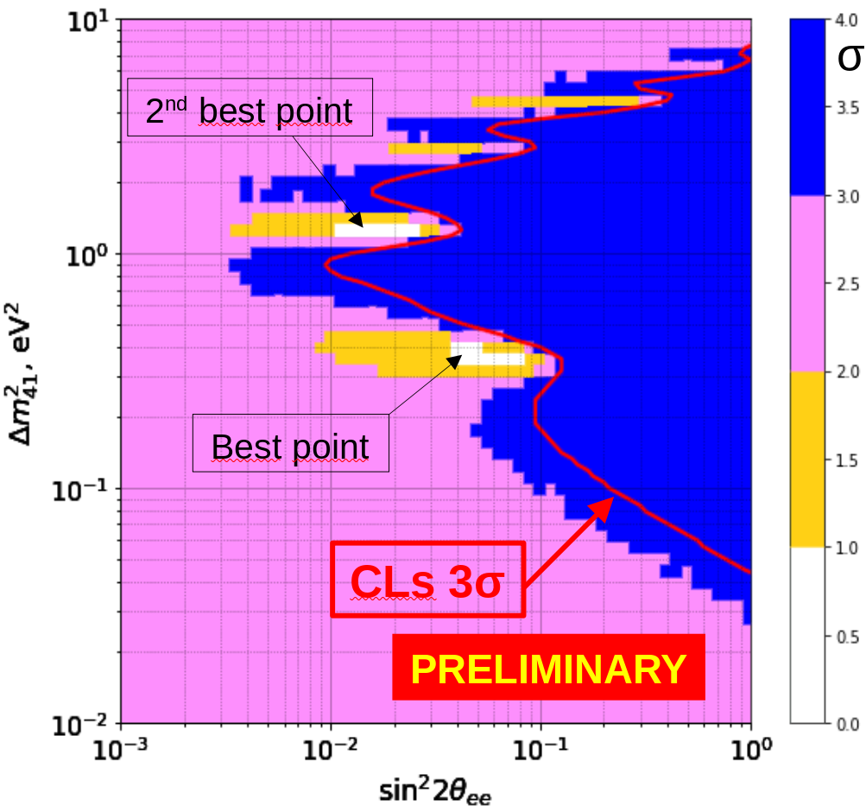
DANSS Experiment
Mikhail Danilov, 2211.01208 [hep-ex]
2305.07417 [hep-ex]
During 6 years the DANSS collected
> 6 million inverse beta decay events. Background measured during 4 reactor-off periods.
Data at 3 distances (10.9 , 11.9 , 12.9 m) from the center of the core of
a 3.1 GWth​ reactor,.
Event rate up to 5 thousand per day.
The significance of the best-fit point in the 4ν case increased 2.35σ.
Around 1 eV the bound on mixing
sin²2θ_{ee} < 0.004

Slide 17
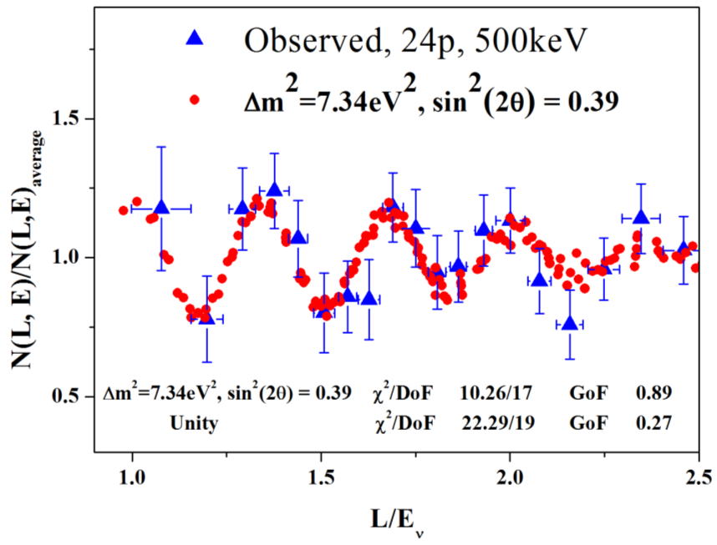
Neutrino-4: another anomaly?
L/E dependence for Neutrino-4 data points vs. expected oscillation signal for the best fit values (red dots).
Serebrov 2019

Slide 18
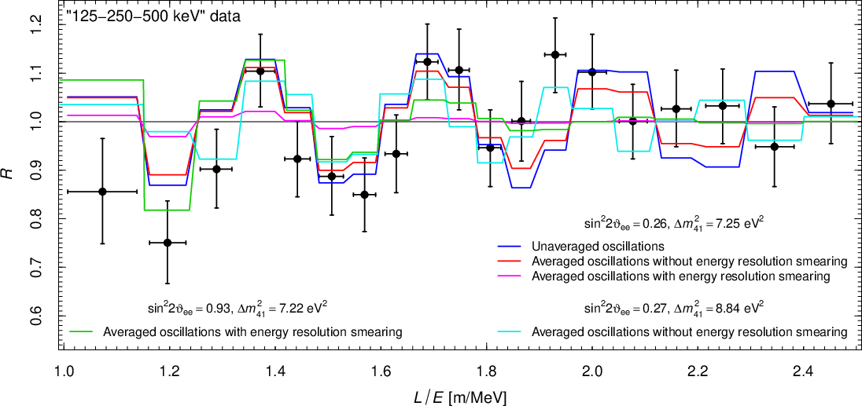
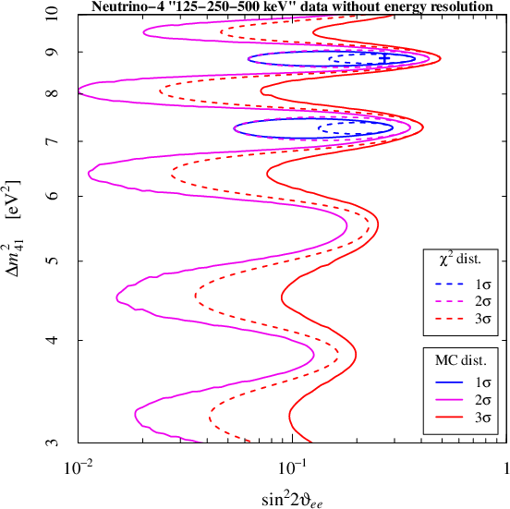
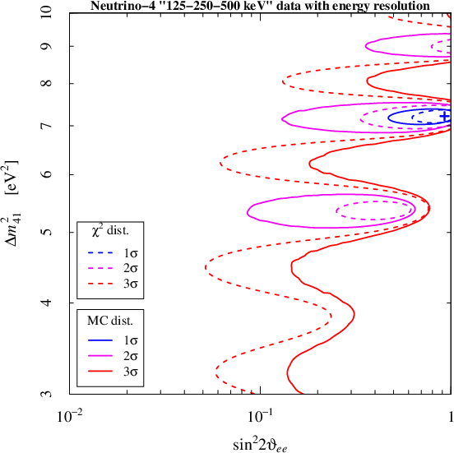
Neutrino-4
C. Giunti, et al, P.L. B816 (2021) 136214
2101.06785 [hep-ph]
Deep study of the data
Energy resolution of the detector, more reliable
Monte Carlo simulation:
→ Significance reduces:
3σ → 2.2σ
→ b.f. point moves to maximal mixing
Strong tension with the KATRIN, PROSPECT, STEREO, solar νe bounds

Slide 19
Mass ordering with reactors
ν_{e}
ν_{μ}
ν_{τ}
Normal ordering
Inverted ordering
Oscillation
frequency
ω₃₂
ν₃
ν₂
ν₁
ω_{ij} = Δm²_{ij} /2E
MASS²
ω₃₂
ω₃₁
Oscillation depth:
ν₂
ν₁
D₃₁ ~ 2D₃₂
ν₃
ω₃₁
ω₃₁ > ω₃₂
ω₃₁ < ω₃₂
Fourier
analysis
S. Petcov M. Piai
ω
ω
Higher frequency -
larger depth
Higher frequency –
smaller depth
D₃₁ = 4|U_{e1}|²|U_{e3}|²
D₃₂ = 4|U_{e2}|²|U_{e3}|²

Slide 20
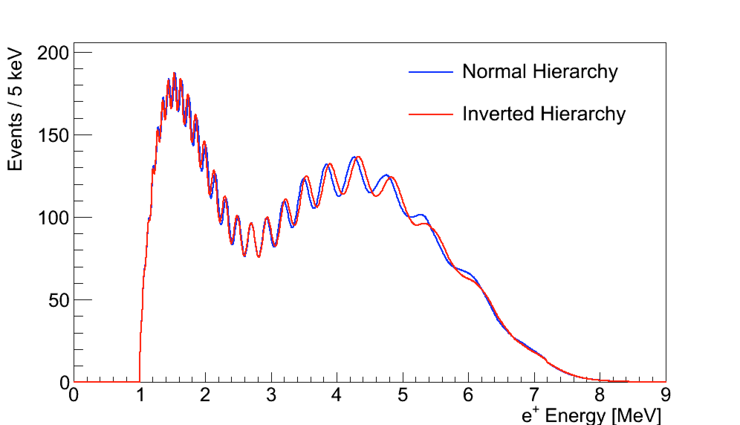
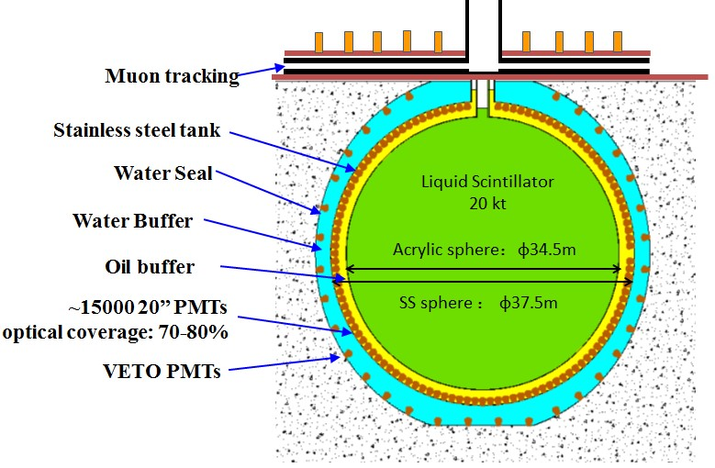
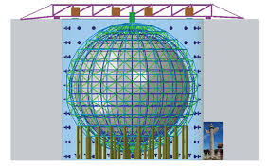
JUNO
Jiangmen Underground
Neutrino Observatory
d = 700 m, L = 53 km, P = 36 GW
IH: bigger
period
20 kt LAB scintillator
n + p → d + γ
Key requirement:
energy resolution 3% at 1 MeV
Operation in 2024 3σ in 6 years

Slide 21
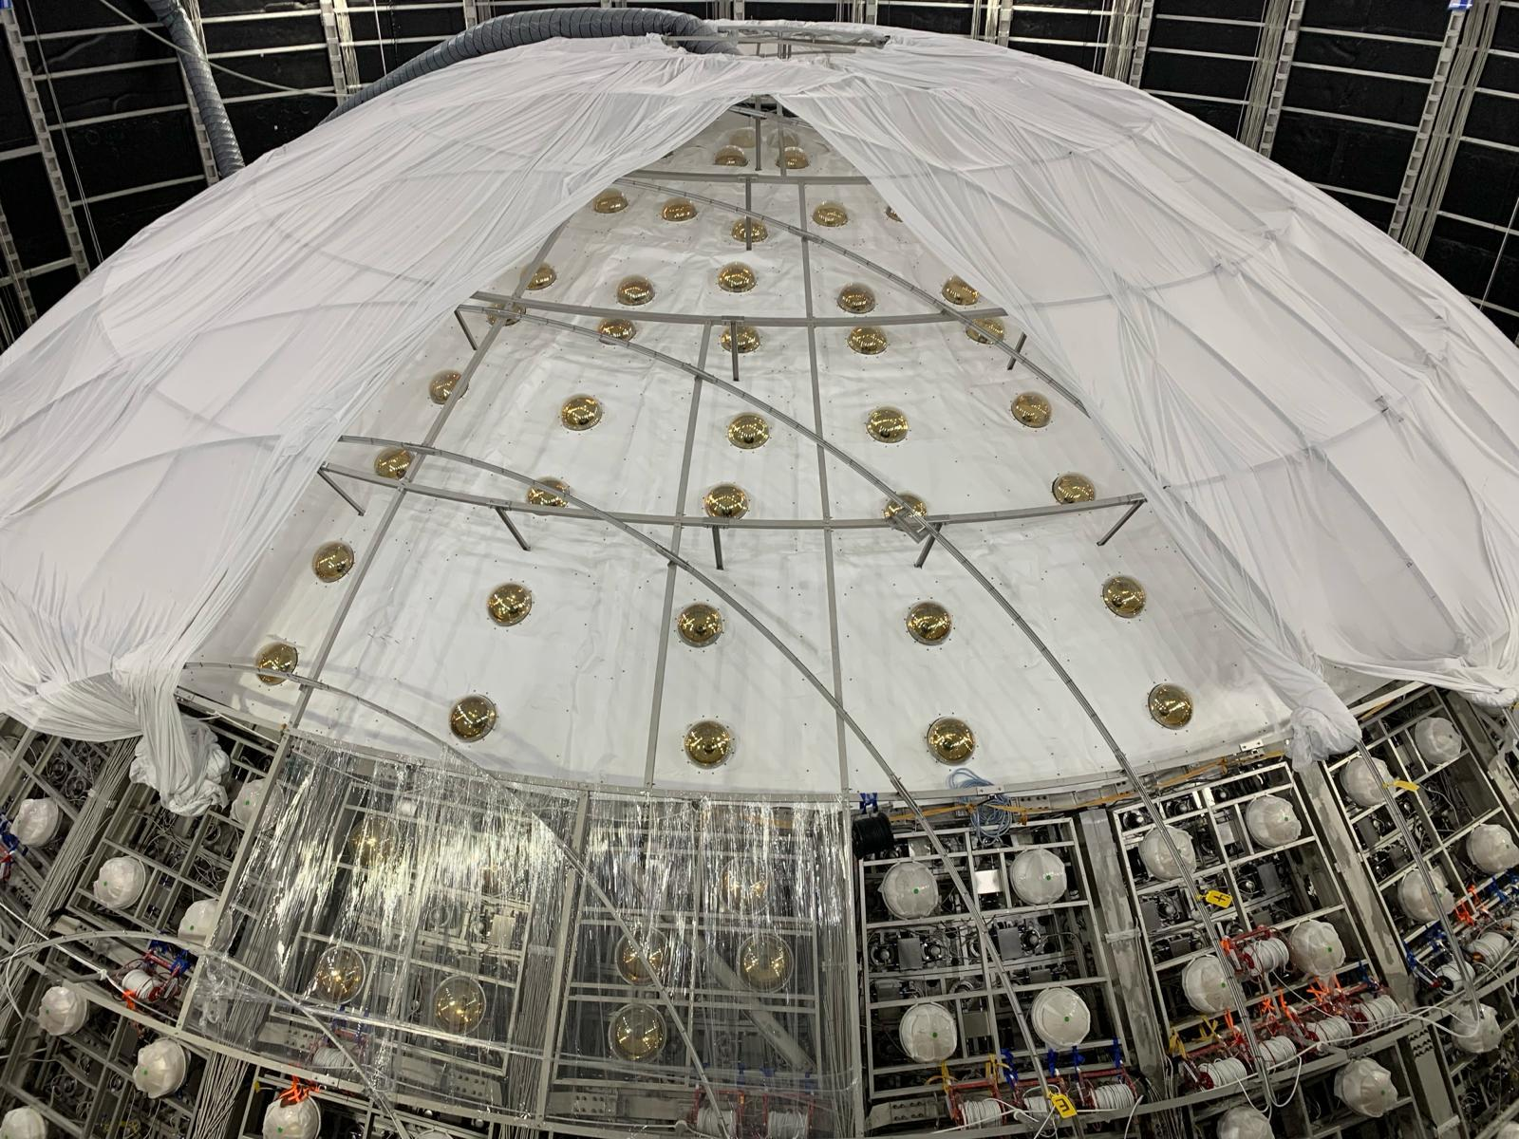
February 2024

Slide 22
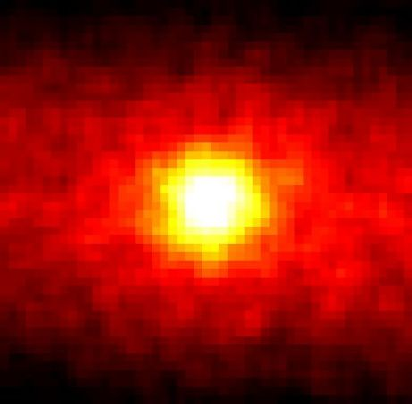
Solar
Neutrinos

Slide 23
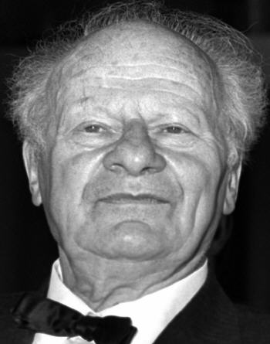
Source
of nuclear
reactions
Following evolution of individual nuclei
Scanning of all possible interactions of a given nuclei – identifying the most probable reactions, e.g.
G. Gamov,
V. Weizecker
P → …
d → …
³He → …
⁴He → …
e p → …
¹²C → …
p +
H. Bethe
H. Bethe and
C. Critchfield
Only few possibilities are found which have character of chains and cycles of reactions
To compute neutrino fluxes it is enough to know:
Total neutrino flux
Branchings
Terminations of chains/cycles

Slide 24
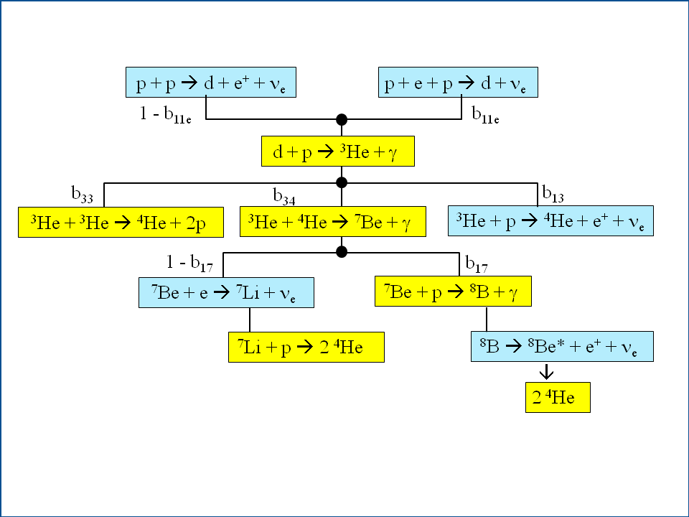
The pp-chain
0.24%
15.4%
2.5 10⁻⁵ %
0.11%
³He: b₃₄ = b₃₄( σ, T, n)
Branchings averaged
over production regions
Two branchings:
⁷Be: b₁₇ = b₁₇( σ, T, n)

Slide 25
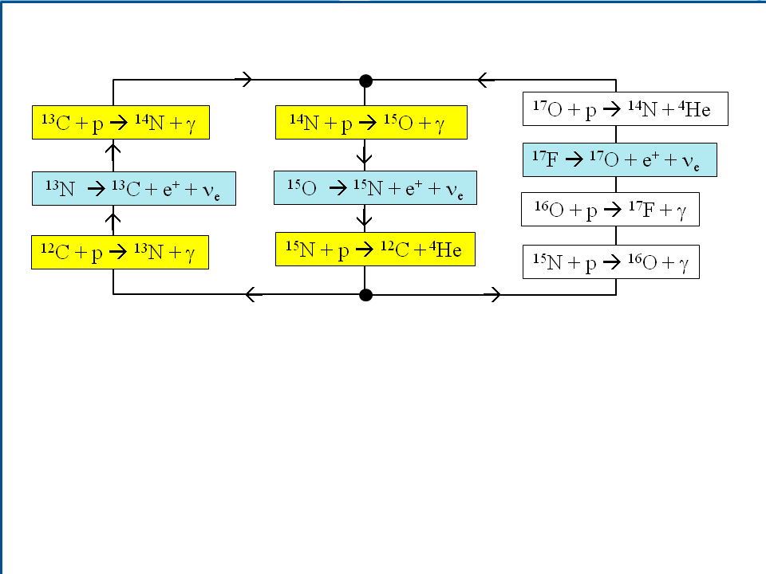
CNO-cycles
1.6% of energy generation
bi-cycle
1%
¹²C, ¹⁴N, ¹⁶O – catalizers of cycles
¹²C, ¹⁶O – initial abundances
¹⁴N – abundance changes during evolution

Slide 26
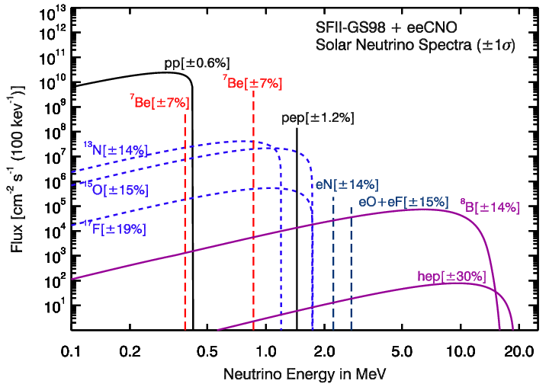
Solar neutrino spectrum
A. Serenelly
pp-, N-, O- asymmetric
with sharp decrease after maximum
Be-, Hep – symmetric spectra due to final state

Slide 27
LMA MSW: evolution of neutrinos
Adiabatic
conversion
Loss of coherence
Oscillations
in matter
of the Earth
ν

Slide 28
LMA-MSW physics
propagation
in the Sun
from the Sun
to the Earth
propagation
in the Earth
projection
ν₁
P_{1e}
ν_{e}
ν_{1m}
ν₁
|U_{e1}^{m}(n₀)²
ν_{e}
P_{2e}
ν_{e}
Σ
ν_{2m}
ν₂
ν₂
|U_{e2}^{m}(n₀)²
|U_{e3}|²
|U_{e3}^{m}(n₀)²
ν_{3m}
ν₃
ν₃
ν_{e}
mixing at
production
adiabatic conversion
loss of
coherence
oscillations
in multi-layer medium
P_{ee} = Σ_{i}|U_{ei}^{m}(n₀)|² P_{ie}
In the Sun: scale invariance:
no dependence of P_{ee} on distance and phase -
oscillations irrelevant
during a day
P_{ie} = |U_{ei}|²

Slide 29
In terms of mixing angles
**
Using the same standard parametrization for mixing matrix in matter:
U_{e1}^{m} = c₁₃^{m} cosθ₁₂^{m}, U_{e2}^{m} = c₁₃^{m} sin θ₁₂^{m}, |U_{e3}^{m} |= s₁₃^{m}
( c₁₃ = cosθ₁₃, c₁₃^{m} = cosθ₁₃^{m} , etc.)
and regeneration factor one finds from general formula
P_{ee} = c₁₃²c₁₃^{m2} P₂^{ad} + s₁₃²s₁₃^{m2} - c₁₃^{m2} cos2θ₁₂^{m} f_{reg}
where
P₂^{ad} = sin²θ₁₂ + cos2θ₁₂ cosθ₁₂^{m}
or
P₂^{ad} = ½ (1 + cos2θ₁₂ cos2θ₁₂^{m})
Here the mixing parameters in matter θ_{ij}^{m} = θ_{ij}^{m}(n₀, E)
should be computed in the neutrino production point

Slide 30
For high energy part
Complete expression
(1-2 mixing)
P = sin²θ + cos2θ cos²θ_{m}⁰ + F_{reg}
contribution from oscillations in the Sun
Contribution from oscillations in the Earth
non-oscillatory
transition
θ_{m}⁰ - mixing angle in matter
in production point
P(E) is determined by the energy dependence of the mixing angle in production point

Slide 31
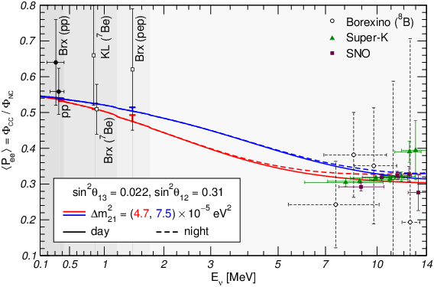
Survival probability
M. Maltoni, A.Y.S.
1507.05287 [hep-ph]
Transition region
resonance turn on
LMA MSW prediction
for two different values of Δm₂₁²
best fit value
from solar data
upturn
best global fit
Borexino Collaboration (Agostini, M. et al.) arXiv:1707.09279 [hep-ex]
Reconstructed exp. points
for SK, SNO and BOREXINO
at high energies

Slide 32
Loss of coherence
ν_{2m}
ν_{1m}
x
From the Sun to the Earth

Slide 33
Oscillations in the Earth
Distance and phase matter
propagation in the Earth
projection
ν_{1m}
ν_{1m}
ν_{e}
ν_{i}
P_{ie}
surface of the Earth
ν_{2m}
ν_{2m}
i = 1,2
decouples
|U_{e3}|²
ν_{e}
ν₃
ν_{3m}
ν_{3m}
P_{3e} = |U_{e3}|²
mixing of mass states
in matter
Σ
oscillations in
multi-layer medium
flavor mixing
in matter
P_{i} = |U_{ei}^{m}(n₀)|²
Adiabaticity violation at the border between layers
mixing at
production
in the Sun

Slide 34
Oscillations in the Earth
**
Incoherent fluxes of mass state arrive at the Earth.
They split into eigenstates in matter and oscillate.
Mixing of the mass states in matter
U^{mass} = U_{PMNS}⁺ U^{m}
For 2ν case
c₁₃²ε sin 2θ₁₂
(cos2θ₁₂ - c₁₃² ε )² + sin²2θ₁₂
sin 2θ‘ =
= c₁₃² ε sin 2θ₁₂^{m}
2V E
Δm₂₁²
determines smallness of effects
ε = = 0.03 E₁₀ ρ_{2.6}
Low density regime
MeV g/cm³

Slide 35
**
Regeneration
A. Ioannisian, A. Smirnov, D. Wyler,
Phys.Rev. D96 (2017) no.3, 036005
arXiv:1702.06097 [hep-ph]
Layers with slowly changing density and density jump
ν₁
ν_{e}
Evolution matrix (matrix of transition amplitudes)
0 1 2 3 n-1 n
S = U^{m}_{n} Π_{k} D_{k}U_{k,k-1}
layers
flavor mixing matrix,
at the detector
D_{k} - describe the adiabatic evolution within layers:
-0.5iφ_{κ}
0.5iφ_{κ}
adiabatic phase
acquired in k layer
D_{k} = diag (e , e )
φ_{κ} = dx(H_{2m} - H_{1m})
U_{k,k-1} - describes change of basis of eigenstates between k and k-1 layers
U_{k,k-1} = U(-Δθ_{k-1} )
Δθ_{k-1} -change of the mixing angle in matter after k-1 layer

Slide 36
Oscillation waves
**
The lowest order plus waves emitted from different jumps
P_{1e} ~ c₁₃² cos²θ_{n}^{f} + c₁₃²sin2θ_{n}^{f} Σ_{j = 0 ...n-1} sinΔθ_{j} cos φ_{j}^{after}
initial wave without density jumps
sum over
density jumps
total phase
acquired after
jump j
~ Δθ_{j}
the amplitude of wave: c₁₃²sin2θ_{n}^{f} sinΔθ_{j}
superposition of waves
sin Δθ_{j} = c₁₃²sin2θ₁₂ ΔV_{j}
E Δm₂₁²

Slide 37
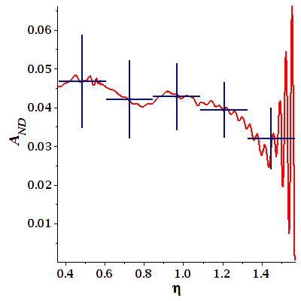
Scanning the Earth
Ioannisian, A. Smirnov,
D. Wyler, Phys.Rev. D96
(2017) no.3, 036005
arXiv:1702.06097 [hep-ph]
ν₁
ν_{e}
Integration above 11 MeV
0 1 2 3 n-1 n
dip: cancellation of waves
Day –Night asymmetry
N (η)
D
A_{DN} = - 1
core
nadir angle →

Slide 38
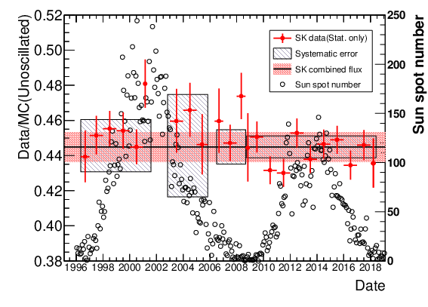
Super-Kamiokande results
Super-Kamiokande Coll. K. Abe et al, 2312.12907 [hep-ex]
E_{e rec} = 3.5 – 19.5 MeV
turn
down?

Slide 39
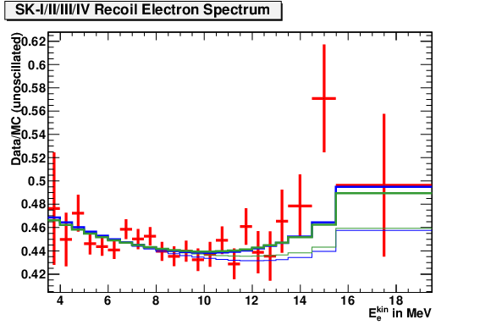
S-K spectrum
Super-Kamiokande Coll. K. Abe et al, 2312.12907 [hep-ex]
upturn
Upturn of the spectrum is finally seen!
Data/MC(no-osc) = 0.4486 +/- 0.0062

Slide 40
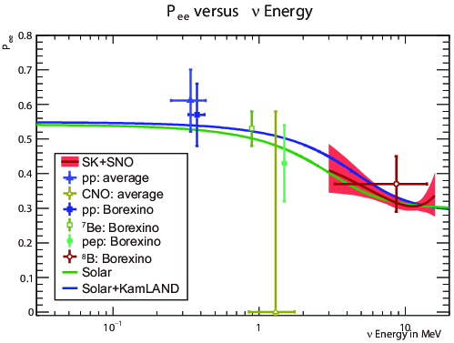
Extraction of survival probability
Super-Kamiokande Coll. K. Abe et al, 2312.12907 [hep-ex]
Data/MC(no-osc) = 0.4486 +/- 0.0062

Slide 41
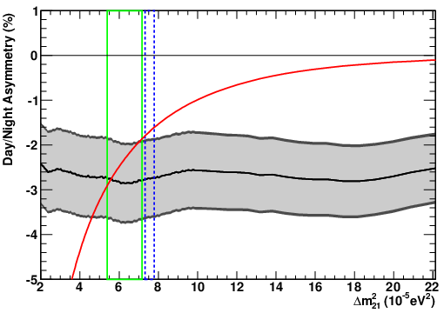
SK Day-Night asymmetry
Super-Kamiokande Coll. K. Abe et al, 2312.12907 [hep-ex]
Best fit and uncertainty band
1σ solar
1σ solar + KamLAND
A_{D/N} (SK-IV) = - 0.0262 +/- 0.0107 (stat) +/- 0.0030 (syst)
A_{D/N} (SK-all) = - 0.0286 +/- 0.0085 (stat) +/- 0.0032 (syst)

Slide 42
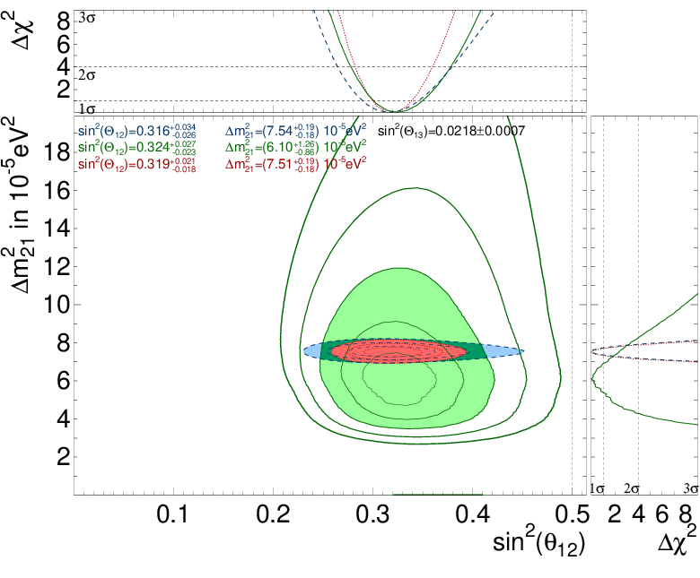
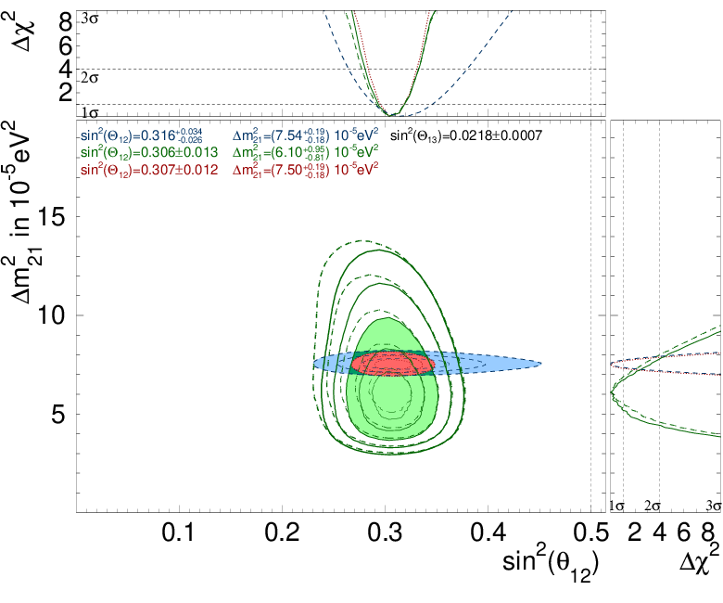
Solar oscillation fit
Super-Kamiokande Coll. K. Abe et al, 2312.12907 [hep-ex]
SK only
Solar global
Δm₂₁² (solar) = (6.10 +0.95/-0.81) 10⁻⁵ eV²
1.5σ difference
Δm₂₁² (KL) = (7.50 +0.19/-0.18) 10⁻⁵ eV²

Slide 43
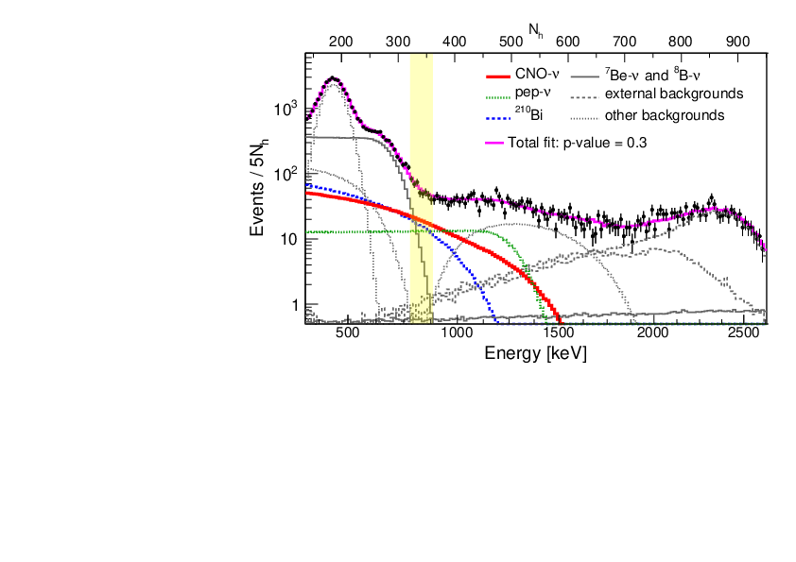
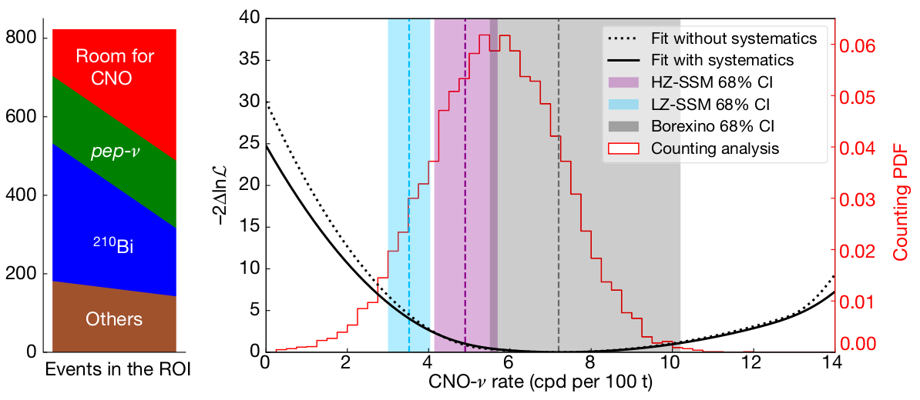
BOREXINO Collaboration (M. Agostini et al
“Digging” CNO neutrinos
BOREXINO Collaboration
(M. Agostini et al) Nature 587 (2020) 577 and 2105.09211 [hep-ex]
intermediate E-region
3.5σ evidence of neutrinos
from the CNO cycle
Energy distribution of events
After taking into account the MSW-effect
Implications: astrophysics
No additional suppression of
the CNO flux on the top of MSW
No new physics in the intermediate energy range

Slide 44
CNO neutrinos: implications
Test of theory of stars evolution of stars
1% contribution to energy production in the Sun
Chemical composition metallicity problem
40% difference for two metallicities
Conversion in the transition region
Predictions of fluxes are rather uncertain
Still adds to the overall consistency of the picture

Slide 45
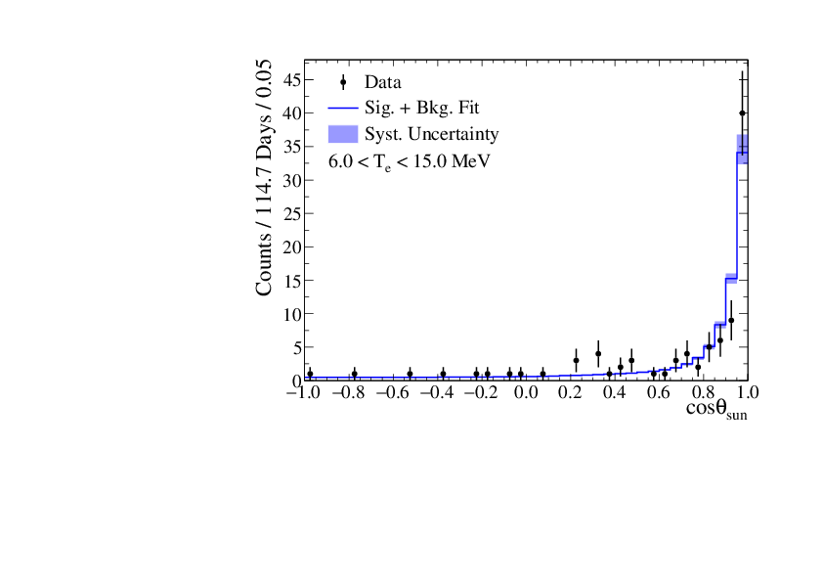
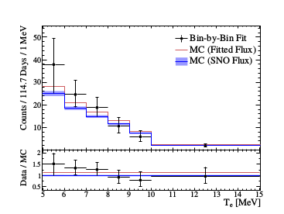
**
Solar neutrinos SNO+ results
SNO+ Collaboration (Anderson, M. et al.) Phys.Rev. D99 (2019) no.1, 012012 1812.03355 [hep-ex]
Water phase: Measurement of the 8B solar neutrino flux in SNO+ with very low backgrounds S/B ~ 4, E > 6 MeV
114.7 days of data
Hint of upturn?
Distribution of event directions wrt. solar direction
The extracted event rate as
function of reconstructed
electron kinetic energy
69.2 kt-day dataset
Flux: 2.53 [-0.28+0.31(stat) -0.10+0.13(syst)] x 10⁻⁶ cm ⁻² s⁻¹

Slide 46
Tests of the BSM physics
**
NSI
Interactions
Steriles
with DM
Decays
ν
Magnetic
Decoherence
moments
sun
Long range
Violation of
forces
fundamental
Lorentz
symmetries
CPT

Slide 47
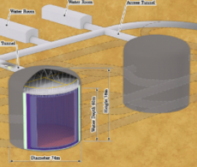
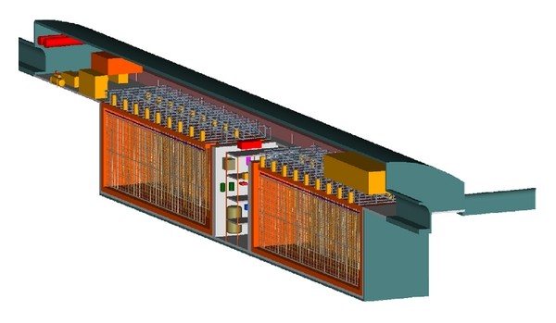
Future experiments
870 tons
SNO+
Double beta decay of Te
Simultaneously solar with E > 3 MeV, upturn
later pep- CNO- later
JUNO
LS 20 kt, too shallow,background?
HyperKamiokande
260 kt each
17 times larger SK. 100 000 νe events/y,
lower PMT coverage, E > 4-5 MeV
shallower than SK, larger background,
> 5 σ D-N in 10 y
DUNE
4 x 11.6 kt (fv) LiAr TPC
ν_{e} + ⁴⁰Ar → ⁴⁰K* + e
Earth matter effect ?

Slide 48
… continued
JinPing
The deepest lab - lowest background
ν + e → ν + e
ASDC (WbLS)
Combining advantages of scintillator (good energy resolution) and cherenkov (directionality) experiments
(water based
Liquid scintillator)
ν + e → ν + e
Theia
30 t f.v.
also 1% Li doped
ν_{e} + ⁷Li → ⁷Be + e
pep, N, O, B Be
Earth tomography
DARWIN
DM experiments hitting neutrino floor
Liquid Xe TPC, 30 t fiducial volume
ν + e → ν + e
pp (1%)

Slide 49
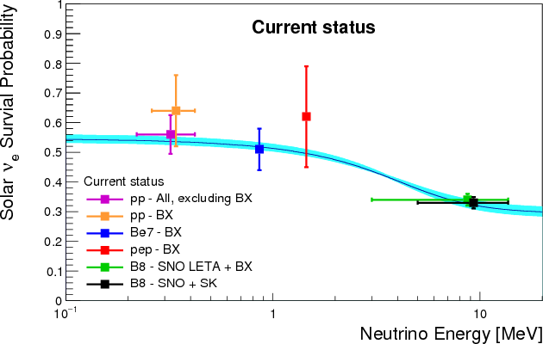
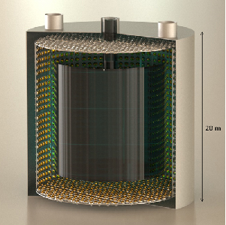
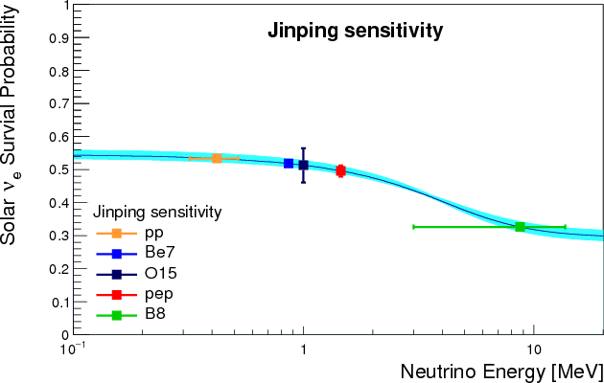
JinPing underground lab
scintillator uploaded
water detectors?
FV: 100 times bigger than BOREXINO
without systematics
Deeper than SNO

Slide 50
Cosmic neutrinos
of high energies

Slide 51
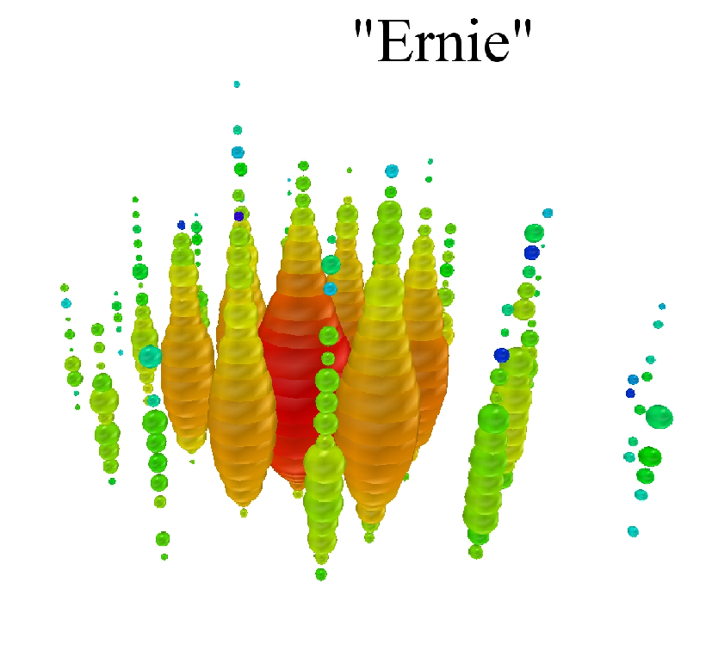
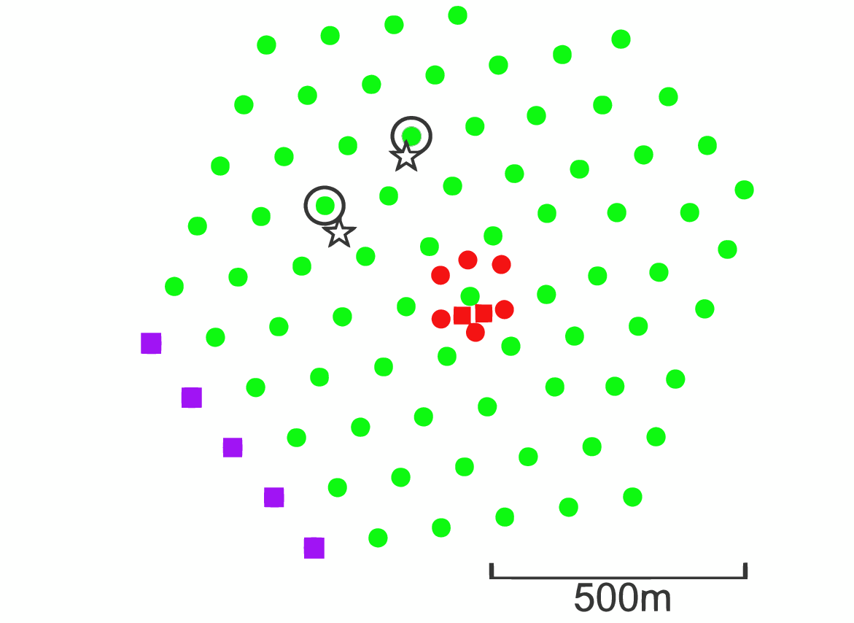
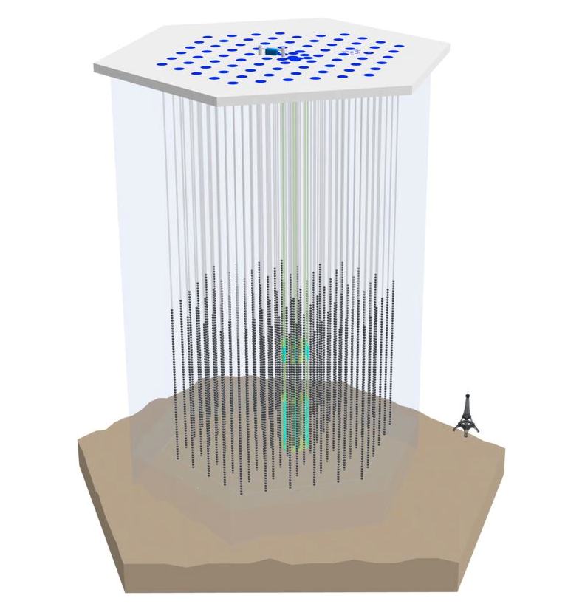

Cosmic neutrinos of high energies
January 2012
Centers of two cascades
E = 1.04 +/- 0.16 PeV
August 2012
Atmospheric neutrino background:
0.082 +/- 0.004 (stat) +0.041/–0.057(syst.)
p-value 2.9 10⁻² (2.8σ)
``Hint’’ of cosmic
neutrinos or
New physics with atmospheric neutrinos
Excess at lower energies 0.02 – 0.3 PeV
28 events (7 with muons) are observed ~ ~ 11 expected
E = 1.14 +/- 0.17 PeV

Slide 52
Sources
p + γ
p + p
CMB, infrared
p + γ → Δ → π⁺ + n
p + p → π⁺ , K ⁺ + X
π ⁺ ◊ μ⁺ ν
π ⁺ ◊ μ⁺ ν
μ ⁺ ◊ e ν ν
also → π⁻ , K ⁻ + X
ν−γ
connection
p + γ → Δ → π⁰ + p
π⁰ → γ γ
p + γ → p + e⁺ + e⁻
EM cascade to low energies 1 – 1000 GeV

Slide 53
Cosmic Neutrinos
central
engine
(BH)
internal
shocks
Relativistic jets
with internal shocks
accretion
disc
Star forming galaxies
infall
Blazars
Active galactic nuclei
GRB ?
stellar envelope
Flavor composition

Slide 54


Oscillations, Flavor composition
Averaged vacuum oscillations
Now and in future

Slide 55



Detection
Auger
Antares

Slide 56

Berezinsky - Zatsepin neutrinos
Cosmogenic
neutrinos
V . Berezinsky at al, arXiv:1003.1496
dN/dE ~ E^{−α} - CR generation
spectrum
m – power of z-evolution
Exclude models with of
UHECR with strong evolution
Upper limits on UHE neutrinos fluxes
allowed by the cascade limit with sensitivities of

Slide 57


Galactic contribution
100 TeV
V. S. Berezinsky and A Yu. S.
Phys. Lett. 48B 269 (1974)
Atm. Nu flux
1934 - 2023

Slide 58
Neutrinos from galactic plane
IceCube Collaboration, R. Abbasi et al.
Science 380 (2023) 6652,
2307.04427 [astro-ph.HE]
E = 1 - 100 TeV
Diffuse flux, matches with gamma rays
6 – 13 % of the all sky HE flux
CR interact with matter near their sources and during propagation, which produces high-energy neutrinos
The signal is consistent with diffuse emission of neutrinos from the Milky Way but could also arise from a population of unresolved point sources
Neutrino emission from the Galactic plane is identified at the 4.5σ level of significance.

Slide 59

.
Neutrinos from galactic plane
IceCube Coll., R. Abbasi. et al.
Science 380 (2023) 6652,
2307.04427 [astro-ph.HE]
The plane of the Milky Way galaxy in photons and neutrinos.}
Each panel is in Galactic coordinates, with the origin being
at the Galactic Center, extending ±15∘ in latitude and ±180∘ in longitude.

Slide 60


Galactic contribution
100 TeV
V. S. Berezinsky and A Yu. S.
Phys. Lett. 48B 269 (1974)
The best-fitting pre-trial significance for the all-sky search is shown as a function of direction in an Aitoff projection of the celestial sphere, in equatorial coordinates (J2000 equinox). The Galactic plane is indicated by a grey curve, and the Galactic Center as a dot.

Slide 61



Neutrinos from NGC1068
R Abbasi et al IceCube Coll.
2211.09972 [astro-ph.HE]
Active Galaxy 14.4 Mpc
Excess 79 +22 -20 events
significance 4.2 σ
E = 1.5 - 15 TeV

Slide 62


NGC1068 and TXS 0506+56
R Abbasi et al IceCube Coll.
2211.09972 [astro-ph.HE]
IC
Bound from gammas
1 % TeV
Dominant: Neutrinos from Hidden in X and γ sources.
Seifert Galaxies . BH and accretion disc in gaseous envelope
V.S. Berezinsky, Neutrino- 77, p 177
V.S. Berezinskii and V L Ginzburg, MNRAS, 194, 3 (1981)
Berezinsky Galaxies

Slide 63



Hidden Hearts of Neutrino Active Galaxies
Kohta Murase,
Astrophys.J.Lett. 941 (2022) 1, L17,
2211.04460 [astro-ph.HE]
Acceleration in turbulent magnetic field

Slide 64

Supernova
neutrinos
SN 1987A

Slide 65

Supernova neutrinos
Collective flavor
trasformation
Shock wave
effect on
conversion
MSW flavor
conversion
inside the star
Propagation
in vacuum
Oscillations
inside the Earth

Slide 66
Δm₄₁² = 1 - 2 eV²
Accelerator neutrinos
LSND

Slide 67


Sources and fluxes
Manipulating with the beam
P + N → N’ + n π + n’ K + …
Polarity of B-field – sign of charges of
→ Neutrinos vs antineutrinos
π → μ + ν_{μ}
off-axis
K → μ + ν_{μ}
K → π + μ + ν_{μ}
K → π + e + ν_{e}
Also charm meson decays in the beam Beam dump experiments
Superbeams, Beta beams, Neutrino factories
μ → e + ν_{μ} + ν_{e}

Slide 68

T2K and NOvA

Slide 69

T2K and NOvA

Slide 70


T2K and NOvA

Slide 71

T2K

Slide 72

NOvA oscillation results

Slide 73
Atmospheric neutrinos
cosmic rays
in the first approximation
p
ν_{e}
atmosphere
ν_{μ} − ν_{τ} vacuum oscillations
π
μ
ν_{μ}
N
e
ν_{μ} − ν_{e} oscillations
in matter
ν_{μ}
ν
core
π → μ + ν_{μ}
μ → e + ν_{μ} + ν_{e}
at low energies:
F_{μ} /F_{e} = 2
?
detector
K → μ + ν_{μ}
ν
K → π + μ + ν_{μ}
mantle
Parametric effects
in ν_{μ} − ν_{e} oscillations
for core crossing
trajectories
D → μ + ν_{μ}
K → π + e + ν_{e}
D → Κ + μ + ν_{μ}
D → K + e + ν_{e}

Slide 74

Oscillations in the Earth
θ_{ν}
zenith
angle
Atmospheric, accelerator neutrinos
mantle
ν_{e} → ν_{μ} , ν_{τ}
1
0.75
0.50
0.25
0
Resonance
enhancement
of oscillations
Θ = 33º
probability
1
0.75
0.50
0.25
0
Parametric
enhancement
of oscillations
core
probability
core-crossing
trajectory

Slide 75


Atmospheric neutrino fluxes
M. Honda et al., arXiv: 1502.03916
x E³
max
Energy spectra
Flavor ratios

Slide 76
Detection
Measurement of E - θ distributions of different type of events.
Compare events for the normal and inverted orderings
“tracks”
Measurements
muon track
E_{μ} θ_{μ} E_{h}
inelasticity
ν_{μ} + N → μ + h
+ cascade
E_{ν} = E_{μ} + E_{h}
ν_{τ} + N → τ + h
reconstruction
E_{h} E_{μ} θ_{μ} → θ_{ν}
→ μ + ν + ν
“cascades”
ν_{e} + N → e + h
ν_{α} + N → ν_{α} + h
cascades
E_{ν} θ_{ν}
reconstruction
ν_{τ} + N → τ + h
→ h + ν
→ e + ν + ν

Slide 77
3ν − oscillations
ν_{f} = U₂₃I_{δ} U₁₃ U₁₂ ν_{mass}
~
ν
~
CP-violation and 2-3 mixing
are excluded from dynamics
of propagation
Propagation basis
ν_{f} = U₂₃I_{δ} ν
I_{δ} = diag (1, 1, e^{iδ} )
Matter potential is unchanged in new basis
ν_{e}
ν_{e}
ν_{e}
ν_{e}
A_{e2}
ν_{μ}
~
~
ν_{μ}
ν₂
ν₂
A_{e3}
~
~
ν_{τ}
ν_{τ}
ν₃
ν₃
projection
propagation
projection
CP appears in projection only
A₂₂
A₃₃
A₂₃
For instance:
A(ν_{e} → ν_{μ}) = cosθ₂₃ A_{e2}e^{-iδ} + sinθ₂₃A_{e3}

Slide 78
3ν probabilities
**
P(ν_{e} → ν_{μ}) = |cos θ₂₃ A_{e2}e^{-iδ} + sin θ₂₃A_{e3}|²
= | cos θ₂₃ |A_{e2}|e ^{i(-δ + φ)} + sin θ₂₃ |A_{e3}| |²
φ = arg (A_{e2} A_{e3}*)
P_{int} = 2s₂₃c₂₃|A_{e2}||A_{e3}|cos(φ - δ)
For constant density and E > 0.5 GeV
|A_{e2}| ~ cos θ₁₃ sin 2θ₁₂^{m} sin φ₁₂^{m}
|A_{e3}| ~ sin 2θ₁₃^{m} sin φ₁₃^{m}
Below 1-3 resonance and above 1-2 resonance
ξ₁₂ >> 1 >> ξ₁₃
ξ_{ij} = 2EV/Δm_{ij} ²
sin2θ₁₃^{m} ~ sin 2θ₁₃ /(1 – ξ₁₃)
small matter corrections
φ₁₃^{m} ~ φ₁₃ (1 – ξ₁₃)
sin2θ₁₂^{m} ~ sin 2θ₁₂ /ξ₁₂
matter dominated limit
If phase is small - vacuum mimicking
φ₁₂^{m} ~ φ₁₂ ξ₁₂ = VL/2
gives formula which appears in all Long baseline experiment papers

Slide 79
Probabilities
E Kh Akhmedov,
S Razzaque,
A. Y.S.
**
for hierarchy determination at high energies
P(ν_{e} → ν_{μ}) = s₂₃²|A_{e3}|²
½
P(ν _{μ} → ν_{μ}) = 1 – ½ sin² 2θ₂₃ - s₂₃⁴|A_{e3}|² + ½ sin² 2θ₂₃ (1 - |A_{e3}|²) cos φ
Reduces
the average
probability
Reduces the depth
of oscillations
interference
Modifies
phase
φ = arg (A₂₂ A₃₃*)
½
P(ν _{μ} → ν_{τ}) = ½ sin² 2θ₂₃ - s₂₃² c₂₃²|A_{e3}|² - ½ sin² 2θ₂₃ (1 - |A_{e3}|²) cos φ

Slide 80

Oscillograms
100
1 - P_{ee}
MSW-resonance
peaks 1-3 frequency
of the Earth
10
Lines of equal probability
in the E – θ_{z} plane
Parametric
ridges
1-3 frequency
ν_{e} → ν_{μ} + ν_{τ}
Parametric peak
1-2 frequency
1
E, GeV
MSW-resonance
peaks 1-2 frequency
0.1
5π/2 3π/2 π/2

Slide 81

E, GeV
Neutrinos and
antineutrinos
10
1
Normal mass ordering
0.1
10
Antineutrinos
No resonances
1
For inverted mass hierarchy the high energy parts of the diagrams E > 1 GeV interchange
M. Maltoni
0.1

Slide 82

Atmospheric neutrino data
Super-Kamiokande
Coll., T. Wester et al.
2311.05105 [hep-ex]
Atmospheric neutrino
oscillation analysis with
neutron tagging and an
expanded fiducial volume
in Super-Kamiokande I-V

Slide 83


Oscillation analysis

Slide 84

Atmospheric neutrinos
Oscillation effects
Energy dependence (integrated over
the zenith angles)
Measured flux spectra,
using all SK I-IV data,
Error bars include all statistical
and systematic errors.
Lines: the HKKM11
(Honda, et al 2011)
model with (solid) and without
(dashed) neutrino oscillation.

Slide 85


Atmospheric neutrinos: IceCube
IceCube Collaboration (Aartsen, M.G. et al.) Phys.Rev.
D91 (2015) 122004 arXiv:1504.03753 [astro-ph.HE]

Slide 86

Ice Cube
100 GeV
Deep Core
10 - 15 GeV
Antares
1 - 3 GeV
Precision
IceCube
Next
Generation
Upgrade
Baikal

Slide 87


DeepCore oscillation result
atmospheric ν_{μ} disappearance,
3 years of data
similar to SK
Δm₃₂² = (2.72 +0.19/−0.20) 10⁻³ eV²
sin²θ₂₃ = 0.53 +0.09/−0.12 (NO)
IceCube Collaboration
(M.G. Aartsen et al.).
arXiv:1410.7227 [hep-ex] |
compatible and comparable in precision
with accelerator experiments

Slide 88



ORCA
Oscillation Research with
Cosmics in the Abyss
115 lines, 20m spaced,
18 DOMs/line, 6m spaced
Instrumented volume ~3.8 Mt,
2070 OM
450 m
31 3” PMTs
Digital photon counting
Directional information
Wide angle view

Slide 89


Sensitivity to mass ordering

Slide 90

INO-ICAL
ICAL Collaboration (Ahmed Shakeel et al.) arXiv:1505.07380 [physics.ins-det]
The 50 kt magnetized iron calorimeter (ICAL) detector at the India-based Neutrino Observatory (INO)
Resistive plate
chambers
Energy and direction of the muons; energy of multi-GeV hadrons;
charge of muon
The energy and zenith angle dependence of the atmospheric neutrinos
in the multi-GeV range.

Slide 91

Race for the mass hierarchy
P. Coyle
Supernova neutrino burst

Slide 92
Enormous physics potential
Energy range: 0.01 – 10⁵ GeV
which is not completely explored
and largely unused
Baselines: 0 – 13000 km
Matter effects: 3 – 15 g/cm³
which change with energy and zenith
angle
Flavor content nue, numu
Lepton number nu - antinu
BAKSAN
Kamiokande
MACRO ...
Achievements:
Discovery of neutrino oscillations
Measurements of 2-3 mixing and mass splitting
Bounds on new physics
- sterile neutrinos
- non-standards interaction
- violation of fundamental symmetries, CPT

Slide 93
Future
No inconsistencies, problems
Matter effects?
Experiments:
Ice Cube
SuperKamiokande II
Deep Core
HyperKamiokande
DC + 7 strings
DUNE
ICAL INO
ORCA
Super-PINGU/ORCA

Slide 94


Daya Bay result

Slide 95



RENO
Measuring U
e3
Daya Bay
Double-CHOOZ

Slide 96

DANSS
Detector of the reactor AntiNeutrino based on Solid Scintillator
M. Danilov, 2211.01208 [hep-ex]
a): Confidence levels for 4ν hypothesis at 1σ, 2σ, 3σ, and 4σ obtained using the Feldman-Cousisns method, the red line corresponds to the 3σ exclusion contour obtained using the Gaussian CLss​ method; b): 90\% C.L. exclusion area (cyan) obtained with the Gaussian CLss​ method in comparison with the RAA+GA expectations; c): The same exclusion area in comparison with the BEST results~\cite{BEST, BEST-2022-arxiv} and expected DANSS sensitivity after the upgrade.

Slide 97

NEOS & RENO
NEOS Collaboration Z. Atif et al 2011.00896 [hep-ex]
Bounds on oscillation parameters
the RENO and NEOS combined search (black)
The best fit values (green circle) :
Δm₁₄² = 2.37 eV²
sin²2θ₁₄ = 0.09
NEOS 90% C.L. (gray shaded),
PROSPECT 95% C.L. (red)
RENO near/far -blue
RAA (dotted): Δm₁₄² = 2.4 eV²
Before: DayaBay/NEOS:
Δm₁₄² = 1.73 eV²
sin²2θ₁₄ = 0.05
another wiggle ....

Slide 98


STEREO and PROSPECT
Stereo Collaboration (M. Licciardi )
2105.13776 [hep-ex]
Stereo
PROSPECT
NEUTRINO-4

Slide 99

STEREO
STEREO Collaboration
H. Almazán (Nature 613 (2023) 7943, 257, 2210.07664 [hep-ex]
The exclusion contour (solid red) and exclusion sensitivity contour (dashed red) at 95% CL .
The results are derived in a 2D Feldman-Cousins framework (red) and the Gaussian CLs method .
The 95% CL parameter space regions of the sterile neutrino as an explanation of the RAA (grey area) is rejected by STEREO below mass splittings of 4 eV2.
The initial RAA best fit point, marked by a star, is rejected with very high confidence level (p-value <10−4).

Slide 100

T2K results
D. Karlen, ( T2K Collaboration)
Universe 2019, 5(1), 21.
Update 2.2 → 2.6×10 ²¹ POT
benchmark
values
The rate of muon–neutrinos in the far detector. Data vs. expected rate for the best fit oscillation parameters.
Confidence intervals for the atmospheric
oscillation parameters for the normal
and inverted mass ordering .

