Slide 1

Neutrinos and
Physics BSM
Between the two deserts

Slide 2
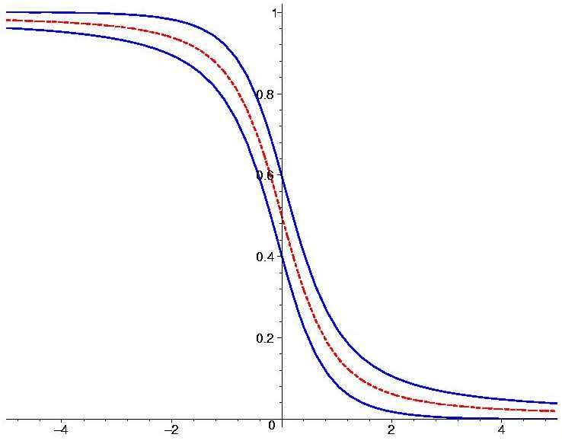
Measurements
MINOS
T2K
NOvA
MSW-effect
Solar
neutrinos
2
KamLAND
Δ
m
Double Chooz
θ
Daya Bay
RENO
NEOS
Atmospheric
Oscillations
Can be resonantly
enhanced in matter
neutrinos
SK
Antares
DeepCore

Slide 3
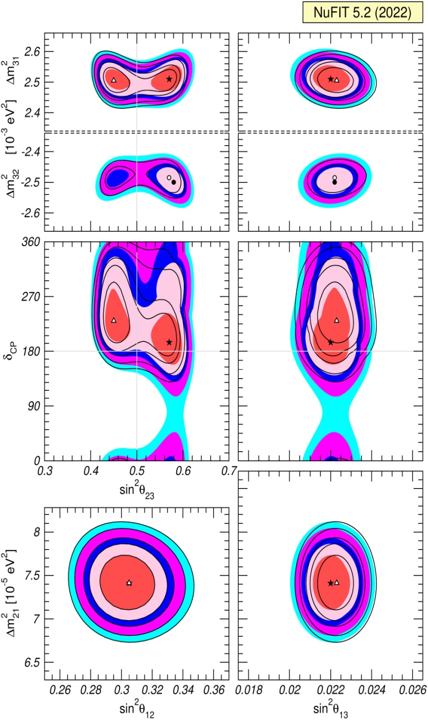
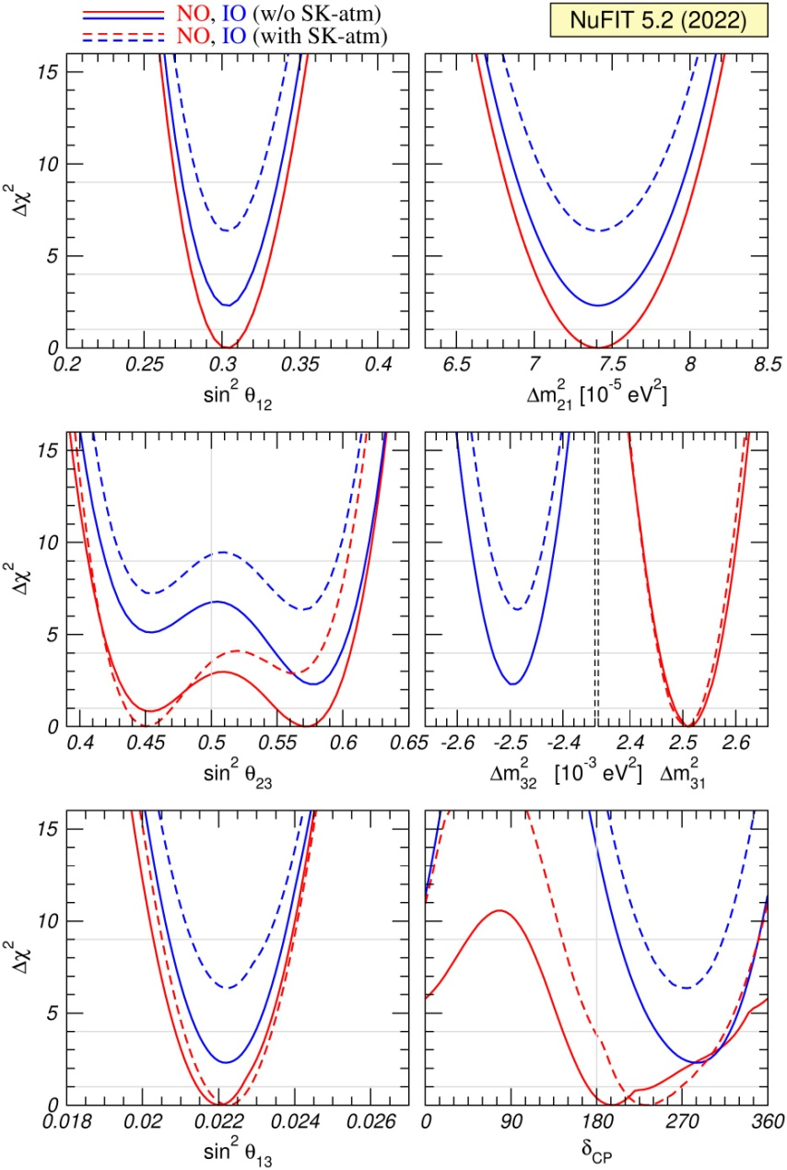
Global fit
NuFIT 5.2 (2022), www.nu-fit.org.

Slide 4
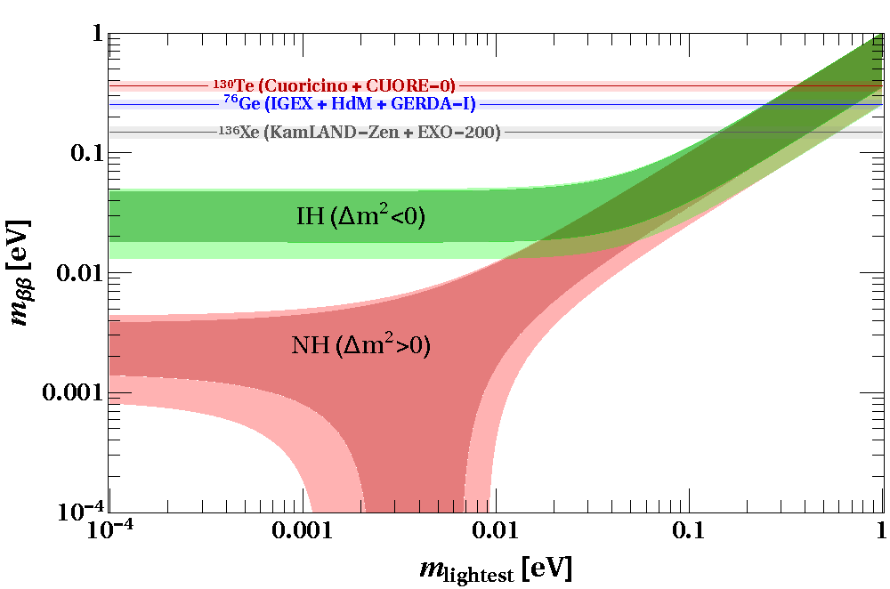
ββ0ν – decay results
p
n
KamLAND-Zen
W
U_{ei}
e
m_{i}
ν
x
m_{ββ}
e
W
U_{ei}
n
p
90% CL upper bound on m_{ββ} depending on NME
m_{ββ} = U_{e1}² m₁ + U_{e2}² m₂ e^{ια} + U_{e3}² m₃ e^{ιφ}

Slide 5
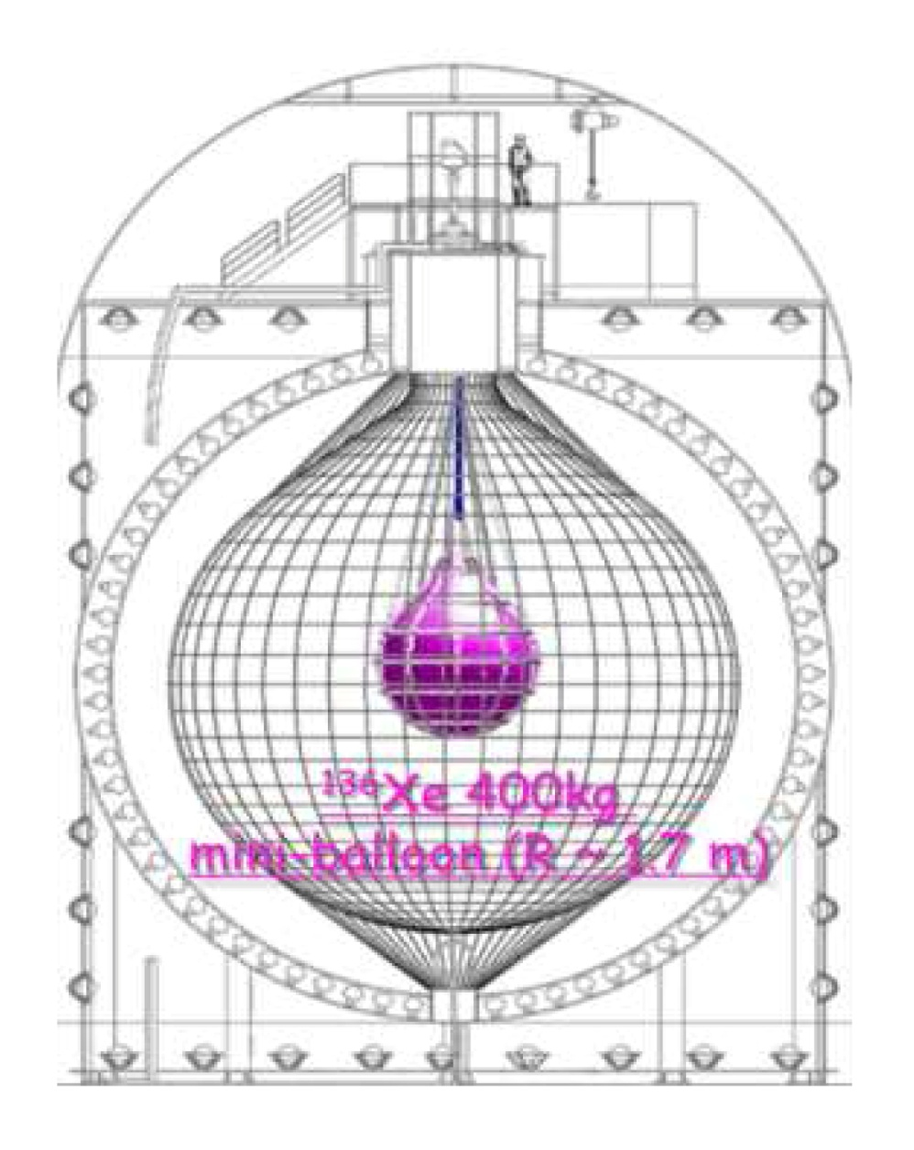
KamLAND-Zen
KamLAND-Zen Collaboration
S. Abe et al. Phys.Rev.Lett. 130 (2023) 5, 051801 2203.02139 [hep-ex]
Xenon-loaded liquid scintillator detector KamLAND-Zen 800
970 kg⋅year exposure:
T > 2.0 × 10²⁶ years at a 90% CL
A combined fit of the KamLAND-Zen 400 and 800 data sets
T > 2.3 × 10²⁶ years at a 90% CL
m_{ββ} < 36 - 156 meV

Slide 6
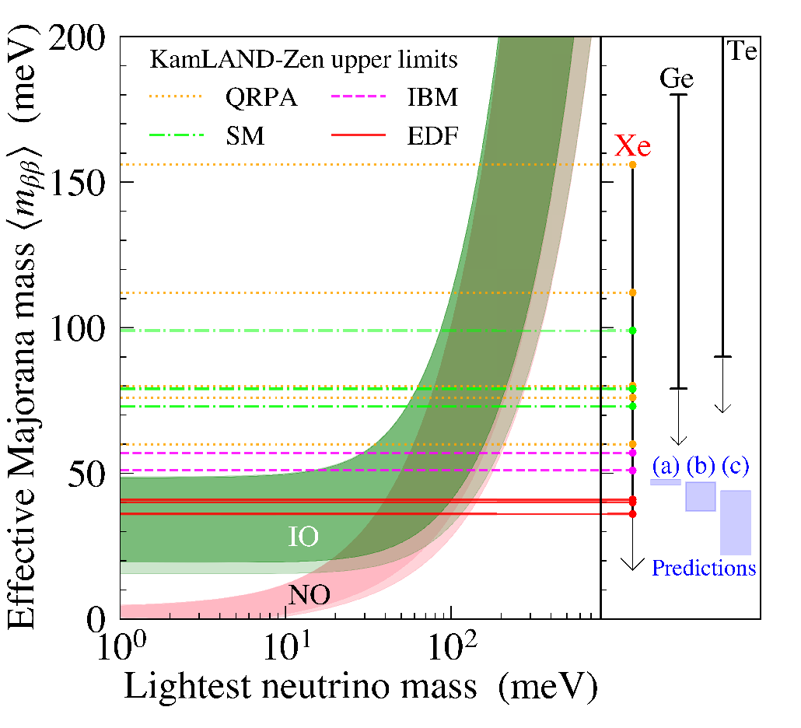
KamLAND-Zen
Upper bounds at 90% C.L.
Nuclear matrix element estimates: energy-density functional (EDF) theory (solid lines),
interacting boson model (IBM)
shell model (SM) (dot-dashed lines),
and quasiparticle random-phase approximation (QRPA) (dotted lines).

Slide 7
Smallness of m
ν
New large
New
mass scale
symmetries
Extra
See-saw
mechanism
dimensions
Forbid the usual
Dirac mass terms
Overlap mechanism
Radiative generation
different localization
of the left and right
components
High dimension
operators
small VEV
``Chiral mismatch’’

Slide 8
Dirac + Majorana
If right components exist, the Majorana mass terms for them:
L = … - ½ M_{R} ν_{R}^{T}Cν_{R} + h.c.
(I, I₃, Y) = (0, 0, 0)
→ mass term does not violate the EW symmetry
|ΔL| = 2
General form of mass
terms (matrix)
m_{L} m_{D}
m_{D}^{T} M_{R}
ν_{L}
N_{L}
N_{L} = ν_{R}^{C}
Limits:
m_{L} = M_{R} = 0
Dirac neutrino = two Majorana neutrinos
with equal but opposite sign masses +/- m_{D}
m_{L} = M_{R} << m_{D}
Pseudo Dirac neutrino
M_{R} >> m_{D}
Seesaw

Slide 9
See-saw
P. Minkowski
T. Yanagida
M. Gell-Mann, P. Ramond, R. Slansky
S. L. Glashow
R.N. Mohapatra, G. Senjanovic
x
H
H
x
m_{ν}
ν
M_{R}
Y
>
x
<
Y
m_{D} = Y<H>
m_{D}
N
N
ν
ν
N
M_{R}
Mass matrix:
M_{R}
ν N
ν
N
0 m_{D}
m_{D}^{T} M_{R}
- Minimal in terms of new particles and assumptions,
- natural extension of SM,
- employing properties
(neutrality) of neutrinos and symmetries
1
M_{R}
if M_{R} >> m_{D}
m_{ν} = - m_{D}^{T} m_{D}

Slide 10
New scale
Scale of seesaw
1
m_{ν}
q – l similarity: m_{D} ~ m_{q} ~ m_{l}
M_{R} = - m_{D}^{T} m_{D}
for the third generations
M_{R} ~ 2 10¹⁴ GeV
M_{GUT} ~ 10¹⁶ GeV
for the heaviest in the presence of mixing
M_{GUT}²
M_{Pl}
M_{R} ~ 10⁸ - 10¹⁴ GeV
double seesaw
10¹⁶ - 10¹⁷ GeV
many heavy singlets (RH neutrinos)
…string theory
N ~ 10²
Also in favor of high scale:
Gauge coupling unification
Leptogenesis
UV completion of the Weinberg operator: Λ ~ M_{R}

Slide 11
ν- mass and Higgs physics
J Elias-Miro et al,
1112.3022 [hep-ph]
introduces new mass scale
<< M_{Pl}
Renormalization of quartic Higgs coupling λ (making it more negative)
H
ν_{L}
F. Vissani
hep-phl9709409
ν_{L}
ν_{R}
H
H
H
H
ν_{R}
ν_{R}
ν_{L}
y²
(2 π )²
δm_{H}² ~ M_{R}² log (q /M_{R})
M_{R}³ m_{ν}
(2 π v)²
Affects stability and lifetime
of the EW vacuum
~ log (q /M_{R})
M_{R} < 10⁷ GeV
M_{R} < 10¹³ - 10¹⁴ GeV

Slide 12
Neutrino option?
Brivio, M. Trott,
1703.10924 [hep-ph]
Both Higgs mass term and quartic
coupling (absent at tree level)
are generated by neutrino loops
RH neutrino masses is the origin
of the EW scale
M_{R} = 10⁷ - 10⁹ GeV
y = 10⁻⁶ - 10^{-4.5}
Dirac Yukawa coupling

Slide 13
See-saw and L-R
New gauge symmetry
ν_{L}
ν_{R}
m_{D}
M_{R}
Naturally embedded into SU(2)_{L} x SU(2)_{R} x U(1)_{B-L}
Φ
ν_{L}
ν_{R}
Δ_{R}
M_{R}
Δ_{L}
< Δ_{R}>
m
W_{R}
Seesaw scale is determined by the scale of L- R symmetry violation
< Δ_{L}> = 0
→ type II
Type I + II

Slide 14
See-saw type-II
New bosons or fermions
H
H
M. Magg and C. Wetterich
G. Lazarides, Q Shafi and C Wetterich
R. Mohapatra, G. Senjanovic,
f
Δ
Seesaw for VEV’s:
h_{Δ}
<Δ> = <H>² f/M_{Δ}²
ν
ν
m_{ν} = h_{Δ} <Δ > = h f <H>² /M_{Δ} ²
Light triplet?
Natural smallness of VEV
Type III

Slide 15
Extended seesaws
R. N. Mohapatra, PRL 56,
6, (1986) 561
R. N. Mohapatra and
J W F Valle PRD 34, 5,
(1986) 1642
New fermions – singlets of L-R symmetry
ν_{L}
ν_{R}
S
μ
m_{D}
M_{D}
M_{R} >> m_{D}
No representations/interactions which give Majorana mass of ν_{R}

Slide 16
Double Seesaw
R.N. Mohapatra
J. Valle
Three additional singlets S which couple to RH neutrinos
0 m_{D}^{T} 0
m_{D} 0 M_{D}^{T}
0 M_{D} M_{S}
ν
ν^{c}
S
M_{S} - scale of B-L violation
M_{S} >> M_{D}
M_{R} = M_{D}^{T} M_{S}⁻¹ M_{D}
can be very
hierarchical
1
M_{D}^{T}
1
M_{D}
m_{ν}= m_{D}^{T} M_{S} m_{D}
If M_{S} ~ M_{Pl}, M_{D} ~ M_{GU}
M_{R} ~ M_{GU}²/M_{Pl} ~ 10¹⁴ GeV
explains
intermediate scale
If m_{D} =A M_{D}
m_{ν} ~ M_{S}
Screening of Dirac structures:
m_{ν} may have completely different structure from m_{D}

Slide 17
Inverse Seesaw
R.N. Mohapatra
J. F. Valle
Decreasing scale of seesaw physics
0 m_{D}^{T} 0
m_{D} 0 M_{D}^{T}
0 M_{D} μ
ν
ν^{c}
S
μ - scale of B-L violation
μ << m_{D} << M_{D}
m_{ν} = m_{D}^{T} M_{D}^{-1T} μ M_{D}⁻¹ m_{D}
the same as in the double seesaw
If
μ ~ keV
M_{D} ~ few TeV within LHC reach
ν^{c} and S form pseudo Dirac neutrino

Slide 18
Scotogenic model
E. Ma, hep-ph 0601225
No RH neutrinos. Why?
H
x
x
H
New elements:
η⁰
λ
higgs doublet ( η⁺ , η⁰ )
- fermionic singlets N_{k} - discrete symmetry Z₂
η⁰
M_{k}
x
ν_{α}
h_{ακ}
h_{βκ}
ν_{β}
Under Z₂ new particles are odd,
SM particles are even
N_{k}
η⁰ has zero VEV
h²
16π²
r ln r
r -1
If Z₂ is exact then
η⁰ or lightest N_{k} are stable and can be Dark Matter particles
m_{ν} = M_{k}
r = M_{η}²/ M_{k}²
For M_{k} = 10 GeV : h = 10⁻⁶

Slide 19
Overlap in extra dimensions
small Dirac masses due to
overlap suppression:
Right handed components are localized
differently in extra dimensions
Grossman
Neubert
Arkani-Hamed,
Dvali, Dimopoulos
Warped extra D
Flat extra D
Hidden
brane
Visible
brane
3D brane
wave functions
f_{R}
f_{L}
f_{L}
overlap
f_{R}
overlap
0
π
m ε f_{L} f_{R} + h. c.
amount of overlap in extra D

Slide 20

Neutrino condensate
Small neutrino masses from gravitational θ-term
G. Dvali and L. Funcke,
Phys.Rev. D93 (2016) no.11, 113002 arXiv:1602.03191 [hep-ph]
No ββ_{0ν} decay due to large q² the vertex does not exist ?
Neutrino mass generation
through the neutrino condensate via non-perturbative interaction
ββ_{0ν} decay - unique process where neutrinos are highly virtual
Neutrino condensation
Due to nonperturbative gravitational interaction <νν>
Analogy with quark condensate)

Slide 21
Vacuum and properties of oscillations
G.Dvali , L Funcke,
1602.03191 [hep-ph]
Order parameter
<Φ_{αβ} > = <ν_{α}^{T}Cν_{β} > ~ Λ_{G} = meV - 0.1 eV
Cosmological phase transition at T ~ Λ_{G}
Neutrinos get masses, in flavor basis m_{αβ} ~ < Φ_{αβ} >
(charged leptons mass generated by usual Higgs field)
m ~ U(θ)^{T} <Φ> U(θ)
<Φ> = diag (Φ₁₁, Φ₂₂, Φ₃₃),
U(θ) - mixing matrix
T < Λ_{G}
Relic neutrinos form bound states φ = (ν_{α}^{T}ν_{β} ),
decay and annihilate into φ (neutrinoless Universe)
Symmetry of system, SU(3)xU(1), spontaneously broken by neutrino condensate - φ are goldstone bosons
φ get small masses due explicit symmetry breaking by WI via loops

Slide 22
TBM: deviations and implications
Tri-bimaximal mixing
P. F. Harrison, D. H. Perkins,
W. G. Scott
0.30
2/3 1/3 0
- 1/6 1/3 - 1/2
- 1/6 1/3 1/2
0.15
U_{tbm} = U₂₃(π/4) U₁₂
U_{tbm} =
0.78
sin²θ₁₂ = 1/3
0.62
0.30 - 0.31
Accidental, numerology,
useful for bookkeeping
Not accidental
Lowest order approximation
which corresponds to weakly
broken (flavor) symmetry
of the Lagrangian
Accidental symmetry
(still useful)
There is no relation of mixing
with masses (mass ratios)
with some other physics
and structures associated
flavons other new particles

Slide 23
Decoupling of masses and mixing
equalities,
zeros
Relations
between
elements
Mass matrix
Mixing
of neutrinos
Ratios of masses from different relations
(in the flavor basis)
Mass ratios
Opens up a possibility that symmetry is behind TBM
Decoupling is always possible, but the key is that relations should be simple to be consequences of simple symmetries

Slide 24
Relations and symmetries
Mixing: very special structure which is not related to mass ratios
For TBM: m₁₂ = - m₁₃ , m₂₂ = m₃₃ , m₁₁ + m₁₃ = m₂₂ + m₂₃
S₄
,
sin θ_{C}
1 – 2 sin² θ_{C}
For Cabibbo mixing:
m₁₂ = (m₁₁ - m₂₂)
~ 1/4
Relation between matrix elements which
leads to Cabibbo mixing independently of values of matrix elements
symmetry which produces the relation dihedral D14
C. Hagedorn, 1204.0715

Slide 25
Deriving the TBM-symmetry
C.S. Lam
Invariance of mass matrices in the flavor basis:
Neutrinos
V_{i}^{T} m_{TBM} V_{i} = m_{TBM}
V_{i} = S, U_{i}
-1 2 2
… -1 2
.. … -1
0 0
0 0 1
0 1 0
S =
1
3
U =
ν_{μ} −ν_{τ} -permutation
charged leptons
diagonal due to symmetry
1 0 0
… ω² 0
… … ω
T =
ω = exp(-2iπ/3)
T⁺ (m_{e}⁺ m _{e})T = m_{e}⁺ m _{e}
S, T, U –elements of S₄

Slide 26
S - symmetry
4
Order 24, permutation of 4 elements
Symmetry of cube
Generators: S, T
Presentation:
S⁴ = T³ = (ST²)² = 1
Irreducible
representations:
1 , 1’ , 2, 3, 3’
Products and
invariants
3 x 3 = 3’ x 3’ = 1 + 2 + 3 + 3’
3 x 3’ = 1’ + 2 + 3 + 3’
New flavor
structure
1’ x 1’ = 1
2 x 3 = 2 x 3’ = 3 + 3’
2 x 2 = 1 + 1’ + 2
1’ x 2 = 2

Slide 27
S_{ν}
Residual symmetries approach
E. Ma,
C. S. Lam ....
Mixing appears as a result of different ways of the flavor symmetry
breaking in the neutrino and charged lepton (Yukawa) sectors.
S₄
T’
G_{f}
A₄
T₇
Residual symmetries
of the mass matrices
Z_{m}
G_{l}
G_{ν}
Z₂ x Z₂
or Z₂
M_{l}
M_{ν}
Intrinsic symmetries
of mass matrices
which do not depend
on values of masses
Symmetry transformations
in mass bases
T
U, S_{ν}
S_{ν} M_{ν} S_{ν} ^{T} = M_{ν}
Discrete finite groups
Flavons to break symmetries
CP-transformations
can be added

Slide 28
A₄ symmetry
E. Ma
G Branco, H P Nilles
A₄
Symmetry group of even permutations
of 4 elements
Symmetry of tetrahedron
Generators: S, T
Presentation
of the group:
no U = A_{μτ}
S² = 1
T³ = 1
(ST)³ = 1
Irreducible representations: 3, 1, 1’, 1’’
Products and
invariants
3x3 = 3 + 3 + 1 + 1’ + 1’’
1’ x 1’’ ~ 1

Slide 29
A_4 symmetry breaking
A₄
``accidental’’ symmetry
due to particular
selection of flavon
representations and
configuration of VEV’s
T
S
A_{μτ}
M_{l}
diagonal
M_{ν}
TBM-type
In turn, this split originates from
different flavor assignments of
the RH components N^{c} and l^{c}
and different higgs multiplets

Slide 30
An A₄ model
G. Altarelli
D. Meloni
symmetry
Yukawa sector mass terms
A₄
Z₄
Charged lepton
Neutrinos
3
1
i
-1
-i
L
L
1
i
n
k
i
φ_{T}
ξ’
H_{d}
H_{u}
i
1’
l^{c}
i
i
1
N^{c}
1, i, -1
-1
at multiplets
flavons
1’’
φ_{S}
M
n = 1, 2, …k = 0, 1
ξ
1
< φ_{T} > = v _{S}(0, 1, 0)
1
< φ_{S} > = v _{S} (1, 1, 1)
Flavon sector
U(1)_{R}
Particular selection
of representations
φ_{T}
φ_{S}
ξ
ξ’
0
2
φ_{T}⁰
φ_{S}⁰
ξ⁰
Driving fields
Vacuum alignment
-1
1
1
GUT-scale or higher?

Slide 31
Generic problem
m = F(Y, v)
Mechanism of
mass generation
VEV’s
Yukawa
couplings
VEV alignment
different contributions
high order corrections
follow from independent sectors:
TBM
Yukawa sector
Scalar potential
tune by additional symmetries
All these
components
should be
correlated
``Natural’’ – consequence
of symmetry?
one step constructions do not work

Slide 32
Linear, Modular, Eclectic

Slide 33
Modular symmetries as flavor symmetries
F. Feruglio
Gui-Jun Ding, S.F. King, Xiang-Gan Liu, S. Petcov, A V. Titov, M. Tanimoto ,
T. Nomura, H. Okada, T Kobayashi, O.Popov Y. Shimizu, P Novichkov,
J. Penedo, T Osaka, A. Romanino, I. De Medeiros Varzielas, X Wang, S. Zhou ...
Motivated by string theory
Symmetry related to (orbifold) compactification of extra dimensions and primary realized on the moduli fields τ which describe geometry of the compactified space.
Hope was to
Reduce number of parameters, more predictive - ?
Connect masses and mixing - ?

Slide 34
Modular symmetries
For single modulus field τ the modular transformation γ
a τ + b
c τ + d
τ → γτ =
The 2x2 matrices of integer numbers
a b
c d
with determinant ad – bc = 1
form the group Γ = SL(2, Z) [special, linear, integer ...]
Modular group Γ_{N} is finite subgroup of Γ, quotient group of the level N:
Γ_{N} = Γ / Γ (Ν)
Isomorphic to the groups considered previously:
Γ₃, Γ₄, Γ₅ are isomorphic to A₄, S₄, A₅, correspondingly

Slide 35
,.
Transformations
In SUSY, the chiral superfields transform as
k_{I}
ϕ^{I} → (cτ + d) ρ(γ) ϕ^{I}
k_{I} is the weight of multiplet
ρ(γ) is the representation of γ element of the group Γ_{N}
Appearance of the weight factor in transformations is new element which leads to new consequences

Slide 36
Yukawa couplings are modular forms
- functions of modulus field τ
- Form multiplets of the group Γ_{N} and transform as superfields:
k_{Y}
Y_{i}(τ) → Y_{i}(γτ) = (cτ + d) ρ(γ)_{ij} Y_{j}(τ)
k is the weight of multiplet
ρ(γ) is the representation of γ element of the group Γ_{N}
dimension of the multiplet is determined by the level N and weight k
Level N characterizes reduction of Γ = SL(2, Z) to finite subgroup

Slide 37
An Example of Modular form
Dependence Y_{i}(τ) is determined by transformation properties
For instance for N = 3 and k_{f} = 2, Y_{i} form triplet with components
Y₁(τ) = 1 + 12q + 36q² + ...
Y₂(τ) = - 6q^{1/3} (1 + 7q + ... )
Y₃(τ) = - 18 q^{2/3} (1 + ... )
i2π τ
q = e
Data fit:
τ = 0.0117 + i 0.995
Y_{i} = (1, - 0.74, - 0.27)
weak hierarchy

Slide 38
Invariant superpotentials
Invariance of terms of the superpotential
α Y ϕ₁ ϕ₂ ϕ₃
α - constant
requires
ρ₁ x ρ₂ x ρ₃ x ρ_{Y} = I
for product of representations
Σ_{ι} k_{i} + k_{Y} = 0
for weights
The latter condition acts to some extent as Froggatt- Nielsen symmetry it gives additional restrictions, forbids some term →texture zeros

Slide 39
Comparison
F. Feruglio and A. Romanino, Rev. Mod. Phys. 93 (2021), 1. 015007
1912.0602
Usual Yukawa coupling
Y L N^{c} H_{u}
Y -constant
Linear traditional flavor symmetry
Y Π_{i} φ_{i} L N^{c} H_{u}
φ_{i} – flavons (dimensionless)
transformation under G –flavor symmetry group:
Y → Y,
φ_{ι} → ρ_{i}(g) φ_{ι}
L → ρ_{L}(g) L,
N^{c} → ρ_{N} (g)N^{c}
Invariance: ρ_{L}(g) ρ_{N}(g) Π_{i} ρ_{i}(g) contains singlet
Modular symmetry
All the factors including coupling transform as
k_{f}
α Y(τ) L N^{c} H_{u}
f(τ) → (cτ + d) ρ_{f}(γ) f(τ)
Invariance: Π_{f} ρ_{f}(g) contains singlet and
Σ_{f} k_{f} = 0
Y Π_{i} φ_{ι} → α Y(τ)

Slide 40
Eclectic flavor symmetry
H.P Nilles, A.Baur, S. Ramos-Sanchez, P.K. Vaudrevange, A. Trautner..
Explicit top-down construction from heterotic string theory compactified on orbifold T² /Z₃
All symmetries used in bottom up approach:
G_{traditional} , G_{modular} , G_{R} , CP
Z₂^{CP} CP transformations
Z₉^{R} discrete R symmetry
appear simultaneously in non-trivially unified fashion
Kahler potential (kinetic terms) is involved and introduce additional parameters, freedom

Slide 41
Neutrino mass and big picture:
Δm₄₁² = 1 - 2 eV²
Leptons, Quarks
LSND
Unification

Slide 42
νMSM
M.Schaposhnikov, …
νMSM with UV completion at the string-Planck scale:
No new physics below M_{Pl}
BAU
Phenomenological scheme
- small neutrino mass via seesaw
lepton asymmetry via oscillations
N₂, N₃ can be produced in
B-decays (BR ~ 10⁻¹⁰ ), etc., SHiP
L
R
N₂, N₃
0.1 - few GeV
split ~ few kev
WDM
N₁
N₁ decouples from generation of
light neutrino mass
3 - 10 kev
radiative decays → 3.5 keV line?
Symmetry: degenerate pair N₂, N₃ massless state N₁
Symmetry breaking: N₂, N₃ splitting and kev mass of N₁

Slide 43
Δm₄₁² = 1 - 2 eV²
Sterile pollution
LSND

Slide 44
(3 + 1) scheme
ν_{e}
ν_{s}
ν_{μ}
ν_{τ}
LSND/MiniBooNE: vacuum oscillations
ν₄
P ~ 4|U_{e4} |² |U_{μ4} |²
restricted by short baseline exp.
BUGEY, CHOOZ, CDHS, NOMAD
mass
Δm²₄₁
For reactor and source experiments
ν₃
Δm²₃₁
P ~ 4|U_{e4}|² (1 - |U_{e4}|²)
ν₂
ν₁
Δm²₂₁
Strong perturbation of 3ν pattern:
δm_{αβ} ~ m₄U_{α4} U_{β4} ~ Δm₃₂²
- additional radiation in the Universe
- bound from LSS?

Slide 45
eV scale steriles and ν - mass matrix
m_{ee} … m_{es}
… … …
m_{es} … m_{ss}
m_{ss} = 1 – 3 eV
BEST, Gallium,
LSND, MiniBooNE Neutrino 4
sin² θ_{es} ~ m_{es}/m_{ss} ~ 0.02 - 0.1
Correction to the mass matrix of active neutrinos
δm = sin²θ_{S} m_{S} ~ (0.02 – 0.3) eV
at the level of largest elements (~ 0.03 eV) of the 3ν mass matrix
ν_{S} effect is not a small perturbation of 3ν picture and its symmetries
To reproduce oscillation data it requires cancellations, fine tuning (cancellation), and should be included in theory/symmetry constructions from the beginning
On the other hand it allows to explain difference of the quark and lepton mixings, large lepton mixing

Slide 46
Leptons vs. Quarks
Complementarity

Slide 47
Leptons vs. quarks
Leptons
Quarks
ν₃
t
mass
mass
ν₂
c
ν₁
u
ν_{f} = U_{PMNS} ν_{mass}
U_{d} = V_{CKM}⁺ U_{u}
U_{u} = (u, c, t)
Mixings of quarks and leptons are strongly different but still related
θ₁₂^{l} + θ₁₂^{q} ~ π/4
Sum up to maximal mixing angle
kind of complementarity
Observation:
θ₂₃^{l} + θ₂₃^{q} ~ π/4
QLC

Slide 48
Quark-Lepton Complementarity: Prediction
C. Giunti, M. Tanimoto
H. Minakata, A Y S
Z - Z. Xing
J Harada
S Antusch , S. F. King
Y Farzan, A Y S
M Picariello ,etc.
U_{PMNS} = V_{CKM}⁺ U_{X}
U_{X} special matrix close to bi-maximal or TBM matrix:
U_{BM} = U₂₃(π/4) U₁₂(π/4)
U_{X} =
θ₁₃^{X} ~ 0
U_{TBM} = U₂₃(π/4) U₁₂(θ_{TBM})
V₁₂⁺ U_{X} = V₁₂⁺(θ_{C}) U₂₃(π/4) U₁₂
permutation - to reduce the lepton mixing matrix to the standard form gives 1-3 rotation matrix with
sin θ₁₃~ ½ sin θ_{C}

Slide 49
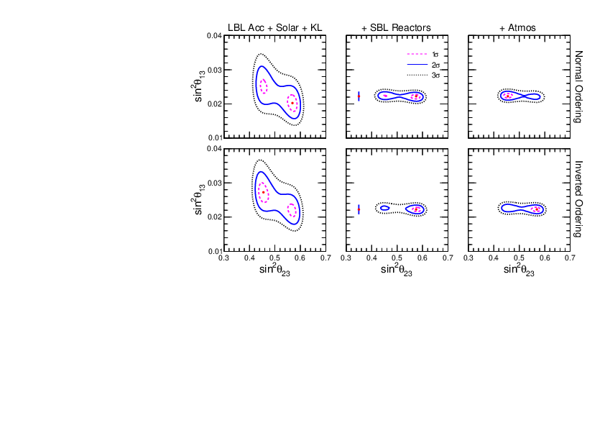
Prediction for 1-3 mixing
More general relation:
sin²θ₁₃ = sin²θ₂₃ sin²θ_{C} (1 + O(λ²))
0.04
0.03
0.02
0.01
θ_{C} - Cabibbo angle
for sin² θ_{C}
predictions
sin² θ₁₃
Difference can be due to deviation of θ₁₂^{l} from θ_{C}
related to difference of q and l- masses
global fit
0.03 0.04 0.05 0.06 0.07
sin² θ₂₃
Renormalization effects
from GUT to low energies

Slide 50
Predictions for δ_{CP}
B. Dasgupta, A Y.S. ,
N.P. B884 (2014) 357
1404.0272 [hep-ph]
If U_{X} = U_{BM}, U_{TBM} , then U_{lept} ~ V_{CKM} can be the only source
of CP violation. Leads to the relation
sin θ₁₃^{q}
sin θ₁₃
λ³
λ = sin θ_{C}
sinδ_{CP} = - sinδ_{CP}^{q} cosθ₂₃
λ
0.93
0.75
λ²
sin δ_{CP} ~ λ² ~ 0.046 or δ_{CP} = 2.6º
δ_{CP} ~ - δ_{CP} or π + δ_{CP}
Leptonic CP is small because the leptonic 1-3 mixing is large

Slide 51

Experiment: CP-phase is close to π?
NOvA-T2K 2σ tension
NOvA: δ_{CP} = 0.82π, T2K δ_{CP} = 1.5π
Global fits
NuFIT 5.2 (2022),
www.nu-fit.org

Slide 52
Setup
Dark sector
SM + ν_{R}
Singlets (fermions, bosons) of GUT
L-R
Neutrino
portal
Sterile
neutrinos
P-S
Axions, Majorons, DM
GUT
Origins of smallness of neutrino mass and large (maximal mixing)

Slide 53
U_{x} from the dark sector
U_{PMNS} ~ V_{CKM}⁺ U_{X}
Common sector for quarks
and leptons. Implies
From the dark sector coupled
to neutrinos. Responsible for large neutrino mixing
smallness of neutrino mass
m_{l} ~ m_{d}
m^{D}_{ν} ~ m_{u}
Q - L unification, GUT
may have special symmetries which lead
to BM or TBM mixing
CKM physics, hierarchy,
of masses and mixings Froggatt-Nielsen (?), relations between masses and mixing

Slide 54
SO(10) GUT + ...
RH-neutrino
16
u_{r} , u_{b} , u_{j} , ν
d_{r} , d_{b} , d_{j} , e
u_{r}^{c}, u_{b}^{c}, u_{j}^{c}, ν^{c}
d_{r}^{c}, d_{b}^{c}, d_{j}^{c}, e^{c}
S
S
S
S
S
S
S
S
S
S
S
S
S
- Enhance mixing
Produce zero order mixing
- Screen Dirac mass hierarchies
S
S
S
S
S
S
S
S
S
S
S
S
S
S
S
S
Hidden sector

Slide 55
GUT/Planck realization of flavor symmetries
SO(10) GUT
Gives very small corrections to mixing
G_{f}
Explicit
spontaneous
G_{basis}
G_{hidden}
10_{H}
16_{f}
16_{H}
S_{f}
1_{H}
G_{basis} = Z₂ x Z₂
M_{S} ~ M_{Pl}

Slide 56
m_{D}
LHC-filic L-R models
P.S.Bhupal Dev,
R.N. Mohapatra,
0910.3924 [hep-ph]
SU(2)_{L} x SU(2)_{R} x U(1)_{B-L}
x P
with GUT embeddings
with q-l similarity
m_{q} ~ m_{l} ~ m^{D}_{ν}
V.Brdar, A. Yu.S
JHEP 02 (2019) 045
Fields L_{L} L_{R} χ_{L} χ_{R} S
B – L -1 -1 1 1 0
Higgs bi-doublet
ν_{l}
l
ν_{l}
l
Φ
inverse seesaw
L
R
M_{D} ~ M_{R} ~ PeV
χ_{L}
χ_{R}
Higgs
doublets
μ ~ 10 keV
S
flavor symmetry in μ
Dark
sector
singlet
breaks
L-R symmetry
μ
with Majorana mass terms

Slide 57
m_{D}
Model with L and R singlets
SU(2)_{L} x SU(2)_{R} x U(1)_{B-L}
x P
V.Brdar, A. Yu.S
JHEP 02 (2019) 045
1809.09115 [hep-ph]
Higgs bi-doublet
ν_{l}
l
ν_{l}
l
Φ
invariant under global U(1)
L
R
broken by μ-terms
χ_{L}
χ_{R}
keV scale sterile neutrino
- DM
S_{L}
S_{R}
μ_{LR}
μ
μ

Slide 58
Δm₄₁² = 1 - 2 eV²
Refractive
LSND
Neutrino mass

Slide 59
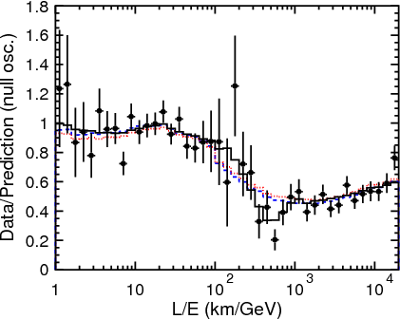
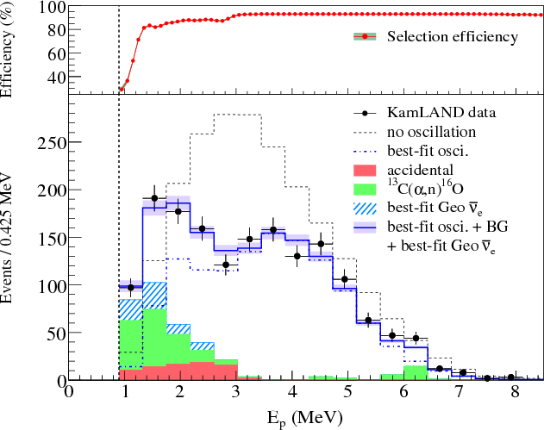
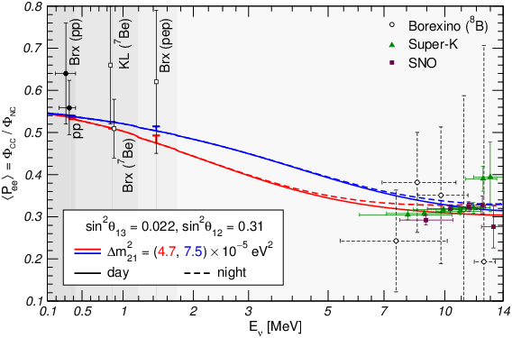
The energy dependence found !
KamLAND
SK
Sun
also MINOS, Daya Bay, RENO ...
in agreement with the presence of the mass term in the Hamiltonian of evolution:

Slide 60
Mass and oscillations
Hamiltonian of evolution responsible for oscillations
H = E = p² + |m|² = p + |m|²/2E
m is usual (vacuum) mass that appears in equation of motion in vacuum
(inertial mass)
For 3 neutrinos:
m → M
3x3 mass matrix
|m|² → MM⁺
Matter potential if
oscillations occur in matter
MM⁺
2E
H = p I + + V
Term with 1/E dependence in H
Leads to energy dependence of
oscillation effects

Slide 61
A simple model
Target (DM): complex scalar field φ with mass m_{φ}
Mediator: χ_{k} – light Majorana fermions with masses m_{χk}
At least two χ are needed to explain data
L = g_{αk} ν_{αL} χ_{kR} φ + ½ m_{χk} χ_{kR}^{T}χ_{kR} + h.c.
k = 1,2, α = e, μ, τ
g_{αk} < 10⁻⁷
bound from SN, ...
We assume zero VEV < φ > = 0
The interaction can be generated via mixing of φ with SM Higgs boson

Slide 62
Refraction on scalar DM
S. F Ge and H Murayama, 1904.02518 [hep-ph]
Ki-Yong Choi, Eung Jin Chun, Jongkuk Kim,
1909.10478 [hep-ph]
Elastic forward scattering of ν on background scalars φ with fermionic χ mediator
2012.09474 [hep-ph]
ν_{α}
Effective potential
ν_{α}
ν_{β}
φ
V
χ_{k}
χ_{k}
φ
φ
Wolfenstein
limit
φ
ν_{β}
Resonance: s = m_{χ}²
1/E tail
0
for φ at rest the resonance ν energy:
E_{R} =
m_{χ}²
2m_{φ}
For small m_{φ} resonance at low,
observable energies
resonance
A.Y.S. , V. Valera, 2106.13829 [hep-ph]
0
E_{R}
E

Slide 63
Refraction mass squared
Introduce the effective or refractive mass squared as
V = m_{ref}²/2E
|Δm_{ref} ²|
existing
observations
m_{ref}² = 2EV
true mass²
m_{ref}² = constant –
checked down to 0.1 MeV
relic ν
E_{R}
E
→ E_{R} << 0.1 MeV
The decrease of m_{ref}² with E allows to avoid
the cosmological bound
on sum of neutrino masses
~ constant m_{ref}² explains oscillation data
Large number density of target particles is required →
form substantial part of whole DM

Slide 64
Vacuum mass vs. Refractive mass
Exists in vacuum:
no background, no interactions.
Appears in background
due to interactions, scattering on the background
Lorentz invariant
Appears in equation of motion,
propagator, dispersion relation
Affects kinematics (decays, resonances)
Determines the group velocity
No dependence on energy
Energy dependence -
due to radiative corrections , RGE effect
Depends on energy and density of background
If go deeper, the difference may not be so significant

Slide 65
Problems
Relic neutrinos: properties, detection
Supernovae neutrinos: theory of collective oscillations
Sterile neutrinos: strengthen bounds
Nature of neutrino mass: vacuum vs refractive
Testing time-energy dependence of oscillation parameters
Physics and astrophys is of Cosmic neutrinos
Neutrino connections to other phenomena

Slide 66
Δm₄₁² = 1 - 2 eV²
Back-up
LSND

Slide 67
S_{n} D
Flavor and CP symmetry
G_{f}x H_{CP}
T’
A₄
S₄
Flavons
Δ(96)
Δ(48)
Residual symmetries
of the mass matrices
G_{l}x H^{l}_{CP}
G_{ν}x H^{ν}_{CP}
Δ(27)
M_{l}
M_{ν}
R. Mohapatra, C C Nishi,
F. Feruglio, C. Hagedorn,
R. Ziegler, E Ma, G-J. Ding, S.F. King, C. Luhn,
A. J. Stuart, Y-L. Zhou,
G_{ν} = Z₂ x Z₂
→ no CP violation δ = 0
G_{ν} = Z₂
→ usually δ = 0, +/- π/2 , π
C. Hagedorn, et al
δ may depend on free parameter and take any value
Y. Farzan, A.S.

Slide 68
More problems
No connection to masses
Mass hierarchy from additional symmetries
U(1) Froggatt- Nielsen mechanism
n
φ
Λ
power n is determined by U(1) charges of the corresponding operators
Discrete symmetries – restricted possibilities to explain mass spectrum (degenerate, partially degenerate spectra)
Missing representations problem

Slide 69
CP-violation, phase
Certain values of δ follow from the flavor symmetries without additional assumptions
Specific transformations which can be responsible (control) value of the phase
Non-trivial CP phase : from generalized CP transformations
when also flavor is changed
Usually maximal CP violation is predicted

Slide 70
Double beta decay
Effective Majorana neutrino mass <mββ>⟨mββ​⟩ as a function
of the lightest neutrino mass.
The dark shaded regions are predictions based on best-fit values
of neutrino oscillation parameters for the normal ordering (NO)
and the inverted ordering (IO), and the light shaded regions indicate the
3σ ranges calculated from oscillation parameter uncertainties
The regions below the horizontal lines are allowed at 90\% C.L.
with 136Xe considering an improved phase space factor
calculation~\cite{Kotila2012,Stoica2013} and commonly used
nuclear matrix element estimates: energy-density functional (EDF) theory~
(solid lines), interacting boson model (IBM) shell model (SM)
(dot-dashed lines), and quasiparticle random-phase approximation (QRPA)
(dotted lines). The side panel shows the corresponding limits for 136Xe,
76Ge and 130Te~ and theoretical model predictions on <mββ>,
Ref.~\cite{Harigaya2012}, (b) Ref.~\cite{Asaka2020}, and
(c) Ref.~\cite{Asai2020} (shaded boxes), in the IO region.

Slide 71
Intrinsic symmetries
Realized for arbitrary values of neutrino and charged lepton mass
can not be broken, always exist
In the mass basis
for Majorana neutrinos
for charged leptons
m = diag( m₁, m₂, m₃)
m_{l} = diag( m_{e}, m_{μ}, m_{τ} )
G_{ν}
G_{l}
iφ_{e}
iφ_{μ}
iφ_{τ}
S₁ = diag (1, -1, -1)
T = diag(e , e , e )
S₂ = diag (- 1, 1, -1)
φ_{α} = 2π k_{α}/m
S_{i}² = I
Z₂ x Z₂
T^{m} = I
Z_{m}
The Klein group
Σ φ_{α} = 0
can use subgroup
Intrinsic symmetries as residual symmetries

Slide 72
Invariance
m₁
m₂
m₃
ν₁
ν₂
ν₃
ν₁ ν₂ ν₃
ν → S_{i}ν

Slide 73
Symmetry group condition
D. Hernandez, A.S.
1204.0445
If intrinsic symmetries are residual symmetries of the unique symmetry group (follow from breaking of unique group)
→ bounds on elements of mixing matrix
S_{i} and T are elements of covering group.
By definition product of these elements (taken in the same basis) also belongs to the finite discrete group:
( U_{PMNS} S_{i} U_{PMNS}⁺ T)^{p} = I
p -integer
For each i the equation gives two relations between mixing parameters
Two such equations for i = 1,2 fix the mixing matrix completely → TBM
Z₂ x Z₂
TBM
In general, the condition allows to fix mixing matrix up to several possibilities

Slide 74
Large flavor mixing from steriles
ν_{e}
ν_{μ}
ν_{τ}
m_{ee} m_{eμ} m_{eτ}
… m_{μμ} m_{μτ}
… … m_{ττ}
m_{eS}
m_{μS}
m_{τS}
no contribution from S
to ββ_{0ν} decay, but S do
contribute to oscillations
Mass
matrix
ν_{S}
… … …
m_{SS}
m_{ν} = m_{a} + m_{ind}
eV scale seesaw
0.2 0.4 0.4
… 2.8 2.0
… … 3.0
2.0 2.0 4.5
… 2.0 4.5
… … 10.0
m_{a} =
m_{ind} =
m_{SS}
1 eV
10⁻² eV
10⁻² eV
produce dominant
μτ-block with small determinant
Enhance lepton mixing
m_{eS} m_{μS} m_{τS} may have certain symmetry
Generate TBM mixing

Slide 75
Bounds on the eV sterile neutrinos
BEST, reactors, LSND/MB
m_{ee}⁰ … m_{es}⁰
… … …
m_{es}⁰ … m_{ss}⁰
After decoupling of sterile neutrino:
m_{ee} = m_{ee}⁰ - ¼ sin² 2θ₄₁ Δm₄₁²
oscillations of active
neutrinos, Cosmology
sterile neutrino
ββ_{0ν} - decay
16(m_{ee}⁰ - m_{ee})²
sin⁴ 2θ₄₁
Δm₄₁² <
m_{ee}⁰ < 0.156 eV (90% C.L.)
KamLAND-Zen , S. Abe et al.
2203.02139 [hep-ex]
sin² 2θ₄₁ = 0.4
Δm₄₁² < 2.4 eV²
disfavour
BEST,
Neutrino-4
For NH: m_{ee} ~ m₂ sin² θ₂₁ = 2.5 10⁻³ eV
For quasi-degenerate: m_{ee} < 0.03 eV
Δm₄₁² < 1.6 eV²

Slide 76
Double beta decay
m_{ee} = U_{e1}² m₁ + U_{e2}² m₂ e^{ια} + U_{e3}² m₃ e^{ιβ}
p
n
In terms of the lightest mass eigenstate
W
m_{ee} = U_{e1}² m₁
+ U_{e2}² (Δm₂₁² + m₁²)^{1/2} e^{ια}
+ U_{e3}² (Δm₃₁² + m₁²)^{1/2} e^{ιβ}
e
Normal mass hierarchy
ν
x
m_{ee}
e
W
m_{ee} = U_{e1}² (Δm₁₃² + m₃²)^{1/2}
+ U_{e2}² (Δm₂₃² + m₃²)^{1/2} e^{ια}
+ U_{e3}² m₃ e^{ιβ}
n
Inverted mass hierarchy
p
m_{ee} = Σ_{k} U_{ek}² m_{k} e^{iφ(κ)}
Strong mass hierarchy:
m_{ee} ~ U_{e2}² (Δm₂₁² )^{1/2} + U_{e3}² (Δm₃₁² )^{1/2} e^{ιξ}
m_{ee} ~ (Δm₃₁² )^{1/2} [r c₁₃² s₁₂² + s₁₃² e^{ιξ} ]

Slide 77
Models
J Griado and F. Feruglio
1807.01125 [hep-ph]
flavon
L E^{c} N^{c} Y ϕ
A₄ 3 1, 1’, 1’’ 3 3 3
k 1 -4 -1 2 3
Y lowest order
modular form
τ and ϕ are fixed by fitting on m₃ /m₂, 1-2 mixing and 1-3 mixing
Predictions:
sin ² θ₂₃ = 0.46
δ /π = 1.434
α₂₁/π = 1.7
α₃₁/π = 1.2

Slide 78
Gui-Jun Ding, S.F. King, Xiang-Gan Liu
1907.11714 [hep-ph]
Models
No flavons
Flavor from single modulus field τ
L E^{c} N^{c} Y
A₄ 3 1, 1’’, 1’ 3 3
k 2 2 0 -2
Higher order modular forms Y⁽²⁾, Y⁽⁴⁾ , Y⁽⁶⁾ constructed as products of Y⁽²⁾
All Yukawas are modular forms
τ is fixed by fitting 12 mixing and 13 mixing
Predictions:
sin ² θ₂₃ = 0.58
m₁ = 0.0946 eV
Cosmological bound?
δ /π = 1.6
m₂ = 0.0950 eV
α₂₁/π = 0.15
m₃ = 0.1071 eV
α₃₁/π = 1.00
Normal ordering
m_{ee} = 0.095 eV

Slide 79
From Model building to Symmetry building
Minimal simplest versions do not reproduce data well.
Generic predictions of masses: weak hierarchy,
often quasi-degenerate, Majorana CP-phases
More parameters needed.
Several moduli, flavons,
Different representations of the same dimension, fine tuning
of corresponding couplings
Different way of construction of finite groups
In the end: # parameters is comparable to # of observables
Use modular symmetry in wrong way?

Slide 80
Implications for Higgs physics
What is wrong with seesaw?
RH neutrinos have Majorana masses which are not protected by EW symmetry and therefore large

Slide 81
Origins of (finite) mass
x
x
Hard mass related to the EW scale
H
H
Gauge
invariance
small effective coupling
ν
ν
small induced VEV formed
by large VEV’s (seesaw II)
…
x
x
Soft mass
VEV created at
small scales
x
Δ
x
melting at T ~ VEV
ν
ν
MAVAN
Environment dependent
masses; relic neutrinos
…
x
x
Gravitationally induced mass
x
Melting couplings
Similarly for Dirac neutrinos

Slide 82
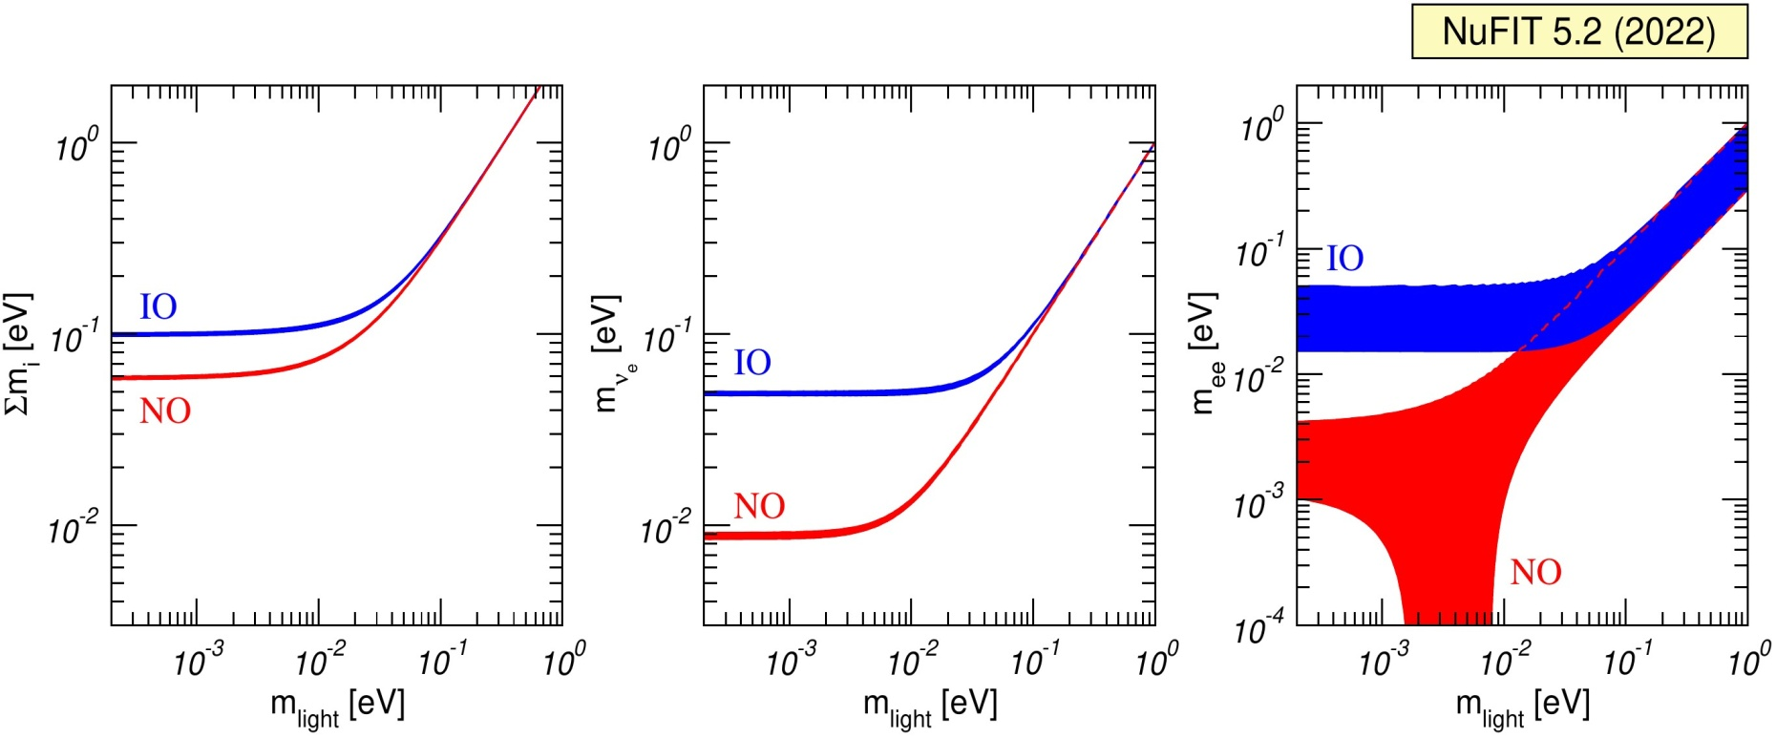
Global fit
NuFIT 5.2 (2022), www.nu-fit.org.

Slide 83
Seesaw mechanism
m_{ν} = - m_{D} (M_{R} )⁻¹ m_{D} ^{T}
m_{D} = U_{L} (m_{D} ^{diag}) U_{R}⁺
B Dasgupta A.S
In the simplest SO(10): U_{L} = V_{CKM}*
then U_{x} is the matrix which diagonalizes
M_{X} = - m_{D}^{diag} U_{R}⁺ (M_{R})⁻¹ U_{R}* m_{D}^{diag}
that is
M_{X} = U_{X} M_{X}^{diag} U_{X}^{T} = U_{X} m_{ν}^{diag} U_{X}^{T} ~ m_{TBM}
M_{R} = - m_{D}^{diag} (m_{TBM})⁻¹ m_{D}^{diag}
very hierarchical, generated by seesaw itself?
→ Double seesaw

Slide 84
Mass scales: double seesaw
0 m_{D}^{T} 0
m_{D} 0 M_{D}^{T}
0 M_{D} M_{S}
ν
ν^{c}
S
M_{S}
M_{S} >> M_{D} - double seesaw
M_{R} = M_{D}^{T} M_{S}⁻¹ M_{D}
For light neutrinos
m_{ν}= m_{D}^{T} M_{D}^{-1T} M_{S} M_{D}⁻¹ m_{D}
Dirac screening: if m_{D} = AM_{D}, A = const
m_{ν} = A²M_{S}
→ determines U_{x}
Structure of m_{ν} is determined by M_{S}, it does not depend on
the Dirac mass matrix structure
Easy to realize

Slide 85
“Usual” mass?
In vacuum:
In presence of interactions:
- appears in equation of motion
- decays
in propagator,
dispersion relation
- resonances
- affects kinematics
of processes
Lorentz invariant
- oscillations
Determines the group velocity
- ββ_{ον} –decays if
L number is broken
Energy dependence of mass due to radiative corrections , RGE effect
For fermions, mass term connects their left and right components
Cosmology: non-relativistic neutrinos, structure formation
Refractive mass?

Slide 86
Relating to mass degeneracy
Symmetry which left mass matrices invariant for specific mass spectra:
Partially degenerate spectrum
m₁ = m₂ , m₃
D. Hernandez, A.S.
Transformation matrix
S_{ν} = O₂
G_{ν} = SO(2) x Z₂
Relation:
m₁
m₂
sin²2θ₂₃ = +/- sin δ = cos κ = = 1
maximal
+/- π/2
Majorana phase
1-2 mixing is undefined
Small corrections to mass matrix lead to 1-2 mass splitting
and 1-2 mixing

Slide 87
Energy dependence of Matter potential
Even in the SM:
C. Lunardini, A.S.
V
~
1/m_{W}² , s << m_{W}²
V ~
1/2m_{W}E, s >> m_{W}²
Above resonance V ~ 1/E → potential can substitute the mass term
Wolfenstein limit
If mediator is light as well as target particle is light, the 1/E dependence shows up at low explored energies.
1/E
resonance
E
Ki-Yong Choi, Eung Jin Chun,
Jongkuk Kim, 1909.10478,
2012.09474 [hep-ph],
Generic feature
of scattering

